Slide 1
Fractions with the Same Denominator (Count, Compare, Add, Subtract)

Slide 2
Identify a fraction as part of a whole

Slide 3
Name the shaded fraction represented in each fraction bar:
1
1
1
2
3
5
2
5
6
3
4
8

Slide 4
Compare fractions with either the same denominator or same numerator

Slide 5
Write < or >.
1
1
1
1
2
2
3
3
>
<
<
>
3
4
8
5
9
7
4
5

Slide 6
Order fractions with either the same denominator or same numerator

Slide 7
Order these fractions from smallest to largest:
1
1
1
1
4
4
4
4
12
2
10
5
15
9
12
5
1
1
1
1
4
4
4
4
1 2
1 0
5
2
1 5
1 2
9
5
smallest
largest
smallest
largest

Slide 8
Add fractions with the same denominator within 1

Slide 9
2
1
3
1
4
5
+
=
+
=
5
5
5
9
9
9
3
3
6
2
3
5
+
=
+
=
8
8
8
7
7
7

Slide 10
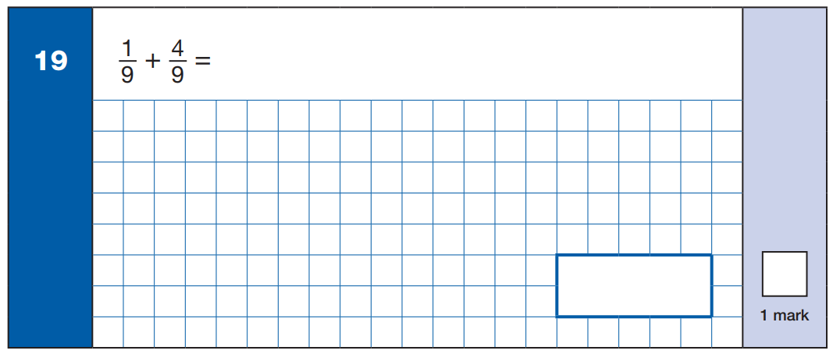
5
9
5
9
2015

Slide 11
1
3
4
+
=
7
7
7
4
7
2015WDN

Slide 12
Subtract fractions with the same denominator within 1

Slide 13
6
1
5
5
4
1
–
=
–
=
7
7
7
8
8
8
4
2
2
3
1
2
–
=
–
=
5
5
5
4
4
4

Slide 14
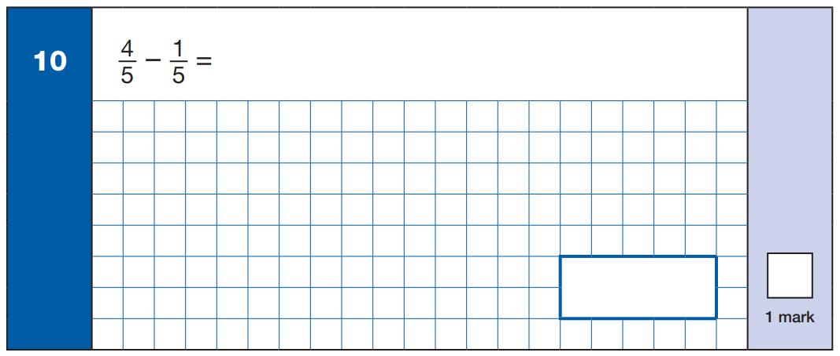
3
5
3
5
2015

Slide 15
5
3
2
–
=
7
7
7
2
7
2015WDN

Slide 16
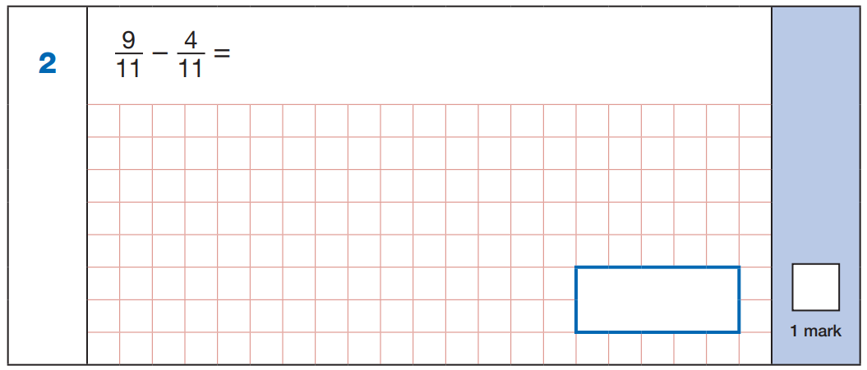
5
11
5
11
2018

Slide 17
7
2
5
–
=
9
9
9
5
9
2018WDN

Slide 18
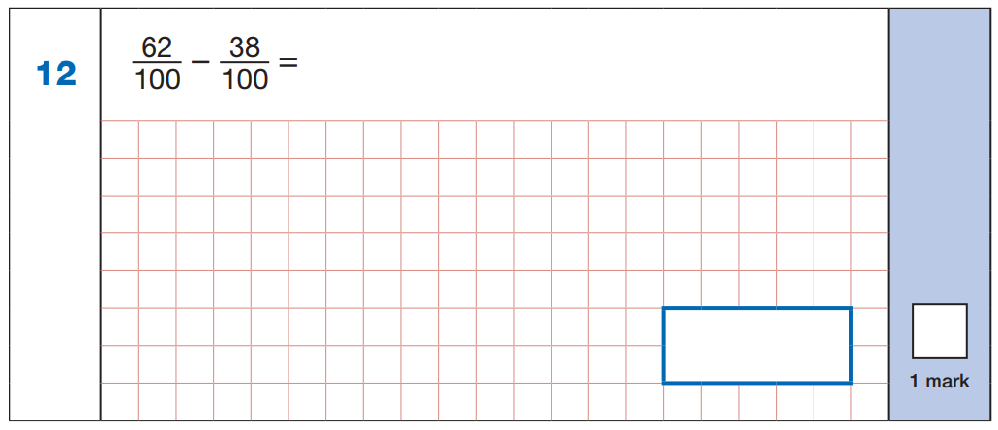
5
1
6 2
-
3 8
2
4
24
100
2017

Slide 19
71
29
–
=
100
100
6
1
7 1
-
2 9
4
2
42
100
2017WDN

Slide 20
Solve missing number problems for addition and subtraction of fractions with the same denominator within 1

Slide 21
3
1
4
1
4
5
+
=
+
=
5
5
5
8
8
8
5
3
2
5
4
1
–
=
–
=
7
7
7
6
6
6

Slide 22
Recognise pairs of fractions that add up to 1

Slide 23
1
4
5
3
+
=
1
+
=
1
5
5
8
8
4
3
2
1
+
=
1
+
=
1
7
7
3
3

Slide 24
Count up in halves, thirds and quarters beyond 1

Slide 25
1
1
1
1
1
1
2
2
3
3
4
2
2
2
2
1
2
3
4
5
6
7
8
2
2
2
2
2
2
2
2
1
2
1
2
1
2
1
2
1
1
1
2
2
2
3
3
3
4
3
3
3
3
3
3
3
3
1
2
3
4
5
6
7
8
9
10
11
12
3
3
3
3
3
3
3
3
3
3
3
3
1
2
3
1
2
3
1
2
3
1
2
3
1
1
1
1
2
2
2
2
3
3
3
3
4
4
4
4
4
4
4
4
4
4
4
4
4
1
2
3
4
5
6
7
8
9
10
11
12
13
14
15
16
4
4
4
4
4
4
4
4
4
4
4
4
4
4
4
4

Slide 26
Convert mixed numbers to improper fractions

Slide 27
Write these mixed numbers as improper fractions:
1
6
5
17
5
29
1
=
2
=
3
=
5
5
6
6
8
8
1 x 5 + 1 =
2 x 6 + 5 =
3 x 8 + 5 =
6
1 7
2 4 + 5 =
2 9
5 + 1 =
1 2 + 5 =

Slide 28
Convert improper fractions to mixed numbers

Slide 29
Write these improper fractions as mixed numbers:
8
3
11
2
21
5
=
1
=
3
=
2
5
5
3
3
8
8
8 ÷ 5 =
1 1 ÷ 3 =
3 r 2
2 1 ÷ 8 =
2 r 5
1 r 3

Slide 30
Add fractions with the same denominator beyond 1 whole, writing the answer as a mixed number

Slide 31
4
2
6
1
3
3
6
2
+
=
=
1
+
=
=
1
5
5
5
5
4
4
4
4
7
5
1 2
4
2
5
7
1
+
=
=
1
+
=
=
1
8
8
8
8
6
6
6
6

Slide 32
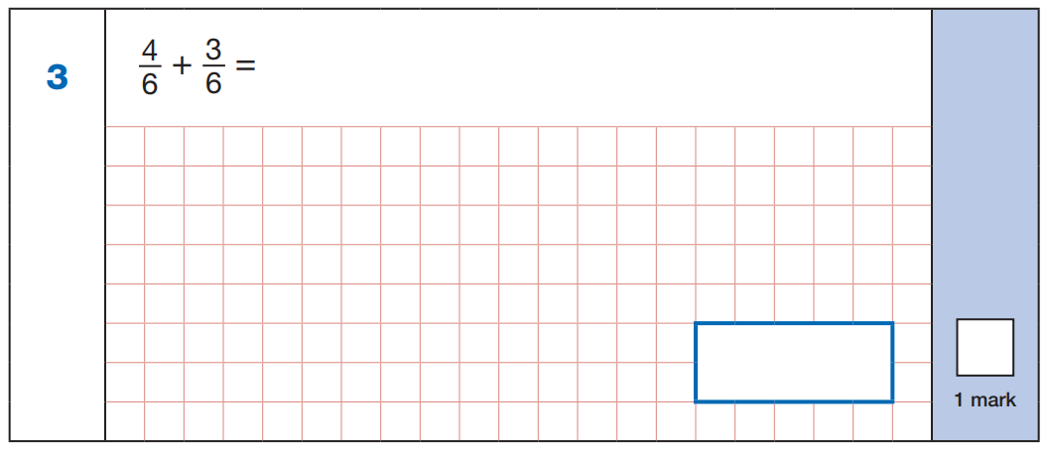
7
6
7
6
2017

Slide 33
5
3
8
+
=
7
7
7
8
7
2017WDN

Slide 34
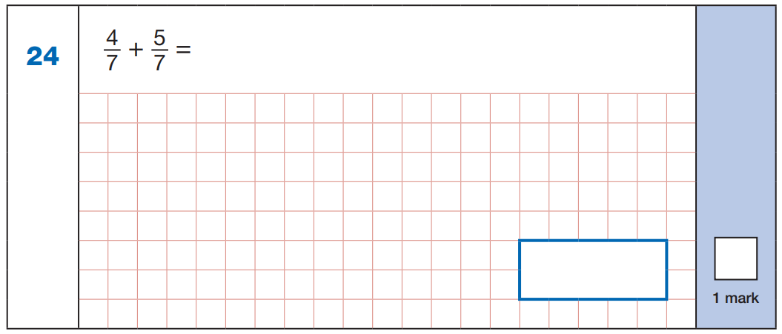
9
7
9
7
2016

Slide 35
3
4
7
+
=
5
5
5
7
5
2016WDN

Slide 36
Subtract a fraction from an improper fraction or mixed number with the same denominator and with 1 whole

Slide 37
3
4
4
2
5
4
1
–
=
1
–
=
5
5
5
7
7
7
8
4
4
9
5
4
–
=
–
=
5
5
5
7
7
7
1
3
2
1
2
2
1
–
=
1
–
=
4
4
4
3
3
3
5
3
2
4
2
2
–
=
–
=
4
4
4
3
3
3

Slide 38
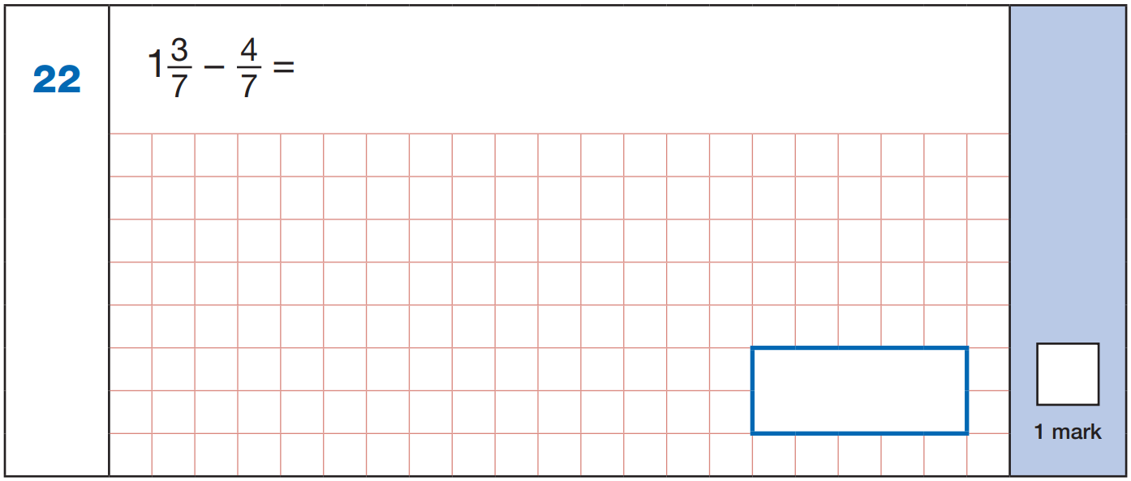
1 0
4
6
-
=
7
7
7
6
7
2019

Slide 39
Solve missing number problems for addition and subtraction of fractions with the same denominator beyond 1

Slide 40
1
4
2
1
3
5
4
5
3
1
–
=
1
–
=
+
=
1
5
5
5
7
7
7
6
6
6
1
2
5
3
8
3
5
1
–
=
+
=
1
–
=
5
5
7
7
7
6
6
6
2
4
9
5
4
–
=
–
=
5
5
5
6
6
6

Slide 41
Add a fraction to a whole number and subtract a fraction from a whole number

Slide 42
3
3
1
3
2
3
3
+
=
3
1
–
=
1
–
=
7
7
4
4
5
5
7
1
1
3
2
3
4
–
=
3
4
–
=
3
3
–
=
2
8
8
4
4
5
5

Slide 43
Add a fraction to a mixed number with the same denominator, without regrouping

Slide 44
3
4
7
2
2
4
3
4
7
1
+
=
1
2
+
=
2
1
+
=
1
10
10
10
5
5
5
8
8
8

Slide 45
Add a fraction to a mixed number with the same denominator, regrouping to make 1 more whole

Slide 46
2
1
3
4
2
3
3
2
1
+
=
2
2
+
=
3
1
+
=
2
3
3
5
5
5
4
4
4
2
1
3
3
4
7
2
3
3
6
2
+
=
= 1
+
=
= 1
+
=
= 1
3
3
3
5
5
5
5
4
4
4
4
2
2
2
2
1 + 1 =
2
2 + 1 =
3
1 + 1 =
2
5
5
4
4

Slide 47
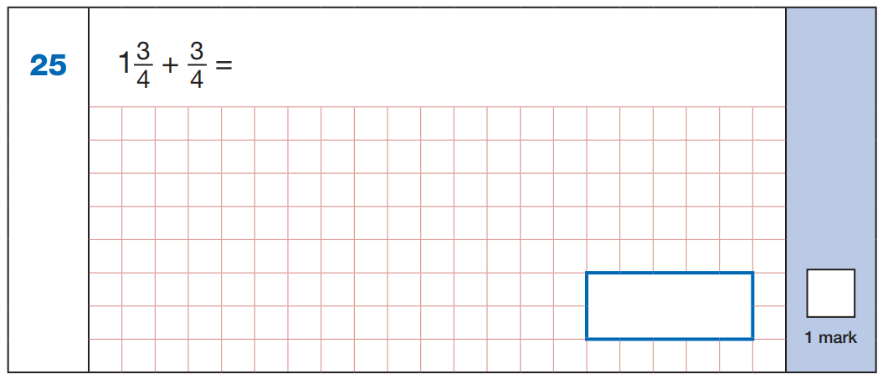
3
3
6
2
+
=
= 1
4
4
4
4
2
1 + 1
4
2
2
4
2018

Slide 48
4
4
1
+
=
5
5
4
4
8
3
+
=
= 1
5
5
5
5
3
1 + 1
5
3
2
5
2018WDN

Slide 49
Add a fraction to a mixed number with the same denominator by converting to an improper fraction

Slide 50
2
1
3
4
2
3
3
2
1
+
=
2
2
+
=
3
1
+
=
2
3
3
5
5
5
4
4
4
5
1
6
1 3
4
1 7
7
3
1 0
+
=
+
=
+
=
3
3
3
5
5
5
4
4
4

Slide 51
7
3
1 0
+
=
4
4
4
1 0
4
2018

Slide 52
4
4
1
+
=
5
5
9
4
1 3
+
=
5
5
5
1 3
5
2018WDN

Slide 53
Add mixed numbers with the same denominator, without regrouping

Slide 54
3
1
4
4
1
5
2
+
2
=
4
3
+
1
=
4
5
5
5
7
7
7

Slide 55
Add mixed numbers with the same denominator, regrouping to make 1 more whole

Slide 56
4
2
1
3
3
2
2
+
2
=
5
2
+
1
=
4
5
5
5
4
4
4
6
6
4 +
3 +
5
4
1
2
4 +
1
3 +
1
5
4

Slide 57
Add mixed numbers with the same denominator by converting to improper fractions

Slide 58
4
2
1
3
3
2
2
+
2
=
5
2
+
1
=
4
5
5
5
4
4
4
1 4
1 2
2 6
1 1
7
1 8
+
=
+
=
5
5
5
4
4
4

Slide 59
Subtract a fraction from a mixed number with the same denominator, without regrouping

Slide 60
9
4
5
4
3
1
5
3
2
1
–
=
1
2
–
=
2
1
–
=
1
10
10
10
5
5
5
8
8
8

Slide 61
Subtract a fraction from a mixed number with the same denominator, regrouping to make 1 fewer whole

Slide 62
1
2
2
1
4
2
1
3
2
2
–
=
1
3
–
=
2
2
–
=
1
3
3
3
5
5
5
4
4
4
4
2
2
6
4
2
5
3
2
1
–
=
1
2
–
=
2
1
–
=
1
3
3
3
5
5
5
4
4
4

Slide 63
Subtract a fraction from a mixed number with the same denominator by converting to an improper fraction

Slide 64
1
2
2
1
4
2
1
3
2
2
–
=
1
3
–
=
2
2
–
=
1
3
3
3
5
5
5
4
4
4
7
2
5
1 6
4
1 2
9
3
6
–
=
–
=
–
=
3
3
3
5
5
5
4
4
4

Slide 65
Subtract mixed numbers with the same denominator, without regrouping

Slide 66
3
1
2
5
2
3
2
–
1
=
1
3
–
2
=
1
5
5
5
7
7
7

Slide 67
Subtract mixed numbers with the same denominator, regrouping to make 1 fewer whole

Slide 68
2
4
3
1
3
2
2
–
1
=
3
–
1
=
1
5
5
5
4
4
4
7
4
5
3
1
–
1
=
2
–
1
=
5
5
4
4

Slide 69
Subtract mixed numbers with the same denominator by converting to improper fractions

Slide 70
2
4
3
1
3
2
2
–
1
=
3
–
1
=
1
5
5
5
4
4
4
1 2
9
3
1 3
7
6
–
=
–
=
5
5
5
4
4
4

Slide 71
Fractions with Denominators which are Common Multiples (Count, Compare, Add, Subtract)

Slide 72
Identify equivalent fractions to a half

Slide 73
x2
x3
x4
x5
x6
1
2
1
3
1
4
1
5
1
6
=
=
=
=
=
2
4
2
6
2
8
2
1 0
2
1 2
x2
x3
x4
x5
x6

Slide 74
Use multiplication to find equivalent fractions

Slide 75
3
6
8
2
8
3
9
1
3
2
=
=
=
=
=
3
4
3
9
5
10
5
20
12
12
x3
x2
x4
x4
x3
1
3
3
6
2
8
2
8
3
9
=
=
=
=
=
3
9
5
1 0
5
2 0
3
1 2
4
1 2
x3
x2
x4
x4
x3

Slide 76
Use division to find equivalent fractions

Slide 77
2
1
5
6
2
10
1
6
4
20
=
=
=
=
=
15
20
9
3
12
3
24
6
5
2
÷3
÷4
÷4
÷3
÷10
6
2
4
1
2 0
5
6
2
1 0
1
=
=
=
=
=
9
3
1 2
3
2 4
6
1 5
5
2 0
2
÷3
÷4
÷4
÷3
÷10

Slide 78
Find equivalent improper fractions

Slide 79
5
15
11
22
20
5
=
=
=
3
9
5
10
12
3
x3
x2
÷4
5
1 5
1 1
2 2
2 0
5
=
=
=
3
9
5
1 0
1 2
3
x3
x2
÷4

Slide 80
Simplify fractions

Slide 81
Simplify these fractions to their lowest terms:
6
1
10
2
20
5
6
3
=
=
=
=
12
2
15
3
24
6
10
5
÷6
÷5
÷4
÷2
6
1
1 0
2
2 0
5
6
3
=
=
=
=
1 2
2
1 5
3
2 4
6
1 0
5
÷6
÷5
÷4
÷2

Slide 82
Compare fractions with denominators as common multiples

Slide 83
Write < or >.
3
7
11
3
2
7
<
>
>
4
8
15
5
3
12
x2
x3
x4
3
6
3
9
2
8
=
=
=
4
8
5
1 5
3
1 2
x2
x3
x4

Slide 84
Compare improper fractions with denominators as common multiples

Slide 85
Write < or >.
5
9
4
17
>
<
4
8
3
12
x2
x4
5
1 0
4
1 6
=
=
4
8
3
1 2
x2
x4

Slide 86
Order fractions with denominators as common multiples

Slide 87
Order these fractions:
x2
7
1 4
=
7
3
13
3
1 0
2 0
10
5
20
4
x2
3
1 3
7
3
5
2 0
1 0
4
x4
3
1 2
smallest
largest
=
5
2 0
x4
x5
3
1 5
=
4
2 0
x5

Slide 88
Add fractions with denominators as common multiples within 1

Slide 89
3
1
7
2
2
8
7
1
1 0
+
=
+
=
+
=
4
8
8
5
15
1 5
12
4
1 2
x2
x3
x3
3
6
2
6
1
3
=
=
=
4
8
5
1 5
4
1 2
x2
x3
x3
6
1
7
6
2
8
7
3
1 0
+
=
+
=
+
=
8
8
8
1 5
1 5
1 5
1 2
1 2
1 2

Slide 90
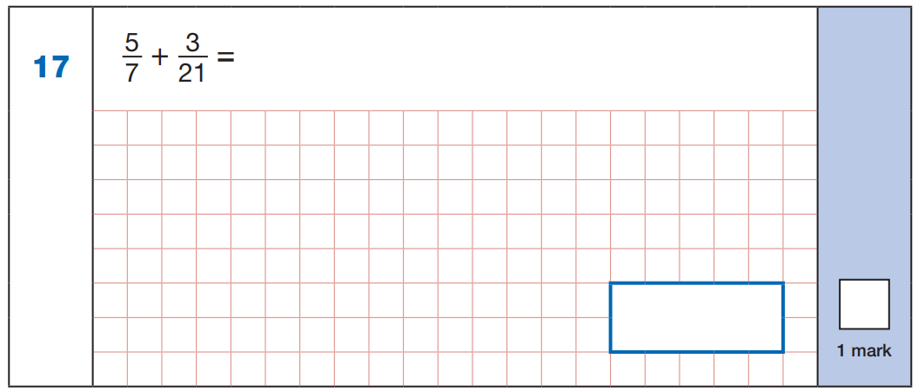
x3
5
1 5
1 5
3
1 8
=
+
=
7
2 1
2 1
2 1
2 1
x3
1 8
2 1
2018

Slide 91
5
4
+
=
9
18
x2
5
1 0
1 0
4
1 4
=
+
=
9
1 8
1 8
1 8
1 8
x2
1 4
1 8
2018WDN

Slide 92
Subtract fractions with denominators as common multiples within 1

Slide 93
3
3
3
4
3
1 3
11
1
8
–
=
–
=
–
=
4
8
8
5
20
2 0
12
4
1 2
x3
x4
x3
3
6
4
1 6
1
3
=
=
=
4
8
5
2 0
4
1 2
x3
x4
x3
6
3
3
1 6
3
1 3
1 1
3
8
–
=
–
=
–
=
8
8
8
2 0
2 0
2 0
1 2
1 2
1 2

Slide 94
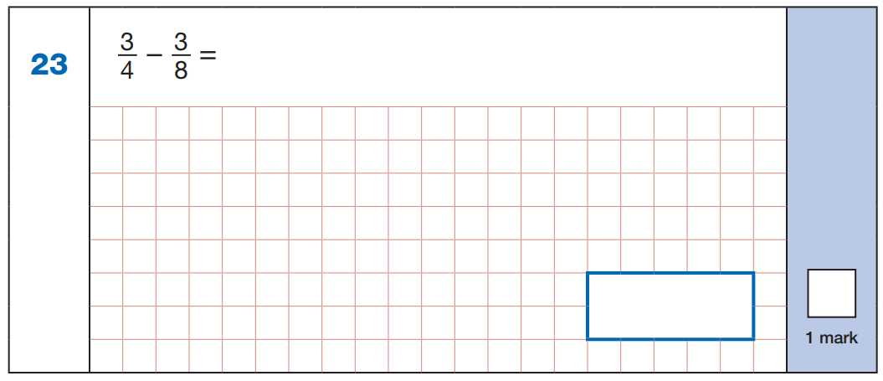
x2
3
6
=
4
8
x2
6
3
3
3
-
=
8
8
8
8
2017

Slide 95
5
5
–
=
6
12
x2
5
1 0
=
6
1 2
x2
1 0
5
5
5
-
=
1 2
1 2
1 2
12
2017WDN

Slide 96
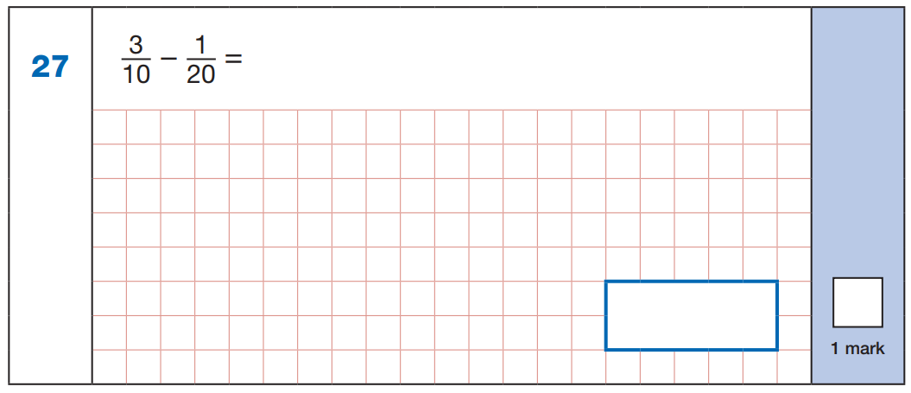
x2
3
6
6
1
5
=
-
=
1 0
2 0
2 0
2 0
2 0
x2
5
2 0
2016

Slide 97
3
1
–
=
6
12
x2
3
6
6
1
5
=
-
=
6
1 2
1 2
1 2
1 2
x2
5
1 2
2016WDN

Slide 98
Solve missing number problems for addition and subtraction of fractions with denominators as common multiples within 1

Slide 99
3
3
9
3
5
1
8
2
2
+
=
–
=
–
=
5
1 0
10
4
8
8
9
9
3
9
3
3
1
2
2
–
=
–
=
+
=
1 0
5
4
8
3
9
9
6
3
6
1
5
6
2
8
–
=
–
=
+
=
1 0
1 0
1 0
8
8
8
9
9
9

Slide 100
Add fractions with denominators as common multiples beyond 1 whole, writing answers as mixed numbers

Slide 101
4
3
1 1
1
5
3
1 4
2
+
=
=
1
+
=
=
1
5
10
1 0
1 0
12
4
1 2
1 2
x2
x3
4
8
3
9
=
=
5
1 0
4
1 2
x2
x3
8
3
1 1
5
9
1 4
+
=
+
=
1 0
1 0
1 0
1 2
1 2
1 2

Slide 102

x2
3
6
=
4
8
x2
6
7
1 3
13
+
=
8
8
8
8
2015

Slide 103
2
5
+
=
3
6
x2
2
4
=
3
6
x2
4
5
9
9
+
=
6
6
6
6
2015WDN

Slide 104
Subtract a fraction from an improper fraction or mixed number with denominators as common multiples and with 1 whole

Slide 105
1
7
8
1
5
3
1
1
7
1
–
=
1
–
=
1
–
=
2
10
1 0
3
6
6
8
4
8
5
7
2
5
1
2
1
–
=
1
–
=
1
–
=
1 0
1 0
6
6
8
8
1 5
7
8
8
5
3
9
2
7
–
=
–
=
–
=
1 0
1 0
1 0
6
6
6
8
8
8

Slide 106
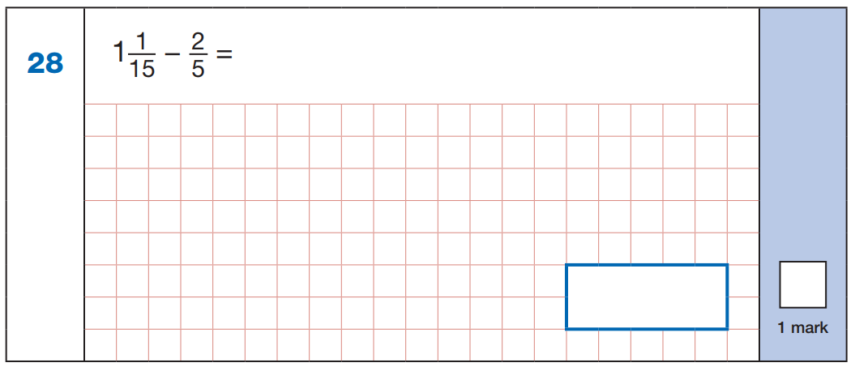
x3
2
6
=
5
1 5
x3
1 6
6
1 0
1 0
-
=
1 5
1 5
1 5
1 5
2018

Slide 107
1
3
1
-
=
12
4
x3
3
9
=
4
1 2
x3
1 3
9
4
4
-
=
1 5
1 2
1 2
1 2
2018WDN

Slide 108
Solve missing number problems for addition and subtraction of fractions with denominators as common multiples beyond 1

Slide 109
1
3
2
3
3
5
4
5
1
1
–
=
1
–
=
+
=
1
6
6
3
8
4
8
6
6
2
1
2
5
3
1
5
1
–
=
+
=
1
–
=
6
3
8
4
2
6
1
4
5
6
1 1
3
5
1
–
=
+
=
1
–
=
6
6
8
8
8
6
6
7
4
3
9
5
4
–
=
–
=
6
6
6
6
6
6

Slide 110
Add a fraction to a mixed number with denominators as common multiples, without regrouping

Slide 111
3
3
9
2
1
7
3
1
7
1
+
=
1
2
+
=
2
1
+
=
1
5
10
10
3
9
9
8
2
8
6
3
6
1
3
4
1
+
2
+
1
+
1 0
1 0
9
9
8
8

Slide 112
Add a fraction to a mixed number with denominators as common multiples, regrouping to make 1 more whole

Slide 113
4
7
5
7
1
3
1
+
=
2
2
+
=
3
5
10
10
8
2
8
8
7
7
4
1
+
2
+
1 0
1 0
8
8
1 5
1 1
1
+
2
+
1 0
8
5
3
1
+
1
2
+
1
1 0
8

Slide 114
Add a fraction to a mixed number with denominators as common multiples by converting to an improper fraction

Slide 115
4
7
5
7
1
3
1
+
=
2
2
+
=
3
5
10
1 0
8
2
8
9
7
2 3
1
+
=
+
=
5
1 0
8
2
1 8
7
2 5
2 3
4
2 7
+
=
+
=
1 0
1 0
1 0
8
8
8

Slide 116
Add mixed numbers with denominators as common multiples, without regrouping

Slide 117
1
2
5
1
1
5
2
+
2
=
4
2
+
1
=
3
6
3
6
2
8
8
1
4
4
1
2
+
2
=
2
+
1
=
6
6
8
8

Slide 118
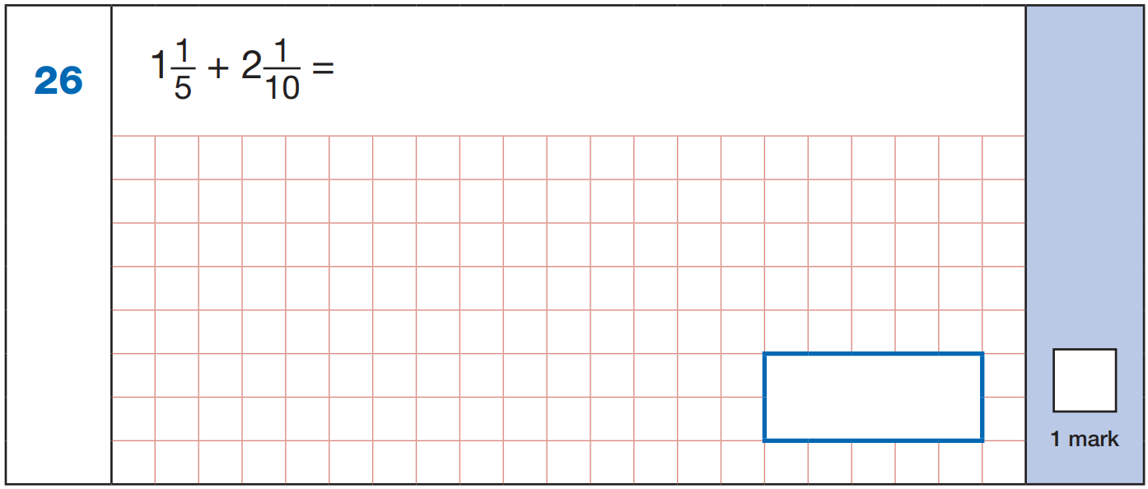
x2
2
1
1
+
2
1
2
1 0
1 0
=
5
1 0
x2
3
3
1 0
2019

Slide 119
Add mixed numbers with denominators as common multiples, regrouping to make 1 more whole

Slide 120
3
7
4
9
1
4
2
+
2
=
5
2
+
1
=
4
4
12
1 2
10
2
1 0
9
7
9
5
2
+
2
2
+
1
1 2
1 2
1 0
1 0
1 6
1 4
4
+
3
+
1 2
1 0
4
4
4
+
1
3
+
1
1 2
1 0

Slide 121
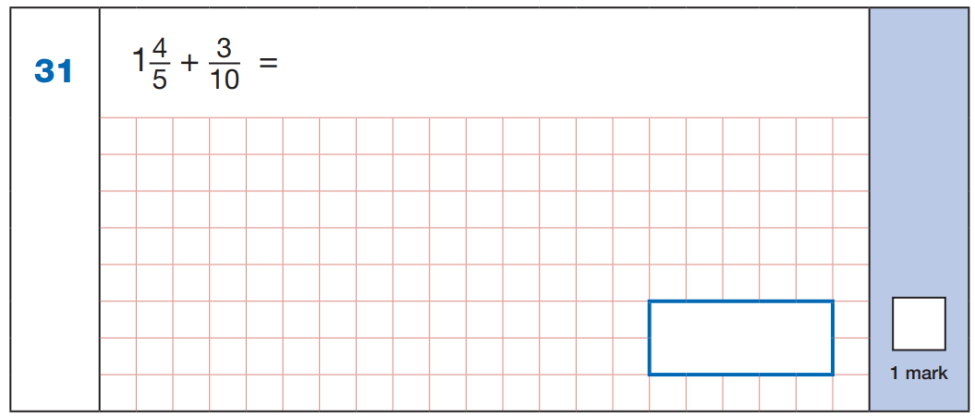
x2
8
3
1
+
4
8
1 0
1 0
=
5
1 0
x2
1 1
1 +
1 0
1
2
1
10
1 +
1
1 0
2016

Slide 122
3
7
1
+
=
5
10
x2
6
7
1
+
3
6
1 0
1 0
=
5
1 0
x2
1 3
1 +
1 0
3
2
3
10
1 +
1
1 0
2016WDN

Slide 123
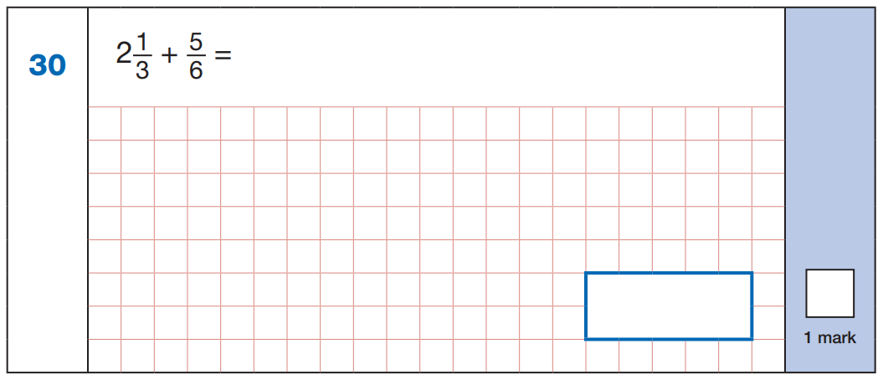
x2
2
5
2
+
1
2
6
6
=
3
6
x2
7
2 +
6
1
3
1
6
2 +
1
6
2017

Slide 124
1
3
3
+
=
2
4
x2
2
3
3
+
1
2
4
4
=
2
4
x2
5
3 +
4
1
4
1
4
3 +
1
4
2017WDN

Slide 125
Add mixed numbers with denominators as common multiples by converting to improper fractions

Slide 126
3
7
4
9
1
4
2
+
2
=
5
2
+
1
=
4
4
12
1 2
10
2
1 0
1 1
3 1
2 9
3
+
=
+
=
4
1 2
1 0
2
3 3
3 1
6 4
2 9
1 5
4 4
+
=
+
=
1 2
1 2
1 2
1 0
1 0
1 0

Slide 127
9
3
+
5
10
x2
9
1 8
=
5
1 0
x2
1 8
3
2 1
2 1
+
=
1 0
1 0
1 0
1 0
2016

Slide 128
3
7
8
7
1
+
=
+
5
10
5
10
x2
8
1 6
=
5
1 0
x2
1 6
7
3 3
3 3
+
=
1 0
1 0
1 0
1 0
2016WDN

Slide 129
7
5
+
3
6
x2
7
1 4
=
3
6
x2
1 4
5
1 9
1 9
+
=
6
6
6
6
2017

Slide 130
1
3
7
3
3
+
=
+
2
4
2
4
x2
7
1 4
=
2
4
x2
1 4
3
1 7
1 7
+
=
4
4
4
4
2017WDN

Slide 131
Subtract a fraction from a mixed number with denominators as common multiples, without regrouping

Slide 132
4
7
1
1
1
3
5
1
2
1
–
=
1
2
–
=
2
1
–
=
1
5
10
10
3
12
12
6
2
6
8
7
4
1
5
3
1
–
2
–
1
–
1 0
1 0
1 2
1 2
6
6

Slide 133
Subtract a fraction from a mixed number with denominators as common multiples, regrouping to make 1 fewer whole

Slide 134
1
7
1 1
3
1
7
2
–
=
1
2
–
=
1
5
15
1 5
8
2
8
3
7
3
4
2
–
2
–
1 5
1 5
8
8
1 8
7
1 1
4
1
–
1
–
1 5
1 5
8
8

Slide 135
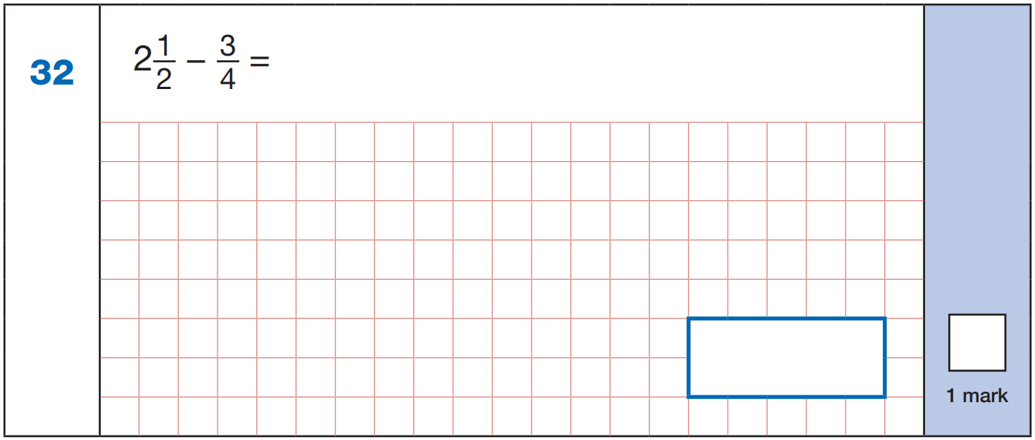
x2
2
3
2
–
1
2
4
4
=
2
4
x2
6
3
3
1
–
=
1
4
4
4
3
1
4
2019

Slide 136
Subtract a fraction from a mixed number with denominators as common multiples by converting to improper fractions

Slide 137
1
7
1 1
3
1
7
2
–
=
1
2
–
=
1
5
15
1 5
8
2
8
1 1
7
1 9
1
–
=
–
=
5
1 5
8
2
3 3
7
2 7
1 9
4
1 5
–
=
–
=
1 5
1 5
1 5
8
8
8

Slide 138
5
3
–
2
4
x2
5
1 0
=
2
4
x2
1 0
3
7
7
–
=
4
4
4
4
2019

Slide 139
Subtract mixed numbers with denominators as common multiples, without regrouping

Slide 140
5
2
1
1
1
3
3
–
1
=
2
2
–
1
=
1
6
3
6
2
8
8
5
4
4
1
3
–
1
=
2
–
1
=
6
6
8
8

Slide 141
Subtract mixed numbers with denominators as common multiples, regrouping to make 1 fewer whole

Slide 142
1
11
4
3
1
8
2
–
1
=
3
–
1
=
1
4
12
1 2
10
2
1 0
3
1 1
3
5
2
–
1
3
–
1
1 2
1 2
1 0
1 0
1 5
1 1
1 3
5
1
–
1
2
–
1
1 2
1 2
1 0
1 0

Slide 143
Subtract mixed numbers with denominators as common multiples by converting to improper fractions

Slide 144
1
11
4
3
1
8
2
–
1
=
3
–
1
=
1
4
12
1 2
10
2
1 0
9
2 3
3 3
3
–
=
–
=
4
1 2
1 0
2
2 7
2 3
4
3 3
1 5
1 8
–
=
–
=
1 2
1 2
1 2
1 0
1 0
1 0

Slide 145
Find a unit fraction of a number

Slide 146
1
1
1
of 24 =
8
of 30 =
6
of 24 =
3
3
5
8
2 4 ÷ 3 =
3 0 ÷ 5 =
2 4 ÷ 8 =

Slide 147
1
of 24 =
8
2 4 ÷ 3 =
3

Slide 148
1
of 30 =
6
3 0 ÷ 5 =
5

Slide 149
1
of 24 =
3
2 4 ÷ 8 =
8

Slide 150
Find a whole quantity given the quantity represented by a unit fraction

Slide 151
1
1
1
of = 7
of = 4
of = 4
21
20
24
3
5
6
7 x 3 =
4 x 5 =
4 x 6 =

Slide 152
1
of = 7
7 x 3 =
21
3

Slide 153
1
of = 4
4 x 5 =
20
5

Slide 154
1
of = 4
4 x 6 =
24
6

Slide 155
1
1
1
of = 100
of = 70
of = 43
400
210
215
4
3
5
1 0 0 x 4 =
7 0 x 3 =
4 3 x 5 =
1
4 3
x
5
2 1
5

Slide 156
Find a quarter by halving twice, or an eighth by halving three times

Slide 157
½ of 48 =
24
½ of 24 =
12
¼ of 48 =
12
½ of 12 =
6
⅛ of 48 =
6

Slide 158
½ of 32 =
16
½ of 16 =
8
¼ of 32 =
8
½ of 8 =
4
⅛ of 32 =
4

Slide 159
Find a non-unit fraction of a number

Slide 160
2
5
3
of 30 =
12
of 24 =
20
of 24 =
9
5
6
8
3 0 ÷ 5 = 6
2 4 ÷ 6 = 4
2 4 ÷ 8 = 3
6 x 2 = 1 2
4 x 5 = 2 0
3 x 3 = 9

Slide 161
3 0 ÷ 5 = 6
2
of 30 =
12
6 x 2 = 1 2
5

Slide 162
2 4 ÷ 6 = 4
5
of 24 =
20
4 x 5 = 2 0
6

Slide 163
2 4 ÷ 8 = 3
3
of 24 =
9
3 x 3 = 9
8

Slide 164
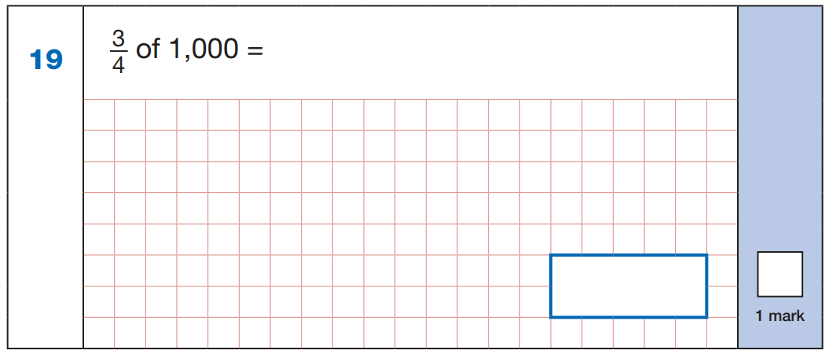
1
2
5
0
2 5 0
4
1 0 0 0
x
3
2
7
5
0
7 5 0
2018

Slide 165
4
of 1000 =
5
2
0
0
2 0 0 x 4 =
8 0 0
.
.
.
.
5
1 0 0 0
8 0 0
2018WDN

Slide 166
Find a whole quantity, given the quantity represented by a non-unit fraction

Slide 167
2
5
3
of = 10
of = 15
of = 15
25
18
25
5
6
5
1 0 ÷ 2 = 5
1 5 ÷ 5 = 3
1 5 ÷ 3 = 5
5 x 5 = 2 5
3 x 6 = 1 8
5 x 5 = 2 5

Slide 168
1 0 ÷ 2 = 5
2
of = 10
5 x 5 = 2 5
25
5

Slide 169
1 5 ÷ 5 = 3
5
of = 15
3 x 6 = 1 8
18
6

Slide 170
1 5 ÷ 3 = 5
3
of = 15
5 x 5 = 2 5
25
5

Slide 171
2
5
3
of = 10
of = 15
of = 15
25
18
25
5
6
5
1 0 x 5 = 5 0
1 5 x 6 = 9 0
1 5 x 5 = 7 5
5 0 ÷ 2 = 2 5
9 0 ÷ 5 = 1 8
7 5 ÷ 3 = 2 5
3
2
2
5
1 5
1
8
1 5
2
5
2
5 0
x
6
5
9 0
x
5
3
7 5
1
4
1
9
0
7
5

Slide 172
Express a remainder as a fraction

Slide 173
1
2
10 ÷ 3 =
3
10 ÷ 4 =
2
3
4
1 0 ÷ 3 = 3 r1
1 0 ÷ 4 = 2 r2
4
1
709 ÷ 5 =
141
709 ÷ 6 =
118
5
6
1
4
1 r4
1
1
8 r1
5
7 0 9
6
7 0 9
2
1
4

Slide 174
1
10 ÷ 3 =
3
1 0 ÷ 3 = 3 r1
3

Slide 175
2
10 ÷ 4 =
2
1 0 ÷ 4 = 2 r2
4

Slide 176
Find a unit fraction of a number, writing the answer as a mixed number

Slide 177
1
3
1
1
1
2
of 13 =
2
of 17 =
4
of 22 =
4
5
5
4
4
5
5
1 x 1 3
1 3
1 x 1 7
1 7
1 x 2 2
2 2
=
=
=
5
5
4
4
5
5

Slide 178
1
3
of 13 =
2
5
5

Slide 179
1
1
of 17 =
4
4
4

Slide 180
1
2
of 22 =
4
5
5

Slide 181
Find a non-unit fraction of a number, writing the answer as a mixed number

Slide 182
3
3
2
1
2
1
of 21 =
15
of 23 =
9
of 17 =
11
4
4
5
5
3
3
3 x 2 1
6 3
2 x 2 3
4 6
2 x 1 7
3 4
=
=
=
4
4
5
5
3
3
1
1
5
3
1 7
4
4
6 3
x
2
2
3
4

Slide 183
3
3
of 21 =
15
4
4

Slide 184
2
1
of 23 =
9
5
5

Slide 185
Fractions with Denominators which are not Common Multiples

Slide 186
Compare fractions with denominators which are not common multiples

Slide 187
Write < or >.
1
3
5
3
5
7
<
>
>
2
5
6
4
8
12
x5
x2
x3
1
5
5
1 0
5
1 5
=
=
=
2
1 0
6
1 2
8
2 4
x5
x2
x3
x2
x3
x2
3
6
3
9
7
1 4
=
=
=
5
1 0
4
1 2
1 2
2 4
x2
x3
x2

Slide 188
Compare improper fractions with denominators which are not common multiples

Slide 189
Write < or >.
3
8
7
5
<
<
2
5
6
4
x5
x2
3
1 5
7
1 4
=
=
2
1 0
6
1 2
x5
x2
x2
x3
8
1 6
5
1 5
=
=
5
1 0
4
1 2
x2
x3

Slide 190
Order fractions with denominators which are not common multiples

Slide 191
Order these fractions:
x3
x6
7
4
11
2
7
2 1
4
2 4
=
=
10
5
15
3
1 0
3 0
5
3 0
x3
x6
2
7
1 1
4
3
1 0
1 5
5
x2
x10
smallest
largest
1 1
2 2
2
2 0
=
=
1 5
3 0
3
3 0
x2
x10

Slide 192
Order improper fractions with denominators which are not common multiples

Slide 193
Order these fractions:
x3
x6
11
7
13
4
1 1
3 3
7
4 2
=
=
10
5
15
3
1 0
3 0
5
3 0
x3
x6
1 3
1 1
4
7
1 5
1 0
3
5
x2
x10
smallest
largest
1 3
2 6
4
4 0
=
=
1 5
3 0
3
3 0
x2
x10

Slide 194
Add fractions with denominators which are not common multiples within 1

Slide 195
1
1
7
1
3
1 9
+
=
+
=
2
5
1 0
5
4
2 0
x5
x2
x4
x5
1
5
1
2
1
4
3
1 5
=
=
=
=
2
1 0
5
1 0
5
2 0
4
2 0
x5
x2
x4
x5
5
2
7
4
1 5
1 9
+
=
+
=
1 0
1 0
1 0
2 0
2 0
2 0

Slide 196

x5
x2
1
5
1
2
=
=
2
1 0
5
1 0
x5
x2
5
2
7
7
+
=
1 0
1 0
1 0
1 0
2018

Slide 197
1
1
+
=
4
6
x3
x2
1
3
1
2
=
=
4
1 2
6
1 2
x3
x2
3
2
5
5
+
=
1 2
1 2
1 2
1 2
2018WDN

Slide 198
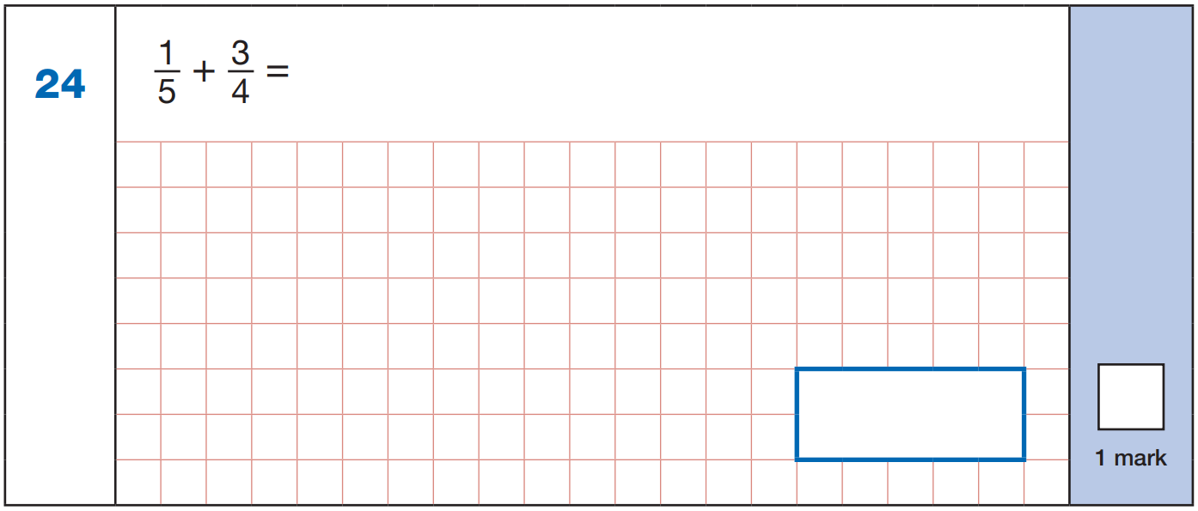
x4
x5
1
4
3
1 5
=
=
5
2 0
4
2 0
x4
x5
4
1 5
1 9
1 9
+
=
2 0
2 0
2 0
2 0
2019

Slide 199
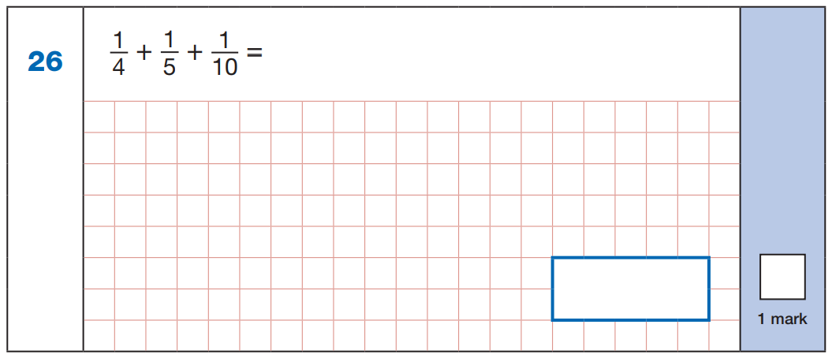
x5
x4
x2
1
5
1
4
1
2
=
=
=
4
2 0
5
2 0
1 0
2 0
x5
x4
x2
5
4
2
1 1
1 1
+
+
=
2 0
2 0
2 0
2 0
2 0
2017

Slide 200
1
1
1
+
+
=
2
3
10
x15
x10
x3
1
1 5
1
1 0
1
3
=
=
=
2
3 0
3
3 0
1 0
3 0
x15
x10
x3
1 5
1 0
3
2 8
2 8
+
+
=
3 0
3 0
3 0
3 0
3 0
2017WDN

Slide 201
Subtract fractions with denominators which are not common multiples within 1

Slide 202
5
1
1 7
3
2
1
–
=
–
=
6
8
2 4
4
3
1 2
x4
x3
x4
x3
5
2 0
1
3
3
9
2
8
=
=
=
=
6
2 4
8
2 4
4
1 2
3
1 2
x4
x3
x4
x3
2 0
3
1 7
9
8
1
–
=
–
=
2 4
2 4
2 4
1 2
1 2
1 2

Slide 203

x4
x3
2
8
1
3
=
=
6
2 4
8
2 4
x4
x3
8
3
5
5
-
=
2 4
2 4
2 4
2 4
2017

Slide 204
2
1
–
=
5
8
x8
x5
2
1 6
1
5
=
=
5
4 0
8
4 0
x8
x5
1 6
5
1 1
1 1
–
=
4 0
4 0
4 0
4 0
2017WDN

Slide 205
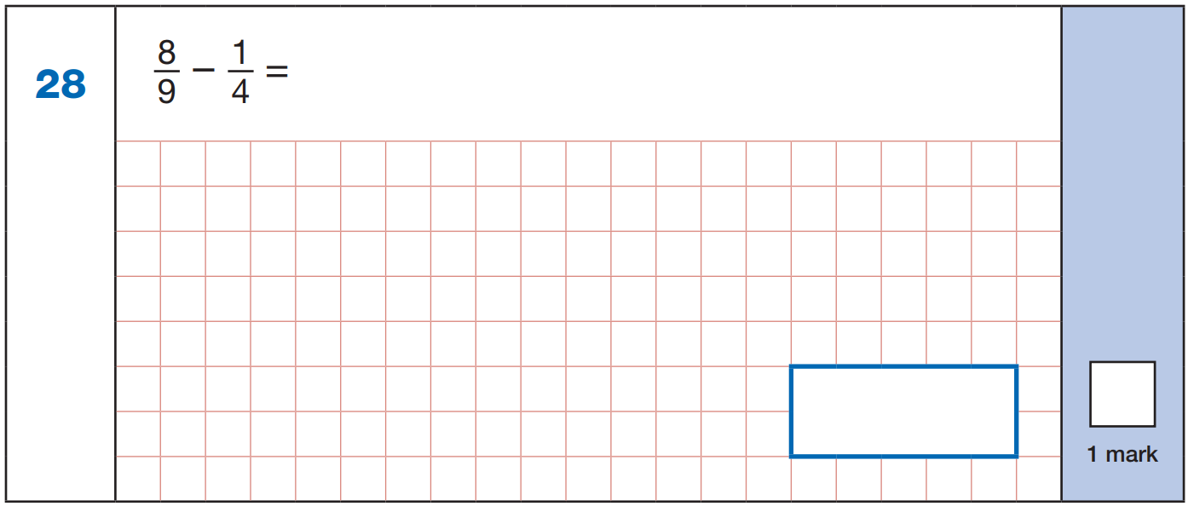
x4
x9
8
3 2
1
9
=
=
9
3 6
4
3 6
x4
x9
3 2
9
2 3
2 3
–
=
3 6
3 6
3 6
3 6
2019

Slide 206
Solve missing number problems for addition and subtraction of fractions with denominators which are not common multiples within 1

Slide 207
3
3
3
1
3
1
+
=
–
=
5
2 0
4
2
1 0
5
3
3
1
1
–
=
–
=
4
5
2
5
x5
x4
x5
x2
3
1 5
3
1 2
1
5
1
2
=
=
=
=
4
2 0
5
2 0
2
1 0
5
1 0
x5
x4
x5
x2
1 5
1 2
3
5
2
3
–
=
–
=
2 0
2 0
2 0
1 0
1 0
1 0

Slide 208
1 1
2
1
–
=
1 5
5
3
1
2
+
=
3
5
x5
x3
1
5
2
6
=
=
3
1 5
5
1 5
x5
x3
5
6
1 1
+
=
1 5
1 5
1 5

Slide 209
Add fractions with denominators which are not common multiples beyond 1 whole, writing answers as mixed numbers

Slide 210
4
3
3 1
1 1
6
1
1 9
5
+
=
=
1
+
=
=
1
5
4
2 0
2 0
7
2
1 4
1 4
x4
x5
x2
x7
4
1 6
3
1 5
6
1 2
1
7
=
=
=
=
5
2 0
4
2 0
7
1 4
2
1 4
x4
x5
x2
x7
1 6
1 5
3 1
1 2
7
1 9
+
=
+
=
2 0
2 0
2 0
1 4
1 4
1 4

Slide 211
Subtract a fraction from an improper fraction or mixed number with a denominator which is not a multiple of the denominator in the fraction and with 1 whole

Slide 212
1
2
5
1
3
5
1
–
=
1
–
=
2
3
6
6
4
1 2
x3
x2
x2
x3
1
3
2
4
1
2
3
9
=
=
=
=
2
6
3
6
6
1 2
4
1 2
x3
x2
x2
x3
3
4
2
9
1
–
=
1
–
6
6
1 2
1 2
9
4
5
1 4
9
5
–
=
–
=
6
6
6
1 2
1 2
1 2

Slide 213
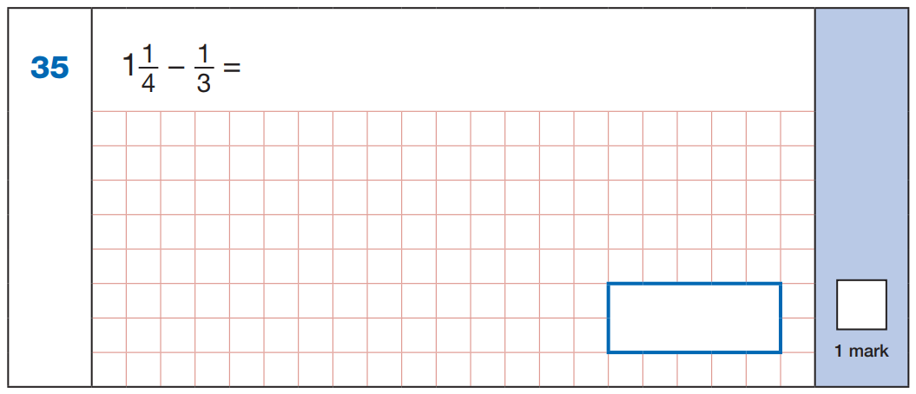
x3
x4
3
4
1
-
1
3
1
4
1 2
1 2
=
=
4
1 2
3
1 2
x3
x4
1 5
4
-
1 2
1 2
1 1
1 2
2016

Slide 214
5
1
-
4
3
x3
x4
5
1 5
1
4
=
=
4
1 2
3
1 2
x3
x4
1 5
4
1 1
1 1
-
=
1 2
1 2
1 2
1 2
2016

Slide 215
1
1
1
–
=
6
4
x2
x3
2
3
1
-
1
2
1
3
1 2
1 2
=
=
6
1 2
4
1 2
x2
x3
1 4
3
-
1 2
1 2
1 1
1 2
2016WDN

Slide 216
1
1
7
1
1
–
=
-
6
4
6
4
x2
x3
7
1 4
1
3
=
=
6
1 2
4
1 2
x2
x3
1 4
3
1 1
1 1
-
=
1 2
1 2
1 2
1 2
2016WDN

Slide 217
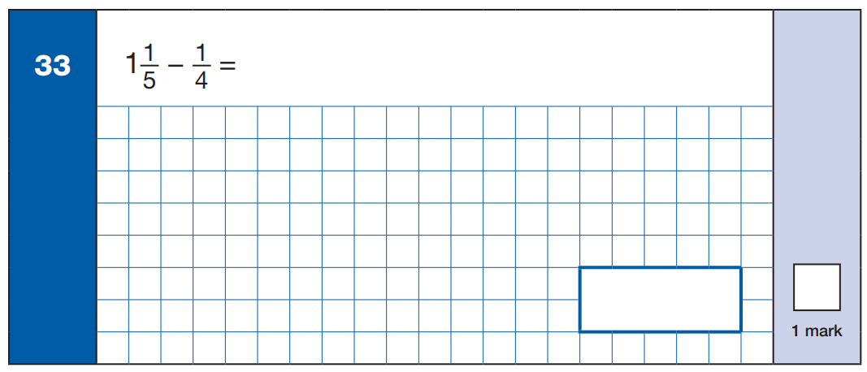
x4
x5
1
4
1
5
4
5
=
=
1
-
=
5
2 0
4
2 0
2 0
2 0
x4
x5
2 4
5
1 9
1 9
-
=
2 0
2 0
2 0
2 0
2015

Slide 218
1
1
1
–
=
5
3
x3
x5
1
3
1
5
3
5
=
=
1
-
=
5
1 5
3
1 5
1 5
1 5
x3
x5
1 8
5
1 3
1 3
-
=
1 5
1 5
1 5
1 5
2015WDN

Slide 219
Solve missing number problems for addition and subtraction of fractions with denominators which are not common multiples beyond 1

Slide 220
1
1 0
2
5
3
5
1
–
=
1
–
=
7
2 1
3
5 6
8
7
8
2
5
3
–
=
+
=
7
3
7
8
x3
x3
x8
x7
8
2 4
2
1 4
5
4 0
3
2 1
=
=
=
=
7
2 1
3
2 1
7
5 6
8
5 6
x3
x3
x8
x7
2 4
1 4
1 0
4 0
2 1
6 1
–
=
+
=
2 1
2 1
2 1
5 6
5 6
5 6

Slide 221
1
1 3
1
+
=
1
3
1 5
5
6
1
–
=
5
3
x3
x3
6
1 8
1
5
=
=
5
1 5
3
1 5
x3
x3
1 8
5
1 3
–
=
1 5
1 5
1 5

Slide 222
Add a fraction to a mixed number with a denominator which is not a multiple of the denominator in the fraction, without regrouping

Slide 223
2
1
1 3
1
1
7
2
+
=
2
1
+
=
1
5
4
2 0
2
5
1 0
x4
x5
x5
x2
2
8
1
5
1
5
1
2
=
=
=
=
5
2 0
4
2 0
2
1 0
5
1 0
x4
x5
x5
x2
8
5
1 3
5
2
7
2
+
=
2
1
+
=
1
2 0
2 0
2 0
1 0
1 0
1 0

Slide 224
Add a fraction to a mixed number with a denominator which is not a multiple of the denominator in the fraction, regrouping to make 1 more whole

Slide 225
2
3
3
1
4
3
1
+
=
2
2
+
=
3
5
4
2 0
2
5
1 0
x4
x5
x5
x2
2
8
3
1 5
1
5
4
8
=
=
=
=
5
2 0
4
2 0
2
1 0
5
1 0
x4
x5
x5
x2
8
1 5
5
8
1
+
=
2
+
=
2 0
2 0
1 0
2 0
2 3
3
1 3
3
1
+
=
1
+
1
2
+
=
2
+
1
2 0
2 0
1 0
1 0

Slide 226
Add a fraction to a mixed number with a denominator which is not a multiple of the denominator in the fraction by converting to an improper fraction

Slide 227
2
3
3
1
4
3
1
+
=
2
2
+
=
3
5
4
2 0
2
5
1 0
7
3
5
4
+
=
+
=
5
4
2
5
x4
x5
x5
x2
7
2 8
3
1 5
5
2 5
4
8
=
=
=
=
5
2 0
4
2 0
2
1 0
5
1 0
x4
x5
x5
x2
2 8
1 5
4 3
2 5
8
3 3
+
=
+
=
2 0
2 0
2 0
1 0
1 0
1 0

Slide 228
Add mixed numbers with denominators which are not common multiples, without regrouping

Slide 229
1
2
1 7
3
1
1 3
2
+
2
=
4
2
+
1
=
3
6
5
3 0
7
2
1 4
x5
x6
x2
x7
1
5
2
1 2
3
6
1
7
=
=
=
=
6
3 0
5
3 0
7
1 4
2
1 4
x5
x6
x2
x7
5
1 2
6
7
2
+
2
=
2
+
1
=
3 0
3 0
1 4
1 4

Slide 230
Add mixed numbers with denominators which are not common multiples, regrouping to make 1 more whole

Slide 231
1
5
3
3
2
5
2
+
2
=
5
2
+
1
=
4
2
7
1 4
4
3
1 2
x7
x2
x3
x4
1
7
5
1 0
3
9
2
8
=
=
=
=
2
1 4
7
1 4
4
1 2
3
1 2
x7
x2
x3
x4
7
1 0
9
8
2
+
2
=
2
+
1
=
1 4
1 4
1 2
1 2
1 7
3
1 7
5
4
+
=
4
+
1
3
+
=
3
+
1
1 4
1 4
1 2
1 2

Slide 232
Add mixed numbers with denominators which are not common multiples by converting to improper fractions

Slide 233
1
5
3
2
+
2
=
5
2
7
1 4
5
1 9
+
=
2
7
x7
x2
1 x = 1 4
5
3 5
1 9
3 8
2 x = 2 8
=
=
2
1 4
7
1 4
3 x = 4 2
x7
x2
4 x = 5 6
5 x = 7 0
3 5
3 8
7 3
+
=
1 4
1 4
1 4

Slide 234
3
2
5
2
+
1
=
4
4
3
1 2
1 1
5
+
=
4
3
x3
x4
1 1
3 3
5
2 0
=
=
4
1 2
3
1 2
x3
x4
3 3
2 0
5 3
+
=
1 2
1 2
1 2

Slide 235
Subtract a fraction from a mixed number with a denominator which is not a multiple of the denominator in the fraction, without regrouping

Slide 236
4
3
1
1
1
5
1
–
=
1
2
–
=
2
5
4
2 0
2
7
1 4
x4
x5
x5
x2
4
1 6
3
1 5
1
7
1
2
=
=
=
=
5
2 0
4
2 0
2
1 4
7
1 4
x4
x5
x5
x2
1 6
1 5
7
2
1
–
=
2
–
=
2 0
2 0
1 4
1 4

Slide 237
Subtract a fraction from a mixed number with a denominator which is not a multiple of the denominator in the fraction, regrouping to make 1 fewer whole

Slide 238
1
3
9
1
1
5
2
–
=
1
2
–
=
1
5
4
2 0
3
2
6
x4
x5
x2
x3
1
4
3
1 5
1
2
1
3
=
=
=
=
5
2 0
4
2 0
3
6
2
6
x4
x5
x2
x3
4
1 5
2
3
2
–
=
2
–
=
2 0
2 0
6
6
2 4
1 5
8
3
1
–
=
1
–
=
2 0
2 0
6
6

Slide 239
Subtract a fraction from a mixed number with a denominator which is not a multiple of the denominator in the fraction by converting to an improper fraction

Slide 240
1
3
9
1
1
5
2
–
=
1
2
–
=
1
5
4
2 0
3
2
6
1 1
3
7
1
–
=
–
=
5
4
3
2
x4
x5
x2
x3
1 1
4 4
3
1 5
7
1 4
1
3
=
=
=
=
5
2 0
4
2 0
3
6
2
6
x4
x5
x2
x3
4 4
1 5
2 9
1 4
3
1 1
–
=
–
=
2 0
2 0
2 0
6
6
6

Slide 241
Subtract mixed numbers with denominators which are not common multiples, without regrouping

Slide 242
3
2
1
3
1
1
2
–
1
=
1
2
–
1
=
1
4
3
1 2
5
2
1 0
x3
x4
x3
x4
3
9
2
8
3
6
1
5
=
=
=
=
4
1 2
3
1 2
5
1 0
2
1 0
x3
x4
x3
x4
9
8
6
5
2
–
1
=
2
–
1
=
1 2
1 2
1 0
1 0

Slide 243
Subtract mixed numbers with denominators which are not common multiples, regrouping to make 1 fewer whole

Slide 244
1
1
1 3
3
5
1 1
3
–
1
=
1
3
–
1
=
1
5
3
1 5
4
6
1 2
x3
x5
x3
x2
1
3
1
5
3
9
5
1 0
=
=
=
=
5
1 5
3
1 5
4
1 2
6
1 2
x3
x5
x3
x2
3
5
9
1 0
3
–
1
3
–
1
1 5
1 5
1 2
1 2
1 8
5
2 1
1 0
2
–
1
2
–
1
1 5
1 5
1 2
1 2

Slide 245
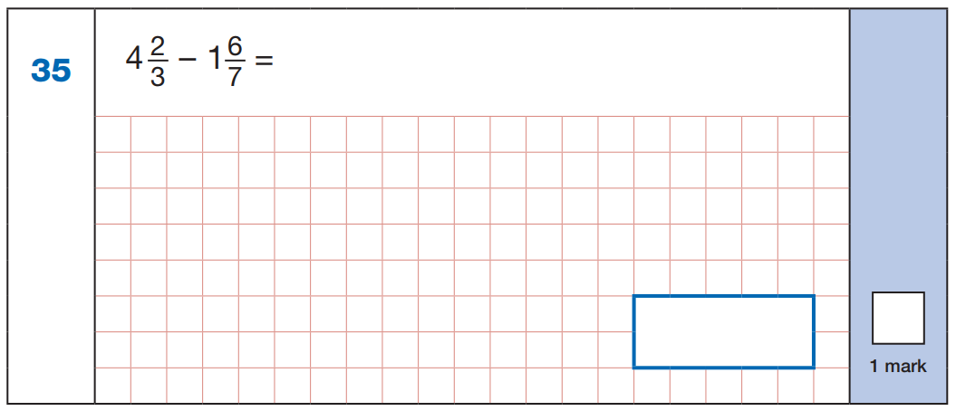
x7
x3
1 4
1 8
4
-
1
2
1 4
6
1 8
2 1
2 1
=
=
3
2 1
7
2 1
x7
x3
3 5
1 8
3
-
1
2 1
2 1
1 7
2
2 1
2018

Slide 246
3
5
4
-
2
=
8
6
x3
x4
9
2 0
4
-
2
3
9
5
2 0
2 4
2 4
=
=
8
2 4
6
2 4
x3
x4
3 3
2 0
3
-
2
2 4
2 4
1 3
1
2 4
2018WDN

Slide 247
Subtract mixed numbers with denominators which are not common multiples by converting to improper fractions

Slide 248
1
1
1 3
3
5
1 1
3
–
1
=
1
3
–
1
=
1
5
3
1 5
4
6
1 2
1 6
4
1 5
1 1
–
=
–
=
5
3
4
6
x3
x5
x3
x2
1 6
4 8
4
2 0
1 5
4 5
1 1
2 2
=
=
=
=
5
1 5
3
1 5
4
1 2
6
1 2
x3
x5
x3
x2
4 8
2 0
2 8
4 5
2 2
2 3
–
=
–
=
1 5
1 5
1 5
1 2
1 2
1 2

Slide 249
1 4
1 3
-
3
7
x7
x3
2
1 4
9 8
1 3
3 9
1 4
=
=
3
2 1
7
2 1
x
7
x7
x3
9
8
9 8
3 9
5 9
5 9
-
=
2 1
2 1
2 1
2 1
2018

Slide 250
3
5
3 5
1 7
4
-
2
=
-
8
6
8
6
x3
x4
1
2
3 5
1 0 5
1 7
6 8
3 5
1 7
=
=
8
2 4
6
2 4
x
3
x
4
x3
x4
1 0
5
6
8
1 0 5
6 8
3 7
3 7
-
=
2 4
2 4
2 4
2 4
2018WDN

Slide 251
Find the fraction that lies halfway between two fractions

Slide 252
Which number lies halfway between and ?
1
2
3
5
5
1 0
x2
1
2
=
5
1 0
x2
x2
2
4
=
5
1 0
x2

Slide 253
Which number lies halfway between and ?
2
3
1 7
3
4
2 4
x8
x4
2
1 6
8
=
=
3
2 4
1 2
x8
x4
x6
x3
3
1 8
9
=
=
4
2 4
1 2
x6
x3

Slide 254
Multiply by a unit fraction

Slide 255
1
1
1
3
1
3
7
1
7
x
=
x
=
x
=
3
3
9
5
4
2 0
10
2
2 0
1 x 1
1
3 x 1
3
7 x 1
7
=
=
=
3 x 3
9
5 x 4
2 0
1 0 x 2
2 0

Slide 256
1
1
1
x
=
3
3
9
1 x 1
1
=
3 x 3
9

Slide 257
3
1
3
x
=
5
4
2 0
3 x 1
3
=
5 x 4
2 0

Slide 258
7
1
7
x
=
10
2
2 0
7 x 1
7
=
1 0 x 2
2 0

Slide 259
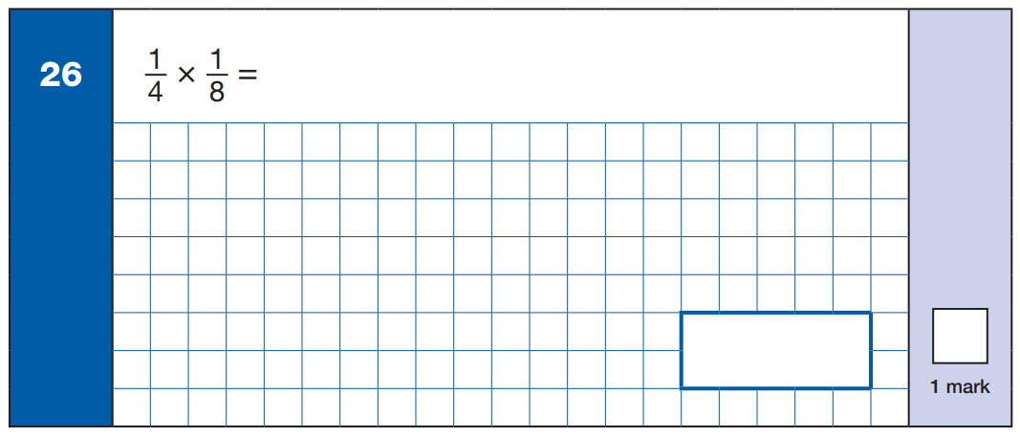
1
3 2
1
3 2
2015

Slide 260
1
1
1
x
=
5
7
3 5
1
3 5
2015WDN

Slide 261
Multiply non-unit fractions

Slide 262
2
2
4
3
3
9
x
=
x
=
3
3
9
5
4
2 0
2 x 2
4
3 x 3
9
=
=
3 x 3
9
5 x 4
2 0

Slide 263
2
2
4
x
=
3
3
9
2 x 2
4
=
3 x 3
9

Slide 264
3
3
9
x
=
5
4
2 0
3 x 3
9
=
5 x 4
2 0

Slide 265
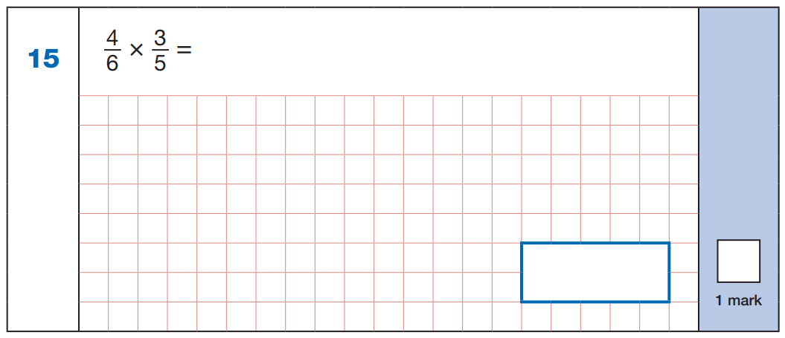
12
30
12
30
2017

Slide 266
3
3
9
x
=
6
8
48
9
48
2017WDN

Slide 267
Multiply non-unit fractions, simplifying at the end

Slide 268
3
8
2
7
5
7
x
=
x
=
4
9
3
10
10
2 0
3 x 8
2 4
7 x 5
3 5
=
=
4 x 9
3 6
1 0 x 1 0
1 0 0
÷12
÷5
2 4
2
3 5
7
=
=
3 6
3
1 0 0
2 0
÷12
÷5

Slide 269
Multiply non-unit fractions, cross-simplifying

Slide 270
5
3
1
7
9
2 1
x
=
x
=
12
10
8
12
10
4 0
1
1
3
5
3
1
7
9
2 1
x
=
x
=
1 2
1 0
8
1 2
1 0
4 0
4
2
4

Slide 271
Divide a fraction by a whole number

Slide 272
1
1
3
3
7
7
÷
3
=
÷
4
=
÷
2
=
3
9
5
2 0
10
2 0
1
3
7
3
x 3
5
x 4
1 0
x 2

Slide 273
1
1
÷
3
=
3
9
1
3
x 3

Slide 274
3
3
÷
4
=
5
2 0
3
5
x 4

Slide 275
7
7
÷
2
=
10
2 0
7
1 0
x 2

Slide 276
Divide a fraction by a whole number (where the numerator is a multiple of the dividend)

Slide 277
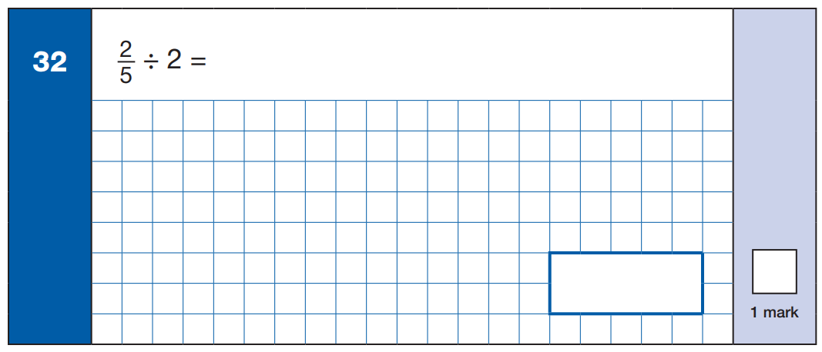
2
5
x 2
2
1 0
2015

Slide 278
2
÷ 2 =
7
2
7
x 2
2
1 4
2015WDN

Slide 279
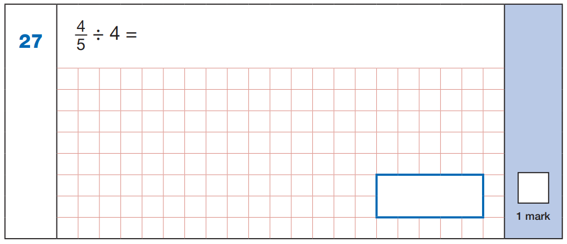
4
5
x 4
4
2 0
2017

Slide 280
3
÷ 3 =
7
3
7
x 3
3
2 1
2017WDN

Slide 281
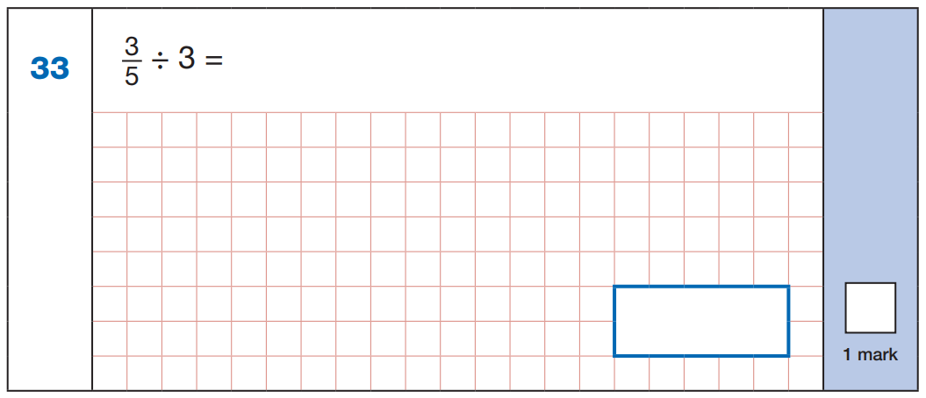
3
5
x 3
3
15
2016

Slide 282
4
÷ 6 =
5
4
5
x 6
4
30
2016WDN

Slide 283

1
4
x 2
1
8
2018

Slide 284
1
÷ 2 =
3
1
3
x 2
1
6
2018WDN

Slide 285
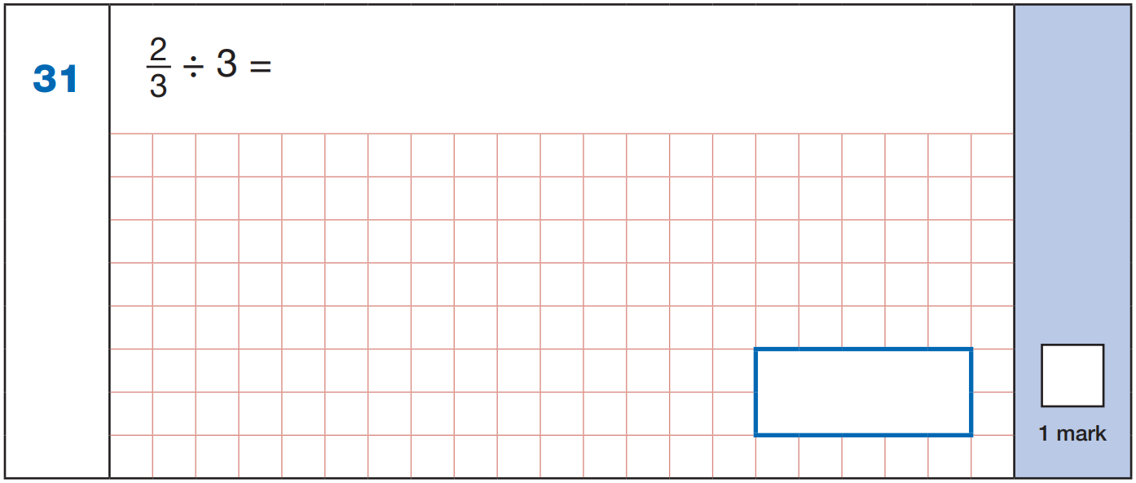
2
3
x 3
2
9
2019

Slide 286

3
4
x 2
3
8
2015

Slide 287
5
÷ 2 =
6
5
6
x 2
5
12
2015WDN

Slide 288
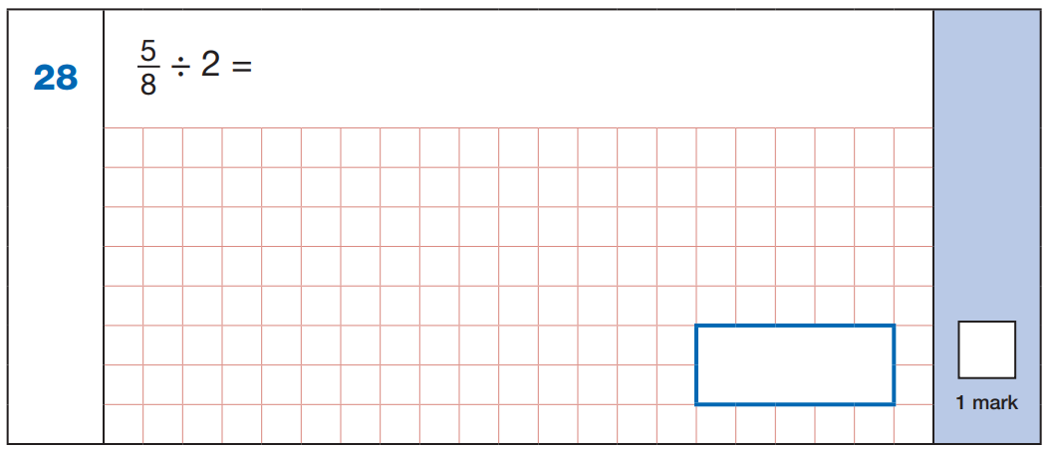
5
8
x 2
5
1 6
2017

Slide 289
7
÷ 2 =
9
7
9
x 2
7
1 8
2017WDN

Slide 290
Multiply a fraction by a whole number

Slide 291
3
3
2
x
5
=
3
x
6
=
4
4
4
3
3 x 5
1 5
2 x 6
1 2
=
=
4
4
3
3

Slide 292
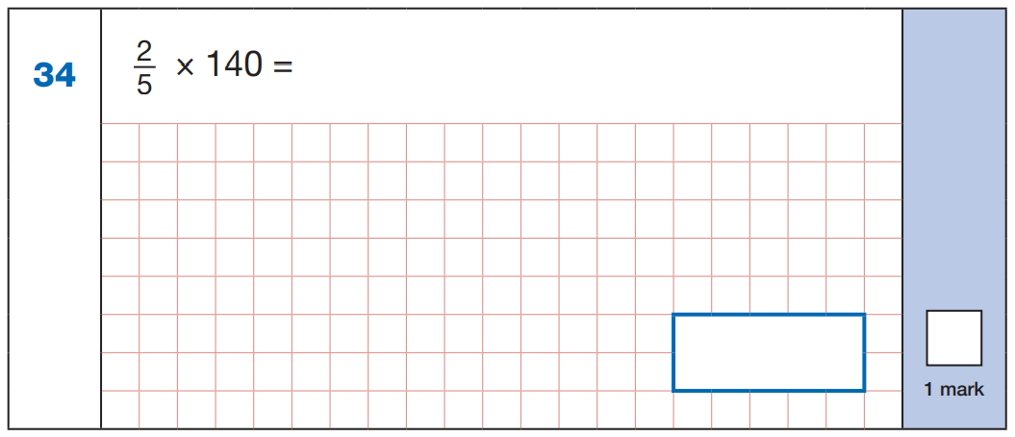
2 x 1 4 0 =
2 8 0
1
2
8
2 8
5
1 4 0
x
2
5
6
4
5
6
5
2 8 0
3
5 6
2016

Slide 293
3
x 180 =
5
3 x 1 8 0 =
5 4 0
1
3
6
3 6
5
1 8 0
x
3
1
0
8
3
1 0
8
5
5 4 0
4
1 0 8
2016WDN

Slide 294
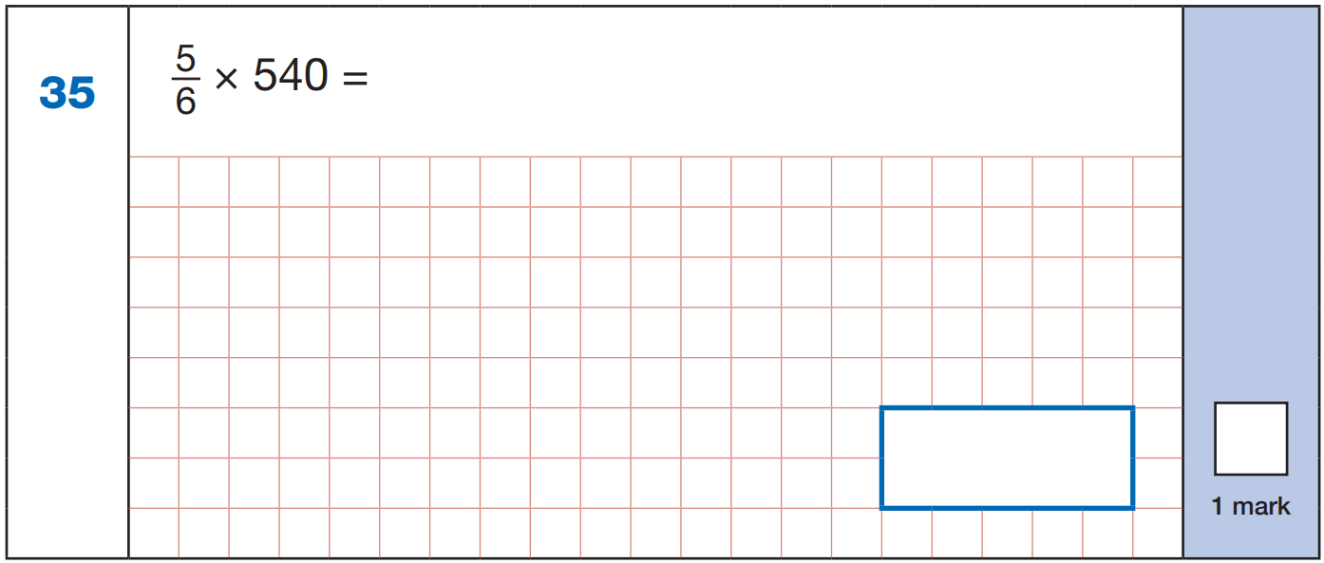
5 4 0 ÷ 6 =
9 0
.
.
9 0 x 5 =
4 5 0
.
.
4 5 0
2019

Slide 295
Multiply a mixed number by a whole number by partitioning

Slide 296
3
1
1
2
2
x
3
=
8
2
x
6
=
13
4
4
4
4
2 x 3 = 6
2 x 6 = 1 2
3
x 3
9
=
2
1
1
6
2
=
x 6
=
1
=
4
4
4
4
4
4
6
+
2
1
=
1 2
+
1
2
=
4
4

Slide 297
2 x 3 = 6
3
1
2
x
3
=
8
1
3
x 3
9
=
2
4
4
=
4
4
4

Slide 298
2 x 6 = 1 2
1
2
2
x
6
=
13
1
x 6
6
=
1
2
4
4
=
4
4
4

Slide 299
1
1
1
1
x
60
=
80
13
x
1
=
19
3
2
2
1 x 6 0 = 6 0
1 x 1 3 = 1 3
1
x 6 0
=
6 0
= 2 0
1
x 1 3
=
1 3
=
6
1
2
3
3
2
2
6 0 + 2 0 = 8 0
1 3
+
1
6
2
1
9
1
2

Slide 300
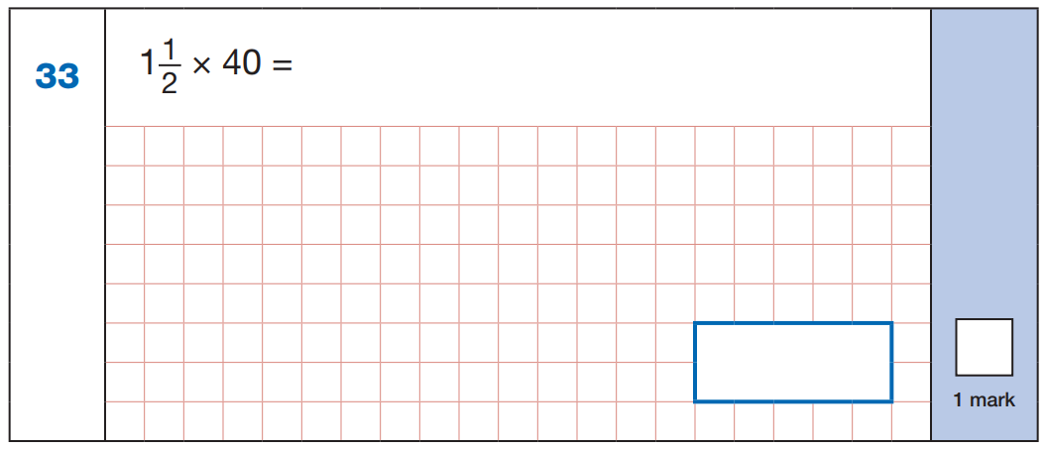
1 x 4 0 = 4 0
1
x 4 0
=
4 0
= 2 0
2
2
6 0
2018

Slide 301
1
1
x 60 =
3
1 x 6 0 = 6 0
1
x 6 0
=
6 0
= 2 0
3
3
8 0
2018WDN

Slide 302
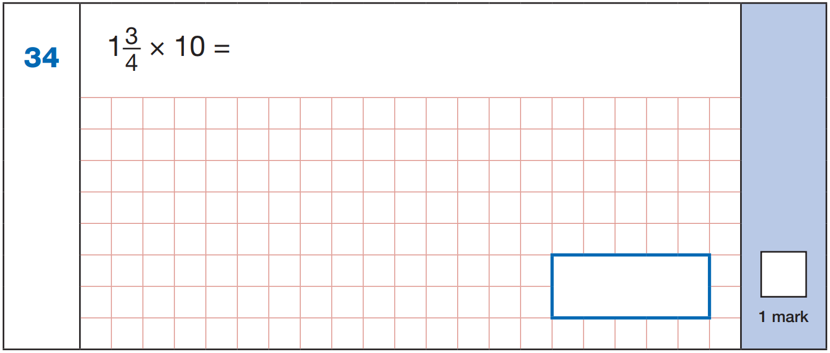
1 x 1 0 = 1 0
1 0
+
7
2
4
3
x 1 0
=
3 0
=
7
2
1
7
2
4
4
4
4
1
7
2
4
2019

Slide 303
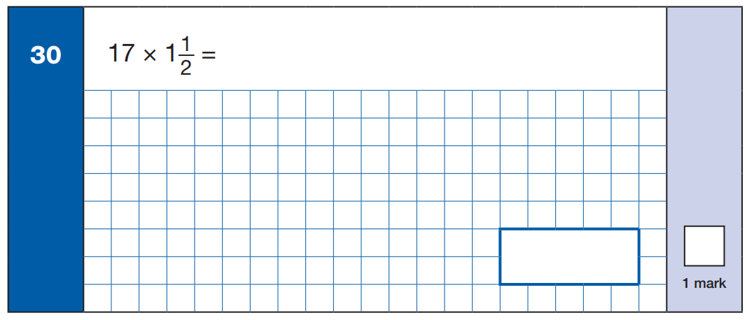
1
1 x 1 7 = 1 7
1 7
+
8
1
2
1
x 1 7
=
1 7
=
8
1
2
5
1
2
2
2
2
2
5
1
2
2015

Slide 304
1
13 x 1 =
2
1 x 1 3 = 1 3
1 3
+
1
6
2
1
x 1 3
=
1 3
=
6
1
1
9
1
2
2
2
2
1
9
1
2
2015WDN

Slide 305

1
1 x 5 7 = 5 7
5 7
+ 2
8
1
2
1
x 5 7
=
5 7
=
2
8
1
8
5
1
2
2
2
2
8
5
1
2
8
1
2
2
2
5 7
1
2017

Slide 306
1
1
x 39 =
2
1
1 x 3 9 = 3 9
3 9
+ 1
9
1
2
1
x 3 9
=
3 9
=
1
9
1
5
8
1
2
2
2
2
5
8
1
1
9
1
2
2
2
3 9
1
2017WDN

Slide 307
Multiply a mixed number by a whole number by converting to an improper fraction

Slide 308
1
1
3
1
2
2
x
3
=
8
2
x
6
=
13
4
4
4
2
4
1 1
3
3 3
9
6
5 4
1
3
2
x
=
x
=
4
4
1
4
4
1
4
4
5 4
1
3
9
6
2 7
1
3
1
x
=
2
4
1
2
2
2 7
2

Slide 309
3
1
2
x
3
=
8
4
4
1 1
3
3 3
x
=
4
1
4

Slide 310
1
1
2
x
6
=
13
4
2
3
9
6
5 4
1
3
2
9
6
2 7
1
3
1
x
=
4
x
=
2
4
1
4
4
5 4
4
1
2
2
2 7
1
2

Slide 311
4
x 6 0
=
2 4 0
.
.
1
1
x
60
=
80
3
3
3
2 4 0 ÷ 3 =
8 0
3
=
1
1
1
x 1 3
=
3 9
1
9
13
x
1
=
19
2
2
2
2
2
1 3
1
9
1
2
x
3
2
3 9
1
3
9

Slide 312
3
x 4 0
=
1 2 0
1 2 0 ÷ 2 =
6 0
.
.
.
.
2
2
6 0
2018

Slide 313
1
1
x 60 =
3
4
x 6 0
=
2 4 0
2 4 0 ÷ 3 =
8 0
.
.
.
.
3
3
8 0
2018WDN

Slide 314
7
=
2
x 1 0
=
7 0
1
7
4
4
4
1
7
2
4
4
7 0
3
1
7
2
4
2019

Slide 315
3
=
1
x 1 7
=
5 1
2
5
2
2
2
2
1 7
2
5
1
2
x
3
2
5 1
1
2
5
1
5
1
2
2015

Slide 316
1
13 x 1 =
2
3
=
1
x 1 3
=
3 9
1
9
2
2
2
1 3
1
9
1
2
x
3
2
3 9
1
1
9
1
3
9
2
2015WDN

Slide 317
3
x 5 7
=
1 7 1
=
8
5
1
2
2
2
2
5 7
8
5
1
2
x
3
2
1 7 1
1
1
8
5
1 7
1
2
2017

Slide 318
1
1
x 39 =
2
3
x 3 9
=
1 1 7
=
8
5
1
2
2
2
2
3 9
5
8
1
2
x
3
2
1 1 7
1
1
5
8
1 1
7
2
2017WDN

Slide 319
Order these fractions:
x3
x6
7
4
11
2
7
2 1
4
2 4
=
=
10
5
15
3
1 0
3 0
5
3 0
x3
x6
2
7
1 1
4
3
1 0
1 5
5
x2
x10
smallest
largest
1 1
2 2
2
2 0
=
=
1 5
3 0
3
3 0
x2
x10

Slide 320
1 1
2
1
–
=
1 5
5
3
1
2
+
=
3
5
x5
x3
1
5
2
6
=
=
3
1 5
5
1 5
x5
x3
5
6
1 1
+
=
1 5
1 5
1 5

