Slide 1
Test A1 –
Place value/Comparing/Ordering/Rounding

Slide 2
Write in digits:
Four hundred and three thousand and sixty
Write in words:
600,902
Six hundred thousand,
nine hundred and two
403,
060
Look at this number: 294 357
Which digit is in the ten-thousands place?
What is the value of the digit 2?
9
200 000
356 078 = 300 000 + + 6 000 + + 8
50 000
70

Slide 3
Write < or >.
1 0 4 5 0 2
4 2 9 2 9 4
349293 309939
Nearest 1 000:
Nearest 10 000:
>
105 000
430 000
99000 909000
<
Write the numbers below in order from smallest to largest:
998 998, 98 989, 898 998, 89 888, 889 889
89888
98989
889889
898998
998998
smallest
largest

Slide 4
Test A2 –
Addition/Subtraction/Roman numerals/Negative numbers

Slide 5
514780 + 88242 =
603022
122071 – 47662 =
74409
0
1
1
6
1
1
1
1
1
1
5 1 4 7 8 0
1 2 2 0 7 1
1
1
+
8 8 2 4 2
-
4 7 6 6 2
6
0
3
0
2
2
7
4
4
0
9
505005 – 15658 =
489347
634098
– 67543 = 566555
4
1
1
1
1
9
4
9
9
5 0 5 0 0 5
5 6 6 5 5 5
1
1
1
1
-
1 5 6 5 8
+
6 7 5 4 3
4
8
9
3
4
7
6
3
4
0
9
8

Slide 6
Write in Roman numerals:
Write in digits:
I = 1
V = 5
X = 10
L = 50
C = 100
D = 500
M = 1000
29
XX
IX
LXIV
64
647
VII
CDXVI
416
DC
XL
3 – 8 =
-5
-4 + 7 =
3
36 – 47 =
-11
-8 + 65 =
57
-14, -10, -6, , , ,
-2
2
6
10
-10
-9
-8
-7
-6
-5
-4
-3
-2
-1
0
1
2
3
4
5
6
7
8
9
10

Slide 7
Test A3 –
Multiplication/Division

Slide 8
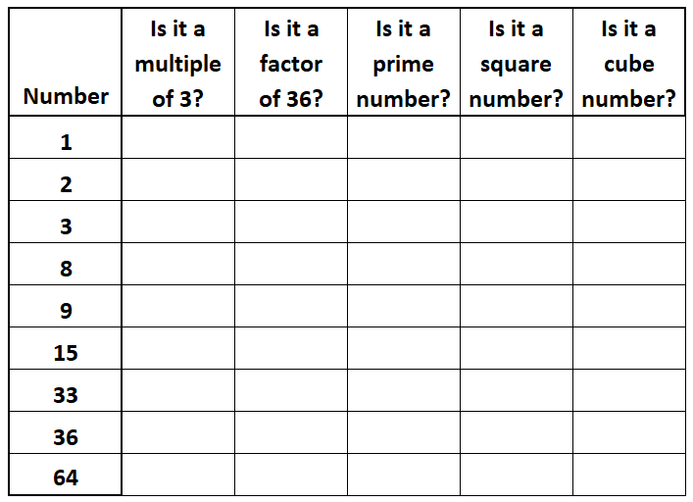
Complete the table by writing Yes or No in each box.
No
Yes
No
Yes
Yes
No
Yes
Yes
No
No
Yes
Yes
Yes
No
No
No
No
No
No
Yes
Yes
Yes
No
Yes
No
Yes
No
No
No
No
Yes
No
No
No
No
Yes
Yes
No
Yes
No
No
No
No
Yes
Yes

Slide 9
2
1
4
3
5
2
3
6
4
5 0 7 3
6
4
8
1
6
5
9
0
7
x
7
x
5
2
x
3
6
x
5
7
1
1
1
3 5
5
1
1
1 2
8
4 8
9
6
4 1
3
4
9
3 2
0
0
2 4
4
8
0
2 9
5
3
5
0
3
3
2
8
2
9
3
7
6
3
3
6
6
9
9
1
6
0
2
1
7
6
6
9 6 1 2
7
1 2 3 2
3
1
5
4
2
3
4
0 r 1
9
8
3 r 2
4
9 3 6 1
5
4 9 1 7
1
1
4
1

Slide 10
7 x 70 =
490
500 x 7 =
3500
7 x 8000 =
56000
90 x 30 =
2700
500 x 40 =
20000
500 x 200 =
100000
210 ÷ 3 =
70
6300 ÷ 9 =
700

Slide 11
Test A4 –
Convert and compare fractions

Slide 12
Write these mixed numbers as improper fractions:
2
5
1
11
3
15
1
=
2
=
3
=
3
3
5
5
4
4
1 x 3 + 2 =
2 x 5 + 1 =
3 x 4 + 3 =
3 + 2 =
5
1 0 + 1 =
1 1
1 2 + 3 =
1 5
Write these improper fractions as mixed numbers:
5
1
16
1
20
6
=
1
=
3
=
2
4
4
5
5
7
7
5 ÷ 4 =
1 6 ÷ 5 =
3 r 1
2 0 ÷ 7 =
2 r 6
1 r 1

Slide 13
4
9
18
3
6
2
6
1
2
3
=
=
=
=
=
7
9
2
8
5
15
4
24
14
27
x4
x3
x6
x2
x3
1
4
3
9
3
1 8
3
6
2
6
=
=
=
=
=
2
8
5
1 5
4
2 4
7
1 4
9
2 7
x4
x3
x6
x2
x3
2
5
21
5
5
17
<
>
<
3
6
24
6
7
21
x2
x4
x3
2
4
5
2 0
5
1 5
=
=
=
3
6
6
2 4
7
2 1
x2
x4
x3

Slide 14
Test A5 –
Add and subtract fractions/Find fractions of numbers

Slide 15
2
2
x3
7
1
x2
8
9
+
=
2
6
+
=
1
2
3
9
9
=
18
9
1 8
=
3
9
9
1 8
x3
x2
6
2
8
7
2
9
+
=
+
=
9
9
9
1 8
1 8
1 8
1
1
x3
11
2
x4
2
3
–
=
1
3
–
=
2
8
2
6
6
=
12
3
1 2
=
2
6
3
1 2
x3
x4
3
1
2
1 1
8
3
–
=
–
=
6
6
6
1 2
1 2
1 2

Slide 16
1
2
5
of 24 =
6
of 35 =
14
of 30 =
25
4
5
6
2 4 ÷ 4 =
3 5 ÷ 5 = 7
3 0 ÷ 6 = 5
7 x 2 = 1 4
5 x 5 = 2 5
2
1
1
7
6
14 ÷ 3 =
4
of 16 =
3
of 10 =
8
3
5
5
8
8
1 4 ÷ 3 = 4 r2
1 x 1 6
1 6
7 x 1 0
7 0
=
=
5
5
8
8

Slide 17
Test A6 –
Decimal place value/Compare decimals/Add and subtract decimals

Slide 18
Hundred thousands
Ten thousands
Tenths
Thousands
Hundreds
Tens
Ones
Hundredths
Thousandths
1
1
1
100s
10s
1s
100 000s
10 000s
1 000s
10
100
1000
Look at this number: 294.35
Look at this number: 813.465
Which digit is
in the tens place?
Which digit is in the hundredths place?
9
6
Which digit is
in the tenths place?
Which digit is in the hundreds place?
3
8
What is the value of the digit 5?
5
What is the value of the digit 5?
5
0.05
0.005
100
1000

Slide 19
Write < or >.
3 4.2
0 0
34.2 30.993
>
3 0.9 9 3
1.4 0 5
1.405 1.44
<
0
1.4 4
0 0
2.9
2.9 2.099
>
2.0 9 9

Slide 20
1.9 + 3.6 =
5.5
5.3 + 1.95 =
7.25
31.8 – 6.45 =
25.35
1
1
2
7
1
.9
0
5.3
0
3 1.8
1
1
+
3.6
+
1.9 5
-
6.4 5
5
5
2
.
7
.
5
2
5
.
5
3
4 – 1.15 =
2.85
37.8 – 14.671 =
23.129
3
9
7
9
4
3 7.8
0 0
.0 0
1
1
1
1
-
1.1 5
-
1 4.6 7 1
2
.
8
5
2
3
1
2
9
.

Slide 21
Test A7 –
Convert between fractions and decimals

Slide 22
Write these fractions as decimals:
3
3
3
=
0.3
=
0.03
=
0.003
10
100
1000
54
54
543
=
0.54
=
0.054
=
0.543
100
1000
1000
1
1
3
3
=
0.2
=
0.5
=
0.6
=
0.75
5
2
5
4
x2
x5
x2
x25
1
2
1
5
3
6
3
7 5
=
=
=
=
5
1 0
2
1 0
5
1 0
4
1 0 0
x2
x5
x2
x25

Slide 23
Write these mixed numbers as decimals:
2
2
2
1
=
1.2
1
=
1
=
1.002
10
1.02
100
1000
32
32
321
4
=
4.32
5
=
5.032
6
=
6.321
100
1000
1000
Write these decimals as fractions:
7
7
7
0.7
=
0.07
=
0.007
=
10
100
1000
10
100
1000
34
34
534
0.34
=
0.034
=
0.534
=
100
1000
1000
100
1000
1000

Slide 24
Write these decimals as mixed numbers:
4
4
4
5.4
=
5
5.04
=
5
5.004
=
5
10
10
100
1000
100
1000
24
24
124
6.24
=
6
7.024
=
7
7.124
=
7
100
1000
1000
100
1000
1000

Slide 25
Test A8 –
Multiply and divide decimals

Slide 26
261.8 x 4 =
1047.2
4.206 x 8 =
33.648
2
3
1
4
2 6 1.8
4.2 0 6
x
4
x
8
4
.
.
1 0
7
2
3 3
6
4
8

Slide 27
40.01 x 10 =
400.1
6.1 x 10 =
61
4 0.0 1
6.1
4
0
0
.
1
1
6
.
36.21 x 100 =
3621
0.6 x 100 =
60
3 6.2 1
0.6
3
6
2
1
.
0
6
0
.
5.8 x 1000 =
5800
7.05 x 1000 =
7050
5.8
7.0 5
5
8
0
0
.
7
0
5
0
.

Slide 28
0.68 ÷ 10 =
0.068
80.08 ÷ 10 =
8.008
0.6 8
8 0.0 8
0
.
8
.
0
0
6
8
0
8
0.7 ÷ 100 =
2.06 ÷ 100 =
0.007
0.0206
0.7
2.0 6
0
.
0
.
0
7
0
2
0
6
0
34.1 ÷ 1000 =
0.0341
146.1 ÷ 1000 =
0.1461
3 4.1
1 4 6.1
0
.
0
.
0
3
4
1
1
4
6
1

