Slide 1
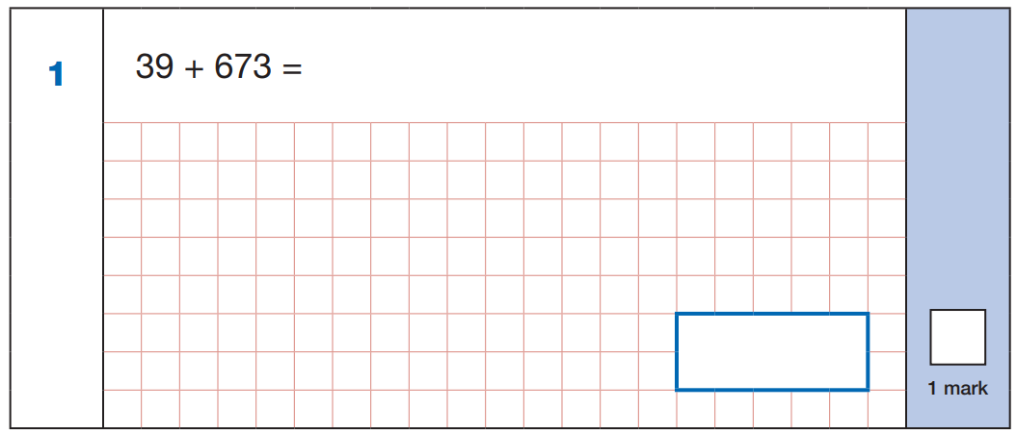
1
1
6 7 3
+
3 9
7
1
2
7 1 2

Slide 2
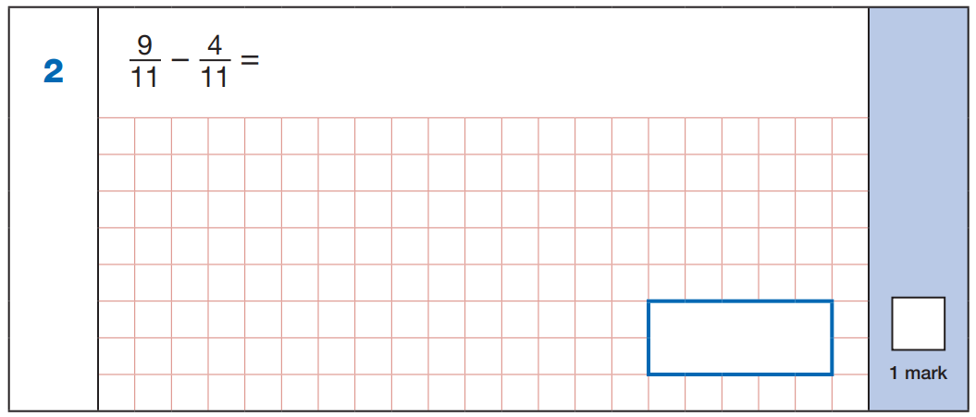
5
11
5
11

Slide 3
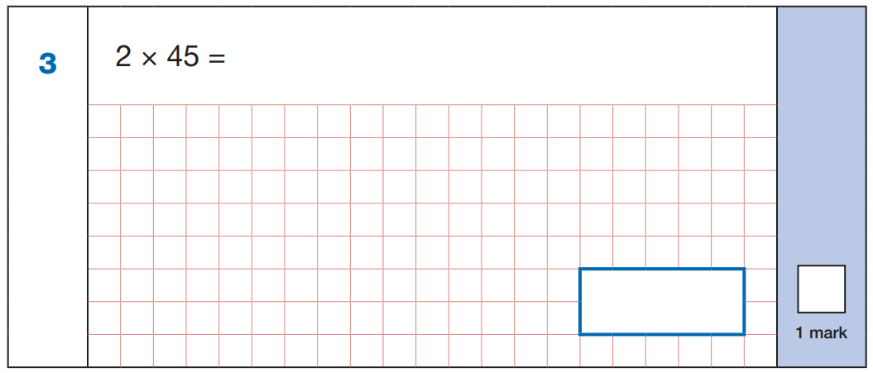
1
4 5
x
2
9
0
9 0

Slide 4
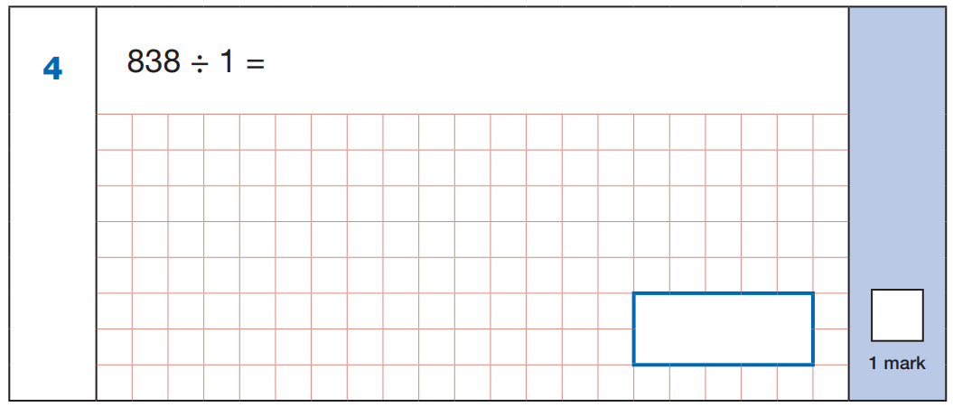
8 3 8

Slide 5
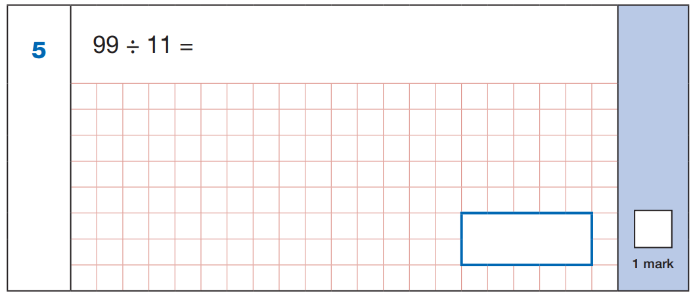
9 x 1 1 = 9 9
9

Slide 6
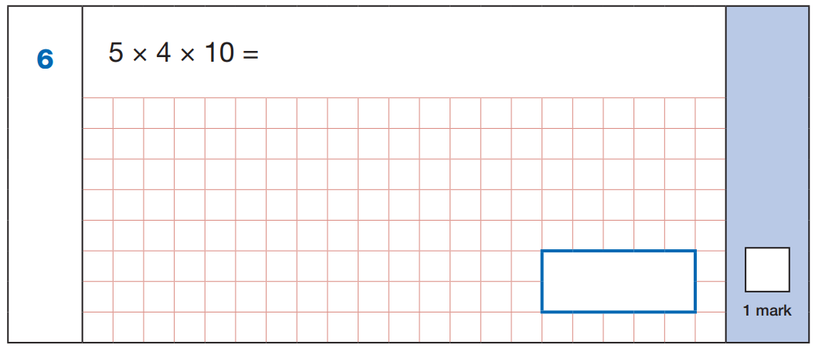
5 x 4 =
2 0
2 0 x 1 0 =
2 0 0
2 0 0

Slide 7
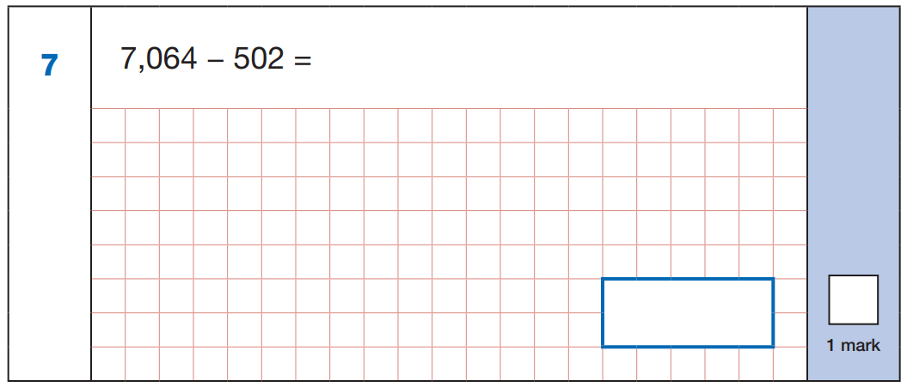
6
7 0 6 4
1
-
5 0 2
6
5
6
2
6 5 6 2

Slide 8
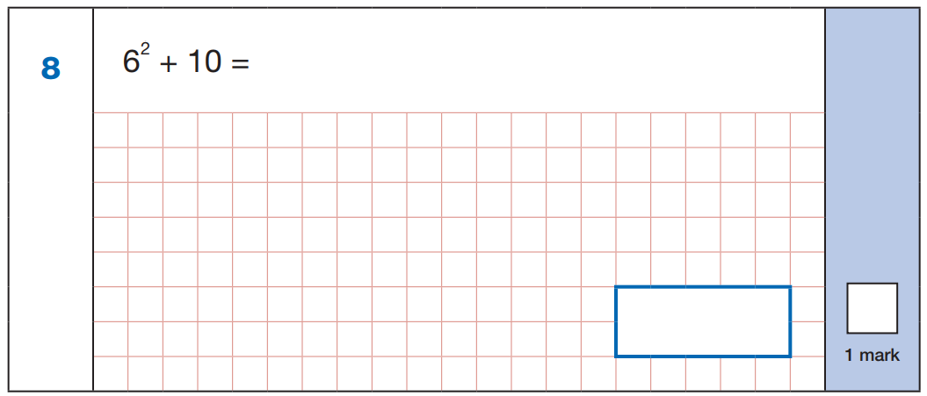
6 x 6 = 3 6
3 6 + 1 0 = 4 6
4 6

Slide 9
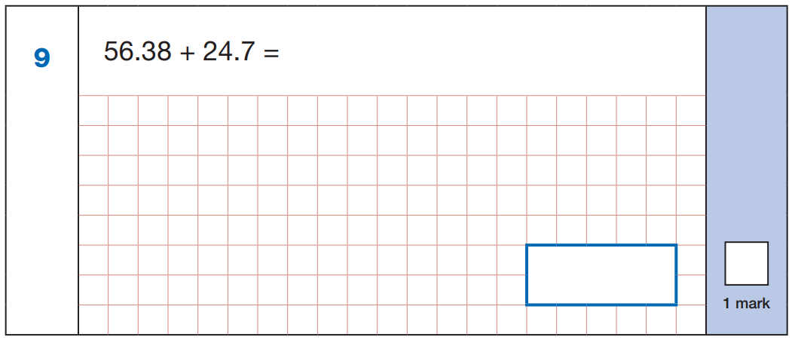
1
1
5 6.3 8
+
2 4.7
0
8
1
0
8
.
8 1.0 8

Slide 10
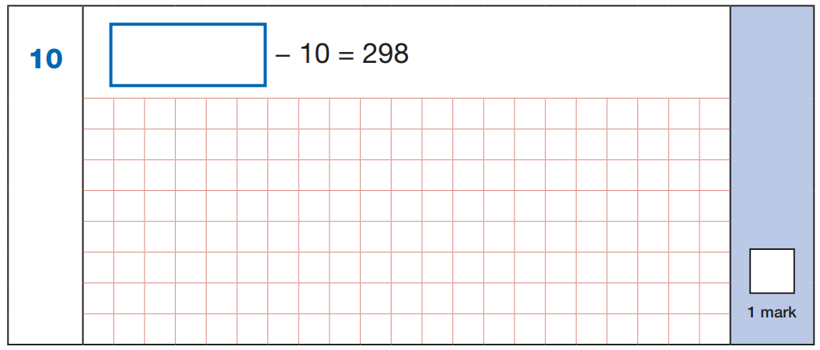
3 0 8
2 9 8 + 1 0 =
3 0 8

Slide 11
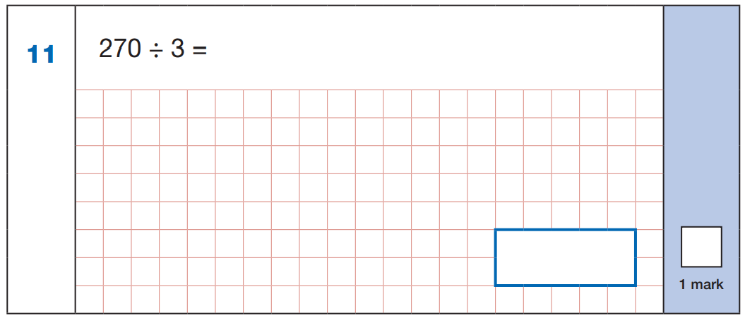
.
9
0
2 7 ÷ 3 = 9
3
2 7 0
9 0
.

Slide 12
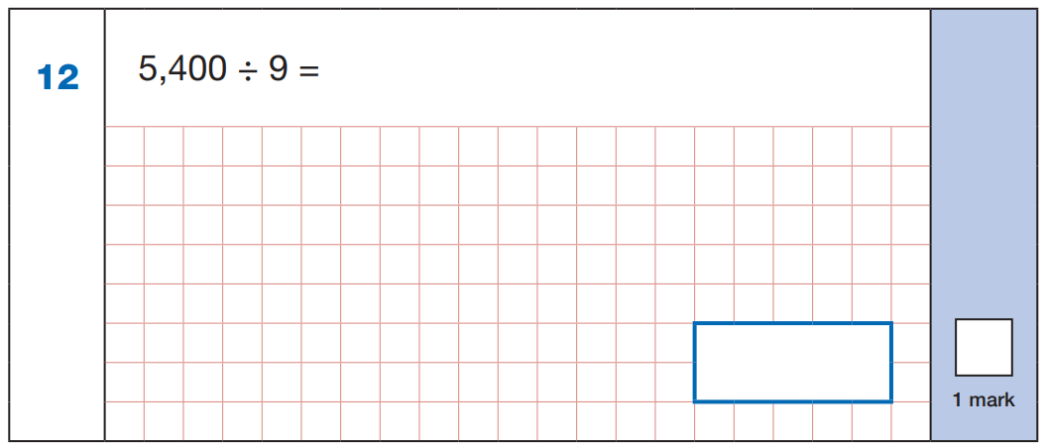
.
.
6
0
0
5 4 ÷ 9 = 6
9
5 4 0 0
6 0 0
.
.

Slide 13
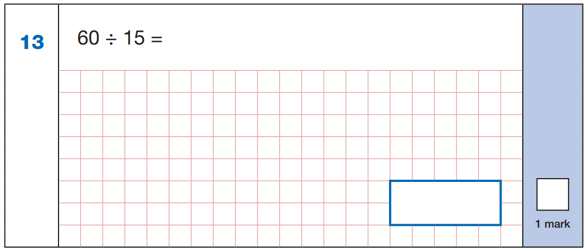
1 x = 1 5
2 x = 3 0
3 x = 4 5
4 x = 6 0
4

Slide 14
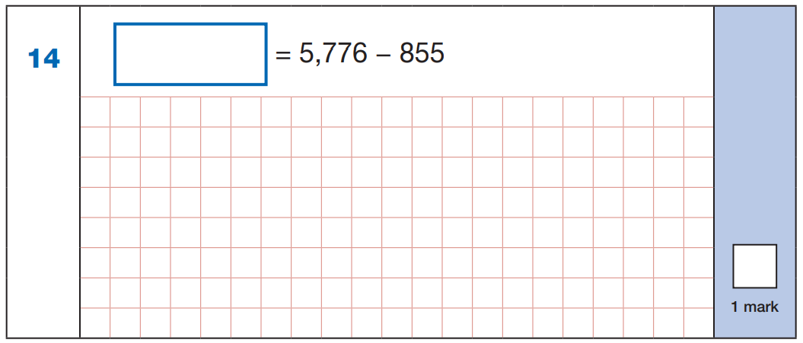
4 9 2 1
4
5 7 7 6
1
-
8 5 5
4
9
2
1

Slide 15
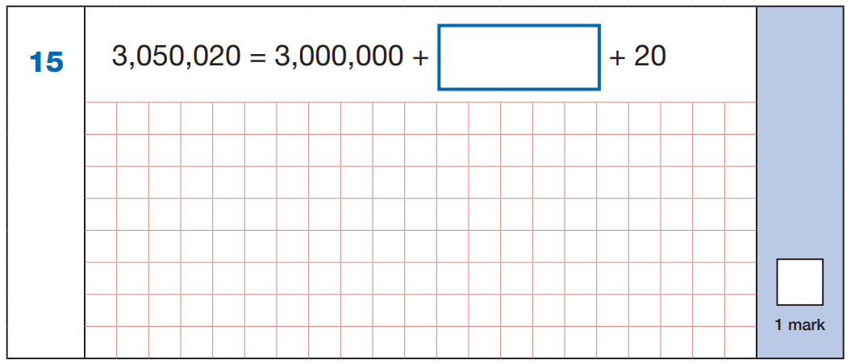
50 000

Slide 16
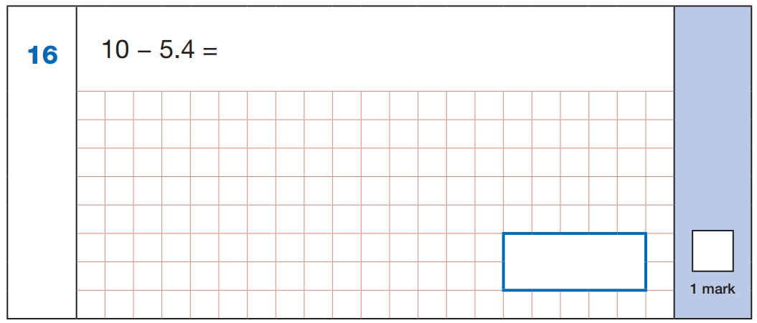
0
9
1
1
1 0
.0
-
5.4
0
4
.
6
4.6

Slide 17
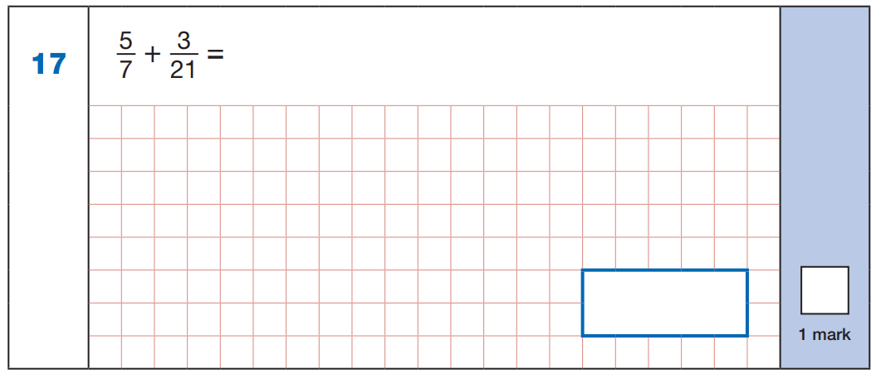
x3
5
1 5
1 5
3
1 8
=
+
=
7
2 1
2 1
2 1
2 1
x3
1 8
2 1

Slide 18
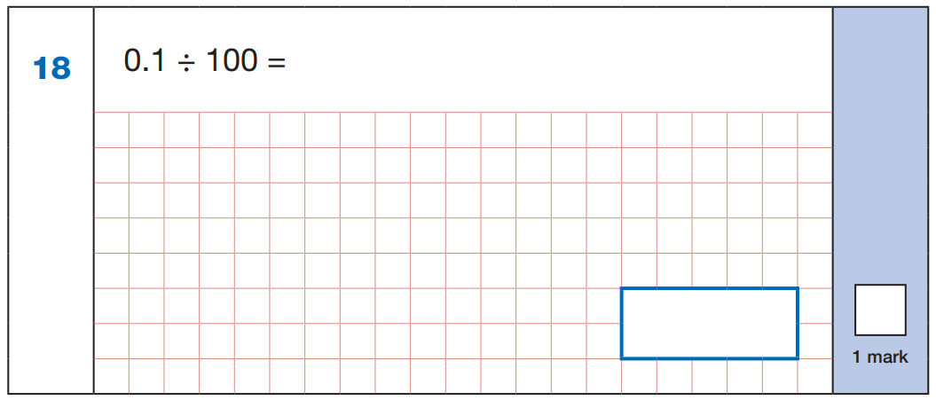
0.1
0
.
0
0
1
0.0 0 1

Slide 19
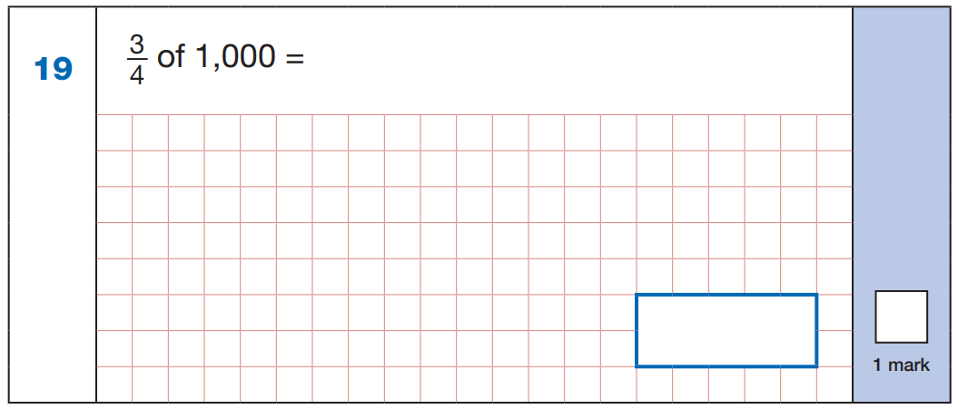
1
2
5
0
2 5 0
4
1 0 0 0
x
3
2
7
5
0
7 5 0

Slide 20
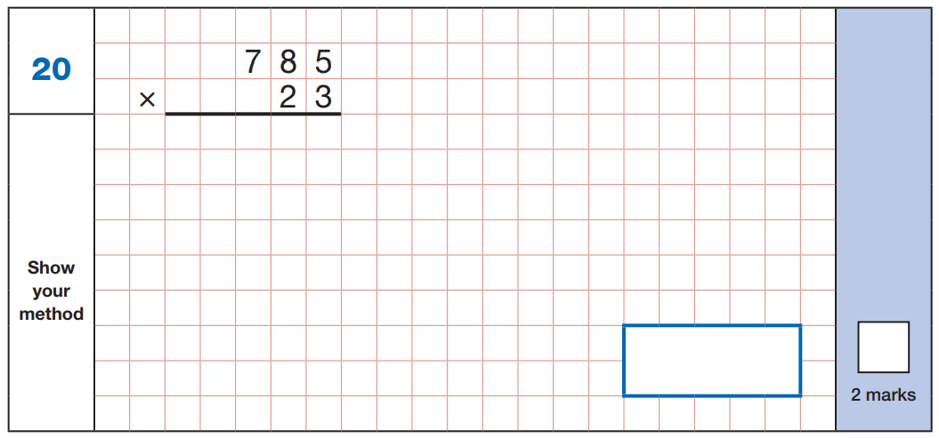
1
1
2
1
1
2 3
5
5
1 5
7
0
0
1
8
0
5
5
18 055

Slide 21
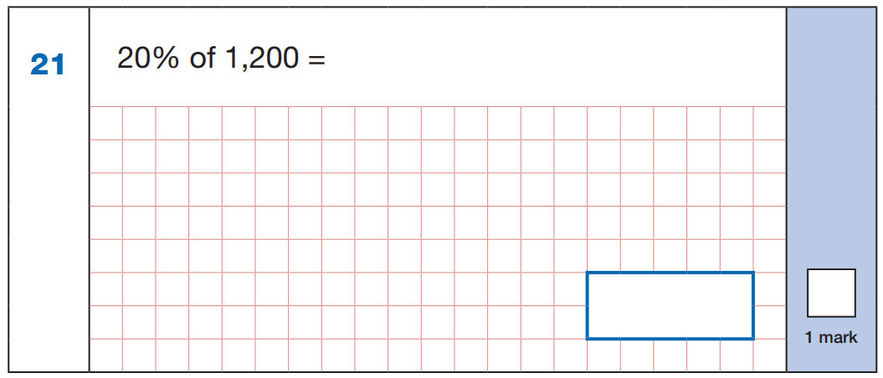
2 0
1 2 0 0 ÷ 1 0 0 =
1 2
1 0 0
1 2 x 2 0 =
2 4 0
.
.
1
2
4
0
5
5
1 2 0 0
2
2 4 0

Slide 22
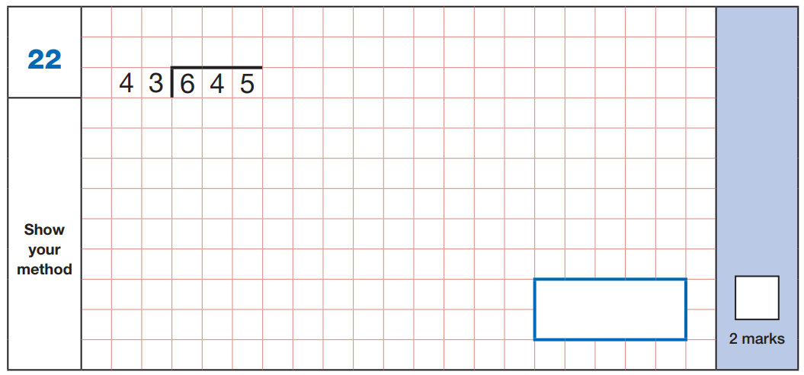
1
5
4 3
1 x
+ 4 3
- 4 3
8
6
2 x
2
1
5
+ 4 3
1
1 2
9
3 x
+ 4 3
1
1
7
2
4 x
+ 4 3
2
1
5
5 x
1 5

Slide 23
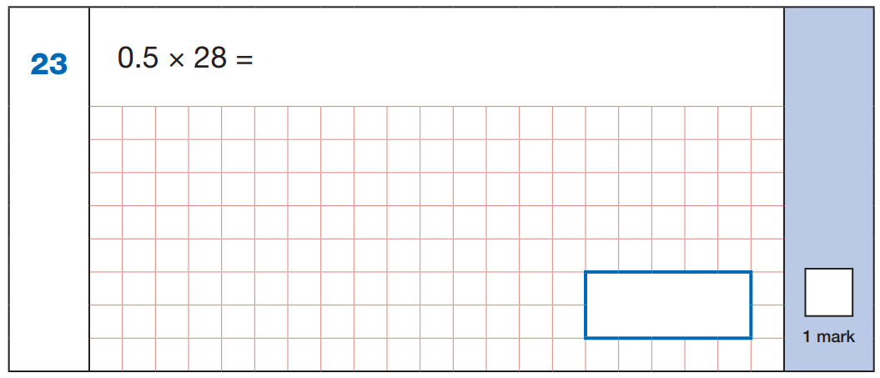
4
2 8
x 0.5
1 4
.
0
1 4

Slide 24
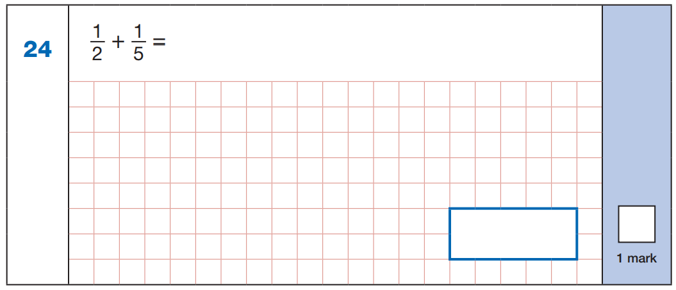
x5
x2
1
5
1
2
=
=
2
1 0
5
1 0
x5
x2
5
2
7
7
+
=
1 0
1 0
1 0
1 0

Slide 25
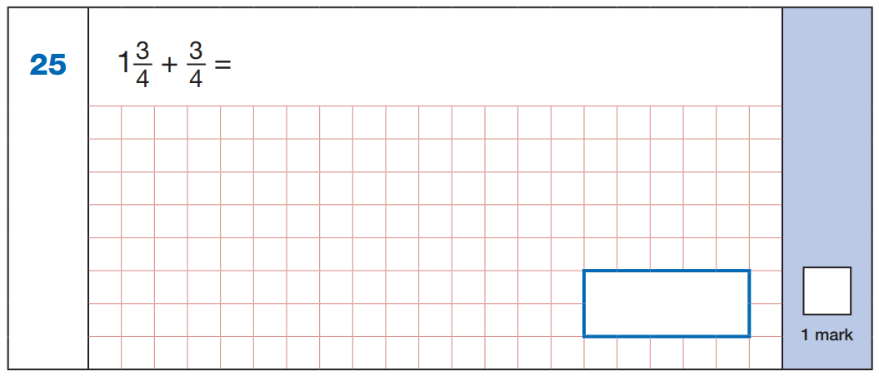
7
3
1 0
+
=
4
4
4
1 0
4

Slide 26
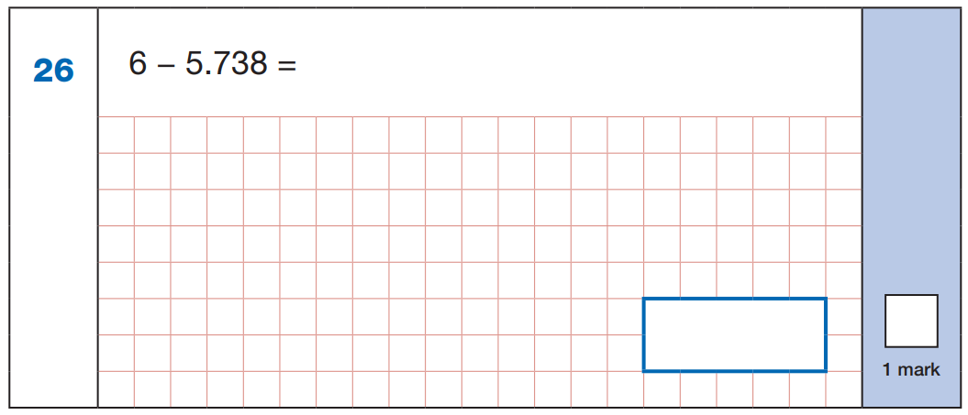
5
9
9
6
.0 0 0
1
1
1
- 5.7 3 8
0
.
2
6
2
0.2 6 2

Slide 27
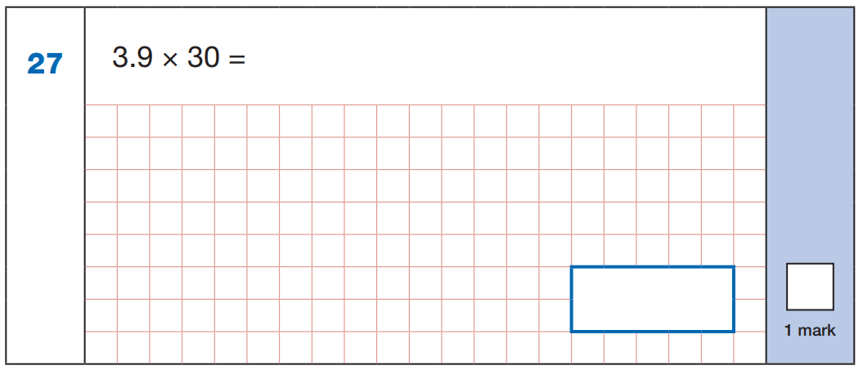
2
3.9
x 3 0
0
0
1 1
7
0
.
1 1 7 0
1 1 7

Slide 28
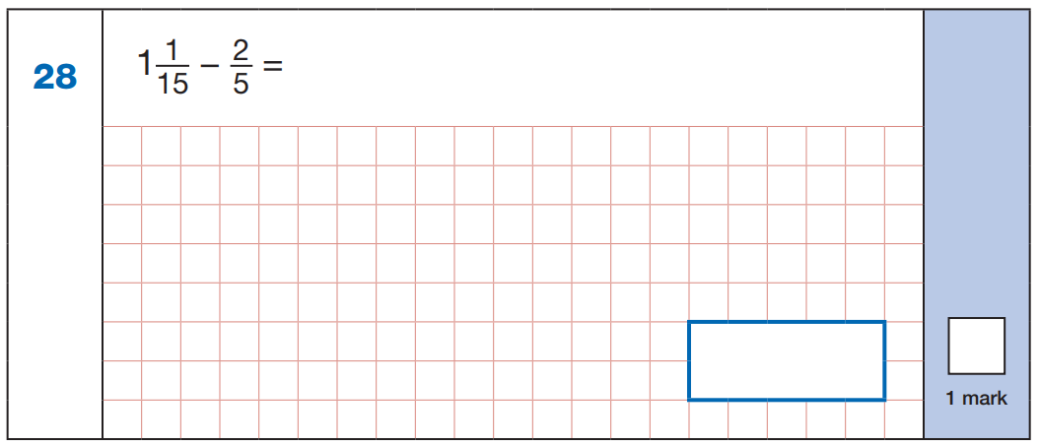
x3
2
6
=
5
1 5
x3
1 6
6
1 0
1 0
-
=
1 5
1 5
1 5
1 5

Slide 29
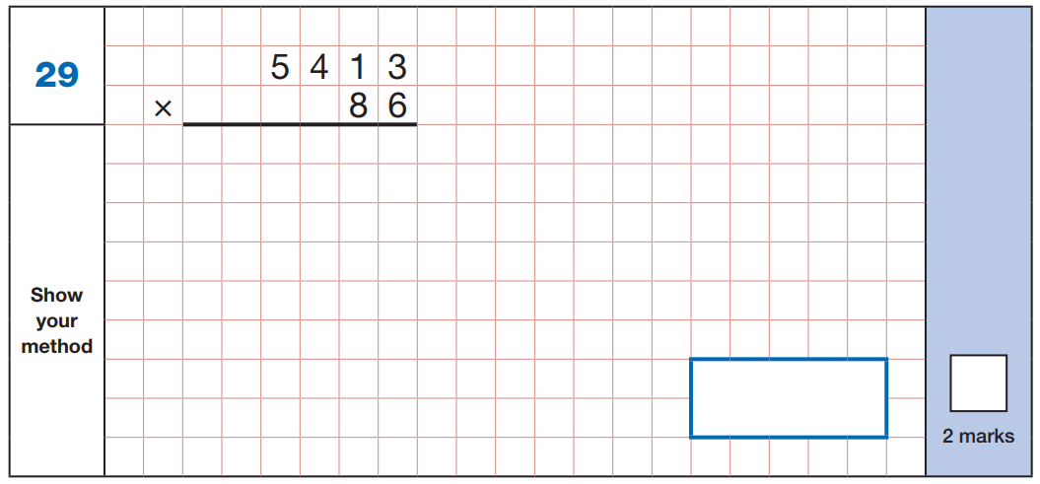
3
1
2
2
1
1
3 2
4
7
8
4 3
3
0
4
0
4
6
5
5
1
8
465 518

Slide 30
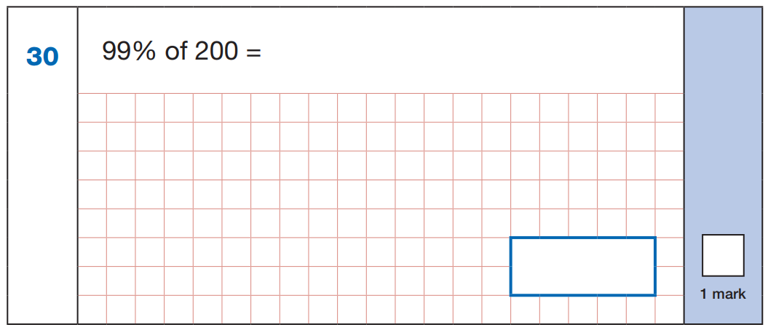
1
9 9
2 0 0 ÷ 1 0 0 =
2
9 9
1 0 0
x
2
1 9
8
1 9 8

Slide 31
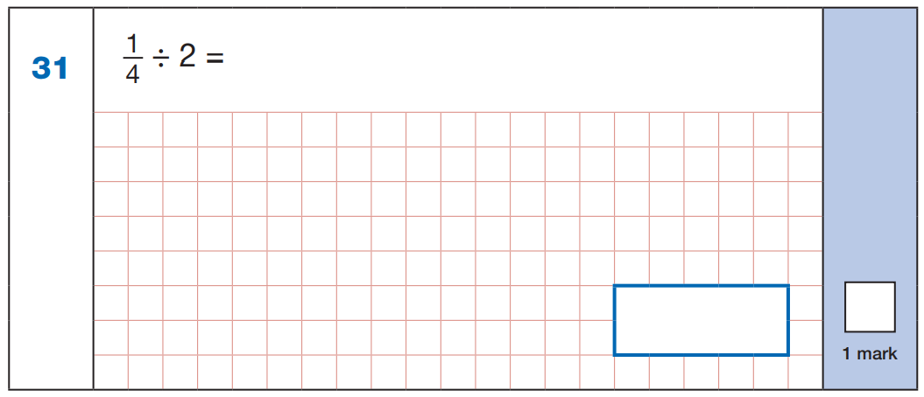
1
4
x 2
1
8

Slide 32
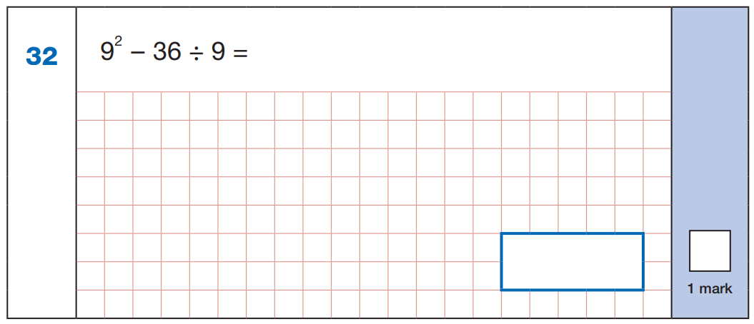
8 1 - 3 6 ÷ 9 =
8 1 - 4 =
7 7

Slide 33
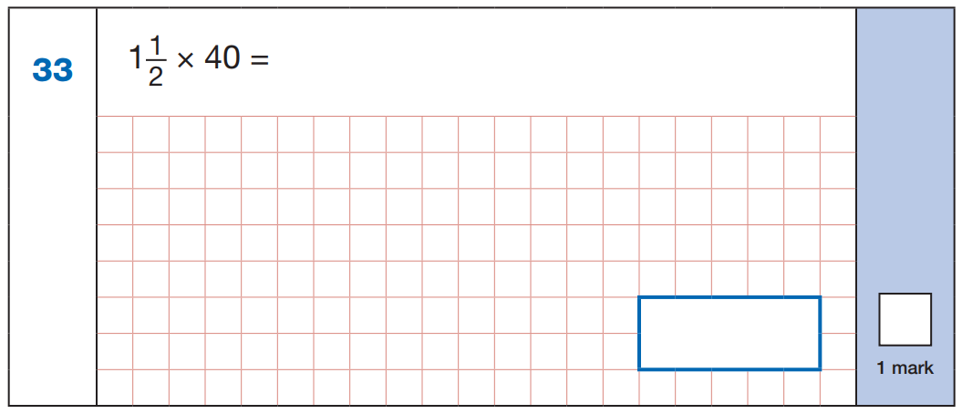
3
x 4 0
=
1 2 0
1 2 0 ÷ 2 =
6 0
.
.
.
.
2
2
6 0

Slide 34
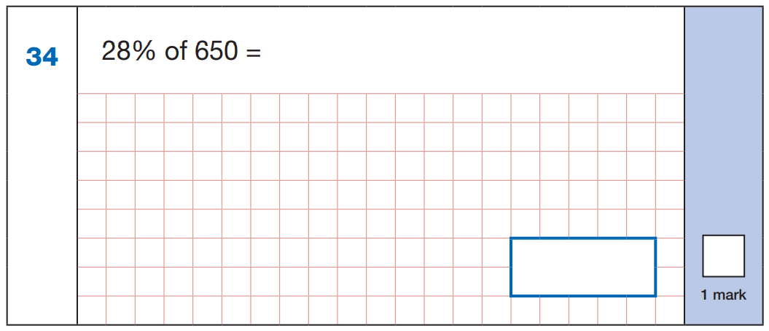
1
4
2 8
6 5 0 ÷ 1 0 0 =
6.5
.
1 0 0
6
5
0
x 2 8
.
5 2
0
1 3
0
0
2
.
1
8
0
1 8 2

Slide 35
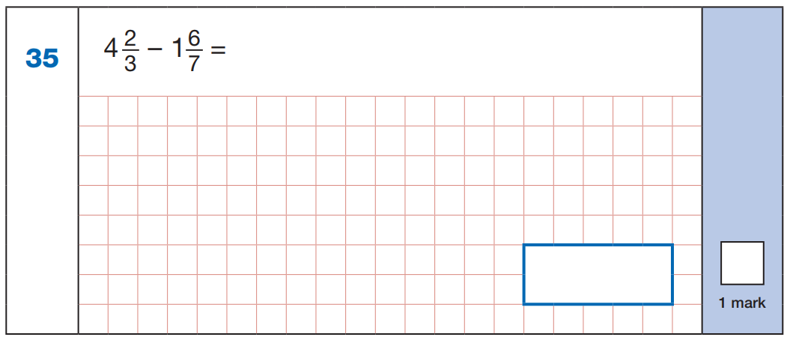
1 4
1 3
-
3
7
x7
x3
2
1 4
9 8
1 3
3 9
1 4
=
=
3
2 1
7
2 1
x
7
x7
x3
9
8
9 8
3 9
5 9
5 9
-
=
2 1
2 1
2 1
2 1

Slide 36
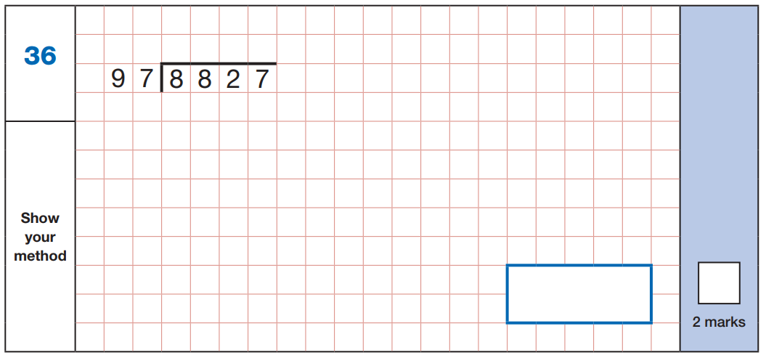
9 7
1 x
9
1
1 9 4
2 x
2 9 1
3 x
- 8 7 3
3 8 8
4 x
9
7
4 8 5
5 x
5 8 2
6 x
6 7 9
7 x
7 7 6
8 x
8 7 3
9 x
9 7 0
1 0 x
9 1

