Slide 1
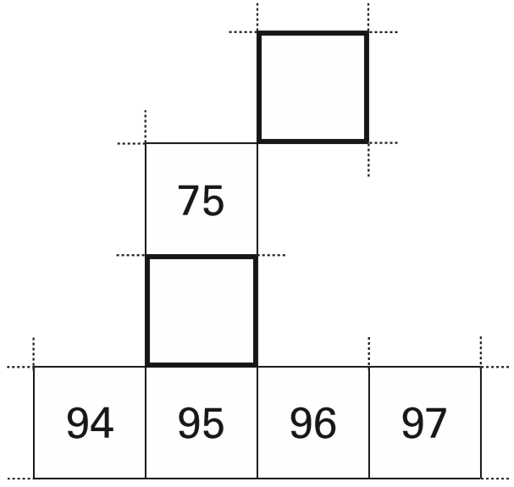
Here is part of a hundred square.
Write in the missing numbers.
65
66
76
85
86
Notes:
B1 2006 Year 4 Optional Paper 1 Q4

Slide 2
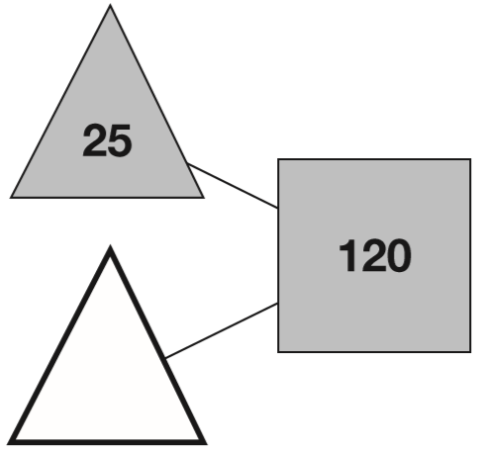
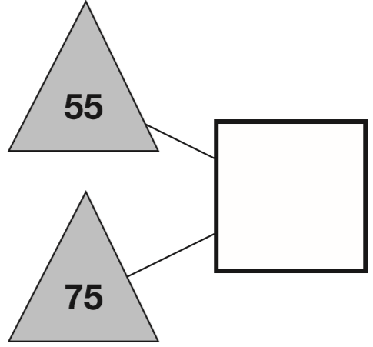
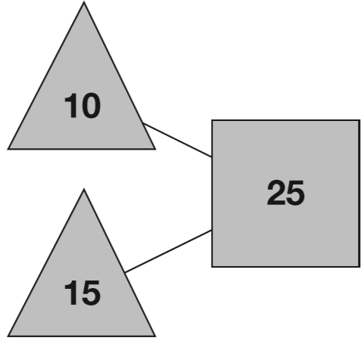
The numbers in the two triangles add up to the number in the square.
Using the same rule, write in the missing numbers.
130
95
0
1
1
1 2 0
1
1
5 5
-
2 5
+
7 5
0
9
5
1 3
0
Notes:
B2 2013 Paper 1 Q1

Slide 3
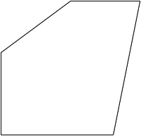
Look at this shape. Draw a cross in the corner with the smallest angle.
✘
Notes:
B3 Pre-2000 or other question

Slide 4
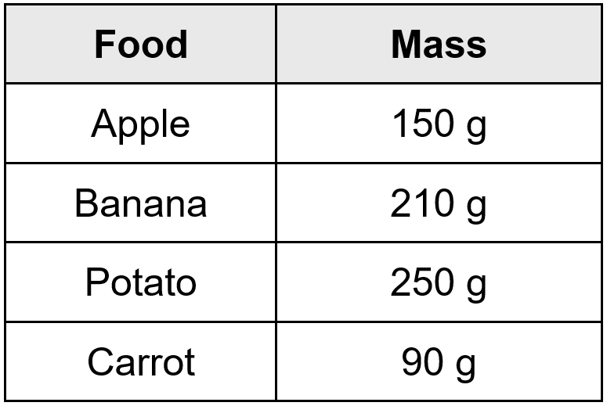
Look at the table.
1
2 5 0
1
-
9 0
160
1
6
0
The potato is _____g heavier than the carrot.
Together, the apple and banana weigh _____g.
360
1 5 0
+
2 1 0
3
6
0
Notes:
B4 Pre-2000 or other question

Slide 5
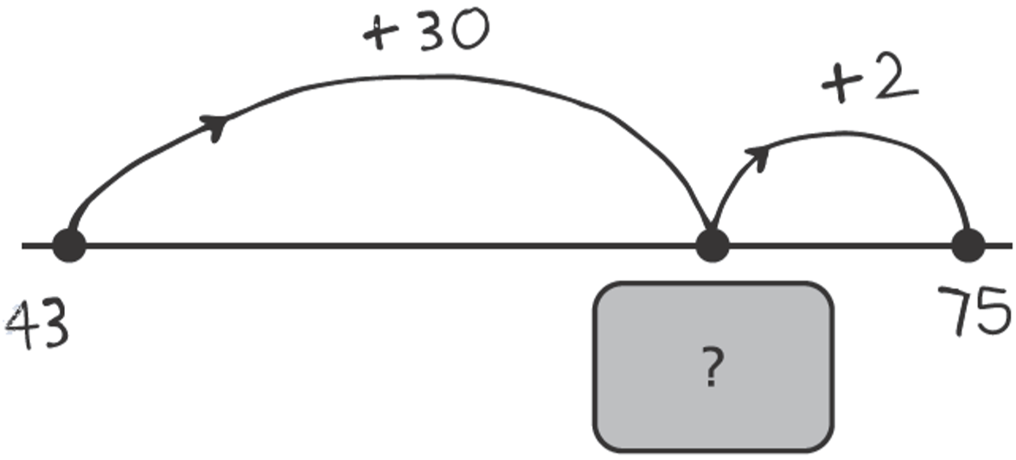
Molly drew a number line to find the answer to 43 + 32
What number is hidden under the card?
73
73
4 3 + 3 0 =
7 3
Notes:
B5 2003 Year 4 Optional Paper 1 Q8

Slide 6
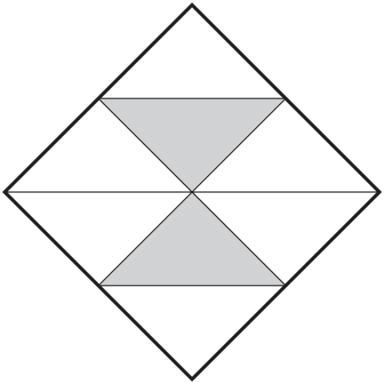
Here is a square.
What fraction of the square is shaded?
2 pieces shaded
2
8 pieces altogether
8
Notes:
B6 2004 Paper 1 Q2

Slide 7
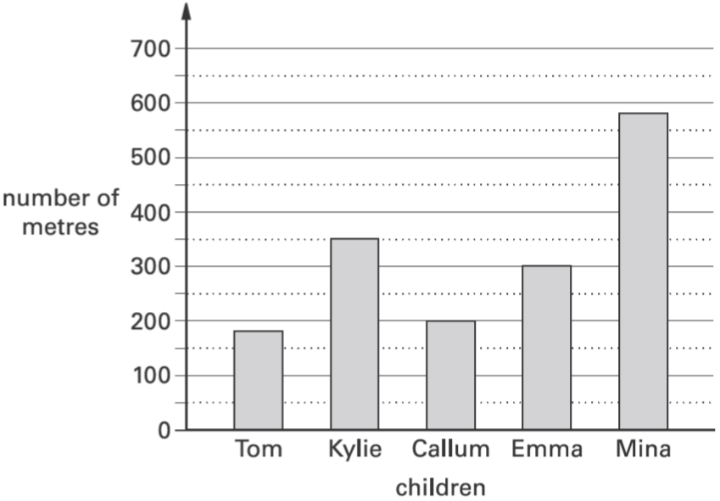
This graph shows the distance some children walk to school.
Who walks between 300 and 400 metres to school?
Kylie
Notes:
B7 2003 Year 3 Optional Paper 1 Q17

Slide 8
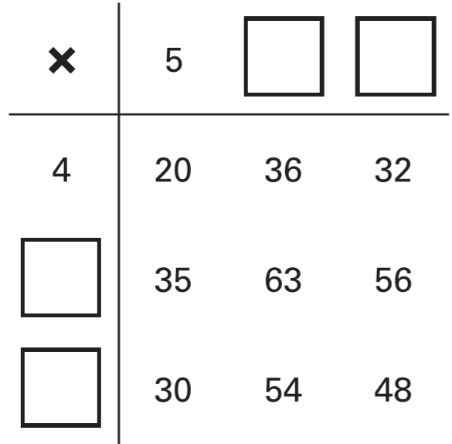
Write in the missing numbers in this multiplication grid.
9
8
7
6
Notes:
B8 2004 Paper 1 Q14

Slide 9
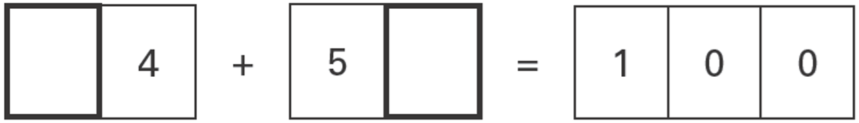
Write in the missing digits.
4
6
1
5 6
+
4 4
1 0
0
Notes:
B9 2006 Year 3 Optional Paper 1 Q23

Slide 10

Write the missing numbers in the sequence.
16
40
64
+8
+8
+8
+8
+8
+8
-4
-4
+4
+4
16
20
24
56
60
64
Notes:
B10 Pre-2000 or other question

Slide 11
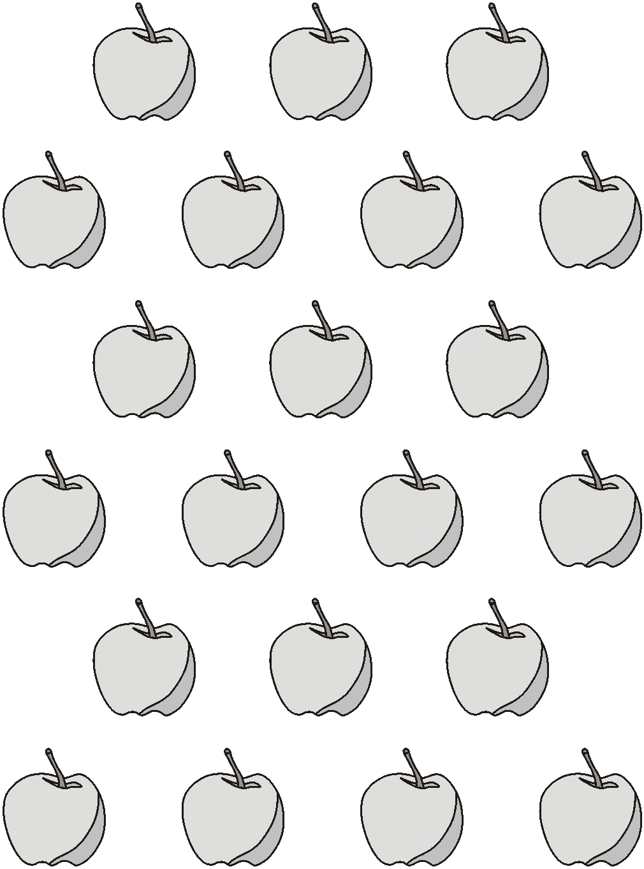
Here are 21 apples.
Put a ring around one third of them.
1
of 21 =
7
3
21 ÷ 3 =
7
Notes:
B11 Pre-2000 or other question

Slide 12
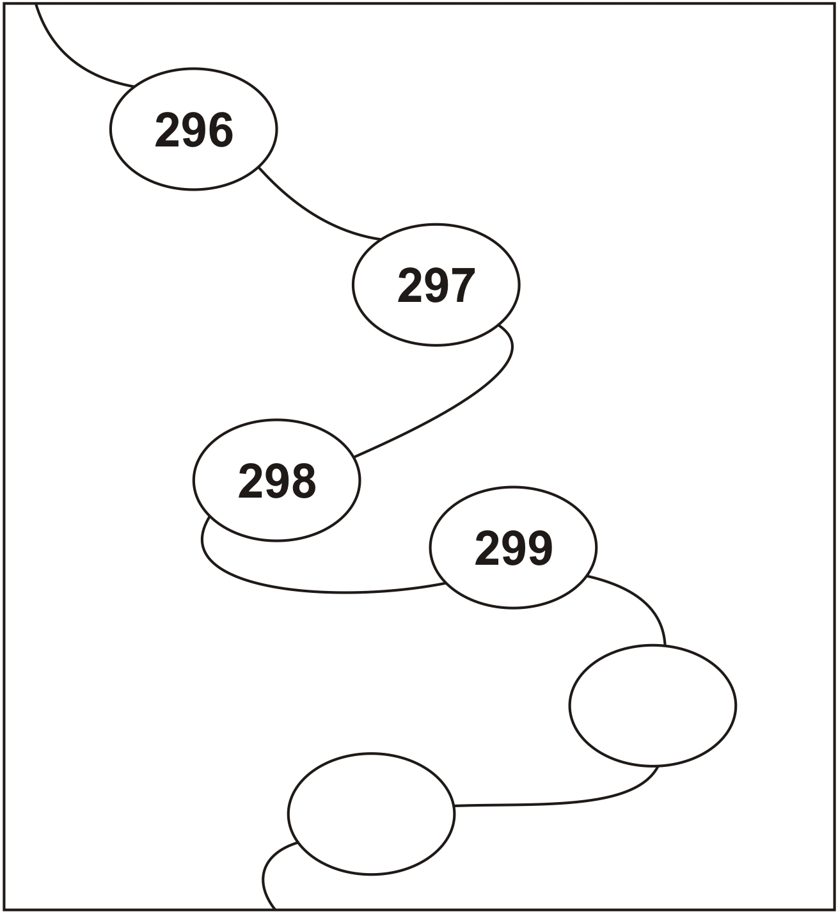
Continue this sequence.
300
301
Notes:
B12 Pre-2000 or other question

Slide 13
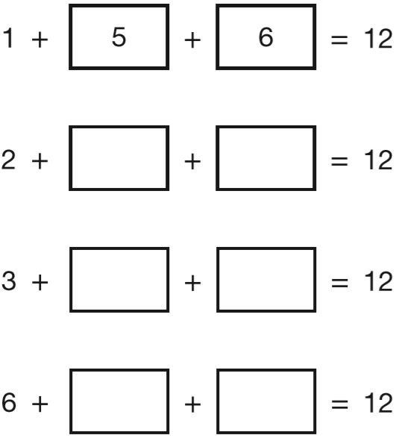
The four sums below can be completed using only the numbers 1 to 8
Use each number once to complete the sums.
One sum has been done for you.
8
2
7
3
8
1
7
4
2
Notes:
B13 2011 Paper 1 Q8

Slide 14
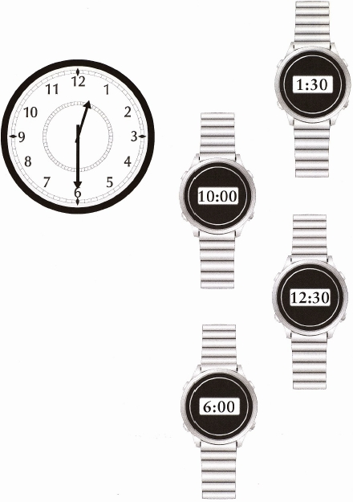
The clock shows the same time as one of the watches.
Draw a line to match the clock to a watch.
Notes:
B14 Pre-2000 or other question

Slide 15
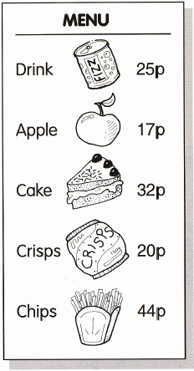
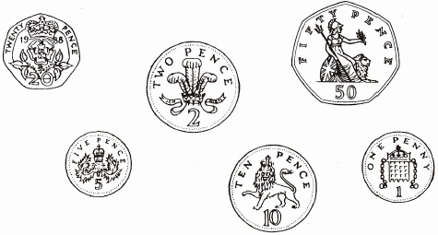
Sally buys crisps and an apple.
Tick the coins she needs.
20p + 17p =
37p
✓
✓
✓
✓
Notes:
B15 Pre-2000 or other question

Slide 16
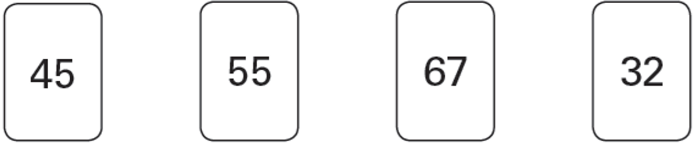
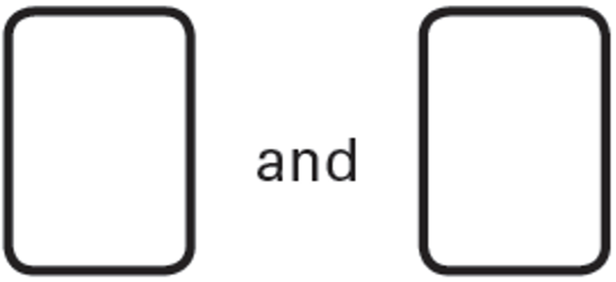
Here are four number cards.
Jade picks the two cards which have a difference of 22
Which cards does she pick?
6 7
–
4 5
67
45
2
2
+13
+10
+12
32
45
55
67
Notes:
B16 2006 Year 4 Optional Paper 1 Q26

Slide 17
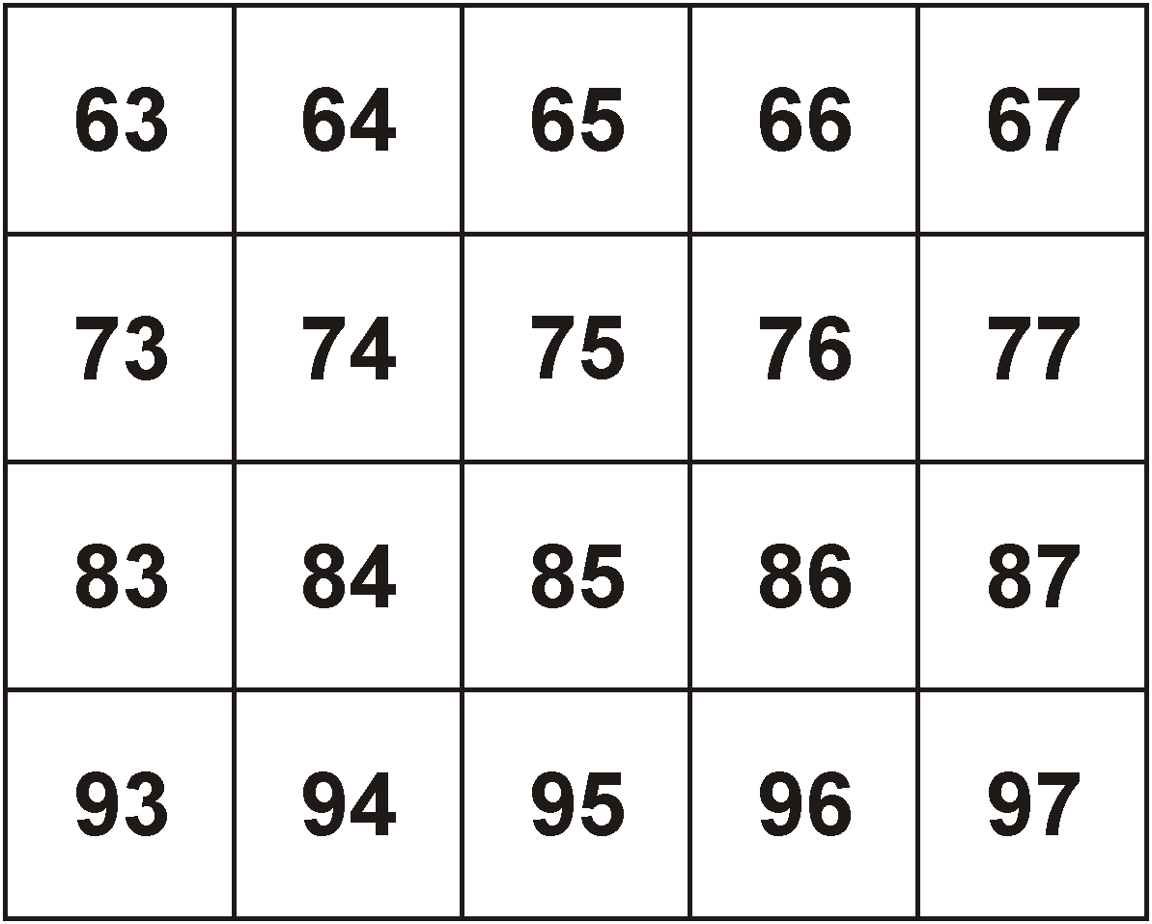
Circle two numbers which add up to 150
0
4
0
4
1
1
1 5 0
1 5 0
1
1
-
6 3
-
7 3
0
8
7
0
7
7
Notes:
B17 Pre-2000 or other question

Slide 18
Ben wants to buy a packet of biscuits.
He gives the shopkeeper 65p
The shopkeeper says, ‘You need 25p more to buy the biscuits.’
How much do the biscuits cost?
90p
1
6 5
+
2 5
9
0
Notes:
B18 2003 Year 3 Optional Paper 1 Q5

Slide 19
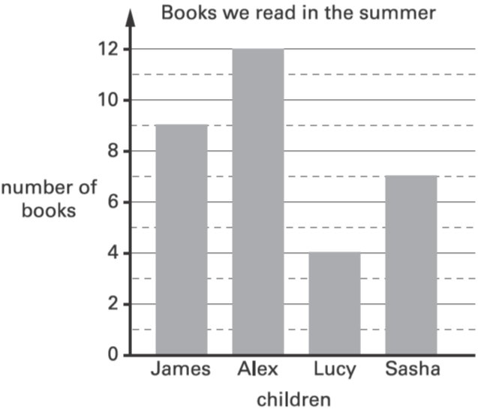
This graph shows the number of books some children read.
How many more books did James read than Lucy?
9 – 4 =
5 more books
9
Which two children read between 5 and 10 books?
James and Sasha
Notes:
B19 2003 Year 4 Optional Paper 1 Q12

Slide 20
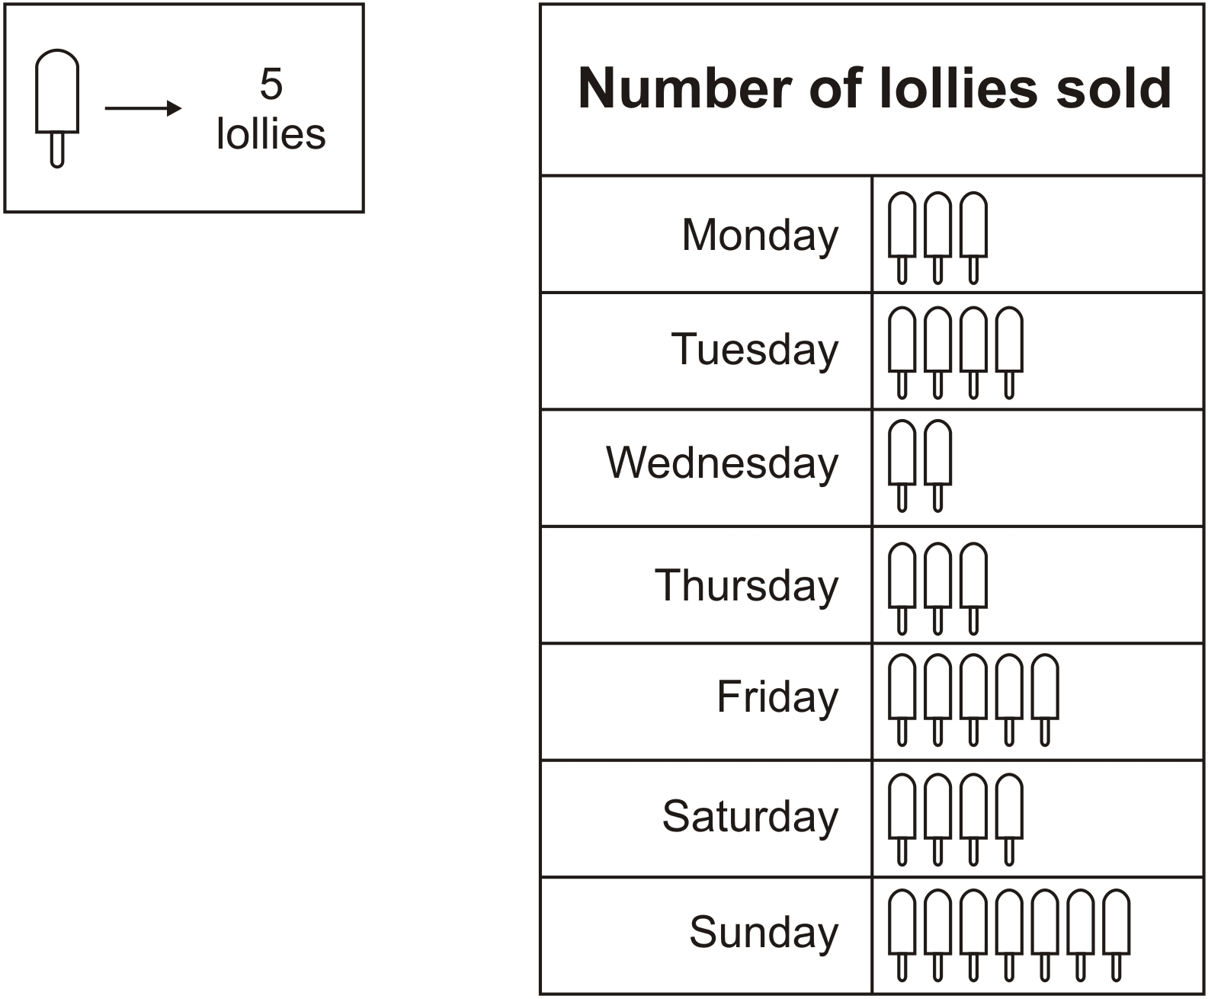
A shop sold 10 ice lollies on Wednesday.
How many lollies were sold on Monday?
3 x 5 =
15 lollies
How many more lollies were sold on Tuesday than on Wednesday?
10 more lollies
4 x 5 =
20 on Tuesday
2 x 5 =
10 on Wednesday
10
20 – 10 =
Notes:
B20 Pre-2000 or other question

Slide 21
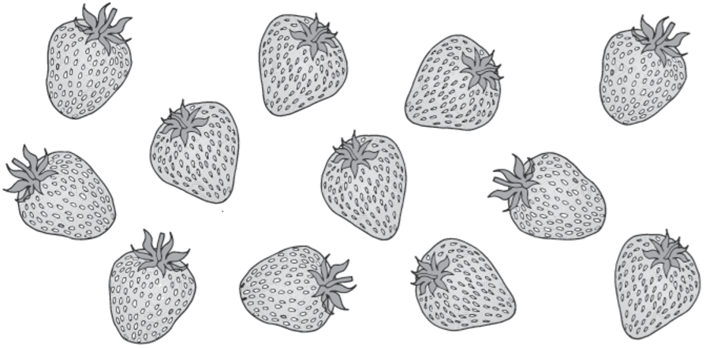
Some children share 12 strawberries.
Each child gets 3 strawberries.
How many children are there?
12 ÷ 3 =
4 children
Notes:
B21 2003 Year 3 Optional Paper 1 Q4

Slide 22
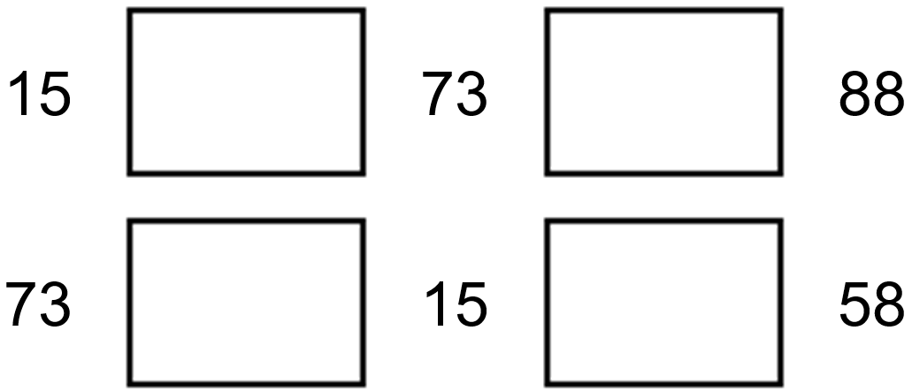
Write one of these signs in each empty box.
You can use each sign more than once.
+ = –
1 5
+
7 3
+
=
8
8
6
1
7 3
1 5
–
1
=
+
=
-
1 5
+
5 8
5
8
7
3
Notes:
B22 Pre-2000 or other question

Slide 23
Mina has 76 marbles in a jar.
The jar is about half full.
Estimate how many marbles Mina will have when the jar is full.
Circle the best estimate.
75 100 125 150 175
1
7 6
x
2
76
1 5
2
76
Notes:
B23 2003 Year 3 Optional Paper 1 Q20

Slide 24
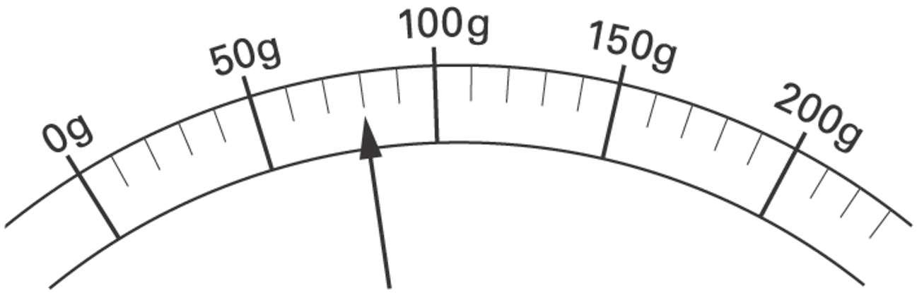
Here is a scale which shows the weight of a letter.
How much does the letter weigh?
80 g
70
80
60
40
50 ÷ 5 =
30
10
20
10
Notes:
B24 2003 Year 3 Optional Paper 1 Q23

Slide 25
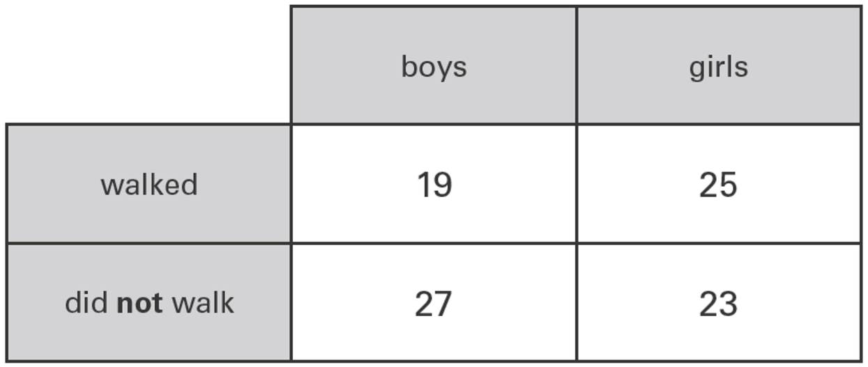
Sarah asked all the children in Year 3, ‘Did you walk to school today?’
The diagram shows her results.
Sarah says, ‘More children walked than did not walk.’
Is she correct?
Explain how you know.
No, Sarah is wrong.
1
2 5
+
1 9
4
4
walked
1
2 7
+
2 3
5
0
did not walk
Notes:
B25 2006 Year 3 Optional Paper 2 Q21

Slide 26
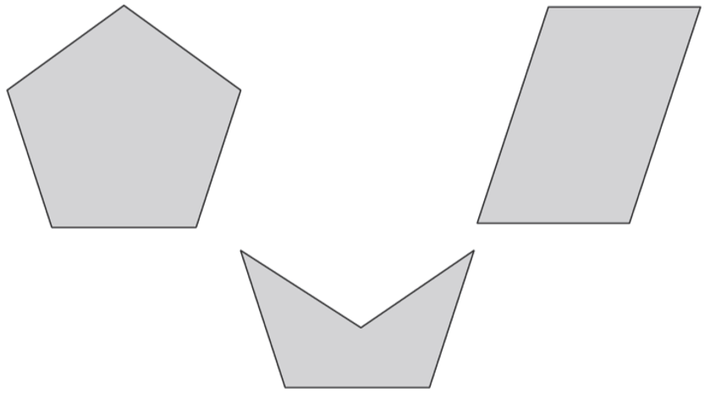
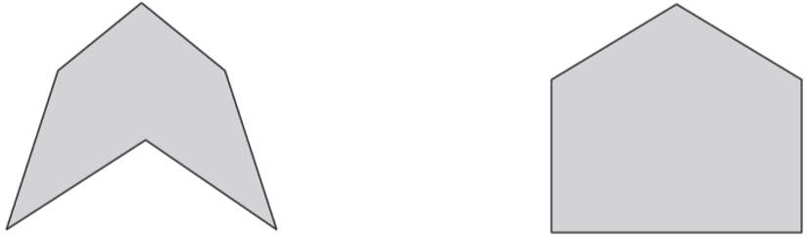
Put a tick in each of the pentagons.
quadrilateral
✓
parallelogram
✓
hexagon
✓
Notes:
B26 2006 Year 3 Optional Paper 1 Q13

Slide 27
On a school trip, 56 people visit the zoo.
23 are girls. 21 are boys. 5 are teachers.
The rest are parents. How many are parents?
7 are parents
2 3
+
2 1
4
4
+ 5 =
49 are girls, boys or teachers
56 – 49 =
7 are parents
+1
+6
49
50
56
Notes:
B27 2006 Year 4 Optional Paper 1 Q7

Slide 28
Sam has 256 stickers.
Beth has 100 more than Sam.
How many stickers does Beth have?
356 stickers
2 5 6 + 1 0 0 =
3 5 6
Notes:
B28 Pre-2000 or other question

Slide 29
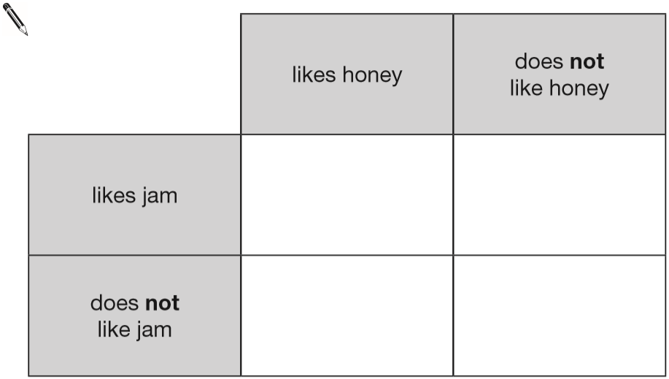
Megan likes honey, but not jam.
Alfie likes honey and jam.
Chen does not like honey or jam.
Donna only likes jam.
Write the children’s names in the correct parts of the sorting diagram.
Alfie
Donna
Megan
Chen
Notes:
B29 2015 Paper 1 Q1

Slide 30
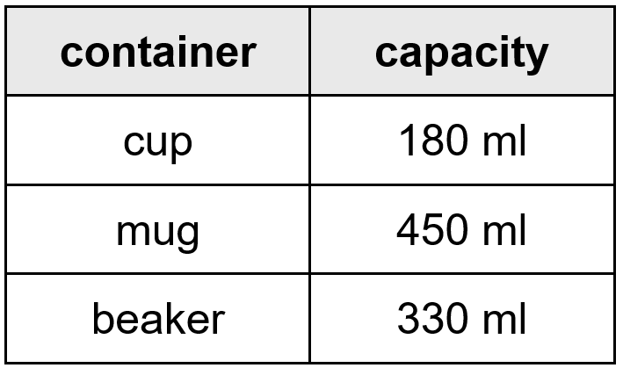
The table shows the capacity of three containers.
Together, the beaker and the cup hold more than the mug.
How much more?
60 ml more
1
4
3 3 0
5 1 0
1
+
1 8 0
-
4 5 0
5
1
0
0
6
0
Notes:
B30 Pre-2000 or other question

Slide 31
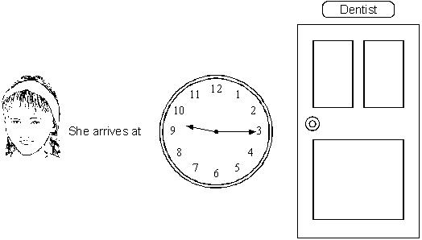
Jodie has to be at the dentist at half past nine.
How many minutes early is she?
9:30
15 minutes early
30 – 15 =
15
9:15
Notes:
B31 Pre-2000 or other question

Slide 32
Three whole numbers add up to 50
Seb says, ‘All three numbers must be even numbers.’
Is Seb correct? Explain how you know.
Seb is wrong.
48 + 1 + 1 = 50 and 1 is an odd number.
If two of the three numbers are odd numbers, then the answer will be an even number.
Notes:
B32 2012 Paper 2 Q25

Slide 33
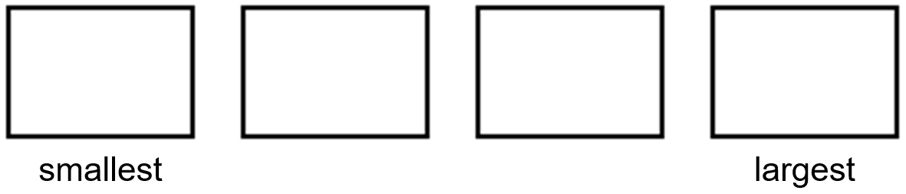
Write these numbers in order starting with the smallest.
1
1
1
1
2
4
8
5
1
1
1
1
8
5
4
2
Notes:
B33 Pre-2000 or other question

Slide 34
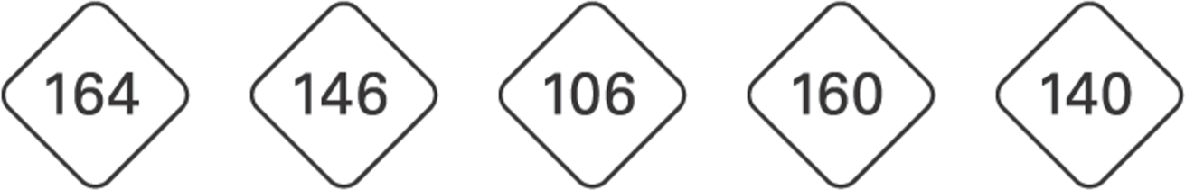
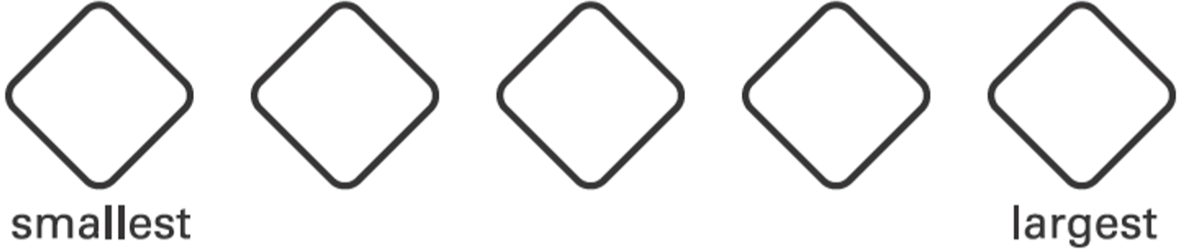
Write these numbers in order.
1 6 4
1 4 6
1 0 6
1 6 0
1 4 0
106
140
146
160
164
Notes:
B34 2003 Year 3 Optional Paper 1 Q15

Slide 35
Ben had 92 cards.
Sam gave him 10 more.
Flo gave him 100 more.
How many cards does Ben have now?
92 + 10 =
102
102 + 100 =
202
Ben has 202
Notes:
B35 Pre-2000 or other question

Slide 36
Karen is thinking of a number.
She says, ‘If I double my number, my answer is 16’
What number is Karen thinking of?
__ x 2 = 16
8
8
16 ÷ 2 =
8
Notes:
B36 Pre-2000 or other question

Slide 37

Tim buys a 19p postcard.
He pays exactly 19p with five coins.
What could the five coins be?
10p
5p
2p
1p
1p
Notes:
B37 Pre-2000 or other question

Slide 38
Two of these numbers round to 80
Circle the two numbers.
7 4 8 2 7 7 8 5
Notes:
B38 2003 Year 3 Optional Paper 1 Q9

Slide 39
Circle the number closest to 500
525 491 511 408 550
25 more
9 less
11 more
92 less
50 more
Notes:
B39 2015 Paper 1 Q2

Slide 40
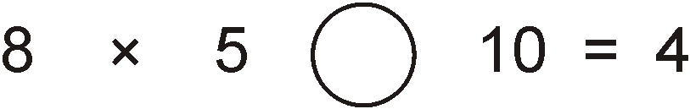
In the circle write +, – × or ÷ to make the calculation correct.
40
÷
Notes:
B40 Pre-2000 or other question

Slide 41
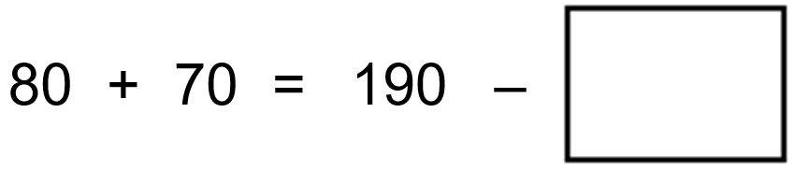
Write the missing number.
150
40
Notes:
B41 Pre-2000 or other question

Slide 42
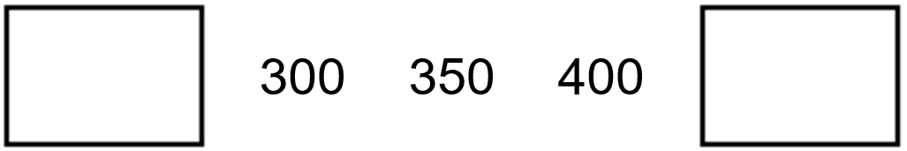
Write the missing number in the sequence.
250
450
Notes:
B42 Pre-2000 or other question

Slide 43
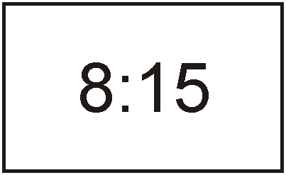
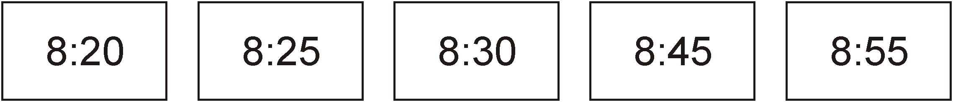
The time is
John has to be ready for school in half an hour.
Tick the time when he has to be ready.
✓
½ hour = 30 minutes
8:15 + 30 minutes =
8:45
15 + 30 =
45
Notes:
B43 Pre-2000 or other question

Slide 44
Ben goes to bed at 7:15 pm.
Grace goes to bed an hour later.
What time does Grace go to bed?
Give your answer using 24 hour clock.
7:15pm + 1 hour =
8:15pm
20:15
8 + 12 = 20
Notes:
B44 Pre-2000 or other question

Slide 45
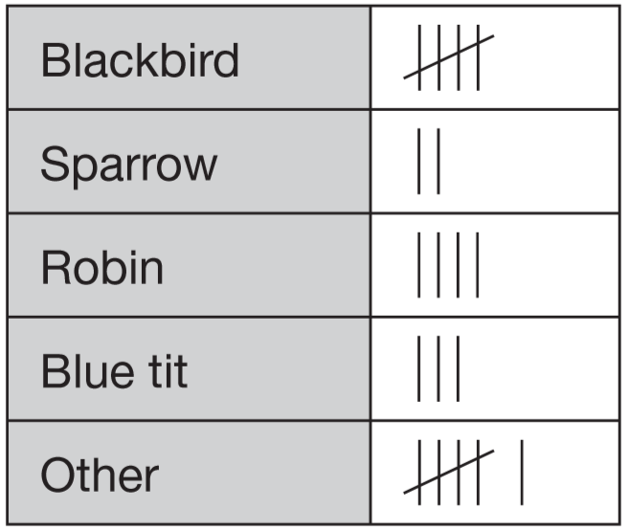
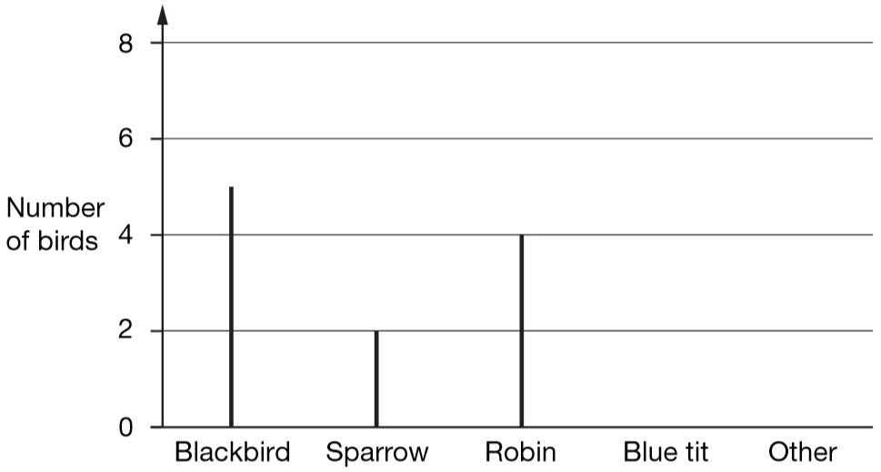
Rosie collects data about birds visiting a bird table.
Here are her results.
Draw two more lines to complete the graph.
Notes:
B45 2006 Paper 1 Q3 first page

Slide 46
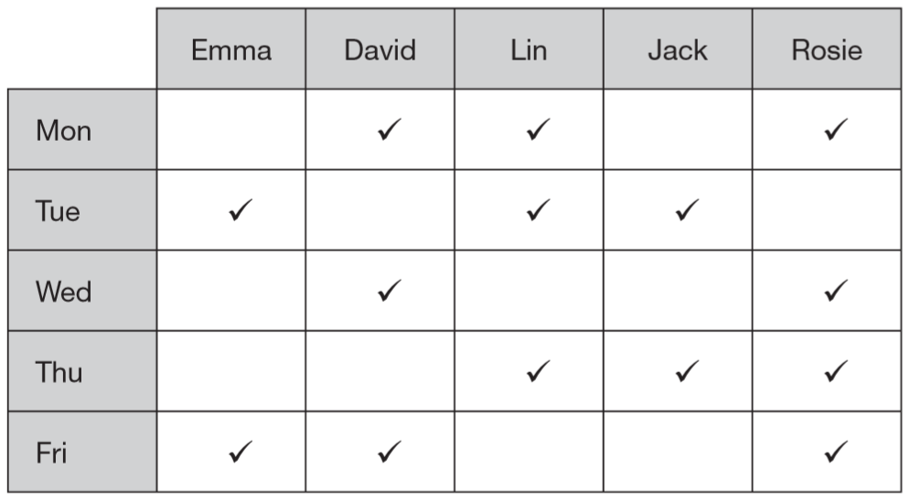
Five children have ticked this table to show on which days they are free to go out.
On how many days are more than two children free to go out?
4 days
On which days are Lin and Rosie both free to go out together?
Monday
and Thursday
Notes:
B46 2006 Paper 1 Q12

Slide 47
There are 21 children in Mr Bell’s class.
The number of boys is one more than the number of girls.
How many boys and girls are there?
___ boys and ___ girls
11 is 1 more than 10
11
10
11 + 10 = 21
boys
girls
1
10
10
20
10
20 ÷ 2 =
Notes:
B47 2006 Year 3 Optional Paper 1 Q25

Slide 48
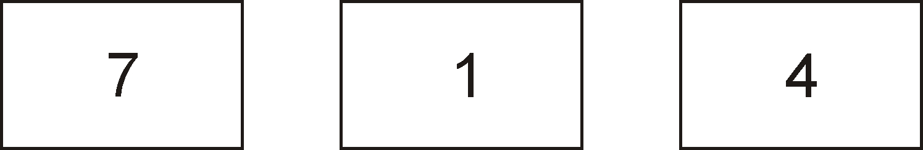

Use all of these digits.
Write the lowest number.
1
4
7
Notes:
B48 Pre-2000 or other question

Slide 49
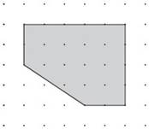
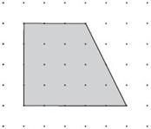
How many right angles do each of the shapes below have?
3
2
Notes:
B49 2003 Year 3 Optional Paper 1 Q22

Slide 50
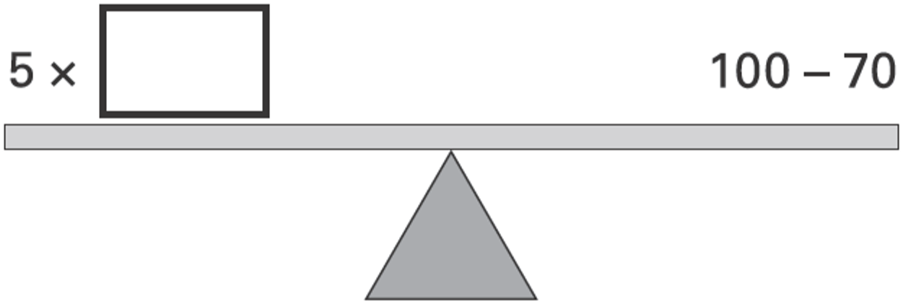
Each side of the number balance has the same answer.
Write in the missing number.
6
6
5 x __ = 30
100 – 70 = 30
6
30 ÷ 5 =
Notes:
B50 2006 Year 3 Optional Paper 1 Q19

Slide 51
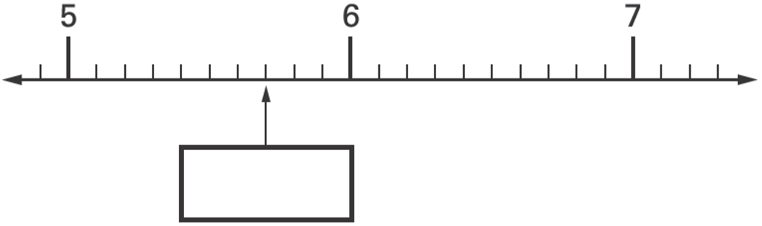
Here is part of a number line.
Write the missing number in the box.
5
7
10
5.7
Notes:
B51 2003 Year 5 Optional Paper 2 Q9

Slide 52
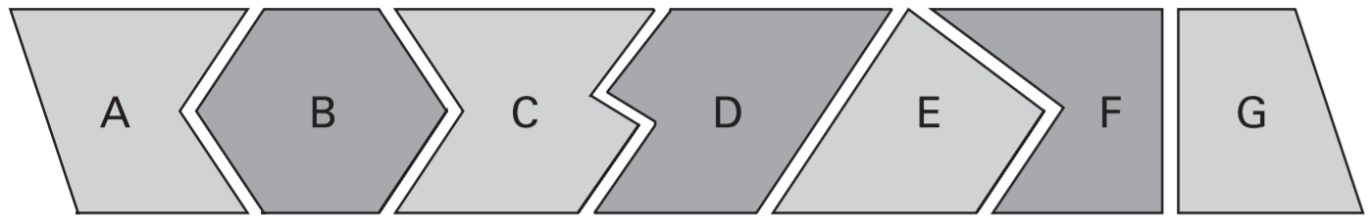
Here are seven shapes.
Write the letters of the two shapes which are pentagons.
A
, F
Notes:
B52 2004 Paper 2 Q8

Slide 53
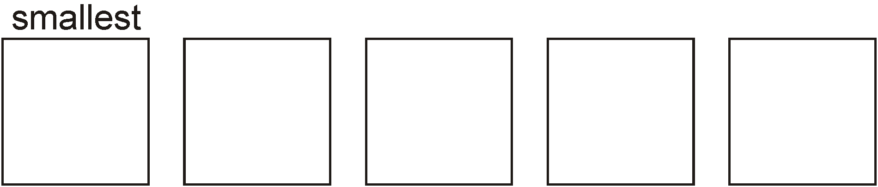
Arrange these decimals in order of size, with the smallest first.
4.7 14.9 2.4 4.2 0.5
4.7
1 4.9
2.4
4.2
0.5
0.5
2.4
4.2
4.7
14.9
Notes:
B53 Pre-2000 or other question

Slide 54
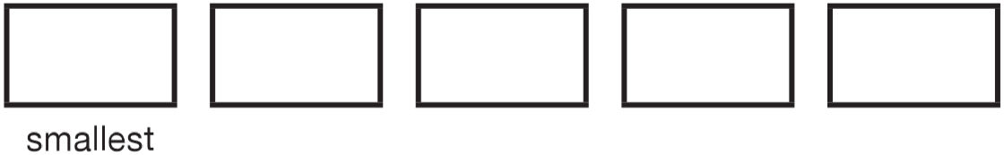
Write these prices in order, starting with the smallest.
72p £2.70 £0.27 £7.20 £2.07
£0.72
£ 0.7 2
£ 2.7 0
£ 0.2 7
£ 7.2 0
£ 2.0 7
£0.27
72p
£2.07
£2.70
£7.20
Notes:
B54 2010 Paper 1 Q1

Slide 55


Look at these digit cards.
Use the cards to make an odd number greater than 500.
6
4
5
Notes:
B55 Pre-2000 or other question

Slide 56
Sam cuts a pizza into ten equal pieces.
He eats one piece.
What fraction of the pizza does he eat?
What fraction of the pizza is left?
1 piece eaten
10 pieces altogether
1
1 0
9
1 0
1
9
1 0
+
=
1 0
1 0
1 0
Notes:
B56 Pre-2000 or other question

Slide 57
Write what the two missing digits could be.
5
1
3
3
4
2
1
5
6 2
3
4
+
1
9 5
3
2
7 5 7
Notes:
B57 Pre-2000 or other question

Slide 58

Draw arrows.
8 + 6 =
14
24 + 6 =
30
17 + 6 =
23
31 + 6 =
37
Notes:
B58 Pre-2000 or other question

Slide 59

Class 6 did a survey of their favourite types of story book.
Here are their results.
How many more children chose adventure books than fantasy books?
9
9 – 4 =
5 children
7
Five girls chose animal books.
How many boys chose animal books?
4
7 – 5 =
2 boys
Notes:
B59 2006 Paper 2 Q3

Slide 60

Look at these digit cards.
Use the cards to make the largest 3-digit number possible.
9
7
3
Use the cards to make the smallest 3-digit number possible.
3
7
9
Notes:
B60 Pre-2000 or other question

Slide 61


Here are five number cards.
Use all five cards to make an addition that has the answer 500
1
1
4
5
8
4
2
Notes:
B61 Pre-2000 or other question

Slide 62

Jake makes a robot using boxes.
How tall is Jake's robot?
55 cm
15 + 5 =
20
20 + 25 =
45
45 + 10 =
55
Notes:
B62 Pre-2000 or other question

Slide 63

There are three classes at Park School.
There are 78 children altogether.
Calculate how many children are in Class 3
25
3 0
7 8
+
2 3
-
5 3
5
3
2
5
25
Notes:
B63 2006 Year 5 Optional Paper 1 Q5

Slide 64
Roger picked 75 plums from his aunt’s plum tree.
He gave 25 plums to his aunt, and kept the rest.
How many plums did Roger keep?
50 plums
7 5
–
2 5
5
0
Notes:
B64 Pre-2000 or other question

Slide 65
Mina buys 200 g of sweets.
She eats 80 g.
What mass of sweets are left?
120 g
2 0 0 – 8 0 =
1 2 0
Notes:
B65 Pre-2000 or other question

Slide 66

Write in the missing digits.
2
9
5 9 3
-
2 0
2
9
3 1
Notes:
B66 Pre-2000 or other question

Slide 67
28 children go swimming in groups of 4
How many groups will there be?
7 groups
28 ÷ 4 =
7
28
4
4
4
4
4
4
4
Notes:
B67 Pre-2000 or other question

Slide 68

Look at this shape. Draw a cross in the corner with the largest angle.
✘
Notes:
B68 Pre-2000 or other question

Slide 69


Here are six number cards.
Use all the number cards to complete the two sums below.
30
20
40
10
50
30
10
40
Notes:
B69 2011 Paper 2 Q2

Slide 70



Here are two signs
< >
Use the signs to make these correct.
>
<
>
Notes:
B70 2003 Year 4 Optional Paper 1 Q18

Slide 71

Here are some angles. Tick the two right angles.
✓
✓
Notes:
B71 2006 Year 3 Optional Paper 1 Q26

Slide 72
Sarah has a bag of 24 marbles.
of the marbles are red.
How many marbles are red?
1
3
1
of 24 =
8 red marbles
3
2 4 ÷ 3 =
8
Notes:
B72 2006 Year 3 Optional Paper 2 Q27

Slide 73

Here is part of a number line.
Write in the numbers missing from the two empty boxes.
8.2
10.1
9
10
Notes:
B73 2003 Year 3 Optional Paper 2 Q21

Slide 74

The signs are missing from these number sentences.
Write in the missing signs, + – × or ÷
The first has been done for you.
28
+
x
28
7
÷
–
7
Notes:
B74 2007 Paper 2 Q12

Slide 75


Here are five number discs.
Look at the cross pattern.
Use each disc once so that the total across is the same as the total down.
One has been done for you.
7
11
1
3
13
9
17
15
13
Notes:
B75 2013 Paper 2 Q14

Slide 76
Which of these numbers give 80 when rounded to the nearest 10?
Circle all the correct numbers.
8 4 8 7 7 2 7 6 9 0
Notes:
B76 2003 Paper 1 Q4

Slide 77
Look at this number.
2 6 1
Write the digit that is in the hundreds place.
Write the digit that is in the tens place.
2
6
Notes:
B77 Pre-2000 or other question

Slide 78


Write in the missing digits.
3
3
1
1
1
1
3
1 3 7
1
7
+
6
+
6 3
3
2 0 0
2
0
0
3
3
Notes:
B78 2003 Year 4 Optional Paper 1 Q27

Slide 79

Write in the missing digits.
9
4
9
7
4
–
5
4
3
Notes:
B79 2003 Year 3 Optional Paper 2 Q18

Slide 80


Class survey of favourite fruit drinks
Complete the pictogram for the class.
8
9
grapefruit
6
How many children altogether chose the three most popular flavours?
10 + 9 + 8 =
19 + 8 =
27 children
Notes:
B80 Pre-2000 or other question

Slide 81

Here are some shapes.
Two of the shapes are octagons.
Put a tick on them.
✓
✓
Notes:
B81 2003 Year 3 Optional Paper 1 Q18

Slide 82

Here are some shapes.
Tick the shape that has shaded.
3
4
3 out of 7
2 out of 4
✓
3 out of 4
3 out of 3
3 out of 6
Notes:
B82 2006 Year 4 Optional Paper 1 Q16

Slide 83

Colour of cars we saw
What colour was the second highest number of cars?
silver
Which two colours of cars were seen the least?
green and blue
Notes:
B83 Pre-2000 or other question

Slide 84


Choose three of these number cards to make an even number that is greater than 400
9
3
1
8
Notes:
B84 2002 Paper 1 Q9

Slide 85
1
Sam put away of the washing.
Ben put away of the washing.
Dad put away the rest.
What fraction of the washing did Dad put away?
8
2
8
5
8
1
2
5
8
+
+
=
8
8
8
8
Notes:
B85 Pre-2000 or other question

Slide 86
Zinzi has a rod 15 cubes long.
She breaks it into two pieces.
One piece is 1 cube longer than the other.
How many cubes are in each piece?
8 cubes in the longer piece, 7 cubes in the shorter piece
longer piece
shorter piece
1
7
7
14
7
14 ÷ 2 =
Notes:
B86 2003 Year 4 Optional Paper 1 Q14

Slide 87

Write a number in each box to make this correct.
10
20
5
4
2
1
Notes:
B87 2006 Year 3 Optional Paper 1 Q8

Slide 88
Circle the biggest fraction.
1
1
1
1
6
4
3
5
Notes:
B88 Pre-2000 or other question

Slide 89

Write in the missing number.
181
159
3
1
2
9 9
3 4 0
1
+
6 0
-
1 5 9
1 5
9
1
8
1
Notes:
B89 2000 Paper 2 Q4

Slide 90

There are five entry gates at an open air concert.
This bar chart shows how many people went through each gate.
How many more people went through gate C than gate D?
250
150
250 – 100 =
✘
✘
How many gates had fewer than 150 people go through?
150
✘
✓
✓
2 gates
50
Notes:
B90 2010 Paper 2 Q2

Slide 91

Each card on the left matches one on the right.
Draw lines to match the cards which are equal in value.
One has been done for you.
50
1
2 5
50
x
2
5
0
40
100
90
90
100
40
Notes:
B91 2000 Paper 1 Q1

Slide 92





Two clocks show the same time. Tick them.
10:30
10:45
✓
✓
Notes:
B92 2003 Year 3 Optional Paper 1 Q13

Slide 93

Complete the table.
23:10
11:10pm
11 + 12 =
23
ten to 7 in the morning
Notes:
B93 Pre-2000 or other question

Slide 94
There are 22 people on the bus.
At the bus stop, 8 people get off and 5 get on.
How many are on the bus now?
22 – 8 =
14
14 + 5 =
19 are on the bus now
28 people can sit in the bus.
Two people can sit on each seat.
How many seats are there?
1
4
seats
1 4
2
2 8
x
2
2
8
Notes:
B94 Pre-2000 or other question

Slide 95

Jack ate half the cherries on the plate.
These are the cherries that were left.
How many cherries were on Jack’s plate before he ate half of them?
20 cherries
10 cherries on the plate.
He ate half, so 10 cherries were eaten.
10 + 10 = 20, so 20 cherries were on the plate before he ate half of them.
Notes:
B95 Pre-2000 or other question

Slide 96

Dan buys a toy that costs 60p.
He pays the 60p with three coins.
Circle three coins that he could use.
50 + 5 + 5 = 60
20 + 20 + 20 = 60
Notes:
B96 2006 Year 3 Optional Paper 1 Q2

Slide 97
A shop sells postcards in packs of 6 and packs of 8.
Alan bought 4 packs of 8 cards.
How many cards did he get?
8
8
8
8
4 x 8 =
32 cards
Shereen bought some packs of 6 cards.
Altogether she has 30 cards.
How many packs of 6 did she buy?
6
6
6
6
6
30 ÷ 6 =
5 packs
Notes:
B97 2000 Paper 2 Q5

Slide 98
Circle the time that is 30 minutes before midnight.
12:30am 12:30pm 11:30am 11:30pm 3am
Notes:
B98 2009 Paper 1 Q1

Slide 99
Circle the number that is closest to 700
750 72 651 69 770
50 more
not close
49 less
not close
70 more
Notes:
B99 2004 Paper 2 Q1

Slide 100

Jade says, ‘I am 9 years old. My birthday is in July.’
Lauren says, ‘I am 2 years younger than Jade. My birthday is in January.’
Write Jade and Lauren in the correct places on this sorting diagram.
Lauren
Jade
Notes:
B100 2006 Year 4 Optional Paper 1 Q5

Slide 101

Sapna makes up a game using seven cards.
Here are the cards.
Josh picks a card without looking.
If Josh picks an odd number then Sapna scores a point.
If Josh picks an even number then Josh scores a point.
Is this a fair game? Explain how you know.
O
E
O
E
O
E
O
It’s not fair.
There are 4 odd numbers but only 3 even numbers…
…so Sapna scores on more than half of the cards.
Notes:
B101 2005 Paper 1 Q14

Slide 102

The scale shows how much Mrs Patel weighs.
How much does Mrs Patel weigh?
65 kg
10 ÷ 2 =
5
5
15
25
35
45
65
55
Notes:
B102 2003 Year 4 Optional Paper 1 Q5

Slide 103
Here are some sentences about an amount of money.
Mark each sentence with a tick if it is correct.
Put a cross if it is not correct.
£1.03 can be made with exactly 1 coin.
£1.03 can be made with exactly 2 coins.
£1.03 can be made with exactly 3 coins.
£1.03 can be made with exactly 4 coins.
✘
no £1.03 coin
✘
no 3p coin
✓
£1 + 2p + 1p
✓
50p + 50p + 2p + 1p
£1 + 1p + 1p + 1p
Notes:
B103 2013 Paper 1 Q9

Slide 104

Look at these shapes.
Explain why the shapes are hexagons.
They all have 6 sides.
Notes:
B104 Pre-2000 or other question

Slide 105

Some children drew this graph.
Sarah has read 12 books and Leela 9 books.
Show these on the graph.
15
Javed has read more books than Tom. How many more?
5
15 – 5 =
10 more
Notes:
B105 Pre-2000 or other question

Slide 106

Use these signs: – + =
You can use each sign more than once.
Write signs in the boxes to make these correct.
–
=
=
+
–
–
=
=
+
Notes:
B106 Pre-2000 or other question

Slide 107
Write these numbers in order, starting with the smallest.
0.6 0.2
3
9
10
10
0.3
0.9
3
9
0.2
0.6
1 0
1 0
Notes:
B107 Pre-2000 or other question

Slide 108

Write the correct numbers in the 3 empty boxes.
49 + 10 =
59
43 – 10 =
33
70 + 10 =
80
80
33 + 10 =
43
33
15 + 10 =
25
0 + 10 =
10
0
10 – 10 =
0
Notes:
B108 Pre-2000 or other question

Slide 109

This table shows how many journeys a taxi driver made on five days and how much money he collected.
How much money did he collect on the day that he made the most journeys?
He collected £112
How much more money did he collect on Monday than on Wednesday?
7
£16 more
8 5
1
–
6 9
1
6
Notes:
B109 2003 Paper 1 Q6

Slide 110


Here are six digit cards.
Use four of the cards to make this addition correct.
2
6
1
4
Notes:
B110 2013 Paper 2 Q3

Slide 111

One of these numbers does not belong in this set.
Cross out the number that does not belong.
Odd numbers end in 1, 3, 5, 7 or 9
✘
Notes:
B111 2003 Year 3 Optional Paper 1 Q2

Slide 112

Draw lines to join the circle to two more number cards which make 150
160
80 + 60 = 140
5 + 5 = 10
140 + 10 = 150
140
Notes:
B112 2002 Paper 1 Q1

Slide 113


A tube holds 10 biscuits.
A box holds 100 biscuits.
This picture shows 124 biscuits.
20
= 124
100
4
How many biscuits are there in this picture?
6
= 206
200
Notes:
B113 Pre-2000 or other question

Slide 114

Robin has these coins.
How much money does he have?
49p
20p
✘
✘
✘
+ 10p = 30p
+ 10p = 40p
✘
✘
+ 5p = 45p
✘
+ 2p = 47p
+ 2p = 49p
Notes:
B114 Pre-2000 or other question

Slide 115

Jan is 9 years old.
Her mother is 31 years old.
How many years older is Jan’s mother?
Circle which of these you could use to work out the answer.
Notes:
B115 Pre-2000 or other question

Slide 116
Mina has 200 ml of apple juice in her cup.
She drinks 140 ml.
How much juice is left?
60 ml
2 0 0 – 1 4 0 =
6 0
Notes:
B116 Pre-2000 or other question

Slide 117
75 children take part in a quiz.
There are 5 children in each team.
How many teams are there altogether?
15 teams
1
5
2
1 5
5
7 5
2
x
5
7
5
Notes:
B117 2006 Year 4 Optional Paper 1 Q10

Slide 118


This is a list of the highest temperatures each day for one week.
How many degrees warmer was it on the hottest day than on the coldest day?
13 – 5 =
8 degrees warmer
Here is a chart of the temperatures. Saturday is missing. Draw in the bar for Saturday.
2
6
10
14
Notes:
B118 Pre-2000 or other question

Slide 119


Tom does a survey of children’s favourite breakfast cereals.
These are the results for Class 6
How many more children in Class 6 prefer Choc Grain than Golden Corn?
10 – 3 =
7 children
3
These are the results for Class 5
How many children in both classes like Honey Bites best?
9
6 + 9 =
15 children
Notes:
B119 2002 Paper 2 Q3

Slide 120

Write these numbers in order of size.
299
456
472
575
901
4 5 6
2 9 9
9 0 1
4 7 2
5 7 5
Notes:
B120 Pre-2000 or other question

Slide 121

Put these times in order, starting with the shortest.
5 minutes 20 seconds 1 minute 100 seconds
5 x 60 =
300 seconds
60 seconds
20 seconds
1 minute
100 seconds
5 minutes
Notes:
B121 2008 Paper 1 Q1

Slide 122
Seb has a box of 120 cubes.
He uses some of the cubes to build a tower.
77 cubes are left over.
How many cubes has he used?
0
1
1
1 2 0
1
-
7 7
43 cubes
0
4
3
Seb has 77 cubes left over. He builds two more towers.
One tower uses 18 cubes and the other uses 35 cubes.
How many of his 77 cubes has he got left now?
24 cubes
1
3 5
7 7
+
1 8
-
5 3
5
3
2
4
Notes:
B122 2014 Paper 2 Q5

Slide 123


These clocks show the start and finish times of a TV programme.
7:00
7:45
45 minutes
For how many minutes does the programme last?
Notes:
B123 2003 Year 4 Optional Paper 1 Q20

Slide 124

Write the missing number.
100
20
1
5 5
+
4 5
1 0
0
Notes:
B124 Pre-2000 or other question

Slide 125

Write in the missing number.
11
89
0
9
1 0 0
1
1
-
1 1
0
8
9
Notes:
B125 2015 Paper 2 Q1

Slide 126

Write these amounts of money in order of size, starting with the smallest amount.
£5.40 £0.65 72p £10 £2.88
£0.72
£10.00
£0.65
72p
£2.88
£5.40
£10
Notes:
B126 2001 Paper 1 Q2

Slide 127
Ben cuts a pizza into 8 equal slices.
Ben eats and Sue eats of the pizza.
What fraction of the pizza is left?
5
1
8
8
2
8
5
1
2
8
+
+
=
8
8
8
8
Notes:
B127 Pre-2000 or other question

Slide 128

The table shows the number of shirts in a shop.
How many shirts are white?
1
2 7
+
7 4
1 0
1
shirts are white
How many shirts are there altogether?
247 shirts
5 6
1 0 1
+
9 0
+
1 4 6
1 4
6
2
4
7
Notes:
B128 Pre-2000 or other question

Slide 129

Complete this diagram so that the three numbers in each line add up to 150
20
9 + 4 + 2 = 15
30
70
3 + 7 + 5 = 15
6 + 2 + 7 = 15
4 + 3 + 8 = 15
Notes:
B129 2006 Paper 1 Q5

Slide 130
Dan’s book has 42 pages.
Dan has read about half the number of pages.
About how many pages could this be?
Circle the number.
10 20 30 40 50
1
of 42 =
2
1
2
2
4 2
Notes:
B130 2006 Year 3 Optional Paper 1 Q12

Slide 131
Sapna and Robbie have some biscuits.
Altogether they have 14 biscuits.
Sapna has 2 more biscuits than Robbie.
How many biscuits do Sapna and Robbie each have?
Robbie
Sapna
Robbie has 6
6
6
2
Sapna has 8
12
6
12 ÷ 2 =
Notes:
B131 2005 Paper 2 Q13

Slide 132

It is a three-digit number.
All the digits are odd.
The digits add up to 7.
What could my number be?
1, 3, 5, …
5
1
1
3
1
3
Notes:
B132 2010 Paper 2 Q3

Slide 133


In these calculations, each missing sign is a + or a –
Write the missing signs in the circles.
–
+
–
+
–
–
Notes:
B133 2014 Paper 2 Q6

Slide 134
There are 24 children in the nursery.
4 boys and 5 girls go outside.
How many children are left inside the nursery?
4 + 5 =
9 children go outside
15 children
24 – 9 =
15 children left inside
Notes:
B134 Pre-2000 or other question

Slide 135

Write these prices in order from smallest to largest.
99p £10.50 £0.75 £9 £2.05
£0.99
£9.00
£0.75
99p
£2.05
£9
£10.50
Notes:
B135 2005 Paper 2 Q1

Slide 136
Dinesh is thinking of a number.
He says, ‘It is more than 7. It is less than 20. It is an odd number.’
Write one number Dinesh might be thinking of.
9
11 13 15 17 19
Notes:
B136 Pre-2000 or other question

Slide 137
1
Circle all the fractions that are bigger than
5
1
1
1
2
6
4
7
5
Notes:
B137 Pre-2000 or other question

Slide 138
Mr Patel bought wood to make two shelves.
The first shelf was 2.8 m long.
The other shelf was 3.9 m long.
What is the shortest length of wood Mr Patel has to buy to make the two shelves? Circle the correct answer to the nearest metre.
3 m 4 m 5 m 6 m 7 m 8 m
1
2
.8
+
3.9
6
.
7
Notes:
B138 Pre-2000 or other question

Slide 139


Here are three digit cards.
Use the cards to make the number nearest to 400
3
7
5
Notes:
B139 2006 Year 4 Optional Paper 1 Q9

Slide 140

Peter and Stella compare colours they like and do not like.
Here is a sorting diagram that shows their results.
Write the two colours that Stella likes but Peter does not like.
white, orange
Peter likes the colour blue but Stella does not. Write blue in the correct place on the sorting diagram.
blue
Notes:
B140 2003 Year 5 Optional Paper 1 Q9

Slide 141






Here are three digit cards.
Use each card once to make these statements correct.
6
5
7
Notes:
B141 2013 Paper 2 Q12

Slide 142

The number 20 goes in two of the squares of this multiplication grid.
Tick the two squares where 20 goes.
✓
✓
Notes:
B142 2013 Paper 1 Q4

Slide 143
Rosie collects data about birds visiting a bird table.
Here are her results.
Rosie saw 20 birds altogether.
What fraction of the birds were blackbirds?
÷5
5 blackbirds
20 birds altogether
5
1
=
2 0
4
÷5
Notes:
B143 2006 Paper 1 Q3 second page

Slide 144

Here are three signs.
= < >
Write in the signs to make these correct.
=
2
1 5
x
5
>
7
5
2 x 6 = 12
<
20 x 6 = 120
Notes:
B144 2006 Year 5 Optional Paper 2 Q12

Slide 145

Round each number to its nearest 10
Draw arrows.
Notes:
B145 Pre-2000 or other question

Slide 146
Raj thinks of a number.
He says, ‘If I subtract 14 from it, I get 29’
What is Raj’s number?
___ – 14 = 29
43
1
3
2 9
4 3
1
+
1 4
–
1 4
4
3
2
9
Notes:
B146 Pre-2000 or other question

Slide 147

Write the missing numbers in the boxes.
2.0
3.0
1.9
2.8
Notes:
B147 Pre-2000 or other question

Slide 148

60 children visit the zoo.
They each vote for their favourite big cat.
Complete the table.
Now look at each sentence below.
Put a tick if it is true.
Nine more children voted for the lion than for the leopard.
The lion was more popular than the tiger.
¼ of the children voted for the tiger.
✘
29
42
✓
8
✘
52
1
5
4
6 0
2
Notes:
B148 2003 Year 3 Optional Paper 1 Q26

Slide 149

A shop sells different kinds of greeting cards.
This pictogram shows how many they sold in a week.
Estimate how many Birthday cards were sold.
350
Estimate how many more Thank You cards than Get Well cards were sold.
400
400 – 150 =
250
150
Notes:
B149 2005 Paper 2 Q8

Slide 150

Josie has these coins.
Circle all the amounts she can make using only two coins each time.
61p 52p 20p £1.05 80p
✘
✘
✘
50p + 2p
£1 + 5p
Notes:
B150 Pre-2000 or other question

Slide 151

Look at angles a, b, c and d.
a
b
d
c
Write the angles in order of size, starting with the smallest.
d
b
a
c
Notes:
B151 Pre-2000 or other question

Slide 152
8 metres of rope is cut into 4 equal lengths to make skipping ropes.
How long is each skipping rope?
2 metres
8
2
2
2
2
8 ÷ 4 =
2
Notes:
B152 Pre-2000 or other question

Slide 153
Dan and Ben ran in a race.
Dan took 25 seconds.
Ben was 3 seconds faster.
How many seconds did Ben take?
25 – 3 =
22
22 seconds
Notes:
B153 Pre-2000 or other question

Slide 154

209 565 450 405 124
Write these numbers in order in the circles.
2 0 9
5 6 5
4 5 0
4 0 5
1 2 4
565
450
405
209
124
Notes:
B154 2003 Year 4 Optional Paper 1 Q1

Slide 155

Write the missing number which is halfway between these two numbers.
+5
+5
15
10 + 20 =
30
30 ÷ 2 =
15
Notes:
B155 Pre-2000 or other question

Slide 156

Jude has a stick measuring 90 cm.
He cuts it into three pieces, as shown.
How long is the last piece?
15 cm
90
15
75
20 + 55 =
75
90 – 75 =
15
Notes:
B156 Pre-2000 or other question

Slide 157

Write the missing number.
33
60
5
6 0
1
–
2 7
3
3
Notes:
B157 Pre-2000 or other question

Slide 158

Here are three clock faces.
Match each clock face to the same time on a digital clock.
7
6
11
2
Notes:
B158 2000 Paper 2 Q3

Slide 159


Here are four shapes.
They each have a different number of right angles.
Write the letter for each shape in the correct order. One has been done for you.
A
B
D
Notes:
B159 2003 Year 5 Optional Paper 1 Q4

Slide 160

Here are five shapes on a grid.
Write the letters of the two shapes that are octagons.
, E
A
hexagon
heptagon
hexagon
Notes:
B160 2006 Year 4 Optional Paper 1 Q11

Slide 161

Complete this sequence.
+4
15
+4
+4
31
Notes:
B161 Pre-2000 or other question

Slide 162

4
6
5
5
6
5
3
3
Each of these four squares has been cut into two new shapes. Write the letters of all the new shapes that are hexagons.
Write the letters of all the new shapes that are pentagons.
B
, F
C
, D
, G
Notes:
B162 2010 Paper 1 Q8

Slide 163


Follow this route with your pencil.
Complete this chart showing the route from START to STOP.
up 3
left 2
up 2
Notes:
B163 Pre-2000 or other question

Slide 164

Here are some shapes on a square grid. One of the shapes has two right angles. Tick the shape.
1
1
0
✓
0
Notes:
B164 2006 Year 5 Optional Paper 1 Q18

Slide 165

Here are two clock faces.
Join each clock face to the correct digital time.
Notes:
B165 2008 Paper 2 Q3

Slide 166


Here are four digit cards.
Use all four digit cards to make this sum correct.
7
6
2
4
Notes:
B166 2009 Paper 1 Q2

Slide 167

Write in the missing numbers.
37
27
-3
-2
-3
-2
37
40
42
27
30
32
Notes:
B167 2006 Year 3 Optional Paper 1 Q11

Slide 168
Tom and Nadia have 16 cards each.
Tom gives Nadia 12 of his cards.
How many cards do Tom and Nadia each have now?
Tom
16 - 12 =
4
Nadia
16 + 12 =
28
Lucy also has 16 cards.
She gives a quarter of her cards to Kiran.
How many cards does Lucy give to Kiran?
1
of 16 =
4
4
Notes:
B168 2003 Paper 1 Q9

Slide 169

Write these prices in order, starting with the smallest.
£25.00
2.50
20.05
20.50
25
Notes:
B169 2012 Paper 1 Q2

Slide 170

Write the missing numbers in the two empty boxes.
49 + 10 = 59
33 + 10 =
43
__ + 10 = 10
0
Notes:
B170 2003 Year 3 Optional Paper 1 Q10

Slide 171
Luke sorts a set of numbers to find those that are odd. He says, ‘I only need to look at the last digit to know if a number is odd.’
Is Luke correct? Explain how you know.
Luke is correct.
If a number ends in 1, 3, 5, 7 or 9, it is odd.
If a number ends in 0, 2, 4, 6 or 8, it is even.
Notes:
B171 2006 Year 5 Optional Paper 2 Q18

Slide 172

There are 5 ice-creams in a box.
Alex buys 7 boxes of ice-creams.
How many ice-creams does she buy altogether?
7 x 5 =
35 ice-creams
35
Notes:
B172 Pre-2000 or other question

Slide 173
Four children share an apple equally.
What fraction of the apple does each child get?
1
4
Notes:
B173 Pre-2000 or other question

Slide 174

Write two numbers, each greater than 100, to complete this subtraction.
0
8
0
0
4
0
9
2
0
1
3
1
2 0 8
+
1 0 1
3
0
9
Notes:
B174 2000 Paper 2 Q7

Slide 175

Continue the number sequence in both directions.
25
28
31
43
46
49
+3
+3
Notes:
B175 Pre-2000 or other question

Slide 176

This table shows the increase in bus fares.
Sohan’s new bus fare is 72p.
How much has his bus fare gone up?
72 – 60 =
12p
Millie says, ‘My bus fare has gone up by 10p.’
How much is Millie’s new bus fare?
85p
Notes:
B176 2001 Paper 1 Q3

Slide 177


Here are five digit cards.
Use each card once to complete the statements below.
6
3
1
4
9
Notes:
B177 2008 Paper 2 Q12

Slide 178



Katie has these digit cards.
She makes different 2-digit numbers with them.
Write all the 2-digit numbers Katie can make with them.
57
75
27
52
72
25
Notes:
B178 2003 Year 3 Optional Paper 1 Q25

Slide 179

Here is a Carroll diagram for sorting numbers.
Write these five numbers in the correct places on the diagram.
25 247 7002 49 990
247
990
25
49
7002
Notes:
B179 2010 Paper 1 Q10

Slide 180

Write these numbers in the correct places on the Venn diagram.
Some numbers are already placed.
99 170 221
Odd numbers end in 1, 3, 5, 7 or 9
99
170
221
Notes:
B180 2001 Paper 2 Q13

Slide 181

Write in the numbers missing from the white squares.
0
12
14
18
20
22
24
26
28
30
Notes:
B181 Pre-2000 or other question

Slide 182
sweets 35p juice 30p
Sarah has 90p.
She buys a packet of sweets and a carton of juice.
How much money does she have left?
25p
8
3 5
9 0
1
+
3 0
–
6 5
6
5
p spent
2
5
p left
Notes:
B182 2006 Year 3 Optional Paper 1 Q16

Slide 183
1
Annie ate of the pizza.
Grace ate of the pizza.
Tom ate the rest.
Who ate the most pizza?
8
2
8
5
Tom
because he ate
8
1
2
5
8
+
+
=
8
8
8
8
Notes:
B183 Pre-2000 or other question

Slide 184

Five children collect money to plant trees.
Here is a bar chart of the amounts they have raised so far.
Their target is £40 altogether.
How much more money do they need to reach the target?
3
5
£15
4
3 + 5 + 4 + 7 + 6 =
25
7
40 – 25 =
15
6
Notes:
B184 Pre-2000 or other question

Slide 185

Write each letter in the correct place on the diagram.
One has been done for you.
P
T
N
Notes:
B185 2003 Year 4 Optional Paper 1 Q7

Slide 186

Each side of this square must add up to 80
Write in the missing numbers.
10
30
Notes:
B186 Pre-2000 or other question

Slide 187
Dev says, ‘When you halve any number that ends in 8 the answer always ends in 4’. Is he correct? Explain how you know.
Dev is wrong.
18 ends in an 8 but half of 18 is 9.
38 ends in an 8 but half of 38 is 19.
Notes:
B187 2011 Paper 2 Q18

Slide 188
Becky has finished reading the ninth page of her book.
There are 32 pages in her book.
How many more pages has she left to read?
23 pages
3 2 – 9 =
2 3
Notes:
B188 Pre-2000 or other question

Slide 189

The numbers in this sequence increase by the same amount each time.
Write the two missing numbers.
570
+40
+40
+40
+40
730
5
1
6 1 0
6 9 0
1
-
4 0
+
4 0
5
7
0
7
3
0
Notes:
B189 2014 Paper 1 Q2

Slide 190

Work out the number halfway between 26 and 48
Write it in the box.
37
26 + 48 =
74
74 ÷ 2 =
37
+11
+11
Notes:
B190 Pre-2000 or other question

Slide 191

In this diagram, the rule is: ‘to make the number in a triangle, multiply the numbers in the two squares above it.’
Write in the three missing numbers.
4
24
40
4
4 x 10 =
3 x 8 =
40
24
32 ÷ 8 =
Notes:
B191 2010 Paper 1 Q6

Slide 192
54 children get on a coach.
23 of them are girls.
How many are boys?
31 are boys
5 4
-
2 3
3
1
Notes:
B192 2006 Year 3 Optional Paper 1 Q10 first page

Slide 193
Apples are sold in packets of 4 at the supermarket.
How many apples are in 72 packs?
288 apples
7 2
x
4
2 8
8
Notes:
B193 Pre-2000 or other question

Slide 194

Here is part of a number line.
Write the missing numbers in the two empty boxes.
3.5
5.4
4
5
Notes:
B194 2006 Year 3 Optional Paper 2 Q24

Slide 195

What fraction of these tiles are circled?
2
2 tiles circled
5
5 tiles altogether
Notes:
B195 Pre-2000 or other question

Slide 196


Here are some angles.
Put the angles in order of size, starting with the smallest.
Write the correct letters in the boxes. One has been done for you.
B
A
C
D
Notes:
B196 2006 Year 4 Optional Paper 1 Q13

Slide 197


Alfie collected information about the pets owned by children in his class. Here are his results.
This bar chart shows the information from the table.
Fill in all the missing labels.
16
14
12
10
8
6
4
2
cat
dog
fish
rabbit
Notes:
B197 2014 Paper 2 Q2

Slide 198

Round each number in a box to the nearest 100
4 7 2
4 1 2
Notes:
B198 2003 Year 3 Optional Paper 2 Q17

Slide 199

This table shows where 100 people went on holiday in 2007 and 2008.
How many more people went to Wales than to Scotland in 2008?
+8
–
28 – 13 =
15 more people
–
Which country had the greatest increase in visitors from 2007 to 2008?
+9
USA
+12
Notes:
B199 2009 Paper 1 Q5

Slide 200

Seb saved up for a new skateboard that cost £40
The table shows how much money he saved each week.
9
11
15
18
22
In which week did Seb reach half the amount he needed for the skateboard?
Week 6
1
of 40 =
20
2
40 ÷ 2 =
20
Notes:
B200 2014 Paper 1 Q11 page 1

Slide 201
The time is 10:35am.
Kate says, ‘The time is closer to 11:00am than to 10:00am.’
Explain why Kate is correct.
There are 60 minutes in an hour.
If it is 10:35, that is 35 minutes past 10:00…
…but only 25 minutes until 11:00
Notes:
B201 2007 Paper 2 Q6

Slide 202

Put different numbers in the circles so that all seven numbers are in order.
25
301
308
Notes:
B202 Pre-2000 or other question

Slide 203

Draw two straight lines from point A to divide the shaded shape into a square and two triangles.
Notes:
B203 2003 Paper 2 Q10

Slide 204

Draw a line to join two other numbers which have a total of 700
1
1
4 7 5
+
2 2 5
7
0
0
Notes:
B204 2000 Paper 2 Q1

Slide 205

Complete the table.
Two hundred and sixty-nine
504
Notes:
B205 Pre-2000 or other question

Slide 206

Match all the times to the correct time of day.
One is done for you.
Notes:
B206 Pre-2000 or other question

Slide 207

Five children made a graph.
Hazel is 135 cm tall. Show this on the graph.
Notes:
B207 Pre-2000 or other question

Slide 208

Write the two missing digits.
6
7
5
5
6
1
6 1
1
1
7
–
2
–
2 7
3
4
3
4
Notes:
B208 2015 Paper 1 Q15

Slide 209
Circle the number that is closest to 250
261 246 255 209 275
11 more
4 less
5 more
41 less
25 more
Notes:
B209 2007 Paper 2 Q1

Slide 210
Circle the number closest to 100
70 120 85 111 909
30 less
20 more
15 less
11 more
not close
Notes:
B210 2011 Paper 2 Q1

Slide 211
There are 104 children at Delton School.
48 children are girls.
How many are boys?
56 are boys
0
9
1 0 4
1
1
-
4 8
0
5
6
Notes:
B211 Pre-2000 or other question

Slide 212

Write in the missing number.
310
4
1 2 0
5 0 0
1
+
7 0
-
1 9 0
1
9
0
3
1
0
Notes:
B212 2003 Year 3 Optional Paper 1 Q29

Slide 213


How many 5p coins equal 50p?
10
10
5p x ___ = 50p
Notes:
B213 Pre-2000 or other question

Slide 214

Draw a line to match each of the four numbers to the nearest hundred.
Notes:
B214 Pre-2000 or other question

Slide 215

Here are 7 shapes.
8
How many of the shapes are octagons?
1
4
Which two shapes are hexagons?
D and E
5
6
6
4
5
Notes:
B215 Pre-2000 or other question

Slide 216

A book has five stories in it.
This is the contents page.
Deep Water finishes on page 68
Which is the longest story?
Jack
12
12
17 – 5 =
8
8
25 – 17 =
16
16
41 – 25 =
18
18
59 – 41 =
9
9
68 – 59 =
Notes:
B216 2010 Paper 1 Q9

Slide 217

Make £1.75
Circle each coin you choose.
£1
+ 50p = £1.50
+ 10p = £1.60
+ 10p = £1.70
+ 5p = £1.75
Notes:
B217 Pre-2000 or other question

Slide 218

Mina and Annie stand on some scales.
They weigh 72 kg together.
Annie weighs 34 kg.
How much does Mina weigh?
38 kg
6
1
7 2
3 8
1
–
3 4
+
3 4
3
8
7
2
Notes:
B218 Pre-2000 or other question

Slide 219
3
Tom ate of the chocolates.
Maria ate of the chocolates.
What fraction of the chocolates is left?
9
2
9
4
9
3
2
4
9
+
+
=
9
9
9
9
Notes:
B219 Pre-2000 or other question

Slide 220


Here are some digit cards.
Write all the three-digit numbers, greater than 500, that can be made using these cards. One has been done for you.
664
662
646
642
624
Notes:
B220 2005 Paper 1 Q9

Slide 221
Nisha says, ‘When you halve any even number, the answer is always an odd number.’ Is she correct? Explain how you know.
Nisha is wrong.
8 is an even number. Half of 8 is 4, which is even.
Notes:
B221 2008 Paper 2 Q8

Slide 222
There are 45 people on a coach.
17 people get off.
How many people are left on the coach?
28 people
3
4 5
1
–
1 7
2
8
Notes:
B222 Pre-2000 or other question

Slide 223
3
5
of a class are boys. What fraction of the class are girls?
8
8
3
5
8
+
=
8
8
8
Notes:
B223 Pre-2000 or other question

Slide 224


Robbie collected information about the colours of some bikes.
Here are his results.
This bar graph shows the information from the table. Fill in all the missing labels.
12
10
8
6
4
2
blue
green
pink
red
Notes:
B224 2005 Paper 1 Q3

Slide 225

Match each clock to the correct time. One has been done for you.
Notes:
B225 2004 Paper 2 Q3

Slide 226

Join each number to the set of numbers that it belongs to.
One has been done for you.
Notes:
B226 2008 Paper 2 Q1

Slide 227

In this block, the pairs of numbers joined together have a difference of 7
Join one more pair of numbers which has a difference of 7
14 – 7 = 7
15 – 8 = 7
Notes:
B227 Pre-2000 or other question

Slide 228


Five children estimated how many cubes were in the jar.
✓
10 less
4 less
8 more
50 more
114 more
There were exactly 50 cubes.
Tick the estimate which was the nearest.
Notes:
B228 Pre-2000 or other question

Slide 229


Here are four digit cards.
Use three of them to make this correct.
47 + 3 =
50
5
3
6
47 + 4 =
51
47 + 5 =
52
47 + 6 =
53
Notes:
B229 2006 Year 5 Optional Paper 2 Q2

Slide 230

Annie, Joe and Sam made paper chains.
Altogether the paper chain measured 35 m.
Annie made 18 m.
Joe made 9 m.
How much did Sam make?
18 + 9 =
27 made by Annie and Joe
Sam made 8 m
35 – 27 =
8
Notes:
B230 Pre-2000 or other question

Slide 231
Liam hires a bike.
He has to return it by 3 pm.
The time is 2:25pm.
How many minutes has he got left?
60 – 25 =
35 minutes
Notes:
B231 2015 Paper 1 Q5 page 1

Slide 232

This is a number triangle with some numbers missing.
The numbers along each edge must add up to 90
Put all the numbers 20, 30, 50 and 60 in the circles to make the totals correct.
60
50
20
30
Notes:
B232 Pre-2000 or other question

Slide 233


Four children made a graph of their heights.
Write their names on the labels.
Anne
Jenny
Karen
Jill
Notes:
B233 Pre-2000 or other question

Slide 234

Match each box to the correct number.
One has been done for you.
1
of 75 =
25
3
7 5 ÷ 3 =
2
5
3
7 5
1
1
of 150 =
3
0
5
5
1 5 0
Notes:
B234 2001 Paper 2 Q14

Slide 235

Reshma has some notes and some coins.
How much money does Reshma have?
£18.10
£10
✘
✘
+ £5 = £15
✘
+ £2 = £17
+ 50p = £17.50
✘
+ 20p = £17.70
✘
+ 20p = £17.90
+ 20p = £18.10
£17.00
✘
£1.10
Notes:
B235 2006 Year 5 Optional Paper 2 Q4

Slide 236

Complete the table.
880
980
990
Notes:
B236 Pre-2000 or other question

Slide 237

Here is part of a number line.
Write the fraction shown by the arrow.
9
10
Notes:
B237 Pre-2000 or other question

Slide 238
Here are some amounts of money.
Circle all the amounts that can be made with three coins.
71p 72p 73p 74p 75p
50p
50p
50p
50p
50p
20p
20p
20p
20p
20p
1p
2p
2p
2p
5p
1p
2p
Notes:
B238 2007 Paper 2 Q7

Slide 239

What number is marked at A?
7.2
7.0
7.1
7.2
7
Notes:
B239 2013 Paper 2 Q1

Slide 240

Write in the missing digit.
The answer does not have a remainder.
1
2 6
7
1
x
3
7
8
Notes:
B240 Pre-2000 or other question

Slide 241
There are 5 balloons in a packet.
There are 18 packets in a box.
How many balloons are there altogether in a box?
4
1 8
x
5
9
0
There are 5 balloons in a packet.
Kofi needs 65 balloons.
How many packets does he need?
1
3
5
6 5
1
Notes:
B241 2003 Paper 2 Q4

Slide 242

Some children made a graph.
In which months are there more than five birthdays?
March and May
How many children were born from July to December?
3
3 + 1 + 2 + 1 + 2 =
9 children
1
2
1
0
2
Notes:
B242 Pre-2000 or other question

Slide 243

Here is a table showing the number of children at five schools.
Tick the school with the most children.
✓
Notes:
B243 Pre-2000 or other question

Slide 244


Use each number card once to make the answer to each calculation an even number.
4
odd x even = even
3
even ÷ odd = even
5
odd + odd = even
Notes:
B244 2004 Paper 1 Q5

Slide 245


Vijay has these t-shirts and shorts.
He can choose which t-shirt and shorts to wear. Complete the table to show all the different ways. One has been done for you.
R R
Y B
Y R
B B
B R
Notes:
B245 2006 Year 3 Optional Paper 1 Q14

Slide 246



Use only these numbers.
Write numbers in the boxes to make these correct.
Numbers can be used more than once.
12 + 8 = 20
12 + 4 = 16
8 + 8 = 16
8 + 4 = 12
16
4
20
20 – 8 = 12
20 – 12 = 8
16 – 4 = 12
16 – 12 = 4
16 – 8 = 8
12 – 4 = 8
12 – 8 = 4
20
4
16
Notes:
B246 Pre-2000 or other question

Slide 247

This scale shows how much Chen weighs.
How much does Chen weigh?
38 kg
Notes:
B247 2014 Paper 2 Q1

Slide 248

Here is part of a number line.
Write the number shown by the arrow.
25
30
35
40 – 20 = a difference of 20
4 jumps
5
20 ÷ 4 =
Notes:
B248 Pre-2000 or other question

Slide 249
Look at each number sentence.
Put a tick if it is correct. Put a cross if it is not correct.
8 x 2 = 8 + 8
3 x 10 = 3 + 3 + 3
5 x 4 = 5 + 5 + 5 + 5
✓
✘
✓
Notes:
B249 2003 Year 4 Optional Paper 1 Q2

Slide 250

The sum of two numbers is 100
Write in the missing digits.
7
6
1
6 3
+
3 7
1 0
0
Notes:
B250 2007 Paper 2 Q3

Slide 251
Circle the number which is nearest in value to 750
570 699 810 852 1050
not close
51 less
60 more
102 more
not close
Notes:
B251 2000 Paper 2 Q2

Slide 252

Write in the missing number.
120
1 0 0 + 2 = 1 0 2
2 2 2
-
1 0 2
1
2
0
Notes:
B252 2006 Year 3 Optional Paper 2 Q17

Slide 253
Circle the number that is closest to 300
338 3030 288 313 130
38 more
not close
12 less
13 more
not close
Notes:
B253 2013 Paper 1 Q3

Slide 254

Write the two missing numbers in this sequence.
100
65
-5
-2
93 + 7 =
100
65
70
72
Notes:
B254 2003 Year 3 Optional Paper 1 Q19

Slide 255
Annie is 134 cm tall.
Sam is 148 cm tall.
How much taller is Sam than Annie?
14 cm taller
1 4 8
-
1 3 4
0
1
4
Notes:
B255 Pre-2000 or other question

Slide 256

The outside of this circle has 11 squares fitted around part of it.
About how many squares could be fitted around the whole circle?
Tick the answer.
80 40 25 100 65
✓
11 x 4 =
44
Notes:
B256 Pre-2000 or other question

Slide 257

Tick the shape the boy is thinking of.
✓
Notes:
B257 Pre-2000 or other question

Slide 258
Joe has a box of 72 chocolates.
He gives 18 of the chocolates to his friends.
How many chocolates are left in the box?
6
7 2
1
–
1 8
5
4
chocolates
Holly has a box of mints.
She has 10 friends.
She gives them 5 mints each.
She has 13 mints left.
How many mints were in the box at the start?
10 x 5 =
50
50 + 13 =
mints
63
Notes:
B258 2011 Paper 1 Q6

Slide 259

Here are two shapes on a square grid.
For each shape, write how many right angles it has.
2
4
Notes:
B259 2015 Paper 2 Q5

Slide 260


A shop has these special offers.
Joe wants to buy 6 pencils.
Which is the cheaper offer?
Explain how you know.
The half price offer is cheaper.
Half of 80p is 40p.
2 packets of 30p pencils cost 60p.
80 ÷ 2 =
40p
30 + 30 =
60p
Notes:
B260 2003 Year 4 Optional Paper 1 Q25

Slide 261

A school has sports day.
The winner of each event scores 10 points.
This chart shows the points scored by each team.
How many events did the Yellow team win?
2 events
Which team came second in the relay?
Blue
Notes:
B261 2004 Paper 2 Q4

Slide 262

Annie finishes school at ten past 3 in the afternoon.
Circle the 24 hour clock that shows ten past 3 in the afternoon.
3:10pm
3 + 12 =
15
Notes:
B262 Pre-2000 or other question

Slide 263

Use any of these numbers.
12 3 9 18 6
Write one number in each box to make a correct sum.
18
12
6
12 = 9 + 3
9 = 6 + 3
Notes:
B263 Pre-2000 or other question

Slide 264

Match each shape to its correct name. One has been done for you.
Notes:
B264 2012 Paper 1 Q1

Slide 265



Patterns are printed on T-shirts.
A shop sells 3 sizes of T-shirt, small, medium and large.
The table shows the number of T-shirts sold in one week.
How many medium T-shirts are sold in the week?
11 + 14 + 9 =
34
How many T-shirts with on them are sold in the week?
15 + 9 + 8 =
32
Notes:
B265 Pre-2000 or other question

Slide 266

Katie draws a number line to help her find the answer to 37 + 21
What number is hidden under the card?
57
57
5 7
3 7 + 2 0 =
Notes:
B266 2003 Year 3 Optional Paper 1 Q7

Slide 267

Write in the missing digits.
1
1
5
7
Notes:
B267 Pre-2000 or other question

Slide 268
Mina and Ben play a game.
Mina scores 70 points.
Ben scores 42 points.
How many more points does Mina score than Ben?
28 more
6
7 0
1
–
4 2
2
8
Notes:
B268 2003 Year 3 Optional Paper 1 Q14

Slide 269
Raj put the cake in the oven at 4:00pm.
He took the cake out of the oven after 1 ½ hours.
At what time did he take the cake out of the oven?
5:30pm
½ hour = 30 minutes
+ 1 hour = 5:00pm
+ 30 minutes = 5:30pm
Notes:
B269 Pre-2000 or other question

Slide 270



Here are three digits.
Use all the digits 6, 1 and 3 to write a number that is between 100 and 140
1
3
6
Use all the digits 6, 1 and 3 to complete this subtraction.
3
1
6
25 + 1 =
26
25 + 3 =
28
25 + 6 =
31
Notes:
B270 Pre-2000 or other question

Slide 271
Lin needs to solve this problem.
‘How many children are in the class?’
Tick all the information that Lin needs to solve her problem.
There are 9 girls in the class.
5 girls in the class wear glasses.
There are twice as many boys as girls in the class.
✓
✓
…so 18 boys
9 + 18 = 27 children in the class
Notes:
B271 2006 Paper 1 Q7 first page

Slide 272
5
of the week had sunny days.
What fraction of the week did not have sunny days?
7
2
7
5
2
7
+
=
7
7
7
Notes:
B272 Pre-2000 or other question

Slide 273
Here is a multiplication.
6 x 10 = 60
Write a division which uses these same 3 numbers.
60 ÷ 10 = 6
60 ÷ 6 = 10
Notes:
B273 2003 Year 4 Optional Paper 1 Q13

Slide 274

The children in Vijay’s class vote for their favourite day out.
Here are their results.
How many children voted for the zoo?
11 children
Notes:
B274 2006 Year 3 Optional Paper 1 Q3

Slide 275



In this diagram, the numbers in the triangles add together to make the number in the circle.
The number in the square is 6 less than the number in the circle.
Write the four missing numbers in these diagrams.
24
61
32 – 8 =
91 – 30 =
91
85 + 6 =
32 – 6 =
26
Notes:
B275 2015 Paper 1 Q6

Slide 276

The two smaller dogs together have the same mass as the bigger dog.
The big dog has a mass of 27 kg.
One of the smaller dogs has a mass of 16 kg.
What is the mass of the other smaller dog?
11 kg
27 – 16 =
11
27
11
16
Notes:
B276 Pre-2000 or other question

Slide 277

Rob has some number cards.
He holds up a card.
He says, ‘If I multiply the number on this card by 5, the answer is 35’
What is the number on the card?
__ x 5 = 35
7
7
35 ÷ 5 =
7
He holds up a different card.
He says, ‘If I divide the number on this card by 6, the answer is 4’
What is the number on the card?
24
24
___ ÷ 6 = 4
4 x 6 =
24
Notes:
B277 Pre-2000 or other question

Slide 278

Write the three missing numbers in this multiplication grid.
7
32
25
Notes:
B278 2014 Paper 1 Q5

Slide 279

Here are six shapes on a square grid. Write the letters of all the shapes that are squares.
a
, d
, e
Notes:
B279 2011 Paper 1 Q5

Slide 280

Write these numbers in order.
6 4
4 6
1 0 6
1 6
16
40
46
64
106
4 0
Notes:
B280 Pre-2000 or other question

Slide 281

Here is part of a number line.
Write in the missing numbers.
20
38
29 – 9 =
20
+1
+8
29 + 10 =
39
29
30
38
39 – 1 =
38
Notes:
B281 2006 Year 4 Optional Paper 1 Q3

Slide 282

Write the missing numbers in the sequence.
794
+10
+10
+10
+10
+10
844
8 0 4 – 1 0 =
7 9 4
Notes:
B282 Pre-2000 or other question

Slide 283
A bag has 90 marbles in it.
4 children take 20 marbles each.
How many marbles are left in the bag?
4 x 2 0 =
8 0
taken
9 0 – 8 0 =
1 0
marbles are left
Notes:
B283 2003 Year 5 Optional Paper 2 Q2

Slide 284

Tick the coins you need to make £3.17
£1
✓
✓
+ £1 = £2
✓
+ 50p = £2.50
✓
✓
+ 50p = £3.00
✓
+ 10p = £3.10
+ 5p = £3.15
✓
+ 1p = £3.16
✓
+ 1p = £3.17
Notes:
B284 Pre-2000 or other question

Slide 285

Here is a diagram for rounding numbers to the nearest 10
Write these numbers in the correct boxes.
One has been done for you.
6 1 4 8 5 9 5 2
48
52
59
Notes:
B285 2006 Year 3 Optional Paper 1 Q9

Slide 286


Holly made a number using these digit cards.
The hundreds digit is greater than 4
Holly’s number is odd.
What number did Holly make?
8
4
5
Notes:
B286 2011 Paper 1 Q1

Slide 287

Here is a diagram for sorting shapes.
One of the shapes is in the wrong place. Put a cross on it.
✘
Notes:
B287 2008 Paper 2 Q2

Slide 288

Here is part of a number line.
Write in the missing number.
6
1 0
0.6
Notes:
B288 2006 Year 4 Optional Paper 1 Q20

Slide 289

Look at this shape. Tick each angle that is less than a right angle.
✓
✓
Notes:
B289 2009 Paper 2 Q3

Slide 290
Write these numbers in order, starting with the smallest.
5
2
6
3
7
7
7
7
2
3
5
6
7
7
7
7
Notes:
B290 Pre-2000 or other question

Slide 291


Put in the missing numbers.
50
3
1
Put in the missing signs.
–
=
=
+
Notes:
B291 Pre-2000 or other question

Slide 292

Write these numbers in order.
108 91 121 89 98
1 0 8
9 1
1 2 1
8 9
9 8
89
91
98
108
121
Notes:
B292 2006 Year 3 Optional Paper 1 Q6

Slide 293

Write in the missing number on this number line.
9.8
.0
9.9
10.1
10.3
Notes:
B293 2001 Paper 2 Q16

Slide 294

Grace says, ‘On my clock face, the big hand is on the 4 and the little hand is between the 8 and the 9’
What is the time on Grace’s clock face?
8:20
Notes:
B294 Pre-2000 or other question

Slide 295
Circle the number that is about the same as the correct answer to
4 9 + 4 8
Do not work out the exact answer.
10 50 40 100 70 200
rounds to 50 + 50
Notes:
B295 Pre-2000 or other question

Slide 296

Write the correct sign =, > or < in each circle.
27
32
<
6
4
>
12
12
=
3
2
>
Notes:
B296 2011 Paper 1 Q11

Slide 297


Here is a table of the number of stamps used each day in school.
How many 25p stamps did the school use on Wednesday?
4 stamps
This is a graph of one kind of stamp they used.
Which stamp is it?
8
6
4
30p stamp
2
0
Notes:
B297 Pre-2000 or other question

Slide 298

Some children were asked to choose their favourite animal in the zoo. This table shows the results.
How many more girls than boys chose giraffes?
12
7 – 4 =
3
13
How many more boys chose lions than elephants?
11
9 – 5 =
4
15
Which animal was chosen by the greatest number of children?
11
monkey
Notes:
B298 2007 Paper 2 Q5

Slide 299


Some children in Class 4 are in a club.
This table shows the club they are in.
How many more children go to recorder than chess?
9
3
9 – 3 =
6 children
This graph should show the same data as the table.
Shade in the correct number
of blocks for computer club.
Notes:
B299 2003 Year 3 Optional Paper 1 Q8

Slide 300

Here is a number line.
Estimate the number marked by the arrow.
7 0
7
of 1 0 0 =
7 0
1 0
1 0 0 ÷ 1 0 = 1 0
1 0 x 7 = 7 0
You get the mark for any number between 65 and 75
Notes:
B300 2006 Paper 2 Q11

Slide 301
Ben went to cubs at 7pm.
He finished one hour later.
What time did he finish?
Give your answer using digital 24 hour clock time.
7pm + 1 hour =
8:00pm
20:00
8 + 12 = 20
Notes:
B301 Pre-2000 or other question

Slide 302

Write in the missing numbers.
160
120
2
3 5 0
1 6 0
1
-
1 9 0
-
4 0
1
6
0
1
2
0
Notes:
B302 Pre-2000 or other question

Slide 303

Write in the missing digits.
5
6
1
6 5
+
3 5
1 0
0
Notes:
B303 2003 Year 3 Optional Paper 1 Q12

Slide 304
There are 219 boys and 187 girls in a school.
What is the total number of children?
406 children
1
1
2 1 9
+
1 8 7
4
0
6
Notes:
B304 Pre-2000 or other question

Slide 305

3.07
£3.00
£0.03
£0.04
Notes:
B305 Pre-2000 or other question

Slide 306


This pictogram shows the number of ice creams a shop sold in one day.
How many more chocolate than strawberry ice creams were sold?
45
50 – 35 =
15
35
50
How many ice creams were sold altogether?
45 + 35 =
80
130 ice creams
80 + 50 =
130
Notes:
B306 2013 Paper 2 Q5

Slide 307

Draw lines to join all the pairs of number cards which have a difference of 30
One has been done for you.
Notes:
B307 2005 Paper 1 Q1

Slide 308

This table shows six different types of cat and where they are found.
Which type of cat is found only in Africa?
cheetah
Which types of cat are found in all three parts of the world?
wildcat
and leopard
Notes:
B308 2010 Paper 1 Q3

Slide 309

Match each shape to its correct name. One has been done for you.
Notes:
B309 2003 Year 3 Optional Paper 1 Q3

Slide 310

This chart shows the musical instruments some children play.
✓
✘
✓
✘
✘
Who plays both recorder and drums?
Nicola
How many children play more than two musical instruments?
2 children
Notes:
B310 2001 Paper 2 Q4

Slide 311

Join each box to the correct number.
One has been done for you.
4
9
2
9 8
1
4 x 4 = 1 6
1
1 6
x
2
3
2
Notes:
B311 2008 Paper 1 Q2

Slide 312
Julie says, ‘I added three odd numbers and my answer was 50’
Explain why Julie cannot be correct.
50 is an even number.
odd + odd + odd = odd
Three odd numbers can’t add up to an even number.
Notes:
B312 2004 Paper 1 Q19

Slide 313

Vijay weighs 29 kilograms.
Sarah weighs 8 kilograms more than Vijay.
Draw an arrow on the scale to show how much Sarah weighs.
37
29 + 8 =
37 kg
Notes:
B313 2006 Year 3 Optional Paper 1 Q18

Slide 314
In a pack of 11 sweets,
2 are red
5 are blue
3 are yellow and
1 is green.
What fraction of the pack is blue?
What fraction of the pack is not red?
5 blue sweets
11 sweets altogether
5
1 1
9 not red sweets
11 sweets altogether
9
1 1
Notes:
B314 Pre-2000 or other question

