Slide 1
Katie’s glass holds a quarter of a litre when it is full.
She nearly fills it to the top with juice.
Tick the approximate amount of juice she puts in the glass.
4 millilitres 20 millilitres 120 millilitres 220 millilitres 420 millilitres
1 litre = 1000 millilitres
¼ litre = 250 millilitres
Notes:
G1 2003 Year 3 Optional Paper 2 Q29

Slide 2
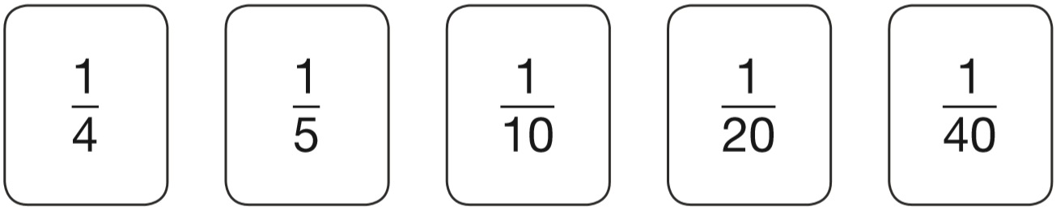
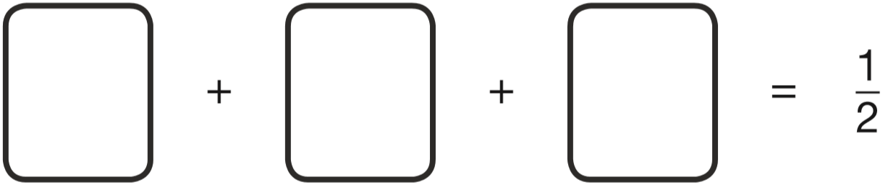
10
8
4
2
40
40
40
40
Use three of these fraction cards to complete the sum below.
1
1
1
20
4
5
2 0
40
Notes:
G2 2015 Level 6 Paper A Q10

Slide 3
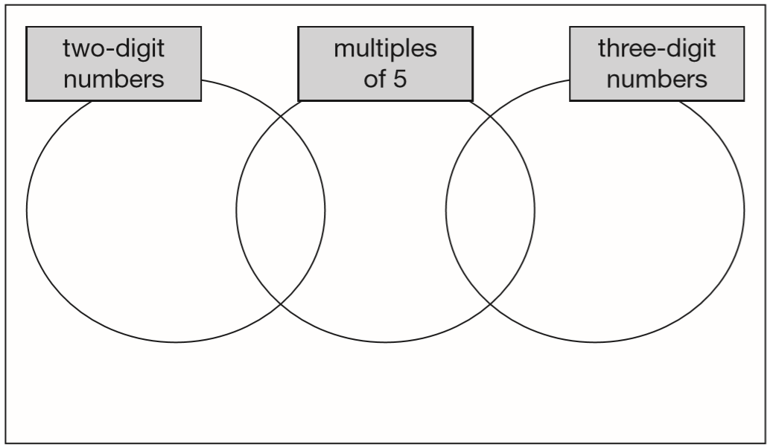
Here is a diagram for sorting numbers.
Write each number in its correct place on the diagram.
2 20 201 2000
2000
20
201
2
Notes:
G3 2014 Paper 1 Q9

Slide 4
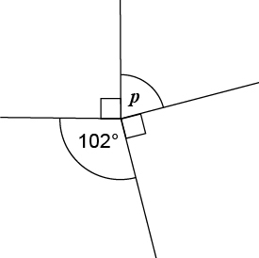
Calculate the size of angle p in the diagram.
A right angle is 90°.
Angles around a point add up to 360°.
78°
90°
p = 360° - 102° - 90° - 90°
90°
p = 360° - 282°
p = 78°
Notes:
G4 Pre-2000 or other question

Slide 5
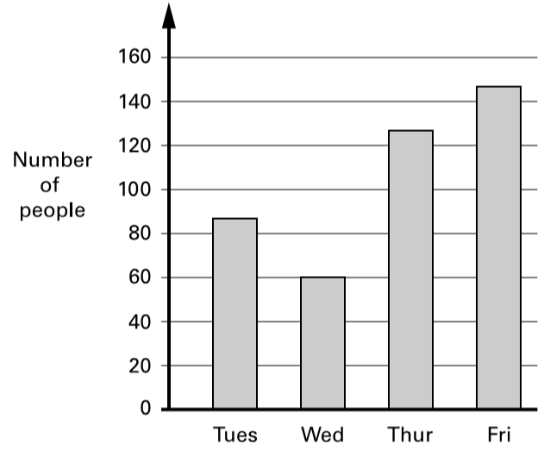
This bar chart shows how many people went to a school play.
Estimate the number of people who went there on Thursday and Friday altogether.
147
127
1
274 people
1 4 7
+
1 2 7
You get the mark for an estimate of between 270 and 280
2
7
4
Each person paid £2.25 for a ticket to get in. How much ticket money was collected on Wednesday?
1
3
2 .
2
5
£2.25 x 60 =
£135 collected
x
6
0
Estimate first:
It will be a bit more than £120
0
0
0
1 3
5
0
0
£
.
1 3 5 0 0
Notes:
G5 2000 Paper 2 Q10

Slide 6
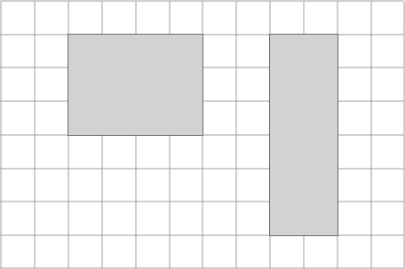
Look at the shaded rectangles drawn on a centimetre square grid. Sam says, “The two rectangles have the same area as each other and the same perimeter as each other.”
Is Sam correct? Explain how you know.
Sam is wrong.
They have the same area but not the same perimeter.
The second rectangle has a larger perimeter because the distance around the outside of the rectangle is 2 cm longer.
Area: 12 cm²
Perimeter: 14 cm
Area: 12 cm²
Perimeter: 16 cm
Notes:
G6 Pre-2000 or other question

Slide 7
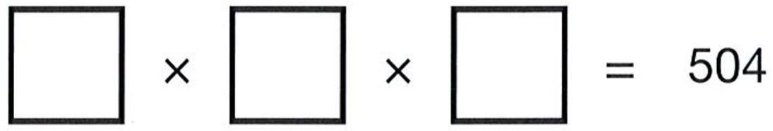
Three single-digit numbers multiply to make 504
Write the missing numbers.
9
8
7
8
4
but multiplying two single-digit numbers can’t give an answer of 84
6
5 0 4
2
7
2
and because 9 x 8 = 72, then 72 x 7 = 504 we have our three numbers.
7
5 0 4
1
Notes:
G7 2012 Paper 2 Q13

Slide 8

Parveen buys 3 small bags of peanuts.
She gives the shopkeeper £2 and gets 80p change.
What is the cost in pence of one bag of peanuts?
40p
£2.00 – £0.80 =
£1.20 spent on 3 bags
£1.20 ÷ 3 =
£0.40
Notes:
G8 Pre-2000 or other question

Slide 9
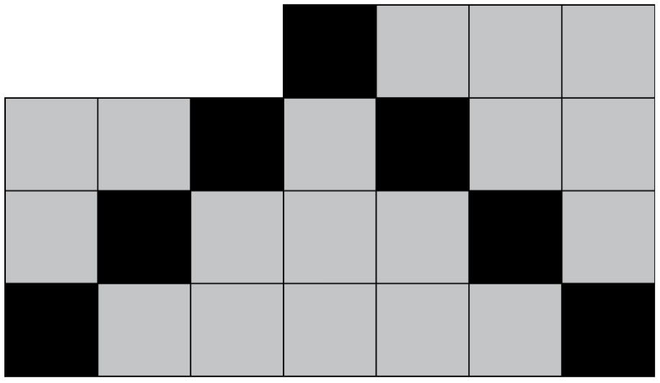
Look at this pattern. What percentage of the pattern is black?
28 percent
7 black squares
25 squares altogether
7
2 5
x4
7
2 8
=
2 5
1 0 0
x4
Notes:
G9 2011 Level 6 Paper A Q4 second page

Slide 10

When full, Sam’s bottle holds a litre of water.
1000 ml
Sam drinks some.
Estimate the amount of water left.
Circle the best estimate.
800 ml 600 ml 80 ml 70 ml 7 ml
Notes:
G10 Pre-2000 or other question

Slide 11
Write in ﬁgures the number twenty thousand and twenty.
20,
020
Notes:
G11 Pre-2000 or other question

Slide 12
Michelle has saved £8.40 in 20p coins.
How many 20p coins does Michelle have?
840p
42 coins
1 coin = 20p
x2
2 coins = 40p
x5
5 coins = £1
x8
840 ÷ 20 =
4
2
£8
40 coins =
2
8 4
Notes:
G12 2000 Paper 2 Q9 second page

Slide 13
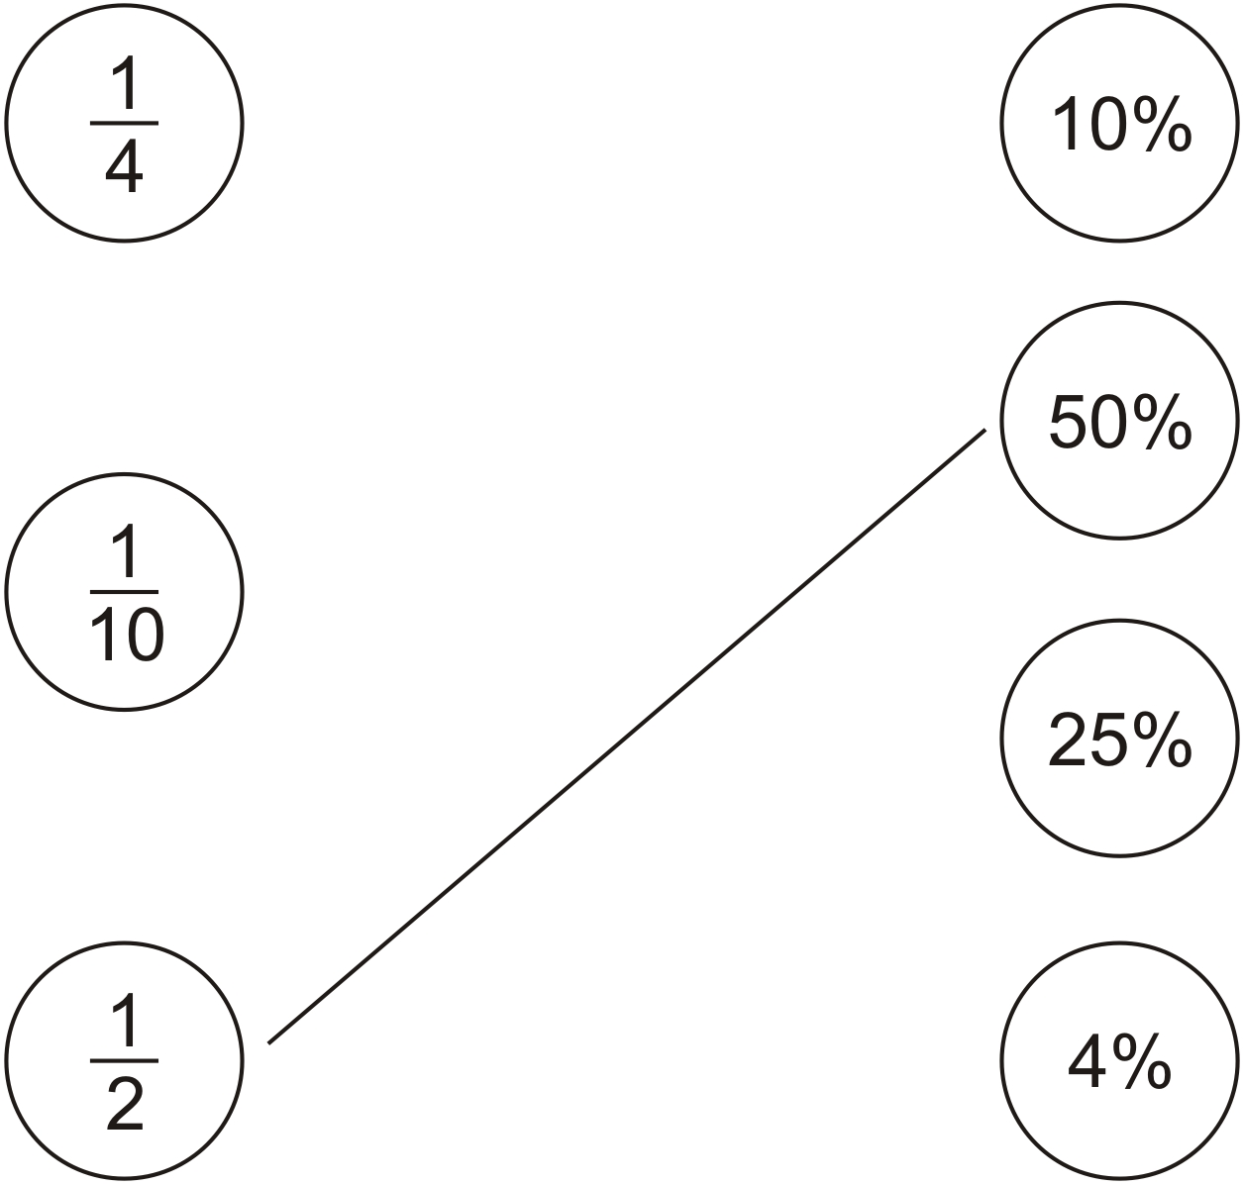
Draw a line to join each fraction to a percentage of the same value.
x25
1
2 5
=
4
1 0 0
x25
x10
1
1 0
=
1 0
1 0 0
x10
Notes:
G13 Pre-2000 or other question

Slide 14
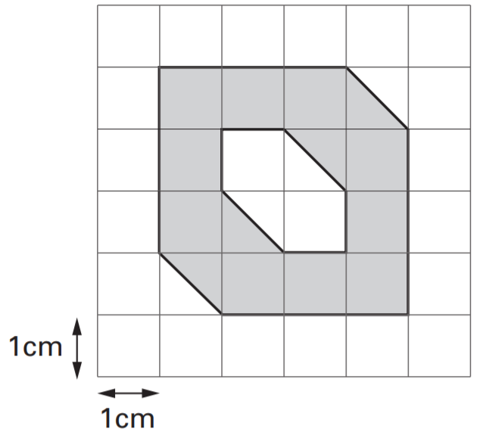
Here is a 1cm square grid. Some of the grid is shaded.
What is the area of the shaded shape?
12 cm²
Notes:
G14 2005 Paper 2 Q12

Slide 15
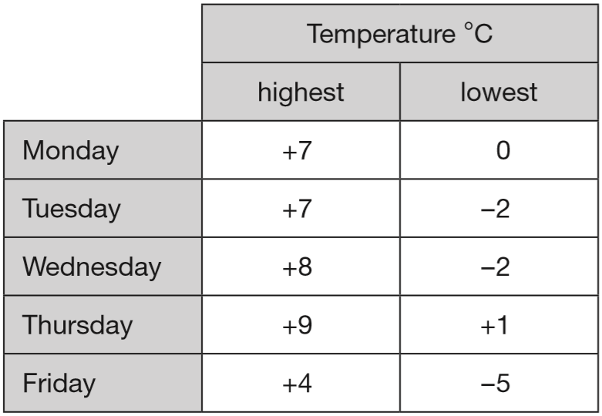
This weather chart shows the highest and lowest temperatures in a town on five days in March.
Which day has the greatest difference between the highest and the lowest temperatures?
Wednesday
What is the difference between the lowest temperatures on Thursday and Friday?
7
9
10
+5
+1
6 degrees
8
-5
0
1
9
Notes:
G15 2014 Paper 1 Q12

Slide 16
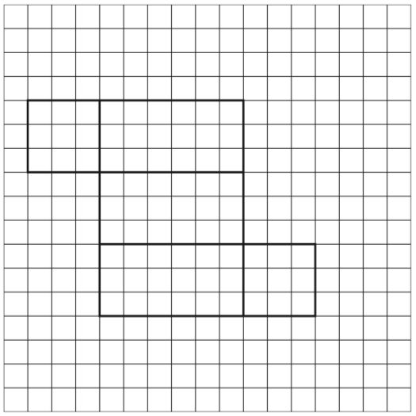
Here is part of a net for a cuboid.
Draw in the missing face to complete the net.
Notes:
G16 2006 Year 5 Optional Paper 1 Q9

Slide 17
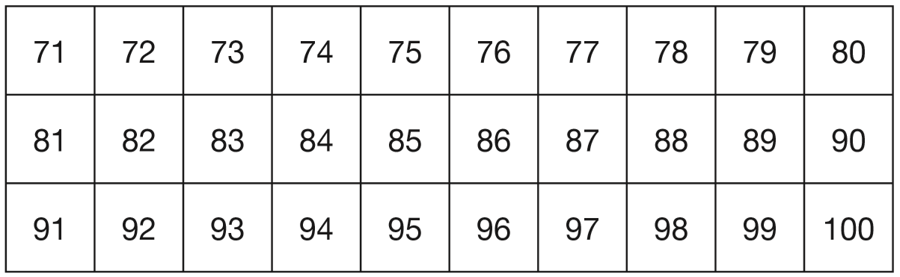
Here is a number chart. Circle the smallest number on the chart that is a multiple of both 2 and 7
10 x 7 = 70
but 70 isn’t on the chart
11 x 7 = 77
but multiples of 2 are even numbers
12 x 7 = 84
Notes:
G17 2008 Paper 1 Q10 first page

Slide 18
Here is the same number chart. Circle the largest number that is not a multiple of 2 or 3 or 5
3
2 r1
3
3
3
9 7
3
9 9
Notes:
G18 2008 Paper 1 Q10 second page

Slide 19
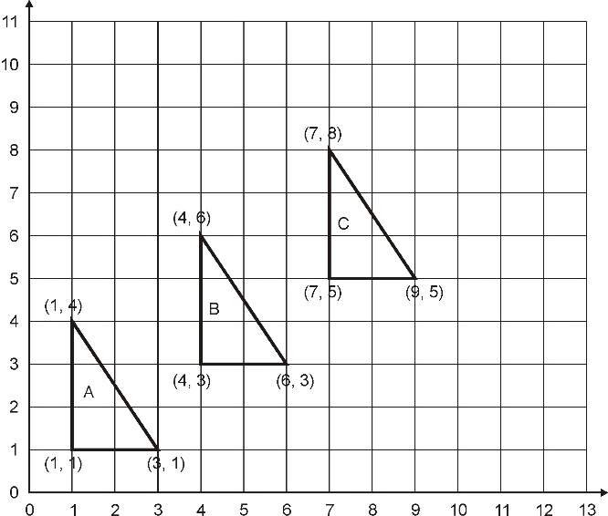
Write the co-ordinates of the next triangle in the sequence.
(10, 7)
(10, 10)
(12, 7)
Notes:
G19 Pre-2000 or other question

Slide 20
14 × 15 × 16 = 3,360
What is the answer to
15 × 16 × 14 =
3,360
With multiplication, order doesn’t matter, and the same multiplicands are used in both questions.
Notes:
G20 Pre-2000 or other question

Slide 21
7
Circle the percentage that is equal to
7% 35% 70% 20% 140%
20
x5
7
3 5
=
2 0
1 0 0
x5
Notes:
G21 Pre-2000 or other question

Slide 22
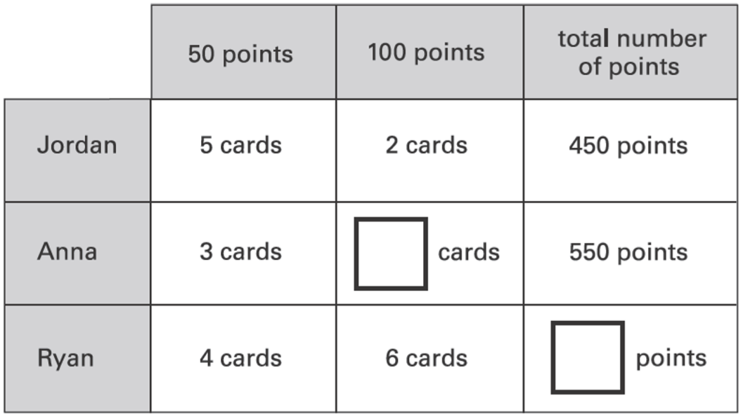
Jordan, Anna and Ryan collect picture cards.
Cards are worth either 50 points or 100 points.
This table shows the cards they have.
Complete the table for Anna and Ryan.
250
200
4
150
400
800
200
600
Notes:
G22 2003 Year 5 Optional Paper 2 Q23

Slide 23
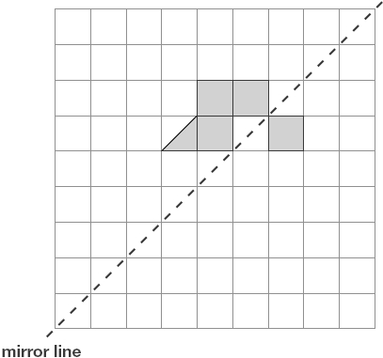
Shade two squares and one triangle to make this design symmetrical about the mirror line.
Notes:
G23 2011 Paper 1 Q10

Slide 24
Shade two squares and one triangle to make this design symmetrical about the mirror line.
Notes:
G24 2011 Paper 1 Q10

Slide 25
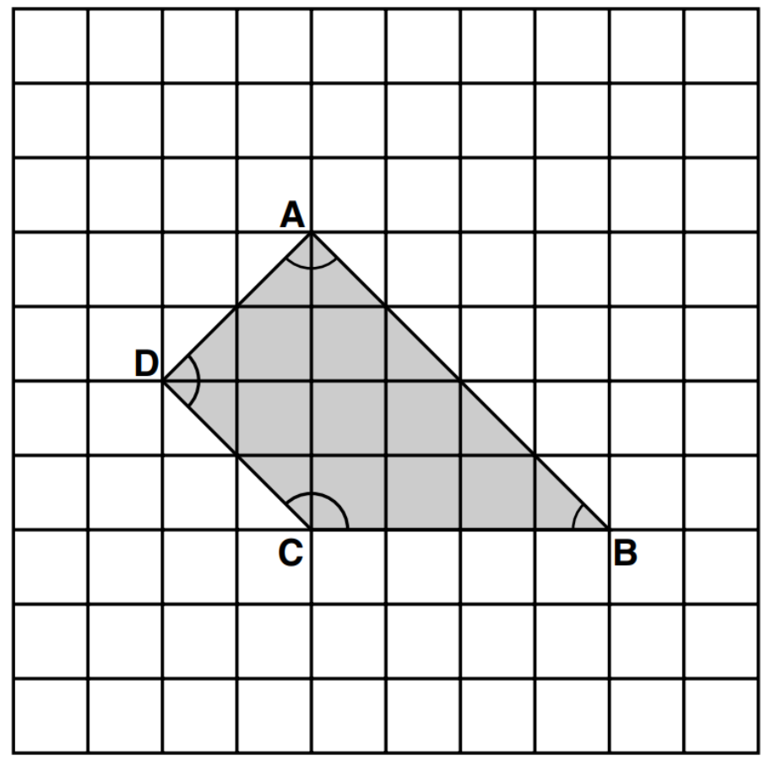
Here is a shape on a square grid. For each of the four sentences below, put a tick if it is true.
Put a cross if it is not true.
1) Angle C is
an obtuse angle.
2) Angle D is
an acute angle.
3) Line AD is
parallel to line BC.
4) Line AB is
perpendicular to line AD.
✓
✘
✘
✓
Notes:
G25 2000 Paper 2 Q20

Slide 26
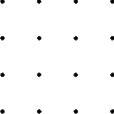
Join the dots to make a pentagon with only one right angle.
Now join the dots to make a pentagon with exactly two right angles.
Notes:
G26 Pre-2000 or other question

Slide 27

In the circle write +, –, ×, or ÷ to make the calculation correct.
6
÷
Notes:
G27 Pre-2000 or other question

Slide 28
Circle the numbers that are multiples of 7
27 42 52 63 77
6 x 7 = 42
9 x 7 = 63
11 x 7 = 77
Notes:
G28 Pre-2000 or other question

Slide 29
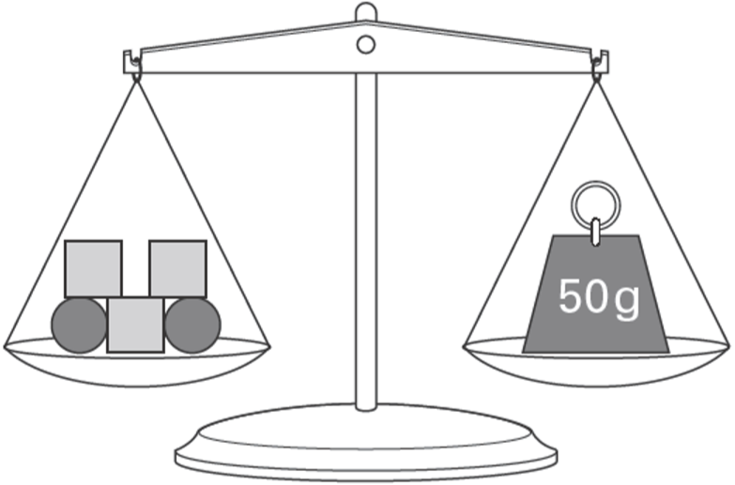
Emma uses 5 shapes to balance a 50 g weight on a scale.
Each square weighs 12 g.
How much does each circle weigh?
7 g
3 x 12 =
36
50 – 36 =
14
12
12
So 2 circles weigh 14 g
7
12
7
7
14 ÷ 2 =
Notes:
G29 2006 Year 5 Optional Paper 1 Q23

Slide 30
Sapna makes a fruit salad using bananas, oranges and apples.
For every one banana, she uses 2 oranges and 3 apples.
Sapna uses 24 fruits. How many oranges does she use?
8
B O O A A A
= 6 fruits
B O O A A A
B O O A A A
B O O A A A
Notes:
G30 2005 Paper 2 Q19

Slide 31
Liam thinks of a number.
He divides it by 9 and then adds 25 to the result.
His answer is 36
What number did Liam start with?
99
99
÷9
11
+25
36
99
11 x 9 =
11
36 – 25 =
Notes:
G31 2010 Paper 2 Q13

Slide 32
Seb bought 2 apples and 3 pears.
He spent £1.59 altogether.
Apples cost 24p each.
How much does one pear cost?
£0.37
or 37p
24p x 2 =
48p spent on apples
£1.59 – £0.48 =
£1.11 spent on 3 pears
£
0
.
7
for each pear
3
3
1.1 1
1
2
Notes:
G32 2012 Paper 2 Q15

Slide 33
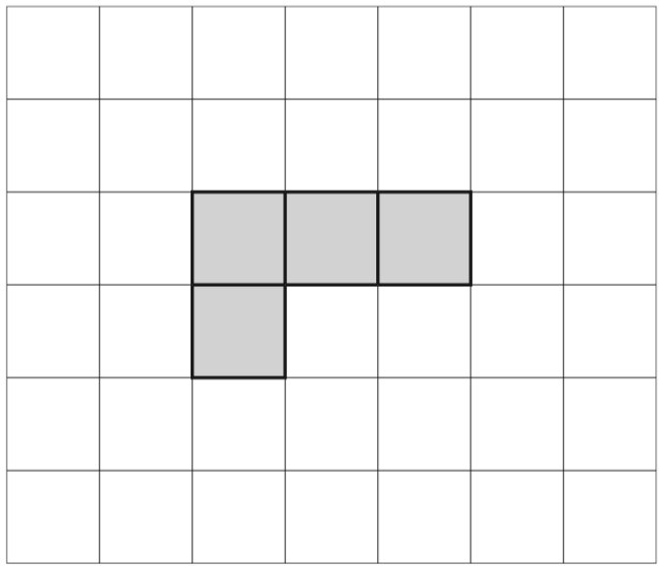
Here is a grid with four squares shaded in.
Shade in one more square to make a shape with a line of symmetry.
Shade in a different square to make a shape with a line of symmetry.
Notes:
G33 2006 Year 4 Optional Paper 1 Q8

Slide 34
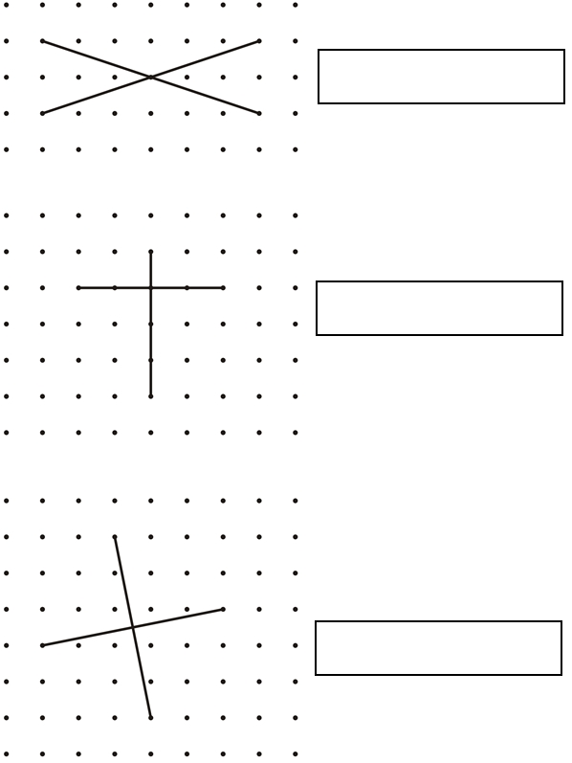
These diagrams show the diagonals
of three quadrilaterals.
Write the names of the quadrilaterals in the boxes.
rectangle
kite
square
Notes:
G34 2003 Paper 1 Q15

Slide 35
The temperature inside an aeroplane is 20°C.
The temperature outside the aeroplane is –30°C.
What is the difference between these temperatures?
+30
+20
The difference is 50°C.
-30
0
20
Notes:
G35 2003 Paper 2 Q11

Slide 36
15% of the people walk 5 km or less.
40% of the people walk 8 km or more.
What percentage of the people walk between 5 km and 8 km?
15 + 40 =
55
45% walk between 5 km and 8 km.
100 – 55 =
45
Notes:
G36 2012 Paper 2 Q10 page 2

Slide 37
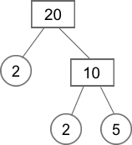
Any number can be written as a product of its prime factors,
for example: 20 = 2 × 2 × 5
90
90
10
9
45
2
Write 90 as a product of its prime factors.
90 = 5 x 3 x 3 x 2
2
5
3
3
5
9
3
3
Notes:
G37 Pre-2000 or other question

Slide 38

Estimate the size of angle x.
Circle the closest estimate.
170° 310° 190° 260° 180°
Notes:
G38 Pre-2000 or other question

Slide 39
Here is a number written in Roman numerals.
DCCIX
Write the number in figures.
7
0
9
M = 1000
D = 500
C = 100
L = 50
X = 10
V = 5
I = 1
Notes:
G39 Pre-2000 or other question

Slide 40
Programmes cost 15p each.
Selling programmes raises £12.30
How many programmes are sold?
82 programmes
1 programme = 15p
x2
2 programmes = 30p
x10
20 programmes = £3
x4
80 programmes = £12
Notes:
G40 2002 Paper 2 Q11 second page

Slide 41
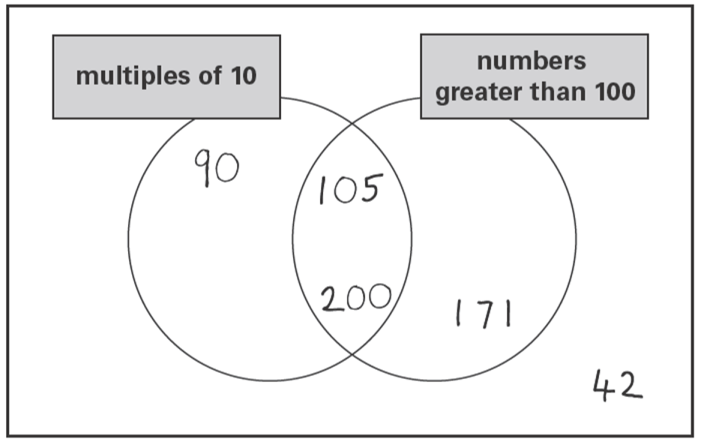
One number is in the wrong place on the sorting diagram.
Put a cross on it.
✘
Notes:
G41 2003 Year 3 Optional Paper 2 Q26

Slide 42
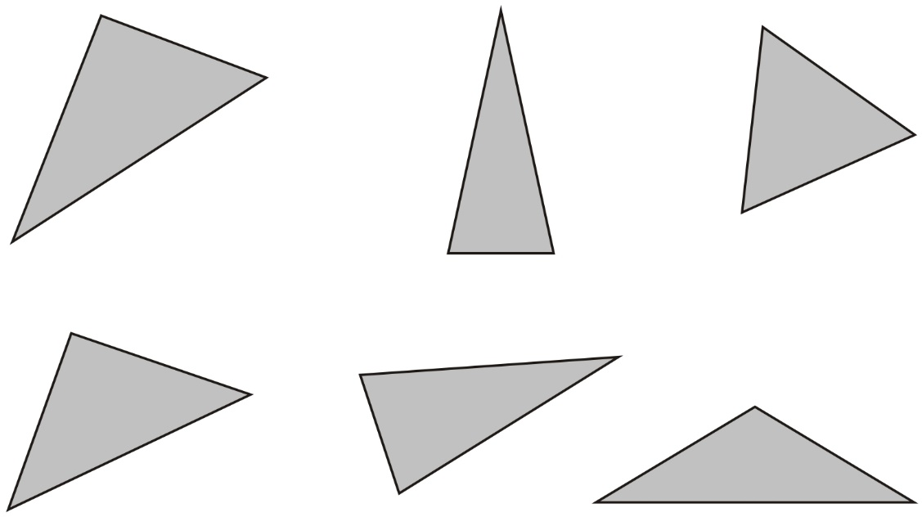
Here are six triangles. One of them is an equilateral triangle. Put a tick in the equilateral triangle.
✓
Notes:
G42 Pre-2000 or other question

Slide 43
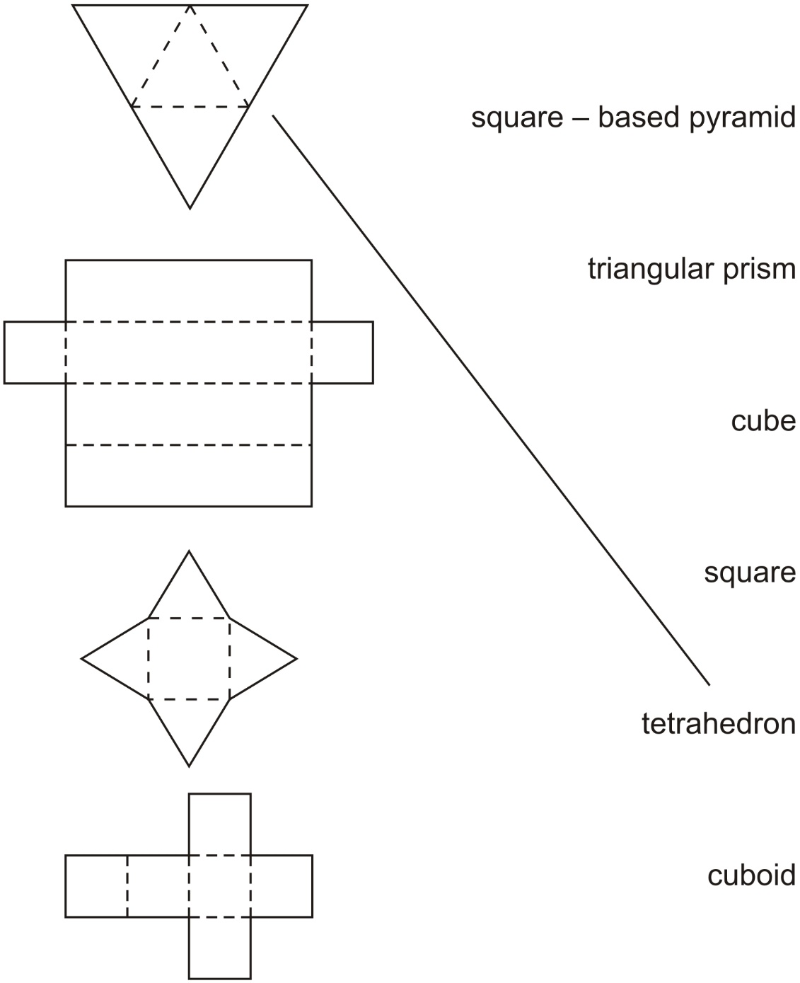
These nets will fold to make 3-D shapes. Match each net to the name of its shape. One has been done for you.
Notes:
G43 Pre-2000 or other question

Slide 44
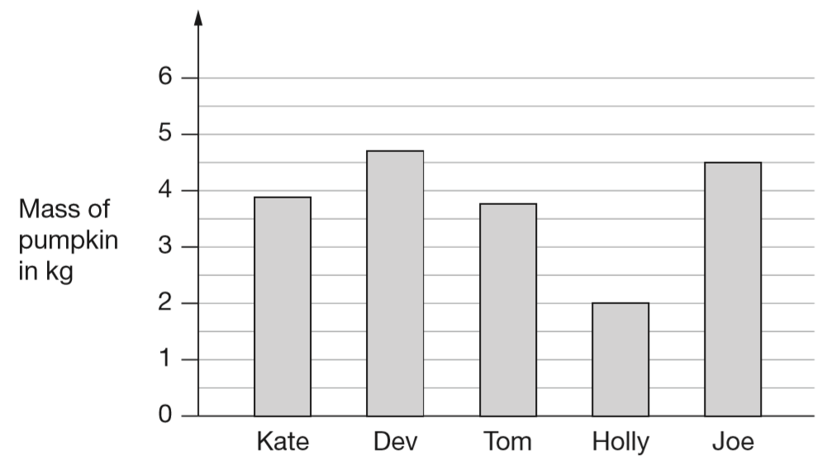
Five children grow pumpkins.
This bar chart shows how heavy their pumpkins are.
How much heavier is Joe’s pumpkin than Holly’s?
1
1
4
– 2 =
2
kg
2
2
or 2.5 kg or 2500 g
What is the mass of Dev’s pumpkin to the nearest kilogram?
5 kg
Notes:
G44 2011 Paper 2 Q5

Slide 45
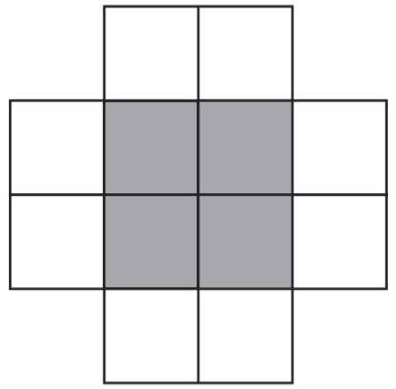
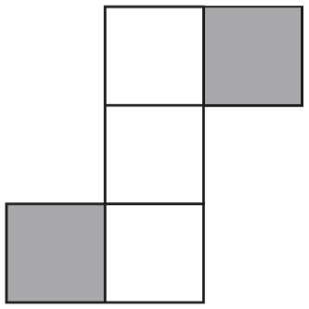
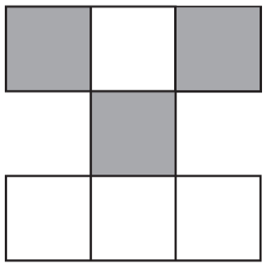
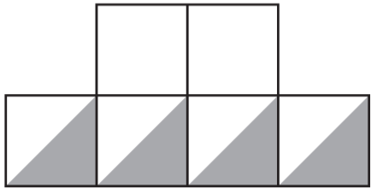
These diagrams are all made of squares.
Put a tick if exactly is shaded. Put a cross if it is not.
1
3
÷4
4
1
2
✓
=
✘
1 2
3
5
÷4
÷4
✘
3
✓
4
1
=
7
1 2
3
÷4
Notes:
G45 2010 Paper 2 Q11

Slide 46
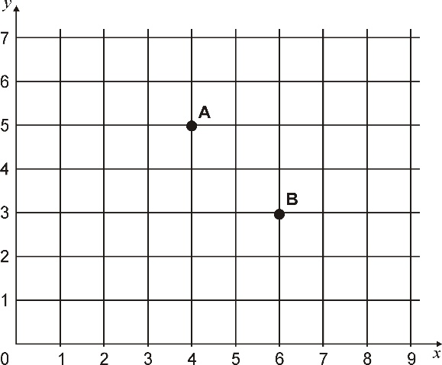
A, B, C and D are the vertices of a rectangle.
A and B are shown on the grid.
D is the point (3, 4).
Write the coordinates of point C.
C: (5, 2)
Notes:
G46 2006 Paper 2 Q9 first page

Slide 47
Notes:
G47 2006 Paper 2 Q9 second page

Slide 48
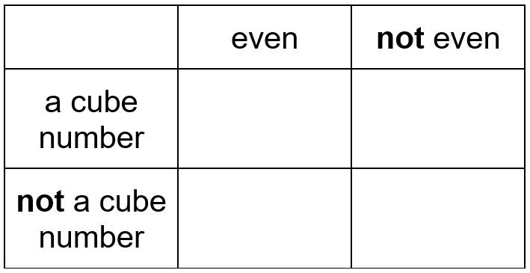
Here is a sorting diagram for numbers.
Write a number less than 100 in each space.
8
27
2
3
Notes:
G48 Pre-2000 or other question

Slide 49
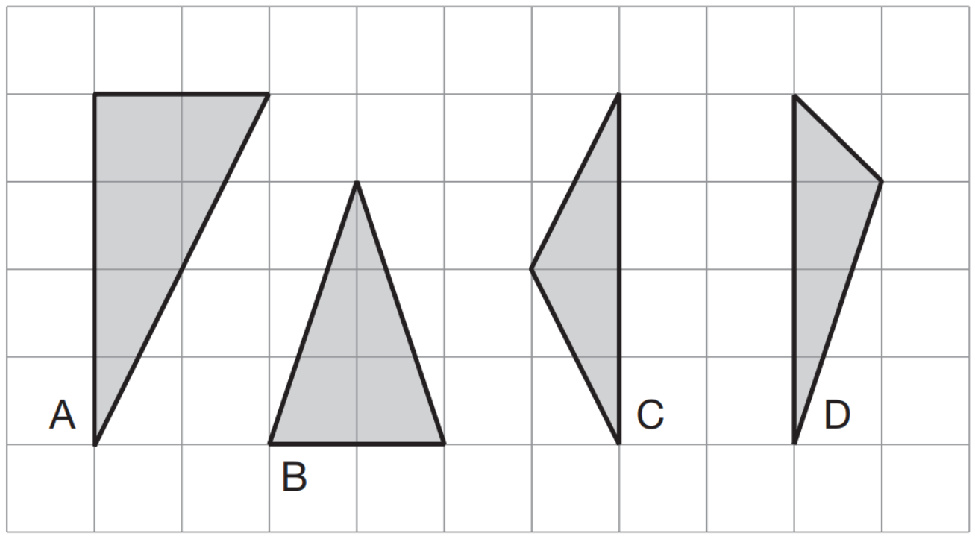
Here are four triangles on a square grid.
Write the letters of the two isosceles triangles.
b
, c
Notes:
G49 2007 Paper 2 Q14

Slide 50
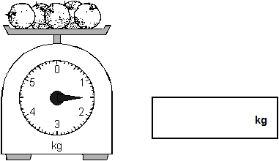
What is the total mass of these apples?
1
1 kg =
2
1.5
Notes:
G50 Pre-2000 or other question

Slide 51
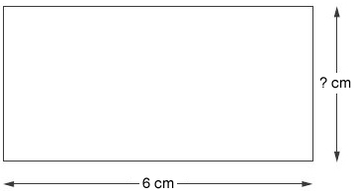
The perimeter of this rectangle is 20 cm.
The length is 6 cm.
How long is the width of the rectangle?
4 cm
6
6 + 6 + 2w = 20
12 + 2w = 20
4
4
2w = 8
w = 4cm
Notes:
G51 Pre-2000 or other question

Slide 52
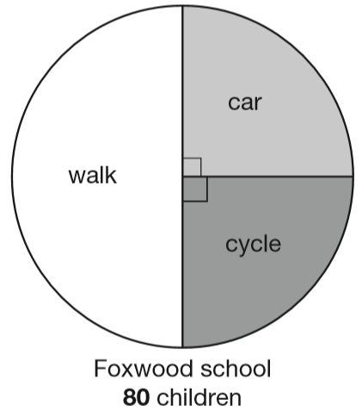
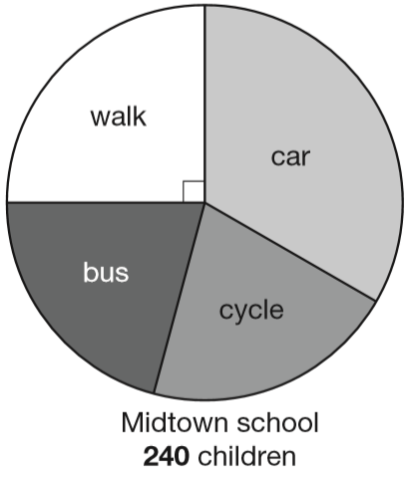
Megan asked children from two different schools, ‘How do you travel to school?’ Here are her results.
Megan says, ‘The number of children walking to Foxwood school is more than the number walking to Midtown school.’
Is she correct? Explain how you know.
Megan is wrong.
1
1
One quarter of 240 is more than one half of 80
of 80 =
40
of 240 =
60
2
4
80 ÷ 2 =
40
240 ÷ 4 =
60
Notes:
G52 2013 Paper 2 Q25 page 1

Slide 53
Megan asked children from two different schools, ‘How do you travel to school?’ Here are her results.
At Midtown school, one third of children travel by car. The number of children who cycle is the same as the number who go on the bus. How many children cycle to Midtown school?
1
of 240 =
60
4
60
80
240 ÷ 4 =
60
50
50
50
1
of 240 =
80
3
240 – 60 – 80
240 ÷ 3 =
80
100
240 – 140 =
100 ÷ 2 =
50 children
Notes:
G53 2013 Paper 2 Q25 page 2

Slide 54


Look at this quadrilateral.
Use a ruler to draw a line in a different place on the quadrilateral to make two triangles.
You can draw one line on the quadrilateral to make two triangles.
Notes:
G54 Pre-2000 or other question

Slide 55
Look at this quadrilateral.
Now draw one line on the quadrilateral to make a quadrilateral and a triangle.
You can draw one line on the quadrilateral to make two triangles.
Notes:
G55 Pre-2000 or other question

Slide 56
Look at this quadrilateral.
Now draw one line on the quadrilateral to make two quadrilaterals.
You can draw one line on the quadrilateral to make two triangles.
Notes:
G56 Pre-2000 or other question

Slide 57
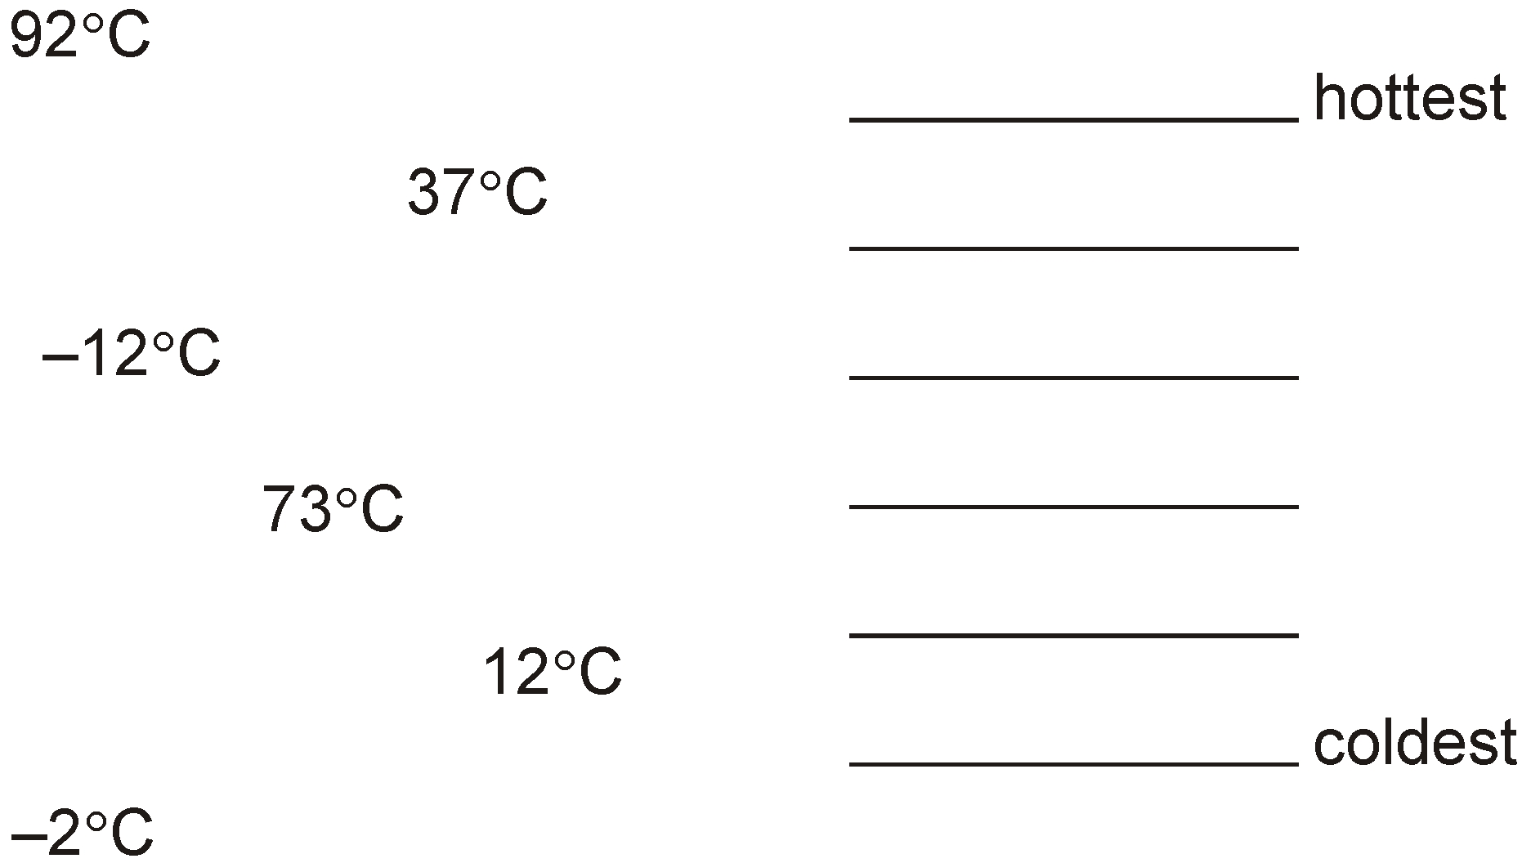
Write these temperatures in order from hottest to coldest.
92°C
73°C
37°C
12°C
-2°C
-12°C
Notes:
G57 Pre-2000 or other question

Slide 58
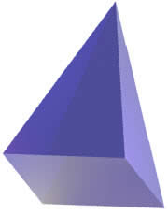
Jack has two square-based pyramids that are the same size. He sticks the square faces together to make a new 3-D shape. How many faces and how many edges does his new 3-D shape have?
Faces:
Edges:
8
4 top
4 top
these now can’t be seen
4 middle
12
4 bottom
4 bottom
Notes:
G58 2014 Level 6 Paper A Q9

Slide 59
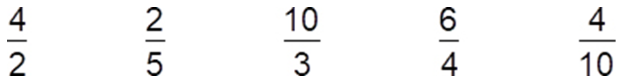
Here are fractions.
Circle the improper fractions.
1
6
Which fraction is equivalent to 1 ?
x2
2
4
3
6
=
1
3
2
4
1
=
2
2
x2
2
4
x2
Which two fractions are equivalent?
and
5
10
2
4
=
5
1 0
x2
Notes:
G59 Pre-2000 or other question

Slide 60

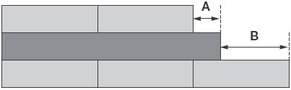
Liam has two different sizes of rectangle.
He makes this pattern with them.
40
A = 5cm
45
B = 15cm
60
Calculate the lengths of A and B.
Notes:
G60 2010 Paper 1 Q13

Slide 61


Write the missing numbers.
20 999
1 9 9 9 9 + 1 0 0 0 =
2 0 9 9 9
38 001
3 9 0 0 1 – 1 0 0 0 =
3 8 0 0 1
Notes:
G61 Pre-2000 or other question

Slide 62
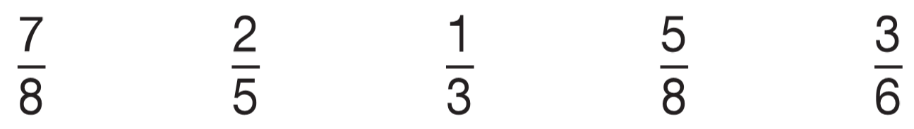
1
3
Circle the fraction that is greater than but less than
2
4
✘
✘
✘
x4
3
1
1
1
4
1
more than
less than
less than
=
equal to
4
2
2
2
8
2
x4
x2
x2
x2
x3
3
6
2
4
1
2
1
3
=
=
=
x2
=
4
8
5
1 0
3
6
3
6
2
6
=
x2
x2
x2
4
8
x3
x2
Notes:
G62 2010 Paper 1 Q20

Slide 63
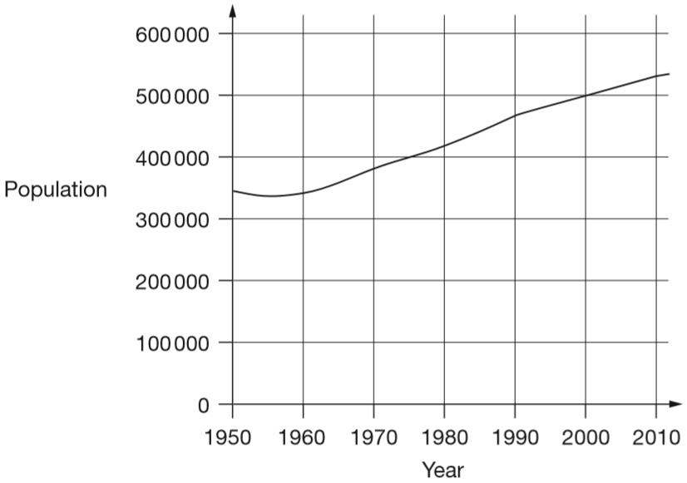
This chart shows the population of Cornwall from 1950 to 2010.
In which year did the population first reach 400 000?
1975
Notes:
G63 2015 Paper 1 Q17 page 1

Slide 64
This chart shows the population of Cornwall from 1950 to 2010.
How much did the population increase from 1950 to 2000?
500 000 – 350 000 =
150 000 people
An answer of between 130 000 and 180 000 gets you the mark.
Notes:
G64 2015 Paper 1 Q17 page 2

Slide 65
This chart shows the population of Cornwall from 1950 to 2010.
What was the population of Cornwall in 2010?
525 000 people
An answer of between 511 000 and 549 000 gets you the mark.
Notes:
G65 2015 Paper 1 Q17 page 3

Slide 66
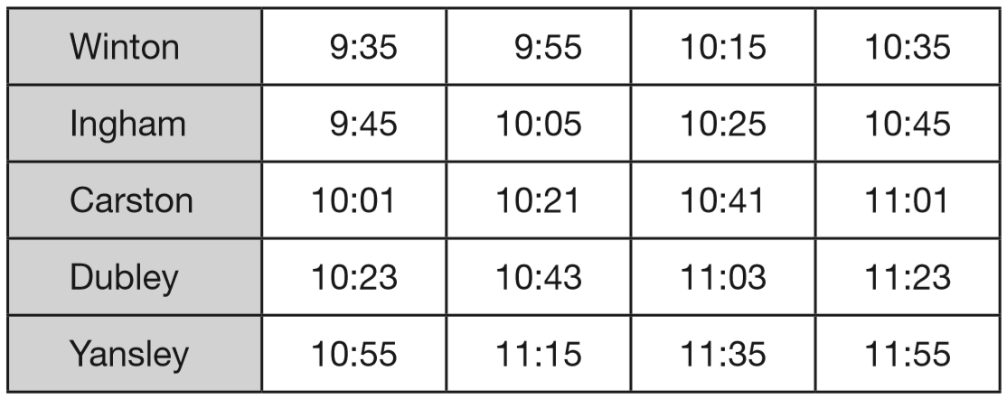
Here is part of the morning bus timetable from Winton to Yansley.
How many minutes does the bus take to get from Ingham to Dubley?
+15m
+23m
15 + 23 =
38 minutes
9:45
10:00
10:23
Notes:
G66 2015 Paper 2 Q17 page 1

Slide 67
Here is part of the morning bus timetable from Winton to Yansley.
Megan is in Carston.
She wants to be in Yansley before 11:30
What is the time of the latest bus she can take from Carston?
10:21
Notes:
G67 2015 Paper 2 Q17 page 2

Slide 68
Here is part of the morning bus timetable from Winton to Yansley.
One morning, the 10:35 bus from Winton gets to Carston 3 minutes early. What time does it get to Carston?
10:58
-2m
-1m
10:58
11:00
11:01
Notes:
G68 2015 Paper 2 Q17 page 3

Slide 69
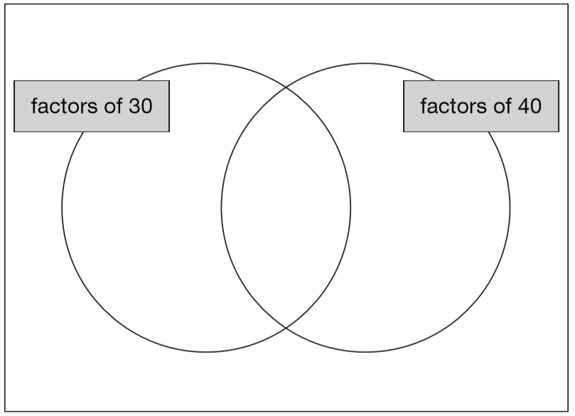
Write these numbers in the correct places on the diagram.
5 6 7 8
6
5
8
7
Notes:
G69 2006 Paper 1 Q13

Slide 70

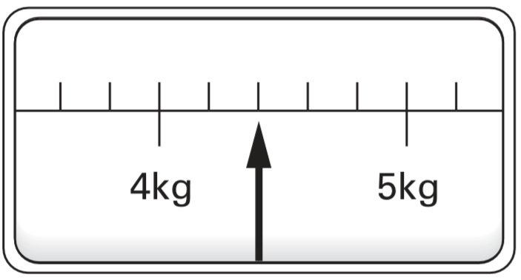
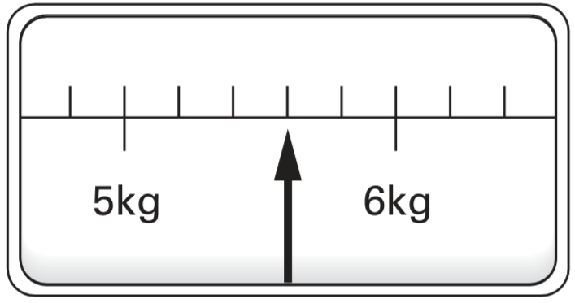
This scale shows the weight of Fred’s cat.
What is the weight of Fred’s cat?
4.4
x2
2
2
4
4
=
5
5
1 0
x2
This scale shows the weight of Fred’s dog.
How much more does Fred’s dog weigh than his cat?
1.2
x2
3
3
6
5.6
5
=
5
5
1 0
- 4.4
x2
1
.
2
Notes:
G70 2004 Paper 2 Q15

Slide 71
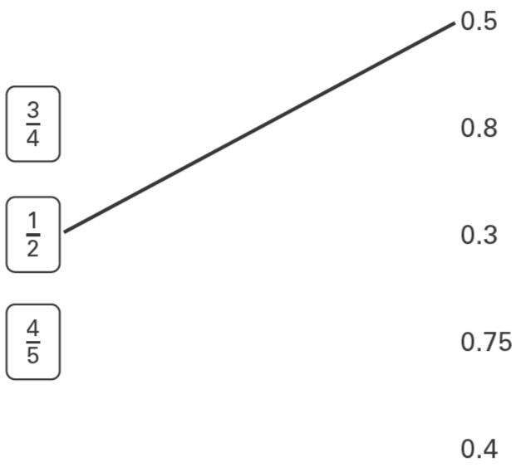
Match each box to the number which has the same value.
One has been done for you.
x25
3
7 5
=
4
1 0 0
x25
x2
4
8
=
5
1 0
x2
Notes:
G71 2003 Year 4 Optional Paper 2 Q25

Slide 72
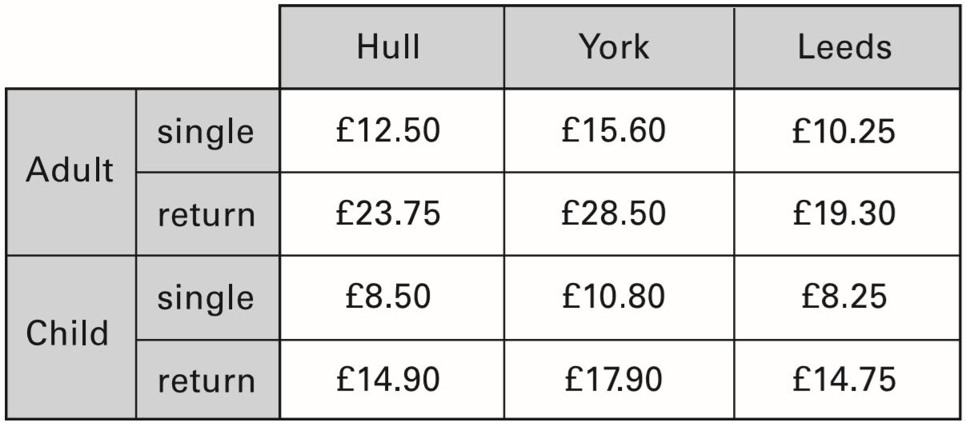
The table shows the cost of coach tickets to different cities.
What is the total cost for a return journey to York for one adult and two children?
£64.30
1
1
1
1
1 7.9 0
3 5.8 0
x
2
+
2 8.5 0
.
£
6
4
.
0
£
3
5
8
0
3
Notes:
G72 2002 Paper 2 Q14 first page

Slide 73
The table shows the cost of coach tickets to different cities.
How much more does it cost for two adults to make a single journey to Hull than to Leeds?
£4.50
1
1
4
2 5.0 0
1 2.5 0
1 0.2 5
1
x
2
x
2
-
2 0.5 0
5
2
0
.
0
£
0
4
.
0
2
5
.
0
£
5
£
0
Notes:
G73 2002 Paper 2 Q14 second page

Slide 74


Write the missing fractions.
5
11
6
5
Notes:
G74 Pre-2000 or other question

Slide 75
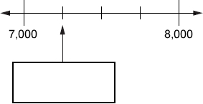
Here is part of a number line.
Write the number shown by the arrow.
1000 ÷ 4 =
250
7250
Notes:
G75 Pre-2000 or other question

Slide 76

Here is a number chart that goes up in fives.
The chart continues in the same way. One of the numbers below will be at the start of a row on the chart. Circle the number.
445 455 465 475 485
5 more than a multiple of 25
One of the numbers below will be at the end of a row on the chart. Circle the number.
345 355 365 375 385
Multiples of 25: 25, 50, 75, 100, …
a multiple of 25
Notes:
G76 2006 Year 4 Optional Paper 2 Q15

Slide 77

Here are six quadrilaterals with their mathematical names. Lara chooses one of the quadrilaterals. She says, ‘It has two acute angles. All four sides are the same length.’ Which quadrilateral did Lara choose?
Notes:
G77 2009 Paper 1 Q13 first page

Slide 78
Stefan chooses one of the quadrilaterals. He says, ‘It has more than one obtuse angle. It has no parallel sides.’ Which quadrilateral did Stefan choose?
Notes:
G78 2009 Paper 1 Q13 second page

Slide 79




Jody has some triangular tiles. He uses two of these tiles to make different shapes.
The perimeter of the isosceles triangle is:
5
5
16 cm
3
The perimeter of the rectangle is:
3
3
1
4
4
The perimeter of the quadrilateral is:
5
5
4
3
14 cm
18 cm
3
3
4
Notes:
G79 Pre-2000 or other question

Slide 80

Draw two more straight lines to make a rectangle.
Notes:
G80 2001 Paper 1 Q6 first page

Slide 81
Draw two more straight lines to make a rectangle.
Notes:
G81 2001 Paper 1 Q6 second page

Slide 82


Here are six digit cards.
Use all six digit cards to make three multiples of 3.
1
9
2
7
3
6
4
5
3
5 7
2
4
3
6
5
7
2
Notes:
G82 2010 Paper 2 Q8

Slide 83

Write these in order of size, starting with the smallest.
0.75
0.43
0
x25
3
7 5
=
3
4
1 0 0
0.34
43%
0.7
4
x25
Notes:
G83 2012 Paper 1 Q23

Slide 84
Sarah, Amy and Liam stand on some weighing scales two at a time.
Here are the measurements:
Sarah and Amy – 70 kg
Sarah and Liam – 80 kg
Liam and Amy – 80 kg
How much does Liam weigh?
Liam is 10 kg heavier than Amy.
45 kg
80
3
5
Liam
45
Amy
35
2
7 0
3
35
10
35
Notes:
G84 2010 Paper 2 Q18

Slide 85

On the grid join dots to make a triangle which does not have a right angle.
Notes:
G85 2002 Paper 2 Q4

Slide 86

On this grid draw a different shape which has the same area as shape A.
Notes:
G86 Pre-2000 or other question

Slide 87

Complete the diagram below to make a shape that is symmetrical about the mirror line.
Notes:
G87 2003 Paper 1 Q3

Slide 88

Here is the calendar for August 1998.
Simon's birthday is on August 20th.
In 1998 he had a party on the Sunday after his birthday.
What was the date of his party?
August 23rd
Tina's birthday is on September 9th.
On what day of the week was her birthday in 1998?
1
8
9
Wednesday
Notes:
G88 Pre-2000 or other question

Slide 89

This graph shows the distance Alfie and Chen walked in an afternoon. They started at 1:45pm and had two breaks.
How many kilometres did they walk between the first and second breaks?
10 – 6 =
4 km
Notes:
G89 2013 Paper 1 Q17 page 1

Slide 90
This graph shows the distance Alfie and Chen walked in an afternoon. They started at 1:45pm and had two breaks.
At what time did Alfie and Chen start their second break?
4:15pm
a quarter past 4
Notes:
G90 2013 Paper 1 Q17 page 2

Slide 91

Liam spends £14 altogether on the Big Wheel and the Rollercoaster.
He goes on the Big Wheel twice.
How many times does he go on the Rollercoaster?
6 times
£2.50 x 2 =
£5.00 spent on the Big Wheel
1 ride = £1.50
£14 – £5 =
£9 spent on the Rollercoaster
x2
2 rides =
£3
x3
6 rides =
£9
Notes:
G91 2010 Paper 1 Q12

Slide 92


This shape is made out of four identical curves. The perimeter of the shape is 28 centimetres.
4 curves = 28 cm
1 curve = 28 ÷ 4 =
7 cm
7
7
A new shape is made out of curves of the same size. What is the perimeter of the new shape?
7
7
6 x 7 cm = 42 cm
7
7
Notes:
G92 2014 Paper 1 Q15

Slide 93
36 and 64 are both square numbers.
They have a sum of 100
Find two square numbers that have a sum of 130
121 and 9
or 81 and 49
1, 4, 9, 16, 25, 36, 49, 64, 81, 100, 121, 144
1
8 1
+
4 9
1 3
0
Notes:
G93 2013 Paper 2 Q23

Slide 94

Write these numbers in order of size, starting with the smallest.
1.01 1.001 1.101 0.11
1.0 1
0
1.0 0 1
1.1 0 1
0.1 1
0
0.11
1.001
1.01
1.101
Notes:
G94 Older Level 6

Slide 95
Estimate the answer to this calculation.
23,901 – 5,097
Circle the correct estimate.
6,000 17,000 18,000 19,000 20,000
24,000 – 5,000 to the nearest thousand
Notes:
G95 Pre-2000 or other question

Slide 96
Books are 25p each at a car boot sale.
Alfie wants to buy 12 books.
He only has £2.35
How much more money does Alfie need?
65p
1 book = 25p
2
9
3.0 0
x4
1
1
£0.65
-
2.3 5
4 books =
£1
£3 – £2.35 =
£
0
.
5
x3
6
12 books =
£3
Notes:
G96 2013 Paper 2 Q7

Slide 97

Here are some shaded shapes on a square grid. Write the letters of the two shapes which are hexagons.
Write the letters of the two shapes which have right angles.
not a right angle
B
, D
4
6
5
C
, E
6
5
Notes:
G97 2005 Paper 1 Q6

Slide 98

Here is a design on a square grid. Complete the design so that it is symmetrical about the mirror line.
Notes:
G98 2012 Paper 2 Q9

Slide 99


Millie has some star-shaped tiles. Each edge of a tile is 5 centimetres long.
She puts two tiles together to make this shape. Work out the perimeter of Millie’s shape.
4
1 8
x
5
9
0
To find perimeter, we only count edges on the outside of the shape.
The perimeter is 90 cm
Notes:
G99 2004 Paper 1 Q15

Slide 100

Here is a shaded square on a grid.
Shade in 3 more squares so that the design is symmetrical in both mirror lines.
Notes:
G100 2003 Year 5 Optional Paper 1 Q18

Slide 101


This jug holds ½ litre.
This bucket holds 5 litres.
500 ml
5000 ml
How many full jugs of water are needed to fill the bucket?
10 jugs
10
10
5000 ÷ 500 =
500 x ___ = 5000
Notes:
G101 Pre-2000 or other question

Slide 102

This diagram shows two identical rectangles on coordinate axes. Write the coordinates of point A and point B.
A: (12,
6)
B: (19,
3)
9
3
6
3
3
7
7
5
12
19
Notes:
G102 2014 Paper 2 Q20

Slide 103

Write in the missing digits.
1
4
1
1
2
3
2
3
x
4
7
300 x 50 = 15 000
1
2 2
6
1
1 2
9
2
0
1
5
1
8
1
Notes:
G103 Pre-2000 or other question

Slide 104

The three numbers missing from these boxes are all prime numbers greater than 3
Write in the missing prime numbers.
13
11
7
1
4
3
7
1 0 0 1
3
2
1
3
1 1
1 4 3
3
Notes:
G104 Older Level 6

Slide 105
Write the missing numbers.
Factors of 20 = {1, _______ , _______ , _______ , _______ , 20}
2
4
5
10
Notes:
G105 Pre-2000 or other question

Slide 106
1
Circle the numbers that are equal to
0.12 0.5 5.0 0.05 0.50
0
0.5
2
x5
1
5
=
2
1 0
x5
Notes:
G106 Pre-2000 or other question

Slide 107

Class 6 did a survey of the number of trees in a country park.
This pie chart shows their results.
Estimate the fraction of trees in the survey that are oak trees.
?
1
1
3
between
and
8
1 0
2 0
60
The children counted 60 ash trees.
Use the pie chart to estimate the number of beech trees they counted.
3
of 60 =
4 5
beech trees
4
6 0 ÷ 4 = 1 5
1 5 x 3 = 4 5
Notes:
G107 2006 Paper 1 Q20

Slide 108

Shade in the reflection of this shape.
Notes:
G108 Pre-2000 or other question

Slide 109

Look at these shapes. Complete the sentences below.
__is a kite
__is not a quadrilateral
__has only 2 right angles
__has 2 acute angles
A
F
E
B
Notes:
G109 2007 Paper 2 Q10

Slide 110

Here is a triangle on a square grid. The triangle is translated so that point A moves to point B. Draw the triangle in its new position.
Notes:
G110 2006 Paper 2 Q24

Slide 111

Circle all the multiples of 10.
Notes:
G111 Pre-2000 or other question

Slide 112





This table shows information about four solid shapes.
One has been done for you.
1
1
6
0
2
1
Notes:
G112 Pre-2000 or other question

Slide 113
Write all the factors of 30 which are also factors of 20
1, 2, 5 and 10
Factors of 20:
Factors of 30:
1 x 20 = 20
→ 1 and 20
1 x 30 = 30
→ 1 and 30
2 x 10 = 20
→ 2 and 10
2 x 15 = 30
→ 2 and 15
4 x 5 = 20
→ 4 and 5
3 x 10 = 30
→ 3 and 10
5 x 6 = 30
→ 5 and 6
Notes:
G113 2005 Paper 2 Q16

Slide 114
Circle the number that is closest to 20
19.95 20.1 19.09 20.09 20.201
0.05 less
0.1 more
0.91 less
0.09 more
0.201 more
0.050
0.100
0.910
0.090
0.201
Notes:
G114 2015 Paper 2 Q18

Slide 115
Circle the value of the digit 9 in the number 6 9 7, 4 3 2
nine thousand nine hundred ninety thousand
nine million nine hundred thousand
It’s in the ten thousands place.
9 x 10 000 =
90 000
Notes:
G115 Pre-2000 or other question

Slide 116
Joe goes skating every Saturday.
He went skating on Saturday January 1st.
Altogether, how many times did Joe go skating in January?
31 days in January
22nd
29th
✘
1st
8th
15th
36th
He went 5 times in January.
Notes:
G116 2011 Paper 2 Q12

Slide 117

The graph shows the journey of a hot-air balloon.
At what height above the ground was the balloon after 10 minutes?
400 metres
After how many minutes of the journey did the balloon begin to go down?
45 minutes
Notes:
G117 Pre-2000 or other question

Slide 118

Match pairs of numbers that have a difference of 1000
One has been done for you.
Notes:
G118 Pre-2000 or other question

Slide 119

Here is a table of temperatures at dawn on the same day.
What is the difference in temperature between London and Paris?
+4
+6
The difference is 10°C.
-4
0
6
At noon the temperature in New York has risen by 5°C.
What is the temperature in New York at noon?
-9 + 5 =
-4°C
+5
-10
-9
-8
-7
-6
-5
-4
-3
-2
-1
0
1
2
3
4
5
6
7
8
9
10
Notes:
G119 Pre-2000 or other question

Slide 120

Use a ruler to draw 2 more lines to make an isosceles triangle.
Notes:
G120 Pre-2000 or other question

Slide 121


Ben has a rectangle (A) and a square (B).
Ben puts B directly on top of A.
12 cm
What is the length of x?
12 – 5 =
7 cm
5 cm
Notes:
G121 Pre-2000 or other question

Slide 122

1
Put a tick on the diagram if exactly of it is shaded.
2
5 shaded
4 white
4½ shaded
4½ shaded
4½ white
4½ white
✓
✘
✓
4 shaded
4 shaded
✘
✘
5 white
5 white
Notes:
G122 2007 Paper 2 Q8

Slide 123
In a supermarket storeroom there are:
7 boxes of tomato soup
5 boxes of pea soup
4 boxes of chicken soup
There are 24 tins in every box.
How many tins of soup are there altogether?
384 tins
7 + 5 + 4 =
16 boxes
2
2
4
x
1
6
1 4
4
2
4
0
3
8
4
tins
Notes:
G123 2004 Paper 2 Q11

Slide 124

Calculate the size of angle x in the diagram.
x = 180° - 63°
x = 117°
Angles on a straight line add up to 180°.
Notes:
G124 Pre-2000 or other question

Slide 125

Put these temperatures in order, starting with the lowest.
21°C −13°C −24°C 0°C 35°C
-24
-13
0
21
35
Notes:
G125 2015 Paper 2 Q2

Slide 126
Circle all the prime factors of 30
2 3 5 6 10
30
30
15
2
10
3
5
3
2
5
Notes:
G126 Pre-2000 or other question

Slide 127

Here is a number pyramid.
The number in a box is the sum of the two numbers below it.
Write the missing numbers.
210,000
500,000 – 290,000 =
210,000
120,000
210,000 – 90,000 =
120,000
Notes:
G127 Pre-2000 or other question

Slide 128

Draw the reflection of the shaded shape in the mirror line.
Notes:
G128 2007 Paper 2 Q2

Slide 129

Here are some shapes on a 1cm square grid.
Write the letter of the shape that has the smallest area.
C
6
6
5
6
6
Notes:
G129 2011 Paper 1 Q13 second page

Slide 130

Draw two lines on the square below to make four triangles that are all the same size.
Notes:
G130 Pre-2000 or other question

Slide 131

Now draw two lines on the square below to make four squares that are all the same size.
Notes:
G131 Pre-2000 or other question

Slide 132
A pack of 20 postcards costs £3.60
A single postcard costs 20p.
Zak buys 1 pack of postcards. Jade buys 20 single postcards.
Zak says to Jade, ‘My postcards cost 40p less than yours.’
Is he correct? Explain how you know.
Zak is correct.
= £4.00
spent by Jade
20 x 20p =
400p
= 40p
£4.00 – £3.60 =
£0.40
Notes:
G132 2006 Year 4 Optional Paper 2 Q19

Slide 133

Match each percentage to its correct decimal equivalent.
0
Notes:
G133 Pre-2000 or other question

Slide 134


Use all four digit cards to make this number sentence correct.
8
2
6
4
1
2
8
2
8
4
x
6
4
x
6
2
1
1
3 2
8
1 6
8
4 9
2
0
5 0
4
0
5
2
4
8
5
2
0
8
Notes:
G134 2010 Paper 2 Q12

Slide 135

This shape is made from 4 shaded squares.
Calculate the perimeter of the shape.
3 square lengths = 15 cm
5
1 square length = 5 cm
5
5
10 x 5 cm = 50 cm
5
5
5
5
5
5
5
Notes:
G135 2006 Paper 1 Q19

Slide 136

4
9 x 4
Notes:
G136 Pre-2000 or other question

Slide 137

A machine only takes 20p coins.
The coins inside total £9.80
How many 20p coins are there?
980p
49 coins
980 ÷ 20 =
49
5 coins = £1
50 coins = £10
49 coins =
£9.80
Notes:
G137 Pre-2000 or other question

Slide 138

Here is a regular octagon with two vertices joined to make the line AB. Join two other vertices to draw one line that is parallel to the line AB.
Notes:
G138 2008 Paper 2 Q21 first page

Slide 139
Here is the octagon again. Join two vertices to draw one line that is perpendicular to the line AB.
Notes:
G139 2008 Paper 2 Q21 second page

Slide 140
Here is the octagon again. Join two vertices to draw one line that is perpendicular to the line AB.
Notes:
G140 2008 Paper 2 Q21 third page

Slide 141


Here is a number chart.
Every third number in the chart has a circle on it.
Will the number 1003 have a circle on it?
Explain how you know.
3
3
4 r1
3
1 0 0 3
1
1
The chart continues in the same way. Here is another row in the chart.
Draw the missing circles.
No. Multiples of 3 are circled. 1003 is not a multiple of 3 because dividing it by 3 gives a remainder.
2
4
2
5
3
7 2
3
7 5
1
1
Notes:
G141 2006 Paper 1 Q15

Slide 142


Alfie has some rectangles.
He makes this shape using three of the rectangles.
3
3
Four 8s = 32
5
5
Four 3s = 12
8
8
8
Two 5s = 10 +
54 cm
3
3
8
3
What is the perimeter of Alfie’s shape?
Notes:
G142 2013 Paper 1 Q23

Slide 143

The shaded shape is a square.
What are the coordinates of A and B?
13
A: (7,
13)
10
B: (17,
13)
3
10
7
17
Notes:
G143 2011 Level 6 Paper A Q3

Slide 144
364 is a multiple of 7 but not a multiple of 3
384 is a multiple of 3 but not a multiple of 7
Find a number between 364 and 384 that is
both a multiple of 7 and a multiple of 3
378
364 + 7 =
371
371 + 7 =
378
1
2
3 r2
1
2
6
3
3 7 1
3
3 7 8
1
1
5
4
7
3 7 8
2
Notes:
G144 2013 Paper 2 Q24

Slide 145

On a school trip, every child is given 2 apples and 5 cherries.
Mrs Smith gives her group 12 apples.
How many cherries does she give her group?
30 cherries
2 apples
5 cherries
x6
x6
12 apples
30 cherries
Notes:
G145 Pre-2000 or other question

Slide 146
13
Tick all the numbers that are equivalent to
0.013
1.3
0.13
0.103
0.130
100
0.13
0
✓
✓
Notes:
G146 Pre-2000 or other question

Slide 147
A torch costs £7.65
Kate buys a torch and two batteries.
She pays £8.75 altogether.
How much does one battery cost?
55p
£8.75 – £7.65 =
£1.10
£1.10 ÷ 2 =
£0.55
8.7 5
£
0
.
-
7.6 5
5
5
.
1
0
2
1.1 0
1
1
1
Notes:
G147 2007 Paper 1 Q9

Slide 148
3
How many quarters are there in 2 ?
11 quarters
4
3
2 x 4 + 3 =
2
4
8 + 3 =
1 1
4
Notes:
G148 Pre-2000 or other question

Slide 149

Circle the fractions that are equal to 80%
÷10
÷2
8 0
8
4
=
=
1 0 0
1 0
5
÷10
÷2
Notes:
G149 Pre-2000 or other question

Slide 150

This scale shows the dates of floods and the height of the water in the floods. How high was the water in the 1955 flood?
1 metre 90 centimetres
2m 60cm
1.9 metres
190 centimetres
How much higher was the water in the 1969 ﬂood than in the 1948 ﬂood?
1m 80cm
180 centimetres
260 – 80 =
80cm
1 metre 80 centimetres
100 ÷ 5 =
20
1.8 metres
Notes:
G150 2008 Paper 2 Q17

Slide 151


A, B, C and D are the vertices of a rectangle.
Write the coordinates of point B.
5
7
Point E is the centre of the rectangle.
Write the coordinates of point E.
3
4
Notes:
G151 Pre-2000 or other question

Slide 152

The diagram shows some shapes on a centimetre square grid.
Which two shapes have the same perimeter as shape A?
D and E
Notes:
G152 Pre-2000 or other question

Slide 153

Here is a table.
The tick in the box shows that 20 is a multiple of 10
Put four more ticks to complete the table.
✓
✓
✓
✓
Notes:
G153 2006 Year 4 Optional Paper 1 Q12

Slide 154
A rectangle has an area of 36 cm².
How long could the sides of the rectangle be?
Give three different examples, using whole numbers.
1 cm x 36 cm
2 cm x 18 cm
3 cm x 12 cm
4 cm x 9 cm
Notes:
G154 Pre-2000 or other question

Slide 155
Megan wants to fill a bucket with water.
A bucket holds 6 litres. A jug holds 500 millilitres.
How many jugs of water does Megan need to fill an empty bucket?
12 jugs
6 litres =
6000 millilitres
6000 ÷ 500 =
1 jug =
500 millilitres
12
2 jugs =
1000 millilitres
x6
12 jugs =
6000 millilitres
Notes:
G155 2013 Paper 2 Q15

Slide 156


Part of this number line is shaded.
x25
1
2
2 5
1
5 0
2
1
1
=
4
4
4
1 0 0
5
1
3
6
1
1
20
x25
12
12
0
1.25
1.5
Circle all the numbers below that belong in the shaded part of the number line.
0
0
4
4
12
20
Notes:
G156 2007 Paper 1 Q24

Slide 157

Here is a triangle. Calculate the size of angle x.
107°
107°
34 + 39 =
73
180 – 73 =
107
Notes:
G157 2006 Year 5 Optional Paper 2 Q26

Slide 158

Here is a grid made of squares.
Shade 10% of this grid.
÷10
x3
1 0
1
3
=
=
1 0 0
1 0
3 0
÷10
x3
30 squares
Notes:
G158 Pre-2000 or other question

Slide 159
Mari is the presenter of a weekly radio show.
She always plays five new songs for every two old songs.
Last week she played 15 new songs.
How many songs did she play altogether?
new: old
5: 2
x3
x3
15:
6
She played 15 new songs and 6 old songs.
15 + 6 = 21
She played 21 songs altogether.
Notes:
G159 2004 Paper 1 Q18

Slide 160

Here is a square grid. Two sides of a kite are drawn on the grid. Complete the kite by drawing the two missing sides.
Notes:
G160 2011 Paper 2 Q23

Slide 161

This shape is made of wooden centimetre cubes.
How many more centimetre cubes are needed to make it into a solid cuboid 3 cm tall, 5 cm long and 5 cm wide?
Middle: 16 cubes
Top: 22 cubes
22 + 16 =
38 cubes needed
Notes:
G161 2015 Paper 1 Q22

Slide 162

Mr Singh buys paving slabs to go around his pond.
He buys 4 rectangular slabs and 4 square slabs.
What is the total cost of the slabs he buys?
1
1 4.0 0
3
2
2
1.9 5
3.5 0
+
7.8 0
x
4
x
4
2
1
.
0
£
8
£
.
0
£
.
0
1 4
0
7
8
Mr Singh says, ‘It would cost more to use square slabs all the way round.’
Explain why he is correct.
1 rectangle is the same size as 2 squares
11
6
so he would need 12 squares
1.9 5
which would cost £23.40
x
1 2
.
0
which is more than £21.80
£
2 3
4
Notes:
G162 2002 Paper 1 Q11

Slide 163

This diagram shows a square with dots at the vertices and at the middle of each side. The square is divided into four triangles, A, B, C and D.
Write the letters of all the triangles that have a right angle.
A
, B
, D
Write the letters of all the isosceles triangles.
A
, C
Notes:
G163 2012 Paper 2 Q6

Slide 164

Mina has 5 more marbles than Kirsty.
Kirsty has 2 more marbles than Seb.
Altogether they have 30 marbles.
How many marbles does each child have?
30
Seb
Kirsty
Mina
7
7
2
7
2
5
30 – (2 + 2 + 5) =
21
21 ÷ 3 =
7
14
9
7
Notes:
G164 2012 Paper 1 Q21

Slide 165
I’m thinking of a 3-D shape.
It has a square base.
It has 4 other faces, which are triangles.
What is the name of the 3-D shape?
Square based pyramid
Notes:
G165 Pre-2000 or other question

Slide 166
Look at these numbers written in Roman numerals.
MCMVII MMCD MDCCXLIII MMDX
Circle the largest number.
What is the value of the smallest number?
1907
2400
1743
2510
M = 1000
D = 500
C = 100
L = 50
X = 10
V = 5
I = 1
1743
Notes:
G166 Pre-2000 or other question

Slide 167
A shop sells jars of honey and honey dippers.
Chen bought three jars of honey and a dipper.
The total cost was £5.40
The dipper cost 75p.
How much did each jar of honey cost?
£1.55
1
4
3
5.4 0
1
£
1
.
5
-
0.7 5
5
3
4.6 5
£
4
.
5
1
1
6
Notes:
G167 2013 Paper 2 Q17

Slide 168

Lin has five blocks which are all the same.
She balances them on the scale with two weights.
Calculate the weight of one block.
800 – 500 = 300
5 blocks = 300 g
1 block =
300 ÷ 5 =
60 g
Notes:
G168 2006 Paper 2 Q17

Slide 169

Put these volumes in order, starting with the smallest.
900 ml ½ litre 1 litre 80 ml
500 ml
1000 ml
80 ml
½ litre
900 ml
1 litre
Notes:
G169 Pre-2000 or other question

Slide 170

Kirsty measured the length of her shadow every hour on one sunny day. She plotted her results on this graph.
Look at the graph.
Estimate the length of Kirsty’s shadow at 3:30pm.
180
160
140
135 centimetres
120
Estimate a time when her shadow was 180 centimetres long.
9:40am
You get the mark for an estimate of between 9:30am and 9:50am
100 ÷ 5 =
20
Notes:
G170 2012 Paper 2 Q19

Slide 171


The number in A is twice the number in D.
The number in B is 5 less than the number in C.
The number in D is 10 more than the number in B.
Write the missing numbers in this diagram.
Now use the same rule for this diagram.
15
110
45
20
25
55
Notes:
G171 2014 Paper 2 Q14

Slide 172

Write in the missing numbers.
One has been done for you.
3
x 1 0 0
=
3 0 0
1
5
0
150
2
2
2
3 0 0
1
3
x 1 0 0
=
3 0 0
7
5
75
4
4
4
3 0 0
2
Notes:
G172 2006 Year 4 Optional Paper 2 Q27

Slide 173
For each of the four sentences below, put a tick if it is true. Put a cross if it is not true.
1) A triangle can have 2 acute angles.
2) A triangle can have 2 obtuse angles.
3) A triangle can have 2 parallel sides.
4) A triangle can have 2 perpendicular sides.
✓
✘
Angles in a triangle add up to 180°. Obtuse angles are more than 90°. If you have 2 obtuse angles, you have more than 180°.
✘
A shape with parallel sides must have at least 4 sides.
✓
Lines on a right angle are perpendicular.
Notes:
G173 2005 Paper 1 Q21

Slide 174

Draw an arrow to show the position for 7,500
7000
8000
10 000 ÷ 10 =
1000
Notes:
G174 Pre-2000 or other question

Slide 175
The area of a rectangle is 16 cm².
One of the sides is 2 cm long.
What is the perimeter of the rectangle?
8
2 cm x _____ = 16 cm²
8 cm
20
2
2
8 + 8 + 2 + 2 =
The perimeter is 20 cm.
8
Notes:
G175 Pre-2000 or other question

Slide 176


Write the missing fractions.
6
5
14
10
10
10
4
2
12
12
Notes:
G176 Pre-2000 or other question

Slide 177
A shop sells food for birds.
Bird seed - £3.79 for a bag
Peanuts - £1.35 for a bag
Bird feeder - £8.95 each
Lara has £10 to spend on peanuts.
How many bags of peanuts can she get for £10?
7 bags
1 bag = £1.35
2 bags = £2.70
4 bags = £5.40
6 bags = £8.10
7 bags = £9.45
Notes:
G177 2009 Paper 2 Q10 page 1

Slide 178

Place these fractions in order of size, starting with the smallest.
1
1
5
5
2
3
12
6
x6
x3
x2
1
6
1
4
5
1 0
=
=
=
2
1 2
3
1 2
6
1 2
x6
x3
x2
1
5
1
5
3
1 2
2
6
Notes:
G178 Pre-2000 or other question

Slide 179
Grace made purple paint by mixing three colours.
50% was red
30% was blue
and the rest was white.
What percentage of the purple paint was white?
20%
50 + 30 =
80% red or blue
100 – 80 =
20% white
Notes:
G179 Pre-2000 or other question

Slide 180


The factor pairs of 8 are
Write all the factor pairs of 42
21
1
4
3
14
3
4 2
1
7
Notes:
G180 Pre-2000 or other question

Slide 181

Here are six rectangles on a grid. Which two rectangles fit together, without overlapping, to make a square?
D and E
Notes:
G181 2008 Paper 1 Q12

Slide 182

Grace has a rectangle that has sides of 4 cm and 5 cm.
Draw a different rectangle on the centimetre grid below that has the same area.
4 x 5 = 20
2 x 10 = 20
Notes:
G182 Pre-2000 or other question

Slide 183

Here is the net of a cube with no top. The shaded square shows the bottom of the cube. Draw an extra square to make the net of a cube which does have a top.
Notes:
G183 2003 Paper 2 Q8

Slide 184
Kim knows that
137 × 28 = 3836
Explain how she can use this information to work out this multiplication.
138 × 28
She can add 28 to 3836
Notes:
G184 Pre-2000 or other question

Slide 185

Here are five number cards.
Use each card once to make every statement below correct.
_____ is a multiple of 3
_____ is a multiple of 4
_____ is a multiple of 5
_____ is a multiple of 6
_____ is a multiple of 7
1
7
51
3
5 1
2
1
3
52
4
5 2
1
50
48
49
Notes:
G185 2015 Paper 2 Q13

Slide 186
Lara chooses a square number.
She rounds it to the nearest hundred.
Her answer is 200
Write all the possible square numbers Lara could have chosen.
169, 196, 225
The square numbers must be between 150 and 249
1
2
3
1
3
1
4
1
5
1
6
x
1
3
x
1
4
x
1
5
x
1
6
3
9
5
6
1
7
5
1
9
6
1
3
0
1
4
0
1
5
0
1
6
0
1
6
9
1
9
6
2
2
5
2
5
6
Notes:
G186 2009 Paper 2 Q19

Slide 187
Chen and Megan each have a parcel.
Chen’s parcel weighs 1½ kg. Megan’s parcel weighs 1.2kg.
How many more grams does Chen’s parcel weigh than Megan’s parcel?
300 grams
1 kilogram = 1000 grams
½ kilogram = 500 grams
1½ kilograms =
1500 grams
1.2 kilograms =
1200 grams
1.200
1500 – 1200 =
300 grams
Notes:
G187 2013 Paper 1 Q20

Slide 188


Raj is making a cake.
He pours 275ml of milk into a jug.
Draw a line on the jug to show the level of milk.
The scales below show how much flour he uses.
How much flour does Raj use?
375
350
325
750 g
275
250
225
175
150
125
75
¾ of 1000 =
750
50
25
100 ÷ 4 =
25
1000g
Notes:
G188 Pre-2000 or other question

Slide 189


Here is an equilateral triangle drawn on a circle.
Use a ruler to draw a regular hexagon on this circle.
12 points ÷ 6 = 2 points from one vertex to the next
Notes:
G189 Pre-2000 or other question

Slide 190

Mina has two cartons of juice.
Each carton contains 220ml.
She empties them both into this jug.
Draw an arrow to show the level of the mixture in the jug.
475
450
425
375
220 x 2 =
440
350
325
275
250
225
175
150
125
100 ÷ 4 =
25
Notes:
G190 2002 Paper 2 Q7

Slide 191

This chart shows when some children were asleep one night.
For how many hours was Luke asleep?
10 hours
How many children woke up after 7am?
9:30
7:30
3 children
Notes:
G191 2006 Year 5 Optional Paper 1 Q12

Slide 192

Calculate the size of angle y.
Angles around a point add up to 360°.
y = 360° - 63° - 73° - 83°
y = 360° - 219°
141°
y = 141°
Notes:
G192 Pre-2000 or other question

Slide 193

This chart shows the amount of money spent in a toy shop in three months.
How much more money was spent in the shop in December than in November?
2
3 2 5 0 0
1
-
1 5 0 0 0
£15 000
£32 500
£
1
7
5
0
0
10 000 ÷ 4 =
2500
Notes:
G193 2001 Paper 1 Q22

Slide 194

Here is a regular hexagon.
Join three of the dots to make an equilateral triangle.
Notes:
G194 2004 Paper 2 Q12 page 1

Slide 195
Here is a regular hexagon.
Join three of the dots to make an equilateral triangle.
Notes:
G195 2004 Paper 2 Q12 page 2

Slide 196
Here is a regular hexagon.
Join three of the dots to make an equilateral triangle.
Notes:
G196 2004 Paper 2 Q12 page 3

Slide 197
Here is a regular hexagon.
Join three of the dots to make an equilateral triangle.
Notes:
G197 2004 Paper 2 Q12 page 4

Slide 198

Here is a shaded shape on a square grid.
Draw the reflection of the shape in the mirror line.
Notes:
G198 2006 Year 5 Optional Paper 2 Q13

Slide 199

A shop sells pairs of socks.
1
5.4 5
+
7.5 0
9
1 2
.
5
Kirsty buys 1 pair of knee socks and 3 pairs of ankle socks.
She pays with a £20 note.
How much change does she get?
1
9
9
2 0
.0 0
1
1
1
-
1 2.9 5
£
0
7
0
.
5
£7.05
Notes:
G199 2015 Paper 1 Q10 page 1

Slide 200
A shop sells pairs of socks.
5 pairs = £8.50
10 pairs =
£17.00
15 pairs =
£25.50
Amy spends £25.50 on trainer socks.
How many pairs of trainer socks does she get?
15 pairs
Notes:
G200 2015 Paper 1 Q10 page 2

Slide 201

Some children do a sponsored walk. The graph shows their results.
How many children walked 21 laps or more?
23 children
13 + 10 =
13
Notes:
G201 2003 Year 5 Optional Paper 1 Q24

Slide 202

Ben’s rectangle is 10 cm long. It has a perimeter of 28 cm.
How wide is his rectangle?
10
10 + 10 + 2w = 28
20 + 2w = 28
4
4
2w = 8
w = 4cm
Notes:
G202 Pre-2000 or other question

Slide 203
John says, ‘Every multiple of 5 ends in 5’
Is he correct? Explain how you know.
John is not correct.
Numbers that end in 0 (e.g. 10, 20) are also multiples of 5
Notes:
G203 2004 Paper 2 Q6

Slide 204

This plan of a garden is made of rectangles and triangles.
The area of each rectangle is 12 square metres.
What is the area of the whole garden?
5 x 12 m² =
60 m²
12
6
6
4 x 6 m² =
24 m²
84 m²
12
12
12
The area of the whole garden is 84 m²
6
6
12
Notes:
G204 Pre-2000 or other question

Slide 205

Match each decimal number to its equivalent fraction.
One has been done for you.
x25
1
2 5
=
4
1 0 0
x25
x2
2
4
=
5
1 0
x2
Notes:
G205 2006 Paper 1 Q11

Slide 206


The pie charts show the results of a school’s netball and football matches. The netball team played 30 games. The football team played 24 games.
Estimate the percentage of games that the netball team lost.
x25
It’s more than ¼ (25%)
1
2 5
=
4
1 0 0
x25
It’s less than ½ (50%)
x50
1
5 0
It’s closer to ¼ than ½ …
=
2
1 0 0
… so I would estimate 35%
x50
(You get the mark for an estimate of between 30% and 36%.)
Notes:
G206 2003 Paper 1 Q21 first page

Slide 207

Draw the reflection of this shape.
Notes:
G207 2003 Year 3 Optional Paper 2 Q25

Slide 208

Amir has three parcels.
Parcels A and B together weigh the same as parcel C.
The three parcels weigh 800 grams altogether.
Parcel A weighs 250g.
How much does parcel B weigh?
800 ÷ 2 =
400
400
400
400 – 250 =
150 grams
Notes:
G208 2009 Paper 1 Q17

Slide 209

Look at this diagram. Calculate the size of angle x and angle y.
Angles on a straight line add up to 180°.
90°
y = 180° - 35°
y = 145°
145°
55°
A right angle is 90°.
x = 180° - 90° - 35°
Angles in a triangle add up to 180°.
x = 55°
Notes:
G209 2002 Paper 1 Q23

Slide 210

Match each percentage to its correct decimal equivalent.
0
Notes:
G210 Pre-2000 or other question

Slide 211

Calculate the size of angle y in this diagram.
A right angle is 90°.
Angles on a straight line add up to 180°.
90°
y = 180° - 90° - 65°
y = 180° - 155°
y = 25°
25°
Notes:
G211 2009 Paper 2 Q18

Slide 212

Write each of these numbers in its correct place on the sorting diagram.
40 8 15
15
40
8
Notes:
G212 2000 Paper 1 Q4

Slide 213


These two shaded triangles are each inside a regular hexagon.
Under each hexagon, tick the correct name of the shaded triangle.
equilateral
isosceles
scalene
equilateral
isosceles
scalene
✓
✓
Notes:
G213 2001 Paper 2 Q18

Slide 214

Write the two other prime numbers that multiply to make 165
11
3
3
3
11 x 3 = 33
5
1 6 5
1
Notes:
G214 Pre-2000 or other question

Slide 215
Circle all the numbers that are one more than a multiple of 4
11 17 25 34 40 49
4 x 4 = 16
6 x 4 = 24
12 x 4 = 48
Notes:
G215 2006 Year 5 Optional Paper 1 Q10

Slide 216


Lindy has 4 triangles, all the same size.
She uses them to make a star.
Calculate the perimeter of the star.
7
13
1
12
13
1 3
5
7
x
4
1
7
5
2
13
13
+ 2 8
8
0
cm
7
Notes:
G216 Pre-2000 or other question

Slide 217

Draw one line from each shape to the rectangle which has the same area.
2
Notes:
G217 Pre-2000 or other question

Slide 218

These are the temperatures at noon and midnight on a day in winter.
How many degrees higher is the temperature at noon than at midnight?
+4
+3
7 degrees higher
-4
0
3
3°C
-4°C
Notes:
G218 2006 Year 4 Optional Paper 2 Q14

Slide 219

Use the graph to work out how many miles are equal to 20 km.
12 miles
Use the graph to work out how many kilometres are equal to 40 miles.
64 kilometres
Notes:
G219 Pre-2000 or other question

Slide 220
The numbers in this sequence increase by 3 each time.
3 6 9 12 . . .
The numbers in this sequence increase by 5 each time.
5 10 15 20 . . .
Both sequences continue.
Write a number greater than 100 which will be in both sequences.
multiples of 3
multiples of 5
2
1
3
5
105
5
1 0 5
3
1 0 5
1
2
4
4
0
120
5
1 2 0
3
1 2 0
2
Notes:
G220 2011 Paper 2 Q15

Slide 221
A square always has four sides.
Is it true that a four-sided shape is always a square?
Explain how you know.
No. A rectangle had 4 sides but it’s not a square.
A square is a four-sided shape where all sides are the same length and all angles are 90°.
Notes:
G221 2008 Paper 1 Q7

Slide 222

Complete this shape so that it is symmetrical about the mirror line.
Notes:
G222 2014 Paper 2 Q3

Slide 223

Here is a kite.
Write the coordinates of point D.
D: (5,
2)
6
2
4
2
2
5
Notes:
G223 2004 Paper 1 Q20

Slide 224

Use the dots to draw one different shape which has a right angle.
Notes:
G224 Pre-2000 or other question

Slide 225

Some children each chose their favourite sport.
This chart shows the results.
Which sport was chosen by the most children?
Swimming
9
8
How many more girls than boys chose basketball?
6
10
6
3
10 – 3 =
7
10
8
Write all the sports that were chosen by more boys than girls.
10
3
5
Football
, Rounders
6
Notes:
G225 2007 Paper 2 Q15

Slide 226
Look at this number.
6 9 7, 4 3 2
What is the value of the digit 6 in the number?
Circle the correct answer.
six thousand
six hundred thousand
sixty thousand
six million
It’s in the hundred thousands place.
6 x 100 000 =
600 000
Notes:
G226 Pre-2000 or other question

Slide 227
Emily, Ben and Nisha take part in a sponsored swim to collect money for charity.
Emily collects £2.75 more than Nisha.
Ben collects £15
Nisha collects £7 less than Ben.
Altogether how much money do the three children collect?
£8 + £2.75 =
£10.75
£15 – £7 =
£8
£10.75 + £15 + £8 =
£33.75
Notes:
G227 2008 Paper 2 Q16

Slide 228
Hassan scores 40 out of 80 in a test.
Kate scores 40% in the same test.
Who has the higher score? Explain how you know.
÷40
x50
÷10
4 0
1
5 0
4 0
4
=
=
= 50%
=
8 0
2
1 0 0
1 0 0
1 0
÷40
x50
÷10
Hassan has the higher score.
4
40 out of 80 is equivalent to 50%
of 80 =
3 2
1 0
50% is higher than 40%
8 0 ÷ 1 0 = 8
Kate only got 32 out of 80
8 x 4 = 3 2
Notes:
G228 2007 Paper 2 Q18

Slide 229

Here is part of a time line. Draw a line from each invention to the correct point on the time line. One has been done for you.
200 ÷ 10 =
20
…so each line represents 20 years
1820
1920
1940
1960
1900
Notes:
G229 2006 Paper 1 Q14

Slide 230
Circle two different numbers which multiply together to make
1 million.
10 100 1000 10000 100000
1 0 0 0 0 0 x 1 0 =
1 0 0 0 0 0 0
1 0 0 0 0 x 1 0 0 =
1 0 0 0 0 0 0
Notes:
G230 2000 Paper 1 Q18

Slide 231
Car Boot Sale Entrance Fee: Adults 50p Children 30p
100 adults and 80 children pay to go in.
How much money do they pay altogether?
£74
100 x 50p =
5000p
= £50.00
80 x 30p =
2400p
= £24.00
£50 + £24 =
£74
Notes:
G231 2003 Year 5 Optional Paper 1 Q25

Slide 232

Draw a rectangle whose perimeter is 18 centimetres (cm).
Notes:
G232 Pre-2000 or other question

Slide 233

Complete the diagram below to make a shape that is symmetrical about the mirror line.
Notes:
G233 2004 Paper 2 Q2

Slide 234

This scale shows length measurements in centimetres and feet.
Estimate the number of centimetres that are equal to 2½ feet.
10
20
30
40
60
70
80
90
77 centimetres
You also get the mark for 76 or 78
Estimate the difference in centimetres between 50cm and 1½ feet.
1½ feet =
4 centimetres
46 centimetres
You also get the mark for 3 or 5
50 – 46 =
4
Notes:
G234 2009 Paper 2 Q20

Slide 235



Here are four digit cards.
Choose two cards each time to make the following two-digit numbers.
The first one is done for you.
an even number
a multiple of 9
a square number
a factor of 96
2 7
or 72
2 5
1 2
Notes:
G235 2003 Paper 1 Q16

Slide 236

Join each fraction to the correct decimal card.
The first one has been done for you.
6
10
6
100
Notes:
G236 2014 Paper 2 Q9

Slide 237
Amir and Lara buy some fruit.
grapes - £2.50 for 1 kilogram
peaches - £1.99 for a box
pineapples - £1.40 each
Amir buys 2 pineapples and a box of peaches.
How much does he pay?
He pays £4.79
2 x £1.40 =
£2.80
£2.80 + £1.99 =
£4.79
1p less than £2
1p less than £4.80
Notes:
G237 2009 Paper 1 Q11 page 1

Slide 238
Amir and Lara buy some fruit.
grapes - £2.50 for 1 kilogram
peaches - £1.99 for a box
pineapples - £1.40 each
Lara buys half a kilogram of grapes and one pineapple.
How much change does she get from £5?
She gets £2.35 change
£2.50 ÷ 2 =
£1.25
£1.25 + £1.40 =
£2.65
£
1
.
5
£5.00 – £2.65 =
£2.35
2
4
9
5.0 0
2.5 0
1
1
2
2
35p more makes £3
-
2.6 5
£2 more makes £5
.
5
£
2
3
Notes:
G238 2009 Paper 1 Q11 page 2

Slide 239

Holly says, ‘One-third of this shape is shaded.’
Is Holly correct? Explain how you know.
x2
Holly is correct.
1
2
=
Two sixths is shaded and that is equivalent to one third.
3
6
x2
The two shaded triangles are the same as one square and that makes one out of three squares (one third) shaded.
Notes:
G239 2011 Paper 1 Q15

Slide 240


Here are four digit cards.
Use two of the four cards to make the number on the number line.
200
400
500
600
800 ÷ 4 =
200
4
2
Notes:
G240 2003 Year 5 Optional Paper 1 Q13

Slide 241

What is the area of this shape?
12 cm²
3cm
4 cm x 3 cm = 12 cm²
10 cm x 7 cm = 70 cm²
70 cm² + 12 cm² = 82 cm²
70 cm²
Notes:
G241 2002 Paper 2 Q22 first page

Slide 242
What is the area of this shape?
10 cm x 4 cm = 40 cm²
6cm
7 cm x 6 cm = 42 cm²
40 cm²
40 cm² + 42 cm² = 82 cm²
42 cm²
Notes:
G242 2002 Paper 2 Q22 second page

Slide 243

1 and 48 is factor pair of 48
Find three other factor pairs of 48
2
4
2
24
2
4 8
1
6
3
16
3
4 8
1
4
12
6
8
Notes:
G243 Pre-2000 or other question

Slide 244



Write each word in the correct box.
faces
vertices
edges
Notes:
G244 2003 Year 3 Optional Paper 1 Q11

Slide 245

Here is part of a shape on a square grid.
Draw two more lines to make a shape which has a line of symmetry.
Notes:
G245 2005 Paper 1 Q13 first page

Slide 246
Here is part of a shape on a square grid.
Draw two more lines to make a shape which has a line of symmetry.
Notes:
G246 2005 Paper 1 Q13 second page

Slide 247

This fence has three posts, equally spaced. Each post is 15 centimetres wide. The length of the fence is 153 centimetres.
Calculate the length of one gap between two posts.
15 + 15 + 15 = 45 cm
2 gaps = 153 – 45 =
108 cm
1 gap = 108 ÷ 2 =
54 cm
Notes:
G247 2003 Paper 2 Q18

Slide 248

Here is a sorting diagram with four sections, A, B, C and D.
Write a number that could go in section C.
10, 30, 50, …
Section B can never have any numbers in it.
Explain why.
All multiples of 20
are also multiples of 10
because 10 is a factor of 20
Notes:
G248 2006 Paper 2 Q13

Slide 249
Liam thinks of a number.
He multiplies the number by 5 and then subtracts 60 from the result.
His answer equals the number he started with.
What was the number Liam started with?
15
15
15
15
15
15
15
60
1
5
2
4
6 0
1 5
7 5
2
x
5
–
6 0
7
5
1
5
Notes:
G249 2004 Paper 1 Q22

Slide 250
Liam thinks of a number.
He multiplies the number by 5 and then subtracts 60 from the result.
His answer equals the number he started with.
What was the number Liam started with?
15
Trial and improvement:
20 x 5 = 100
100 – 60 = 40
12 x 5 = 60
60 – 60 = 0
15 x 5 = 75
75 – 60 = 15
Notes:
G250 2004 Paper 1 Q22

Slide 251

In a country dance there are 3 boys and 2 girls in every line.
42 boys take part in the dance.
How many girls take part?
28 girls
3 boys
2 girls
x14
x14
42 boys
28 girls
1
4
1 4
3
4 2
x
2
1
2
8
Notes:
G251 Pre-2000 or other question

Slide 252

n and p stand for two numbers.
n is a multiple of 5
p is a multiple of 6
Find numbers that n and p stand for.
5, 10, 15, 20, 25, 30, 35, …
6, 12, 18, 24, 30, 36, 42, …
n = 20, p = 30
n = 40, p = 60
n = 60, p = 90
Notes:
G252 2015 Level 6 Paper B Q7

Slide 253

Put these masses in order, starting with the heaviest.
800 g ½ kg 1 kg 60 g
500 g
1000 g
1 kg
800 g
½ kg
60 g
Notes:
G253 Pre-2000 or other question

Slide 254

Write the two missing digits in this multiplication.
6
2
1
70 x 30 =
2100
8
6
9
69 x 29 =
x
2
9
1
1
6 2
1
1 3
8
0
2
0
0
1
Notes:
G254 2013 Paper 2 Q18

Slide 255
70
Circle the number that is equal to
0.70 0.007 0.07 0.7
0.07
0
1000
Notes:
G255 Pre-2000 or other question

Slide 256

Here is a part of a train timetable.
How long does the first train from Edinburgh take to travel to Inverness?
3 hours 35 minutes
+1h
+1h
+1h
+25m
+10m
9:35
10:35
11:35
12:35
13:00
13:10
Notes:
G256 2004 Paper 1 Q23 first page

Slide 257
Here is a part of a train timetable.
Ellen is at Glasgow station at 1:30pm.
She wants to travel to Perth. She catches the next train.
At what time will she arrive in Perth?
15:15
Notes:
G257 2004 Paper 1 Q23 second page

Slide 258



Look at each of these diagrams. On each one, put a tick if it is the net of a square based pyramid. Put a cross if it is not.
✓
✓
✘
Notes:
G258 2000 Paper 2 Q13

Slide 259

This shape is three-quarters of a circle. How many degrees is angle x?
Angles around a point add up to 360°.
A whole turn is 360°.
90°
¾ of 360° =
270°
360° - 90° = 270°
270°
Notes:
G259 2001 Paper 1 Q13

Slide 260

Complete the table.
✓
✓
✓
✘
✓
✘
Notes:
G260 Pre-2000 or other question

Slide 261
Look at these numbers written in Roman numerals.
One is not written correctly. Put a cross on it.
MMCM MCMM MMMC MMCC MCCC
2900
3100
2200
1300
✘
M = 1000
C = 100
Notes:
G261 Pre-2000 or other question

Slide 262
A shop sells fruit.
Chen buys 2 apples and 3 bananas. He pays £2.35
Megan buys 2 apples and 1 banana. She pays £1.25
How much does one banana cost?
55p
£2.35 – £1.25 =
£1.10
Chen pays £1.10 more for 2 extra bananas.
2 bananas = £1.10
1 banana =
£
0
.
5
5
2
1.1 0
1
1
Notes:
G262 2015 Paper 1 Q24

Slide 263

The line on the grid is one side of a square.
On the grid, draw the other three sides of the square.
Notes:
G263 Pre-2000 or other question

Slide 264

Look at the shape drawn on the square grid. For each of the four sentences below, put a tick if it is true. Put a cross if it is not true.
The shape has exactly 2 right angles.
2) The shape has 2 pairs of parallel lines.
3) The shape has one line of symmetry.
4) The shape is a quadrilateral.
✓
✘
1 pair
✘
not symmetrical
✓
4-sided shape
Notes:
G264 Pre-2000 or other question

Slide 265
Circle the two prime numbers.
29 39 49 59 69
1
3
49 ÷ 7 = 7
2
3
3
3 9
3
6 9
Notes:
G265 2006 Paper 2 Q23

Slide 266

Circle the fractions that are equal to 60%
x6
÷10
÷2
3 6
6 0
6
3
6
=
=
=
1 0 0
1 0
5
1 0
6 0
x6
÷10
÷2
Notes:
G266 Pre-2000 or other question

Slide 267

Here is a shaded square.
Write the coordinates for point A.
(3,
11)
11
3
Notes:
G267 2003 Year 5 Optional Paper 2 Q30

Slide 268


This table shows the number of things to eat in five children’s lunch boxes.
7
6
5
6
Here is a graph of the information for four of the children. Which child’s information is missing from the graph?
6
6
4
4
Nik
Notes:
G268 2011 Level 6 Paper B Q5

Slide 269
A rectangle has an area of 100 cm².
How long could the sides of the rectangle be?
Give three different examples, using whole numbers.
1 cm x 100 cm
2 cm x 50 cm
4 cm x 25 cm
5 cm x 20 cm
Notes:
G269 Pre-2000 or other question

Slide 270


Complete the missing numbers to make the calculations correct.
303
300
1000
0.7
0.007
707
700
707
1000
1000
Notes:
G270 Pre-2000 or other question

Slide 271

Here is a quadrilateral drawn on a square grid.
On the same grid, draw a different quadrilateral that has the same area.
Notes:
G271 Pre-2000 or other question

Slide 272
There are twelve points marked around this circle. The points are equally spaced. Join 3 points to make an equilateral triangle.
The sides of an equilateral triangle are the same length.
12 points ÷ 3 = 4 points from one vertex to the next
Notes:
G272 Pre-2000 or other question

Slide 273
An iced cake costs 10p more than a plain cake.
Sarah bought two of each cake.
They cost £1 altogether.
What is the cost of an iced cake?
20p + 10p =
30p
100p
iced
iced
plain
plain
20p
10p
20p
10p
20p
20p
100p – 20p =
80p
80p ÷ 4 =
20p
Notes:
G273 2010 Paper 1 Q15

Slide 274

Mina thinks of a 3-D shape. She says, ‘It has 5 faces. Two opposite faces are triangles. The other faces are rectangles.’ What is the name of the 3-D shape?
Triangular prism
Notes:
G274 2012 Paper 2 Q14

Slide 275

Draw the reflection of the shaded shape in the mirror line.
Notes:
G275 2001 Paper 1 Q4

Slide 276

Some children take part in the long jump.
The graph shows the distances the children jumped.
115
Estimate how much further Lucy jumped than Nicola.
180 – 115 =
65 cm further
Notes:
G276 2003 Year 5 Optional Paper 1 Q30

Slide 277

Write in the missing number.
13
1
1
1 4
.7
2 3
.2
+
8.5
–
1 0.2
2
3
.
2
1
3
.
0
Notes:
G277 2015 Paper 2 Q14

Slide 278
How many halves are there in 15?
30
2 halves in 1
x15
30
30
halves in 15
= 15
2
2 x 15 = 30
Notes:
G278 Pre-2000 or other question

Slide 279

Here is a shaded shape on a square grid.
Rehsma translates the shape from point A to point B.
Draw the new position of the shape after the translation.
Notes:
G279 2006 Year 5 Optional Paper 1 Q28

Slide 280

Here are five shapes on a square grid.
Which two shapes fit together to make a square?
B and D
Notes:
G280 2001 Paper 2 Q15

Slide 281

The numbers in this sequence increase by the same amount each time. Write in the missing numbers.
5
9
3 equal jumps
a difference of 12
12 ÷ 3 = 4
…so it’s an increase of 4 with each jump
Notes:
G281 2006 Paper 2 Q12

Slide 282
October has 31 days. On October 24th, Zak says, ‘My birthday is exactly two weeks from now.’ Write the date of Zak’s birthday.
31 – 24 =
7 days until October 31st
November 7th
2 weeks = 14 days
October 31st + 7 days =
November 7th
Notes:
G282 2006 Year 4 Optional Paper 2 Q12

Slide 283
A bottle holds 1 litre of lemonade.
Rachel fills 5 glasses with lemonade.
She puts 150 millilitres in each glass.
How much lemonade is left in the bottle?
1000 millilitres
250 millilitres
2
0
9
1 5 0
1
0 0 0
1
1
x
5
- 7 5 0
7
5
0
ml poured out
0
2
5
0
ml left
Notes:
G283 2003 Paper 1 Q12

Slide 284

Complete this three-digit number so that it is a multiple of 9
3 x 9 = 27
7 0
30 x 9 = 270
Notes:
G284 Pre-2000 or other question

Slide 285

Write one number in each place in the sorting diagram.
10
11
Notes:
G285 Pre-2000 or other question

Slide 286
Five children shared 4 packs of sweets equally.
What fraction of a packet did they each receive?
4
5
Notes:
G286 Pre-2000 or other question

Slide 287


Here is an
open top cube.
Here is the net from which it is made.
Put a tick on the square which is its base.
✓
Notes:
G287 2003 Year 5 Optional Paper 1 Q12

Slide 288

Here is one side of a square drawn on a coordinate grid.
The square has a vertex at (6, 1). Draw the other three sides of the square on the grid.
Notes:
G288 2010 Paper 2 Q14

Slide 289

Write the three missing numbers in the empty boxes.
45,200
55,190
65,180
65,190
75,170
Notes:
G289 Pre-2000 or other question

Slide 290

The perimeter of this rectangle is 50 centimetres.
Calculate the length of the rectangle.
length
18
50 – 14 = 36
2 lengths = 36
7
1 length =
1
8
cm
2
3 6
1
18
Check: 7 + 7 + 18 + 18 = 50
Notes:
G290 2010 Paper 1 Q21

Slide 291
Circle two numbers which have a difference of 2
–1 – 0.5 0 0.5 1 1.5
+0.5
+1.5
0.5 + 1.5 =
2.0
-0.5
0
1.5
+1
+1
2
1 + 1 =
-1
0
1
Notes:
G291 2001 Paper 2 Q11

Slide 292
Circle the two decimals which are closest in value to each other.
0.9 0.09 0.99 0.1 0.01
0
0
Notes:
G292 Older Level 6

Slide 293
Write a cross on the numbers that are not square numbers.
1³ 2³ 3³ 4³ 5³
✘
✘
✘
125
1
27
5 x 5 x 5 =
1 x 1 x 1 =
3 x 3 x 3 =
1
1 x 1 =
64
4 x 4 x 4 =
64
8
8 x 8 =
2 x 2 x 2 =
2
2 5
2
x
1 6
5
x
4
1 2
5
6
4
Notes:
G293 Pre-2000 or other question

Slide 294
Guide books cost £1.50 each. The waxworks sells £24 worth of guide books. How many guide books is this?
16 guide books
£1.50 = 1 book
x2
x2
£3.00
= 2 books
x8
x8
£24.00
= 16 books
Notes:
G294 2001 Paper 2 Q10 second page

Slide 295

Write the correct whole number in the box.
5 miles is approximately kilometres.
8
8
1 mile = km
= 1.6 km
5
5
1 kilometre = mile
8
Notes:
G295 Pre-2000 or other question

Slide 296
Put a ring around all the square numbers.
4 7 24 25 36 40
2 x 2 = 4
5 x 5 = 25
6 x 6 = 36
Notes:
G296 2006 Year 5 Optional Paper 2 Q21

Slide 297
A school buys some yo-yos as prizes.
The yo-yos cost £4.25 each.
The school has £40 to spend on prizes.
They buy as many yo-yos as they can.
How much money is left?
£1.75 is left.
1 yoyo = £4.25
2 yoyos =
£8.50
£40.00 – £38.25 =
£1.75
4 yoyos =
£17.00
8 yoyos =
£34.00
9 yoyos =
£38.25
10 yoyos =
more than £40 so too expensive
Notes:
G297 2012 Paper 2 Q22

Slide 298
Seb had some cherries.
Every day he ate 10 cherries and gave 5 away.
After he gave the last 5 cherries away, he had eaten 40 cherries altogether.
How many cherries did Seb have at the start?
60 cherries
10 eaten
5 given away
x4
x4
40 eaten
20 given away
40 + 20 =
60 cherries altogether
Notes:
G298 2015 Paper 2 Q12

Slide 299

Three different numbers add up to 40
The numbers are all even.
Each number is less than 20
Write what the three different numbers could be.
2, 4, 6, 8, 10, 12, 14, 16, 18
14
16
14
16
12
10
18
18
18
10
6
8
18 + 16 =
34
40 – 34 =
6
Notes:
G299 2010 Paper 1 Q17

Slide 300


A piece of cheese has a mass of 350 grams.
Mark an arrow on the scale to show the reading for 350 g.
100
200
300
400
Notes:
G300 Pre-2000 or other question

Slide 301

Draw one line from each calculation on the left to the correct box on the right. One has been done for you.
20
120
83
100
90
80
Notes:
G301 2006 Paper 2 Q2

Slide 302

200 girls and 100 boys were asked about their favourite meal.
These pie charts show the results.
50 + 75 = 125 fish and chips
200 + 100 = 300 children
1
of 200 = 50
4
3
of 100 = 75
4
For each statement put a tick if it is true.
Three-quarters of the boys chose fish and chips.
Three times as many boys as girls chose fish and chips.
Altogether, half of the children chose fish and chips.
25 more boys than girls chose fish and chips.
✓
✘
✘
✓
Notes:
G302 2015 Level 6 Paper A Q4

Slide 303

Join the dots to make 4 different triangles.
One has been done for you.
Notes:
G303 Pre-2000 or other question

Slide 304

Match each quadrilateral to the correct description.
One has been done for you.
Notes:
G304 2003 Year 5 Optional Paper 2 Q18

Slide 305

A, B and C are three corners of a rectangle.
What are the coordinates of the fourth corner?
(4, 6)
Notes:
G305 2003 Year 4 Optional Paper 2 Q28 first page

Slide 306
(4, 6)
Notes:
G306 2003 Year 4 Optional Paper 2 Q28 second page

Slide 307
14,890 festival tickets were sold before the event.
Another 6,752 were sold on the day.
546 people did not arrive at the festival.
How many people were at the festival altogether?
21,096 people
3
1
1
1
5
1
1 4 8 9 0
2 1 6 4 2
1
-
+
6 7 5 2
5 4 6
2
1
6
4
2
2
1
0
9
6
Notes:
G307 Pre-2000 or other question

Slide 308

Look at the diagram. AB is a straight line. Work out the size of angle k.
Angles on a straight line add up to 180°.
Angles in a triangle add up to 180°.
k = 180° - 95° - 50°
k = 35°
35°
50°
95°
Notes:
G308 Pre-2000 or other question

Slide 309


Kate and Jamie each have some money.
Altogether they have £1.50
Kate gives Jamie 10p so that they both have the same amount.
How much money did each have at the start?
£
0
7
5
.
8 5
2
1.5 0
1
1
So they each had 75p
after Kate gave Jamie 10p
6 5
At the start:
Kate had 10p more
Jamie had 10p less
Notes:
G309 2007 Paper 2 Q17

Slide 310

Purple paint is made by mixing blue and red paint.
Use the picture to work out the missing numbers.
For 25 tins of purple paint you need _____ tins of blue paint
and _____ tins of red paint.
15
10
3 blue 2 red 5 purple
x5
x5
x5
15 blue
10 red
25 purple
Notes:
G310 Pre-2000 or other question

Slide 311

Hayley makes a sequence of numbers.
Her rule is: ‘find half the last number then add 10’
Write in the next two numbers in her sequence.
22
21
24 ÷ 2 =
12
22 ÷ 2 =
11
12 + 10 =
22
11 + 10 =
21
Notes:
G311 2003 Paper 2 Q7

Slide 312

The table shows information about three solid shapes.
Complete the table.
8
5
6
5
5
Notes:
G312 Pre-2000 or other question

Slide 313
The numbers in this sequence increase by 30 each time.
20 50 80 110 …
The sequence continues in the same way.
Which number in the sequence will be closest to 300?
140, 170, 200, 230, 260, 290, 320
290
Multiples of 30: 30, 60, 90, 120, …
300
330
10 less
10 less
Sequence: 20, 50, 80, 110, …
290
320
closest
Notes:
G313 2015 Paper 1 Q7

Slide 314
Explain why 16 is a square number.
4 x 4 = 16
You get a square number when you multiply a number by itself.
Notes:
G314 Pre-2000 or other question

Slide 315

Here is some flour on a weighing scale.
How many grams of flour are on the scale?
0.4 kg =
4 0 0 g
0.4 0 0 kg
0
4
0 0
.
How much more flour must be added to the scale to make 1.6kg?
1.6
-
0.4
1
.
2
kilograms
Notes:
G315 2006 Paper 2 Q22

Slide 316

40 children each chose their favourite flavour of yogurt.
This chart shows the results.
How many children chose lemon yogurt?
7
20 – 13 =
36
How many more children chose raspberry than plain yogurt?
13
36 – 20 =
16 raspberry
40 – 36 =
4 plain
16 – 4 =
12 children
Notes:
G316 2008 Paper 2 Q15

Slide 317

Fill in the gaps in the sentences below.
4
The shape has ____ right angles.
It has ____ straight sides.
It has ____ pairs of parallel lines.
____ sides are the same length.
4
2
4
Notes:
G317 Pre-2000 or other question

Slide 318

Here is a pentagon drawn on a coordinate grid. The pentagon is symmetrical.
9
What are the coordinates of point C?
C: (10,
9)
4
3
7
3
10
Notes:
G318 2003 Paper 1 Q23

Slide 319

Here is part of a number line.
Write in the two missing numbers.
1
2
3
1
1
2
2
4
4
2
2
2
–
=
1
4
4
Notes:
G319 2004 Paper 2 Q17

Slide 320
102 people came to a car boot sale and paid 15p each to go in.
How much money was collected?
100 x 15p =
1500p
= £15.00
£15.30 was collected
2 x 15p =
30p
Each car had to pay £7 to be at the sale.
The school collected £399 from the cars.
How many cars were there?
57 cars
5
7
7
3 9 9
4
Notes:
G320 Pre-2000 or other question

Slide 321
Dev has a bag of 50p coins and Holly has a bag of 20p coins.
Both bags have the same amount of money in.
There are thirty 50p coins in Dev’s bag.
How many 20p coins are there in Holly’s bag?
75 coins
two 50p coins = £1
five 20p coins = £1
x15
x15
seventy-five 20p coins =
thirty 50p coins =
£15
£15
2
1 5
x
5
7
5
Notes:
G321 2011 Paper 2 Q13

Slide 322

Write the correct number shown by the arrow.
740
750
760
770
780
790
800
775
810 – 730 =
80
80 ÷ 8 =
10
Notes:
G322 Pre-2000 or other question

Slide 323
A box of crisps contains three different flavours.
prawn cocktail cheese and onion salt and vinegar
A quarter of the packets are prawn cocktail flavour.
30% are cheese and onion flavour.
What percentage are salt and vinegar flavour?
45%
x25
1
2 5
=
25% prawn cocktail
4
1 0 0
x25
55% cheese and onion or prawn cocktail
30 + 25 =
100 – 55 =
45% salt and vinegar
Notes:
G323 2013 Level 6 Paper A Q1 (adapted)

Slide 324

Here is a centimetre square grid.
On the grid draw a rectangle which has a perimeter of 10 square centimetres.
Notes:
G324 Pre-2000 or other question

Slide 325



Here are six digit cards.
Draw the reflection of the shaded shape in the mirror line.
Choose two cards each time to make the following two-digit numbers. Use each digit card once.
3
5
8 1
4 x 4 = 16, 5 x 5 = 25, 6 x 6 = 36,
7 x 7 = 49, 8 x 8 = 64, 9 x 9 = 81
6 4
3 x 3 x 3 = 27, 4 x 4 x 4 = 64
Notes:
G325a AND G325b Pre-2000 or other question (first) and 2010 Paper 2 Q4 (second)

Slide 326

Write what the three missing digits could be in this calculation.
6
3
6
378 ÷ 2 =
Not a 2-digit number
378 ÷ 3 =
Not a 2-digit number
378 ÷ 4 =
9
4 r2
Not a whole number
4
3 7 8
1
378 ÷ 5 =
Not a whole number
6
3
378 ÷ 6 =
6
3 7 8
1
Notes:
G326 2003 Paper 2 Q13

Slide 327
Write what the three missing digits could be in this calculation.
5
4
7
5
4
378 ÷ 7 =
7
3 7 8
2
Notes:
G327 2003 Paper 2 Q13

Slide 328
Write what the three missing digits could be in this calculation.
4
2
9
378 ÷ 8 =
4
7 r2
Not a whole number
8
3 7 8
5
4
2
378 ÷ 9 =
9
3 7 8
1
Notes:
G328 2003 Paper 2 Q13

Slide 329
A 3-D shape has 8 vertices. It has 6 faces. Each face is the same.
What is the correct name for this shape?
Cube
Notes:
G329 Pre-2000 or other question

Slide 330


Joe has some triangular tiles and some quarter-circle tiles.
He uses 2 triangles and 7 quarter-circles to make this ‘flying bird’ design.
Joe makes some more of these ‘flying bird’ designs.
He uses 56 quarter-circles.
How many triangles does he use?
2 triangles 7 quarter-circles
x8
x8
He uses 16 triangles
56 quarter-circles
Notes:
G330 2011 Paper 2 Q19

Slide 331

This regular 12-sided shape has a number at each vertex.
Ben turns the pointer from zero, clockwise through 150°. Which number will the pointer now be at?
30°
30°
30°
A whole turn is 360°.
30°
When the pointer moves from one number to the next, it has moved 1/12 of a turn.
30°
1/12 of 360° = 30°
150 ÷ 30 = 5
The pointer will now be at 5.
Notes:
G331 2008 Paper 1 Q18 first page

Slide 332
This regular 12-sided shape has a number at each vertex.
Nisha turns the pointer clockwise from number 2 to number 11. Through how many degrees does the pointer turn?
30°
30°
30°
30°
A whole turn is 360°.
30°
1/12 of 360° = 30°
30°
9 x 30° = 270°
30°
30°
30°
Quicker method:
Spot the right angle!
Three-quarter turn = 270°
Notes:
G332 2008 Paper 1 Q18 second page

Slide 333
30 children are going on a trip.
It costs £5 including lunch.
Some children take their own packed lunch. They pay only £3
The 30 children pay a total of £110
How many children are taking their own packed lunch?
20
30 x £5 = 150
£150 - £110 = £40
less paid due to some children having own packed lunch
40 ÷ 2 =
20 children paid less
÷ 2 because £2 less was paid per child with own packed lunch
Notes:
G333 2003 Paper 1 Q26

Slide 334
30 children are going on a trip.
It costs £5 including lunch.
Some children take their own packed lunch. They pay only £3
The 30 children pay a total of £110
How many children are taking their own packed lunch?
Trial and improvement…
5 x £3 = £15
What if 5 children paid £3?
Wrong! That adds up to £140, not £110
25 x £5 = £125
10 x £3 = £30
What if 10 children paid £3?
Wrong! That adds up to £130, not £110
20 x £5 = £100
20 x £3 = £60
What if 20 children paid £3?
20 children are taking their own packed lunch.
10 x £5 = £50
Notes:
G334 2003 Paper 1 Q26

Slide 335


Write the missing numbers in the sequence.
467,050 468,050 469,050
Calculate the size of angle x.
Angles on a straight line add up to 180°.
470,050
466,050
Angles in a triangle add up to 180°.
118°
48°
62°
180° - 132°
180° - 62°
180° - 70° - 48°
Notes:
G335a AND G335b Pre-2000 or other question (first question) and Pre-2000 or other question (second question)

Slide 336
Annie has collected 10p coins.
They are worth £10.
How many 10p coins does Annie have?
1000p
100 coins
1000 ÷ 10 =
100
£1 = 10 coins
£10
= 100 coins
Notes:
G336 Pre-2000 or other question

Slide 337

The graph shows the heights of 28 children in Alfie’s class, to the nearest centimetre.
Alfie is 153 cm tall.
He says, ‘Only one person in my class is taller than I am.’
Emma says, ‘You can’t tell this from the graph.’
Explain why Emma is correct.
2 children are between 150 and 159 cm.
One of these children is Alfie, but the other child could be 154-159 cm.
There is also another child who is at least 160 cm tall.
Notes:
G337 2015 Level 6 Paper A Q13

Slide 338

Match each shape on the left to one with equal area on the right.
Notes:
G338 2002 Paper 1 Q5

Slide 339



Work out the missing numbers below. The first one is done for you.
because
10 + 20 + 30 = 60
10
Now use different numbers to complete the sentence below.
because
20 + 40 = 60
2
20
4
6
because
6 + 12 + 18 + 24 = 60
Notes:
G339 2011 Level 6 Paper B Q8

Slide 340

Debbie has a pack of cards numbered from 1 to 20
She picks four different number cards.
Exactly three of the four numbers are multiples of 5
Exactly three of the four numbers are even numbers.
All four of the numbers add up to less than 40
Write what the numbers could be.
5, 10, 15, 20
2, 4, 6, 8, …
4, 5, 10 and 20
One of the multiples of 5 that isn’t one of the cards has to be 5 or 15… because we need 3 even numbers.
The multiple of 5 that is one of the cards has to be 5… because the numbers have to add up to less than 40.
20 + 10 + 5 = 35 … so the other number has to be 2 or 4, because it has to be even and the total has to be under 40
Notes:
G340 2003 Paper 1 Q25

Slide 341

Write what the three missing digits could be.
2
7
1
2
7
2 8 x 3 = 8 4
3
8 1
2
2 9 x 3 = 8 7
Notes:
G341 Pre-2000 or other question

Slide 342
99
Circle the number that is equal to
0.99 0.099 9.9 0.990 9.990
0.099
1000
Notes:
G342 Pre-2000 or other question

Slide 343

In this diagram, the number in each box is the sum of the two numbers below it.
Write the missing numbers.
3
1
2
+
3
=
4
2
1
1 1
7
6
+
=
4
4
2
1 1
1 4
2 5
+
=
4
4
4
3
1
2
–
1
=
4
4
2
1
1
4
1 1
5
6
2
–
=
4
4
4
Notes:
G343 2014 Paper 1 Q18

Slide 344
Tickets for a school play cost £2.75 each.
Dev sold 23 tickets.
How much ticket money did Dev collect?
1
1
2
1
2 .
7
5
x
2
3
1
8
2
5
He collected £63.25
5
5
0
0
£
6
2
.
3
5
Holly collected £77 altogether from selling tickets.
How many tickets did she sell?
She sold 28 tickets.
1 ticket = £2.75
2 tickets = £5.50
4 tickets = £11
28 tickets = £77
Notes:
G344 2011 Paper 2 Q6

Slide 345

Complete this two digit number so that it is a multiple of 6.
12 x 6 = 72
2
8
13 x 6 = 78
Notes:
G345 Pre-2000 or other question

Slide 346
The perimeter of a rectangle is one metre.
Each longer side is 36 centimetres.
What is the length of each shorter side?
14 cm
36
1 metre = 100 centimetres
36 + 36 = 72
14
14
100 – 72 = 28
2 shorter sides = 28 cm
36
1 shorter side = 28 ÷ 2 =
14 cm
Check: 36 + 36 + 14 + 14 = 100
Notes:
G346 Pre-2000 or other question

Slide 347


The diagram above shows a net that folds to make a box. There are two different nets shown below. Each net folds to make a box. The base of each box is labelled. For each box, label the face that will be the lid.
lid
lid
Notes:
G347 Pre-2000 or other question

Slide 348

40 children predicted who would win the boys’ race at sports day.
This pie chart shows their predictions.
10 children predicted the winner of the race correctly. Who won the race?
Explain how you know.
Jack won.
The pie chart shows ¼ for Jack.
¼ of 40 = 10
Notes:
G348 2009 Paper 1 Q21 page 2

Slide 349
40 children predicted who would win the boys’ race at sports day.
This pie chart shows their predictions.
What percentage of the children predicted that Stefan would win?
20%
25%
x50
x25
1
5 0
1
2 5
50%
=
=
2
1 0 0
4
1 0 0
x50
x25
20%
50 + 25 + 5 =
80
100 – 80 =
20
Notes:
G349 2009 Paper 1 Q21 page 1

Slide 350

This graph shows the cost of phone calls in the daytime and in the evening.
How much does it cost to make a 9 minute call in the daytime?
45p
How much more does it cost to make a 6 minute call in the daytime than in the evening?
30 – 10 =
20p
Notes:
G350 2002 Paper 1 Q10

Slide 351

< = >
Write the correct sign in each box to make these sentences correct.
<
x2
1
2
=
>
3
6
x2
x2
1
2
=
=
2
4
x2
Notes:
G351 Pre-2000 or other question

Slide 352
Circle two numbers with a difference of 8
–5 –4 –3 –2 –1 0 1 2 3 4 5
+5
+3
+4
+4
+3
+5
-5
0
3
-4
0
4
-3
0
5
Notes:
G352 Pre-2000 or other question

Slide 353
Emma saves £3.50 each week.
How much has she saved after 16 weeks?
£56
3
3.
5
0
1 week = £3.50
x
1
6
x2
2 1
0
0
2 weeks =
£7
3
5
0
0
x8
£
5
6
0
0
.
16 weeks =
£56
Notes:
G353 Pre-2000 or other question

Slide 354

Halid makes a sequence of 5 numbers.
The first number is 2
The last number is 18
His rule is to add the same amount each time.
Write in the missing numbers.
6
10
14
4 equal jumps
a difference of 16
16 ÷ 4 = 4
…so it’s an increase of 4 with each jump
Notes:
G354 Pre-2000 or other question

Slide 355

PQ is a straight line. Calculate the size of angle x.
Angles on a straight line add up to 180°.
x = 180° - 47° - 26°
x = 180° - 73°
x = 107°
107°
Notes:
G355 2003 Year 5 Optional Paper 2 Q26

Slide 356
What is the perimeter of a square with an area of 64 cm²?
8
8 cm
_____ x _____ = 64 cm²
8 cm
32 cm
4 x 8 cm =
8
8
The perimeter of the square is 32 cm.
8
Now give an example of a rectangle with an area of 64 cm² but a different perimeter.
2 cm
4 cm
32 cm
1 cm
16 cm
_____ x _____ = 64 cm²
64 cm
32
16
64
68 cm
32 + 32 + 2 + 2 =
40 cm
16 + 16 + 4 + 4 =
130 cm
64 + 64 + 1 + 1 =
2
4
2
1
4
1
A rectangle with a length of 32 cm and a width of 2 cm has an area of 64 cm² and a perimeter of 68 cm.
A rectangle with a length of 16 cm and a width of 4 cm has an area of 64 cm² and a perimeter of 40 cm.
32
A rectangle with a length of 64 cm and a width of 1 cm has an area of 64 cm² and a perimeter of 130 cm.
16
64
Notes:
G356 Pre-2000 or other question

Slide 357
Write all the numbers between 50 and 100 that are factors of 180
Factors of 180:
60 and 90
180 ÷ 1 =
180
1 and 180
180 ÷ 2 =
90
2 and 90
180 ÷ 3 =
60
3 and 60
180 ÷ 4 =
45
4 and 45
4
5
4
1 8 0
2
180 ÷ 5 =
36
5 and 36
3
6
5
1 8 0
3
Notes:
G357 2009 Paper 1 Q18

Slide 358

This graph shows the temperature on a day in July.
What is the temperature at 2pm?
You get the mark for any answer between 29°C and 29.9°C
29.5°C
For how many hours is the temperature above 25°C?
4 hours
Notes:
G358 2006 Year 5 Optional Paper 1 Q20

Slide 359

Here are two thermometers.
They show two different temperatures.
What is the difference between the two temperatures?
+5
+13
13°C
-5°C
-5
0
13
The difference is 18°C.
Notes:
G359 2007 Paper 1 Q13

Slide 360

Draw in the reflection of the shape in the mirror line.
Notes:
G360 Pre-2000 or other question

Slide 361

The diagram shows four lines drawn on a square grid. The lines are AB, BC, CD and DA. Which two of the lines are parallel?
DA, BC
Which two of the lines are perpendicular?
AB, CD
Notes:
G361 2012 Paper 2 Q20

Slide 362

Two 2-digit numbers multiply to make 176
Write the two missing numbers.
1 1 1 6
12 x 12 = 144
20 x 10 = 200
10 can’t be one of the numbers
1
6
1 1
1 7 6
6
Notes:
G362 2011 Paper 2 Q17

Slide 363
A shape has 4 right angles.
It has 4 sides which are not all the same length.
Write the name of this shape.
rectangle
Notes:
G363 Pre-2000 or other question

Slide 364

Here is part of a number line.
Write the number shown by the arrow.
1000
1001
997½
998½
999½
1000½
1000.5
Notes:
G364 2000 Paper 2 Q14

Slide 365


Chen has some right-angled triangular tiles.
5
13
He makes this shape with four of his triangular tiles and three square tiles. What is the perimeter of Chen’s shape?
5
13
72 cm
13
4 x 5 = 20
4 x 13 = 52 +
5
72 cm
13
5
Notes:
G365 2015 Paper 2 Q20

Slide 366
Here is a centimetre square grid.
On the grid draw a shape which has a perimeter of 10 centimetres.
Notes:
G366 Pre-2000 or other question

Slide 367

Alfie has two sticks.
He puts them end to end.
One stick is 10cm longer than the other stick.
How long are the two sticks?
35cm and 45cm
80
longer
shorter
80 – 10 =
70
35
70 ÷ 2 =
35
shorter
10
shorter
35
Notes:
G367 2014 Paper 2 Q19

Slide 368

Here are some tiles on a square grid. Three different tiles can be fitted together without overlapping to make a shape identical to tile A. Write the letters of the three tiles.
B, C and G
Notes:
G368 2012 Paper 2 Q16

Slide 369

Here is a shaded rectangle.
What are the co-ordinates of B?
M is half way between D and C.
What are the co-ordinates of M?
7
(8,
7)
(5,
3)
3
2
5
8
Notes:
G369 Pre-2000 or other question

Slide 370

Complete this table to show the numbers rounded to the nearest 100
One has been done for you.
3200
31 600
316 300
Notes:
G370 2012 Paper 1 Q10

Slide 371

Here is a diagram for sorting numbers.
Write these three numbers in the correct boxes.
You may not need to use all of the boxes.
9 17 20
only in the 1 and 17 times tables
17
17
doesn’t end in 0, 2, 4, 6 or 8
20
9
20
ends in 0
in the 3 times table
in the 2, 4, 5 and 10 times tables
9
doesn’t end in 0, 2, 4, 6 or 8
Notes:
G371 2001 Paper 1 Q12

Slide 372

Write in the two missing digits.
6
5
Notes:
G372 2002 Paper 1 Q19

Slide 373
Three-quarters of a number is 48
What is the number?
3
of = 48
64
4
Check that it works!
4 8 ÷ 3 = 1 6
6 4 ÷ 4 = 1 6
1 6 x 4 = 6 4
1 6 x 3 = 4 8
2
1
1
6
1 6
1
6
1 6
3
4 8
x
4
4
6 4
x
3
1
2
6
4
4
8
Notes:
G373 2003 Paper 1 Q24

Slide 374


Write these fractions in order of size starting with the smallest.
x5
x4
x2
1 5
1 2
1 8
=
=
=
2 0
2 0
2 0
x5
x4
x2
3
3
1 7
9
5
4
2 0
1 0
Notes:
G374 2005 Paper 1 Q22

Slide 375

This jug has 1 litre of water in it.
Lauren pours out 400 millilitres of water.
Draw an arrow to show the new level of water in the jug.
1000 – 400 =
600
1000 ml
800 ml
600 ml
400 ml
200 ml
1000 ÷ 5 =
200
Notes:
G375 2006 Year 4 Optional Paper 2 Q21

Slide 376
This statement is not true.
‘A multiple of 10 added to a multiple of 10 always makes a multiple of 20’
Give an example to show that this statement is not true.
30 + 20 = 50
50 is not a multiple of 20
Notes:
G376 2006 Year 4 Optional Paper 2 Q26

Slide 377
An isosceles triangle has a perimeter of 12cm. One of its sides is 5cm. What could the length of each of the other two sides be?
Two different answers are possible. Give both answers.
5cm + ______ + ______ = 12cm
5cm
2cm
3.5cm
5cm + _______ + _______ = 12cm
3.5cm
12cm – 5cm = 7cm
7cm ÷ 2 = 3.5cm
Notes:
G377 2003 Paper 1 Q20

Slide 378

Class 6 did a survey of mushrooms growing in a field.
The diagram shows the distances of mushrooms from the centre of the field.
How many mushrooms were more than 10 metres from the centre?
14 mushrooms
Notes:
G378 2015 Paper 2 Q11 page 1

Slide 379
Class 6 did a survey of mushrooms growing in a field.
The diagram shows the distances of mushrooms from the centre of the field.
What fraction of the mushrooms were less than 10 metres from the centre?
7 less than 10 m
14 more than 10 m
21 altogether
÷7
7
1
=
2 1
3
÷7
Notes:
G379 2015 Paper 2 Q11 page 2

Slide 380

Here is a quadrilateral on a square grid.
The quadrilateral is translated so that point A moves to point B. Draw the quadrilateral in its new position.
Notes:
G380 2010 Paper 1 Q24

Slide 381

A car usually costs £30,999
How much does it cost in the sale?
£29,999
3 0 9 9 9 – 1 0 0 0 =
2 9 9 9 9
Notes:
G381 Pre-2000 or other question

Slide 382

Tick each of the cards that shows more than a half.
x4
x50
1
4
1
5 0
=
=
= 50%
2
8
✓
✓
2
1 0 0
x4
x50
= 0.50
✓
= 0.5
x2
x3
✓
1
2
1
3
=
=
2
4
2
6
x2
x3
Notes:
G382 Pre-2000 or other question

Slide 383
Circle the numbers that are multiples of 4
14 24 34 44 54
6 x 4 = 24
11 x 4 = 44
1
3 r2
4
5 4
1
Notes:
G383 Pre-2000 or other question

Slide 384
Write all the multiples of 3 that are greater than 10 and smaller than 20
12, 15, 18
Notes:
G384 Pre-2000 or other question

Slide 385

Match each fraction to its correct percentage equivalent.
x20
2
4 0
=
5
1 0 0
x20
x2
2
4
=
5 0
1 0 0
x2
Notes:
G385 Pre-2000 or other question

Slide 386

Calculate the perimeter of this square.
32 cm
8cm
4 x 8 = 32 cm
8cm
8cm
Notes:
G386 Pre-2000 or other question

Slide 387

On the grid below, use a ruler to draw a pentagon that has three right angles.
Notes:
G387 Pre-2000 or other question

Slide 388

Tick the months that have 31 days.
30 days has September,
April, June and November,
All the rest have 31,
Except for February, it’s the one,
Which only has 28 days clear,
And 29 in each Leap Year
✓
✓
✓
✓
✓
✓
✓
Notes:
G388 Pre-2000 or other question

Slide 389

Draw the reflection of the shaded shape in the mirror line.
Notes:
G389 2009 Paper 1 Q8

Slide 390

Write these numbers in the correct places on this sorting diagram.
16 26 36
16
36
26
Notes:
G390 2003 Year 4 Optional Paper 2 Q26

Slide 391

Match each fraction to its correct decimal equivalent.
x5
1
5
=
0.5
2
1 0
x5
x25
1
2 5
=
0.25
4
1 0 0
x25
x25
3
7 5
=
0.75
4
1 0 0
x25
Notes:
G391 Pre-2000 or other question

Slide 392

Draw two more lines on this grid to make a square.
Notes:
G392 2006 Year 3 Optional Paper 2 Q28

Slide 393
Draw two more lines on this grid to make a square.
Notes:
G393 2006 Year 3 Optional Paper 2 Q28

Slide 394

Tom’s bedroom door is about 190 cm tall.
Estimate Tom’s height.
Draw a circle around the best estimate.
60 cm 90 cm 130 cm 160 cm
Half of 190 =
9
5
1 9 0
2
1
Notes:
G394 Pre-2000 or other question

Slide 395

Here are four masses.
2 kilograms 1 tonne 800 grams ½ kilogram
Write the masses in order, starting with the lightest.
1000 kg
0.8 kg
0.5 kg
½ kilogram
800 grams
2 kilograms
1 tonne
Notes:
G395 2011 Paper 2 Q16

Slide 396






overlap
same side so they will overlap
This is a drawing of a pentagonal prism. Tick the one shape that is a net for the pentagonal prism.
✓
missing rectangle
only 1 pentagon
Notes:
G396 2004 Paper 1 Q13

Slide 397

Draw the reflection of the shape in the mirror line.
Notes:
G397 2003 Year 5 Optional Paper 2 Q13

Slide 398

Use a ruler to draw the reflection of this shape in the mirror line.
Notes:
G398 Pre-2000 or other question

Slide 399

Draw two more circles on this grid to make a design that has a line of symmetry.
Notes:
G399 2008 Paper 2 Q13 first page

Slide 400
Draw two more circles on this grid to make a design that has a line of symmetry.
Notes:
G400 2008 Paper 2 Q13 second page

Slide 401
Tick the correct phrase to complete the sentence.
A number that is not prime is called a _______
prime factor
square number
composite number
common factor
✓
Notes:
G401 Pre-2000 or other question

Slide 402
A shop sells notebooks and pens.
Hassan bought a notebook and a pen. He paid £1.10
Kate bought a notebook and 2 pens. She paid £1.45
Calculate the cost of a notebook.
75p
£1.10
£1.45 – £1.10 =
£0.35
N
P
£1.10 – £0.35 =
£0.75
£0.75
£0.35
N
P
P
£0.75
£0.35
£0.35
£1.45
Notes:
G402 2007 Paper 1 Q18

Slide 403


This is an open top box.
Put a tick for each diagram if it is a net for the box. Put a cross if it is not. The base is shaded in each one.
✓
✘
✓
✓
Notes:
G403 Pre-2000 or other question

Slide 404

Write the three missing digits to make this subtraction correct.
7
1
3
8
1
3
7
1
9 7 8 4 2
1
-
1 2 3 6 5
2
5
8
5
4
7
7
Notes:
G404 Pre-2000 or other question

Slide 405

Match each fraction to the percentage which has the same value.
One has been done for you.
x25
3
7 5
=
4
1 0 0
x25
x10
1
1 0
=
1 0
1 0 0
x10
x10
1 0
1 0 0
=
1 0
1 0 0
x10
Notes:
G405 2006 Year 5 Optional Paper 1 Q13

Slide 406

Here is a regular octagon.
Calculate the sizes of angles a and b.
Angles in a regular shape are the same size.
Angles on a straight line add up to 180°.
b = 180° - 135°
45°
b = 45°
135°
a = 180° - 45°
a = 135°
135°
Notes:
G406 Pre-2000 or other question

Slide 407
Write the missing numbers in the sequence.
273,001 283,001 293,001
263,001
303,001
Notes:
G407 Pre-2000 or other question

Slide 408

0
Circle two fractions that are equivalent to 0.6
x10
6
6 0
1 0
1 0 0
x10
Notes:
G408 2003 Year 5 Optional Paper 2 Q27

Slide 409


Kyle has drawn triangle ABC on this grid.
Holly has started to draw an identical triangle DEF.
What will be the coordinates of point F?
4
3
Notes:
G409 2003 Year 5 Optional Paper 2 Q20

Slide 410

This chart shows the favourite snacks of some boys and girls.
How many snacks were chosen by more girls than boys?
✘
✓
✘
2 snacks
✓
✘
Notes:
G410 2011 Paper 1 Q16 page 1

Slide 411
This chart shows the favourite snacks of some boys and girls.
How many more boys than girls chose raisins?
18 – 11 =
7
4
11 – 7 =
18
16
7
14
12
8
11
6
4
2
Notes:
G411 2011 Paper 1 Q16 page 2

Slide 412
This chart shows the favourite snacks of some boys and girls.
Which snack was chosen by twice as many boys as girls?
banana
18
16
7
14
5
12
8
11
10
3
6
4
5
2
Notes:
G412 2011 Paper 1 Q16 page 3

Slide 413




and each stand for a different number.
34
34
17
17
34
2 circles = 34
17
What is the value of ?
1 circle =
1
7
2
3 4
1
Notes:
G413 2003 Year 4 Optional Paper 2 Q33

Slide 414

Use the dots to draw a shape that has 4 straight sides and no right angles.
Notes:
G414 Pre-2000 or other question

Slide 415

These are the temperatures in York and Rome on a day in winter.
How many degrees colder is it in York than in Rome?
5 degrees colder
7 – 2 =
7
On another day, the temperature in York is 4°C
Rome is 7 degrees colder than York.
What is the temperature in Rome?
2
-3 degrees
4 – 7 =
-3
-4
-3
0
4
Notes:
G415 2000 Paper 1 Q8

Slide 416

Here is a Venn diagram for sorting numbers.
Write each number in its correct place on the diagram.
10 11 12 13
11
10
12
13
Notes:
G416 2012 Paper 1 Q16

Slide 417

1
Circle the two fractions that are greater than
2
x4
x5
1
4
1
5
=
=
2
8
2
1 0
x4
x5
Notes:
G417 2003 Year 4 Optional Paper 1 Q24

Slide 418

Write these numbers in order, starting with the smallest.
8.12 1.8 8.118 8.2 1.28
0
00
00
0
8.1 2
0
0 0
1.8
8.1 1 8
8.2
0 0
1.2 8
0
1.28
1.8
8.118
8.12
8.2
Notes:
G418 2014 Paper 1 Q17

Slide 419

This pie chart shows how the children in Class 6 best like their potatoes cooked.
32 children took part in the survey.
For each statement put a tick if it is correct.
10 children like chips best.
25% of the children like mashed potatoes best.
of the children like roast potatoes best.
12 children like jacket potatoes best.
✘
1
5
2
of 32 =
8
8
3 2 ÷ 8 = 4
4 x 2 = 8
Notes:
G419 2005 Paper 1 Q18

Slide 420
This pie chart shows how the children in Class 6 best like their potatoes cooked.
32 children took part in the survey.
For each statement put a tick if it is correct.
10 children like chips best.
25% of the children like mashed potatoes best.
of the children like roast potatoes best.
12 children like jacket potatoes best.
✘
✓
1
5
÷2
x25
2
1
2 5
=
=
8
1 0 0
4
1 0 0
÷2
x25
Notes:
G420 2005 Paper 1 Q18

Slide 421
This pie chart shows how the children in Class 6 best like their potatoes cooked.
32 children took part in the survey.
For each statement put a tick if it is correct.
10 children like chips best.
25% of the children like mashed potatoes best.
of the children like roast potatoes best.
12 children like jacket potatoes best.
✘
✓
1
1
✘
5
8
✓
3
of 32 =
1 2
8
3 2 ÷ 8 = 4
4 x 3 = 1 2
Notes:
G421 2005 Paper 1 Q18

Slide 422

This is the scale on the side of a measuring jar.
There is some coloured water in the jar.
How much more water is needed to make 2 litres?
700 ml
or 0.7 litres
2000 – 1300 =
700
2.0 – 1.3 =
0.7
1 litre 300 ml
or 1.3 litres
Notes:
G422 Pre-2000 or other question

Slide 423

Write the correct sign >, < or = in each of the following.
6
14
<
27
17
>
20
20
=
Notes:
G423 2005 Paper 1 Q12

Slide 424
There are twelve points marked around this circle.
The points are equally spaced.
Join 4 points to make a square.
The sides of a square are the same length.
12 points ÷ 4 =
3 points from one vertex to the next
Notes:
G242 2009 Paper 2 Q13 / Pre-2000 or other question

Slide 425

Write in the missing numbers.
One is done for you.
2433
0.457
0.023
Notes:
G425 Pre-2000 or other question

Slide 426


Here are two shapes made with centimetre squares.
Each shape has 5 squares. Write one other thing which is the same about the two shapes.
They are symmetrical.
They have a perimeter of 12 squares.
They have the same area.
Notes:
G426 Pre-2000 or other question

Slide 427


Liam has two rectangular tiles like this.
5
He makes this L shape.
What is the perimeter of Liam’s L shape?
11
11
6
?
3 x 11 = 33
3 x 5 = 15
5
5
+ 6
54 cm
11
Notes:
G427 2000 Paper 1 Q19

Slide 428

Here is part of a number line.
Write the two missing numbers in the boxes.
1000
5
20 ÷ 4 =
955
1010
Notes:
G428 2005 Paper 2 Q9

Slide 429

Here is a sorting diagram for numbers.
Write a number less than 100 in each space.
4
9
6
7
Notes:
G429 2004 Paper 1 Q12

Slide 430

Fill in the three missing whole numbers in this calculation.
Each number is less than 10
7
5
3
3
5
3
1 0 5
1
7 x 5 =
3 5
Notes:
G430 2014 Paper 2 Q23

Slide 431


Here are five number cards.
Use four of the cards to complete these calculations.
100
0.47
4 7.
.
0
4
7
4.07
10
4.0 7
4
0
7
.
Notes:
G431 2011 Paper 1 Q20

Slide 432

Sarah draws a quadrilateral. It has these properties:
• it has 2 long sides the same length;
• it has 2 short sides the same length;
• it does NOT have any right angles;
• it does NOT have reflective symmetry.
Write the mathematical name for Sarah’s quadrilateral.
parallelogram
Notes:
G432 Pre-2000 or other question

Slide 433

Write the missing numbers.
11
1
5 x 2 + 1 =
5
2
1 0 + 1 =
1 1
2
17
2
=
3
5
5
1 7 ÷ 5 =
3 r 2
Notes:
G433 Pre-2000 or other question

Slide 434

This pie chart shows the ingredients to make a food mixture for wild birds. Estimate the percentage of the mixture that is suet.
x20
You get the mark for an estimate of between 15% and 25%
1
2 0
=
= 20%
5
1 0 0
x20
Mina uses 100 grams of millet in the mixture.
Estimate how many grams of sunflower seeds she should use.
100 g x 3 =
300 g
You get the mark for an estimate of between 201 g and 399 g
Notes:
G434 2012 Paper 1 Q22

Slide 435

The pointer on this dial turns in a clockwise direction. The pointer is at 0. Which number does it point to after a turn of 270°?
The pointer moves from 10 to 11.
How many degrees does it turn through?
30°
30°
30°
30°
A three quarter turn is 270°.
30°
30°
It points to 9.
30°
30°
30°
30°
30°
30°
1/12 of 360° =
30°
Notes:
G435 Pre-2000 or other question

Slide 436

Here is a square drawn on a coordinate grid.
What are the coordinates of the point at the centre of the square?
6
7
10
7
4
3
6
9
Notes:
G436 2006 Year 5 Optional Paper 1 Q24

Slide 437

Here is part of a temperature scale.
What is the temperature shown at A?
-7°C
13°C
What temperature is 20 degrees higher than A?
+7
+13
20 – 7 =
13
-7
0
13
Notes:
G437 2013 Paper 2 Q13

Slide 438


The table shows information about three solid shapes.
Complete the table.
8
9
6
6
4
Notes:
G438 Pre-2000 or other question

Slide 439
A cake costs 15p more than a biscuit.
Megan bought a cake and two biscuits for 90p.
How much do a cake and a biscuit each cost?
Each cake costs 40p
Each biscuit costs 25p
90p
cake
biscuit
biscuit
25p
15p
25p
25p
90 – 15 =
75p
75p ÷ 3 =
25p
2
5
p
3
7 5
1
Notes:
G439 2013 Paper 1 Q24

Slide 440
1 is both a square number and a cube number.
4 is a square number, but not a cube number.
What is the next number that is both a square number and a cube number?
64
8
2 x 2 x 2 =
27
3 x 3 x 3 =
64
64
8 x 8 =
4 x 4 x 4 =
Notes:
G440 Pre-2000 or other question

Slide 441

Here is a shape on a grid. For each of the four sentences below, put a tick if it is true. Put a cross if it is not true.
1) The shape is a quadrilateral.
2) The shape has 2 lines of symmetry.
3) The shape is a parallelogram.
4) The shape has one right angle.
✓
4-sided shape
✘
1 line of symmetry
✘
kite
✓
Notes:
G441 2014 Paper 1 Q14

Slide 442

This graph shows the height of a balloon at different times.
From the graph, find the height of the balloon at 50 seconds.
46 metres
47 metres also gets you the mark
Notes:
G442 2004 Paper 2 Q16 first page

Slide 443
This graph shows the height of a balloon at different times.
Use the graph to find how long it took the balloon to rise from 30 metres to 60 metres.
80 – 25 =
55 seconds
Notes:
G443 2004 Paper 2 Q16 second page

Slide 444

Here is a pattern on a grid.
What percentage of the grid is shaded?
40% is shaded
x4
10 pieces shaded
25 pieces altogether
1 0
4 0
=
2 5
1 0 0
x4
Notes:
G444 2006 Paper 2 Q21

Slide 445
Tick the two weights which are the same.
1.5 kilograms 1 kilogram 50 grams 15 kilograms
150 grams 1500 grams
✓
1500 g
1050 g
15000 g
✓
Notes:
G445 2006 Year 4 Optional Paper 2 Q28

Slide 446

The shaded shape is an isosceles triangle.
Write in the missing co-ordinate.
28
28
10
18
10
8
Notes:
G446 Pre-2000 or other question

Slide 447

Complete the reflection of this pattern in the mirror line.
Notes:
G447 2006 Year 3 Optional Paper 1 Q7

Slide 448


Here are four number cards.
Which two number cards are factors of 42?
3
7
1
4
6 x 7 = 42
3
4 2
1
42 ÷ 7 = 6
Notes:
G448 2003 Year 5 Optional Paper 1 Q19

Slide 449

A shop sells packs of sweets.
Each pack has one red sweet and two green sweets.
Sam buys some packs so he has 4 red sweets.
How many green sweets does he have?
8 green sweets
1 red
2 green
x4
x4
4 red
8 green
Notes:
G449 Pre-2000 or other question

Slide 450
Circle all the numbers that are multiples of 4
8 24 5 30 12
2 x 4 = 8
6 x 4 = 24
3 x 4 = 12
Notes:
G450 2006 Year 3 Optional Paper 1 Q20

Slide 451
Lake School collected 10p coins for charity.
They raised £31.50
How many 10p coins did they collect?
3150p
315 coins
3150 ÷ 10 =
315
£1 = 10 coins
£10
= 100 coins
£30
= 300 coins
£31
= 310 coins
£31.50
= 315 coins
Notes:
G451 Pre-2000 or other question

Slide 452

On the grid, draw a rectangle which has the same area as this shaded pentagon.
2 x 7 = 14
14
Notes:
G452 2000 Paper 2 Q11

Slide 453

Match each length to the correct box on the right.
One has been done for you.
6 0 ÷ 1 0 =
6
6 0 0 ÷ 1 0 0 =
6
6 x 1 0 0 0 =
6 0 0 0
Notes:
G453 2006 Year 5 Optional Paper 1 Q19

Slide 454
Circle three numbers that add to make a multiple of 10
11 12 13 14 15 16 17 18 19
The ones digits need to add up to 10 or 20, so that the number ends in a 0
Notes:
G454 2005 Paper 1 Q2 first page

Slide 455
Circle three numbers that add to make a multiple of 10
11 12 13 14 15 16 17 18 19
The ones digits need to add up to 10 or 20, so that the number ends in a 0
Notes:
G455 2005 Paper 1 Q2 second page

Slide 456

This ring is made of regular pentagons, with sides of 5 centimetres.
What is the length of the outer edge of the ring?
100 cm
10cm
5 pale grey
5 dark grey
10 x 10 cm = 100 cm
Notes:
G456 Pre-2000 or other question

Slide 457

Look at the shaded shape on the square grid. For each statement below, tick or cross to show if it is True or False.
1)The shaded shape is a quadrilateral.
2)The shaded shape has four equal sides.
3)The shaded shape has four equal angles.
4)The shaded shape has two pairs of parallel sides.
✓
✘
✘
✓
Notes:
G457 Pre-2000 or other question

Slide 458

Abbie takes the temperature outside at midday on the first day of each month. The graph shows her results from January to December.
How many months on the graph show a temperature between 10°C and 20°C?
5 months
Notes:
G458 2004 Paper 1 Q9 first page

Slide 459
Abbie takes the temperature outside at midday on the first day of each month. The graph shows her results from January to December.
Find the difference in temperature shown on the graph between July and August.
7°C
July
18°C
August
25°C
25 – 18 =
7°C
Notes:
G459 2004 Paper 1 Q9 second page

Slide 460

Complete the table.
386 000
810 000
800 000
3 8 5 7 0 4
8 0 9 6 0 1
8 0 9 6 0 1
Notes:
G460 Pre-2000 or other question

Slide 461
Write the missing numbers.
There are _____ days in a year and _____ days in a leap year.
365
366
Notes:
G461 Pre-2000 or other question

Slide 462

Here is part of a calendar.
Tyrone’s birthday is on December 18th.
On what day of the week is Tyrone’s birthday?
Saturday
16
17
18
Notes:
G462 2003 Year 5 Optional Paper 1 Q3

Slide 463

Here is a grid of centimetre squares.
On the grid draw a quadrilateral.
It must have only one pair of parallel sides.
Notes:
G463 Pre-2000 or other question

Slide 464


Millie and Ryan play a number game. What's my number?
Is it under 20? Yes
Is it a multiple of 3? Yes
Is it a multiple of 5? Yes
What is the number?
15
They play the game again.
Is it under 20? No
Is it under 25? Yes
Is it odd? Yes
Is it a prime number? Yes
What is the number?
23
Notes:
G464 Pre-2000 or other question

Slide 465

Here is a regular octagon.
Join three of the dots to make an isosceles triangle.
Notes:
G465 2004 Paper 2 Q12 page 5

Slide 466
Here is a regular octagon.
Join three of the dots to make an isosceles triangle.
Notes:
G466 2004 Paper 2 Q12 page 6

Slide 467
Here is a regular octagon.
Join three of the dots to make an isosceles triangle.
Notes:
G467 2004 Paper 2 Q12 page 7

Slide 468
Here is a regular octagon.
Join three of the dots to make an isosceles triangle.
Notes:
G468 2004 Paper 2 Q12 page 8

Slide 469
Here is a regular octagon.
Join three of the dots to make an isosceles triangle.
Notes:
G469 2004 Paper 2 Q12 page 9

Slide 470
Here is a regular octagon.
Join three of the dots to make an isosceles triangle.
Notes:
G470 2004 Paper 2 Q12 page 10

Slide 471
Here is a regular octagon.
Join three of the dots to make an isosceles triangle.
Notes:
G471 2004 Paper 2 Q12 page 11

Slide 472
Here is a regular octagon.
Join three of the dots to make an isosceles triangle.
Notes:
G472 2004 Paper 2 Q12 page 12

Slide 473
Here is a regular octagon.
Join three of the dots to make an isosceles triangle.
Notes:
G473 2004 Paper 2 Q12 page 13

Slide 474
Here is a regular octagon.
Join three of the dots to make an isosceles triangle.
Notes:
G474 2004 Paper 2 Q12 page 14

Slide 475

Nisha’s kettle holds 2 litres of water.
How many millilitres are equal to 1 cup?
1
litre =
250 millilitres
4
2
5
0
millilitres
8
2 0 0 0
4
1
½
¼
1
Notes:
G475 2008 Paper 1 Q22

Slide 476

Here is a rectangle with a width of 15.7 centimetres.
The perimeter of this rectangle is 85 centimetres.
Calculate the length of the rectangle.
26.8 cm
26.8
1
1
4
1 5
.7
8 5
.0
1
+
1 5.7
–
3 1.4
15.7
3
1
.
4
5
3
.
6
.
2
6
8
cm
2
5 3.6
26.8
1
1
Notes:
G476 2005 Paper 2 Q24

Slide 477

This three-digit number has 2 and 7 as factors.
2 9 4
Write another three-digit number which has 2 and 7 as factors.
1 x 7 = 7
7 0 0
100 x 7 = 700
Notes:
G477 Pre-2000 or other question

Slide 478
Here is a recipe for pasta sauce
300g tomatoes 120g onions 75g mushrooms
Josh makes the pasta sauce using 900g of tomatoes.
What weight of onions should he use?
360 g
300g tomatoes
120g onions
x3
x3
900g tomatoes
360g onions
Notes:
G478 2003 Year 5 Optional Paper 2 Q31

Slide 479

Children in Year 6 make number patterns.
This group uses the rule ‘2 less than’.
Write in the missing number.
-2
Notes:
G479 Pre-2000 or other question

Slide 480

This is part of a number line. Write in the missing numbers.
0
0
0
2.089
2.095
Notes:
G480 2012 Level 6 Paper B Q2

Slide 481

Here are some nets of shapes.
For each net, put a tick if it folds to make a pyramid.
Put a cross if it does not.
✘
✓
✘
✓
Notes:
G481 2008 Paper 2 Q5

Slide 482

This grid is made of hexagons. Draw the reflection of the shaded shape in the mirror line.
Notes:
G482 2005 Paper 2 Q5

Slide 483

Tick two cards that give a total of 5
3
1
3
+ 1
=
5
4
4
✓
✓
4
4
+
4 + 1 =
=
5
4
1
1
3
+ 1
=
5
2
2
✓
✓
2
4
+
4 + 1 =
=
5
2
Notes:
G483 2002 Paper 1 Q8

Slide 484

The distance from A to B is three times as far as from B to C.
The distance from A to C is 60 centimetres.
Calculate the distance from A to B.
45 centimetres
15
15
15
15
60 ÷ 4 =
15
3 x 15 =
45
Notes:
G484 2002 Paper 2 Q21

Slide 485


Here are four labels.
Write each label in the correct position on the sorting diagram below.
not
multiples of 9
multiples of 9
even
not even
Notes:
G485 2008 Paper 2 Q9

Slide 486

Draw two more lines on this grid to complete the rectangle.
Notes:
G486 2006 Year 5 Optional Paper 2 Q20

Slide 487
Grace has a rectangle with sides of 4 cm and 5 cm.
Draw a different rectangle that has the same perimeter.
4 + 4 + 5 + 5 =
18
Notes:
G487 Pre-2000 or other question

Slide 488
The diagram shows some shapes on a centimetre square grid.
Which two shapes have the same area as shape A?
B and C
5
5
5
3
3
Notes:
G488 Pre-2000 or other question

Slide 489
Luke buys 750 grams of apples.
Each apple weighs between 140 grams and 160 grams.
Circle the number of apples that Luke buys.
4 5 6 7 8
1 apple = 150 grams
2 apples = 300 grams
4 apples = 600 grams
5 apples = 750 grams
Notes:
G489 2006 Year 5 Optional Paper 2 Q15

Slide 490
Chen is cooking some pasta.
The recipe says he needs 350 grams of pasta for 4 people.
How many kilograms of pasta does he need for 12 people?
1.05 kg
350 grams = 4 people
1
x3
3 5 0
1050 grams =
12 people
x
3
1 0
5
0
1 0 5 0 ÷ 1 0 0 0 =
1.0 5
.
1
5
0
.
0
Notes:
G490 2014 Paper 1 Q20

Slide 491


Zak draws this shape on a grid.
Lauren starts to draw an identical shape on the grid below.
Write the coordinates of the missing point.
6
3
Notes:
G491 2006 Year 4 Optional Paper 2 Q16

Slide 492




Each shape stands for a number. Work out the value of each shape.
15
6
6
27 – 15 =
12
15
2 circles = 12
15
15
6
1 circle =
6
12 ÷ 2 =
6
15
6
9
15 + 6 =
21
9
30 – 21 =
9
3 triangles = 45
1 triangle =
15
1
5
3
4 5
1
Notes:
G492 Pre-2000 or other question

Slide 493

Here is part of a number line.
Write the number shown by the arrow.
-5
Notes:
G493 Pre-2000 or other question

Slide 494

Here is a hexagon. Draw two straight lines across the hexagon to make two triangles and two quadrilaterals.
Notes:
G494 2015 Paper 1 Q13

Slide 495
Ben thinks of a number.
He adds half of the number to a quarter of the number.
The result is 60
What was the number Ben first thought of?
1
1
80
+
=
2
4
3
Check that it works!
2
1
3
of = 60
+
80
=
4
4
4
4
½ of 80 = 40
¼ of 80 = 20
6 0 ÷ 3 = 2 0
40 + 20 = 60
2 0 x 4 = 8 0
Notes:
G495 2008 Paper 1 Q21

Slide 496

Here is a number sequence.
Write the missing number.
15
+2
+3
+4
+5
Notes:
G496 Pre-2000 or other question

Slide 497
All the children in Class 6 vote to pick a class captain.
The choice is Holly or Dev or Joe.
Dev gets 10% of the votes.
Joe gets twice as many votes as Holly.
What percentage of the votes does the winner get?
60%
90%
10%
Holly
30%
Joe
60%
90 ÷ 3 =
30
30%
30%
30%
Notes:
G497 2011 Paper 2 Q24

Slide 498

Three identical blocks are placed in a line 80 centimetres long.
The gaps between the blocks are each 7cm.
Work out the length of each block.
7 x 2 = 14 cm for the 2 gaps
80 – 14 =
66 cm for the 3 blocks
1 block = 66 ÷ 3 =
22 cm
Notes:
G498 2006 Year 5 Optional Paper 2 Q25

Slide 499
Place these numbers in order of size, starting with the smallest.
0.19 0.9 0.091 0.109
0.1 9
0
0.9
0 0
0.0 9 1
0.1 0 9
0.091
0.109
0.19
0.9
Notes:
G499 Pre-2000 or other question

Slide 500

Here is part of a number line.
Write in the number indicated by the arrow.
8900
1000 ÷ 10 =
100
Notes:
G500 Pre-2000 or other question

Slide 501

Draw the reflection of all the shaded shapes in the mirror line.
Notes:
G501 2013 Paper 1 Q2

Slide 502

The London Eye is a big wheel with pods to carry passengers.
It takes 30 minutes for the wheel to make a complete turn.
This graph shows the height of a pod above the ground as the wheel turns.
How long from the start does it take the pod to reach a height of 75 metres?
135
8 minutes
How many metres above the ground is the pod at its highest point?
135 metres
You get the mark for an answer between 130 and 140 metres.
Notes:
G502 2009 Paper 2 Q17

Slide 503

Match each fraction to its correct percentage equivalent.
x2
1 2
2 4
=
5 0
1 0 0
x2
÷3
x4
1 2
4
1 6
=
=
7 5
2 5
1 0 0
÷3
x4
÷4
x10
2 4
6
6 0
=
=
4 0
1 0
1 0 0
÷4
x10
Notes:
G503 Pre-2000 or other question

Slide 504

Complete the table.
8
12
5
9
5
5
Notes:
G504 Pre-2000 or other question

Slide 505

Calculate the size of angle p in the diagram.
A right angle is 90°.
Angles around a point add up to 360°.
p = 360° - 90° - 50° - 50°
90°
p = 360° - 190°
p = 170°
170°
Notes:
G505 2013 Paper 2 Q21

Slide 506

Write the missing digits.
1
3
2
5
Notes:
G506 Pre-2000 or other question

Slide 507
Two letters have a total weight of 120 grams.
One letter weighs twice as much as the other letter.
Write the weight of the heavier letter.
80 grams
120
40 + 40 =
80
80
40
40
40
40
120 ÷ 3 =
40
Notes:
G507 2003 Year 4 Optional Paper 2 Q29

Slide 508
Jade makes fruit salad.
For every three apples, she uses one banana.
She uses 27 apples.
How many bananas does she use?
9 bananas
apples: bananas
3: 1
x9
x9
27:
9
Notes:
G508 2006 Year 4 Optional Paper 2 Q13

Slide 509


Write the missing numbers.
29 000
3 0 0 0 0 – 1 0 0 0 =
2 9 0 0 0
290 000
3 0 0 0 0 0 – 1 0 0 0 0 =
2 9 0 0 0 0
Notes:
G509 Pre-2000 or other question

Slide 510

Write the two missing values to make these equivalent fractions correct.
34
2
x2
17
2
=
3
1 7
3 4
5
5
=
5
1 0
1 7 ÷ 5 =
x2
3 r 2
1
1 7
x
2
3
4
Notes:
G510 Pre-2000 or other question

Slide 511

Draw the reflection of the shaded triangle in the mirror line.
Notes:
G511 Older Level 6

Slide 512


Lara has some identical rectangles. They are 7 centimetres long and 2 centimetres wide.
She uses five of her rectangles to make the large rectangle below. What is the perimeter of the large rectangle?
2
2
2
2
2
10 x 2 = 20
2 x 7 = 14
7
7
20 + 14 =
34
The perimeter is 34 cm
2
2
2
2
2
Notes:
G512 2009 Paper 1 Q20

Slide 513
Lara has some identical rectangles. They are 7 centimetres long and 2 centimetres wide.
7 cm x 2 cm = 14 cm²
She uses five of her rectangles to make the large rectangle below. What is the area of the large rectangle?
10
2
2
2
2
2
5 x 14 cm² = 70 cm²
7 cm x 10 cm = 70 cm²
7
Notes:
G513 Pre-2000 or other question

Slide 514

Here is the calendar for the August when Luke was on holiday.
Luke came back from holiday on August 4th.
He went on holiday two weeks before that date.
On what date did Luke go on holiday?
July 21st
July
21
July
28
Notes:
G514 2006 Year 5 Optional Paper 1 Q21

Slide 515

These cuboids are made from small cubes. Write how many small cubes there are in each cuboid. The first is done for you.
10
16
30
Notes:
G515 Pre-2000 or other question

Slide 516

Find two cube numbers that total 152
125
27
1, 8, 27, 64, 125
Notes:
G516 Pre-2000 or other question

Slide 517
Chris saves 50p coins.
He has saved 45 of them.
How much money has Chris saved?
£22.50
1 coin = 50p
x2
40 coins + 2 coins + 2 coins + 1 coin = 45 coins
2 coins = £1
£20 + £1 + £1 + 50p =
£22.50
x10
20 coins = £10
x2
45 £1 coins =
£45
40 coins = £20
÷2
45 50p coins =
2
5
£
2
.
0
2
4 5.0 0
1
Notes:
G517 2000 Paper 2 Q9 first page

Slide 518
Forest School sells badges for charity.
For each badge sold, £1.20 is given to a charity.
How much does the charity get when 12 badges are sold?
£1.20 x 12 =
£14.40
If the charity got £24, how many badges were sold?
£24.00 ÷ £1.20 =
20 badges were sold
10 x £1.20 =
£12
x2
20 x £1.20 =
£24
Notes:
G518 2006 Paper 2 Q8

Slide 519

Here are four lengths.
Write the lengths in order, starting with the shortest.
5.5cm
55cm
0.55cm
5 5.
0.5 5
5.5
.
.
.
5
5
5
0
5
5
0
5
5.5 mm
5 cm
55 mm
0.55 m
Notes:
G519 Pre-2000 or other question

Slide 520
Seb goes on a sponsored walk to collect money for charity.
His aunt promises to pay 75p for each kilometre he walks.
She pays him £6.75 at the end of the walk.
How many kilometres does Seb walk?
9 kilometres
1 kilometre = £0.75
2 kilometres =
£1.50
4 kilometres =
£3.00
8 kilometres =
£6.00
9 kilometres =
£6.75
Notes:
G520 2012 Paper 2 Q10 page 1

Slide 521
Complete this sentence.
All equilateral triangles have
sides of the same length
angles of the same size (60°)
Notes:
G521 Pre-2000 or other question

Slide 522

Class 6 count how many seeds they find under two trees.
They show the data in a graph.
How many seeds did they find in week 3 altogether?
6 0 + 4 5 =
1 0 5
70
In how many weeks did they find more than 40 chestnut seeds?
50
30
5 weeks
10
Notes:
G522 2005 Paper 1 Q15

Slide 523


Here are five letters on a scale.
Match each letter to one of the capacities in the list below.
1.2 l
B
E
1.2
0
1.7
0
1.25 l
C
x25
1
2 5
1.2 5
=
4
1 0 0
1.5 6
1.56 l
D
x25
1.0 7
A
Notes:
G523 2012 Paper 1 Q19

Slide 524

Two of these diagrams are nets for a triangular prism.
Put a tick in them.
overlap
no face
at this end
✓
can’t fold to make 3 faces in middle
✓
Notes:
G524 2003 Year 4 Optional Paper 1 Q32

Slide 525


Here are some number cards.
Use two of the cards to make a fraction which is less than
1
2
3
5
3
3
How much less than 1 is your fraction?
11
9
7
8
11
less
1 1
3
8
1 1
+
=
1 1
1 1
1 1
Notes:
G525 Pre-2000 or other question

Slide 526


Here are four digit cards.
Use each of the digits once to make a total that is a multiple of 5
3
6
5
4
= 9 0
Notes:
G526 2003 Year 5 Optional Paper 1 Q8

Slide 527
Round each of these numbers to the nearest whole number.
13.7 is nearest to _____
8 is nearest to _____
3.38 is nearest to _____
14
3
3
1
8
because is less than
8
8
2
3
Notes:
G527 Pre-2000 or other question

Slide 528

Write in the missing numbers in this sequence.
120
30
480 ÷ 2 = 240
120 ÷ 2 =
60
30 ÷ 2 =
15
240 ÷ 2 =
120
60 ÷ 2 =
30
Notes:
G528 Pre-2000 or other question

Slide 529

Find two square numbers that total 45
36
9
Square numbers:
1,
4,
9,
16,
25,
36,
49
Notes:
G529 2005 Paper 1 Q19

Slide 530
The temperature in the fridge is 4°C.
The temperature in the freezer is -18°C.
What is the difference in temperature between the fridge and the freezer?
+18
+4
The difference is 22°C.
-18
0
4
Notes:
G530 2006 Year 5 Optional Paper 1 Q17

Slide 531
Jamie takes three parcels to be posted.
One parcel has a mass of 750 g
Another weighs 2.8 kg
The total mass of the three parcels is 5.13 kg
What is the mass of the third parcel?
0.750 kg
or 0.75 kg
1.58 kg
1
4
1
0
0
2.8
5.1 3
1
+
0.7 5
–
3.5 5
5
5
8
3
.
5
1
.
Notes:
G531 Pre-2000 or other question

Slide 532

All the children at Park School chose their favourite soup.
The graph shows the results.
How many more children chose chicken soup than mushroom soup?
75
90 – 75 =
15 children
90
50 ÷ 5 = 10
Notes:
G532 2005 Paper 2 Q18 first page

Slide 533
All the children at Park School chose their favourite soup.
The graph shows the results.
Robbie says, ‘More than half of the children chose tomato soup.’
Is he correct?
Explain how you can tell from the graph.
75
135
90
300
135 + 90 + 75 =
Half of 300 =
150
Robbie is wrong.
135 is less than 150
Notes:
G533 2005 Paper 2 Q18 second page

Slide 534


Here is part of a number grid.
Here is another part of the same grid.
Write in the missing number.
+3
+5
+3
98
+5
Notes:
G534 2003 Year 4 Optional Paper 2 Q31

Slide 535

Here are three supermarket bills.
Tom rounds each bill to the nearest £10 and then adds them up. What is the total amount that Tom gets?
£70 + £70 + £60 =
£200
£70
£70
£60
Mary adds up the three bills exactly.
What is the difference between her total and Tom’s total?
1
1
7 4.6 8
+
6 5.9 0
1
1 4
0
5
8
.
The difference is 37p
+
5 9.0 5
£
1
9
.
3
9
6
Notes:
G535 2004 Paper 2 Q13

Slide 536
Megan says, ‘If two rectangles have the same perimeter, they must have the same area.’
Is she correct? Explain how you know.
Megan is wrong.
5
6
1
1
2
2
6
A rectangle with a length of 6 cm and a width of 1 cm has a perimeter of 14 cm and an area of 6 cm²
5
A rectangle with a length of 5 cm and a width of 2 cm has a perimeter of 14 cm but an area of 10 cm²
Notes:
G536 2013 Level 6 Paper A Q8

Slide 537
Emma thinks of two prime numbers.
She adds the two numbers together.
Her answer is 36
Write all the possible pairs of prime numbers Emma could be thinking of.
5 and 31,
7 and 29,
13 and 23,
17 and 19
Prime numbers: 2, 3, 5, 7, 11, 13, 17, 19, 23, 29, 31
Notes:
G537 2014 Level 6 Paper A Q6

Slide 538
A gardener plants tulip bulbs in a flower bed.
She plants 3 red bulbs for every 4 white bulbs.
She plants 60 red bulbs.
How many white bulbs does she plant?
80 white bulbs
3 red bulbs
4 white bulbs
x20
x20
60 red bulbs
80 white bulbs
60 ÷ 3 =
20
Notes:
G538 2012 Paper 2 Q17

Slide 539

Write in what the missing numbers could be.
20
2
30
3
50
5
40
4
10
20
2
___ ÷ __ = 10
Notes:
G539 2001 Paper 2 Q7

Slide 540
8 friends share £434 equally between them.
How much does each person receive?
£54.25
£
5
4
.
2
5
8
4 3 4
.0 0
3
2
4
Notes:
G540 Pre-2000 or other question

Slide 541
3
Circle the number that is equal to
0.34 7.5 3.4 0.075 0.75
4
x25
3
7 5
=
0.75
4
1 0 0
x25
Notes:
G541 Pre-2000 or other question

Slide 542
Ryan collects 2 comics each week for a whole year.
How many comics does he collect in a year?
104 comics
1 year = 52 weeks
5 2
x
2
1 0
4
Notes:
G542 2003 Year 4 Optional Paper 1 Q11

Slide 543

On the grid, draw the reflection of the shape in the mirror line.
Notes:
G543 Pre-2000 or other question

Slide 544


Two thermometers show the temperature inside and outside a greenhouse on a day in January.
How many degrees warmer was it inside the greenhouse than outside?
9 degrees
11 – 2 =
9
11
Later the temperatures were
What is the difference between these two temperatures?
2
7 degrees
+7
-10
-9
-8
-7
-6
-5
-4
-3
-2
-1
0
1
2
3
4
5
6
7
8
9
10
Notes:
G544 2002 Paper 2 Q8

Slide 545



The following quadrilaterals all have a perimeter of 36 cm. Here is a table to show the length of each side.
Complete the table. One quadrilateral is done for you.
3 cm
15 cm
15 cm
9 cm
9 cm
9 cm
10 cm
8 cm
8 cm
Notes:
G545 2013 Level 6 Paper A Q3

Slide 546

P stands for a multiple of 3
Q stands for a different multiple of 3
Tick each statement according to whether it is always true, sometimes true or never true.
9 + 3 = 12
✓
9 + 6 = 15
✓
✓
3 x 6 = 18
6 x 12 = 72
Notes:
G546 Older Level 6

Slide 547

Here is a grid of 20 squares.
What percentage of the grid is shaded?
30%
6 squares shaded
6
20 squares altogether
2 0
x5
6
3 0
=
2 0
1 0 0
x5
Notes:
G547 2009 Paper 2 Q21

Slide 548

Sophie poured some water out of a litre jug.
Look how much is left in the jug.
Estimate how many millilitres of water are left.
900 ml
9
of 1 0 0 0 =
9 0 0
1000 ml
1 0
1 0 0 0 ÷ 1 0 = 1 0 0
1 0 0 x 9 = 9 0 0
Notes:
G548 2003 Year 5 Optional Paper 1 Q28

Slide 549
This relationship connects the number of pencils and the number of boxes.
number of pencils = number of boxes × 12
How many pencils are in 18 boxes?
236 pencils
9
1 8
x
1 2
2 3
6
Notes:
G549 Pre-2000 or other question

Slide 550
A drink and a box of popcorn together cost 90p.
2 drinks and a box of popcorn together costs £1.45
What does a box of popcorn cost?
35p
90p
£1.45 – £0.90 =
£0.55
drink
55p
popcorn
90p – 55p =
35p
drink
55p
drink
55p
popcorn
£1.45
Notes:
G550 Pre-2000 or other question

Slide 551


Here are five number cards.
Use three of the number cards to make this calculation correct.
1
1
3
1
2
2
2
Notes:
G551 2010 Paper 1 Q14 first page

Slide 552
Here are five number cards.
Use three of the number cards to make this calculation correct.
1
1
1
3
2
2
2
2
1
2 x 2 =
5
2
1
4 x 2 =
10
2
Notes:
G552 2010 Paper 1 Q14 second page

Slide 553

A field measures 89.5 m by 60 m.
What is the perimeter of the field?
299 m
1
1
8 9.5
x
2
.
1 7
9
0
2 x 60 = 1 2 0
60
2 9 9 m
89.5
Notes:
G553 Pre-2000 or other question

Slide 554

The lines drawn on the grid are two sides of a pentagon.
Complete the pentagon.
Notes:
G554 2003 Year 5 Optional Paper 1 Q7

Slide 555

Here are five shapes made from equilateral triangles. Write the letter of the shape that is a rhombus.
Write the letter of the shape that has only one pair of parallel sides.
2 pairs
E
3 pairs
4 sides are the same length
(but angles are not right angles)
D
0 pairs
1 pair
2 pairs
Notes:
G555 2011 Paper 2 Q14

Slide 556

Here is a grid of dots. Point A and point B are joined by a straight line. Draw a line to join point A to another dot on the grid so that the two lines make a right angle.
Notes:
G556 2010 Paper 1 Q19

Slide 557

The diagram shows two identical squares.
A is the point (10, 10).
What are the coordinates
of B and C?
20
0
B is ( , )
C is ( , )
10
10
10
20
Notes:
G557 2005 Paper 2 Q15

Slide 558
The factors of 11 sum to 12
Write the other number whose factors sum to 12
6
because 1 + 2 + 3 + 6 = 12
Notes:
G558 2012 Level 6 Paper B Q8

Slide 559
9
Circle the percentage that is equal to
90% 90.9% 99% 9.9% 9%
100
Notes:
G559 Pre-2000 or other question

Slide 560

Put these values in order with the smallest first.
5² 3² 3³ 2³
27
8
25
9
3 x 3 x 3 =
2 x 2 x 2 =
5 x 5 =
3 x 3 =
2³
3²
5²
3³
Notes:
G560 Pre-2000 or other question

Slide 561

Here is a number line.
Draw an arrow to show the position of 0.111
00
0
0.110
Notes:
G561 Older Level 6

Slide 562

Write the three prime numbers which multiply to make 231
1 1
7
3
÷ 2 will give a remainder.
7
7
3
2 3 1
2
1 1 x 7 = 7 7
Notes:
G562 2001 Paper 2 Q23

Slide 563
Circle all the multiples of 8 in this list of numbers.
18 32 56 68 72
4 x 8 = 32
7 x 8 = 56
9 x 8 = 72
Notes:
G563 2002 Paper 1 Q7

Slide 564


Look at the cuboid below.
Draw two more faces to complete the net of the cuboid.
Notes:
G564 2015 Paper 2 Q9

Slide 565

Here are five shaded triangles on a square grid.
Write the letter of each triangle that has a right angle.
Write the letter of each triangle that has two equal sides.
C
, D
A
, D
Notes:
G565 2010 Paper 2 Q16

Slide 566
Sarah had a bag of cherries.
She ate 5 cherries, then gave
half of what she had left to Liam.
Liam ate 5 of his cherries, then gave half of what he had left to Amy.
Amy got 2 cherries.
How many cherries did Sarah have in her bag at the start?
23
18 + 5 =
18
Half of __ = 9
4 + 5 =
9
4
Half of __ = 2
23
23
-5
18
÷2
9
-5
4
÷2
2
Notes:
G566 2010 Paper 1 Q25

Slide 567

Here is a shaded shape on a 1 cm square grid.
What is the area of the shaded shape?
10 cm²
Notes:
G567 2012 Paper 2 Q18

Slide 568

Here is a grid of regular hexagons. The shaded shape has an area of 3 hexagons and a perimeter of 14cm.
Draw another shape on the grid which has an area of 4 hexagons and a perimeter of 14cm.
Notes:
G568 2007 Paper 1 Q14

Slide 569

Draw the reflection of the shaded shape in the mirror line.
Notes:
G569 2008 Paper 1 Q4

Slide 570

Put a tick in each row to complete this table.
One has been done for you.
x50
6
1
5 0
=
1 0 0
2
1 0 0
✓
x50
x10
✓
1
1 0
=
2
2 0
✓
x10
2 1
1 0 0
Notes:
G570 2001 Paper 1 Q8

Slide 571


On this scale, the arrow shows the weight of a pineapple.
Here is a different scale.
Mark with an arrow the weight of the same pineapple.
÷2
4
2
4
=
1
1.4
1 0
5
10
÷2
2
1
5
Notes:
G571 2001 Paper 2 Q17

Slide 572

This table shows the weight of some fruits and vegetables. Complete the table.
.
00
1.2
1200
00
1
2
0
0
.
.
0.25
0
2 5 0
.
0
2
5
0
.
30
0
0.0 3
3
0
0
0
.
Notes:
G572 2002 Paper 1 Q15

Slide 573


Rebecca has rectangular tiles like this.
20 cm x 10 cm = 200 cm²
She makes a larger rectangle using 4 of the tiles.
40
What is the area of the larger rectangle?
4 x 200 cm² =
800 cm²
20
40 cm x 20 cm = 800 cm²
Notes:
G573 2003 Year 5 Optional Paper 1 Q31

Slide 574

Join the dots to draw a rectangle that has
an area of 20 cm² and a perimeter of 18 cm.
2 cm
1 cm
10 cm
4 cm
_____ x _____ = 20 cm²
20 cm
5 cm
5 + 5 + 4 + 4 =
18
Notes:
G574 Pre-2000 or other question

Slide 575
Jamie draws a triangle. He says, ‘Two of the three angles in my triangle are obtuse.’ Explain why Jamie cannot be correct.
Angles in a triangle add up to 180°.
Obtuse angles are larger than 90°.
If you have two angles which are larger than 90°, you will have more than 180°.
Notes:
G575 2007 Paper 1 Q25

Slide 576

This shape is made with two cuboids. Write how many small cubes there are in this shape.
4 x 4 x 2 – 8 cubes missing
8
8
4
4
24
Notes:
G576 Pre-2000 or other question

Slide 577

This chart shows the times when 5 children were at a swimming pool one afternoon.
Who was the next person to arrive after Stefan?
50 m
40 m
Lara
Who spent the longest time at the swimming pool?
45 m
55 m
Grace
45 m
Notes:
G577 2009 Paper 2 Q7

Slide 578




Here are three digit cards.
Choose two cards each time to make the following two-digit numbers. The first one is done for you.
an even number
an prime number
a common factor of 60 and 90
a common multiple of 5 and 13
6 1
51 is a multiple of 3
1 5
4 x 15 = 60, 6 x 15 = 90
6 5
13 x 5 = 65
Notes:
G578 Pre-2000 or other question

Slide 579

A and B are two chain wheels on a bike.
For every 2 complete turns that wheel A makes, wheel B makes 5 complete turns.
If wheel A makes 150 turns, how many turns will wheel B make?
375 turns
2
7 5
7
5
2 A-turns
5 B-turns
x
5
1 5 0
2
1
x75
x75
3 7
5
150 A-turns
375 B-turns
If wheel B makes 90 turns, how many turns will wheel A make?
1
36 turns
2 A-turns
5 B-turns
1 8
1
8
x18
x18
x
2
5
9 0
36 A-turns
90 B-turns
4
3
6
Notes:
G579 Pre-2000 or other question

Slide 580

Here is part of the morning train timetable from Perth to Midland in Australia.
What time is the first train from Maylands that stops at Success Hill?
07:33
Notes:
G580 2011 Paper 2 Q20 page 1

Slide 581
Here is part of the morning train timetable from Perth to Midland in Australia.
Mr Evans is in Perth and wants to be in Midland by 08:00
What is the time of the latest train he can take from Perth?
07:35
Notes:
G581 2011 Paper 2 Q20 page 2

Slide 582

Here is a square with a design on it. The square is reflected in the mirror line. Draw the missing triangle and dots on the reflected square.
Notes:
G582 2002 Paper 1 Q3

Slide 583

Here is a sorting diagram.
Write a correct number in each of the two boxes.
10
1
Notes:
G583 2006 Year 5 Optional Paper 2 Q14

Slide 584




Here are four diagrams. On each one, put a tick if it is a net of a cube. Put a cross if it is not.
overlap
✓
✘
✘
✓
overlap
Notes:
G584 2005 Paper 1 Q16

Slide 585

A, B and C are three corners of a square.
What are the co-ordinates of the other corner?
(4, 3)
Notes:
G585 Pre-2000 or other question

Slide 586
Notes:
G586 Pre-2000 or other question

Slide 587



Here are some number cards.
Joe picks two even numbers. Dev picks two odd numbers.
Joe gives one of his cards to Dev. Dev gives one of his cards to Joe.
Joe says, ‘Now my cards are both square numbers.’
Dev says, ‘Now my cards are both multiples of 5.’
What numbers did they each start with?
9, 16
10, 15
10
16
9
15
Notes:
G587 2011 Paper 2 Q25

Slide 588
Alfie buys two books, each at the same price.
He pays with a £10 note and gets £2.30 change.
What is the cost of one book?
£3.85
0
9
1 0
.0 0
1
1
-
2.3 0
0
7
7
.
0
£
3
.
8
5
Two books cost £7.70
2
7.7 0
1
1
Notes:
G588 2013 Paper 1 Q16

Slide 589

1 and 35 is a factor pair of 35
What is the other factor pair of 35?
5
7
Notes:
G589 Pre-2000 or other question

Slide 590


Complete the number sentences using these cards.
3 6.5 5
3 6 5.5
0.2
x10
0.0 0 2
÷100
7 8 0 0
.
7.8
÷1000
4 7.3
4 7 3 0.
x100
Notes:
G590 Pre-2000 or other question

Slide 591


All the water in these two containers is to be poured into the empty container below.
Draw where the water level will be in the container.
450 ml
1000 ml
¾ litre
750 ml
500 ml
300 + 450 =
750 ml poured in
Notes:
G591 Pre-2000 or other question

Slide 592

A white square is painted in one corner of a grey square.
Each side of the white square is half the length of a side of the grey square. What is the area of the grey section?
12 cm x 12 cm = 144 cm²
6 cm x 6 cm = 36 cm²
6cm
144 cm² - 36 cm² = 108 cm²
6cm
Notes:
G592 2007 Paper 2 Q26 first page

Slide 593
A white square is painted in one corner of a grey square.
Each side of the white square is half the length of a side of the grey square. What is the area of the grey section?
6cm
6cm
6 cm x 6 cm = 36 cm²
12 cm x 6 cm = 72 cm²
36 cm²
6cm
72 cm² + 36 cm² = 108 cm²
72 cm²
6cm
Notes:
G593 2007 Paper 2 Q26 second page

Slide 594

Here is a grid with eight squares shaded in.
Shade in two more squares to make a symmetrical pattern.
✓
✓
✓
✓
✓
✓
Notes:
G594 2003 Paper 1 Q7

Slide 595


Strips of paper are each 30 centimetres long.
Sunita makes a streamer that is 280 cm long.
How many strips does she use?
Steve joins strips of paper together to make a streamer.
The strips overlap each other by 5 cm.
11 strips
280 – 30 =
250
last strip
250 ÷ 25 =
10
other strips
How long is a streamer made from only 2 strips?
1 + 10 =
11 strips
25 + 30 =
55 cm
Notes:
G595 Pre-2000 or other question

Slide 596
Amir says, ‘All numbers that end in a 4 are multiples of 4.’
Is he correct? Explain how you know.
Amir is wrong.
14 ends in a 4 but it is not a multiple of 4
(because it’s not in the 4 times table).
Notes:
G596 2009 Paper 1 Q12

Slide 597


Here is a triangle made using the pins on a pin board.
Show how to make a square. Use the pins below.
Notes:
G597 Pre-2000 or other question

Slide 598
Here is a triangle made using the pins on a pin board.
Now show how to make a different sized square. Use the pins below.
Notes:
G598 Pre-2000 or other question

Slide 599
Here is a triangle made using the pins on a pin board.
Now show how to make another square which is a different size to the ones you have drawn.
Use the pins below.
Notes:
G599 Pre-2000 or other question

Slide 600

A shape has 4 right angles.
It has 4 straight sides.
All 4 sides are the same length.
Draw what the shape could be.
Notes:
G600 Pre-2000 or other question

Slide 601
A different shape has 4 right angles.
It has 4 straight sides.
It has 2 pairs of parallel lines.
Draw what the shape could be.
Notes:
G601 Pre-2000 or other question

Slide 602
A shape has no right angles.
It has 4 straight sides.
It has 2 pairs of parallel lines.
Draw what the shape could be.
Notes:
G602 Pre-2000 or other question

Slide 603
Write the missing numbers in this sequence.
8
2
3
2
1
6
6 4
3 2
4 ÷ 2 =
2
2
1 6 ÷ 2 =
2
1
8
Notes:
G603 2003 Year 5 Optional Paper 2 Q1

Slide 604
£11.25
Calculate ¾ of £15
2
1
3
.
7
5
3.7 5
4
1 5.0 0
3
2
x
3
£
.
1 1
2
5
Notes:
G604 2006 Paper 2 Q14

Slide 605
In a class, 18 of the children are girls.
A quarter of the children in the class are boys.
Altogether, how many children are there in the class?
so three quarters are girls
24
3
Check that it works!
of = 18
24
4
¾ of 24 =
18 girls
¼ of 24 =
6 boys
1 8 ÷ 3 = 6
18 + 6 =
24 children
6 x 4 = 2 4
Notes:
G605 2012 Paper 1 Q24

Slide 606

You save £1.50 per week.
How many weeks before you can buy a book which costs £18.49?
13 weeks
1 week = £1.50
2 weeks = £3.00
4 weeks = £6.00
12 weeks = £18.00
…but that’s not enough
13 weeks = £19.50
Notes:
G606 Pre-2000 or other question

Slide 607
A shop sells flowers.
daffodils: 99p for a bunch roses: 40p each
John buys 3 bunches of daffodils.
How much does he pay altogether?
£2.97
£1 x 3 = £3
£3.00 – 3p =
£2.97
Karpal has £4.00 to spend on roses.
How many roses can she buy for £4.00?
400p
10 roses
400 ÷ 40 =
10
£0.40 x ___ = £4.00
10
Notes:
G607 Pre-2000 or other question

Slide 608

Grace has a square. It has a perimeter of 28 cm.
What is the side length of her square?
28 ÷ 4 =
7cm
Notes:
G608 Pre-2000 or other question

Slide 609
Chen chooses a prime number.
He multiplies it by 10
and then rounds it to the nearest hundred.
His answer is 400
Write all the possible prime numbers Chen could have chosen.
35 to 44 before multiplying by 10
350 to 449 before rounding
37,
39,
41,
43
Notes:
G609 2013 Level 6 Paper B Q5

Slide 610

This is what it costs to visit a castle.
How much will it cost for 18 children (under 11) to visit the castle?
£17.10
4
9
5
x
1
8
1
7 6
0
9
5
0
£ .
0
1 7
1
Notes:
G610 Pre-2000 or other question

Slide 611
Round the following numbers.
5 4 0 to the nearest 100 _______
2 3 6 to the nearest 10 _______
1¾ to the nearest whole number _______
500
240
2
1.7 5
Notes:
G611 2009 Paper 2 Q2

Slide 612

The jug holds 800 ml of water when it is full.
Estimate the amount of water that is in the jug.
200 ml
1
of 8 0 0 =
2 0 0
4
8 0 0 ÷ 4 = 2 0 0
Notes:
G612 Pre-2000 or other question

Slide 613
Jack says, "Two 3D shapes with the same number of faces as each other also have the same number of vertices as each other."
Is Jack correct? Explain how you know.
Jack is not correct.
A square based pyramid has 5 faces and 5 vertices.
A triangular prism
has 5 faces and 6 vertices.
Notes:
G613 Pre-2000 or other question

Slide 614

Draw the reflection of this triangle in the mirror line.
Notes:
G614 Pre-2000 or other question

Slide 615
Emily chooses two numbers.
She adds the two numbers together and divides the result by 2
Her answer is 44
One of Emily’s numbers is 12
What is Emily’s other number?
76
76
+12
88
÷2
44
76
88 – 12 =
88
44 x 2 =
Notes:
G615 2008 Paper 2 Q14

Slide 616
David and his friends prepare a picnic.
Each person at the picnic will get:
3 sandwiches, 2 bananas, 1 packet of crisps
The children pack 45 sandwiches.
How many bananas do they pack?
30 bananas
3 S 2 B 1 C
x15
45 S
30 B
1
5
2 x 1 5 =
3 0
3
4 5
1
Notes:
G616 2006 Paper 2 Q19

Slide 617
Four children are in a race.
Chen is 2 metres ahead of Alfie.
Nina is 5 metres behind Megan.
Alfie is 3 metres behind Megan.
Write the names of the runners in order, starting with the child who is furthest ahead.
Chen
2m
Alfie
Megan
3m
Alfie
Megan
5m
Nina
Megan
Chen
Alfie
Nina
furthest ahead
Notes:
G617 2013 Paper 1 Q15

Slide 618
Explain why 125 is a cube number.
5 x 5 x 5 = 125
When you multiply a number by itself, and then by itself again, you get a cube number.
Notes:
G618 Pre-2000 or other question

Slide 619

This chart shows the number of books some children read last month.
How many children altogether read more than 9 books?
4 + 2 = 6 children
10
7 children read 4 books.
1 child read 5 books.
Lin says, ‘That means 2 children read 6 books’.
Explain how she can work this out from the chart.
4
2
10 children read 4 to 6 books
7 + 1 = 8
…so you need 2 more to make 10
Notes:
G619 2006 Paper 1 Q17

Slide 620

A school collects money for charity.
This chart shows how much has been collected.
The target is £3000
Estimate how much more money the school needs to reach the target.
2400
£3000 – £2400 =
£600
Anil says, ‘The chart shows that we will reach the target in two months.’
Use the chart to explain why Anil may be wrong.
The school only collected £200 in December, so if it only collects £200 for each of the next two months, it won’t reach the extra £600 it needs.
Notes:
G620 Pre-2000 or other question

Slide 621

Here are some shapes on a grid. Write the letter of each shape that has one pair of parallel sides.
A, C
Notes:
G621 2007 Paper 1 Q17

Slide 622

Shade in two more squares to make this design symmetrical about the mirror line.
✓
✓
✓
✓
✓
✓
Notes:
G622 2001 Paper 2 Q3 first page

Slide 623
Notes:
G623 2001 Paper 2 Q3 second page

Slide 624

Tina measures the angles in a triangle. The sketch shows her results. How can you tell that Tina has made a mistake?
Angles in a triangle add up to 180°.
35° + 75° + 45° = 155°
Notes:
G624 Pre-2000 or other question

Slide 625

Steve needs to put 1 litre of water in a bucket.
He has a 500 ml jug.
Explain how he can measure 1 litre of water.
1 litre = 1000 ml
½ litre = 500 ml
He can fill the jug, pour it in the bucket, then fill the jug again and pour it in again.
2 x 500 = 1000
Notes:
G625 Pre-2000 or other question

Slide 626
Write one number which fits all three of these statements.
It is a multiple of 4
It is a multiple of 6
It ends in ‘8’
4, 8, 12, 16, 20, 24, 28, 32, 36, 40, 44, 48
6, 12, 18, 24, 30, 36, 42, 48, 54, 60, 66, 72
48
Explain why a number which ends in ‘3’ cannot be a multiple of 4
Multiples of 4 are always even numbers.
Notes:
G626 2007 Paper 1 Q15

Slide 627

The shaded shape is a parallelogram.
Write in the coordinates of point A.
A: (40,
27)
27
5
5
15
20
35
40
Notes:
G627 2002 Paper 1 Q17

Slide 628
Runa and Jon each start with the same number.
Runa rounds the number to the nearest hundred.
Jon rounds the number to the nearest ten.
Runa’s answer is double Jon’s answer. Explain how this can be.
100 is double 50
51 rounded to the nearest hundred is 100
51 rounded to the nearest ten is 50
They could also have started with 50, 52, 53 or 54
Notes:
G628 2012 Level 6 Paper A Q5

Slide 629

Draw a rectangle whose perimeter is 18 centimetres (cm).
You must use the lines of the grid.
Notes:
G629 Pre-2000 or other question

Slide 630
Draw a rectangle whose perimeter is 18 centimetres (cm).
You must use the lines of the grid.
Notes:
G630 Pre-2000 or other question

Slide 631
Write these numbers in order, starting with the smallest.
5
7
17
4
4
6
12
3
x3
x2
x4
5
1 5
7
1 4
4
1 6
=
=
=
4
1 2
6
1 2
3
1 2
x3
x2
x4
7
5
4
1 7
6
4
3
1 2
Notes:
G631 Pre-2000 or other question

Slide 632
There are twelve points marked around this circle. The points are equally spaced. Join 3 points to make an isosceles triangle.
Two sides of an isosceles triangle are the same length.
Notes:
G632 Pre-2000 or other question

Slide 633
There are twelve points marked around this circle. The points are equally spaced. Join 3 points to make an isosceles triangle.
Two sides of an isosceles triangle are the same length.
Notes:
G633 Pre-2000 or other question

Slide 634
There are twelve points marked around this circle. The points are equally spaced. Join 3 points to make an isosceles triangle.
Two sides of an isosceles triangle are the same length.
Notes:
G634 Pre-2000 or other question

Slide 635
There are twelve points marked around this circle. The points are equally spaced. Join 3 points to make an isosceles triangle.
Two sides of an isosceles triangle are the same length.
Notes:
G635 Pre-2000 or other question

Slide 636

Here is a diagram for sorting numbers.
Write one number in each white section of the diagram.
20
1020
1
1001
Notes:
G636 2003 Paper 2 Q14

Slide 637

Here are some shapes drawn on a grid.
Write the letters of the two shapes that are equal in area.
A and D
8
7
8
9
Notes:
G637 2003 Year 4 Optional Paper 2 Q32

Slide 638

Mandy bounces a ball. She plots the results on this graph.
After 50 seconds Mandy has done 65 bounces. Plot this on the graph.
Use the graph to estimate the number of bounces Mandy has done after 35 seconds.
50 bounces
Notes:
G638 Pre-2000 or other question

Slide 639


Here are four triangles drawn on a square grid. Write the letter for each triangle in the correct region of the sorting diagram. One has been done for you.
B
D
C
Notes:
G639 2002 Paper 2 Q12

Slide 640

Here are five shapes on a square grid.
Write in the missing letters.
Shape ____ has two pairs of parallel sides.
Shape ____ is a pentagon.
Shape ____ has reflective symmetry.
C
A
E
Notes:
G640 Pre-2000 or other question

Slide 641


Mike has a triangle grid.
He shades in 2 triangles to make a shape with 4 sides.
Shade in 2 triangles on this grid to make a different shape with 4 sides.
Notes:
G641 Pre-2000 or other question

Slide 642
Mike has a triangle grid.
He shades in 2 triangles to make a shape with 4 sides.
Shade in 4 small triangles on this grid to make a bigger triangle.
Notes:
G642 Pre-2000 or other question

Slide 643
Mike has a triangle grid.
He shades in 2 triangles to make a shape with 4 sides.
Shade in more than 4 small triangles on this grid to make a bigger triangle.
Notes:
G643 Pre-2000 or other question

