Slide 1
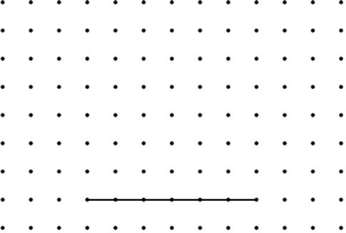
Draw three more lines on this centimetre grid to complete the parallelogram with an area of 24 cm².
Area of a parallelogram:
Base x height
4 cm
6 cm x _____ = 24 cm²
Notes:
P1 Pre-2000 or other question

Slide 2
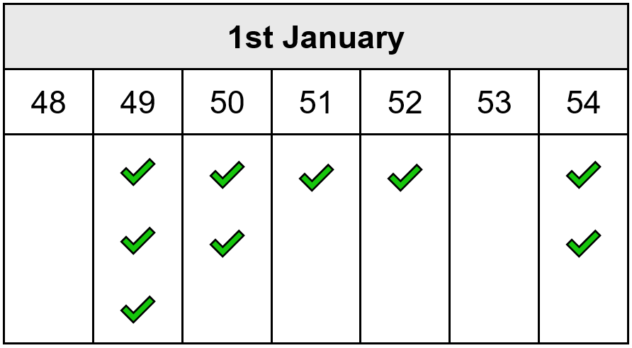
Carol counts the matches in 10 boxes.
She works out that the mean number of matches in a box is 51
Here are her results for 9 boxes.
Calculate how many matches are in the 10th box.
✓
3 x 2 = 6 less
2 x 1 = 2 less
1 x 1 = 1 more
2 x 3 = 6 more
2 x 1 = 2 more
Notes:
P2 Older Level 6

Slide 3
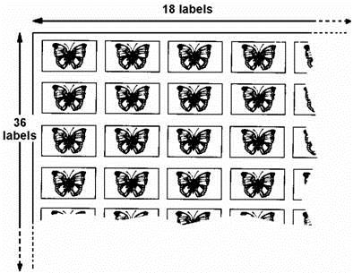
A shop sells sheets of sticky labels.
On each sheet there are 36 rows and 18 columns of labels.
`
How many labels are there altogether on 45 sheets?
29,160
1
3
4
2
4
3
6
6
4
8
x
1
8
x
4
5
1
1
2 8
8
3 2
4
0
3
6
0
2 5
9
2
0
6
4
8
2
9
1
6
0
Notes:
P3 Pre-2000 or other question

Slide 4
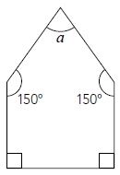
The diagram shows a pentagon.
Each side of the pentagon is the same length.
Is the shape a regular pentagon?
Explain your answer.
Work out the size of angle a.
60°
No, because regular shapes have angles of the same size, not just sides of the same length.
That’s because you can make 3 triangles from a pentagon
3 x 180 = 540
90°
90°
A right angle is 90°.
Angles in a pentagon add up to 540°.
a = 540° - 150° - 150° - 90° - 90°
a = 540° - 300° - 180° =
60°
Notes:
P4 20011 Level 6 Paper A Q8

Slide 5
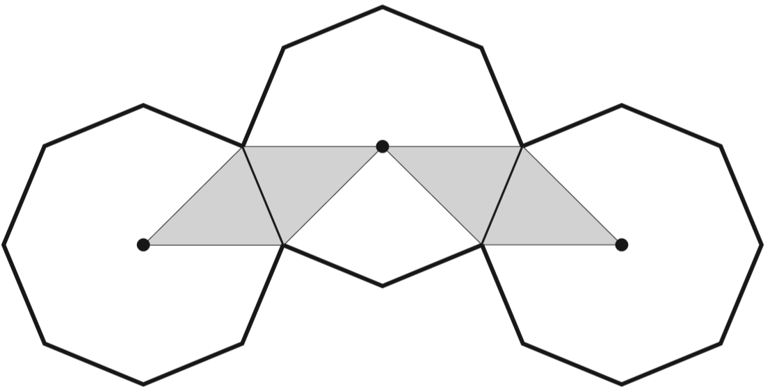
The diagram shows three regular octagons joined together.
There is a dot at the centre of each octagon.
What fraction of the diagram is shaded?
4 pieces shaded
24 pieces altogether
4
2 4
÷4
4
1
=
2 4
6
÷4
Notes:
P5 2007 Paper 2 Q25

Slide 6
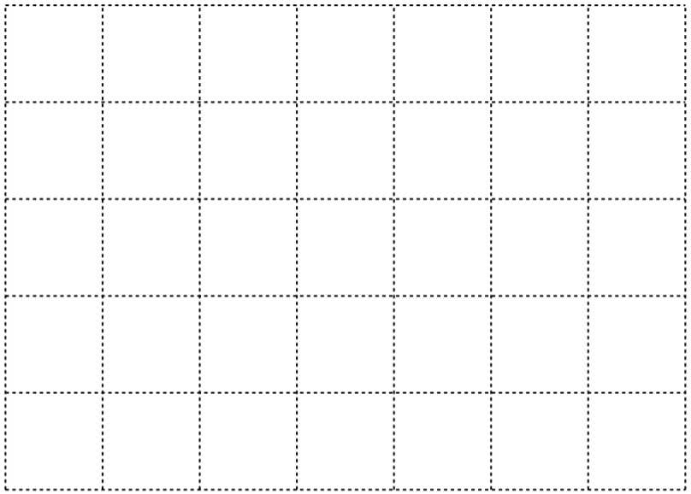
On the centimetre square grid, draw a triangle that has
an area of 5 cm².
Area of a triangle:
Base x height ÷ 2
5 cm x 2 cm ÷ 2 =
5 cm²
Notes:
P6 Pre-2000 or other question

Slide 7
On the centimetre square grid, draw a triangle that has
an area of 5 cm².
Area of a triangle:
Base x height ÷ 2
5 cm x 2 cm ÷ 2 =
5 cm²
Notes:
P7 Pre-2000 or other question

Slide 8
On the centimetre square grid, draw a triangle that has
an area of 5 cm².
Area of a triangle:
Base x height ÷ 2
5 cm x 2 cm ÷ 2 =
5 cm²
Notes:
P8 Pre-2000 or other question

Slide 9
On the centimetre square grid, draw a triangle that has
an area of 5 cm².
Area of a triangle:
Base x height ÷ 2
5 cm x 2 cm ÷ 2 =
5 cm²
Notes:
P9 Pre-2000 or other question

Slide 10
On the centimetre square grid, draw a triangle that has
an area of 5 cm².
Area of a triangle:
Base x height ÷ 2
2 cm x 5 cm ÷ 2 =
5 cm²
Notes:
P10 Pre-2000 or other question

Slide 11
On the centimetre square grid, draw a triangle that has
an area of 5 cm².
Area of a triangle:
Base x height ÷ 2
2 cm x 5 cm ÷ 2 =
5 cm²
Notes:
P11 Pre-2000 or other question

Slide 12
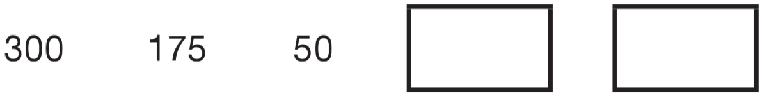
Liam makes a sequence of numbers starting with 300
He subtracts 125 each time.
Write the next two numbers in Liam’s sequence.
-75
-200
1
1
0
1 2 5
1 2 5
1
+
7 5
-125
-75
-50
-
5 0
2
0
0
7
5
-200
-75
0
50
Notes:
P12 2010 Paper 1 Q18

Slide 13


5 miles is approximately equal to 8 km.
Complete the sentences below:
1 mile is approximately equal to
1 km is approximately equal to
8
3
=
1
5
5
3
1
or 1.6
5
5
or 0.625
8
Notes:
P13 Pre-2000 or other question

Slide 14
There are 25 children in the lunch queue, including Nik.
Nik says, ‘There are twice as many children in front of me as there are behind me’. How many children are in front of Nik?
16 children
24 children other than Nick
24
16
16
8
8 + 8 =
in front
behind
8
8
8
24 ÷ 3 =
8
Notes:
P14 2011 Level 6 Paper A Q3

Slide 15
3
1
1
What number is exactly halfway between 2 and 3 ?
4
2
3
8
3
1 1
2 2
2
=
=
4
4
8
1
7
1 4
2 8
3
=
=
=
2
2
4
8
2 5
1
3
=
8
8
Notes:
P15 Pre-2000 or other question

Slide 16
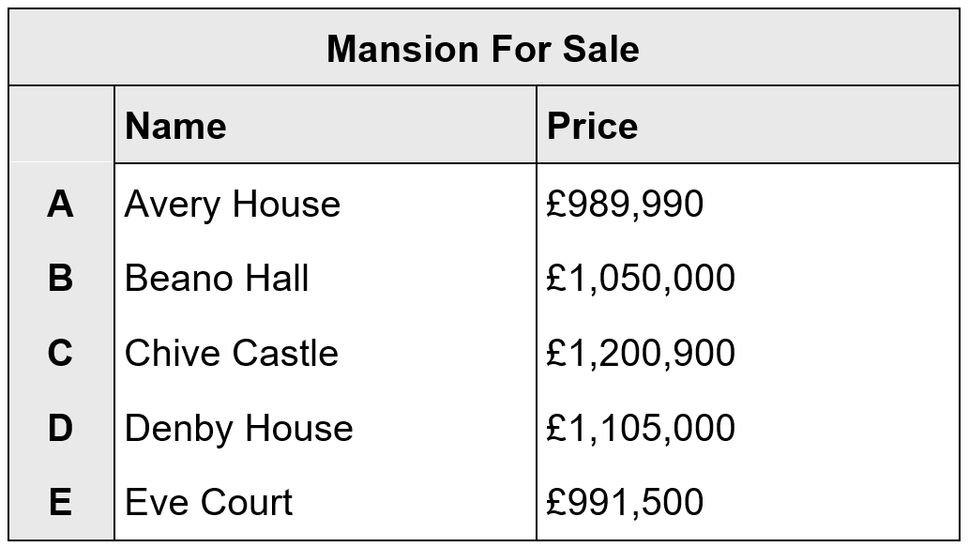
Mr Jones looks at the prices of 5 mansions.
He wants to look at mansions costing between £990,000 and £1,110,000.
Write the letters of the mansions that he looks at.
D,
B,
E
less than £990,000
more than £1,110,000
Notes:
P16 Pre-2000 or other question

Slide 17
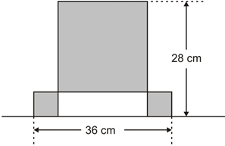
This design has one large square and two identical small squares.
The design measures 36 centimetres by 28 centimetres.
Calculate the length of a side of the large square.
20 cm
1l + 1s = 28
1l + 2s = 36
1 small = 8 cm
20
28
1 large = 20 cm
8
20
8
8
Notes:
P17 2009 Paper 1 Q24

Slide 18
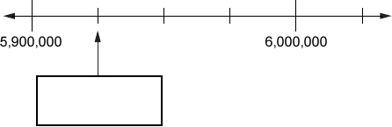
Here is part of a number line.
Write the number shown by the arrow.
5 925 000
6 000 000 – 5 900 000 =
100 000
100 000 ÷ 4 =
25 000
Notes:
P18 Pre-2000 or other question

Slide 19
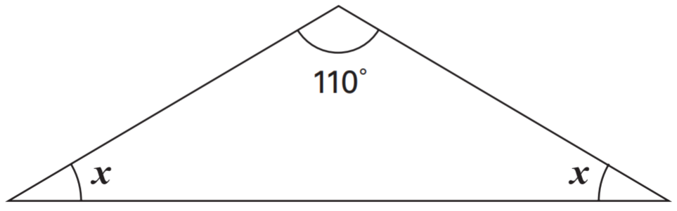
Here is an isosceles triangle. Calculate the size of angle x.
Angles in a triangle add up to 180°.
Isosceles triangles have two equal angles.
180° - 110° = 70°
70° ÷ 2 = 35°
x = 35°
35°
35°
Notes:
P19 2005 Paper 2 Q21

Slide 20
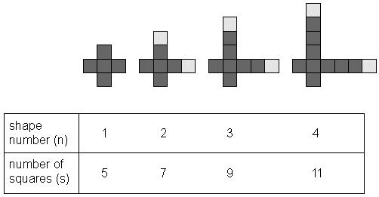
Here is a sequence of shapes made from squares.
There is a formula which connects the number of squares (s) used in a shape, with the shape number (n).
Tick the correct formula.
s = 3n + 2
s = 3n + 1
s = 2n + 3
s = 5n – 3
s = 2n + 5
✓
Notes:
P20 Older Level 6

Slide 21
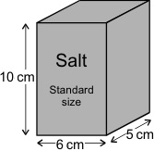
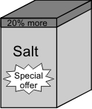
a) What is the volume of this standard size box of salt?
b) What is the volume of this special offer box of salt, which is 20% bigger?
20% of 300 =
60
300 + 60 =
360cm³
10cm x 6cm x 5cm =
300cm³
c) The standard size box contains enough salt to fill up 10 salt pots. How many salt pots may be filled up from the special offer box of salt?
20% of 10 =
2
10 + 2 =
12 salt pots
Notes:
P21 Pre-2000 or other question

Slide 22
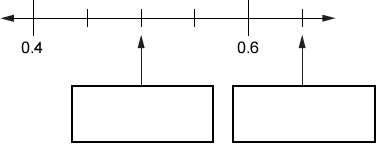
Here is part of a number line.
Write the numbers shown by the arrows.
0.45
0.55
0
0
0.50
0.5
0.65
Notes:
P22 Pre-2000 or other question

Slide 23
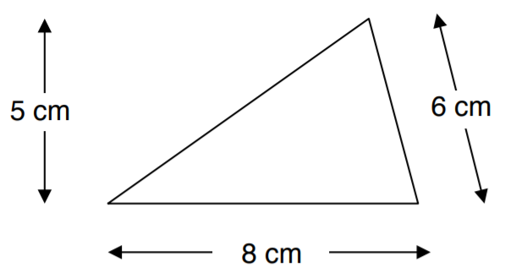
Calculate the area of the triangle.
8 cm x 5 cm ÷ 2 =
20 cm²
Notes:
P23 Pre-2000 or other question

Slide 24
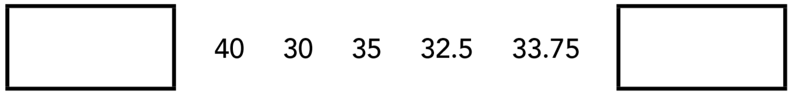
The rule to get each number in a sequence is
subtract the previous number from 100, then divide the answer by 2
Here is part of the sequence. Write the two missing numbers.
20
33.125
4 0 x 2 =
0
9
9
9
8 0
1 0 0.0 0
1
1
1
1
1 0 0 – 8 0 =
2 0
-
3 3.7 5
6
6
2
5
.
3
3
1
2
5
.
2
6 6.2 5
0
1
Notes:
P24 2011 Level 6 Paper B Q2

Slide 25
In Class 6, 80% of the children like crisps.
75% of the children who like crisps also like chocolate.
In Class 6, what percentage of the children like both crisps and chocolate?
60%
80% like crisps
20% don’t
20%
20%
20%
20%
and chocolate
80 ÷ 4 = 20
Notes:
P25 Older Level 6

Slide 26
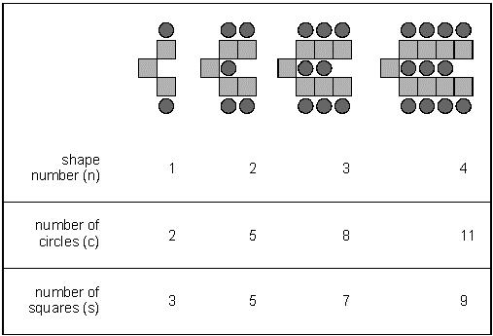
Here is a sequence of shapes made from squares and circles.
The sequence continues in the same way. The formula for the number of circles (c) in relation to the shape number (n) is
c = 3n − 1
Use the formula to work out the shape number which has 104 circles.
4
8
2
6
shape number 35
104 = 3n – 1
105 = 3n
35 = n
Write the formula for the number of squares (s) in shape number (n).
S = _______
2n + 1
Notes:
P26 Older Level 6

Slide 27
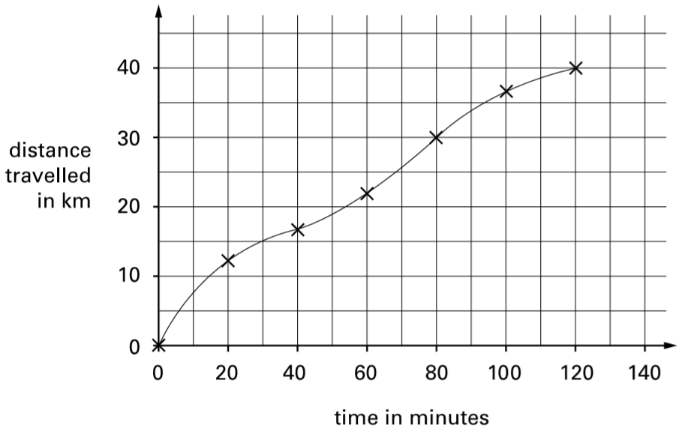
Carol went on a 40-kilometre cycle ride.
This is a graph of how far she had gone at different times.
How many minutes did Carol take to travel the last 10 kilometres of the ride?
120 – 80 =
40 minutes
Notes:
P27 2000 Paper 2 Q19 first page

Slide 28
Carol went on a 40-kilometre cycle ride.
This is a graph of how far she had gone at different times.
Use the graph to estimate the distance travelled in the first 20 minutes of the ride.
35
25
12 kilometres
15
You also get the mark for an estimate of 13 kilometres.
5
Notes:
P28 2000 Paper 2 Q19 second page

Slide 29
Carol went on a 40-kilometre cycle ride.
This is a graph of how far she had gone at different times.
Carol says, ‘I travelled further in the first hour than in the second hour.’ Explain how the graph shows this.
It shows 22 km travelled in the first 60 minutes.
This means that
40 – 22 = 18 km travelled in the second hour.
22 km is further than 18 km.
Notes:
P29 2000 Paper 2 Q19 third page

Slide 30
Children were asked to choose between a safari park and a zoo for the school trip.
They had a vote.
The result was a ratio of 10:3 in favour of going to a safari park.
130 children voted in favour of going to a safari park.
How many children voted in favour of going to the zoo?
39 children
10 : 3
x13
130 :
39
Notes:
P30 Older Level 6

Slide 31
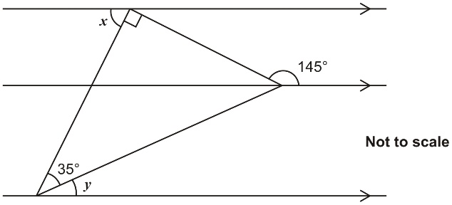
The diagram shows a right-angled triangle and three parallel lines. Calculate the size of angle x and angle y.
55°
35°
90°
125°
55°
35°
55°
125°
20°
160°
125°
20°
Notes:
P31 Older Level 6

Slide 32
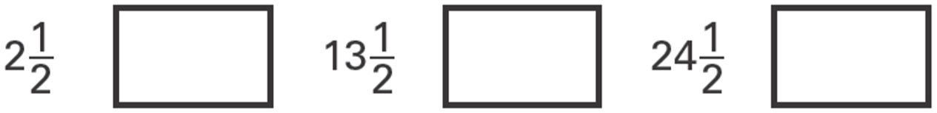
The numbers in this sequence increase by equal amounts each time.
Write in the missing numbers.
8
19
30
1
1
2
+ 5
=
8
2 jumps = a difference of 11
2
2
1 1
1
1 jump =
=
5
1
1
13
+ 5
=
2
2
19
2
2
1
1
24
+ 5
=
30
2
2
Notes:
P32 2006 Year 5 Optional Paper 1 Q27

Slide 33


2x + y = 20
when x = 6
8
8
(2 x 6) + ___ = 20
when y = 2
9
9
(2 x ___) + 2 = 20
Notes:
P33 Pre-2000 or other question

Slide 34
96 pupils and teachers go by minibus to the sports tournament.
How many 15-seater minibuses will be required?
7 minibuses
1 5
1x
3 0
2x
4 5
3x
6 0
4x
7 5
5x
9 0
6x
1 0 5
7x
Notes:
P34 Pre-2000 or other question

Slide 35
In a class the ratio of boys to girls is 7:4
There are 9 more boys than girls.
How many children are in the class?
33 children
B
3 3 3 3 3 3 3 3 3 3 3
B
B
B
B
B
B
G
G
G
G
9
3 bars = 9
1 bar =
9 ÷ 3 =
3
Total (11 bars) =
3 x 11 =
33
Notes:
P35 Older Level 6

Slide 36
3 000 000
Write in figures the number three million.
Notes:
P36 Pre-2000 or other question

Slide 37
Write a fraction which is greater than 0.7 and less than 0.71
0.700
0.710
7 0 1
0.701
1 0 0 0
Notes:
P37 Older Level 6

Slide 38
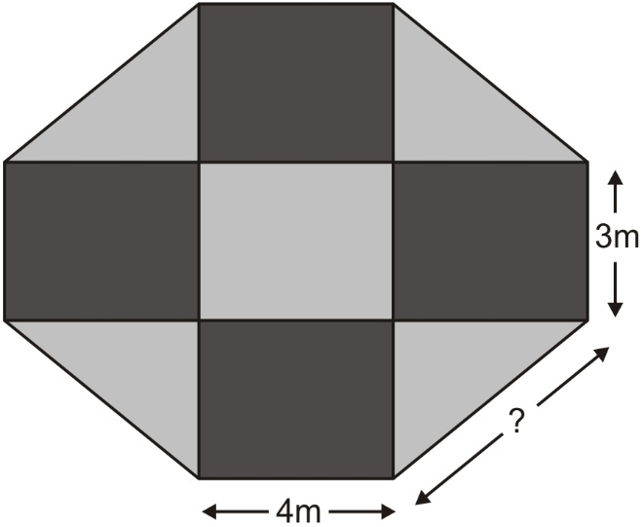
This plan of a garden is made of rectangles and triangles. The perimeter of the garden is 34 metres.
What is the length of the longest side of each triangle?
5 metres
4
4 + 4 + 3 + 3 + 4s = 34
5
5
14 + 4s = 34
4s = 20
3
s = 5m
5
5
Notes:
P38 Pre-2000 or other question

Slide 39
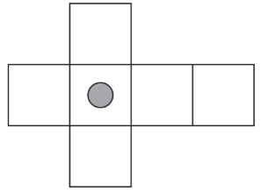
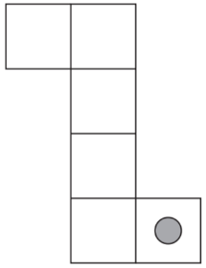
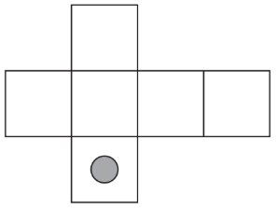
Here are three nets of a cube. On each net draw one more dot so that each cube will have dots on opposite faces.
Notes:
P39 2013 Paper 1 Q5

Slide 40
bag of 6 green apples for 75p bag of 10 red apples for 90p
Jason bought some bags of green apples and some bags of red apples. He spent £4.20
How many bags of each type of apple did he buy?
1 green 75p
1 red 90p
2 green bags, 3 red bags
2 green £1.50
2 red £1.80
£2.70 + £1.50 = £4.20
3 green £2.25
3 red £2.70
Nika and Hassan bought some bags of apples.
Nika says, ‘I bought more apples than Hassan, but I spent less money.’
Explain how this is possible.
Nika might have bought 3 bags of green apples and Hassan might have bought 2 bags of red apples.
3 green bags is £2.25 for 18 apples (3 x 6)
2 red bags is £1.80 for 20 apples (2 x 10)
Notes:
P40 2002 Paper 1 Q18

Slide 41
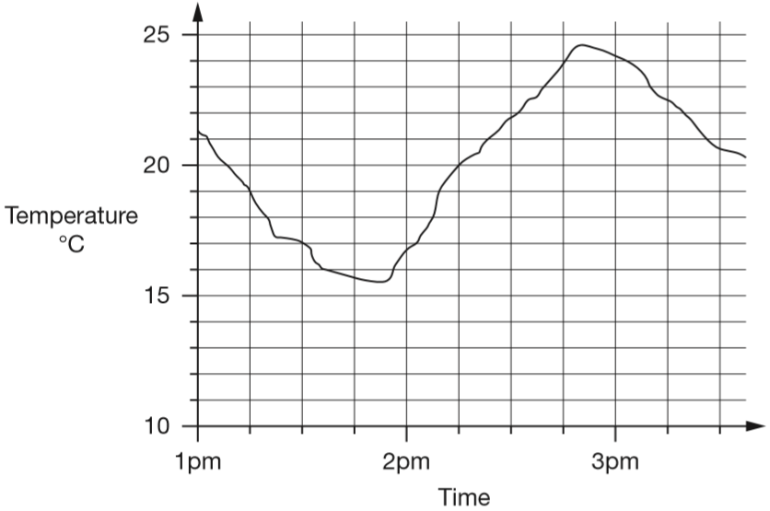
This graph shows how the temperature changed in Liam’s room one afternoon.
Estimate the temperature at 3:15pm.
22.5°C
You get the mark for an estimate of between 22.2 and 22.8
Notes:
P41 2014 Paper 2 Q18 page 1

Slide 42
This graph shows how the temperature changed in Liam’s room one afternoon.
Estimate the time when the temperature was highest.
2:50pm
You get the mark for an estimate of between 2:48pm and 2:52pm
2:45pm
Notes:
P42 2014 Paper 2 Q18 page 2

Slide 43
This graph shows how the temperature changed in Liam’s room one afternoon.
How much did the temperature change from 2pm to 2:30pm? Give your answer to the nearest degree.
just under 22
just under 17
22 – 17 =
5 degrees
Notes:
P43 2014 Paper 2 Q18 page 3

Slide 44
Liam did a survey of 55 people to see how many were left-handed.
Liam says, ‘The results show that exactly 10% of the people in the survey are left-handed.’
Explain why Liam cannot be correct.
10% of 55 is 5.5
You can’t have 5.5 people.
1 0
5 5 ÷ 1 0 0 =
0.5 5
.
of 5 5
0
5
5
x 1 0 =
5.5
1 0 0
.
5 5
.
÷10
.
1 0
1
5 5 ÷ 1 0 =
5.5
=
of 5 5
.
1 0 0
1 0
5
5
÷10
Notes:
P44 2014 Paper 1 Q19

Slide 45
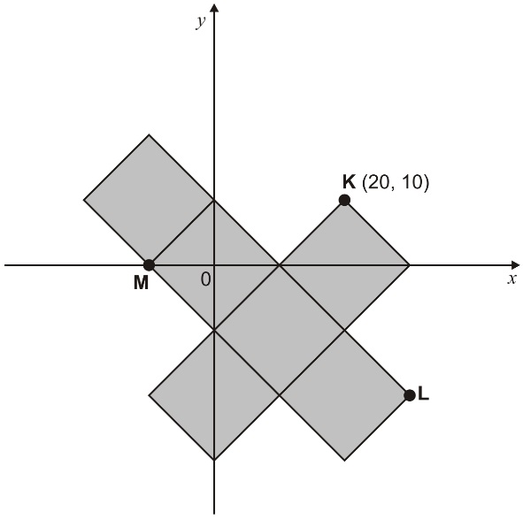
The diagram shows 6 shaded squares.
K is the point (20, 10).
What are the coordinates of L and M?
M: (-10,
0)
10
L: (30,
-20)
10
10
10
10
10
20
30
-10
10
10
-20
Notes:
P45 Older Level 6

Slide 46
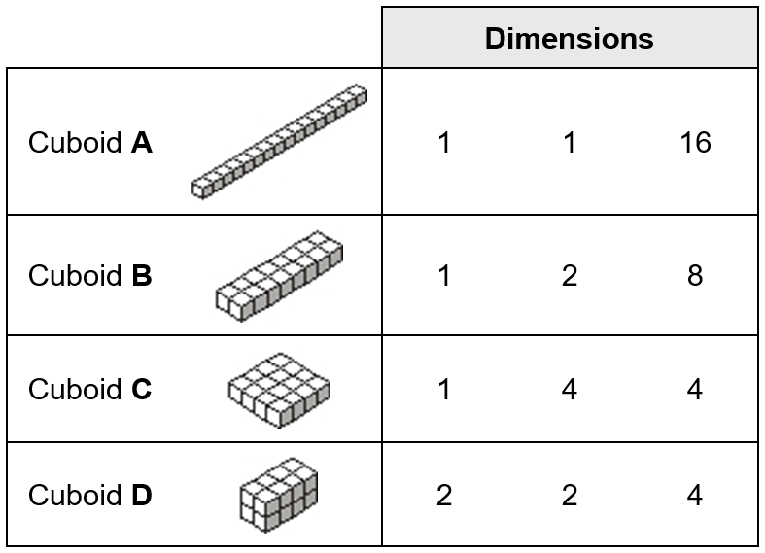
You can make only four different cuboids with 16 cubes.
Which cuboid has the largest volume?
Tick the correct answer below.
Cuboid A
Cuboid B
Cuboid C
Cuboid D
All the same
Explain how you know.
✓
They all have a volume of 16 cubes.
Volume is how much space a 3D shape takes up.
Notes:
P46 Pre-2000 or other question

Slide 47
You can make only four different cuboids with 16 cubes.
How many of cuboid D make a cube of dimensions 4 × 4 × 4?
4
Notes:
P47 Pre-2000 or other question

Slide 48
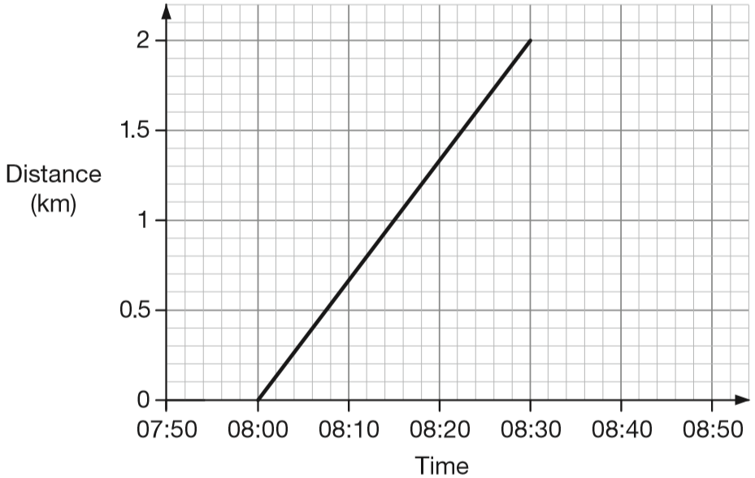
Alfie and his brother walked from home to their school.
Their school is 2 kilometres from home.
The graph shows information about Alfie’s journey.
How does the graph show that Alfie walked at a constant speed for all of his journey?
It’s a straight line.
Alfie’s brother left home 10 minutes before Alfie. He arrived at school 20 minutes after Alfie. He walked at a constant speed for all of his journey. At what time did Alfie overtake his brother?
08:10
Notes:
P48 2014 Level 6 Paper A Q4

Slide 49
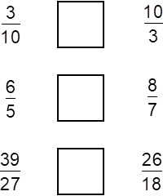
Write the correct sign < = or > in each box to make these sentences correct.
<
1
1
1
>
1
5
7
÷3
÷2
1 2
4
8
4
=
=
12
8
2 7
9
1 8
9
1
=
1
27
18
÷3
÷2
Notes:
P49 Pre-2000 or other question

Slide 50
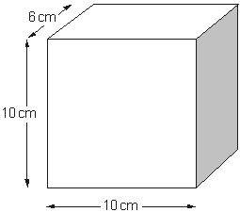
a) The diagram shows a cuboid. What is the volume of this cuboid?
10 cm x 10 cm x 6 cm =
600 cm³
b) The volume of a different cuboid is half the volume of the cuboid in part a. What could the dimensions of this different cuboid be?
10cm
10cm
3cm
_____ x _____ x _____ = 300cm³
10cm x 6cm x 5cm = 300cm³
If one length is halved, volume is halved.
Notes:
P50 Pre-2000 or other question

Slide 51
If you know 40% of a number, explain how you could work out the original number.
Divide by 40 to get 1%, then multiply by 100 to get 100%
100%
Divide by 4 to get 10%, then multiply by 10 to get 100%
10%
10%
10%
10%
10%
10%
10%
10%
10%
10%
Notes:
P51 2010 Paper 1 Q26

Slide 52
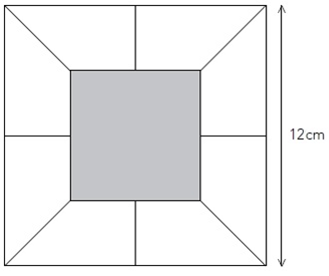
The diagram shows a square of side length 12 cm.
Inside the square are 8 congruent trapeziums and a shaded square.
The side length of the shaded square is 6 cm.
What is the area of one of the trapeziums?
13.5 cm²
12 cm
12 cm x 12 cm = 144 cm²
6 cm x 6 cm = 36 cm²
6 cm
8 trapeziums = 144 cm² – 36 cm²
= 108 cm²
6 cm
5
1 trapezium =
1
3
.
cm²
8
1 0 8
.0
2
4
Notes:
P52 2011 Level 6 Paper B Q7

Slide 53
The sum of two numbers is 5
The difference between the numbers is 0.5
What are the numbers?
2.25 and 2.75
Half of 5 =
2.5
Half of 0.5 =
0.25
2.5 + 0.25 =
2.75
2.5 – 0.25 =
2.25
Notes:
P53 Older Level 6

Slide 54
There are 60g of rice in one portion.
How many portions are there in a 3 kg bag of rice?
50 portions
3000g
50
3000 ÷ 60 =
60g = 1 portion
60g = 1 portion
x100
x10
6000g =
100 portions
600g =
10 portions
÷2
x5
3000g =
50 portions
3000g =
50 portions
Notes:
P54 Pre-2000 or other question

Slide 55
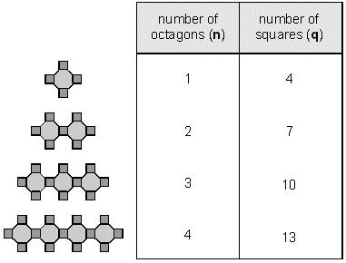
Here is a sequence of patterns made from octagons and squares.
The sequence continues.
How many squares will there be in the pattern that has 40 octagons?
3
6
40 x 3 + 1 =
121 squares
q represents the number of squares.
n represents the number of octagons.
What is the rule connecting q and n?
9
12
q = 3n + 1
Notes:
P55 Older Level 6

Slide 56
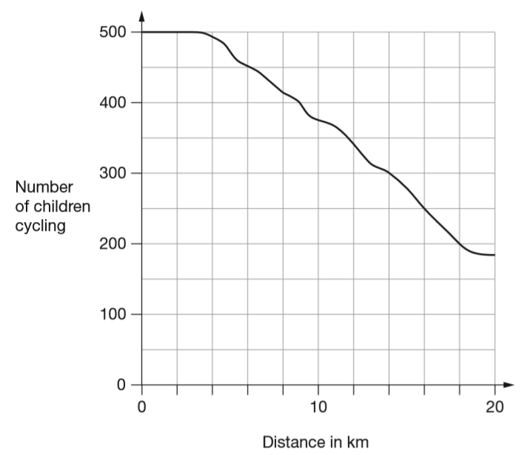
500 children started a 20 kilometre sponsored cycle ride. This graph shows how far they cycled.
At what distance were exactly half of the children still cycling?
2
5
0
2
5 0 0
1
250
16 kilometres
2
4
6
8
12
14
16
18
Notes:
P56 2011 Paper 1 Q19 page 1

Slide 57
500 children started a 20 kilometre sponsored cycle ride. This graph shows how far they cycled.
Estimate how many children completed the 20 kilometre cycle ride.
185 children
You get the mark for an estimate of between 180 and 190.
250
150
Notes:
P57 2011 Paper 1 Q19 page 2

Slide 58
x is a whole number.
40 < x < 45
x could be 41, 42, 43 or 44
k is a whole number.
29 < 2k < 35
k could be ____________
30, 31, 32, 33, 34
2k =
15
16
17
k =
15, 16 or 17
w is a whole number.
18 < 3w + 1 < 24
w could be ___________
3w + 1 =
19, 20, 21, 22, 23
3w =
18, 19, 20, 21, 22
6 or 7
w =
6
7
Notes:
P58 2012 Level 6 Paper B Q7

Slide 59
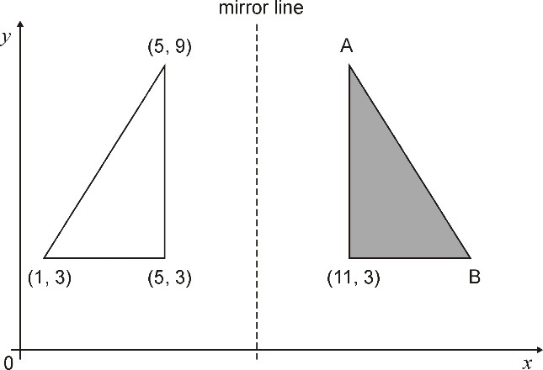
The shaded triangle is a reflection of the white triangle in the mirror line. Write the co-ordinates of point A and point B.
A: (11,
9)
9
B: (15,
3)
3
4
4
1
5
11
15
Notes:
P59 2000 Paper 1 Q22

Slide 60
Alfie has some photographs printed.
The cost is £2.50 for postage and 12 pence for each print.
Alfie uses this formula for the total cost (C) in pence.
C = 250 + 12n
n stands for the number of photographs.
The total cost for Alfie is £6.70
How many photographs does he have printed?
35 photographs
670 = 250 + 12n
670 – 250 =
420
12n = 420
n = 420 ÷ 12 =
35
Notes:
P60 2015 Level 6 Paper B Q4

Slide 61
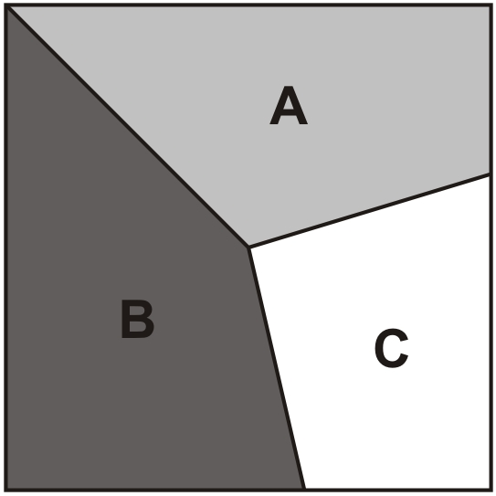
This square is divided into three parts.
1
Part A is of the area of the square.
Part B is of the area of the square.
What fraction of the area of the square is part C?
3
2
5
4
1
2
1 5
+
=
3
5
5
6
1 1
1 1
4
+
=
1 – =
1 5
1 5
1 5
1 5
1 5
Notes:
P61 Older Level 6

Slide 62
272 children and 26 adults from Hill School go on a coach trip.
How many 42-seat coaches does the school need to hire?
8 coaches
298
272 + 26 =
4 2
1x
+ 4 2
8
4
2x
+ 4 2
1
1 2
6
3x
+ 1 2 6
3x
2
5
2
6x
+ 4 2
2
9
4
7x
plus another coach for 4 more people
Notes:
P62 2003 Year 5 Optional Paper 2 Q21

Slide 63

Here are five number cards.
Write the missing number so that the mean is 2
3
10
÷ 5 = 2
3
1 + 4 + 1 + 1 + = 10
Notes:
P63 2014 Level 6 Paper A Q3 first page

Slide 64
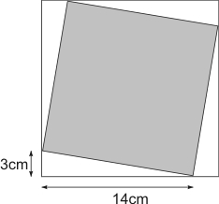
The diagram shows a shaded square inside a larger square.
Calculate the area of:
the larger square
the shaded square
1
4
1
7
x
1
7
1 1
9
1
7
0
2
8
9
cm²
14 x 3 ÷ 2 =
21 cm²
4 x 21 cm² =
84 cm²
289 cm² – 84 cm² = 205 cm²
Notes:
P64 Older Level 6

Slide 65
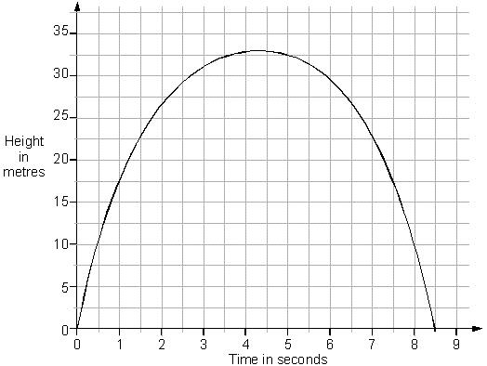
This is a graph of a firework rocket, showing its height at different times.
Estimate from the graph for how many seconds the rocket is more than 20 metres above the ground.
7.2 – 1.2 =
6 seconds
Estimate from the graph how many metres the rocket falls in the last second of its flight.
17.5 metres
1.2
7.2
Notes:
P65 Older Level 6

Slide 66
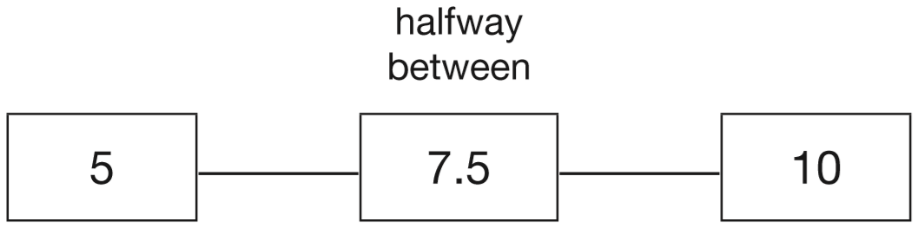
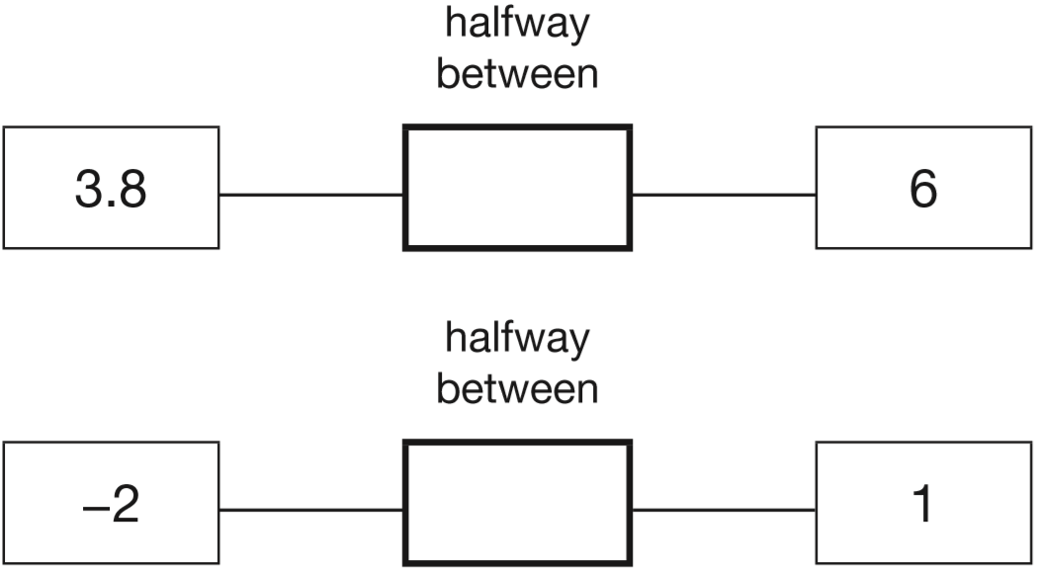
The number 7.5 is halfway between 5 and 10
Add, then divide by 2
6 + 3.8 = 9.8
Write in the missing numbers.
4.9
9.8 ÷ 2 =
4
.
9
2
9.8
4.9
1
-2 + 1 = -1
-0.5
-1 ÷ 2 =
-0.5
Notes:
P66 2015 Level 6 Paper A Q1

Slide 67
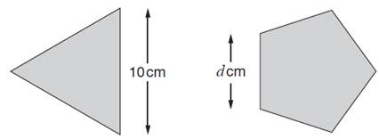
Here are an equilateral triangle and a regular pentagon.
Each side of the triangle is 10 cm.
Each side of the pentagon is d cm.
The perimeter of the pentagon is 4 centimetres more than the perimeter of the triangle.
What number does d represent?
30cm
34cm
6.8
6
.
cm
8
5
3 4
.0
10
4
10
Notes:
P67 2014 Level 6 Paper A Q2

Slide 68
Two families go to the cinema.
The Smith family buy tickets for one adult and four children and pay £19
The Jones family buy tickets for two adults and two children and pay £17
What is the cost of one child's ticket?
£3.50
A + 4C = 19
2A + 8C = 38
2A + 2C = 17
6C = 21
£21 ÷ 6 =
£3.50
Notes:
P68 Older Level 6

Slide 69

In a survey, the ratio of the number of people who preferred milk chocolate to those who preferred plain chocolate was 5 : 3
46 more people preferred milk chocolate, to plain chocolate.
How many people were in the survey?
184 people
M
23 23 23 23 23 23 23 23
M
M
M
M
P
P
P
46
2 bars = 46
1 bar =
46 ÷ 2 =
23
Total (8 bars) =
23 x 8 =
184
Notes:
P69 Older Level 6

Slide 70


Write the missing fractions.
16
8
27
10
10
10
8
16
5
10
55
9
4
60
20
20
20
20
11
55
4
20
Notes:
P70 Pre-2000 or other question

Slide 71
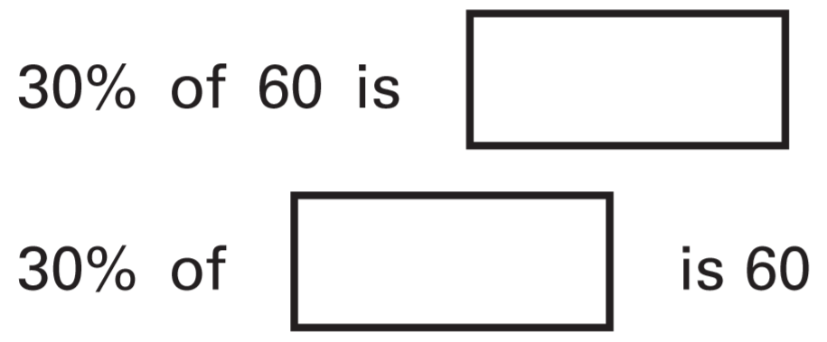
Write in the missing numbers.
÷10
1 8
3 0
3
=
1 0 0
1 0
÷10
2 0 0
3
of 60 =
1 8
1 0
3
of = 60
200
6 0 ÷ 1 0 = 6
10
6 x 3 = 1 8
6 0 ÷ 3 = 2 0
2 0 x 1 0 = 2 0 0
Notes:
P71 2005 Paper 2 Q23

Slide 72
Write the number four million, forty-four thousand, and forty-four
in figures.
044
044,
4,
Notes:
P72 Pre-2000 or other question

Slide 73
John had £5
He gave 25% of it to charity.
How much did he give?
÷25
2 5
1
=
£1.25
1 0 0
4
1
.
2
5
÷25
4
5.0 0
1
2
100%
50%
50%
To find 50%
÷ 2
25%
25%
25%
25%
To find 25%
÷ 4
Notes:
P73 Pre-2000 or other question

Slide 74
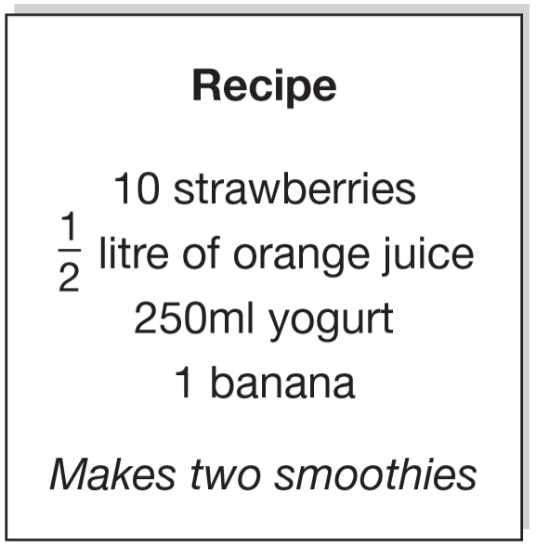
Here is a recipe for fruit smoothies.
Stefan uses the recipe to make smoothies. He uses 1 litre of yogurt.
How many strawberries does he use?
40
250 ml
10 strawberries
x4
x4
1 litre
40 strawberries
1000 ml
Notes:
P74 2009 Paper 2 Q22 page 1

Slide 75
Here is a recipe for fruit smoothies.
Amir wants to make 5 smoothies.
He has 1 litre of orange juice.
How many more millilitres of orange juice does he need?
He needs 250 ml more.
½ litre = 500 ml
for 2 smoothies
÷2
250 ml
for 1 smoothie
x5
1250 ml
for 5 smoothies
1250 – 1000 =
250 ml
Notes:
P75 2009 Paper 2 Q22 page 2

Slide 76
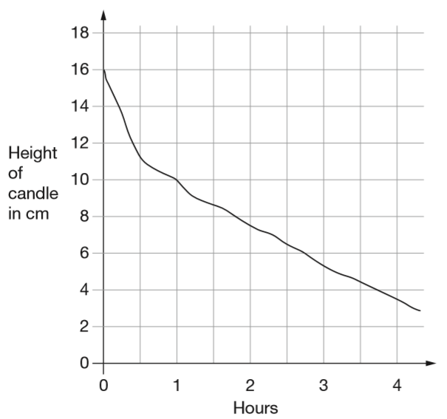
This graph shows the height of a candle as it burns.
What is the height of the candle after 2 hours?
7.5 cm
Notes:
P76 2007 Paper 2 Q22 first page

Slide 77
This graph shows the height of a candle as it burns.
How long does the candle take to burn down from 16cm to 4cm?
3¾ hours
3 hours 45 minutes
Notes:
P77 2007 Paper 2 Q22 second page

Slide 78
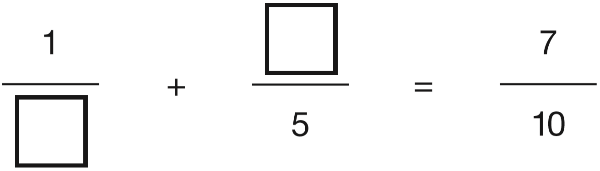
Write numbers in the boxes to make this fraction calculation correct.
3
6
10
10
Now write two different numbers to make the calculation correct.
1
2
5
2
4
10
10
10
2
Notes:
P78 2014 Level 6 Paper A Q8

Slide 79
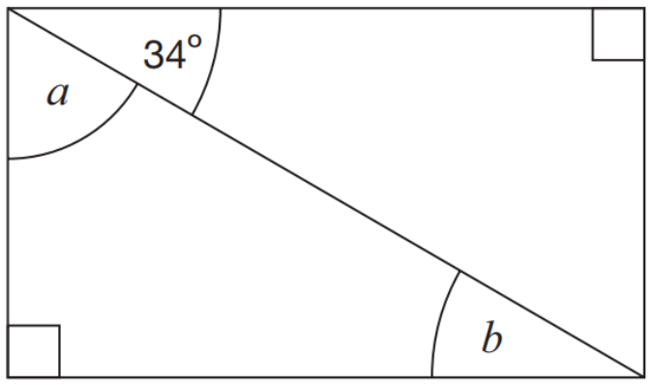
Here is a rectangle. Calculate the size of angles a and b.
56°
34°
Angles on a right angle add up to 90°.
56°
a = 90° - 34° =
Z (or backwards-Z) angles (on parallel lines) are the same size.
Notes:
P79 2015 Paper 1 Q20

Slide 80
A dragon lived in a cave.
The dragon doubled in size every day.
After 20 days the dragon filled the cave.
After how many days did the dragon half-fill the cave?
19 days
Notes:
P80 2011 Level 6 Paper A Q13

Slide 81
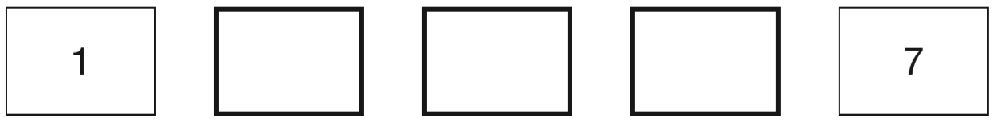
The numbers in this sequence increase by equal amounts each time.
Write in the three missing numbers.
2.5
4
5.5
+1.5
+1.5
+1.5
+1.5
4 jumps =
6 more
1 jump =
6 ÷ 4 =
1.5 more
1
.
5
4
6
.0
2
Notes:
P81 2015 Paper 2 Q21

Slide 82
m stands for a whole number greater than 10 and less than 20
n stands for a whole number greater than 2 and less than 10
What is the smallest number that m × n could be?
m = 11
n = 3
11 x 3 =
33
What is the largest number that m – n could be?
m = 19
n = 3
19 – 3 =
16
Notes:
P82 2008 Paper 2 Q23

Slide 83
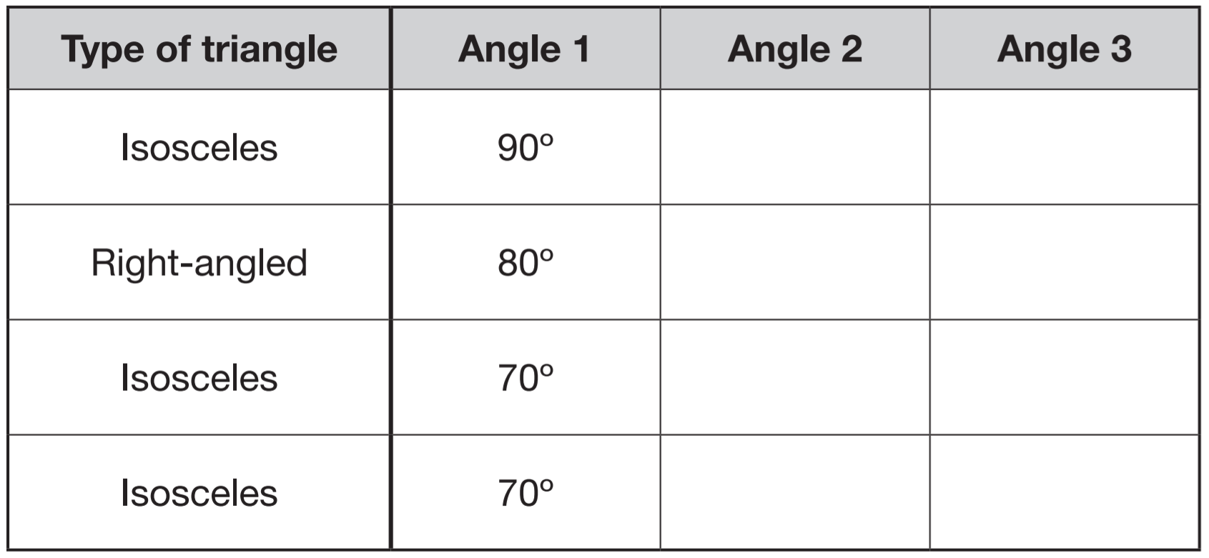
Anna has four different triangles. Complete the table to show the size of the angles in each triangle.
45°
45°
90°
10°
70°
40°
55°
55°
Angles in a triangle add up to 180°.
180° - 70° = 110°
Isosceles triangles have two equal angles.
110° ÷ 2 = 55°
Notes:
P83 2015 Level 6 Paper A Q12

Slide 84
Ellie had a piece of ribbon that was ¾m long.
She cut it and gave half to Grace.
What fraction of a metre did she give to Grace?
3
m
8
3
3
÷ 2 =
4
8
Notes:
P84 Pre-2000 or other question

Slide 85
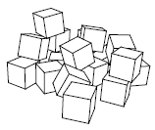
Jon has 20 centimetre cubes. He wants to make a cube with edges that are 3 cm long.
How many more centimetre cubes does he need?
3cm x 3cm x 3cm =
27cm³
He needs 7 more cubes.
Notes:
P85 2012 Level 6 Paper A Q10 second page

Slide 86
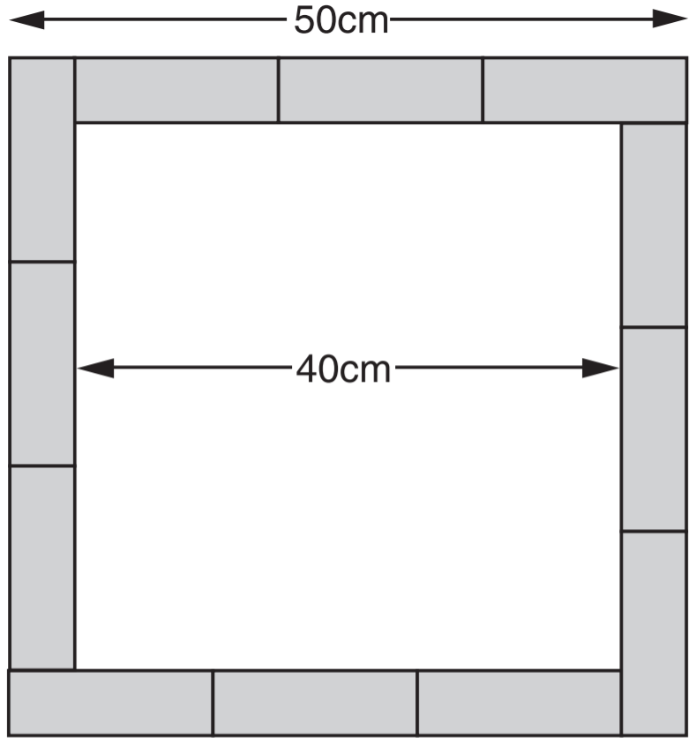
Twelve rectangles, all the same size, are arranged to make a square, as shown in the diagram. Calculate the area of one of the rectangles.
2500 cm²
50 cm x 50 cm =
1600 cm²
40 cm x 40 cm =
12 rectangles =
900 cm²
1 rectangle =
7
5
cm²
1 2
9 0 0
6
Notes:
P86 Older Level 6

Slide 87
Twelve rectangles, all the same size, are arranged to make a square, as shown in the diagram. Calculate the area of one of the rectangles.
2 widths = 50cm – 40cm = 10cm
Width of a rectangle = 5 cm
_______________________
5 cm + 3 lengths = 50 cm
1
5
3
4 5
3 lengths = 45 cm
1
Length of a rectangle = 15 cm
________________________
15 cm x 5 cm =
2
1 5
x
5
7
5
cm²
Notes:
P87 Older Level 6

Slide 88


Here is a cube. The cube is shaded all the way round so that the top half is grey and the bottom half is white.
Here is the net of the cube. Complete the shading.
Notes:
P88 2006 Paper 2 Q16

Slide 89

Join pairs of equivalent fractions.
One is done for you.
÷3
6
2
=
÷2
1 5
5
1 0
5
=
÷3
1 2
6
÷7
1 4
2
÷2
=
2 1
3
÷7
÷4
8
2
÷5
=
1 2
3
2 5
5
=
÷4
3 0
6
÷5
Notes:
P89 Pre-2000 or other question

Slide 90

The diagram shows a shaded triangle inside a rectangle.
What is the area of the shaded triangle?
4 cm x 6 cm ÷ 2 =
12 cm²
30 cm²
6
12 cm²
18 cm²
6
Notes:
P90 2014 Level 6 Paper A Q11

Slide 91

g stands for a number on a grey card.
w stands for a number on a white card.
Join all pairs of numbers that match this rule:
2g + w = 10
One is done for you.
2 x 2 + __ = 10
3 x 2 + __ = 10
4 x 2 + __ = 10
Notes:
P91 2015 Level 6 Paper B Q1

Slide 92

Here is a parallelogram on a 1 cm square grid.
What is the area of the parallelogram?
Area of a parallelogram:
Base x height
4 cm x 3 cm = 12 cm²
3
4
Notes:
P92 Pre-2000 or other question

Slide 93
Jack is rounding to the nearest hundred thousand.
Write the smallest whole number that he can round to 3,400,000
3, 3 5 0, 0 0 0
Grace is rounding to the nearest hundred thousand.
Write the largest whole number that she can round to 3,400,000
3, 4 4 9, 9 9 9
Notes:
P93 Pre-2000 or other question

Slide 94
The cost to hire a boat on a lake is worked out using the information below.
Cost to hire a boat: £4.50 per boat and then £3.50 per hour
Four friends hire a boat for five hours.
They share the cost equally.
How much does each person pay?
£5.50
£4.50 + (5 x £3.50) =
£22.00
£4.50 + £17.50 =
£22.00 ÷ 4 =
£5.50 each
Chen’s family hires a boat and pays a total of £15
How many hours did they have the boat for?
3 hours
£4.50 + £3.50 =
£8.00 for 1 hour
£8.00 + £3.50 =
£11.50 for 2 hours
£11.50 + £3.50 =
£15.00 for 3 hours
Notes:
P94 2014 Level 6 Paper B Q6

Slide 95

Write the missing numbers in the sequence.
6,742,000 6,842,000 6,942,000
6,642,000
7,042,000
Notes:
P95 Pre-2000 or other question

Slide 96
What is 10% of a half?
5%
whole (100%)
half (50%)
half (50%)
5%
5%
5%
5%
5%
5%
5%
5%
5%
5%
5%
5%
5%
5%
5%
5%
5%
5%
5%
5%
What percentage of 20 is 19?
95%
x5
1 9
9 5
=
2 0
1 0 0
x5
Notes:
P96 2013 Level 6 Paper A Q5

Slide 97
This sequence of numbers goes up by 40 each time.
40 80 120 160 200 …
This sequence continues.
Will the number 2140 be in the sequence? Explain how you know.
multiples of 40
2140 ÷ 40 =
53 r20
It will not be in the sequence.
All numbers in the sequence are multiples of 40.
5
3 r2
4
2 1 4
1
2140 is not in the 40 times table.
Notes:
P97 2000 Paper 1 Q20

Slide 98

For each of these points, put a tick to show if it is inside the square.
70
(50, 70)
(60, -30)
(-10, 50)
(-30, -30)
✘
50
✓
✓
-30
-10
50
✘
60
-30
-30
Notes:
P98 2007 Paper 1 Q19

Slide 99

k stands for a number.
Complete the number sentences below.
One has been done for you.
k – 2
2k + 3
½k + 6
Notes:
P99 2010 Paper 2 Q23

Slide 100

The shape ABCD is a rectangle. BD is parallel to EF.
Calculate the sizes of the angles x and y.
55°
125°
55°
35°
145°
35°
90°
Notes:
P100 Older Level 6

Slide 101
A sequence starts at 500 and 80 is subtracted each time.
500 420 340 ...
The sequence continues in the same way.
Write the first two numbers in the sequence which are less than zero.
260
180
100
20
-60
-140
-80
-60
-20
-140
-60
0
20
Notes:
P101 2002 Paper 1 Q20

Slide 102

A cuboid has a square base.
It is twice as tall as it is wide.
Its volume is 250 cubic centimetres.
Calculate the width of the cuboid.
5cm
1cm 1cm 2cm
5cm 5cm 10cm
10cm 10cm 20cm
_____ x _____ x _____ = 250cm³
Notes:
P102 Older Level 6

Slide 103

Draw two more lines to complete the triangle with an area of 10 cm².
Area of a triangle:
Base x height ÷ 2
4
5 cm x __ cm ÷ 2 = 10 cm²
Notes:
P103 Pre-2000 or other question

Slide 104
Draw two more lines to complete the triangle with an area of 10 cm².
Area of a triangle:
Base x height ÷ 2
4
5 cm x __ cm ÷ 2 = 10 cm²
Notes:
P104 Pre-2000 or other question

Slide 105
Draw two more lines to complete the triangle with an area of 10 cm².
Area of a triangle:
Base x height ÷ 2
4
5 cm x __ cm ÷ 2 = 10 cm²
Notes:
P105 Pre-2000 or other question

Slide 106
Draw two more lines to complete the triangle with an area of 10 cm².
Area of a triangle:
Base x height ÷ 2
4
5 cm x __ cm ÷ 2 = 10 cm²
Notes:
P106 Pre-2000 or other question

Slide 107
Draw two more lines to complete the triangle with an area of 10 cm².
Area of a triangle:
Base x height ÷ 2
4
5 cm x __ cm ÷ 2 = 10 cm²
Notes:
P107 Pre-2000 or other question

Slide 108
Draw two more lines to complete the triangle with an area of 10 cm².
Area of a triangle:
Base x height ÷ 2
4
5 cm x __ cm ÷ 2 = 10 cm²
Notes:
P108 Pre-2000 or other question

Slide 109
Draw two more lines to complete the triangle with an area of 10 cm².
Area of a triangle:
Base x height ÷ 2
4
5 cm x __ cm ÷ 2 = 10 cm²
Notes:
P109 Pre-2000 or other question

Slide 110

The diagram shows two shaded equilateral triangles.
Calculate the size of angle x and angle y.
Equilateral triangles have angles of 60°.
Angles in a triangle add up to 180°.
y = 180° - 60° - 35° =
85°
x = 360° - 60° - 60° - 85°
85°
Angles around a point add up to 360°.
x = 155°
60°
35°
155°
Angles on a straight line add up to 180°.
180° - 80° - 65°
60°
60°
85°
60°
180° - 60° - 40°
180° - 55° - 40°
60°
60°
80°
Notes:
P110 Older Level 6

Slide 111

Here is a sequence of shapes.
Each time a square is added to a shape, two more circles are added.
The sequence of shapes continues.
The formula for the sequence is c = 2s + 2
Calculate the number of circles when the number of squares in a shape is 150
C = (2 x 150) + 2
300 + 2 =
302
How many squares are there in a shape that has 100 circles?
100 = (2 x __) + 2
98 = 2 x __
49 squares
98 ÷ 2 =
Notes:
P111 2013 Level 6 Paper A Q6

Slide 112


Here are five digit cards.
Use each card once to make these calculations correct.
1 2
4 0
.0
5
0
Notes:
P112 Pre-2000 or other question

Slide 113

Here is part of a number line.
Write the missing numbers in the boxes.
20 ÷ 4 =
5
-10
-5
25
30
35
40
45
-10
45
Notes:
P113 2009 Paper 2 Q12

Slide 114

The diagram shows an isosceles triangle and a square on a straight line. Calculate angle a.
Angles in a square are 90°.
Angles in a triangle add up to 180°.
180° - 34° = 146°
Isosceles triangles have two equal angles.
146° ÷ 2 = 73°
Angles on a straight line add up to 180°.
180° - 90° - 73° = 17°
17°
a = 17°
73°
73°
90°
Notes:
P114 2013 Level 6 Paper B Q3

Slide 115

This pie chart shows the lunch choices of year 6 children at a school.
28 children in year 6 have a school meal.
How many go home for lunch?
20 children
35% = 28
÷7
5% =
4
x5
20
25% =
Notes:
P115 Older Level 6

Slide 116

Here is an equilateral triangle inside a square. The perimeter of the triangle is 48 centimetres. Calculate the perimeter of the square.
16
In equilateral triangles, all sides are the same length.
3 sides = 48 cm
16
16
16
16
1 side =
1
6
cm
3
4 8
1
In squares, all sides are the same length.
2
1 6
x
4
6
4
cm
16
Notes:
P116 2004 Paper 1 Q25

Slide 117
Look at this number.
3, 1 6 7, 8 1 0
What is the value of the digit 6 in the number?
Circle the correct answer.
six thousand six million sixty thousand
six hundred six hundred thousand
It’s in the ten thousands place.
6 x 10 000 =
60 000
Notes:
P117 Pre-2000 or other question

Slide 118
Three apples have a mean (average) mass of 100 grams.
The largest apple is removed.
The mean mass of the remaining two apples is 70 grams.
What is the mass of the largest apple?
160 grams
so 3 apples weigh 300 grams together
300
÷ 3 = 100
140
÷ 2 = 70
so 2 apples weigh 140 grams together
160
140 + = 300
Notes:
P118 2015 Level 6 Paper B Q11

Slide 119
A builder needs 7600 bricks to build a wall.
There are 500 bricks in a load.
How many loads must the builder buy?
16 loads
1 load = 500 bricks
2 loads = 1000 bricks
14 loads = 7000 bricks
15 loads = 7500 bricks
… but the builder needs 100 more bricks
16 loads = 8000 bricks
£ .
The price of one load of 500 bricks is £230
What is the cost in pence of one brick?
230 00
23000 ÷ 500 =
4
6
p
5
2 3 0
3
Notes:
P119 2010 Paper 2 Q15

Slide 120

Two matchsticks have the same length as three bottle tops.
How many bottle tops will have the same length as 50 matchsticks?
75 bottle tops
2 M 3 BT
x25
50 M
75 BT
1
2
5
2 5
2
5 0
1
x
3
7
5
Notes:
P120 2007 Paper 1 Q21

Slide 121


There are n counters in Alfie’s bag.
Alfie puts 3 more counters in the bag.
Write an expression for the number of counters that are in the bag now.
n + 3
Megan has two boxes. There are m counters in each box.
She puts all her counters together in a pile, then removes 5 of them.
Write an expression for the number of counters
that are in the pile now.
2m – 5
Notes:
P121 2014 Level 6 Paper B Q1

Slide 122

Here is a trapezium with a height of 10 centimetres.
The parallel sides are 5.5cm long and 10.5cm long.
Find the area of the trapezium.
80 cm²
10 cm x 5.5 cm =
55 cm²
10 cm x 5 cm ÷ 2 =
25 cm²
55 cm²
55 cm² + 25 cm² =
80 cm²
25 cm²
5.5
5
Notes:
P122 2013 Level 6 Paper B Q12

Slide 123

Here is a regular decagon, with two diagonals drawn in.
Calculate the sizes of angles a, b and c
36°
72°
144°
360° ÷ 10 =
36°
36°
180° - 36° =
144°
144° ÷ 2 =
72°
72°
72°
Notes:
P123 Pre-2000 or other question

Slide 124



1
of this square is shaded.
3
The same square is used in the diagrams below.
What fraction of this diagram is shaded?
÷2
2
1
=
6
3
÷2
What fraction of this diagram is shaded?
1 piece shaded
9 equal parts
1
9
1
1
÷ 3 =
3
9
Notes:
P124 2008 Paper 1 Q19

Slide 125

Write the missing digits to make the calculation correct.
3
7
. 0 0
3
3
2
Notes:
P125 Pre-2000 or other question

Slide 126

Calculate the volume of the prism.
Area of a triangle:
Base x height ÷ 2
4 cm x 3 cm ÷ 2 =
6 cm²
Volume of a prism:
Area of 2D shape x depth
6cm² x 3cm =
18cm³
Notes:
P126 Pre-2000 or other question

Slide 127
These are the prices of fruit in a shop.
Oranges 5 for 90p
Cherries 80p for 100 grams
Emma buys 15 oranges. How much does she pay?
£2.70
5 oranges = 90p
x3
15 oranges =
£2.70
Reshma buys some cherries. They cost £1.20
How many grams of cherries does she buy?
150 grams
80p = 100 grams
÷2
40p =
50 grams
x3
£1.20 =
150 grams
Notes:
P127 2006 Year 5 Optional Paper 2 Q17

Slide 128

Calculate the area of the parallelogram.
Area of a parallelogram:
Base x height
7 cm x 4 cm = 28 cm²
Notes:
P128 Pre-2000 or other question

Slide 129

Jon makes a sequence of numbers. His rule is to add the same amount each time. Write in the missing numbers.
4
9
14
+1
+4
-1
0
4
4 equal jumps
+1
+19
a difference of 20
-1
0
19
20 ÷ 4 = 5
…so it’s an increase of 5 with each jump
Notes:
P129 2012 Level 6 Paper A Q1

Slide 130
p and q each stand for whole numbers.
p + q = 1000
p is 150 greater than q.
Calculate the numbers p and q.
q = 425
p = 425 + 150 =
575
1000
p
q
425
150
425
1000 – 150 =
850
4
2
5
850 ÷ 2 =
425
2
8 5 0
1
Notes:
P130 2001 Paper 2 Q27 first page

Slide 131
p and q each stand for whole numbers.
p + q = 1000
p is 150 greater than q.
Calculate the numbers p and q.
q = 425
p = 575
-75
+75
0
425
500
575
1000
1000 ÷ 2 =
500
150 ÷ 2 =
75
Notes:
P131 2001 Paper 2 Q27 second page

Slide 132



A and B are two points on the graph of y = x + 5
Write the missing co-ordinates of A and B.
4
-3
9 = x + 5
y = -8 + 5
Write the co-ordinates of the point where the graph of
y = x + 5 crosses the x-axis.
(-5,
0)
Notes:
P132 Older Level 6

Slide 133

Two telephone companies, Supertalk and Quickline, have different charges for long distance calls. This graph shows the charges for different lengths of calls.
Estimate from the graph how many seconds longer a £2 call lasts with Supertalk compared to Quickline.
400 – 140 =
260 seconds
Estimate from the graph the length of a call when Quickline becomes cheaper to use than Supertalk. Give your answer to the nearest 10 seconds.
470 seconds
Notes:
P133 Older Level 6

Slide 134


Here are some picture frame sizes.
For each frame, the length is twice the height, subtract 4
What is the length of a frame which has a height of 36 cm?
36 x 2 – 4 =
68
For each frame, the length (L) is twice the height (H), subtract 4
Write this in symbols.
L = 2H – 4
Notes:
P134 Pre-2000 or other question (edited)

Slide 135

ABCD is a rectangle drawn on coordinate axes.
The sides of the rectangle are parallel to the axes.
What are the coordinates of D and E?
-4)
D: (-10,
8)
E: (0,
Notes:
P135 2009 Paper 1 Q23

Slide 136


Write the missing numbers.
7,999,000
8, 0 0 0, 0 0 0 – 1, 0 0 0 =
7, 9 9 9, 0 0 0
7,990,000
8, 0 0 0, 0 0 0 – 1 0, 0 0 0 =
7, 9 9 0, 0 0 0
Notes:
P136 Pre-2000 or other question

Slide 137

Here is a number line.
Draw an arrow to show the position of
13
32
x4
1
4
3
2
8
1 2
=
8
3 2
4
8
12
32
32
32
x4
Notes:
P137 Older Level 6

Slide 138

The diagram shows part of a number line. Two of the fractions are not complete. Write the missing numerator in each box.
3
17
3 1
3
+
=
1 0
4
6 2
1 5
7 7
+
=
2 0
2 0
2 0
3 1
1
–
=
1 0
2
1 7
3
2 0
3 1
5
2 6
6
3
–
=
=
2
= 2
1 0
1 0
1 0
1 0
5
Notes:
P138 2012 Level 6 Paper A Q14

Slide 139

The two cuboids have the same volume.
Calculate the length x.
5cm
10cm x 6cm x 5cm =
300cm³
5cm
5cm
12cm x ____ x ____ = 300cm³
2
5
1 2
3 0 0
6
Notes:
P139 Pre-2000 or other question

Slide 140
Alfie did a survey to find which soup was most popular.
The choices were:
• tomato
• chicken
• mushroom
A quarter of the children chose chicken soup.
Four times as many children chose tomato soup as mushroom soup.
What fraction of the children chose tomato soup?
1 2
2 0
¾ tomato or mushroom
¼ chicken
T
T
T
T
M
3
3
3
3
3
3
3
20
20
20
20
20
÷ 5 =
4
2 0
Notes:
P140 2014 Level 6 Paper A Q12 (adapted)

Slide 141

Four large circles and five small circles fit exactly inside this rectangle. The diameter of a large circle is 17.5 centimetres.
Calculate the diameter of a small circle.
3
2
1 7.5
x
4
.
70 cm
7
0
0
17.5 cm
17.5 cm
17.5 cm
1
4
cm
5
7 0
2
Notes:
P141 2006 Paper 2 Q25

Slide 142

Here is a flag.
1
3
1
2
5
x
6
0
0
0
0
7
5
0
0
7
5
0
0
cm²
What is the area of this flag?
20% of the flag is a hexagon. What area of the flag is a hexagon?
1
5
0
0
cm²
5
7 5 0 0
2
Notes:
P142 Pre-2000 or other question

Slide 143

In this diagram R is an equal distance from P and Q.
What are the coordinates of R?
15)
R: (50,
15
15
15
50
50
50
Notes:
P143 2015 Paper 2 Q22

Slide 144

In this pattern white hexagons surround shaded hexagons.
How many white hexagons are needed to surround a line of 100 shaded hexagons?
204
100 x 2 + 4 =
204
Shaded White
1 6
2 8
3 10
4 12
1S 6W
3S 10W
4S 12W
2
4
6
8
2S 8W
W represents the number of white hexagons.
S represents the number of shaded hexagons.
What is the rule connecting W and S?
W = 2S + 4
Notes:
P144 Older Level 6

Slide 145

Here is a flag.
60 cm x 10 cm =
600 cm²
15 cm x 30 cm =
450 cm²
600 cm²
450 cm² +
Calculate the area of the shaded cross.
1050 cm²
Notes:
P145 Older Level 6

Slide 146
Two numbers are in the ratio 4 : 5
One of the numbers is 60
There are two possible values for the other number.
What are the two possible values?
48 and 75
4 : 5
4 : 5
x15
x12
60 :
75
48 :
60
2
1
5
1 5
4
6 0
x
5
2
7
5
Notes:
P146 2014 Level 6 Paper B Q4

Slide 147
The distance from Calais to Paris is 320 kilometres.
5 miles is approximately 8 kilometres.
Calculate the approximate distance in miles from Calais to Paris.
200 miles
5 miles = 8 kilometres
x40
x40
320 ÷ 8 =
40
200 miles =
320 kilometres
5 x 40 =
200
Notes:
P147 2000 Paper 2 Q21

Slide 148
Annie swims on average 0.87 km in 30 minutes.
If she continues at the same speed, how far will she swim in 2 hours, rounded to one decimal place?
Circle your answer.
3.2 km 3.3 km 3.4 km 3.5 km 3.6 km
3
2
0.8 7
x
4
.
8
3
4
Notes:
P148 Pre-2000 or other question

Slide 149
Cheddar cheese costs £7.50 for 1kg.
Marie buys 200 grams of cheddar cheese.
How much does she pay?
1000 g = £7.50
÷10
£1.50
100 g =
75p
1000 g = £7.50
x2
÷5
£
1
.
0
200 g =
£1.50
5
200 g =
7.5 0
5
2
Cream cheese costs £3.60 for 1kg.
Robbie buys a pot of cream cheese for 90p.
How many grams of cream cheese does he buy?
250 grams
£3.60 = 1000 grams
÷4
£0.90 =
1000 ÷ 4 =
250 grams
Notes:
P149 2003 Paper 2 Q21

Slide 150


A cube has shaded triangles on three of its faces.
Here is the net of the cube. Draw in the two missing shaded triangles.
T
L
R
R
T
L
base
hidden
hidden
Notes:
P150 2002 Paper 2 Q19

Slide 151

This graph shows the outside temperature from 4pm to 10pm on a day in winter.
At what time was the temperature -2°C?
8:45pm
8:30
How many degrees did the temperature drop from 5pm to 7pm?
8:45
3 degrees
Notes:
P151 2010 Paper 2 Q17

Slide 152
A newspaper reported, ‘6 million people (to the nearest million) watched a football match on television.’
What is the smallest number of people that could have watched the football match on television?
5, 5 0 0, 0 0 0
Notes:
P152 Pre-2000 or other question

Slide 153
250 000 people visited a theme park in one year.
15% of the people visited in April and 40% of the people visited in August. How many people visited the park in the rest of the year?
1 5 + 4 0 = 5 5
1 0 0 - 5 5 =
4 5
2
2
4 5
2 5 0 0 0 0 ÷ 1 0 0 =
2 5 0 0
1 0 0
x 4 5
1 2
5
1 0
0
0
1
1
2
5
0 0
people
Notes:
P153 2003 Paper 2 Q24

Slide 154
Amy thought of a number.
She added 0.5 to her number and then doubled the result.
Then she subtracted 0.5 and doubled the new result.
Her final answer was 61
What number did Amy start with?
15
15
+0.5
15.5
x2
31
-0.5
30.5
x2
61
1
5
.
3
0
5
.
15.5 – 0.5 =
15
30.5 + 0.5 =
31
5
3 1
.0
6 1
.0
2
1
1
2
1
Notes:
P154 2014 Paper 2 Q21

Slide 155
Write the missing numbers so that 2a + 5b = 30
One is done for you.
2a + 5b = 30 when a = 0 and b = ___
2a + 5b = 30 when a = 5 and b = ___
2a + 5b = 30 when a = 15 and b = ___
6
(2 x 5) + (5 x __) = 30
4
10 + (5 x __) = 30
5 x __ = 20
0
(2 x 15) + (5 x __) = 30
30 + (5 x __) = 30
Notes:
P155 2014 Level 6 Paper A Q1

Slide 156

Some children work out how much money two shopkeepers get from selling fruit. They use pie charts to show this.
Mrs Binns gets £350 selling bananas. Estimate how much she gets selling oranges.
£360 ÷ 4 =
£90
Mrs Binns gets a total of £1000 and
Mr Adams gets a total of £800
Estimate how much more Mrs Binns gets than Mr Adams for selling peaches.
¼ of £1000 =
£250
¼ of £800 =
£200
£250 - £200 =
£50 more
Notes:
P156 Pre-2000 or other question

Slide 157


The area of this square is 36 cm².
The square is cut into quarters to create 4 identical rectangles.
6
6
1
.
1.5
1.5
5
6
.0
6
4
2
6
What is the perimeter of one of the small rectangles?
15 cm
Notes:
P157 2015 Level 6 Paper A Q11

Slide 158

Write in the missing number.
If 2 x 2.5 = 5
Then 20 x 2.5 = 50
So 50 ÷ 2.5 = 20
And 50 ÷ 20 = 2.5
20
2
0
1
2.5
5 0
2
.5
+
2.5
5
.
0
so 2 x 2.5 = 5
Notes:
P158 2003 Paper 1 Q22

Slide 159
20% of Megan’s number is 64
What is 50% of Megan’s number?
160
100%
32
32
32
32
32
32
32
32
32
32
10%
10%
10%
10%
10%
10%
10%
10%
10%
10%
20% = 64
10% = ½ of 64 =
32
50% = 32 x 5 =
1 6 0
Notes:
P159 2013 Paper 1 Q21 first page

Slide 160
20% of Megan’s number is 64
What is 50% of Megan’s number?
160
÷10
÷50
2 0
2
5 0
1
=
=
1 0 0
1 0
1 0 0
2
÷10
÷50
2
1
of = 64
of 3 2 0 =
1 6 0
320
10
2
6 4 ÷ 2 = 3 2
3 2 x 1 0 = 3 2 0
Notes:
P160 2013 Paper 1 Q21 second page

Slide 161



Josh has some tiles.
Each tile is 10 cm long.
Two tiles fitted together are 18 cm long.
10
8
Calculate the length of five tiles fitted together.
42 cm
10
8
8
8
8
10 + (4 x 8) =
Notes:
P161 2005 Paper 1 Q24

Slide 162

This shape has been made from two isosceles triangles.
What is the size of angle p?
Isosceles triangles have two equal angles.
Angles in a triangle add up to 180°.
180° - 35° - 35° = 110°
Angles around a point add up to 360°.
140°
360° - 110° - 110° = 140°
110°
p = 140°
110°
35°
35°
Notes:
P162 Pre-2000 or other question

Slide 163


A cube has shaded shapes on three of its faces.
T
hidden
T
Here is a net of the cube. Draw in the two missing shaded shapes.
F
L
F
L
Notes:
P163 2007 Paper 1 Q22

Slide 164

n stands for number.
Match the equivalent expressions.
One has been done for you.
Notes:
P164 Pre-2000 or other question

Slide 165
I’m thinking of a number.
I multiply it by 10 and add 25.
My answer is 100.
What is the number?
7.5
100 – 25 =
75
75 ÷ 10 =
7.5
Notes:
P165 Pre-2000 or other question

Slide 166
k, m and n each stand for a whole number.
They add together to make 1500
k + m + n = 1500
m is three times as big as n.
k is twice as big as n.
Calculate the numbers k, m and n.
m
k
n
1500
2
5
0
6
1 5 0 0
3
m =
3 x 2 5 0 =
7 5 0
k =
2 x 2 5 0 =
5 0 0
n =
2 5 0
Notes:
P166 2003 Paper 2 Q20

Slide 167
Emily makes 250 grams of a snack mixture. 15% of the weight is raisins, 25% is banana chips and the rest is peanuts.
How many grams of peanuts does she use?
150 grams
15 + 25 = 40% is not peanuts.
100 – 40 = 60% is peanuts.
6
÷10
of 250 =
1 5 0
6 0
6
1 0
=
1 0 0
1 0
2 5 0 ÷ 1 0 = 2 5
3
÷10
2 5 x 6 = 1 5 0
2 5
x
6
1 5
0
Notes:
P167 2008 Paper 1 Q24

Slide 168
Here is an equation.
m – 2n = 10
When n = 20 what is the value of m?
m = 50
m – (2 x 20) = 10
m – 40 = 10
n = 5
When m = 20 what is the value of n?
20 – (2 x n) = 10
2 x n = 10
Notes:
P168 2013 Level 6 Paper A Q4

Slide 169
Circle the largest number.
4,944,444 4,444,944 4,994,449 444,444 4,949,444
4 9 4 4 4 4 4
4 4 4 4 9 4 4
4 9 9 4 4 4 9
4 4 4 4 4 4
4 9 4 9 4 4 4
Notes:
P169 Pre-2000 or other question

Slide 170

7
Circle the fraction that is bigger than
5
not improper
not improper
x5
x6
x5
x3
1 1
5 5
7
4 2
4
2 0
7
2 1
=
=
=
=
6
3 0
5
3 0
3
1 5
5
1 5
x5
x6
x5
x3
Notes:
P170 Pre-2000 or other question

Slide 171

The points A, B and C are equally spaced. What are the co-ordinates of point B?
Point D is directly below point C. What are the co-ordinates of the point D?
6
B: (5,
4)
4
2
D: (10, 0)
5
10
Notes:
P171 Pre-2000 or other question

Slide 172

A hot liquid is left to cool in a science experiment. This graph shows how the temperature of the liquid changes as it cools.
Read from the graph how many minutes it takes for the temperature to reach 40°C
18 minutes
19 minutes also gets you the mark.
Read from the graph how many minutes the temperature is above 60°C
5
15
25
35
45
55
65
7 minutes
An answer of between 6 minutes and 7.5 minutes gets you the mark.
Notes:
P172 2001 Paper 2 Q25

Slide 173

On Monday all the children at Grange School each play one sport.
They choose either hockey or rounders.
There are 103 children altogether in the school.
27 girls choose hockey.
Write all this information in the table. Then complete the table.
54 – 26
28
22 + 28
50
27
53 – 27
26
22 + 27
103
49
103 – 49
54
Notes:
P173 2005 Paper 2 Q22

Slide 174

The diagram shows 4 identical shaded triangles in a rectangle.
The rectangle measures 36 centimetres by 24 centimetres.
Calculate the area of one shaded triangle.
Area of a triangle:
Base x height ÷ 2
18
18 cm x 12 cm ÷ 2 =
216 cm² ÷ 2 =
108 cm²
12
Notes:
P174 Older Level 6

Slide 175


Write the missing fractions.
3
5
1
3
3
12
Notes:
P175 Pre-2000 or other question

Slide 176

Two of the ingredients of chocolate are cocoa and sugar.
In milk chocolate,
20% of the mass is cocoa, 55% is sugar.
A bar of milk chocolate contains 50 grams of cocoa.
How many grams of sugar does it contain?
137.5 grams
20% = 50
÷4
5% =
12.5
x11
137.5
55% =
Notes:
P176 Older Level 6

Slide 177
1 kilogram of grapes costs £5.80
Megan buys 700 grams of grapes.
How much does she pay?
1000 g = £5.80
4
5
0.5 8
÷10
£4.06
x
7
100 g =
£0.58
£
.
6
4
0
x7
700 g =
£4.06
1 kilogram of cheese costs £13.50
Megan buys a piece of cheese costing £2.49
What is the mass of the cheese to the nearest 100 grams?
200 grams
1000 g = £13.50
÷10
100 g =
£1.35
x2
200 g =
£2.70
Notes:
P177 2015 Level 6 Paper B Q2

Slide 178

Work out the area of each shape.
Rectangle:
Triangle:
7
2
7 cm x 2 cm =
14 cm²
4
Area of a triangle:
Base x height ÷ 2
6
6 cm x 4 cm ÷ 2 =
12 cm²
Notes:
P178 Pre-2000 or other question

Slide 179

The two shaded squares below are the same size.
A is the point (17, 8).
B is the point (7, −2).
What are the co-ordinates
of the point C?
C: (-3,
-12)
8
10
10
10
-3
7
17
-2
10
-12
Notes:
P179 Older Level 6

Slide 180


In this tower, two numbers are multiplied to give the number above.
Write the missing numbers in the tower below to make it correct.
1800
1
2
7
5
x
2
4
3 0
0
2
.
1 5
0
0
1
5
12.5
6
1
8
0
0
6
3
7 5
1
.0
Notes:
P180 2015 Level 6 Paper A Q3

Slide 181

Here is part of a number line.
What is the value of X?
125
125
100 ÷ 4 =
25
-25
-50
-75
What is the value of Y?
-75
Notes:
P181 2015 Paper 1 Q11

Slide 182

This is a rectangle with its two diagonals.
Angle x = 58°
Circle the two angles that are the same size as angle x
a b c d e
Notes:
P182 Pre-2000 or other question

Slide 183

Write the missing numbers.
3,000,000
80,000
Notes:
P183 Pre-2000 or other question

Slide 184

Megan makes a sequence of numbers starting with 100
She subtracts 45 each time.
Write the next two numbers in the sequence.
-35
-80
-45
-35
-10
-80
-35
0
10
Notes:
P184 Pre-2000 or other question

Slide 185
5
What is as a decimal?
0.625
8
0
.
6
2
5
.0
0
0
8 5
2
4
5
Notes:
P185 Pre-2000 or other question

Slide 186
Peanuts cost 60p for 100 grams.
What is the cost of 350 grams of peanuts?
£1.80 + £0.30 =
£2.10
30p =
50 grams
÷2
30p =
50 grams
60p = 100 grams
x3
x7
£1.80 =
300 grams
£2.10 =
350 grams
Notes:
P186 2000 Paper 1 Q15 first page

Slide 187
Print charges:
3p per page
75p for the cover
Jon pays £4.35 for his book, including the cover.
How many pages are in his book?
120 pages
120
£4.35 – £0.75 =
£3.60 spent on pages
360 ÷ 3 =
Write a formula for the total cost of printing a book with cover.
t stands for the total cost in pence.
Use n for the number of pages.
t = ________
3n + 75
Notes:
P187 Older Level 6

Slide 188
Triangle ABC is isosceles and has a perimeter of 20 centimetres. Sides AB and AC are each twice as long as BC.
Calculate the length of the side BC.
4cm
BC
AB
AC
8cm
A
4
4
4
4
4
C
4cm
8cm
20
20 ÷ 5 = 4
B
Notes:
P188 2001 Paper 1 Q21

Slide 189

Gavin was ill in March.
This is his temperature chart.
For how many days was his temperature marked as more than 37°C?
9 days
Which date showed the largest change in temperature from the day before?
8th March
Estimate Gavin’s highest temperature shown on the graph. Give your answer to 1 decimal place.
39.1 degrees
Notes:
P189 Pre-2000 or other question

Slide 190


Sarah makes a pie chart to show the proportion of boys and girls in her class.
The next day another boy joins Sarah's class.
She makes a new pie chart.
Calculate the angle for boys on the new pie chart.
150 degrees
14 + 1 =
15 boys
1 5
1 5 0
=
14 + 21 + 1 =
36 children
3 6
3 6 0
Notes:
P190 Older Level 6

Slide 191

The squared paper shows the nets of cuboid A and cuboid B.
Do the cuboids have the same volume? Show calculations to explain how you know.
12cm³
4cm x 3cm x 1cm =
12cm³
3cm x 2cm x 2cm =
The cuboids have the same volume.
Notes:
P191 Pre-2000 or other question

Slide 192


There are 90 children in Year 6 at Woodland Junior School. They are split into three classes.
Each child chose football or netball or hockey.
In 6M, 13 children chose hockey. The rest of the class were split equally between football and netball.
In 6P, 9 children chose netball. Twice as many children chose football as chose hockey.
In 6T, the ratio of children who chose football to netball to hockey was 1:2:3
Complete this table.
5
F
5
N
5
N
5
H
5
H
5
H
5
30 ÷ 6 =
27 – 13 =
14
14 ÷ 2 =
7
7
7
F
8
F
8
H
8
33 – 9 =
24
16
8
8
24 ÷ 3 =
5
10
15
Notes:
P192 2015 Level 6 Paper B Q3

Slide 193


Write the missing numbers.
12
7
48
8
Notes:
P193 Pre-2000 or other question

Slide 194

In a survey of children’s favourite fruit juices, these were the results.
20 more children chose grape than chose apple.
How many children took part in the survey?
400 children
5
30 – 25 =
5% =
20
x20
400
100% =
Notes:
P194 2015 Level 6 Paper B Q10 first page

Slide 195

The diagram shows three identical isosceles triangles.
What are the sizes of angles r and t?
40°
Isosceles triangles have two equal angles.
Angles in a triangle add up to 180°.
180° - 40° = 140°
150°
70°
140° ÷ 2 = 70°
70°
70°
110°
70°
70°
Angles around a point add up to 360°.
360° - 70° - 70° - 70° = 150°
40°
70°
r = 150°
Angles on a straight line add up to 180°.
180° - 70° = 110°
t = 110°
Notes:
P195 2014 Level 6 Paper A Q7

Slide 196



Look at the information in these two pie charts.
Use the information in the two pie charts to complete the pie chart below.
11
not 11
6
3
÷ 2 =
8
8
Notes:
P196 2012 Level 6 Paper A Q11

Slide 197

In this diagram AB is parallel to CD.
Work out the value of angle x.
Calculate the value of angle y.
x = 40°
Angles on a straight line add up to 180°.
40°
180° - 65° =
115°
25°
115°
Angles in a triangle add up to 180°.
y = 180° - 115° - 40° =
25°
Notes:
P197 Older Level 6

Slide 198

150 people take part in a walk. This chart shows the number of people still walking at different times.
Use the chart to estimate the time when two-thirds of the people are still on the walk.
12:45pm
2
100
of 150 =
3
Notes:
P198 Older Level 6

Slide 199

Here is information about pupils in a class.
• The total number of pupils is 30
• 26 of the pupils do not wear glasses.
• A quarter of the pupils who do wear glasses are boys.
• There are 2 more boys than girls.
Use the information to fill in the missing numbers in the table below.
1
15
16
3
11
14
4
26
Notes:
P199 2011 Level 6 Paper A Q1

Slide 200


Write the missing numbers.
16
2
10
1
10
800
x16
x80
1
1 6
2
1 6 0
=
=
1 0
1 6 0
1 0
8 0 0
x16
x80
Notes:
P200 2011 Level 6 Paper A Q11

Slide 201

Alfie asks some boys and girls about their favourite hobby.
He shows the results on a graph.
The graph shows that 44% of boys chose sport.
Estimate the percentage of girls who chose sport.
120
70
62
62 – 35 =
27 percent
120 boys chose reading.
Estimate the number of boys who chose cinema.
30% = 120
35
÷10
3% =
12
12
x4
12% =
48 boys
Notes:
P201 2013 Level 6 Paper B Q6

Slide 202

Megan goes on a walking holiday for five days.
The table shows how far she walked on the first four days.
Megan says, ‘My average for the first four days is more than 15km.’
Explain why Megan is correct.
14 + 23 + 13 + 13 =
63
63 ÷ 4 =
more than 15
(15.75)
Friday is her last day. She wants to increase her average to 17km
How many kilometres must she walk on Friday?
22 kilometres
85
÷ 5 = 17
22
63 + = 85
Notes:
P202 2013 Level 6 Paper B Q7

Slide 203


Complete the number sentences.
3
10
13
2 x 5
1 0
=
1 3
1 3
Notes:
P203 Pre-2000 or other question

Slide 204
Look at these equations.
a = 2b
b = 3c
Which equation below is also true?
Put a ring round the correct one.
b = 2a a = 2b + 3c a = 5c
a = 6c a + b = 5
a = 6c
2b = 6c
Notes:
P204 2012 Level 6 Paper B Q10

Slide 205
A shop makes 100 sandwiches.
All the sandwiches are either cheese or tuna.
Some of the sandwiches also have salad with the cheese or tuna.
30 sandwiches have cheese with salad.
15 sandwiches have tuna without salad.
75 sandwiches have salad.
How many sandwiches have cheese without salad?
100 sandwiches
75 salad
25 no salad
30 cheese
15 tuna
10 cheese
10 sandwiches have cheese without salad.
Notes:
P205 2013 Level 6 Paper A Q9

Slide 206

Here is a triangle on a 1 cm square grid.
What is the area of the triangle?
Area of a triangle:
Base x height ÷ 2
5 cm x 3 cm ÷ 2 =
7 ½ cm²
7
.
5
cm²
2
1 5
.0
3
1
5
Notes:
P206 Pre-2000 or other question

Slide 207
Put brackets into this expression to make it correct.
10² ÷ 10 ÷ 10 ÷ 10 ÷ 10 = 100
( )
( )
100
1
1
Notes:
P207 Older Level 6

Slide 208

Circle the biggest fraction.
1
1
3
2
2
2
1
1
6
5
4
3
Notes:
P208 Pre-2000 or other question

Slide 209

Mark with arrows the points –1.5 and 0.45 on the number line.
0
0
0.5
0.4
-1.5
0.45
Notes:
P209 Pre-2000 or other question

Slide 210
n stands for a whole number.
2n is greater than 30
5n is less than 100
Write all the numbers that n stands for.
16, 17, 18, 19
2 x
> 30
16 or more
5 x
< 100
19 or less
Notes:
P210 2014 Paper 1 Q22

Slide 211

The diagram shows the graph of y = x − 7
Write the coordinates of one point on the line between A and B.
1 – 7 = -6
(1, -6)
(3, -4)
(5, -2)
(2, -5)
(4, -3)
(6, -1)
Notes:
P211 Older Level 6

Slide 212

This graph shows the temperature in a greenhouse.
Use the graph to find the time when the temperature was 25°C.
3:15pm
1:30
2:30
3:30
Notes:
P212 2006 Paper 2 Q18 page 1

Slide 213
This graph shows the temperature in a greenhouse.
Use the graph to ﬁnd the difference between the temperature at 2pm and the temperature at 4pm.
33
33 – 20 =
13 degrees
You also get the mark for an answer of 14 degrees.
1:30
2:30
3:30
Notes:
P213 2006 Paper 2 Q18 page 2

Slide 214

The pie chart shows the Year groups of children at Woodland Infant School. There are 56 children in Year 1
How many children are there in Reception?
32
35% = 56
20%
÷7
45 + 35 =
80
5% =
8
100 – 80 =
20
x4
20% =
32
Notes:
P214 2014 Level 6 Paper B Q10

Slide 215


Here is a cube.
The top half of the cube has been shaded all the way round.
Here is a net for the cube. One square has been shaded for you. Shade more of the net so that it could fold to make the cube above.
Notes:
P215 2015 Level 6 Paper B Q9

Slide 216

Here are the ingredients for fish pie for two people.
Omar makes fish pie for 3 people.
How many grams of fish should he use?
375 grams
2 people = 250 grams
÷2
1 person =
125 grams
x3
3 people =
375 grams
Notes:
P216 Pre-2000 or other question

Slide 217


The triangle and rectangle below have the same area.
Work out the value of w.
w x 4 cm = 12 cm²
w = 3 cm
4 cm x 6 cm ÷ 2 =
12 cm²
Notes:
P217 Pre-2000 or other question

Slide 218

Lili and Julian each start with the same number.
Lili works out half of the number.
Julian works out three-quarters of the number.
The sum of their answers is 275
What was the number they started with?
220
1
3
+
=
5
2
4
of
220
= 275
4
2
3
5
+
=
4
4
4
2 7 5 ÷ 5 =
5 5
5 5 x 4 =
2 2 0
Notes:
P218 Older Level 6

Slide 219


Amit has some small cubes. The edge of each cube is 1.5 centimetres. He makes a larger cube out of the small cubes. The volume of this larger cube is 216 cm³. How many small cubes does he use?
6cm
6cm
6cm
____ x ____ x ____ = 216cm³
Use trial and error:
3
5 x 5 x 5 = 125
3 6
x
6
10 x 10 x 10 = 1000
2 1
6
6 x 6 x 6 =
4
6 ÷ 1.5 =
…so each edge is made up of 4 cubes
4 x 4 x 4 =
…so he uses 64 cubes.
64
Notes:
P219 Older Level 6

Slide 220


Here is part of a number line.
It is divided into equal sections.
100 ÷ 5 =
20
-80
-60
-40
-20
20
40
60
80
Write the letter of the section where each of these numbers belongs.
The number 99 has been done for you.
G
A
E
H
Notes:
P220 2011 Paper 2 Q22

Slide 221

Triangle ABC is equilateral. Calculate the size of angle x.
Equilateral triangles have angles of 60°.
Angles in a quadrilateral add up to 360°.
60°
x = 360° - 108° - 60° - 60°
That’s because you can make 2 triangles from a quadrilateral
2 x 180 = 360
x = 360° - 228° =
132°
72°
58°
132°
60°
60°
Notes:
P221 Older Level 6

Slide 222
200 children went on holiday.
10% of the children went to Wales.
25% of the children went to Scotland.
How many more children went to Scotland than went to Wales?
30
100%
10%
10%
10%
10%
10%
10%
10%
10%
10%
10%
To find 10%
÷ 10
25%
25%
25%
25%
To find 25%
÷ 4
200 ÷ 10 =
20
30
50 – 20 =
200 ÷ 4 =
50
Notes:
P222 2014 Paper 2 Q15

Slide 223
A 5p coin has a diameter of 1.8 centimetres.
Holly makes a straight line of 5p coins worth £10
How long is Holly’s line? Give your answer in metres.
3.6 m
20 5p coins =
£1
200 x 1.8 cm =
360 cm
x10
2 x 100
1.8 x 100 =
180
200 5p coins =
£10
2
0
0
180 x 2 =
360
x
1 .
8
1 6
0
0
2
0
0
0
3
6
0
.
0
Notes:
P223 2011 Paper 2 Q26

Slide 224


In a survey of how children travel to school, these were the results.
Abby wants to make a pie chart to show the results.
Complete the table to show the angles of each section of the pie chart.
x18
x36
÷5
x18
÷10
÷5
4 5
1 6 2
1 0
3 6
2 0
9
7 2
4
1
=
=
=
=
=
=
3 6 0
3 6 0
1 0 0
2 0
3 6 0
1 0 0
1 0
1 0 0
2 0
36°
162°
72°
x18
x36
÷5
x18
÷10
÷5
Notes:
P224 Pre-2000 or other question

Slide 225

Here is a line on coordinate axes.
36
24
12
25
50
75
Points O, P, Q and R are equally spaced.
The coordinates of P are (25,12).
What are the coordinates of R?
36)
R: (75,
Notes:
P225 2012 Paper 2 Q24

Slide 226
Linda buys a pair of trainers.
She says, ‘I bought this pair of trainers when there was 20% off the normal price. I paid £18 for them.’
What was the normal price of the trainers?
£22.50
100 – 20 = 80
80% = £18
80% = £18
÷4
÷8
20% =
£4.50
10% =
£2.25
x5
x10
100% =
£22.50
100% =
£22.50
Notes:
P226 Older Level 6

Slide 227
Here is an equation.
k = 100 − 4n
Find the value of k when n = 60
k = 100 – (4 x 60) =
-140
100 – 240 =
Find the value of n when k = 99
99 = 100 – 4n
4n = 1
n = ¼
Notes:
P227 2015 Level 6 Paper A Q6

Slide 228
Paulo makes a sequence of numbers. He chooses a starting number and then subtracts equal amounts each time.
The third number in his sequence is 45
The tenth number is –32
What is the first number in the sequence?
67
67
56
+11
+11
7 equal jumps
+32
+45
a difference of 77
-32
0
45
77 ÷ 7 = 11
…so it’s an decrease of 11 with each jump
Notes:
P228 Older Level 6

Slide 229

This photograph shows three Russian dolls.
The real-life height of the largest Russian doll is 13.5cm
What is the real-life height of the smallest Russian doll?
9.6 cm
3
4.5 x = 13.5
1x = 4.5
2x =
9.0
3x =
13.5
3.2 x 3 =
9.6
Notes:
P229 2013 Level 6 Paper A Q10

Slide 230

Here is a square on coordinate axes.
C is the centre of the square.
Find the coordinates of P and Q.
20
P: (-12,
-30)
Q: (38,
-30)
25
25
25
-12
13
38
-5
25
-30
Notes:
P230 2014 Level 6 Paper A Q13

Slide 231


Kate has some rectangles. Each one is 4 centimetres by 9 centimetres.
She makes a design with them.
Calculate the width and height of her design.
4
Width = 9 + 4 + 9 =
22 cm
9
Height = 4 + 9 + 4 =
17 cm
4
4
9
9
Notes:
P231 2000 Paper 1 Q16

Slide 232

Here is a rectangle with six identical shaded squares inside it.
The width of the rectangle is 7.2 centimetres.
Calculate the length of the rectangle.
12 cm
3 squares = 7.2
1 square =
2
.
4
3
7.2
1
5 squares =
2
2.4
x
5
1 2
0
.
Notes:
P232 2004 Paper 2 Q22

Slide 233

On the grid draw a triangle with the same area as the shaded rectangle.
Area of a triangle:
Base x height ÷ 2
4
4
__ cm x __ cm ÷ 2 = 8 cm²
Notes:
P233 Pre-2000 or other question

Slide 234
On the grid draw a triangle with the same area as the shaded rectangle.
Area of a triangle:
Base x height ÷ 2
4
4
__ cm x __ cm ÷ 2 = 8 cm²
Notes:
P234 Pre-2000 or other question

Slide 235
On the grid draw a triangle with the same area as the shaded rectangle.
Area of a triangle:
Base x height ÷ 2
4
4
__ cm x __ cm ÷ 2 = 8 cm²
Notes:
P235 Pre-2000 or other question

Slide 236
On the grid draw a triangle with the same area as the shaded rectangle.
Area of a triangle:
Base x height ÷ 2
4
4
__ cm x __ cm ÷ 2 = 8 cm²
Notes:
P236 Pre-2000 or other question

Slide 237
On the grid draw a triangle with the same area as the shaded rectangle.
Area of a triangle:
Base x height ÷ 2
4
4
__ cm x __ cm ÷ 2 = 8 cm²
Notes:
P237 Pre-2000 or other question

Slide 238
On the grid draw a triangle with the same area as the shaded rectangle.
Area of a triangle:
Base x height ÷ 2
8
2
__ cm x __ cm ÷ 2 = 8 cm²
Notes:
P238 Pre-2000 or other question

Slide 239
On the grid draw a triangle with the same area as the shaded rectangle.
Area of a triangle:
Base x height ÷ 2
2
8
__ cm x __ cm ÷ 2 = 8 cm²
Notes:
P239 Pre-2000 or other question

Slide 240
4
5
Anna says is greater than
Explain why Anna is correct.
7
9
x9
4
3 6
is larger because it’s equivalent to
4
3 6
7
6 3
=
7
6 3
x9
5
3 5
is only equivalent to
9
6 3
x7
5
3 5
=
9
6 3
x7
Notes:
P240 2014 Level 6 Paper B Q8

Slide 241

On the centimetre square grid, draw a parallelogram that has an area of 8 cm² .
Area of a parallelogram:
Base x height
4 cm x 2 cm = 8 cm²
2
Notes:
P241 Pre-2000 or other question

Slide 242
On the centimetre square grid, draw a parallelogram that has an area of 8 cm² .
Area of a parallelogram:
Base x height
4 cm x 2 cm = 8 cm²
2
Notes:
P242 Pre-2000 or other question

Slide 243
On the centimetre square grid, draw a parallelogram that has an area of 8 cm² .
Area of a parallelogram:
Base x height
4 cm x 2 cm = 8 cm²
2
Notes:
P243 Pre-2000 or other question

Slide 244
On the centimetre square grid, draw a parallelogram that has an area of 8 cm² .
Area of a parallelogram:
Base x height
2 cm x 4 cm = 8 cm²
Notes:
P244 Pre-2000 or other question

Slide 245

Write the letter of the arrow that points to the number 50 000
B
100 000
1 000 000 ÷ 10 =
100 000
Notes:
P245 2012 Level 6 Paper B Q4

Slide 246
k stands for a whole number.
k + 7 is greater than 100
k – 7 is less than 90
Find all the numbers that k could be.
100 – 7 = 93
so k > 93
90 + 7 = 97
so k < 97
94, 95 and 96
Notes:
P246 2006 Paper 1 Q23

Slide 247
Raisins cost 80p for 100 grams.
Jack pays £2 for a bag of raisins.
How many grams of raisins does he get?
250 grams
£1.60 + £0.40 =
£2.00
40p =
50 grams
250 grams
200 + 50 =
÷2
80p = 100 grams
40p = 50 grams
x2
x5
£1.60 =
200 grams
£2.00 =
250 grams
Notes:
P247 2000 Paper 1 Q15 second page

Slide 248
A cuboid is made from centimetre cubes.
It has a volume of 30 cubic centimetres.
What could the length, height and width be?
30cm
1cm
1cm
______ x ______ x ______ = 30cm³
15cm x 2cm x 1cm = 30cm³
5cm x 3cm x 2cm = 30cm³
6cm x 5cm x 1cm = 30cm³
Notes:
P248 Pre-2000 or other question

Slide 249


The perimeter of a square is 72 centimetres.
18
1
8
cm
4
7 2
18
18
3
18
The square is cut in half to make two identical rectangles.
9
What is the perimeter of one rectangle?
18 + 18 + 9 + 9 =
54 cm
18
18
9
Notes:
P249 2008 Paper 2 Q24

Slide 250

People in a village were asked if they shop in the village, or in the town, or in both. The bar chart shows the results.
Altogether 246 people took part in the survey. How many people shop in both the village and the town?
103 people
1
1 9 7
+
1 5 2
3
4
9
3 4 9
-
2 4 6
1
0
3
Notes:
P250 2012 Level 6 Paper A Q6

Slide 251
Chloe and Denise each bought identical T-shirts from the same shop.
Chloe bought hers on Monday when there was 15% off the original price.
Denise bought hers on Friday when there was 20% off the original price.
Chloe paid 35p more than Denise.
What was the original price of the T-shirt?
£7.00
20 – 15 = 5
5% = £0.35
x20
100% =
£7.00
Notes:
P251 Older Level 6

Slide 252
The diagram shows a cuboid.
What is the volume of this cuboid?
10cm x 10cm x 6cm =
600cm³
The volume of a different cuboid is half the volume of the cuboid above. What could the dimensions of this different cuboid be?
_____ x _____ x _____ = 300cm³
10cm
10cm
3cm
Notes:
P252 Pre-2000 or other question

Slide 253

Write the missing number to make this calculation correct.
6.3
2
4
3
.
3 2
1x
1
2 4.3
3
2
7
7
7 .
6
+ 3 2
1
-
1 8.0
- 6 4
6
4
2x
.
0
6
3
1
3
7
+ 3 2
- 1 2 8
9
6
3x
9
6
+ 3 2
1
1
2
8
4x
+ 3 2
1
6
0
5x
Notes:
P253 2012 Paper 2 Q21

Slide 254

Vicki puts 10 books on a shelf.
The 10 books take up 28 centimetres.
What is the mean (average) thickness of her books?
28 ÷ 10 =
2.8 centimetres
Notes:
P254 Pre-2000 or other question

Slide 255
Look at this information.
Tom was born in 1988
Ben was born in 2000
Tom and Ben have the same birthday. The ratio of Tom’s age to Ben’s age on their birthday in 2001 was 13 : 1
What was the ratio of Tom’s age to Ben’s age on their birthday in 2003? Write the ratio in its simplest form.
5 : 1
15 : 3
Tom = 15 years old
÷3
Ben = 3 years old
5 : 1
2006
In what year was the ratio of Tom’s age to Ben’s age 3 : 1?
16 : 4
17 : 5
18 : 6
÷3
3 : 1
Notes:
P255 2012 Level 6 Paper A Q12

Slide 256

This cuboid is made from centimetre cubes.
It is 4 centimetres by 3 centimetres by 2 centimetres.
What is the volume of the cuboid?
4 cm x 3 cm x 2 cm =
24 cm³
Notes:
P256 Pre-2000 or other question

Slide 257

These patterns are drawn on square grids.
In pattern A, the ratio of black squares to grey squares is 1 : 2
What is the ratio of black squares to grey squares in pattern B?
1 : 3
3 : 6
4 :
12
÷3
÷4
1 : 2
1 : 3
Notes:
P257 2011 Level 6 Paper A Q4 first page

Slide 258

The diagram shows two overlapping squares and a straight line.
Calculate the value of angles x and y.
Angles in a square are 90°.
Angles in a quadrilateral add up to 360°.
x = 360° - 125° - 90° - 90° =
55°
55°
Angles on a straight line add up to 180°.
Vertically opposite angles are the same size.
90°
90°
Angles in a triangle add up to 180°.
y = 180° - 125° - 30° =
25°
125°
90°
25°
30°
Notes:
P258 Older Level 6

Slide 259

A and B are two numbers on the number line below.
-80
-60
-40
-20
0
20
40
60
The difference between A and B is 140
Write the values of A and B.
140 ÷ 7 =
20
A = -80
B = 60
Notes:
P259 2005 Paper 1 Q23

Slide 260

The diagram shows a right-angled triangle inside a circle.
The circle has a radius of 5 centimetres.
12.5 cm²
Calculate the area of the triangle.
5 cm
5 x 5 = 25
12.5
25 ÷ 2 =
Notes:
P260 Older Level 6

Slide 261

n stands for a number.
Complete this table of values.
20
(5 x ) – 2
98
100 – 2
(5 x ) – 2 = 38
8
8
(5 x ) = 40
8
Notes:
P261 2000 Paper 2 Q18

Slide 262

The dotted line is a diagonal of this rhombus.
50°
80°
If angle a = 80°, what is angle b?
80°
20°
50°
80°
180° - 80° =
100°
100° ÷ 2 =
50°
80°
50°
20°
80°
80°
50°
If angle b = 80°, what is angle a?
180° - (2 x 80°) =
20°
Notes:
P262 2012 Level 6 Paper B Q9

Slide 263

This is a centimetre grid. On the grid draw a triangle which has an area of 7.5 cm² and which has an obtuse angle.
Area of a triangle:
Base x height ÷ 2
5
3
__ cm x __ cm ÷ 2 = 7.5 cm²
Notes:
P263 Older Level 6

Slide 264

You can make only six different cuboids with 24 cubes. Complete the table to show the dimensions. Two have been done for you.
1
3
8
1
4
6
2
2
6
2
3
4
Notes:
P264 Pre-2000 or other question

Slide 265
20% of the children in a sports club play tennis.
25% of the children who play tennis also play rounders.
There are 8 children in the club who play both tennis and rounders.
How many children are there in the sports club altogether?
160
20% tennis
80% not tennis
5%
5% =
8
both
x20
160
100% =
Notes:
P265 2015 Level 6 Paper A Q9

Slide 266

Calculate the area of this triangle.
12 cm x 9 cm ÷ 2 =
108 cm² ÷ 2 =
54 cm²
Notes:
P266 Pre-2000 or other question

Slide 267

Write the two missing values to make these equivalent fractions correct.
x 3
25
36
x 3
÷2
x5
1 0
5
2 5
=
=
1 2
6
3 0
÷2
x5
Notes:
P267 Pre-2000 or other question

Slide 268
In a zoo, the adult polar bear weighs three times more than the baby elephant. Together they weigh 700 kilograms.
How much does the polar bear weigh?
525 kilograms
700
bear
175
bear
175
bear
175
elephant
175
700 ÷ 4 =
175
175 x 3 =
525
Notes:
P268 2013 Level 6 Paper B Q2

Slide 269

A is the point (10, 60). B is the point (20, 20). M is the midpoint of line AB.
Write the coordinates of M.
C is on the x-axis, directly below B.
Write the coordinates of C.
60
M: (15,
40)
20
40
20
C: (20,
0)
20
5
5
10
15
20
Notes:
P269 2001 Paper 1 Q20

Slide 270
4
1
Is greater than ?
Show how you know.
Yes
9
3
x3
1
3
1
3
4
=
is only equivalent to so is larger.
3
9
3
9
9
x3
4
8
Is half of ?
Show how you know.
No
9
18
4
8
is equivalent to (the same size as)
9
1 8
x2
4
8
4
2
4
=
Half of would be or
9
1 8
9
9
1 8
x2
Notes:
P270 2012 Level 6 Paper A Q7

Slide 271

Here is part of a number line.
Write the number shown by the arrow.
6 250 000
6 500 000
1 000 000 ÷ 4 =
250 000
6 750 000
Notes:
P271 Pre-2000 or other question

Slide 272

j and k stand for two numbers.
Double j equals half of k.
Write numbers to complete the sentence below.
j
j
k
1
4
2
8
3
12
4
16
Notes:
P272 2012 Paper 2 Q23

Slide 273

This map has a scale of 1 centimetre to 6 kilometres.
The road from Ridlington to Carborough measured on the map is 6.6 cm long.
What is the length of the road in kilometres?
39.6 kilometres
1 cm = 6 km
3
x6.6
6.6
39.6 km
6.6 cm =
x
6
3 9
6
.
Notes:
P273 Pre-2000 or other question

Slide 274

This is a centimetre grid.
Draw 3 more lines to make a parallelogram with an area of 10cm².
Area of a parallelogram:
Base x height
5 cm
2
____ x 2 cm = 10 cm²
Notes:
P274 2001 Paper 1 Q25

Slide 275

Carol has a rule for a sequence of numbers.
Her rule is: ‘The next number is the sum of the two previous numbers.’ Use Carol’s rule to write in the three missing numbers.
2
-1
1
__ + 0 = 1
1
__ + 1 = 0
-1
__ - 1 = 1
2
Notes:
P275 Older Level 6

Slide 276
This is the cost to visit the waxworks.
Adults £8.50 Children £4.50
On Friday morning 12 adults and 20 children visit the waxworks.
How much do they pay altogether?
£102 + £90 =
£192 altogether
6
8.5 0
20 x £4.50 =
£90
x
1 2
£9
£
.
0
2 x £4.50 =
1 0 2
0
10 x £9 =
£90
12 x £8 = £96
12 x 50p = £6
10 x £4.50 =
£45
12 x £8.50 = £102
2 x £45 =
£90
Notes:
P276 2001 Paper 2 Q10 first page

Slide 277
3
5
What fraction is exactly half-way between and ?
2 3
5
7
3 5
x7
3
2 1
=
5
3 5
x7
x5
5
2 5
=
7
3 5
x5
Notes:
P277 Older Level 6

Slide 278

Write the missing number.
5
2.5
1x = 1.5
2x = 3.0
3x = 4.5
2
.
5
4x = 6.0
5
1 2.5
2
5x = 7.5
Notes:
P278 2014 Level 6 Paper A Q10

Slide 279

The table shows Tom’s test results for different subjects.
÷2
x5
In what subject did Tom get the highest mark?
85%
3 4
1 7
8 5
=
=
4 0
2 0
1 0 0
90%
÷2
x5
Reasoning
÷7
x10
In what subject did Tom get the lowest mark?
6 3
9
9 0
=
=
7 0
1 0
1 0 0
60%
÷7
x10
Spelling
In which two subjects did he get the same marks?
x5
1 2
6 0
=
2 0
1 0 0
x5
Arithmetic and Reading
Notes:
P279 Pre-2000 or other question

Slide 280

This graph shows how the weight of a baby changed over twelve months.
From the graph, what was the weight of the baby at 10 months?
8.7
You also get the mark for 8.6 or 8.8
more than 8½
8.5
less than 9
9.0
Notes:
P280 2002 Paper 2 Q17 first page

Slide 281
This graph shows how the weight of a baby changed over twelve months.
How much more did the baby weigh at 5 months than at birth?
3.3 kilograms
You also get the mark for 3.2 or 3.4
6
5 months = 7 kg
7
.0
1
-
3.7
birth =
3.7 kg
3
.
3
more than 3½
3.5
less than 4
4.0
Notes:
P281 2002 Paper 2 Q17 second page

Slide 282

In a survey people were asked if they like tea and coffee.
The results are in this Venn diagram.
What percentage of people in the survey like both tea and coffee?
36%
x2
18 like both
1 8
3 6
=
50 altogether
5 0
1 0 0
x2
46%
What percentage of people in the survey do not like coffee?
x2
23 do not like coffee
2 3
4 6
=
50 altogether
5 0
1 0 0
x2
Notes:
P282 2014 Level 6 Paper B Q7

Slide 283

Here is a T-shape made from 3 identical rectangles.
The area of the T-shape is 90 cm².
6
6
3 rectangles = 90 cm²
1 rectangle =
90 cm² ÷ 3 =
30 cm²
__ x 6 = 30 cm²
6
6
The value of x is 5.
Work out the value of x.
Notes:
P283 2012 Level 6 Paper A Q4

Slide 284
Look at these numbers.
¾ of a million 2,099,999 2,101,999 80,000 2,109,000
What is the largest number?
What is the smallest number?
750,000
2,109,000
80,000
Notes:
P284 Pre-2000 or other question

Slide 285
Grace, Ellie and Alfie bought 5 pizzas to share.
Grace ate 1 pizzas.
Ellie ate 1 pizzas.
And Alfie ate the rest.
How many pizzas did Alfie eat?
1
3
9
=
2
2
6
2
5
10
3
=
3
6
5
1 pizzas
6
1 0
9
1 9
1
+
=
3
=
6
6
6
6
1
5
5
3 0
3 0
1 9
1 1
5 – 3 =
1
=
– =
6
6
1
6
6
6
6
Notes:
P285 Pre-2000 or other question

Slide 286

Annie ate ¼ of a cake.
Four other children shared the remainder equally.
What fraction of the cake did each of the other children get?
¾ other children
3
3
¼ Annie
÷ 4 =
4
4
1 6
16
3
3
3
3
16
16
16
16
Notes:
P286 Pre-2000 or other question

Slide 287

In this sequence each number is double the previous number.
Write in the missing numbers.
0.75
1.5
96
1
.
1
0
.
5
5
7
4 8
2
3
.0
2
1
0
1
1
1.5
x
2
9
6
Notes:
P287 2003 Paper 2 Q16

Slide 288

Here is a triangle drawn on a square grid.
Draw a rectangle on the grid with the same area as the triangle.
4 cm x 4 cm ÷ 2 =
8 cm²
Notes:
P288 2006 Paper 2 Q15

Slide 289

F is the centre of a regular pentagon.
Work out the value of angle x.
Isosceles triangles have two equal angles.
54°
54°
Angles in a triangle add up to 180°.
180° - 72° = 108°
54°
54°
72°
72°
108° ÷ 2 = 54°
54°
54°
72°
72°
54° + 54° =
108°
Angle x is 108°
54°
54°
54°
54°
Angles in a pentagon add up to 540°.
540° ÷ 5 = 108°
Notes:
P289 Older Level 6

Slide 290


Joe has two strips of card. Each strip is 36 centimetres long.
One strip is divided into three equal parts.
The other strip is divided into four equal parts.
12
12
12
9
9
9
9
Joe uses the two strips to make this shape.
What is the total length of Joe’s shape?
12
12
12
3
9
9
9
9
39 cm
3 + 36 =
Notes:
P290 2011 Paper 1 Q25

Slide 291

The diagram shows three identical shaded triangles on co-ordinate axes.
25
What are the co-ordinates of A and B?
6
25
19
A: (19,
25
25)
B: (-6,
19)
6
25
-6
19
6
Notes:
P291 2013 Level 6 Paper A Q12

Slide 292

Javed makes rectangular frames with grey centimetre squares.
n stands for the number of grey centimetre squares in a frame.
Javed has a formula for working out n.
n = 2 (l + w) – 4
Javed makes a frame with l = 28 and w = 15
Use the formula to work out how many grey squares he uses.
86 – 4 =
2 x (28 + 15) – 4 =
2 x 43 – 4 =
82 grey squares
Javed makes a square frame with 84 grey squares.
Use the formula to find how many grey squares are in each side of the square frame.
l = 22
84 = 2 (2l) – 4
84 = 4l – 4
4l = 88
22 grey squares
Notes:
P292 Older Level 6

Slide 293

The graph shows the average heights of girls in the UK from age 6 – 11 years.
Emily is 1.38m tall. She is the average height for her age.
How old is she?
10 years
Zoe is 9½ years old.
She is also 1.38m tall.
How much taller than average is she? Give your answer in centimetres.
138 – 135 =
3 centimetres
Notes:
P293 2012 Level 6 Paper B Q1

Slide 294

The diagram shows a shaded triangle inside a larger triangle.
The area of the shaded triangle is 52 cm².
The area of the shaded triangle is of the area of the larger triangle.
Calculate the area of the larger triangle.
4
9
117 cm²
4
of
117
= 52
9
52 cm²
5 2 ÷ 4 =
1 3
1 3 x 9 =
1 1 7
Notes:
P294 Older Level 6

Slide 295
n stands for a number between 50 and 60
Complete these statements.
One has been done for you.
n + 10 stands for a number between 60 and 70 .
10 × n stands for a number between ___ and ___
n – 5 stands for a number between ___ and ___
500
600
45
55
Notes:
P295 2006 Year 5 Optional Paper 2 Q27

Slide 296
A packet contains 1.5 kilograms of guinea pig food.
Remi feeds her guinea pig 30 grams of food each day.
How many days does the packet of food last?
1500 grams
1500 ÷ 30 =
50
days
1 day = 30 grams
x10
10 days
= 300 grams
x5
50 days
= 1500 grams
Notes:
P296 2003 Paper 1 Q19

Slide 297
Here are three equations.
a + b + c = 30
a + b = 24
b + c = 14
What are the values of a, b and c?
6 more
a + 8 = 24
b + 6 = 14
c = 6
b = 8
a = 16
Notes:
P297 2011 Level 6 Paper A Q5

Slide 298

Shenaz buys a pack of 24 cans of cola for £6.00
What is the cost of each can?
25p
2
5
2 4
1x
2
4
6
0
0
+ 2 4
24 cans = £6.00
- 4 8
1
4
8
2x
÷6
1
2
0
+ 2 4
4 cans =
£1.00
7
2
3x
÷4
+ 2 4
1
1 can =
£0.25
9
6
4x
+ 2 4
1
2
0
5x
Notes:
P298 Pre-2000 or other question

Slide 299
What is the value of 4x + 7 when x = 5?
(4 x 5) + 7 =
27
Notes:
P299 Pre-2000 or other question

Slide 300

Jim draws a graph to show how high two rockets go during their flight.
Estimate how much higher rocket A reaches than rocket B.
325
325 – 175 =
150 metres
Estimate the time after the start when the two rockets are at the same height.
175
27 seconds
Jim says, ‘The graph shows that rocket A was more than 200 m above the ground for about 23 seconds.’
Explain how the graph shows this.
3
26
reaches at 3s, falls at 26s
26 – 3 = 23
Notes:
P300 Older Level 6

Slide 301




Two companies sell toys online. They charge to deliver.
Describe the delivery cost of the second company.
The first company is done for you.
The delivery cost is £5
(the same) whatever the
cost of the toy.
Notes:
P301 2015 Level 6 Paper A Q2

Slide 302

Write the same number in each box to make this correct.
3
.
5
3.5
3.5
3.5
1 0.5
3
1
Notes:
P302 2003 Year 5 Optional Paper 1 Q21

Slide 303
Write two fractions, each greater than 0 and less than 1, which have a difference of ¾
7
1
7
1
3
8
–
=
8
8
8
4
3
1
+
=
4
8
6
1
7
+
=
8
8
8
Notes:
P303 Older Level 6

Slide 304

Here is a centimetre grid.
Draw two more lines to make a quadrilateral with an area of 18 cm².
9 cm²
3 cm x 6 cm ÷ 2 = 9 cm²
9 cm² + 9 cm² = 18 cm²
Notes:
P304 Older Level 6

Slide 305


Kate has some rectangles. They each measure 16 centimetres by 50 centimetres.
She makes this design with four of the rectangles.
x = 50 – 16 =
34 cm
50
16
16
16
50
y = 16 + 50 + 16 =
82 cm
Work out the lengths x and y.
Notes:
P305 2007 Paper 2 Q23

Slide 306

Here is part of a number line.
Write the missing numbers in the boxes.
200 ÷ 4 =
50
-50
50
100
-100
150
Notes:
P306 2003 Year 5 Optional Paper 1 Q11

Slide 307
Shortcrust pastry is made using flour, margarine and lard.
The flour, margarine and lard are mixed in the ratio
8 : 3 : 2 by weight.
How many grams of margarine and lard are needed to mix with 200 grams of flour?
75 grams of margarine, 50 grams of lard
8 : 3 : 2
x25
200 :
75 :
50
200 ÷ 8 =
25
Notes:
P307 Older Level 6

Slide 308

Here is a sequence of patterns made from squares and circles.
The sequence continues in the same way. Calculate how many squares there will be in the pattern which has 25 circles.
x 2 + 1
12 squares
x 2 + 1
9
11
13
15
17
19
21
23
25
x 2 + 1
12
25
x 2 + 1
25 – 1 = 24
24 ÷ 2 =
12
Notes:
P308 2001 Paper 1 Q23

Slide 309


The arrow below points to the mean of the three numbers shown by crosses.
6 + 2 + 1 =
9
9 ÷ 3 =
3
Draw an arrow that points to the mean of the three numbers shown below.
17 + 14 + 5 =
36
36 ÷ 3 =
12
The arrow below points to the mean of three numbers. One of the numbers is missing. Draw a cross to show the position of the missing number.
7
-4 + 6 + = 9
9
÷ 3 = 3
Notes:
P309 2014 Level 6 Paper B Q2

Slide 310
1 5
427 children visit a castle.
They go in groups of 15
One group has less than 15
Every group of children has one adult with them.
How many adults will need to go?
1x
+ 1 5
3
0
2x
+ 1 5
4
5
3x
29 adults
+ 1 5
1 group = 15 children
6
0
2
8 r7
4x
10 groups = 150 children
+ 1 5
1
5
4
2
7
7
5
5x
20 groups = 300 children
- 3 0
+ 1 5
1
2
7
30 groups = 450 children
9
0
6x
29 groups = 435 children
+ 1 5
1 0
5
7x
28 groups = 420 children
…but this is less than 427
+ 1 5
1
2
0
8x
Notes:
P310 Pre-2000 or other question

Slide 311
This is Kirsty’s recipe for breakfast cereal.
50 grams of oats 30 grams of raisins 40 grams of nuts
If she uses 125 grams of oats, how many grams of raisins does she need?
75 grams
25 g oats
15 g raisins
25 g oats
15 g raisins
÷2
÷2
x5
x5
50 g oats
30 g raisins
125 g oats
75 g raisins
x2
x2
100 g oats
60 g raisins
125 g oats
60 + 15 =
75 g raisins
Notes:
P311 2015 Paper 1 Q19

Slide 312
1 gallon is approximately 4.5 litres.
Mrs Smith buys 8 gallons of petrol.
How many litres of petrol does she buy?
36 litres
4
4.5
x
8
.
3 6
0
Notes:
P312 Pre-2000 or other question

Slide 313
n stands for a number.
n + 7 = 13
What is the value of n + 10?
6
16
Notes:
P313 Pre-2000 or other question

Slide 314
Alfie says, ‘When you multiply two numbers together, the answer is always greater than either of the numbers you started with.’
Is Alfie correct? Explain how you know.
Alfie is wrong.
If one of the numbers is 1, the answer will be the same as (not greater than) the other number. e.g. 3 x 1 = 3
If one of the numbers is 0, the answer will always be 0 no matter how large the other number is. e.g. 5 x 0 = 0
If one of the numbers is less than 1, the answer will always be smaller than the other number.
e.g. ½ x 4 = 2
e.g. 5 x 0.1 = 0.5
Notes:
P314 2015 Paper 1 Q23

Slide 315

Lauren has three small equilateral triangles and one large equilateral triangle. The small triangles have sides of 7 centimetres.
Lauren makes this shape.
Calculate the perimeter of the shape.
7
7
7
7
14
3 x 7 = 21
2 x 14 = 28 +
14
14
49 cm
Notes:
P315 2001 Paper 2 Q20

Slide 316
1
2
Which is larger, or ?
Explain how you know.
3
5
x5
2
6
is larger because it’s equivalent to
1
5
5
1 5
=
3
1 5
x5
1
5
is only equivalent to
3
1 5
x3
2
6
=
5
1 5
x3
Notes:
P316 2002 Paper 1 Q24

Slide 317

a and b each represent a whole number between 1 and 10
2a + b = 8
Write the three possible combinations of a and b
One is done for you.
2
4
(2 x 2) + __ = 8
4
3
2
(2 x 3) + __ = 8
2
Notes:
P317 Pre-2000 or other question

Slide 318

Archery is an Olympic sport.
In 2008, two archers called Park and Zhang were in the women’s final.
Both archers shot 12 arrows. Zhang won the final by 1 point.
Complete the table for Zhang below.
110 points
So 103 points on
9 or 10 point arrows
7
32
27
7
9 x 7 = 63
50
4
10 x 4 = 40
50 + 32 + 27 =
109 points
7 + 63 + 40 = 110 points
Notes:
P318 2012 Level 6 Paper B Q12

Slide 319


Mr Jones has two sizes of square paving stones.
He uses them to make a path. The path measures 1.55 metres by 3.72 metres. Calculate the width of a small paving stone.
6
2
.
0
m
or 62 cm
6
3.7 2
3
1
Notes:
P319 Pre-2000 or other question

Slide 320
A sequence of numbers starts at 11 and follows the rule
‘double the last number and then subtract 3’
11 19 35 67 131...
The sequence continues.
The number 4099 is in the sequence.
Calculate the number which comes immediately before 4099 in the sequence.
2051
x2
4102
-3
4099
2051
4 0 9 9 + 3 = 4 1 0 2
2
0
5
1
2
4 1 0 2
1
Notes:
P320 2004 Paper 2 Q23

Slide 321
Small peaches – 15p each
Large peaches – 25p each
Emily has £5 to spend on peaches.
She decides to buy only small peaches or only large peaches.
How many more small peaches than large peaches can she buy for £5?
1 small peach = 15p
1 large peach = 25p
10 small peaches = £1.50
4 large peaches = £1.00
20 small peaches = £3.00
20 large peaches = £5.00
30 small peaches = £4.50
32 small peaches = £4.80
33 – 20 =
13 more small peaches
33 small peaches = £4.95
Notes:
P321 2008 Paper 2 Q18

Slide 322

80 people were asked if they owned a pet.
30 had dogs
25 had cats
10 had other pets
15 had no pets
Complete the pie chart to show this information.
÷10
2 5
2.5
=
8 0
8
÷10
÷10
other
pets
1 0
1
=
8 0
8
÷10
cats
Notes:
P322 Pre-2000 or other question

Slide 323

Use these measurements to complete the sentences below.
circumference
4
The radius of a circle is _____ cm;
its diameter is _____ cm and
its circumference is approximately _____ cm.
diameter
8
radius
25
Notes:
P323 Pre-2000 or other question

Slide 324

Ann makes a pattern of L shapes with sticks.
Ann says, ‘I find the number of sticks for a shape by first multiplying the shape–number by 4, then adding 3.’
Work out the number of sticks for the shape that has shape-number 10
10 x 4 + 3 =
43 sticks
Ann uses 59 sticks to make another L shape in this pattern.
What is its shape-number?
Shape-number 14
59 = x 4 + 3
56 = x 4
14
14
14
56 ÷ 4 =
Write a formula to work out the number of sticks for any L shape.
Use S for the number of sticks and N for the shape-number.
S = 4N + 3
Notes:
P324 Pre-2000 or other question

Slide 325

In this tower, two numbers are multiplied to give the number above.
Write the missing numbers in the tower below to make it correct.
.0
7.5
2
.
5
4
2.5
3
7.5
1
Notes:
P325 2013 Level 6 Paper A Q2

Slide 326

1
In this circle, each shaded part is of the area of the circle.
The two white parts have equal areas.
5
2
3
1 – =
for 2 white parts
3
5
5
10
3
3
÷ 2 =
3
5
1 0
10
3
What fraction of the circle is one of the white areas?
1 0
3
3
2
2
1 0
+
+
+
=
1 0
1 0
1 0
1 0
1 0
Notes:
P326 2013 Level 6 Paper A Q7

Slide 327
Here is a recipe for raspberry ice cream.
Raspberry ice cream for 8 people:
½ litre of cream 1kg raspberries 250g sugar
This recipe is for 8 people. Josie makes enough raspberry ice cream for 12 people. How much cream does she use?
500 + 250 =
750 ml
250 ml
½ litre = 500 ml
4 people =
÷2
÷2
8 people = 500 ml
Fred makes raspberry ice cream in the same way.
He uses 2½ kg of raspberries. How much sugar does he use?
500g raspberries =
125g sugar
÷2
÷2
1000g raspberries = 250g sugar
x2
x2
2000g raspberries =
500g sugar
500 + 125 =
625g sugar
Notes:
P327 2001 Paper 2 Q19

Slide 328

Mina buys 200g of Cheddar cheese and 150g of Edam cheese.
How much does she pay altogether?
£2.63
Cheddar
100g = 82p
Edam
100g = 66p
x2
÷2
200g =
£1.64
50g =
33p
x3
150g =
99p
Altogether
£1.64 + £0.99 =
£2.63
Notes:
P328 2012 Paper 1 Q12 first page

Slide 329
Seb buys some Cottage cheese for £1.35
How many grams of cottage cheese does he get?
300g
100g = 45p
x2
200g =
90p
300g =
90p + 45p =
£1.35
Notes:
P329 2012 Paper 1 Q12 second page

Slide 330
Look at this expression.
10y + 2
When y = 0.4, the value of 10y + 2 is an even number because 10 × 0.4 + 2 = 6
Write a value for y so that 10y + 2 is a prime number.
0.1
0.1
10 x ___ + 2 = 3
Now write a value for y so that 10y + 2 is a square number.
0.2
0.2
10 x ___ + 2 = 4
Notes:
P330 2012 Level 6 Paper A Q9

Slide 331

The points (−5, −2) and (4, 7) lie on the same line.
If the line were extended, would it pass through point (−100, −103)?
Explain how you know.
No. y is always 3 more than x.
-103 is 3 less than -100
Use x and y to write the equation of the line.
y = x + 3
x = y – 3
Notes:
P331 Older Level 6

Slide 332

This chart gives the cost of showing advertisements on television at different times.
An advertisement lasts 25 seconds.
Use the graph to estimate how much cheaper it is to show it in the daytime compared with the evening.
£1100 - £550 =
£550
An advertisement was shown in the daytime and again in the evening. The total cost was £1200
How long was the advertisement in seconds?
15 seconds
Notes:
P332 Older Level 6

Slide 333

This graph shows the number of people living in a town.
How many people lived in the town in 1985?
25 000
20 000 ÷ 4 =
5000
Notes:
P333 2008 Paper 1 Q20 first page

Slide 334
This graph shows the number of people living in a town.
In which year was the number of people the same as in 1950?
1997
Notes:
P334 2008 Paper 1 Q20 second page

Slide 335
This graph shows the number of people living in a town.
Find the year when the number of people ﬁrst went below 20 000
1964
Notes:
P335 2008 Paper 1 Q20 third page

Slide 336
The numbers in this sequence increase by 7 each time.
1 8 15 22 29 ....
The sequence continues in the same way.
Will the number 777 be in the sequence? Explain how you know.
Multiples of 7: 7, 14, 21, 28, …
The numbers in this sequence are always 1 more than a multiple of 7.
777 ÷ 7 = 111
…so 777 is a multiple of 7
It will not be in the sequence.
Notes:
P336 2008 Paper 1 Q23

Slide 337

Write three decimals, each greater than zero, which add together to make a total of 0.01
0.001
0.002
0.007
0
Notes:
P337 Older Level 6

Slide 338
How many boxes of 40 matches can be filled from 2,688 matches?
67 boxes
1 box = 40
7 boxes = 280
10 boxes = 400
6
7 r8
60 boxes = 2400
40
2 6 8 8
28
67 boxes = 2680
68 boxes = 2720
…but that’s too many
Notes:
P338 Pre-2000 or other question

Slide 339

This diagram shows four regular hexagons.
Shade in one third of the diagram.
x8
1
8
=
3
2 4
x8
Notes:
P339 2003 Paper 2 Q23

Slide 340

Write in the missing numbers.
5
7
3
. 0 0
6
4
Notes:
P340 Pre-2000 or other question

Slide 341

Here is an equilateral triangle inside a rectangle.
Calculate the value of angle x.
Equilateral triangles have angles of 60°.
60°
The corners of a rectangle are right angles (90°).
90° - 60° - 12° =
18°
60°
60°
Notes:
P341 2001 Paper 2 Q26

Slide 342

Rectangle ABCD has a perimeter of 24 centimetres.
Sides AB and DC are twice as long as sides AD and BC.
Calculate the length of side AD.
4cm
8
AD
BC
AB
DC
4
4
4
4
4
4
4
4
24
8
24 ÷ 6 = 4
Notes:
P342 2003 Year 5 Optional Paper 2 Q28

Slide 343

The diagram shows a rectangle. Calculate angles x and y.
36°
108°
54°
108°
36°
Angles in a triangle add up to 180°.
Isosceles triangles have two equal angles.
180° - 36° - 36° = 108°
Vertically opposite angles are the same size.
x = 108°
Z angles are the same size.
Angles on a right angle add up to 90°.
54°
y = 90° - 36° =
Notes:
P343 Pre-2000 or other question

Slide 344
Circle the largest number.
5,055,555
5,555,055
555,555
5,055,055
Notes:
P344 Pre-2000 or other question

Slide 345
Every 100g of brown bread contains 6g of fibre.
A loaf of bread weighs 800g and has 20 equal slices.
How much fibre is there in one slice?
100 g bread = 6 g fibre
x8
800 g bread =
48 g fibre
So there are 48g in the whole loaf of 20 slices.
Fibre in 1 slice =
48 ÷ 20 =
2.4 g
.
2
4
2 0
.0
8
4 8
Notes:
P345 2004 Paper 2 Q24

Slide 346

Calculate the area of this parallelogram.
Area of a parallelogram:
Base x height
12 cm x 4 cm = 48 cm²
Notes:
P346 Pre-2000 or other question

Slide 347

Cleo has 24 centimetre cubes. She uses all 24 cubes to make a cuboid with dimensions 6 cm, 2 cm and 2 cm.
6cm x 2cm x 2cm = 24cm³
Write the dimensions of a different cuboid she can make using all 24 cubes.
4cm x 3cm x 2cm = 24cm³
12cm x 2cm x 1cm = 24cm³
24cm x 1cm x 1cm = 24cm³
8cm x 3cm x 1cm = 24cm³
6cm x 4cm x 1cm = 24cm³
Notes:
P347 2012 Level 6 Paper A Q10 first page

Slide 348
A shop sells rolls of wire.
Two rolls, A and B, each have 45 metres of wire on them.
The wire on roll A is cut into 1.25 m lengths.
The wire on roll B is cut into 2.25 m lengths.
How many more lengths of wire are cut from roll A than roll B
16 lengths
36 – 20 =
Roll A
1 length = 1.25 m
Roll B
1 length = 2.25 m
2 lengths =
2.5 m
2 lengths =
4.5 m
4 lengths =
5 m
4 lengths =
9 m
x9
x5
36 lengths =
45 m
20 lengths =
45 m
Notes:
P348 2013 Paper 2 Q22

Slide 349
A circle has a diameter of 22 cm.
What is the length of its radius?
11 cm
22 cm ÷ 2 =
11 cm
diameter
radius
Notes:
P349 Pre-2000 or other question

Slide 350

How fast you can type accurately is called your typing speed. The regions of the graph show information about different typing speeds.
Darren’s level of typing is elementary. In 20 minutes he should be able to type between 500 and 700 words.
Jo’s level of typing is intermediate.
How many words should she be able to type in 20 minutes?
Between _____ and _____
700
1000
Notes:
P350 2012 Level 6 Paper A Q8 first page

Slide 351
How fast you can type accurately is called your typing speed. The regions of the graph show information about different typing speeds.
Kath’s typing speed is 30 words per minute.
What level is Kath’s typing?
Explain how you know.
1 minute = 30 words
so 10 minutes = 300 words
Elementary
because lines drawn vertically on 10 minutes and horizontally on 300 words cross in this section.
Notes:
P351 2012 Level 6 Paper A Q8 second page

Slide 352

a) The dots on the line are equally spaced.
What are the coordinates of the point A?
A: (2,
1)
3
1
2
1
1
2
2
2
4
6
Notes:
P352 Pre-2000 or other question

Slide 353
b) Megan says, 'The point B has coordinates (11,5).' Use the graph to explain why she cannot be correct.
The co-ordinates of point B are (12, 6).
x co-ordinates are increasing by 2 each time from an even number and 11 is an odd number.
(10, 5)
(12, 6)
(8, 4)
y co-ordinates are increasing by 1 each time and point B is the 6th, not the 5th, point.
(2, 1)
Notes:
P353 Pre-2000 or other question

Slide 354
The rule for this sequence of numbers is ‘add 3 each time’.
1 4 7 10 13 16 …
The sequence continues in the same way.
Mary says, ‘No matter how far you go there will never be a multiple of 3 in the sequence.’ Is she correct? Explain how you know.
3 6 9 12 15 …
multiples of 3
Mary is correct.
The numbers in the sequence are always 1 more than a multiple of 3.
Notes:
P354 2001 Paper 2 Q22

Slide 355

A and B are joined by a straight line on coordinate axes.
The dots on the line are equally spaced.
What are the coordinates of C?
Notes:
P355 2011 Paper 1 Q23 first page

Slide 356
30
5
5
20
5
C: (13,
15
15)
5
10
3
3
3
3
10
13
12
22
Notes:
P356 2011 Paper 1 Q23 second page

