Slide 1
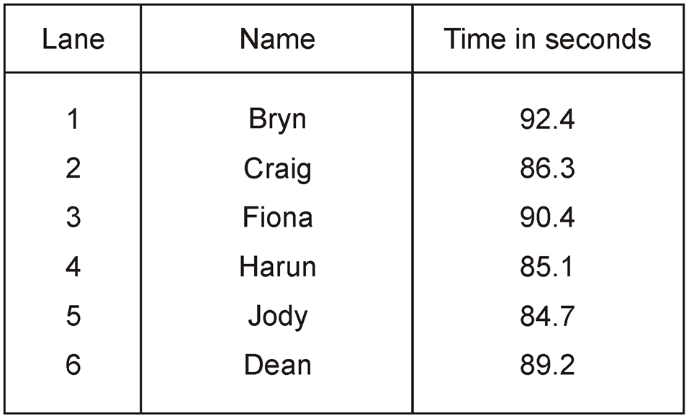
Six children swim a 50 metre race.
Who finished first?
Jody
How many seconds faster was Dean than Fiona?
1.2 seconds
8
9 0.4
1
-
8 9.2
2
0
1
.
Notes:
S1 Pre-2000 or other question

Slide 2
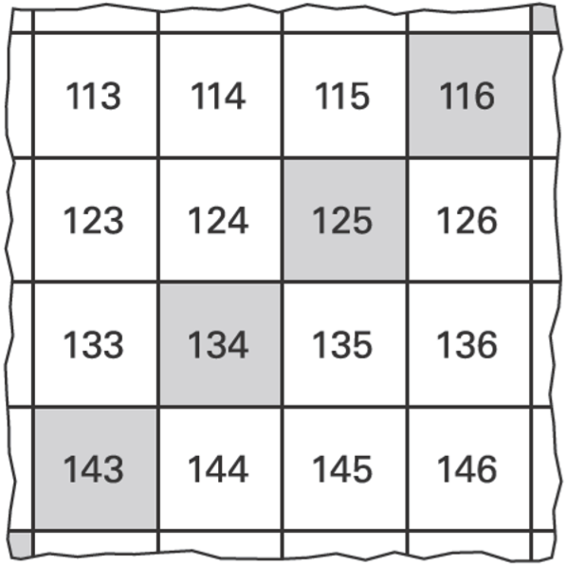
Here is part of a number square.
The shaded numbers are part of a sequence.
Explain the rule for the sequence.
add 9
Notes:
S2 2003 Year 5 Optional Paper 2 Q19

Slide 3
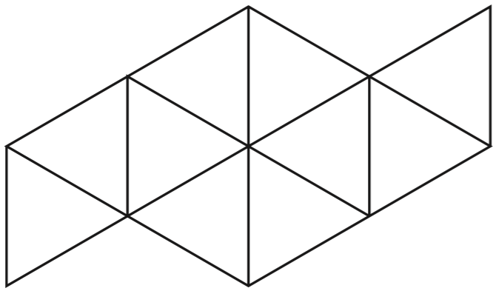
1
Shade of this shape.
5
x2
1
2
=
5
1 0
x2
Notes:
S3 2015 Paper 2 Q10 page 1

Slide 4
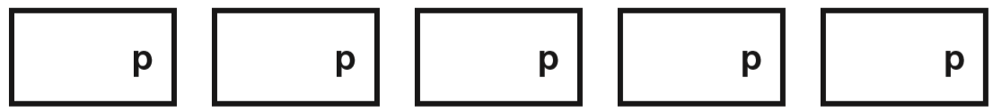
Liam has five coins.
Three of the coins add up to 30p.
Three of the coins add up to 40p.
All five coins add up to £1
What are the coins that Liam has?
10, 10, 10
20, 5, 5
20, 10, 10
50
20
10
10
10
40p
30p
Notes:
S4 2015 Paper 1 Q16

Slide 5
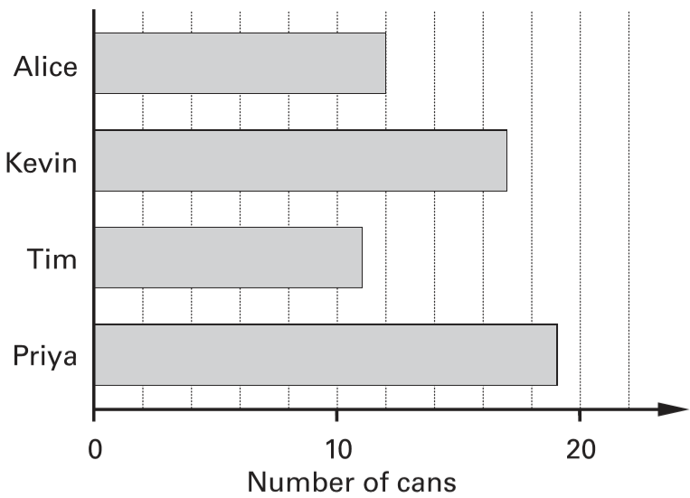
Some children collect cans for recycling.
Here is a chart of how many cans they collect in the first week.
How many cans has Kevin collected?
17 cans
2
4
6
8
12
14
16
18
10 ÷ 5 = 2
Notes:
S5 2003 Paper 2 Q6 first page

Slide 6
Some children collect cans for recycling.
Here is a chart of how many cans they collect in the first week.
Alice’s target is to collect 30 cans. How many more cans does Alice need to reach her target?
30 – 12 =
18 cans
2
4
6
8
12
14
16
18
Notes:
S6 2003 Paper 2 Q6 second page

Slide 7
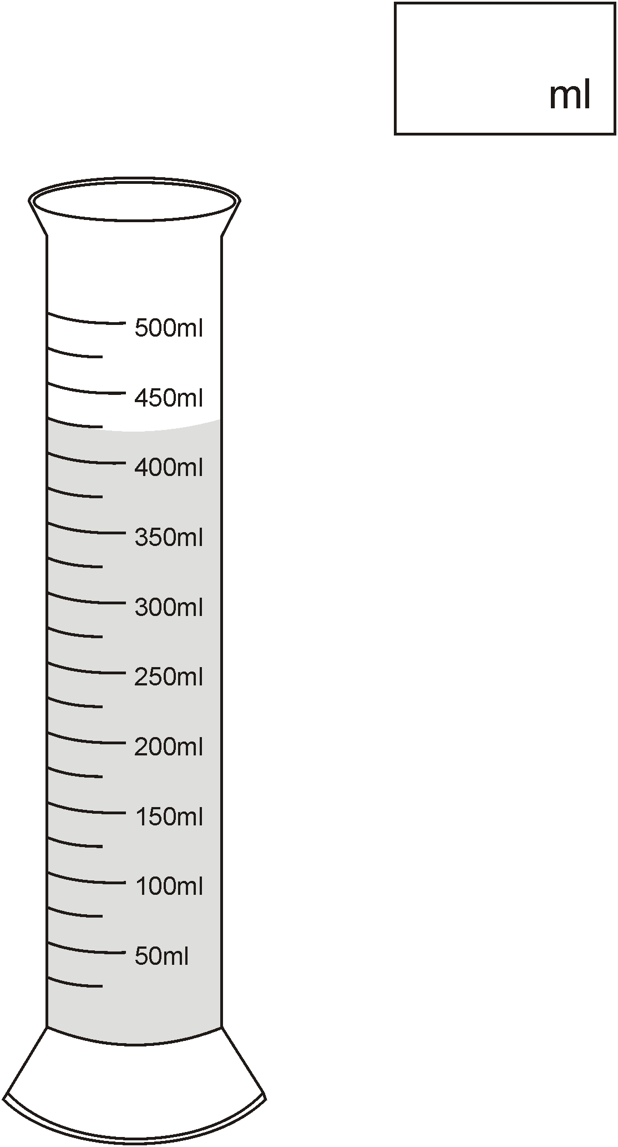
How much water is in this container?
425
425
375
325
275
225
175
125
75
25
25
50 ÷ 2 =
Notes:
S7 Pre-2000 or other question

Slide 8


Look at these digits.
Use the digits to make the largest possible even number.
Use each digit once.
7
5
3
8
Notes:
S8 Pre-2000 or other question

Slide 9
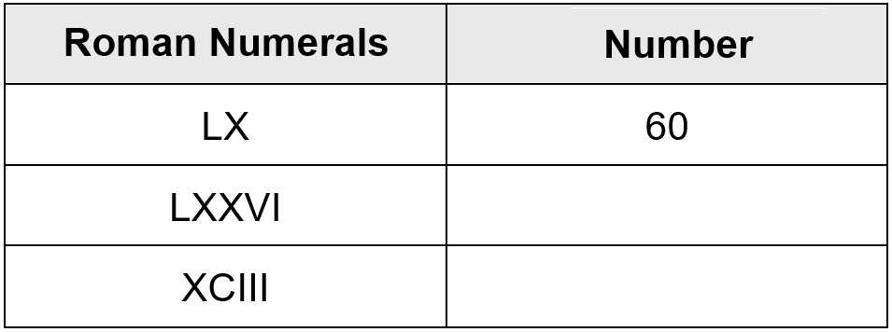
Complete the table.
C = 100
L = 50
X = 10
V = 5
I = 1
76
93
Notes:
S9 Pre-2000 or other question

Slide 10
Here is a row of numbers.
1 2 3 4 5 6 7 8 9 10 11 12 13 14 15 16 17 18
Find three numbers next to each other which add up to 39.
Draw a ring round them.
10 + 10 + 10 = 30
13 + 13 + 13 = 39
12 + 13 + 14 = 39
Notes:
S10 Pre-2000 or other question

Slide 11
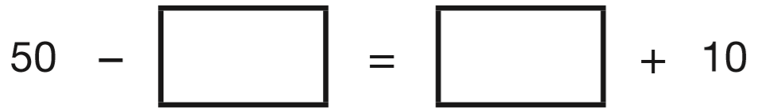
Write numbers in the boxes to make this calculation correct.
10
30
20
20
0
40
1
39
Notes:
S11 2014 Paper 2 Q17

Slide 12
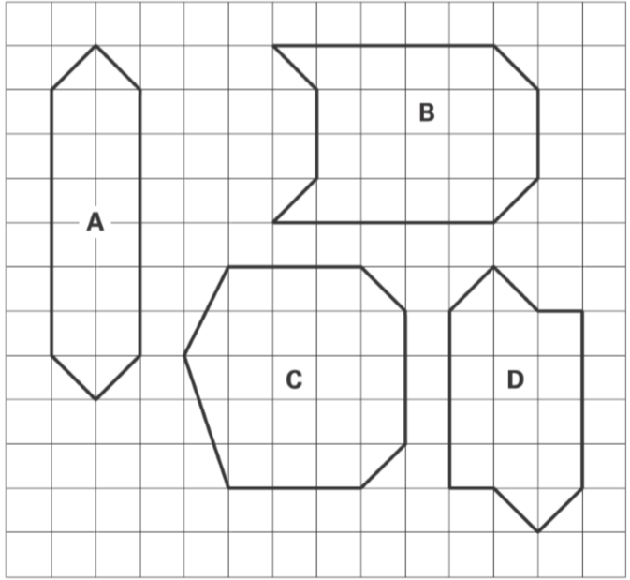
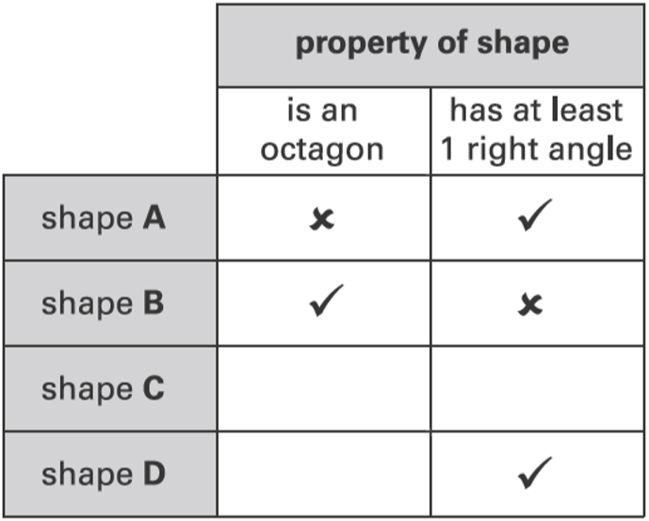
Here are four shapes on a square grid.
Complete the table.
✘
✘
✓
Notes:
S12 2003 Year 4 Optional Paper 1 Q26

Slide 13
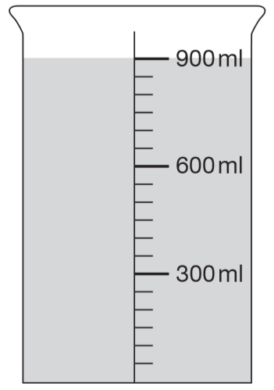
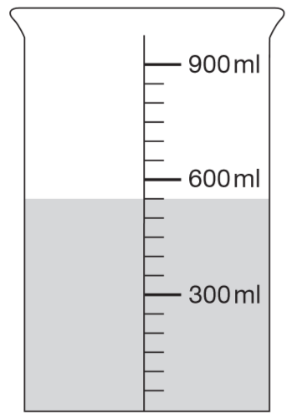
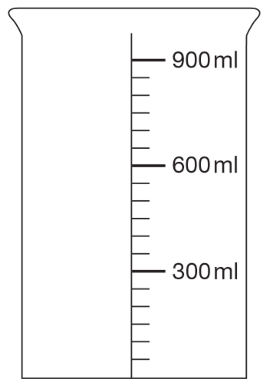
This container has 900 millilitres of water in it.
Lara pours out some water so that it looks like this.
Then she pours out another 150ml of water. Draw an arrow to show the new level of the water.
550
300 ÷ 6 =
50
How much water has Lara poured out?
550 – 150 =
400 ml
900 – 550 =
350 ml
Notes:
S13 2009 Paper 1 Q16

Slide 14
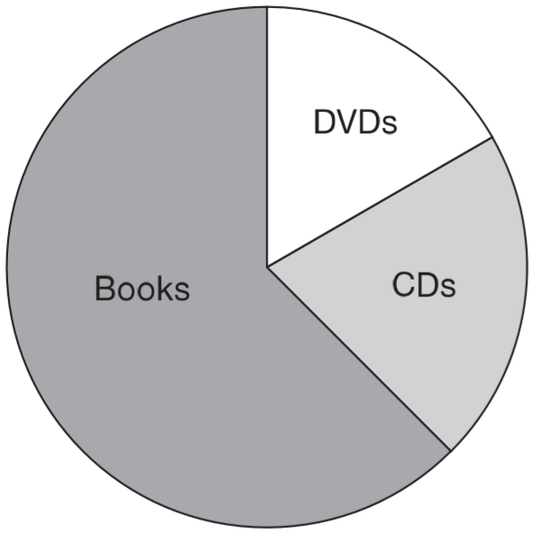
A shop sells books, CDs and DVDs.
This pie chart shows the sales of each in one week.
Estimate the fraction of the total sales that were DVDs.
200
1
6
200
200
In this week, 200 CDs were sold.
Estimate how many books were sold.
200
200 x 3 =
600
Notes:
S14 2010 Paper 1 Q22

Slide 15
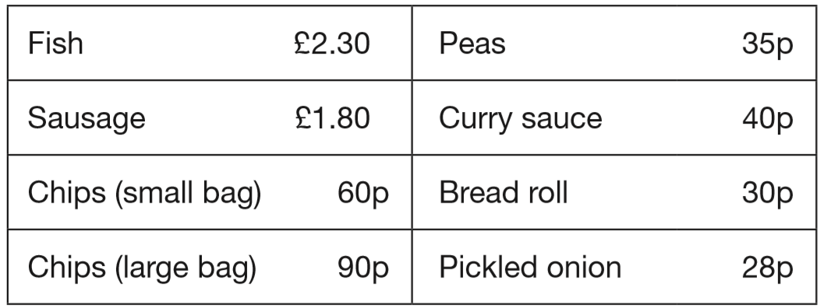
These are some prices in a fish and chip shop.
Alfie buys one fish, a large bag of chips and a pickled onion.
How much does he pay?
£2.30
+ £0.90 =
£3.20
£3.20 + £0.28 =
£3.48
£3.48
Notes:
S15 2015 Paper 2 Q3 page 1

Slide 16
These are some prices in a fish and chip shop.
£1.80
+ £0.30 =
£2.10
Megan buys a sausage and a bread roll.
Chen buys a small bag of chips and a curry sauce.
How much more does Megan pay than Chen?
£0.60
+ £0.40 =
£1
£2.10 – £1.00 =
£1.10
Megan pays £1.10 more.
Notes:
S16 2015 Paper 2 Q3 page 2

Slide 17
Stefan has a bag that contains 3 blue marbles and 5 red marbles only. What fraction of the marbles in the bag are blue?
3 blue marbles
3
8 marbles altogether
8
4 blue marbles
6 red marbles
Stefan adds one blue marble and one red marble to the bag.
What fraction of the marbles in the bag are blue now?
÷2
4 blue marbles
4
2
=
10 marbles altogether
1 0
5
÷2
Notes:
S17 2009 Paper 2 Q15

Slide 18
Here are some pairs of numbers.
For each pair, circle the number that is nearer to 5
.0
3.5 9.5
2.5 5.5
4.5 6.5
Notes:
S18 2006 Year 5 Optional Paper 1 Q8

Slide 19
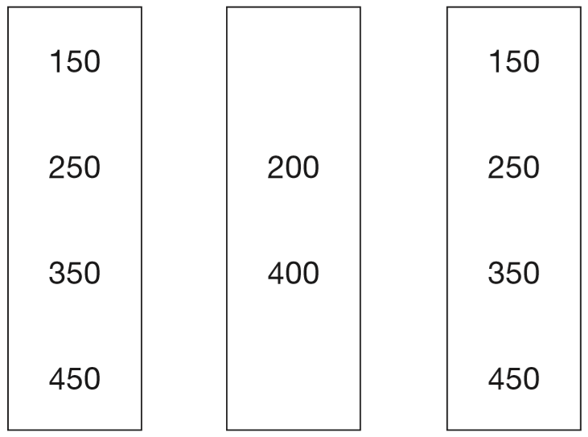
Circle one number in each box to make a total of 1000
Notes:
S19 2007 Paper 1 Q2

Slide 20
Circle one number in each box to make a total of 1000
Notes:
S20 2007 Paper 1 Q2

Slide 21
Circle one number in each box to make a total of 1000
Notes:
S21 2007 Paper 1 Q2

Slide 22
Leila knows that
65 x 3 = 195
Explain how she can use this information to find the answer to this multiplication: 165 x 3
She can work out 100 x 3 = 300
then add 300 to the answer, so 300 + 195 = 495
Notes:
S22 2000 Paper 1 Q23

Slide 23

Here are some numbers.
6 2 32 5
Write each number in a box to make this number story correct.
There are sweets in a bag.
friends share them equally.
Each friend gets sweets.
sweets are left over.
32 ÷ 5 =
6 r2
32
32 ÷ 6 =
5 r2
5
6
2
Notes:
S23 2006 Year 5 Optional Paper 2 Q6

Slide 24
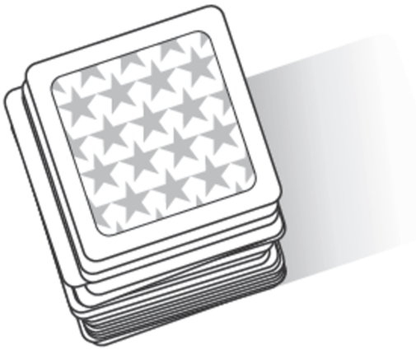
There are 64 picture cards in this pile.
Five children each take the same number of cards.
24 cards are left over.
How many cards does each child take?
8 cards
64 – 24 =
40 cards are taken
40 ÷ 5 =
8 cards are taken by each child
64
8
8
8
8
8
24
40
Notes:
S24 2006 Year 4 Optional Paper 2 Q20

Slide 25
Circle three numbers which add to make 190
10 30 50 70 90
30 + 70 = 100
190 – 90 = 100
30 + 70 + 90 = 190
Notes:
S25 2001 Paper 2 Q1

Slide 26
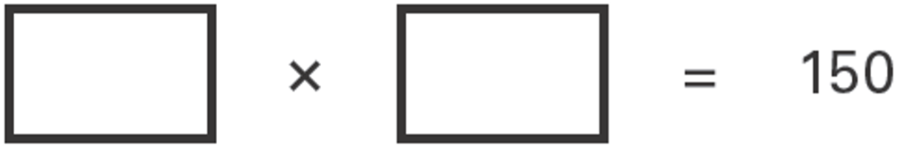
Write what the missing numbers could be.
1 5 0
1
1 5
1 0
7 5
2
5 0
3
3 0
5
Notes:
S26 2003 Year 5 Optional Paper 2 Q4

Slide 27
Circle the approximate measurement.
The length of a banana is about …
2 cm 20 cm 2 mm 2 m 20 m
The mass of an apple is about …
2 g 20 kg 200 kg 200 g 2 kg
A glass of fruit juice is about …
2 ml 2 l 20 ml 200 ml 20 l
Notes:
S27 2014 Paper 2 Q12

Slide 28
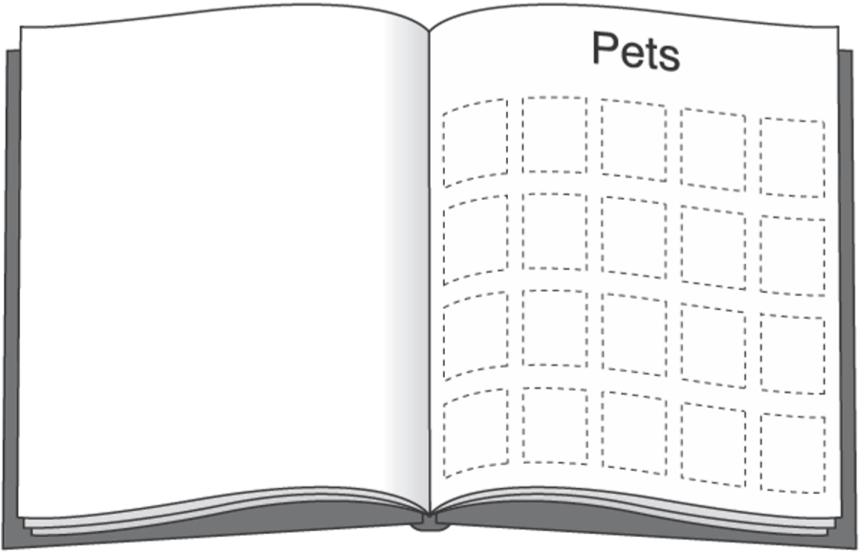
Meg has 20 pet stickers to go on this page.
¼ of them are dog stickers.
½ of them are cat stickers.
The rest are rabbit stickers.
How many rabbit stickers does she have?
D
D
D
D
D
C
C
C
C
C
C
C
C
C
C
20 – 15 =
5 rabbit stickers
1
of 20 =
5 dog
4
1
of 20 =
10 cat
2
Notes:
S28 2003 Year 4 Optional Paper 1 Q28

Slide 29
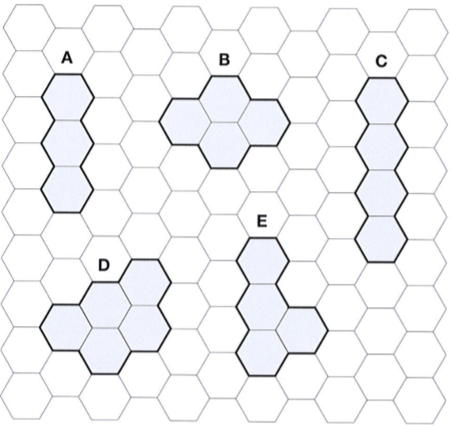
Here are five shapes on a regular grid.
Which shape has only one line of symmetry?
D
Notes:
S29 2012 Paper 1 Q13

Slide 30
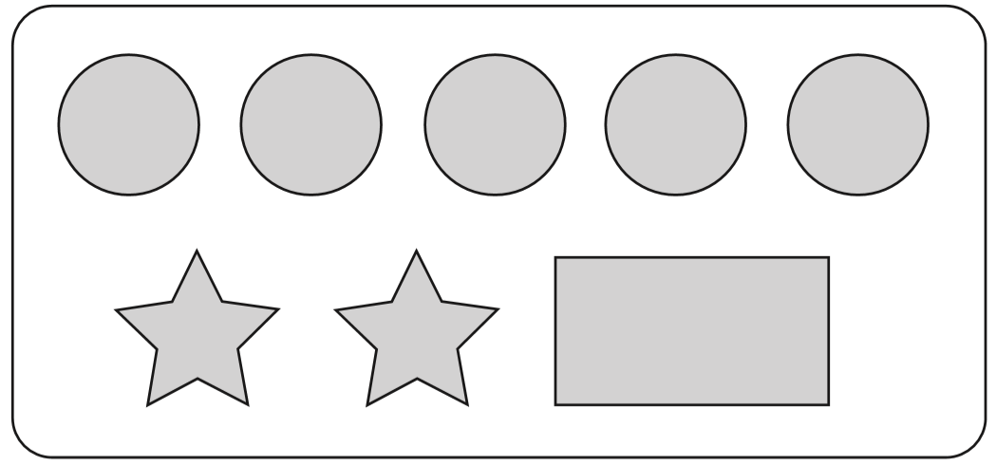
On a sheet of stickers there are 5 circles, 2 stars and one rectangle.
How many stickers are there altogether on 4 sheets?
5 + 2 + 1 =
8
8 x 4 =
32 stickers
Nisha needs 55 circles. How many sheets of stickers does she need?
55 ÷ 5 =
11 sheets
Ben has 10 sheets of stickers.
How many more circles than rectangles does he have?
10 x 5 =
50 circles
10 rectangles
50 – 10 =
40 more circles than rectangles
Notes:
S30 2008 Paper 1 Q8

Slide 31
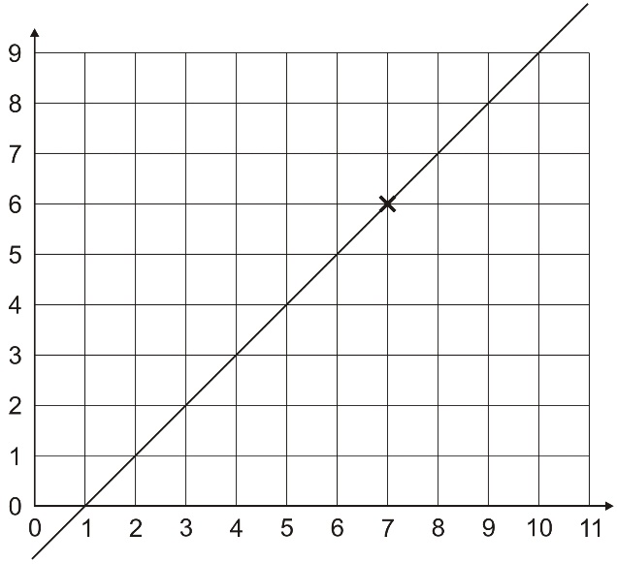
(7, 6) are coordinates of a point on the line.
Tick which of these are coordinates of other points on the line.
(3, 2)
(9, 10)
(5, 4)
(4, 2)
(10, 9)
(7, 9)
✓
✘
✓
✘
✓
✘
Notes:
S31 Pre-2000 or other question

Slide 32
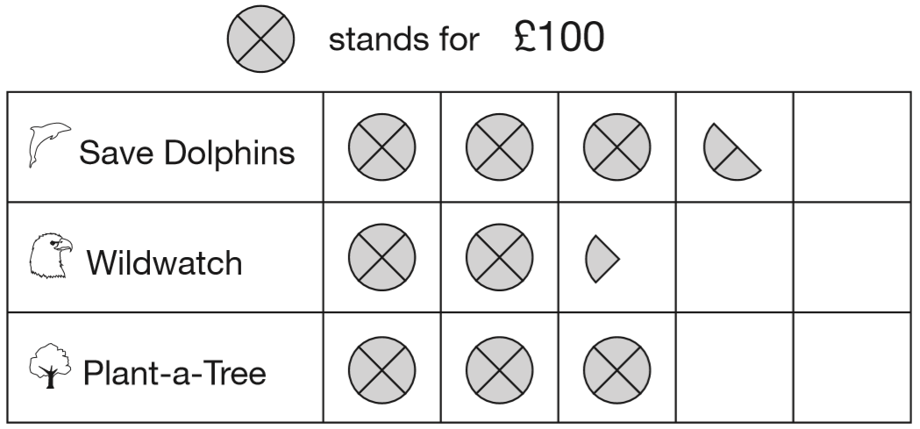
Park School collects money for three charities.
This pictogram shows how much they have collected.
How much more have they collected for Save Dolphins than Plant-a-Tree?
350
£50
½ of 100 =
50
300
350 – 300 =
50
Notes:
S32 2008 Paper 1 Q5 first page

Slide 33
Park School collects money for three charities.
This pictogram shows how much they have collected.
The target for Wildwatch is £500. How much more money do they need to collect for Wildwatch?
350
225
£275
300
¼ of 100 =
25
500 – 225 =
275
Notes:
S33 2008 Paper 1 Q5 second page

Slide 34
Park School collects money for three charities.
This pictogram shows how much they have collected.
How much money have they collected altogether, rounded to the nearest hundred pounds?
350
225
£900
300
350 + 225 + 300 =
875
8 7 5
rounds to 900
Notes:
S34 2008 Paper 1 Q5 third page

Slide 35
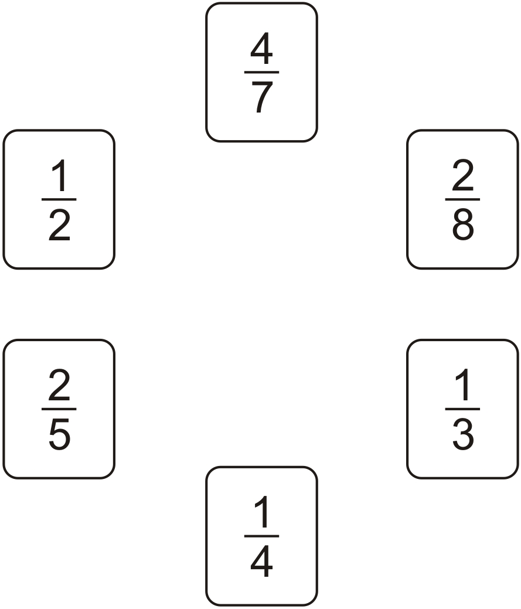
Draw one line to join two fractions which have the same value.
x2
1
2
=
4
8
x2
Notes:
S35 Pre-2000 or other question

Slide 36
John and Paula go to a fair.
Galaxy £1.50 per ride Lazer 90p per ride
Big Wheel £1.20 per ride Spaceship 75p per ride
John has £2
He goes on one ride and has exactly 80p left.
Which ride does he go on?
Big Wheel
£1.20
£2.00 – ______ = £0.80
Paula has a 50p coin and three 20p coins.
She pays for a ride on the Laser.
How much money is left?
20p
50 + 20 + 20 + 20 =
110p
= £1.10
£1.10 – £0.90 =
£0.20
Notes:
S36 Pre-2000 or other question

Slide 37
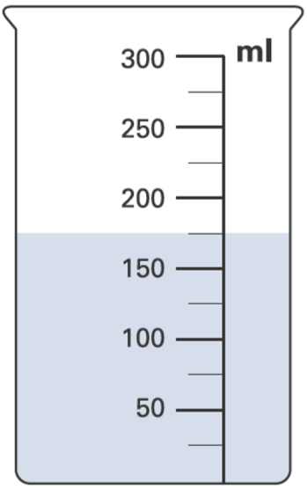
David puts this amount of water in a container.
Then he pours 50 millilitres of the water out.
How much water is left in the container?
175 – 50 =
125 ml is left.
175
125
75
25
25
50 ÷ 2 =
Notes:
S37 2003 Year 4 Optional Paper 2 Q22

Slide 38
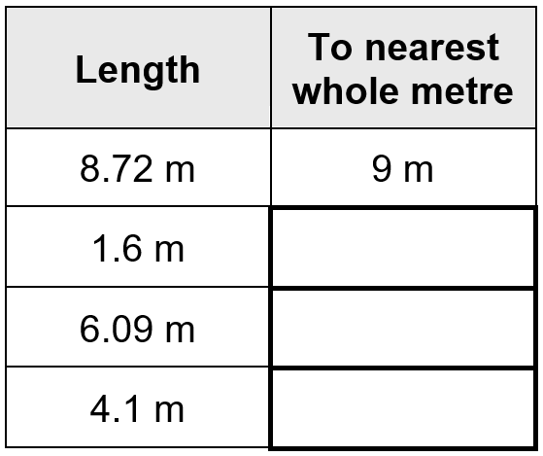
Round the lengths to the nearest whole metre.
2 m
6 m
4 m
Notes:
S38 Pre-2000 or other question

Slide 39
A car costs more than £8600 but less than £9100
Circle the prices that the car could cost.
£8569 £9090 £9130 £8999
too small
too big
Notes:
S39 2003 Year 5 Optional Paper 2 Q16

Slide 40
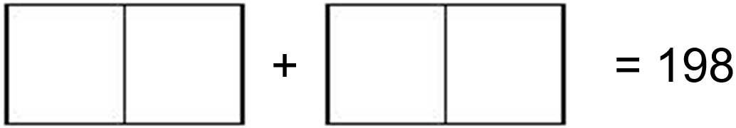
Write in the four missing digits.
Put one digit in each box.
1
9 9
9 9
9 9
9 9
+
1 9
8
Notes:
S40 Pre-2000 or other question

Slide 41
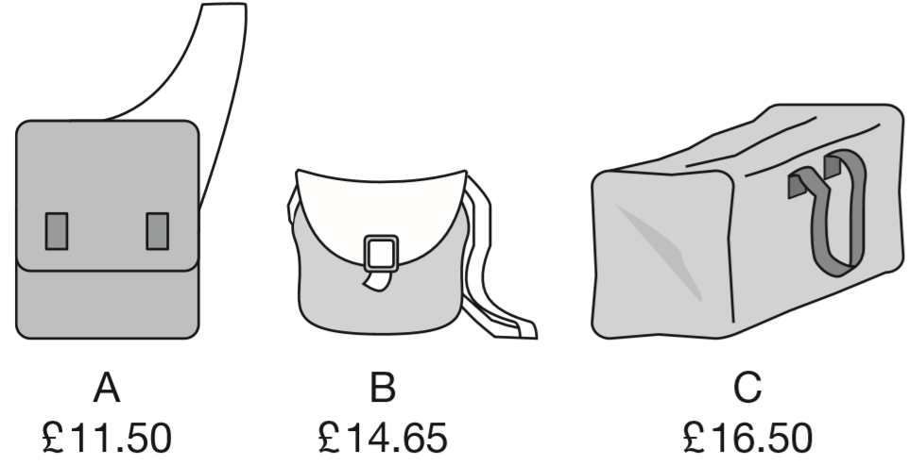
Here are three bags in a shop.
How much does bag B cost to the nearest pound?
£15
Jamie buys bag A and bag C.
How much change does he get from £40?
£ 1 4 . 6 5
1
1 6.5 0
£40 – £28 =
£12
+
1 1.5 0
2
8
.
0
0
Notes:
S41 2007 Paper 1 Q6

Slide 42

Draw two different rectangles.
Use the dots.
Notes:
S42 Pre-2000 or other question

Slide 43
Write what the missing numbers could be.
_____ is an odd number, and is greater than 15
_____ is a number greater than 100 and can be divided by 4,
with no remainder.
17
400
Notes:
S43 Pre-2000 or other question

Slide 44
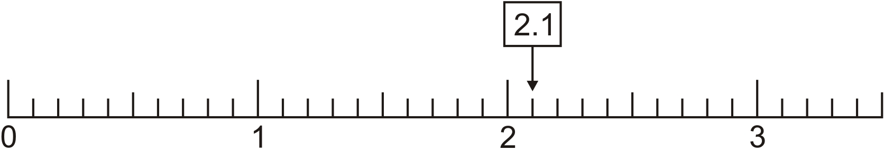
2.1 is marked on the number line.
Mark 0.65 on the number line.
2.10
.00
.00
.00
.00
0.70
0.60
Notes:
S44 Pre-2000 or other question

Slide 45
Plants are sold in trays of 20
Ivana buys 7 trays of plants.
How many plants is this?
140 plants
7 x 20 =
140
David wants 240 plants.
How many trays does he need to buy?
12 trays
240 ÷ 20 =
12
Notes:
S45 2001 Paper 2 Q5

Slide 46

Write these lengths in order, starting with the shortest.
½m 25mm 3.5cm 20cm
50cm
2.5cm
3.5cm
20cm
25mm
3.5cm
20cm
½m
Notes:
S46 2003 Paper 2 Q15

Slide 47
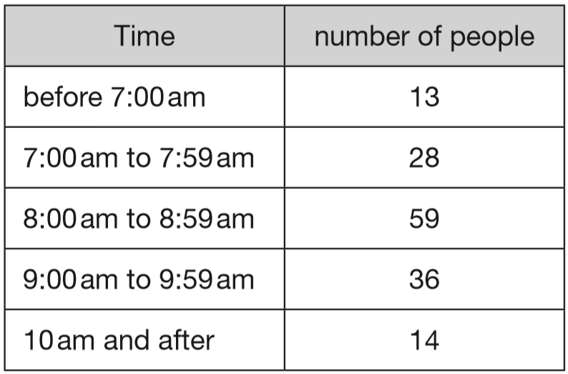
Amy did a survey of what time people get up on a Sunday morning. This table shows her results for 150 people.
How many people get up at 8am or later?
109 people
1
5 9
+
3 6
9
5
+
1 4
1 0
9
Notes:
S47 2014 Paper 2 Q16 page 1

Slide 48
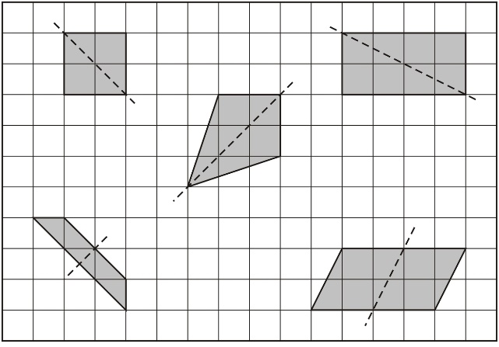
Here are five quadrilaterals on a square grid.
A dotted line has been drawn on each quadrilateral.
For each shape, put a tick if the dotted line is a line of symmetry.
✓
✘
✓
✓
✘
Notes:
S48 2009 Paper 2 Q8

Slide 49
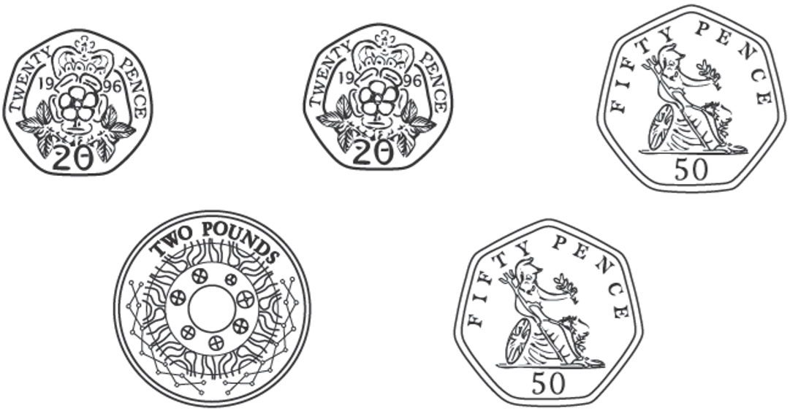
Dan has these coins.
Vijay has £1.50
How much more money does Dan have than Vijay?
2
3.4 0
1
-
1.5 0
£
1
.
0
more
9
Notes:
S49 2006 Year 3 Optional Paper 1 Q27

Slide 50
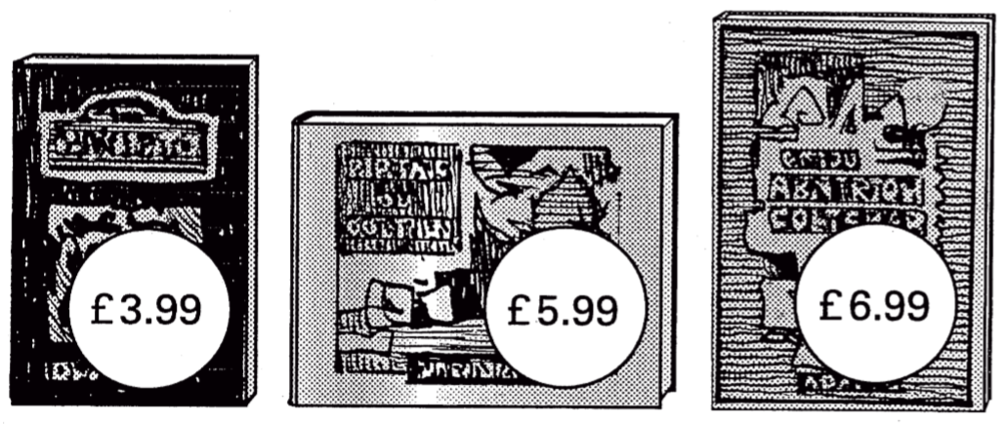
Book Sale: Any 3 books for £14.50
Lee bought these three books in the sale for £14.50
How much money did he save altogether compared to the full price of the books?
£2.47
£3.99 + £5.99 + £6.99 =
£16.97
full price
1 6.9 7
£4 + £6 + £7 =
£17
-
1 4.5 0
£17.00 – £0.03 =
£16.97
£
.
4
0
2
7
Notes:
S50 2001 Paper 1 Q14

Slide 51
Emma buys 5 bunches of flowers.
Each bunch of flowers costs £1.20
How much does Emma pay altogether?
£6
1
1.2 0
x
5
£
.
0
6
0
Notes:
S51 2006 Year 5 Optional Paper 1 Q3

Slide 52
Which number below is four thousand and seven?
Put a ring round it.
47 407 4,007 40,007 400,007
Notes:
S52 Pre-2000 or other question

Slide 53
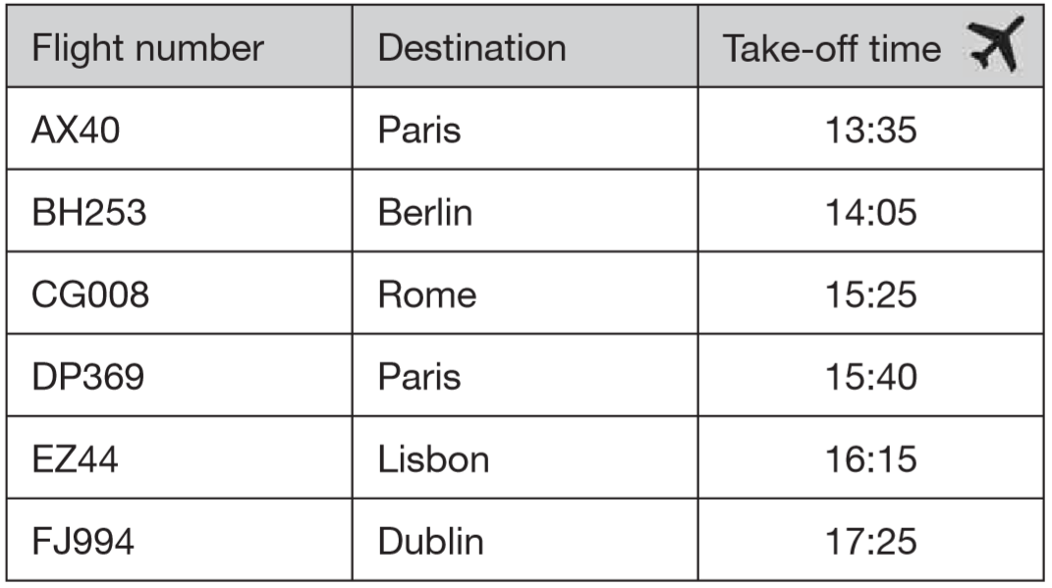
This table shows when flights take off at an airport.
How many flights take off between 3pm and 5pm?
between 15:00 and 17:00
✓
3 flights take off
✓
✓
Notes:
S53 2009 Paper 2 Q11 page 1

Slide 54
This table shows when flights take off at an airport.
How much later does the second flight to Paris take off than the first?
+1h
+1h
+5m
13:35
14:35
15:35
15:40
2 hours 5 minutes
Notes:
S54 2009 Paper 2 Q11 page 2

Slide 55
This table shows when flights take off at an airport.
The flight to Dublin takes 50 minutes. What time does it arrive in Dublin?
+35m
+15m
17:25
18:00
18:15
18:15
Notes:
S55 2009 Paper 2 Q11 page 3

Slide 56
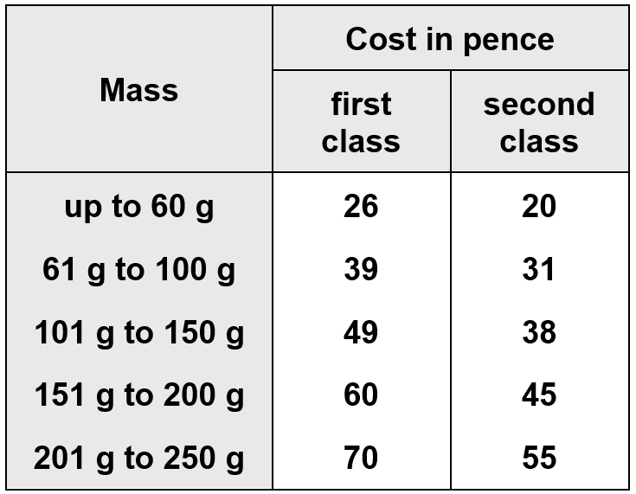
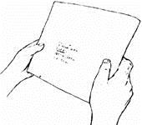
This table shows the cost of sending a letter.
Paul is sending a letter.
It costs 38p second class.
How much would it cost him to send it first class?
49p
Jenny has a letter with a mass of 170 g.
What does it cost to send it first class?
60p
Notes:
S56 Pre-2000 or other question

Slide 57
Write a decimal that is between 3.7 and 3.8
3.71
3.70
3.80
Notes:
S57 Pre-2000 or other question

Slide 58

Write the missing numbers in the sequence.
18
36
54
+6
+6
+6
+6
+6
+6
Notes:
S58 Pre-2000 or other question

Slide 59
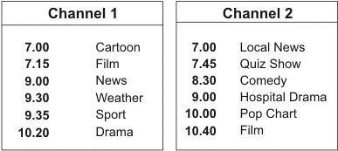
Here are the times of some television programmes.
What is showing on Channel 2 at ten minutes to eight?
Quiz Show
7:50
Tom watches Hospital Drama and then changes to Channel 1 at the end. What is showing on Channel 1 when he changes channel?
Sport
10:00
The film on Channel 2 starts at 10.40
It lasts for one and a half hours.
At what time does the film end?
+1h
+20m
+10m
12:10
10:40
11:40
12:00
12:10
Notes:
S59 Pre-2000 or other question

Slide 60
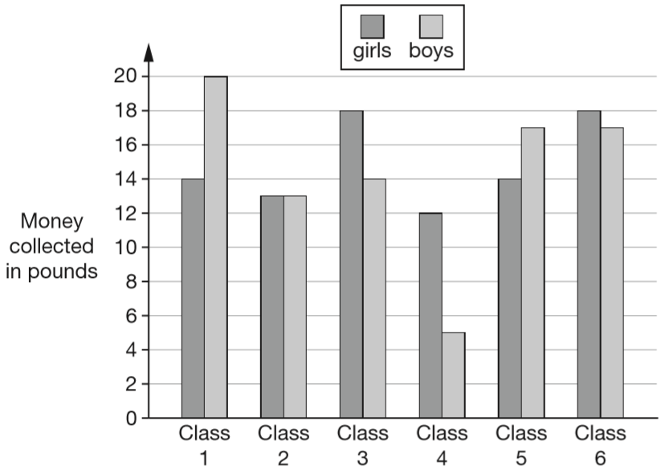
Six classes at Winward Primary School collected some money.
The chart shows how much money the boys and girls collected.
In Class 4, how much more money did the girls collect than the boys?
£12 – £5 =
£7 more
Notes:
S60 2015 Paper 1 Q9 page 1

Slide 61
Six classes at Winward Primary School collected some money.
The chart shows how much money the boys and girls collected.
How many classes collected more than £30?
20
4 classes
18
18
17
17
14
14
14
13
13
12
5
✓
✘
✓
✘
✓
✓
Notes:
S61 2015 Paper 1 Q9 page 2

Slide 62
A shop sells candles.
plain candles - 35p each star candles - 60p each stripe candles - 85p each
Sapna buys 4 star candles and 2 stripe candles.
How much does she pay altogether?
She pays £4.10
1
6 0p x 4 = £2.4 0
8 5p x 2 = £1.7 0
+
£
4
1
0
.
Special offer: Buy 10 candles and get 50p off.
Josh buys 10 plain candles in the special offer.
How much does he pay for the 10 candles?
He pays £3
3 5p x 1 0 =
£3.5 0
£3.5 0 – £0.5 0 =
£3.0 0
Notes:
S62 2005 Paper 1 Q7

Slide 63
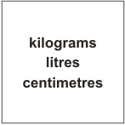
Choose one of the words in the box to complete each sentence below.
You can measure how tall you are in __________
You can measure how heavy you are in _________
You can measure how much you drink in ________
centimetres
kilograms
litres
Notes:
S63 Pre-2000 or other question

Slide 64
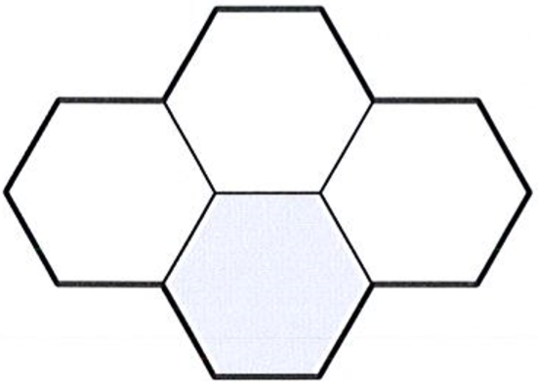
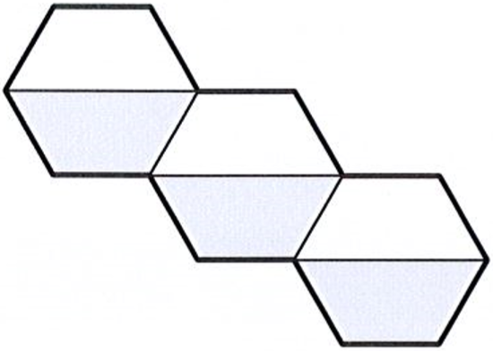
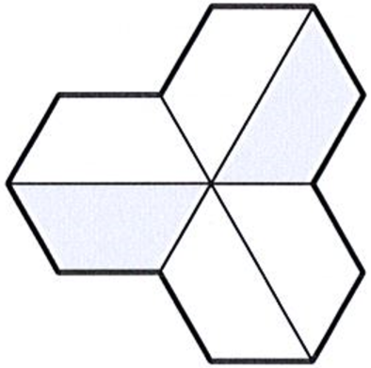
Here are three shapes made from regular hexagons.
Write the fraction of each shape that is shaded.
÷3
÷2
1
3
1
2
1
=
=
4
6
2
6
3
÷3
÷2
Notes:
S64 2012 Paper 2 Q4

Slide 65
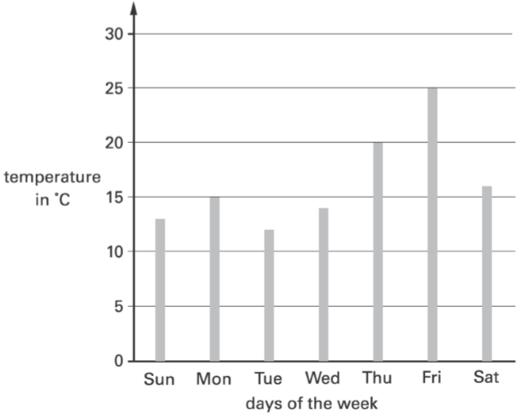
This graph shows the temperature at midday each day for a week.
Estimate how much higher the temperature was on Friday than on Saturday.
25
25 – 16 =
9 degrees higher
16
Notes:
S65 2003 Year 4 Optional Paper 1 Q30

Slide 66

In athletics, Holly did the ‘Hop, step, jump’.
The length of her ‘hop’ was 0.86 m
The length of her ‘step’ was 1.21 m
The length of her ‘jump’ was 3.78 m
What was the total length of Holly’s ‘Hop, step, jump’ to one decimal place?
Circle the correct answer.
5.8 m 5.9 m 6.0 m 6.1 m
1
0.8 6
+
1.2 1
0
2
.
7
1
2.0 7
5.8 5
+
3.7 8
8
5
.
5
Notes:
S66 Pre-2000 or other question

Slide 67
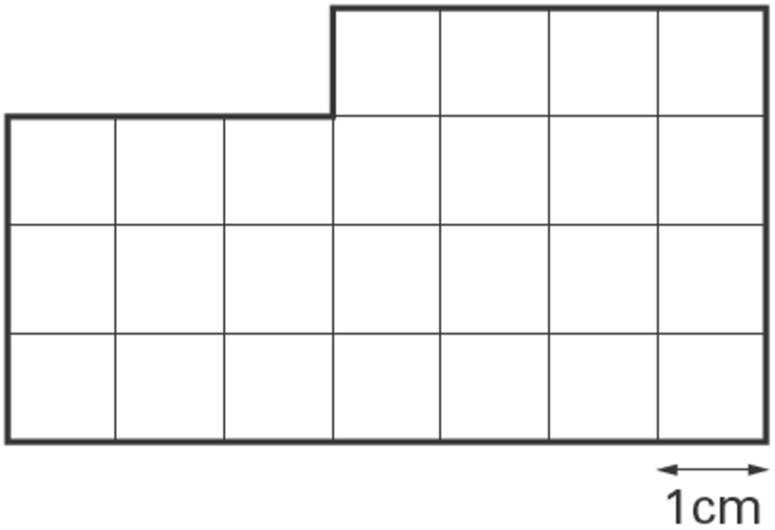
Here is a shape divided into centimetre squares.
What is the perimeter of the shape?
22 cm
4
1
3
4
3
7
Notes:
S67 2006 Year 5 Optional Paper 1 Q15

Slide 68
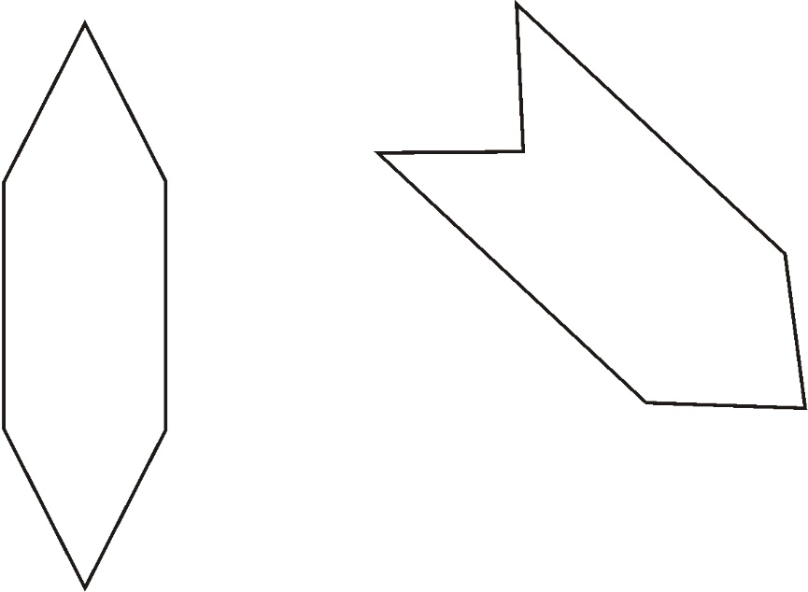
Each of these shapes has one or more lines of symmetry. Draw all the lines of symmetry on each shape.
Notes:
S68 Pre-2000 or other question

Slide 69
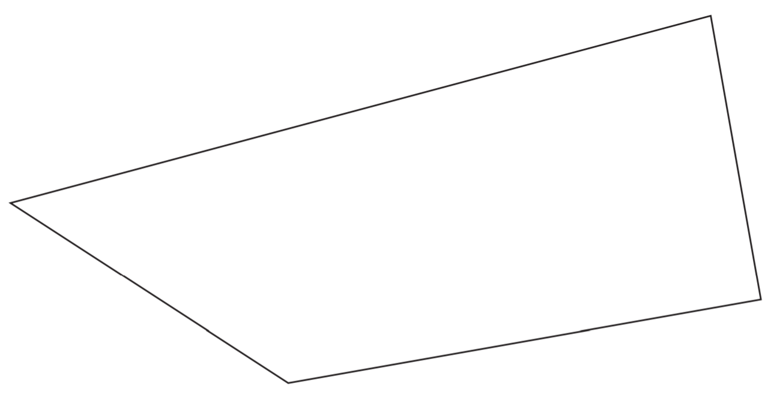
In this shape, one of the angles is obtuse.
Tick the obtuse angle.
✓
Notes:
S69 2014 Paper 1 Q8

Slide 70
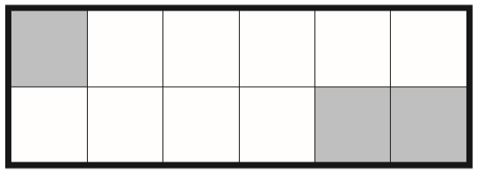
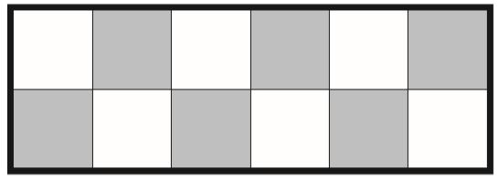
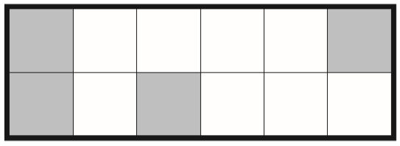
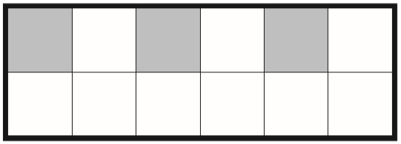
1
Tick each shape that is exactly shaded.
4
✓
✘
x3
1
3
=
4
1 2
x3
✘
✓
Notes:
S70 2013 Paper 1 Q14

Slide 71


Leon and Sara each started with different numbers.
Leon says, ‘I added 5 to my number.’
Sara says, ‘I subtracted 8 from my number.’
Leon and Sara both get the same answer.
What numbers could they have started with?
Leon
5
10
5
10
+5
10
15
18
23
-8
18
23
Sara
Notes:
S71 2000 Paper 1 Q12

Slide 72

One of these watches is 3 minutes fast.
The other watch is 4 minutes slow.
What is the correct time?
12:02
12:05 – 3 minutes =
12:02
11:58 + 4 minutes =
12:02
+2m
+2m
12:05
11:58
12:00
12:02
Notes:
S72 2002 Paper 2 Q15

Slide 73

Write in the missing numbers.
12
8
96 ÷ 12 =
8
16
80
5
6 2
9 6
1
–
4 6
–
1 6
1
6
8
0
Notes:
S73 2004 Paper 2 Q5

Slide 74

Here is a 1 cm square grid. Some of the grid is shaded.
What is the area of the shaded shape?
18 cm²
6
3
3
6
Notes:
S74 Pre-2000 or other question

Slide 75

Kiz asked each child in his class, ‘What kind of television programme do you prefer to watch?’ Here are his results.
How many more children prefer to watch cartoons than films?
11 – 4 =
7 children
11
4
Notes:
S75 2003 Year 5 Optional Paper 2 Q10

Slide 76

Write in the missing number.
2
5 r3
103
4
1 0 3
2
25 x 4 + 3 =
103
2
2 5
x
4
1 0
0
Notes:
S76 2006 Year 4 Optional Paper 2 Q29

Slide 77
4 pineapples cost £3.40
Calculate the cost of 1 pineapple.
85p
£
0
.
8
5
4
3.4 0
3
2
Notes:
S77 2003 Year 4 Optional Paper 2 Q27

Slide 78
3
Draw an arrow on the number line to show 1
4
1
2
3
1
2
3
1
1
1
4
4
4
4
4
4
Notes:
S78 2003 Year 4 Optional Paper 1 Q21

Slide 79
An aeroplane takes off on Tuesday at 22:47
It lands on Wednesday at 07:05
How long in hours and minutes is the flight?
8 hours and 18 minutes
+13m
+1h
+7h5m
22:47
23:00
00:00
07:05
13 + 5 = 18
Notes:
S79 Pre-2000 or other question

Slide 80

How many faces, vertices and edges does a cuboid have?
Faces:
Vertices:
Edges:
6
8
12
Notes:
S80 Pre-2000 or other question

Slide 81

Each missing digit in these calculations is 2, 5 or 7
Write in the missing digits.
You may use each digit more than once.
7
2
5
1
2
5
7
5
2 5
x
3
7
5
Notes:
S81 2005 Paper 2 Q6

Slide 82

A school has a quiz each year. There are two teams.
Here are their results.
In which year did North beat South by 100 points?
2002
Notes:
S82 2004 Paper 2 Q10 first page

Slide 83
A school has a quiz each year. There are two teams.
Here are their results.
In which year did South beat North by the greatest amount?
2000
Notes:
S83 2004 Paper 2 Q10 second page

Slide 84

These are the times letters are collected from a post box.
What is the latest time letters are collected on Wednesday?
6:30pm
Carla posts a letter at 9am on Monday.
How long will it be before it is collected?
5 hours
+3h
+2h
9:00
12:00
2:00
Gareth posts a letter on Saturday at 3pm.
When is it collected from the post box?
Day:
Time:
Monday
8am
Notes:
S84 Pre-2000 or other question

Slide 85
Kate has a piece of ribbon one metre long.
She cuts off 30 centimetres.
How many centimetres of ribbon are left?
100 – 30 =
70 centimetres
Notes:
S85 2007 Paper 1 Q4

Slide 86
Kirsty ran a race in one and a half minutes.
Mina took 10 seconds longer.
How many seconds did Mina take to run the race?
1 minute 30 seconds
1 minute 40 seconds
100 seconds
1 minute = 60 seconds
60 + 40 =
100 seconds
Notes:
S86 2012 Paper 2 Q12 page 1

Slide 87
There are 12 pencils in a box.
A school buys 24 boxes.
How many pencils does the school buy?
288 pencils
4
2 4
x
1 2
2 8
8
Notes:
S87 Pre-2000 or other question

Slide 88

Write the missing number.
1 8 7
7
1 7
x
1 1
1 8
7
Notes:
S88 2013 Paper 2 Q8

Slide 89



Amy has some circular tiles and some rectangular tiles.
She makes these patterns with them. For each pattern, put a tick if it has a line of symmetry. Put a cross if it does not.
✓
✘
✓
✘
Notes:
S89 2010 Paper 1 Q16

Slide 90

Jade asked each child in her class, ‘Do you stay at school or go home for lunch?’ Here are her results.
How many more girls stay at school than go home for lunch?
9 – 5 =
4 more girls
9
5
Notes:
S90 2006 Year 4 Optional Paper 1 Q14

Slide 91


Here is part of a number grid.
Here is another part of the same grid.
Write in the missing numbers.
-2
-2
74
+10
+10
86
Notes:
S91 2006 Year 5 Optional Paper 2 Q8

Slide 92

Liam, Sarah and Amy buy lunch at a salad bar.
Liam has £2.50 to spend
He buys a tuna salad and an apple pie.
How much money has he got left?
+ £0.50 =
£2.10
£1.60
£2.50 – £2.10 =
£0.40
He has 40p left.
Notes:
S92 2010 Paper 1 Q4 page 1

Slide 93
Liam, Sarah and Amy buy lunch at a salad bar.
Sarah buys a cheese salad and a yogurt.
Amy buys an egg salad.
How much more does Sarah pay than Amy?
+ £0.35 =
£1.55
£1.20
£1.55 – £0.90 =
£0.65
Sarah pays 65p more than Amy.
Notes:
S93 2010 Paper 1 Q4 page 2

Slide 94
One battery weighs the same as 60 paperclips.
One pencil sharpener weighs the same as 20 paperclips.
How many pencil sharpeners weigh the same as one battery?
battery 60
3 sharpeners
sharpener 20
sharpener 20
sharpener 20
How many paperclips weigh the same as 2 batteries and 4 pencil sharpeners together?
200 paperclips
2 x 60 =
120
4 x 20 =
80
120 + 80 =
200
Notes:
S94 2009 Paper 1 Q6

Slide 95

One jug contains water and the other jug contains oil.
How much more oil is there than water?
500 – 150 =
350 ml
500
150
100
50
200 ÷ 4 =
50
Notes:
S95 2015 Paper 2 Q15

Slide 96

Here are five coins.
Stefan takes two coins and
Lara takes the other three coins.
Stefan takes 15p more than Lara.
Tick the two coins Stefan takes.
✓
✓
50 + 10 = 60
20 + 20 + 5 = 45
60 – 45 = 15
Notes:
S96 2009 Paper 2 Q5

Slide 97

This graph shows the age of players at a football club.
How many players are aged 30 or younger?
12
12 + 8 + 7 =
27 players
8
7
A player aged 36 and a player aged 39 join the club.
Add this information to the graph.
Notes:
S97 2009 Paper 1 Q10

Slide 98

The numbers in this sequence increase by 101 each time.
Write the next two numbers in the sequence.
909
1010
1
8 0 8
9 0 9
+
1 0 1
+
1 0 1
9
0
9
1 0
1
0
Notes:
S98 2006 Year 4 Optional Paper 1 Q24

Slide 99


Eggs are put in trays of 12
The trays are packed in boxes.
Each box contains 180 eggs.
How many trays are in each box?
15 trays
1
5
1 2
1 8 0
6
Notes:
S99 Pre-2000 or other question

Slide 100

This diagram has four angles marked A, B, C and D.
Write the letters of the angles that are obtuse angles.
A
, D
Reflex angle
Over 180°
More than half a turn
Notes:
S100 2011 Paper 2 Q9

Slide 101


Karen makes a fraction using two number cards.
She says, ‘My fraction is equivalent to
One of the number cards is 6’
What could Karen’s fraction be?
1
2
x6
1
6
6
3
=
2
1 2
x6
x3
12
6
1
3
=
2
6
x3
Notes:
S101 2003 Paper 2 Q12

Slide 102

Write in what the missing numbers could be.
200
200
30
20
40
10
20
30
10
40
1
49
Notes:
S102 2002 Paper 2 Q20

Slide 103
What is the remainder when you divide 53 by 8?
5
53 ÷ 8 =
6 r5
1 x 8 = 8
2 x 8 = 16
3 x 8 = 24
4 x 8 = 32
5 x 8 = 40
6 x 8 = 48
7 x 8 = 56
+ 5 = 53
Notes:
S103 2003 Year 4 Optional Paper 1 Q29

Slide 104

The children in Farm School Orchestra each play one instrument.
The table show how many children play each instrument.
How many more children play a recorder than play a violin?
23 – 7 =
16 more
How many children do not play a percussion instrument?
23 + 4 + 5 + 7 =
39 children
27
32
39
Notes:
S104 2006 Year 5 Optional Paper 2 Q5

Slide 105
pack of 4 cans of lemonade £1.20 pack of 6 cans of lemonade £1.70
Asim and Mike both buy 12 cans of lemonade.
Asim buys 3 packs of 4 cans.
Mike buys 2 packs of 6 cans.
Mike says to Asim, ‘You paid 50p more than me.’
Is Mike correct? Explain how you know.
1.2 0
x
3
£
.
0
3
6
paid by Asim
1
£3.60 – £3.40 = £0.20
1.7 0
x
2
Mike is wrong.
£
.
0
3
4
paid by Mike
Asim pays 20p more.
Notes:
S105 2003 Year 5 Optional Paper 1 Q20

Slide 106

Here is a baby’s drinking cup.
How many millilitres of water are in the cup?
125 millilitres
125
100
75
50
25
100 ÷ 4 =
25
Notes:
S106 2006 Paper 2 Q5

Slide 107

Write these numbers in order from highest to lowest.
1003 3010 3001 1030 310 130 1300 103
3010
3001
1300
1030
1003
310
130
103
Notes:
S107 Pre-2000 or other question

Slide 108


Here are some number cards.
Use five of the number cards to make this correct.
1
1
4
9
9
4
9
4
4
9
Notes:
S108 2001 Paper 2 Q6

Slide 109

Children run a 100 metres race on Sports Day.
Here are their times.
What is the winner's time?
0.03 less
14.83 seconds
0.39 more
Who has the time nearest to 16 seconds?
1.17 less
Sue
1.00 more
16.00
0.11 less
Notes:
S109 Pre-2000 or other question

Slide 110


Here are some numbers.
1 2 3 4 5
Write one of the numbers in each box to make these correct.
30
3
4
5
Notes:
S110 2006 Year 4 Optional Paper 1 Q28

Slide 111

The diagram is made of squares.
What fraction of the diagram is shaded?
5
5 parts shaded
9 equal parts
9
Notes:
S111 2005 Paper 1 Q11

Slide 112


Here are five digit cards.
Use all five digit cards to make this correct.
5
4
1
0
8
Notes:
S112 2004 Paper 2 Q7

Slide 113
A box of four balls costs £2.96
How much does each ball cost?
74p
£
0
.
7
4
4
2.9 6
2
1
Dean and Alex buy 3 boxes of balls between them.
Dean pays £4.50
How much must Alex pay?
£4.38
2
1
2.9 6
8.8 8
x
3
-
4.5 0
£
.
8
8
8
£
4
.
8
3
Notes:
S113 2002 Paper 2 Q6

Slide 114
In the number 4,378, the ﬁgure 7 represents 7 tens.
What does the ﬁgure 3 represent?
What does the ﬁgure 4 represent?
3 hundreds
4 thousands
Notes:
S114 Pre-2000 or other question

Slide 115
A number multiplied by itself gives the answer 49
Circle the number.
2 3 4 5 6 7 8 9
7 x 7 = 49
Notes:
S115 Pre-2000 or other question

Slide 116

Use the dots to draw a square with sides 6 cm long.
Notes:
S116 Pre-2000 or other question

Slide 117

This was the time on Selin’s watch when she set off for a walk.
What time did the watch show 20 minutes before this?
-5m
-15m
9:55
9:55
10:00
10:15
What time did it show an hour and a half after she set off for the walk?
10:15
11:45
10:15 + 1 hour = 11:15
Half an hour = 30 minutes
11:45
11:15 + 30 minutes =
Notes:
S117 2001 Paper 1 Q10

Slide 118

Write these numbers in order.
One has been done for you.
3.03 3 3.3 3.23 3.2
3.3
3.23
3.0 3
3
3.2
.0 0
3.3
0
3.2 3
3.03
3.2
0
Notes:
S118 2003 Year 5 Optional Paper 1 Q27

Slide 119

Rose made shapes using four squares on a centimetre grid.
What is the length of the shortest perimeter?
What is the length of the longest perimeter?
10
8
8cm
12
12cm
Notes:
S119 Pre-2000 or other question

Slide 120
Alan has 45 beans.
He plants 3 beans in each of his pots.
How many pots does he need?
1
5
pots
3
4 5
1
Leila puts 4 seeds in each of her pots.
She uses 6 pots and has 1 seed left over.
How many seeds did she start with?
4 x 6 = 2 4
2 4 + 1 = 2 5
seeds
Notes:
S120 2004 Paper 1 Q6

Slide 121
Annie had 36 sweets.
She ate of them.
Ben had 40 sweets.
He ate of them.
How many more sweets did Annie eat than Ben?
12
36 ÷ 3 =
2
24
3
12 x 2 =
8
1
40 ÷ 5 =
5
16 sweets
16
24 – 8 =
Notes:
S121 Pre-2000 or other question

Slide 122

Here is a grid of equilateral triangles.
Draw all the lines of symmetry on the shaded triangle.
Notes:
S122 2006 Year 4 Optional Paper 2 Q18

Slide 123

Ben fits a square-based pyramid exactly on top of a cube.
1 at top
How many faces, vertices and edges does Ben’s new shape have?
Faces:
Vertices:
Edges:
4 round top
4 round top
4 round middle
4 round middle
9
4 joining up
4 round middle
9
4 round bottom
4 at base
16
1 at base
Notes:
S123 Pre-2000 or other question

Slide 124

Write the missing number.
20
7
140 ÷ 20 =
7
Notes:
S124 Pre-2000 or other question

Slide 125
Circle the number closest in value to 0.1
0.01 0.05 0.11 0.2 0.9
0.10
0.09 less
0.05 less
0.01 more
0.10 more
0.80 more
0
0
0
0
0.9
0.1
0.1
0.1 1
0.2
1
1
-
0.0 1
-
0.0 5
-
0.1
0
-
0.1
-
0.1
0
0
0
0
0
0
8
0
0
.
9
0
.
5
0
.
1
.
1
.
Notes:
S125 2002 Paper 2 Q18

Slide 126

Here is a set of 20 squares around a shaded space.
What is the area of the shaded space?
11 squares
Notes:
S126 2013 Paper 2 Q10

Slide 127

Tick the two shapes that have three-quarters shaded.
÷4
1 2
3
5
=
✓
1 6
4
8
÷4
1 0
1 6
÷2
4
6
3
✓
=
8
8
4
÷2
Notes:
S127 Pre-2000 or other question

Slide 128
These are the radio programmes one morning.
7:00 Music show
7:55 Weather report
8:00 News
8:15 Travel news
8:25 Sport
8:45 Holiday programme
Josh turns the radio on at 7:25am.
How many minutes does he have to wait for the Weather report?
He has to wait 30 minutes
+15m
+25m
The Holiday programme lasts for 40 minutes.
At what time does the Holiday programme finish?
8:45
9:00
9:25
It finishes at 9:25
Notes:
S128 2005 Paper 1 Q4

Slide 129

Here are some shaded shapes on a grid.
Which three shapes have reflective symmetry?
A
, C
, E
Notes:
S129 2000 Paper 1 Q9

Slide 130
Cinema tickets cost £3.65 each.
Hannah buys 4 tickets.
How much does Hannah pay?
£14.60
2
2
3.6 5
x
4
£
.
0
1 4
6
Notes:
S130 2004 Paper 2 Q9 first page

Slide 131
A letter costs 65p to send.
Carla has 20p stamps and 5p stamps.
How many of each stamp does she need?
3 20p and 1 5p
3 x 20 =
60
2 20p and 5 5p
1 x 5 =
5
1 20p and 9 5p
2 x 20 =
40
0 20p and 13 5p
5 x 5 =
25
1 x 20 =
20
9 x 5 =
45
0 x 20 =
0
13 x 5 =
65
Notes:
S131 Pre-2000 or other question

Slide 132

The children at Brook School collect computer vouchers.
Altogether, they need 10 000
vouchers to get a computer.
How many more vouchers do they need?
100
600
100 + 600 + 300 + 500 =
1500
300
10000 – 1500 =
8500
500
Notes:
S132 2003 Year 4 Optional Paper 2 Q30

Slide 133

1
Shade of this shape.
5
x2
1
2
=
5
1 0
x2
Notes:
S133 2008 Paper 2 Q10

Slide 134

The table shows the cost of a new football kit.
Altogether, how much does the complete football kit cost?
£18.85
1
1
8.7 5
+
5.9 5
1 4
7
.
0
+
4.1 5
£
1
8
.
8
5
Notes:
S134 2013 Paper 1 Q8

Slide 135

Tick the two numbers which have a total of 10
10.00
1
1
9.89
8.99
9.9 9
+
0.0 1
0
1 0
.
0
✓
0.91
0.1
✓
Notes:
S135 2005 Paper 1 Q10

Slide 136
Two of these sentences could be true.
Tick the two sentences that could be true.
Adam’s pencil is 12 centimetres long.
Leah is 12 metres tall.
Jake’s glass holds 12 litres of milk.
Kate’s younger sister weighs 12 kilograms.
✓
✘
✘
✓
Notes:
S136 2003 Year 4 Optional Paper 1 Q15

Slide 137


Here are four digit cards.
Write in three of the digits to make the total nearest to 1000
3
5
2
1002
1
6 5 0
+
3 5 2
1 0
0
2
Notes:
S137 2003 Year 5 Optional Paper 2 Q15

Slide 138

Round these numbers to one decimal place.
10.2
672.1
24.8
Notes:
S138 Pre-2000 or other question

Slide 139
Tom, Amy and Helen want to go on a boat trip. There are three boats.
Lark: 50 minute trip
Heron: 70 minute trip
Kestrel: 90 minute trip
1 hour 10 minutes
1 hour 30 minutes
Tom and Amy go on the Heron. They leave at 2:15pm.
At what time do they return?
3:25pm
+45m
+25m
+1h
+10m
2:15
3:00
3:25
2:15
3:15
3:25
70 – 45 = 25
Helen goes on the Kestrel and gets back at 4:15pm.
At what time did the boat leave?
2:45pm
-15m
-60m
-15m
-15m
-15m
-1h
2:45
3:00
4:00
4:15
2:45
3:00
3:15
4:15
Notes:
S139 Pre-2000 or other question

Slide 140
Chen has £9.10
He wants to buy a game which costs £11.50
How much more does he need to save?
1 1.5 0
–
9.1 0
2
4
more
£
.
0
Notes:
S140 2003 Year 4 Optional Paper 1 Q9

Slide 141
Circle three numbers that add to make 750
450 350 250 150 50
Notes:
S141 2014 Paper 2 Q4

Slide 142

In the chart any three numbers in a line, across or down, have a total of 18.45
Write the missing number.
1
1
8.6 1
1 8.4 5
+
3.6 9
-
1 2.3 0
3
0
6
.
5
1 2
.
0
1
1
6.15
1 1.0 7
1 7.2 2
+
6.1 5
+
1.2 3
1
7
.
2
1
8
.
5
2
4
Notes:
S142 Pre-2000 or other question

Slide 143

Here are two model boats on a centimetre scale.
3 cm
4 cm
How far apart are the boats?
1 ½ cm or 1.5 cm
What is the difference in the lengths of the two boats?
4 cm – 3 cm =
1 cm
Notes:
S143 2011 Paper 2 Q7

Slide 144

Kirsty, Seb, Mina, Jack and Donna belong to a sports club.
This table shows the sports they do in one week.
How many of the children do not go swimming?
2 children
✓
✓
✘
✘
✘
Notes:
S144 2012 Paper 1 Q6 first page

Slide 145
Kirsty, Seb, Mina, Jack and Donna belong to a sports club.
This table shows the sports they do in one week.
Write the names of all the children who go both jogging and cycling.
Seb, Kirsty, Jack
Notes:
S145 2012 Paper 1 Q6 second page

Slide 146

Three children measure the height of their sunﬂowers.
Here are their results.
How tall is Lauren’s sunﬂower?
130 cm
How much taller is Zak’s sunﬂower than Jade’s?
100 – 40 =
60 cm
Notes:
S146 2006 Year 4 Optional Paper 1 Q25

Slide 147


Joe places some apples on a weighing scale.
The pointer shows the mass of the apples.
100 ÷ 5 =
20
He takes away one apple.
The mass goes down by 120 grams.
Draw the pointer in its new position on the scale below.
760
760 – 120 =
640
Notes:
S147 2011 Paper 1 Q14

Slide 148


Leon’s grid has two shaded shapes.
Leon says, ‘Shape A has a larger area than shape B.’ Explain how he could have worked this out.
He could have counted the number of triangles that are shaded.
On this grid draw a different shape.
It must have the same area as shape A.
any shape with 6 triangles
Notes:
S148 Pre-2000 or other question

Slide 149
Jamie, Kate and Hassan run a 50m race.
Kate’s time is 13 seconds.
Jamie finishes 5 seconds before Kate.
Hassan finishes 3 seconds after Jamie.
What is Hassan’s time in seconds?
13 – 5 =
8 seconds
8 + 3 =
11 seconds
11 seconds
Notes:
S149 2007 Paper 2 Q13

Slide 150
50 children need two pencils each.
There are 20 pencils in a box.
How many boxes of pencils are needed?
50 x 2 =
100 pencils needed
100 ÷ 20 =
5 boxes needed
50 children need one pen each.
Pens are sold in packs of 4
How many packs of pens need to be bought?
50 ÷ 4 =
12 r2
…but you can’t buy ’12 remainder 2’ packs of pens!
If you only buy 12 packs, there will be 2 children (the ‘remainder 2’) who don’t get pens.
13 packs need to be bought.
Notes:
S150 2007 Paper 2 Q9

Slide 151

Emma buys these three jars of jam.
What is the total cost of the three jars?
1
0.8 2
+
0.7 0
1
1
5
2
.
+
0.6 5
2
.
£
1
7
Jack buys one jar of cherry jam for 82p.
He pays with a £5 note.
How much change does he get?
4
9
5.0 0
1
1
-
0.8 2
£
.
8
4
1
Notes:
S151 Pre-2000 or other question

Slide 152



Circle one amount each time to make these sentences correct.
One has been done for you.
The distance from London to Manchester is about
A tea cup is likely to hold about
A hen’s egg is likely to weigh about
Notes:
S152 2003 Year 5 Optional Paper 2 Q22

Slide 153

Write the missing number.
6
3
__ ÷ 2 = 3
12 ÷ 4 =
6
Notes:
S153 Pre-2000 or other question

Slide 154
Seb made a jump of two and a half metres.
Kirsty’s jump was 10 centimetres longer.
How long was Kirsty’s jump?
2 m 50 cm
2 m 60 cm
2 metres 60 centimetres
or 260 centimetres or 2.6 metres
1 metre = 100 centimetres
½ metre = 50 centimetres
Notes:
S154 2012 Paper 2 Q12 page 2

Slide 155
Write the answers to these calculations in Roman numerals.
One has been done for you.
V + VI = XI
IX + XLV =
XC − XXIV =
C = 100
L = 50
X = 10
V = 5
I = 1
5
6
11
LIX
9
45
54
LXVI
90
24
66
Notes:
S155 Pre-2000 or other question

Slide 156

Look at this number.
24.65
Circle the number below that shows the value of the 6.
Notes:
S156 Pre-2000 or other question

Slide 157

Write the number that is nearest to 5000 which uses all the digits 4, 5, 6 and 7
4
7
6
5
smallest number greater than 5000:
5
4
6
7
- 467 more
largest number less than 5000:
4
7
6
5
- 235 less
Notes:
S157 Pre-2000 or other question

Slide 158
Complete the number sentences.
340 ÷ 7 = _____ remainder _____
______ ÷ 3 = 295 remainder 2
4
8
r 4
48
4
7
3 4 0
6
887
2
1
2 9 5
2
9
5
r 2
x
3
3
8 8 7
2
1
8
8
5
+ 2 =
8 8 7
Notes:
S158 Pre-2000 or other question

Slide 159

Write the correct number in the IN box.
7
7
x6
42
+3
45
42 ÷ 6 =
7
42
45 – 3 =
Notes:
S159 Pre-2000 or other question

Slide 160


Parveen has the same number of 20p and 50p coins.
She has £7.00
How many of each coin does she have?
70p
x 10 = £7
10 of each coin
Notes:
S160 2003 Year 4 Optional Paper 2 Q23

Slide 161

Write the two missing numbers in this sequence.
1
3
1
1
4
4
2
2
1
4
4
Notes:
S161 2003 Year 5 Optional Paper 1 Q7

Slide 162
bottle of milk - 39p
cake - 29p
Ben buys three bottles of milk and six cakes.
How much does he spend altogether?
£2.91
2
5
1
3 9
2 9
1.7 4
x
3
x
6
+
1.1 7
£ .
7
£ .
4
£
2
9
1 1
1 7
.
1
Notes:
S162 2008 Paper 2 Q4

Slide 163

Put ticks and crosses on the chart to complete it correctly.
✓
✓
✓
✘
✘
✓
Notes:
S163 2006 Paper 2 Q7

Slide 164

Each of these diagrams is divided into equal parts. Some of the parts are shaded.
Write the letters of all the diagrams that have exactly
shaded.
1
2
C and E
3
3
1
3
1
=
=
8
9
3
6
2
Write the letters of all the diagrams that have exactly
shaded.
1
3
B
3
2
1
=
5
4
2
Notes:
S164 2014 Paper 1 Q6

Slide 165

Which shape has the longest perimeter?
14
14
18
C has the longest perimeter.
D has the largest area
(5 hexagons) but the perimeter is not as large because fewer hexagon sides are on the outside of the shape.
16
17
Notes:
S165 2012 Paper 1 Q13 first page

Slide 166
Circle the number which is closer to 1000
996 1006
Explain how you know.
996 is 4 less than 1000
1006 is 6 more than 1000
Notes:
S166 2012 Paper 1 Q3

Slide 167

This table shows the opening times of a pet clinic.
How many hours is the clinic open on Thursday?
6h 30m
6h 30m
4 hours
On which day is the clinic open for the longest time?
4h
5h 30m
Saturday
7h 30m
Liam takes his dog to the clinic on Saturday. He arrives at 9:25am. How many minutes is it before the clinic opens?
35 minutes
Notes:
S167 2010 Paper 2 Q5

Slide 168


This diagram shows how nine people travel to work and how far away they live.
How many people live more than 4km from work?
4 people
Notes:
S168 2013 Paper 1 Q6 page 1

Slide 169
This diagram shows how nine people travel to work and how far away they live.
How far from work does person G live?
5 km
Notes:
S169 2013 Paper 1 Q6 page 2

Slide 170
This diagram shows how nine people travel to work and how far away they live.
Write the letter of the person who lives 2km from work and cycles.
D
Notes:
S170 2013 Paper 1 Q6 page 3

Slide 171


Martin has some bricks.
They are 12cm long, 6cm high and 6cm deep.
He builds this tower with five bricks.
How tall is the tower?
1
6
1 8
+
1 2
12
3
0
+
1 2
6
4
2
cm tall
12
6
Notes:
S171 2003 Paper 1 Q11

Slide 172


Each of these bags contains £1.60
Each bag contains only one type of coin.
Complete this table to show how many coins are in each bag.
One has been done for you.
16 x 10p = £1.60
160 ÷ 10 =
16
8 x 20p = £1.60
160 ÷ 20 =
8
Notes:
S172 2003 Paper 1 Q8

Slide 173

Write the largest whole number to make this statement true.
22
Notes:
S173 2004 Paper 2 Q21

Slide 174


There are 3 chocolates in a tube.
There are 4 tubes in row.
12 chocolates
3 x 4 =
3 3 3 3
12 x 5 =
60 chocolates
There are 5 rows in a box.
12
12
12
12
12
How many chocolates are there in a box?
60 chocolates
Notes:
S174 Pre-2000 or other question

Slide 175

Write these numbers in order. One has been done for you.
2.04 24 0.4 0.24 4
2.0 4
2 4
.0 0
0.4
0
0.2 4
4
.0 0
0.24
0.4
2.04
4
Notes:
S175 2006 Year 4 Optional Paper 2 Q22

Slide 176

Here are some signs.
÷ x =
Write two of the signs to make this correct.
=
x
÷
=
2
6
2
2 6
4
1 0 4
2
x
4
1 0
4
Notes:
S176 2006 Year 4 Optional Paper 1 Q6

Slide 177
Mrs Patel buys 4 milkshakes costing 65p each and 3 sandwiches costing £1.70 each.
Work out the total cost.
£7.70
2
2
2
0.6 5
1.7 0
2.6 0
5.1 0
x
4
x
3
+
7
0
.
.
0
£
7
.
0
5
1
£
2
6
£
Notes:
S177 Pre-2000 or other question

Slide 178

A box holds 6 eggs.
How many boxes are needed to hold 52 eggs?
9 boxes
52 ÷ 6 =
8 r4
but the remainder 4 eggs need to be put in a box as well
Notes:
S178 Pre-2000 or other question

Slide 179

Emma parks her car at 9.30 am.
She collects the car at 1.20 pm.
How much does she pay?
£1.70
+1h
+1h
+1h
9:30
10:30
11:30
12:30
Dan and Mark both use the car park.
Dan says, ‘I paid exactly twice as much as Mark but I only stayed 10 minutes longer.’
Explain how Dan could be correct.
Dan might have stayed 2 hours but Dan might have only stayed 1 hour 50 minutes.
Notes:
S179 Pre-2000 or other question

Slide 180


Here is a graph of guitar sales.
The table below shows the change in sales from month to month. Use the graph to complete the table.
90
80
70
60
40
20
Down 30
Up 10
Which month had the greatest change in sales compared with the month before?
March
Notes:
S180 Pre-2000 or other question

Slide 181


The ancient Egyptians used pictures to show numbers.
The table gives some of these pictures.
Write in figures the number that each picture below is showing.
The first one is done for you.
1100
1020
Notes:
S181 Pre-2000 or other question

Slide 182

Write in the missing number.
1046
Notes:
S182 2003 Year 4 Optional Paper 1 Q4

Slide 183
Jenny can walk 103 metres in 1 minute.
How far can she walk in 2 minutes?
206 metres
1 0 3
x
2
2
0
6
Notes:
S183 Pre-2000 or other question

Slide 184
Write what the four missing digits could be.
0
1
3 0 0
2
3 1 0
3 2 0
30 x 10 =
31 x 10 =
32 x 10 =
300
310
320
Notes:
S184 Pre-2000 or other question

Slide 185

Write in the missing number.
87.62
0
1
1
4
1
5
3
1 6 4.5
0
1
-
7 6.8 8
0
8
7
.
2
6
Notes:
S185 2013 Paper 2 Q16

Slide 186

It costs Ben £4.16 to post two parcels.
One parcel costs £3.32 to post.
How much does the other parcel cost to post?
3
74p
4.1 6
1
-
3.3 2
£
0
.
4
7
Notes:
S186 2003 Year 3 Optional Paper 2 Q28

Slide 187

Write one number from each circle to make this calculation correct.
5
6
30
5
8
40
Notes:
S187 2011 Paper 1 Q2

Slide 188

Andy has these cards:
He made the number 42.5 with four of his cards.
Use some of Andy’s cards to show the number 10 times as big as 42.5
4 2 5
Use some of Andy’s cards to show the number 100 times as big as 42.5
4 2 5 0
4 2.5
4 2 5
.
4 2 5
0
.
Notes:
S188 Pre-2000 or other question

Slide 189




Here are some patterns made with identical triangles.
Tick the two patterns that have a line of symmetry.
✓
✓
Notes:
S189 2006 Year 5 Optional Paper 1 Q6

Slide 190
These are the prices in a shoe shop.
boots - £45.50 sandals - £12.75 trainers - £34.99
How much more do the boots cost than the trainers?
4
1
4
£34.99 + 1p = £35
4 5.5 0
1
£35 + £10 = £45
-
3 4.9 9
£45 + 50p = £45.50
£
1
0
.
1
more
5
Rosie buys a pair of trainers and a pair of sandals.
How much change does she get from £50?
1
1
4
9
9
£47.74 + 26p = £48
3 4.9 9
5 0.0 0
1
1
1
-
4 7.7 4
£48 + £2 = £50
+
1 2.7 5
2
change
4
7
.
4
£
0
2
.
6
7
Notes:
S190 2006 Paper 2 Q6

Slide 191

Mina and Seb share these coins so that they each have the same amount of money.
Total value =
110p
110p ÷ 2 =
55p
5
5
2
1 1 0
1
Mina chooses her coins first.
Seb takes the rest of the coins.
What coins could Mina choose?
50p and 5p
or 20p, 20p, 10p and 5p
Notes:
S191 2012 Paper 2 Q3

Slide 192

The diagram shows part of a ruler.
Complete these sentences.
The distance between A and B is _____ cm.
The distance between C and D is _____ cm.
1 ½
5
Notes:
S192 Pre-2000 or other question

Slide 193

These are the prices in a fish and chip shop.
Luke has £3
He wants to buy one fish, peas and two large bags of chips.
How much more money does he need?
1
1
1.9 5
He needs 73p more
+
0.3 8
2
3
.
3
+
1.4 0
3
.
7
3
Notes:
S193 2003 Paper 2 Q9

Slide 194

About how much water could the kettle hold?
Circle the correct amount.
2 litres 5 litres 10 litres
20 litres 50 litres
Notes:
S194 2006 Year 4 Optional Paper 1 Q17

Slide 195

A farmer has 157 eggs.
He stores them in trays.
Each tray holds 20 eggs.
How many trays does he need to store all the eggs?
8 trays
1 tray = 20 eggs
5 trays = 100 eggs
6 trays = 120 eggs
7 trays = 140 eggs
… isn’t enough
8 trays = 160 eggs
Notes:
S195 2006 Year 3 Optional Paper 2 Q18

Slide 196
Look at this number.
46.3
Draw a ring around the value of the 3
3 30
3
3
100
10
Notes:
S196 Pre-2000 or other question

Slide 197


A shop sells batteries in packs of four and packs of two.
Mary buys 2 packs of two batteries.
Hamid buys 1 pack of four.
How much more does Mary pay than Hamid?
£1.70
£1.48
22p
1
6
1.7 0
8 5
1
+
8 5
-
1.4 8
£
.
2
£ .
0
2
1 7
0
Notes:
S197 2000 Paper 1 Q6 second page

Slide 198
A shop sells batteries in packs of four and packs of two.
Simon and Nick want two batteries each.
They buy a pack of four and share the cost equally.
How much does each pay?
74p
£
0
.
7
4
2
1.4 8
1
Notes:
S198 2000 Paper 1 Q6 first page

Slide 199

Jamie is cooking pasta.
He weighs 350 grams of pasta.
Draw an arrow on the scale to show 350 grams.
100 ÷ 4 =
25
325
350
Notes:
S199 2003 Paper 1 Q2

Slide 200

These are the prices of sandwiches, drinks and fruit.
Shereen buys a tuna sandwich, milk and a pear.
How much does she pay?
1
1.7 0
She pays £2.45
+
0.5 5
2
2
5
.
+
0.2 0
2
.
4
5
Notes:
S200 2004 Paper 1 Q3 first page

Slide 201
These are the prices of sandwiches, drinks and fruit.
Mike has 80p to spend on a fruit and a drink.
What two things can he buy for exactly 80p?
Milk and melon
1
5
5
+
2 5
8
0
Notes:
S201 2004 Paper 1 Q3 second page

Slide 202

1
Shade more triangles on this shape so that is shaded.
3
x4
1
4
=
3
1 2
x4
Notes:
S202 2015 Paper 2 Q10 page 2

Slide 203

Write these times in order, starting with the shortest.
24 days 1 month 10 weeks 48 hours
28-31 days
10 x 7 =
70 days
48 ÷ 24 =
2 days
48 hours
24 days
1 month
10 weeks
Notes:
S203 2010 Paper 1 Q5

Slide 204
Dan says,
‘I choose a number.
I multiply it by 5
Then I subtract 7
My answer is 38’
What number did Dan choose?
9
x5
45
-7
38
45 ÷ 5 =
9
45
38 + 7 =
9
Notes:
S204 2006 Year 3 Optional Paper 2 Q26

Slide 205



These three square tiles have symmetrical patterns on them.
Draw the line of symmetry on each tile.
Notes:
S205 2015 Paper 1 Q4

Slide 206
Plastic cups are sold in packs of 8
Amir needs 27 cups.
How many packs must he buy?
4 packs
8
8
8
8
27 ÷ 8 =
3 r3
…but Amir needs the ‘remainder 3’ cups
There are 30 paper plates in a pack.
Amir buys 2 packs.
He uses 37 plates.
How many plates are left?
…so we round our remainder up
23 plates
30 x 2 =
60 plates bought
60 – 37 =
23 plates left
Notes:
S206 2009 Paper 2 Q4

Slide 207

Freddie is half as tall as his mother.
Freddie is one metre shorter than his father.
Freddie’s father is 180 centimetres tall.
How many centimetres tall is Freddie’s mother?
160cm
80cm
Freddie:
180cm – 100cm =
160cm
Freddie’s mother:
80cm x 2 =
Notes:
S207 2012 Paper 1 Q17

Slide 208


Write a different digit in each box to make these correct.
3 4
4
6
x
2
6
8
1
3 9
9
7
x
2
7
8
Notes:
S208 2006 Year 3 Optional Paper 2 Q20

Slide 209

Five children took part in a chess competition.
They each played six games.
This table shows how many games each child won, drew or lost.
How many children drew more games than they lost?
✓
✘
3 children
✓
✘
✓
Notes:
S209 2013 Paper 2 Q11 first page

Slide 210
Five children took part in a chess competition.
They each played six games.
This table shows how many games each child won, drew or lost.
Each child scores two points for a win, one point for a draw, no points for a loss.
Who scored the most points?
5
6
Chen
9
8
5
Notes:
S210 2013 Paper 2 Q11 second page

Slide 211
Sarah has a packet of balloons. The contents of the packet are
5 red balloons 5 blue balloons 10 yellow balloons
Sarah says, ‘One-quarter of the balloons are red.’
Is Sarah correct? Explain how you know.
÷5
5 red balloons
20 balloons altogether
5
1
=
2 0
4
÷5
1
of 20 =
5
4
Sarah is correct.
There are 20 balloons in total. 5 are red.
Five twentieths is equivalent to one quarter.
One quarter of 20 is 5.
Notes:
S211 2010 Paper 2 Q7

Slide 212

Here are some apples.
What is the total weight of these apples?
550 grams
200 ÷ 4 =
50
450
500
550
Notes:
S212 2003 Year 5 Optional Paper 1 Q15

Slide 213


Here are four digit cards.
Use each digit card once to make the decimal number nearest to 20
1
9
4
2
With 19, the difference will be less than 1
With 21, the difference would be more than 1
Because the number we have is less than 20, we want to make it as large as possible.
Notes:
S213 2008 Paper 1 Q14

Slide 214

Jamie makes a time line of part of his day.
What time does Jamie’s morning break start?
10:45
12:30
Lunch lasts for three-quarters of an hour. What time does lunch finish?
¾ h = 45 m
1:15pm
+30m
+15m
12:30
1:00
1:15
Notes:
S214 2007 Paper 1 Q8

Slide 215

Here is a repeating pattern of shapes. Each shape is numbered.
The pattern continues in the same way.
Write the numbers of the next two stars in the pattern.
11,
16
Complete this sentence.
Shape number 35 will be a circle because ...
35 is a multiple of 5
Notes:
S215 2003 Paper 1 Q10

Slide 216

Here is a chocolate bar.
William eats 3 pieces and Amber eats 2 pieces.
What fraction of the chocolate bar remains?
3 pieces left
8 pieces altogether
3
A
8
W
W
A
W
Notes:
S216 2003 Year 5 Optional Paper 1 Q17

Slide 217
Circle the two divisions which have an answer of 5 remainder 2
17 ÷ 5 17 ÷ 3 22 ÷ 4 22 ÷ 5
17 ÷ 5 =
3 r2
17 ÷ 3 =
5 r2
22 ÷ 4 =
5 r2
22 ÷ 5 =
4 r2
Notes:
S217 2003 Year 5 Optional Paper 1 Q14

Slide 218
Sam has 90 bricks.
He uses of them to build a tower.
Grace has 120 bricks.
She uses of them to build a tower.
How many bricks are left over altogether?
1
8
2
8
3
1 8
9 0
1
5
9 0
5
4
x
3
–
5 4
2
of 90 = 36
5
4
3
6
5
5
120 ÷ 6 =
20
6
20 x 5 =
100
1
120 – 100 =
20
of 120 = 20
6
56 bricks
Sam has 36 left over.
Grace has 20 left over.
36 + 20 =
56
Notes:
S218 Pre-2000 or other question

Slide 219
Seb has to see the doctor at 10:05am.
He gets to the doctor’s surgery at 9:52am.
How many minutes early is he?
+8m
+5m
8 + 5 =
13 minutes early
9:52
10:00
10:05
He leaves the doctor’s surgery at 10:25am.
He gets to school 45 minutes later.
What time does he arrive at school?
+35m
+10m
11:10am
10:25
11:00
11:10
Notes:
S219 2014 Paper 1 Q4

Slide 220



Here are some number cards:
You must not use the same card more than once in each answer.
Use some of the four number cards to make numbers that are as close as possible to the numbers written below.
Examples:
5
1
5
9
3
7
5
1
1
5
3
7
1
5
7
3
Notes:
S220 Pre-2000 or other question

Slide 221


Emily is making a cake.
She puts flour on the scales.
She then adds sugar to the flour.
450g
600g
How much sugar does she add?
600 – 450 =
150 grams
Notes:
S221 2003 Year 5 Optional Paper 2 Q11

Slide 222


Look at angles a, b, c, d and e.
Write the angles in order of size, starting with the smallest.
d
e
a
b
c
Notes:
S222 Pre-2000 or other question

Slide 223

Amy went on a cycling holiday.
This chart shows how far she cycled each day.
How much further did Amy cycle on Friday than on Wednesday?
16 – 11 =
5 miles
Notes:
S223 2015 Paper 2 Q6 page 1

Slide 224
Amy went on a cycling holiday.
This chart shows how far she cycled each day.
How far did Amy cycle altogether on the three days she cycled the most?
16 + 15 + 14 =
40 miles
Notes:
S224 2015 Paper 2 Q6 page 2

Slide 225

The numbers in this sequence increase by 75 each time.
Write in the two missing numbers.
650
1025
6
1
7 2 5
9 5 0
1
-
7 5
+
7 5
6
5
0
1 0
2
5
Notes:
S225 2008 Paper 1 Q6

Slide 226

Write what the missing numbers could be.
30
40
10
21
20
1
20
Notes:
S226 2003 Year 5 Optional Paper 2 Q12

Slide 227
Ben counts in multiples of 25
Circle the numbers he says.
52 75 125 255 300
2 5 5 0 7 5 1 0 0
Notes:
S227 Pre-2000 or other question

Slide 228

Write in the missing digits.
6
7
1
1
6
4 4
+
3 8
7
8
5
1
Notes:
S228 2002 Paper 1 Q12

Slide 229


This number machine multiplies all numbers by 2, and then adds 1.
Write the missing numbers in the table.
1 3
x
2
2
6
+ 1 =
2 7
27
1 1 7 – 1 =
1 1 6
5
8
2
1 1 6
58
1
Notes:
S229 Pre-2000 or other question

Slide 230

Hassan has a jug with some water in it.
He adds another 140 millilitres of water.
Draw a line to show the new level of water.
80 + 140 =
220
80
60
40
100 ÷ 5 =
20
20
Notes:
S230 2007 Paper 2 Q16

Slide 231

Draw two more lines to match 3500 to numbers with the same value.
35 x 100 =
3500
3500 x 1 =
3500
35 x 10 =
350
350 x 10 =
3500
350 x 100 =
35000
Notes:
S231 2003 Year 4 Optional Paper 2 Q18

Slide 232


Here are three fractions.
Write the fractions in the correct boxes on the number line.
1
1
1
4
3
2
Notes:
S232 2006 Year 5 Optional Paper 1 Q11

Slide 233

Four children run in a race.
Gemma takes 5 minutes 20 seconds.
Complete the graph for Gemma.
20 seconds = 1/3 of a minute
Notes:
S233 2003 Year 4 Optional Paper 2 Q19

Slide 234

A camping shop sells tents, sleeping bags and backpacks.
This chart shows how many of each they sold in June.
The shop had 20 sleeping bags at the beginning of June.
How many of these sleeping bags did the shop have left at the end of June?
4
4
4
3
5 bags left
4 + 4 + 4 + 3 =
15 bags sold
20 – 15 =
5 bags left
Notes:
S234 2000 Paper 1 Q10 first page

Slide 235
A camping shop sells tents, sleeping bags and backpacks.
This chart shows how many of each they sold in June.
In July, the shop sold three times as many tents as in June.
How many tents did the shop sell in July?
4
2
6 tents
3 x 6 =
18 tents
Notes:
S235 2000 Paper 1 Q10 second page

Slide 236
A shop sells food for birds.
Bird seed - £3.79 for a bag
Peanuts - £1.35 for a bag
Bird feeder - £8.95 each
Amir has £20.
He wants to buy a bird-feeder and 4 bags of bird seed.
How much more money does he need?
£4.11
3
3
1
1
1
3.7 9
1 5.1 6
x
4
+
8.9 5
6
2
1
£4.11
.
.
1
£
1 5
1
£
4
– £2 0 =
Notes:
S236 2009 Paper 2 Q10 page 2

Slide 237

A film lasts for 1 hour and 30 minutes and is shown twice.
Complete the timetable for showing the film.
+1h
+20m
+10m
6:10
4:40
5:40
6:00
6:10
Notes:
S237 Pre-2000 or other question

Slide 238

Here is a rectangle with 13 identical shaded squares inside it.
What fraction of the rectangle is shaded?
13 pieces shaded
35 pieces altogether
1 3
3 5
Notes:
S238 2003 Paper 1 Q18

Slide 239

Some children go camping.
It costs £2.20 for each child to camp each night.
They go for 6 nights.
How much will each child have to pay for the 6 nights?
1
2.2 0
x
6
£
.
0
1 3
2
There are 70 children.
Each tent takes up to 6 children.
What is the least number of tents they will need?
12 tents
70 ÷ 6 =
11 r4
…but the ‘remainder 4’ children also need a tent!
Notes:
S239 Pre-2000 or other question

Slide 240


Dan is making a cuboid by fitting shapes together.
Here are four of the faces of the cuboid he is making.
Which other shapes does Dan need to complete his cuboid? Tick them.
✓
✓
Notes:
S240 2006 Year 3 Optional Paper 1 Q22

Slide 241


Here is half of a symmetrical picture.
Which of these is the reflection of the picture? Write its letter.
B
mouth
✓
eyelashes
eyes
Notes:
S241 2003 Year 4 Optional Paper 1 Q3

Slide 242

Lisa places a counter on square D4
W
E
S
She moves in 2 squares east and 3 squares south.
Write the position of the square she moves it to.
F1
Notes:
S242 2003 Year 4 Optional Paper 2 Q16

Slide 243

Mr Khan makes a blackcurrant drink for a party. He pours blackcurrant squash into a jug.
How much water must he add to make 500 millilitres of drink?
4
5
0 0
1
-
1 4 0
3
6
0
ml
140
100 ÷ 5 =
20
Notes:
S243 2004 Paper 1 Q16

Slide 244
There are 275 children in Fernley School.
They get into groups of eight.
What is the largest number of groups of eight that they can make?
34
3
4
r 4
So they can make 34 groups of 8 and will have 4 children left
8
2 7 5
3
Notes:
S244 Pre-2000 or other question

Slide 245
The difference between two numbers is 2
When each number is rounded to the nearest hundred, the difference between them is 100
Write what the two numbers could be.
149 rounds down to 100
151 rounds up to 200
249 rounds down to 200
251 rounds up to 400
248 rounds down to 200
250 rounds up to 400
2 4 8
2 5 8
Notes:
S245 2015 Paper 1 Q21

Slide 246

A shop sells three types of sunglasses.
What is the difference in price between the most expensive and least expensive sunglasses?
4
1
7
5.8 5
1
-
2.9 9
£
2
.
6
8
£5.85 – £3 =
£2.85
£2.85 + 1p =
£2.86
Notes:
S246 2004 Paper 1 Q10 first page

Slide 247

A shop sells three types of sunglasses.
The shop also sells sun hats.
Ryan buys the £4.69 sunglasses and a sun hat.
How much change does he get from £10?
1
4.6 9
+
3.2 9
9
7
.
8
0
9
9
1 0
.0 0
1
1
1
£7.98 + £2 = £9.98
-
7.9 8
+ 2p = £10
0
2
0
.
2
He gets £2.02 change
Notes:
S247 2004 Paper 1 Q10 second page

Slide 248

Complete the table.
3
10
0.7
9
100
0.93
Notes:
S248 Pre-2000 or other question

Slide 249

Here are five rectangles, each with a shaded pattern.
For each rectangle, put a tick if the pattern has a line of symmetry.
✓
✘
✓
✘
✓
Notes:
S249 2006 Year 3 Optional Paper 2 Q22

Slide 250

Here is part of the timetable for Class 6 on a Monday.
How long is it from the end of break to the start of lunch?
+1h
+5m
+20m
10:55
11:55
12:00
12:20
1 hour 25 minutes
Nisha leaves the Science lesson after 25 minutes to go to the dentist.
What time does she leave the Science lesson?
+15m
+10m
12:10
11:45
12:00
12:10
Notes:
S250 2008 Paper 1 Q15

Slide 251


This scale shows the mass of Amy’s kitten when it was one month old.
450
This scale shows the mass of the kitten when it was two months old.
775
25
100 ÷ 4 =
What is the increase in mass?
775 – 450 =
325 grams
Notes:
S251 2010 Paper 2 Q10

Slide 252

This number square is torn.
What was the largest number on the square before it was torn?
96
66
72
84
90
96
Notes:
S252 Pre-2000 or other question

Slide 253
The three missing numbers are each greater than zero.
Write in what the missing numbers could be.
998
1
1
500
400
100
Notes:
S253 Pre-2000 or other question

Slide 254
Circle each number which has a remainder of 2 when divided by 5
15 32 26 24 27 45
15 ÷ 5 =
3
26 ÷ 5 =
5r1
27 ÷ 5 =
5r2
32 ÷ 5 =
6r2
24 ÷ 5 =
4r4
45 ÷ 5 =
9
Notes:
S254 Pre-2000 or other question

Slide 255
Lauren has some cherries.
She eats 2 of them.
Then she eats half of what is left.
She now has 6 cherries.
How many cherries did she start with?
14
-2
12
÷2
6
12 + 2 =
14
6 x 2 =
12
14 cherries
Notes:
S255 2006 Year 4 Optional Paper 1 Q27

Slide 256

Shade more squares so that exactly half of the shape is shaded.
x6
1
6
=
2
1 2
x6
Notes:
S256 Pre-2000 or other question

Slide 257



Here are some number cards:
Joan picked these three cards:
Make a smaller number with Joan’s three cards.
134
or 143
Make the biggest number you can with Joan’s three cards.
431
She made the number 314 with her cards.
Which extra card should Joan pick to make her number 10 times as big?
0
314 x 10 =
3140
Notes:
S257 Pre-2000 or other question

Slide 258


Put a ring around the lightest box.
300g
50g
400g
150g
200g
Notes:
S258 Pre-2000 or other question

Slide 259

The table shows the different faces of some 3-D shapes.
Write numbers on the faces to show how many of each there are.
2
3
6
4
1
Notes:
S259 2006 Year 4 Optional Paper 1 Q22

Slide 260


The Fun Day started at this time in the morning.
It finished at this time in the afternoon.
+30m
+1h
+3h
10:30
11:00
12:00
3:00
10:30
3:00
4
How long did the Fun Day last? ___ hours ___ minutes
30
Notes:
S260 2003 Year 3 Optional Paper 2 Q22

Slide 261

Here is a number sentence.
Circle all the numbers below that make the number sentence correct.
30 40 50 60 70
60 + 27 = 87
70 + 27 = 97
Notes:
S261 2006 Paper 2 Q10

Slide 262
flowerpots £12.75 each spades £9.65
Nicola has £50
She buys 3 flowerpots and a spade.
How much money does she have left?
£2.10
2
1
1
1
4
9
1 2.7 5
3 8.2 5
5 0.0 0
1
1
x
3
+
9.6 5
-
4 7.9 0
.
1
3
8
.
5
£
4
7
9
0
£
0
2
.
0
2
Notes:
S262 Pre-2000 or other question

Slide 263

Use the digits 2, 3 and 4 once to make the multiplication which has the greatest product.
3
2
4
1
4 2
3 2
x
3
x
4
1 2
6
1 2
8
Notes:
S263 2004 Paper 2 Q14

Slide 264
Two of these numbers divide by 5 with no remainder.
Circle the two numbers.
67 33 25 57 13 60
Notes:
S264 Pre-2000 or other question

Slide 265


Here is a table of the pets owned by six children.
Here is a graph of the pets of five of the children.
6
6
4
3
The pets of one of the children are not on the graph.
Whose pets are not on the graph?
Terry
Notes:
S265 Pre-2000 or other question

Slide 266

The chart shows the number of sunny days and the number of windy days in six months.
Which months had more windy days than sunny days?
May and October
How many months had more than 15 sunny days?
✓
✓
✓
✓
✓
4
✓
How many more sunny days than windy days were there in June?
20 – 13 =
7 more
Notes:
S266 2007 Paper 1 Q10

Slide 267



Write the value of each diagram.
200
1231
1000
30
1
10
3
2013
2000
Notes:
S267 Pre-2000 or other question

Slide 268

1
1
1
6
5
Notes:
S268 Pre-2000 or other question

Slide 269


Look at the diagrams.
Complete the fractions.
2
4
9
Notes:
S269 Pre-2000 or other question

Slide 270


The rule for this number sequence is "double and subtract 1"
Write in the missing number.
17
9 x 2 =
18
18 – 1 = 17
Here is part of another sequence with the same rule.
Write in the missing number.
6
6
x2
12
+1
13
12 ÷ 2 =
6
12
13 – 1 =
Notes:
S270 Pre-2000 or other question

Slide 271
Lauren buys 4 ice creams.
Each ice cream costs 85p.
How much do they cost altogether?
£3.40
2
8 5
x
4
£ .
0
3 4
Notes:
S271 2006 Year 4 Optional Paper 1 Q23

Slide 272
Circle the two numbers which add up to 1
0.1 0.65 0.99 0.45 0.35
1
1
0.6 5
+
0.3 5
1
0
0
.
Notes:
S272 Pre-2000 or other question

Slide 273

Here is a doubling sequence.
Write the three missing numbers.
19
76
304
1
1
1
9
3 8
1 5 2
2
3 8
x
2
x
2
1
7
6
3
0
4
Notes:
S273 2015 Paper 2 Q4

Slide 274

Each brick is 12cm long.
Martin makes a line of bricks 132cm long.
How many bricks does he use?
132 ÷ 12 =
11
bricks
Notes:
S274 2003 Paper 1 Q11 second page

Slide 275

Here are five shapes on a square grid. Write the letters of the two shapes which have a line of symmetry.
A
, E
Notes:
S275 2004 Paper 1 Q7

Slide 276

The shaded rectangle covers squares (D, 4) and (E, 4).
Draw and shade the rectangle that covers (B, 5) and (B, 6).
Notes:
S276 Pre-2000 or other question

Slide 277
Kirsty, Seb and Mina made toffee apples to sell at the school fair.
They made 80 toffee apples altogether.
Kirsty sold 12 toffee apples.
Seb sold 25 toffee apples.
Mina sold 17 toffee apples.
How many toffee apples were left?
1
7
2 5
8 0
1
+
1 7
–
5 4
4
2
2
6
left
+
1 2
26 were left
5
4
Kirsty sold her 12 toffee apples for 50p each.
How much money did she collect?
1 toffee apple = 50p
2 toffee apples =
£1
x6
12 toffee apples =
£6
She collected £6
Notes:
S277 2012 Paper 1 Q4

Slide 278

Here is part of a number sequence.
The numbers increase by the same amount each time.
The sequence continues.
Circle all of the numbers below that would appear in the sequence.
840 905 989 1000 2051
multiples of 5
Notes:
S278 2007 Paper 1 Q5

Slide 279

Write these numbers in order of size, starting with the smallest.
3.01 13.0 0.31 1.30 3.1
3.0 1
1 3.0
0
0.3 1
1.3 0
3.1
0
0.31
1.30
3.01
3.1
13.0
Notes:
S279 2007 Paper 2 Q11

Slide 280
In the high jump, Vijay jumped 96cm on his first try.
He jumped 1m 15cm on his second try.
How much higher did he jump on his second try?
115cm
19cm higher
1
0
0
1 1 5
1
+4cm
+15cm
-
9 6
96cm
1m
1m 15cm
0
1
9
Notes:
S280 2006 Year 3 Optional Paper 2 Q16

Slide 281

Join each of these calculations to the number that is nearest to the correct answer. One has been done for you.
4
1
3 5 7
6 2
1
-
1 4 9
x
8
2
0
8
4 9
6
6
6
7
9
1
7 7 7
8 0 1
1
1
1
-
6 7 9
-
4 4 4
0
9
8
3
5
7
Notes:
S281 2010 Paper 2 Q1

Slide 282

Sarah is cooking.
Tick the most likely capacity of the pan.
✓
Notes:
S282 Pre-2000 or other question

Slide 283

Ellie has a pile of three books.
Two of the books are 16 mm thick. The other book is 35 mm thick.
What is the height of the pile of books?
67 mm
1
1 6
+
1 6
3
2
+
3 5
6
7
Notes:
S283 Pre-2000 or other question

Slide 284
A rectangular swimming pool is 25 metres long and 10 metres wide.
David swims 5 lengths.
Rosie swims 12 widths.
How much further does David swim than Rosie?
5 metres
2
2 5
1 2 x 1 0 =
1 2 0
x
5
1 2
5
1 2 5 – 1 2 0 =
5
Notes:
S284 2006 Paper 1 Q9

Slide 285

Here is the cost of pizzas.
Jill orders one small cheese pizza with extra tomato.
What is the total cost?
£3.80 + £0.50 =
£4.30
Ben buys one small pizza and one medium pizza. They cost him £10
Which two could they be?
one small ________ pizza
and one medium _________ pizza
tuna
salami
Notes:
S285 Pre-2000 or other question

Slide 286

A shop sells T-shirts.
This chart shows how many T-shirts were sold in a month.
Write the colours of the T-shirts that sold more than 400 in the month.
blue and white
Notes:
S286 2014 Paper 1 Q3 page 1

Slide 287
A shop sells T-shirts.
This chart shows how many T-shirts were sold in a month.
How many red T-shirts and orange T-shirts were sold altogether?
350 + 250 =
600
350
250
Notes:
S287 2014 Paper 1 Q3 page 2

Slide 288
A shop sells T-shirts.
This chart shows how many T-shirts were sold in a month.
How many more white than blue T-shirts were sold?
500
575 – 500 =
75 more
3
of 100 =
75
4
575
1
2
5
2 5
4
1 0 0
x
3
2
7
5
Notes:
S288 2014 Paper 1 Q3 page 3

Slide 289

This diagram shows a shaded rectangle surrounded by squares.
What fraction of the diagram is shaded?
3 pieces shaded
15 pieces altogether
3
1 5
÷3
3
1
=
1 5
5
÷3
Notes:
S289 2011 Paper 2 Q11

Slide 290

Circle the two fractions that have the same value.
x5
1
5
=
2
1 0
x5
Notes:
S290 2003 Year 3 Optional Paper 1 Q30

Slide 291

A shop sells greetings cards. Each card has a price code on it.
These are the codes.
Tina buys two cards. One card has code AA on it. The other card has code DD on it.
How much does Tina pay?
1
1.7 0
+
0.7 5
4
£
2
.
5
Omar buys a card. He pays with a £2 coin. He gets 45p change. What is the code on his card?
CC
£2.00 - £0.45 =
£1.55
1
9
2.0 0
1
1
-
0.4 5
£
.
5
1
5
Notes:
S291 2002 Paper 1 Q6

Slide 292

Here are some shapes on a grid.
Which shape has the longest perimeter?
E
Notes:
S292 Pre-2000 or other question

Slide 293


Look at the parcels on the scales.
Write them in order, starting from the lightest.
1 ½ kg
½ kg
2 kg
C
A
B
Notes:
S293 Pre-2000 or other question

Slide 294


Complete the number sentences using these cards.
25 = 2.5
7 = 0.07
3.6 = 360
2 5
.
2.5
÷ 10
7
.
0.0 7
÷ 100
3.6
x 100
3 6 0
.
Notes:
S294 Pre-2000 or other question

Slide 295


This rectangle has 4 small squares inside.
Draw a rectangle that has 12 small squares inside.
Notes:
S295 2006 Year 3 Optional Paper 1 Q15

Slide 296

Write in the missing number.
1031
Notes:
S296 2003 Year 5 Optional Paper 1 Q1

Slide 297

This calculation has the same number missing from each box.
Write the missing number in the boxes.
7
7
7
Notes:
S297 Pre-2000 or other question

Slide 298
Popcorn - £1.95
Milkshake - £1.25
Nico buys a box of popcorn and two milkshakes.
How much does Nico spend altogether?
He spends £4.45
1
1
1.9 5
+
1.2 5
3
2
0
.
+
1.2 5
4
.
4
5
Notes:
S298 2004 Paper 2 Q9 second page

Slide 299



Draw one line of symmetry on each of these designs.
Notes:
S299 2002 Paper 2 Q5

Slide 300

Ben has 2 types of coin in his pocket.
He has 4 coins of one type and 2 coins of another type.
Altogether he has £1
What two types of coins does he have?
Ben has 4 ___p coins and 2 ___p coins.
20
20
20
20
10
10
20
10
Notes:
S300 Pre-2000 or other question

Slide 301

1
Shade of this shape.
4
x2
1
2
=
4
8
x2
Notes:
S301 2003 Year 3 Optional Paper 1 Q28

Slide 302
These are the prices of coconuts and bananas.
coconuts - 78p each bananas - £1.20 for 1kg
Josh buys one coconut and half a kilogram of bananas.
How much does he spend altogether?
1
0.7 8
£1.2 0 ÷ 2 =
£0.6 0
+
0.6 0
3
£
1
.
8
Oranges cost 25p each.
How many oranges can Josh buy for £1.50?
6 oranges
1 orange = 25p
2 oranges =
50p
4 oranges =
£1
6 oranges =
£1.50
Notes:
S302 2005 Paper 2 Q4

Slide 303
Sam and Ben share a pizza with their Dad.
Sam ate of the pizza.
Ben ate of the pizza.
Dad ate the rest.
What fraction of the pizza did Dad eat?
x2
1
1
2
3
=
3
6
1
x2
6
÷3
3
1
=
6
2
÷3
1
2
3
6
+
+
=
6
6
6
6
Notes:
S303 Pre-2000 or other question

Slide 304
Pam has £1.37
She wants to buy a box of crayons which cost £2.75
How much more money does she need?
6
2.7 5
1
-
1.3 7
£
1
.
8
more
3
Notes:
S304 Pre-2000 or other question

Slide 305
Nadia is working with whole numbers.
She says, ‘If you add a two-digit number to a two-digit number you cannot get a four-digit number.’
Is she correct? Explain why.
Nadia is correct.
99 is the largest two-digit number.
99 + 99 = 198, which is a three-digit number.
So adding a two-digit number to a two-digit number cannot give you more than 198
Notes:
S305 2000 Paper 2 Q12

Slide 306

Here is part of a centimetre scale, with two points marked.
What is the distance between point A and point B?
4½ cm
4.5 cm
Notes:
S306 2015 Paper 2 Q8 page 1

Slide 307
Here is part of a centimetre scale, with two points marked.
C
4½ cm
4½ cm
Point C is twice as far from point A as it is from point B.
On the scale above, mark one place where point C could be.
Notes:
S307 2015 Paper 2 Q8 page 2

Slide 308

Write the missing numbers in this sequence.
2.46
0
2.5
Notes:
S308 Pre-2000 or other question

Slide 309
Ben saved twenty-four 10p coins and ten 20p coins.
How much money has Ben saved?
£4.40
2 4 x 1 0 = 2 4 0
£ .
1 0 x 2 0 = 2 0 0
£ .
£4.40
£2.40 + £2.00 =
Notes:
S309 2003 Year 3 Optional Paper 1 Q27

Slide 310

Here are some regular 2-D shapes. A hand hides part of each one. Match each regular shape to its name. One has been done for you.
Notes:
S310 2003 Year 5 Optional Paper 2 Q6

Slide 311
Megan and Chen each have a bag of counters.
Megan’s bag has 5 blue counters and 5 green counters.
Chen’s bag has 10 blue counters, 5 green counters and 5 red counters.
They each take a counter from their bag without looking.
Chen says, ‘I am more likely than Megan to take a blue counter.’
Is Chen correct? Explain how you know.
Chen is wrong.
5
Megan has 5 out of 10 blue.
1 0
5
1 0
=
1 0
2 0
1 0
Chen has 10 out of 20 blue.
2 0
They are equally likely to take a blue counter.
Notes:
S311 2015 Paper 2 Q23

Slide 312

Seb saved up for a new skateboard that cost £40
The table shows how much money he saved each week.
6
5
3
5
4
5
7
5
11
14
19
23
28
35
40
If Seb had saved an extra £1 each week, in which week would he have reached his target of £40?
Week 8
Notes:
S312 2014 Paper 1 Q11 page 2

Slide 313
Holly takes half an hour to walk from home to school.
She arrives at school at 8:25am.
At what time did she leave home?
30 minutes
-5m
-25m
7:55am
7:55
8:00
8:25
Dev leaves school at half past three.
He arrives home at ten past four.
How many minutes did it take him to get home?
+30m
+10m
30 + 10 =
40 minutes
3:30
4:00
4:10
Notes:
S313 2011 Paper 1 Q7

Slide 314
These are all times on the same morning.
A 7:56 am
B quarter to eight
C six minutes to eight
D half past seven
Write the letters for the times in order, starting with the earliest.
7:45 am
7:54 am
7:30 am
D
B
C
A
Notes:
S314 2012 Paper 1 Q15

Slide 315
Here is a list of numbers.
1140 1400 1440 1040 1410
Complete these sentences.
The smallest number in the list is _______
The largest number in the list is _______
1040
1440
1 1 4 0
1 4 0 0
1 4 4 0
1 0 4 0
1 4 1 0
Notes:
S315 2006 Year 5 Optional Paper 1 Q2

Slide 316

Some children ran in two races on sports day. Here are their times.
Who finished the 100m race in second place?
1st
A smaller time is faster...
2nd
... so Teri finished second.
Notes:
S316 2003 Paper 1 Q14 first page

Slide 317
Some children ran in two races on sports day. Here are their times.
In the 800m race, how many seconds did Barry finish ahead of Elise?
+3s
+2s
2:57
3:00
3:02
He finished 5 seconds ahead.
Notes:
S317 2003 Paper 1 Q14 second page

Slide 318

The three numbers on each line add up to 763
Write in the missing numbers.
6
5
1
3 2 8
7 6 3
1
+
2 7 1
-
5 9 9
5
9
9
1
6
4
164
304
1
5
2 9 5
7 6 3
1
+
1 6 4
-
4 5 9
4
5
9
3
0
4
Notes:
S318 2003 Year 5 Optional Paper 2 Q24

Slide 319

At what time does the castle close on Wednesday July 15th?
7 pm
For which months is the castle open seven days a week?
July and August
On Sunday March 8th John goes into the castle at 3pm.
He stays until closing time.
For how many hours does he stay in the castle?
2 hours
Notes:
S319 Pre-2000 or other question

Slide 320

Class 6 launched some balloons at a school fete.
This diagram shows how far some of the balloons travelled.
How many balloons on the diagram travelled between 20km and 30km?
5
Estimate how far Hassan’s balloon travelled.
35 km
Notes:
S320 2007 Paper 1 Q7

Slide 321

Amy chooses two of these cards.
She adds the numbers on her two cards together.
She rounds the result to the nearest 10
Her answer is 60
Which two cards did Amy choose?
55 to 64 before rounding
She chose 33 and 23
43 + 11 = 54
…too low!
43 + 23 = 66
…too high!
33 + 11 = 44
…too low!
33 + 23 = 56
…which rounds to 60
Notes:
S321 2010 Paper 1 Q2

Slide 322

1
Shade of this shape.
4
x3
1
3
=
4
1 2
x3
Notes:
S322 2012 Paper 1 Q9

Slide 323

Two of the fractions below are equivalent. Circle them.
x4
x5
2
8
2
1 0
=
=
3
1 2
3
1 5
x4
x5
Notes:
S323 2009 Paper 1 Q22

Slide 324

Write what the numbers in the boxes could be.
2
30
3
40
4
50
5
60
6
70
Notes:
S324 2009 Paper 2 Q14

Slide 325

Circle one number on the grid which can be divided by 9 with a remainder of 1
10 x 9 = 90
11 x 9 = 99
12 x 9 = 108
109 ÷ 9 =
12 r1
13 x 9 = 117
118 ÷ 9 =
13 r1
1
3
r 1
9
1 1 8
2
Notes:
S325 Pre-2000 or other question

Slide 326
Zak has more than 10 counters and fewer than 20 counters.
When he groups them in threes no counters are left over.
How many counters could Zak have?
12, 15 or 18
Multiples of 3: 3, 6, 9, 12, 15, 18, 21
12 ÷ 3 = 4
15 ÷ 3 = 5
18 ÷ 3 = 6
Notes:
S326 2006 Year 4 Optional Paper 1 Q15

Slide 327

Robin has bought this packet of biscuits.
Tick the amount the biscuits are most likely to weigh.
10kg
250kg
5g
250g
100g
5kg
✓
Notes:
S327 Pre-2000 or other question

Slide 328
Cinema prices:
adults £3.25
children £2.00
How much will it cost for 2 adults and 3 children to go to the cinema?
1
£12.50
3.2 5
2.0 0
6.5 0
6.0 0
x
2
x
3
+
1 2
0
.
.
0
£
5
.
0
6
0
£
6
5
£
Notes:
S328 Pre-2000 or other question

Slide 329

Class 6 collect litter from a park.
This chart shows some of the litter they have collected so far.
How many bottles have Class 6 collected?
450 bottles
300
How many more bags than cans have they collected?
425
425 – 300 =
125
Notes:
S329 2011 Paper 1 Q3

Slide 330

This table shows the number of visitors to a library during a week.
How many days had a total of more than 150 visitors?
4 days
7 2
✓
+
9 5
1 6
7
✘
✘
8 1
+
5 5
✓
1 3
6
✓
9 3
✓
+
8 5
1 7
8
Notes:
S330 2006 Year 4 Optional Paper 2 Q25

Slide 331

These two shapes are made from equilateral triangles.
Draw one line of symmetry on each shape.
Notes:
S331 2006 Paper 1 Q2

Slide 332

Use these signs.
= < >
Write the correct signs in the boxes.
16
=
16
56
>
54
35
>
25
60
=
60
Notes:
S332 Pre-2000 or other question

Slide 333


How much heavier is parcel A than parcel B?
150g
450g
300g
450 – 300 =
150
Notes:
S333 Pre-2000 or other question

Slide 334

Write in the missing digit.
1
5
_ x 8 = _6
7
2
2 x 8 = 16
7 x 8 = 56
5
7
8
4 5 6
5
Notes:
S334 Pre-2000 or other question

Slide 335

Complete the table.
4 joining
8
4 at base
Notes:
S335 2003 Year 3 Optional Paper 2 Q19

Slide 336
Jemma thinks of a number. She says,
‘Add 3 to my number and then multiply the result by 5
The answer is 35’
What is Jemma’s number?
4
+3
7
x5
35
Jemma’s number is 4
7 – 3 =
4
7
35 ÷ 5 =
Riaz thinks of a number. He says,
‘Halve my number and then add 17
The answer is 23’
What is Riaz’s number?
12
÷2
6
+17
23
Riaz’s number is 12
6 x 2 =
12
23 – 17 =
6
Notes:
S336 2002 Paper 2 Q9

Slide 337
These are some prices in a flower shop.
Tulips – £1.20 for a bunch
Roses – 40p each
Daffodils – 55p for a bunch
How many roses can you buy for exactly £2?
5 roses
1 = 40p
2 = 80p
3 = £1.20
4 = £1.60
5 = £2.00
Amy buys one bunch of tulips and three bunches of daffodils.
How much does she pay altogether?
1
5 5
£1.2 0 + £1.6 5 =
£2.8 5
x
3
£ .
5
1 6
Notes:
S337 2010 Paper 2 Q6

Slide 338

Luke needs 200 grams of flour.
Draw an arrow on the scale to show 200 g.
100
200
300
400
Notes:
S338 2006 Year 5 Optional Paper 1 Q4

Slide 339
At a tournament there are 7 players in each team.
There are 112 players altogether.
How many teams is this?
16 teams
1
6
7
1 1 2
4
Notes:
S339 2013 Paper 2 Q2

Slide 340
A film starts at 6:45pm.
It lasts 2 hours and 35 minutes.
What time will the film finish?
+2h
+15m
+20m
6:45
8:45
9:00
9:20
It will finish at 9:20pm
Notes:
S340 2004 Paper 1 Q11

Slide 341
Circle two numbers which add to make 0.12
0.1 0.5 0.05 0.7 0.07 0.2
1
0.0 7
+
0.0 5
1
0
.
2
Notes:
S341 2000 Paper 1 Q11

Slide 342
9, 8 and 3
Write 3 numbers less than 10 which total 20.
Don’t write the same number more than once.
9 + 8 =
17
9, 7 and 4
9, 6 and 5
8, 7 and 5
17 + __ = 20
3
Notes:
S342 Pre-2000 or other question

Slide 343

This chart shows the number of cars in a car park at different times on one day.
There are 80 cars in the car park when it is full.
How many empty spaces were there in the car park at 3pm?
50
80 – 50 =
30 empty spaces
45
20 ÷ 4 = 5
Notes:
S343 2008 Paper 2 Q6 first page

Slide 344
This chart shows the number of cars in a car park at different times on one day.
There are 80 cars in the car park when it is full.
Circle all the times when the car park was less than half full.
10 am 11 am 12 noon 1 pm
2 pm 3 pm 4 pm
80 ÷ 2 = 40
Notes:
S344 2008 Paper 2 Q6 second page

Slide 345

Complete the sequence.
3 4
x
2
68
6
8
1
1 3 6
272
x
2
2
7
2
Notes:
S345 Pre-2000 or other question

Slide 346

Here are shapes made with centimetre squares.
Which shape has a perimeter of 10 cm?
E
Notes:
S346 Pre-2000 or other question

Slide 347

Annie has a £2 coin. Sam has these coins.
✘
How much more money does Annie have?
She has 55p more
✘
✘
✘
1
9
2.0 0
1
1
-
1.4 5
✘
✘
✘
✘
£
.
5
0
5
50p
+ 30p = 80p
+ 20p = £1.00
+ 45p = £1.45
Notes:
S347 Pre-2000 or other question

Slide 348

The letter D has a line of symmetry.
Tick all the other letters that have a line of symmetry.
✓
✓
Notes:
S348 2003 Year 3 Optional Paper 1 Q24

Slide 349

Lewis makes a call from a telephone box.
He has £2 in coins.
He uses these five coins to make the call.
How much money has he got left from the £2?
50 + 20 + 20 + 10 + 10 =
110
110p =
£1.10
90p
£2.00 – £1.10 =
£0.90
Notes:
S349 2001 Paper 1 Q7

Slide 350
Max jumped 2.25 metres on his second try at the long jump.
This was 75 centimetres longer than on his first try.
How far in metres did he jump on his first try?
0.75 metres
He jumped 1.5 metres.
1
2.2 5
1
-
0.7 5
1
.
0
m
5
Notes:
S350 2003 Year 4 Optional Paper 2 Q21

Slide 351
Miss Wood’s class had 120 pencils at the start of the year.
12 children use 5 pencils each.
11 children use 4 pencils each.
How many pencils are left at the end of the year?
12 x 5 =
60
11 x 4 =
44
16 pencils
60 + 44 =
104 pencils are used
120 – 104 =
16 pencils are left
Notes:
S351 2003 Year 3 Optional Paper 2 Q24

Slide 352

Write the missing numbers.
5000
4000 + 1000 = 5000
1900
2000 – 100 = 1900
Notes:
S352 Pre-2000 or other question

Slide 353
There are 24 coloured cubes in a box.
Three-quarters of the cubes are red, four of the cubes are blue and the rest are green. How many green cubes are in the box?
2
3
of 24 =
18 red
4 blue
18 + 4 =
22 red or blue
4
24 – 22 =
2 green
6
24 ÷ 4 =
18
6 x 3 =
One more blue cube is put into the box.
What fraction of the cubes in the box are blue now?
1
5
÷5
5 blue cubes
5
1
=
25 cubes altogether
2 5
5
÷5
Notes:
S353 2002 Paper 2 Q13

Slide 354

Write in the missing numbers.
One has been done for you.
10
8
Notes:
S354 2003 Year 5 Optional Paper 2 Q5

Slide 355

Vijay has a jug with some water in.
How many more millilitres must he add to make 1 litre?
700 ml more
1 litre = 1000 ml
700
1000 – 300 =
300 ml
Notes:
S355 2006 Year 3 Optional Paper 2 Q19

Slide 356
Here is part of a number sequence.
The numbers in the sequence increase by 25 each time.
50 75 100 125 …
Circle all of the numbers below that will appear in the sequence.
255 650 735 900 995
25
150, 175, 200, 225, 250, 275, 300, …
Notes:
S356 2011 Paper 1 Q9

Slide 357

Here is a CD rack.
One rack holds 25 CDs.
David has 83 CDs.
How many racks does he need to hold all his CDs?
He needs 4 racks.
83 ÷ 25 =
3 r8
25
25
25
8
3 full racks
8 left over…
…but these need to be held on a rack as well…
…so we round up.
Lin has 6 racks full of CDs.
How many CDs does Lin have altogether?
She has 150 CDs.
3
25
25
25
25
25
25
2 5
x
6
1 5
0
Notes:
S357 2006 Paper 1 Q4

Slide 358
cat food 35p
Sarah’s cat eats one tin of cat food each day.
How much does it cost to feed Sarah’s cat for 7 days?
£2.45
3
3 5
x
7
£ .
5
2 4
Notes:
S358 2003 Year 4 Optional Paper 1 Q22

Slide 359

Numbers are missing on four of these calculator buttons.
Write in numbers to make the answer 47
1 0
1 0
Notes:
S359 Pre-2000 or other question

Slide 360

Here are the start and finish times of some children doing a sponsored walk.
How much longer did Claire take than Tim?
Claire
1h 25m
+1h
+25m
9:30
10:30
10:55
Tim
1h 20m
+1h
+15m
+5m
9:45
10:45
11:00
11:05
Claire took 5 minutes longer.
Notes:
S360 2003 Paper 2 Q17

Slide 361

3
Sarah wants to shade of this shape.
She has shaded 2 triangles.
4
How many more triangles must she shade so that is shaded?
3
4
She needs to shade
4 more triangles so that
6 are shaded altogether
x2
3
6
=
4
8
x2
Notes:
S361 2006 Year 3 Optional Paper 1 Q30

Slide 362
Circle all the numbers that are greater than 0.6
0.5 0.8 0.23 0.09 0.67
0.60
0.60
0.60
Notes:
S362 2007 Paper 1 Q16

Slide 363
Circle the number nearest to 1000
1060 1049 1100 960 899
60 more
49 more
100 more
40 less
101 less
Notes:
S363 2001 Paper 1 Q5

Slide 364

Here are four designs made from two sizes of circles.
Write the letters of all the designs that have line symmetry.
A
, B
Notes:
S364 2013 Paper 1 Q10

Slide 365

A shop sells scarves and hats.
Ben buys one of the scarves and the £4.50 hat. How much change does he get from £20?
1
1
9
9
7.9 5
2 0.0 0
1
1
1
+
4.5 0
-
1 2.4 5
5
change
.
4
5
£
0
7
.
5
1 2
Emily buys two scarves and a hat.
What is the most she could pay?
1
1
1
1
7.9 5
1 5.9 0
+
7.9 5
+
6.5 0
4
.
9
0
£
2
2
.
0
1 5
Notes:
S365 2008 Paper 1 Q11

Slide 366

Here is a number line.
0.5
0.1
0.2
0.3
0.4
0.6
0.7
0.8
0.9
0.30
0.40
0.7
What is the value of X?
Estimate the value of Y.
0.33
You get the mark for any estimate between 0.31 and 0.34
Notes:
S366 2012 Paper 2 Q11

Slide 367

The first two numbers in this sequence are 2.1 and 2.2
The sequence then follows the rule:
‘to get the next number, add the two previous numbers’
Write in the next two numbers in the sequence.
10.8
17.3
1
6
.5
1 0
.8
+
4.3
+
6.5
1 0
8
1
7
3
.
.
Notes:
S367 2003 Paper 1 Q17

Slide 368

Draw crosses on the two shapes that are in the wrong places in the sorting diagram.
✘
✘
Notes:
S368 Pre-2000 or other question

Slide 369

A fraction of each shape is shaded. Match each fraction to the correct place on the number line. One has been done for you.
x4
x2
1
4
3
6
=
=
2
8
4
8
x4
x2
1
2
3
4
5
6
7
8
8
8
8
8
8
8
Notes:
S369 2009 Paper 1 Q9

Slide 370

Children take part in a long jump on Sports Day.
Sue jumped 212 cm.
Draw Sue’s long jump result on the graph.
Use the graph to estimate how much further Sam jumped than Jan.
175 – 112 =
63 cm
You get the mark for an estimate of between 60 and 65 centimetres.
112
175
Notes:
S370 Pre-2000 or other question

Slide 371

Here is a set of stamps.
David posts a parcel.
It costs £1.90
He uses two of these stamps.
Which two stamps does he use?
£1.75 and 15p
Notes:
S371 Pre-2000 or other question

Slide 372


Here is a number machine.
Here is another number machine.
Write the four missing numbers.
18
21
2
1
2
4 2
45
1
4 5
x
2
9
0
90
Notes:
S372 2012 Paper 1 Q5

Slide 373


A line starts at A and goes along the dotted lines to B.
It divides the area of the grid into halves.
Divide the area of the grid below into halves. Start at A and go along the dotted lines to B.
16 squares
24 squares
8 on each side
12 on each side
Notes:
S373 Pre-2000 or other question

Slide 374
Zak puts a cake in the oven at 6:50
He takes it out of the oven 50 minutes later.
What time does he take the cake out?
7:40
+10m
+40m
6:50
7:00
7:40
Notes:
S374 2006 Year 4 Optional Paper 1 Q21

Slide 375

Dev has five coins.
He has £1.60 altogether.
Write what the five coins could be.
£1
50p
20p
20p
5p
10p
10p
50p
50p
20p
20p
20p
50p
50p
50p
5p
5p
Notes:
S375 2011 Paper 1 Q4

Slide 376

How much does it cost to hire a rowing boat for three hours?
1
It costs £7.50
2.5 0
x
3
£
.
0
7
5
Sasha pays £3.00 to hire a motor boat.
She goes out at 3:20pm.
By what time must she return?
3:20pm + 30 minutes =
3:50pm
£1.50 = 15 minutes
x2
x2
£3.00
= 30 minutes
Notes:
S376 2001 Paper 2 Q9

Slide 377

  Look at the ruler below.
I want the distance between E and F to be 3½ cm.
There are two places F could be.
Show the two places by drawing arrows on the ruler.
Notes:
S377 Pre-2000 or other question

Slide 378

These are the opening times at a swimming pool.
How many hours is the pool open on a Sunday?
+5h
+4h
9 hours
7:00
12:00
4:00
Which day has the latest closing time?
Friday
Habib arrives at the pool at 5:20pm on Saturday.
How many minutes is it before the pool closes?
40
40 minutes
20 + __ = 60
Notes:
S378 2000 Paper 2 Q8

Slide 379

This diagram shows the distances of different towns from Birmingham.
Write the name of a town which is between 30 and 50 miles from Birmingham.
Stoke
Derby
Use the diagram to estimate the distance in miles from Birmingham to Mansfield.
62 miles
You get the mark for an estimate of between 60 and 65 miles.
Notes:
S379 Pre-2000 or other question

Slide 380
Jack leaves for school at 8:10
It takes him 40 minutes to get to school.
Tick the time Jack gets to school.
8:30 8:40 8:50 9:00 9:50
Notes:
S380 2003 Year 5 Optional Paper 2 Q3

Slide 381
Circle two numbers which divide by 5 with no remainder.
7 60 19 45 37 58
Notes:
S381 Pre-2000 or other question

Slide 382

This table shows the four most popular names for baby girls born each year from 2004 to 2008.
✘
✘
✘
✓
✓
✓
In how many years was Olivia in the top three most popular names?
✓
✓
✓
3 years
✘
Write all the years when Emily was a more popular name than Jessica.
2004
2007
2008
Notes:
S382 2010 Paper 2 Q9

Slide 383

Here is a centimetre grid.
Draw a rectangle whose longer sides are 6cm
Notes:
S383 2003 Year 4 Optional Paper 1 Q10

Slide 384
Here are some shapes on a grid.
Which shape has the largest area?
B
B has the largest area because it takes up the most space.
Notes:
S384 Pre-2000 or other question

Slide 385

Here are the sunrise and sunset times for some days in July.
How many minutes earlier is the sunset on 28th July than on 7th July?
5 + 18 =
23 minutes
+5m
+18m
20:55
21:00
21:19
Notes:
S385 2003 Year 5 Optional Paper 1 Q26

Slide 386

The diagram shows the volume of water in two measuring jugs.
Which jug contains more water?
Jug A
325
How much more does it contain?
400 – 325 =
75 ml
400
100 ÷ 4 =
25
Notes:
S386 Pre-2000 or other question

Slide 387


Shade one third of this shape.
Shade one quarter of this shape.
x2
1
2
=
3
6
x2
x2
1
2
=
4
8
x2
Notes:
S387 2001 Paper 2 Q12

Slide 388

The Cave has co-ordinates
(7 , 4).
What are the co-ordinates of the Treasure?
(3,
5)
Notes:
S388 Pre-2000 or other question

Slide 389

The diagram shows distances on a train journey from Exeter to York.
How many kilometres is it altogether from Exeter to York?
1 3 0
+
2 1 5
1
3
4
5
+
1 0 6
4
5
1
kilometres
What is the distance from Derby to York rounded to the nearest 10km?
110 km
1 0 6
Notes:
S389 2006 Paper 1 Q8

Slide 390
Amy did a survey of what time people get up on a Sunday morning. This table shows her results for 150 people.
Amy says, ‘Two-thirds of the 150 people in the survey get up before 9am.’ Amy is correct. Explain how you know.
1
5 9
2
of 150 =
100
+
2 8
3
1
8
7
150 ÷ 3 =
50
+
1 3
50 x 2 =
100
1 0
0
Notes:
S390 2014 Paper 2 Q16 page 2

Slide 391

Here are some number cards:
You can use each card once to make the number 1,735, like this:
What is the biggest number you can make with the four cards?
7
5
3
1
Explain why you cannot make an even number with the four cards.
All digits are odd.
The ones digit of an even number must be even (0, 2, 4, 6 or 8).
Notes:
S391 Pre-2000 or other question

Slide 392


Here is a design and a mirror line.
Which one of the designs below is the reflection of the design in the mirror line?
Tick the correct design.
✓
Notes:
S392 2003 Paper 2 Q5

Slide 393

How much water is in this container?
550 ml
How much more water is needed to make 1 litre?
1000 – 550 =
450 ml more
Notes:
S393 Pre-2000 or other question

Slide 394

The table shows the time taken for school teams to complete the relay race.
2 x 60 + 5 =
125 seconds
60 + 50 =
110 seconds
Which team finished first?
Yellow
Which team finished last?
Red
Notes:
S394 Pre-2000 or other question

Slide 395

Here is a shaded rectangle drawn on a grid of centimetre squares.
What is the area of the shaded rectangle?
15 cm²
Notes:
S395 2006 Year 5 Optional Paper 2 Q22

Slide 396
Asif, Vicky and Nita go to town by bus. This is what they pay.
Asif: 75p Vicky: £1.35 Nita: £1.55
How much more does Nita pay than Asif?
0
1.5 5
1
-
0.7 5
£
0
.
0
8
Vicky then takes another bus from town to visit her auntie. She pays 90p on this bus. How much has Vicky paid altogether for her two bus tickets?
1
1.3 5
+
0.9 0
2
£
2
.
5
Notes:
S396 2002 Paper 1 Q4

Slide 397

Children in Year 6 make number patterns.
This group uses the rule ‘divide by 3’.
Write in the missing number.
162
1
5 4
x
3
1 6
2
Notes:
S397 Pre-2000 or other question

Slide 398

Here is a centimetre square grid. On the grid draw a shape which has an area of 10 square centimetres.
Notes:
S398 Pre-2000 or other question

Slide 399
Josh thinks of a number.
He adds 4
He multiplies his result by 3
Then he takes away 9
His final answer is 90
What number did Josh start with?
29
29
+4
33
x3
99
-9
90
29
33
33 – 4 =
99 ÷ 3 =
90 + 9 =
99
Notes:
S399 2005 Paper 2 Q11

Slide 400

Write two more numbers in this diagram so that the total of all the numbers is 1000.
400 + 300 + 50 =
750
1000 – 750 =
250
1
249
Notes:
S400 Pre-2000 or other question

Slide 401



In this diagram the rule is:
‘double the number in the square and add the number in the triangle to make the number in the circle.’
Use the same rule to write in the missing numbers below.
150 – 10 =
140
1
140 ÷ 2 =
70
3 5
x
2
70
7
0
85
+ 1 5
8
5
Notes:
S401 2009 Paper 1 Q4

Slide 402



3
Complete these fractions to make each equivalent to
5
6
9
15
x2
x4
x3
3
6
3
1 2
3
9
=
=
=
5
1 0
5
1 5
5
1 5
x2
x4
x3
Notes:
S402 2001 Paper 1 Q19

Slide 403



These diagrams are made from regular octagons.
Draw the line of symmetry on each diagram.
Notes:
S403 2011 Paper 2 Q3

Slide 404

Three children do a sponsored silence.
This is a chart of the money they collected.
Estimate how much Sheena collected.
£33
You get the mark for an estimate of between £33 and £34.
Together Gary and Pip collected more than £60
Explain how the chart shows this.
Pip collected £35 because the chart shows 3 circles and 1 half circle.
Gary collected more than £25 because the chart shows 2 circles and more than half of another circle.
35 + more than 25 = more than 60
Notes:
S404 Pre-2000 or other question

Slide 405

Class 6 did a survey of birthday dates. This chart shows the number of people with birthdays in each three months of the year.
From the chart, how many people have a birthday before July?
18
16
14
12 + 7 =
19 people
12
8
Nobody has a birthday in October.
Six people have a birthday in November. How many people have a birthday in December?
6
4
2
14 – 6 =
8 people
Notes:
S405 2008 Paper 1 Q9

Slide 406


Here are five number cards.
A and B stand for two different whole numbers.
The sum of all the numbers on all five cards is 30
What could be the values of A and B?
1 0 x 3 = 3 0
10
0
0 x 2 = 0
3 0
Notes:
S406 2004 Paper 2 Q20

Slide 407
Here are five number cards.
A and B stand for two different whole numbers.
The sum of all the numbers on all five cards is 30
What could be the values of A and B?
8 x 3 = 2 4
8
3
3 x 2 = 6
3 0
Notes:
S407 2004 Paper 2 Q20

Slide 408
Here are five number cards.
A and B stand for two different whole numbers.
The sum of all the numbers on all five cards is 30
What could be the values of A and B?
6 x 3 = 1 8
6
6
6 x 2 = 1 2
3 0
But they can’t be the same!
Notes:
S408 2004 Paper 2 Q20

Slide 409
Here are five number cards.
A and B stand for two different whole numbers.
The sum of all the numbers on all five cards is 30
What could be the values of A and B?
5 x 3 = 1 5
5
7.5
7.5 x 2 = 1 5
3 0
But they can’t be decimals!
Notes:
S409 2004 Paper 2 Q20

Slide 410
Here are five number cards.
A and B stand for two different whole numbers.
The sum of all the numbers on all five cards is 30
What could be the values of A and B?
4 x 3 = 1 2
4
9
9 x 2 = 1 8
3 0
Notes:
S410 2004 Paper 2 Q20

Slide 411
Here are five number cards.
A and B stand for two different whole numbers.
The sum of all the numbers on all five cards is 30
What could be the values of A and B?
2 x 3 = 6
2
12
1 2 x 2 = 2 4
3 0
Notes:
S411 2004 Paper 2 Q20

Slide 412
Here are five number cards.
A and B stand for two different whole numbers.
The sum of all the numbers on all five cards is 30
What could be the values of A and B?
0 x 3 = 0
0
15
1 5 x 2 = 3 0
3 0
Notes:
S412 2004 Paper 2 Q20

Slide 413

Here are five patterns. For each pattern put a tick if it has a line of symmetry. Put a cross if it does not.
✓
✘
✓
✘
✓
Notes:
S413 2007 Paper 1 Q12

Slide 414

This table shows the numbers of children who went walking, sailing or climbing at an outdoor centre.
How many children went sailing in May, June and July altogether?
107 children
92
50 + 42 =
92 + 15 =
9 2
+
1 5
1 0
7
Notes:
S414 2000 Paper 1 Q7 first page

Slide 415
This table shows the numbers of children who went walking, sailing or climbing at an outdoor centre.
How many more children went walking in June than climbing in June?
53 children
7
8 0
1
–
2 7
5
3
Notes:
S415 2000 Paper 1 Q7 second page

Slide 416

The table below shows five journeys a taxi driver made one day.
The 12 km journey took 40 minutes. What time did the taxi finish its journey?
10:20
+20m
+20m
9:40
10:00
10:20
Notes:
S416 2012 Paper 2 Q8 page 3

Slide 417


The pie charts show the results of a school’s netball and football matches. The netball team played 30 games. The football team played 24 games.
David says, ‘The two teams won the same number of games.’
Is he correct? Explain how you know.
David is wrong.
1
of 30 =
15
netball wins
2
30 games
24 games
1
of 24 =
12
football wins
2
Notes:
S417 2003 Paper 1 Q21 second page

Slide 418

Emma counts how many letters there are in each of 40 words.
The bar chart shows her results.
How many words have fewer than 4 letters in them?
7 + 5 + 2 =
14 words
What fraction of the 40 words have more than 6 letters in them?
8
7
÷5
8
1
=
2
4 0
5
÷5
Notes:
S418 2006 Year 5 Optional Paper 2 Q23

Slide 419

Write in the missing numbers.
5
6
4
5
Notes:
S419 2013 Paper 1 Q11

Slide 420

Alfie places three cubes on a coordinate grid.
The base of his shape is a rectangle.
Complete this sentence:
The four vertices of the rectangle are
(2, 3), (5, 3), (5, 4) and:
(2, 4)
Notes:
S420 2013 Paper 1 Q13

Slide 421
Here is a number written in Roman numerals.
XXIV
Write the number in figures.
24
X = 10
V = 5
I = 1
Notes:
S421 Pre-2000 or other question

Slide 422
Circle the numbers that add up to 100
64 32 16 8 4 2 1
Notes:
S422 2005 Paper 2 Q2

Slide 423

The jug shows how much juice Tom has.
How much juice is in the jug?
80 ml
He fills the jug up to 400 ml with water. How much water does he put in the jug?
400 – 80 =
320 ml
80
60
40
100 ÷ 5 =
20
20
Notes:
S423 Pre-2000 or other question

Slide 424
The table below shows five journeys a taxi driver made one day.
On journey number 5, the passengers shared the cost equally.
How much did each passenger pay?
£12 ÷ 4 =
£3 each
Notes:
S424 2012 Paper 2 Q8 page 1

Slide 425
The table below shows five journeys a taxi driver made one day.
How many passengers made journeys of more than 10 km?
✓
1 + 1 + 4 =
6 passengers
✓
✓
Notes:
S425 2012 Paper 2 Q8 page 2

Slide 426
Megan and Chen are washing cars.
Megan gets £39 and Chen gets £55
They share what they get equally between them.
How much does each of them get?
£47
1
5 5
£
4
7
+
3 9
2
9 4
1
9
4
Notes:
S426 2013 Paper 1 Q7

Slide 427
Fares to France:
Adults £23.00
Children £11.50
There are 2 adults and 3 children in a family.
How much does it cost the family to go to France?
£84.50
1
1
2 3.0 0
1 1.5 0
4 6.0 0
x
2
x
3
+
3 4.5 0
.
3
4
.
0
£
4
.
0
4
6
0
0
5
8
5
Notes:
S427 Pre-2000 or other question

Slide 428

Write in the missing digits to make this correct.
2
1
2 x 6 = 12
3
2
7 x 6 = 42
__ x 6 + 2 = 20
3
__ x 6 = 18
3
Notes:
S428 2001 Paper 1 Q9

Slide 429

Here is a number sequence.
Write in the missing numbers.
+5
+5
+5
+5
23
+3
+2
+3
+2
+3
+2
+3
+2
+5
+5
16
+5
Notes:
S429 Pre-2000 or other question

Slide 430

Here is a jug with some water in it.
How many more millilitres of water must be added so that there are 500 ml in the jug?
350 ml more
350
500 – 150 =
150 ml
Notes:
S430 2006 Year 5 Optional Paper 2 Q9

Slide 431

Here are some shapes on a 1cm square grid.
What is the perimeter of shape A?
14 cm
Notes:
S431 2011 Paper 1 Q13 first page

Slide 432


Here is a shape made from matching triangles.
Circle the fraction of the shape that is shaded.
÷2
2 triangles shaded
12 triangles altogether
2
1
=
1 2
6
÷2
Notes:
S432 2006 Year 5 Optional Paper 2 Q16

Slide 433

Circle the three numbers which divide by 5 with no remainder.
Notes:
S433 Pre-2000 or other question

Slide 434

This graph shows the number of people visiting a shop.
275 people visited on Tuesday.
Draw the missing bar on the graph.
550
500
450
Estimate how many more people visited the shop on Saturday than Friday.
390
350
250
110 more people
500 – 390 =
150
50
Notes:
S434 2006 Year 3 Optional Paper 2 Q23

Slide 435
The numbers in this sequence increase by 10 each time.
3 13 23 …
The sequence continues in the same way.
Write two numbers from the sequence that add to make a total of 96
43 and 53
Explain why it is not possible to find three numbers from the sequence that add to make a total of 96
All numbers in the sequence have 3 as the ones digit.
3 + 3 + 3 = 9
So adding three numbers in the sequence will add to make a number with a ones digit of 9
Notes:
S435 2014 Paper 2 Q8

Slide 436

How many vertices does this 3-D shape have?
6 vertices
Triangular prism
Notes:
S436 Pre-2000 or other question

Slide 437

Here is part of a number line.
Write in the missing fraction.
3
4
2
4
4
4
Notes:
S437 2011 Paper 2 Q8

Slide 438
Five children share a bag of cherries.
Each child gets 6 cherries.
There are 3 cherries left over.
How many cherries were in the bag altogether?
5 x 6 =
30 cherries given to children
30 + 3 =
33 cherries
33 cherries
33 ÷ 5 =
6 r3
Notes:
S438 2006 Year 3 Optional Paper 1 Q24

Slide 439

Write these numbers in order of size, starting with the smallest.
901 1091 910 109 190
109
190
901
910
1091
9 0 1
1 0 9 1
9 1 0
1 0 9
1 9 0
Notes:
S439 2006 Paper 1 Q1

Slide 440
Mr Tyler is 1.97 m tall.
His young daughter is 83 cm tall.
What is the difference in their heights, to the nearest 10 cm?
110 cm
1 9 7
-
8 3
1
1
4
cm
rounds to 110 cm
Notes:
S440 Pre-2000 or other question

Slide 441
Tick the two divisions that have the same answer.
100 ÷ 10 100 ÷ 5 100 ÷ 2 20 ÷ 2
✓
✓
1 0
2
0
5
0
1 0
5
1 0 0
2
1 0 0
Notes:
S441 2006 Year 3 Optional Paper 1 Q29

Slide 442

Emily has these coins.
How much more money does Emily need to make exactly £5?
She has £1.95
+ 5p = £2
+ £3 = £5
She needs £3.05 more
4
9
5.0 0
1
1
-
1.9 5
£
.
5
3
0
Notes:
S442 2008 Paper 2 Q7 first page

Slide 443

A clock shows this time.
How long is it from this time until 5pm?
1 hour 20 minutes
+20m
+1h
3:40
4:00
5:00
What time was it quarter of an hour before the time on the clock?
¼ hour = 15 minutes
It was 3:25pm
40 – 15 =
25
Notes:
S443 2006 Paper 1 Q6

Slide 444


Write what the three missing numbers could be.
70
4
1
Write what the two missing numbers could be.
60
5
Notes:
S444 Pre-2000 or other question

Slide 445


Write the missing number in each calculation.
25 – 4 =
21
7
21 ÷ 3 =
7
35 – 3 =
32
8
32 ÷ 4 =
8
Notes:
S445 2015 Paper 2 Q16

Slide 446

Each missing digit in this sum is a 9 or a 1
Write in the missing digits.
9
9
9
1
1
1
201 – 11 = 190
90 + 90 + 10 = 190
Notes:
S446 2006 Paper 2 Q4

Slide 447

One length of a swimming pool is 25 metres.
How many lengths are there in a 150 metre race?
6 lengths
1 length = 25 metres
4 lengths = 100 metres
5 lengths = 125 metres
6 lengths = 150 metres
Notes:
S447 Pre-2000 or other question

Slide 448

A spoonful is 5ml.
How many spoonfuls can you get from a 375ml bottle?
55 spoonfuls
5
5
5
3 7 5
2
Notes:
S448 Pre-2000 or other question

Slide 449
Vijay buys 9 party bags.
Each bag costs 99p.
How much do they cost altogether?
£8.91
8
9 9
x
9
99p = 1p less than £1
£ .
1
8 9
9 x £1 = £9
£9.00 – £0.09 =
£8.91
Notes:
S449 2006 Year 3 Optional Paper 2 Q25

Slide 450

Tony and Gemma looked for snails, worms, slugs and beetles in their gardens. They each made a pie chart of what they found.
Estimate the number of worms that Tony found.
23 worms
You get the mark for an estimate of between 21 and 26
Who found more snails?
Explain how you know.
Tony found more.
¼ of 80 = 20 for Tony
½ of 36 = 18 for Gemma
1
1
of 36 =
of 80 =
18
20
1
8
4
2
80 ÷ 4 =
20
36 ÷ 2 =
2
3 6
1
Notes:
S450 2000 Paper 1 Q17

Slide 451

A survey was done to find out children’s favourite season.
This chart shows the results.
How many more children chose autumn than chose spring?
12 – 5 =
7
Notes:
S451 2012 Paper 2 Q7 page 1

Slide 452
A survey was done to find out children’s favourite season.
This chart shows the results.
Kirsty says, ‘Exactly twice as many children chose summer as chose winter.’
Is Kirsty correct?
Explain how you know.
Kirsty is wrong.
8 chose winter.
15 chose summer.
8 x 2 = 16, not 15
Notes:
S452 2012 Paper 2 Q7 page 2

Slide 453

Here is part of a number line.
Draw an arrow to show the position of 0.32
0
0.1
0
0.2
0
0.3
0
0.4
0
Notes:
S453 2006 Year 5 Optional Paper 2 Q11

Slide 454
Reshma buys 4 packets of balloons.
She pays with a £5 note and gets 40p change.
How much does one packet of balloons cost?
£1.15
4
5.0 0
1
-
0.4 0
£
1
.
1
5
£
.
0
4
6
4
4.6 0
2
Notes:
S454 2006 Year 5 Optional Paper 1 Q14

Slide 455
Circle all the numbers that are less than 0.4
0.3 0.8 0.23 0.09 0.63
0
Notes:
S455 Pre-2000 or other question

Slide 456
Liam buys two apples.
He pays with a £1 coin and gets 64p change.
How much does one apple cost?
18p
100 – 64 =
for 2 apples
36p
36p ÷ 2 =
1
8
p
2
3 6
1
Notes:
S456 2014 Paper 1 Q7

Slide 457

These are the opening times at Black Tower Castle.
How many hours is the castle open on Saturdays?
+2h
+6h
10:00
12:00
6:00
8 hours
Alfie arrived at the castle at 5pm on a Thursday.
How long could he stay before closing time?
+1h
+30m
1 hour 30 minutes
5:00
6:00
6:30
Notes:
S457 2013 Paper 2 Q9

Slide 458

Jack says, “My rhombus is a regular quadrilateral.”
Explain why Jack is not correct.
Regular shapes have sides of the same length and angles of the same size.
A rhombus does not have angles of the same size.
Notes:
S458 Pre-2000 or other question

Slide 459
Circle two decimals that have a difference of 0.5
0.2 0.25 0.4 0.45 0.6 0.75
0.7
0.75
0.9
0.95
0.1
0.25
Notes:
S459 2009 Paper 1 Q14

Slide 460
The coach leaves the school at 9:30
It gets back to school three hours later.
At what time does it get back?
12:30
Notes:
S460 2006 Year 3 Optional Paper 1 Q10 second page

Slide 461
Nisha has thirty 5p coins and twenty 10p coins.
How much money does she have altogether?
£3.50
3 0
x
5
£ .
0
1 5
2 0 x 1 0 = 2 0 0
£ .
£2.00 + £1.50 =
£3.50
Notes:
S461 2008 Paper 2 Q7 second page

Slide 462
These are the start and finish times on a video cassette recorder.
START 14:45
FINISH 17:25
For how long was the video recording?
2 hours and 40 minutes
+2h
+15m
+25m
14:45
16:45
17:00
17:25
15 + 25 = 40
Notes:
S462 Pre-2000 or other question

Slide 463
grapefruit 45p each melons 59p each
Zak has one 50p coin and three 20p coins.
He buys a grapefruit and a melon.
How much money does he have left?
50 + 20 + 20 + 20 =
110
p
£1.10
He has 6p left.
1
5 9
£1.10 – £1.04 =
£0.06
+
4 5
£ .
1 0
4
Notes:
S463 2006 Year 4 Optional Paper 1 Q19

Slide 464

Megan has 7 coins that make one pound.
The coins are of only two different kinds.
What are the 7 coins?
20p
20p
20p
20p
10p
10p
50p
10p
10p
10p
10p
10p
10p
10p
10p
10p
Notes:
S464 2014 Paper 2 Q7

Slide 465
Dev and Joe each buy a book.
Dev pays with a £5 note and gets £1.05 change.
Joe’s book costs £7
How much more does Joe’s book cost than Dev’s book?
£3.9 5
£3.0 5
4
9
6
9
5.0 0
7.0 0
1
1
1
1
-
1.0 5
-
3.9 5
£
.
5
.
5
3
9
£
3
0
Notes:
S465 2011 Paper 1 Q12

Slide 466
Look at these digits.
5 0 8 2
Make the largest number possible with the digits.
Write your number in words.
8
5
2
0
eight thousand, five hundred and twenty
Notes:
S466 Pre-2000 or other question

Slide 467
David needs to solve this problem.
‘How much do two oranges and one apple cost?’
Tick all the information that David needs to solve his problem.
An orange costs 5p more than an apple.
An apple costs 20p
David has £1
✓
…so 25p per orange
✓
2 x 25p + 20p = 75p
Notes:
S467 2006 Paper 1 Q7 second page

Slide 468
Tick the correct answer.
About how much does a new-born baby weigh?
0.3 kg 3 kg 30 kg 300 kg
About how much milk does a baby’s bottle hold?
3 millilitres 300 millilitres 3 litres 300 litres
✓
✓
Notes:
S468 Pre-2000 or other question

Slide 469

Here are a pencil sharpener, a key and a rubber.
8cm 3mm
8.3cm
24
53
What is the length of all three things together?
Give your answer in millimetres.
83 millimetres
What is the length of the key?
Give your answer in millimetres.
53 – 24 =
29 millimetres
Notes:
S469 2002 Paper 1 Q13

Slide 470


A boat can safely carry 145 kilograms.
Work out if the boat can safely carry Mary and Bob.
The boat can safely carry Mary and Bob.
5 9.5
+
8 0.3
9
.
1 3
8
is less than 145.0
Notes:
S470 Pre-2000 or other question

