Slide 1
Recognise place value in numbers with up to six digits

Slide 2
Write in ﬁgures the number twenty thousand and twenty.
20,
020
Notes:
G11 Pre-2000 or other question

Slide 3
Write the number 53,148 in words.
Fifty-three
thousand,
one hundred and forty-eight
Notes:
2015 (Sample) Paper 3 Q7

Slide 4
Circle the value of the digit 9 in the number 6 9 7, 4 3 2
nine thousand nine hundred ninety thousand
nine million nine hundred thousand
It’s in the ten thousands place.
9 x 10 000 =
90 000
Notes:
G115 Pre-2000 or other question

Slide 5
Look at this number.
6 9 7, 4 3 2
What is the value of the digit 6 in the number?
Circle the correct answer.
six thousand
six hundred thousand
sixty thousand
six million
It’s in the hundred thousands place.
6 x 100 000 =
600 000
Notes:
G226 Pre-2000 or other question

Slide 6
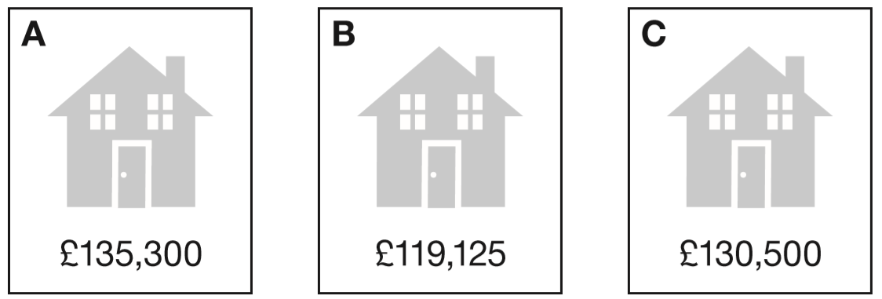
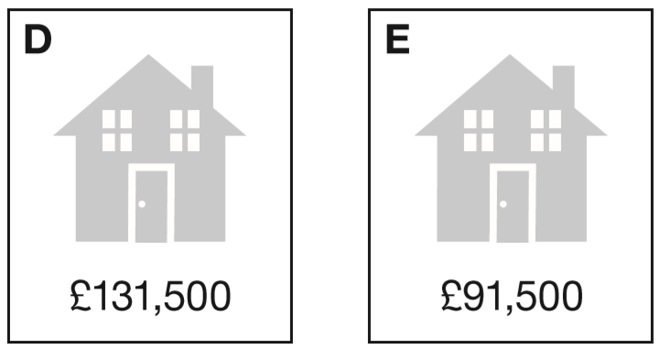

Put these houses in order of price starting with the lowest price.
One has been done for you.
E
C
D
A
1 3 5 3 0 0
1 1 9 1 2 5
1 3 0 5 0 0
1 3 1 5 0 0
9 1 5 0 0
Notes:
2016 Paper 2 Q2

Slide 7
Round numbers with up to 6 digits

Slide 8
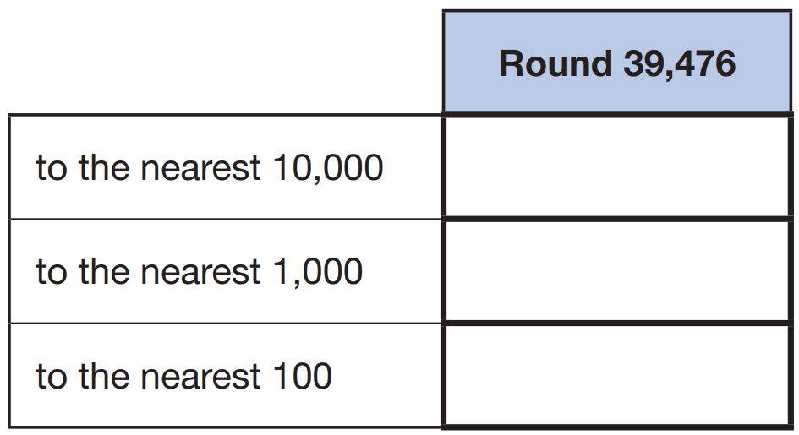
Complete the table.
3 9 4 7 6
40 000
3 9 4 7 6
39 000
3 9 4 7 6
39 500
Notes:
2019 Paper 2 Q14

Slide 9
Round 84,516
to the nearest 10: ________
to the nearest 100: ________
to the nearest 1,000: ________
84 520
8 4 5 1 6
8 4 5 1 6
84 500
8 4 5 1 6
85 000
Notes:
2017 Paper 2 Q10

Slide 10
Round 124,531
to the nearest 10,000 __________
to the nearest 1,000 __________
to the nearest 100 __________
120 000
1 2 4 5 3 1
125 000
1 2 4 5 3 1
124 500
1 2 4 5 3 1
Notes:
2015 (Sample) Paper 2 Q14

Slide 11
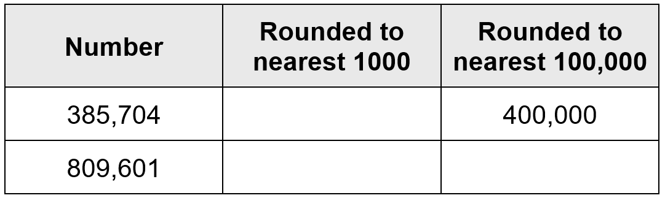
Complete the table.
386 000
810 000
800 000
3 8 5 7 0 4
8 0 9 6 0 1
8 0 9 6 0 1
Notes:
G460 Pre-2000 or other question

Slide 12
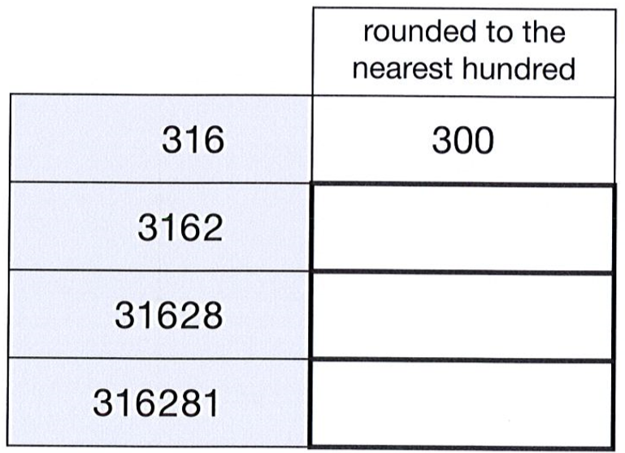
Complete this table to show the numbers rounded to the nearest 100
One has been done for you.
3200
31 600
316 300
Notes:
G370 2012 Paper 1 Q10

Slide 13
Runa and Jon each start with the same number.
Runa rounds the number to the nearest hundred.
Jon rounds the number to the nearest ten.
Runa’s answer is double Jon’s answer. Explain how this can be.
100 is double 50
51 rounded to the nearest hundred is 100
51 rounded to the nearest ten is 50
They could also have started with 50, 52, 53 or 54
Notes:
G628 2012 Level 6 Paper A Q5

Slide 14
Identify Roman numerals

Slide 15

At the end of a film, the year is given in Roman numerals.
Write the year MMVI in figures.
M = 1000
2006
V = 5
I = 1
Notes:
2017 Paper 2 Q15

Slide 16
Here is a number written in Roman numerals.
DCCIX
Write the number in figures.
7
0
9
M = 1000
D = 500
C = 100
L = 50
X = 10
V = 5
I = 1
Notes:
G39 Pre-2000 or other question

Slide 17
Look at these numbers written in Roman numerals.
MCMVII MMCD MDCCXLIII MMDX
Circle the largest number.
What is the value of the smallest number?
1907
2400
1743
2510
M = 1000
D = 500
C = 100
L = 50
X = 10
V = 5
I = 1
1743
Notes:
G166 Pre-2000 or other question

Slide 18
Look at these numbers written in Roman numerals.
One is not written correctly. Put a cross on it.
MMCM MCMM MMMC MMCC MCCC
2900
3100
2200
1300
✘
M = 1000
C = 100
Notes:
G261 Pre-2000 or other question

Slide 19
Solve problems involving the addition or subtraction of 10, 100, 1000 or 10 000

Slide 20
The numbers in this sequence decrease by the same amount each time.
303,604 302,604 301,604 300,604 …
What is the next number in the sequence?
299,604
Notes:
2018 Paper 2 Q6

Slide 21

Write the missing numbers in the sequence.
467,050 468,050 469,050
466,050
470,050
Notes:
G335a Pre-2000 or other question

Slide 22
Write the missing numbers in the sequence.
273,001 283,001 293,001
263,001
303,001
Notes:
G407 Pre-2000 or other question

Slide 23
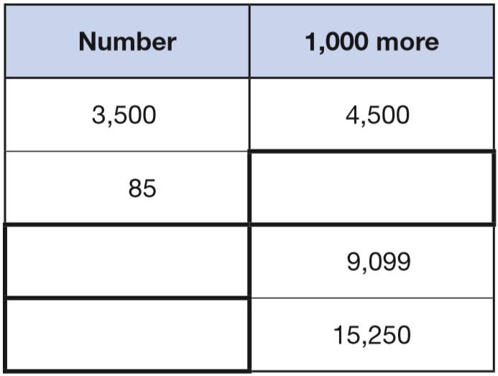
Complete this table with the missing numbers.
One row has been done for you.
1085
1000 + 85 =
8099
9099 – 1000 =
14250
15250 – 1000 =
Notes:
2017 Paper 2 Q5

Slide 24


Write the missing numbers.
29 000
3 0 0 0 0 – 1 0 0 0 =
2 9 0 0 0
290 000
3 0 0 0 0 0 – 1 0 0 0 0 =
2 9 0 0 0 0
Notes:
G509 Pre-2000 or other question

Slide 25


Write the missing numbers.
20 999
1 9 9 9 9 + 1 0 0 0 =
2 0 9 9 9
38 001
3 9 0 0 1 – 1 0 0 0 =
3 8 0 0 1
Notes:
G61 Pre-2000 or other question

Slide 26
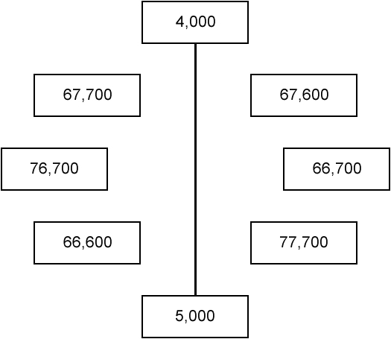
Match pairs of numbers that have a difference of 1000
One has been done for you.
Notes:
G118 Pre-2000 or other question

Slide 27
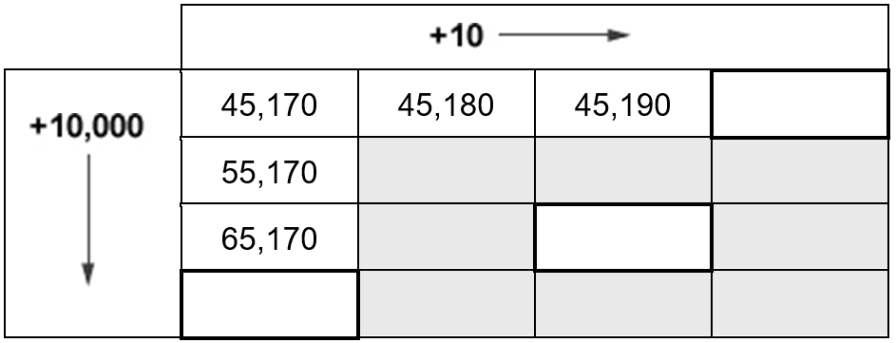
Write the three missing numbers in the empty boxes.
45,200
55,190
65,180
65,190
75,170
Notes:
G289 Pre-2000 or other question

Slide 28
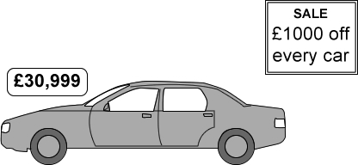
A car usually costs £30,999
How much does it cost in the sale?
£29,999
3 0 9 9 9 – 1 0 0 0 =
2 9 9 9 9
Notes:
G381 Pre-2000 or other question

Slide 29
Find missing digits in addition and subtraction problems

Slide 30
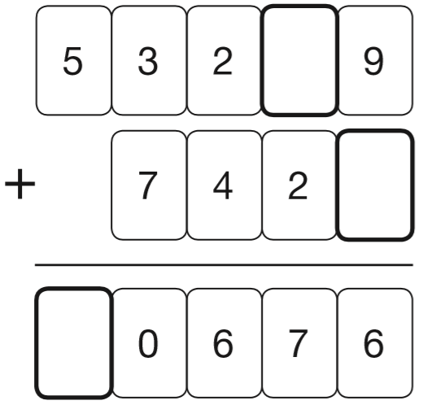
Write the three missing digits to make this addition correct.
1
1
4
7
6
Notes:
2018 Paper 3 Q4

Slide 31

Write the three missing digits to make this subtraction correct.
7
1
3
8
1
3
7
1
9 7 8 4 2
1
-
1 2 3 6 5
2
5
8
5
4
7
7
Notes:
G404 Pre-2000 or other question

Slide 32
Solve number problems involving addition and subtraction

Slide 33
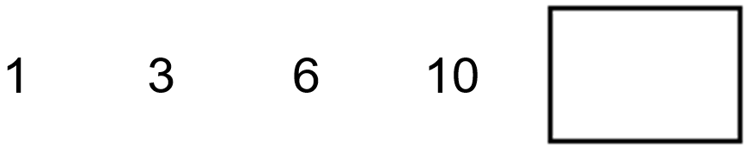
Here is a number sequence.
Write the missing number.
15
+2
+3
+4
+5
Notes:
G496 Pre-2000 or other question

Slide 34
Estimate the answer to this calculation.
23,901 – 5,097
Circle the correct estimate.
6,000 17,000 18,000 19,000 20,000
24,000 – 5,000 to the nearest thousand
Notes:
G95 Pre-2000 or other question

Slide 35
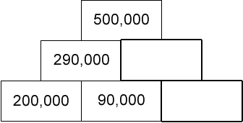
Here is a number pyramid.
The number in a box is the sum of the two numbers below it.
Write the missing numbers.
210,000
500,000 – 290,000 =
210,000
120,000
210,000 – 90,000 =
120,000
Notes:
G127 Pre-2000 or other question

Slide 36
Solve word problems involving addition and subtraction

Slide 37
Four children are in a race.
Chen is 2 metres ahead of Alfie.
Nina is 5 metres behind Megan.
Alfie is 3 metres behind Megan.
Write the names of the runners in order, starting with the child who is furthest ahead.
Chen
2m
Alfie
Megan
3m
Alfie
Megan
5m
Nina
Megan
Chen
Alfie
Nina
furthest ahead
Notes:
G617 2013 Paper 1 Q15

Slide 38
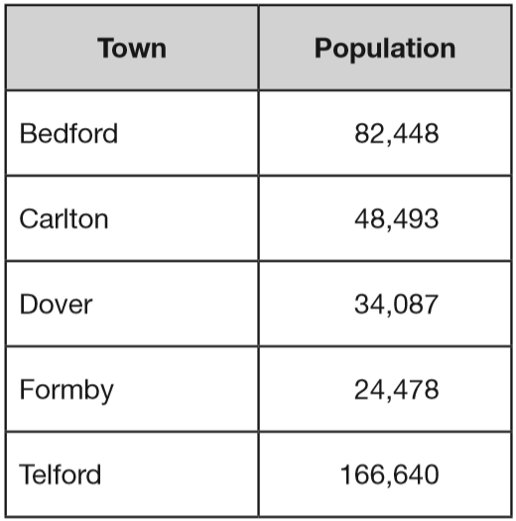
This table shows the number of people living in various towns in England.
What is the total of the numbers of people living in Formby and in Telford?
1
1
1
1 6 6 6 4 0
+
2 4 4 7 8
1
9
1
1
1
8
What is the difference between the numbers of people living in Bedford and in Dover?
7
3
8 2 4 4 8
1
1
-
3 4 0 8 7
4
8
3
6
1
Notes:
2016 Paper 2 Q4

Slide 39
At the start of June, there were 1,793 toy cars in the shop.
During June,
• 8,728 more toy cars were delivered
• 9,473 toy cars were sold.
How many toy cars were left in the shop at the end of June?
1048
0
1
1
1
1
1
4
1 7 9 3
1 0 5 2 1
1
1
+
8 7 2 8
-
9 4 7 3
1 0
5
2
1
1
0
4
8
Notes:
2017 Paper 2 Q8

Slide 40
14,890 festival tickets were sold before the event.
Another 6,752 were sold on the day.
546 people did not arrive at the festival.
How many people were at the festival altogether?
21,096 people
3
1
1
1
5
1
1 4 8 9 0
2 1 6 4 2
1
-
+
6 7 5 2
5 4 6
2
1
6
4
2
2
1
0
9
6
Notes:
G307 Pre-2000 or other question

Slide 41
Solve number problems involving multiplication and division

Slide 42
Write the missing numbers in this sequence.
8
2
3
2
1
6
6 4
3 2
4 ÷ 2 =
2
2
1 6 ÷ 2 =
2
1
8
Notes:
G603 2003 Year 5 Optional Paper 2 Q1

Slide 43
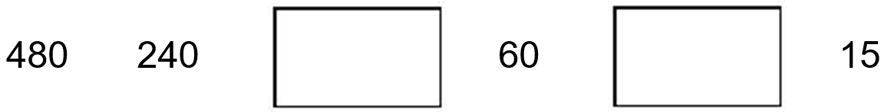
Write in the missing numbers in this sequence.
120
30
480 ÷ 2 = 240
120 ÷ 2 =
60
30 ÷ 2 =
15
240 ÷ 2 =
120
60 ÷ 2 =
30
Notes:
G528 Pre-2000 or other question

Slide 44
14 × 15 × 16 = 3,360
What is the answer to
15 × 16 × 14 =
3,360
With multiplication, order doesn’t matter, and the same multiplicands are used in both questions.
Notes:
G20 Pre-2000 or other question

Slide 45
Kim knows that
137 × 28 = 3836
Explain how she can use this information to work out this multiplication.
138 × 28
She can add 28 to 3836
Notes:
G184 Pre-2000 or other question

Slide 46
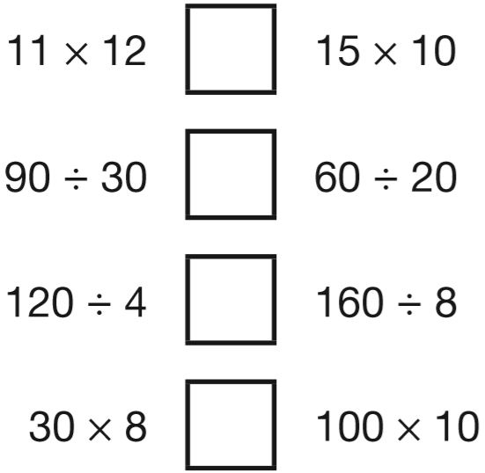
> = <
Write the correct symbol in each box to make the statements correct.
<
132
150
=
3
3
>
30
20
<
240
1000
Notes:
2018 Paper 2 Q10

Slide 47
Circle two different numbers which multiply together to make
1 million.
10 100 1000 10000 100000
1 0 0 0 0 0 x 1 0 =
1 0 0 0 0 0 0
1 0 0 0 0 x 1 0 0 =
1 0 0 0 0 0 0
Notes:
G230 2000 Paper 1 Q18

Slide 48
Circle two numbers that multiply together to equal 1 million.
200 2,000 5,000 50,000
5 0 0 0 x 2 0 0 =
1 0 0 0 0 0 0
Notes:
2016 Paper 3 Q19

Slide 49
Find missing digits in multiplication or division problems

Slide 50
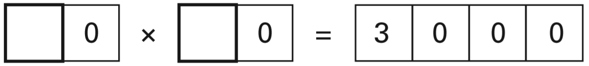
Write in the two missing digits.
6
5
Notes:
G372 2002 Paper 1 Q19

Slide 51

Write what the three missing digits could be.
2
7
1
2
7
2 8 x 3 = 8 4
3
8 1
2
2 9 x 3 = 8 7
Notes:
G311 Pre-2000 or other question

Slide 52
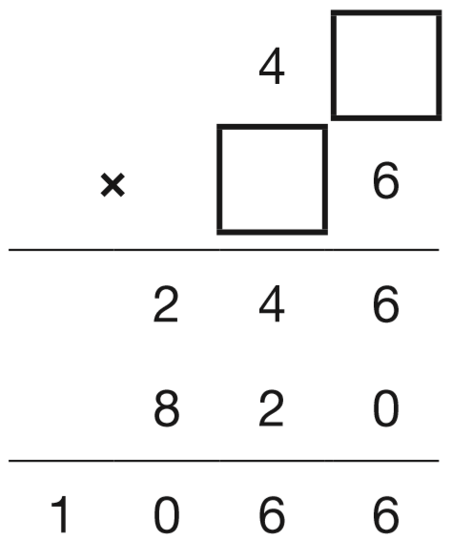
Write the two missing digits to make this long multiplication correct.
1
1 or 6
2
Notes:
2015 (Sample) Paper 2 Q10

Slide 53
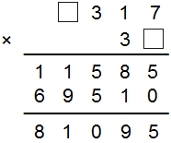
Write the missing digits.
1
3
2
5
Notes:
G506 Pre-2000 or other question

Slide 54

Write in the missing digits.
1
4
1
1
2
3
2
3
x
4
7
300 x 50 = 15 000
1
2 2
6
1
1 2
9
2
0
1
5
1
8
1
Notes:
G103 Pre-2000 or other question

Slide 55
Find missing numbers in multiplication problems

Slide 56
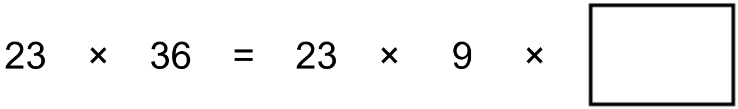
4
9 x 4
Notes:
G136 Pre-2000 or other question

Slide 57
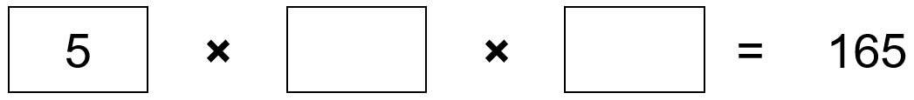
Write the two other prime numbers that multiply to make 165
11
3
3
3
11 x 3 = 33
5
1 6 5
1
Notes:
G214 Pre-2000 or other question

Slide 58
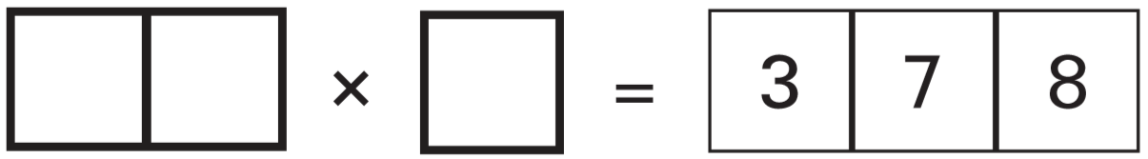
Write what the three missing digits could be in this calculation.
6
3
6
378 ÷ 2 =
Not a 2-digit number
378 ÷ 3 =
Not a 2-digit number
378 ÷ 4 =
9
4 r2
Not a whole number
4
3 7 8
1
378 ÷ 5 =
Not a whole number
6
3
378 ÷ 6 =
6
3 7 8
1
Notes:
G326 2003 Paper 2 Q13

Slide 59
Write what the three missing digits could be in this calculation.
5
4
7
5
4
378 ÷ 7 =
7
3 7 8
2
Notes:
G327 2003 Paper 2 Q13

Slide 60
Write what the three missing digits could be in this calculation.
4
2
9
378 ÷ 8 =
4
7 r2
Not a whole number
8
3 7 8
5
4
2
378 ÷ 9 =
9
3 7 8
1
Notes:
G328 2003 Paper 2 Q13

Slide 61
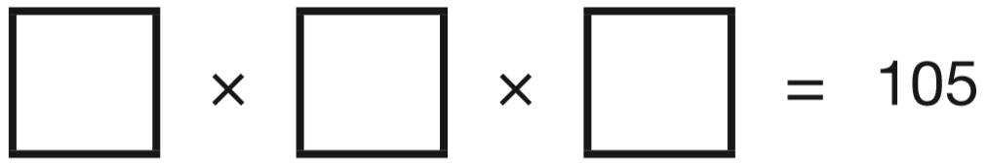
Fill in the three missing whole numbers in this calculation.
Each number is less than 10
7
5
3
3
5
3
1 0 5
1
7 x 5 =
3 5
Notes:
G430 2014 Paper 2 Q23

Slide 62
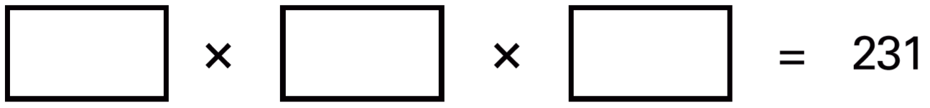
Write the three prime numbers which multiply to make 231
1 1
7
3
÷ 2 will give a remainder.
7
7
3
2 3 1
2
1 1 x 7 = 7 7
Notes:
G562 2001 Paper 2 Q23

Slide 63
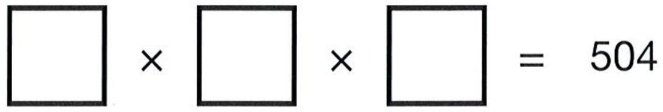
Three single-digit numbers multiply to make 504
Write the missing numbers.
9
8
7
8
4
but multiplying two single-digit numbers can’t give an answer of 84
6
5 0 4
2
7
2
and because 9 x 8 = 72, then 72 x 7 = 504 we have our three numbers.
7
5 0 4
1
Notes:
G7 2012 Paper 2 Q13

Slide 64
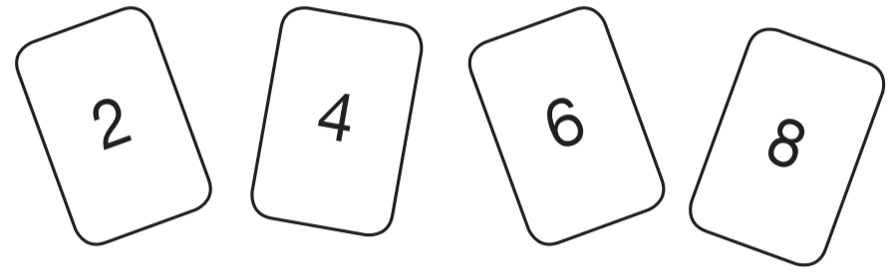

Use all four digit cards to make this number sentence correct.
8
2
6
4
1
2
8
2
8
4
x
6
4
x
6
2
1
1
3 2
8
1 6
8
4 9
2
0
5 0
4
0
5
2
4
8
5
2
0
8
Notes:
G134 2010 Paper 2 Q12

Slide 65

Write the two missing digits in this multiplication.
6
2
1
70 x 30 =
2100
8
6
9
69 x 29 =
x
2
9
1
1
6 2
1
1 3
8
0
2
0
0
1
Notes:
G254 2013 Paper 2 Q18

Slide 66
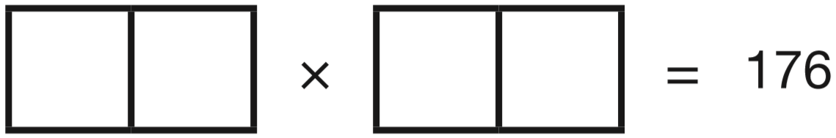
Two 2-digit numbers multiply to make 176
Write the two missing numbers.
1 1 1 6
12 x 12 = 144
20 x 10 = 200
10 can’t be one of the numbers
1
6
1 1
1 7 6
6
Notes:
G362 2011 Paper 2 Q17

Slide 67
Solve word problems involving multiplication or division

Slide 68
Luke buys 750 grams of apples.
Each apple weighs between 140 grams and 160 grams.
Circle the number of apples that Luke buys.
4 5 6 7 8
1 apple = 150 grams
2 apples = 300 grams
4 apples = 600 grams
5 apples = 750 grams
Notes:
G489 2006 Year 5 Optional Paper 2 Q15

Slide 69
This relationship connects the number of pencils and the number of boxes.
number of pencils = number of boxes × 12
How many pencils are in 18 boxes?
236 pencils
9
1 8
x
1 2
2 3
6
Notes:
G549 Pre-2000 or other question

Slide 70
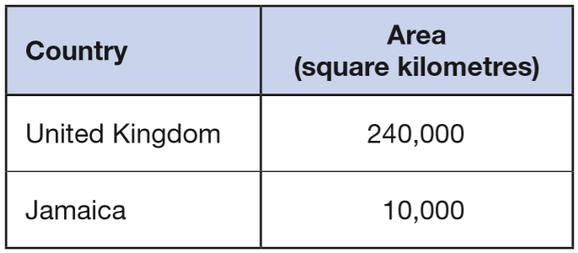
This table shows the areas of the United Kingdom and Jamaica.
The area of the United Kingdom is larger than the area of Jamaica. How many times larger is the United Kingdom?
_____ times larger
24
24
10 000 x ___ = 240 000
240 000 ÷ 10 000 =
24
Notes:
2018 Paper 3 Q12

Slide 71
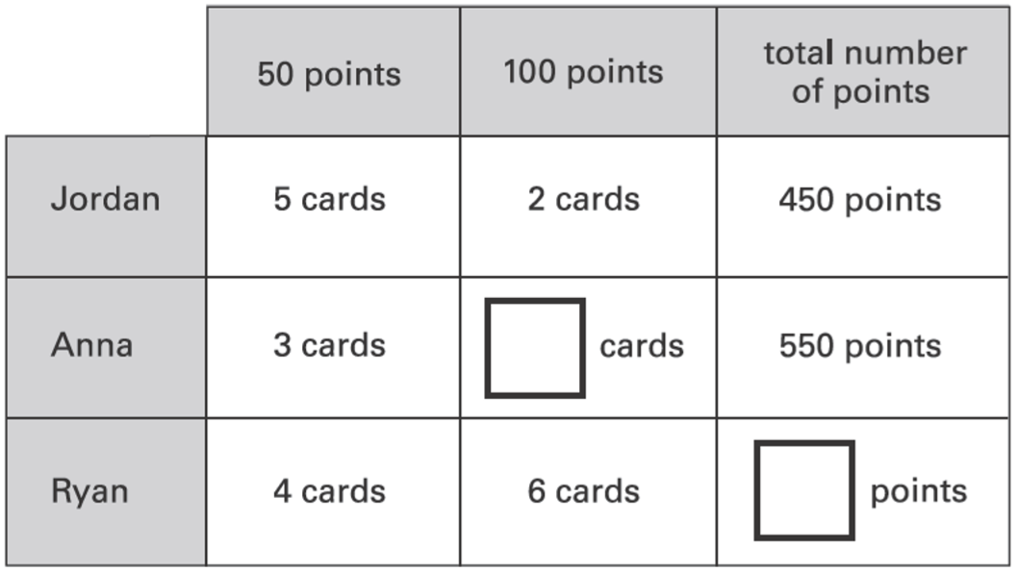
Jordan, Anna and Ryan collect picture cards.
Cards are worth either 50 points or 100 points.
This table shows the cards they have.
Complete the table for Anna and Ryan.
250
200
4
150
400
800
200
600
Notes:
G22 2003 Year 5 Optional Paper 2 Q23

Slide 72
A group of friends earns £80 by washing cars.
They share the money equally.
They get £16 each.
How many friends are in the group?
5 friends
80 ÷ 16 =
1 friend = £16
5
+16
10 x 16 = 160
2 friends =
£32
so 5 x 16 = 80
+16
3 friends =
£48
+16
4 friends =
£64
+16
5 friends =
£80
Notes:
2017 Paper 3 Q2

Slide 73
In a supermarket storeroom there are:
7 boxes of tomato soup
5 boxes of pea soup
4 boxes of chicken soup
There are 24 tins in every box.
How many tins of soup are there altogether?
384 tins
7 + 5 + 4 =
16 boxes
2
2
4
x
1
6
1 4
4
2
4
0
3
8
4
tins
Notes:
G123 2004 Paper 2 Q11

Slide 74
A box contains trays of melons.
There are 15 melons in a tray.
There are 3 trays in a box.
A supermarket sells 40 boxes of melons.
How many melons does the supermarket sell?
45 melons in a box
1800 melons
1
2
1 5
4 5
x
3
x
0
4
4
5
1 8
0
0
Notes:
2018 Paper 2 Q15

Slide 75
A toy shop orders 11 boxes of marbles.
Each box contains 6 bags of marbles.
Each bag contains 45 marbles.
How many marbles does the shop order in total?
11 x 6 =
66 bags
66 x 45 =
2970 marbles
2
3
6
6
x
4
5
3 3
0
2 6
4
0
2
9
7
0
Notes:
2016 Paper 3 Q11

Slide 76
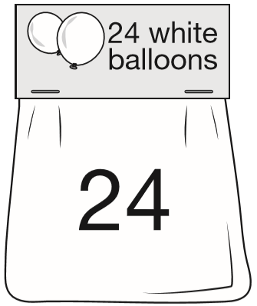
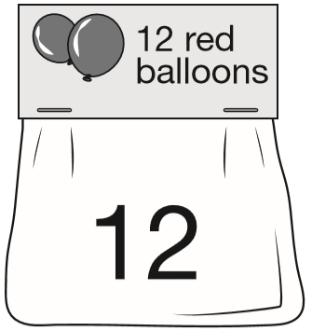
144
Adam buys 6 bags of white balloons.
Chen buys 3 bags of red balloons.
Adam says, ‘I have four times as many balloons as Chen.’
Explain why Adam is correct.
6 x 24 =
3 x 12 =
36
2
2
2 4
3 6
x
6
x
4
1 4
4
1 4
4
Adam has 6 x 24 = 144 balloons
Chen has 3 x 12 = 36 balloons
36 x 4 = 144
144 ÷ 4 = 36
3
6
4
1 4 4
2
Notes:
2017 Paper 3 Q12

Slide 77
Solve number problems using the four operations

Slide 78
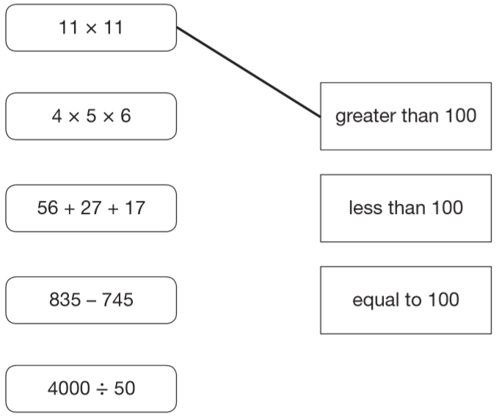
Draw one line from each calculation on the left to the correct box on the right. One has been done for you.
20
120
83
100
90
80
Notes:
G301 2006 Paper 2 Q2

Slide 79
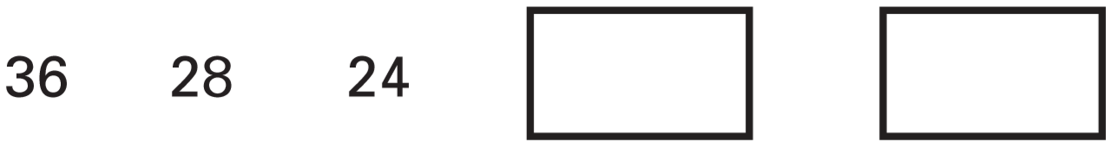
Hayley makes a sequence of numbers.
Her rule is: ‘find half the last number then add 10’
Write in the next two numbers in her sequence.
22
21
24 ÷ 2 =
12
22 ÷ 2 =
11
12 + 10 =
22
11 + 10 =
21
Notes:
G311 2003 Paper 2 Q7

Slide 80
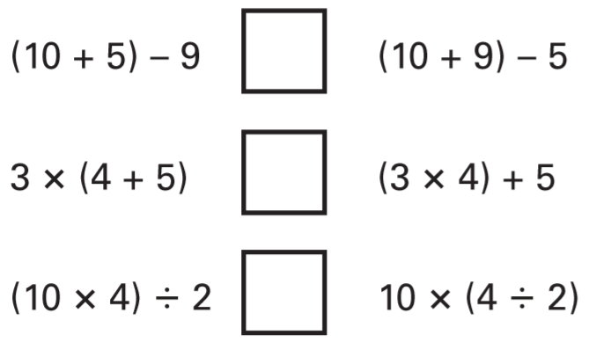
Write the correct sign >, < or = in each of the following.
6
14
<
27
17
>
20
20
=
Notes:
G423 2005 Paper 1 Q12

Slide 81
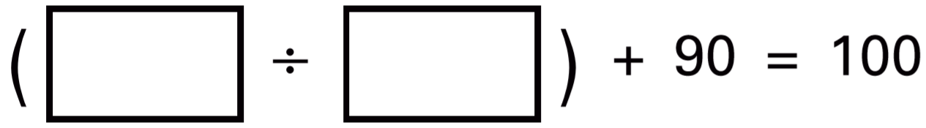
Write in what the missing numbers could be.
20
2
30
3
50
5
40
4
10
20
2
___ ÷ __ = 10
Notes:
G539 2001 Paper 2 Q7

Slide 82

In the circle write +, –, ×, or ÷ to make the calculation correct.
6
÷
Notes:
G27 Pre-2000 or other question

Slide 83
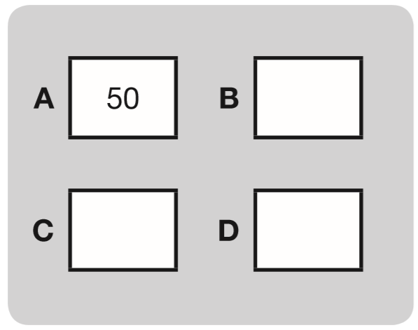
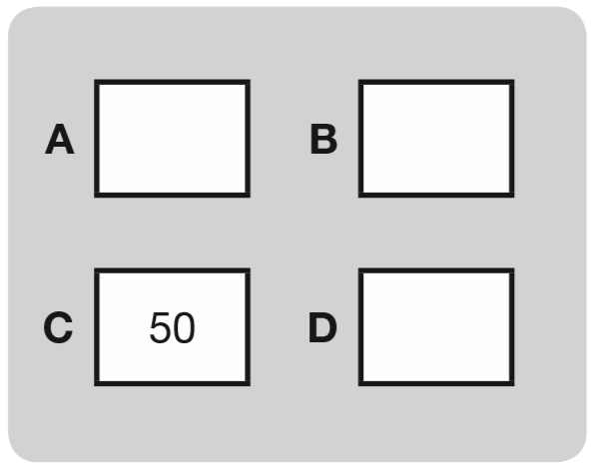
The number in A is twice the number in D.
The number in B is 5 less than the number in C.
The number in D is 10 more than the number in B.
Write the missing numbers in this diagram.
Now use the same rule for this diagram.
15
110
45
20
25
55
Notes:
G171 2014 Paper 2 Q14

Slide 84
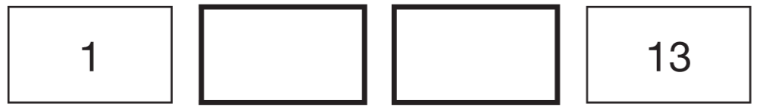
The numbers in this sequence increase by the same amount each time. Write in the missing numbers.
5
9
3 equal jumps
a difference of 12
12 ÷ 3 = 4
…so it’s an increase of 4 with each jump
Notes:
G281 2006 Paper 2 Q12

Slide 85

Halid makes a sequence of 5 numbers.
The first number is 2
The last number is 18
His rule is to add the same amount each time.
Write in the missing numbers.
6
10
14
4 equal jumps
a difference of 16
16 ÷ 4 = 4
…so it’s an increase of 4 with each jump
Notes:
G354 Pre-2000 or other question

Slide 86
Find unknown values in pictorial equations

Slide 87


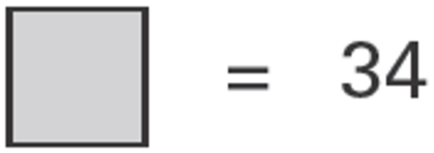

and each stand for a different number.
34
34
17
17
34
2 circles = 34
17
What is the value of ?
1 circle =
1
7
2
3 4
1
Notes:
G413 2003 Year 4 Optional Paper 2 Q33

Slide 88
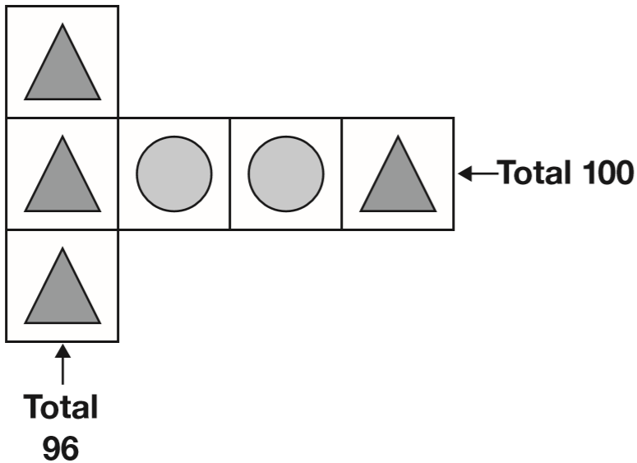
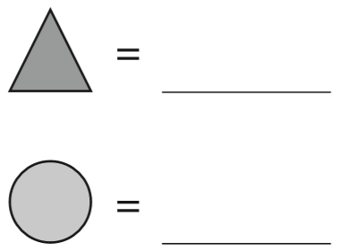
Each shape stands for a number.
Work out the value of each shape.
32
18
18
32 + circle + circle + 32 = 100
32
32
32 + 32 =
64
32
64 + 2 circles = 100
3 triangles = 96
100 – 64 =
36
1 triangle =
2 circles = 36
32
1 circle =
18
32
3
2
3
9 6
1
8
2
3 6
1
18
Notes:
2016 Paper 3 Q4

Slide 89
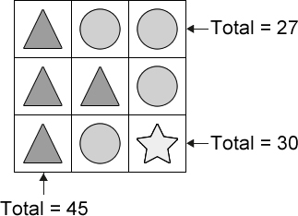



Each shape stands for a number. Work out the value of each shape.
15
6
6
27 – 15 =
12
15
2 circles = 12
15
15
6
1 circle =
6
12 ÷ 2 =
6
15
6
9
15 + 6 =
21
9
30 – 21 =
9
3 triangles = 45
1 triangle =
15
1
5
3
4 5
1
Notes:
G492 Pre-2000 or other question

Slide 90
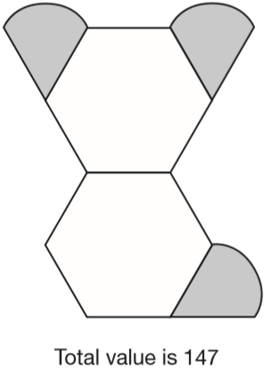
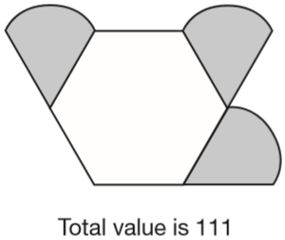
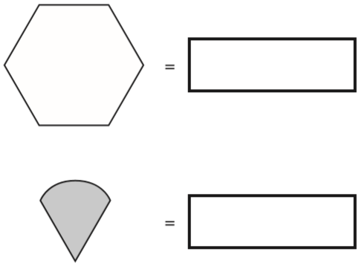

Amina is making designs with two different shapes.
She gives each shape a value.
Calculate the value of each shape.
25
25
25
25
36
36
36
25
36
25
25
this shape has 1 extra hexagon
147 – 111 =
36
36 + 3 = 111
so 3 = 75
111 – 36 =
75
= 75 ÷ 3 =
25
Notes:
2018 Paper 2 Q21

Slide 91
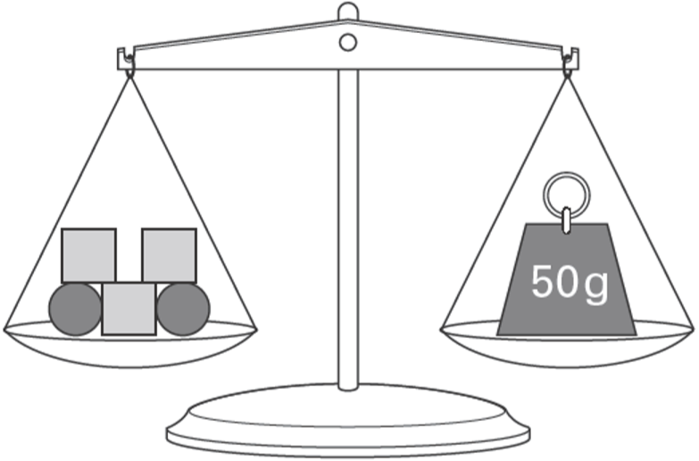
Emma uses 5 shapes to balance a 50 g weight on a scale.
Each square weighs 12 g.
How much does each circle weigh?
7 g
3 x 12 =
36
50 – 36 =
14
12
12
So 2 circles weigh 14 g
7
12
7
7
14 ÷ 2 =
Notes:
G29 2006 Year 5 Optional Paper 1 Q23

Slide 92
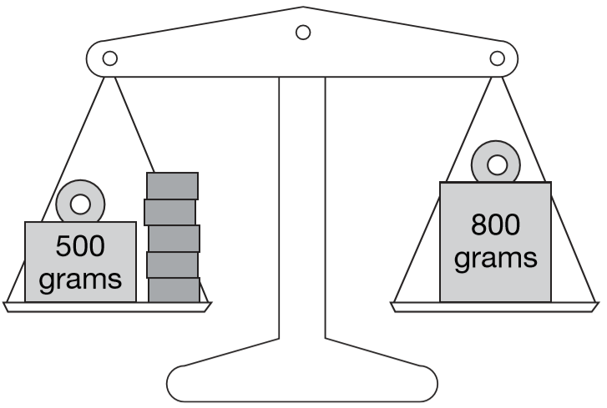
Lin has five blocks which are all the same.
She balances them on the scale with two weights.
Calculate the weight of one block.
800 – 500 = 300
5 blocks = 300 g
1 block =
300 ÷ 5 =
60 g
Notes:
G168 2006 Paper 2 Q17

Slide 93
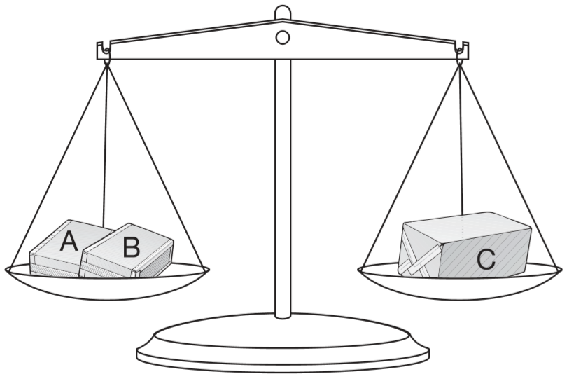
Amir has three parcels.
Parcels A and B together weigh the same as parcel C.
The three parcels weigh 800 grams altogether.
Parcel A weighs 250g.
How much does parcel B weigh?
800 ÷ 2 =
400
400
400
400 – 250 =
150 grams
Notes:
G208 2009 Paper 1 Q17

Slide 94
Solve word problems using the four operations

Slide 95
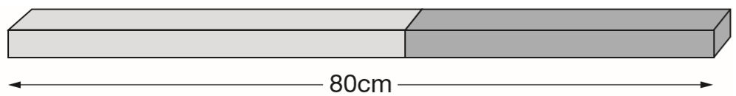
Alfie has two sticks.
He puts them end to end.
One stick is 10cm longer than the other stick.
How long are the two sticks?
35cm and 45cm
80
longer
shorter
80 – 10 =
70
35
70 ÷ 2 =
35
shorter
10
shorter
35
Notes:
G367 2014 Paper 2 Q19

Slide 96
A cake costs 15p more than a biscuit.
Megan bought a cake and two biscuits for 90p.
How much do a cake and a biscuit each cost?
Each cake costs 40p
Each biscuit costs 25p
90p
cake
biscuit
biscuit
25p
15p
25p
25p
90 – 15 =
75p
75p ÷ 3 =
25p
2
5
p
3
7 5
1
Notes:
G439 2013 Paper 1 Q24

Slide 97
Two letters have a total weight of 120 grams.
One letter weighs twice as much as the other letter.
Write the weight of the heavier letter.
80 grams
120
40 + 40 =
80
80
40
40
40
40
120 ÷ 3 =
40
Notes:
G507 2003 Year 4 Optional Paper 2 Q29

Slide 98
Sarah, Amy and Liam stand on some weighing scales two at a time.
Here are the measurements:
Sarah and Amy – 70 kg
Sarah and Liam – 80 kg
Liam and Amy – 80 kg
How much does Liam weigh?
Liam is 10 kg heavier than Amy.
45 kg
80
3
5
Liam
45
Amy
35
2
7 0
3
35
10
35
Notes:
G84 2010 Paper 2 Q18

Slide 99
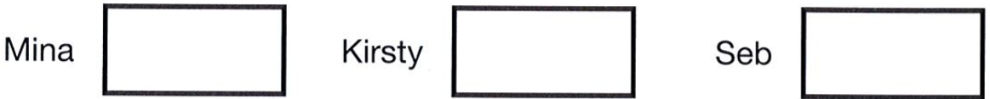
Mina has 5 more marbles than Kirsty.
Kirsty has 2 more marbles than Seb.
Altogether they have 30 marbles.
How many marbles does each child have?
30
Seb
Kirsty
Mina
7
7
2
7
2
5
30 – (2 + 2 + 5) =
21
21 ÷ 3 =
7
14
9
7
Notes:
G164 2012 Paper 1 Q21

Slide 100
There are 2,400 leaflets in a box.
William and Ally take 450 leaflets each.
Adam and Chen share the rest of the leaflets equally.
How many leaflets does Adam get?
900 taken
1500 shared
750 leaflets
1
1
4 5 0
2 4 0 0
1
+
4 5 0
-
9 0 0
7
5
0
9
0
0
1
5
0
0
2
1 5 0 0
1
2400 leaflets
750 Adam
750 Chen
450
450
1500
900
Notes:
2017 Paper 3 Q16

Slide 101
Layla makes jewellery to sell at a school fair.
Each bracelet has 53 beads. She makes 68 bracelets.
Each necklace has 105 beads. She makes 34 necklaces.
How many beads does Layla use altogether?
3604
3570
7174 beads
4
1
2
2
6
8
1
0
5
1
5
3 6 0 4
x
3
x
3
4
+
3 5 7 0
2 0
4
4
2
0
7
1
7
4
3 4
0
0
3
1
5
0
3
6
0
4
3
5
7
0
Notes:
2019 Paper 3 Q19

Slide 102
Liam thinks of a number.
He multiplies the number by 5 and then subtracts 60 from the result.
His answer equals the number he started with.
What was the number Liam started with?
15
15
15
15
15
15
15
60
1
5
2
4
6 0
1 5
7 5
2
x
5
–
6 0
7
5
1
5
Notes:
G249 2004 Paper 1 Q22

Slide 103
Liam thinks of a number.
He multiplies the number by 5 and then subtracts 60 from the result.
His answer equals the number he started with.
What was the number Liam started with?
15
Trial and improvement:
20 x 5 = 100
100 – 60 = 40
12 x 5 = 60
60 – 60 = 0
15 x 5 = 75
75 – 60 = 15
Notes:
G250 2004 Paper 1 Q22

Slide 104
30 children are going on a trip.
It costs £5 including lunch.
Some children take their own packed lunch. They pay only £3
The 30 children pay a total of £110
How many children are taking their own packed lunch?
20
30 x £5 = 150
£150 - £110 = £40
less paid due to some children having own packed lunch
40 ÷ 2 =
20 children paid less
÷ 2 because £2 less was paid per child with own packed lunch
Notes:
G333 2003 Paper 1 Q26

Slide 105
30 children are going on a trip.
It costs £5 including lunch.
Some children take their own packed lunch. They pay only £3
The 30 children pay a total of £110
How many children are taking their own packed lunch?
Trial and improvement…
5 x £3 = £15
What if 5 children paid £3?
Wrong! That adds up to £140, not £110
25 x £5 = £125
10 x £3 = £30
What if 10 children paid £3?
Wrong! That adds up to £130, not £110
20 x £5 = £100
20 x £3 = £60
What if 20 children paid £3?
20 children are taking their own packed lunch.
10 x £5 = £50
Notes:
G334 2003 Paper 1 Q26

Slide 106
Calculate differences in temperature

Slide 107
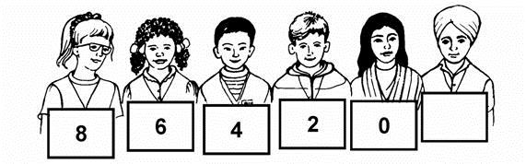
Children in Year 6 make number patterns.
This group uses the rule ‘2 less than’.
Write in the missing number.
-2
Notes:
G479 Pre-2000 or other question

Slide 108

Here is part of a number line.
Write the number shown by the arrow.
-5
Notes:
G493 Pre-2000 or other question

Slide 109

Write these temperatures in order from hottest to coldest.
92°C
73°C
37°C
12°C
-2°C
-12°C
Notes:
G57 Pre-2000 or other question

Slide 110

Put these temperatures in order, starting with the lowest.
21°C −13°C −24°C 0°C 35°C
-24
-13
0
21
35
Notes:
G125 2015 Paper 2 Q2

Slide 111
Circle two numbers which have a difference of 2
–1 – 0.5 0 0.5 1 1.5
+0.5
+1.5
0.5 + 1.5 =
2.0
-0.5
0
1.5
+1
+1
2
1 + 1 =
-1
0
1
Notes:
G291 2001 Paper 2 Q11

Slide 112
Circle two numbers with a difference of 8
–5 –4 –3 –2 –1 0 1 2 3 4 5
+5
+3
+4
+4
+3
+5
-5
0
3
-4
0
4
-3
0
5
Notes:
G352 Pre-2000 or other question

Slide 113

Here is part of a temperature scale.
What is the temperature shown at A?
-7°C
13°C
What temperature is 20 degrees higher than A?
+7
+13
20 – 7 =
13
-7
0
13
Notes:
G437 2013 Paper 2 Q13

Slide 114
The temperature in the fridge is 4°C.
The temperature in the freezer is -18°C.
What is the difference in temperature between the fridge and the freezer?
+18
+4
The difference is 22°C.
-18
0
4
Notes:
G530 2006 Year 5 Optional Paper 1 Q17

Slide 115
The temperature inside an aeroplane is 20°C.
The temperature outside the aeroplane is –30°C.
What is the difference between these temperatures?
+30
+20
The difference is 50°C.
-30
0
20
Notes:
G35 2003 Paper 2 Q11

Slide 116

This table shows the temperature at 9am on three days in January.
What is the difference between the temperature on 1st January and the temperature on 8th January?
+4
+5
The difference is 9°C.
-4
0
5
On 22nd January the temperature was 7 degrees lower than on 15th January. What was the temperature on 22nd January?
-6
-1
The temperature was -6°C.
-6
0
1
Notes:
2016 Paper 3 Q2

Slide 117

Here is a table of temperatures at dawn on the same day.
What is the difference in temperature between London and Paris?
+4
+6
The difference is 10°C.
-4
0
6
At noon the temperature in New York has risen by 5°C.
What is the temperature in New York at noon?
-9 + 5 =
-4°C
+5
-10
-9
-8
-7
-6
-5
-4
-3
-2
-1
0
1
2
3
4
5
6
7
8
9
10
Notes:
G119 Pre-2000 or other question

Slide 118
Read scales or tables to calculate differences in temperature

Slide 119

These are the temperatures at noon and midnight on a day in winter.
How many degrees higher is the temperature at noon than at midnight?
+4
+3
7 degrees higher
-4
0
3
3°C
-4°C
Notes:
G218 2006 Year 4 Optional Paper 2 Q14

Slide 120

Here are two thermometers.
They show two different temperatures.
What is the difference between the two temperatures?
+5
+13
13°C
-5°C
-5
0
13
The difference is 18°C.
Notes:
G359 2007 Paper 1 Q13

Slide 121

These are the temperatures in York and Rome on a day in winter.
How many degrees colder is it in York than in Rome?
5 degrees colder
7 – 2 =
7
On another day, the temperature in York is 4°C
Rome is 7 degrees colder than York.
What is the temperature in Rome?
2
-3 degrees
4 – 7 =
-3
-4
-3
0
4
Notes:
G415 2000 Paper 1 Q8

Slide 122


Two thermometers show the temperature inside and outside a greenhouse on a day in January.
How many degrees warmer was it inside the greenhouse than outside?
9 degrees
11 – 2 =
9
11
Later the temperatures were
What is the difference between these two temperatures?
2
7 degrees
+7
-10
-9
-8
-7
-6
-5
-4
-3
-2
-1
0
1
2
3
4
5
6
7
8
9
10
Notes:
G544 2002 Paper 2 Q8

Slide 123

Here are the temperatures in four cities at midnight and at midday.
At midnight, how many degrees colder was Paris than Rome?
+4
+3
7 °C colder.
-4
0
3
Which city was 6 degrees colder at midnight than at midday?
Oslo
+6
-16
-15
-14
-13
-12
-11
-10
-9
-8
-7
-6
-5
-4
-3
-2
-1
0
1
2
3
4
5
6
7
8
9
Notes:
2018 Paper 2 Q5

Slide 124

This weather chart shows the highest and lowest temperatures in a town on five days in March.
Which day has the greatest difference between the highest and the lowest temperatures?
Wednesday
What is the difference between the lowest temperatures on Thursday and Friday?
7
9
10
+5
+1
6 degrees
8
-5
0
1
9
Notes:
G15 2014 Paper 1 Q12

Slide 125

This graph shows the temperature in six cities on one day in January.
Which city was 4 degrees warmer than Kiev?
+2
+2
-2
0
2
Paris
Notes:
2015 (Sample) Paper 2 Q3 page 1

Slide 126
This graph shows the temperature in six cities on one day in January.
What was the difference between the temperature in Oslo and the temperature in Berlin?
3 degrees
-5
+3
-10
-9
-8
-7
-6
-5
-4
-3
-2
-1
0
1
2
3
4
5
6
7
8
9
10
Notes:
2015 (Sample) Paper 2 Q3 page 2

Slide 127
Identify multiples

Slide 128

Circle all the multiples of 10.
Notes:
G111 Pre-2000 or other question

Slide 129

Write one number in each place in the sorting diagram.
10
11
Notes:
G285 Pre-2000 or other question

Slide 130
Circle the numbers that are multiples of 4
14 24 34 44 54
6 x 4 = 24
11 x 4 = 44
1
3 r2
4
5 4
1
Notes:
G383 Pre-2000 or other question

Slide 131
Circle all the numbers that are multiples of 4
8 24 5 30 12
2 x 4 = 8
6 x 4 = 24
3 x 4 = 12
Notes:
G450 2006 Year 3 Optional Paper 1 Q20

Slide 132
Circle all the multiples of 8 in this list of numbers.
18 32 56 68 72
4 x 8 = 32
7 x 8 = 56
9 x 8 = 72
Notes:
G563 2002 Paper 1 Q7

Slide 133
Circle the numbers that are multiples of 7
27 42 52 63 77
6 x 7 = 42
9 x 7 = 63
11 x 7 = 77
Notes:
G28 Pre-2000 or other question

Slide 134

Here is a table.
The tick in the box shows that 20 is a multiple of 10
Put four more ticks to complete the table.
✓
✓
✓
✓
Notes:
G153 2006 Year 4 Optional Paper 1 Q12

Slide 135
Circle all the numbers that are one more than a multiple of 4
11 17 25 34 40 49
4 x 4 = 16
6 x 4 = 24
12 x 4 = 48
Notes:
G215 2006 Year 5 Optional Paper 1 Q10

Slide 136
Write all the multiples of 3 that are greater than 10 and smaller than 20
12, 15, 18
Notes:
G384 Pre-2000 or other question

Slide 137

In the circles, write a multiple that belongs to each set.
One has been done for you.
120
180
160
140
210
270
240
320
360
Notes:
2015 (Sample) Paper 2 Q7

Slide 138


Here are four labels.
Write each label in the correct position on the sorting diagram below.
not
multiples of 9
multiples of 9
even
not even
Notes:
G485 2008 Paper 2 Q9

Slide 139

Here is a diagram for sorting numbers.
Write one number in each white section of the diagram.
20
1020
1
1001
Notes:
G636 2003 Paper 2 Q14

Slide 140

Here is a diagram for sorting numbers.
Write each number in its correct place on the diagram.
2 20 201 2000
2000
20
201
2
Notes:
G3 2014 Paper 1 Q9

Slide 141
Recognise and use rules for multiples

Slide 142
John says, ‘Every multiple of 5 ends in 5’
Is he correct? Explain how you know.
John is not correct.
Numbers that end in 0 (e.g. 10, 20) are also multiples of 5
Notes:
G203 2004 Paper 2 Q6

Slide 143
Amir says, ‘All numbers that end in a 4 are multiples of 4.’
Is he correct? Explain how you know.
Amir is wrong.
14 ends in a 4 but it is not a multiple of 4
(because it’s not in the 4 times table).
Notes:
G596 2009 Paper 1 Q12

Slide 144
This statement is not true.
‘A multiple of 10 added to a multiple of 10 always makes a multiple of 20’
Give an example to show that this statement is not true.
30 + 20 = 50
50 is not a multiple of 20
Notes:
G376 2006 Year 4 Optional Paper 2 Q26

Slide 145
Circle three numbers that add to make a multiple of 10
11 12 13 14 15 16 17 18 19
The ones digits need to add up to 10 or 20, so that the number ends in a 0
Notes:
G454 2005 Paper 1 Q2 first page

Slide 146
Circle three numbers that add to make a multiple of 10
11 12 13 14 15 16 17 18 19
The ones digits need to add up to 10 or 20, so that the number ends in a 0
Notes:
G455 2005 Paper 1 Q2 second page

Slide 147


Chen uses these digit cards.
She makes a 2-digit number and a 1-digit number.
She multiplies them together.
Her answer is a multiple of 10
What could Chen’s multiplication be?
6 x 5 = 30
a multiple of 10
9
6
5
Notes:
2017 Paper 3 Q3

Slide 148


Here are four digit cards.
Use each of the digits once to make a total that is a multiple of 5
3
6
5
4
= 9 0
Notes:
G526 2003 Year 5 Optional Paper 1 Q8

Slide 149


Here are six digit cards.
Use all six digit cards to make three multiples of 3.
1
9
2
7
3
6
4
5
3
5 7
2
4
3
6
5
7
2
Notes:
G82 2010 Paper 2 Q8

Slide 150

Here are five number cards.
Use each card once to make every statement below correct.
_____ is a multiple of 3
_____ is a multiple of 4
_____ is a multiple of 5
_____ is a multiple of 6
_____ is a multiple of 7
1
7
51
3
5 1
2
1
3
52
4
5 2
1
50
48
49
Notes:
G185 2015 Paper 2 Q13

Slide 151

Complete this two digit number so that it is a multiple of 6.
12 x 6 = 72
2
8
13 x 6 = 78
Notes:
G345 Pre-2000 or other question

Slide 152

Complete this three-digit number so that it is a multiple of 9
3 x 9 = 27
7 0
30 x 9 = 270
Notes:
G284 Pre-2000 or other question

Slide 153

P stands for a multiple of 3
Q stands for a different multiple of 3
Tick each statement according to whether it is always true, sometimes true or never true.
9 + 3 = 12
✓
9 + 6 = 15
✓
✓
3 x 6 = 18
6 x 12 = 72
Notes:
G546 Older Level 6

Slide 154

Here is a sorting diagram with four sections, A, B, C and D.
Write a number that could go in section C.
10, 30, 50, …
Section B can never have any numbers in it.
Explain why.
All multiples of 20
are also multiples of 10
because 10 is a factor of 20
Notes:
G248 2006 Paper 2 Q13

Slide 155
Identify common multiples on diagrams

Slide 156

One number is in the wrong place on the sorting diagram.
Put a cross on it.
✘
Notes:
G41 2003 Year 3 Optional Paper 2 Q26

Slide 157

Here is a sorting diagram.
Write a correct number in each of the two boxes.
10
1
Notes:
G583 2006 Year 5 Optional Paper 2 Q14

Slide 158

Write each of these numbers in its correct place on the sorting diagram.
40 8 15
15
40
8
Notes:
G212 2000 Paper 1 Q4

Slide 159

Write these numbers in the correct places on this sorting diagram.
16 26 36
16
36
26
Notes:
G390 2003 Year 4 Optional Paper 2 Q26

Slide 160

Here is a Venn diagram for sorting numbers.
Write each number in its correct place on the diagram.
10 11 12 13
11
10
12
13
Notes:
G416 2012 Paper 1 Q16

Slide 161
Identify common multiples

Slide 162

Here is a diagram for sorting numbers.
Write one number in each box.
One is done for you.
6
5
1
Notes:
2015 (Sample) Paper 3 Q1

Slide 163
Write one number which fits all three of these statements.
It is a multiple of 4
It is a multiple of 6
It ends in ‘8’
4, 8, 12, 16, 20, 24, 28, 32, 36, 40, 44, 48
6, 12, 18, 24, 30, 36, 42, 48, 54, 60, 66, 72
48
Explain why a number which ends in ‘3’ cannot be a multiple of 4
Multiples of 4 are always even numbers.
Notes:
G626 2007 Paper 1 Q15

Slide 164

Here is a number chart. Circle the smallest number on the chart that is a multiple of both 2 and 7
10 x 7 = 70
but 70 isn’t on the chart
11 x 7 = 77
but multiples of 2 are even numbers
12 x 7 = 84
Notes:
G17 2008 Paper 1 Q10 first page

Slide 165
Here is the same number chart. Circle the largest number that is not a multiple of 2 or 3 or 5
3
2 r1
3
3
3
9 7
3
9 9
Notes:
G18 2008 Paper 1 Q10 second page

Slide 166
Write all the common multiples of 3 and 8 that are less than 50
24 and 48
Multiples of 8: 8, 16, 24, 32, 40, 48
8 x 3
16 x 3
1
6
3
4 8
1
Notes:
2016 Paper 2 Q14

Slide 167
364 is a multiple of 7 but not a multiple of 3
384 is a multiple of 3 but not a multiple of 7
Find a number between 364 and 384 that is
both a multiple of 7 and a multiple of 3
378
364 + 7 =
371
371 + 7 =
378
1
2
3 r2
1
2
6
3
3 7 1
3
3 7 8
1
1
5
4
7
3 7 8
2
Notes:
G144 2013 Paper 2 Q24

Slide 168

n and p stand for two numbers.
n is a multiple of 5
p is a multiple of 6
Find numbers that n and p stand for.
5, 10, 15, 20, 25, 30, 35, …
6, 12, 18, 24, 30, 36, 42, …
n = 20, p = 30
n = 40, p = 60
n = 60, p = 90
Notes:
G252 2015 Level 6 Paper B Q7

Slide 169



Work out the missing numbers below. The first one is done for you.
because
10 + 20 + 30 = 60
10
Now use different numbers to complete the sentence below.
because
20 + 40 = 60
2
20
4
6
because
6 + 12 + 18 + 24 = 60
Notes:
G339 2011 Level 6 Paper B Q8

Slide 170
Recognise vocabulary of factors

Slide 171


Here are four number cards.
Which two number cards are factors of 42?
3
7
1
4
6 x 7 = 42
3
4 2
1
42 ÷ 7 = 6
Notes:
G448 2003 Year 5 Optional Paper 1 Q19

Slide 172

1 and 35 is a factor pair of 35
What is the other factor pair of 35?
5
7
Notes:
G589 Pre-2000 or other question

Slide 173
Write the missing numbers.
Factors of 20 = {1, _______ , _______ , _______ , _______ , 20}
2
4
5
10
Notes:
G105 Pre-2000 or other question

Slide 174


The factor pairs of 8 are
Write all the factor pairs of 42
21
1
4
3
14
3
4 2
1
7
Notes:
G180 Pre-2000 or other question

Slide 175

1 and 48 is factor pair of 48
Find three other factor pairs of 48
2
4
2
24
2
4 8
1
6
3
16
3
4 8
1
4
12
6
8
Notes:
G243 Pre-2000 or other question

Slide 176
Write all the numbers between 50 and 100 that are factors of 180
Factors of 180:
60 and 90
180 ÷ 1 =
180
1 and 180
180 ÷ 2 =
90
2 and 90
180 ÷ 3 =
60
3 and 60
180 ÷ 4 =
45
4 and 45
4
5
4
1 8 0
2
180 ÷ 5 =
36
5 and 36
3
6
5
1 8 0
3
Notes:
G357 2009 Paper 1 Q18

Slide 177

This three-digit number has 2 and 7 as factors.
2 9 4
Write another three-digit number which has 2 and 7 as factors.
1 x 7 = 7
7 0 0
100 x 7 = 700
Notes:
G477 Pre-2000 or other question

Slide 178
The factors of 11 sum to 12
Write the other number whose factors sum to 12
6
because 1 + 2 + 3 + 6 = 12
Notes:
G558 2012 Level 6 Paper B Q8

Slide 179
Identify common factors

Slide 180

Write these numbers in the correct places on the diagram.
5 6 7 8
6
5
8
7
Notes:
G69 2006 Paper 1 Q13

Slide 181

Tick the numbers that are common factors of both 12 and 18
✓
6 x 2 = 12 and 9 x 2 = 18
✓
4 x 3 = 12 and 6 x 3 = 18
✓
2 x 6 = 12 and 3 x 6 = 18
12 is not in the 9 times table
18 is not in the 12 times table
Notes:
2018 Paper 3 Q5

Slide 182
Write all the factors of 30 which are also factors of 20
1, 2, 5 and 10
Factors of 20:
Factors of 30:
1 x 20 = 20
→ 1 and 20
1 x 30 = 30
→ 1 and 30
2 x 10 = 20
→ 2 and 10
2 x 15 = 30
→ 2 and 15
4 x 5 = 20
→ 4 and 5
3 x 10 = 30
→ 3 and 10
5 x 6 = 30
→ 5 and 6
Notes:
G113 2005 Paper 2 Q16

Slide 183
Write three factors of 30 that are not factors of 15
2, 6, 10, 30
Factors of 15:
Factors of 30:
✘
✘
1 x 30 = 30
✘
1 x 15 = 15
→ 1 and 15
→ 1 and 30
✘
✘
2 x 15 = 30
✘
3 x 5 = 15
→ 3 and 5
→ 2 and 15
3 x 10 = 30
✘
→ 3 and 10
5 x 6 = 30
✘
→ 5 and 6
Notes:
2017 Paper 3 Q8

Slide 184
Identify prime numbers

Slide 185
Circle the two prime numbers.
29 39 49 59 69
1
3
49 ÷ 7 = 7
2
3
3
3 9
3
6 9
Notes:
G265 2006 Paper 2 Q23

Slide 186
Circle the prime number.
95 89 87
Explain how you know the other numbers are not prime.
1
9
95 is in the 5 times table
5
9 5
4
87 is in the 3 times table
2
9
3
8 7
2
89 is only in the 1 times table and the 89 times table
and a number with only 2 factors is a prime number.
95 and 87 have more than 2 factors.
Notes:
2019 Paper 2 Q18

Slide 187

Here is a diagram for sorting numbers.
Write these three numbers in the correct boxes.
You may not need to use all of the boxes.
9 17 20
only in the 1 and 17 times tables
17
17
doesn’t end in 0, 2, 4, 6 or 8
20
9
20
ends in 0
in the 3 times table
in the 2, 4, 5 and 10 times tables
9
doesn’t end in 0, 2, 4, 6 or 8
Notes:
G371 2001 Paper 1 Q12

Slide 188
Tick the correct phrase to complete the sentence.
A number that is not prime is called a _______
prime factor
square number
composite number
common factor
✓
Notes:
G401 Pre-2000 or other question

Slide 189
Emma thinks of two prime numbers.
She adds the two numbers together.
Her answer is 36
Write all the possible pairs of prime numbers Emma could be thinking of.
5 and 31,
7 and 29,
13 and 23,
17 and 19
Prime numbers: 2, 3, 5, 7, 11, 13, 17, 19, 23, 29, 31
Notes:
G537 2014 Level 6 Paper A Q6

Slide 190
Identify prime factors

Slide 191

Any number can be written as a product of its prime factors,
for example: 20 = 2 × 2 × 5
90
90
10
9
45
2
Write 90 as a product of its prime factors.
90 = 5 x 3 x 3 x 2
2
5
3
3
5
9
3
3
Notes:
G37 Pre-2000 or other question

Slide 192
Circle all the prime factors of 30
2 3 5 6 10
30
30
15
2
10
3
5
3
2
5
Notes:
G126 Pre-2000 or other question

Slide 193
Identify square numbers

Slide 194
Put a ring around all the square numbers.
4 7 24 25 36 40
2 x 2 = 4
5 x 5 = 25
6 x 6 = 36
Notes:
G296 2006 Year 5 Optional Paper 2 Q21

Slide 195
Explain why 16 is a square number.
4 x 4 = 16
You get a square number when you multiply a number by itself.
Notes:
G314 Pre-2000 or other question

Slide 196

Here is a sorting diagram for numbers.
Write a number less than 100 in each space.
4
9
6
7
Notes:
G429 2004 Paper 1 Q12

Slide 197

Find two square numbers that total 45
36
9
Square numbers:
1,
4,
9,
16,
25,
36,
49
Notes:
G529 2005 Paper 1 Q19

Slide 198
36 and 64 are both square numbers.
They have a sum of 100
Find two square numbers that have a sum of 130
121 and 9
or 81 and 49
1, 4, 9, 16, 25, 36, 49, 64, 81, 100, 121, 144
1
8 1
+
4 9
1 3
0
Notes:
G93 2013 Paper 2 Q23

Slide 199
Lara chooses a square number.
She rounds it to the nearest hundred.
Her answer is 200
Write all the possible square numbers Lara could have chosen.
169, 196, 225
The square numbers must be between 150 and 249
1
2
3
1
3
1
4
1
5
1
6
x
1
3
x
1
4
x
1
5
x
1
6
3
9
5
6
1
7
5
1
9
6
1
3
0
1
4
0
1
5
0
1
6
0
1
6
9
1
9
6
2
2
5
2
5
6
Notes:
G186 2009 Paper 2 Q19

Slide 200
Use vocabulary of multiples, factors, primes, squares and cubes

Slide 201

Write each number in its correct place on the diagram.
16 17 18 19
17
19
18
16
Notes:
2016 Paper 2 Q5

Slide 202

A square number and a prime number have a total of 22
What are the two numbers?
9
13
Square numbers: 1, 4, 9, 16, 25
Prime numbers: 2, 3, 5, 7, 11, 13, 17, 19, 23
Notes:
2017 Paper 3 Q18

Slide 203



Here are four digit cards.
Choose two cards each time to make the following two-digit numbers.
The first one is done for you.
an even number
a multiple of 9
a square number
a factor of 96
2 7
or 72
2 5
1 2
Notes:
G235 2003 Paper 1 Q16

Slide 204




Here are three digit cards.
Choose two cards each time to make the following two-digit numbers. The first one is done for you.
an even number
a prime number
a common factor of 60 and 90
a common multiple of 5 and 13
6 1
51 is a multiple of 3
1 5
4 x 15 = 60, 6 x 15 = 90
6 5
13 x 5 = 65
Notes:
G578 Pre-2000 or other question

Slide 205

Here are five numbers.
2 3 4 5 6
Write each number on the correct cards.
The number 2 has been written on the correct cards for you.
3
3
3
5
4
6
5
Notes:
2019 Paper 3 Q11

Slide 206


Millie and Ryan play a number game. What's my number?
Is it under 20? Yes
Is it a multiple of 3? Yes
Is it a multiple of 5? Yes
What is the number?
15
They play the game again.
Is it under 20? No
Is it under 25? Yes
Is it odd? Yes
Is it a prime number? Yes
What is the number?
23
Notes:
G464 Pre-2000 or other question

Slide 207

Put these values in order with the smallest first.
5² 3² 3³ 2³
27
8
25
9
3 x 3 x 3 =
2 x 2 x 2 =
5 x 5 =
3 x 3 =
2³
3²
5²
3³
Notes:
G560 Pre-2000 or other question

Slide 208
Write a cross on the numbers that are not square numbers.
1³ 2³ 3³ 4³ 5³
✘
✘
✘
125
1
27
5 x 5 x 5 =
1 x 1 x 1 =
3 x 3 x 3 =
1
1 x 1 =
64
4 x 4 x 4 =
64
8
8 x 8 =
2 x 2 x 2 =
2
2 5
2
x
1 6
5
x
4
1 2
5
6
4
Notes:
G293 Pre-2000 or other question

Slide 209

Here is a sorting diagram for numbers.
Write a number less than 100 in each space.
8
27
2
3
Notes:
G48 Pre-2000 or other question

Slide 210
Explain why 125 is a cube number.
5 x 5 x 5 = 125
When you multiply a number by itself, and then by itself again, you get a cube number.
Notes:
G618 Pre-2000 or other question

Slide 211


Here are six digit cards.
Choose two cards each time to make the following two-digit numbers. Use each digit card once.
3
5
8 1
4 x 4 = 16, 5 x 5 = 25, 6 x 6 = 36,
7 x 7 = 49, 8 x 8 = 64, 9 x 9 = 81
6 4
3 x 3 x 3 = 27, 4 x 4 x 4 = 64
Notes:
G325a Pre-2000 or other question

Slide 212
1 is both a square number and a cube number.
4 is a square number, but not a cube number.
What is the next number that is both a square number and a cube number?
64
8
2 x 2 x 2 =
27
3 x 3 x 3 =
64
64
8 x 8 =
4 x 4 x 4 =
Notes:
G440 Pre-2000 or other question

Slide 213

Find two cube numbers that total 152
125
27
1, 8, 27, 64, 125
Notes:
G516 Pre-2000 or other question

Slide 214

The three numbers missing from these boxes are all prime numbers greater than 3
Write in the missing prime numbers.
13
11
7
1
4
3
7
1 0 0 1
3
2
1
3
1 1
1 4 3
3
Notes:
G104 Older Level 6

Slide 215
Find numbers to fit rules

Slide 216



Here are some number cards.
Joe picks two even numbers. Dev picks two odd numbers.
Joe gives one of his cards to Dev. Dev gives one of his cards to Joe.
Joe says, ‘Now my cards are both square numbers.’
Dev says, ‘Now my cards are both multiples of 5.’
What numbers did they each start with?
9, 16
10, 15
10
16
9
15
Notes:
G587 2011 Paper 2 Q25

Slide 217

Three different numbers add up to 40
The numbers are all even.
Each number is less than 20
Write what the three different numbers could be.
2, 4, 6, 8, 10, 12, 14, 16, 18
14
16
14
16
12
10
18
18
18
10
6
8
18 + 16 =
34
40 – 34 =
6
Notes:
G299 2010 Paper 1 Q17

Slide 218

Debbie has a pack of cards numbered from 1 to 20
She picks four different number cards.
Exactly three of the four numbers are multiples of 5
Exactly three of the four numbers are even numbers.
All four of the numbers add up to less than 40
Write what the numbers could be.
5, 10, 15, 20
2, 4, 6, 8, …
4, 5, 10 and 20
One of the multiples of 5 that isn’t one of the cards has to be 5 or 15… because we need 3 even numbers.
The multiple of 5 that is one of the cards has to be 5… because the numbers have to add up to less than 40.
20 + 10 + 5 = 35 … so the other number has to be 2 or 4, because it has to be even and the total has to be under 40
Notes:
G340 2003 Paper 1 Q25

Slide 219
Chen chooses a prime number.
He multiplies it by 10
and then rounds it to the nearest hundred.
His answer is 400
Write all the possible prime numbers Chen could have chosen.
35 to 44 before multiplying by 10
350 to 449 before rounding
37,
39,
41,
43
Notes:
G609 2013 Level 6 Paper B Q5

Slide 220
Identify rules in sequences

Slide 221


Here is part of a number grid.
Here is another part of the same grid.
Write in the missing number.
+3
+5
+3
98
+5
Notes:
G534 2003 Year 4 Optional Paper 2 Q31

Slide 222

Here is a number chart that goes up in fives.
The chart continues in the same way. One of the numbers below will be at the start of a row on the chart. Circle the number.
445 455 465 475 485
5 more than a multiple of 25
One of the numbers below will be at the end of a row on the chart. Circle the number.
345 355 365 375 385
Multiples of 25: 25, 50, 75, 100, …
a multiple of 25
Notes:
G76 2006 Year 4 Optional Paper 2 Q15

Slide 223


Here is a number chart.
Every third number in the chart has a circle on it.
Will the number 1003 have a circle on it?
Explain how you know.
3
3
4 r1
3
1 0 0 3
1
1
The chart continues in the same way. Here is another row in the chart.
Draw the missing circles.
No. Multiples of 3 are circled. 1003 is not a multiple of 3 because dividing it by 3 gives a remainder.
2
4
2
5
3
7 2
3
7 5
1
1
Notes:
G141 2006 Paper 1 Q15

Slide 224
The numbers in this sequence increase by 3 each time.
3 6 9 12 . . .
The numbers in this sequence increase by 5 each time.
5 10 15 20 . . .
Both sequences continue.
Write a number greater than 100 which will be in both sequences.
multiples of 3
multiples of 5
2
1
3
5
105
5
1 0 5
3
1 0 5
1
2
4
4
0
120
5
1 2 0
3
1 2 0
2
Notes:
G220 2011 Paper 2 Q15

Slide 225
The numbers in this sequence increase by 30 each time.
20 50 80 110 …
The sequence continues in the same way.
Which number in the sequence will be closest to 300?
140, 170, 200, 230, 260, 290, 320
290
Multiples of 30: 30, 60, 90, 120, …
300
330
10 less
10 less
Sequence: 20, 50, 80, 110, …
290
320
closest
Notes:
G313 2015 Paper 1 Q7

Slide 226
Solve problems by working backwards

Slide 227

In this sequence, the rule to get the next number is:
Multiply by 2, and then add 3
Write the missing numbers.
1 1
1 0 9
x2 +3
x2 +3
x2 +3
2 5 – 3 =
2 2
5 3
x
2
2 2 ÷ 2 =
1 1
1 0
6
+ 3 =
1 0 9
Notes:
2019 Paper 2 Q8

Slide 228
Emily chooses two numbers.
She adds the two numbers together and divides the result by 2
Her answer is 44
One of Emily’s numbers is 12
What is Emily’s other number?
76
76
+12
88
÷2
44
76
88 – 12 =
88
44 x 2 =
Notes:
G615 2008 Paper 2 Q14

Slide 229
Sarah had a bag of cherries.
She ate 5 cherries, then gave
half of what she had left to Liam.
Liam ate 5 of his cherries, then gave half of what he had left to Amy.
Amy got 2 cherries.
How many cherries did Sarah have in her bag at the start?
23
18 + 5 =
18
Half of __ = 9
4 + 5 =
9
4
Half of __ = 2
23
23
-5
18
÷2
9
-5
4
÷2
2
Notes:
G566 2010 Paper 1 Q25

Slide 230
Liam thinks of a number.
He divides it by 9 and then adds 25 to the result.
His answer is 36
What number did Liam start with?
99
99
÷9
11
+25
36
99
11 x 9 =
11
36 – 25 =
Notes:
G31 2010 Paper 2 Q13

Slide 231
Jack chose a number.
He multiplied the number by 7
Then he added 85
His answer was 953
What number did Jack choose?
124
x7
868
+85
953
8
4
1
1
2
4
9 5 3
He chose 124
1
7
8 6 8
1
2
-
8 5
8
6
8
Notes:
2019 Paper 2 Q9

