Slide 1
Identify the shaded fraction of a shape

Slide 2
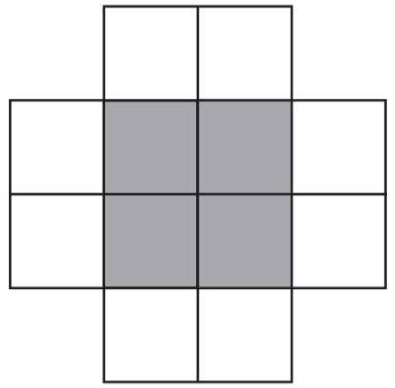
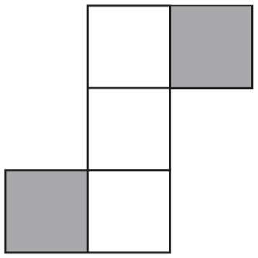
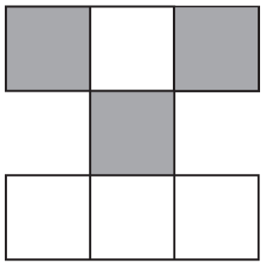
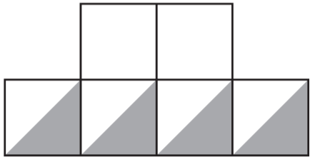
These diagrams are all made of squares.
Put a tick if exactly is shaded. Put a cross if it is not.
1
3
÷4
4
1
2
✓
=
✘
1 2
3
5
÷4
÷4
✘
3
✓
4
1
=
7
1 2
3
÷4
Notes:
G45 2010 Paper 2 Q11

Slide 3
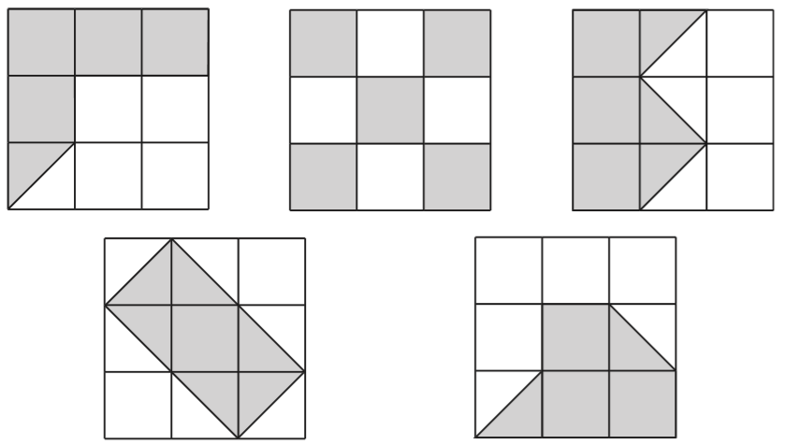
1
Put a tick on the diagram if exactly of it is shaded.
2
5 shaded
4 white
4½ shaded
4½ shaded
4½ white
4½ white
✓
✘
✓
4 shaded
4 shaded
✘
✘
5 white
5 white
Notes:
G122 2007 Paper 2 Q8

Slide 4
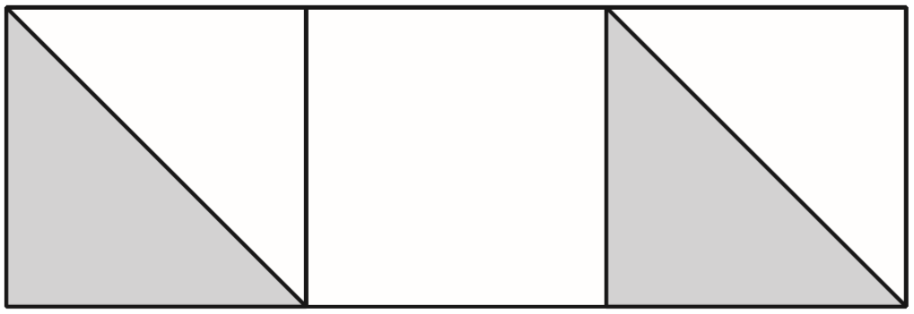
Holly says, ‘One-third of this shape is shaded.’
Is Holly correct? Explain how you know.
x2
Holly is correct.
1
2
=
Two sixths is shaded and that is equivalent to one third.
3
6
x2
The two shaded triangles are the same as one square and that makes one out of three squares (one third) shaded.
Notes:
G239 2011 Paper 1 Q15

Slide 5
Compare fractions

Slide 6
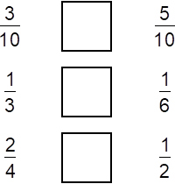
< = >
Write the correct sign in each box to make these sentences correct.
<
x2
1
2
=
>
3
6
x2
x2
1
2
=
=
2
4
x2
Notes:
G351 Pre-2000 or other question

Slide 7
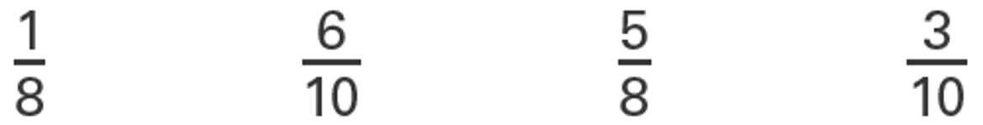
1
Circle the two fractions that are greater than
2
x4
x5
1
4
1
5
=
=
2
8
2
1 0
x4
x5
Notes:
G417 2003 Year 4 Optional Paper 1 Q24

Slide 8

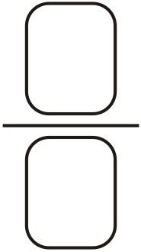
Here are some number cards.
Use two of the cards to make a fraction which is less than
1
2
3
5
3
3
How much less than 1 is your fraction?
11
9
7
8
11
less
1 1
3
8
1 1
+
=
1 1
1 1
1 1
Notes:
G525 Pre-2000 or other question

Slide 9
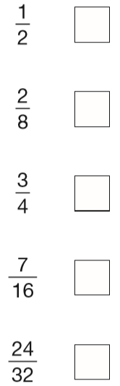
5
Tick the fractions less than
8
x2
x4
✓
5
1 0
5
2 0
x4
=
=
1
4
8
1 6
8
3 2
=
2
8
x2
x4
✓
x4
x2
✘
3
6
=
4
8
x2
✓
✘
Notes:
2019 Paper 3 Q18

Slide 10
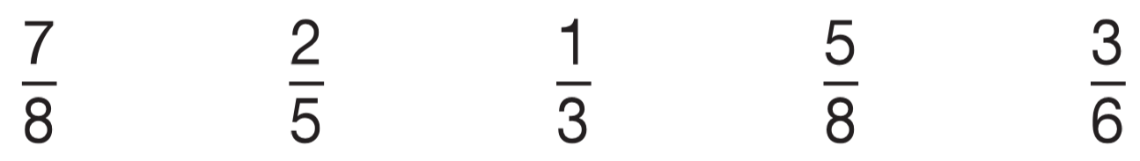
1
3
Circle the fraction that is greater than but less than
2
4
✘
✘
✘
x4
3
1
1
1
4
1
more than
less than
less than
=
equal to
4
2
2
2
8
2
x4
x2
x2
x2
x3
3
6
2
4
1
2
1
3
=
=
=
x2
=
4
8
5
1 0
3
6
3
6
2
6
=
x2
x2
x2
4
8
x3
x2
Notes:
G62 2010 Paper 1 Q20

Slide 11
Order fractions

Slide 12
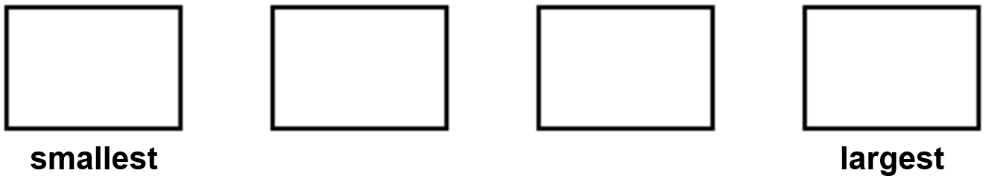
Place these fractions in order of size, starting with the smallest.
1
1
5
5
2
3
12
6
x6
x3
x2
1
6
1
4
5
1 0
=
=
=
2
1 2
3
1 2
6
1 2
x6
x3
x2
1
5
1
5
3
1 2
2
6
Notes:
G178 Pre-2000 or other question

Slide 13
Write these numbers in order, starting with the smallest.
5
7
17
4
4
6
12
3
x3
x2
x4
5
1 5
7
1 4
4
1 6
=
=
=
4
1 2
6
1 2
3
1 2
x3
x2
x4
7
5
4
1 7
6
4
3
1 2
Notes:
G631 Pre-2000 or other question

Slide 14
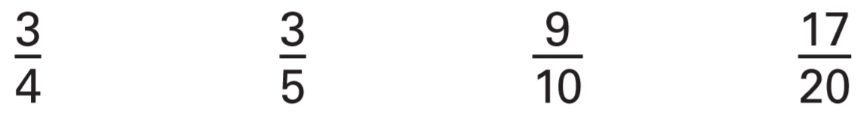
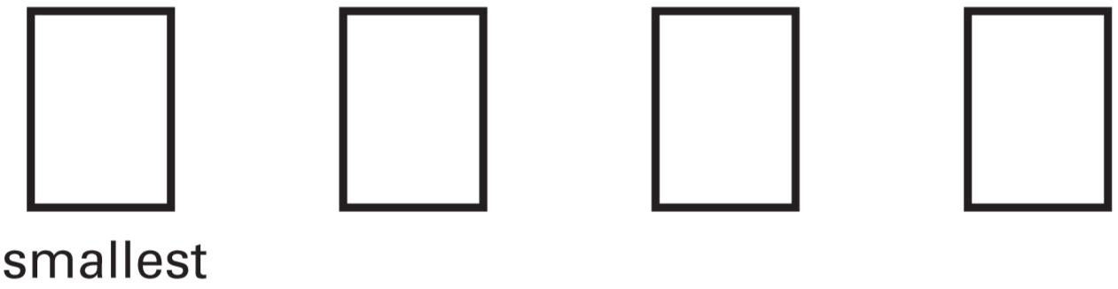
Write these fractions in order of size starting with the smallest.
x5
x4
x2
1 5
1 2
1 8
=
=
=
2 0
2 0
2 0
x5
x4
x2
3
3
1 7
9
5
4
2 0
1 0
Notes:
G374 2005 Paper 1 Q22

Slide 15
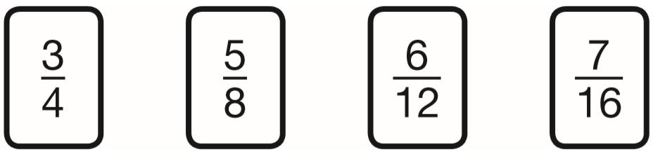
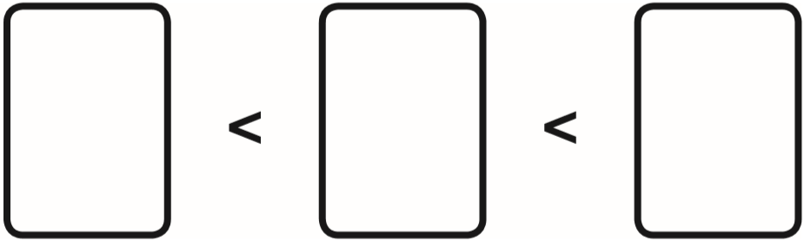
Here are four fraction cards.
Use any three of the cards to make this correct.
12
10
16
16
x4
3
1 2
=
4
1 6
x4
7
5
3
x2
1 6
8
4
5
1 0
=
8
1 6
x2
Notes:
2015 (Sample) Paper 3 Q13 page 1

Slide 16
Here are four fraction cards.
Use any three of the cards to make this correct.
x6
3
1 8
=
4
2 4
x6
x3
5
1 5
=
8
2 4
6
5
3
x3
1 2
8
4
x2
6
1 2
=
1 2
2 4
x2
Notes:
2015 (Sample) Paper 3 Q13 page 2

Slide 17
Here are four fraction cards.
Use any three of the cards to make this correct.
over ½
½
under ½
5
7
6
3
8
1 6
1 2
4
Notes:
2015 (Sample) Paper 3 Q13 page 3

Slide 18
Convert between mixed numbers and improper fractions

Slide 19
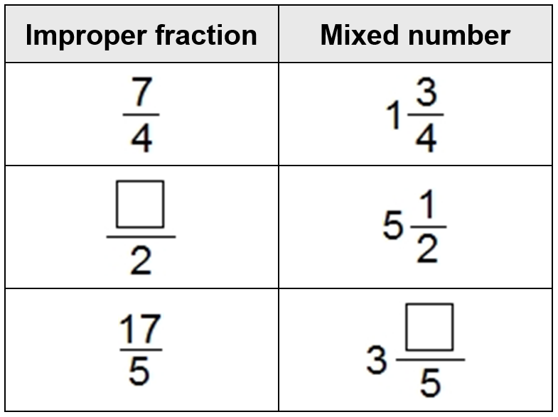
Write the missing numbers.
11
1
5 x 2 + 1 =
5
2
1 0 + 1 =
1 1
2
17
2
=
3
5
5
1 7 ÷ 5 =
3 r 2
Notes:
G433 Pre-2000 or other question

Slide 20
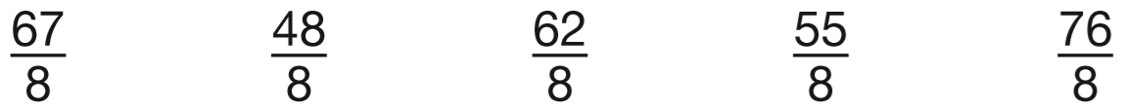
7
Circle the improper fraction that is equivalent to 6
8
7
6 x 8 + 7 =
6
8
4 8 + 7 =
5 5
Notes:
2018 Paper 2 Q13

Slide 21

Write the two missing values to make these equivalent fractions correct.
34
2
x2
17
2
=
3
1 7
3 4
5
5
=
5
1 0
1 7 ÷ 5 =
x2
3 r 2
1
1 7
x
2
3
4
Notes:
G510 Pre-2000 or other question

Slide 22
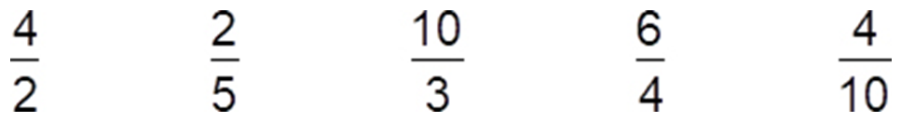
Here are fractions.
Circle the improper fractions.
1
6
Which fraction is equivalent to 1 ?
x2
2
4
3
6
=
1
3
2
4
1
=
2
2
x2
2
4
x2
Which two fractions are equivalent?
and
5
10
2
4
=
5
1 0
x2
Notes:
G59 Pre-2000 or other question

Slide 23
3
How many quarters are there in 2 ?
11 quarters
4
3
2 x 4 + 3 =
2
4
8 + 3 =
1 1
4
Notes:
G148 Pre-2000 or other question

Slide 24
How many halves are there in 15?
30
2 halves in 1
x15
30
30
halves in 15
= 15
2
2 x 15 = 30
Notes:
G278 Pre-2000 or other question

Slide 25
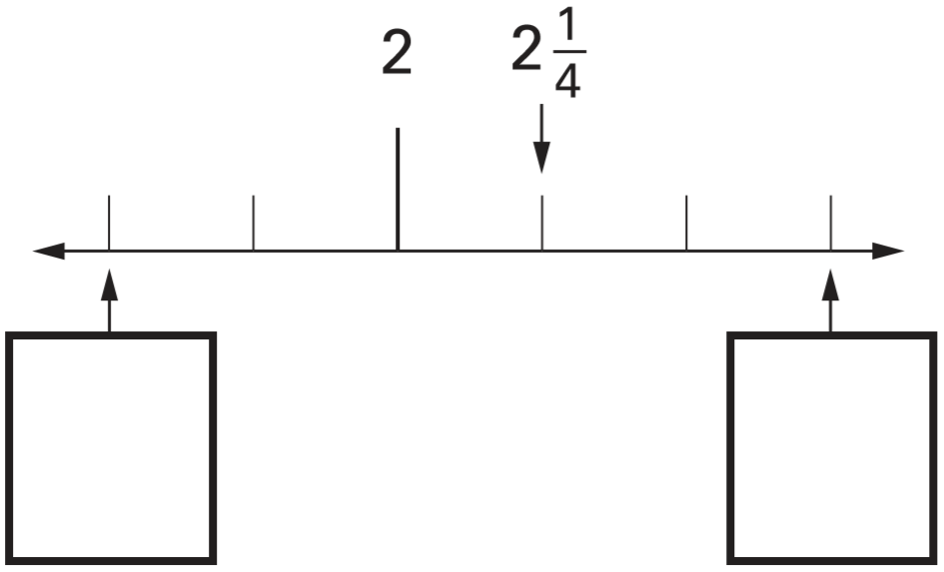
Here is part of a number line.
Write in the two missing numbers.
1
2
3
1
1
2
2
4
4
2
2
2
–
=
1
4
4
Notes:
G319 2004 Paper 2 Q17

Slide 26
Round fractions and decimals to the nearest whole number

Slide 27
Round the following numbers.
5 4 0 to the nearest 100 _______
2 3 6 to the nearest 10 _______
1¾ to the nearest whole number _______
500
240
2
1.7 5
Notes:
G611 2009 Paper 2 Q2

Slide 28
Round each of these numbers to the nearest whole number.
13.7 is nearest to _____
8 is nearest to _____
3.38 is nearest to _____
14
3
3
1
8
because is less than
8
8
2
3
Notes:
G527 Pre-2000 or other question

Slide 29
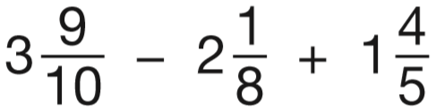
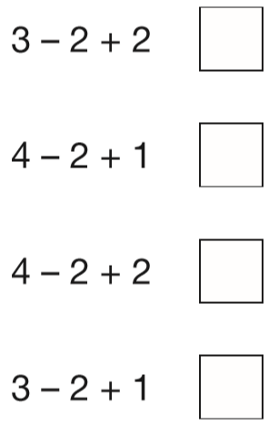
Layla wants to estimate the answer to this calculation.
Tick the calculation below
that is the best estimate.
more than ½
so round up
less than ½
so round down
more than ½
so round up
4
2
2
✓
Notes:
2018 Paper 2 Q19

Slide 30
Complete missing number problems for fraction addition and subtraction

Slide 31


Write the missing fractions.
5
11
6
5
Notes:
G74 Pre-2000 or other question

Slide 32


Write the missing fractions.
6
5
14
10
10
10
4
2
12
12
Notes:
G176 Pre-2000 or other question

Slide 33


Complete the missing numbers to make the calculations correct.
303
300
1000
0.7
0.007
707
700
707
1000
1000
Notes:
G270 Pre-2000 or other question

Slide 34
Solve problems involving fraction addition and subtraction

Slide 35
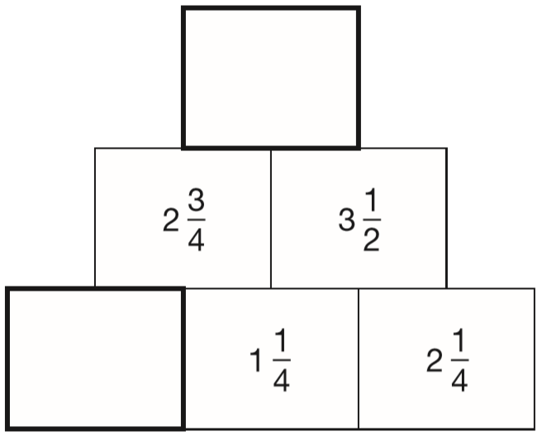
In this diagram, the number in each box is the sum of the two numbers below it.
Write the missing numbers.
3
1
2
+
3
=
4
2
1
1 1
7
6
+
=
4
4
2
1 1
1 4
2 5
+
=
4
4
4
3
1
2
–
1
=
4
4
2
1
1
4
1 1
5
6
2
–
=
4
4
4
Notes:
G343 2014 Paper 1 Q18

Slide 36
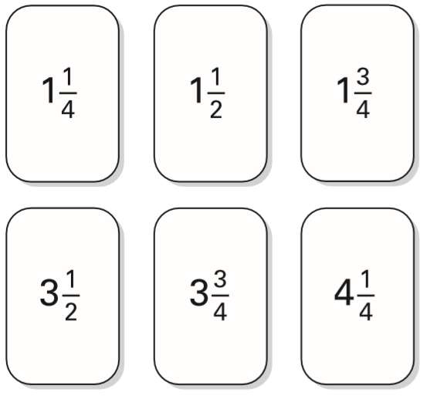
Tick two cards that give a total of 5
3
1
3
+ 1
=
5
4
4
✓
✓
4
4
+
4 + 1 =
=
5
4
1
1
3
+ 1
=
5
2
2
✓
✓
2
4
+
4 + 1 =
=
5
2
Notes:
G483 2002 Paper 1 Q8

Slide 37
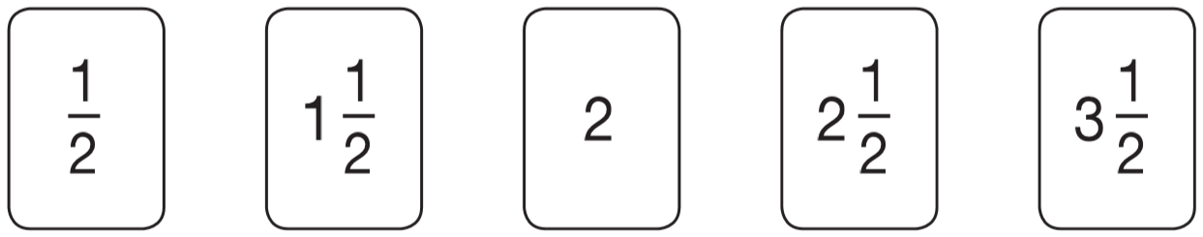
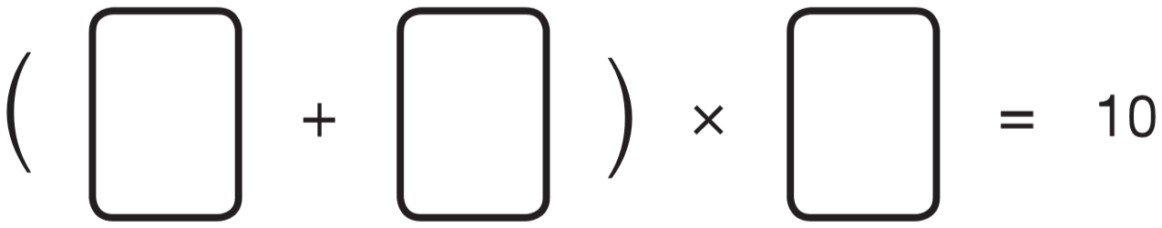
Here are five number cards.
Use three of the number cards to make this calculation correct.
1
1
3
1
2
2
2
Notes:
G551 2010 Paper 1 Q14 first page

Slide 38
Here are five number cards.
Use three of the number cards to make this calculation correct.
1
1
1
3
2
2
2
2
1
2 x 2 =
5
2
1
4 x 2 =
10
2
Notes:
G552 2010 Paper 1 Q14 second page

Slide 39
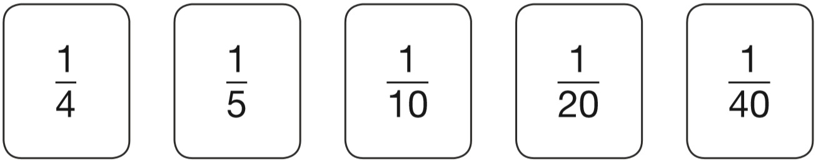
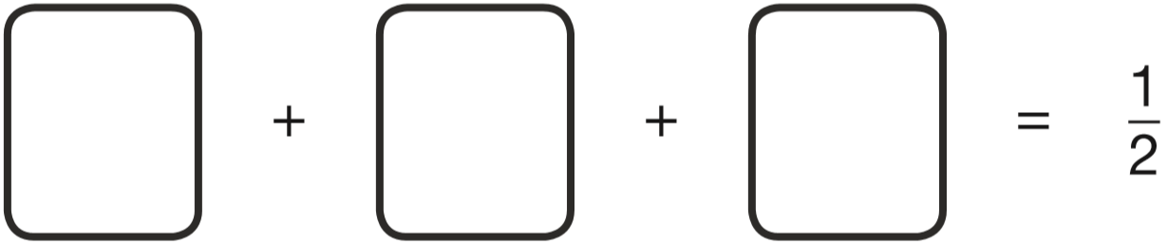
10
8
4
2
40
40
40
40
Use three of these fraction cards to complete the sum below.
1
1
1
20
4
5
2 0
40
Notes:
G2 2015 Level 6 Paper A Q10

Slide 40

The numbers in this sequence increase by the same amount each time.
Write the missing numbers.
3
7
2
8
8
5
5
5
5
+
+
+
+
8
8
8
8
8
5
3
1
5
–
=
2
+
8
8
8
4
8
2
5
2
+
8
8
Notes:
2017 Paper 3 Q21

Slide 41
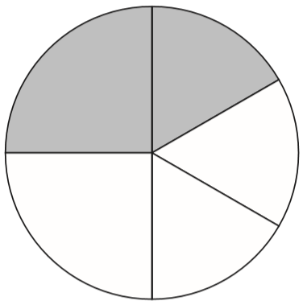
1
1
In this circle, and are shaded.
What fraction of the whole circle is not shaded?
4
6
7
1 2
5
1
1
5
+
=
1 2
4
6
1 2
1
1
x3
x2
6
4
1
3
1
2
=
=
4
1 2
6
1 2
x3
x2
3
2
5
+
=
1 2
1 2
1 2
1 2
5
7
-
=
1 2
1 2
1 2
Notes:
2017 Paper 2 Q23

Slide 42
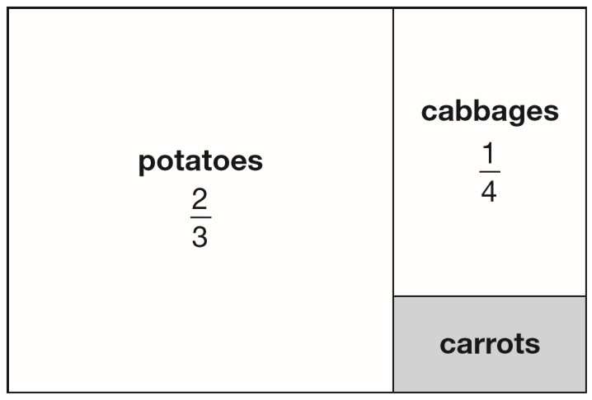
This is a diagram of a vegetable garden.
It shows the fractions of the garden planted with potatoes and cabbages.
The remaining area is planted with carrots.
What fraction of the garden is planted with carrots?
x4
x3
2
8
1
3
=
=
3
1 2
4
1 2
1 2
1 1
1
-
=
is carrots
x4
x3
1 2
1 2
1 2
8
3
1 1
is potatoes or cabbages
+
=
1 2
1 2
1 2
Notes:
2018 Paper 3 Q18

Slide 43
Find a fraction of a number

Slide 44
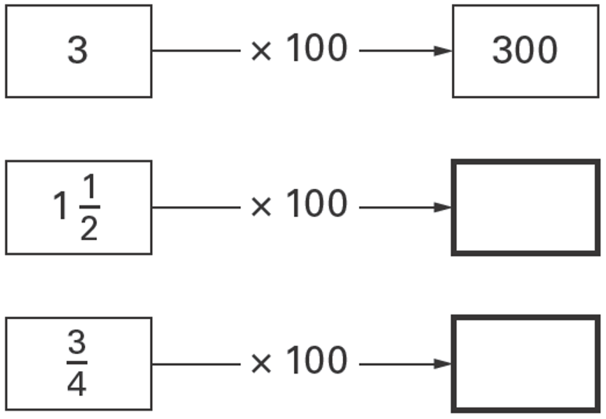
Write in the missing numbers.
One has been done for you.
3
x 1 0 0
=
3 0 0
1
5
0
150
2
2
2
3 0 0
1
3
x 1 0 0
=
3 0 0
7
5
75
4
4
4
3 0 0
2
Notes:
G172 2006 Year 4 Optional Paper 2 Q27

Slide 45
Five children shared 4 packs of sweets equally.
What fraction of a packet did they each receive?
4
5
Notes:
G286 Pre-2000 or other question

Slide 46
Three-quarters of a number is 48
What is the number?
3
of = 48
64
4
Check that it works!
4 8 ÷ 3 = 1 6
6 4 ÷ 4 = 1 6
1 6 x 4 = 6 4
1 6 x 3 = 4 8
2
1
1
6
1 6
1
6
1 6
3
4 8
x
4
4
6 4
x
3
1
2
6
4
4
8
Notes:
G373 2003 Paper 1 Q24

Slide 47
In a class, 18 of the children are girls.
A quarter of the children in the class are boys.
Altogether, how many children are there in the class?
so three quarters are girls
24
3
Check that it works!
of = 18
24
4
¾ of 24 =
18 girls
¼ of 24 =
6 boys
1 8 ÷ 3 = 6
18 + 6 =
24 children
6 x 4 = 2 4
Notes:
G605 2012 Paper 1 Q24

Slide 48
Ben thinks of a number.
He adds half of the number to a quarter of the number.
The result is 60
What was the number Ben first thought of?
1
1
80
+
=
2
4
3
Check that it works!
2
1
3
of = 60
+
80
=
4
4
4
4
½ of 80 = 40
¼ of 80 = 20
6 0 ÷ 3 = 2 0
40 + 20 = 60
2 0 x 4 = 8 0
Notes:
G495 2008 Paper 1 Q21

Slide 49
2
On Saturday Lara read of her book.
On Sunday she read the other 90 pages to finish the book.
How many pages are there in Lara’s book?
5
150 pages
90
Sat
Sat
Sun
Sun
30
30
30
Sun
30
30
3
of = 90
150
30
5
90 ÷ 3 =
150
30 x 5 =
9 0 ÷ 3 = 3 0
3 0 x 5 = 1 5 0
Notes:
2015 (Sample) Paper 2 Q20

Slide 50
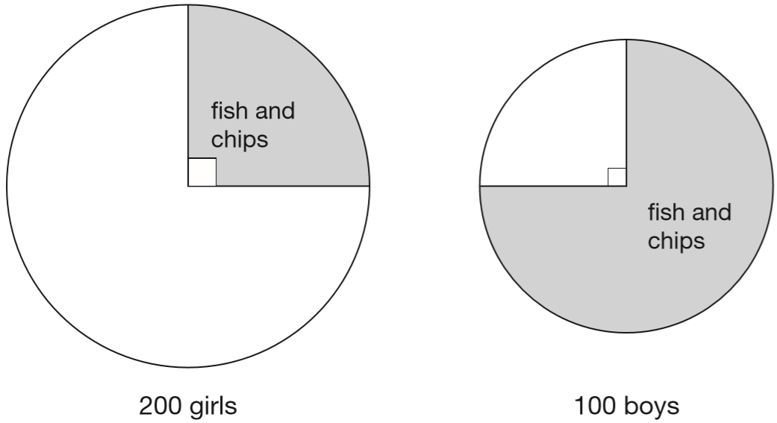
200 girls and 100 boys were asked about their favourite meal.
These pie charts show the results.
50 + 75 = 125 fish and chips
200 + 100 = 300 children
1
of 200 = 50
4
3
of 100 = 75
4
For each statement put a tick if it is true.
Three-quarters of the boys chose fish and chips.
Three times as many boys as girls chose fish and chips.
Altogether, half of the children chose fish and chips.
25 more boys than girls chose fish and chips.
✓
✘
✘
✓
Notes:
G302 2015 Level 6 Paper A Q4

Slide 51
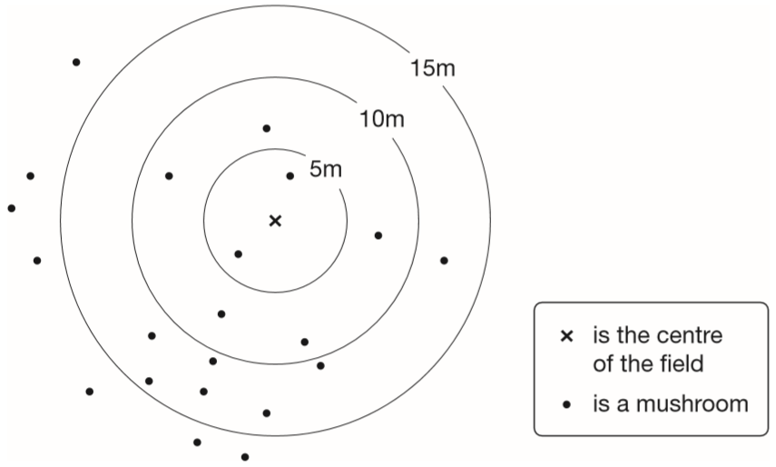
Class 6 did a survey of mushrooms growing in a field.
The diagram shows the distances of mushrooms from the centre of the field.
How many mushrooms were more than 10 metres from the centre?
14 mushrooms
Notes:
G378 2015 Paper 2 Q11 page 1

Slide 52
Class 6 did a survey of mushrooms growing in a field.
The diagram shows the distances of mushrooms from the centre of the field.
What fraction of the mushrooms were less than 10 metres from the centre?
7 less than 10 m
14 more than 10 m
21 altogether
÷7
7
1
=
2 1
3
÷7
Notes:
G379 2015 Paper 2 Q11 page 2

Slide 53
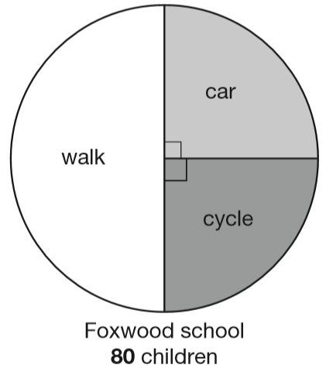
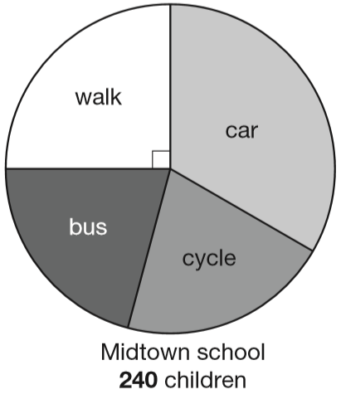
Megan asked children from two different schools, ‘How do you travel to school?’ Here are her results.
Megan says, ‘The number of children walking to Foxwood school is more than the number walking to Midtown school.’
Is she correct? Explain how you know.
Megan is wrong.
1
1
One quarter of 240 is more than one half of 80
of 80 =
40
of 240 =
60
2
4
80 ÷ 2 =
40
240 ÷ 4 =
60
Notes:
G52 2013 Paper 2 Q25 page 1

Slide 54
Megan asked children from two different schools, ‘How do you travel to school?’ Here are her results.
At Midtown school, one third of children travel by car. The number of children who cycle is the same as the number who go on the bus. How many children cycle to Midtown school?
1
of 240 =
60
4
60
80
240 ÷ 4 =
60
50
50
50
1
of 240 =
80
3
240 – 60 – 80
240 ÷ 3 =
80
100
240 – 140 =
100 ÷ 2 =
50 children
Notes:
G53 2013 Paper 2 Q25 page 2

Slide 55
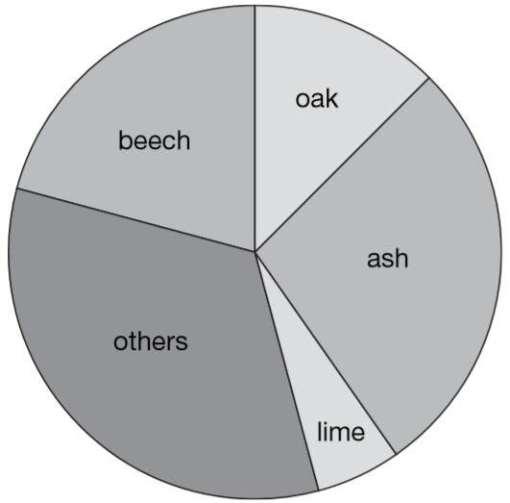
Class 6 did a survey of the number of trees in a country park.
This pie chart shows their results.
Estimate the fraction of trees in the survey that are oak trees.
?
1
1
3
between
and
8
1 0
2 0
60
The children counted 60 ash trees.
Use the pie chart to estimate the number of beech trees they counted.
3
of 60 =
4 5
beech trees
4
6 0 ÷ 4 = 1 5
1 5 x 3 = 4 5
Notes:
G107 2006 Paper 1 Q20

Slide 56
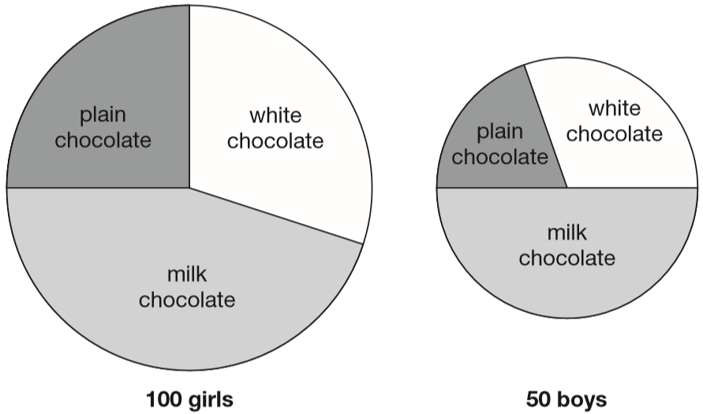
100 girls and 50 boys were asked which kind of chocolate they like best. These two pie charts show the results.
Dev says, ‘The pie charts show that more girls than boys liked milk chocolate best.’
Dev is correct.
Explain how you know.
1
1
of 100 = 25
of 50 =
25
4
2
Half of 50 = 25 boys
50 ÷ 2 =
25
Over a quarter of 100 = over 25 girls
Notes:
2015 (Sample) Paper 2 Q18

Slide 57
Recognise place value in numbers with up to three decimal places

Slide 58
Look at this number.
23,451.96
4
Write the digit that is in the hundreds place.
Write the digit that is in the hundredths place.
6
Ten thousands
Tens
Tenths
Thousands
Hundreds
Ones
Hundredths
1
1
10000
1000
100
10
1
10
100
1
1
100s
10s
1s
10 000s
1 000s
10
100
2 3 4 5 1 9 6
Notes:
2015 (Sample) Paper 3 Q3

Slide 59
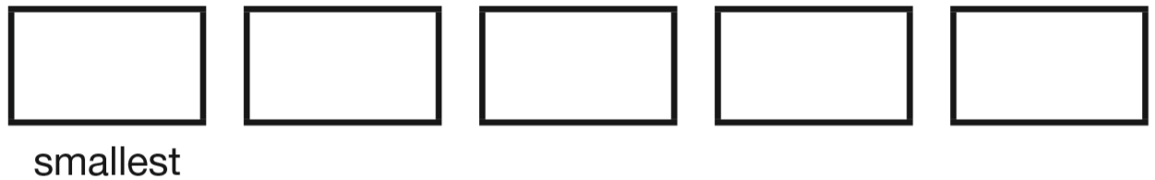
Write these numbers in order, starting with the smallest.
8.12 1.8 8.118 8.2 1.28
0
00
00
0
8.1 2
0
0 0
1.8
8.1 1 8
8.2
0 0
1.2 8
0
1.28
1.8
8.118
8.12
8.2
Notes:
G418 2014 Paper 1 Q17

Slide 60
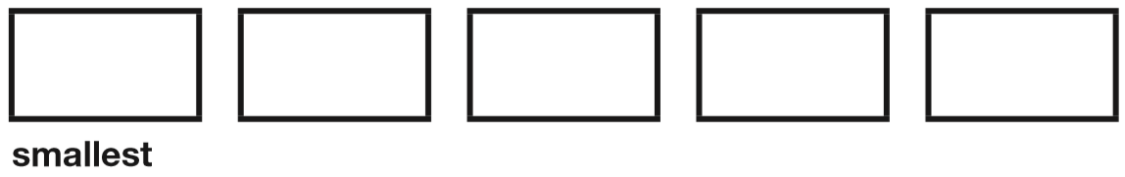
Write these numbers in order, starting with the smallest.
0.78 0.607 5.6 0.098 4.003
0
00
0.7 8
0
0.6 0 7
5.6
0 0
0.0 9 8
4.0 0 3
0.098
0.607
0.78
4.003
5.6
Notes:
2016 Paper 3 Q5

Slide 61
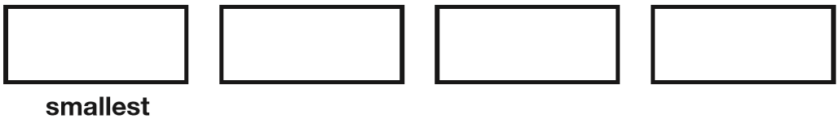
Write these numbers in order of size, starting with the smallest.
1.9 0.96 1.253 0.328
00
0
1.9
0 0
0.9 6
0
1.2 5 3
0.3 2 8
0.328
0.96
1.253
1.9
Notes:
2017 Paper 2 Q6

Slide 62
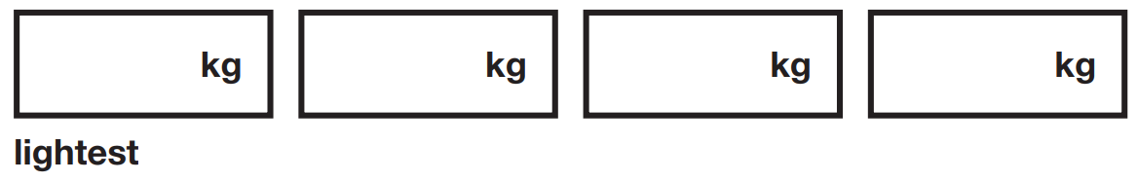
Write these masses in order, starting with the lightest.
1.250
0.990
1.25 kg 0.99 kg 1.025kg 0.009 kg
0
1.2 5
0
0.9 9
1.0 2 5
0.0 0 9
0.009
0.99
1.025
1.25
Notes:
2019 Paper 3 Q4

Slide 63
Place these numbers in order of size, starting with the smallest.
0.19 0.9 0.091 0.109
0.1 9
0
0.9
0 0
0.0 9 1
0.1 0 9
0.091
0.109
0.19
0.9
Notes:
G499 Pre-2000 or other question

Slide 64
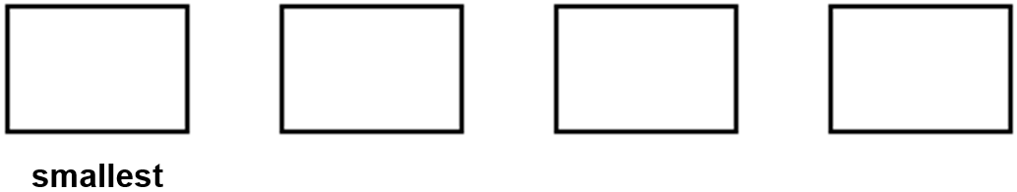
Write these numbers in order of size, starting with the smallest.
1.01 1.001 1.101 0.11
1.0 1
0
1.0 0 1
1.1 0 1
0.1 1
0
0.11
1.001
1.01
1.101
Notes:
G94 Older Level 6

Slide 65
Circle the number that is closest to 20
19.95 20.1 19.09 20.09 20.201
0.05 less
0.1 more
0.91 less
0.09 more
0.201 more
0.050
0.100
0.910
0.090
0.201
Notes:
G114 2015 Paper 2 Q18

Slide 66
Circle the two decimals which are closest in value to each other.
0.9 0.09 0.99 0.1 0.01
0
0
Notes:
G292 Older Level 6

Slide 67
Identify decimals on number lines

Slide 68
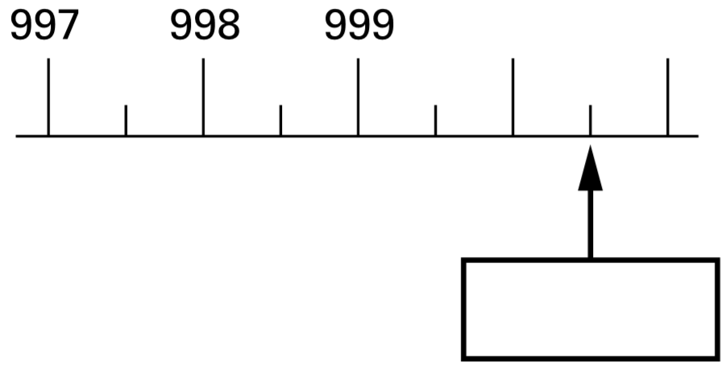
Here is part of a number line.
Write the number shown by the arrow.
1000
1001
997½
998½
999½
1000½
1000.5
Notes:
G364 2000 Paper 2 Q14

Slide 69
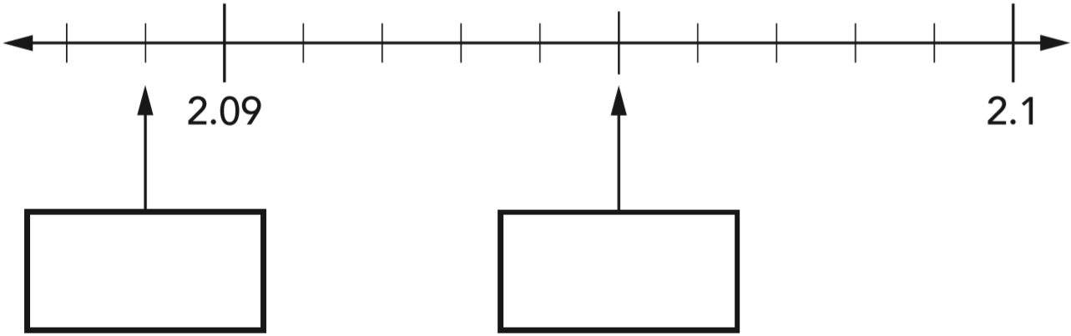
This is part of a number line. Write in the missing numbers.
0
0
0
2.089
2.095
Notes:
G480 2012 Level 6 Paper B Q2

Slide 70
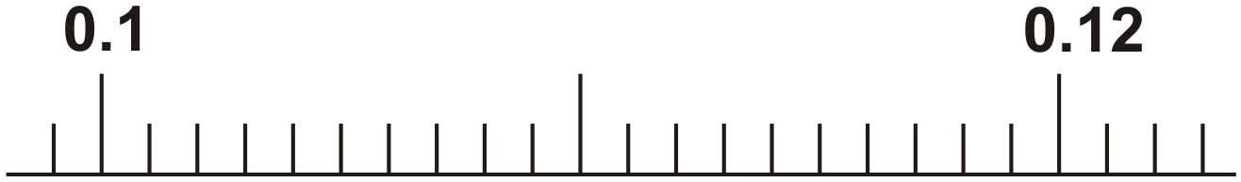
Here is a number line.
Draw an arrow to show the position of 0.111
00
0
0.110
Notes:
G561 Older Level 6

Slide 71
Convert between fractions and decimals

Slide 72
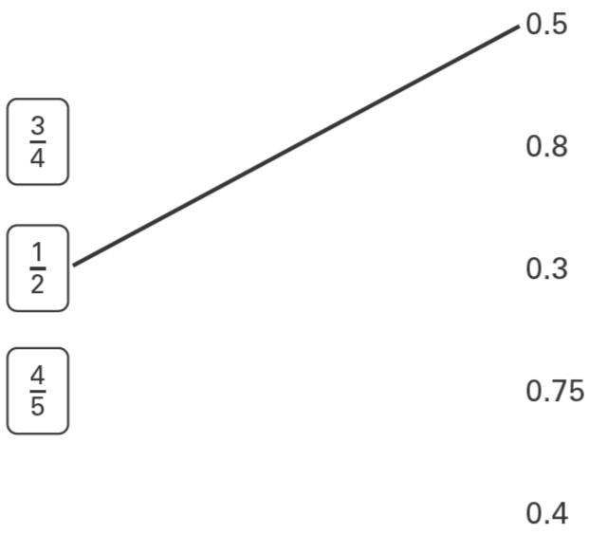
Match each box to the number which has the same value.
One has been done for you.
x25
3
7 5
=
4
1 0 0
x25
x2
4
8
=
5
1 0
x2
Notes:
G71 2003 Year 4 Optional Paper 2 Q25

Slide 73
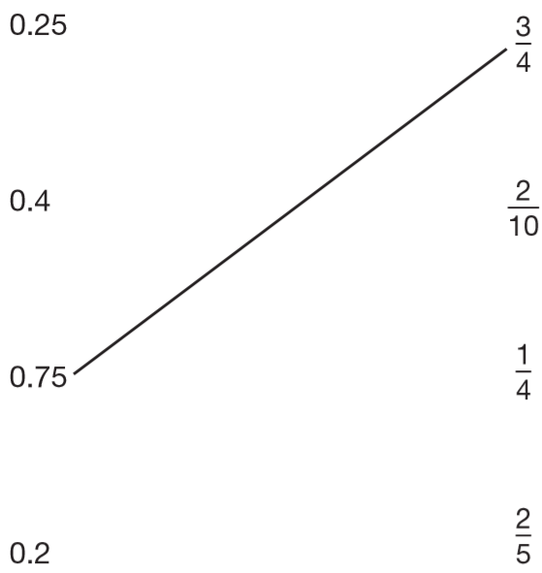
Match each decimal number to its equivalent fraction.
One has been done for you.
x25
1
2 5
=
4
1 0 0
x25
x2
2
4
=
5
1 0
x2
Notes:
G205 2006 Paper 1 Q11

Slide 74
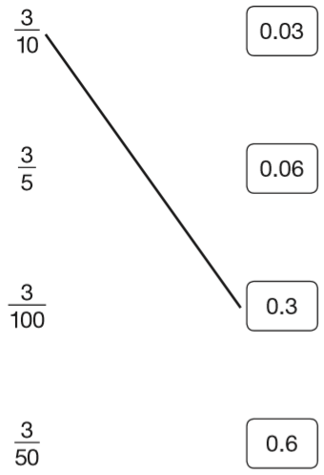
Join each fraction to the correct decimal card.
The first one has been done for you.
6
10
6
100
Notes:
G236 2014 Paper 2 Q9

Slide 75
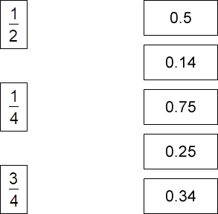
Match each fraction to its correct decimal equivalent.
x5
1
5
=
0.5
2
1 0
x5
x25
1
2 5
=
0.25
4
1 0 0
x25
x25
3
7 5
=
0.75
4
1 0 0
x25
Notes:
G391 Pre-2000 or other question

Slide 76
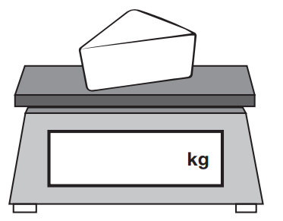
Amina is shopping. She says,
‘I would like to buy one-quarter of a kilogram of cheese.’
Write one-quarter on the scales as a decimal.
x25
1
2 5
=
4
1 0 0
x25
The cheese costs £1.35
Amina pays with a £2 coin.
How much change should Amina get?
0.25
65p
£2.00 – £1.35 =
1
9
2.0 0
1
1
-
1.3 5
.
5
£
0
6
change
Notes:
2019 Paper 2 Q11

Slide 77

Here are three symbols.
< > =
Write one symbol in each box to make the statements correct.
70
0.7
>
7
0
100
100
<
0
23
230
0.023
100
1000
Notes:
2019 Paper 2 Q12

Slide 78

Write in the missing numbers.
One is done for you.
2433
0.457
0.023
Notes:
G425 Pre-2000 or other question

Slide 79
3
Circle the number that is equal to
0.34 7.5 3.4 0.075 0.75
4
x25
3
7 5
=
0.75
4
1 0 0
x25
Notes:
G541 Pre-2000 or other question

Slide 80
1
Circle the numbers that are equal to
0.12 0.5 5.0 0.05 0.50
0
0.5
2
x5
1
5
=
2
1 0
x5
Notes:
G106 Pre-2000 or other question

Slide 81

1
Tick the two numbers that are equivalent to
4
✓
x25
1
2 5
✓
=
4
1 0 0
x25
Notes:
2018 Paper 2 Q7

Slide 82
13
Tick all the numbers that are equivalent to
0.013
1.3
0.13
0.103
0.130
100
0.13
0
✓
✓
Notes:
G146 Pre-2000 or other question

Slide 83
70
Circle the number that is equal to
0.70 0.007 0.07 0.7
0.07
0
1000
Notes:
G255 Pre-2000 or other question

Slide 84
99
Circle the number that is equal to
0.99 0.099 9.9 0.990 9.990
0.099
1000
Notes:
G342 Pre-2000 or other question

Slide 85

0
Circle two fractions that are equivalent to 0.6
x10
6
6 0
1 0
1 0 0
x10
Notes:
G408 2003 Year 5 Optional Paper 2 Q27

Slide 86
Compare fractions and decimals

Slide 87

Put a tick in each row to complete this table.
One has been done for you.
x50
6
1
5 0
=
1 0 0
2
1 0 0
✓
x50
x10
✓
1
1 0
=
2
2 0
✓
x10
2 1
1 0 0
Notes:
G570 2001 Paper 1 Q8

Slide 88

Write these in order of size, starting with the smallest.
0.75
0.43
0
x25
3
7 5
=
3
4
1 0 0
0.34
43%
0.7
4
x25
Notes:
G83 2012 Paper 1 Q23

Slide 89




In each box, circle the number that is greater.
x5
1.5
1
5
=
2
1 0
x5
1.25
1.30
x25
1
2 5
=
4
1 0 0
1.05
1.40
x25
x2
3
6
=
1.6
5
1 0
x2
Notes:
2017 Paper 3 Q17

Slide 90


Part of this number line is shaded.
x25
1
2
2 5
1
5 0
2
1
1
=
4
4
4
1 0 0
5
1
3
6
1
1
20
x25
12
12
0
1.25
1.5
Circle all the numbers below that belong in the shaded part of the number line.
0
0
4
4
12
20
Notes:
G156 2007 Paper 1 Q24

Slide 91
Add, subtract, multiply and divide decimals with up to three decimal places

Slide 92
Two decimal numbers add together to equal 1
One of the numbers is 0.007
What is the other number?
0.993
0.007 + = 1
0.993
7 + 993 = 1000
so 0.007 + 0.993 = 1.000
0
9
9
1
.0 0 0
1
1
1
- 0.0 0 7
0
.
9
9
3
Notes:
2015 (Sample) Paper 3 Q12

Slide 93

Write in the missing number.
13
1
1
1 4
.7
2 3
.2
+
8.5
–
1 0.2
2
3
.
2
1
3
.
0
Notes:
G277 2015 Paper 2 Q14

Slide 94

6 small bricks have the same mass as 5 large bricks.
The mass of one small brick is 2.5 kg.
What is the mass of one large brick?
3 kg
15 kg
6 small bricks =
6 x 2.5 =
3
5 large bricks = 15 kg
2.5
x
6
1 large brick =
15 ÷ 5 =
3 kg
1 5
0
.
Notes:
2016 Paper 3 Q16

Slide 95


Complete the number sentences using these cards.
3 6.5 5
3 6 5.5
0.2
x10
0.0 0 2
÷100
7 8 0 0
.
7.8
÷1000
4 7.3
4 7 3 0.
x100
Notes:
G590 Pre-2000 or other question

Slide 96


Here are six cards.
Use a card to complete each calculation.
÷10
x1000
5.3
5.3
5.3
0.5 3
.
5 3 0 0
0.0 5 3
÷100
Notes:
2015 (Sample) Paper 3 Q6

Slide 97


Here are five number cards.
Use four of the cards to complete these calculations.
100
0.47
4 7.
.
0
4
7
4.07
10
4.0 7
4
0
7
.
Notes:
G431 2011 Paper 1 Q20

Slide 98

Complete this table by rounding the numbers to the nearest hundred.
20 900
2 0 9 0 6
2100
2 0 9 0.6
200
2 0 9.0 6
Notes:
2016 Paper 3 Q15

Slide 99
Recognise a percentage as a fraction with a denominator of 100

Slide 100
9
Circle the percentage that is equal to
90% 90.9% 99% 9.9% 9%
100
Notes:
G559 Pre-2000 or other question

Slide 101
15% of the people walk 5 km or less.
40% of the people walk 8 km or more.
What percentage of the people walk between 5 km and 8 km?
15 + 40 =
55
45% walk between 5 km and 8 km.
100 – 55 =
45
Notes:
G36 2012 Paper 2 Q10 page 2

Slide 102
Grace made purple paint by mixing three colours.
50% was red
30% was blue
and the rest was white.
What percentage of the purple paint was white?
20%
50 + 30 =
80% red or blue
100 – 80 =
20% white
Notes:
G179 Pre-2000 or other question

Slide 103


The pie charts show the results of a school’s netball and football matches. The netball team played 30 games. The football team played 24 games.
Estimate the percentage of games that the netball team lost.
x25
It’s more than ¼ (25%)
1
2 5
=
4
1 0 0
x25
It’s less than ½ (50%)
x50
1
5 0
It’s closer to ¼ than ½ …
=
2
1 0 0
… so I would estimate 35%
x50
(You get the mark for an estimate of between 30% and 36%.)
Notes:
G206 2003 Paper 1 Q21 first page

Slide 104

This pie chart shows the ingredients to make a food mixture for wild birds. Estimate the percentage of the mixture that is suet.
x20
You get the mark for an estimate of between 15% and 25%
1
2 0
=
= 20%
5
1 0 0
x20
Mina uses 100 grams of millet in the mixture.
Estimate how many grams of sunflower seeds she should use.
100 g x 3 =
300 g
You get the mark for an estimate of between 201 g and 399 g
Notes:
G434 2012 Paper 1 Q22

Slide 105

40 children predicted who would win the boys’ race at sports day.
This pie chart shows their predictions.
10 children predicted the winner of the race correctly. Who won the race?
Explain how you know.
Jack won.
The pie chart shows ¼ for Jack.
¼ of 40 = 10
Notes:
G348 2009 Paper 1 Q21 page 2

Slide 106
40 children predicted who would win the boys’ race at sports day.
This pie chart shows their predictions.
What percentage of the children predicted that Stefan would win?
20%
25%
x50
x25
1
5 0
1
2 5
50%
=
=
2
1 0 0
4
1 0 0
x50
x25
20%
50 + 25 + 5 =
80
100 – 80 =
20
Notes:
G349 2009 Paper 1 Q21 page 1

Slide 107
All the children in Class 6 vote to pick a class captain.
The choice is Holly or Dev or Joe.
Dev gets 10% of the votes.
Joe gets twice as many votes as Holly.
What percentage of the votes does the winner get?
60%
90%
10%
Holly
30%
Joe
60%
90 ÷ 3 =
30
30%
30%
30%
Notes:
G497 2011 Paper 2 Q24

Slide 108
Connect fractions, decimals and percentages

Slide 109
7
Circle the percentage that is equal to
7% 35% 70% 20% 140%
20
x5
7
3 5
=
2 0
1 0 0
x5
Notes:
G21 Pre-2000 or other question

Slide 110

Circle the fractions that are equal to 80%
÷10
÷2
8 0
8
4
=
=
1 0 0
1 0
5
÷10
÷2
Notes:
G149 Pre-2000 or other question

Slide 111

Tick the fractions that are equal to 20%.
✘
x5
1
5
=
= 5%
2 0
1 0 0
✘
x5
x20
1
2 0
✓
=
= 20%
5
1 0 0
x20
✓
÷3
x20
3
1
2 0
=
=
= 20%
1 5
5
1 0 0
✘
÷3
x20
Notes:
2019 Paper 2 Q20

Slide 112

Circle the fractions that are equal to 60%
x6
÷10
÷2
3 6
6 0
6
3
6
=
=
=
1 0 0
1 0
5
1 0
6 0
x6
÷10
÷2
Notes:
G266 Pre-2000 or other question

Slide 113

Match each fraction to its correct percentage equivalent.
x20
2
4 0
=
5
1 0 0
x20
x2
2
4
=
5 0
1 0 0
x2
Notes:
G385 Pre-2000 or other question

Slide 114

Match each fraction to the percentage which has the same value.
One has been done for you.
x25
3
7 5
=
4
1 0 0
x25
x10
1
1 0
=
1 0
1 0 0
x10
x10
1 0
1 0 0
=
1 0
1 0 0
x10
Notes:
G405 2006 Year 5 Optional Paper 1 Q13

Slide 115

Match each fraction to its correct percentage equivalent.
x2
1 2
2 4
=
5 0
1 0 0
x2
÷3
x4
1 2
4
1 6
=
=
7 5
2 5
1 0 0
÷3
x4
÷4
x10
2 4
6
6 0
=
=
4 0
1 0
1 0 0
÷4
x10
Notes:
G503 Pre-2000 or other question

Slide 116

Draw a line to join each fraction to a percentage of the same value.
x25
1
2 5
=
4
1 0 0
x25
x10
1
1 0
=
1 0
1 0 0
x10
Notes:
G13 Pre-2000 or other question

Slide 117

Match each percentage to its correct decimal equivalent.
0
Notes:
G133 Pre-2000 or other question

Slide 118

Match each percentage to its correct decimal equivalent.
0
Notes:
G210 Pre-2000 or other question

Slide 119

Tick each of the cards that shows more than a half.
x4
x50
1
4
1
5 0
=
=
= 50%
2
8
✓
✓
2
1 0 0
x4
x50
= 0.50
✓
= 0.5
x2
x3
✓
1
2
1
3
=
=
2
4
2
6
x2
x3
Notes:
G382 Pre-2000 or other question

Slide 120
Connect a fraction and a percentage of a shape

Slide 121

Here is a pattern on a grid.
What percentage of the grid is shaded?
40% is shaded
x4
10 pieces shaded
25 pieces altogether
1 0
4 0
=
2 5
1 0 0
x4
Notes:
G444 2006 Paper 2 Q21

Slide 122

Here is a grid of 20 squares.
What percentage of the grid is shaded?
30%
6 squares shaded
6
20 squares altogether
2 0
x5
6
3 0
=
2 0
1 0 0
x5
Notes:
G547 2009 Paper 2 Q21

Slide 123

This model is made with 20 cubes.
What percentage of the cubes in the model is black?
35 percent
7 black cubes
20 cubes altogether
7
2 0
x5
7
3 5
=
2 0
1 0 0
x5
Notes:
2015 (Sample) Paper 3 Q17

Slide 124

Look at this pattern. What percentage of the pattern is black?
28 percent
7 black squares
25 squares altogether
7
2 5
x4
7
2 8
=
2 5
1 0 0
x4
Notes:
G9 2011 Level 6 Paper A Q4 second page

Slide 125

Here is a grid made of squares.
Shade 10% of this grid.
÷10
x3
1 0
1
3
=
=
1 0 0
1 0
3 0
÷10
x3
30 squares
Notes:
G158 Pre-2000 or other question

Slide 126
Solve word problems involving making connections between fractions and percentages

Slide 127
Hassan scores 40 out of 80 in a test.
Kate scores 40% in the same test.
Who has the higher score? Explain how you know.
÷40
x50
÷10
4 0
1
5 0
4 0
4
=
=
= 50%
=
8 0
2
1 0 0
1 0 0
1 0
÷40
x50
÷10
Hassan has the higher score.
4
40 out of 80 is equivalent to 50%
of 80 =
3 2
1 0
50% is higher than 40%
8 0 ÷ 1 0 = 8
Kate only got 32 out of 80
8 x 4 = 3 2
Notes:
G228 2007 Paper 2 Q18

Slide 128
A cat sleeps for 12 hours each day. 50% of its life is spent asleep.
A koala sleeps for 18 hours each day. ____% of its life is spent asleep.
75
÷12
x50
÷6
x25
1 2
1
5 0
1 8
3
7 5
=
=
=
=
2 4
2
1 0 0
2 4
4
1 0 0
÷12
x50
÷6
x25
Notes:
2017 Paper 2 Q18

Slide 129

Amina asked 60 children to choose their favourite flavour of jelly. These were her results.
What percentage of the 60 children chose orange?
÷15
x25
1 5
1
2 5
=
=
= 25%
6 0
4
1 0 0
÷15
x25
Notes:
2019 Paper 2 Q15

Slide 130
A box of crisps contains three different flavours.
prawn cocktail cheese and onion salt and vinegar
A quarter of the packets are prawn cocktail flavour.
30% are cheese and onion flavour.
What percentage are salt and vinegar flavour?
45%
x25
1
2 5
=
25% prawn cocktail
4
1 0 0
x25
55% cheese and onion or prawn cocktail
30 + 25 =
100 – 55 =
45% salt and vinegar
Notes:
G323 2013 Level 6 Paper A Q1 (adapted)

Slide 131

This pie chart shows how the children in Class 6 best like their potatoes cooked.
32 children took part in the survey.
For each statement put a tick if it is correct.
10 children like chips best.
25% of the children like mashed potatoes best.
of the children like roast potatoes best.
12 children like jacket potatoes best.
✘
1
5
2
of 32 =
8
8
3 2 ÷ 8 = 4
4 x 2 = 8
Notes:
G419 2005 Paper 1 Q18

Slide 132
This pie chart shows how the children in Class 6 best like their potatoes cooked.
32 children took part in the survey.
For each statement put a tick if it is correct.
10 children like chips best.
25% of the children like mashed potatoes best.
of the children like roast potatoes best.
12 children like jacket potatoes best.
✘
✓
1
5
÷2
x25
2
1
2 5
=
=
8
1 0 0
4
1 0 0
÷2
x25
Notes:
G420 2005 Paper 1 Q18

Slide 133
This pie chart shows how the children in Class 6 best like their potatoes cooked.
32 children took part in the survey.
For each statement put a tick if it is correct.
10 children like chips best.
25% of the children like mashed potatoes best.
of the children like roast potatoes best.
12 children like jacket potatoes best.
✘
✓
1
1
✘
5
8
✓
3
of 32 =
1 2
8
3 2 ÷ 8 = 4
4 x 3 = 1 2
Notes:
G421 2005 Paper 1 Q18

