Slide 1
Recognise that angles are measured in degrees and estimate their size

Slide 2
Kirsty says, ‘When you double the size of an acute angle, you always get an obtuse angle.’
Explain why Kirsty is not correct.
An acute angle is less than 90°
1° is an acute angle
Double 1° is 2° which is still less than 90°
Notes:
2019 Paper 3 Q13

Slide 3

Estimate the size of angle x.
Circle the closest estimate.
170° 310° 190° 260° 180°
Notes:
G38 Pre-2000 or other question

Slide 4
Find missing angles on a straight line

Slide 5

Calculate the size of angle x in the diagram.
x = 180° - 63°
x = 117°
Angles on a straight line add up to 180°.
Notes:
G124 Pre-2000 or other question

Slide 6
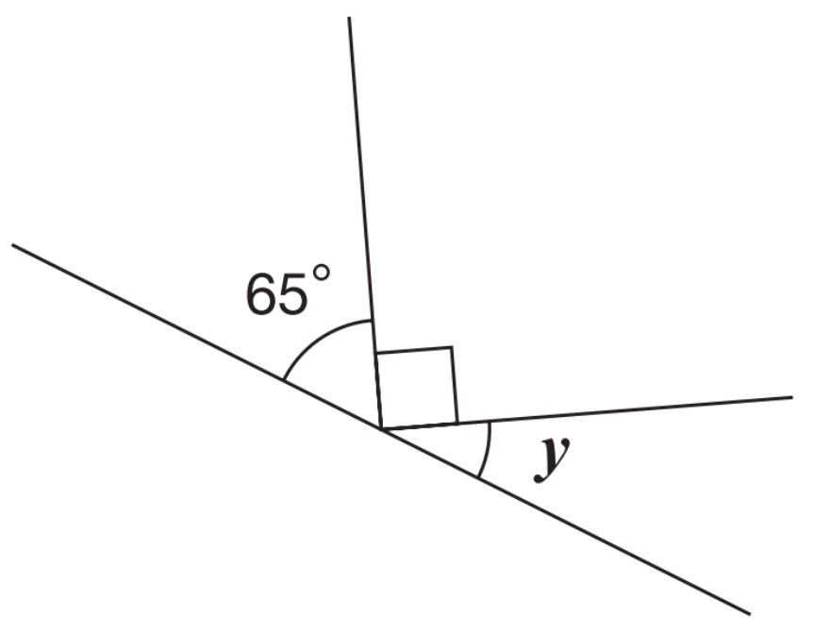
Calculate the size of angle y in this diagram.
A right angle is 90°.
Angles on a straight line add up to 180°.
90°
y = 180° - 90° - 65°
y = 180° - 155°
y = 25°
25°
Notes:
G211 2009 Paper 2 Q18

Slide 7
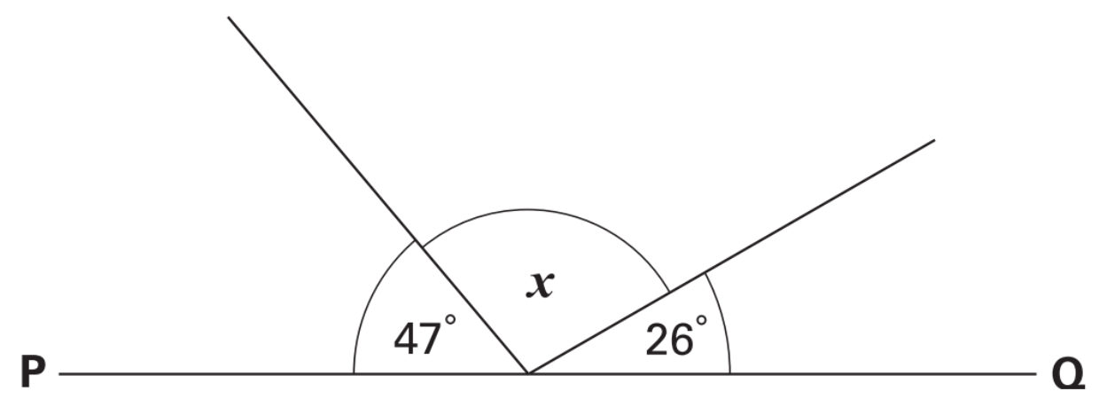
PQ is a straight line. Calculate the size of angle x.
Angles on a straight line add up to 180°.
x = 180° - 47° - 26°
x = 180° - 73°
x = 107°
107°
Notes:
G355 2003 Year 5 Optional Paper 2 Q26

Slide 8
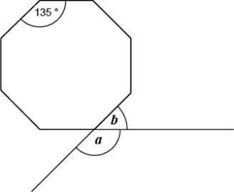
Here is a regular octagon.
Calculate the sizes of angles a and b.
Angles in a regular shape are the same size.
Angles on a straight line add up to 180°.
b = 180° - 135°
45°
b = 45°
135°
a = 180° - 45°
a = 135°
135°
Notes:
G406 Pre-2000 or other question

Slide 9
Find missing angles on a point

Slide 10
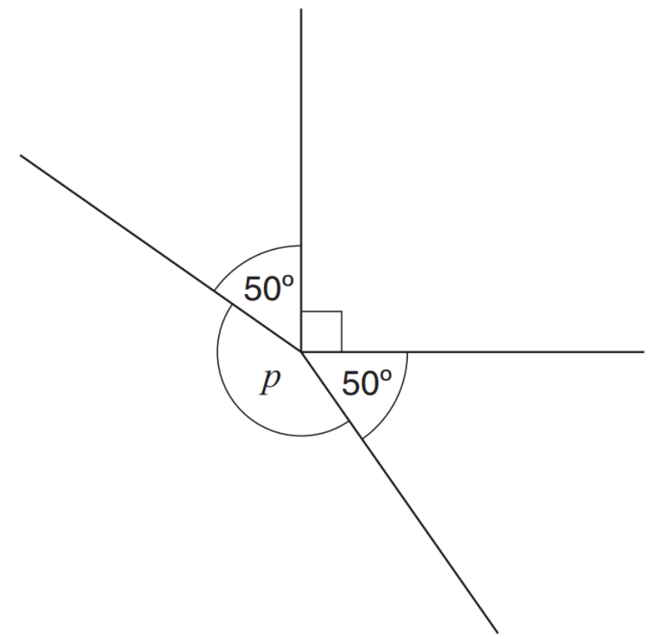
Calculate the size of angle p in the diagram.
A right angle is 90°.
Angles around a point add up to 360°.
p = 360° - 90° - 50° - 50°
90°
p = 360° - 190°
p = 170°
170°
Notes:
G505 2013 Paper 2 Q21

Slide 11
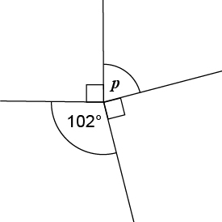
Calculate the size of angle p in the diagram.
A right angle is 90°.
Angles around a point add up to 360°.
78°
90°
p = 360° - 102° - 90° - 90°
90°
p = 360° - 282°
p = 78°
Notes:
G4 Pre-2000 or other question

Slide 12
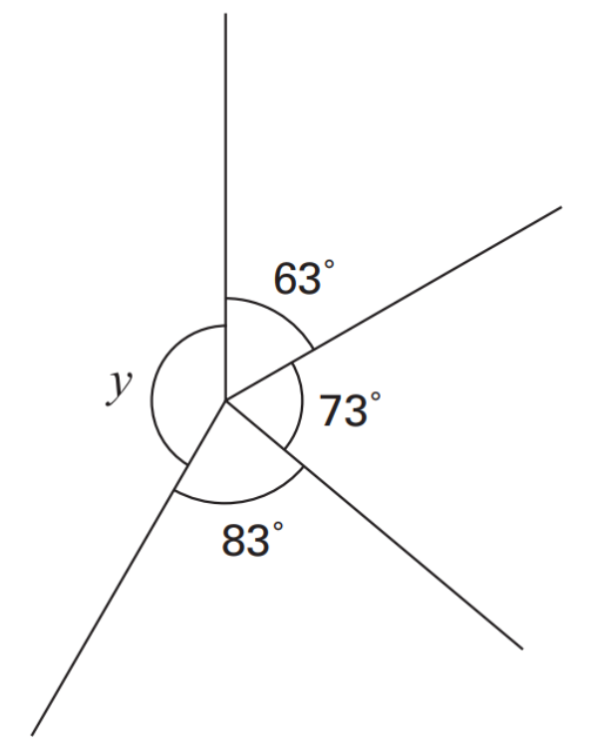
Calculate the size of angle y.
Angles around a point add up to 360°.
y = 360° - 63° - 73° - 83°
y = 360° - 219°
141°
y = 141°
Notes:
G192 Pre-2000 or other question

Slide 13
Recognise angles in turns

Slide 14
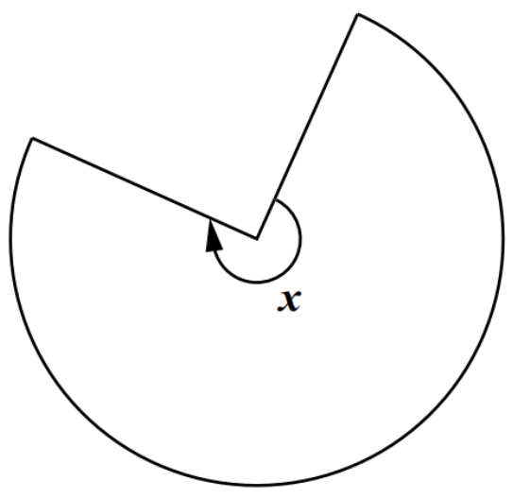
This shape is three-quarters of a circle. How many degrees is angle x?
Angles around a point add up to 360°.
A whole turn is 360°.
90°
¾ of 360° =
270°
360° - 90° = 270°
270°
Notes:
G259 2001 Paper 1 Q13

Slide 15
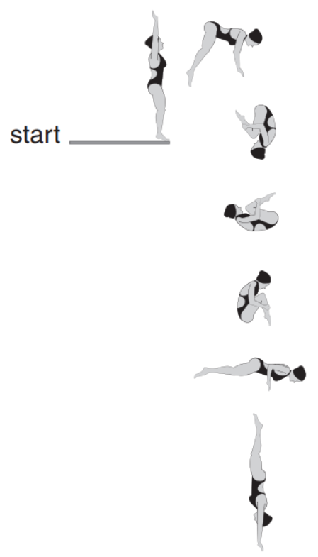
Layla completes one-and-a-half somersaults in a dive. How many degrees does Layla turn through in her dive?
90°
90°
Angles around a point add up to 360°.
90°
A whole turn is 360°.
Angles on a straight line add up to 180°.
90°
A half turn is 180°.
90°
One-and-a-half turns = 360° + 180°
= 540°
6 x 90° = 540°
90°
Notes:
2017 Paper 2 Q16

Slide 16
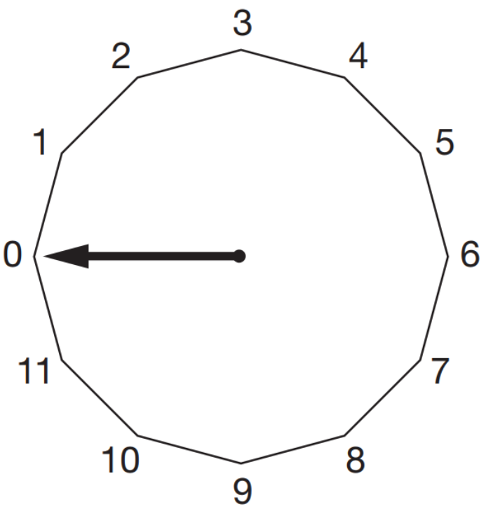
This regular 12-sided shape has a number at each vertex.
Ben turns the pointer from zero, clockwise through 150°. Which number will the pointer now be at?
30°
30°
30°
A whole turn is 360°.
30°
When the pointer moves from one number to the next, it has moved 1/12 of a turn.
30°
1/12 of 360° = 30°
150 ÷ 30 = 5
The pointer will now be at 5.
Notes:
G331 2008 Paper 1 Q18 first page

Slide 17
This regular 12-sided shape has a number at each vertex.
Nisha turns the pointer clockwise from number 2 to number 11. Through how many degrees does the pointer turn?
30°
30°
30°
30°
A whole turn is 360°.
30°
1/12 of 360° = 30°
30°
9 x 30° = 270°
30°
30°
30°
Quicker method:
Spot the right angle!
Three-quarter turn = 270°
Notes:
G332 2008 Paper 1 Q18 second page

Slide 18
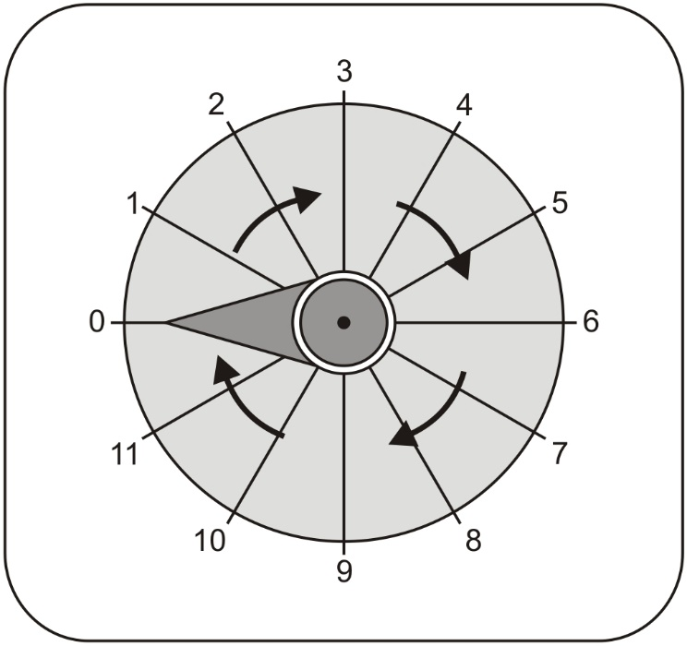
The pointer on this dial turns in a clockwise direction. The pointer is at 0. Which number does it point to after a turn of 270°?
The pointer moves from 10 to 11.
How many degrees does it turn through?
30°
30°
30°
30°
A three quarter turn is 270°.
30°
30°
It points to 9.
30°
30°
30°
30°
30°
30°
1/12 of 360° =
30°
Notes:
G435 Pre-2000 or other question

Slide 19
Apply knowledge that angles in a triangle always total 180 degrees

Slide 20
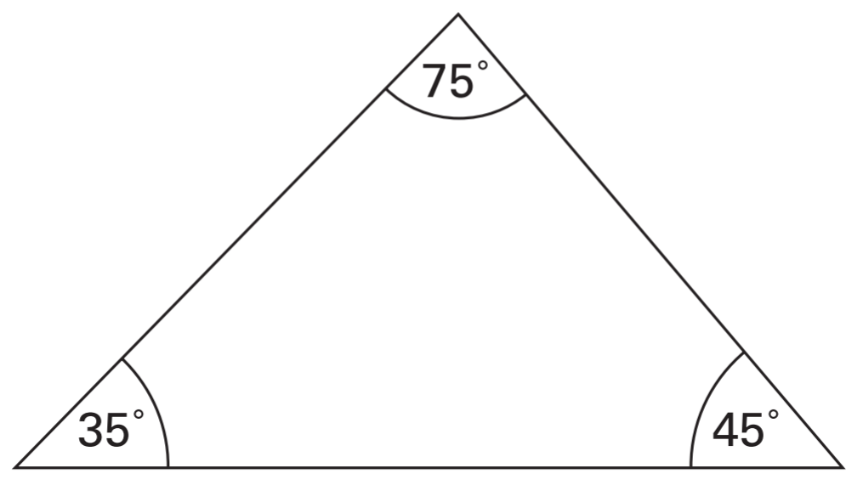
Tina measures the angles in a triangle. The sketch shows her results. How can you tell that Tina has made a mistake?
Angles in a triangle add up to 180°.
35° + 75° + 45° = 155°
Notes:
G624 Pre-2000 or other question

Slide 21
Jamie draws a triangle. He says, ‘Two of the three angles in my triangle are obtuse.’ Explain why Jamie cannot be correct.
Angles in a triangle add up to 180°.
Obtuse angles are larger than 90°.
If you have two angles which are larger than 90°, you will have more than 180°.
Notes:
G575 2007 Paper 1 Q25

Slide 22
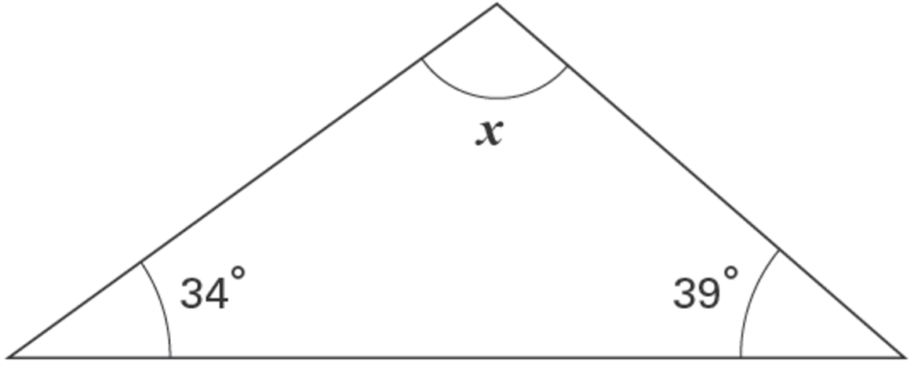
Here is a triangle. Calculate the size of angle x.
107°
107°
34 + 39 =
73
180 – 73 =
107
Notes:
G157 2006 Year 5 Optional Paper 2 Q26

Slide 23
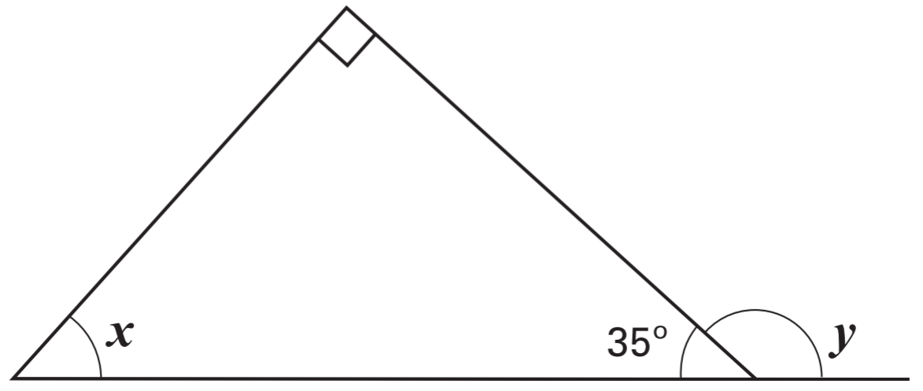
Look at this diagram. Calculate the size of angle x and angle y.
Angles on a straight line add up to 180°.
90°
y = 180° - 35°
y = 145°
145°
55°
A right angle is 90°.
x = 180° - 90° - 35°
Angles in a triangle add up to 180°.
x = 55°
Notes:
G209 2002 Paper 1 Q23

Slide 24
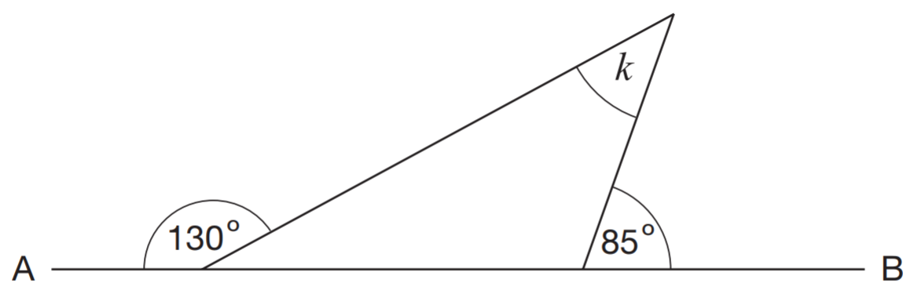
Look at the diagram. AB is a straight line. Work out the size of angle k.
Angles on a straight line add up to 180°.
Angles in a triangle add up to 180°.
k = 180° - 95° - 50°
k = 35°
35°
50°
95°
Notes:
G308 Pre-2000 or other question

Slide 25
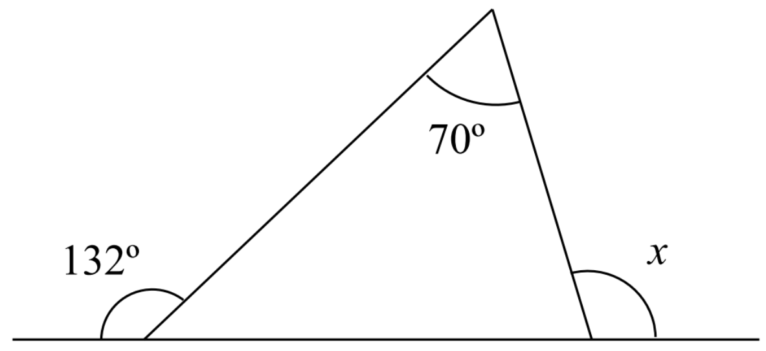
Calculate the size of angle x.
Angles on a straight line add up to 180°.
Angles in a triangle add up to 180°.
118°
48°
62°
180° - 132°
180° - 62°
180° - 70° - 48°
Notes:
G335a Pre-2000 or other question

Slide 26
Recognise isosceles triangles

Slide 27
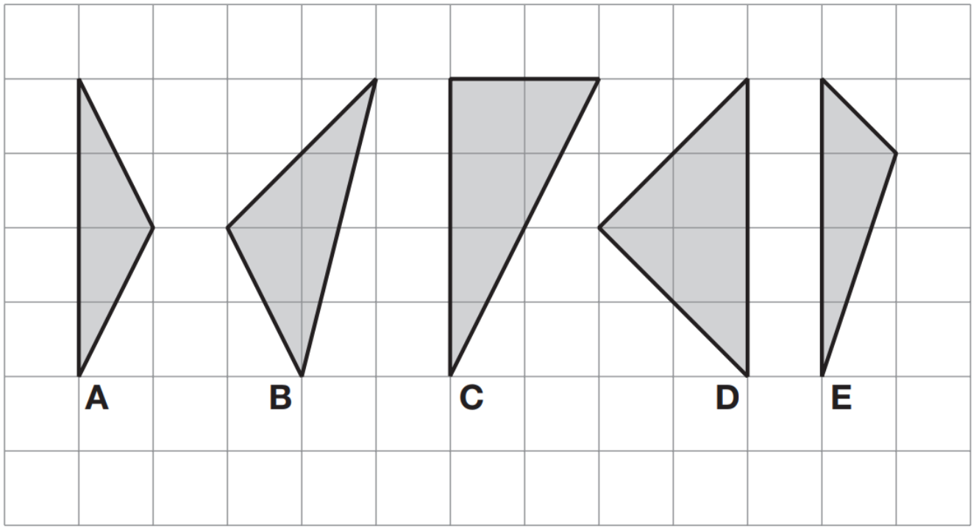
Here are five shaded triangles on a square grid.
Write the letter of each triangle that has a right angle.
Write the letter of each triangle that has two equal sides.
C
, D
A
, D
Notes:
G565 2010 Paper 2 Q16

Slide 28
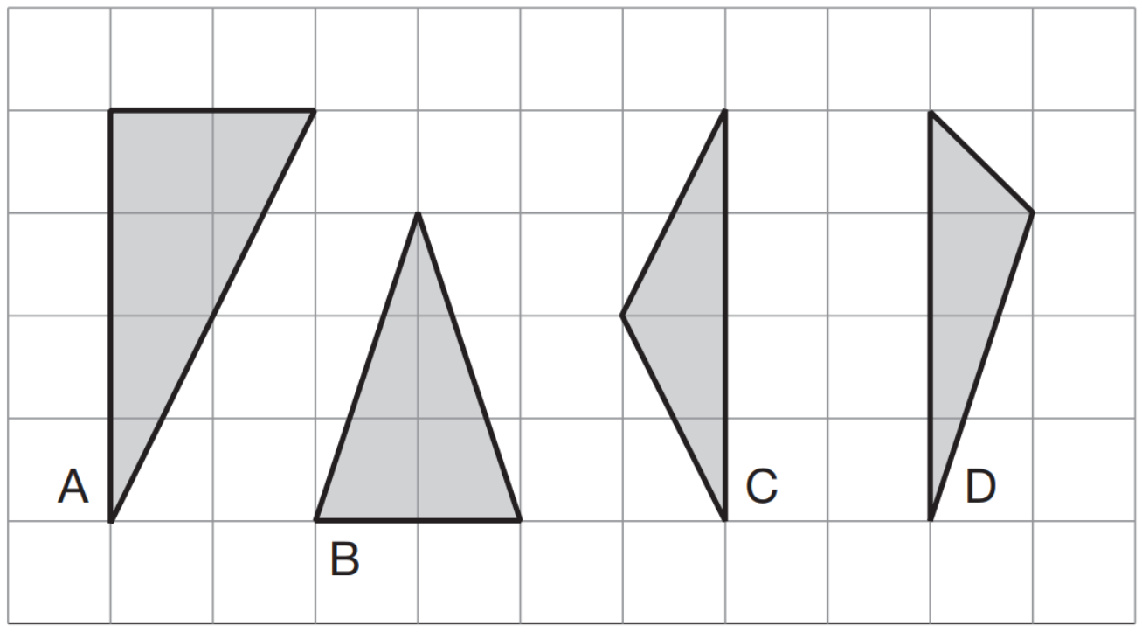
Here are four triangles on a square grid.
Write the letters of the two isosceles triangles.
b
, c
Notes:
G49 2007 Paper 2 Q14

Slide 29
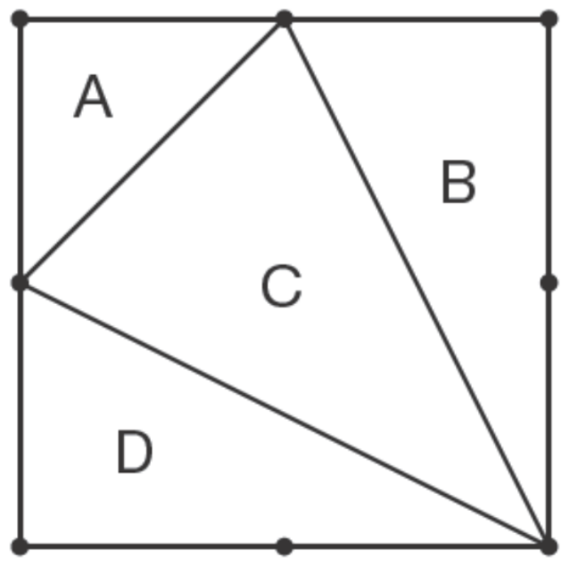
This diagram shows a square with dots at the vertices and at the middle of each side. The square is divided into four triangles, A, B, C and D.
Write the letters of all the triangles that have a right angle.
A
, B
, D
Write the letters of all the isosceles triangles.
A
, C
Notes:
G163 2012 Paper 2 Q6

Slide 30
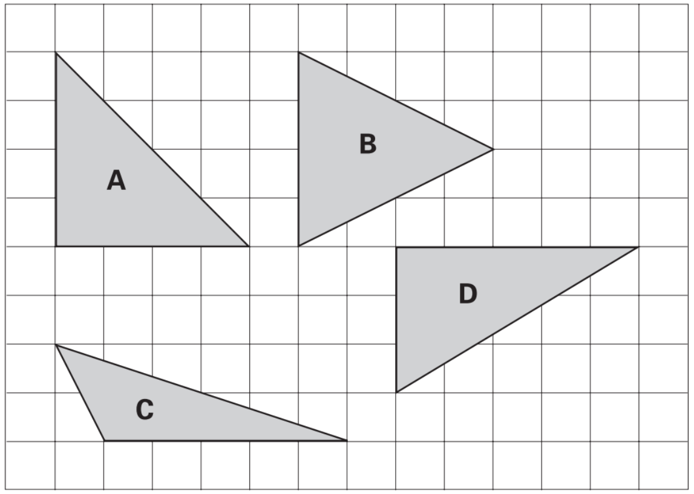
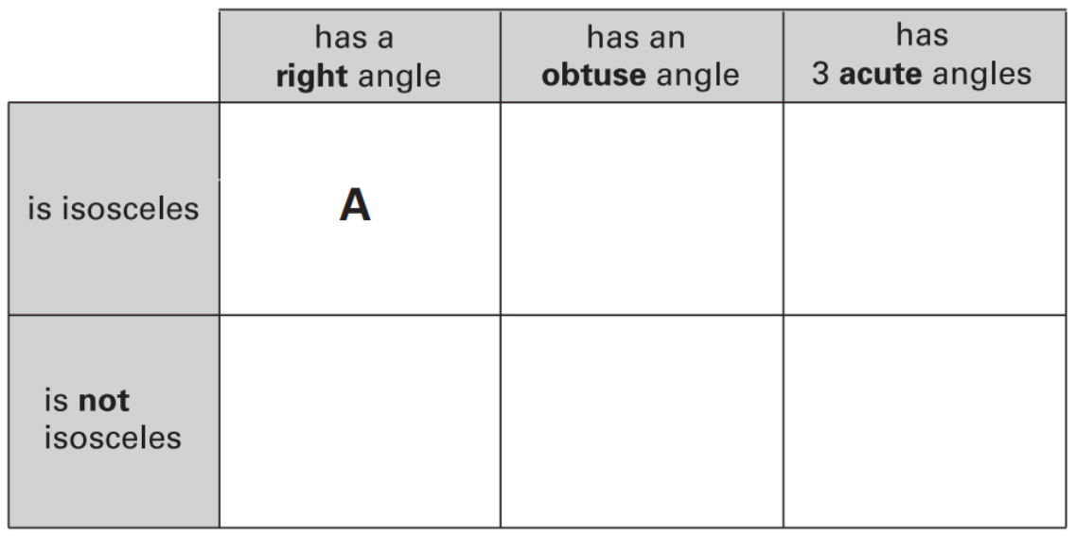
Here are four triangles drawn on a square grid. Write the letter for each triangle in the correct region of the sorting diagram. One has been done for you.
B
D
C
Notes:
G639 2002 Paper 2 Q12

Slide 31
An isosceles triangle has a perimeter of 12cm. One of its sides is 5cm. What could the length of each of the other two sides be?
Two different answers are possible. Give both answers.
5cm + ______ + ______ = 12cm
5cm
2cm
3.5cm
5cm + _______ + _______ = 12cm
3.5cm
12cm – 5cm = 7cm
7cm ÷ 2 = 3.5cm
Notes:
G377 2003 Paper 1 Q20

Slide 32
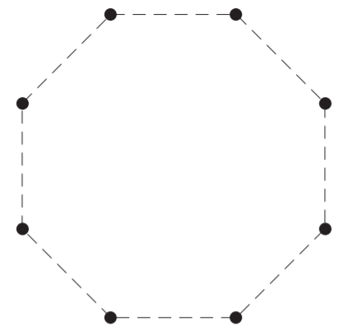
Here is a regular octagon.
Join three of the dots to make an isosceles triangle.
Notes:
G465 2004 Paper 2 Q12 page 5

Slide 33
Here is a regular octagon.
Join three of the dots to make an isosceles triangle.
Notes:
G466 2004 Paper 2 Q12 page 6

Slide 34
Here is a regular octagon.
Join three of the dots to make an isosceles triangle.
Notes:
G467 2004 Paper 2 Q12 page 7

Slide 35
Here is a regular octagon.
Join three of the dots to make an isosceles triangle.
Notes:
G468 2004 Paper 2 Q12 page 8

Slide 36
Here is a regular octagon.
Join three of the dots to make an isosceles triangle.
Notes:
G469 2004 Paper 2 Q12 page 9

Slide 37
Here is a regular octagon.
Join three of the dots to make an isosceles triangle.
Notes:
G470 2004 Paper 2 Q12 page 10

Slide 38
Here is a regular octagon.
Join three of the dots to make an isosceles triangle.
Notes:
G471 2004 Paper 2 Q12 page 11

Slide 39
Here is a regular octagon.
Join three of the dots to make an isosceles triangle.
Notes:
G472 2004 Paper 2 Q12 page 12

Slide 40
Here is a regular octagon.
Join three of the dots to make an isosceles triangle.
Notes:
G473 2004 Paper 2 Q12 page 13

Slide 41
Here is a regular octagon.
Join three of the dots to make an isosceles triangle.
Notes:
G474 2004 Paper 2 Q12 page 14

Slide 42
Recognise equilateral triangles

Slide 43
Complete this sentence.
All equilateral triangles have
sides of the same length
angles of the same size (60°)
Notes:
G521 Pre-2000 or other question

Slide 44
Two of the angles in a triangle are 70° and 40°.
Jack says, ‘The triangle is equilateral.’
Explain why Jack is not correct.
The angles in an equilateral triangle are always the same (60°)
Notes:
2018 Paper 3 Q14

Slide 45
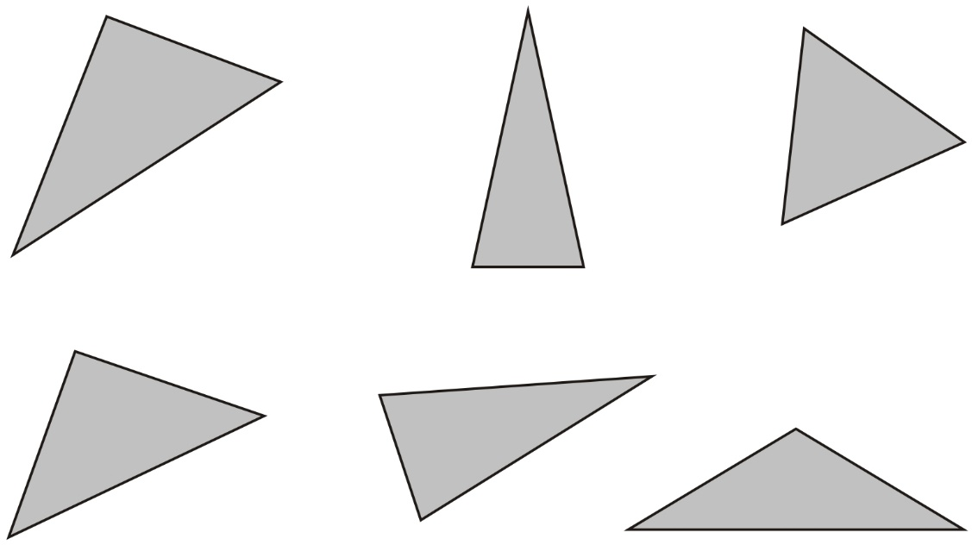
Here are six triangles. One of them is an equilateral triangle. Put a tick in the equilateral triangle.
✓
Notes:
G42 Pre-2000 or other question

Slide 46
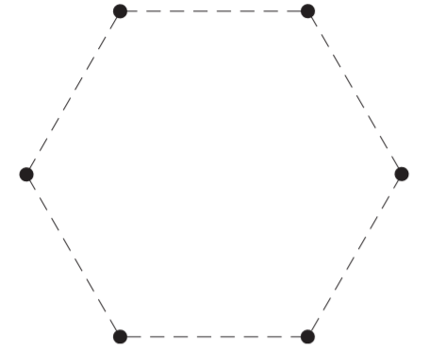
Here is a regular hexagon.
Join three of the dots to make an equilateral triangle.
Notes:
G194 2004 Paper 2 Q12 page 1

Slide 47
Here is a regular hexagon.
Join three of the dots to make an equilateral triangle.
Notes:
G195 2004 Paper 2 Q12 page 2

Slide 48
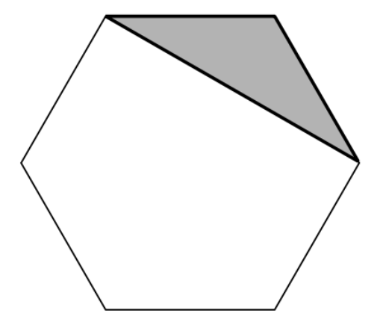
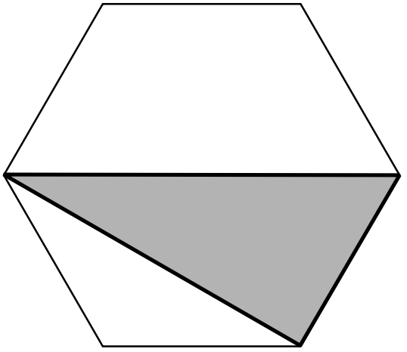
These two shaded triangles are each inside a regular hexagon.
Under each hexagon, tick the correct name of the shaded triangle.
equilateral
isosceles
scalene
equilateral
isosceles
scalene
✓
✓
Notes:
G213 2001 Paper 2 Q18

Slide 49
Recognise parallel and perpendicular lines

Slide 50
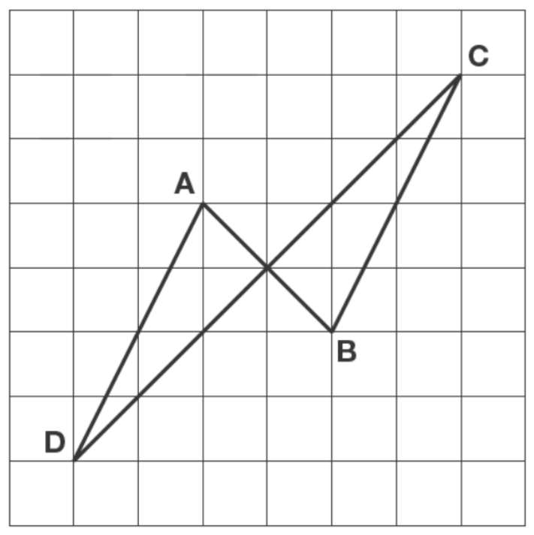
The diagram shows four lines drawn on a square grid. The lines are AB, BC, CD and DA. Which two of the lines are parallel?
DA, BC
Which two of the lines are perpendicular?
AB, CD
Notes:
G361 2012 Paper 2 Q20

Slide 51

Look at the letters below.
Circle the letter that has both parallel and perpendicular lines.
Notes:
2017 Paper 3 Q15

Slide 52
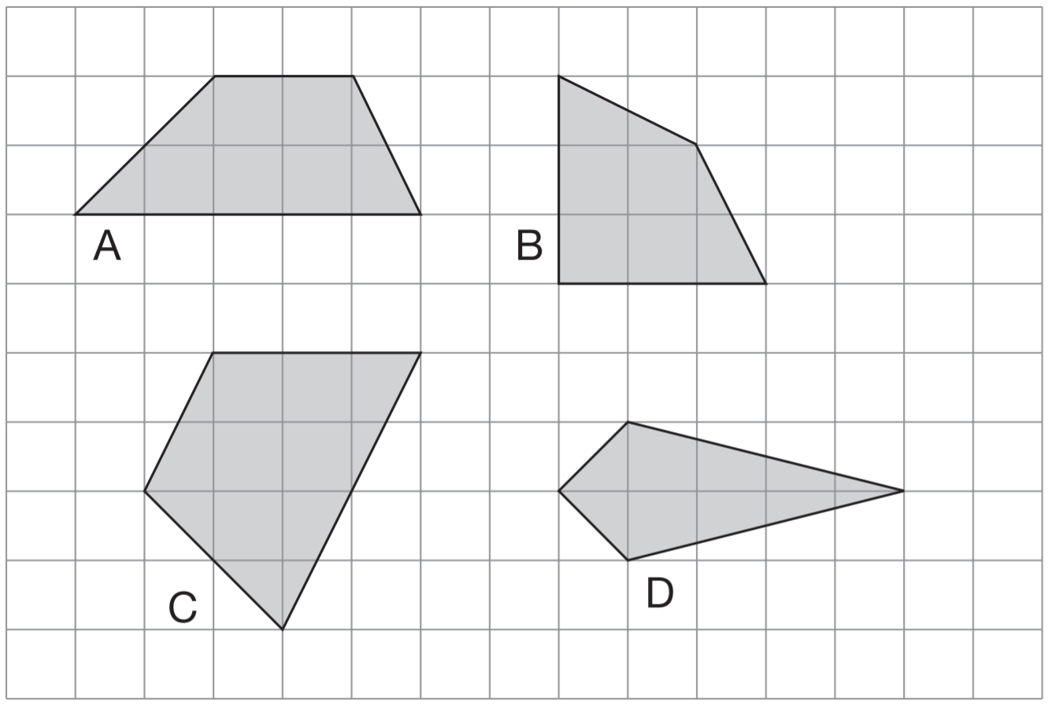
Here are some shapes on a grid. Write the letter of each shape that has one pair of parallel sides.
A, C
Notes:
G621 2007 Paper 1 Q17

Slide 53
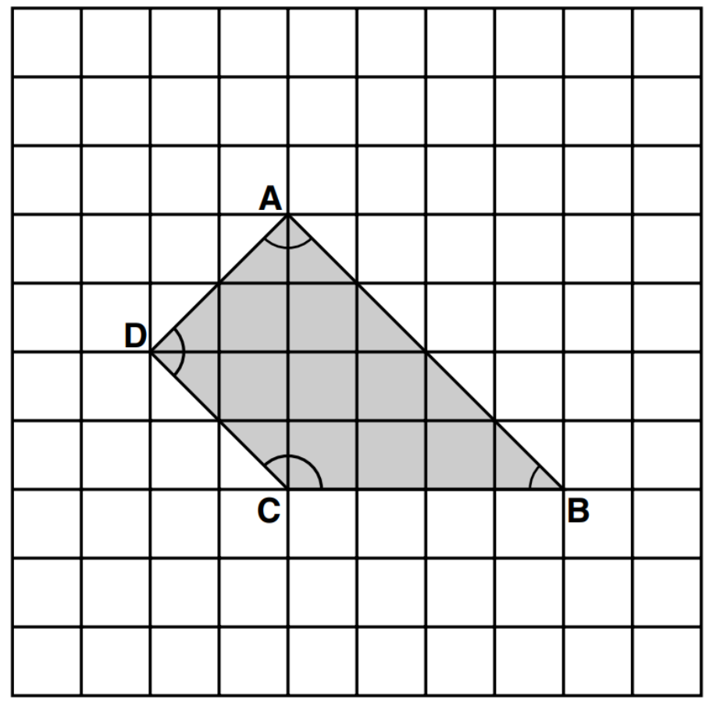
Here is a shape on a square grid. For each of the four sentences below, put a tick if it is true.
Put a cross if it is not true.
1) Angle C is
an obtuse angle.
2) Angle D is
an acute angle.
3) Line AD is
parallel to line BC.
4) Line AB is
perpendicular to line AD.
✓
✘
✘
✓
Notes:
G25 2000 Paper 2 Q20

Slide 54
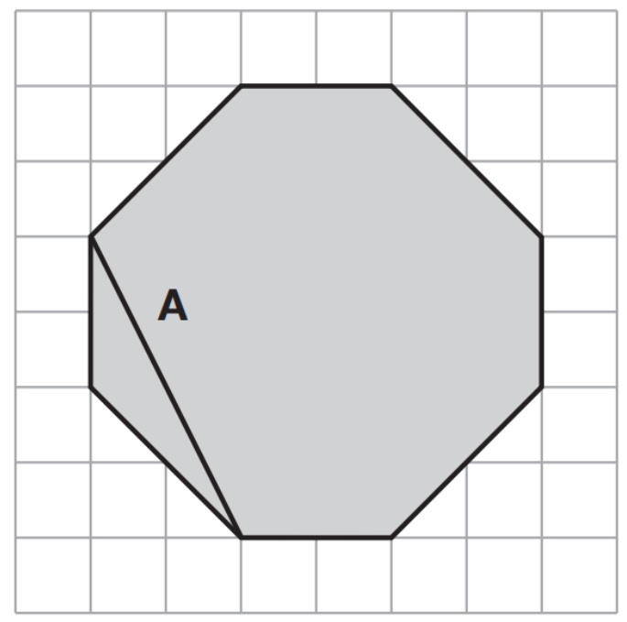
The diagram shows a shaded octagon on a square grid.
Line A joins two vertices of the octagon.
a) Join two vertices to draw a line perpendicular to line A.
b) Join two other vertices to draw a line parallel to line A.
Notes:
2015 (Sample) Paper 2 Q13

Slide 55
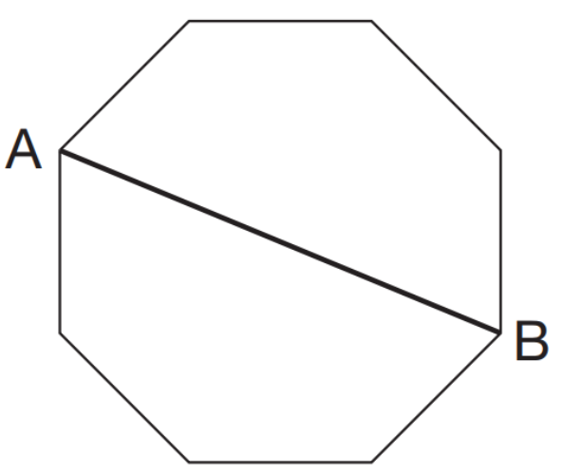
Here is a regular octagon with two vertices joined to make the line AB. Join two other vertices to draw one line that is parallel to the line AB.
Notes:
G138 2008 Paper 2 Q21 first page

Slide 56
Here is the octagon again. Join two vertices to draw one line that is perpendicular to the line AB.
Notes:
G139 2008 Paper 2 Q21 second page

Slide 57
Here is the octagon again. Join two vertices to draw one line that is perpendicular to the line AB.
Notes:
G140 2008 Paper 2 Q21 third page

Slide 58
Measure angles and lines

Slide 59
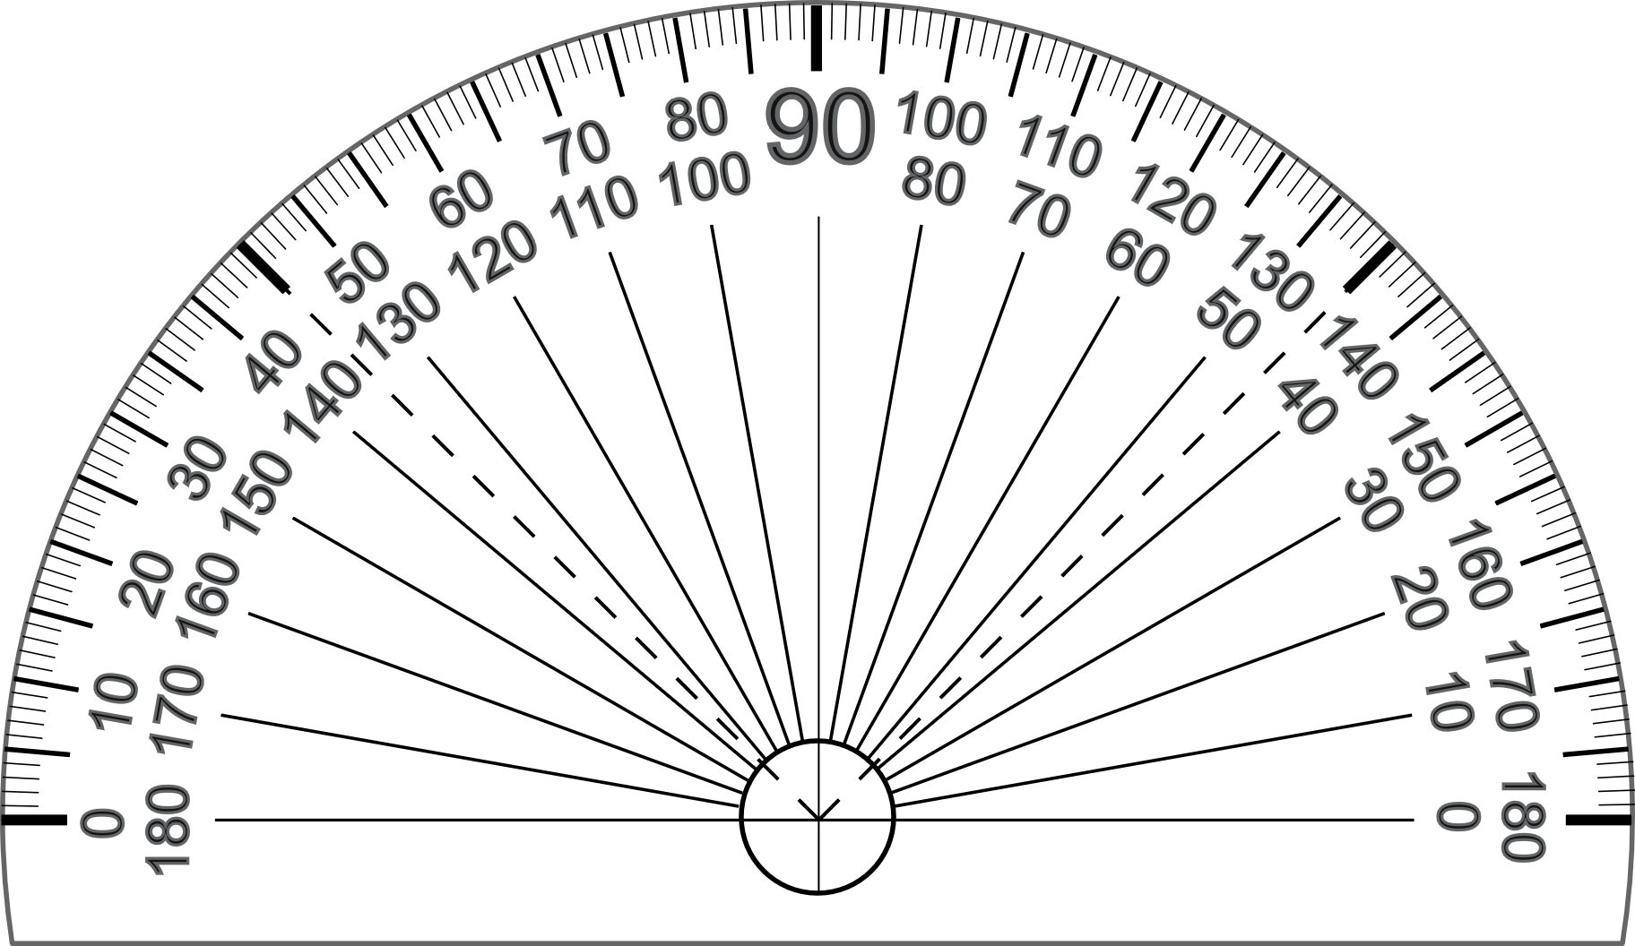
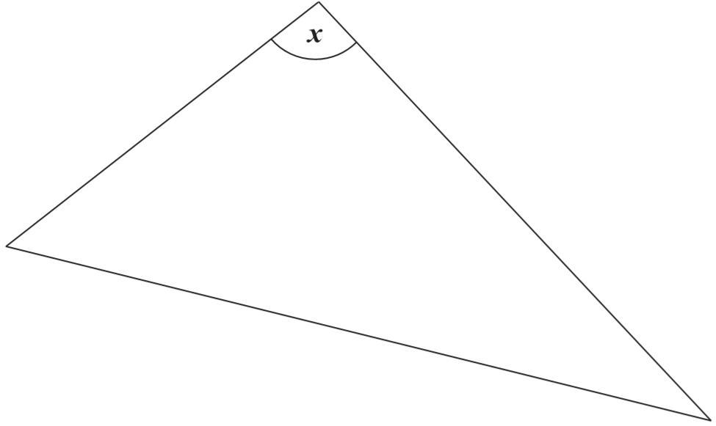
Measure angle x accurately.
Use a protractor (angle measurer).
95°
Notes:
2004 Paper 2 Q18

Slide 60
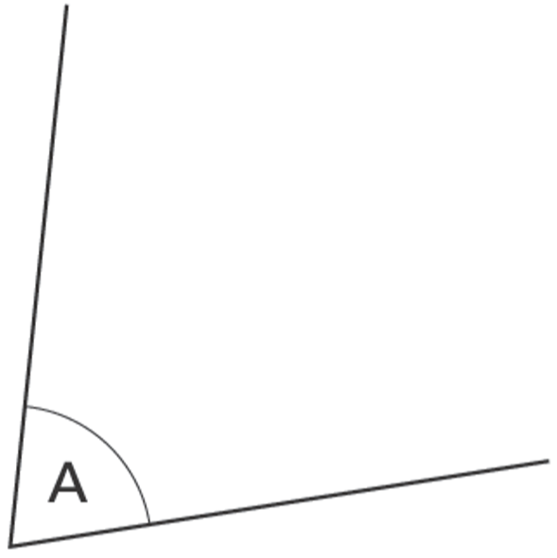
Measure angle A accurately. Use a protractor (angle measurer).
75°
Notes:
2003 Year 5 Optional Paper 1 Q22

Slide 61
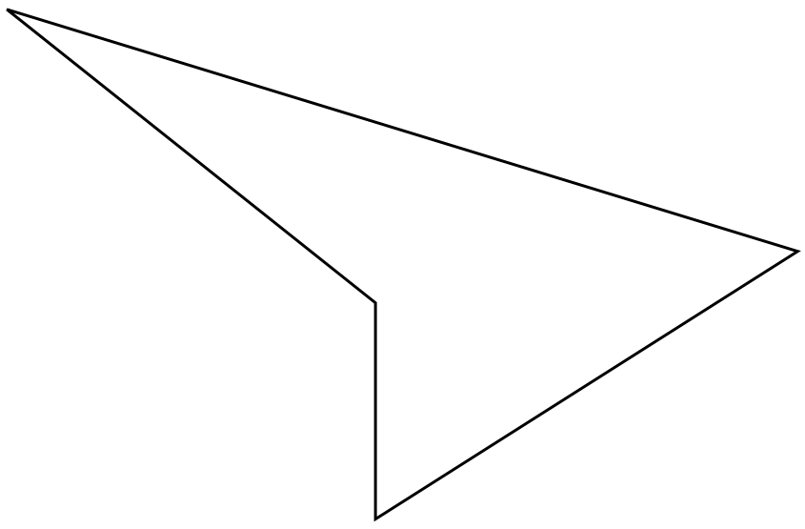
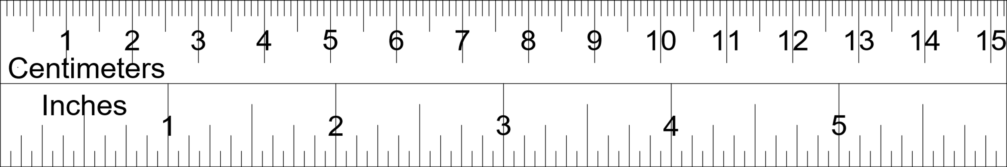
Measure accurately the longest side of this shape.
Give your answer in millimetres.
10.2 x 10 =
102 millimetres
101 mm and 103 mm also get you the mark.
Measure accurately the smallest angle in the shape.
10.2 cm
Use a protractor (angle measurer).
22°
21° and 23° also get you the mark.
Notes:
2001 Paper 1 Q17

Slide 62
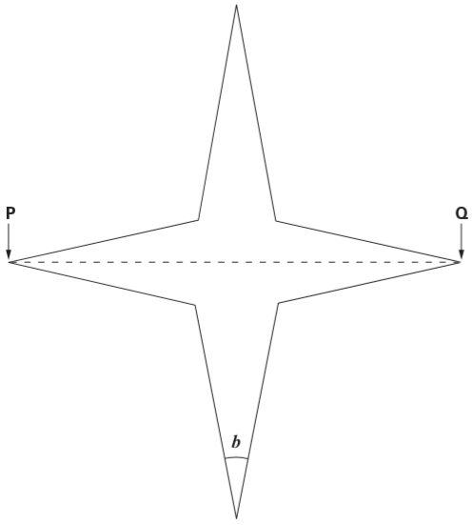

Use a ruler to measure accurately the width of the star, from P to Q.
Give your answer in millimetres.
12.7 x 10 =
127 millimetres
126 mm and 128 mm also get you the mark.
12.7 cm
Use a protractor (angle measurer) to measure angle b.
22°
21° and 23° also get you the mark.
Notes:
2005 Paper 1 Q17

Slide 63
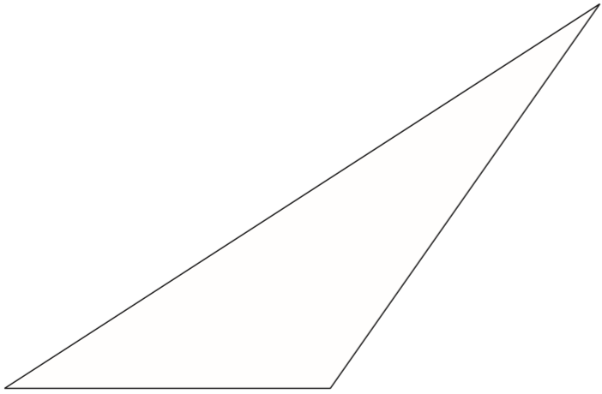
Measure the length of the shortest side of this triangle in millimetres.
Measure the size of the largest angle in this triangle.
6.7 x 10 =
67 millimetres
An answer between 65 mm and 69 mm gets you the mark.
125°
6.7 cm
An answer between 123° and 127° gets you the mark.
Notes:
2015 Paper 1 Q12

Slide 64
Identify different types of quadrilateral from descriptions

Slide 65
A square always has four sides.
Is it true that a four-sided shape is always a square?
Explain how you know.
No. A rectangle had 4 sides but it’s not a square.
A square is a four-sided shape where all sides are the same length and all angles are 90°.
Notes:
G221 2008 Paper 1 Q7

Slide 66
A shape has 4 right angles.
It has 4 sides which are not all the same length.
Write the name of this shape.
rectangle
Notes:
G363 Pre-2000 or other question

Slide 67
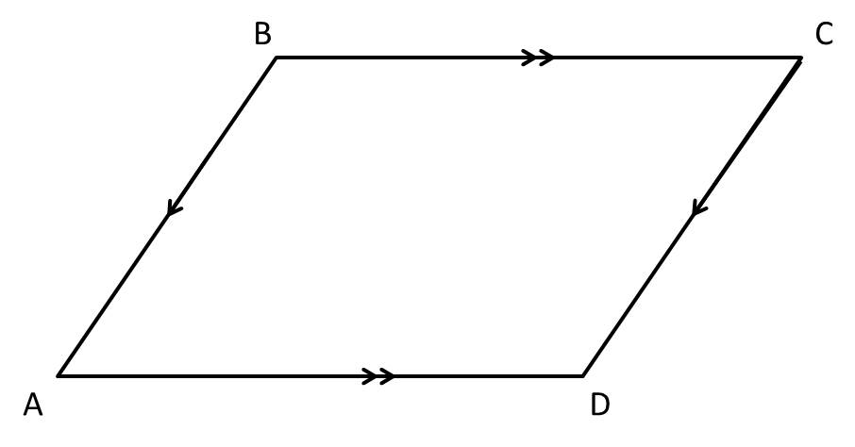
Sarah draws a quadrilateral. It has these properties:
• it has 2 long sides the same length;
• it has 2 short sides the same length;
• it does NOT have any right angles;
• it does NOT have reflective symmetry.
Write the mathematical name for Sarah’s quadrilateral.
parallelogram
Notes:
G432 Pre-2000 or other question

Slide 68
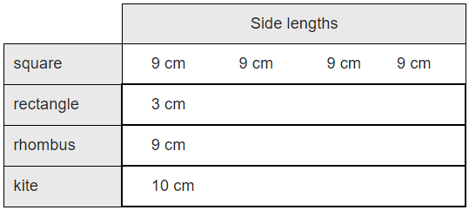
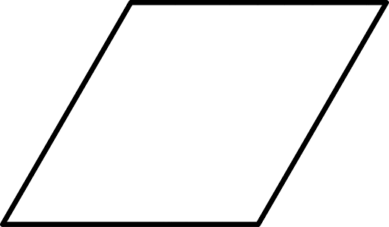
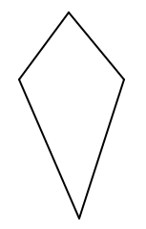
The following quadrilaterals all have a perimeter of 36 cm. Here is a table to show the length of each side.
Complete the table. One quadrilateral is done for you.
3 cm
15 cm
15 cm
9 cm
9 cm
9 cm
10 cm
8 cm
8 cm
Notes:
G545 2013 Level 6 Paper A Q3

Slide 69
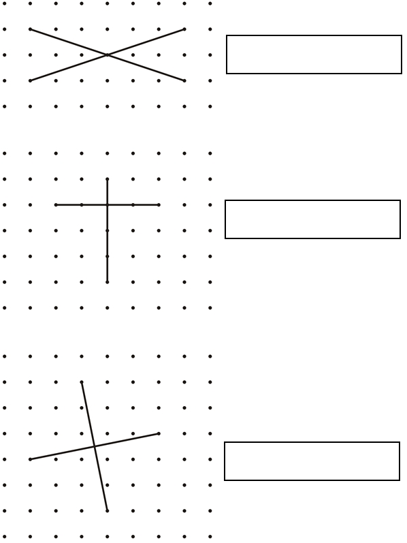
These diagrams show the diagonals
of three quadrilaterals.
Write the names of the quadrilaterals in the boxes.
rectangle
kite
square
Notes:
G34 2003 Paper 1 Q15

Slide 70
Rotate shapes mentally

Slide 71
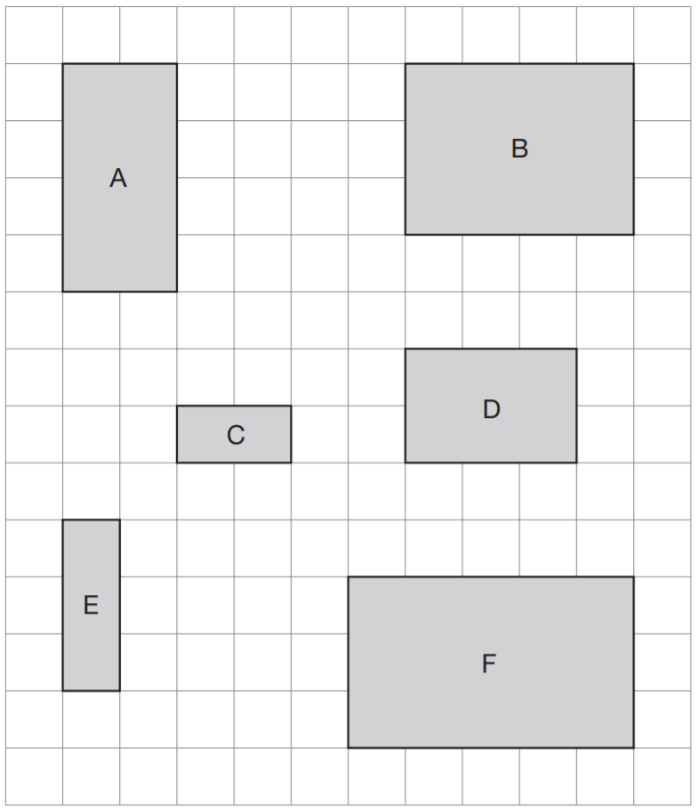
Here are six rectangles on a grid. Which two rectangles fit together, without overlapping, to make a square?
D and E
Notes:
G181 2008 Paper 1 Q12

Slide 72
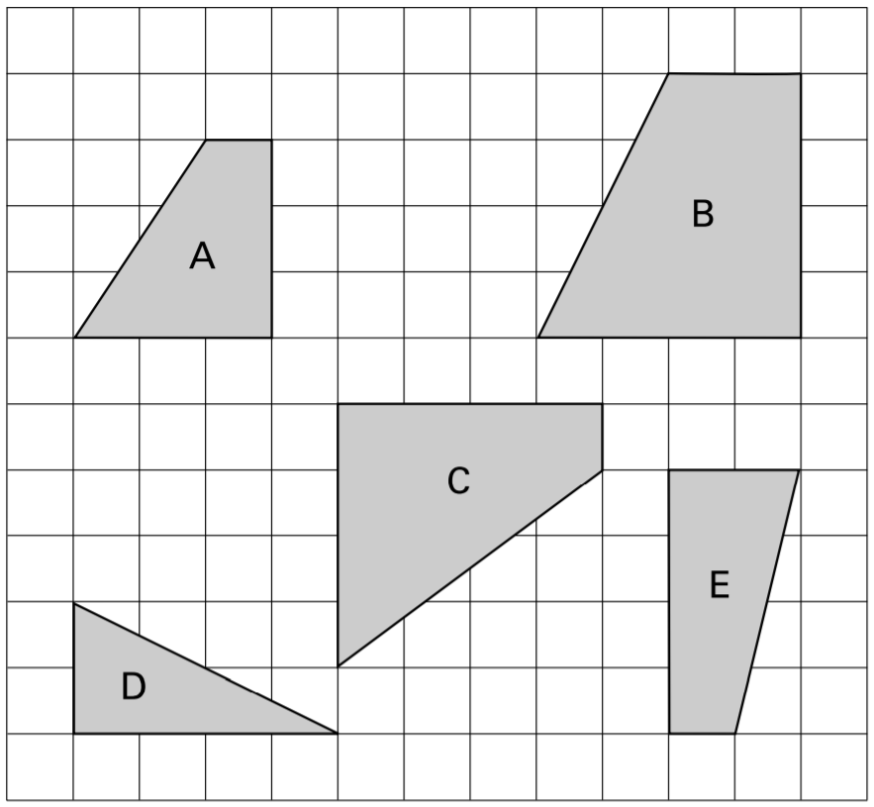
Here are five shapes on a square grid.
Which two shapes fit together to make a square?
B and D
Notes:
G280 2001 Paper 2 Q15

Slide 73
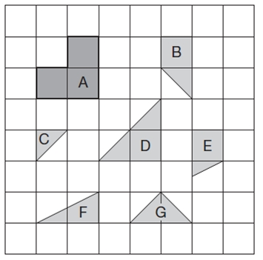
Here are some tiles on a square grid. Three different tiles can be fitted together without overlapping to make a shape identical to tile A. Write the letters of the three tiles.
B, C and G
Notes:
G368 2012 Paper 2 Q16

Slide 74
Make 2D shapes

Slide 75
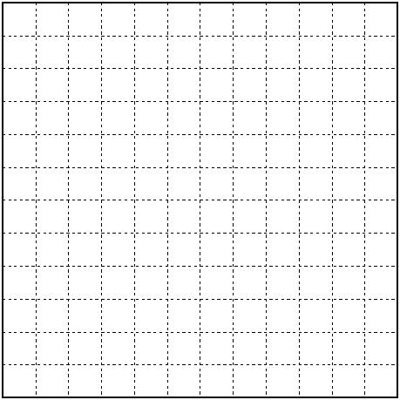
Here is a grid of centimetre squares.
On the grid draw a quadrilateral.
It must have only one pair of parallel sides.
Notes:
G463 Pre-2000 or other question

Slide 76
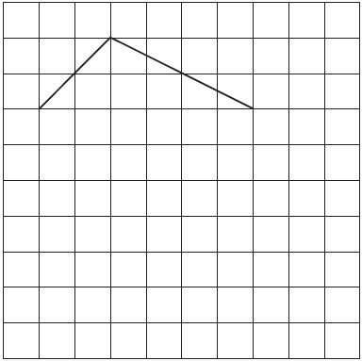
The lines drawn on the grid are two sides of a pentagon.
Complete the pentagon.
Notes:
G554 2003 Year 5 Optional Paper 1 Q7

Slide 77
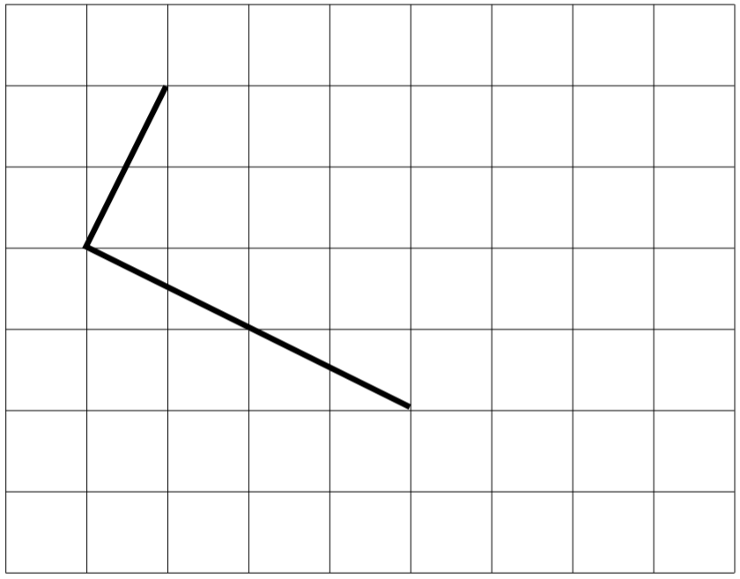
Draw two more straight lines to make a rectangle.
Notes:
G80 2001 Paper 1 Q6 first page

Slide 78
Draw two more straight lines to make a rectangle.
Notes:
G81 2001 Paper 1 Q6 second page

Slide 79
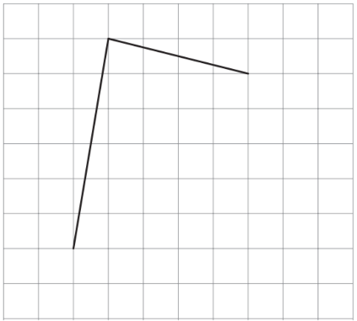
Here is a square grid. Two sides of a kite are drawn on the grid. Complete the kite by drawing the two missing sides.
Notes:
G160 2011 Paper 2 Q23

Slide 80
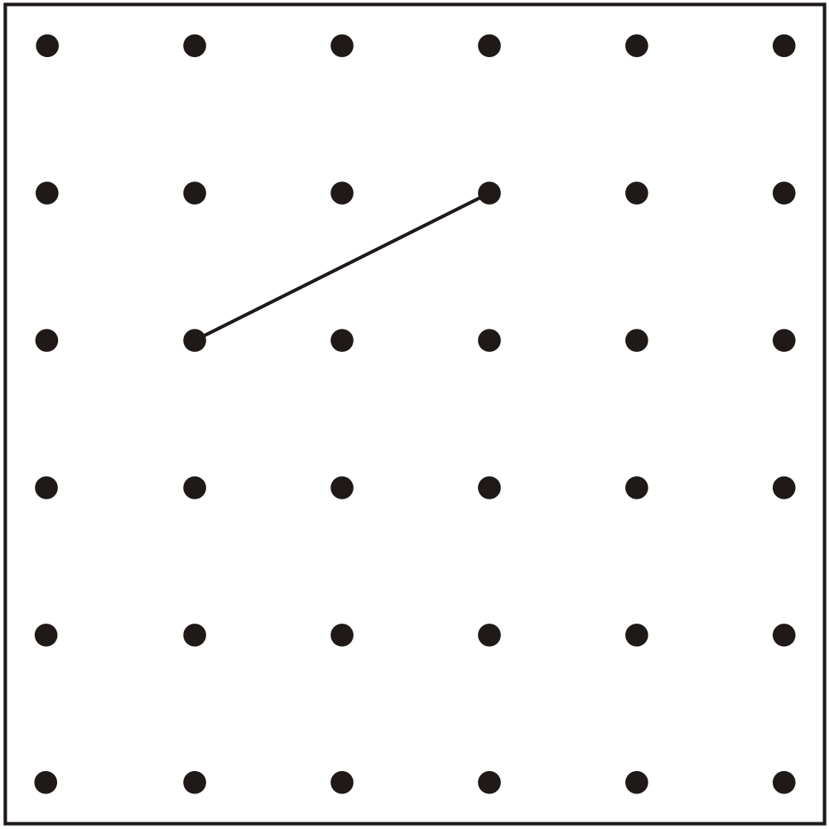
The line on the grid is one side of a square.
On the grid, draw the other three sides of the square.
Notes:
G263 Pre-2000 or other question

Slide 81

Draw two more lines on this grid to make a square.
Notes:
G392 2006 Year 3 Optional Paper 2 Q28

Slide 82
Draw two more lines on this grid to make a square.
Notes:
G393 2006 Year 3 Optional Paper 2 Q28

Slide 83

Draw two more lines on this grid to complete the rectangle.
Notes:
G486 2006 Year 5 Optional Paper 2 Q20

Slide 84

Join dots on the grid to make a quadrilateral that has 3 acute angles.
Notes:
2015 (Sample) Paper 3 Q15

Slide 85

Here is a grid of dots. Point A and point B are joined by a straight line. Draw a line to join point A to another dot on the grid so that the two lines make a right angle.
Notes:
G556 2010 Paper 1 Q19

Slide 86

On the grid join dots to make a triangle which does not have a right angle.
Notes:
G85 2002 Paper 2 Q4

Slide 87

Use a ruler to draw 2 more lines to make an isosceles triangle.
Notes:
G120 Pre-2000 or other question

Slide 88

Use the dots to draw one different shape which has a right angle.
Notes:
G224 Pre-2000 or other question

Slide 89

On the grid below, use a ruler to draw a pentagon that has three right angles.
Notes:
G387 Pre-2000 or other question

Slide 90

Use the dots to draw a shape that has 4 straight sides and no right angles.
Notes:
G414 Pre-2000 or other question

Slide 91

Here is a hexagon. Draw two straight lines across the hexagon to make two triangles and two quadrilaterals.
Notes:
G494 2015 Paper 1 Q13

Slide 92

Join the dots to make a pentagon with only one right angle.
Now join the dots to make a pentagon with exactly two right angles.
Notes:
G26 Pre-2000 or other question

Slide 93

Adam has this rectangular piece of card. It is marked with grid lines.
Adam makes two straight cuts along the grid lines.
The two cuts divide the rectangle into 3 shapes:
• 2 squares of different size, and
• 1 rectangle.
Using the grid lines, draw two lines that show where Adam could have made his cuts. Use a ruler.
Notes:
2019 Paper 2 Q21

Slide 94


Here is an equilateral triangle drawn on a circle.
Use a ruler to draw a regular hexagon on this circle.
12 points ÷ 6 = 2 points from one vertex to the next
Notes:
G189 Pre-2000 or other question

Slide 95
There are twelve points marked around this circle. The points are equally spaced. Join 3 points to make an equilateral triangle.
The sides of an equilateral triangle are the same length.
12 points ÷ 3 = 4 points from one vertex to the next
Notes:
G272 Pre-2000 or other question

Slide 96
There are twelve points marked around this circle. The points are equally spaced. Join 3 points to make an isosceles triangle.
Two sides of an isosceles triangle are the same length.
Notes:
G632 Pre-2000 or other question

Slide 97
There are twelve points marked around this circle. The points are equally spaced. Join 3 points to make an isosceles triangle.
Two sides of an isosceles triangle are the same length.
Notes:
G633 Pre-2000 or other question

Slide 98
There are twelve points marked around this circle. The points are equally spaced. Join 3 points to make an isosceles triangle.
Two sides of an isosceles triangle are the same length.
Notes:
G634 Pre-2000 or other question

Slide 99
There are twelve points marked around this circle. The points are equally spaced. Join 3 points to make an isosceles triangle.
Two sides of an isosceles triangle are the same length.
Notes:
G635 Pre-2000 or other question

Slide 100
There are twelve points marked around this circle.
The points are equally spaced.
Join 4 points to make a square.
The sides of a square are the same length.
12 points ÷ 4 =
3 points from one vertex to the next
Notes:
G242 2009 Paper 2 Q13 / Pre-2000 or other question

Slide 101


Mike has a triangle grid.
He shades in 2 triangles to make a shape with 4 sides.
Shade in 2 triangles on this grid to make a different shape with 4 sides.
Notes:
G641 Pre-2000 or other question

Slide 102
Mike has a triangle grid.
He shades in 2 triangles to make a shape with 4 sides.
Shade in 4 small triangles on this grid to make a bigger triangle.
Notes:
G642 Pre-2000 or other question

Slide 103
Mike has a triangle grid.
He shades in 2 triangles to make a shape with 4 sides.
Shade in more than 4 small triangles on this grid to make a bigger triangle.
Notes:
G643 Pre-2000 or other question

Slide 104


Look at this quadrilateral.
Use a ruler to draw a line in a different place on the quadrilateral to make two triangles.
You can draw one line on the quadrilateral to make two triangles.
Notes:
G54 Pre-2000 or other question

Slide 105
Look at this quadrilateral.
Now draw one line on the quadrilateral to make a quadrilateral and a triangle.
You can draw one line on the quadrilateral to make two triangles.
Notes:
G55 Pre-2000 or other question

Slide 106
Look at this quadrilateral.
Now draw one line on the quadrilateral to make two quadrilaterals.
You can draw one line on the quadrilateral to make two triangles.
Notes:
G56 Pre-2000 or other question

Slide 107

Draw two lines on the square below to make four triangles that are all the same size.
Notes:
G130 Pre-2000 or other question

Slide 108

Now draw two lines on the square below to make four squares that are all the same size.
Notes:
G131 Pre-2000 or other question

Slide 109

Join the dots to make 4 different triangles.
One has been done for you.
Notes:
G303 Pre-2000 or other question

Slide 110


Here is a triangle made using the pins on a pin board.
Show how to make a square. Use the pins below.
Notes:
G597 Pre-2000 or other question

Slide 111
Here is a triangle made using the pins on a pin board.
Now show how to make a different sized square. Use the pins below.
Notes:
G598 Pre-2000 or other question

Slide 112
Here is a triangle made using the pins on a pin board.
Now show how to make another square which is a different size to the ones you have drawn.
Use the pins below.
Notes:
G599 Pre-2000 or other question

Slide 113

A shape has 4 right angles.
It has 4 straight sides.
All 4 sides are the same length.
Draw what the shape could be.
Notes:
G600 Pre-2000 or other question

Slide 114
A different shape has 4 right angles.
It has 4 straight sides.
It has 2 pairs of parallel lines.
Draw what the shape could be.
Notes:
G601 Pre-2000 or other question

Slide 115
A shape has no right angles.
It has 4 straight sides.
It has 2 pairs of parallel lines.
Draw what the shape could be.
Notes:
G602 Pre-2000 or other question

Slide 116
Recognise angles in 2D shapes

Slide 117

Here are some shaded shapes on a square grid. Write the letters of the two shapes which are hexagons.
Write the letters of the two shapes which have right angles.
not a right angle
B
, D
4
6
5
C
, E
6
5
Notes:
G97 2005 Paper 1 Q6

Slide 118

Look at these shapes. Complete the sentences below.
__is a kite
__is not a quadrilateral
__has only 2 right angles
__has 2 acute angles
A
F
E
B
Notes:
G109 2007 Paper 2 Q10

Slide 119

Circle the pentagon with exactly four acute angles.
only 1 acute angle
all obtuse angles
4 acute angles but not a pentagon
4 acute angles (1 reflex angle)
All obtuse angles and not a pentagon
Notes:
2017 Paper 3 Q13

Slide 120
Recognise angles and parallel lines in 2D shapes

Slide 121

Complete the table.
✓
✓
✓
✘
✓
✘
Notes:
G260 Pre-2000 or other question

Slide 122

Fill in the gaps in the sentences below.
4
The shape has ____ right angles.
It has ____ straight sides.
It has ____ pairs of parallel lines.
____ sides are the same length.
4
2
4
Notes:
G317 Pre-2000 or other question

Slide 123


The diagonals of this quadrilateral cross at right angles.
✓
Tick all the quadrilaterals that have diagonals which cross at right angles.
✓
Notes:
2016 Paper 3 Q18

Slide 124

Look at the shaded shape on the square grid. For each statement below, tick or cross to show if it is True or False.
1)The shaded shape is a quadrilateral.
2)The shaded shape has four equal sides.
3)The shaded shape has four equal angles.
4)The shaded shape has two pairs of parallel sides.
✓
✘
✘
✓
Notes:
G457 Pre-2000 or other question

Slide 125

Here are five shapes made from equilateral triangles. Write the letter of the shape that is a rhombus.
Write the letter of the shape that has only one pair of parallel sides.
2 pairs
E
3 pairs
4 sides are the same length
(but angles are not right angles)
D
0 pairs
1 pair
2 pairs
Notes:
G555 2011 Paper 2 Q14

Slide 126

Here are six quadrilaterals with their mathematical names. Lara chooses one of the quadrilaterals. She says, ‘It has two acute angles. All four sides are the same length.’ Which quadrilateral did Lara choose?
Notes:
G77 2009 Paper 1 Q13 first page

Slide 127
Stefan chooses one of the quadrilaterals. He says, ‘It has more than one obtuse angle. It has no parallel sides.’ Which quadrilateral did Stefan choose?
Notes:
G78 2009 Paper 1 Q13 second page

Slide 128
For each of the four sentences below, put a tick if it is true. Put a cross if it is not true.
1) A triangle can have 2 acute angles.
2) A triangle can have 2 obtuse angles.
3) A triangle can have 2 parallel sides.
4) A triangle can have 2 perpendicular sides.
✓
✘
Angles in a triangle add up to 180°. Obtuse angles are more than 90°. If you have 2 obtuse angles, you have more than 180°.
✘
A shape with parallel sides must have at least 4 sides.
✓
Lines on a right angle are perpendicular.
Notes:
G173 2005 Paper 1 Q21

Slide 129
Recognise angles, parallel lines and symmetry in 2D shapes

Slide 130

Look at the shape drawn on the square grid. For each of the four sentences below, put a tick if it is true. Put a cross if it is not true.
The shape has exactly 2 right angles.
2) The shape has 2 pairs of parallel lines.
3) The shape has one line of symmetry.
4) The shape is a quadrilateral.
✓
✘
1 pair
✘
not symmetrical
✓
4-sided shape
Notes:
G264 Pre-2000 or other question

Slide 131

Match each quadrilateral to the correct description.
One has been done for you.
Notes:
G304 2003 Year 5 Optional Paper 2 Q18

Slide 132

Here is a shape on a grid. For each of the four sentences below, put a tick if it is true. Put a cross if it is not true.
1) The shape is a quadrilateral.
2) The shape has 2 lines of symmetry.
3) The shape is a parallelogram.
4) The shape has one right angle.
✓
4-sided shape
✘
1 line of symmetry
✘
kite
✓
Notes:
G441 2014 Paper 1 Q14

Slide 133

Here are five shapes on a square grid.
Write in the missing letters.
Shape ____ has two pairs of parallel sides.
Shape ____ is a pentagon.
Shape ____ has reflective symmetry.
C
A
E
Notes:
G640 Pre-2000 or other question

Slide 134
Identify faces, edges and vertices in different 3D shapes

Slide 135

Triangular prism
5 faces
6 vertices
9 edges
Notes:
https://www.mathsisfun.com/geometry/common-3d-shapes.html

Slide 136

Square-based pyramid
5 faces
5 vertices
8 edges
Notes:
https://www.mathsisfun.com/geometry/common-3d-shapes.html

Slide 137

Triangle-based pyramid
4 faces
4 vertices
6 edges
Notes:
https://www.mathsisfun.com/geometry/common-3d-shapes.html

Slide 138

Cuboid
6 faces
8 vertices
12 edges
Notes:
https://www.mathsisfun.com/geometry/common-3d-shapes.html

Slide 139

Cube
6 faces
8 vertices
12 edges
Notes:
https://www.mathsisfun.com/geometry/common-3d-shapes.html

Slide 140

Cone
1 flat face, 1 curved face
1 vertex
1 edge
Notes:
https://www.mathsisfun.com/geometry/common-3d-shapes.html

Slide 141

Cylinder
2 flat faces, 1 curved face
0 vertices
2 edges
Notes:
https://www.mathsisfun.com/geometry/common-3d-shapes.html

Slide 142

Sphere
1 curved face
0 vertices
0 edges
Notes:
https://www.mathsisfun.com/geometry/common-3d-shapes.html

Slide 143

This table shows information about four solid shapes.
One has been done for you.
1
1
6
0
2
1
Notes:
G112 Pre-2000 or other question

Slide 144


Write each word in the correct box.
faces
vertices
edges
Notes:
G244 2003 Year 3 Optional Paper 1 Q11

Slide 145

The table shows information about three solid shapes.
Complete the table.
8
5
6
5
5
Notes:
G312 Pre-2000 or other question

Slide 146

The table shows information about three solid shapes.
Complete the table.
8
9
6
6
4
Notes:
G438 Pre-2000 or other question

Slide 147

Complete the table.
8
12
5
9
5
5
Notes:
G504 Pre-2000 or other question

Slide 148
Jack has two square-based pyramids that are the same size. He sticks the square faces together to make a new 3-D shape. How many faces and how many edges does his new 3-D shape have?
Faces:
Edges:
8
4 top
4 top
these now can’t be seen
4 middle
12
4 bottom
4 bottom
Notes:
G58 2014 Level 6 Paper A Q9

Slide 149
Identify 3D shapes from their description

Slide 150
I’m thinking of a 3-D shape.
It has a square base.
It has 4 other faces, which are triangles.
What is the name of the 3-D shape?
Square based pyramid
Notes:
G165 Pre-2000 or other question

Slide 151
Mina thinks of a 3-D shape. She says, ‘It has 5 faces. Two opposite faces are triangles. The other faces are rectangles.’ What is the name of the 3-D shape?
Triangular prism
Notes:
G274 2012 Paper 2 Q14

Slide 152
A 3-D shape has 8 vertices. It has 6 faces. Each face is the same.
What is the correct name for this shape?
Cube
Notes:
G329 Pre-2000 or other question

Slide 153
Jack says, "Two 3D shapes with the same number of faces as each other also have the same number of vertices as each other."
Is Jack correct? Explain how you know.
Jack is not correct.
A square based pyramid has 5 faces and 5 vertices.
A triangular prism
has 5 faces and 6 vertices.
Notes:
G613 Pre-2000 or other question

Slide 154
Identify nets of 3D shapes

Slide 155


Look at the cuboid below.
Draw two more faces to complete the net of the cuboid.
Notes:
G564 2015 Paper 2 Q9

Slide 156

Here is part of a net for a cuboid.
Draw in the missing face to complete the net.
Notes:
G16 2006 Year 5 Optional Paper 1 Q9

Slide 157




Here are four diagrams. On each one, put a tick if it is a net of a cube. Put a cross if it is not.
overlap
✓
✘
✘
✓
overlap
Notes:
G584 2005 Paper 1 Q16

Slide 158



Look at each of these diagrams. On each one, put a tick if it is the net of a square based pyramid. Put a cross if it is not.
✓
✓
✘
Notes:
2000 Paper 2 Q13

Slide 159






overlap
same side so they will overlap
This is a drawing of a pentagonal prism. Tick the one shape that is a net for the pentagonal prism.
✓
missing rectangle
only 1 pentagon
Notes:
G396 2004 Paper 1 Q13

Slide 160

Here are some nets of shapes.
For each net, put a tick if it folds to make a pyramid.
Put a cross if it does not.
✘
✓
✘
✓
Notes:
G481 2008 Paper 2 Q5

Slide 161

Two of these diagrams are nets for a triangular prism.
Put a tick in them.
overlap
no face
at this end
✓
can’t fold to make 3 faces in middle
✓
Notes:
G524 2003 Year 4 Optional Paper 1 Q32

Slide 162

These nets will fold to make 3-D shapes. Match each net to the name of its shape. One has been done for you.
Notes:
G43 Pre-2000 or other question

Slide 163
Identify the base or lid of a cube or cuboid

Slide 164

Here is the net of a cube with no top. The shaded square shows the bottom of the cube. Draw an extra square to make the net of a cube which does have a top.
Notes:
G183 2003 Paper 2 Q8

Slide 165


Here is an
open top cube.
Here is the net from which it is made.
Put a tick on the square which is its base.
✓
Notes:
G287 2003 Year 5 Optional Paper 1 Q12

Slide 166


The diagram above shows a net that folds to make a box. There are two different nets shown below. Each net folds to make a box. The base of each box is labelled. For each box, label the face that will be the lid.
lid
lid
Notes:
G347 Pre-2000 or other question

Slide 167


This is an open top box.
Put a tick for each diagram if it is a net for the box. Put a cross if it is not. The base is shaded in each one.
✓
✘
✓
✓
Notes:
G403 Pre-2000 or other question

Slide 168
Find volume by counting cubes

Slide 169


Emma makes a cuboid using 12 cubes.
Write the letter of the cuboid that has a different volume from Emma’s cuboid.
12
18
12
C
12
12
Notes:
2016 Paper 3 Q10

Slide 170

These cuboids are made from small cubes. Write how many small cubes there are in each cuboid. The first is done for you.
10
16
30
Notes:
G515 Pre-2000 or other question

Slide 171

This shape is made with two cuboids. Write how many small cubes there are in this shape.
4 x 4 x 2 – 8 cubes missing
8
8
4
4
24
Notes:
G576 Pre-2000 or other question

Slide 172

This shape is made of wooden centimetre cubes.
How many more centimetre cubes are needed to make it into a solid cuboid 3 cm tall, 5 cm long and 5 cm wide?
Middle: 16 cubes
Top: 22 cubes
22 + 16 =
38 cubes needed
Notes:
G161 2015 Paper 1 Q22

Slide 173
Draw the reflection of a shape in a vertical mirror line on a squared grid

Slide 174

Here is a shaded shape on a square grid.
Reflect the shape in the mirror line.
Notes:
2019 Paper 2 Q4

Slide 175

Here is a shape on a grid. Complete the design so that it is symmetrical about the mirror line.
Notes:
2018 Paper 2 Q1

Slide 176

Complete the diagram below to make a shape that is symmetrical about the mirror line.
Notes:
G233 2004 Paper 2 Q2

Slide 177

Draw in the reflection of the shape in the mirror line.
Notes:
G360 Pre-2000 or other question

Slide 178

Draw the reflection of this triangle in the mirror line.
Notes:
G614 Pre-2000 or other question

Slide 179

On the grid, draw the reflection of the shape in the mirror line.
Notes:
G543 Pre-2000 or other question

Slide 180

Here is a design on a square grid. Complete the design so that it is symmetrical about the mirror line.
Notes:
G98 2012 Paper 2 Q9

Slide 181
Draw the reflection of a shape in a vertical mirror line on different grids

Slide 182

Draw the reflection of the shaded shape in the mirror line.
Notes:
G128 2007 Paper 2 Q2

Slide 183

Draw the reflection of the shaded shape in the mirror line.
Notes:
G275 2001 Paper 1 Q4

Slide 184

Draw the reflection of the shaded shape in the mirror line.
Notes:
G325b 2010 Paper 2 Q4

Slide 185


This diagram shows a shaded shape inside a border of squares. Draw the reflection of the shape in the mirror line.
Notes:
2016 Paper 2 Q6

Slide 186

This grid is made of hexagons. Draw the reflection of the shaded shape in the mirror line.
Notes:
G482 2005 Paper 2 Q5

Slide 187

Draw the reflection of the shaded shape in the mirror line.
Notes:
G569 2008 Paper 1 Q4

Slide 188
Draw the reflection of a shape in a horizontal mirror line

Slide 189

Complete the diagram below to make a shape that is symmetrical about the mirror line.
Notes:
G87 2003 Paper 1 Q3

Slide 190

Shade in the reflection of this shape.
Notes:
G108 Pre-2000 or other question

Slide 191

Complete this shape so that it is symmetrical about the mirror line.
Notes:
G222 2014 Paper 2 Q3

Slide 192

Draw the reflection of the shaded shape in the mirror line.
Notes:
G389 2009 Paper 1 Q8

Slide 193
Shade squares to make a design symmetrical

Slide 194

Complete the reflection of this pattern in the mirror line.
Notes:
G447 2006 Year 3 Optional Paper 1 Q7

Slide 195

Draw the reflection of all the shaded shapes in the mirror line.
Notes:
G501 2013 Paper 1 Q2

Slide 196

Here is a grid with four squares shaded in.
Shade in one more square to make a shape with a line of symmetry.
Shade in a different square to make a shape with a line of symmetry.
Notes:
G33 2006 Year 4 Optional Paper 1 Q8

Slide 197

Here is a square with a design on it. The square is reflected in the mirror line. Draw the missing triangle and dots on the reflected square.
Notes:
G582 2002 Paper 1 Q3

Slide 198

Here is part of a shape on a square grid.
Draw two more lines to make a shape which has a line of symmetry.
Notes:
G245 2005 Paper 1 Q13 first page

Slide 199
Here is part of a shape on a square grid.
Draw two more lines to make a shape which has a line of symmetry.
Notes:
G246 2005 Paper 1 Q13 second page

Slide 200

Here is a grid with eight squares shaded in.
Shade in two more squares to make a symmetrical pattern.
✓
✓
✓
✓
✓
✓
Notes:
G594 2003 Paper 1 Q7

Slide 201

Draw two more circles on this grid to make a design that has a line of symmetry.
Notes:
G399 2008 Paper 2 Q13 first page

Slide 202
Draw two more circles on this grid to make a design that has a line of symmetry.
Notes:
G400 2008 Paper 2 Q13 second page

Slide 203

Shade in two more squares to make this design symmetrical about the mirror line.
✓
✓
✓
✓
✓
✓
Notes:
G622 2001 Paper 2 Q3 first page

Slide 204
Notes:
G623 2001 Paper 2 Q3 second page

Slide 205

Shade two squares and one triangle to make this design symmetrical about the mirror line.
Notes:
G23 2011 Paper 1 Q10

Slide 206
Shade two squares and one triangle to make this design symmetrical about the mirror line.
Notes:
G24 2011 Paper 1 Q10

Slide 207
Draw the reflection of a shape in a diagonal mirror line

Slide 208

Here is a shaded shape on a square grid.
Draw the reflection of the shape in the mirror line.
Notes:
G198 2006 Year 5 Optional Paper 2 Q13

Slide 209

Draw the reflection of this shape.
Notes:
G207 2003 Year 3 Optional Paper 2 Q25

Slide 210

Draw the reflection of the shape in the mirror line.
Notes:
G397 2003 Year 5 Optional Paper 2 Q13

Slide 211

Use a ruler to draw the reflection of this shape in the mirror line.
Notes:
G398 Pre-2000 or other question

Slide 212

Draw the reflection of the shaded triangle in the mirror line.
Notes:
G511 Older Level 6

Slide 213

Here is a shaded square on a grid.
Shade in 3 more squares so that the design is symmetrical in both mirror lines.
Notes:
G100 2003 Year 5 Optional Paper 1 Q18

Slide 214
Translate a shape

Slide 215


A triangle is translated from position A to position B.
Complete the sentence.
6
5
Notes:
2016 Paper 3 Q12

Slide 216

Here is a triangle on a square grid. The triangle is translated so that point A moves to point B. Draw the triangle in its new position.
Notes:
G110 2006 Paper 2 Q24

Slide 217

Here is a shaded shape on a square grid.
Rehsma translates the shape from point A to point B.
Draw the new position of the shape after the translation.
Notes:
G279 2006 Year 5 Optional Paper 1 Q28

Slide 218

Here is a shaded shape on a grid. The shape is translated so that point A moves to point B. Draw the shape in its new position.
Notes:
2015 (Sample) Paper 3 Q8

Slide 219

Here is a quadrilateral on a square grid.
The quadrilateral is translated so that point A moves to point B. Draw the quadrilateral in its new position.
Notes:
G380 2010 Paper 1 Q24

Slide 220
Translate a shape on a simple co-ordinate grid

Slide 221


Kyle has drawn triangle ABC on this grid.
Holly has started to draw an identical triangle DEF.
What will be the coordinates of point F?
4
3
Notes:
G409 2003 Year 5 Optional Paper 2 Q20

Slide 222


Zak draws this shape on a grid.
Lauren starts to draw an identical shape on the grid below.
Write the coordinates of the missing point.
6
3
Notes:
G491 2006 Year 4 Optional Paper 2 Q16

Slide 223

Here is a shape on a grid. The shape is translated so that point A moves to (7, 8). Draw the shape in its new position.
Notes:
2018 Paper 2 Q12

Slide 224

Write the co-ordinates of the next triangle in the sequence.
(10, 7)
(10, 10)
(12, 7)
Notes:
G19 Pre-2000 or other question

Slide 225
Calculate co-ordinates on a simple co-ordinate grid using knowledge of the properties of squares and rectangles

Slide 226

The shaded shape is a square.
What are the coordinates of A and B?
13
A: (7,
13)
10
B: (17,
13)
3
10
7
17
Notes:
G143 2011 Level 6 Paper A Q3

Slide 227

Here is a shaded square.
Write the coordinates for point A.
(3,
11)
11
3
Notes:
G267 2003 Year 5 Optional Paper 2 Q30

Slide 228

Here is a shaded rectangle.
What are the co-ordinates of B?
M is half way between D and C.
What are the co-ordinates of M?
7
(8,
7)
(5,
3)
3
2
5
8
Notes:
G369 Pre-2000 or other question

Slide 229

Here is a square drawn on a coordinate grid.
What are the coordinates of the point at the centre of the square?
6
7
10
7
4
3
6
9
Notes:
G436 2006 Year 5 Optional Paper 1 Q24

Slide 230

The diagram shows two identical squares.
A is the point (10, 10).
What are the coordinates
of B and C?
20
0
B is ( , )
C is ( , )
10
10
10
20
Notes:
G557 2005 Paper 2 Q15

Slide 231

ABDE is a rectangle on coordinate axes.
The sides of the rectangle are parallel to the axes.
Point C is the centre of the rectangle.
What are the coordinates of B and D?
30
8
22
B is ( , )
D is ( , )
55
30
8
14
55
14
15
15
25
40
55
Notes:
2019 Paper 3 Q21

Slide 232

This diagram shows two identical rectangles on coordinate axes. Write the coordinates of point A and point B.
A: (12,
6)
B: (19,
3)
9
3
6
3
3
7
7
5
12
19
Notes:
G102 2014 Paper 2 Q20

Slide 233


A, B, C and D are the vertices of a rectangle.
Write the coordinates of point B.
5
7
Point E is the centre of the rectangle.
Write the coordinates of point E.
3
4
Notes:
G151 Pre-2000 or other question

Slide 234
Calculate co-ordinates on a simple co-ordinate grid using knowledge of the properties of shapes

Slide 235

Here is a kite.
Write the coordinates of point D.
D: (5,
2)
6
2
4
2
2
5
Notes:
G223 2004 Paper 1 Q20

Slide 236

Here is a pentagon drawn on a coordinate grid. The pentagon is symmetrical.
9
What are the coordinates of point C?
C: (10,
9)
4
3
7
3
10
Notes:
G318 2003 Paper 1 Q23

Slide 237

The shaded shape is an isosceles triangle.
Write in the missing co-ordinate.
28
28
10
18
10
8
Notes:
G446 Pre-2000 or other question

Slide 238

The shaded shape is a parallelogram.
Write in the coordinates of point A.
A: (40,
27)
27
5
5
15
20
35
40
Notes:
G627 2002 Paper 1 Q17

Slide 239
Calculate and plot the co-ordinates of tilted squares or rectangles on a simple co-ordinate grid

Slide 240

A, B, C and D are the vertices of a rectangle.
A and B are shown on the grid.
D is the point (3, 4).
Write the coordinates of point C.
C: (5, 2)
Notes:
G46 2006 Paper 2 Q9 first page

Slide 241
Notes:
G47 2006 Paper 2 Q9 second page

Slide 242

A, B and C are three corners of a square.
What are the co-ordinates of the other corner?
(4, 3)
Notes:
G585 Pre-2000 or other question

Slide 243
Notes:
G586 Pre-2000 or other question

Slide 244

Here is one side of a square drawn on a coordinate grid.
The square has a vertex at (6, 1). Draw the other three sides of the square on the grid.
Notes:
G288 2010 Paper 2 Q14

Slide 245

A, B and C are three corners of a rectangle.
What are the coordinates of the fourth corner?
(4, 6)
Notes:
G305 2003 Year 4 Optional Paper 2 Q28 first page

Slide 246
(4, 6)
Notes:
G306 2003 Year 4 Optional Paper 2 Q28 second page

