Slide 1
Recognise place value in numbers with up to seven digits

Slide 2
3 000 000
Write in figures the number three million.
Notes:
P36 Pre-2000 or other question

Slide 3
Write the number four million, forty-four thousand, and forty-four
in figures.
044
044,
4,
Notes:
P72 Pre-2000 or other question

Slide 4
Look at this number.
3, 1 6 7, 8 1 0
What is the value of the digit 6 in the number?
Circle the correct answer.
six thousand six million sixty thousand
six hundred six hundred thousand
It’s in the ten thousands place.
6 x 10 000 =
60 000
Notes:
P117 Pre-2000 or other question

Slide 5
Circle the largest number.
4,944,444 4,444,944 4,994,449 444,444 4,949,444
4 9 4 4 4 4 4
4 4 4 4 9 4 4
4 9 9 4 4 4 9
4 4 4 4 4 4
4 9 4 9 4 4 4
Notes:
P169 Pre-2000 or other question

Slide 6
Circle the largest number.
5,055,555
5,555,055
555,555
5,055,055
Notes:
P344 Pre-2000 or other question

Slide 7
Look at these numbers.
¾ of a million 2,099,999 2,101,999 80,000 2,109,000
What is the largest number?
What is the smallest number?
750,000
2,109,000
80,000
Notes:
P284 Pre-2000 or other question

Slide 8
Order the numbers starting with the largest.
Match each number with its order.
1,009,909
1st
largest
1,023,065
2nd
1,009,099
3rd
1,230,650
4th
smallest
Notes:
2019 Paper 2 Q3

Slide 9
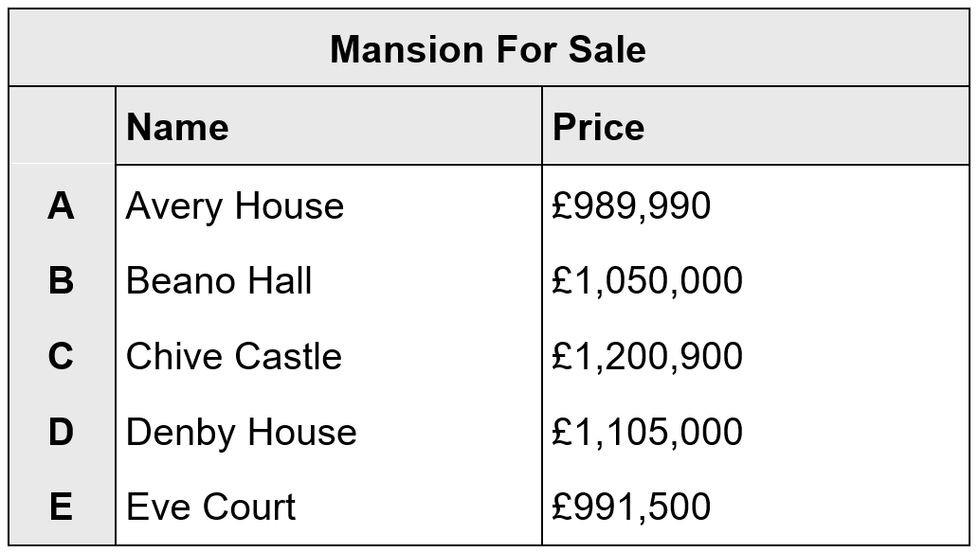
Mr Jones looks at the prices of 5 mansions.
He wants to look at mansions costing between £990,000 and £1,110,000.
Write the letters of the mansions that he looks at.
D,
B,
E
less than £990,000
more than £1,110,000
Notes:
P16 Pre-2000 or other question

Slide 10
3,576,219
Which digit is in the ten thousands place?
7
Round 3,576,219 to the nearest million.
4 000 000
Notes:
2019 Paper 3 Q2

Slide 11
Jack is rounding to the nearest hundred thousand.
Write the smallest whole number that he can round to 3,400,000
3, 3 5 0, 0 0 0
Grace is rounding to the nearest hundred thousand.
Write the largest whole number that she can round to 3,400,000
3, 4 4 9, 9 9 9
Notes:
P93 Pre-2000 or other question

Slide 12
A newspaper reported, ‘6 million people (to the nearest million) watched a football match on television.’
What is the smallest number of people that could have watched the football match on television?
5, 5 0 0, 0 0 0
Notes:
P152 Pre-2000 or other question

Slide 13
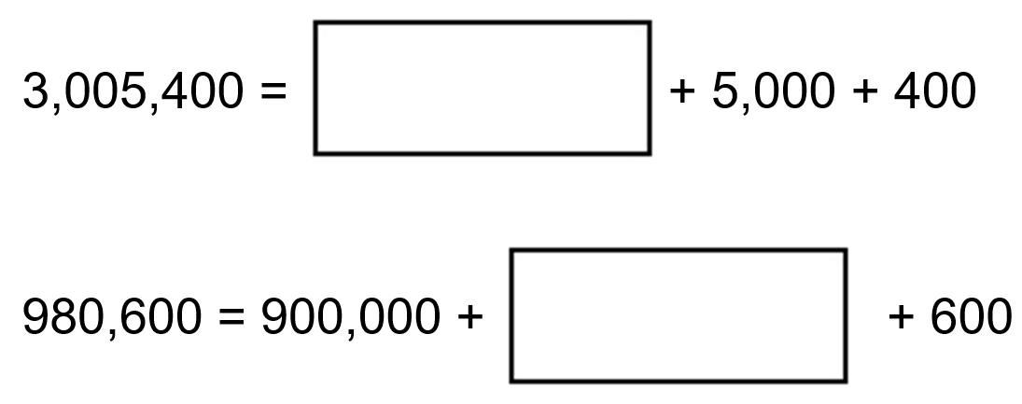
Write the missing numbers.
3,000,000
80,000
Notes:
P183 Pre-2000 or other question

Slide 14
Write the number that is five less than ten million.
0
9
9
9
9
9
9
10,000,000 – 5 =
9,999,995
1 0 0 0 0 0 0 0
1
1
1
1
1
1
1
-
5
0
9
9
9
9
9
9
5
Write the number that is one hundred thousand less than six million.
6,000,000 – 100,000 =
5,900,000
5
6 0 0 0 0 0 0
1
-
1 0 0 0 0 0
5
9
0
0
0
0
0
Notes:
2016 Paper 2 Q16

Slide 15
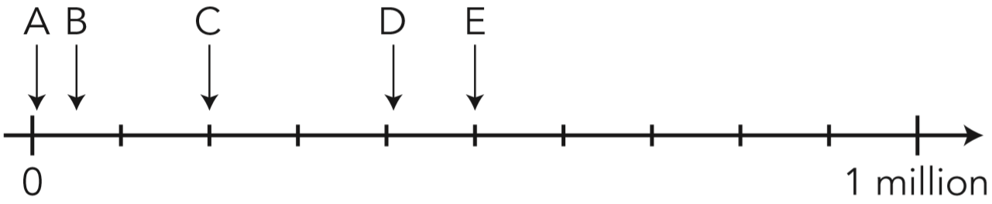
Write the letter of the arrow that points to the number 50 000
B
100 000
1 000 000 ÷ 10 =
100 000
Notes:
P245 2012 Level 6 Paper B Q4

Slide 16
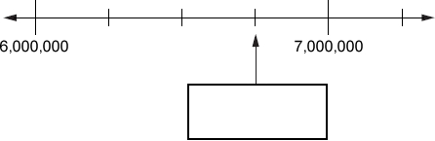
Here is part of a number line.
Write the number shown by the arrow.
6 250 000
6 500 000
1 000 000 ÷ 4 =
250 000
6 750 000
Notes:
P271 Pre-2000 or other question

Slide 17
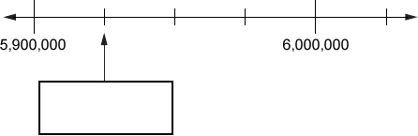
Here is part of a number line.
Write the number shown by the arrow.
5 925 000
6 000 000 – 5 900 000 =
100 000
100 000 ÷ 4 =
25 000
Notes:
P18 Pre-2000 or other question

Slide 18
Solve problems involving addition and subtraction

Slide 19

Write the missing numbers in the sequence.
6,742,000 6,842,000 6,942,000
6,642,000
7,042,000
Notes:
P95 Pre-2000 or other question

Slide 20


Write the missing numbers.
7,999,000
8, 0 0 0, 0 0 0 – 1, 0 0 0 =
7, 9 9 9, 0 0 0
7,990,000
8, 0 0 0, 0 0 0 – 1 0, 0 0 0 =
7, 9 9 0, 0 0 0
Notes:
P136 Pre-2000 or other question

Slide 21
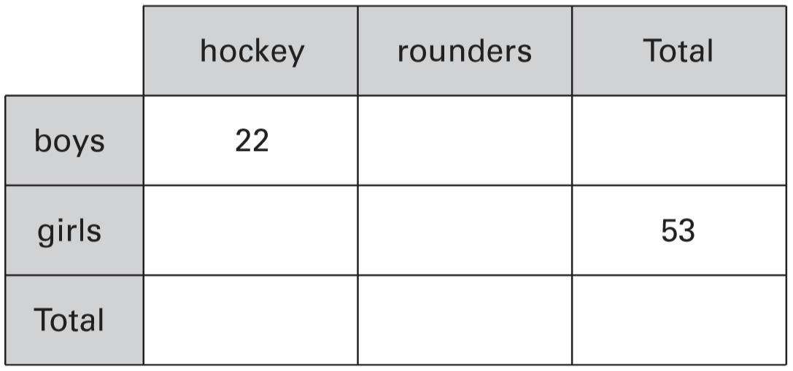
On Monday all the children at Grange School each play one sport.
They choose either hockey or rounders.
There are 103 children altogether in the school.
27 girls choose hockey.
Write all this information in the table. Then complete the table.
54 – 26
28
22 + 28
50
27
53 – 27
26
22 + 27
103
49
103 – 49
54
Notes:
P173 2005 Paper 2 Q22

Slide 22
A shop makes 100 sandwiches.
All the sandwiches are either cheese or tuna.
Some of the sandwiches also have salad with the cheese or tuna.
30 sandwiches have cheese with salad.
15 sandwiches have tuna without salad.
75 sandwiches have salad.
How many sandwiches have cheese without salad?
100 sandwiches
75 salad
25 no salad
30 cheese
15 tuna
10 cheese
10 sandwiches have cheese without salad.
Notes:
P205 2013 Level 6 Paper A Q9

Slide 23
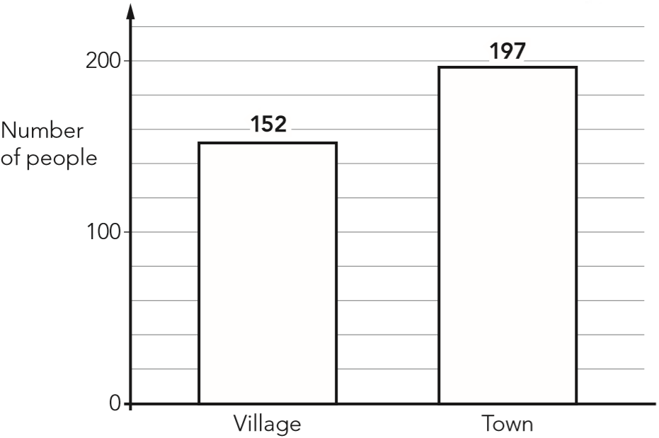
People in a village were asked if they shop in the village, or in the town, or in both. The bar chart shows the results.
Altogether 246 people took part in the survey. How many people shop in both the village and the town?
103 people
1
1 9 7
+
1 5 2
3
4
9
3 4 9
-
2 4 6
1
0
3
Notes:
P250 2012 Level 6 Paper A Q6

Slide 24
Solve problems involving multiplication or division

Slide 25
5,542 ÷ 17 = 326
Explain how you can use this fact to find the answer to 18 × 326
This shows that 17 x 326 = 5542
so you can work out 326 + 5542
because 1 x 326 = 326
and if you add 1 times a number to 17 times a number,
you get 18 times that number.
Notes:
2016 Paper 3 Q21

Slide 26
There are 25 children in the lunch queue, including Nik.
Nik says, ‘There are twice as many children in front of me as there are behind me’. How many children are in front of Nik?
16 children
24 children other than Nick
24
16
16
8
8 + 8 =
in front
behind
8
8
8
24 ÷ 3 =
8
Notes:
P14 2011 Level 6 Paper A Q3

Slide 27
A dragon lived in a cave.
The dragon doubled in size every day.
After 20 days the dragon filled the cave.
After how many days did the dragon half-fill the cave?
19 days
Notes:
P80 2011 Level 6 Paper A Q13

Slide 28
A builder needs 7600 bricks to build a wall.
There are 500 bricks in a load.
How many loads must the builder buy?
16 loads
1 load = 500 bricks
2 loads = 1000 bricks
14 loads = 7000 bricks
15 loads = 7500 bricks
… but the builder needs 100 more bricks
16 loads = 8000 bricks
£ .
The price of one load of 500 bricks is £230
What is the cost in pence of one brick?
230 00
23000 ÷ 500 =
4
6
p
5
2 3 0
3
Notes:
P119 2010 Paper 2 Q15

Slide 29
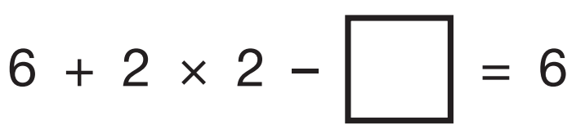
Write the missing number.
4
4
6 + 4 = 10
Notes:
2019 Paper 2 Q16

Slide 30


Write the missing numbers.
12
7
48
8
Notes:
P193 Pre-2000 or other question

Slide 31
Put brackets into this expression to make it correct.
10² ÷ 10 ÷ 10 ÷ 10 ÷ 10 = 100
( )
( )
100
1
1
Notes:
P207 Older Level 6

Slide 32
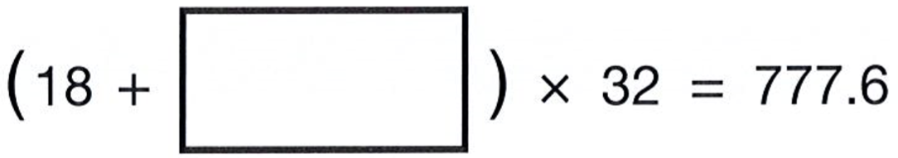
Write the missing number to make this calculation correct.
6.3
2
4
3
.
3 2
1x
1
2 4.3
3
2
7
7
7 .
6
+ 3 2
1
-
1 8.0
- 6 4
6
4
2x
.
0
6
3
1
3
7
+ 3 2
- 1 2 8
9
6
3x
9
6
+ 3 2
1
1
2
8
4x
+ 3 2
1
6
0
5x
Notes:
P253 2012 Paper 2 Q21

Slide 33
96 pupils and teachers go by minibus to the sports tournament.
How many 15-seater minibuses will be required?
7 minibuses
1 5
1x
3 0
2x
4 5
3x
6 0
4x
7 5
5x
9 0
6x
1 0 5
7x
Notes:
P34 Pre-2000 or other question

Slide 34
272 children and 26 adults from Hill School go on a coach trip.
How many 42-seat coaches does the school need to hire?
8 coaches
298
272 + 26 =
4 2
1x
+ 4 2
8
4
2x
+ 4 2
1
1 2
6
3x
+ 1 2 6
3x
2
5
2
6x
+ 4 2
2
9
4
7x
plus another coach for 4 more people
Notes:
P62 2003 Year 5 Optional Paper 2 Q21

Slide 35
1 5
427 children visit a castle.
They go in groups of 15
One group has less than 15
Every group of children has one adult with them.
How many adults will need to go?
1x
+ 1 5
3
0
2x
+ 1 5
4
5
3x
29 adults
+ 1 5
1 group = 15 children
6
0
2
8 r7
4x
10 groups = 150 children
+ 1 5
1
5
4
2
7
7
5
5x
20 groups = 300 children
- 3 0
+ 1 5
1
2
7
30 groups = 450 children
9
0
6x
29 groups = 435 children
+ 1 5
1 0
5
7x
28 groups = 420 children
…but this is less than 427
+ 1 5
1
2
0
8x
Notes:
P310 Pre-2000 or other question

Slide 36
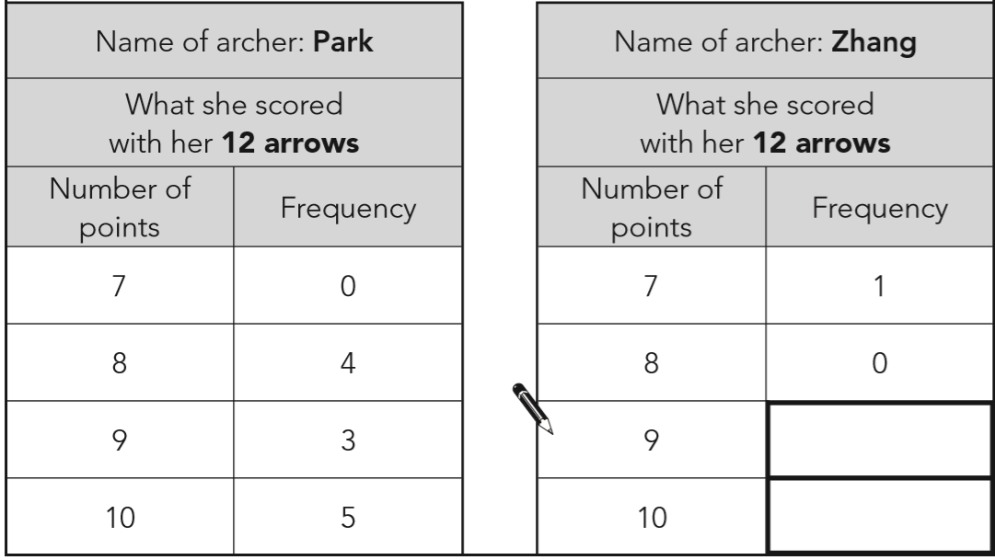
Archery is an Olympic sport.
In 2008, two archers called Park and Zhang were in the women’s final.
Both archers shot 12 arrows. Zhang won the final by 1 point.
Complete the table for Zhang below.
110 points
So 103 points on
9 or 10 point arrows
7
32
27
7
9 x 7 = 63
50
4
10 x 4 = 40
50 + 32 + 27 =
109 points
7 + 63 + 40 = 110 points
Notes:
P318 2012 Level 6 Paper B Q12

Slide 37
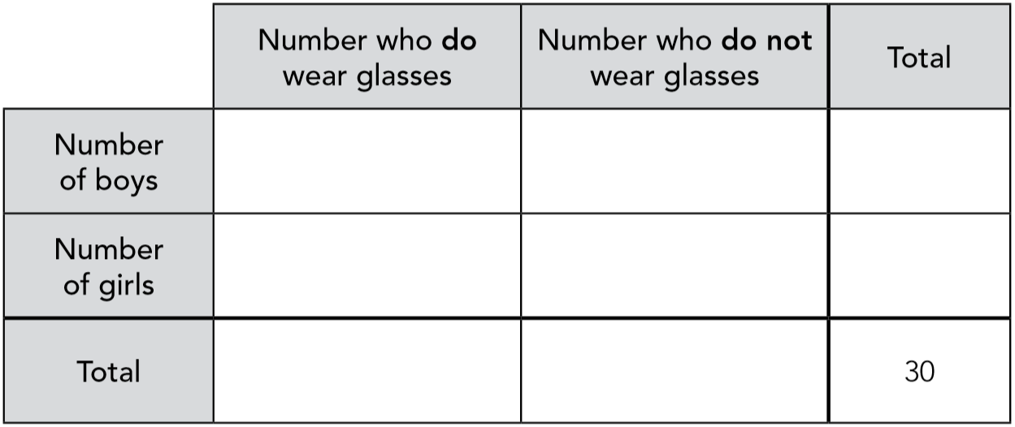
Here is information about pupils in a class.
• The total number of pupils is 30
• 26 of the pupils do not wear glasses.
• A quarter of the pupils who do wear glasses are boys.
• There are 2 more boys than girls.
Use the information to fill in the missing numbers in the table below.
1
15
16
3
11
14
4
26
Notes:
P199 2011 Level 6 Paper A Q1

Slide 38
Adam is making booklets.
Each booklet must have 34 sheets of paper.
He has 2 packets of paper.
There are 500 sheets of paper in each packet.
How many complete booklets can Adam make from 2 packets of paper?
2 x 500 =
1000 sheets
29 complete booklets
3 4
1
1x
1 7 0
5x
+ 3 4
2
9
+ 1 3 6
1
4x
3
4
1
0
0
0
6
8
2x
3
0
6
+ 3 4
- 6 8
1 0
2
3x
3 2
0
+ 3 4
- 3 0 6
1
1
3
6
4x
1 4
+ 3 4
1
7
0
5x
Notes:
2019 Paper 3 Q20 first page

Slide 39
Adam is making booklets.
Each booklet must have 34 sheets of paper.
He has 2 packets of paper.
There are 500 sheets of paper in each packet.
How many complete booklets can Adam make from 2 packets of paper?
2 x 500 =
1000 sheets
0
9
1
1 booklet = 34 sheets
29 booklets =
1
1 0 2 0
1
1
x10
-
3 4
10 booklets =
340 sheets
0
9
8
6
+340
20 booklets =
680 sheets
+340
30 booklets =
1020 sheets
…but that’s too many!
Notes:
2019 Paper 3 Q20 second page

Slide 40
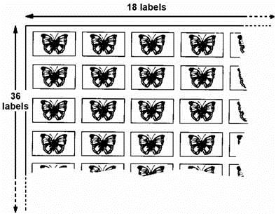
A shop sells sheets of sticky labels.
On each sheet there are 36 rows and 18 columns of labels.
`
How many labels are there altogether on 45 sheets?
29,160
1
3
4
2
4
3
6
6
4
8
x
1
8
x
4
5
1
1
2 8
8
3 2
4
0
3
6
0
2 5
9
2
0
6
4
8
2
9
1
6
0
Notes:
P3 Pre-2000 or other question

Slide 41
How many boxes of 40 matches can be filled from 2,688 matches?
67 boxes
1 box = 40
7 boxes = 280
10 boxes = 400
6
7 r8
60 boxes = 2400
40
2 6 8 8
28
67 boxes = 2680
68 boxes = 2720
…but that’s too many
Notes:
P338 Pre-2000 or other question

Slide 42
Identify negative numbers on number lines

Slide 43
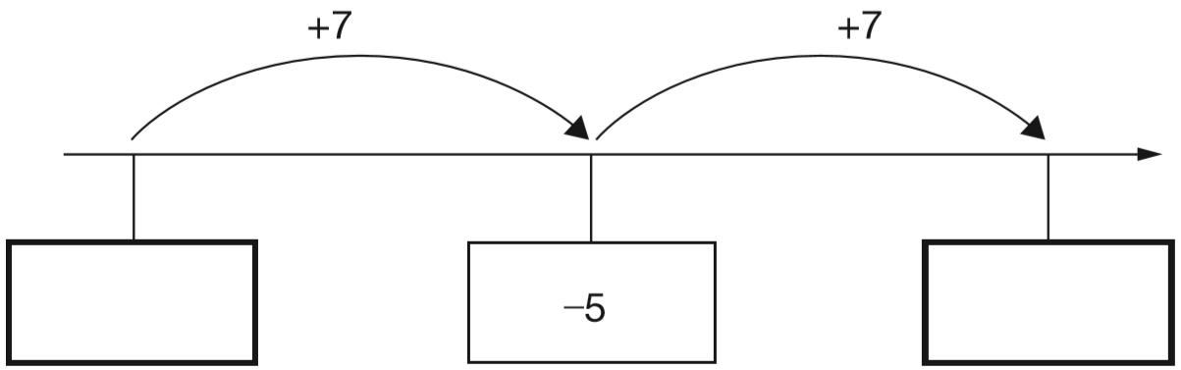
Here is part of a number line.
Write the missing numbers in the boxes.
+5
+2
-11
-10
-9
-8
-7
-6
-4
-3
-2
-1
0
1
-12
2
-5 – 7 =
-12
Notes:
2015 (Sample) Paper 3 Q2

Slide 44
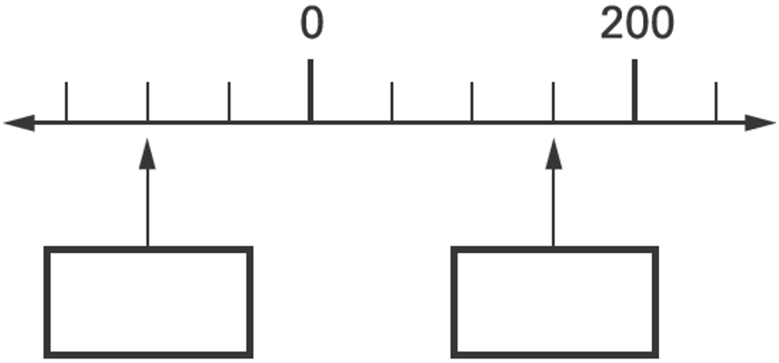
Here is part of a number line.
Write the missing numbers in the boxes.
200 ÷ 4 =
50
-50
50
100
-100
150
Notes:
P306 2003 Year 5 Optional Paper 1 Q11

Slide 45
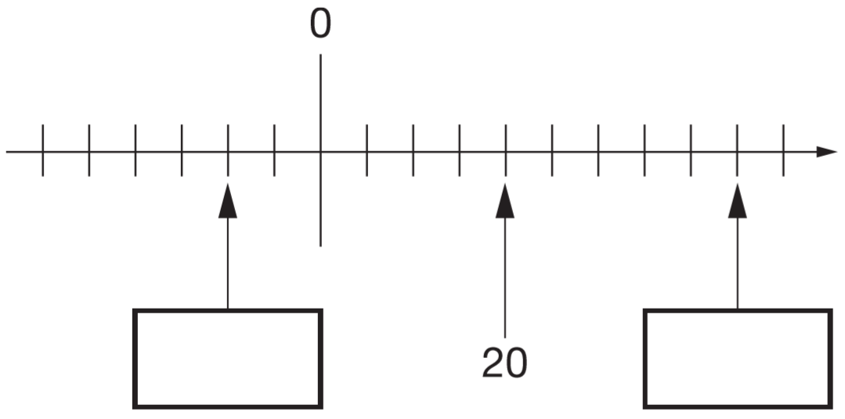
Here is part of a number line.
Write the missing numbers in the boxes.
20 ÷ 4 =
5
-10
-5
25
30
35
40
45
-10
45
Notes:
P113 2009 Paper 2 Q12

Slide 46
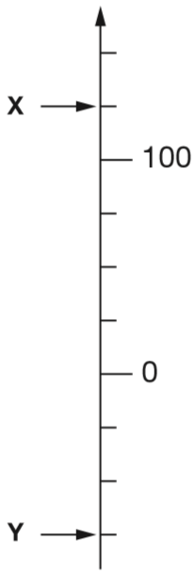
Here is part of a number line.
What is the value of X?
125
125
100 ÷ 4 =
25
-25
-50
-75
What is the value of Y?
-75
Notes:
P181 2015 Paper 1 Q11

Slide 47
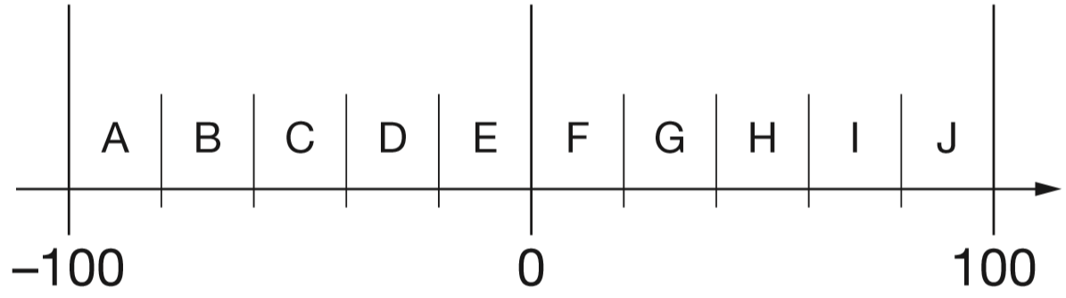
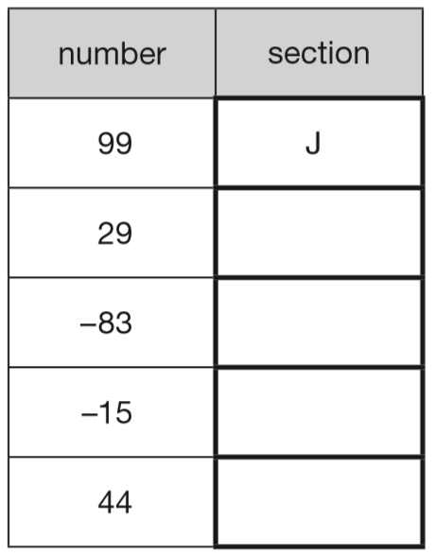
Here is part of a number line.
It is divided into equal sections.
100 ÷ 5 =
20
-80
-60
-40
-20
20
40
60
80
Write the letter of the section where each of these numbers belongs.
The number 99 has been done for you.
G
A
E
H
Notes:
P220 2011 Paper 2 Q22

Slide 48
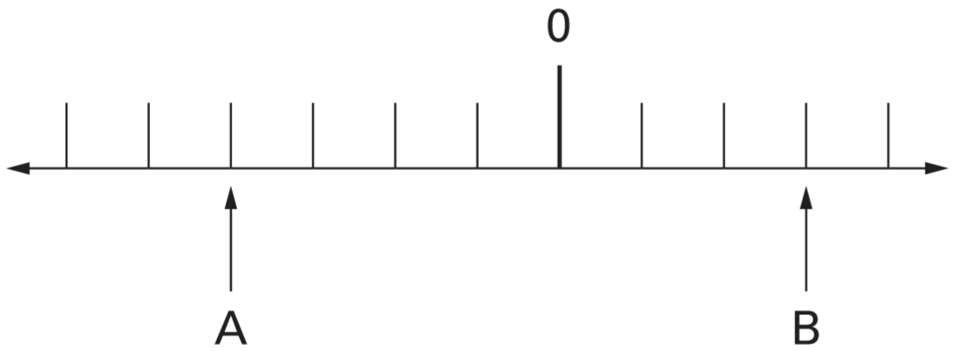
A and B are two numbers on the number line below.
-80
-60
-40
-20
0
20
40
60
The difference between A and B is 140
Write the values of A and B.
140 ÷ 7 =
20
A = -80
B = 60
Notes:
P259 2005 Paper 1 Q23

Slide 49
Complete sequences involving negative numbers

Slide 50
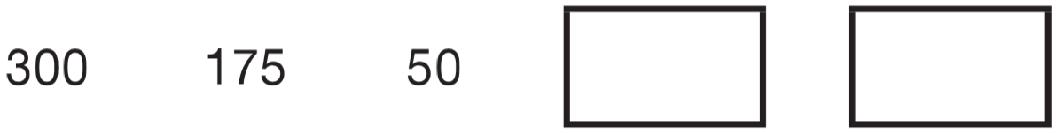
Liam makes a sequence of numbers starting with 300
He subtracts 125 each time.
Write the next two numbers in Liam’s sequence.
-75
-200
1
1
0
1 2 5
1 2 5
1
+
7 5
-125
-75
-50
-
5 0
2
0
0
7
5
-200
-75
0
50
Notes:
P12 2010 Paper 1 Q18

Slide 51
A sequence starts at 500 and 80 is subtracted each time.
500 420 340 ...
The sequence continues in the same way.
Write the first two numbers in the sequence which are less than zero.
260
180
100
20
-60
-140
-80
-60
-20
-140
-60
0
20
Notes:
P101 2002 Paper 1 Q20

Slide 52
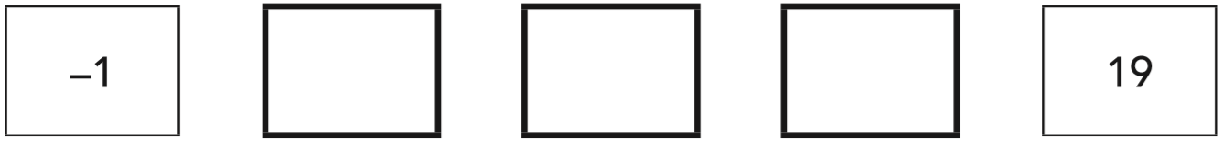
Jon makes a sequence of numbers. His rule is to add the same amount each time. Write in the missing numbers.
4
9
14
+1
+4
-1
0
4
4 equal jumps
+1
+19
a difference of 20
-1
0
19
20 ÷ 4 = 5
…so it’s an increase of 5 with each jump
Notes:
P129 2012 Level 6 Paper A Q1

Slide 53

Megan makes a sequence of numbers starting with 100
She subtracts 45 each time.
Write the next two numbers in the sequence.
-35
-80
-45
-35
-10
-80
-35
0
10
Notes:
P184 Pre-2000 or other question

Slide 54
Paulo makes a sequence of numbers. He chooses a starting number and then subtracts equal amounts each time.
The third number in his sequence is 45
The tenth number is –32
What is the first number in the sequence?
67
67
56
+11
+11
7 equal jumps
+32
+45
a difference of 77
-32
0
45
77 ÷ 7 = 11
…so it’s an decrease of 11 with each jump
Notes:
P228 Older Level 6

Slide 55

Carol has a rule for a sequence of numbers.
Her rule is: ‘The next number is the sum of the two previous numbers.’ Use Carol’s rule to write in the three missing numbers.
2
-1
1
__ + 0 = 1
1
__ + 1 = 0
-1
__ - 1 = 1
2
Notes:
P275 Older Level 6

Slide 56
Use knowledge of multiples to identify rules in sequences

Slide 57
The rule for this sequence of numbers is ‘add 3 each time’.
1 4 7 10 13 16 …
The sequence continues in the same way.
Mary says, ‘No matter how far you go there will never be a multiple of 3 in the sequence.’ Is she correct? Explain how you know.
3 6 9 12 15 …
multiples of 3
Mary is correct.
The numbers in the sequence are always 1 more than a multiple of 3.
Notes:
P354 2001 Paper 2 Q22

Slide 58
This sequence of numbers goes up by 40 each time.
40 80 120 160 200 …
This sequence continues.
Will the number 2140 be in the sequence? Explain how you know.
multiples of 40
2140 ÷ 40 =
53 r20
It will not be in the sequence.
All numbers in the sequence are multiples of 40.
5
3 r2
4
2 1 4
1
2140 is not in the 40 times table.
Notes:
P97 2000 Paper 1 Q20

Slide 59
The numbers in this sequence increase by 7 each time.
1 8 15 22 29 ....
The sequence continues in the same way.
Will the number 777 be in the sequence? Explain how you know.
Multiples of 7: 7, 14, 21, 28, …
The numbers in this sequence are always 1 more than a multiple of 7.
777 ÷ 7 = 111
…so 777 is a multiple of 7
It will not be in the sequence.
Notes:
P336 2008 Paper 1 Q23

Slide 60
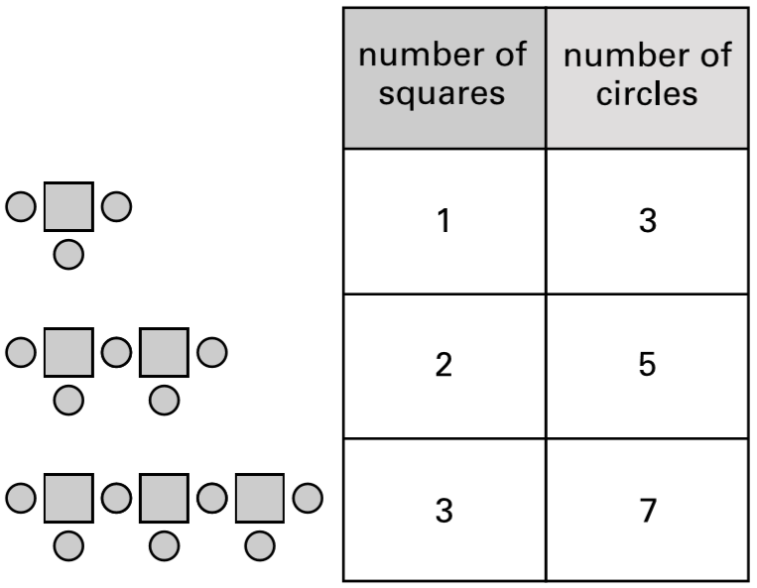
Here is a sequence of patterns made from squares and circles.
The sequence continues in the same way. Calculate how many squares there will be in the pattern which has 25 circles.
x 2 + 1
12 squares
x 2 + 1
9
11
13
15
17
19
21
23
25
x 2 + 1
12
25
x 2 + 1
25 – 1 = 24
24 ÷ 2 =
12
Notes:
P308 2001 Paper 1 Q23

Slide 61
A sequence of numbers starts at 11 and follows the rule
‘double the last number and then subtract 3’
11 19 35 67 131...
The sequence continues.
The number 4099 is in the sequence.
Calculate the number which comes immediately before 4099 in the sequence.
2051
x2
4102
-3
4099
2051
4 0 9 9 + 3 = 4 1 0 2
2
0
5
1
2
4 1 0 2
1
Notes:
P320 2004 Paper 2 Q23

