Slide 1
Find a fraction of a shape

Slide 2
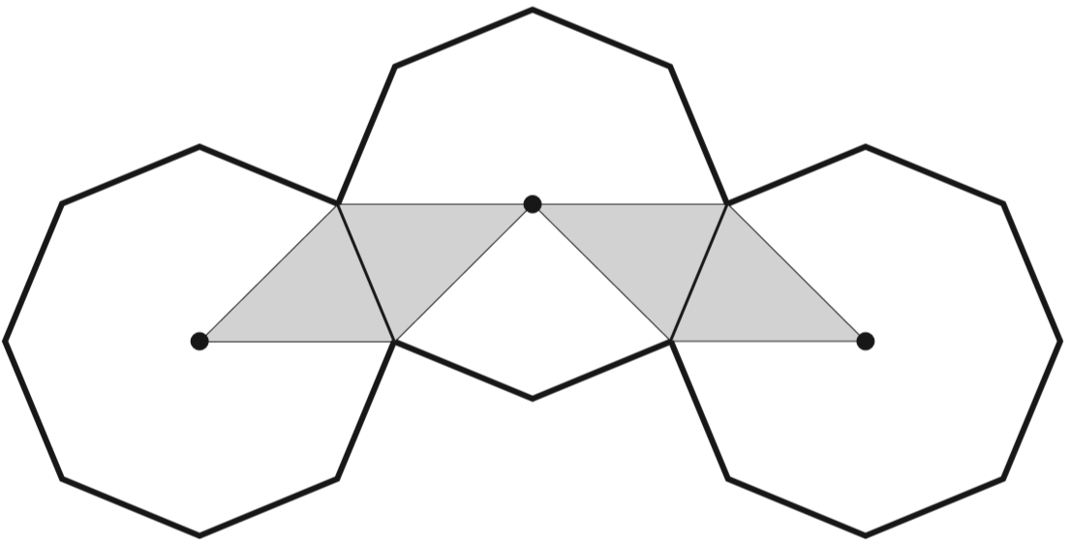
The diagram shows three regular octagons joined together.
There is a dot at the centre of each octagon.
What fraction of the diagram is shaded?
4 pieces shaded
24 pieces altogether
4
2 4
÷4
4
1
=
2 4
6
÷4
Notes:
P5 2007 Paper 2 Q25

Slide 3
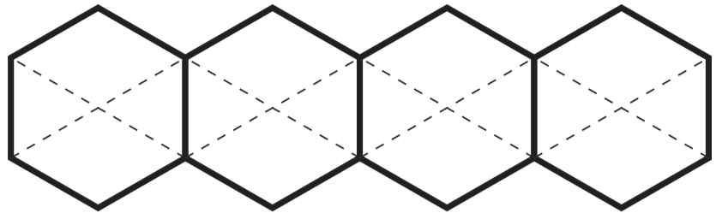
This diagram shows four regular hexagons.
Shade in one third of the diagram.
x8
1
8
=
3
2 4
x8
Notes:
P339 2003 Paper 2 Q23

Slide 4
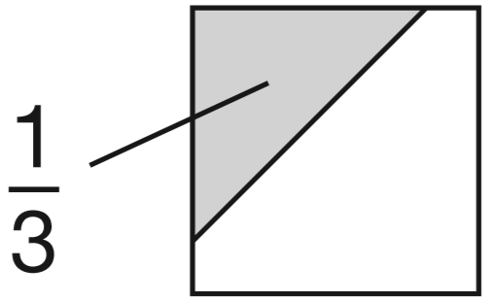
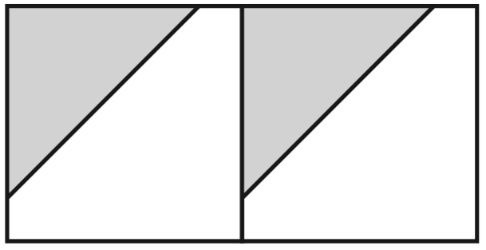
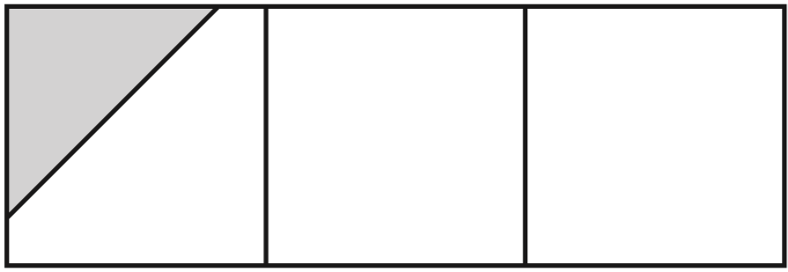
1
of this square is shaded.
3
The same square is used in the diagrams below.
What fraction of this diagram is shaded?
÷2
2
1
=
6
3
÷2
What fraction of this diagram is shaded?
1 piece shaded
9 equal parts
1
9
1
1
÷ 3 =
3
9
Notes:
P124 2008 Paper 1 Q19

Slide 5
Complete fraction arithmetic problems

Slide 6
1
2
Which is larger, or ?
Explain how you know.
3
5
x5
2
6
is larger because it’s equivalent to
1
5
5
1 5
=
3
1 5
x5
1
5
is only equivalent to
3
1 5
x3
2
6
=
5
1 5
x3
Notes:
P316 2002 Paper 1 Q24

Slide 7
4
5
Anna says is greater than
Explain why Anna is correct.
7
9
x9
4
3 6
is larger because it’s equivalent to
4
3 6
7
6 3
=
7
6 3
x9
5
3 5
is only equivalent to
9
6 3
x7
5
3 5
=
9
6 3
x7
Notes:
P240 2014 Level 6 Paper B Q8

Slide 8
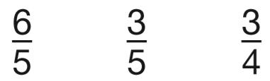
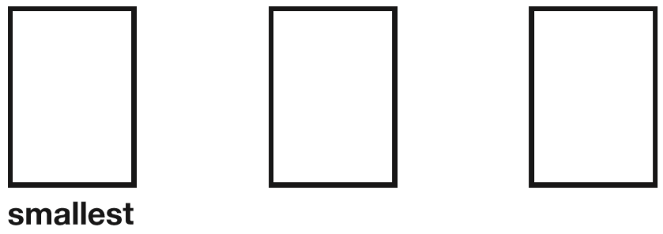
x4
6
2 4
=
5
2 0
Write these fractions in order, starting with the smallest.
x4
x4
3
3
6
3
1 2
5
=
5
4
5
2 0
x4
x5
3
1 5
=
4
2 0
x5
Notes:
2018 Paper 2 Q14

Slide 9
4
1
Is greater than ?
Show how you know.
Yes
9
3
x3
1
3
1
3
4
=
is only equivalent to so is larger.
3
9
3
9
9
x3
4
8
Is half of ?
Show how you know.
No
9
18
4
8
is equivalent to (the same size as)
9
1 8
x2
4
8
4
2
4
=
Half of would be or
9
1 8
9
9
1 8
x2
Notes:
P270 2012 Level 6 Paper A Q7

Slide 10
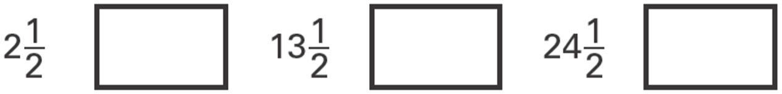
The numbers in this sequence increase by equal amounts each time.
Write in the missing numbers.
8
19
30
1
1
2
+ 5
=
8
2 jumps = a difference of 11
2
2
1 1
1
1 jump =
=
5
1
1
13
+ 5
=
2
2
19
2
2
1
1
24
+ 5
=
30
2
2
Notes:
P32 2006 Year 5 Optional Paper 1 Q27

Slide 11
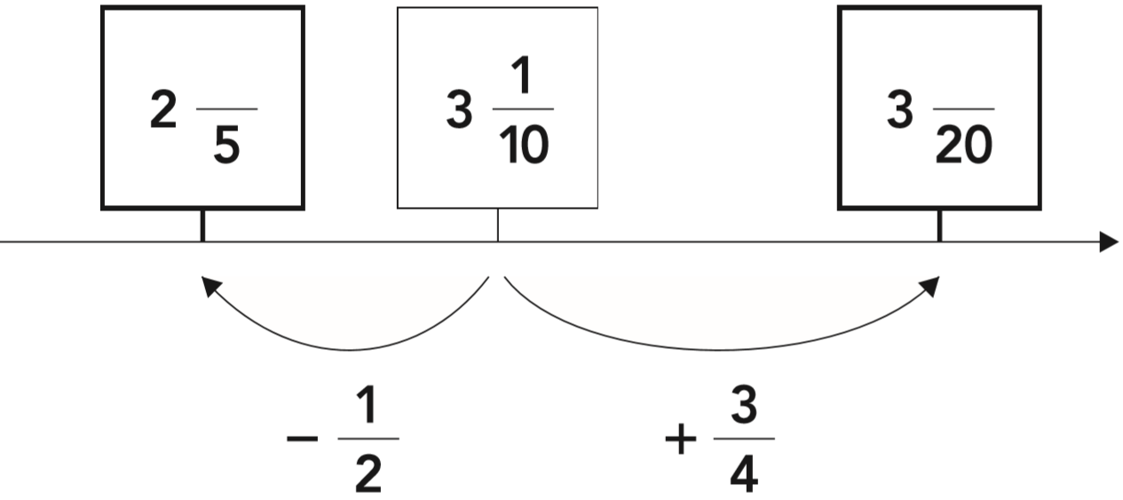
The diagram shows part of a number line. Two of the fractions are not complete. Write the missing numerator in each box.
3
17
3 1
3
+
=
1 0
4
6 2
1 5
7 7
+
=
2 0
2 0
2 0
3 1
1
–
=
1 0
2
1 7
3
2 0
3 1
5
2 6
6
3
–
=
=
2
= 2
1 0
1 0
1 0
1 0
5
Notes:
P138 2012 Level 6 Paper A Q14

Slide 12
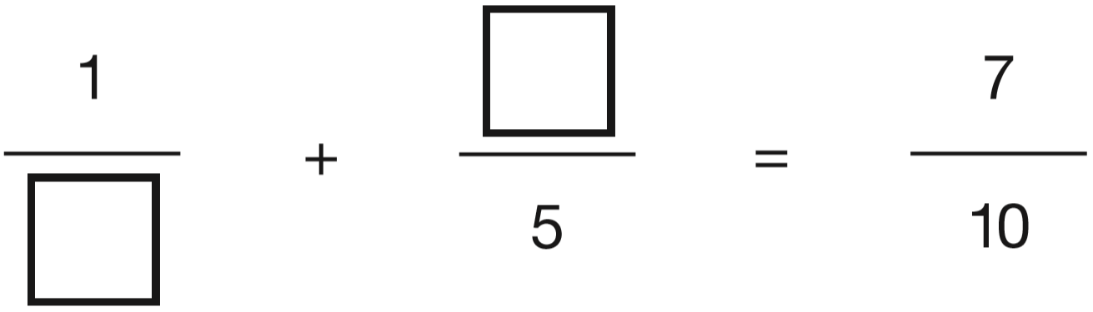
Write numbers in the boxes to make this fraction calculation correct.
3
6
10
10
Now write two different numbers to make the calculation correct.
1
2
5
2
4
10
10
10
2
Notes:
P78 2014 Level 6 Paper A Q8

Slide 13

7
Circle the fraction that is bigger than
5
not improper
not improper
x5
x6
x5
x3
1 1
5 5
7
4 2
4
2 0
7
2 1
=
=
=
=
6
3 0
5
3 0
3
1 5
5
1 5
x5
x6
x5
x3
Notes:
P170 Pre-2000 or other question

Slide 14

Circle the biggest fraction.
1
1
3
2
2
2
1
1
6
5
4
3
Notes:
P208 Pre-2000 or other question

Slide 15

Write the two missing values to make these equivalent fractions correct.
x 3
25
36
x 3
÷2
x5
1 0
5
2 5
=
=
1 2
6
3 0
÷2
x5
Notes:
P267 Pre-2000 or other question

Slide 16
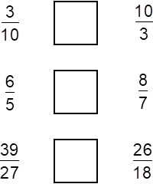
Write the correct sign < = or > in each box to make these sentences correct.
<
1
1
1
>
1
5
7
÷3
÷2
1 2
4
8
4
=
=
12
8
2 7
9
1 8
9
1
=
1
27
18
÷3
÷2
Notes:
P49 Pre-2000 or other question

Slide 17
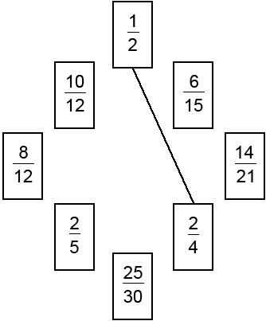
Join pairs of equivalent fractions.
One is done for you.
÷3
6
2
=
÷2
1 5
5
1 0
5
=
÷3
1 2
6
÷7
1 4
2
÷2
=
2 1
3
÷7
÷4
8
2
÷5
=
1 2
3
2 5
5
=
÷4
3 0
6
÷5
Notes:
P89 Pre-2000 or other question

Slide 18
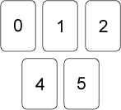
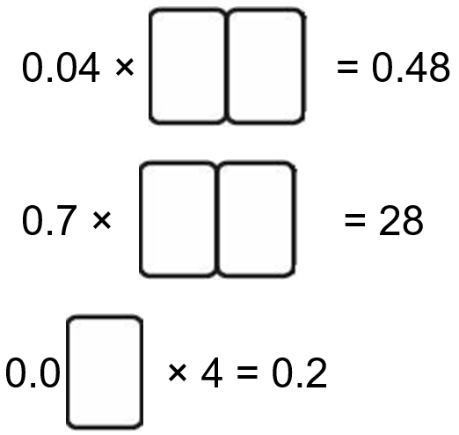
Here are five digit cards.
Use each card once to make these calculations correct.
1 2
4 0
.0
5
0
Notes:
P112 Pre-2000 or other question

Slide 19


Write the missing fractions.
3
5
1
3
3
12
Notes:
P175 Pre-2000 or other question

Slide 20


Complete the number sentences.
3
10
13
2 x 5
1 0
=
1 3
1 3
Notes:
P203 Pre-2000 or other question

Slide 21
Grace, Ellie and Alfie bought 5 pizzas to share.
Grace ate 1 pizzas.
Ellie ate 1 pizzas.
And Alfie ate the rest.
How many pizzas did Alfie eat?
1
3
9
=
2
2
6
2
5
10
3
=
3
6
5
1 pizzas
6
1 0
9
1 9
1
+
=
3
=
6
6
6
6
1
5
5
3 0
3 0
1 9
1 1
5 – 3 =
1
=
– =
6
6
1
6
6
6
6
Notes:
P285 Pre-2000 or other question

Slide 22
3
1
1
What number is exactly halfway between 2 and 3 ?
4
2
3
8
3
1 1
2 2
2
=
=
4
4
8
1
7
1 4
2 8
3
=
=
=
2
2
4
8
2 5
1
3
=
8
8
Notes:
P15 Pre-2000 or other question

Slide 23


Write the missing fractions.
16
8
27
10
10
10
8
16
5
10
55
9
4
60
20
20
20
20
11
55
4
20
Notes:
P70 Pre-2000 or other question

Slide 24
Solve word problems involving fractions

Slide 25
Alfie did a survey to find which soup was most popular.
The choices were:
• tomato
• chicken
• mushroom
A quarter of the children chose chicken soup.
Four times as many children chose tomato soup as mushroom soup.
What fraction of the children chose tomato soup?
1 2
2 0
¾ tomato or mushroom
¼ chicken
T
T
T
T
M
3
3
3
3
3
3
3
20
20
20
20
20
÷ 5 =
4
2 0
Notes:
P140 2014 Level 6 Paper A Q12 (adapted)

Slide 26
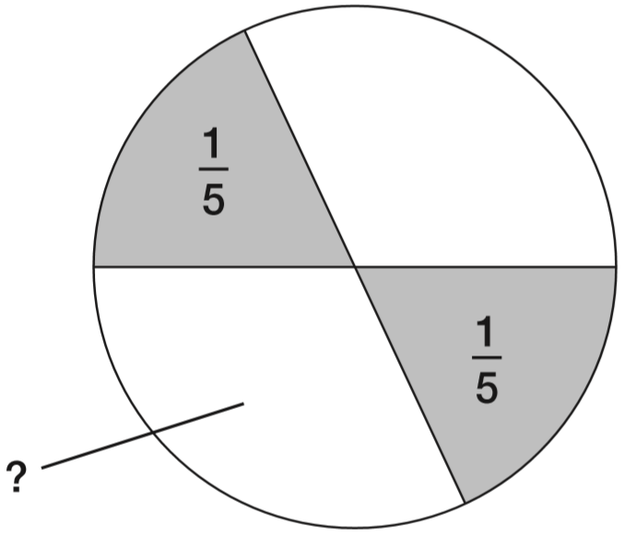
1
In this circle, each shaded part is of the area of the circle.
The two white parts have equal areas.
5
2
3
1 – =
for 2 white parts
3
5
5
10
3
3
÷ 2 =
3
5
1 0
10
3
What fraction of the circle is one of the white areas?
1 0
3
3
2
2
1 0
+
+
+
=
1 0
1 0
1 0
1 0
1 0
Notes:
P326 2013 Level 6 Paper A Q7

Slide 27
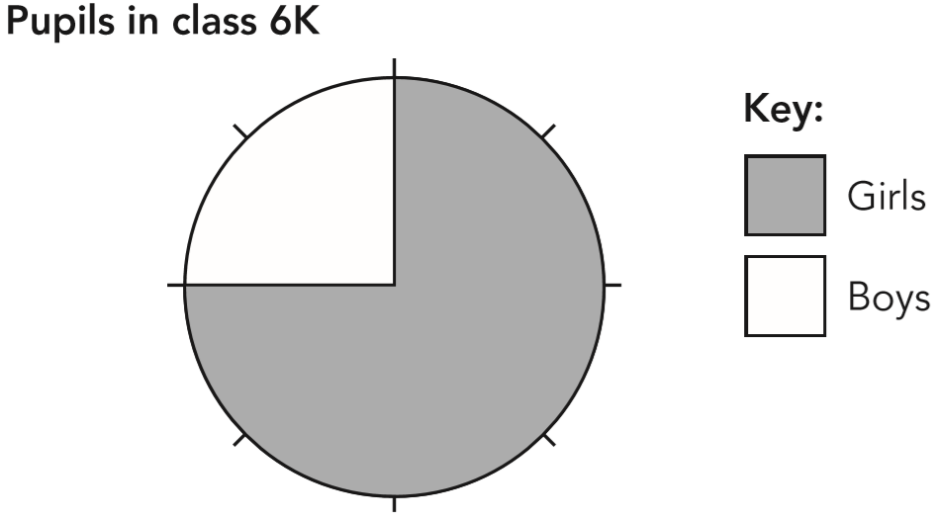
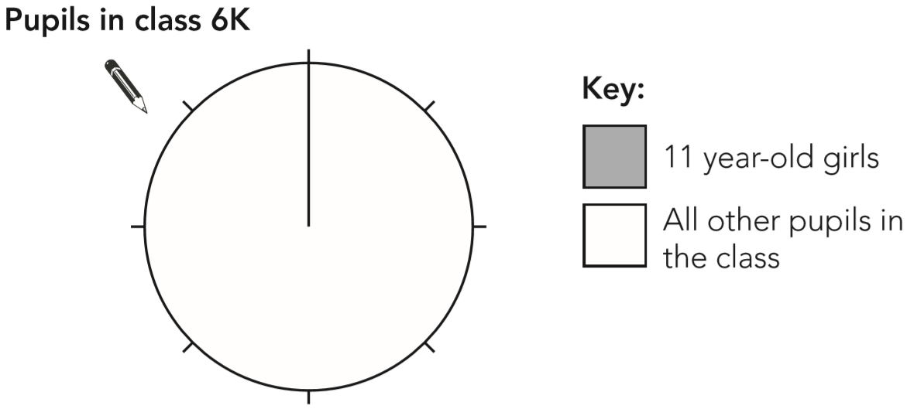
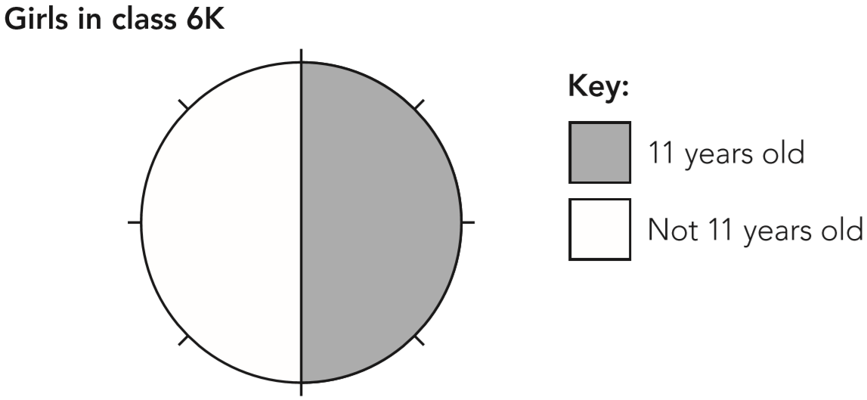
Look at the information in these two pie charts.
Use the information in the two pie charts to complete the pie chart below.
11
not 11
6
3
÷ 2 =
8
8
Notes:
P196 2012 Level 6 Paper A Q11

Slide 28
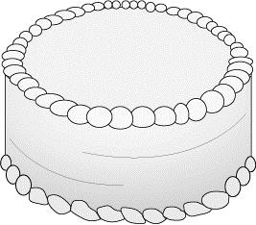
Annie ate ¼ of a cake.
Four other children shared the remainder equally.
What fraction of the cake did each of the other children get?
¾ other children
3
3
¼ Annie
÷ 4 =
4
4
1 6
16
3
3
3
3
16
16
16
16
Notes:
P286 Pre-2000 or other question

Slide 29
The length of a day on Earth is 24 hours.
The length of a day on Mercury is 58 times the length of a day on Earth.
What is the length of a day on Mercury, in hours?
2
3
1408 hours
2
5 8
8
1 7 6
x 2 4 =
4 2 2 4
x
3
3
3
1 7
4
+ 2 =
1 7 6
1
1
4
0
3
2
1
8
1
7
6
3
4 2 2 4
1
2
6
4
x
2
4
1 7 6
1
7
0
4
x
8
3
5
2
0
1 4
0
8
4
2
2
4
Notes:
2018 Paper 2 Q23

Slide 30


5 miles is approximately equal to 8 km.
Complete the sentences below:
1 mile is approximately equal to
1 km is approximately equal to
8
3
=
1
5
5
3
1
or 1.6
5
5
or 0.625
8
Notes:
P13 Pre-2000 or other question

Slide 31
Ellie had a piece of ribbon that was ¾m long.
She cut it and gave half to Grace.
What fraction of a metre did she give to Grace?
3
m
8
3
3
÷ 2 =
4
8
Notes:
P84 Pre-2000 or other question

Slide 32
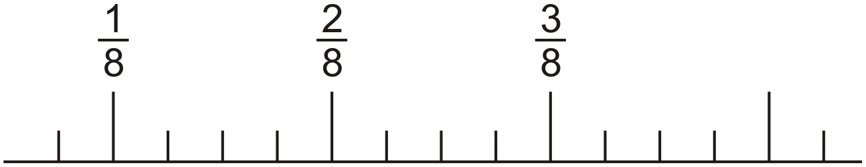
Here is a number line.
Draw an arrow to show the position of
13
32
x4
1
4
3
2
8
1 2
=
8
3 2
4
8
12
32
32
32
x4
Notes:
P137 Older Level 6

Slide 33

Write two fractions, each greater than 0 and less than 1, which have a difference of ¾
7
1
7
1
3
8
–
=
8
8
8
4
3
1
+
=
4
8
6
1
7
+
=
8
8
8
Notes:
P303 Older Level 6

Slide 34
Lili and Julian each start with the same number.
Lili works out half of the number.
Julian works out three-quarters of the number.
The sum of their answers is 275
What was the number they started with?
220
1
3
+
=
5
2
4
of
220
= 275
4
2
3
5
+
=
4
4
4
2 7 5 ÷ 5 =
5 5
5 5 x 4 =
2 2 0
Notes:
P218 Older Level 6

Slide 35
3
5
What fraction is exactly half-way between and ?
2 3
5
7
3 5
x7
3
2 1
=
5
3 5
x7
x5
5
2 5
=
7
3 5
x5
Notes:
P277 Older Level 6

Slide 36
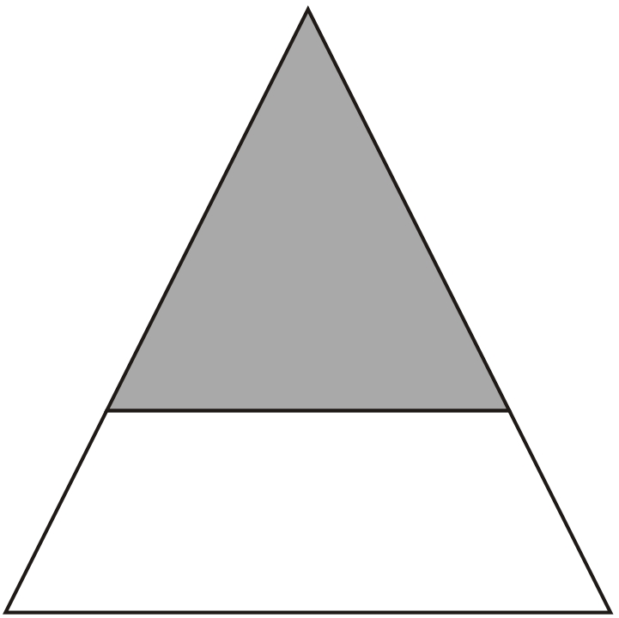
The diagram shows a shaded triangle inside a larger triangle.
The area of the shaded triangle is 52 cm².
The area of the shaded triangle is of the area of the larger triangle.
Calculate the area of the larger triangle.
4
9
117 cm²
4
of
117
= 52
9
52 cm²
5 2 ÷ 4 =
1 3
1 3 x 9 =
1 1 7
Notes:
P294 Older Level 6

Slide 37
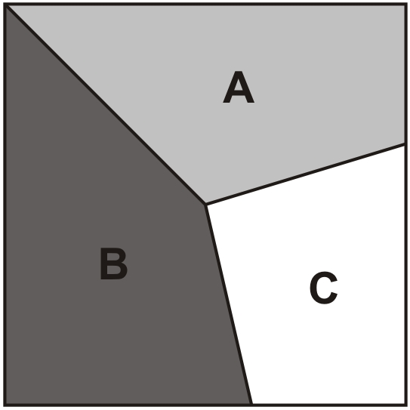
This square is divided into three parts.
1
Part A is of the area of the square.
Part B is of the area of the square.
What fraction of the area of the square is part C?
3
2
5
4
1
2
1 5
+
=
3
5
5
6
1 1
1 1
4
+
=
1 – =
1 5
1 5
1 5
1 5
1 5
Notes:
P61 Older Level 6

Slide 38
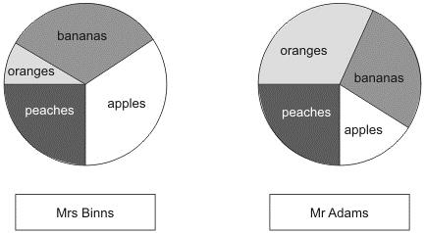
Some children work out how much money two shopkeepers get from selling fruit. They use pie charts to show this.
Mrs Binns gets £350 selling bananas. Estimate how much she gets selling oranges.
£360 ÷ 4 =
£90
Mrs Binns gets a total of £1000 and
Mr Adams gets a total of £800
Estimate how much more Mrs Binns gets than Mr Adams for selling peaches.
¼ of £1000 =
£250
¼ of £800 =
£200
£250 - £200 =
£50 more
Notes:
P156 Pre-2000 or other question

Slide 39
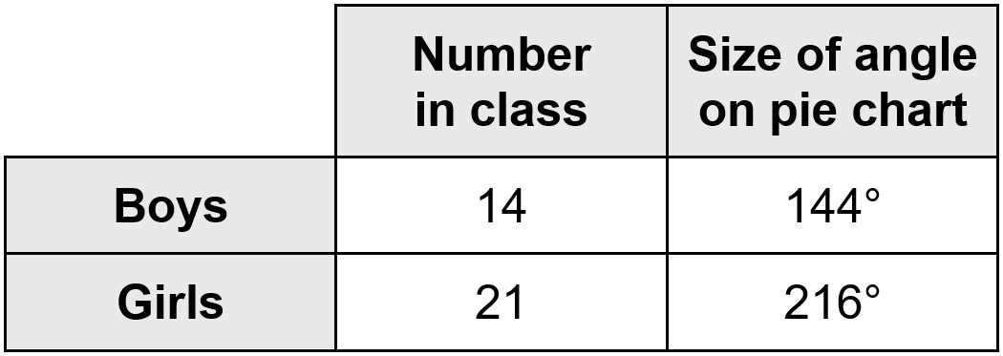
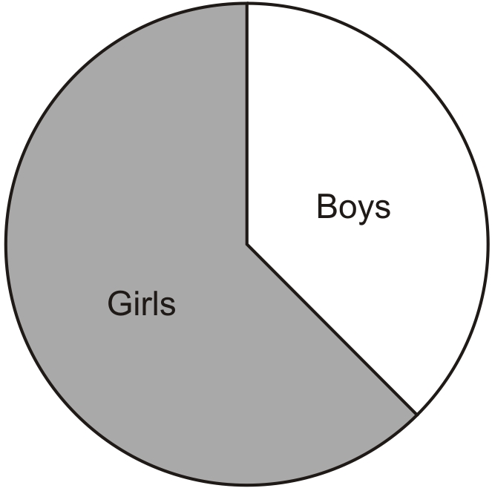
Sarah makes a pie chart to show the proportion of boys and girls in her class.
The next day another boy joins Sarah's class.
She makes a new pie chart.
Calculate the angle for boys on the new pie chart.
150 degrees
14 + 1 =
15 boys
1 5
1 5 0
=
14 + 21 + 1 =
36 children
3 6
3 6 0
Notes:
P190 Older Level 6

Slide 40
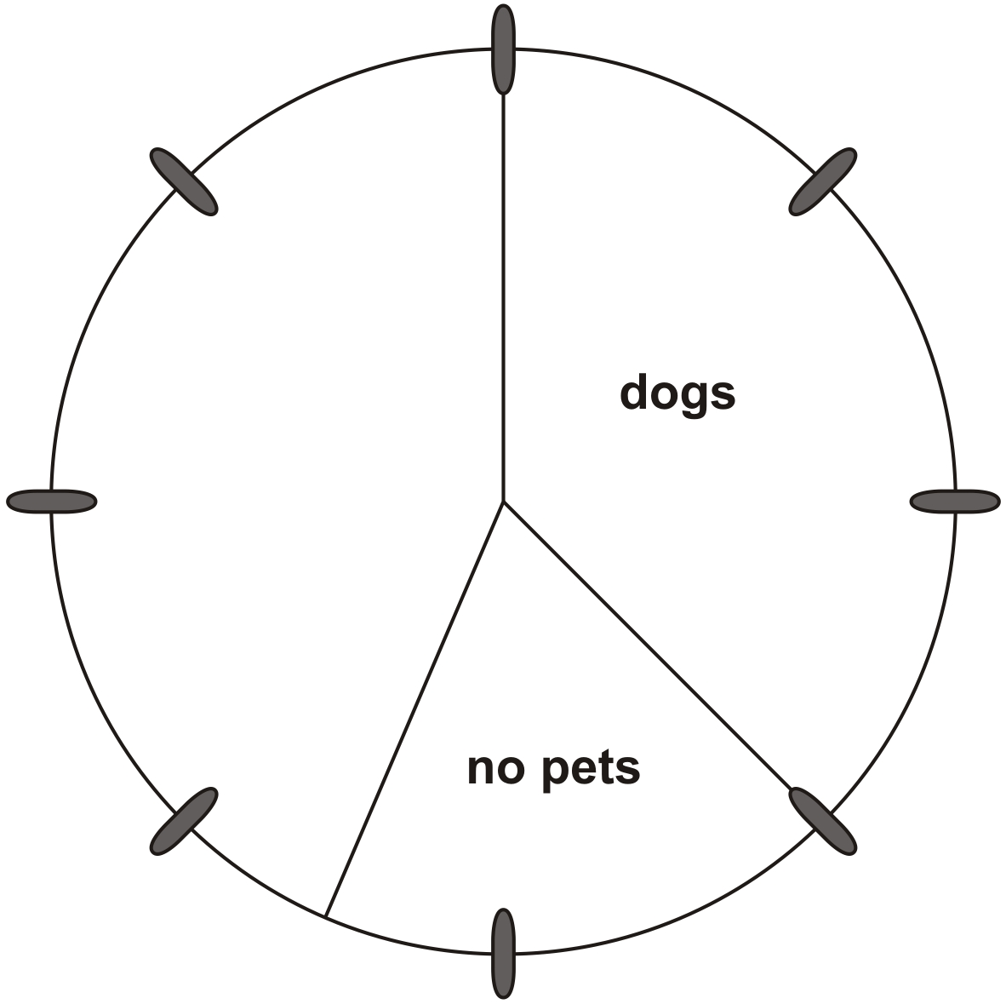
80 people were asked if they owned a pet.
30 had dogs
25 had cats
10 had other pets
15 had no pets
Complete the pie chart to show this information.
÷10
2 5
2.5
=
8 0
8
÷10
÷10
other
pets
1 0
1
=
8 0
8
÷10
cats
Notes:
P322 Pre-2000 or other question

Slide 41
Solve problems involving decimals

Slide 42
1 gallon is approximately 4.5 litres.
Mrs Smith buys 8 gallons of petrol.
How many litres of petrol does she buy?
36 litres
4
4.5
x
8
.
3 6
0
Notes:
P312 Pre-2000 or other question

Slide 43
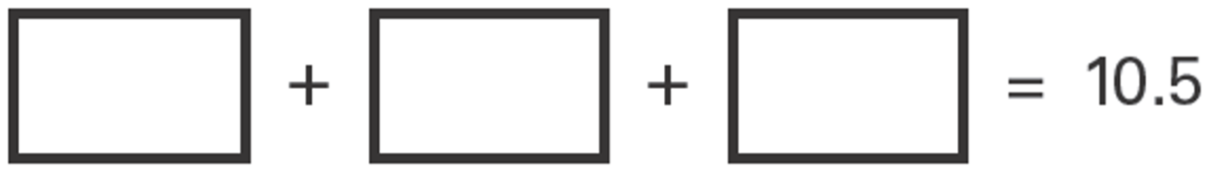
Write the same number in each box to make this correct.
3
.
5
3.5
3.5
3.5
1 0.5
3
1
Notes:
P302 2003 Year 5 Optional Paper 1 Q21

Slide 44
2
Adam says, 0.25 is smaller than
Explain why he is correct.
5
x20
2 5
2
4 0
Two fifths is equivalent to four tenths, which is 0.4
0.25 is smaller than 0.4 because it has fewer tenths.
0.25 =
=
1 0 0
5
1 0 0
x20
0.25 is twenty-five hundredths.
Two fifths is equivalent to forty hundredths.
Notes:
2017 Paper 2 Q20

Slide 45
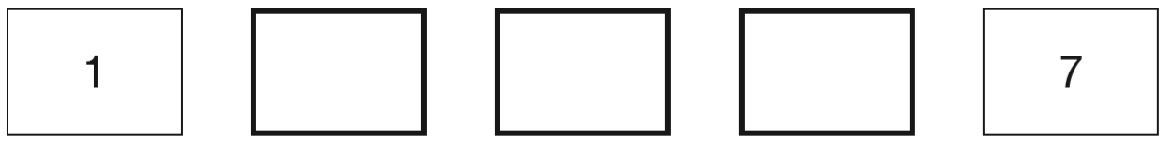
The numbers in this sequence increase by equal amounts each time.
Write in the three missing numbers.
2.5
4
5.5
+1.5
+1.5
+1.5
+1.5
4 jumps =
6 more
1 jump =
6 ÷ 4 =
1.5 more
1
.
5
4
6
.0
2
Notes:
P81 2015 Paper 2 Q21

Slide 46
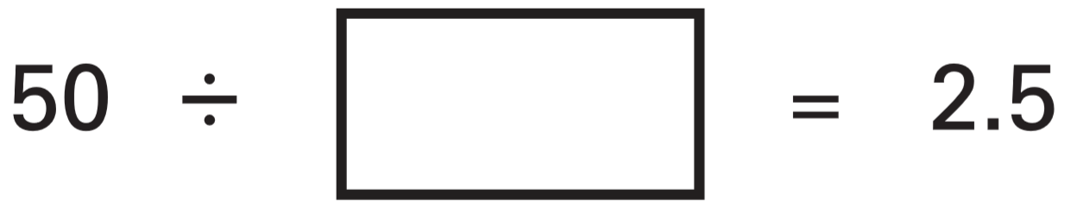
Write in the missing number.
If 2 x 2.5 = 5
Then 20 x 2.5 = 50
So 50 ÷ 2.5 = 20
And 50 ÷ 20 = 2.5
20
2
0
1
2.5
5 0
2
.5
+
2.5
5
.
0
so 2 x 2.5 = 5
Notes:
P158 2003 Paper 1 Q22

Slide 47
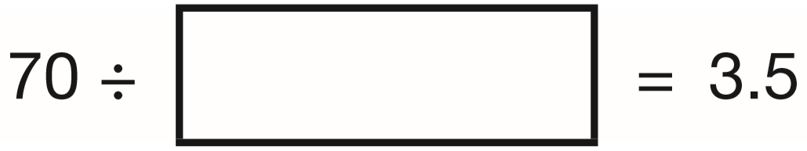
Write the missing number.
If 2 x 3.5 = 7
Then 20 x 3.5 = 70
So 70 ÷ 3.5 = 20
And 70 ÷ 20 = 3.5
20
2
0
1
3.5
7 0
3
.5
+
3.5
7
.
0
so 2 x 3.5 = 7
Notes:
2016 Paper 2 Q18

Slide 48
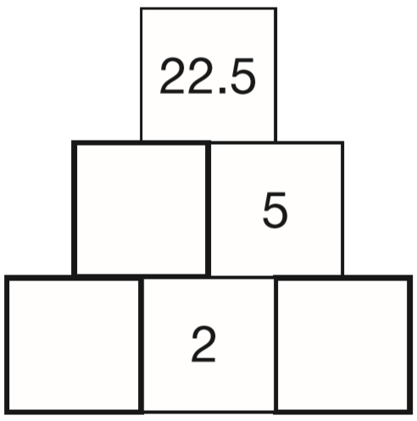
Here is a number pyramid.
The number in a box is the product of the two numbers below it.
Write the missing numbers.
.
4
5
5
2 2.5
2
4.5
2
.
5
2.25
2.5
2
5
.0
1
2
.
5
2
2
4.5
0
1
Notes:
2015 (Sample) Paper 3 Q14

Slide 49
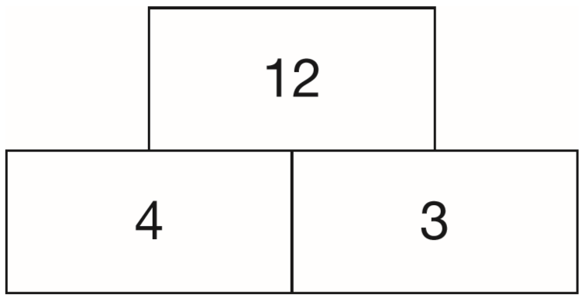
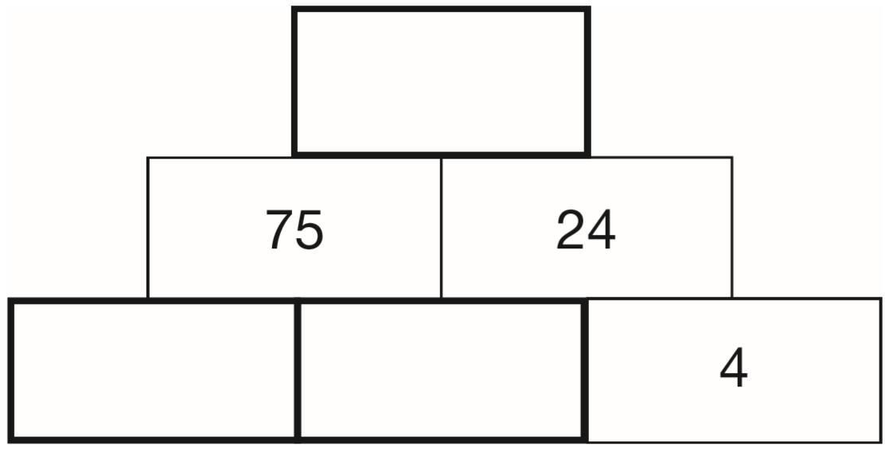
In this tower, two numbers are multiplied to give the number above.
Write the missing numbers in the tower below to make it correct.
1800
1
2
7
5
x
2
4
3 0
0
2
.
1 5
0
0
1
5
12.5
6
1
8
0
0
6
3
7 5
1
.0
Notes:
P180 2015 Level 6 Paper A Q3

Slide 50
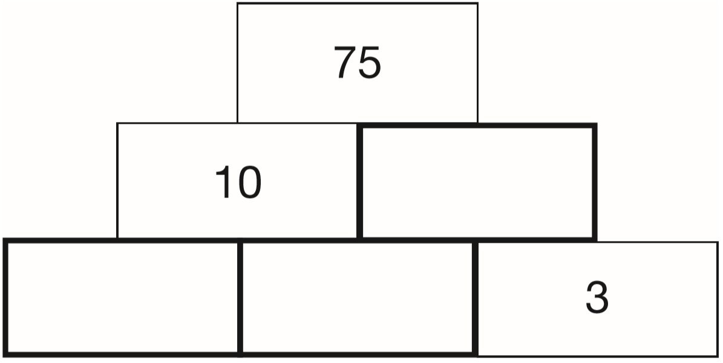
In this tower, two numbers are multiplied to give the number above.
Write the missing numbers in the tower below to make it correct.
.0
7.5
2
.
5
4
2.5
3
7.5
1
Notes:
P325 2013 Level 6 Paper A Q2

Slide 51

In this sequence each number is double the previous number.
Write in the missing numbers.
0.75
1.5
96
1
.
1
0
.
5
5
7
4 8
2
3
.0
2
1
0
1
1
1.5
x
2
9
6
Notes:
P287 2003 Paper 2 Q16

Slide 52
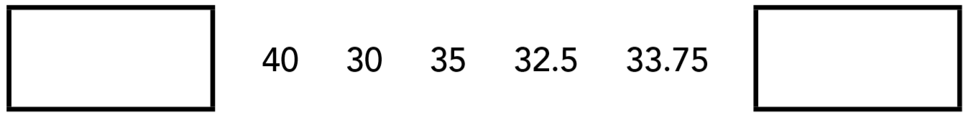
The rule to get each number in a sequence is
subtract the previous number from 100, then divide the answer by 2
Here is part of the sequence. Write the two missing numbers.
20
33.125
4 0 x 2 =
0
9
9
9
8 0
1 0 0.0 0
1
1
1
1
1 0 0 – 8 0 =
2 0
-
3 3.7 5
6
6
2
5
.
3
3
1
2
5
.
2
6 6.2 5
0
1
Notes:
P24 2011 Level 6 Paper B Q2

Slide 53
What number is halfway between 1.4 and 2.1?
1.75
Add, then divide by 2
1.4 + 2.1 = 3.5
1.4
1.5
1.6
1.7
1.8
1.9
2.0
2.1
1.75
3.5 ÷ 2 =
1.75
1
.
5
7
2
3.5
0
1
1
1.7
0
0
1.8
1.75
Notes:
2015 (Sample) Paper 2 Q12

Slide 54
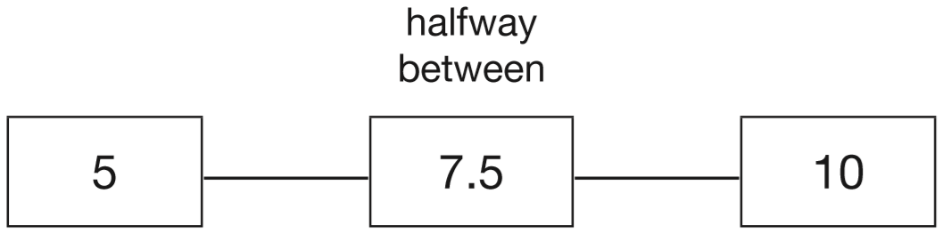
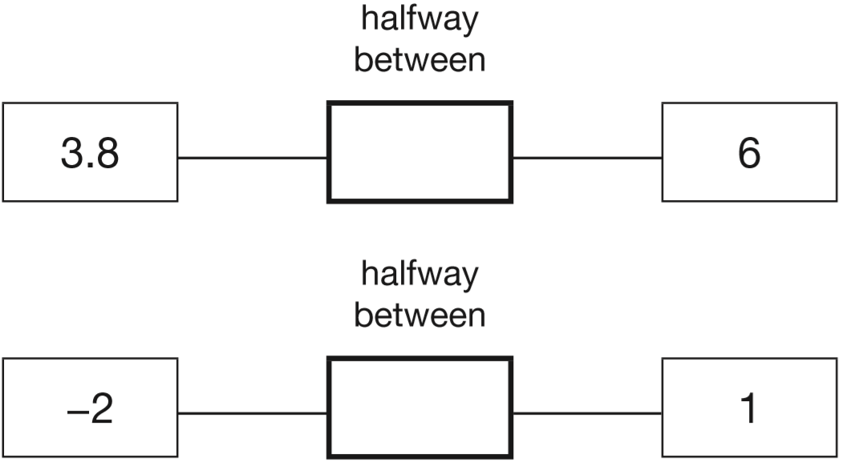
The number 7.5 is halfway between 5 and 10
Add, then divide by 2
6 + 3.8 = 9.8
Write in the missing numbers.
4.9
9.8 ÷ 2 =
4
.
9
2
9.8
4.9
1
-2 + 1 = -1
-0.5
-1 ÷ 2 =
-0.5
Notes:
P66 2015 Level 6 Paper A Q1

Slide 55
Annie swims on average 0.87 km in 30 minutes.
If she continues at the same speed, how far will she swim in 2 hours, rounded to one decimal place?
Circle your answer.
3.2 km 3.3 km 3.4 km 3.5 km 3.6 km
3
2
0.8 7
x
4
.
8
3
4
Notes:
P148 Pre-2000 or other question

Slide 56
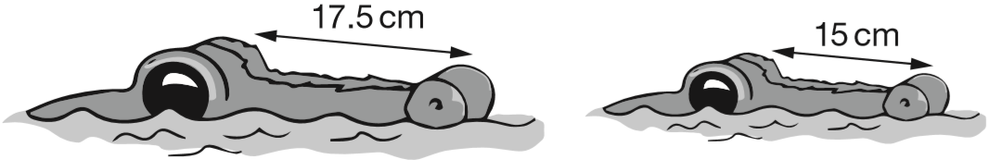
The length of an alligator can be estimated by:
• measuring the distance from its eyes to its nose
• then multiplying that distance by 12
What is the difference in the estimated lengths of these two alligators?
30 cm
9
6
6
1 7.5
1 5
x
1 2
x
1 2
2 1
.
0
0
1 8
0
2 1 0 – 1 8 0 =
3 0
Notes:
2018 Paper 2 Q20

Slide 57
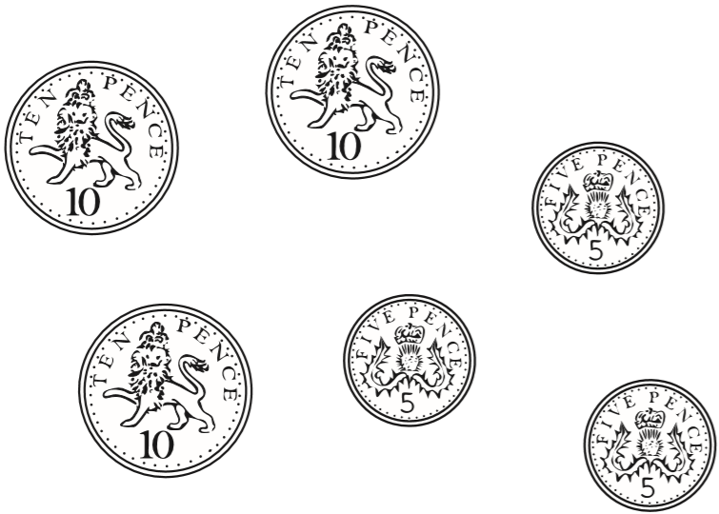
The mass of a 10p coin is 6.5g.
The mass of a 5p coin is half the mass of a 10p coin.
What is the mass of these six coins altogether?
29.25 g
1
3
.
6.5
2
5
1
1
6.5
6.5
2
6.5
0
1 9.5
0
3.25
x
1
3
+
9.7 5
.
1 9
5
9
2
5
2
.
3.25
6.5
1
3.25
3.2 5
x
3
.
9
7
5
Notes:
2015 (Sample) Paper 3 Q9

Slide 58
Alfie says, ‘When you multiply two numbers together, the answer is always greater than either of the numbers you started with.’
Is Alfie correct? Explain how you know.
Alfie is wrong.
If one of the numbers is 1, the answer will be the same as (not greater than) the other number. e.g. 3 x 1 = 3
If one of the numbers is 0, the answer will always be 0 no matter how large the other number is. e.g. 5 x 0 = 0
If one of the numbers is less than 1, the answer will always be smaller than the other number.
e.g. ½ x 4 = 2
e.g. 5 x 0.1 = 0.5
Notes:
P314 2015 Paper 1 Q23

Slide 59
33,630 = 354 × 95
Use this multiplication to complete the calculations below.
354 × 9.5 =
3,540 × 95 =
3,363 ÷ 95 =
33,630 ÷ 95 = 354
3363
95 ÷ 10
336 300
354 x 10
35.4
33630 ÷ 10
354 ÷ 10
Notes:
2018 Paper 3 Q19

Slide 60
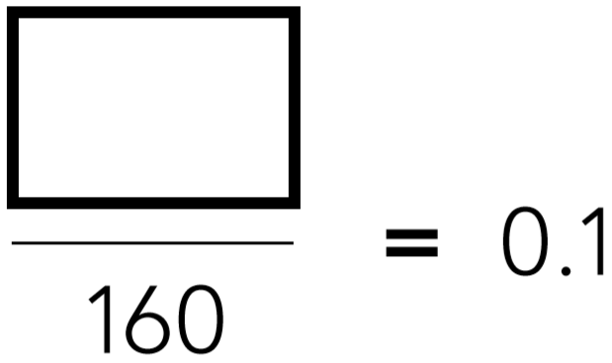
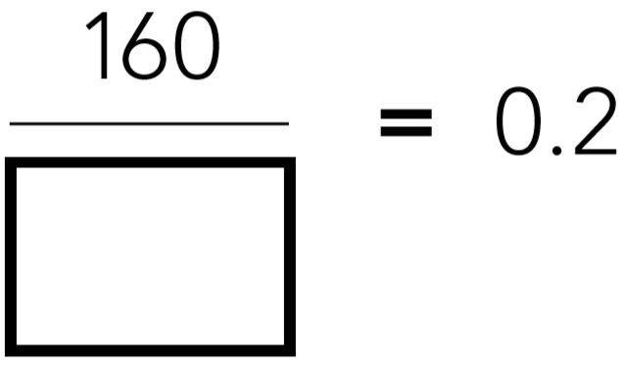
Write the missing numbers.
16
2
10
1
10
800
x16
x80
1
1 6
2
1 6 0
=
=
1 0
1 6 0
1 0
8 0 0
x16
x80
Notes:
P200 2011 Level 6 Paper A Q11

Slide 61
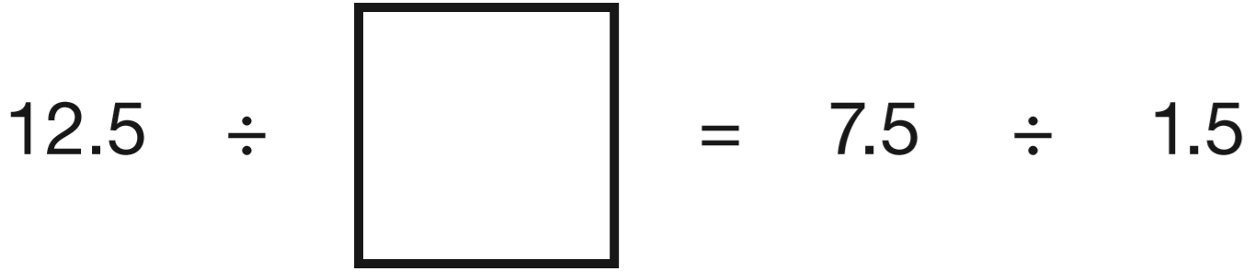
Write the missing number.
5
2.5
1x = 1.5
2x = 3.0
3x = 4.5
2
.
5
4x = 6.0
5
1 2.5
2
5x = 7.5
Notes:
P278 2014 Level 6 Paper A Q10

Slide 62
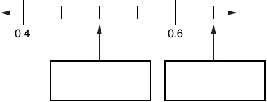
Here is part of a number line.
Write the numbers shown by the arrows.
0.45
0.55
0
0
0.50
0.5
0.65
Notes:
P22 Pre-2000 or other question

Slide 63

Write in the missing numbers.
5
7
3
. 0 0
6
4
Notes:
P340 Pre-2000 or other question

Slide 64
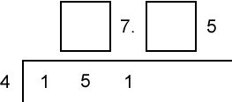
Write the missing digits to make the calculation correct.
3
7
. 0 0
3
3
2
Notes:
P125 Pre-2000 or other question

Slide 65
5
What is as a decimal?
0.625
8
0
.
6
2
5
.0
0
0
8 5
2
4
5
Notes:
P185 Pre-2000 or other question

Slide 66
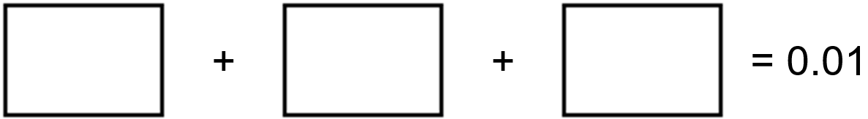
Write three decimals, each greater than zero, which add together to make a total of 0.01
0.001
0.002
0.007
0
Notes:
P337 Older Level 6

Slide 67
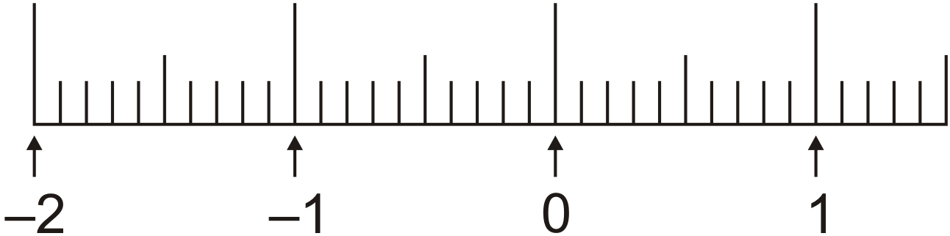
Mark with arrows the points –1.5 and 0.45 on the number line.
0
0
0.5
0.4
-1.5
0.45
Notes:
P209 Pre-2000 or other question

Slide 68
Write a fraction which is greater than 0.7 and less than 0.71
0.700
0.710
7 0 1
0.701
1 0 0 0
Notes:
P37 Older Level 6

Slide 69
The sum of two numbers is 5
The difference between the numbers is 0.5
What are the numbers?
2.25 and 2.75
Half of 5 =
2.5
Half of 0.5 =
0.25
2.5 + 0.25 =
2.75
2.5 – 0.25 =
2.25
Notes:
P53 Older Level 6

Slide 70
Complete sequences involving decimals

Slide 71
Amy thought of a number.
She added 0.5 to her number and then doubled the result.
Then she subtracted 0.5 and doubled the new result.
Her final answer was 61
What number did Amy start with?
15
15
+0.5
15.5
x2
31
-0.5
30.5
x2
61
1
5
.
3
0
5
.
15.5 – 0.5 =
15
30.5 + 0.5 =
31
5
3 1
.0
6 1
.0
2
1
1
2
1
Notes:
P154 2014 Paper 2 Q21

Slide 72
Lara chooses a number less than 100
She divides it by 3 and then subtracts 11
She then divides this result by 2
Her answer is 10.5
What was the number she started with?
96
96
÷3
32
-11
21
÷2
10.5
21 + 11 =
32
1
3 2
1 0.5
x
3
x
2
9
6
2
1
.
0
Notes:
2015 (Sample) Paper 3 Q16

Slide 73
Lara chooses a number less than 20
She divides it by 2 and then adds 6
She then divides this result by 3
Her answer is 4.5
What was the number she started with?
15
15
÷2
7.5
+6
13.5
÷3
4.5
1
13.5 – 6 =
7.5
1
7.5
4.5
x
2
x
3
1 3
.
1 5
.
5
0
Notes:
2016 Paper 3 Q13

Slide 74
I’m thinking of a number.
I multiply it by 10 and add 25.
My answer is 100.
What is the number?
7.5
100 – 25 =
75
75 ÷ 10 =
7.5
Notes:
P165 Pre-2000 or other question

Slide 75
Solve problems involving percentages

Slide 76
Jack has £400
He spends 35% of his money on a new bike.
How much does Jack spend on his new bike?
He spends £140
3 5
4 0 0 ÷ 1 0 0 =
4
35% of 400 =
140
1 0 0
2
3 5
x
4
10% =
40
1 4
0
30% =
40 x 3 =
120
5% =
40 ÷ 2 =
20
35% =
120 + 20 =
140
Notes:
2018 Paper 3 Q8

Slide 77
200 children went on holiday.
10% of the children went to Wales.
25% of the children went to Scotland.
How many more children went to Scotland than went to Wales?
30
100%
10%
10%
10%
10%
10%
10%
10%
10%
10%
10%
To find 10%
÷ 10
25%
25%
25%
25%
To find 25%
÷ 4
200 ÷ 10 =
20
30
50 – 20 =
200 ÷ 4 =
50
Notes:
P222 2014 Paper 2 Q15

Slide 78
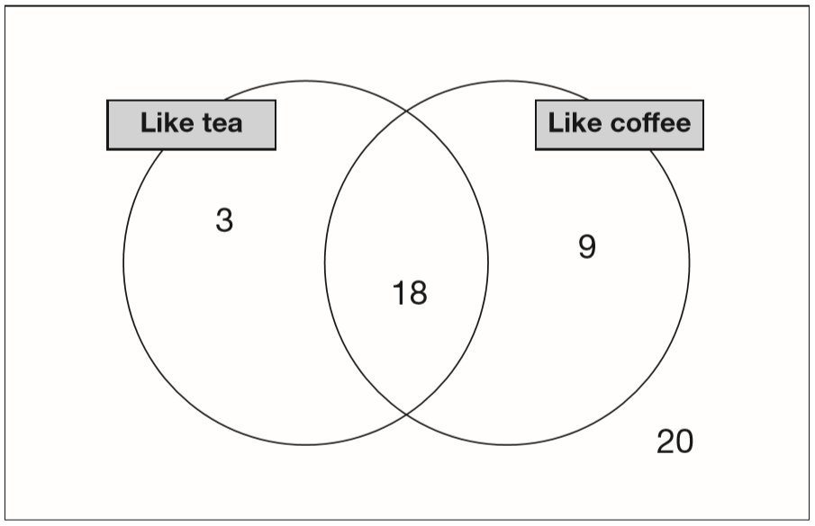
In a survey people were asked if they like tea and coffee.
The results are in this Venn diagram.
What percentage of people in the survey like both tea and coffee?
36%
x2
18 like both
1 8
3 6
=
50 altogether
5 0
1 0 0
x2
46%
What percentage of people in the survey do not like coffee?
x2
23 do not like coffee
2 3
4 6
=
50 altogether
5 0
1 0 0
x2
Notes:
P282 2014 Level 6 Paper B Q7

Slide 79
Liam did a survey of 55 people to see how many were left-handed.
Liam says, ‘The results show that exactly 10% of the people in the survey are left-handed.’
Explain why Liam cannot be correct.
10% of 55 is 5.5
You can’t have 5.5 people.
1 0
5 5 ÷ 1 0 0 =
0.5 5
.
of 5 5
0
5
5
x 1 0 =
5.5
1 0 0
.
5 5
.
÷10
.
1 0
1
5 5 ÷ 1 0 =
5.5
=
of 5 5
.
1 0 0
1 0
5
5
÷10
Notes:
P44 2014 Paper 1 Q19

Slide 80
250 000 people visited a theme park in one year.
15% of the people visited in April and 40% of the people visited in August. How many people visited the park in the rest of the year?
1 5 + 4 0 = 5 5
1 0 0 - 5 5 =
4 5
2
2
4 5
2 5 0 0 0 0 ÷ 1 0 0 =
2 5 0 0
1 0 0
x 4 5
1 2
5
1 0
0
0
1
1
2
5
0 0
people
Notes:
P153 2003 Paper 2 Q24

Slide 81
Emily makes 250 grams of a snack mixture. 15% of the weight is raisins, 25% is banana chips and the rest is peanuts.
How many grams of peanuts does she use?
150 grams
15 + 25 = 40% is not peanuts.
100 – 40 = 60% is peanuts.
6
÷10
of 250 =
1 5 0
6 0
6
1 0
=
1 0 0
1 0
2 5 0 ÷ 1 0 = 2 5
3
÷10
2 5 x 6 = 1 5 0
2 5
x
6
1 5
0
Notes:
P167 2008 Paper 1 Q24

Slide 82
John had £5
He gave 25% of it to charity.
How much did he give?
÷25
2 5
1
=
£1.25
1 0 0
4
1
.
2
5
÷25
4
5.0 0
1
2
100%
50%
50%
To find 50%
÷ 2
25%
25%
25%
25%
To find 25%
÷ 4
Notes:
P73 Pre-2000 or other question

Slide 83
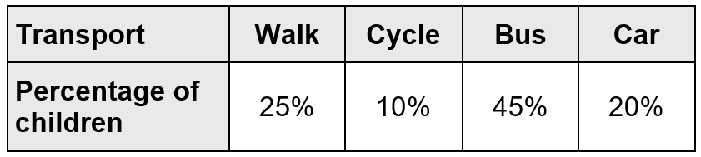
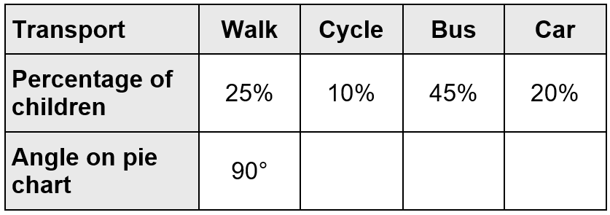
In a survey of how children travel to school, these were the results.
Abby wants to make a pie chart to show the results.
Complete the table to show the angles of each section of the pie chart.
x18
x36
÷5
x18
÷10
÷5
4 5
1 6 2
1 0
3 6
2 0
9
7 2
4
1
=
=
=
=
=
=
3 6 0
3 6 0
1 0 0
2 0
3 6 0
1 0 0
1 0
1 0 0
2 0
36°
162°
72°
x18
x36
÷5
x18
÷10
÷5
Notes:
P224 Pre-2000 or other question

Slide 84
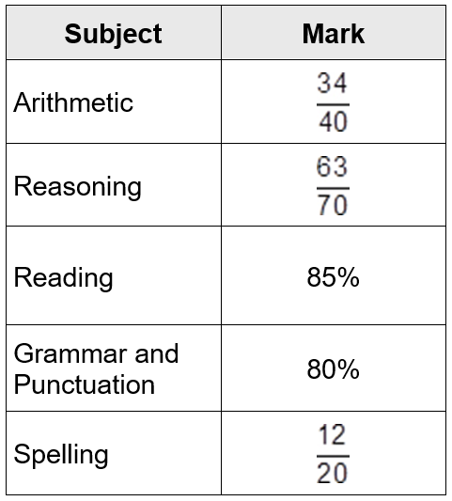
The table shows Tom’s test results for different subjects.
÷2
x5
In what subject did Tom get the highest mark?
85%
3 4
1 7
8 5
=
=
4 0
2 0
1 0 0
90%
÷2
x5
Reasoning
÷7
x10
In what subject did Tom get the lowest mark?
6 3
9
9 0
=
=
7 0
1 0
1 0 0
60%
÷7
x10
Spelling
In which two subjects did he get the same marks?
x5
1 2
6 0
=
2 0
1 0 0
x5
Arithmetic and Reading
Notes:
P279 Pre-2000 or other question

Slide 85
Calculate a whole quantity given a percentage

Slide 86
If you know 40% of a number, explain how you could work out the original number.
Divide by 40 to get 1%, then multiply by 100 to get 100%
100%
Divide by 4 to get 10%, then multiply by 10 to get 100%
10%
10%
10%
10%
10%
10%
10%
10%
10%
10%
Notes:
P51 2010 Paper 1 Q26

Slide 87

Write in the missing numbers.
÷10
1 8
3 0
3
=
1 0 0
1 0
÷10
2 0 0
3
of 60 =
1 8
1 0
3
of = 60
200
6 0 ÷ 1 0 = 6
10
6 x 3 = 1 8
6 0 ÷ 3 = 2 0
2 0 x 1 0 = 2 0 0
Notes:
P71 2005 Paper 2 Q23

Slide 88
20% of Megan’s number is 64
What is 50% of Megan’s number?
160
100%
32
32
32
32
32
32
32
32
32
32
10%
10%
10%
10%
10%
10%
10%
10%
10%
10%
20% = 64
10% = ½ of 64 =
32
50% = 32 x 5 =
1 6 0
Notes:
P159 2013 Paper 1 Q21 first page

Slide 89
20% of Megan’s number is 64
What is 50% of Megan’s number?
160
÷10
÷50
2 0
2
5 0
1
=
=
1 0 0
1 0
1 0 0
2
÷10
÷50
2
1
of = 64
of 3 2 0 =
1 6 0
320
10
2
6 4 ÷ 2 = 3 2
3 2 x 1 0 = 3 2 0
Notes:
P160 2013 Paper 1 Q21 second page

Slide 90

In a survey of children’s favourite fruit juices, these were the results.
20 more children chose grape than chose apple.
How many children took part in the survey?
400 children
5
30 – 25 =
5% =
20
x20
400
100% =
Notes:
P194 2015 Level 6 Paper B Q10 first page

Slide 91

The pie chart shows the Year groups of children at Woodland Infant School. There are 56 children in Year 1
How many children are there in Reception?
32
35% = 56
20%
÷7
45 + 35 =
80
5% =
8
100 – 80 =
20
x4
20% =
32
Notes:
P214 2014 Level 6 Paper B Q10

Slide 92
20% of the children in a sports club play tennis.
25% of the children who play tennis also play rounders.
There are 8 children in the club who play both tennis and rounders.
How many children are there in the sports club altogether?
160
20% tennis
80% not tennis
5%
5% =
8
both
x20
160
100% =
Notes:
P265 2015 Level 6 Paper A Q9

Slide 93
In Class 6, 80% of the children like crisps.
75% of the children who like crisps also like chocolate.
In Class 6, what percentage of the children like both crisps and chocolate?
60%
80% like crisps
20% don’t
20%
20%
20%
20%
and chocolate
80 ÷ 4 = 20
Notes:
P25 Older Level 6

Slide 94
What is 10% of a half?
5%
whole (100%)
half (50%)
half (50%)
5%
5%
5%
5%
5%
5%
5%
5%
5%
5%
5%
5%
5%
5%
5%
5%
5%
5%
5%
5%
What percentage of 20 is 19?
95%
x5
1 9
9 5
=
2 0
1 0 0
x5
Notes:
P96 2013 Level 6 Paper A Q5

Slide 95

This pie chart shows the lunch choices of year 6 children at a school.
28 children in year 6 have a school meal.
How many go home for lunch?
20 children
35% = 28
÷7
5% =
4
x5
20
25% =
Notes:
P115 Older Level 6

Slide 96

Two of the ingredients of chocolate are cocoa and sugar.
In milk chocolate,
20% of the mass is cocoa, 55% is sugar.
A bar of milk chocolate contains 50 grams of cocoa.
How many grams of sugar does it contain?
137.5 grams
20% = 50
÷4
5% =
12.5
x11
137.5
55% =
Notes:
P176 Older Level 6

Slide 97
Linda buys a pair of trainers.
She says, ‘I bought this pair of trainers when there was 20% off the normal price. I paid £18 for them.’
What was the normal price of the trainers?
£22.50
100 – 20 = 80
80% = £18
80% = £18
÷4
÷8
20% =
£4.50
10% =
£2.25
x5
x10
100% =
£22.50
100% =
£22.50
Notes:
P226 Older Level 6

Slide 98
Chloe and Denise each bought identical T-shirts from the same shop.
Chloe bought hers on Monday when there was 15% off the original price.
Denise bought hers on Friday when there was 20% off the original price.
Chloe paid 35p more than Denise.
What was the original price of the T-shirt?
£7.00
20 – 15 = 5
5% = £0.35
x20
100% =
£7.00
Notes:
P251 Older Level 6

