Slide 1
Apply knowledge of angles with isosceles triangles

Slide 2
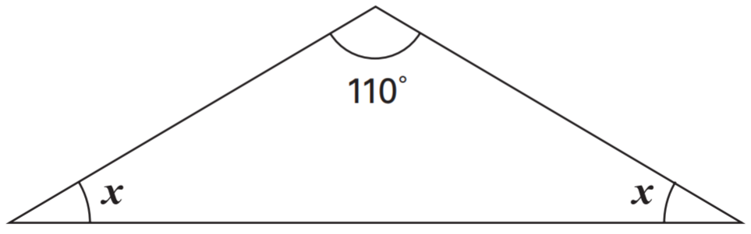
Here is an isosceles triangle. Calculate the size of angle x.
Angles in a triangle add up to 180°.
Isosceles triangles have two equal angles.
180° - 110° = 70°
70° ÷ 2 = 35°
x = 35°
35°
35°
Notes:
P19 2005 Paper 2 Q21

Slide 3
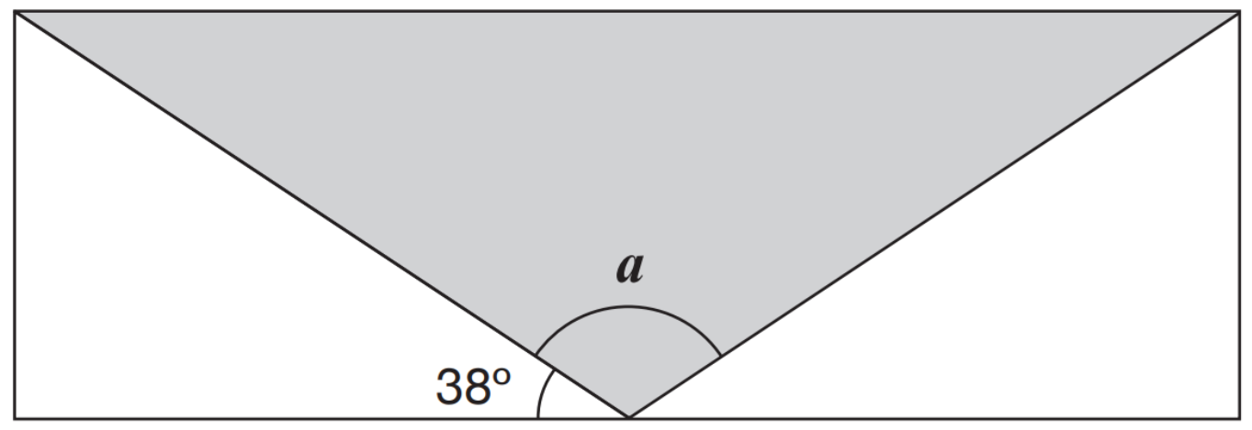
A shaded isosceles triangle is drawn inside a rectangle.
Calculate the size of angle a.
Angles on a straight line add up to 180°.
180° - 38° - 38° = 104°
a = 104°
104°
38°
Notes:
2015 (Sample) Paper 2 Q15

Slide 4
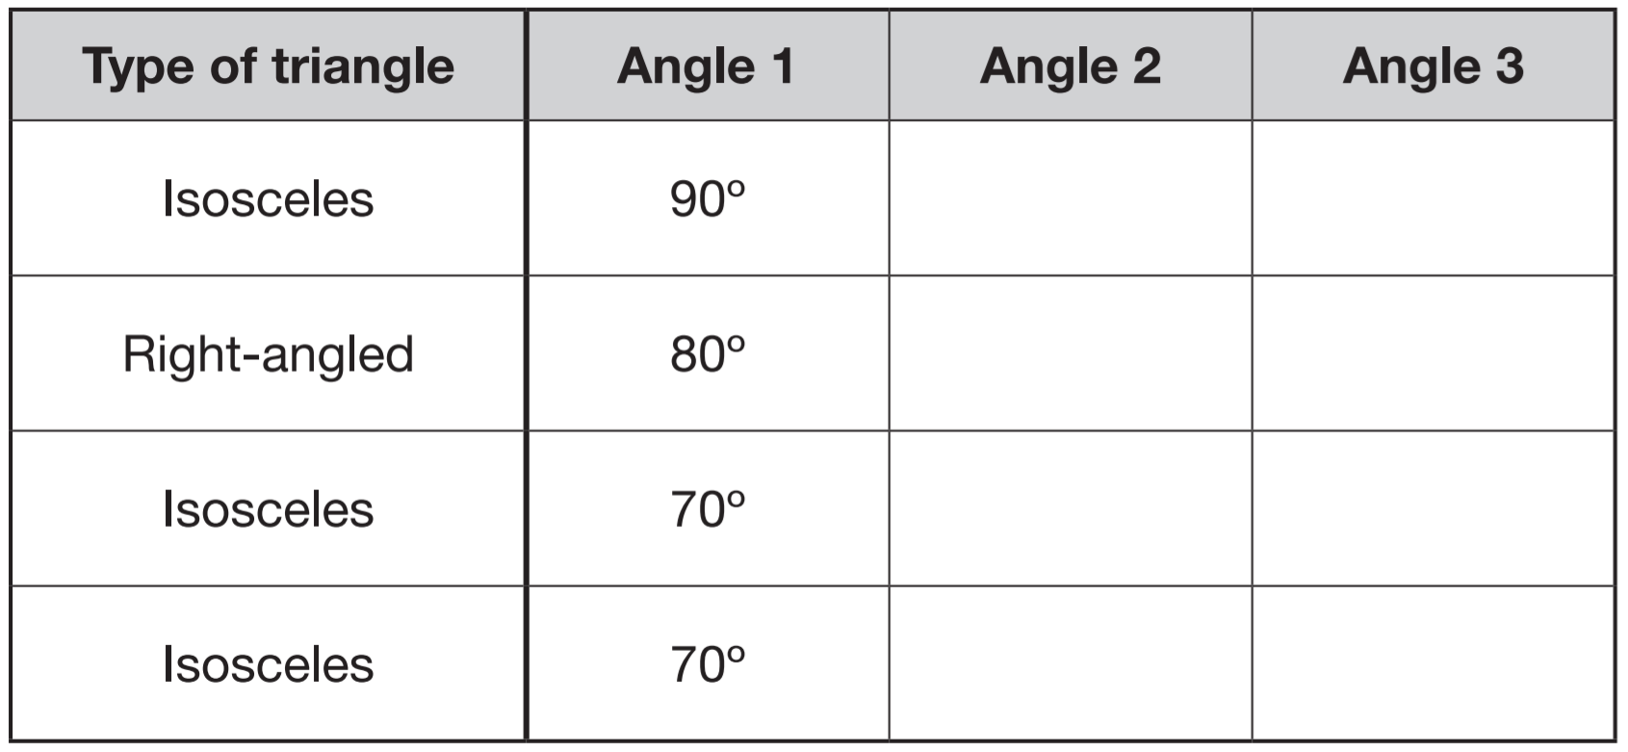
Anna has four different triangles. Complete the table to show the size of the angles in each triangle.
45°
45°
90°
10°
70°
40°
55°
55°
Angles in a triangle add up to 180°.
180° - 70° = 110°
Isosceles triangles have two equal angles.
110° ÷ 2 = 55°
Notes:
P83 2015 Level 6 Paper A Q12

Slide 5
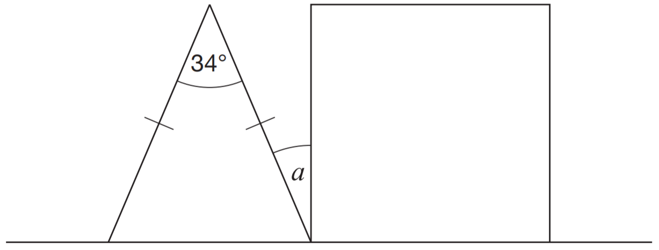
The diagram shows an isosceles triangle and a square on a straight line. Calculate angle a.
Angles in a square are 90°.
Angles in a triangle add up to 180°.
180° - 34° = 146°
Isosceles triangles have two equal angles.
146° ÷ 2 = 73°
Angles on a straight line add up to 180°.
180° - 90° - 73° = 17°
17°
a = 17°
73°
73°
90°
Notes:
P114 2013 Level 6 Paper B Q3

Slide 6
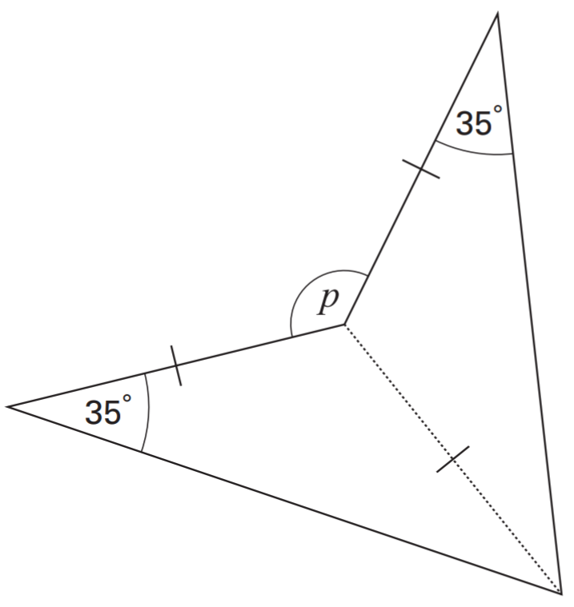
This shape has been made from two isosceles triangles.
What is the size of angle p?
Isosceles triangles have two equal angles.
Angles in a triangle add up to 180°.
180° - 35° - 35° = 110°
Angles around a point add up to 360°.
140°
360° - 110° - 110° = 140°
110°
p = 140°
110°
35°
35°
Notes:
P162 Pre-2000 or other question

Slide 7
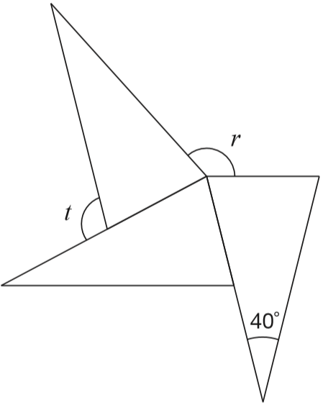
The diagram shows three identical isosceles triangles.
What are the sizes of angles r and t?
40°
Isosceles triangles have two equal angles.
Angles in a triangle add up to 180°.
180° - 40° = 140°
150°
70°
140° ÷ 2 = 70°
70°
70°
110°
70°
70°
Angles around a point add up to 360°.
360° - 70° - 70° - 70° = 150°
40°
70°
r = 150°
Angles on a straight line add up to 180°.
180° - 70° = 110°
t = 110°
Notes:
P195 2014 Level 6 Paper A Q7

Slide 8
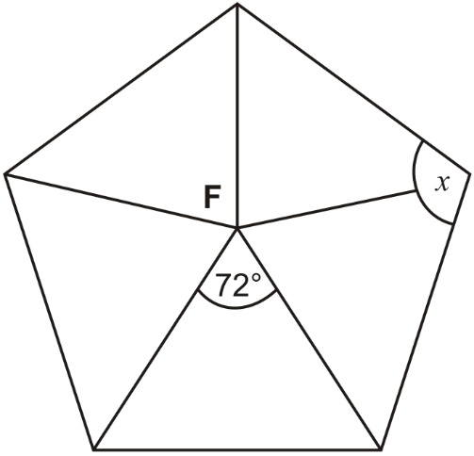
F is the centre of a regular pentagon.
Work out the value of angle x.
Isosceles triangles have two equal angles.
54°
54°
Angles in a triangle add up to 180°.
180° - 72° = 108°
54°
54°
72°
72°
108° ÷ 2 = 54°
54°
54°
72°
72°
54° + 54° =
108°
Angle x is 108°
54°
54°
54°
54°
Angles in a pentagon add up to 540°.
540° ÷ 5 = 108°
Notes:
P289 Older Level 6

Slide 9
Apply knowledge of angles and lengths in equilateral triangles

Slide 10
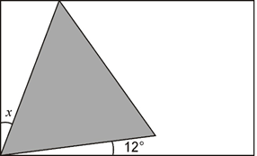
Here is an equilateral triangle inside a rectangle.
Calculate the value of angle x.
Equilateral triangles have angles of 60°.
60°
The corners of a rectangle are right angles (90°).
90° - 60° - 12° =
18°
60°
60°
Notes:
P341 2001 Paper 2 Q26

Slide 11
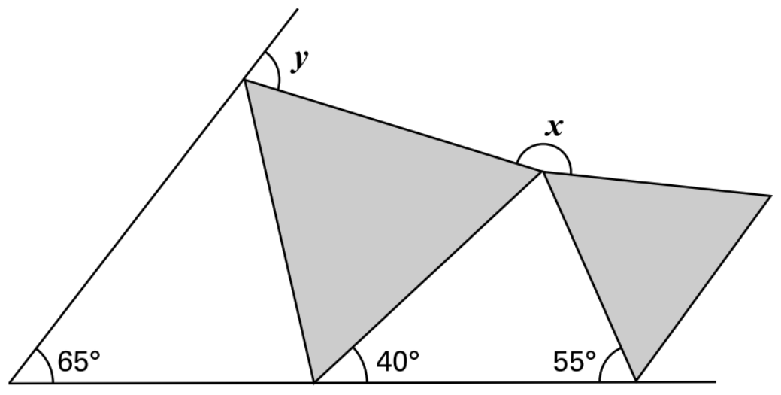
The diagram shows two shaded equilateral triangles.
Calculate the size of angle x and angle y.
Equilateral triangles have angles of 60°.
Angles in a triangle add up to 180°.
y = 180° - 60° - 35° =
85°
x = 360° - 60° - 60° - 85°
85°
Angles around a point add up to 360°.
x = 155°
60°
35°
155°
Angles on a straight line add up to 180°.
180° - 80° - 65°
60°
60°
85°
60°
180° - 60° - 40°
180° - 55° - 40°
60°
60°
80°
Notes:
P110 Older Level 6

Slide 12
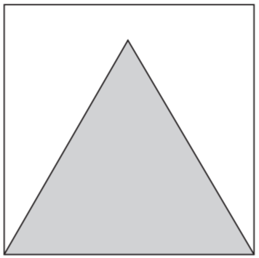
Here is an equilateral triangle inside a square. The perimeter of the triangle is 48 centimetres. Calculate the perimeter of the square.
16
In equilateral triangles, all sides are the same length.
3 sides = 48 cm
16
16
16
16
1 side =
1
6
cm
3
4 8
1
In squares, all sides are the same length.
2
1 6
x
4
6
4
cm
16
Notes:
P116 2004 Paper 1 Q25

Slide 13
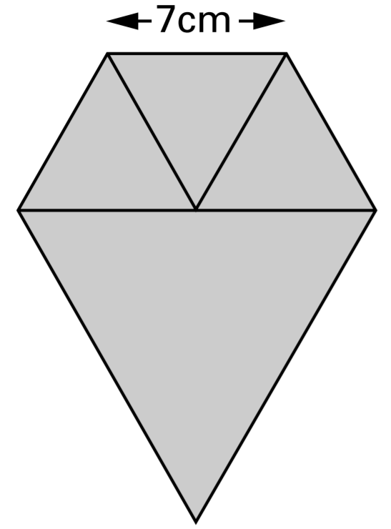
Lauren has three small equilateral triangles and one large equilateral triangle. The small triangles have sides of 7 centimetres.
Lauren makes this shape.
Calculate the perimeter of the shape.
7
7
7
7
14
3 x 7 = 21
2 x 14 = 28 +
14
14
49 cm
Notes:
P315 2001 Paper 2 Q20

Slide 14
Apply knowledge of angles in quadrilaterals (360) and pentagons (540)

Slide 15
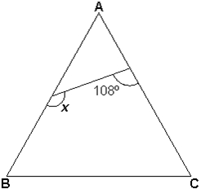
Triangle ABC is equilateral. Calculate the size of angle x.
Equilateral triangles have angles of 60°.
Angles in a quadrilateral add up to 360°.
60°
x = 360° - 108° - 60° - 60°
That’s because you can make 2 triangles from a quadrilateral
2 x 180 = 360
x = 360° - 228° =
132°
72°
58°
132°
60°
60°
Notes:
P221 Older Level 6

Slide 16
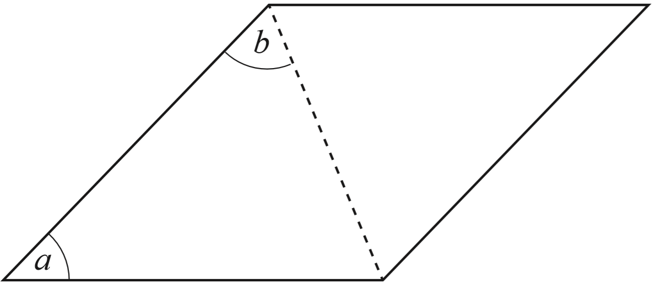
The dotted line is a diagonal of this rhombus.
50°
80°
If angle a = 80°, what is angle b?
80°
20°
50°
80°
180° - 80° =
100°
100° ÷ 2 =
50°
80°
50°
20°
80°
80°
50°
If angle b = 80°, what is angle a?
180° - (2 x 80°) =
20°
Notes:
P262 2012 Level 6 Paper B Q9

Slide 17
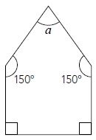
The diagram shows a pentagon.
Each side of the pentagon is the same length.
Is the shape a regular pentagon?
Explain your answer.
Work out the size of angle a.
60°
No, because regular shapes have angles of the same size, not just sides of the same length.
That’s because you can make 3 triangles from a pentagon
3 x 180 = 540
90°
90°
A right angle is 90°.
Angles in a pentagon add up to 540°.
a = 540° - 150° - 150° - 90° - 90°
a = 540° - 300° - 180° =
60°
Notes:
P4 20011 Level 6 Paper A Q8

Slide 18
Recognise vertically opposite angles and Z angles

Slide 19
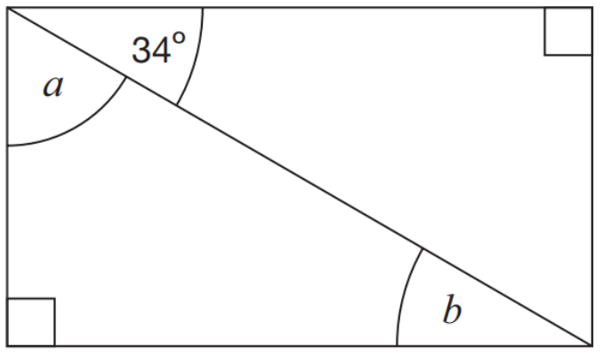
Here is a rectangle. Calculate the size of angles a and b.
56°
34°
Angles on a right angle add up to 90°.
56°
a = 90° - 34° =
Z (or backwards-Z) angles (on parallel lines) are the same size.
Notes:
P79 2015 Paper 1 Q20

Slide 20
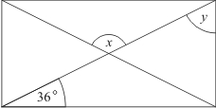
The diagram shows a rectangle. Calculate angles x and y.
36°
108°
54°
108°
36°
Angles in a triangle add up to 180°.
Isosceles triangles have two equal angles.
180° - 36° - 36° = 108°
Vertically opposite angles are the same size.
x = 108°
Z angles are the same size.
Angles on a right angle add up to 90°.
54°
y = 90° - 36° =
Notes:
P343 Pre-2000 or other question

Slide 21
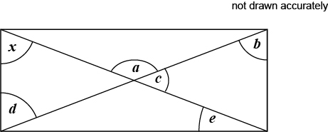
This is a rectangle with its two diagonals.
Angle x = 58°
Circle the two angles that are the same size as angle x
a b c d e
Notes:
P182 Pre-2000 or other question

Slide 22
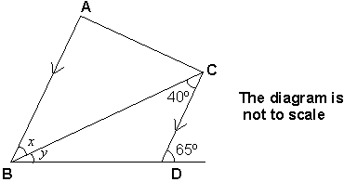
In this diagram AB is parallel to CD.
Work out the value of angle x.
Calculate the value of angle y.
x = 40°
Angles on a straight line add up to 180°.
40°
180° - 65° =
115°
25°
115°
Angles in a triangle add up to 180°.
y = 180° - 115° - 40° =
25°
Notes:
P197 Older Level 6

Slide 23
Solve problems involving angles

Slide 24
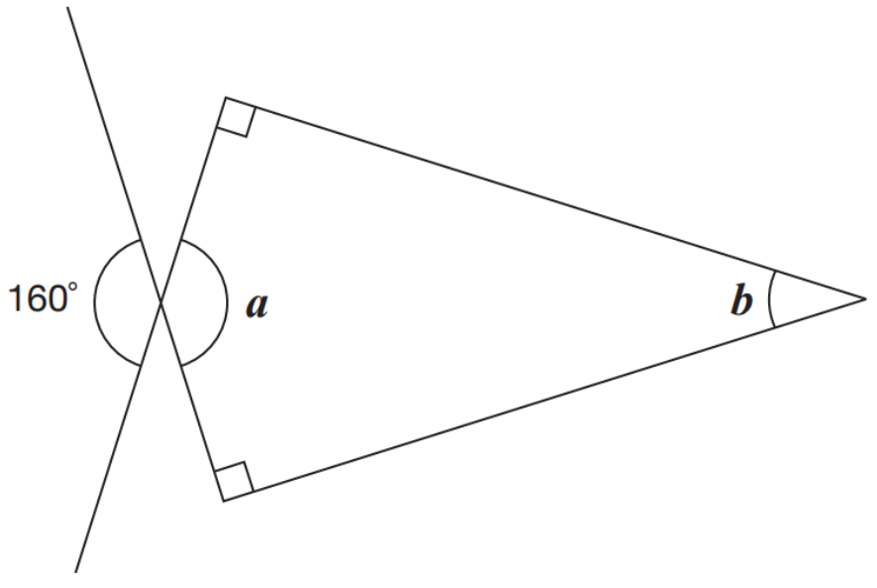
Calculate the size of angles a and b.
90°
160°
20°
90°
Vertically opposite angles are the same size.
a = 160°
Angles in a quadrilateral add up to 360°.
b = 360° - 160° - 90° - 90° =
20°
Notes:
2016 Paper 2 Q17

Slide 25
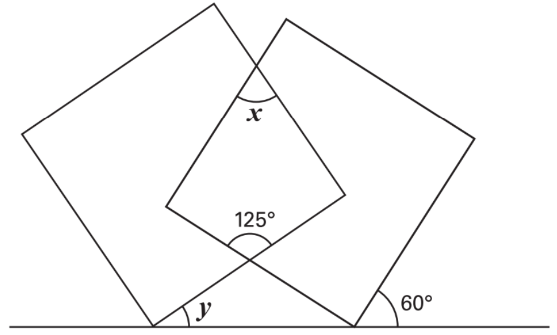
The diagram shows two overlapping squares and a straight line.
Calculate the value of angles x and y.
Angles in a square are 90°.
Angles in a quadrilateral add up to 360°.
x = 360° - 125° - 90° - 90° =
55°
55°
Angles on a straight line add up to 180°.
Vertically opposite angles are the same size.
90°
90°
Angles in a triangle add up to 180°.
y = 180° - 125° - 30° =
25°
125°
90°
25°
30°
Notes:
P258 Older Level 6

Slide 26
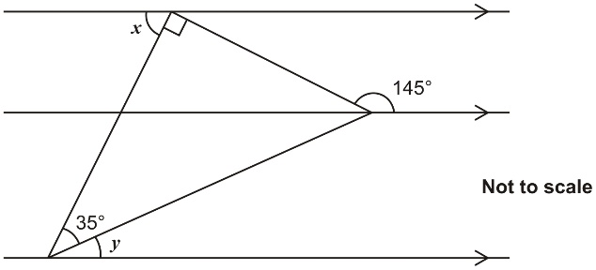
The diagram shows a right-angled triangle and three parallel lines. Calculate the size of angle x and angle y.
55°
35°
90°
125°
55°
35°
55°
125°
20°
160°
125°
20°
Notes:
P31 Older Level 6

Slide 27
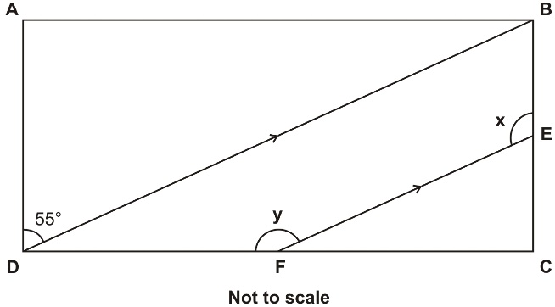
The shape ABCD is a rectangle. BD is parallel to EF.
Calculate the sizes of the angles x and y.
55°
125°
55°
35°
145°
35°
90°
Notes:
P100 Older Level 6

Slide 28
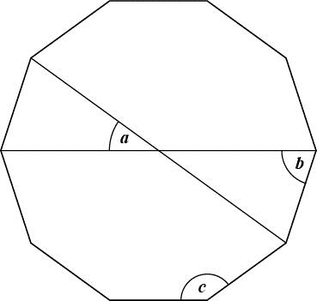
Here is a regular decagon, with two diagonals drawn in.
Calculate the sizes of angles a, b and c
36°
72°
144°
360° ÷ 10 =
36°
36°
180° - 36° =
144°
144° ÷ 2 =
72°
72°
72°
Notes:
P123 Pre-2000 or other question

Slide 29
Draw shapes by measuring angles

Slide 30
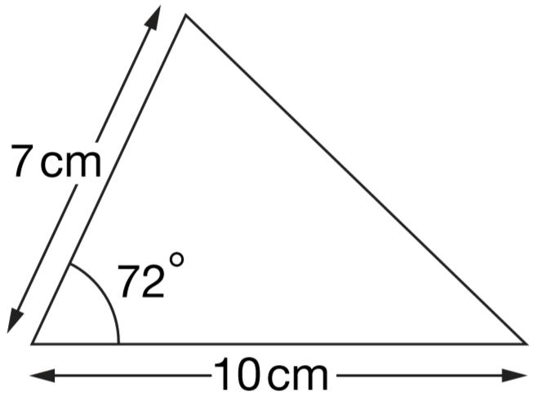
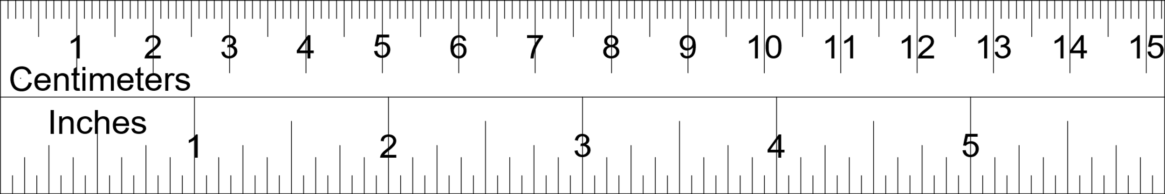
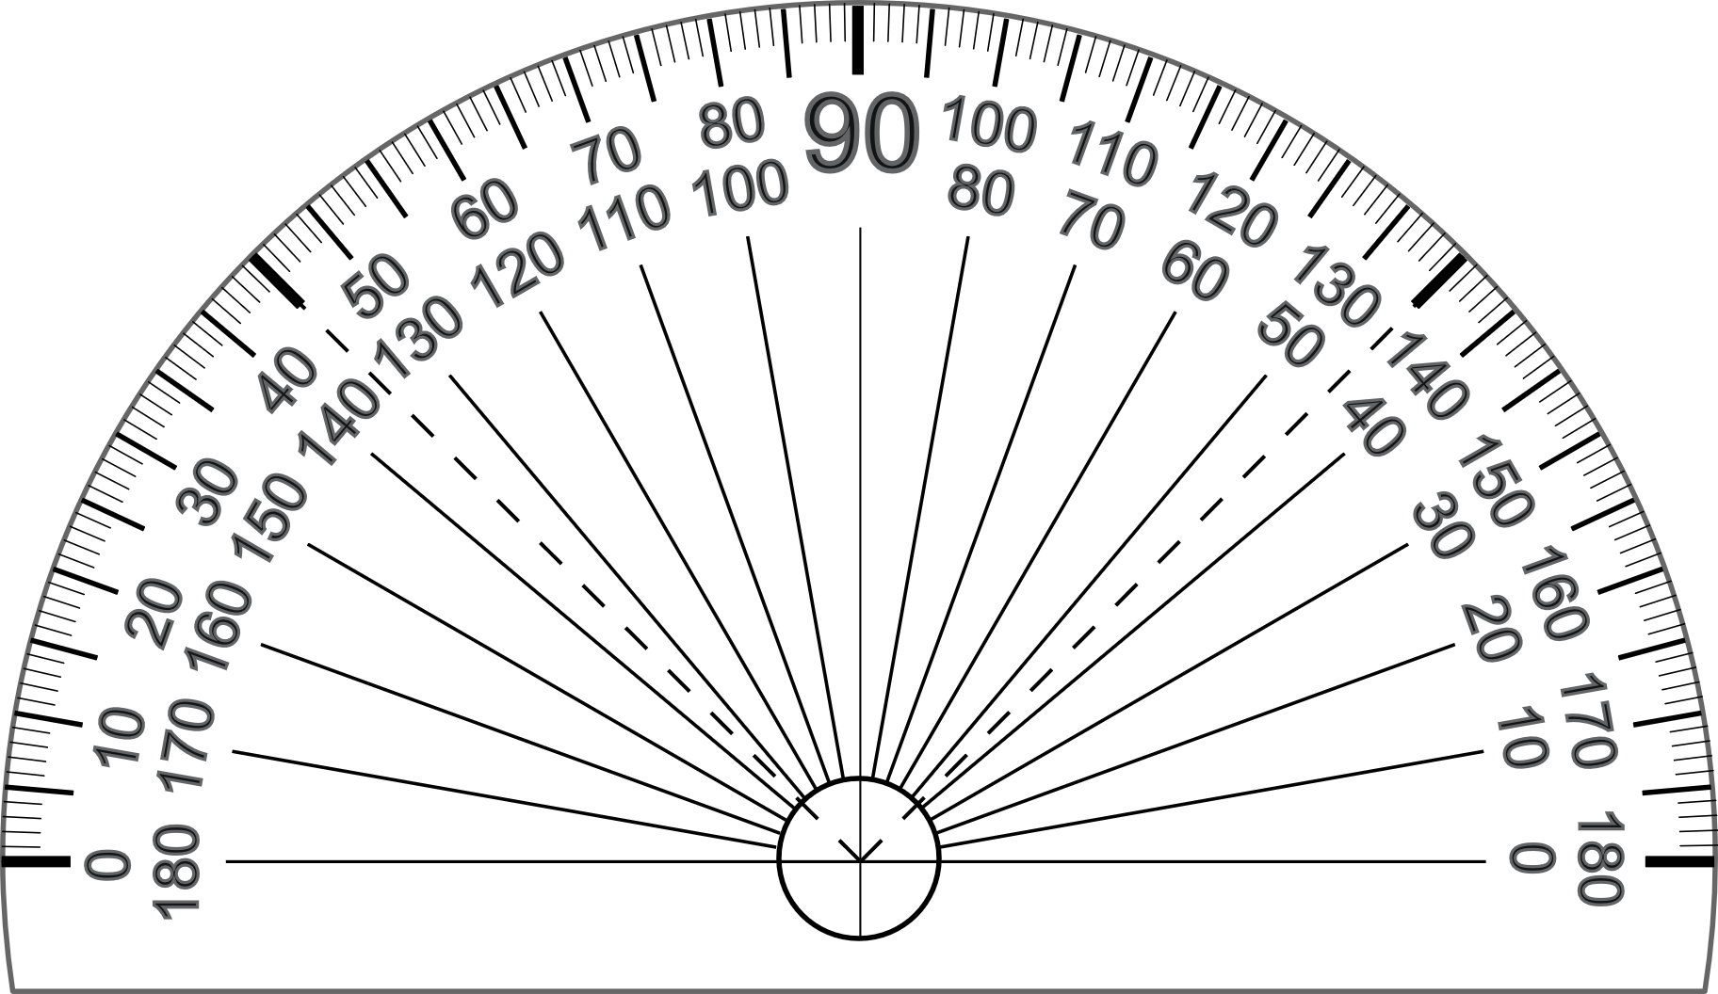
Here is a sketch of a triangle.
It is not drawn to scale.
Draw the full-size triangle accurately below.
Use a protractor and a ruler.
One line has been
drawn for you.
Notes:
2006 Paper 1 Q21

Slide 31
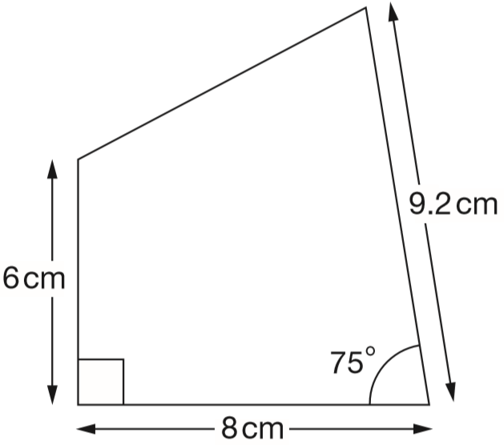
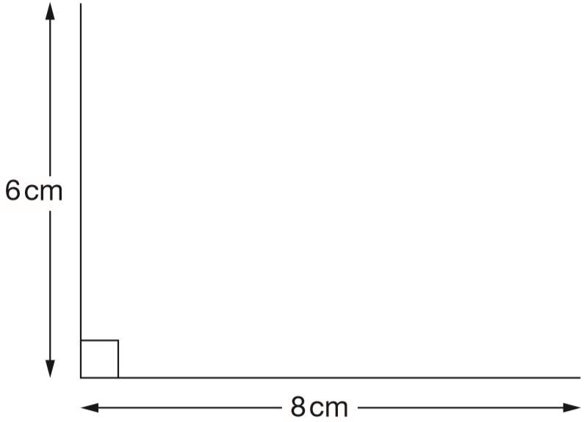
Here is a sketch of a quadrilateral.
It is not drawn to scale.
Draw the full-size quadrilateral accurately below.
Use a protractor (angle measurer) and a ruler.
Two of the lines have been drawn for you.
Notes:
2011 Paper 1 Q24

Slide 32
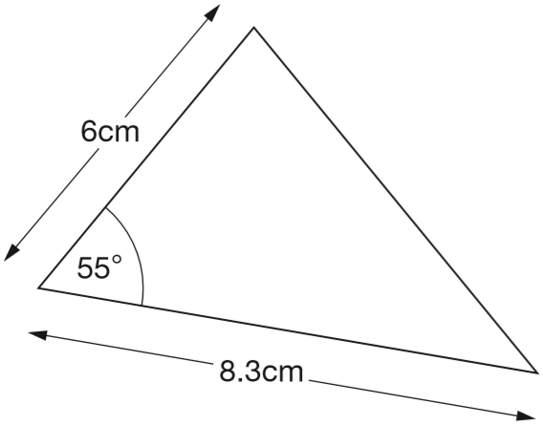
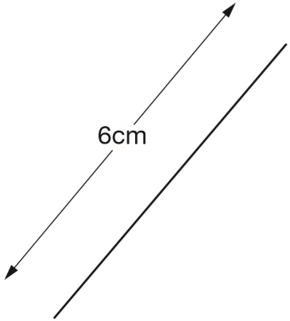
Here is a sketch of a triangle.
It is not drawn to scale.
Draw the full-size triangle accurately below.
Use a protractor (angle measurer) and a ruler.
One line has been drawn for you.
Notes:
2014 Paper 2 Q22

Slide 33
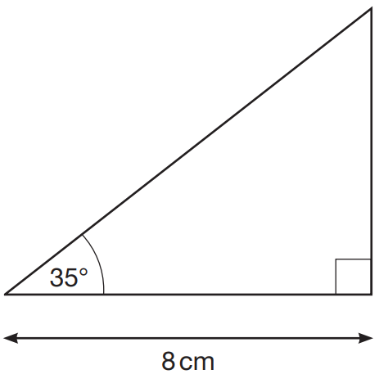
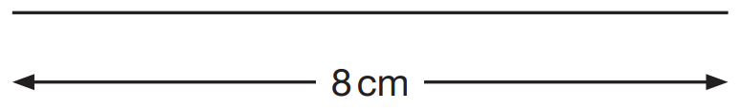
Here is a sketch of a triangle. It is not drawn to scale.
Draw the full-size triangle accurately below.
Use an angle measurer (protractor) and a ruler.
One line has been drawn for you.
Notes:
2019 Paper 2 Q13

Slide 34
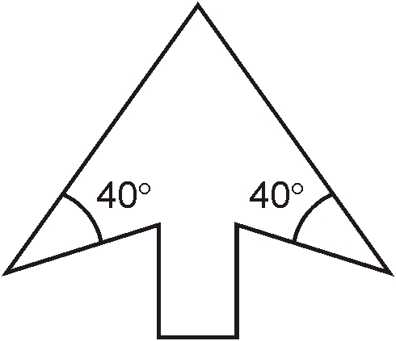
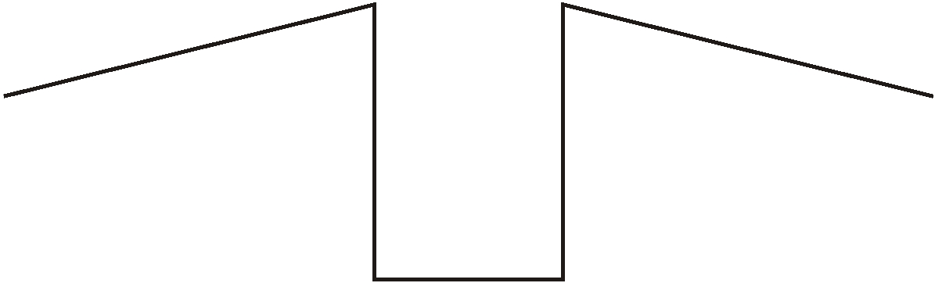
This is a design for an arrowhead.
Below is part of a larger scale drawing of the arrowhead. The drawing has the same size angles as the design. Draw two more lines to complete the arrowhead accurately. Use an angle measurer (protractor).
Notes:
Pre-2000 or other question

Slide 35
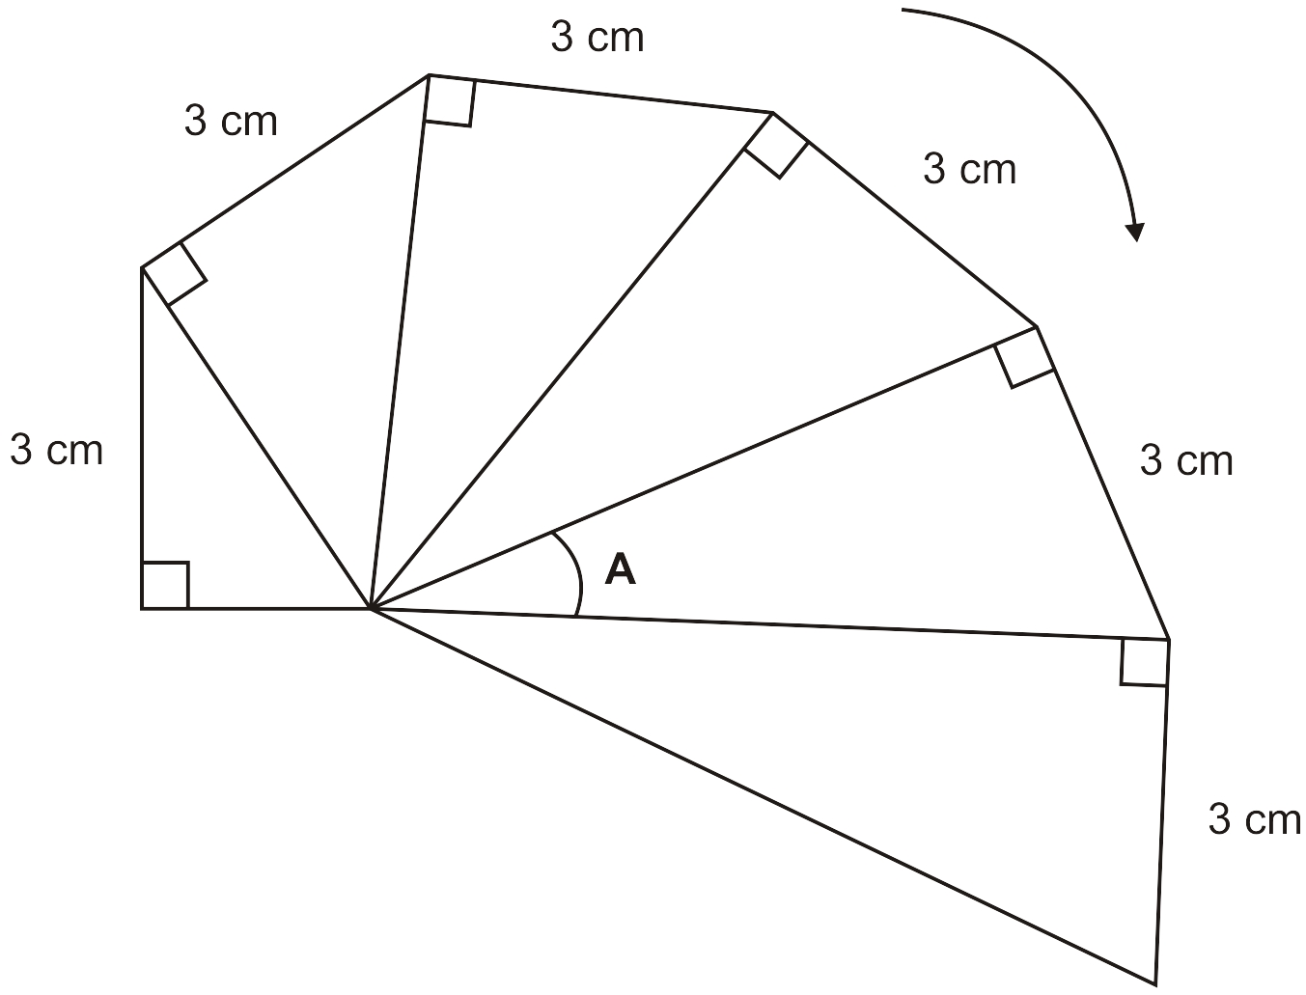
Here is the start of a spiral sequence of right-angled triangles.
Draw accurately the next right-angled triangle on the diagram.
Use an angle measurer to find the size of angle A.
25°
Notes:
Pre-2000 or other question

Slide 36
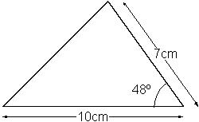
Here is a sketch of a triangle.
It is not drawn to scale.
Draw the full size triangle accurately, below.
Use an angle measurer (protractor) and a ruler.
One line has been done for you.
Notes:
Pre-2000 or other question

Slide 37
Recognise parts of a circle

Slide 38
A bicycle wheel has a diameter of 64 cm.
What is the radius of the bicycle wheel?
32 cm
3
2
2
6 4
diameter
radius
Notes:
2017 Paper 3 Q11

Slide 39
A circle has a diameter of 22 cm.
What is the length of its radius?
11 cm
22 cm ÷ 2 =
11 cm
diameter
radius
Notes:
P349 Pre-2000 or other question

Slide 40

Use these measurements to complete the sentences below.
circumference
4
The radius of a circle is _____ cm;
its diameter is _____ cm and
its circumference is approximately _____ cm.
diameter
8
radius
25
Notes:
P323 Pre-2000 or other question

Slide 41
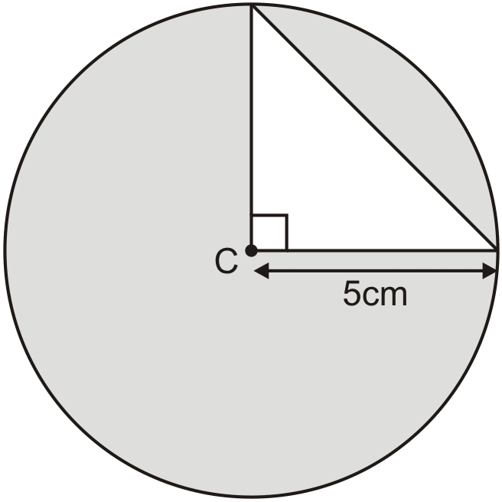
The diagram shows a right-angled triangle inside a circle.
The circle has a radius of 5 centimetres.
12.5 cm²
Calculate the area of the triangle.
5 cm
5 x 5 = 25
12.5
25 ÷ 2 =
Notes:
P260 Older Level 6

Slide 42
Solve problems involving nets of 3D shapes

Slide 43
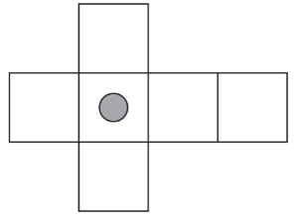
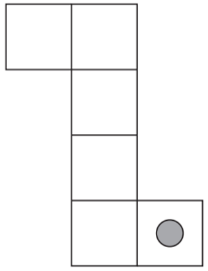
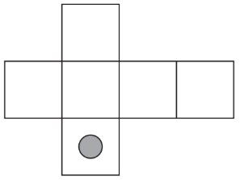
Here are three nets of a cube. On each net draw one more dot so that each cube will have dots on opposite faces.
Notes:
P39 2013 Paper 1 Q5

Slide 44

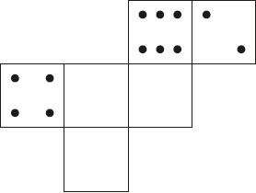
On a dice, the sum of the dots on opposite faces is always 7.
Draw dots on the three empty faces of the net so that it could fold up to make a dice.
Notes:
2018 Paper 3 Q17

Slide 45
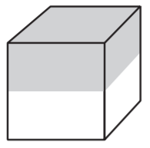
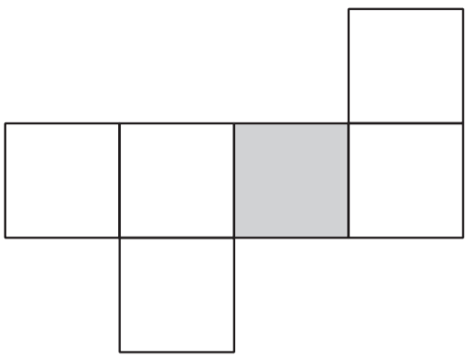
Here is a cube. The cube is shaded all the way round so that the top half is grey and the bottom half is white.
Here is the net of the cube. Complete the shading.
Notes:
P88 2006 Paper 2 Q16

Slide 46
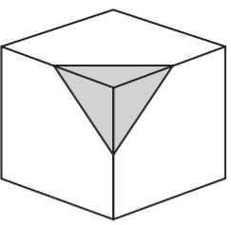
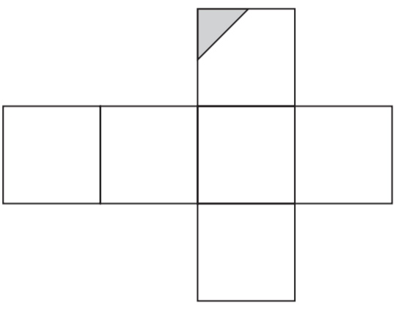
A cube has shaded triangles on three of its faces.
Here is the net of the cube. Draw in the two missing shaded triangles.
T
L
R
R
T
L
base
hidden
hidden
Notes:
P150 2002 Paper 2 Q19

Slide 47
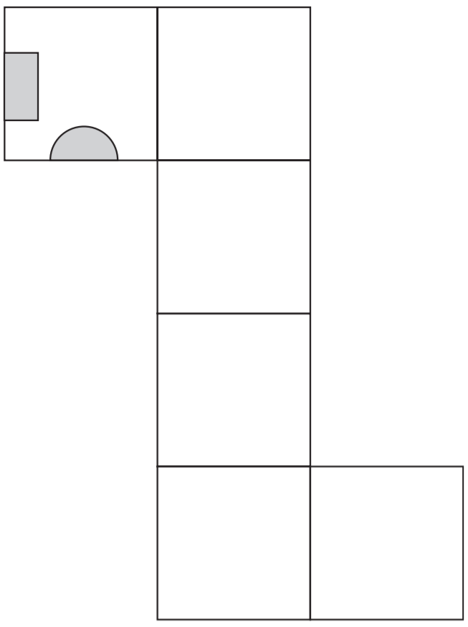
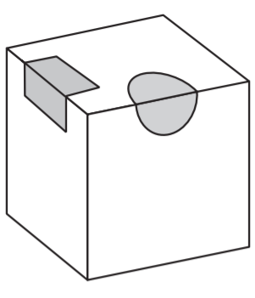
A cube has shaded shapes on three of its faces.
T
hidden
T
Here is a net of the cube. Draw in the two missing shaded shapes.
F
L
F
L
Notes:
P163 2007 Paper 1 Q22

Slide 48
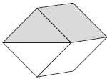
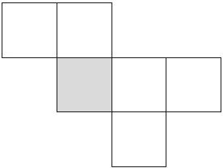
Here is a cube.
The top half of the cube has been shaded all the way round.
Here is a net for the cube. One square has been shaded for you. Shade more of the net so that it could fold to make the cube above.
Notes:
P215 2015 Level 6 Paper B Q9

Slide 49
Calculate volume

Slide 50
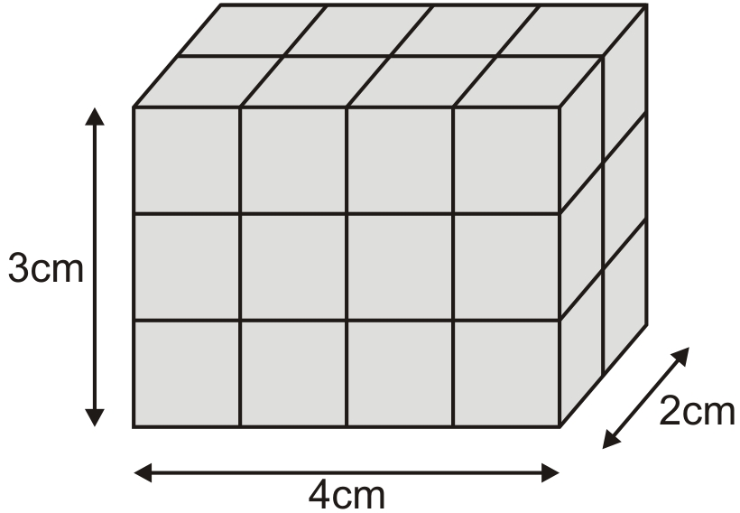
This cuboid is made from centimetre cubes.
It is 4 centimetres by 3 centimetres by 2 centimetres.
What is the volume of the cuboid?
4 cm x 3 cm x 2 cm =
24 cm³
Notes:
P256 Pre-2000 or other question

Slide 51

a) The diagram shows a cuboid. What is the volume of this cuboid?
10 cm x 10 cm x 6 cm =
600 cm³
b) The volume of a different cuboid is half the volume of the cuboid in part a. What could the dimensions of this different cuboid be?
10cm
10cm
3cm
_____ x _____ x _____ = 300cm³
10cm x 6cm x 5cm = 300cm³
If one length is halved, volume is halved.
Notes:
P50 Pre-2000 or other question

Slide 52

Jon has 20 centimetre cubes. He wants to make a cube with edges that are 3 cm long.
How many more centimetre cubes does he need?
3cm x 3cm x 3cm =
27cm³
He needs 7 more cubes.
Notes:
P85 2012 Level 6 Paper A Q10 second page

Slide 53

Calculate the volume of the prism.
Area of a triangle:
Base x height ÷ 2
4 cm x 3 cm ÷ 2 =
6 cm²
Volume of a prism:
Area of 2D shape x depth
6cm² x 3cm =
18cm³
Notes:
P126 Pre-2000 or other question

Slide 54
Write the possible dimensions of a cuboid given volume

Slide 55

Cleo has 24 centimetre cubes. She uses all 24 cubes to make a cuboid with dimensions 6 cm, 2 cm and 2 cm.
6cm x 2cm x 2cm = 24cm³
Write the dimensions of a different cuboid she can make using all 24 cubes.
4cm x 3cm x 2cm = 24cm³
12cm x 2cm x 1cm = 24cm³
24cm x 1cm x 1cm = 24cm³
8cm x 3cm x 1cm = 24cm³
6cm x 4cm x 1cm = 24cm³
Notes:
P347 2012 Level 6 Paper A Q10 first page

Slide 56
A cuboid is made from centimetre cubes.
It has a volume of 30 cubic centimetres.
What could the length, height and width be?
30cm
1cm
1cm
______ x ______ x ______ = 30cm³
15cm x 2cm x 1cm = 30cm³
5cm x 3cm x 2cm = 30cm³
6cm x 5cm x 1cm = 30cm³
Notes:
P248 Pre-2000 or other question

Slide 57

You can make only six different cuboids with 24 cubes. Complete the table to show the dimensions. Two have been done for you.
1
3
8
1
4
6
2
2
6
2
3
4
Notes:
P264 Pre-2000 or other question

Slide 58

You can make only four different cuboids with 16 cubes.
Which cuboid has the largest volume?
Tick the correct answer below.
Cuboid A
Cuboid B
Cuboid C
Cuboid D
All the same
Explain how you know.
✓
They all have a volume of 16 cubes.
Volume is how much space a 3D shape takes up.
Notes:
P46 Pre-2000 or other question

Slide 59
You can make only four different cuboids with 16 cubes.
How many of cuboid D make a cube of dimensions 4 × 4 × 4?
4
Notes:
P47 Pre-2000 or other question

Slide 60
Calculate missing lengths given volume

Slide 61


Cube A and cuboid B have the same volume.
Calculate the missing length on cuboid B.
9cm
3
3 6
x
6
2 1
6
6cm x 6cm x 6cm =
216cm³
6cm x 4cm x ____ = 216cm³
9cm
9
9cm
216 ÷ 24 =
24cm² x _____ = 216cm³
Notes:
2017 Paper 3 Q24

Slide 62

The two cuboids have the same volume.
Calculate the length x.
5cm
10cm x 6cm x 5cm =
300cm³
5cm
5cm
12cm x ____ x ____ = 300cm³
2
5
1 2
3 0 0
6
Notes:
P139 Pre-2000 or other question

Slide 63

A cuboid has a square base.
It is twice as tall as it is wide.
Its volume is 250 cubic centimetres.
Calculate the width of the cuboid.
5cm
1cm 1cm 2cm
5cm 5cm 10cm
10cm 10cm 20cm
_____ x _____ x _____ = 250cm³
Notes:
P102 Older Level 6

Slide 64
Calculate volume from nets

Slide 65

This is the net of a cube.
What is the volume of the cube?
20cm ÷ 4 = 5cm
5cm x 5cm x 5cm =
125cm³
Notes:
2018 Paper 2 Q22

Slide 66

The squared paper shows the nets of cuboid A and cuboid B.
Do the cuboids have the same volume? Show calculations to explain how you know.
12cm³
4cm x 3cm x 1cm =
12cm³
3cm x 2cm x 2cm =
The cuboids have the same volume.
Notes:
P191 Pre-2000 or other question

Slide 67
Solve problems involving volume of cubes and cuboids

Slide 68

Amina made this cuboid using centimetre cubes.
Stefan makes a cuboid that is 5 cm longer, 5 cm taller and 5 cm wider than Amina’s cuboid.
What is the difference between the number of cubes in Amina’s and Stefan’s cuboids?
720 cubes
4cm x 6cm x 3cm =
72cm³
7 9 2
9cm x 11cm x 8cm =
792cm³
-
7 2
7
7
2
0
9 9
x
8
7 9
2
Notes:
2019 Paper 2 Q23

Slide 69


Amit has some small cubes. The edge of each cube is 1.5 centimetres. He makes a larger cube out of the small cubes. The volume of this larger cube is 216 cm³. How many small cubes does he use?
6cm
6cm
6cm
____ x ____ x ____ = 216cm³
Use trial and error:
3
5 x 5 x 5 = 125
3 6
x
6
10 x 10 x 10 = 1000
2 1
6
6 x 6 x 6 =
4
6 ÷ 1.5 =
…so each edge is made up of 4 cubes
4 x 4 x 4 =
…so he uses 64 cubes.
64
Notes:
P219 Older Level 6

Slide 70
The diagram shows a cuboid.
What is the volume of this cuboid?
10cm x 10cm x 6cm =
600cm³
The volume of a different cuboid is half the volume of the cuboid above. What could the dimensions of this different cuboid be?
_____ x _____ x _____ = 300cm³
10cm
10cm
3cm
Notes:
P252 Pre-2000 or other question

Slide 71


a) What is the volume of this standard size box of salt?
b) What is the volume of this special offer box of salt, which is 20% bigger?
20% of 300 =
60
300 + 60 =
360cm³
10cm x 6cm x 5cm =
300cm³
c) The standard size box contains enough salt to fill up 10 salt pots. How many salt pots may be filled up from the special offer box of salt?
20% of 10 =
2
10 + 2 =
12 salt pots
Notes:
P21 Pre-2000 or other question

Slide 72
Solve ratio problems involving co-ordinates on a simple co-ordinate grid

Slide 73

a) The dots on the line are equally spaced.
What are the coordinates of the point A?
A: (2,
1)
3
1
2
1
1
2
2
2
4
6
Notes:
P352 Pre-2000 or other question

Slide 74
b) Megan says, 'The point B has coordinates (11,5).' Use the graph to explain why she cannot be correct.
The co-ordinates of point B are (12, 6).
x co-ordinates are increasing by 2 each time from an even number and 11 is an odd number.
(10, 5)
(12, 6)
(8, 4)
y co-ordinates are increasing by 1 each time and point B is the 6th, not the 5th, point.
(2, 1)
Notes:
P353 Pre-2000 or other question

Slide 75

In this diagram R is an equal distance from P and Q.
What are the coordinates of R?
15)
R: (50,
15
15
15
50
50
50
Notes:
P143 2015 Paper 2 Q22

Slide 76

The points A, B and C are equally spaced. What are the co-ordinates of point B?
Point D is directly below point C. What are the co-ordinates of the point D?
6
B: (5,
4)
4
2
D: (10, 0)
5
10
Notes:
P171 Pre-2000 or other question

Slide 77

Here is a line on coordinate axes.
36
24
12
25
50
75
Points O, P, Q and R are equally spaced.
The coordinates of P are (25,12).
What are the coordinates of R?
36)
R: (75,
Notes:
P225 2012 Paper 2 Q24

Slide 78

A is the point (10, 60). B is the point (20, 20). M is the midpoint of line AB.
Write the coordinates of M.
C is on the x-axis, directly below B.
Write the coordinates of C.
60
M: (15,
40)
20
40
20
C: (20,
0)
20
5
5
10
15
20
Notes:
P269 2001 Paper 1 Q20

Slide 79

A and B are joined by a straight line on coordinate axes.
The dots on the line are equally spaced.
What are the coordinates of C?
Notes:
P355 2011 Paper 1 Q23 first page

Slide 80
30
5
5
20
5
C: (13,
15
15)
5
10
3
3
3
3
10
13
12
22
Notes:
P356 2011 Paper 1 Q23 second page

Slide 81
Identify and plot points on a full co-ordinate grid

Slide 82

For each of these points, put a tick to show if it is inside the square.
70
(50, 70)
(60, -30)
(-10, 50)
(-30, -30)
✘
50
✓
✓
-30
-10
50
✘
60
-30
-30
Notes:
P98 2007 Paper 1 Q19

Slide 83

The vertices of a quadrilateral have these coordinates:
(1, 5)
(5, 4)
(1, −3)
(−3, 4)
One side of the quadrilateral has been drawn on the grid. Complete the quadrilateral.
Notes:
2017 Paper 2 Q17

Slide 84

ABCD is a rectangle drawn on coordinate axes.
The sides of the rectangle are parallel to the axes.
What are the coordinates of D and E?
-4)
D: (-10,
8)
E: (0,
Notes:
P135 2009 Paper 1 Q23

Slide 85

Layla draws a square on this coordinate grid.
Three of the vertices are marked.
What are the coordinates of the missing vertex?
(-3,
1)
Notes:
2018 Paper 3 Q10 first page

Slide 86
(-3,
1)
Notes:
2018 Paper 3 Q10 second page

Slide 87

The two shaded squares below are the same size.
A is the point (17, 8).
B is the point (7, −2).
What are the co-ordinates
of the point C?
C: (-3,
-12)
8
10
10
10
-3
7
17
-2
10
-12
Notes:
P179 Older Level 6

Slide 88

Here is a square on coordinate axes.
C is the centre of the square.
Find the coordinates of P and Q.
20
P: (-12,
-30)
Q: (38,
-30)
25
25
25
-12
13
38
-5
25
-30
Notes:
P230 2014 Level 6 Paper A Q13

Slide 89

The diagram shows three identical shaded triangles on co-ordinate axes.
25
What are the co-ordinates of A and B?
6
25
19
A: (19,
25
25)
B: (-6,
19)
6
25
-6
19
6
Notes:
P291 2013 Level 6 Paper A Q12

Slide 90

The diagram shows 6 shaded squares.
K is the point (20, 10).
What are the coordinates of L and M?
M: (-10,
0)
10
L: (30,
-20)
10
10
10
10
10
20
30
-10
10
10
-20
Notes:
P45 Older Level 6

Slide 91
Translate a shape on a full co-ordinate grid

Slide 92

Here is a triangle drawn on a coordinate grid.
The triangle is translated
7 right and 5 up. Draw the triangle in its new position.
Notes:
2017 Paper 3 Q7

Slide 93

Here are two identical shaded triangles on coordinate axes.
Write the coordinates of points A and B.
3
8
A: (12,
0)
3
B: (9,
-8)
3
9
12
8
-8
Notes:
2015 (Sample) Paper 3 Q20

Slide 94

On the grid there are three points joined by two lines.
Lara plots another point on the grid at (–1, 2).
She joins the points to make a quadrilateral.
Complete Lara’s quadrilateral on the grid. Use a ruler.
Then Lara translates the quadrilateral 4 squares to the right. Draw the quadrilateral in its new position on the grid.
Notes:
2019 Paper 3 Q10

Slide 95
Reflect a shape on a full co-ordinate grid

Slide 96

The shaded triangle is a reflection of the white triangle in the mirror line. Write the co-ordinates of point A and point B.
A: (11,
9)
9
B: (15,
3)
3
4
4
1
5
11
15
Notes:
P59 2000 Paper 1 Q22

Slide 97

Here are two triangles drawn on coordinate axes.
Triangle B is a reflection of triangle A in the x-axis.
Two of the new vertices of triangle B are (10, −10) and (20, −30).
What are the coordinates of the third vertex of triangle B?
(10, -10)
(-10, -40)
(20, -30)
(-10,
-40)
Notes:
2016 Paper 2 Q20

Slide 98
Identify co-ordinates from equations on a line graph

Slide 99



A and B are two points on the graph of y = x + 5
Write the missing co-ordinates of A and B.
4
-3
9 = x + 5
y = -8 + 5
Write the co-ordinates of the point where the graph of
y = x + 5 crosses the x-axis.
(-5,
0)
Notes:
P132 Older Level 6

Slide 100

The points (−5, −2) and (4, 7) lie on the same line.
If the line were extended, would it pass through point (−100, −103)?
Explain how you know.
No. y is always 3 more than x.
-103 is 3 less than -100
Use x and y to write the equation of the line.
y = x + 3
x = y – 3
Notes:
P331 Older Level 6

Slide 101

The diagram shows the graph of y = x − 7
Write the coordinates of one point on the line between A and B.
1 – 7 = -6
(1, -6)
(3, -4)
(5, -2)
(2, -5)
(4, -3)
(6, -1)
Notes:
P211 Older Level 6

