Slide 1
Estimate values on a line graph to use in calculations

Slide 2
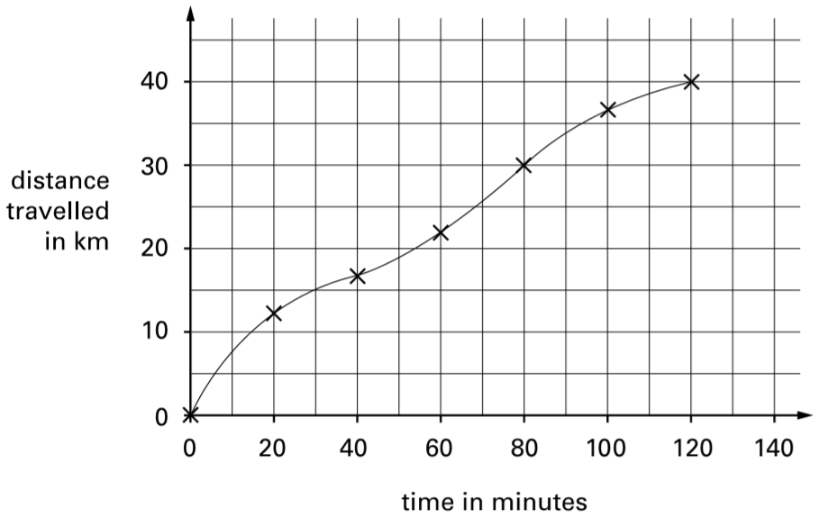
Carol went on a 40-kilometre cycle ride.
This is a graph of how far she had gone at different times.
How many minutes did Carol take to travel the last 10 kilometres of the ride?
120 – 80 =
40 minutes
Notes:
P27 2000 Paper 2 Q19 first page

Slide 3
Carol went on a 40-kilometre cycle ride.
This is a graph of how far she had gone at different times.
Use the graph to estimate the distance travelled in the first 20 minutes of the ride.
35
25
12 kilometres
15
You also get the mark for an estimate of 13 kilometres.
5
Notes:
P28 2000 Paper 2 Q19 second page

Slide 4
Carol went on a 40-kilometre cycle ride.
This is a graph of how far she had gone at different times.
Carol says, ‘I travelled further in the first hour than in the second hour.’ Explain how the graph shows this.
It shows 22 km travelled in the first 60 minutes.
This means that
40 – 22 = 18 km travelled in the second hour.
22 km is further than 18 km.
Notes:
P29 2000 Paper 2 Q19 third page

Slide 5
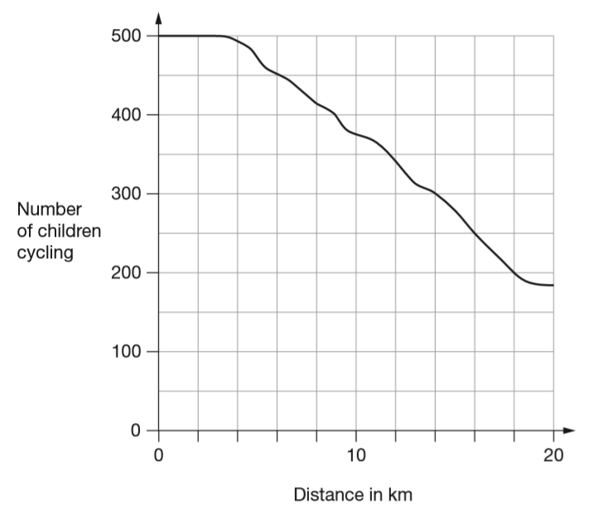
500 children started a 20 kilometre sponsored cycle ride. This graph shows how far they cycled.
At what distance were exactly half of the children still cycling?
2
5
0
2
5 0 0
1
250
16 kilometres
2
4
6
8
12
14
16
18
Notes:
P56 2011 Paper 1 Q19 page 1

Slide 6
500 children started a 20 kilometre sponsored cycle ride. This graph shows how far they cycled.
Estimate how many children completed the 20 kilometre cycle ride.
185 children
You get the mark for an estimate of between 180 and 190.
250
150
Notes:
P57 2011 Paper 1 Q19 page 2

Slide 7
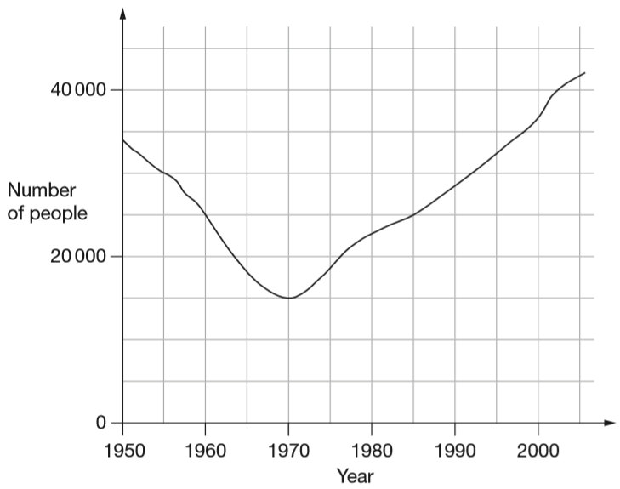
This graph shows the number of people living in a town.
How many people lived in the town in 1985?
25 000
20 000 ÷ 4 =
5000
Notes:
P333 2008 Paper 1 Q20 first page

Slide 8
This graph shows the number of people living in a town.
In which year was the number of people the same as in 1950?
1997
Notes:
P334 2008 Paper 1 Q20 second page

Slide 9
This graph shows the number of people living in a town.
Find the year when the number of people ﬁrst went below 20 000
1964
Notes:
P335 2008 Paper 1 Q20 third page

Slide 10
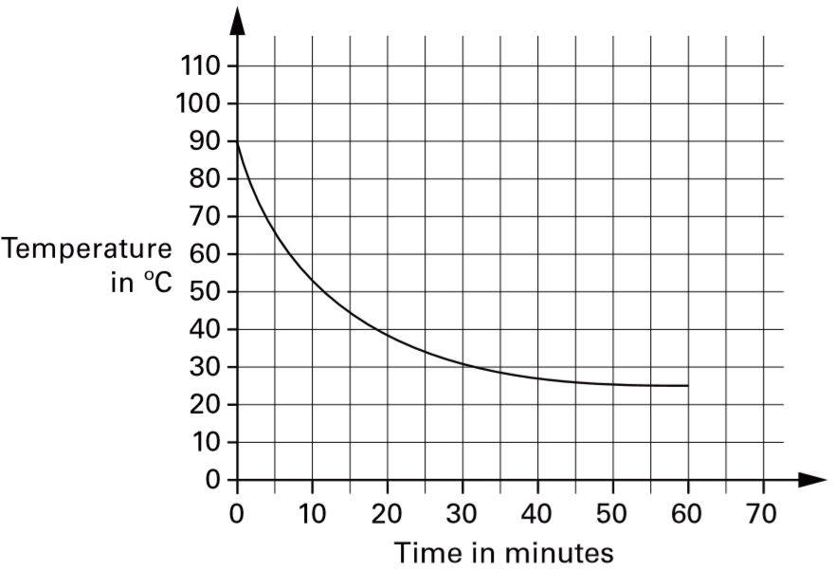
A hot liquid is left to cool in a science experiment. This graph shows how the temperature of the liquid changes as it cools.
Read from the graph how many minutes it takes for the temperature to reach 40°C
18 minutes
19 minutes also gets you the mark.
Read from the graph how many minutes the temperature is above 60°C
5
15
25
35
45
55
65
7 minutes
An answer of between 6 minutes and 7.5 minutes gets you the mark.
Notes:
P172 2001 Paper 2 Q25

Slide 11
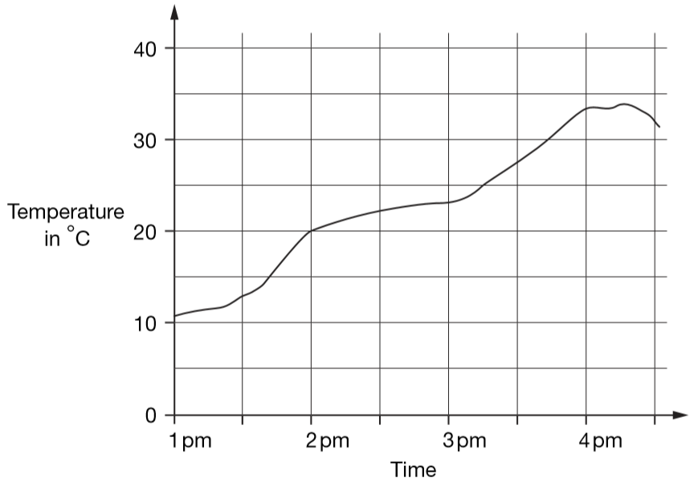
This graph shows the temperature in a greenhouse.
Use the graph to find the time when the temperature was 25°C.
3:15pm
1:30
2:30
3:30
Notes:
P212 2006 Paper 2 Q18 page 1

Slide 12
This graph shows the temperature in a greenhouse.
Use the graph to ﬁnd the difference between the temperature at 2pm and the temperature at 4pm.
33
33 – 20 =
13 degrees
You also get the mark for an answer of 14 degrees.
1:30
2:30
3:30
Notes:
P213 2006 Paper 2 Q18 page 2

Slide 13
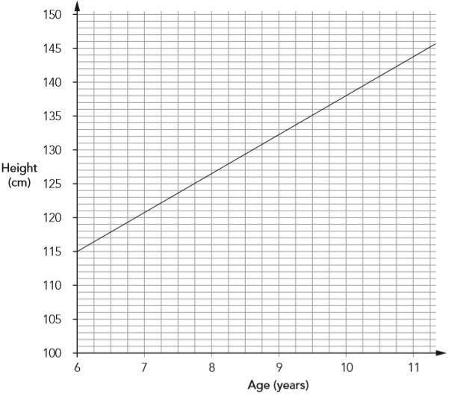
The graph shows the average heights of girls in the UK from age 6 – 11 years.
Emily is 1.38m tall. She is the average height for her age.
How old is she?
10 years
Zoe is 9½ years old.
She is also 1.38m tall.
How much taller than average is she? Give your answer in centimetres.
138 – 135 =
3 centimetres
Notes:
P293 2012 Level 6 Paper B Q1

Slide 14
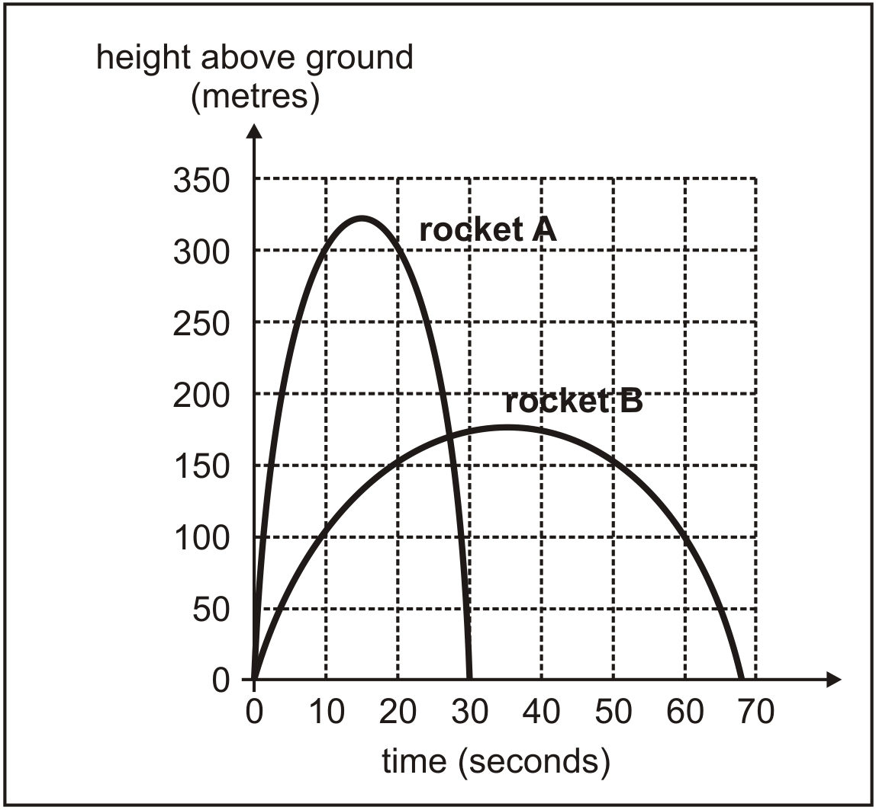
Jim draws a graph to show how high two rockets go during their flight.
Estimate how much higher rocket A reaches than rocket B.
325
325 – 175 =
150 metres
Estimate the time after the start when the two rockets are at the same height.
175
27 seconds
Jim says, ‘The graph shows that rocket A was more than 200 m above the ground for about 23 seconds.’
Explain how the graph shows this.
3
26
reaches at 3s, falls at 26s
26 – 3 = 23
Notes:
P300 Older Level 6

Slide 15
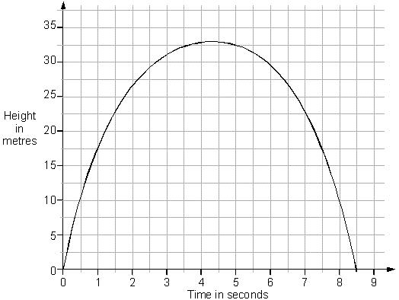
This is a graph of a firework rocket, showing its height at different times.
Estimate from the graph for how many seconds the rocket is more than 20 metres above the ground.
7.2 – 1.2 =
6 seconds
Estimate from the graph how many metres the rocket falls in the last second of its flight.
17.5 metres
1.2
7.2
Notes:
P65 Older Level 6

Slide 16
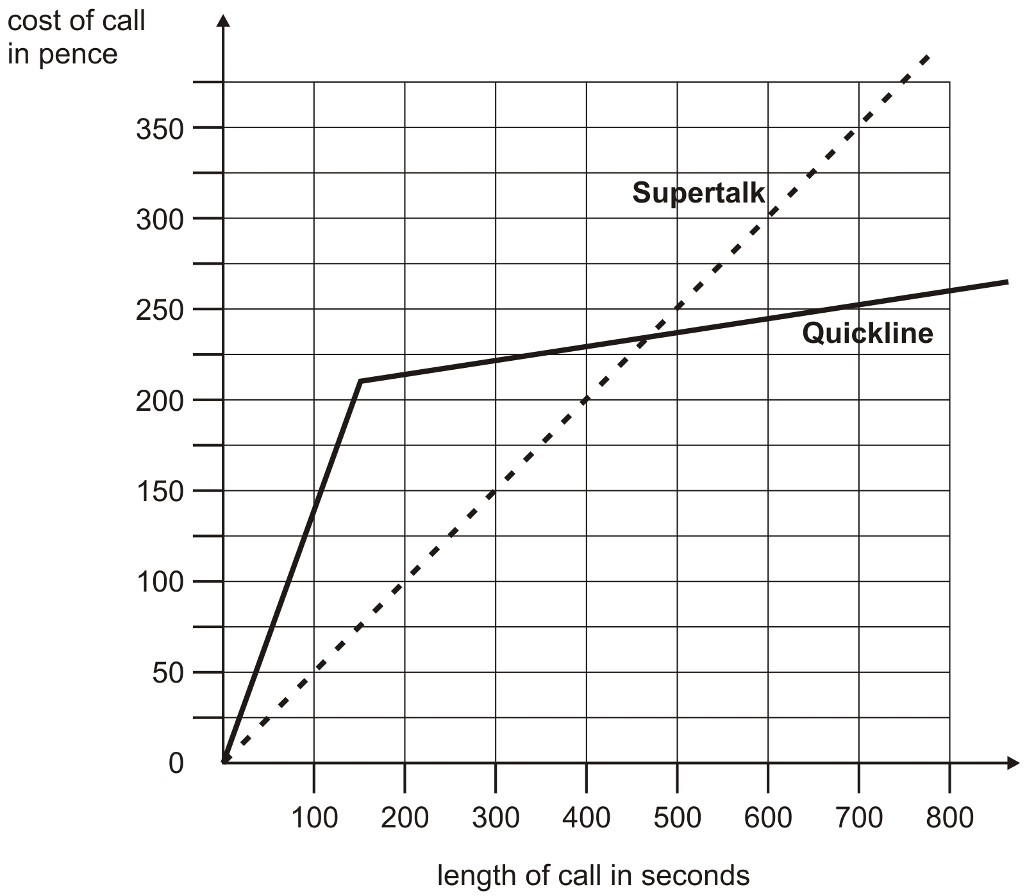
Two telephone companies, Supertalk and Quickline, have different charges for long distance calls. This graph shows the charges for different lengths of calls.
Estimate from the graph how many seconds longer a £2 call lasts with Supertalk compared to Quickline.
400 – 140 =
260 seconds
Estimate from the graph the length of a call when Quickline becomes cheaper to use than Supertalk. Give your answer to the nearest 10 seconds.
470 seconds
Notes:
P133 Older Level 6

Slide 17
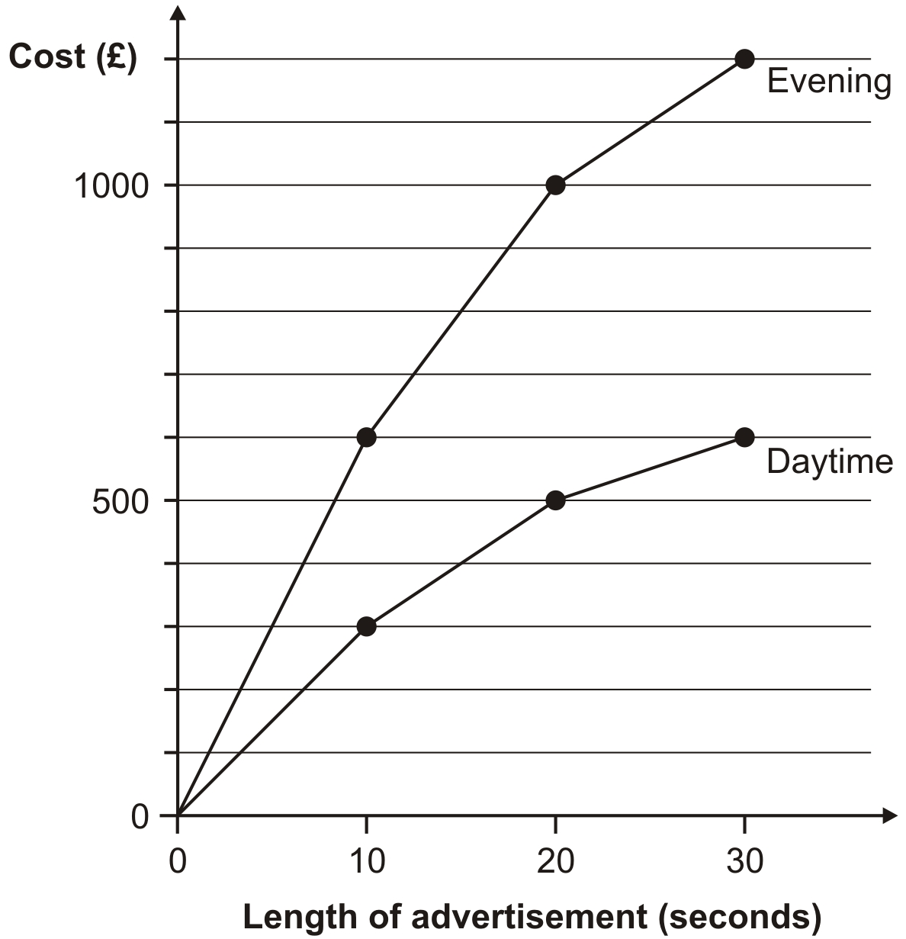
This chart gives the cost of showing advertisements on television at different times.
An advertisement lasts 25 seconds.
Use the graph to estimate how much cheaper it is to show it in the daytime compared with the evening.
£1100 - £550 =
£550
An advertisement was shown in the daytime and again in the evening. The total cost was £1200
How long was the advertisement in seconds?
15 seconds
Notes:
P332 Older Level 6

Slide 18
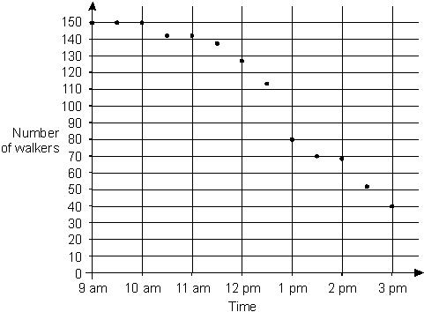
150 people take part in a walk. This chart shows the number of people still walking at different times.
Use the chart to estimate the time when two-thirds of the people are still on the walk.
12:45pm
2
100
of 150 =
3
Notes:
P198 Older Level 6

Slide 19
Estimate decimals or negative numbers on a line graph to use in calculations

Slide 20
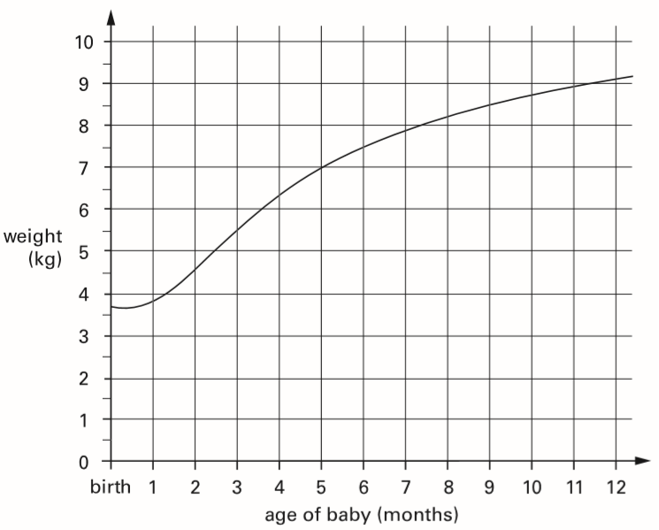
This graph shows how the weight of a baby changed over twelve months.
From the graph, what was the weight of the baby at 10 months?
8.7
You also get the mark for 8.6 or 8.8
more than 8½
8.5
less than 9
9.0
Notes:
P280 2002 Paper 2 Q17 first page

Slide 21
This graph shows how the weight of a baby changed over twelve months.
How much more did the baby weigh at 5 months than at birth?
3.3 kilograms
You also get the mark for 3.2 or 3.4
6
5 months = 7 kg
7
.0
1
-
3.7
birth =
3.7 kg
3
.
3
more than 3½
3.5
less than 4
4.0
Notes:
P281 2002 Paper 2 Q17 second page

Slide 22
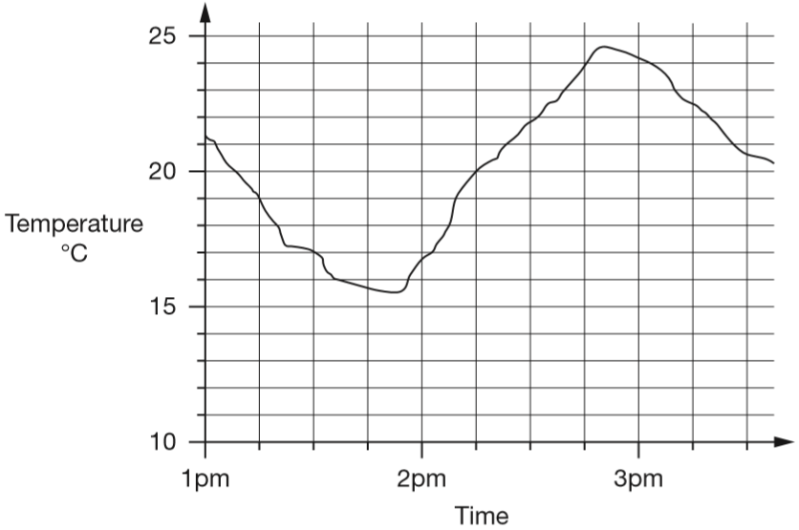
This graph shows how the temperature changed in Liam’s room one afternoon.
Estimate the temperature at 3:15pm.
22.5°C
You get the mark for an estimate of between 22.2 and 22.8
Notes:
P41 2014 Paper 2 Q18 page 1

Slide 23
This graph shows how the temperature changed in Liam’s room one afternoon.
Estimate the time when the temperature was highest.
2:50pm
You get the mark for an estimate of between 2:48pm and 2:52pm
2:45pm
Notes:
P42 2014 Paper 2 Q18 page 2

Slide 24
This graph shows how the temperature changed in Liam’s room one afternoon.
How much did the temperature change from 2pm to 2:30pm? Give your answer to the nearest degree.
just under 22
just under 17
22 – 17 =
5 degrees
Notes:
P43 2014 Paper 2 Q18 page 3

Slide 25
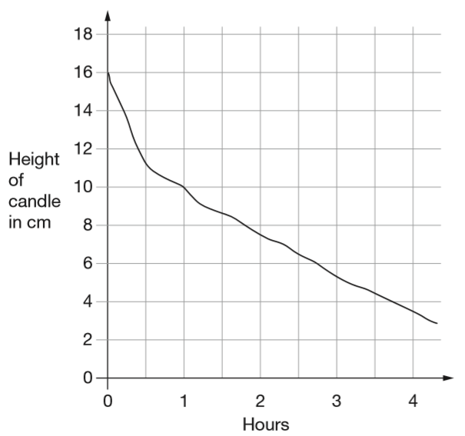
This graph shows the height of a candle as it burns.
What is the height of the candle after 2 hours?
7.5 cm
Notes:
P76 2007 Paper 2 Q22 first page

Slide 26
This graph shows the height of a candle as it burns.
How long does the candle take to burn down from 16cm to 4cm?
3¾ hours
3 hours 45 minutes
Notes:
P77 2007 Paper 2 Q22 second page

Slide 27
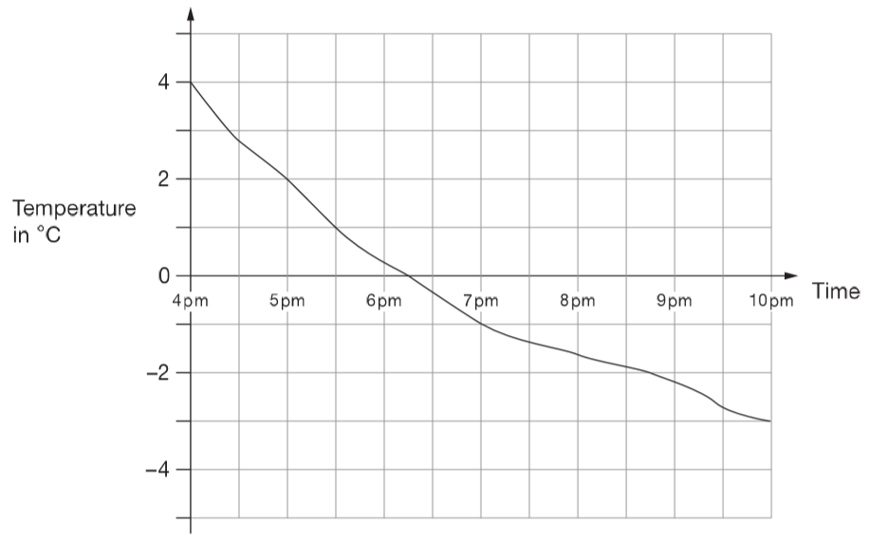
This graph shows the outside temperature from 4pm to 10pm on a day in winter.
At what time was the temperature -2°C?
8:45pm
8:30
How many degrees did the temperature drop from 5pm to 7pm?
8:45
3 degrees
Notes:
P151 2010 Paper 2 Q17

Slide 28
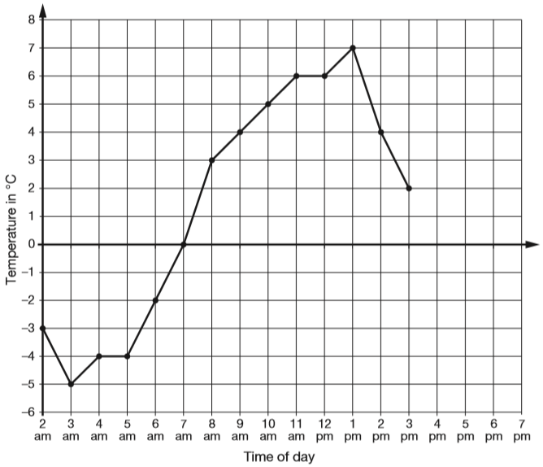
This graph shows the temperature in °C from 2 am to 3 pm on a cold day.
How many degrees warmer was it at 3 pm than at 3 am?
+5
+2
7 degrees
-5
0
2
At 6 pm the temperature was 4 degrees lower than at 3 pm.
What was the temperature at 6 pm?
-2
-2
-2
0
2
-2 degrees
Notes:
2017 Paper 3 Q4

Slide 29
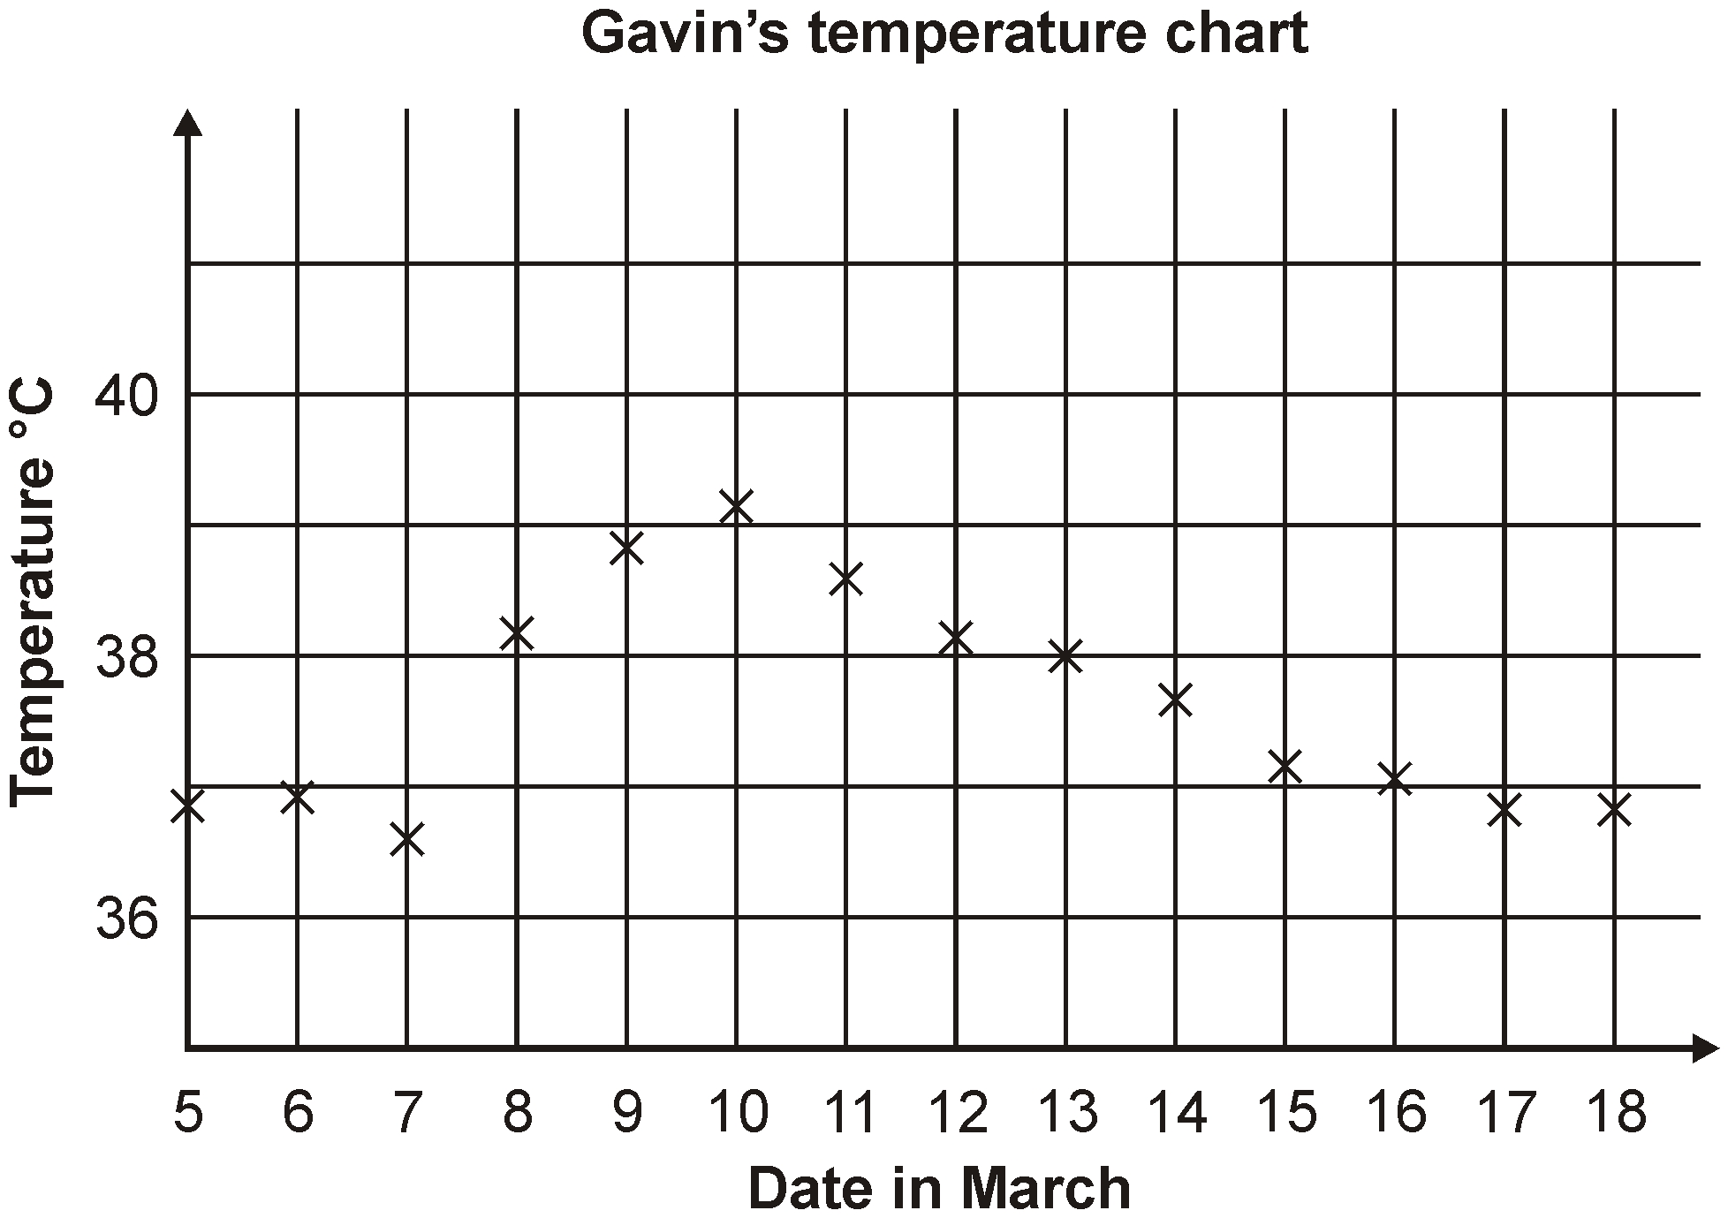
Gavin was ill in March.
This is his temperature chart.
For how many days was his temperature marked as more than 37°C?
9 days
Which date showed the largest change in temperature from the day before?
8th March
Estimate Gavin’s highest temperature shown on the graph. Give your answer to 1 decimal place.
39.1 degrees
Notes:
P189 Pre-2000 or other question

Slide 30
Solve problems involving information presented in line graphs

Slide 31
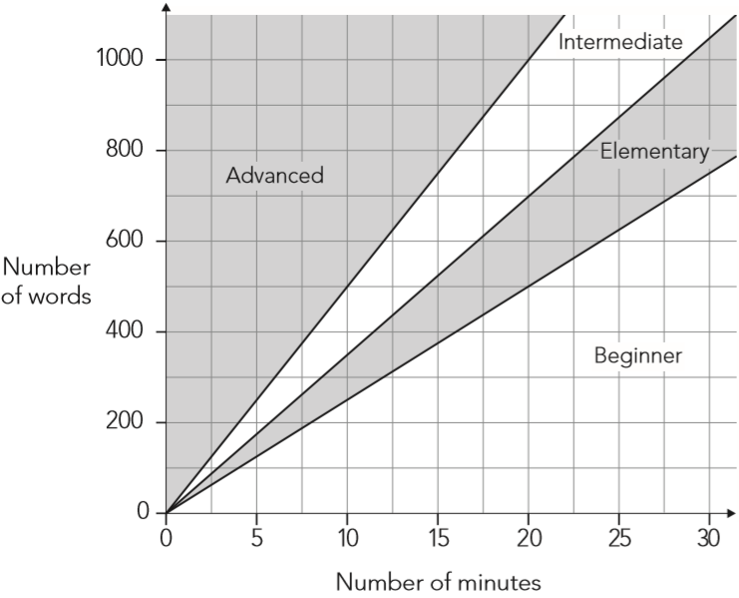
How fast you can type accurately is called your typing speed. The regions of the graph show information about different typing speeds.
Darren’s level of typing is elementary. In 20 minutes he should be able to type between 500 and 700 words.
Jo’s level of typing is intermediate.
How many words should she be able to type in 20 minutes?
Between _____ and _____
700
1000
Notes:
P350 2012 Level 6 Paper A Q8 first page

Slide 32
How fast you can type accurately is called your typing speed. The regions of the graph show information about different typing speeds.
Kath’s typing speed is 30 words per minute.
What level is Kath’s typing?
Explain how you know.
1 minute = 30 words
so 10 minutes = 300 words
Elementary
because lines drawn vertically on 10 minutes and horizontally on 300 words cross in this section.
Notes:
P351 2012 Level 6 Paper A Q8 second page

Slide 33
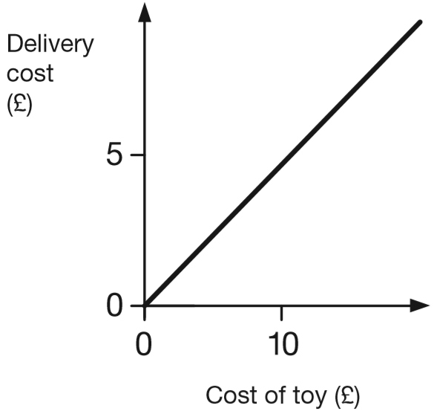
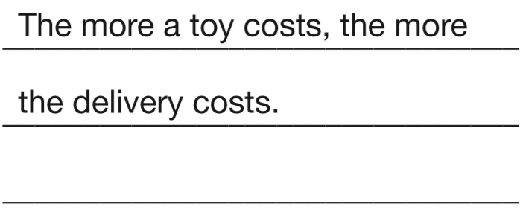
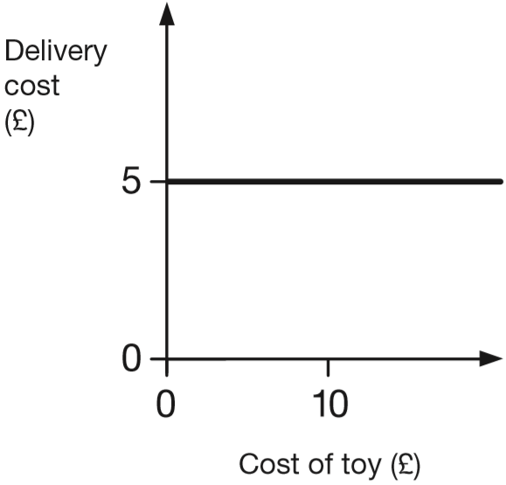

Two companies sell toys online. They charge to deliver.
Describe the delivery cost of the second company.
The first company is done for you.
The delivery cost is £5
(the same) whatever the
cost of the toy.
Notes:
P301 2015 Level 6 Paper A Q2

Slide 34
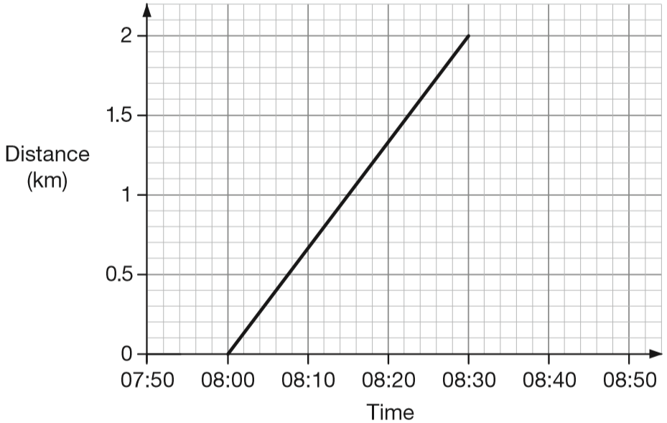
Alfie and his brother walked from home to their school.
Their school is 2 kilometres from home.
The graph shows information about Alfie’s journey.
How does the graph show that Alfie walked at a constant speed for all of his journey?
It’s a straight line.
Alfie’s brother left home 10 minutes before Alfie. He arrived at school 20 minutes after Alfie. He walked at a constant speed for all of his journey. At what time did Alfie overtake his brother?
08:10
Notes:
P48 2014 Level 6 Paper A Q4

Slide 35
Calculate the mean

Slide 36
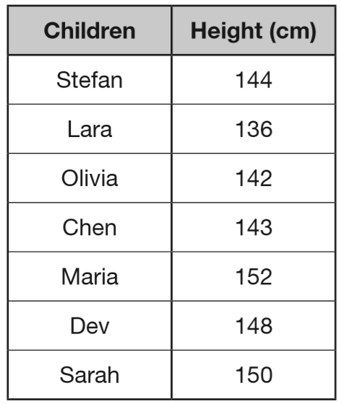
Seven children measured their heights.
What is the mean height of the children?
145 cm
1
4
5
cm
7
1 0 1 5
3
3
280
422
565
717
865
1015
Notes:
2015 (Sample) Paper 2 Q17

Slide 37
Last year, Jacob went to four concerts.
Three of his tickets cost £5 each.
The other ticket cost £7
What was the mean cost of the tickets?
£22 total cost on 4 tickets
£5.40
5 + 5 + 5 + 7 =
£22
£
5
4
0
.
4
2 2.0 0
2
Notes:
2018 Paper 2 Q18

Slide 38

Here are five number cards.
Write the missing number so that the mean is 2
3
10
÷ 5 = 2
3
1 + 4 + 1 + 1 + = 10
Notes:
P63 2014 Level 6 Paper A Q3 first page

Slide 39
Three apples have a mean (average) mass of 100 grams.
The largest apple is removed.
The mean mass of the remaining two apples is 70 grams.
What is the mass of the largest apple?
160 grams
so 3 apples weigh 300 grams together
300
÷ 3 = 100
140
÷ 2 = 70
so 2 apples weigh 140 grams together
160
140 + = 300
Notes:
P118 2015 Level 6 Paper B Q11

Slide 40
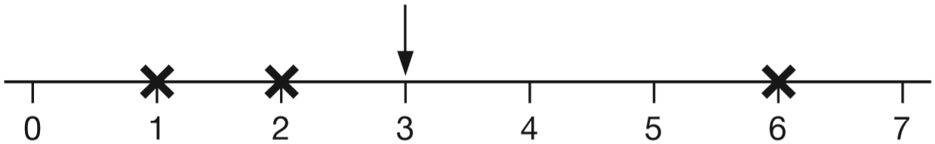
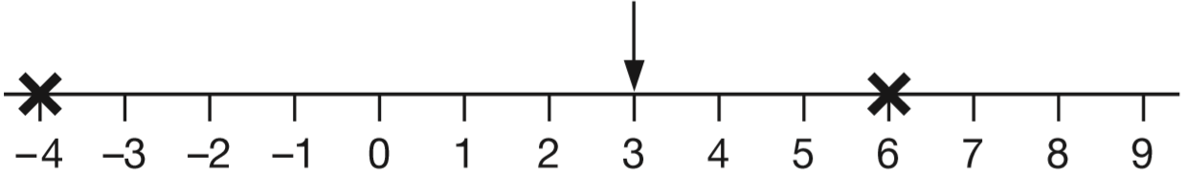
The arrow below points to the mean of the three numbers shown by crosses.
6 + 2 + 1 =
9
9 ÷ 3 =
3
Draw an arrow that points to the mean of the three numbers shown below.
17 + 14 + 5 =
36
36 ÷ 3 =
12
The arrow below points to the mean of three numbers. One of the numbers is missing. Draw a cross to show the position of the missing number.
7
-4 + 6 + = 9
9
÷ 3 = 3
Notes:
P309 2014 Level 6 Paper B Q2

Slide 41
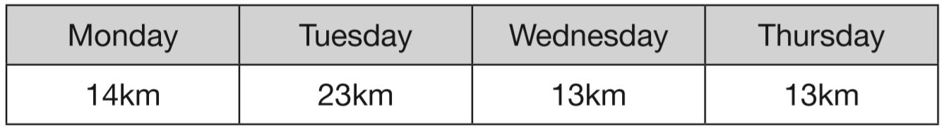
Megan goes on a walking holiday for five days.
The table shows how far she walked on the first four days.
Megan says, ‘My average for the first four days is more than 15km.’
Explain why Megan is correct.
14 + 23 + 13 + 13 =
63
63 ÷ 4 =
more than 15
(15.75)
Friday is her last day. She wants to increase her average to 17km
How many kilometres must she walk on Friday?
22 kilometres
85
÷ 5 = 17
22
63 + = 85
Notes:
P202 2013 Level 6 Paper B Q7

Slide 42
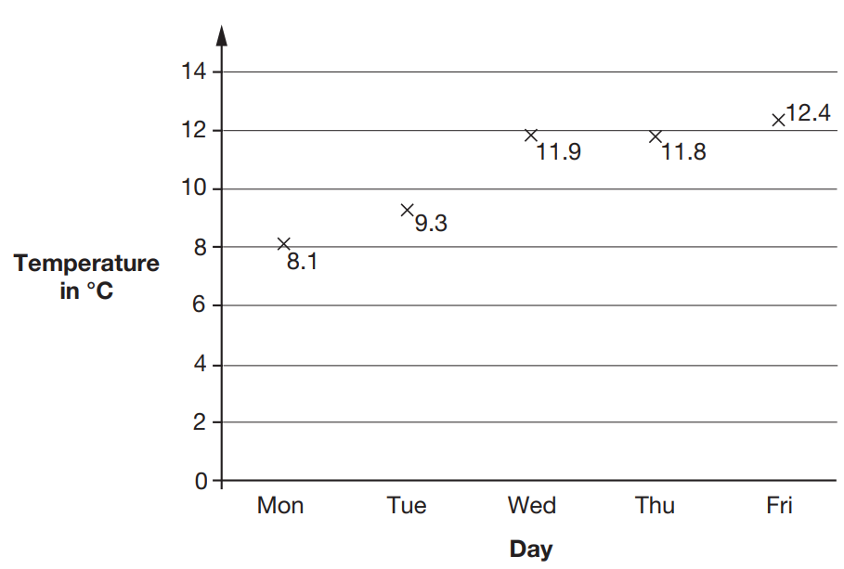
This graph shows the maximum temperature for five days.
For what fraction of the five days was the maximum temperature below 10 °C?
2 days below
5 days altogether
2
5
Notes:
2019 Paper 2 Q22 page 1

Slide 43
This graph shows the maximum temperature for five days.
What was the mean maximum temperature, to one decimal place?
53.4
29.2
41.0
17.4
10.7 °C
1
0
.
6
8
5
3
4
0
5 3
.4
1
0
.
6
8
Notes:
2019 Paper 2 Q22 page 2

Slide 44
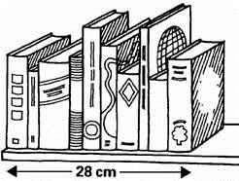
Vicki puts 10 books on a shelf.
The 10 books take up 28 centimetres.
What is the mean (average) thickness of her books?
28 ÷ 10 =
2.8 centimetres
Notes:
P254 Pre-2000 or other question

Slide 45
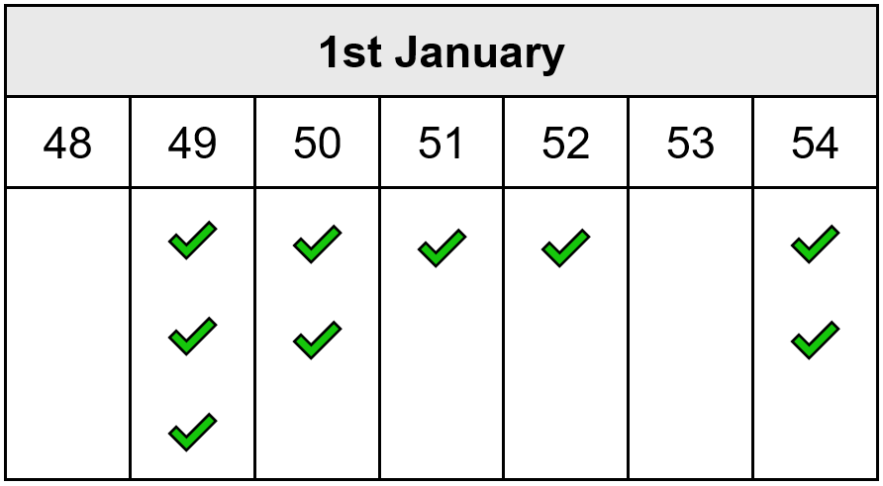
Carol counts the matches in 10 boxes.
She works out that the mean number of matches in a box is 51
Here are her results for 9 boxes.
Calculate how many matches are in the 10th box.
✓
3 x 2 = 6 less
2 x 1 = 2 less
1 x 1 = 1 more
2 x 3 = 6 more
2 x 1 = 2 more
Notes:
P2 Older Level 6

