Slide 1
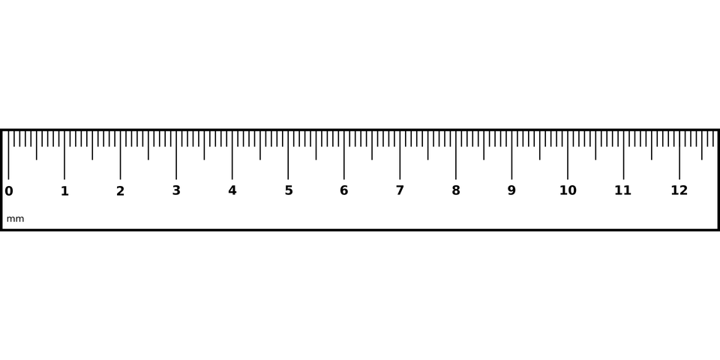
millimetres (mm) in a centimetre (cm)
10

Slide 2
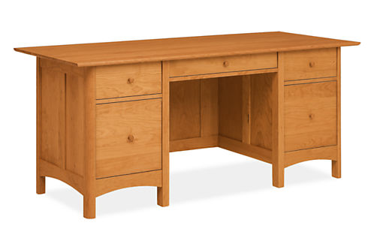
centimetres (cm) in a metre (m)
100
1 m
100 cm

Slide 3
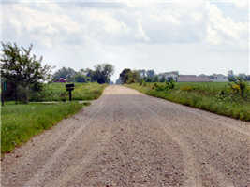
metres (m) in a kilometre (km)
1000

Slide 4
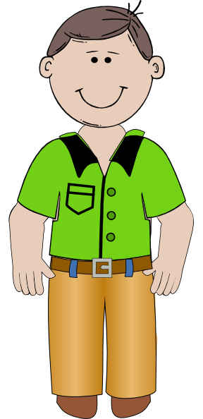
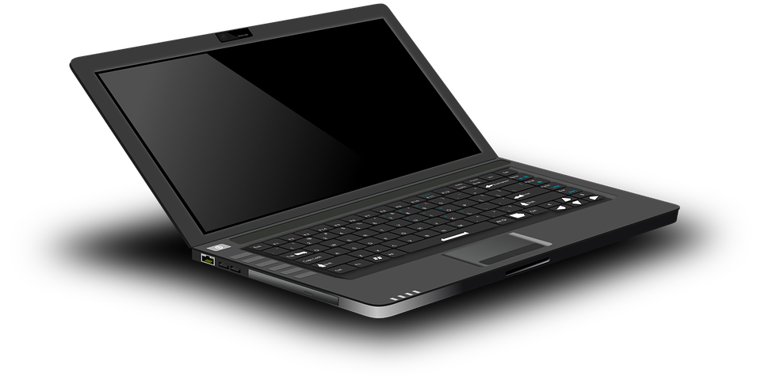
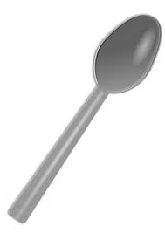


grams (g) in a kilogram (kg)
2½ kg
1000
25 g
500 g
75 kg
½ kg
1 g

Slide 5

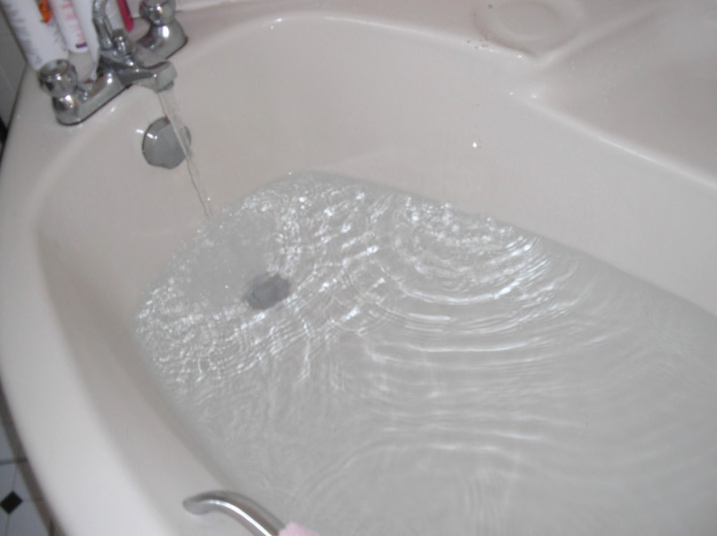
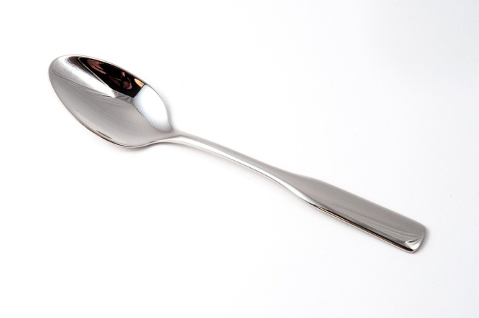
millilitres (ml) in a litre (l)
1000
500 ml
80 l
½ l
5 ml

Slide 6
1 mile = ___ kilometres
1.6

Slide 7
8 kilometres = _ miles
5

Slide 8
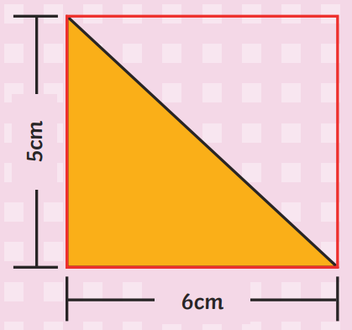
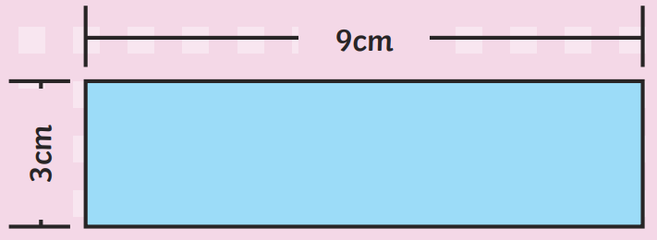
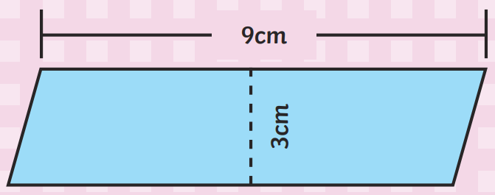
the amount of 2D space something takes up e.g. length x width = ____ of a rectangle e.g. base x height = ____ of a parallelogram e.g. base x height ÷ 2 = ____ of a triangle
area

Slide 9
the distance around the outside e.g. a rectangle with longer sides of 6 cm and shorter sides of 4 cm will have a _________ of 20 cm
perimeter
6 cm
4 cm
4 cm
6 cm

Slide 10
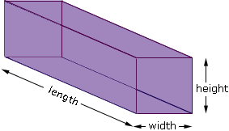
the amount of 3D space something takes up e.g. length x width x height = ______ of a cuboid
volume

Slide 11
seconds in a minute
60

Slide 12
minutes in an hour
60

Slide 13
hours in a day
24

Slide 14
September, April, June and November have __ days
30

Slide 15
January, March, May, July, August, October and December have __ days
31

Slide 16
February has 28 days or 29 in a ____ ____
leap year

Slide 17
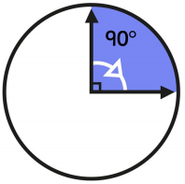
degrees in a quarter turn
90

Slide 18
degrees in a half turn
180

Slide 19
degrees in three quarters of a turn
270

Slide 20
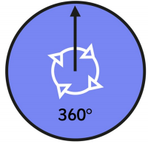
degrees in a whole turn
360

Slide 21
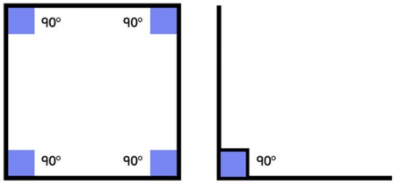
degrees in a right angle e.g. on angle diagrams, a right angle is shown with a small square
90

Slide 22
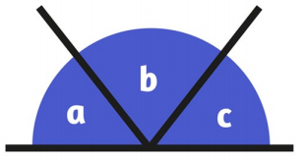
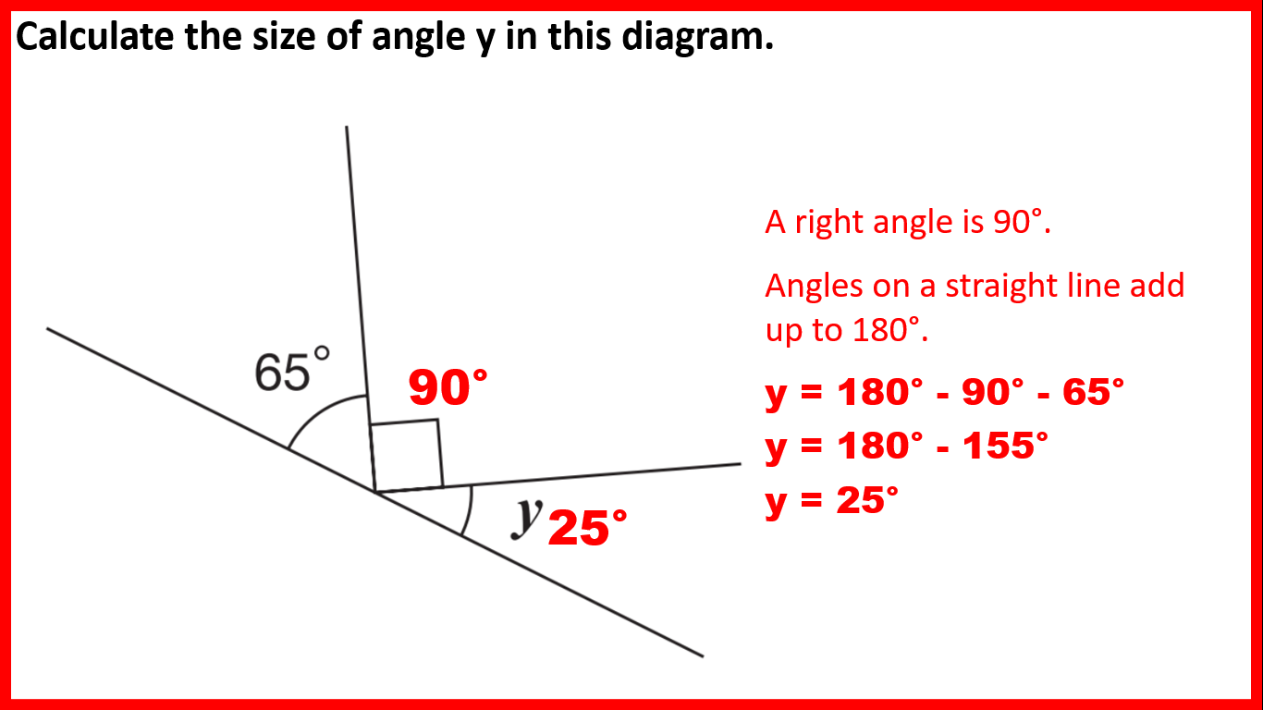
degrees on a straight line e.g. you can find an unknown angle on a straight line by subtracting the other angle(s) from ___
180

Slide 23
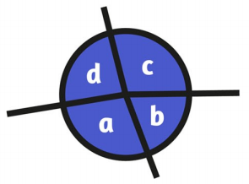
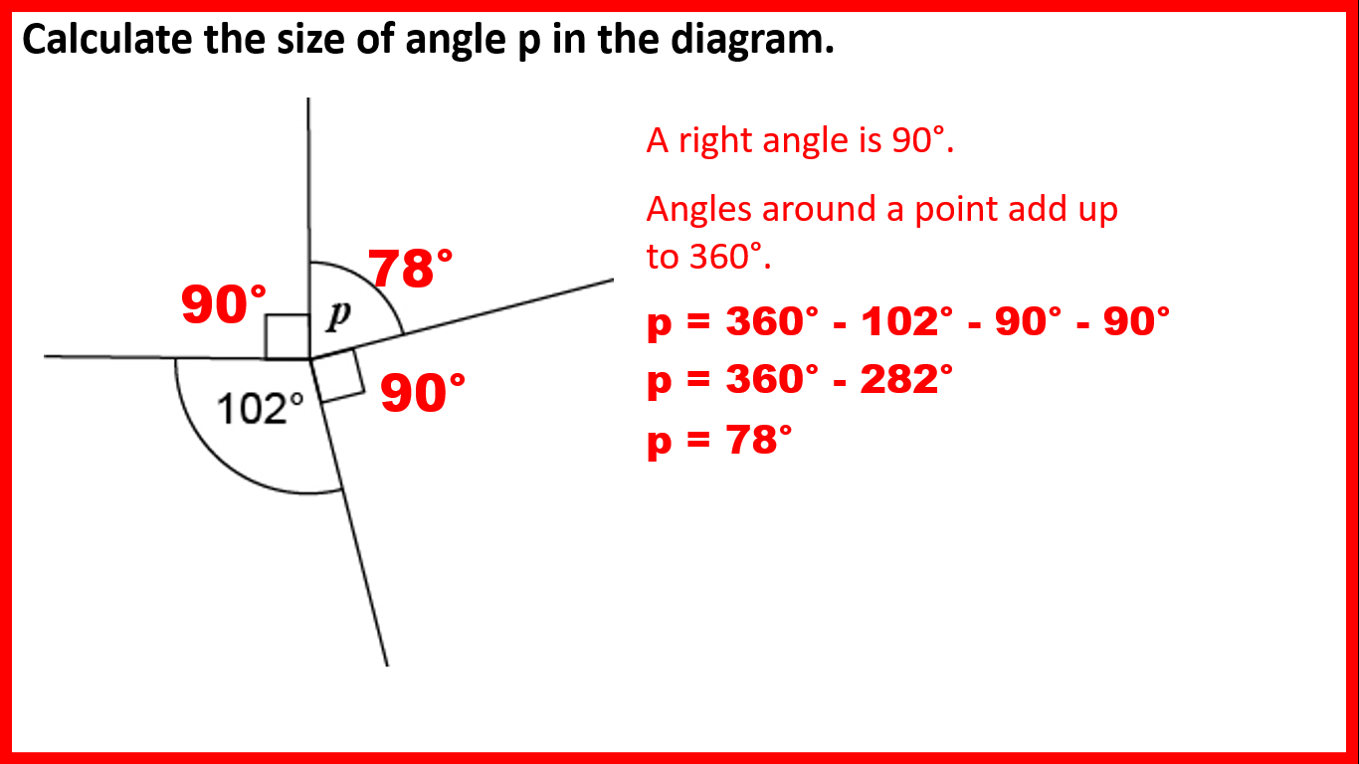
degrees around a point e.g. you can find an unknown angle on a point by subtracting the other angle(s) from ___
360

Slide 24
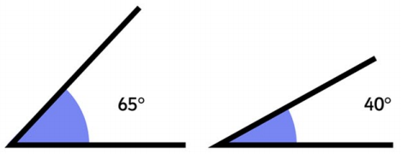
angles less than 90 degrees are _____ angles
acute

Slide 25
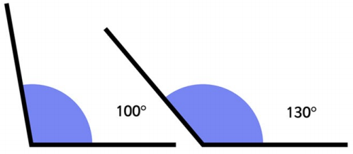
angles greater than 90 degrees but less than 180 degrees are ______ angles
obtuse

Slide 26
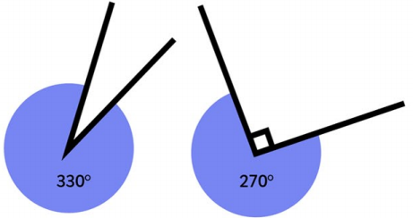
angles greater than 180 degrees are ______ angles
reflex

Slide 27
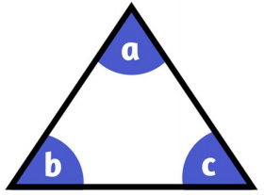
angles in a triangle total ___ degrees e.g. you can find an unknown angle in a triangle by subtracting the total of the other two angles from ___
180

Slide 28
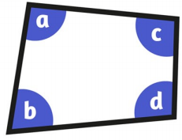
angles in a quadrilateral total ___ degrees e.g. you can find an unknown angle in a quadrilateral by subtracting the total of the other three angles from ___
360

Slide 29
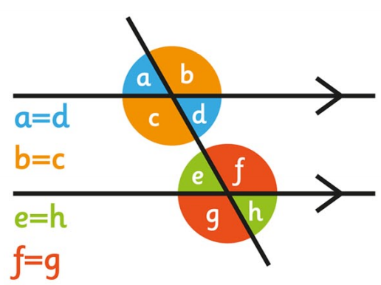
when two straight lines cross, opposite angles are _____
equal

Slide 30
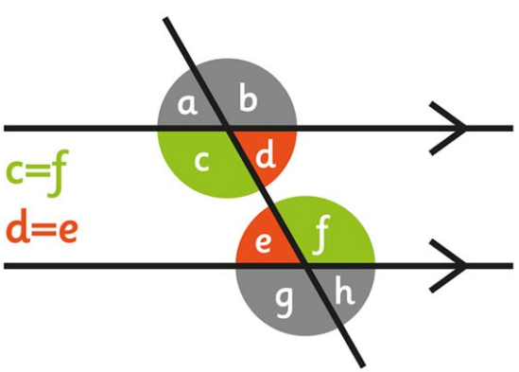
on parallel lines, alternate (Z or backwards-Z) angles are _____
equal

Slide 31
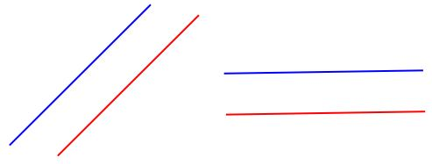
lines would never cross no matter how far we extended them (like train tracks)
parallel

Slide 32
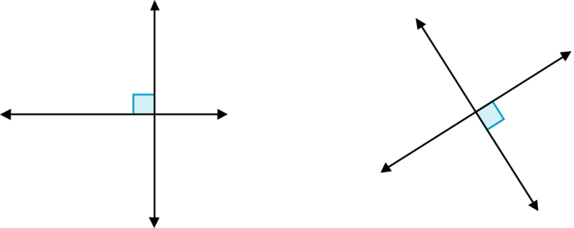
lines that cross at right angles or would cross at right angles if we extended them
perpendicular

Slide 33
a shape with four sides
quadrilateral

Slide 34
a shape with five sides
pentagon

Slide 35
a shape with six sides
hexagon

Slide 36
a shape with eight sides
octagon

Slide 37
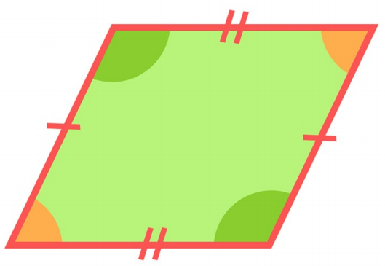
a quadrilateral which has two pairs of parallel lines is called a _____________
parallelogram

Slide 38
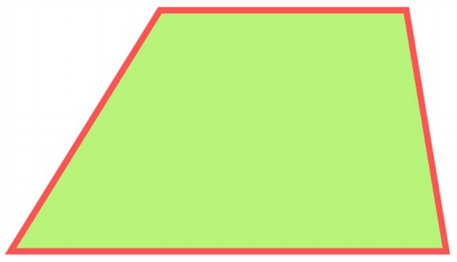
a quadrilateral which has one pair of parallel lines is called a _________
trapezium

Slide 39
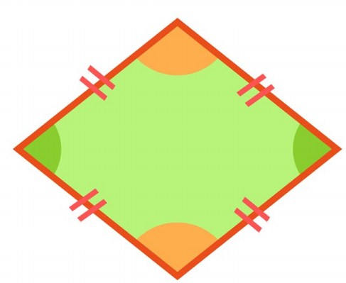
a parallelogram with sides of the same length is called a _______
rhombus

Slide 40
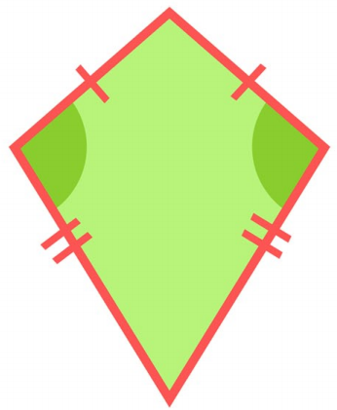
a quadrilateral with two pairs of equal sides adjacent (next) to each other is called a ____
kite

Slide 41
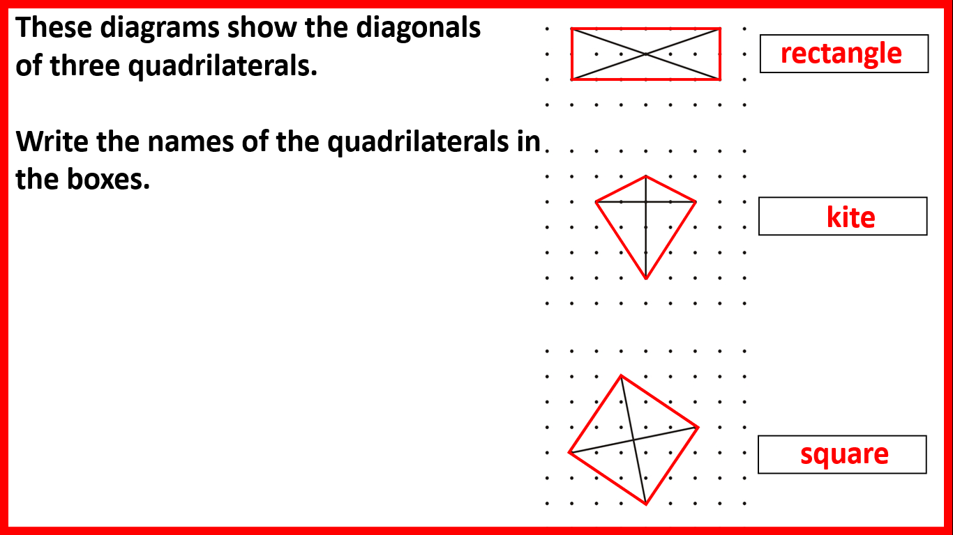
a line drawn from one vertex to the opposite vertex
diagonal

Slide 42
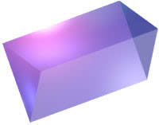
a 2D shape that has been 'stretched out' to make a 3D shape
prism

Slide 43
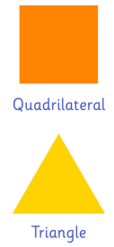

a shape with equal sides and equal angles
regular

Slide 44
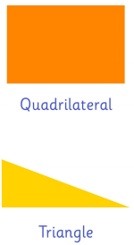

a shape which does not have equal sides and/or equal angles
irregular

Slide 45
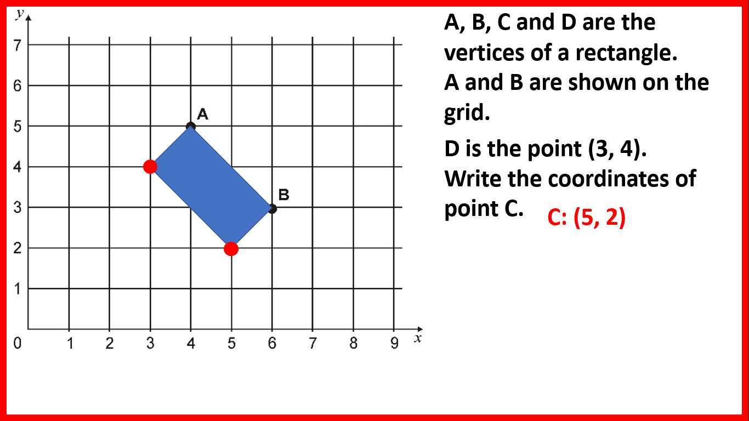
do we write the x or y coordinate first?
x

Slide 46
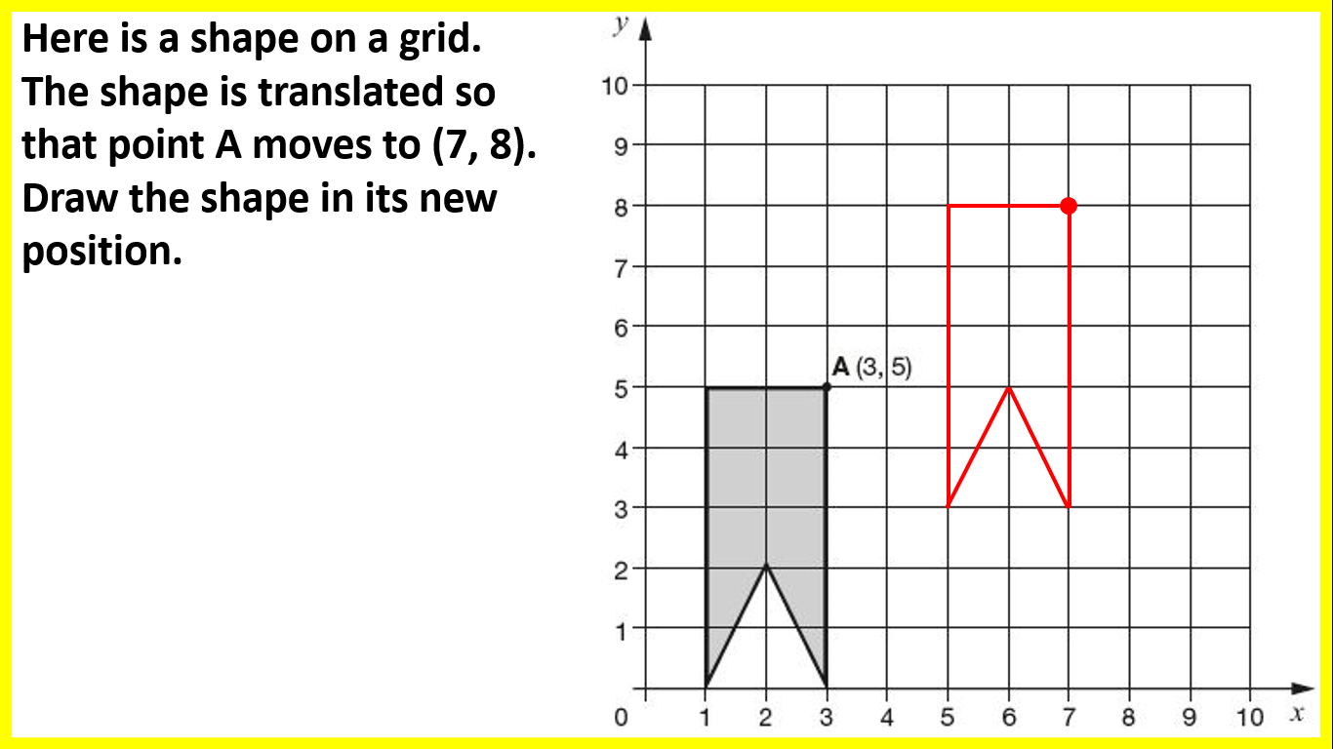
when we _________ a shape we move it to a new position (without changing its size or rotating it)
translate

Slide 47
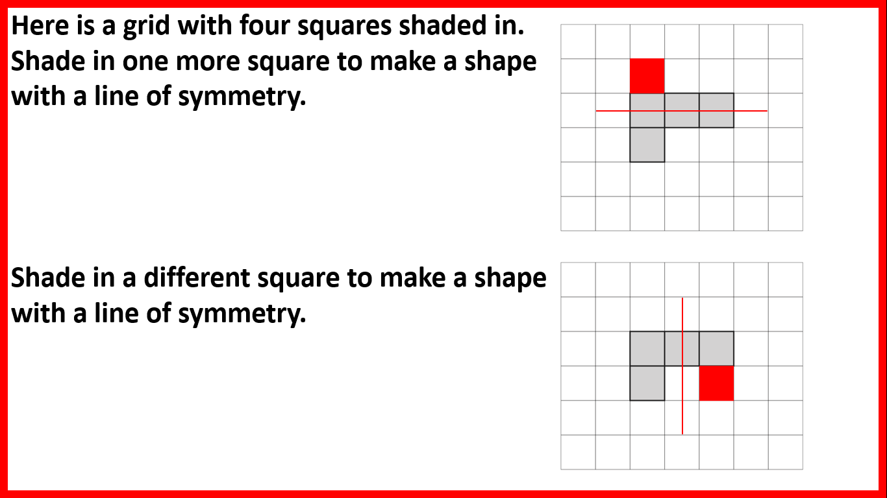
when you have the same reflected on both sides, you have ________
symmetry

Slide 48
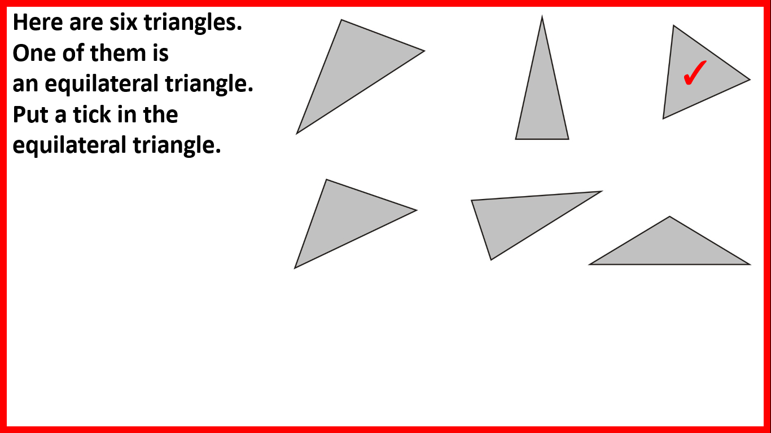
a triangle with sides of the same length and angles of the same size (60 degrees) is called an ___________ triangle
equilateral

Slide 49
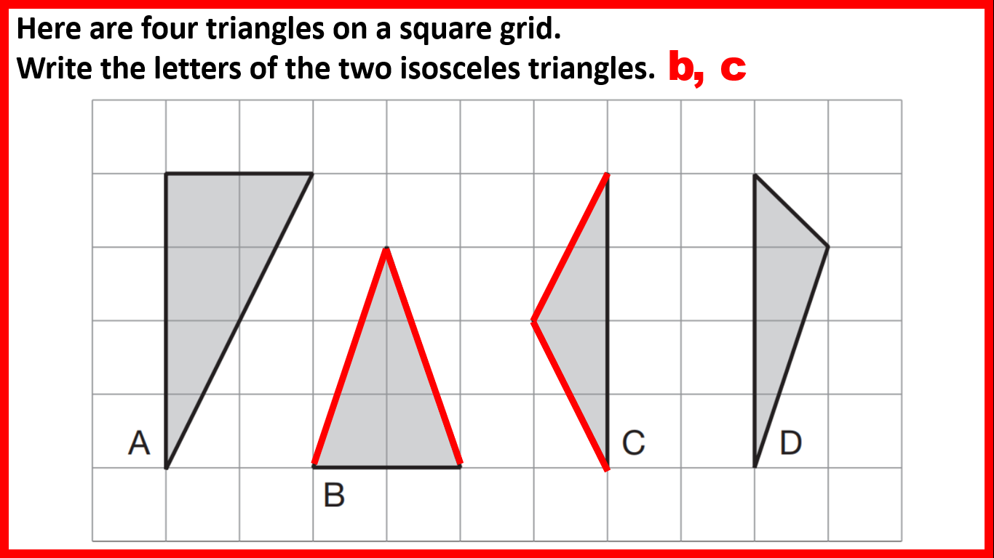
a triangle with two sides of the same length and two angles of the same size is called an _________ triangle
isosceles

Slide 50
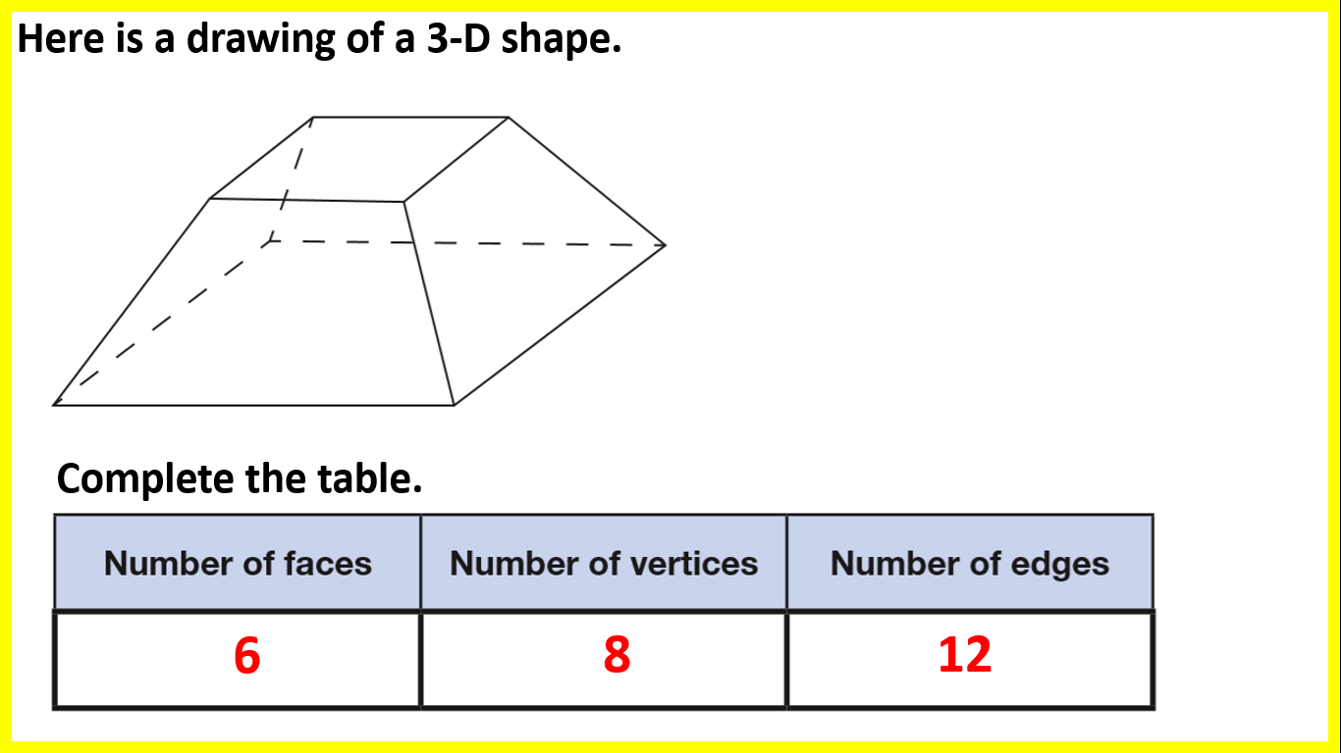
the flat surfaces of a 3D shape are called _____
faces

Slide 51
the 'lines' joining faces of a 3D shape are called _____
edges

Slide 52
the 'pointy bits' (where edges meet) of a 3D shape are called ________
vertices

Slide 53
part: part e.g. a cake is cut into 18 slices. 15 are eaten. 3 are not eaten. The _____ of eaten to uneaten slices is 15:3 e.g. a _____ of 15:3 can be simplified to 5:1
ratio

Slide 54
with algebra, 3y means 3 _____ y
multiplied by

Slide 55
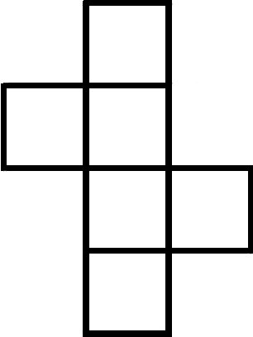
a 2D representation of the faces of a 3D shape
net

Slide 56
the perimeter of a circle
circumference
circumference

Slide 57
the length from the centre to the edge of a circle
radius
radius

Slide 58
a line connecting two points on the edge of a circle which passes through its centre
diameter
diameter

Slide 59
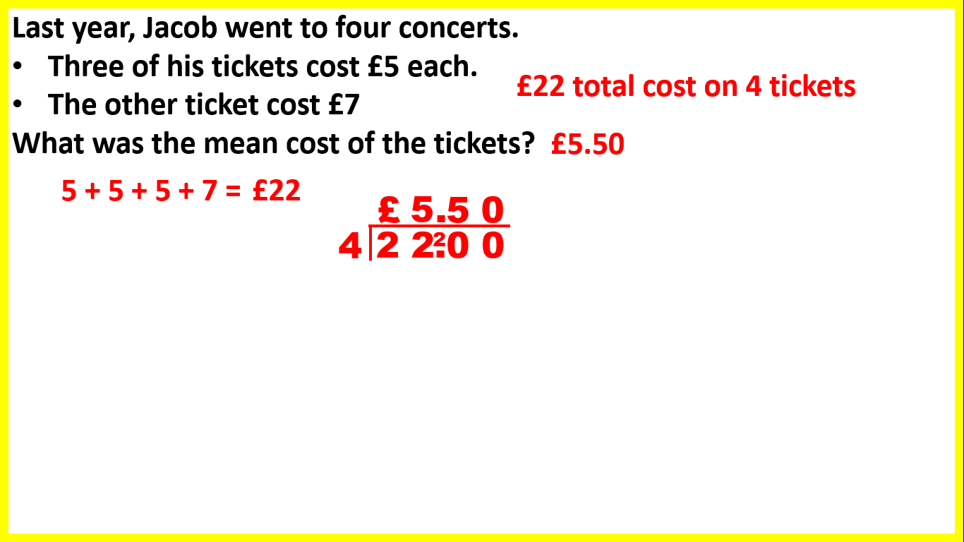
another word for average is the ____ to find the ____, you add up the numbers and divide by how many numbers there are
mean

