Slide 1
Recognise place value in two-digit numbers

Slide 2
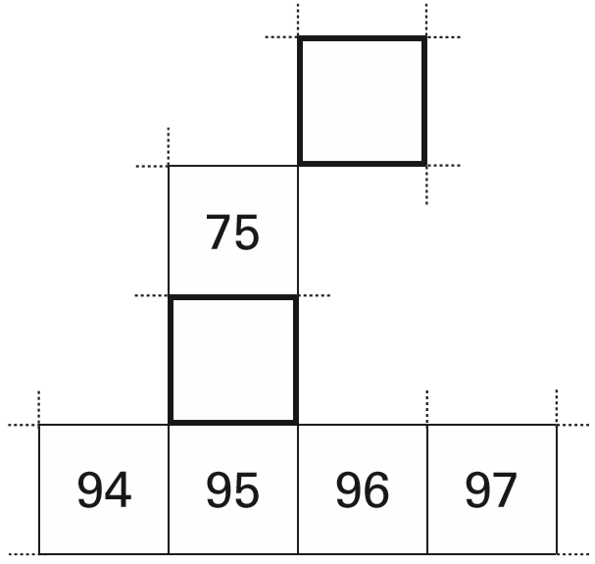
Here is part of a hundred square.
Write in the missing numbers.
65
66
76
85
86
Notes:
B1 2006 Year 4 Optional Paper 1 Q4

Slide 3
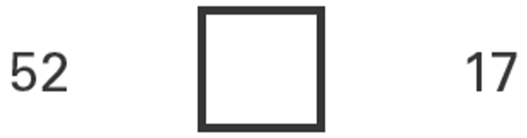
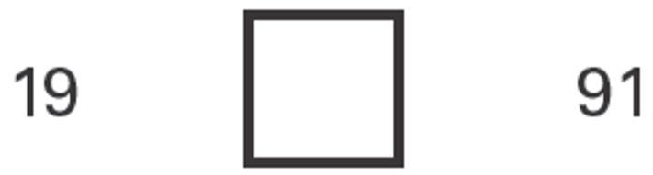
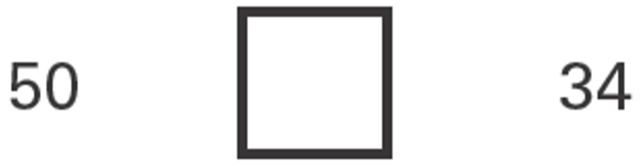
Here are two signs
< >
Use the signs to make these correct.
>
<
>
Notes:
B70 2003 Year 4 Optional Paper 1 Q18

Slide 4
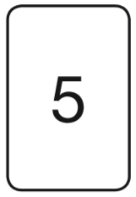
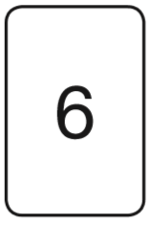
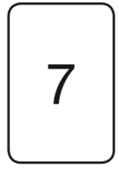
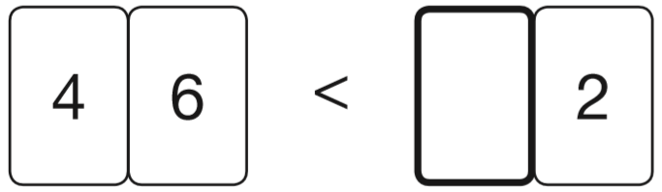
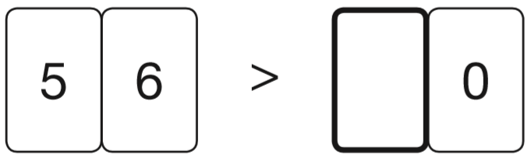
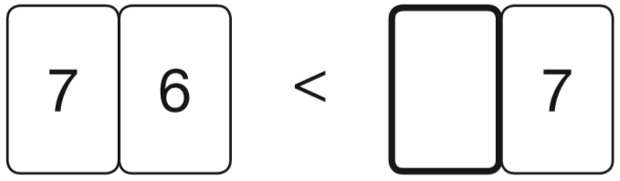
Here are three digit cards.
Use each card once to make these statements correct.
6
5
7
Notes:
B141 2013 Paper 2 Q12

Slide 5
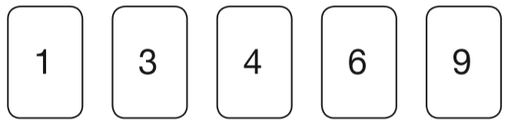
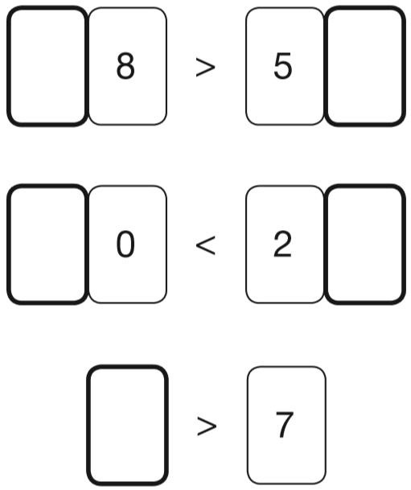
Here are five digit cards.
Use each card once to complete the statements below.
6
3
1
4
9
Notes:
B177 2008 Paper 2 Q12

Slide 6

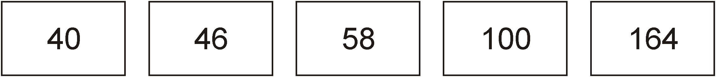
Five children estimated how many cubes were in the jar.
✓
10 less
4 less
8 more
50 more
114 more
There were exactly 50 cubes.
Tick the estimate which was the nearest.
Notes:
B228 Pre-2000 or other question

Slide 7
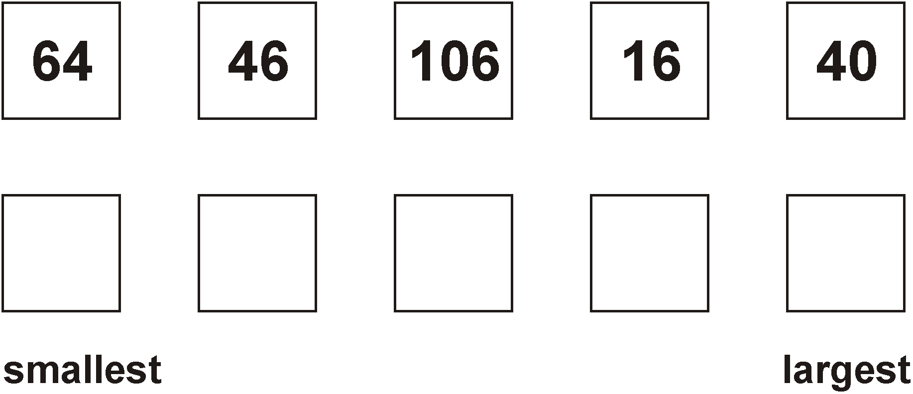
Write these numbers in order.
6 4
4 6
1 0 6
1 6
16
40
46
64
106
4 0
Notes:
B280 Pre-2000 or other question

Slide 8
Recognise place value in three-digit numbers

Slide 9
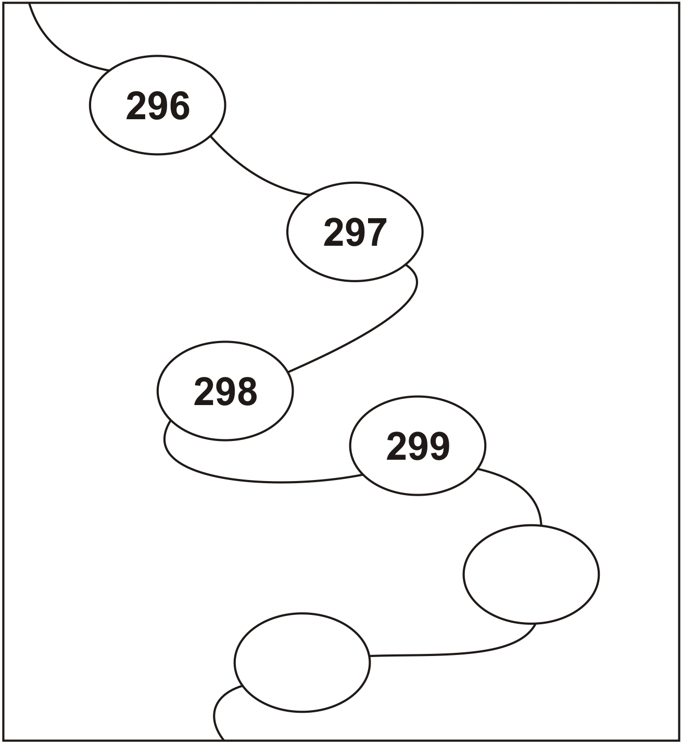
Continue this sequence.
300
301
Notes:
B12 Pre-2000 or other question

Slide 10
Look at this number.
2 6 1
Write the digit that is in the hundreds place.
Write the digit that is in the tens place.
2
6
Notes:
B77 Pre-2000 or other question

Slide 11
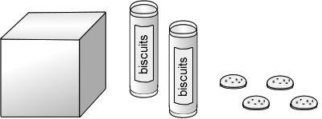
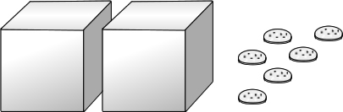
A tube holds 10 biscuits.
A box holds 100 biscuits.
This picture shows 124 biscuits.
20
= 124
100
4
How many biscuits are there in this picture?
6
= 206
200
Notes:
B113 Pre-2000 or other question

Slide 12
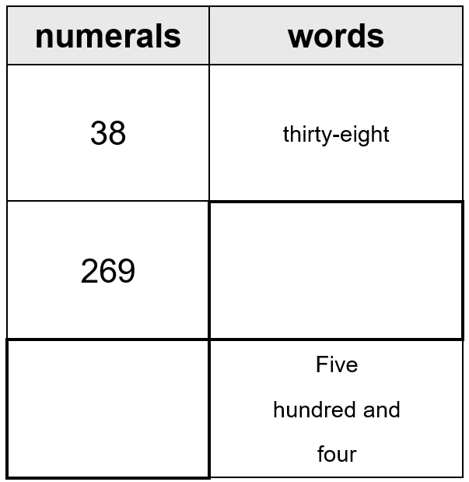
Complete the table.
Two hundred and sixty-nine
504
Notes:
B205 Pre-2000 or other question

Slide 13
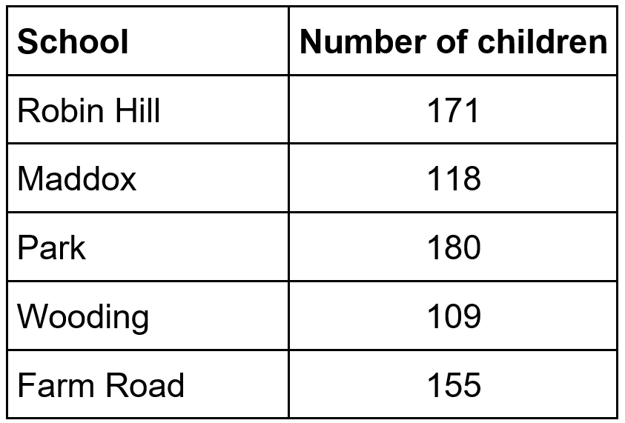
Here is a table showing the number of children at five schools.
Tick the school with the most children.
✓
Notes:
B243 Pre-2000 or other question

Slide 14
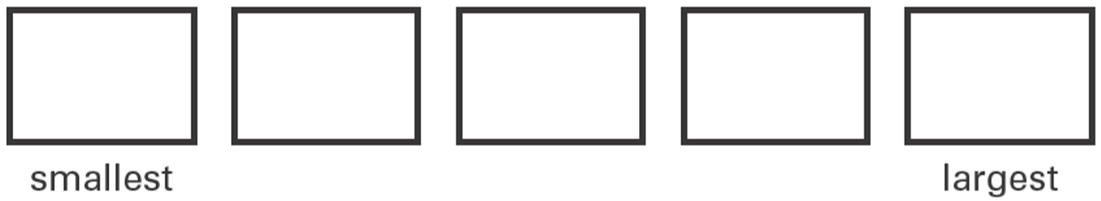
Write these numbers in order.
108 91 121 89 98
1 0 8
9 1
1 2 1
8 9
9 8
89
91
98
108
121
Notes:
B292 2006 Year 3 Optional Paper 1 Q6

Slide 15
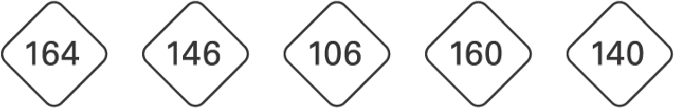
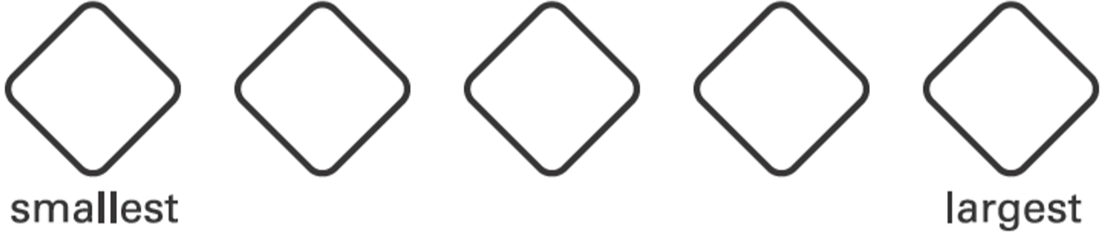
Write these numbers in order.
1 6 4
1 4 6
1 0 6
1 6 0
1 4 0
106
140
146
160
164
Notes:
B34 2003 Year 3 Optional Paper 1 Q15

Slide 16

209 565 450 405 124
Write these numbers in order in the circles.
2 0 9
5 6 5
4 5 0
4 0 5
1 2 4
565
450
405
209
124
Notes:
B154 2003 Year 4 Optional Paper 1 Q1

Slide 17
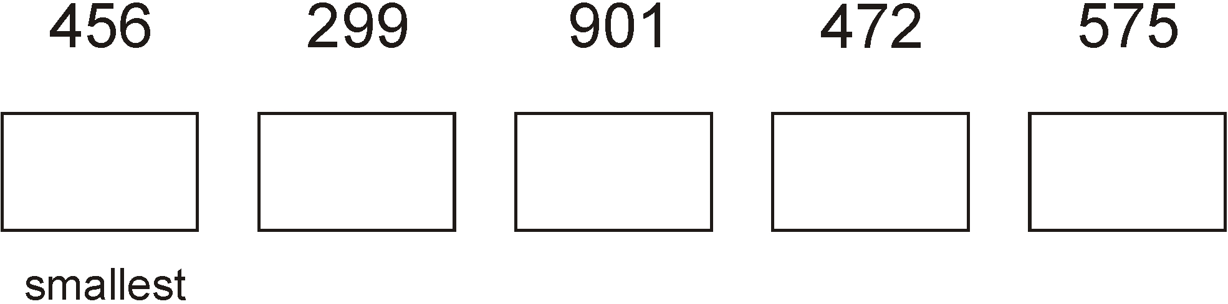
Write these numbers in order of size.
299
456
472
575
901
4 5 6
2 9 9
9 0 1
4 7 2
5 7 5
Notes:
B120 Pre-2000 or other question

Slide 18
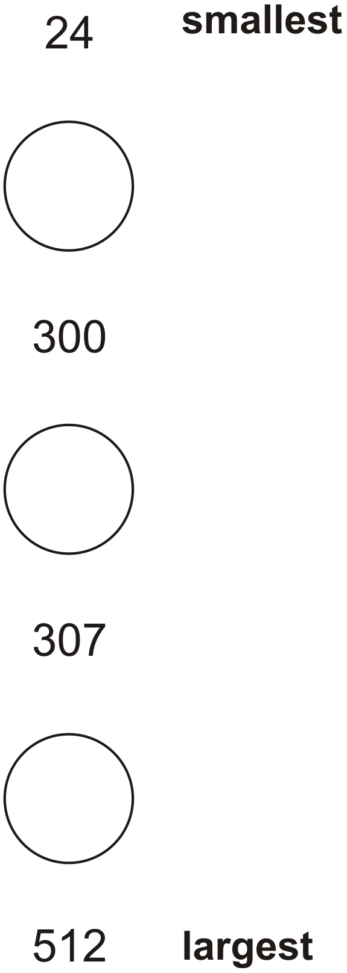
Put different numbers in the circles so that all seven numbers are in order.
25
301
308
Notes:
B202 Pre-2000 or other question

Slide 19
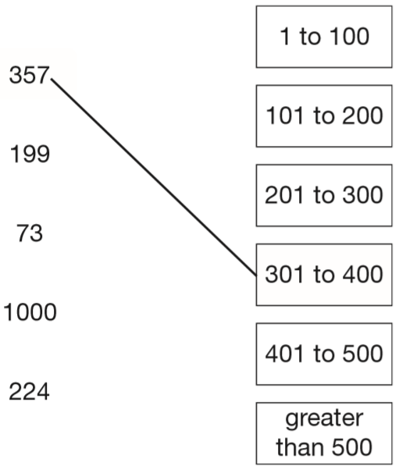
Join each number to the set of numbers that it belongs to.
One has been done for you.
Notes:
B226 2008 Paper 2 Q1

Slide 20
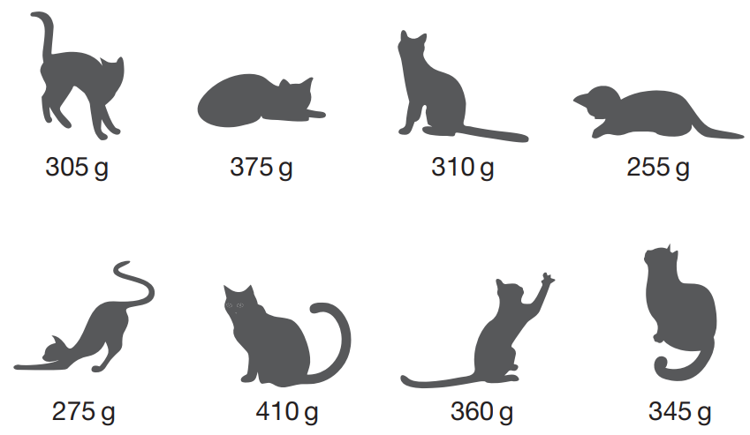
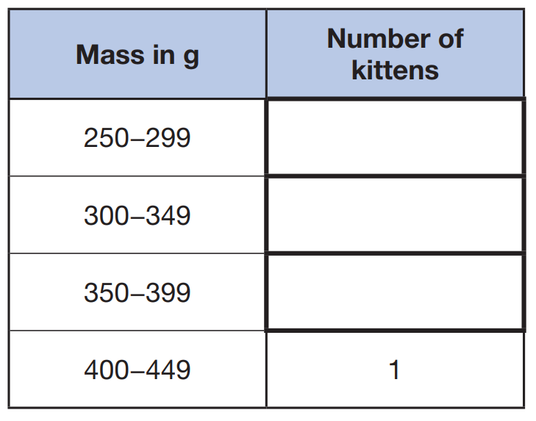
This picture shows the masses of eight kittens.
The masses of the kittens are to be put in four groups.
Write the missing numbers in the table. One has been done for you.
✘
✘
✘
✘
2
3
2
✘
✘
✘
Notes:
2019 Paper 3 Q7 page 2

Slide 21
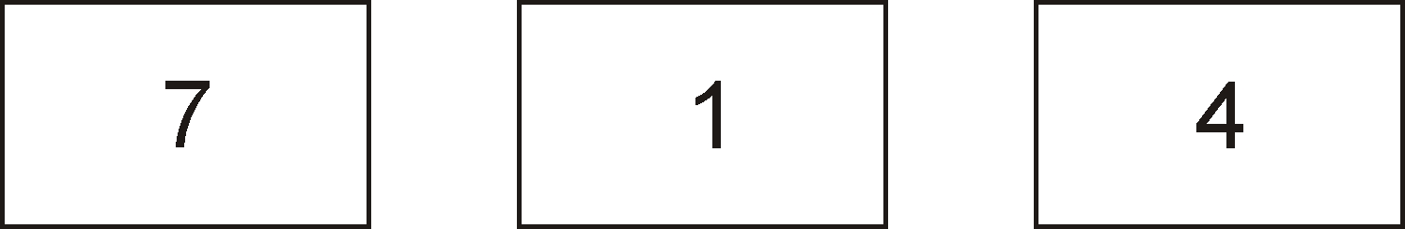

Use all of these digits.
Write the lowest number.
1
4
7
Notes:
B48 Pre-2000 or other question

Slide 22


Look at these digit cards.
Use the cards to make the largest 3-digit number possible.
9
7
3
Use the cards to make the smallest 3-digit number possible.
3
7
9
Notes:
B60 Pre-2000 or other question

Slide 23
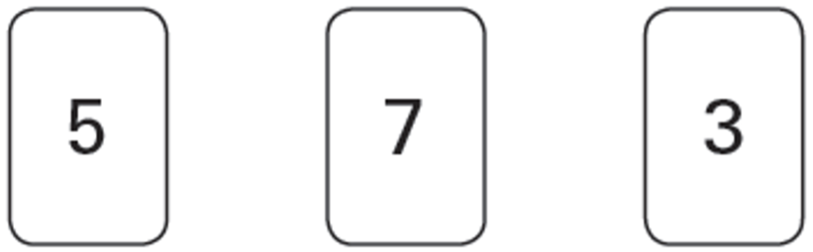

Here are three digit cards.
Use the cards to make the number nearest to 400
3
7
5
Notes:
B139 2006 Year 4 Optional Paper 1 Q9

Slide 24
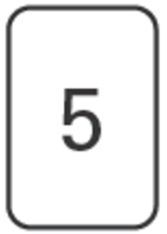
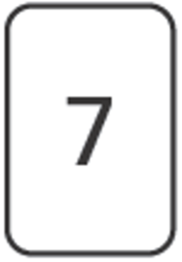
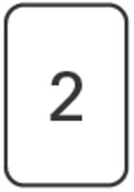
Katie has these digit cards.
She makes different 2-digit numbers with them.
Write all the 2-digit numbers Katie can make with them.
57
75
27
52
72
25
Notes:
B178 2003 Year 3 Optional Paper 1 Q25

Slide 25
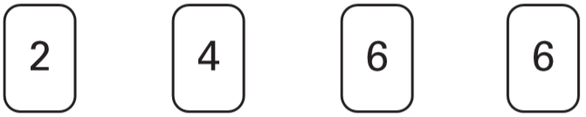
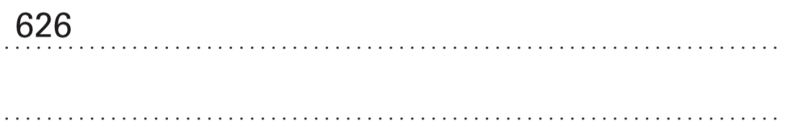
Here are some digit cards.
Write all the three-digit numbers, greater than 500, that can be made using these cards. One has been done for you.
664
662
646
642
624
Notes:
B220 2005 Paper 1 Q9

Slide 26
Round to the nearest 10 or 100

Slide 27
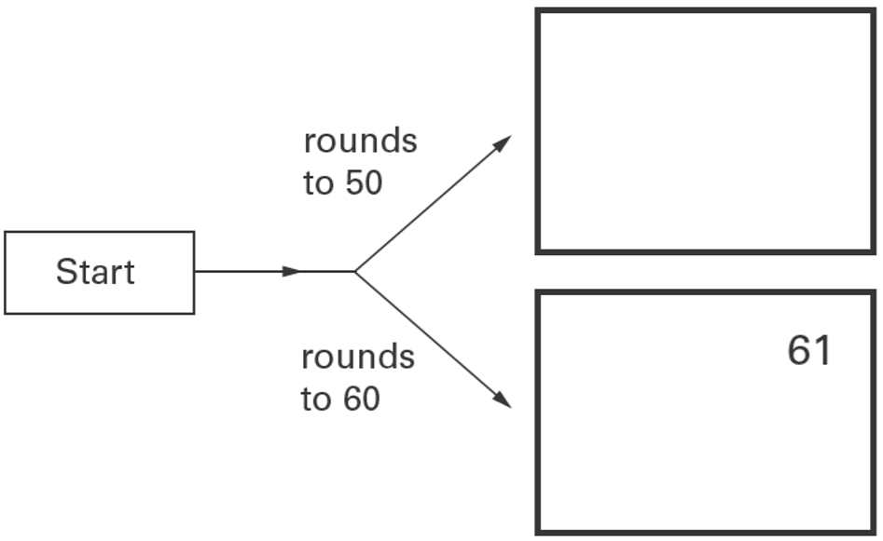
Here is a diagram for rounding numbers to the nearest 10
Write these numbers in the correct boxes.
One has been done for you.
6 1 4 8 5 9 5 2
48
52
59
Notes:
B285 2006 Year 3 Optional Paper 1 Q9

Slide 28
Two of these numbers round to 80
Circle the two numbers.
7 4 8 2 7 7 8 5
Notes:
B38 2003 Year 3 Optional Paper 1 Q9

Slide 29
Which of these numbers give 80 when rounded to the nearest 10?
Circle all the correct numbers.
8 4 8 7 7 2 7 6 9 0
Notes:
B76 2003 Paper 1 Q4

Slide 30
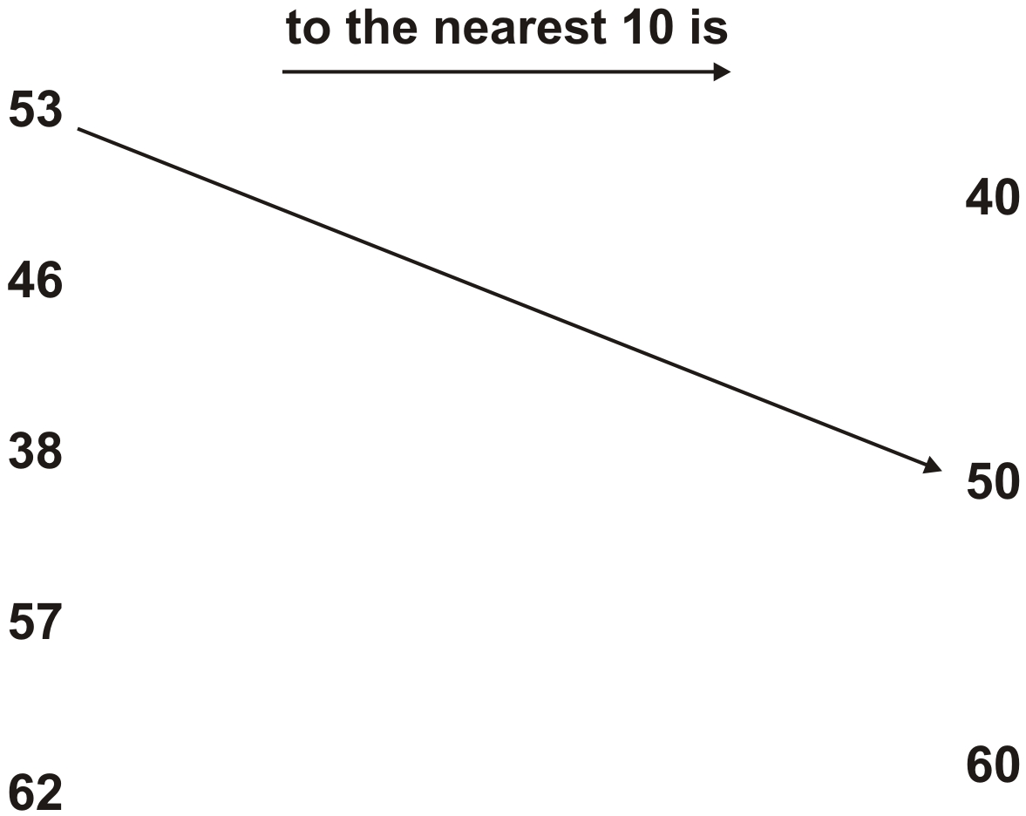
Round each number to its nearest 10
Draw arrows.
Notes:
B145 Pre-2000 or other question

Slide 31
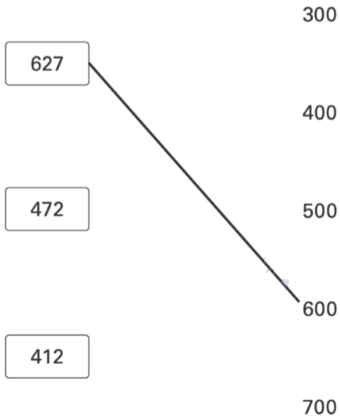
Round each number in a box to the nearest 100
4 7 2
4 1 2
Notes:
B198 2003 Year 3 Optional Paper 2 Q17

Slide 32
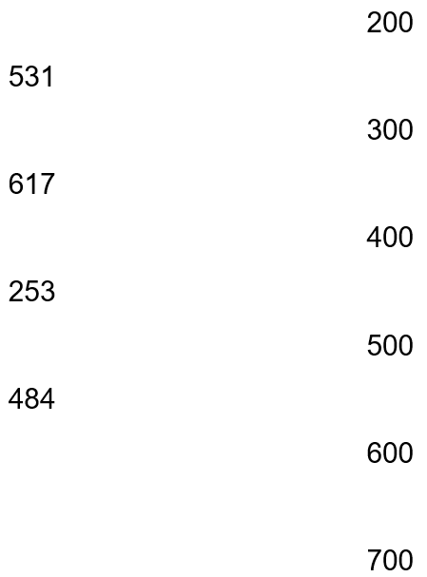
Draw a line to match each of the four numbers to the nearest hundred.
Notes:
B214 Pre-2000 or other question

Slide 33
Use the inverse to find missing numbers in addition and subtraction problems

Slide 34
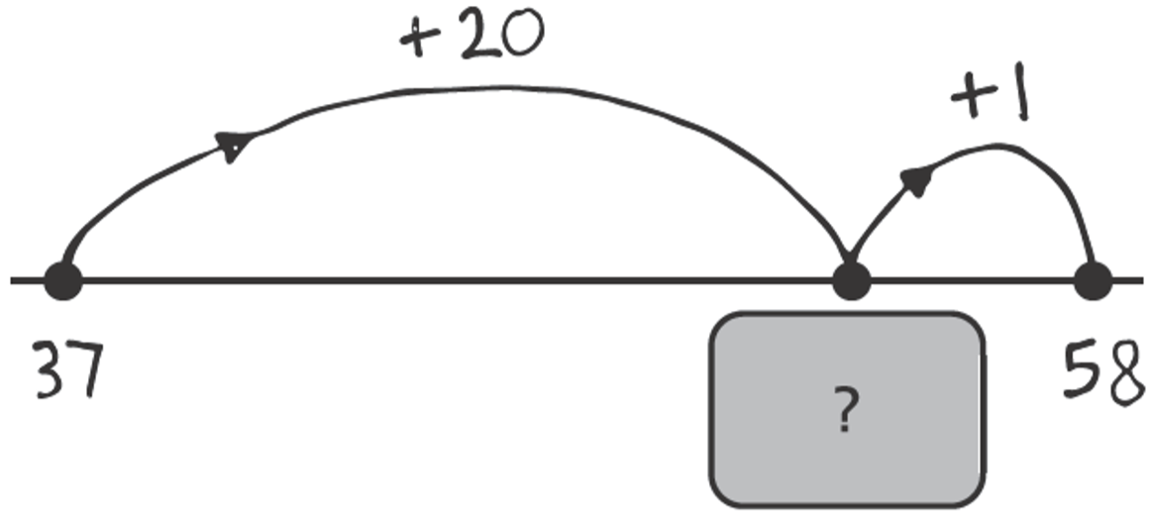
Katie draws a number line to help her find the answer to 37 + 21
What number is hidden under the card?
57
57
5 7
3 7 + 2 0 =
Notes:
B266 2003 Year 3 Optional Paper 1 Q7

Slide 35
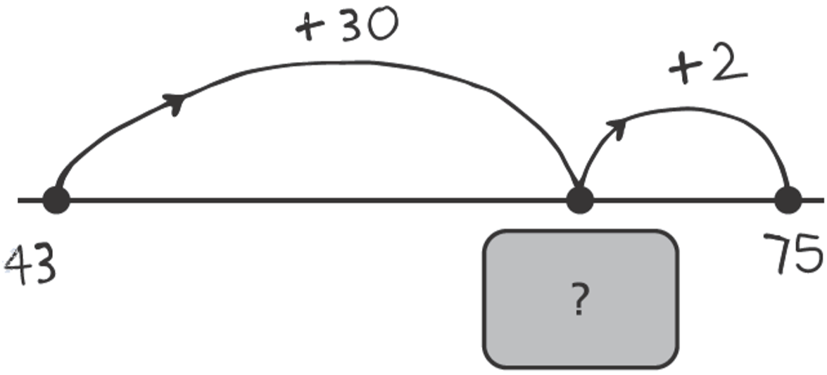
Molly drew a number line to find the answer to 43 + 32
What number is hidden under the card?
73
73
4 3 + 3 0 =
7 3
Notes:
B5 2003 Year 4 Optional Paper 1 Q8

Slide 36
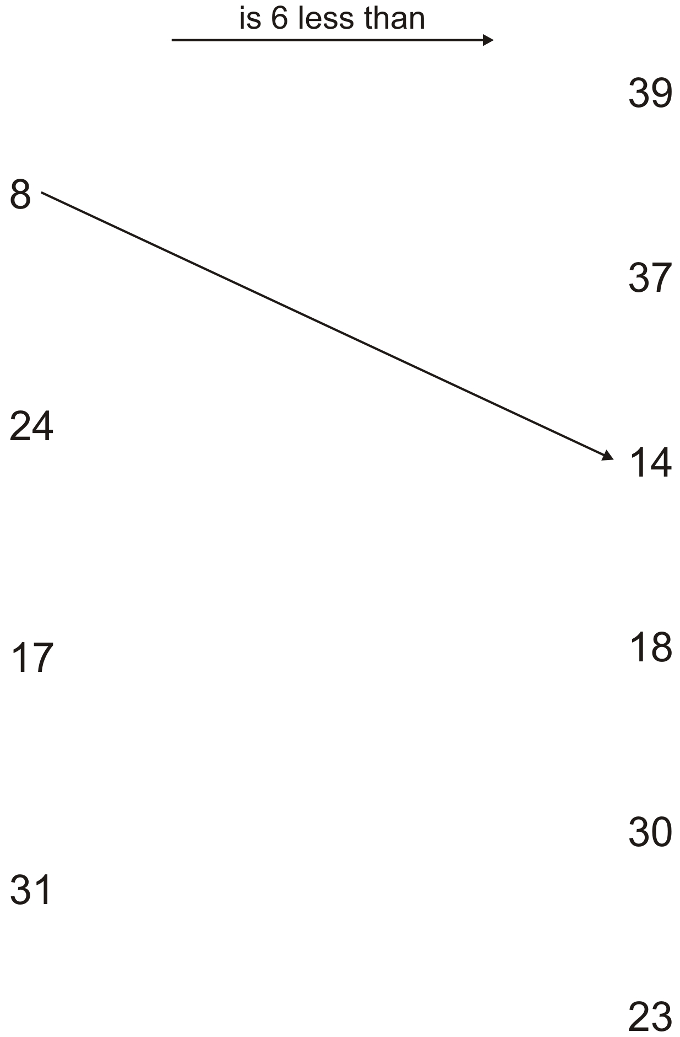
Draw arrows.
8 + 6 =
14
24 + 6 =
30
17 + 6 =
23
31 + 6 =
37
Notes:
B58 Pre-2000 or other question

Slide 37
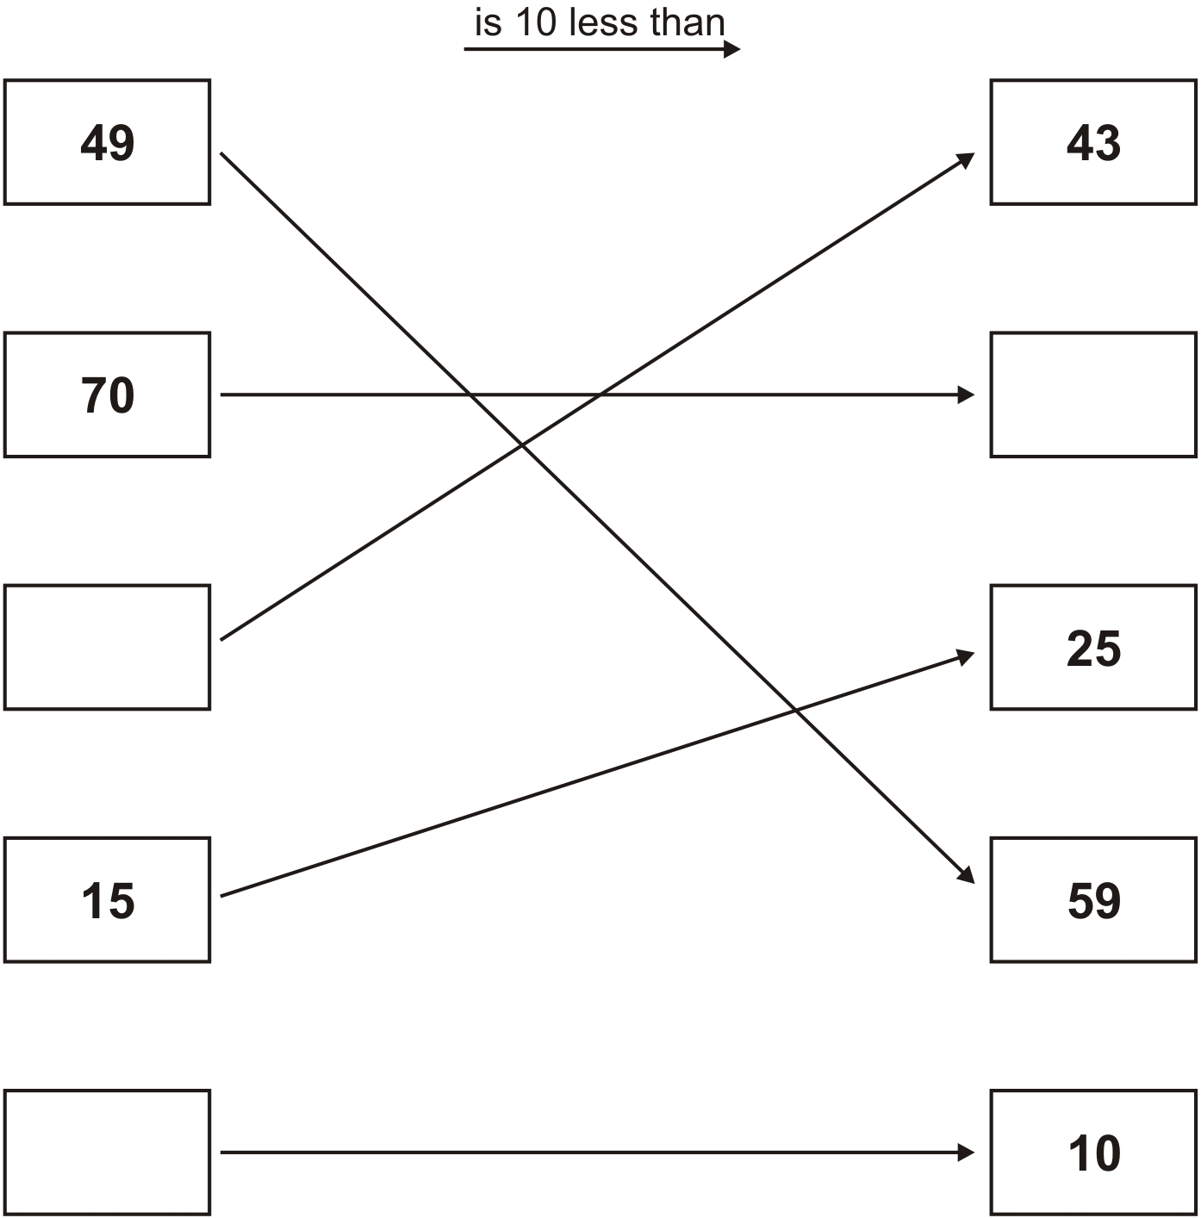
Write the correct numbers in the 3 empty boxes.
49 + 10 =
59
43 – 10 =
33
70 + 10 =
80
80
33 + 10 =
43
33
15 + 10 =
25
0 + 10 =
10
0
10 – 10 =
0
Notes:
B108 Pre-2000 or other question

Slide 38
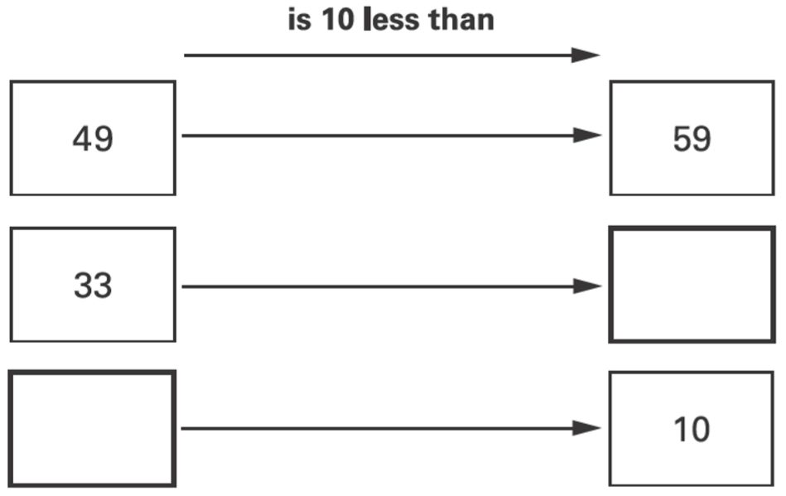
Write the missing numbers in the two empty boxes.
49 + 10 = 59
33 + 10 =
43
__ + 10 = 10
0
Notes:
B170 2003 Year 3 Optional Paper 1 Q10

Slide 39
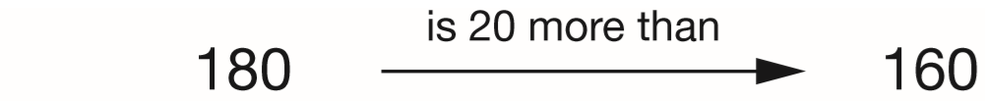
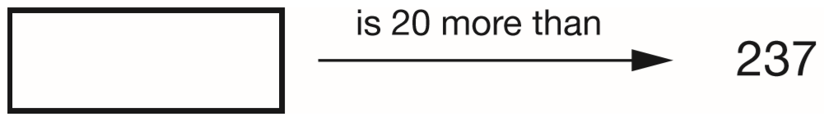
Write the missing number.
One is done for you.
257
237 + 20 =
257
Notes:
2015 (Sample) Paper 2 Q1

Slide 40
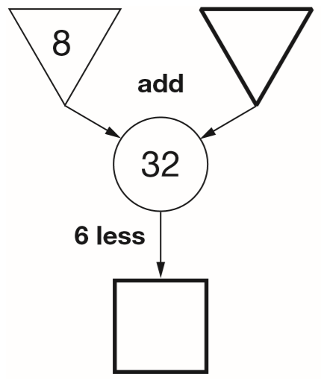
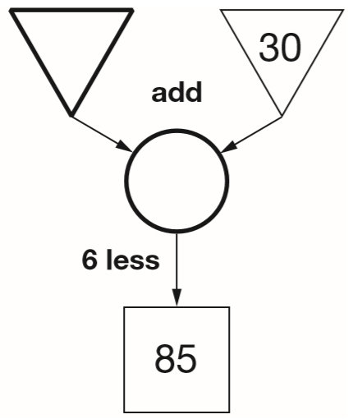
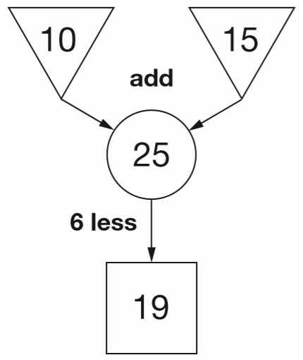
In this diagram, the numbers in the triangles add together to make the number in the circle.
The number in the square is 6 less than the number in the circle.
Write the four missing numbers in these diagrams.
24
61
32 – 8 =
91 – 30 =
91
85 + 6 =
32 – 6 =
26
Notes:
B275 2015 Paper 1 Q6

Slide 41
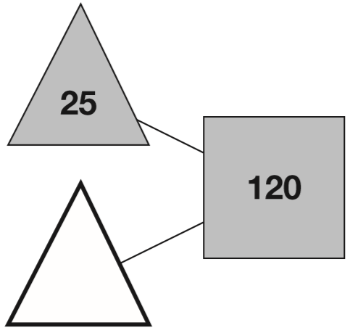
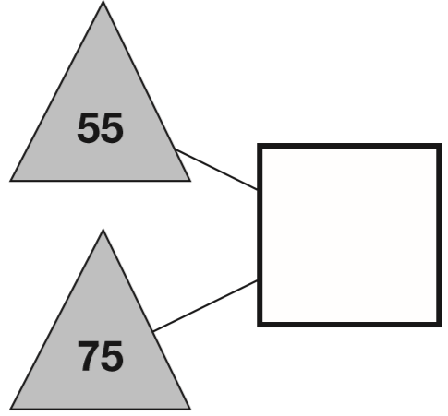

The numbers in the two triangles add up to the number in the square.
Using the same rule, write in the missing numbers.
130
95
0
1
1
1 2 0
1
1
5 5
-
2 5
+
7 5
0
9
5
1 3
0
Notes:
B2 2013 Paper 1 Q1

Slide 42


Stefan completes this calculation.
Write an addition calculation he could use to check his answer.
2 8
6 7
9 5
Notes:
2018 Paper 2 Q2

Slide 43
Find missing numbers in the addition or subtraction of multiple numbers

Slide 44

Write in the missing number.
11
89
0
9
1 0 0
1
1
-
1 1
0
8
9
Notes:
B125 2015 Paper 2 Q1

Slide 45

Write in the missing number.
310
4
1 2 0
5 0 0
1
+
7 0
-
1 9 0
1
9
0
3
1
0
Notes:
B212 2003 Year 3 Optional Paper 1 Q29

Slide 46

Write in the missing number.
120
1 0 0 + 2 = 1 0 2
2 2 2
-
1 0 2
1
2
0
Notes:
B252 2006 Year 3 Optional Paper 2 Q17

Slide 47

Write in the missing numbers.
160
120
2
3 5 0
1 6 0
1
-
1 9 0
-
4 0
1
6
0
1
2
0
Notes:
B302 Pre-2000 or other question

Slide 48

Write the missing number.
150
40
Notes:
B41 Pre-2000 or other question

Slide 49

Write in the missing number.
181
159
3
1
2
9 9
3 4 0
1
+
6 0
-
1 5 9
1 5
9
1
8
1
Notes:
B89 2000 Paper 2 Q4

Slide 50

Write the missing number.
100
20
1
5 5
+
4 5
1 0
0
Notes:
B124 Pre-2000 or other question

Slide 51
Complete simple addition and subtraction sequences with missing numbers

Slide 52

Write in the missing numbers.
37
27
-3
-2
-3
-2
37
40
42
27
30
32
Notes:
B167 2006 Year 3 Optional Paper 1 Q11

Slide 53

Write the two missing numbers in this sequence.
100
65
-5
-2
93 + 7 =
100
65
70
72
Notes:
B254 2003 Year 3 Optional Paper 1 Q19

Slide 54

Here is part of a number line.
Write in the missing numbers.
20
38
29 – 9 =
20
+1
+8
29 + 10 =
39
29
30
38
39 – 1 =
38
Notes:
B281 2006 Year 4 Optional Paper 1 Q3

Slide 55

Write the missing numbers in the sequence.
16
40
64
+8
+8
+8
+8
+8
+8
-4
-4
+4
+4
16
20
24
56
60
64
Notes:
B10 Pre-2000 or other question

Slide 56

The numbers in this sequence increase by the same amount each time. Write the missing numbers.
35
56
70
+7
+7
+7
+7
+7
42 – 7 =
35
Notes:
2018 Paper 3 Q1

Slide 57

Complete this sequence.
+4
15
+4
+4
31
Notes:
B161 Pre-2000 or other question

Slide 58

Continue the number sequence in both directions.
25
28
31
43
46
49
+3
+3
Notes:
B175 Pre-2000 or other question

Slide 59

Complete the table.
880
980
990
Notes:
B236 Pre-2000 or other question

Slide 60

Write the missing numbers in the sequence.
794
+10
+10
+10
+10
+10
844
8 0 4 – 1 0 =
7 9 4
Notes:
B282 Pre-2000 or other question

Slide 61

Write the missing number in the sequence.
250
450
Notes:
B42 Pre-2000 or other question

Slide 62

The numbers in this sequence increase by 14 each time.
Write the missing numbers.
68
110
152
7
1
1
8 2
9 6
1 3 8
1
–
1 4
+
1 4
+
1 4
6
8
1 1
0
1
5
2
Notes:
2016 Paper 3 Q1

Slide 63

The numbers in this sequence increase by 45 each time.
Write the missing numbers.
110
290
335
+ 45
+ 45
+ 45
+ 45
+ 45
1
1
1 5 5
2 4 5
2 9 0
-
4 5
+
4 5
+
4 5
1
1
0
2
9
0
3
3
5
Notes:
2019 Paper 2 Q5

Slide 64

The numbers in this sequence increase by the same amount each time.
Write the two missing numbers.
570
+40
+40
+40
+40
730
5
1
6 1 0
6 9 0
1
-
4 0
+
4 0
5
7
0
7
3
0
Notes:
B189 2014 Paper 1 Q2

Slide 65
Use number cards to write correct addition and subtraction calculations

Slide 66



Use only these numbers.
Write numbers in the boxes to make these correct.
Numbers can be used more than once.
12 + 8 = 20
12 + 4 = 16
8 + 8 = 16
8 + 4 = 12
16
4
20
20 – 8 = 12
20 – 12 = 8
16 – 4 = 12
16 – 12 = 4
16 – 8 = 8
12 – 4 = 8
12 – 8 = 4
20
4
16
Notes:
B246 Pre-2000 or other question

Slide 67

Use any of these numbers.
12 3 9 18 6
Write one number in each box to make a correct sum.
18
12
6
12 = 9 + 3
9 = 6 + 3
Notes:
B263 Pre-2000 or other question

Slide 68

The four sums below can be completed using only the numbers 1 to 8
Use each number once to complete the sums.
One sum has been done for you.
8
2
7
3
8
1
7
4
2
Notes:
B13 2011 Paper 1 Q8

Slide 69


Here are six number cards.
Use all the number cards to complete the two sums below.
30
20
40
10
50
30
10
40
Notes:
B69 2011 Paper 2 Q2

Slide 70


Here are six digit cards.
Use four of the cards to make this addition correct.
2
6
1
4
Notes:
B110 2013 Paper 2 Q3

Slide 71


Here are four digit cards.
Use all four digit cards to make this sum correct.
7
6
2
4
Notes:
B166 2009 Paper 1 Q2

Slide 72


Here are four digit cards.
Use three of them to make this correct.
47 + 3 =
50
5
3
6
47 + 4 =
51
47 + 5 =
52
47 + 6 =
53
Notes:
B229 2006 Year 5 Optional Paper 2 Q2

Slide 73



Here are three digits.
Use all the digits 6, 1 and 3 to write a number that is between 100 and 140
1
3
6
Use all the digits 6, 1 and 3 to complete this subtraction.
3
1
6
25 + 1 =
26
25 + 3 =
28
25 + 6 =
31
Notes:
B270 Pre-2000 or other question

Slide 74

Circle two numbers which add up to 150
0
4
0
4
1
1
1 5 0
1 5 0
1
1
-
6 3
-
7 3
0
8
7
0
7
7
Notes:
B17 Pre-2000 or other question

Slide 75


Here are five number cards.
Use all five cards to make an addition that has the answer 500
1
1
4
5
8
4
2
Notes:
B61 Pre-2000 or other question

Slide 76
Find missing digits in addition and subtraction calculations

Slide 77

Write in the missing digits.
9
4
9
7
4
–
5
4
3
Notes:
B79 2003 Year 3 Optional Paper 2 Q18

Slide 78

Write the two missing digits.
6
7
5
5
6
1
6 1
1
1
7
–
2
–
2 7
3
4
3
4
Notes:
B208 2015 Paper 1 Q15

Slide 79

The sum of two numbers is 100
Write in the missing digits.
7
6
1
6 3
+
3 7
1 0
0
Notes:
B250 2007 Paper 2 Q3

Slide 80

Write in the missing digits.
5
6
1
6 5
+
3 5
1 0
0
Notes:
B303 2003 Year 3 Optional Paper 1 Q12

Slide 81

Write in the missing digits.
4
6
1
5 6
+
4 4
1 0
0
Notes:
B9 2006 Year 3 Optional Paper 1 Q23

Slide 82


Write in the missing digits.
3
3
1
1
1
1
3
1 3 7
1
7
+
6
+
6 3
3
2 0 0
2
0
0
3
3
Notes:
B78 2003 Year 4 Optional Paper 1 Q27

Slide 83

Write the missing digits to make this addition correct.
1
8
7
1
1
8
1
2
+
7
2
2 0 0
Notes:
2019 Paper 3 Q5

Slide 84

Write two numbers, each greater than 100, to complete this subtraction.
0
8
0
0
4
0
9
2
0
1
3
1
2 0 8
+
1 0 1
3
0
9
Notes:
B174 2000 Paper 2 Q7

Slide 85

Write the three missing digits to make this addition correct.
1
1
6
6
Notes:
2016 Paper 2 Q3

Slide 86

Write in the missing digits.
1
1
5
7
Notes:
B267 Pre-2000 or other question

Slide 87
Write what the two missing digits could be.
5
1
3
3
4
2
1
5
6 2
3
4
+
1
9 5
3
2
7 5 7
Notes:
B57 Pre-2000 or other question

Slide 88

Write in the missing digits.
2
9
5 9 3
-
2 0
2
9
3 1
Notes:
B66 Pre-2000 or other question

Slide 89
Complete puzzles involving addition and subtraction

Slide 90

Draw lines to join the circle to two more number cards which make 150
160
80 + 60 = 140
5 + 5 = 10
140 + 10 = 150
140
Notes:
B112 2002 Paper 1 Q1

Slide 91

Draw a line to join two other numbers which have a total of 700
1
1
4 7 5
+
2 2 5
7
0
0
Notes:
B204 2000 Paper 2 Q1

Slide 92

In this block, the pairs of numbers joined together have a difference of 7
Join one more pair of numbers which has a difference of 7
14 – 7 = 7
15 – 8 = 7
Notes:
B227 Pre-2000 or other question

Slide 93

Draw lines to join all the pairs of number cards which have a difference of 30
One has been done for you.
Notes:
B307 2005 Paper 1 Q1

Slide 94


Here are four number cards.
Jade picks the two cards which have a difference of 22
Which cards does she pick?
6 7
–
4 5
67
45
2
2
+13
+10
+12
32
45
55
67
Notes:
B16 2006 Year 4 Optional Paper 1 Q26

Slide 95


Here are five number discs.
Look at the cross pattern.
Use each disc once so that the total across is the same as the total down.
One has been done for you.
7
11
1
3
13
9
17
15
13
Notes:
B75 2013 Paper 2 Q14

Slide 96

Complete this diagram so that the three numbers in each line add up to 150
20
9 + 4 + 2 = 15
30
70
3 + 7 + 5 = 15
6 + 2 + 7 = 15
4 + 3 + 8 = 15
Notes:
B129 2006 Paper 1 Q5

Slide 97

Each side of this square must add up to 80
Write in the missing numbers.
10
30
Notes:
B186 Pre-2000 or other question

Slide 98

This is a number triangle with some numbers missing.
The numbers along each edge must add up to 90
Put all the numbers 20, 30, 50 and 60 in the circles to make the totals correct.
60
50
20
30
Notes:
B232 Pre-2000 or other question

Slide 99


Put in the missing numbers.
50
3
1
Put in the missing signs.
–
=
=
+
Notes:
B291 Pre-2000 or other question

Slide 100

Write one of these signs in each empty box.
You can use each sign more than once.
+ = –
1 5
+
7 3
+
=
8
8
6
1
7 3
1 5
–
1
=
+
=
-
1 5
+
5 8
5
8
7
3
Notes:
B22 Pre-2000 or other question

Slide 101

Use these signs: – + =
You can use each sign more than once.
Write signs in the boxes to make these correct.
–
=
=
+
–
–
=
=
+
Notes:
B106 Pre-2000 or other question

Slide 102


In these calculations, each missing sign is a + or a –
Write the missing signs in the circles.
–
+
–
+
–
–
Notes:
B133 2014 Paper 2 Q6

Slide 103
Find the number closest to or furthest from a three-digit number

Slide 104
Circle the number closest to 100
70 120 85 111 909
30 less
20 more
15 less
11 more
not close
Notes:
B210 2011 Paper 2 Q1

Slide 105
Circle the number that is closest to 300
338 3030 288 313 130
38 more
not close
12 less
13 more
not close
Notes:
B253 2013 Paper 1 Q3

Slide 106
Circle the number closest to 500
525 491 511 408 550
25 more
9 less
11 more
92 less
50 more
Notes:
B39 2015 Paper 1 Q2

Slide 107
Circle the number that is closest to 700
750 72 651 69 770
50 more
not close
49 less
not close
70 more
Notes:
B99 2004 Paper 2 Q1

Slide 108
Ali puts these five numbers in their correct places on a number line.
511 499 502 555 455
11 more
1 less
2 more
55 more
45 less
499
Write the number closest to 500
Write the number furthest from 500
555
Notes:
2016 Paper 2 Q1

Slide 109
Circle the number that is closest to 250
261 246 255 209 275
11 more
4 less
5 more
41 less
25 more
Notes:
B209 2007 Paper 2 Q1

Slide 110
Circle the number which is nearest in value to 750
570 699 810 852 1050
not close
51 less
60 more
102 more
not close
Notes:
B251 2000 Paper 2 Q2

Slide 111
Interpret tables to solve addition and subtraction problems

Slide 112

Some children were asked to choose their favourite animal in the zoo. This table shows the results.
How many more girls than boys chose giraffes?
12
7 – 4 =
3
13
How many more boys chose lions than elephants?
11
9 – 5 =
4
15
Which animal was chosen by the greatest number of children?
11
monkey
Notes:
B298 2007 Paper 2 Q5

Slide 113

Sarah asked all the children in Year 3, ‘Did you walk to school today?’
The diagram shows her results.
Sarah says, ‘More children walked than did not walk.’
Is she correct?
Explain how you know.
No, Sarah is wrong.
1
2 5
+
1 9
4
4
walked
1
2 7
+
2 3
5
0
did not walk
Notes:
B25 2006 Year 3 Optional Paper 2 Q21

Slide 114

There are three classes at Park School.
There are 78 children altogether.
Calculate how many children are in Class 3
25
3 0
7 8
+
2 3
-
5 3
5
3
2
5
25
Notes:
B63 2006 Year 5 Optional Paper 1 Q5

Slide 115

This table shows how many journeys a taxi driver made on five days and how much money he collected.
How much money did he collect on the day that he made the most journeys?
He collected £112
How much more money did he collect on Monday than on Wednesday?
7
£16 more
8 5
1
–
6 9
1
6
Notes:
B109 2003 Paper 1 Q6

Slide 116

This table shows where 100 people went on holiday in 2007 and 2008.
How many more people went to Wales than to Scotland in 2008?
+8
–
28 – 13 =
15 more people
–
Which country had the greatest increase in visitors from 2007 to 2008?
+9
USA
+12
Notes:
B199 2009 Paper 1 Q5

Slide 117

A book has five stories in it.
This is the contents page.
Deep Water finishes on page 68
Which is the longest story?
Jack
12
12
17 – 5 =
8
8
25 – 17 =
16
16
41 – 25 =
18
18
59 – 41 =
9
9
68 – 59 =
Notes:
B216 2010 Paper 1 Q9

Slide 118



Patterns are printed on T-shirts.
A shop sells 3 sizes of T-shirt, small, medium and large.
The table shows the number of T-shirts sold in one week.
How many medium T-shirts are sold in the week?
11 + 14 + 9 =
34
How many T-shirts with on them are sold in the week?
15 + 9 + 8 =
32
Notes:
B265 Pre-2000 or other question

Slide 119

Look at the table.
1
2 5 0
1
-
9 0
160
1
6
0
The potato is _____g heavier than the carrot.
Together, the apple and banana weigh _____g.
360
1 5 0
+
2 1 0
3
6
0
Notes:
B4 Pre-2000 or other question

Slide 120

The table shows the capacity of three containers.
Together, the beaker and the cup hold more than the mug.
How much more?
60 ml more
1
4
3 3 0
5 1 0
1
+
1 8 0
-
4 5 0
5
1
0
0
6
0
Notes:
B30 Pre-2000 or other question

Slide 121
Solve one-step addition and subtraction problems

Slide 122

Jan is 9 years old.
Her mother is 31 years old.
How many years older is Jan’s mother?
Circle which of these you could use to work out the answer.
Notes:
B115 Pre-2000 or other question

Slide 123
54 children get on a coach.
23 of them are girls.
How many are boys?
31 are boys
5 4
-
2 3
3
1
Notes:
B192 2006 Year 3 Optional Paper 1 Q10 first page

Slide 124
There are 45 people on a coach.
17 people get off.
How many people are left on the coach?
28 people
3
4 5
1
–
1 7
2
8
Notes:
B222 Pre-2000 or other question

Slide 125
Mina and Ben play a game.
Mina scores 70 points.
Ben scores 42 points.
How many more points does Mina score than Ben?
28 more
6
7 0
1
–
4 2
2
8
Notes:
B268 2003 Year 3 Optional Paper 1 Q14

Slide 126
Ben wants to buy a packet of biscuits.
He gives the shopkeeper 65p
The shopkeeper says, ‘You need 25p more to buy the biscuits.’
How much do the biscuits cost?
90p
1
6 5
+
2 5
9
0
Notes:
B18 2003 Year 3 Optional Paper 1 Q5

Slide 127
Roger picked 75 plums from his aunt’s plum tree.
He gave 25 plums to his aunt, and kept the rest.
How many plums did Roger keep?
50 plums
7 5
–
2 5
5
0
Notes:
B64 Pre-2000 or other question

Slide 128
Raj thinks of a number.
He says, ‘If I subtract 14 from it, I get 29’
What is Raj’s number?
___ – 14 = 29
43
1
3
2 9
4 3
1
+
1 4
–
1 4
4
3
2
9
Notes:
B146 Pre-2000 or other question

Slide 129
Becky has finished reading the ninth page of her book.
There are 32 pages in her book.
How many more pages has she left to read?
23 pages
3 2 – 9 =
2 3
Notes:
B188 Pre-2000 or other question

Slide 130

Mina and Annie stand on some scales.
They weigh 72 kg together.
Annie weighs 34 kg.
How much does Mina weigh?
38 kg
6
1
7 2
3 8
1
–
3 4
+
3 4
3
8
7
2
Notes:
B218 Pre-2000 or other question

Slide 131
Circle the number that is about the same as the correct answer to
4 9 + 4 8
Do not work out the exact answer.
10 50 40 100 70 200
rounds to 50 + 50
Notes:
B295 Pre-2000 or other question

Slide 132
Sam has 256 stickers.
Beth has 100 more than Sam.
How many stickers does Beth have?
356 stickers
2 5 6 + 1 0 0 =
3 5 6
Notes:
B28 Pre-2000 or other question

Slide 133
Mina buys 200 g of sweets.
She eats 80 g.
What mass of sweets are left?
120 g
2 0 0 – 8 0 =
1 2 0
Notes:
B65 Pre-2000 or other question

Slide 134
Mina has 200 ml of apple juice in her cup.
She drinks 140 ml.
How much juice is left?
60 ml
2 0 0 – 1 4 0 =
6 0
Notes:
B116 Pre-2000 or other question

Slide 135
There are 104 children at Delton School.
48 children are girls.
How many are boys?
56 are boys
0
9
1 0 4
1
1
-
4 8
0
5
6
Notes:
B211 Pre-2000 or other question

Slide 136
Annie is 134 cm tall.
Sam is 148 cm tall.
How much taller is Sam than Annie?
14 cm taller
1 4 8
-
1 3 4
0
1
4
Notes:
B255 Pre-2000 or other question

Slide 137
There are 219 boys and 187 girls in a school.
What is the total number of children?
406 children
1
1
2 1 9
+
1 8 7
4
0
6
Notes:
B304 Pre-2000 or other question

Slide 138
This picture shows the masses of eight kittens.
What is the difference in mass between the heaviest kitten and the lightest kitten?
155 g
1
3
0
4 1 0
1
-
2 5 5
1
5
5
Notes:
2019 Paper 3 Q7 page 1

Slide 139
Solve two-step addition and subtraction problems

Slide 140

Jake makes a robot using boxes.
How tall is Jake's robot?
55 cm
15 + 5 =
20
20 + 25 =
45
45 + 10 =
55
Notes:
B62 Pre-2000 or other question

Slide 141
There are 24 children in the nursery.
4 boys and 5 girls go outside.
How many children are left inside the nursery?
4 + 5 =
9 children go outside
15 children
24 – 9 =
15 children left inside
Notes:
B134 Pre-2000 or other question

Slide 142
sweets 35p juice 30p
Sarah has 90p.
She buys a packet of sweets and a carton of juice.
How much money does she have left?
25p
8
3 5
9 0
1
+
3 0
–
6 5
6
5
p spent
2
5
p left
Notes:
B182 2006 Year 3 Optional Paper 1 Q16

Slide 143

Annie, Joe and Sam made paper chains.
Altogether the paper chain measured 35 m.
Annie made 18 m.
Joe made 9 m.
How much did Sam make?
18 + 9 =
27 made by Annie and Joe
Sam made 8 m
35 – 27 =
8
Notes:
B230 Pre-2000 or other question

Slide 144

The two smaller dogs together have the same mass as the bigger dog.
The big dog has a mass of 27 kg.
One of the smaller dogs has a mass of 16 kg.
What is the mass of the other smaller dog?
11 kg
27 – 16 =
11
27
11
16
Notes:
B276 Pre-2000 or other question

Slide 145
On a school trip, 56 people visit the zoo.
23 are girls. 21 are boys. 5 are teachers.
The rest are parents. How many are parents?
7 are parents
2 3
+
2 1
4
4
+ 5 =
49 are girls, boys or teachers
56 – 49 =
7 are parents
+1
+6
49
50
56
Notes:
B27 2006 Year 4 Optional Paper 1 Q7

Slide 146
Ben had 92 cards.
Sam gave him 10 more.
Flo gave him 100 more.
How many cards does Ben have now?
92 + 10 =
102
102 + 100 =
202
Ben has 202
Notes:
B35 Pre-2000 or other question

Slide 147
Seb has a box of 120 cubes.
He uses some of the cubes to build a tower.
77 cubes are left over.
How many cubes has he used?
0
1
1
1 2 0
1
-
7 7
43 cubes
0
4
3
Seb has 77 cubes left over. He builds two more towers.
One tower uses 18 cubes and the other uses 35 cubes.
How many of his 77 cubes has he got left now?
24 cubes
1
3 5
7 7
+
1 8
-
5 3
5
3
2
4
Notes:
B122 2014 Paper 2 Q5

Slide 148

Adam wants to use a mental method to calculate 182 – 97
He starts from 182
Here are some methods that Adam could use.
Tick the methods that are correct.
only subtracts 87
✓
✓
subtracts 103
Notes:
2018 Paper 2 Q16

Slide 149
Make different combinations

Slide 150


Vijay has these t-shirts and shorts.
He can choose which t-shirt and shorts to wear. Complete the table to show all the different ways. One has been done for you.
R R
Y B
Y R
B B
B R
Notes:
B245 2006 Year 3 Optional Paper 1 Q14

Slide 151
Adam chooses the colours for a new team shirt.
The shirt has two colours.
There are four colours to choose from: yellow, blue, white and red.
Write the two missing combinations.
The shirt could be:
• yellow and blue
• yellow and white
• yellow and red
• blue and white.
__________ and __________
__________ and __________
Y B W R
YB, YW, YR
BW, BR
WR
blue
red
white
red
Notes:
2018 Paper 3 Q2

Slide 152
Solve problems involving unequal distribution

Slide 153
There are 21 children in Mr Bell’s class.
The number of boys is one more than the number of girls.
How many boys and girls are there?
___ boys and ___ girls
11 is 1 more than 10
11
10
11 + 10 = 21
boys
girls
1
10
10
20
10
20 ÷ 2 =
Notes:
B47 2006 Year 3 Optional Paper 1 Q25

Slide 154
Zinzi has a rod 15 cubes long.
She breaks it into two pieces.
One piece is 1 cube longer than the other.
How many cubes are in each piece?
8 cubes in the longer piece, 7 cubes in the shorter piece
longer piece
shorter piece
1
7
7
14
7
14 ÷ 2 =
Notes:
B86 2003 Year 4 Optional Paper 1 Q14

Slide 155
Sapna and Robbie have some biscuits.
Altogether they have 14 biscuits.
Sapna has 2 more biscuits than Robbie.
How many biscuits do Sapna and Robbie each have?
Robbie
Sapna
Robbie has 6
6
6
2
Sapna has 8
12
6
12 ÷ 2 =
Notes:
B131 2005 Paper 2 Q13

Slide 156

Jude has a stick measuring 90 cm.
He cuts it into three pieces, as shown.
How long is the last piece?
15 cm
90
15
75
20 + 55 =
75
90 – 75 =
15
Notes:
B156 Pre-2000 or other question

Slide 157
Solve problems involving times tables knowledge

Slide 158

In this grid, there are four multiplications.
Write the three missing numbers.
32
21 ÷ 3 = 7
7
56 ÷ 8 = 7
12
Notes:
2019 Paper 2 Q1

Slide 159

Write the three missing numbers in this multiplication grid.
7
32
25
Notes:
B278 2014 Paper 1 Q5

Slide 160

Write in the missing numbers in this multiplication grid.
9
8
7
6
Notes:
B8 2004 Paper 1 Q14

Slide 161

Write a number in each box to make this correct.
10
20
5
4
2
1
Notes:
B87 2006 Year 3 Optional Paper 1 Q8

Slide 162

The number 20 goes in two of the squares of this multiplication grid.
Tick the two squares where 20 goes.
✓
✓
Notes:
B142 2013 Paper 1 Q4

Slide 163

In this diagram, the rule is: ‘to make the number in a triangle, multiply the numbers in the two squares above it.’
Write in the three missing numbers.
4
24
40
4
4 x 10 =
3 x 8 =
40
24
32 ÷ 8 =
Notes:
B191 2010 Paper 1 Q6

Slide 164
Look at each number sentence.
Put a tick if it is correct. Put a cross if it is not correct.
8 x 2 = 8 + 8
3 x 10 = 3 + 3 + 3
5 x 4 = 5 + 5 + 5 + 5
✓
✘
✓
Notes:
B249 2003 Year 4 Optional Paper 1 Q2

Slide 165
Here is a multiplication.
6 x 10 = 60
Write a division which uses these same 3 numbers.
60 ÷ 10 = 6
60 ÷ 6 = 10
Notes:
B273 2003 Year 4 Optional Paper 1 Q13

Slide 166

In the circle write +, – × or ÷ to make the calculation correct.
40
÷
Notes:
B40 Pre-2000 or other question

Slide 167

Each card on the left matches one on the right.
Draw lines to match the cards which are equal in value.
One has been done for you.
50
1
2 5
50
x
2
5
0
40
100
90
90
100
40
Notes:
B91 2000 Paper 1 Q1

Slide 168

Here are three signs.
= < >
Write in the signs to make these correct.
=
2
1 5
x
5
>
7
5
2 x 6 = 12
<
20 x 6 = 120
Notes:
B144 2006 Year 5 Optional Paper 2 Q12

Slide 169

Write in the numbers missing from the white squares.
0
12
14
18
20
22
24
26
28
30
Notes:
B181 Pre-2000 or other question

Slide 170

Write in the missing digit.
The answer does not have a remainder.
1
2 6
7
1
x
3
7
8
Notes:
B240 Pre-2000 or other question

Slide 171
Solve word problems involving multiplication and division

Slide 172
Lin needs to solve this problem.
‘How many children are in the class?’
Tick all the information that Lin needs to solve her problem.
There are 9 girls in the class.
5 girls in the class wear glasses.
There are twice as many boys as girls in the class.
✓
✓
…so 18 boys
9 + 18 = 27 children in the class
Notes:
B271 2006 Paper 1 Q7 first page

Slide 173

Some children share 12 strawberries.
Each child gets 3 strawberries.
How many children are there?
12 ÷ 3 =
4 children
Notes:
B21 2003 Year 3 Optional Paper 1 Q4

Slide 174
28 children go swimming in groups of 4
How many groups will there be?
7 groups
28 ÷ 4 =
7
28
4
4
4
4
4
4
4
Notes:
B67 Pre-2000 or other question

Slide 175
8 metres of rope is cut into 4 equal lengths to make skipping ropes.
How long is each skipping rope?
2 metres
8
2
2
2
2
8 ÷ 4 =
2
Notes:
B152 Pre-2000 or other question

Slide 176

There are 5 ice-creams in a box.
Alex buys 7 boxes of ice-creams.
How many ice-creams does she buy altogether?
7 x 5 =
35 ice-creams
35
Notes:
B172 Pre-2000 or other question

Slide 177

The outside of this circle has 11 squares fitted around part of it.
About how many squares could be fitted around the whole circle?
Tick the answer.
80 40 25 100 65
✓
11 x 4 =
44
Notes:
B256 Pre-2000 or other question

Slide 178

Rob has some number cards.
He holds up a card.
He says, ‘If I multiply the number on this card by 5, the answer is 35’
What is the number on the card?
__ x 5 = 35
7
7
35 ÷ 5 =
7
He holds up a different card.
He says, ‘If I divide the number on this card by 6, the answer is 4’
What is the number on the card?
24
24
___ ÷ 6 = 4
4 x 6 =
24
Notes:
B277 Pre-2000 or other question

Slide 179
Karen is thinking of a number.
She says, ‘If I double my number, my answer is 16’
What number is Karen thinking of?
__ x 2 = 16
8
8
16 ÷ 2 =
8
Notes:
B36 Pre-2000 or other question

Slide 180
A shop sells postcards in packs of 6 and packs of 8.
Alan bought 4 packs of 8 cards.
How many cards did he get?
8
8
8
8
4 x 8 =
32 cards
Shereen bought some packs of 6 cards.
Altogether she has 30 cards.
How many packs of 6 did she buy?
6
6
6
6
6
30 ÷ 6 =
5 packs
Notes:
B97 2000 Paper 2 Q5

Slide 181
75 children take part in a quiz.
There are 5 children in each team.
How many teams are there altogether?
15 teams
1
5
2
1 5
5
7 5
2
x
5
7
5
Notes:
B117 2006 Year 4 Optional Paper 1 Q10

Slide 182
Apples are sold in packets of 4 at the supermarket.
How many apples are in 72 packs?
288 apples
7 2
x
4
2 8
8
Notes:
B193 Pre-2000 or other question

Slide 183
There are 5 balloons in a packet.
There are 18 packets in a box.
How many balloons are there altogether in a box?
4
1 8
x
5
9
0
There are 5 balloons in a packet.
Kofi needs 65 balloons.
How many packets does he need?
1
3
5
6 5
1
Notes:
B241 2003 Paper 2 Q4

Slide 184
Solve number problems using the four operations

Slide 185

Write the correct sign =, > or < in each circle.
27
32
<
6
4
>
12
12
=
3
2
>
Notes:
B296 2011 Paper 1 Q11

Slide 186

Each side of the number balance has the same answer.
Write in the missing number.
6
6
5 x __ = 30
100 – 70 = 30
6
30 ÷ 5 =
Notes:
B50 2006 Year 3 Optional Paper 1 Q19

Slide 187

The signs are missing from these number sentences.
Write in the missing signs, + – × or ÷
The first has been done for you.
28
+
x
28
7
÷
–
7
Notes:
B74 2007 Paper 2 Q12

Slide 188

Write the missing number.
33
60
5
6 0
1
–
2 7
3
3
Notes:
B157 Pre-2000 or other question

Slide 189
Solve word problems using the four operations

Slide 190
Tom and Nadia have 16 cards each.
Tom gives Nadia 12 of his cards.
How many cards do Tom and Nadia each have now?
Tom
16 - 12 =
4
Nadia
16 + 12 =
28
Lucy also has 16 cards.
She gives a quarter of her cards to Kiran.
How many cards does Lucy give to Kiran?
1
of 16 =
4
4
Notes:
B168 2003 Paper 1 Q9

Slide 191
Joe has a box of 72 chocolates.
He gives 18 of the chocolates to his friends.
How many chocolates are left in the box?
6
7 2
1
–
1 8
5
4
chocolates
Holly has a box of mints.
She has 10 friends.
She gives them 5 mints each.
She has 13 mints left.
How many mints were in the box at the start?
10 x 5 =
50
50 + 13 =
mints
63
Notes:
B258 2011 Paper 1 Q6

Slide 192
A bag has 90 marbles in it.
4 children take 20 marbles each.
How many marbles are left in the bag?
4 x 2 0 =
8 0
taken
9 0 – 8 0 =
1 0
marbles are left
Notes:
B283 2003 Year 5 Optional Paper 2 Q2

Slide 193
A pack of paper has 150 sheets.
4 children each take 7 sheets.
How many sheets of paper are left in the packet?
4 x 7 =
28 taken
4
1 5 0
1
-
2 8
1
2
2
sheets are left
Notes:
2015 (Sample) Paper 2 Q2

Slide 194
There are 22 people on the bus.
At the bus stop, 8 people get off and 5 get on.
How many are on the bus now?
22 – 8 =
14
14 + 5 =
19 are on the bus now
28 people can sit in the bus.
Two people can sit on each seat.
How many seats are there?
1
4
seats
1 4
2
2 8
x
2
2
8
Notes:
B94 Pre-2000 or other question

Slide 195
Recognise vocabulary of odd and even

Slide 196

One of these numbers does not belong in this set.
Cross out the number that does not belong.
Odd numbers end in 1, 3, 5, 7 or 9
✘
Notes:
B111 2003 Year 3 Optional Paper 1 Q2

Slide 197
Luke sorts a set of numbers to find those that are odd. He says, ‘I only need to look at the last digit to know if a number is odd.’
Is Luke correct? Explain how you know.
Luke is correct.
If a number ends in 1, 3, 5, 7 or 9, it is odd.
If a number ends in 0, 2, 4, 6 or 8, it is even.
Notes:
B171 2006 Year 5 Optional Paper 2 Q18

Slide 198
Nisha says, ‘When you halve any even number, the answer is always an odd number.’ Is she correct? Explain how you know.
Nisha is wrong.
8 is an even number. Half of 8 is 4, which is even.
Notes:
B221 2008 Paper 2 Q8

Slide 199
Julie says, ‘I added three odd numbers and my answer was 50’
Explain why Julie cannot be correct.
50 is an even number.
odd + odd + odd = odd
Three odd numbers can’t add up to an even number.
Notes:
B312 2004 Paper 1 Q19

Slide 200
Three whole numbers add up to 50
Seb says, ‘All three numbers must be even numbers.’
Is Seb correct? Explain how you know.
Seb is wrong.
48 + 1 + 1 = 50 and 1 is an odd number.
If two of the three numbers are odd numbers, then the answer will be an even number.
Notes:
B32 2012 Paper 2 Q25

Slide 201

Sapna makes up a game using seven cards.
Here are the cards.
Josh picks a card without looking.
If Josh picks an odd number then Sapna scores a point.
If Josh picks an even number then Josh scores a point.
Is this a fair game? Explain how you know.
O
E
O
E
O
E
O
It’s not fair.
There are 4 odd numbers but only 3 even numbers…
…so Sapna scores on more than half of the cards.
Notes:
B101 2005 Paper 1 Q14

Slide 202
Use knowledge of odd and even numbers to solve problems

Slide 203
Dinesh is thinking of a number.
He says, ‘It is more than 7. It is less than 20. It is an odd number.’
Write one number Dinesh might be thinking of.
9
11 13 15 17 19
Notes:
B136 Pre-2000 or other question

Slide 204

Write these numbers in the correct places on the Venn diagram.
Some numbers are already placed.
99 170 221
Odd numbers end in 1, 3, 5, 7 or 9
99
170
221
Notes:
B180 2001 Paper 2 Q13

Slide 205


Use each number card once to make the answer to each calculation an even number.
4
odd x even = even
3
even ÷ odd = even
5
odd + odd = even
Notes:
B244 2004 Paper 1 Q5

Slide 206


Holly made a number using these digit cards.
The hundreds digit is greater than 4
Holly’s number is odd.
What number did Holly make?
8
4
5
Notes:
B286 2011 Paper 1 Q1

Slide 207

Look at these digit cards.
Use the cards to make an odd number greater than 500.
6
4
5
Notes:
B55 Pre-2000 or other question

Slide 208


Choose three of these number cards to make an even number that is greater than 400
9
3
1
8
Notes:
B84 2002 Paper 1 Q9

Slide 209

It is a three-digit number.
All the digits are odd.
The digits add up to 7.
What could my number be?
1, 3, 5, …
5
1
1
3
1
3
Notes:
B132 2010 Paper 2 Q3

Slide 210

Here is a Carroll diagram for sorting numbers.
Write these five numbers in the correct places on the diagram.
25 247 7002 49 990
247
990
25
49
7002
Notes:
B179 2010 Paper 1 Q10

