Slide 1
Identify information in tables or diagrams

Slide 2
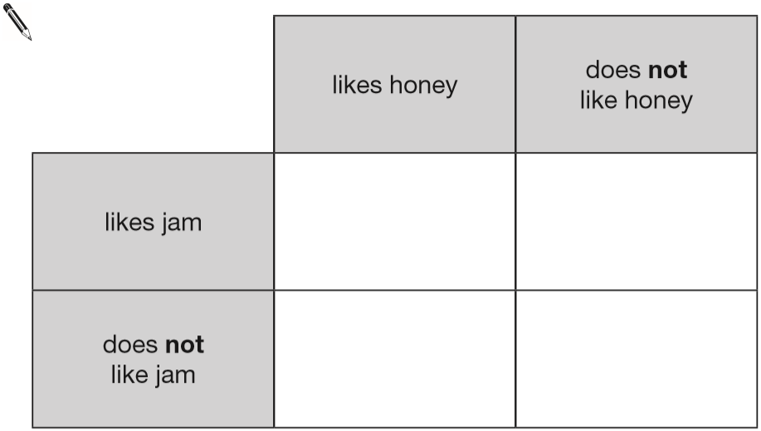
Megan likes honey, but not jam.
Alfie likes honey and jam.
Chen does not like honey or jam.
Donna only likes jam.
Write the children’s names in the correct parts of the sorting diagram.
Alfie
Donna
Megan
Chen
Notes:
B29 2015 Paper 1 Q1

Slide 3
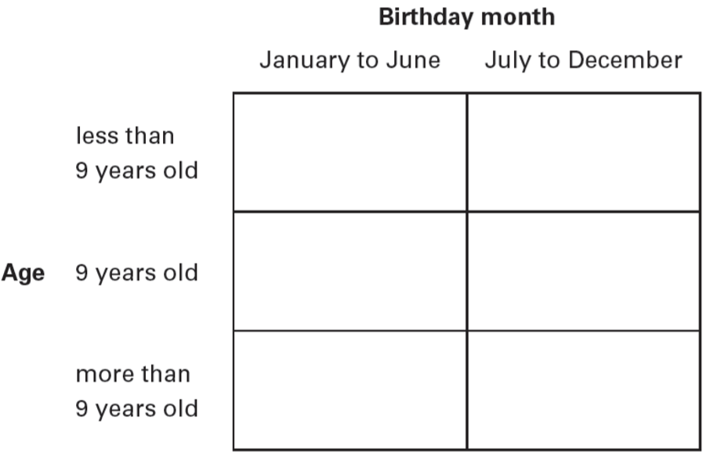
Jade says, ‘I am 9 years old. My birthday is in July.’
Lauren says, ‘I am 2 years younger than Jade. My birthday is in January.’
Write Jade and Lauren in the correct places on this sorting diagram.
Lauren
Jade
Notes:
B100 2006 Year 4 Optional Paper 1 Q5

Slide 4
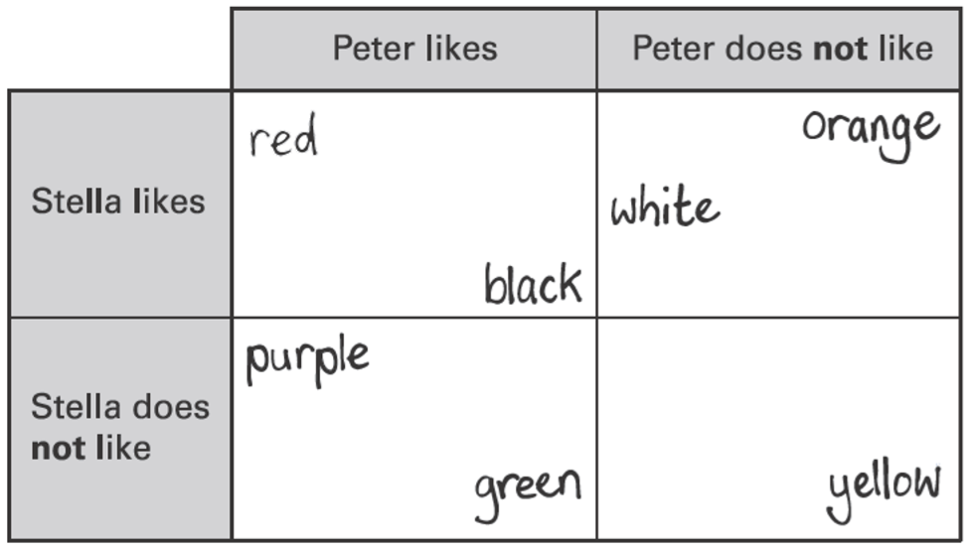
Peter and Stella compare colours they like and do not like.
Here is a sorting diagram that shows their results.
Write the two colours that Stella likes but Peter does not like.
white, orange
Peter likes the colour blue but Stella does not. Write blue in the correct place on the sorting diagram.
blue
Notes:
B140 2003 Year 5 Optional Paper 1 Q9

Slide 5
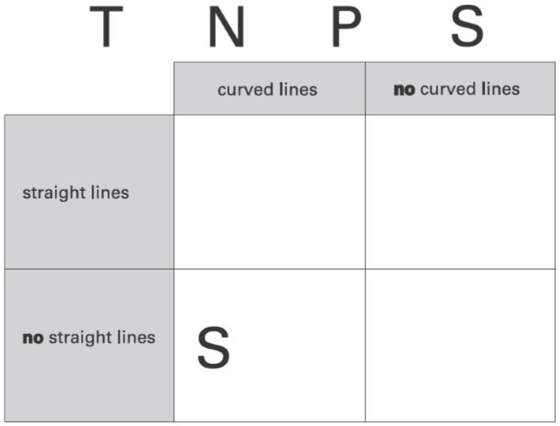
Write each letter in the correct place on the diagram.
One has been done for you.
P
T
N
Notes:
B185 2003 Year 4 Optional Paper 1 Q7

Slide 6
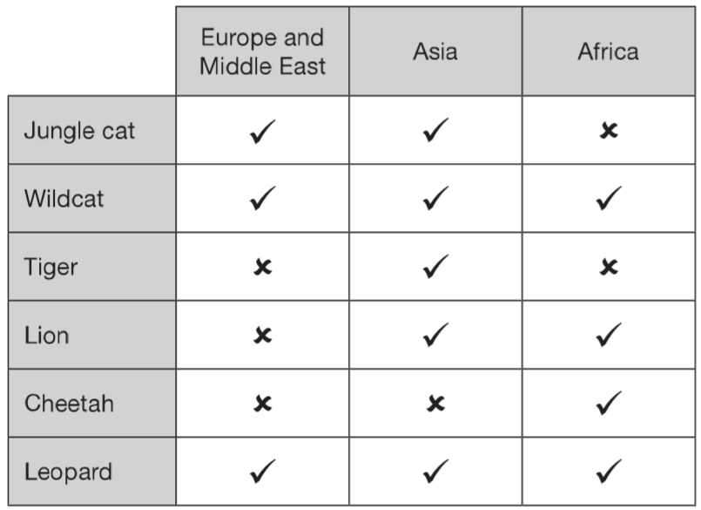
This table shows six different types of cat and where they are found.
Which type of cat is found only in Africa?
cheetah
Which types of cat are found in all three parts of the world?
wildcat
and leopard
Notes:
B308 2010 Paper 1 Q3

Slide 7
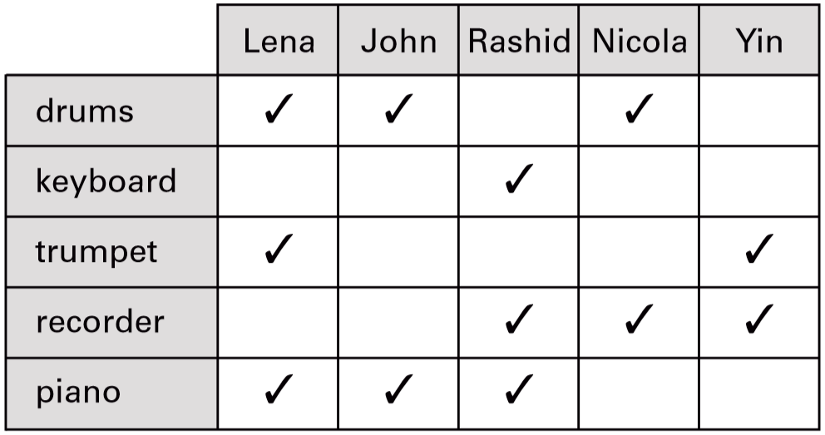
This chart shows the musical instruments some children play.
✓
✘
✓
✘
✘
Who plays both recorder and drums?
Nicola
How many children play more than two musical instruments?
2 children
Notes:
B310 2001 Paper 2 Q4

Slide 8
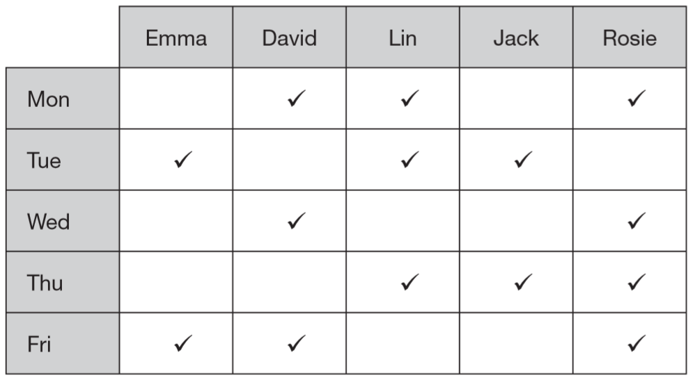
Five children have ticked this table to show on which days they are free to go out.
On how many days are more than two children free to go out?
4 days
On which days are Lin and Rosie both free to go out together?
Monday
and Thursday
Notes:
B46 2006 Paper 1 Q12

Slide 9
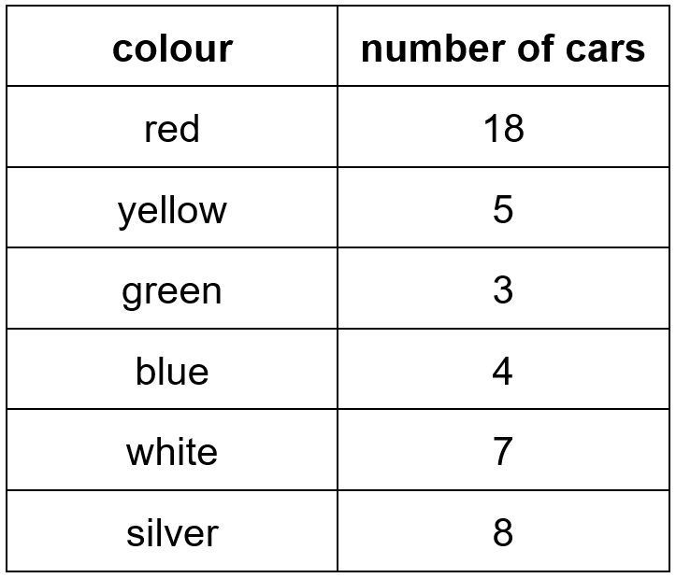
Colour of cars we saw
What colour was the second highest number of cars?
silver
Which two colours of cars were seen the least?
green and blue
Notes:
B83 Pre-2000 or other question

Slide 10
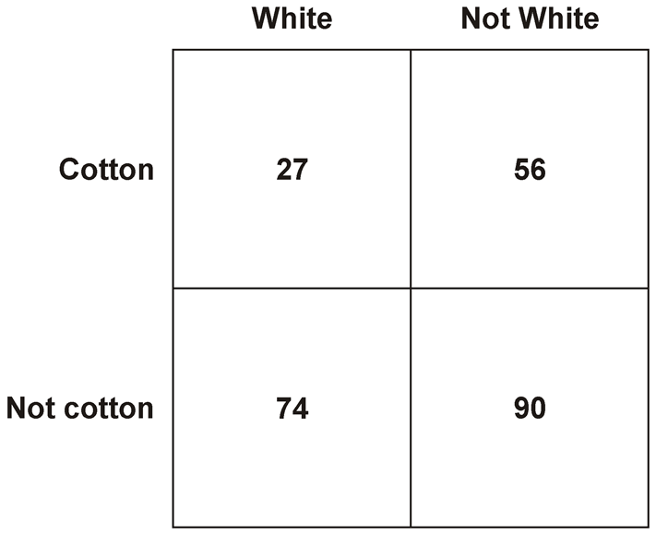
The table shows the number of shirts in a shop.
How many shirts are white?
1
2 7
+
7 4
1 0
1
shirts are white
How many shirts are there altogether?
247 shirts
5 6
1 0 1
+
9 0
+
1 4 6
1 4
6
2
4
7
Notes:
B128 Pre-2000 or other question

Slide 11
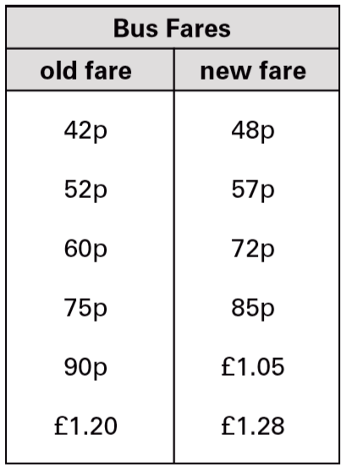
This table shows the increase in bus fares.
Sohan’s new bus fare is 72p.
How much has his bus fare gone up?
72 – 60 =
12p
Millie says, ‘My bus fare has gone up by 10p.’
How much is Millie’s new bus fare?
85p
Notes:
B176 2001 Paper 1 Q3

Slide 12
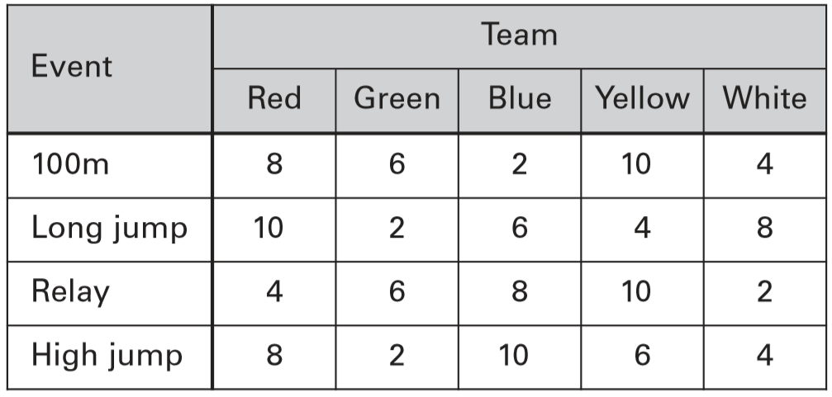
A school has sports day.
The winner of each event scores 10 points.
This chart shows the points scored by each team.
How many events did the Yellow team win?
2 events
Which team came second in the relay?
Blue
Notes:
B261 2004 Paper 2 Q4

Slide 13
Identify information from pictograms

Slide 14
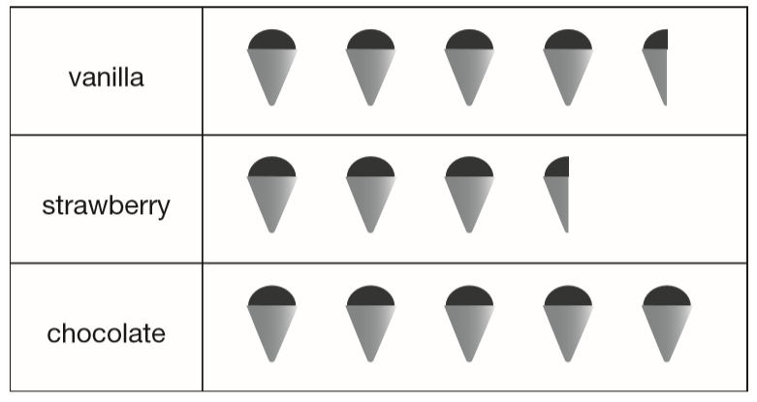
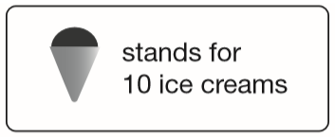
This pictogram shows the number of ice creams a shop sold in one day.
How many more chocolate than strawberry ice creams were sold?
45
50 – 35 =
15
35
50
How many ice creams were sold altogether?
45 + 35 =
80
130 ice creams
80 + 50 =
130
Notes:
B306 2013 Paper 2 Q5

Slide 15
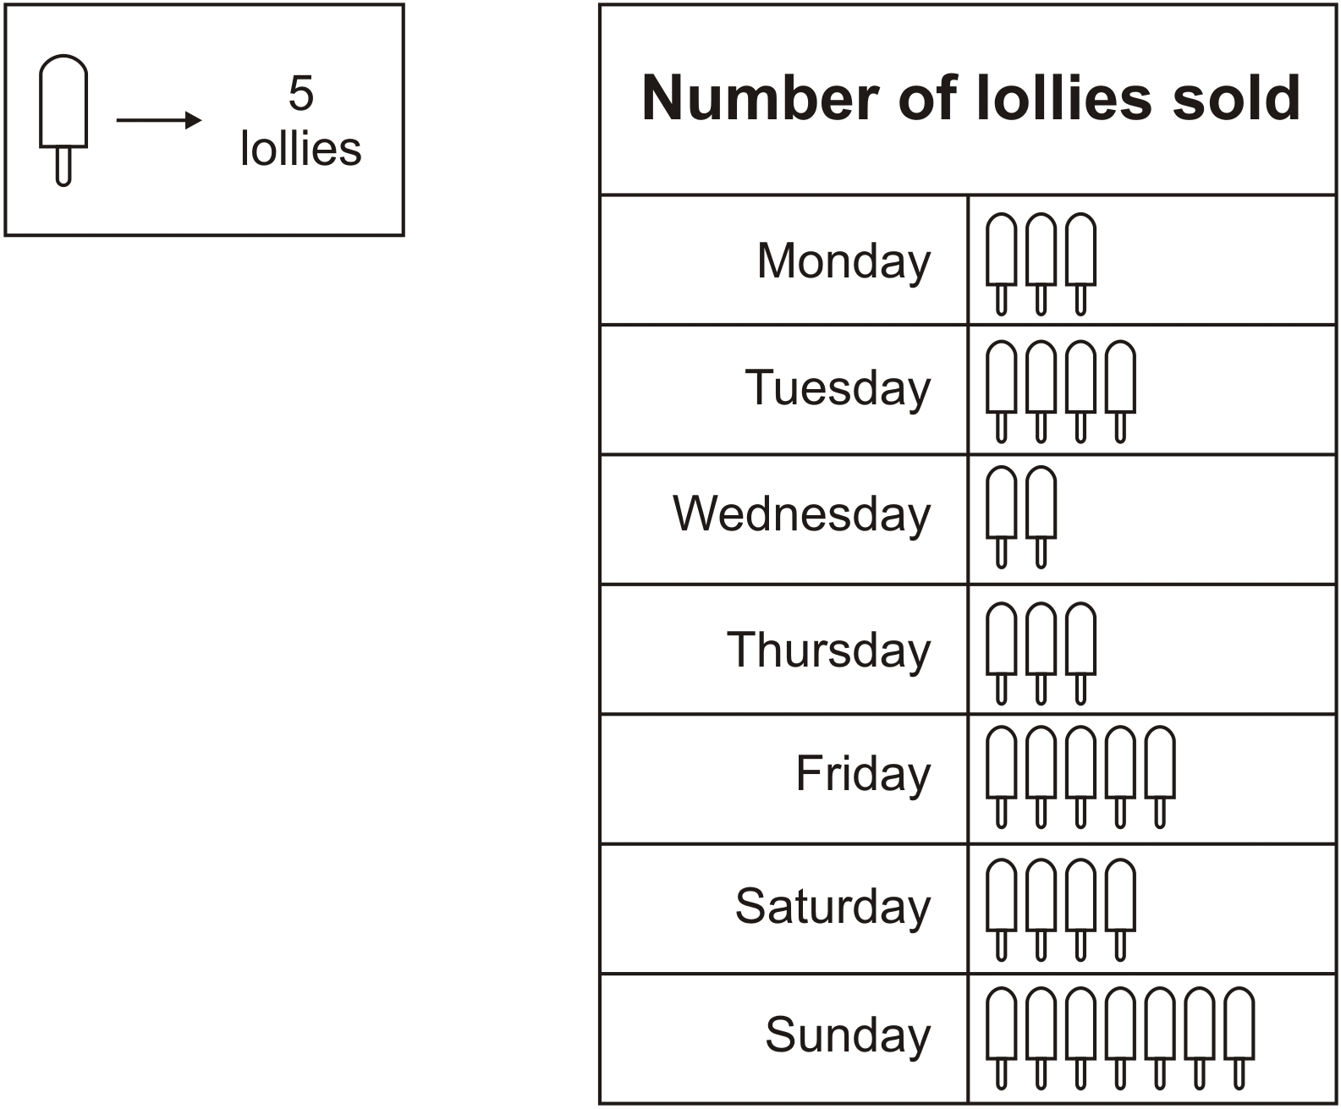
A shop sold 10 ice lollies on Wednesday.
How many lollies were sold on Monday?
3 x 5 =
15 lollies
How many more lollies were sold on Tuesday than on Wednesday?
10 more lollies
4 x 5 =
20 on Tuesday
2 x 5 =
10 on Wednesday
10
20 – 10 =
Notes:
B20 Pre-2000 or other question

Slide 16
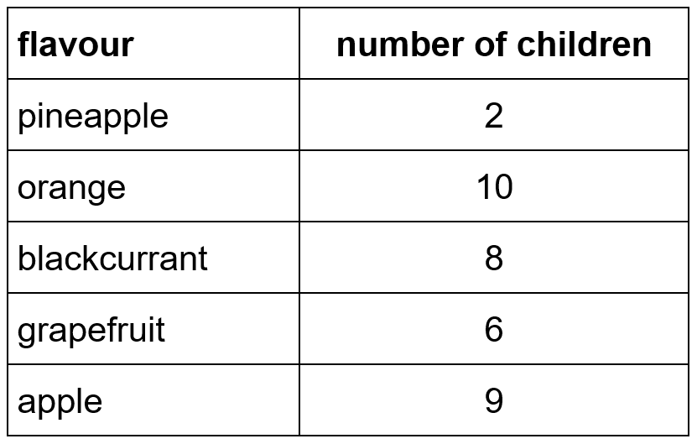
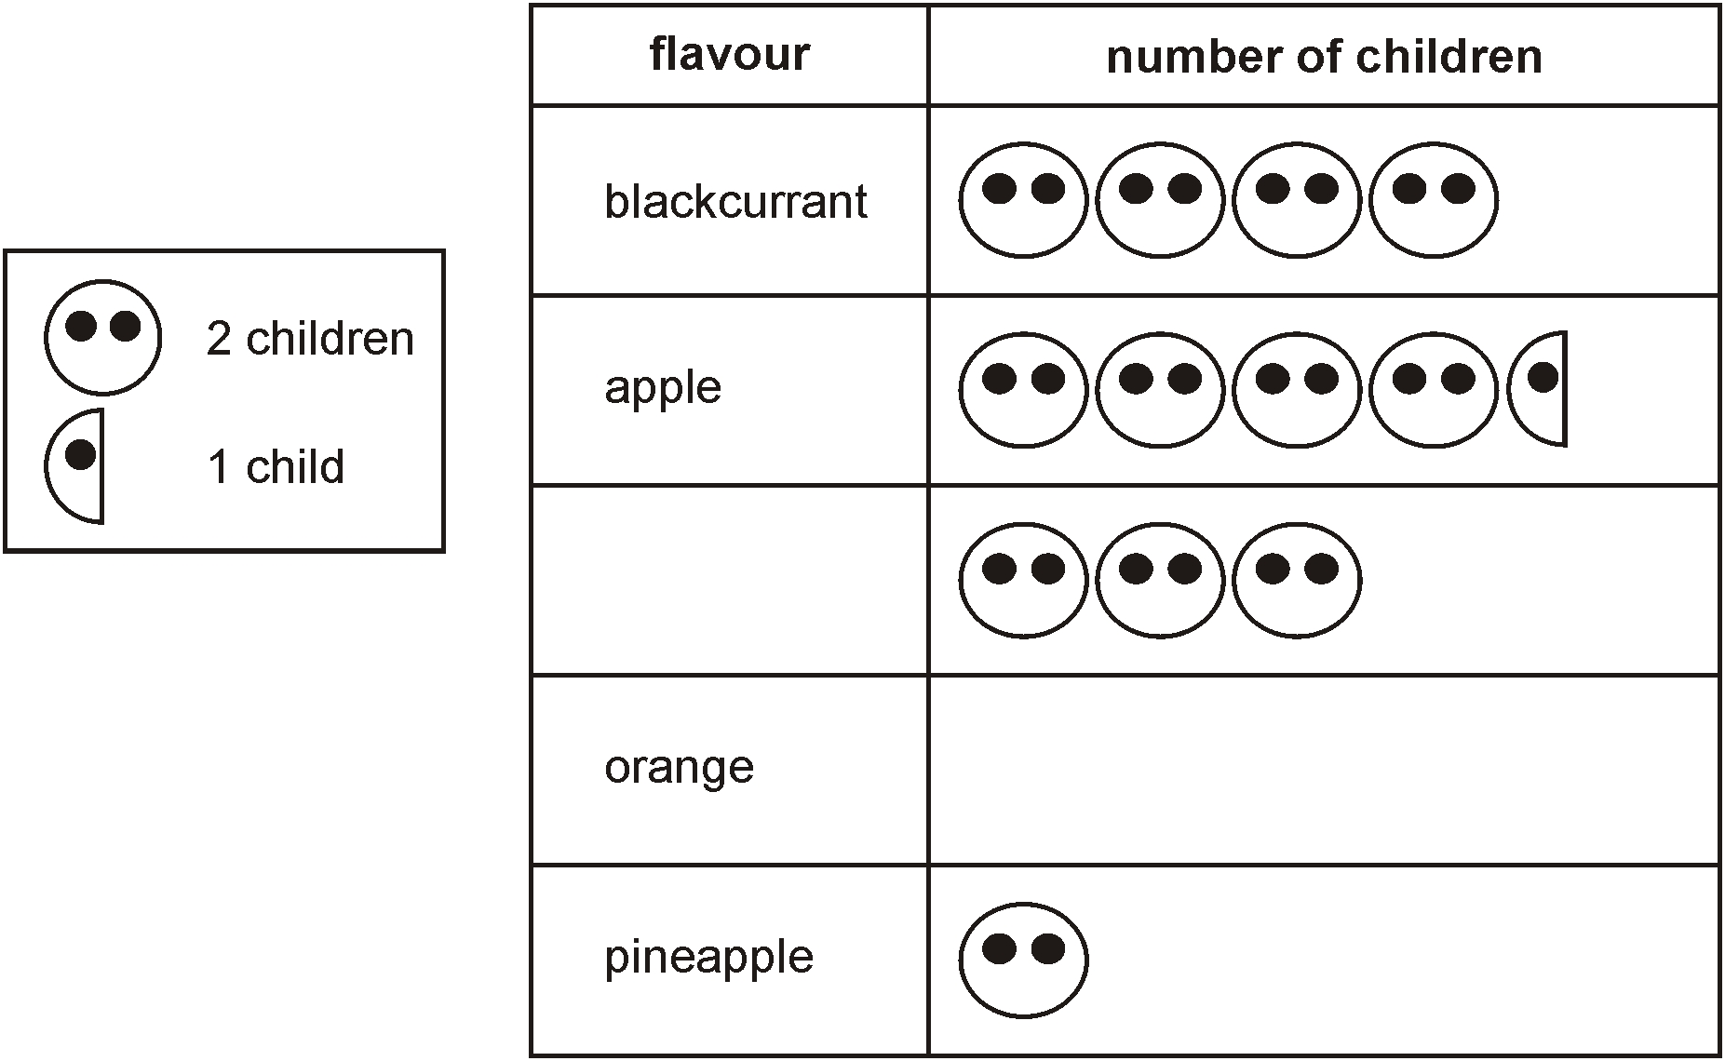
Class survey of favourite fruit drinks
Complete the pictogram for the class.
8
9
grapefruit
6
How many children altogether chose the three most popular flavours?
10 + 9 + 8 =
19 + 8 =
27 children
Notes:
B80 Pre-2000 or other question

Slide 17
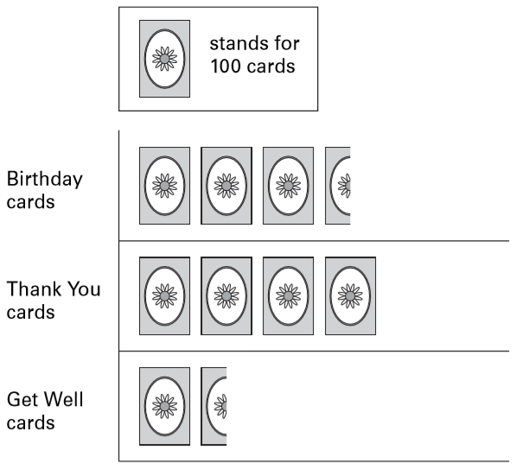
A shop sells different kinds of greeting cards.
This pictogram shows how many they sold in a week.
Estimate how many Birthday cards were sold.
350
Estimate how many more Thank You cards than Get Well cards were sold.
400
400 – 150 =
250
150
Notes:
B149 2005 Paper 2 Q8

Slide 18
Plot information on bar charts

Slide 19
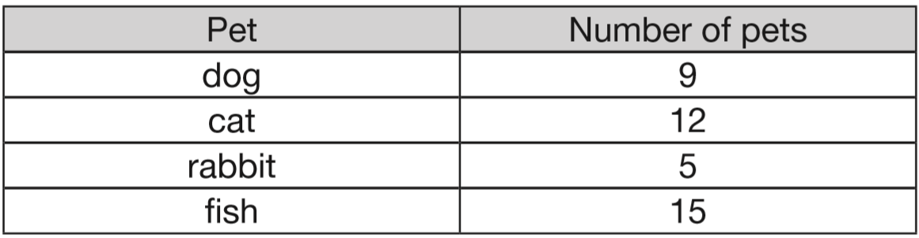
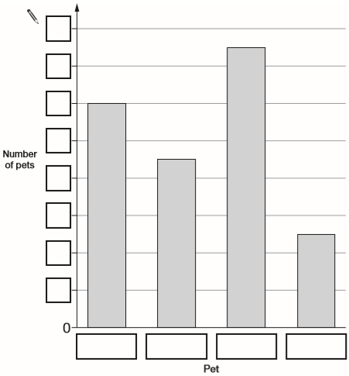
Alfie collected information about the pets owned by children in his class. Here are his results.
This bar chart shows the information from the table.
Fill in all the missing labels.
16
14
12
10
8
6
4
2
cat
dog
fish
rabbit
Notes:
B197 2014 Paper 2 Q2

Slide 20
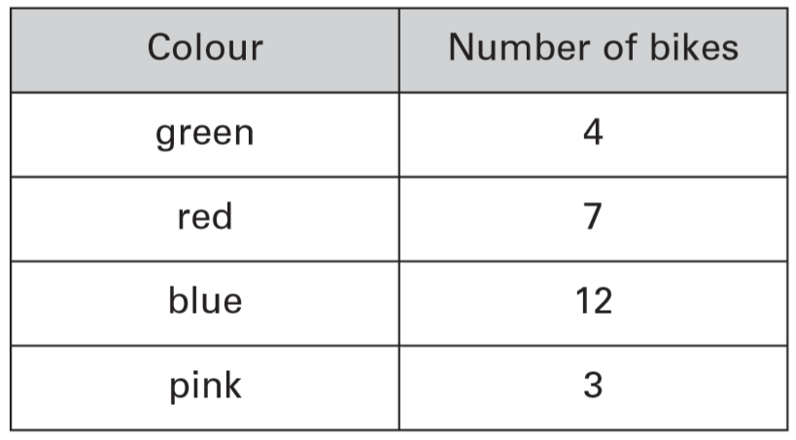
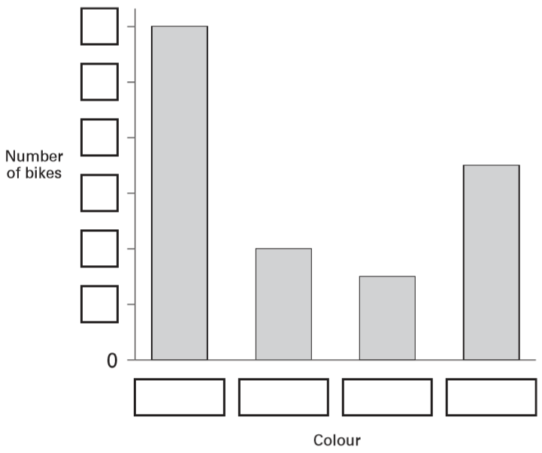
Robbie collected information about the colours of some bikes.
Here are his results.
This bar graph shows the information from the table. Fill in all the missing labels.
12
10
8
6
4
2
blue
green
pink
red
Notes:
B224 2005 Paper 1 Q3

Slide 21
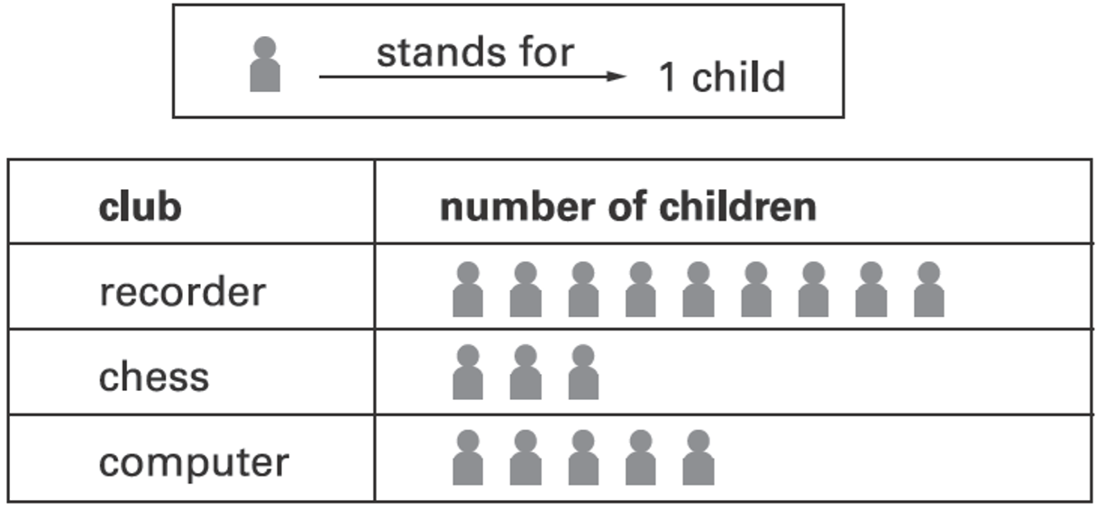
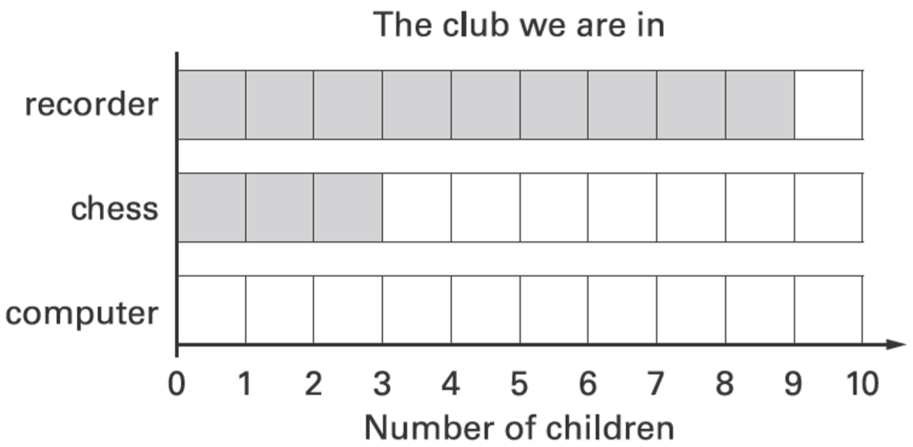
Some children in Class 4 are in a club.
This table shows the club they are in.
How many more children go to recorder than chess?
9
3
9 – 3 =
6 children
This graph should show the same data as the table.
Shade in the correct number
of blocks for computer club.
Notes:
B299 2003 Year 3 Optional Paper 1 Q8

Slide 22
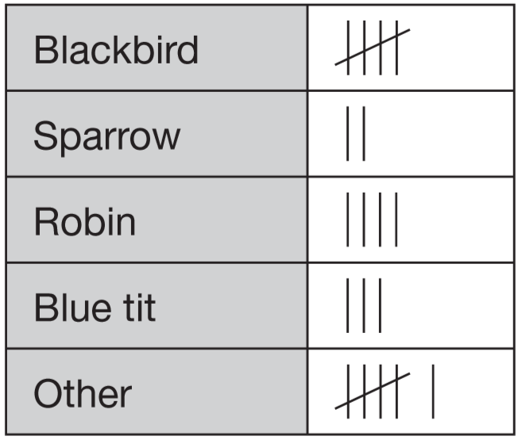
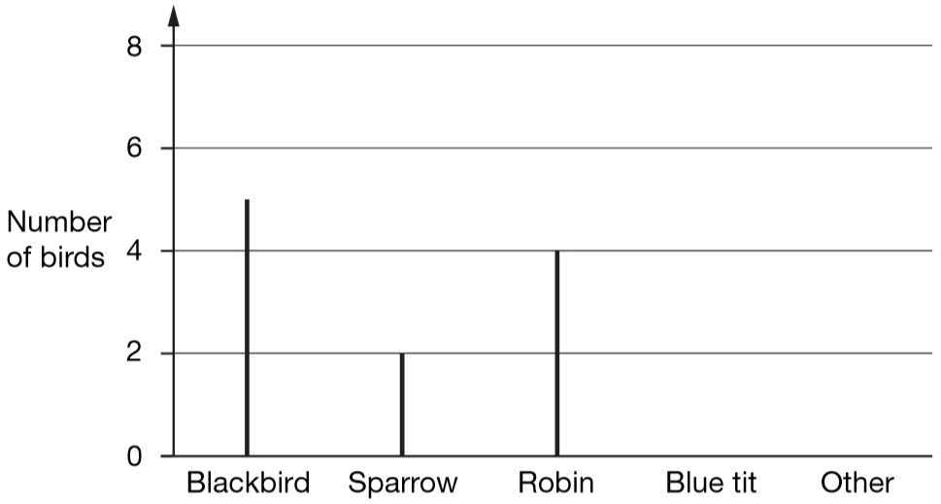
Rosie collects data about birds visiting a bird table.
Here are her results.
Draw two more lines to complete the graph.
Notes:
B45 2006 Paper 1 Q3 first page

Slide 23
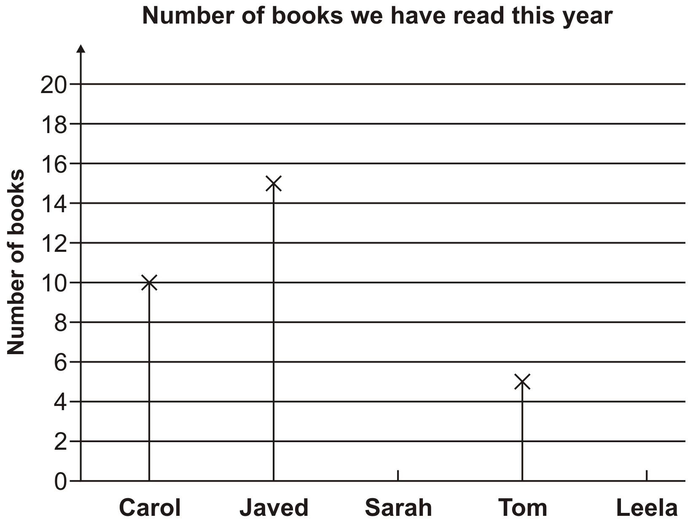
Some children drew this graph.
Sarah has read 12 books and Leela 9 books.
Show these on the graph.
15
Javed has read more books than Tom. How many more?
5
15 – 5 =
10 more
Notes:
B105 Pre-2000 or other question

Slide 24
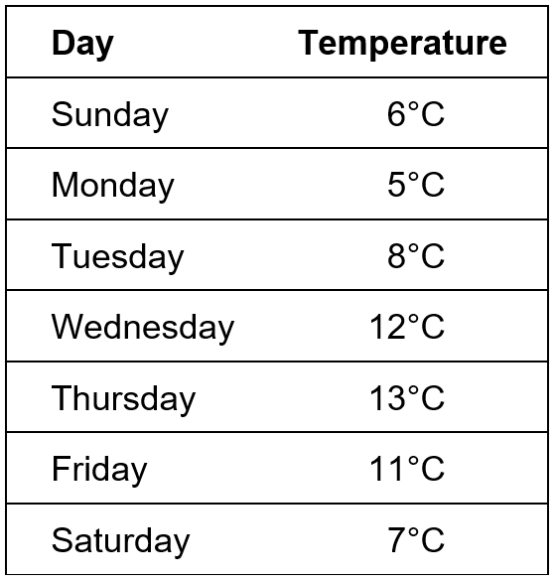
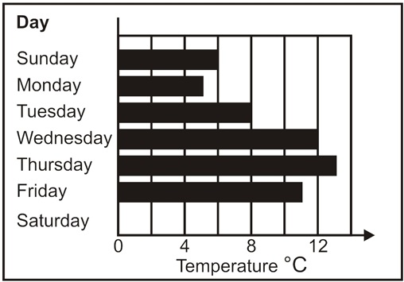
This is a list of the highest temperatures each day for one week.
How many degrees warmer was it on the hottest day than on the coldest day?
13 – 5 =
8 degrees warmer
Here is a chart of the temperatures. Saturday is missing. Draw in the bar for Saturday.
2
6
10
14
Notes:
B118 Pre-2000 or other question

Slide 25
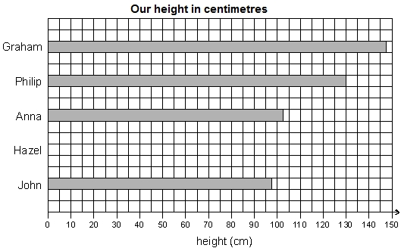
Five children made a graph.
Hazel is 135 cm tall. Show this on the graph.
Notes:
B207 Pre-2000 or other question

Slide 26
Identify information from simple bar charts

Slide 27
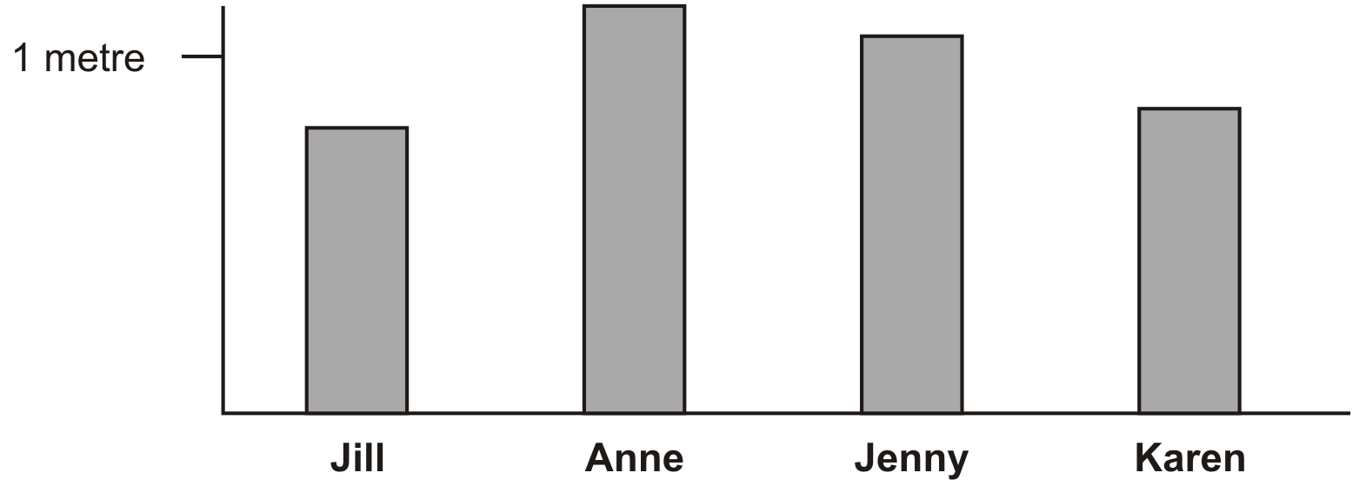
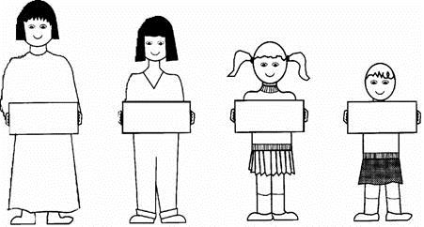
Four children made a graph of their heights.
Write their names on the labels.
Anne
Jenny
Karen
Jill
Notes:
B233 Pre-2000 or other question

Slide 28
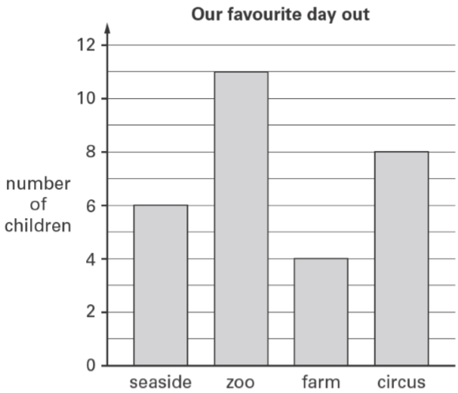
The children in Vijay’s class vote for their favourite day out.
Here are their results.
How many children voted for the zoo?
11 children
Notes:
B274 2006 Year 3 Optional Paper 1 Q3

Slide 29
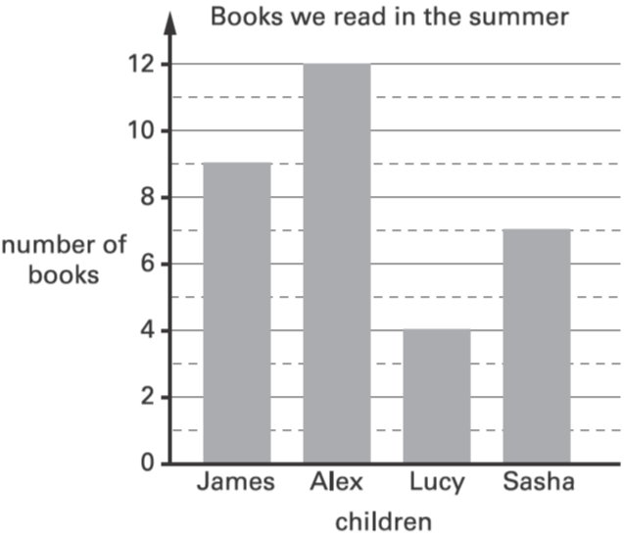
This graph shows the number of books some children read.
How many more books did James read than Lucy?
9 – 4 =
5 more books
9
Which two children read between 5 and 10 books?
James and Sasha
Notes:
B19 2003 Year 4 Optional Paper 1 Q12

Slide 30
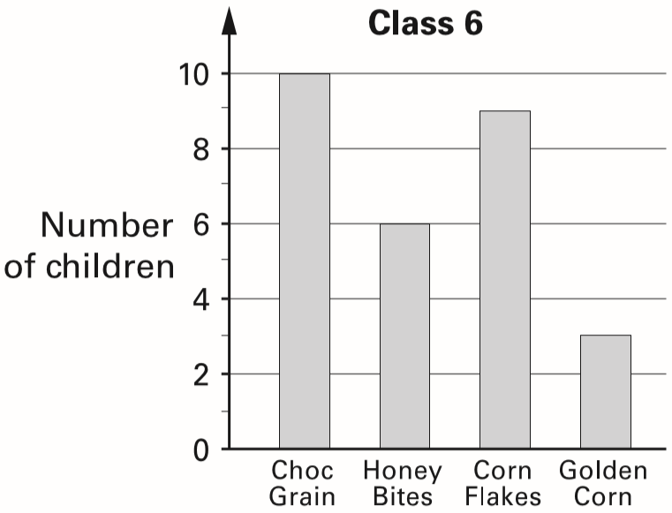
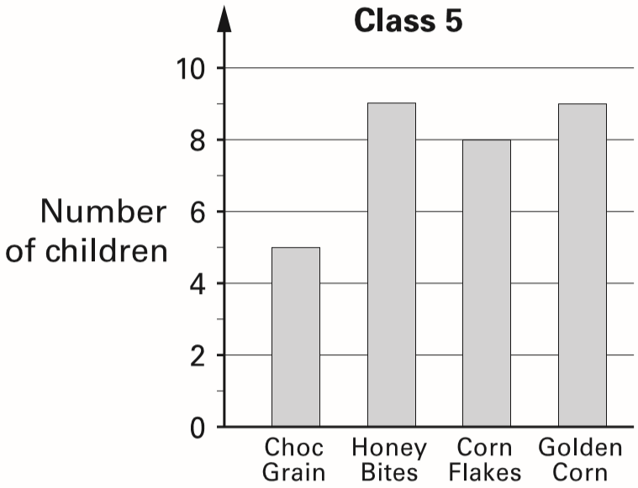
Tom does a survey of children’s favourite breakfast cereals.
These are the results for Class 6
How many more children in Class 6 prefer Choc Grain than Golden Corn?
10 – 3 =
7 children
3
These are the results for Class 5
How many children in both classes like Honey Bites best?
9
6 + 9 =
15 children
Notes:
B119 2002 Paper 2 Q3

Slide 31
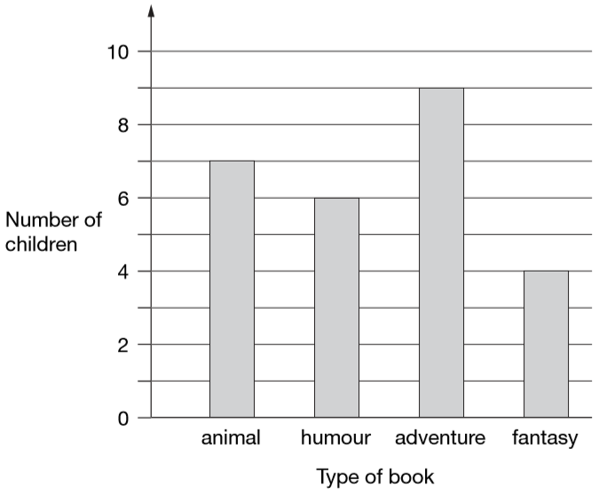
Class 6 did a survey of their favourite types of story book.
Here are their results.
How many more children chose adventure books than fantasy books?
9
9 – 4 =
5 children
7
Five girls chose animal books.
How many boys chose animal books?
4
7 – 5 =
2 boys
Notes:
B59 2006 Paper 2 Q3

Slide 32
Identify information from bar charts

Slide 33
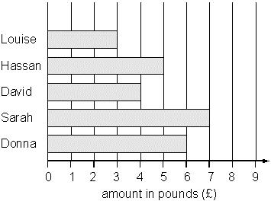
Five children collect money to plant trees.
Here is a bar chart of the amounts they have raised so far.
Their target is £40 altogether.
How much more money do they need to reach the target?
3
5
£15
4
3 + 5 + 4 + 7 + 6 =
25
7
40 – 25 =
15
6
Notes:
B184 Pre-2000 or other question

Slide 34
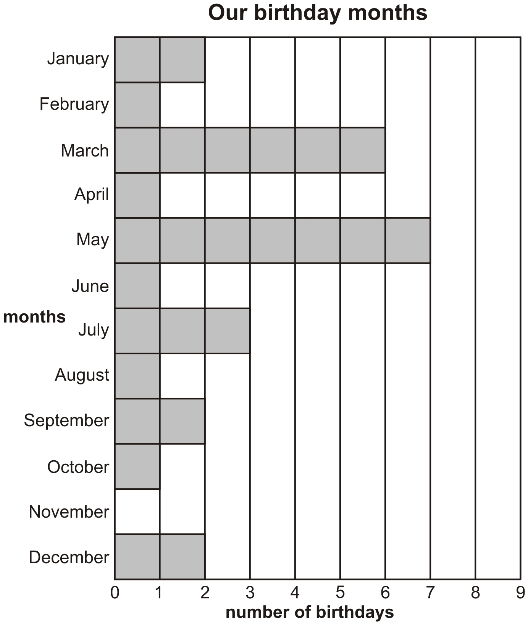
Some children made a graph.
In which months are there more than five birthdays?
March and May
How many children were born from July to December?
3
3 + 1 + 2 + 1 + 2 =
9 children
1
2
1
0
2
Notes:
B242 Pre-2000 or other question

Slide 35
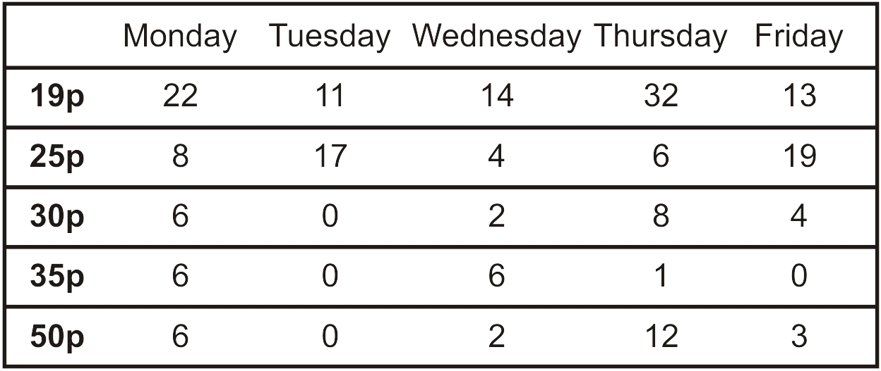
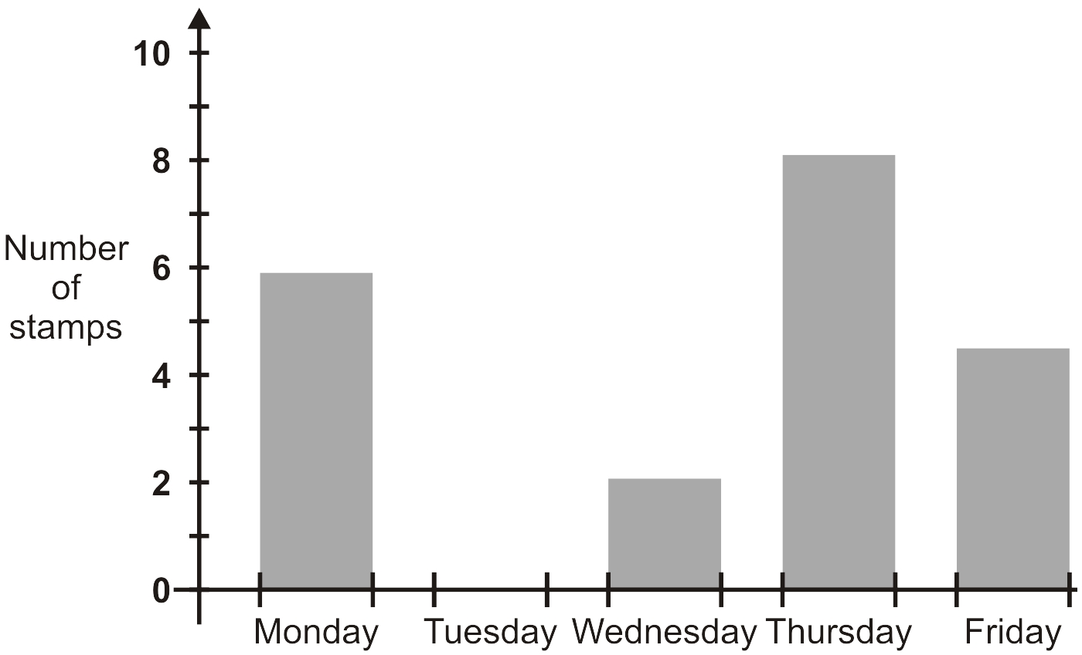
Here is a table of the number of stamps used each day in school.
How many 25p stamps did the school use on Wednesday?
4 stamps
This is a graph of one kind of stamp they used.
Which stamp is it?
8
6
4
30p stamp
2
0
Notes:
B297 Pre-2000 or other question

Slide 36
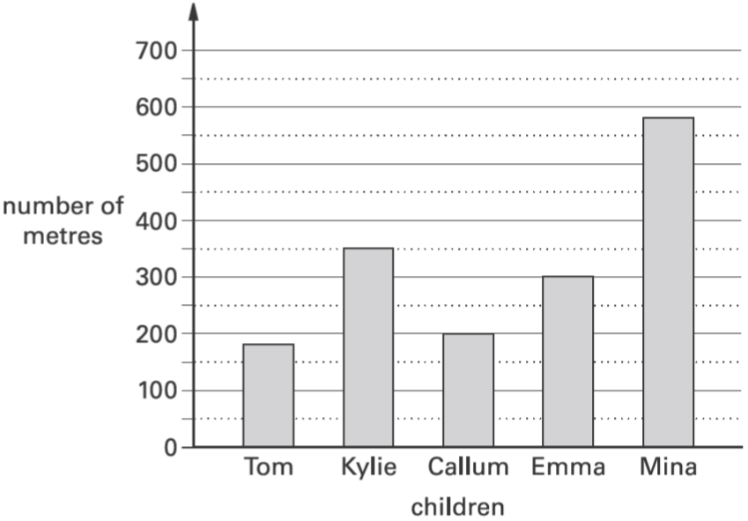
This graph shows the distance some children walk to school.
Who walks between 300 and 400 metres to school?
Kylie
Notes:
B7 2003 Year 3 Optional Paper 1 Q17

Slide 37
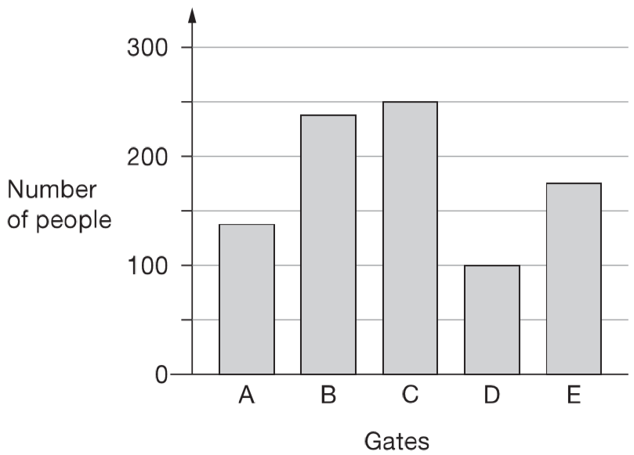
There are five entry gates at an open air concert.
This bar chart shows how many people went through each gate.
How many more people went through gate C than gate D?
250
150
250 – 100 =
✘
✘
How many gates had fewer than 150 people go through?
150
✘
✓
✓
2 gates
50
Notes:
B90 2010 Paper 2 Q2

Slide 38
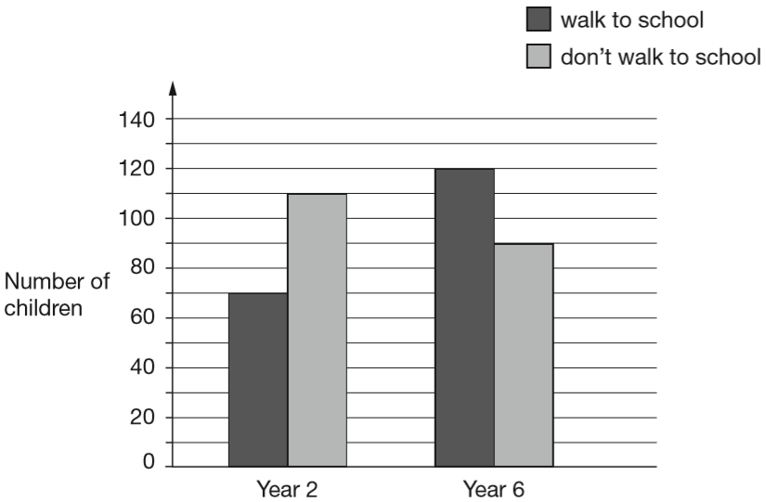
William asks the children in Year 2 and Year 6 if they walk to school.
This graph shows the results.
Altogether, how many children don’t walk to school?
110 + 90 =
200 children
110
90
Notes:
2017 Paper 2 Q1 page 1

Slide 39
William asks the children in Year 2 and Year 6 if they walk to school.
This graph shows the results.
How many more Year 6 children than Year 2 children walk to school?
120 – 70 =
50 children
70
Notes:
2017 Paper 2 Q1 page 2

