Slide 1
Identify fractions

Slide 2
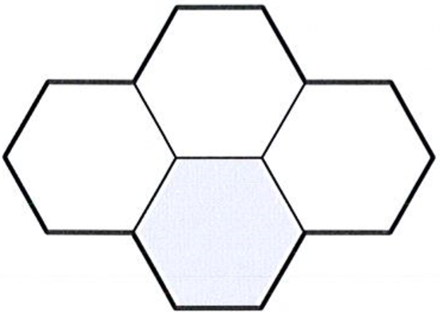
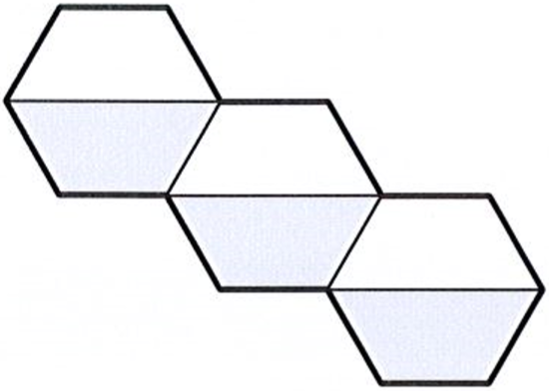
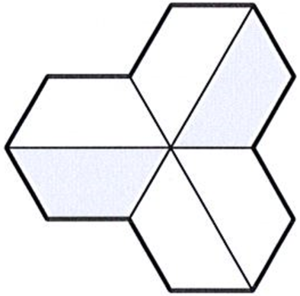
Here are three shapes made from regular hexagons.
Write the fraction of each shape that is shaded.
÷3
÷2
1
3
1
2
1
=
=
4
6
2
6
3
÷3
÷2
Notes:
S64 2012 Paper 2 Q4

Slide 3
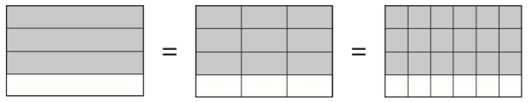
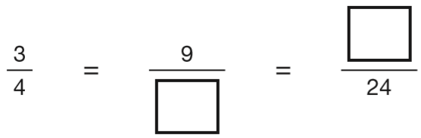
These diagrams show three equivalent fractions.
Write the missing values.
x3
x2
18
12
x3
x2
Notes:
2018 Paper 2 Q4

Slide 4
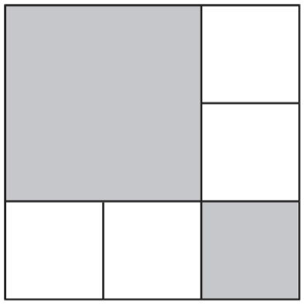
The diagram is made of squares.
What fraction of the diagram is shaded?
5
5 parts shaded
9 equal parts
9
Notes:
S111 2005 Paper 1 Q11

Slide 5
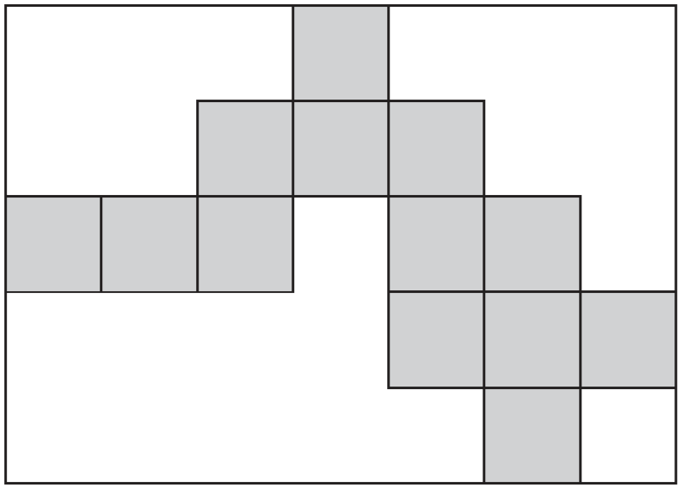
Here is a rectangle with 13 identical shaded squares inside it.
What fraction of the rectangle is shaded?
13 pieces shaded
35 pieces altogether
1 3
3 5
Notes:
S238 2003 Paper 1 Q18

Slide 6
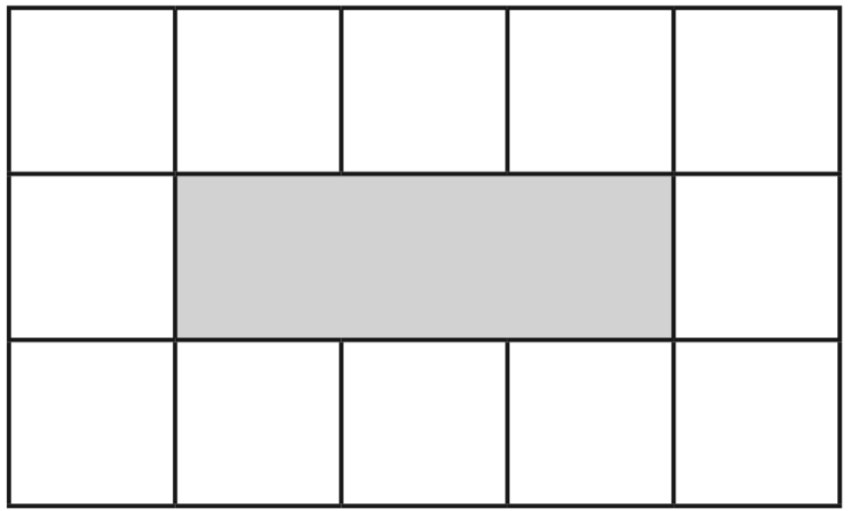
This diagram shows a shaded rectangle surrounded by squares.
What fraction of the diagram is shaded?
3 pieces shaded
15 pieces altogether
3
1 5
÷3
3
1
=
1 5
5
÷3
Notes:
S289 2011 Paper 2 Q11

Slide 7
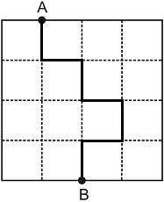
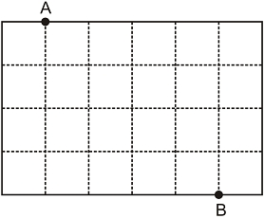
A line starts at A and goes along the dotted lines to B.
It divides the area of the grid into halves.
Divide the area of the grid below into halves. Start at A and go along the dotted lines to B.
16 squares
24 squares
8 on each side
12 on each side
Notes:
S373 Pre-2000 or other question

Slide 8
Identify simple fraction sequences

Slide 9
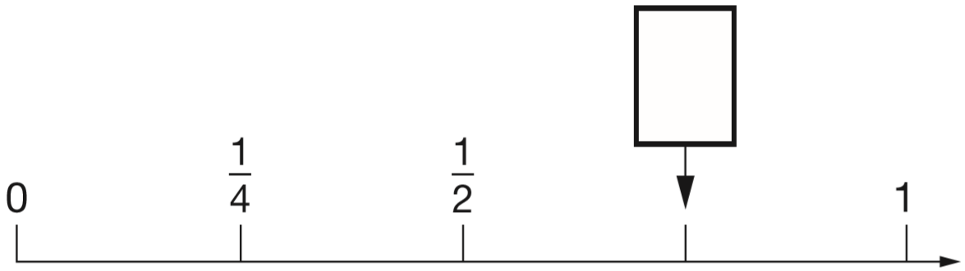
Here is part of a number line.
Write in the missing fraction.
3
4
2
4
4
4
Notes:
S437 2011 Paper 2 Q8

Slide 10
3
Draw an arrow on the number line to show 1
4
1
2
3
1
2
3
1
1
1
4
4
4
4
4
4
Notes:
S78 2003 Year 4 Optional Paper 1 Q21

Slide 11
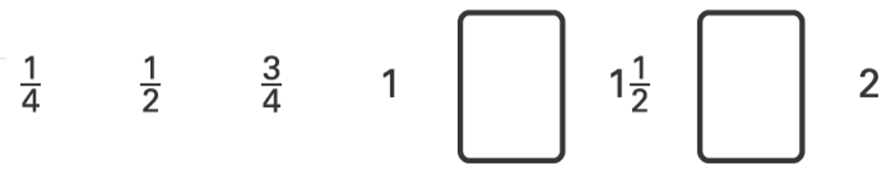
Write the two missing numbers in this sequence.
1
3
1
1
4
4
2
2
1
4
4
Notes:
S161 2003 Year 5 Optional Paper 1 Q7

Slide 12
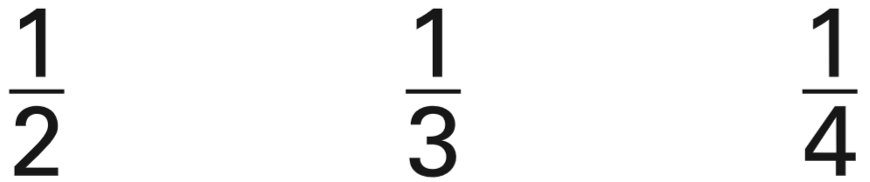
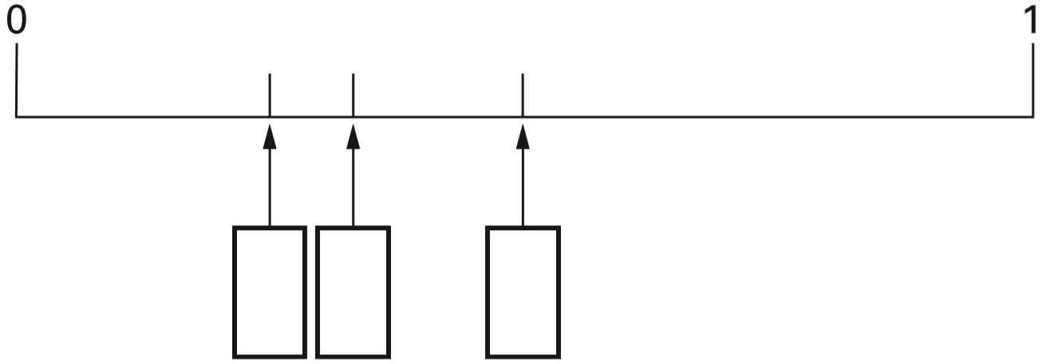
Here are three fractions.
Write the fractions in the correct boxes on the number line.
1
1
1
4
3
2
Notes:
S232 2006 Year 5 Optional Paper 1 Q11

Slide 13
Find equivalent fractions from numbers

Slide 14
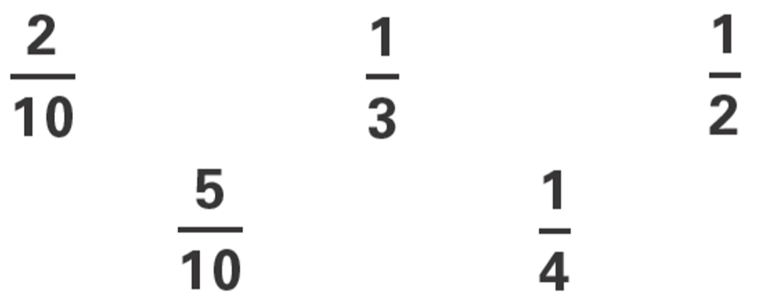
Circle the two fractions that have the same value.
x5
1
5
=
2
1 0
x5
Notes:
S290 2003 Year 3 Optional Paper 1 Q30

Slide 15
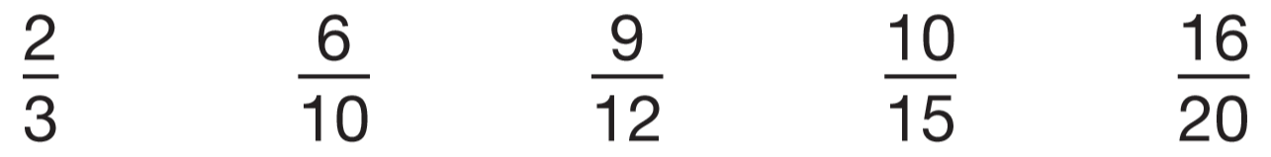
Two of the fractions below are equivalent. Circle them.
x4
x5
2
8
2
1 0
=
=
3
1 2
3
1 5
x4
x5
Notes:
S323 2009 Paper 1 Q22

Slide 16
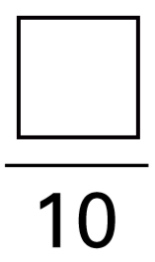
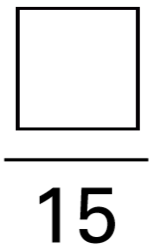
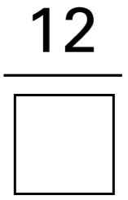
3
Complete these fractions to make each equivalent to
5
6
9
20
x2
x4
x3
3
6
3
1 2
3
9
=
=
=
5
1 0
5
2 0
5
1 5
x2
x4
x3
Notes:
S402 2001 Paper 1 Q19

Slide 17
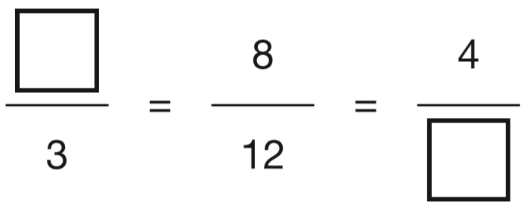
Write the two missing values to make these equivalent fractions correct.
x4
÷2
2
6
x4
÷2
Notes:
2016 Paper 2 Q7

Slide 18
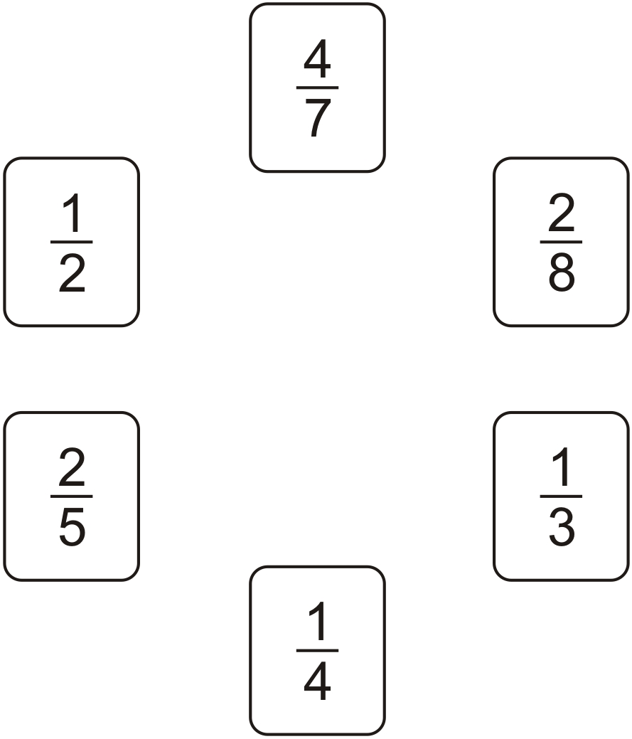
Draw one line to join two fractions which have the same value.
x2
1
2
=
4
8
x2
Notes:
S35 Pre-2000 or other question

Slide 19

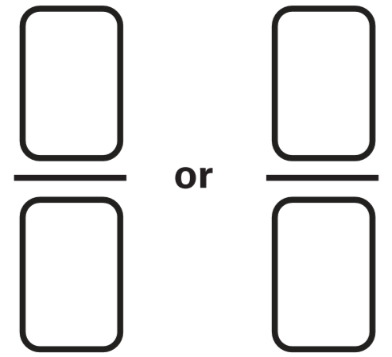
Karen makes a fraction using two number cards.
She says, ‘My fraction is equivalent to
One of the number cards is 6’
What could Karen’s fraction be?
1
2
x6
1
6
6
3
=
2
1 2
x6
x3
12
6
1
3
=
2
6
x3
Notes:
S101 2003 Paper 2 Q12

Slide 20
Sarah has a packet of balloons. The contents of the packet are
5 red balloons 5 blue balloons 10 yellow balloons
Sarah says, ‘One-quarter of the balloons are red.’
Is Sarah correct? Explain how you know.
÷5
5 red balloons
20 balloons altogether
5
1
=
2 0
4
÷5
1
of 20 =
5
4
Sarah is correct.
There are 20 balloons in total. 5 are red.
Five twentieths is equivalent to one quarter.
One quarter of 20 is 5.
Notes:
S211 2010 Paper 2 Q7

Slide 21
Find equivalent fractions from diagrams

Slide 22
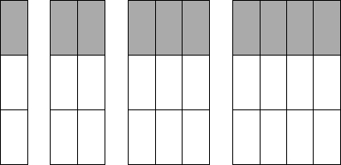

Look at the diagrams.
Complete the fractions.
2
4
9
Notes:
S269 Pre-2000 or other question

Slide 23
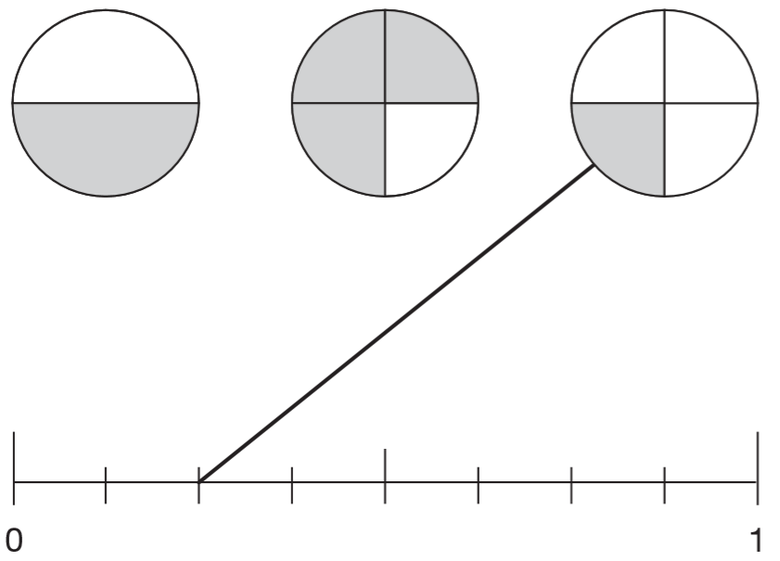
A fraction of each shape is shaded. Match each fraction to the correct place on the number line. One has been done for you.
x4
x2
1
4
3
6
=
=
2
8
4
8
x4
x2
1
2
3
4
5
6
7
8
8
8
8
8
8
8
Notes:
S369 2009 Paper 1 Q9

Slide 24
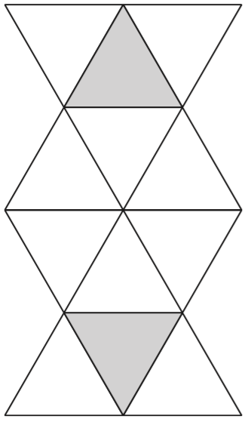
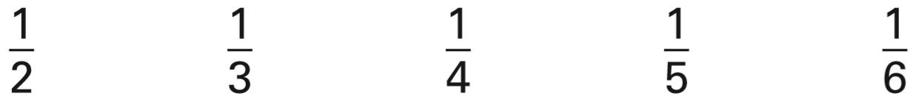
Here is a shape made from matching triangles.
Circle the fraction of the shape that is shaded.
÷2
2 triangles shaded
12 triangles altogether
2
1
=
1 2
6
÷2
Notes:
S432 2006 Year 5 Optional Paper 2 Q16

Slide 25
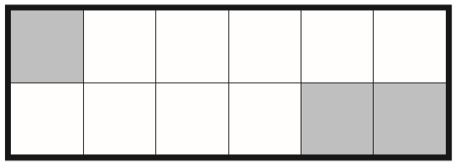
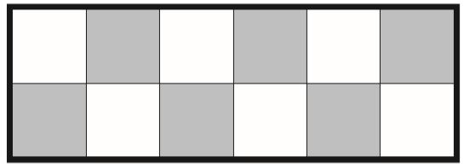
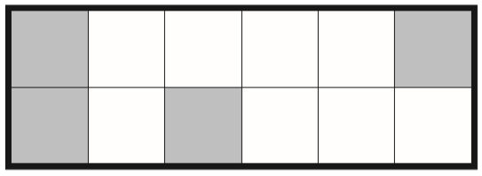
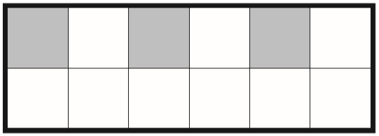
1
Tick each shape that is exactly shaded.
4
✓
✘
x3
1
3
=
4
1 2
x3
✘
✓
Notes:
S70 2013 Paper 1 Q14

Slide 26
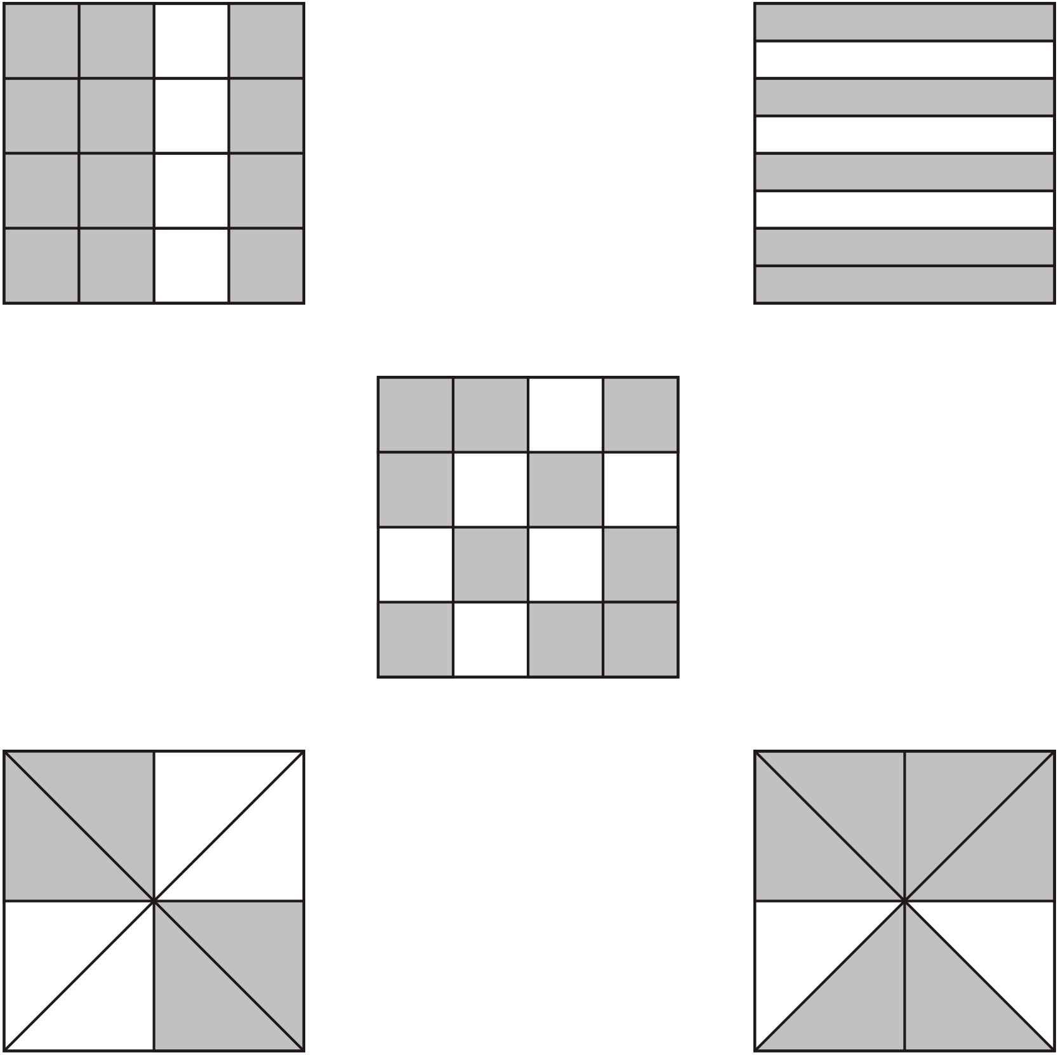
Tick the two shapes that have three-quarters shaded.
÷4
1 2
3
5
=
✓
1 6
4
8
÷4
1 0
1 6
÷2
4
6
3
✓
=
8
8
4
÷2
Notes:
S127 Pre-2000 or other question

Slide 27
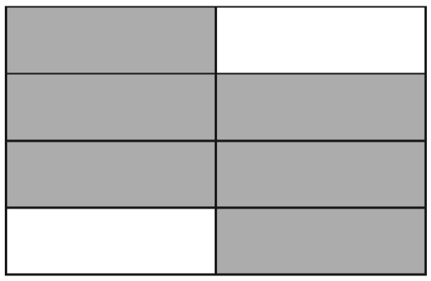
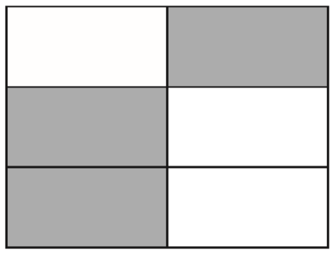
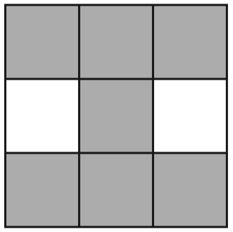
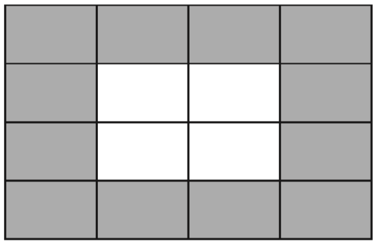
3
Tick two shapes that have shaded.
4
÷2
6
3
3
✓
=
8
4
6
÷2
÷4
7
1 2
3
✓
=
9
1 6
4
÷4
Notes:
2017 Paper 2 Q9

Slide 28
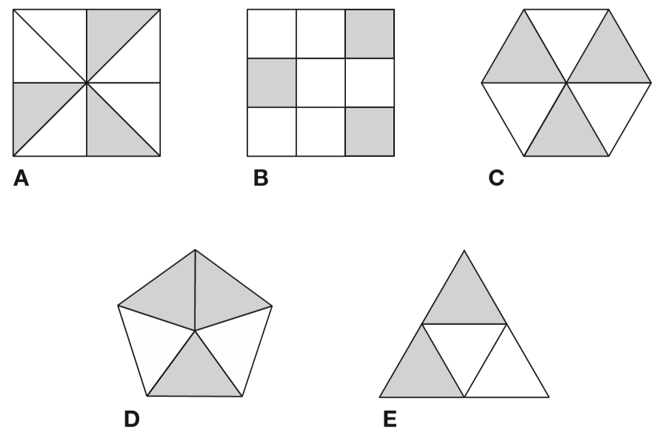
Each of these diagrams is divided into equal parts. Some of the parts are shaded.
Write the letters of all the diagrams that have exactly
shaded.
1
2
C and E
3
3
1
3
1
=
=
8
9
3
6
2
Write the letters of all the diagrams that have exactly
shaded.
1
3
B
3
2
1
=
5
4
2
Notes:
S164 2014 Paper 1 Q6

Slide 29
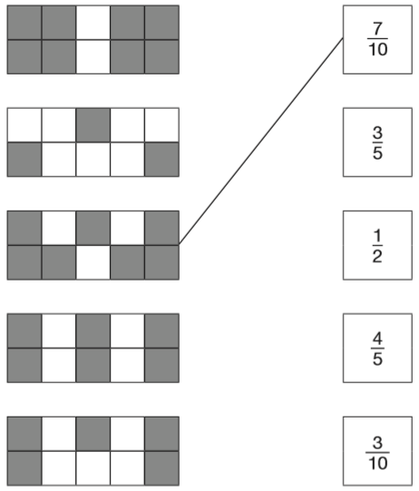
Here are some shapes made of squares.
A fraction of each shape is shaded.
Match each shape to its equivalent fraction.
One has been done for you.
÷2
8
4
=
1 0
5
÷2
÷2
6
3
=
1 0
5
÷5
÷2
5
1
=
1 0
2
÷5
Notes:
2015 (Sample) Paper 2 Q4

Slide 30
Shade a fraction of a shape

Slide 31
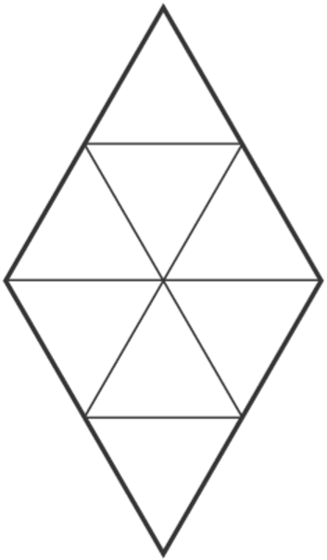
1
Shade of this shape.
4
x2
1
2
=
4
8
x2
Notes:
S301 2003 Year 3 Optional Paper 1 Q28

Slide 32
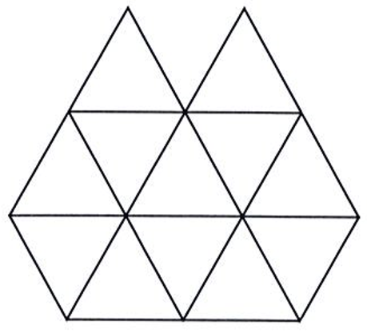
1
Shade of this shape.
4
x3
1
3
=
4
1 2
x3
Notes:
S322 2012 Paper 1 Q9

Slide 33
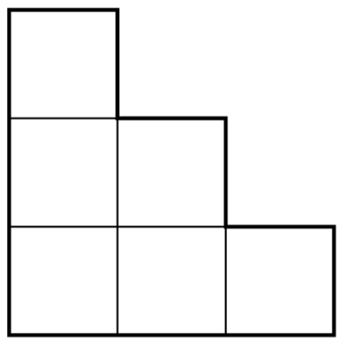
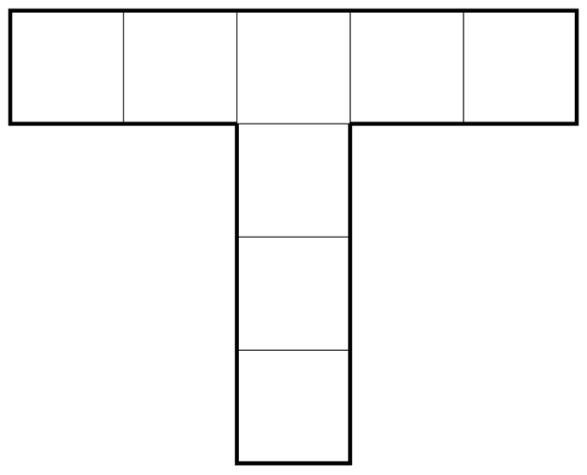
Shade one third of this shape.
Shade one quarter of this shape.
x2
1
2
=
3
6
x2
x2
1
2
=
4
8
x2
Notes:
S387 2001 Paper 2 Q12

Slide 34
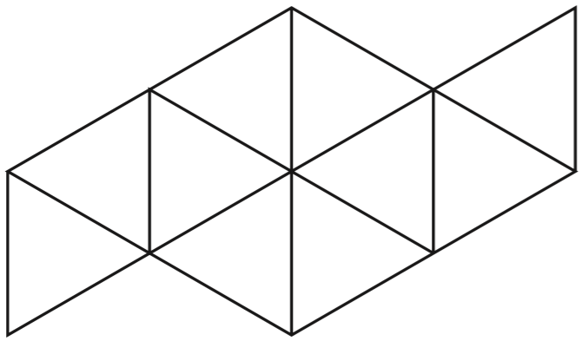
1
Shade of this shape.
5
x2
1
2
=
5
1 0
x2
Notes:
S3 2015 Paper 2 Q10 page 1

Slide 35
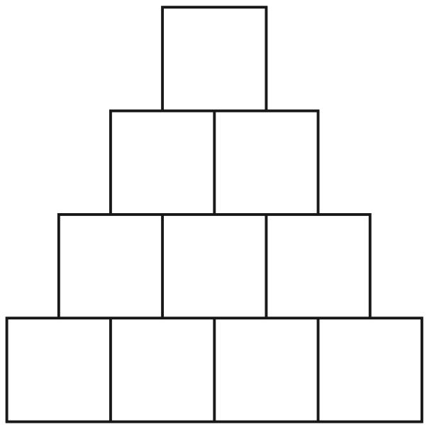
1
Shade of this shape.
5
x2
1
2
=
5
1 0
x2
Notes:
S133 2008 Paper 2 Q10

Slide 36
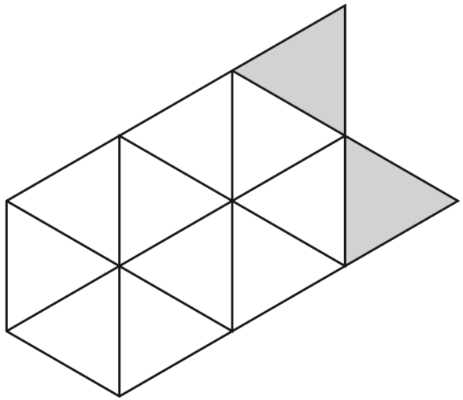
1
Shade more triangles on this shape so that is shaded.
3
x4
1
4
=
3
1 2
x4
Notes:
S202 2015 Paper 2 Q10 page 2

Slide 37
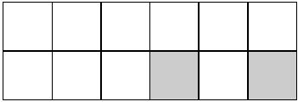
Shade more squares so that exactly half of the shape is shaded.
x6
1
6
=
2
1 2
x6
Notes:
S256 Pre-2000 or other question

Slide 38
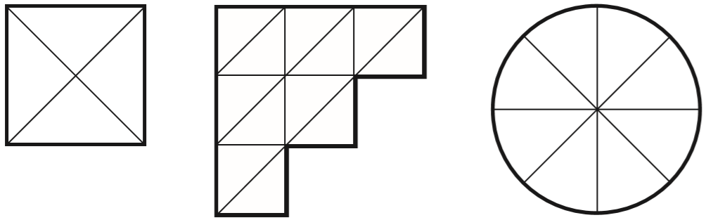
Each diagram below is divided into equal sections.
Shade three-quarters of each diagram.
x3
x2
3
9
3
6
=
=
4
1 2
4
8
x3
x2
Notes:
2016 Paper 2 Q10

Slide 39
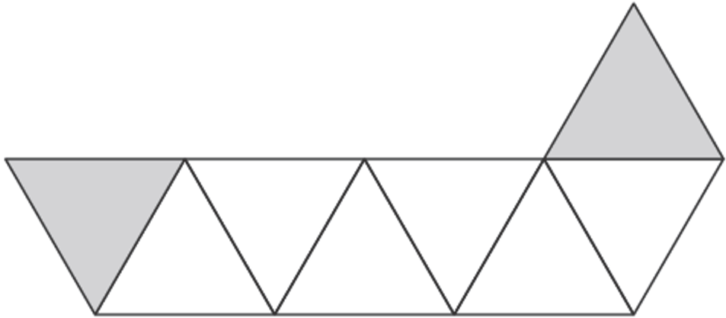
3
Sarah wants to shade of this shape.
She has shaded 2 triangles.
4
How many more triangles must she shade so that is shaded?
3
4
She needs to shade
4 more triangles so that
6 are shaded altogether
x2
3
6
=
4
8
x2
Notes:
S361 2006 Year 3 Optional Paper 1 Q30

Slide 40
Find a fraction of a number

Slide 41
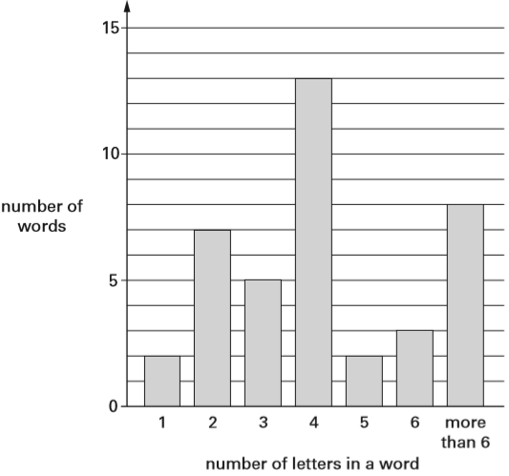
Emma counts how many letters there are in each of 40 words.
The bar chart shows her results.
How many words have fewer than 4 letters in them?
7 + 5 + 2 =
14 words
What fraction of the 40 words have more than 6 letters in them?
8
7
÷8
8
1
=
2
4 0
5
÷8
Notes:
S418 2006 Year 5 Optional Paper 2 Q23

Slide 42
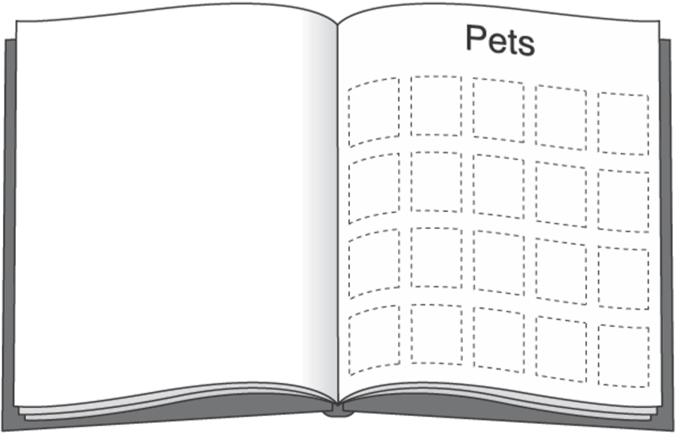
Meg has 20 pet stickers to go on this page.
¼ of them are dog stickers.
½ of them are cat stickers.
The rest are rabbit stickers.
How many rabbit stickers does she have?
D
D
D
D
D
C
C
C
C
C
C
C
C
C
C
20 – 15 =
5 rabbit stickers
1
of 20 =
5 dog
4
1
of 20 =
10 cat
2
Notes:
S28 2003 Year 4 Optional Paper 1 Q28

Slide 43

Write the missing number.
6
3
__ ÷ 2 = 3
12 ÷ 4 =
6
Notes:
S153 Pre-2000 or other question

Slide 44
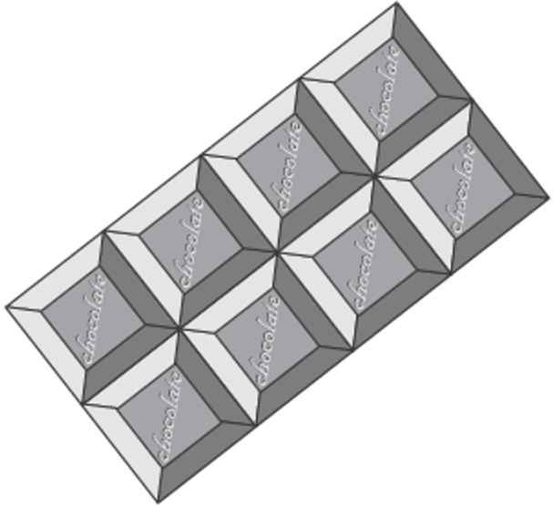
Here is a chocolate bar.
William eats 3 pieces and Amber eats 2 pieces.
What fraction of the chocolate bar remains?
3 pieces left
8 pieces altogether
3
A
8
W
W
A
W
Notes:
S216 2003 Year 5 Optional Paper 1 Q17

Slide 45
Megan and Chen each have a bag of counters.
Megan’s bag has 5 blue counters and 5 green counters.
Chen’s bag has 10 blue counters, 5 green counters and 5 red counters.
They each take a counter from their bag without looking.
Chen says, ‘I am more likely than Megan to take a blue counter.’
Is Chen correct? Explain how you know.
Chen is wrong.
5
Megan has 5 out of 10 blue.
1 0
5
1 0
=
1 0
2 0
1 0
Chen has 10 out of 20 blue.
2 0
They are equally likely to take a blue counter.
Notes:
S311 2015 Paper 2 Q23

Slide 46
There are 24 coloured cubes in a box.
Three-quarters of the cubes are red, four of the cubes are blue and the rest are green. How many green cubes are in the box?
2
3
of 24 =
18 red
4 blue
18 + 4 =
22 red or blue
4
24 – 22 =
2 green
6
24 ÷ 4 =
18
6 x 3 =
One more blue cube is put into the box.
What fraction of the cubes in the box are blue now?
1
5
÷5
5 blue cubes
5
1
=
25 cubes altogether
2 5
5
÷5
Notes:
S353 2002 Paper 2 Q13

Slide 47
Stefan has a bag that contains 3 blue marbles and 5 red marbles only. What fraction of the marbles in the bag are blue?
3 blue marbles
3
8 marbles altogether
8
4 blue marbles
6 red marbles
Stefan adds one blue marble and one red marble to the bag.
What fraction of the marbles in the bag are blue now?
÷2
4 blue marbles
4
2
=
10 marbles altogether
1 0
5
÷2
Notes:
S17 2009 Paper 2 Q15

Slide 48
Annie had 36 sweets.
She ate of them.
Ben had 40 sweets.
He ate of them.
How many more sweets did Annie eat than Ben?
12
36 ÷ 3 =
2
24
3
12 x 2 =
8
1
40 ÷ 5 =
5
16 sweets
16
24 – 8 =
Notes:
S121 Pre-2000 or other question

Slide 49
Sam has 90 bricks.
He uses of them to build a tower.
Grace has 120 bricks.
She uses of them to build a tower.
How many bricks are left over altogether?
1
8
2
8
3
1 8
9 0
1
5
9 0
5
4
x
3
–
5 4
2
of 90 = 36
5
4
3
6
5
5
120 ÷ 6 =
20
6
20 x 5 =
100
1
120 – 100 =
20
of 120 = 20
6
56 bricks
Sam has 36 left over.
Grace has 20 left over.
36 + 20 =
56
Notes:
S218 Pre-2000 or other question

Slide 50
A book has 276 pages.
Amina has read of the book.
How many pages are left for Amina to read?
1
92 pages read
3
184 pages
9
2
1
2 7 6
9 2
1
3
2 7 6
-
9 2
x
2
1
8
4
1 8
4
276 pages
read
92
92
92
left
184
Notes:
2018 Paper 3 Q16

Slide 51
Sam and Ben share a pizza with their Dad.
Sam ate of the pizza.
Ben ate of the pizza.
Dad ate the rest.
What fraction of the pizza did Dad eat?
x2
1
1
2
3
=
3
6
1
x2
6
÷3
3
1
=
6
2
÷3
1
2
3
6
+
+
=
6
6
6
6
Notes:
S303 Pre-2000 or other question

Slide 52
Solve problems involving finding a fraction of a number

Slide 53

Amy did a survey of what time people get up on a Sunday morning. This table shows her results for 150 people.
Amy says, ‘Two-thirds of the 150 people in the survey get up before 9am.’ Amy is correct. Explain how you know.
1
5 9
2
of 150 =
100
+
2 8
3
1
8
7
150 ÷ 3 =
50
+
1 3
50 x 2 =
100
1 0
0
Notes:
S390 2014 Paper 2 Q16 page 2

Slide 54


The pie charts show the results of a school’s netball and football matches. The netball team played 30 games. The football team played 24 games.
David says, ‘The two teams won the same number of games.’
Is he correct? Explain how you know.
David is wrong.
1
of 30 =
15
netball wins
2
30 games
24 games
1
of 24 =
12
football wins
2
Notes:
S417 2003 Paper 1 Q21 second page

Slide 55

Tony and Gemma looked for snails, worms, slugs and beetles in their gardens. They each made a pie chart of what they found.
Estimate the number of worms that Tony found.
23 worms
You get the mark for an estimate of between 21 and 26
Who found more snails?
Explain how you know.
Tony found more.
¼ of 80 = 20 for Tony
½ of 36 = 18 for Gemma
1
1
of 36 =
of 80 =
18
20
1
8
4
2
80 ÷ 4 =
20
36 ÷ 2 =
2
3 6
1
Notes:
S450 2000 Paper 1 Q17

Slide 56

A shop sells books, CDs and DVDs.
This pie chart shows the sales of each in one week.
Estimate the fraction of the total sales that were DVDs.
200
1
6
200
200
In this week, 200 CDs were sold.
Estimate how many books were sold.
200
200 x 3 =
600
Notes:
S14 2010 Paper 1 Q22

Slide 57


This chart shows the number of different types of big cat in a zoo.
There are 20 big cats in the zoo altogether.
Here are some statements about the chart.
Tick the statements that are true.
✓
✘
more than ½ of the 20 cats
✓
✘
less than ¼ of 20
Notes:
2018 Paper 3 Q6

Slide 58
Compare and order numbers with tenths and hundredths

Slide 59

Look at this number.
24.65
Circle the number below that shows the value of the 6.
Notes:
S156 Pre-2000 or other question

Slide 60
Look at this number.
46.3
Draw a ring around the value of the 3
3 30
3
3
100
10
Notes:
S196 Pre-2000 or other question

Slide 61

Complete the table.
3
10
0.7
9
100
0.93
Notes:
S248 Pre-2000 or other question

Slide 62

Here is a number line.
0.5
0.1
0.2
0.3
0.4
0.6
0.7
0.8
0.9
0.30
0.40
0.7
What is the value of X?
Estimate the value of Y.
0.33
You get the mark for any estimate between 0.31 and 0.34
Notes:
S366 2012 Paper 2 Q11

Slide 63

Here is part of a number line.
Draw an arrow to show the position of 0.32
0
0.1
0
0.2
0
0.3
0
0.4
0
Notes:
S453 2006 Year 5 Optional Paper 2 Q11

Slide 64

2.1 is marked on the number line.
Mark 0.65 on the number line.
2.10
.00
.00
.00
.00
0.70
0.60
Notes:
S44 Pre-2000 or other question

Slide 65

Write these numbers in order.
One has been done for you.
3.03 3 3.3 3.23 3.2
3.3
3.23
3.0 3
3
3.2
.0 0
3.3
0
3.2 3
3.03
3.2
0
Notes:
S118 2003 Year 5 Optional Paper 1 Q27

Slide 66

Write these numbers in order. One has been done for you.
2.04 24 0.4 0.24 4
2.0 4
2 4
.0 0
0.4
0
0.2 4
4
.0 0
0.24
0.4
2.04
4
Notes:
S175 2006 Year 4 Optional Paper 2 Q22

Slide 67

Write these numbers in order of size, starting with the smallest.
3.01 13.0 0.31 1.30 3.1
3.0 1
1 3.0
0
0.3 1
1.3 0
3.1
0
0.31
1.30
3.01
3.1
13.0
Notes:
S279 2007 Paper 2 Q11

Slide 68
Circle all the numbers that are greater than 0.6
0.5 0.8 0.23 0.09 0.67
0.60
0.60
0.60
Notes:
S362 2007 Paper 1 Q16

Slide 69
Circle all the numbers that are less than 0.4
0.3 0.8 0.23 0.09 0.63
0
Notes:
S455 Pre-2000 or other question

Slide 70
Write a decimal that is between 3.7 and 3.8
3.71
3.70
3.80
Notes:
S57 Pre-2000 or other question

Slide 71
Circle the number closest in value to 0.1
0.01 0.05 0.11 0.2 0.9
0.10
0.09 less
0.05 less
0.01 more
0.10 more
0.80 more
0
0
0
0
0.9
0.1
0.1
0.1 1
0.2
1
1
-
0.0 1
-
0.0 5
-
0.1
0
-
0.1
-
0.1
0
0
0
0
0
0
8
0
0
.
9
0
.
5
0
.
1
.
1
.
Notes:
S125 2002 Paper 2 Q18

Slide 72


Here are four digit cards.
Use each digit card once to make the decimal number nearest to 20
1
9
4
2
With 19, the difference will be less than 1
With 21, the difference would be more than 1
Because the number we have is less than 20, we want to make it as large as possible.
Notes:
S213 2008 Paper 1 Q14

Slide 73
Add and subtract decimals

Slide 74
Circle the two numbers which add up to 1
0.1 0.65 0.99 0.45 0.35
.00
0
1
1
0.6 5
+
0.3 5
1
0
0
.
Notes:
S272 Pre-2000 or other question

Slide 75
Circle two numbers which add to make 0.12
0.1 0.5 0.05 0.7 0.07 0.2
1
0.0 7
+
0.0 5
1
0
.
2
Notes:
S341 2000 Paper 1 Q11

Slide 76
Circle two numbers that add together to equal 0.25
0.05 0.23 0.2 0.5
0
0.2
0.2 3
0.0 5
0
+
+
0.2
2
✓
✘
.
5
4
0
0
.
3
Notes:
2016 Paper 2 Q8

Slide 77
Circle two decimals that have a difference of 0.5
0.2 0.25 0.4 0.45 0.6 0.75
0.7
0.75
0.9
0.95
0.1
0.25
Notes:
S459 2009 Paper 1 Q14

Slide 78
Here are some pairs of numbers.
For each pair, circle the number that is nearer to 5
.0
3.5 9.5
2.5 5.5
4.5 6.5
Notes:
S18 2006 Year 5 Optional Paper 1 Q8

Slide 79

Tick the two numbers which have a total of 10
10.00
1
1
9.89
8.99
9.9 9
+
0.0 1
0
1 0
.
0
✓
0.91
0.1
✓
Notes:
S135 2005 Paper 1 Q10

Slide 80

Write in the missing number.
87.62
0
1
1
4
1
5
3
1 6 4.5
0
1
-
7 6.8 8
0
8
7
.
2
6
Notes:
S185 2013 Paper 2 Q16

Slide 81

Write the missing numbers in this sequence.
2.46
0
2.5
Notes:
S308 Pre-2000 or other question

Slide 82

The first two numbers in this sequence are 2.1 and 2.2
The sequence then follows the rule:
‘to get the next number, add the two previous numbers’
Write in the next two numbers in the sequence.
10.8
17.3
1
6
.5
1 0
.8
+
4.3
+
6.5
1 0
8
1
7
3
.
.
Notes:
S367 2003 Paper 1 Q17

Slide 83


A boat can safely carry 145 kilograms.
Work out if the boat can safely carry Mary and Bob.
The boat can safely carry Mary and Bob.
5 9.5
+
8 0.3
9
.
1 3
8
is less than 145.0
Notes:
S470 Pre-2000 or other question

Slide 84
Jacob cuts 4 metres of ribbon into three pieces.
The length of the first piece is 1.28 metres.
The length of the second piece is 1.65 metres.
Work out the length of the third piece.
1.07 metres
or 107 centimetres
1
3
9
1.6 5
4.0 0
1
1
+
1.2 8
-
2.9 3
9
.
7
m
2
.
3
1
0
Notes:
2016 Paper 3 Q6

Slide 85

In athletics, Holly did the ‘Hop, step, jump’.
The length of her ‘hop’ was 0.86 m
The length of her ‘step’ was 1.21 m
The length of her ‘jump’ was 3.78 m
What was the total length of Holly’s ‘Hop, step, jump’ to one decimal place?
Circle the correct answer.
5.8 m 5.9 m 6.0 m 6.1 m
1
0.8 6
+
1.2 1
0
2
.
7
1
2.0 7
5.8 5
+
3.7 8
8
5
.
5
Notes:
S66 Pre-2000 or other question

Slide 86

In the chart any three numbers in a line, across or down, have a total of 18.45
Write the missing number.
1
1
8.6 1
1 8.4 5
+
3.6 9
-
1 2.3 0
3
0
6
.
5
1 2
.
0
1
1
6.15
1 1.0 7
1 7.2 2
+
6.1 5
+
1.2 3
1
7
.
2
1
8
.
5
2
4
Notes:
S142 Pre-2000 or other question

Slide 87
Multiply and divide decimals by 10 or 100

Slide 88

Write the missing number to make this division correct.
10
7 5
.
7.5
Notes:
2017 Paper 3 Q1

Slide 89

Write the missing number to make this division correct.
10
0.3
0.0 3
Notes:
2019 Paper 2 Q6

Slide 90
Amina’s bed is 190 cm in length and 91 cm in width.
She is making a one-tenth scale model of the bed.
What are the length and width of Amina’s model?
Length = _____ cm Width = _____ cm
19
9.1
1 9 0 ÷ 1 0 =
1 9
9 1 ÷ 1 0 =
.
9 1
9
.
1
Notes:
2019 Paper 3 Q12

Slide 91

Andy has these cards:
He made the number 42.5 with four of his cards.
Use some of Andy’s cards to show the number 10 times as big as 42.5
4 2 5
Use some of Andy’s cards to show the number 100 times as big as 42.5
4 2 5 0
4 2.5
4 2 5
.
4 2 5
0
.
Notes:
S188 Pre-2000 or other question

Slide 92


Complete the number sentences using these cards.
25 = 2.5
7 = 0.07
3.6 = 360
2 5
.
2.5
÷ 10
7
.
0.0 7
÷ 100
3.6
x 100
3 6 0
.
Notes:
S294 Pre-2000 or other question

Slide 93
Round decimals

Slide 94

Write in the missing numbers.
One has been done for you.
10
8
Notes:
S354 2003 Year 5 Optional Paper 2 Q5

Slide 95

Write in the missing numbers.
5
6
4
5
Notes:
S419 2013 Paper 1 Q11

Slide 96

Round the lengths to the nearest whole metre.
2 m
6 m
4 m
Notes:
S38 Pre-2000 or other question

Slide 97

Round these numbers to one decimal place.
10.2
672.1
24.8
Notes:
S138 Pre-2000 or other question

