Slide 1
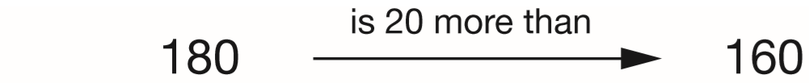
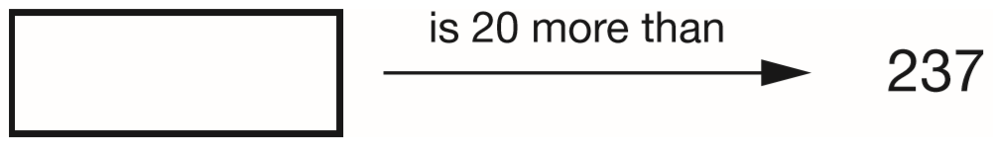
Write the missing number.
One is done for you.
257
237 + 20 =
257
Notes:
2015 (Sample) Paper 2 Q1

Slide 2
A pack of paper has 150 sheets.
4 children each take 7 sheets.
How many sheets of paper are left in the packet?
4 x 7 =
28 taken
4
1 5 0
1
-
2 8
1
2
2
sheets are left
Notes:
2015 (Sample) Paper 2 Q2

Slide 3
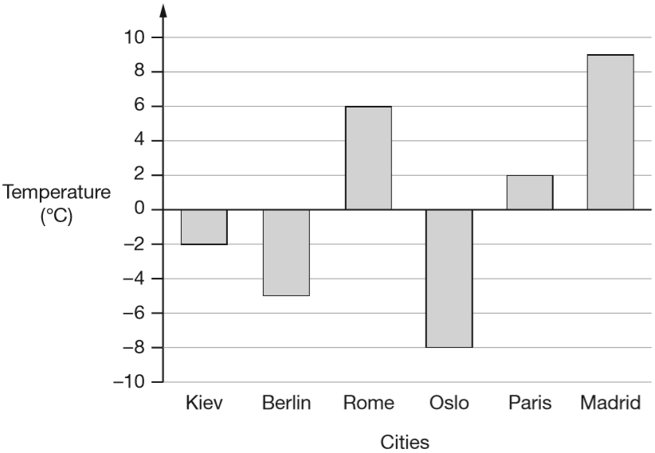
This graph shows the temperature in six cities on one day in January.
Which city was 4 degrees warmer than Kiev?
+2
+2
-2
0
2
Paris
Notes:
2015 (Sample) Paper 2 Q3 page 1

Slide 4
This graph shows the temperature in six cities on one day in January.
What was the difference between the temperature in Oslo and the temperature in Berlin?
3 degrees
-5
+3
-10
-9
-8
-7
-6
-5
-4
-3
-2
-1
0
1
2
3
4
5
6
7
8
9
10
Notes:
2015 (Sample) Paper 2 Q3 page 2

Slide 5
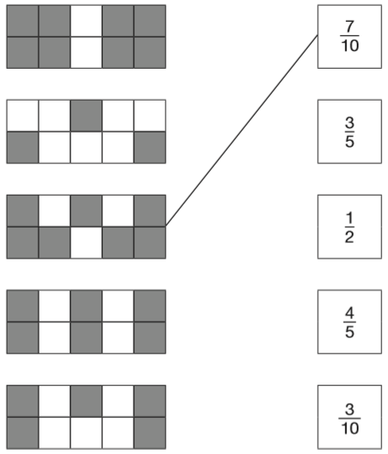
Here are some shapes made of squares.
A fraction of each shape is shaded.
Match each shape to its equivalent fraction.
One has been done for you.
÷2
8
4
=
1 0
5
÷2
÷2
6
3
=
1 0
5
÷5
÷2
5
1
=
1 0
2
÷5
Notes:
2015 (Sample) Paper 2 Q4

Slide 6

What is 444 minutes in hours and minutes?
7
24
60 minutes = 1 hour
120 minutes
= 2 hours
240 minutes
= 4 hours
360 minutes
= 6 hours
420 minutes
= 7 hours
+ 24 minutes
Notes:
2015 (Sample) Paper 2 Q5

Slide 7
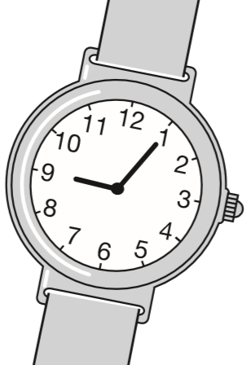
Stefan’s watch shows five minutes past nine.
The watch is twelve minutes fast.
What is the correct time?
-7m
-5m
8:53
8:53
9:00
9:05
Notes:
2015 (Sample) Paper 2 Q6

Slide 8
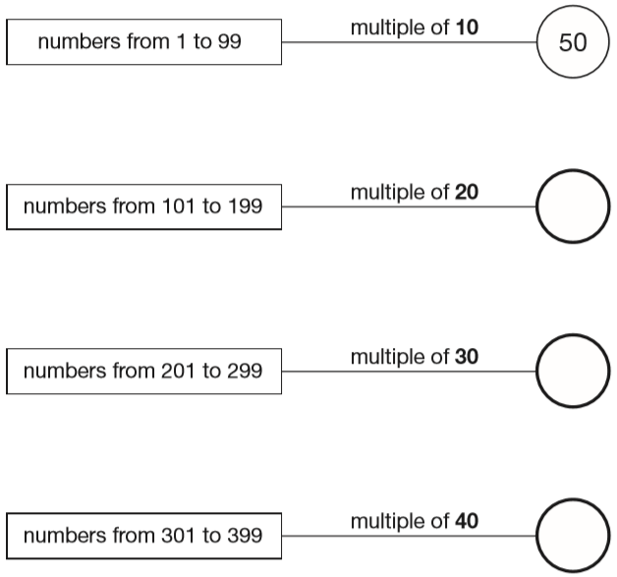
In the circles, write a multiple that belongs to each set.
One has been done for you.
120
180
160
140
210
270
240
320
360
Notes:
2015 (Sample) Paper 2 Q7

Slide 9
Maria bakes cakes and sells them in bags. She uses this formula to work out how much to charge for one bag of cakes.
Cost = number of cakes × 20p + 15p for the bag
How much will a bag of 12 cakes cost?
£2.55
12 x 20p =
240p
= £2.40
£2.40 + £0.15 =
£2.55
Notes:
2015 (Sample) Paper 2 Q8 page 1

Slide 10
Maria bakes cakes and sells them in bags. She uses this formula to work out how much to charge for one bag of cakes.
Cost = number of cakes × 20p + 15p for the bag
Olivia buys a bag of cakes for £5.15
Use the formula to calculate how many cakes are in the bag.
25 cakes
£5.15 = £0.15 =
£5.00
1 cake = 20p
25
£5.00 ÷ 20p =
5 cakes = £1
500 ÷ 20 =
25
25 cakes = £5
Notes:
2015 (Sample) Paper 2 Q8 page 2

Slide 11
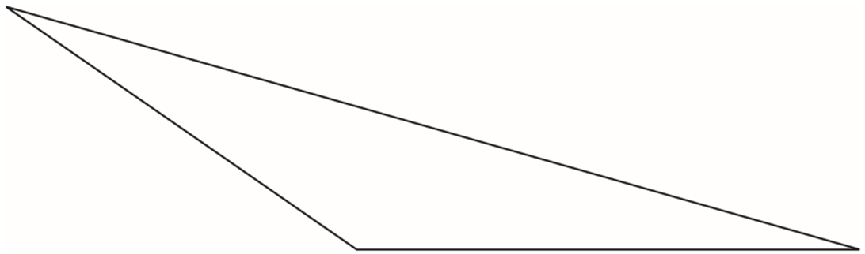
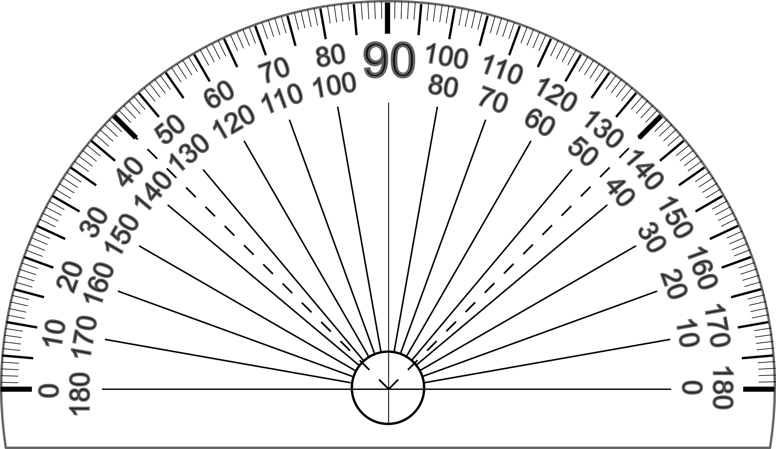
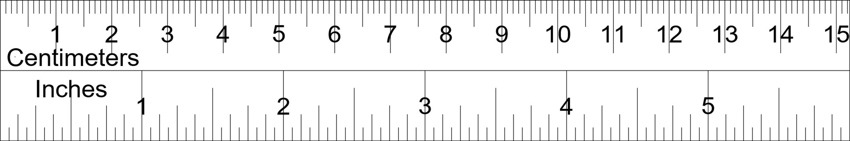
Here is a triangle.
Measure the shortest side accurately, in centimetres.
Measure the largest angle.
5.7 cm
6.7 cm
5.7 cm
You get the mark for an answer between 5.5 and 5.9 cm
145 degrees
You get the mark for an answer between 143 and 147 degrees
Notes:
2015 (Sample) Paper 2 Q9

Slide 12
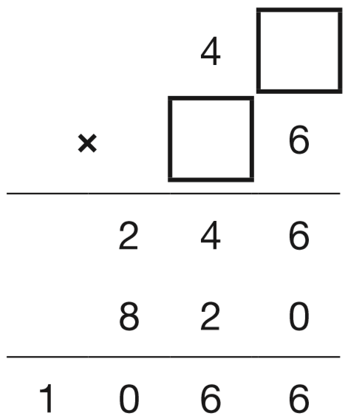
Write the two missing digits to make this long multiplication correct.
1
1 or 6
2
Notes:
2015 (Sample) Paper 2 Q10

Slide 13
Here is a number written in Roman numerals.
CXV
Write the number in figures.
115
C = 100
X = 10
V = 5
Notes:
2015 (Sample) Paper 2 Q11

Slide 14
What number is halfway between 1.4 and 2.1?
1.75
Add, then divide by 2
1.4 + 2.1 = 3.5
1.4
1.5
1.6
1.7
1.8
1.9
2.0
2.1
1.75
3.5 ÷ 2 =
1.75
1
.
5
7
2
3.5
0
1
1
1.7
0
0
1.8
1.75
Notes:
2015 (Sample) Paper 2 Q12

Slide 15
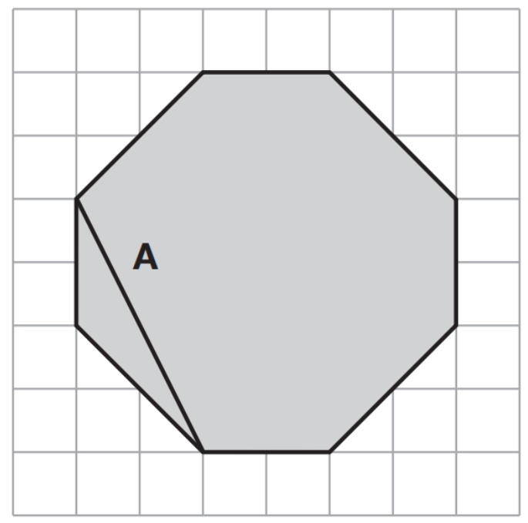
The diagram shows a shaded octagon on a square grid.
Line A joins two vertices of the octagon.
a) Join two vertices to draw a line perpendicular to line A.
b) Join two other vertices to draw a line parallel to line A.
Notes:
2015 (Sample) Paper 2 Q13

Slide 16
Round 124,531
to the nearest 10,000 __________
to the nearest 1,000 __________
to the nearest 100 __________
120 000
1 2 4 5 3 1
125 000
1 2 4 5 3 1
124 500
1 2 4 5 3 1
Notes:
2015 (Sample) Paper 2 Q14

Slide 17
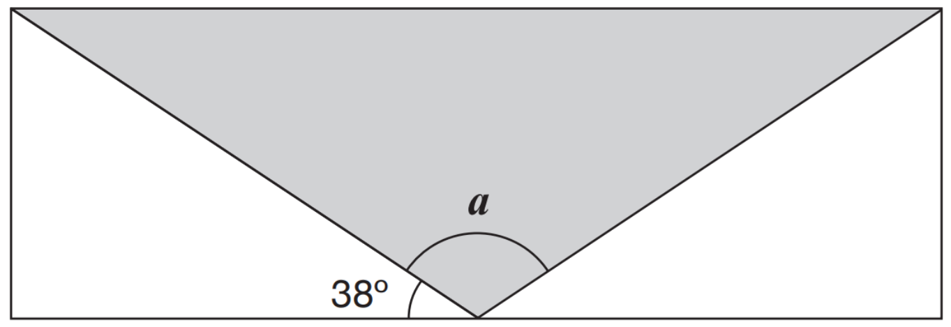
A shaded isosceles triangle is drawn inside a rectangle.
Calculate the size of angle a.
Angles on a straight line add up to 180°.
180° - 38° - 38° = 104°
a = 104°
104°
38°
Notes:
2015 (Sample) Paper 2 Q15

Slide 18
Large pizzas cost £8.50 each.
Small pizzas cost £6.75 each.
Five children together buy one large pizza and three small pizzas.
They share the cost equally.
How much does each child pay?
£5.75
2
1
6.7 5
2 0.2 5
x
3
£
5
.
+
8.5 0
7
5
.
5
2
7
£
2 0
2
£
8
.
5
5
2 8.7 5
3
2
Notes:
2015 (Sample) Paper 2 Q16

Slide 19
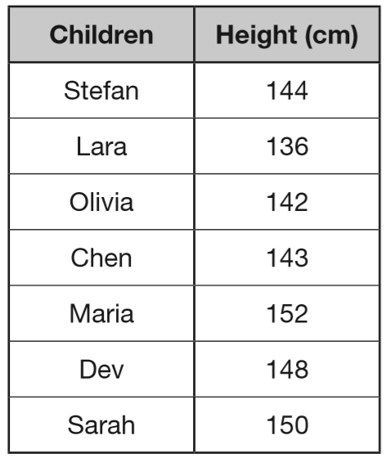
Seven children measured their heights.
What is the mean height of the children?
145 cm
1
4
5
cm
7
1 0 1 5
3
3
280
422
565
717
865
1015
Notes:
2015 (Sample) Paper 2 Q17

Slide 20
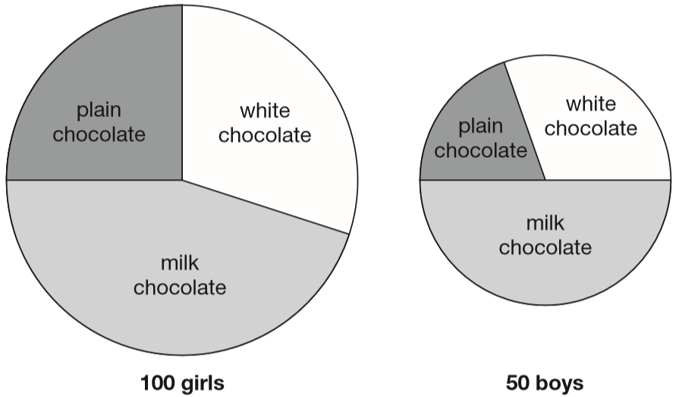
100 girls and 50 boys were asked which kind of chocolate they like best. These two pie charts show the results.
Dev says, ‘The pie charts show that more girls than boys liked milk chocolate best.’
Dev is correct.
Explain how you know.
1
1
of 100 = 25
of 50 =
25
4
2
Half of 50 = 25 boys
50 ÷ 2 =
25
Over a quarter of 100 = over 25 girls
Notes:
2015 (Sample) Paper 2 Q18

Slide 21
One gram of gold costs £32.94
What is the cost of half a kilogram of gold?
£16470
1 kilogram = 1000 grams
½ kilogram = 500 grams
£32.94 x 500 =
3 2.9 4
x 1000 to find 1 kg
£32940
3
2
9
4
0
.
then ÷ 2 to find ½ kg
£16470
1
6
4
0
£
7
2
3 2 9 4 0
1
1
1
4
2
x 100 to find 100 g
3 2.9 4
3 2 9 4
then x 5 to find 500 g
3
2
9
4
.
x
5
£
1 6
4
7
0
Notes:
2015 (Sample) Paper 2 Q19

Slide 22
2
On Saturday Lara read of her book.
On Sunday she read the other 90 pages to finish the book.
How many pages are there in Lara’s book?
5
150 pages
90
Sat
Sat
Sun
Sun
30
30
30
Sun
30
30
3
of = 90
150
30
5
90 ÷ 3 =
150
30 x 5 =
9 0 ÷ 3 = 3 0
3 0 x 5 = 1 5 0
Notes:
2015 (Sample) Paper 2 Q20

Slide 23
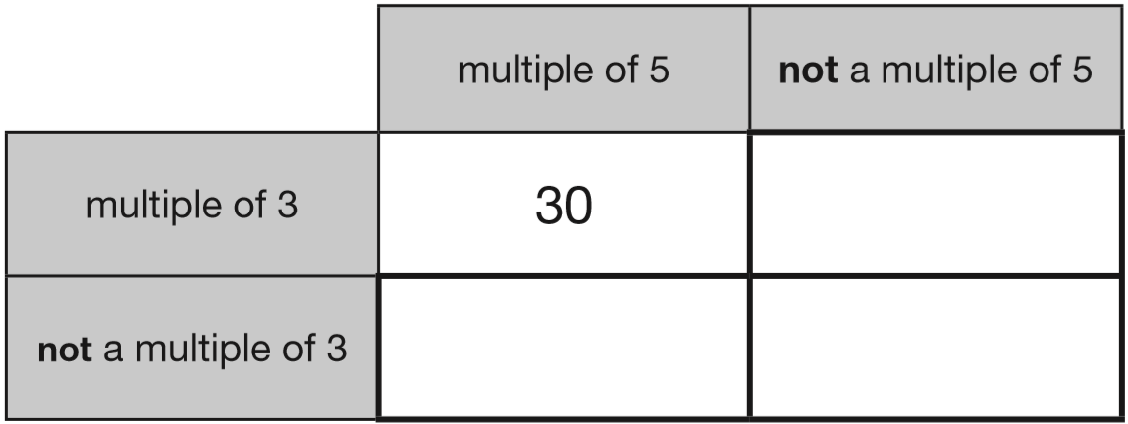
Here is a diagram for sorting numbers.
Write one number in each box.
One is done for you.
6
5
1
Notes:
2015 (Sample) Paper 3 Q1

Slide 24
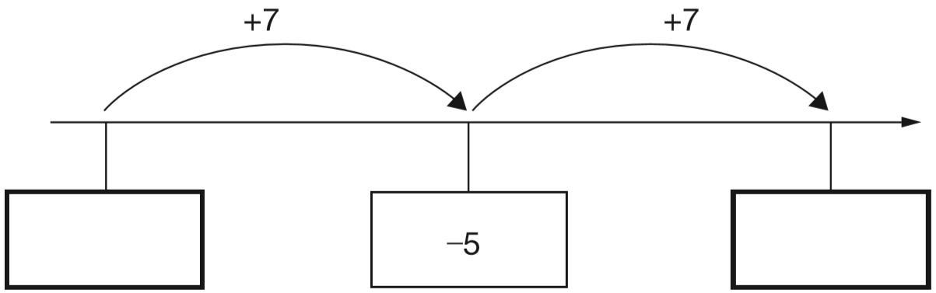
Here is part of a number line.
Write the missing numbers in the boxes.
+5
+2
-11
-10
-9
-8
-7
-6
-4
-3
-2
-1
0
1
-12
2
-5 – 7 =
-12
Notes:
2015 (Sample) Paper 3 Q2

Slide 25
Look at this number.
23,451.96
4
Write the digit that is in the hundreds place.
Write the digit that is in the hundredths place.
6
Ten thousands
Tens
Tenths
Thousands
Hundreds
Ones
Hundredths
1
1
10000
1000
100
10
1
10
100
1
1
100s
10s
1s
10 000s
1 000s
10
100
2 3 4 5 1 9 6
Notes:
2015 (Sample) Paper 3 Q3

Slide 26
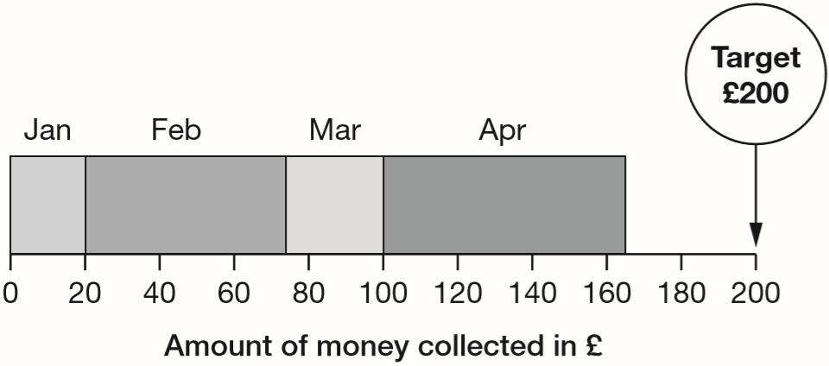
A school plans to collect £200 between January and May.
This chart shows how much they collected by the end of April.
Write the name of each month where they collected more than £50
How much money did they collect in February and March altogether?
20
53
27
64
70
170
February, April
£80
They collected £80
100 – 20 =
£80
53 + 27 =
Notes:
2015 (Sample) Paper 3 Q4

Slide 27
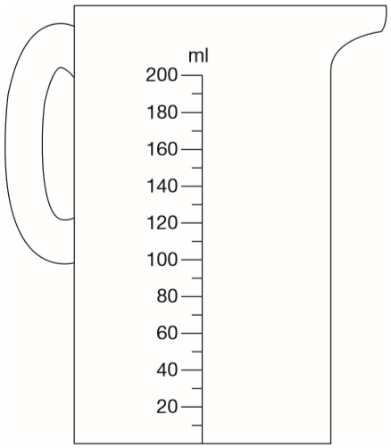
Chen pours 165 millilitres of milk into a measuring jug.
Draw an arrow on the jug to show the level of the milk.
170
Notes:
2015 (Sample) Paper 3 Q5

Slide 28
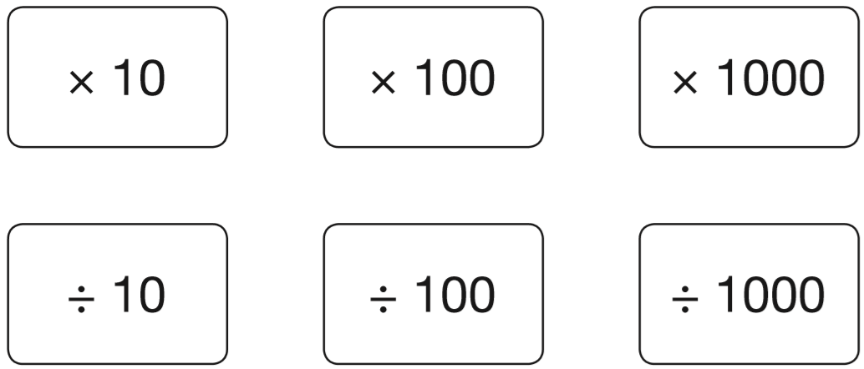
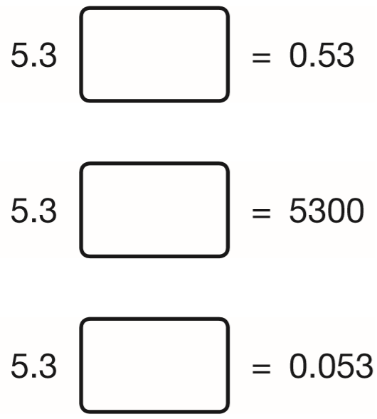
Here are six cards.
Use a card to complete each calculation.
÷10
x1000
5.3
5.3
5.3
0.5 3
.
5 3 0 0
0.0 5 3
÷100
Notes:
2015 (Sample) Paper 3 Q6

Slide 29
Write the number 53,148 in words.
Fifty-three
thousand,
one hundred and forty-eight
Notes:
2015 (Sample) Paper 3 Q7

Slide 30
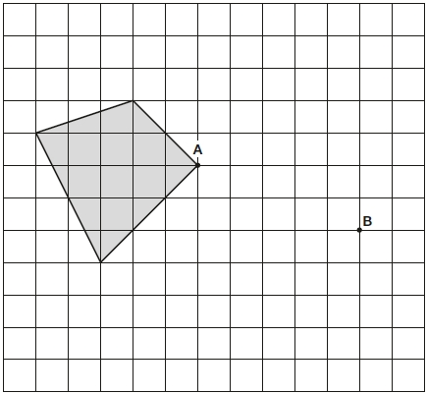
Here is a shaded shape on a grid. The shape is translated so that point A moves to point B. Draw the shape in its new position.
Notes:
2015 (Sample) Paper 3 Q8

Slide 31
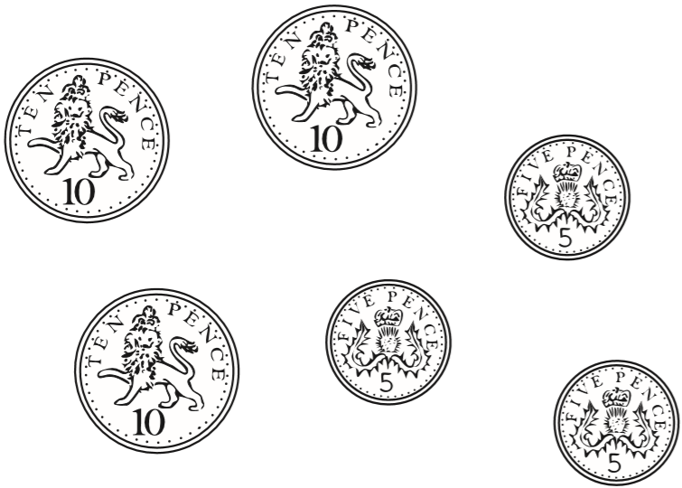
The mass of a 10p coin is 6.5g.
The mass of a 5p coin is half the mass of a 10p coin.
What is the mass of these six coins altogether?
29.25 g
1
3
.
6.5
2
5
1
1
6.5
6.5
2
6.5
0
1 9.5
0
3.25
x
1
3
+
9.7 5
.
1 9
5
9
2
5
2
.
3.25
6.5
1
3.25
3.2 5
x
3
.
9
7
5
Notes:
2015 (Sample) Paper 3 Q9

Slide 32
A bag of 5 lemons costs £1
A bag of 4 oranges costs £1.80
How much more does one orange cost than one lemon?
100p
180p
25p more
20p per lemon
100 ÷ 5 =
45 – 20 =
25p
180 ÷ 4 =
45p per orange
4
5
4
1 8 0
2
Notes:
2015 (Sample) Paper 3 Q10

Slide 33
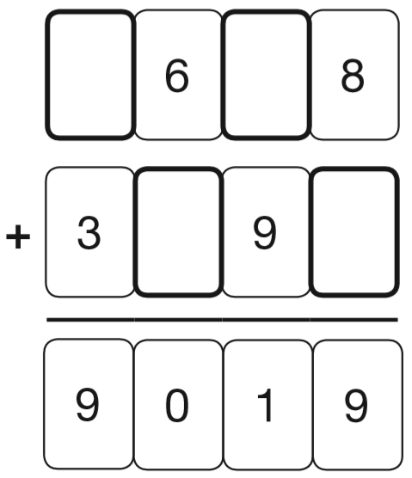
Write the four missing digits to make this addition correct.
1
1
5
2
3
1
Notes:
2015 (Sample) Paper 3 Q11

Slide 34
Two decimal numbers add together to equal 1
One of the numbers is 0.007
What is the other number?
0.993
0.007 + = 1
0.993
7 + 993 = 1000
so 0.007 + 0.993 = 1.000
0
9
9
1
.0 0 0
1
1
1
- 0.0 0 7
0
.
9
9
3
Notes:
2015 (Sample) Paper 3 Q12

Slide 35
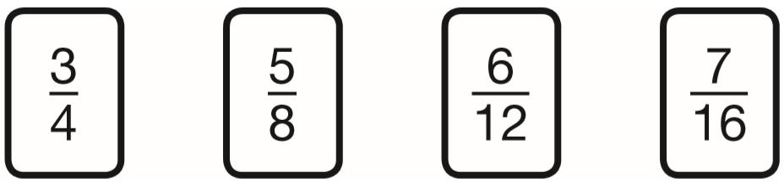
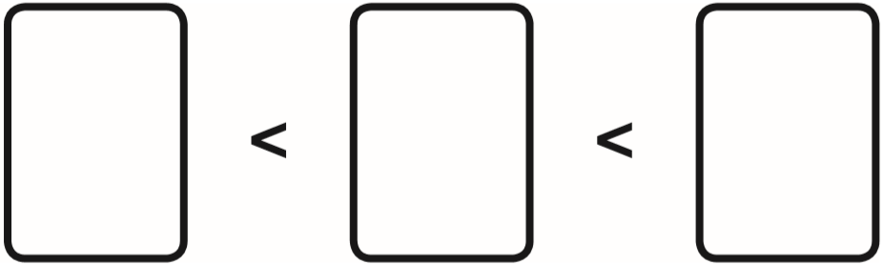
Here are four fraction cards.
Use any three of the cards to make this correct.
12
10
16
16
x4
3
1 2
=
4
1 6
x4
7
5
3
x2
1 6
8
4
5
1 0
=
8
1 6
x2
Notes:
2015 (Sample) Paper 3 Q13 page 1

Slide 36
Here are four fraction cards.
Use any three of the cards to make this correct.
x6
3
1 8
=
4
2 4
x6
x3
5
1 5
=
8
2 4
6
5
3
x3
1 2
8
4
x2
6
1 2
=
1 2
2 4
x2
Notes:
2015 (Sample) Paper 3 Q13 page 2

Slide 37
Here are four fraction cards.
Use any three of the cards to make this correct.
over ½
½
under ½
5
7
6
3
8
1 6
1 2
4
Notes:
2015 (Sample) Paper 3 Q13 page 3

Slide 38
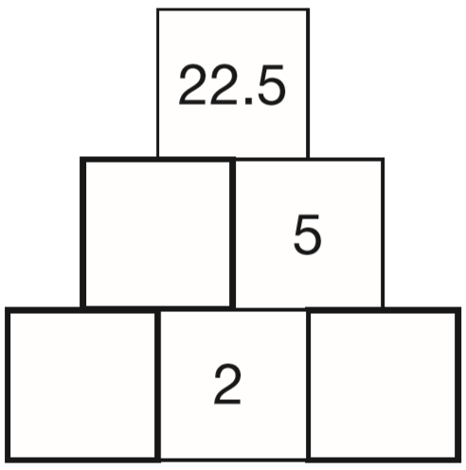
Here is a number pyramid.
The number in a box is the product of the two numbers below it.
Write the missing numbers.
.
4
5
5
2 2.5
2
4.5
2
.
5
2.25
2.5
2
5
.0
1
2
.
5
2
2
4.5
0
1
Notes:
2015 (Sample) Paper 3 Q14

Slide 39

Join dots on the grid to make a quadrilateral that has 3 acute angles.
Notes:
2015 (Sample) Paper 3 Q15

Slide 40
Lara chooses a number less than 100
She divides it by 3 and then subtracts 11
She then divides this result by 2
Her answer is 10.5
What was the number she started with?
96
96
÷3
32
-11
21
÷2
10.5
21 + 11 =
32
1
3 2
1 0.5
x
3
x
2
9
6
2
1
.
0
Notes:
2015 (Sample) Paper 3 Q16

Slide 41
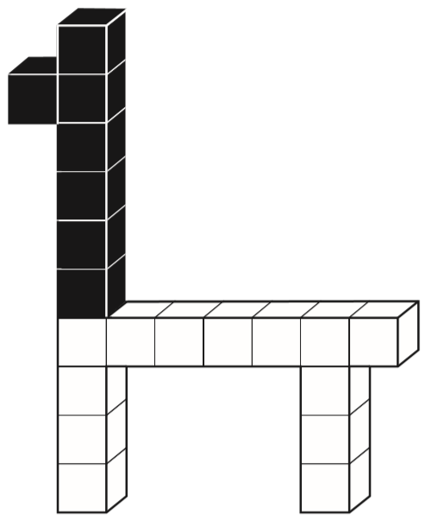
This model is made with 20 cubes.
What percentage of the cubes in the model is black?
35 percent
7 black cubes
20 cubes altogether
7
2 0
x5
7
3 5
=
2 0
1 0 0
x5
Notes:
2015 (Sample) Paper 3 Q17

Slide 42
Here are the ingredients for chocolate ice cream.
cream 400 ml
milk 500 ml
egg yolks 4
chocolate 120 g
sugar 100 g
Stefan has only 300ml of cream to make chocolate ice cream.
How much chocolate should he use?
400 cream = 120 chocolate
÷4
÷4
100 cream =
30 chocolate
x3
x3
300 cream =
90 chocolate
400 cream = 120 chocolate
x3
x3
1200 cream =
360 chocolate
÷4
÷4
90 g chocolate
300 cream =
90 chocolate
Notes:
2015 (Sample) Paper 3 Q18

Slide 43
The area of a rugby pitch is 6,108 square metres. A football pitch measures 112 metres long and 82 metres wide. How much larger is the area of the football pitch than the area of the rugby pitch?
1
7
1
1
2
9 1 8 4
1
x
8
2
-
6 1 0 8
1
2
2
4
3
0
7
6
The area of the football pitch is 3076 square metres larger.
8
9
6
0
9
1
8
4
Notes:
2015 (Sample) Paper 3 Q19

Slide 44
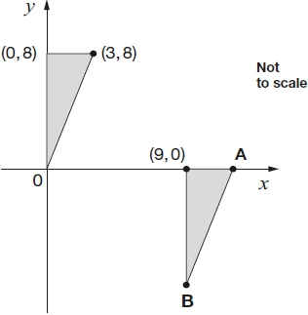
Here are two identical shaded triangles on coordinate axes.
Write the coordinates of points A and B.
3
8
A: (12,
0)
3
B: (9,
-8)
3
9
12
8
-8
Notes:
2015 (Sample) Paper 3 Q20

