Slide 1
Ali puts these five numbers in their correct places on a number line.
511 499 502 555 455
11 more
1 less
2 more
55 more
45 less
499
Write the number closest to 500
Write the number furthest from 500
555
Notes:
2016 Paper 2 Q1

Slide 2
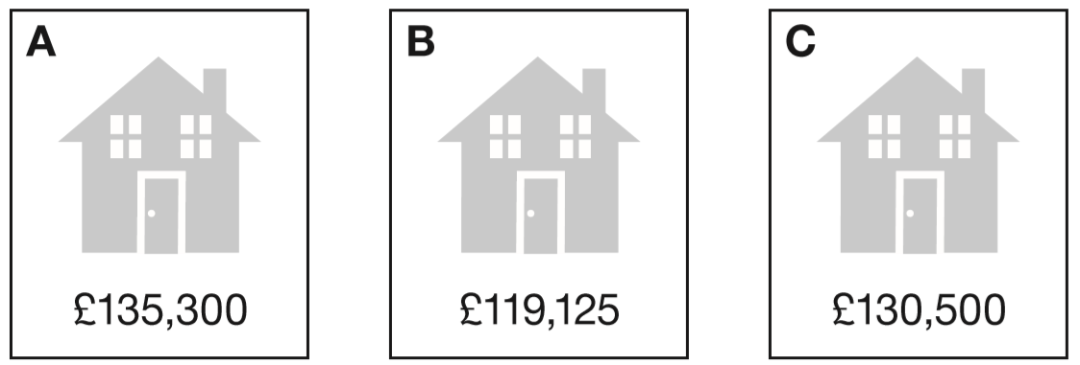
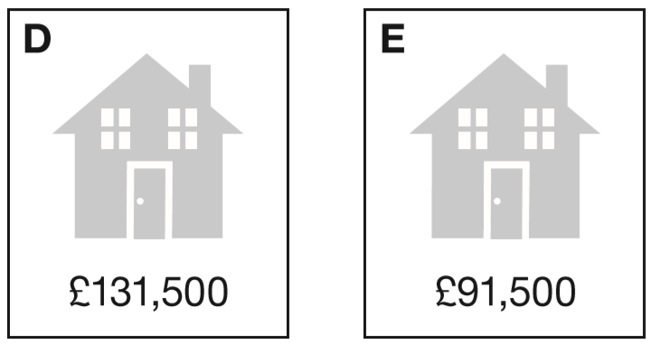
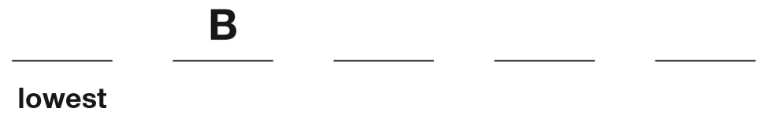
Put these houses in order of price starting with the lowest price.
One has been done for you.
E
C
D
A
1 3 5 3 0 0
1 1 9 1 2 5
1 3 0 5 0 0
1 3 1 5 0 0
9 1 5 0 0
Notes:
2016 Paper 2 Q2

Slide 3
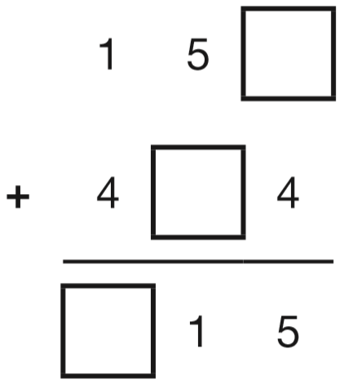
Write the three missing digits to make this addition correct.
1
1
6
6
Notes:
2016 Paper 2 Q3

Slide 4
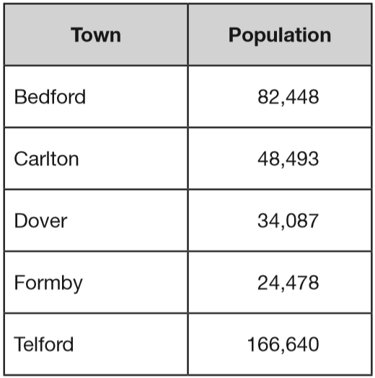
This table shows the number of people living in various towns in England.
What is the total of the numbers of people living in Formby and in Telford?
1
1
1
1 6 6 6 4 0
+
2 4 4 7 8
1
9
1
1
1
8
What is the difference between the numbers of people living in Bedford and in Dover?
7
3
8 2 4 4 8
1
1
-
3 4 0 8 7
4
8
3
6
1
Notes:
2016 Paper 2 Q4

Slide 5
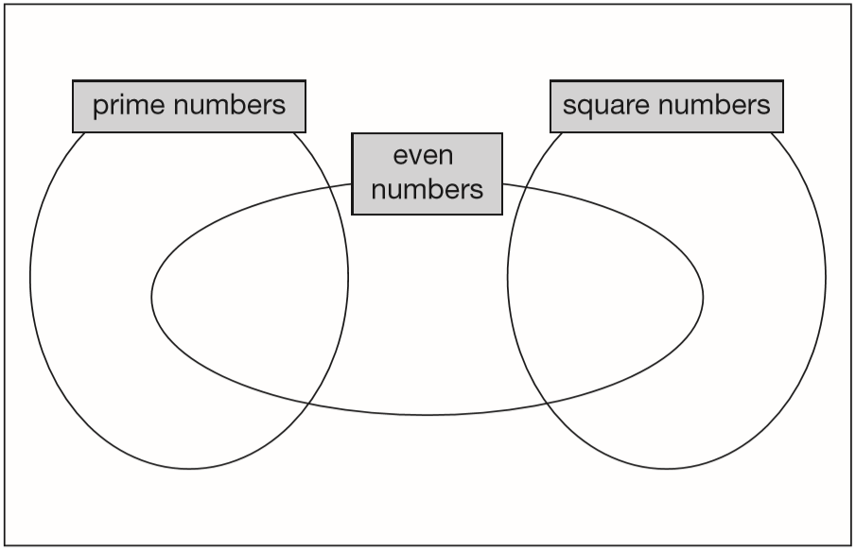
Write each number in its correct place on the diagram.
16 17 18 19
17
19
18
16
Notes:
2016 Paper 2 Q5

Slide 6
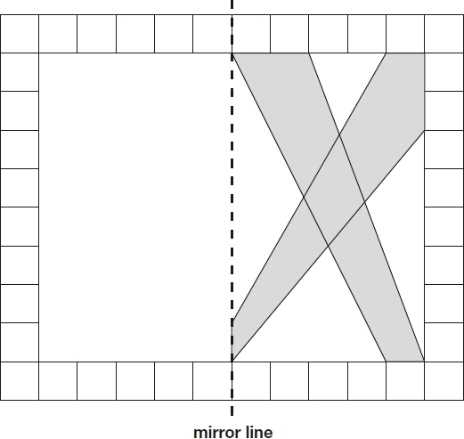
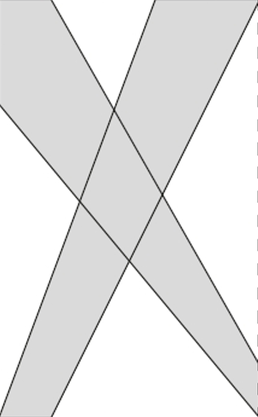
This diagram shows a shaded shape inside a border of squares. Draw the reflection of the shape in the mirror line.
Notes:
2016 Paper 2 Q6

Slide 7
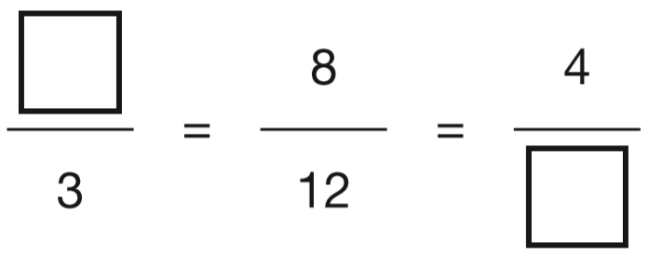
Write the two missing values to make these equivalent fractions correct.
x4
÷2
2
6
x4
÷2
Notes:
2016 Paper 2 Q7

Slide 8
Circle two numbers that add together to equal 0.25
0.05 0.23 0.2 0.5
0
0.2
0.2 3
0.0 5
0
+
+
0.2
2
✓
.
5
4
0
0
.
3
Notes:
2016 Paper 2 Q8

Slide 9
6 pencils cost £1.68
3 pencils and 1 rubber cost £1.09
What is the cost of 1 rubber?
1 pencil costs 28p
3 pencils costs 84p
25p
£
0
.
8
2
2
0
2 8
1.0 9
1
6
1.6 8
1
4
x
3
-
0.8 4
8
4
£
.
5
0
2
Notes:
2016 Paper 2 Q9

Slide 10
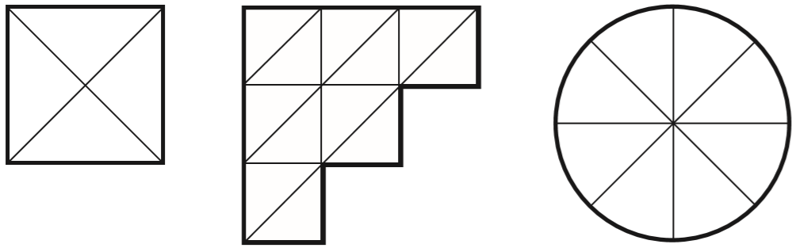
Each diagram below is divided into equal sections.
Shade three-quarters of each diagram.
x3
x2
3
9
3
6
=
=
4
1 2
4
8
x3
x2
Notes:
2016 Paper 2 Q10

Slide 11
A packet contains 1.5 kg of oats.
Every day Maria uses 50 g of oats to make porridge.
How many days does the packet of oats last?
30 days
1 kilogram = 1000 grams
1 day = 50 g
1.5 kilograms = 1500 grams
x2
2 days = 100 g
1500 ÷ 50 =
30
x5
10 days = 500 g
x3
30 days = 1500 g
Notes:
2016 Paper 2 Q11

Slide 12
n = 22
What is 2n + 9?
53
2 x 22 =
44
44 + 9 =
53
2q + 4 = 100
Work out the value of q.
48
100 – 4 =
96
96 ÷ 2 =
48
4
8
2
9 6
1
Notes:
2016 Paper 2 Q12

Slide 13
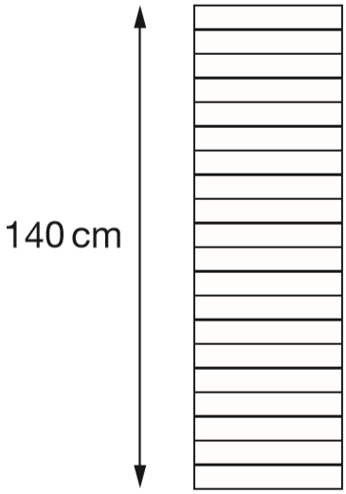
A stack of 20 identical boxes is 140 cm tall.
Stefan takes three boxes off the top.
How tall is the stack now?
119 cm
140 ÷ 20 =
7 cm each box
21 cm taken off
3 x 7 =
140 – 21 =
119 cm left
Notes:
2016 Paper 2 Q13

Slide 14
Write all the common multiples of 3 and 8 that are less than 50
24 and 48
Multiples of 8: 8, 16, 24, 32, 40, 48
8 x 3
16 x 3
1
6
3
4 8
1
Notes:
2016 Paper 2 Q14

Slide 15
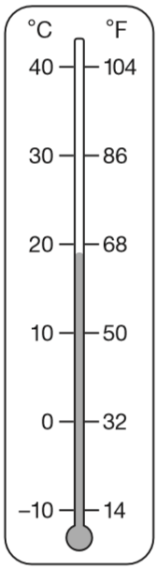
This thermometer shows temperatures in both °C and °F.
Work out what 25 °C is in °F.
77 °F
Half-way between 68 and 86
Add, then divide by 2
1
8 6
+
6 8
7
7
1 5
4
2
1 5 4
1
+5
+4
-4
-5
68
69
70
71
72
73
74
75
76
77
78
79
80
81
82
83
84
85
86
Notes:
2016 Paper 2 Q15

Slide 16
Write the number that is five less than ten million.
0
9
9
9
9
9
9
10,000,000 – 5 =
9,999,995
1 0 0 0 0 0 0 0
1
1
1
1
1
1
1
-
5
0
9
9
9
9
9
9
5
Write the number that is one hundred thousand less than six million.
6,000,000 – 100,000 =
5,900,000
5
6 0 0 0 0 0 0
1
-
1 0 0 0 0 0
5
9
0
0
0
0
0
Notes:
2016 Paper 2 Q16

Slide 17
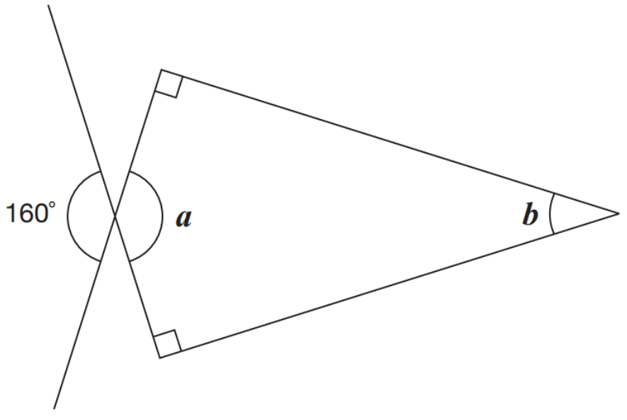
Calculate the size of angles a and b.
90°
160°
20°
90°
Vertically opposite angles are the same size.
a = 160°
Angles in a quadrilateral add up to 360°.
b = 360° - 160° - 90° - 90° =
20°
Notes:
2016 Paper 2 Q17

Slide 18
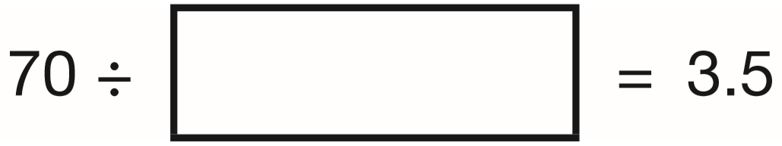
Write the missing number.
If 2 x 3.5 = 7
Then 20 x 3.5 = 70
So 70 ÷ 3.5 = 20
And 70 ÷ 20 = 3.5
20
2
0
1
3.5
7 0
3
.5
+
3.5
7
.
0
so 2 x 3.5 = 7
Notes:
2016 Paper 2 Q18

Slide 19
Miss Mills is making jam to sell at the school fair.
Strawberries cost £7.50 per kg.
Sugar costs 79p per kg.
10 glass jars cost £6.90
She uses 12 kg of strawberries and 10 kg of sugar
to make 20 jars full of jam.
Calculate the total cost to make 20 jars full of jam.
6
7.5 0
x
1 2
£
.
9 0
0
0
7 9 x 1 0 =
£ .
£90
7 9 0
£7.90
£13.80
£6.90 x 2 =
£13.80
£111.70
£90 + £7.90 + £13.80 =
£111.70
Notes:
2016 Paper 2 Q19

Slide 20
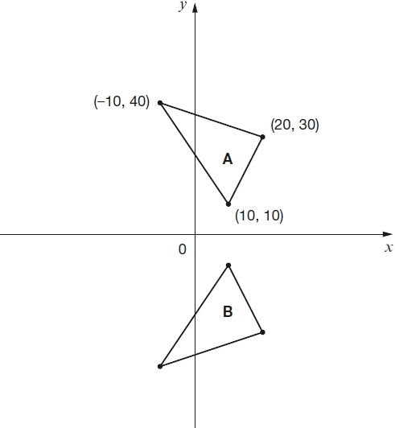
Here are two triangles drawn on coordinate axes.
Triangle B is a reflection of triangle A in the x-axis.
Two of the new vertices of triangle B are (10, −10) and (20, −30).
What are the coordinates of the third vertex of triangle B?
(10, -10)
(-10, -40)
(20, -30)
(-10,
-40)
Notes:
2016 Paper 2 Q20

Slide 21
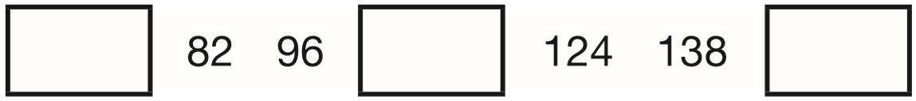
The numbers in this sequence increase by 14 each time.
Write the missing numbers.
68
110
152
7
1
1
8 2
9 6
1 3 8
1
–
1 4
+
1 4
+
1 4
6
8
1 1
0
1
5
2
Notes:
2016 Paper 3 Q1

Slide 22
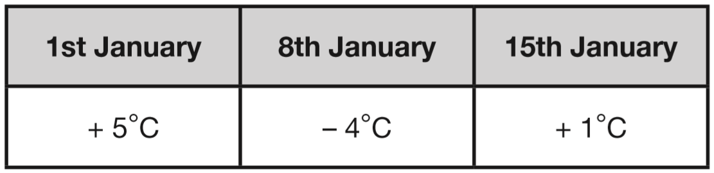
This table shows the temperature at 9am on three days in January.
What is the difference between the temperature on 1st January and the temperature on 8th January?
+4
+5
The difference is 9°C.
-4
0
5
On 22nd January the temperature was 7 degrees lower than on 15th January. What was the temperature on 22nd January?
-6
-1
The temperature was -6°C.
-6
0
1
Notes:
2016 Paper 3 Q2

Slide 23
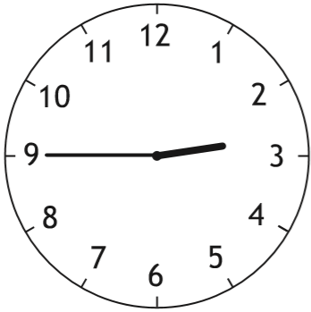
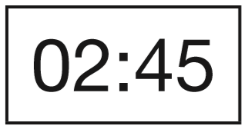
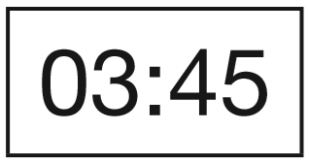
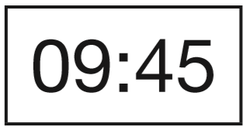
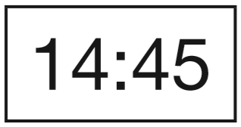
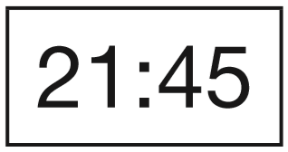
A clock shows this time twice a day.
Tick the two digital clocks that show this time.
✓
✓
Notes:
2016 Paper 3 Q3

Slide 24
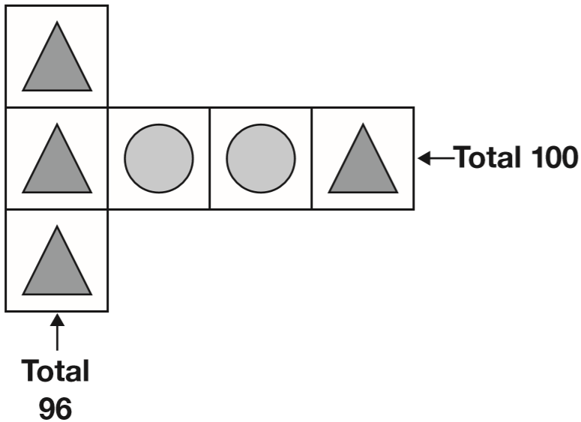
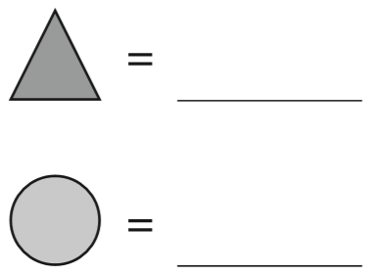
Each shape stands for a number.
Work out the value of each shape.
32
18
18
32 + circle + circle + 32 = 100
32
32
32 + 32 =
64
32
64 + 2 circles = 100
3 triangles = 96
100 – 64 =
36
1 triangle =
2 circles = 36
32
1 circle =
18
32
3
2
3
9 6
1
8
2
3 6
1
18
Notes:
2016 Paper 3 Q4

Slide 25
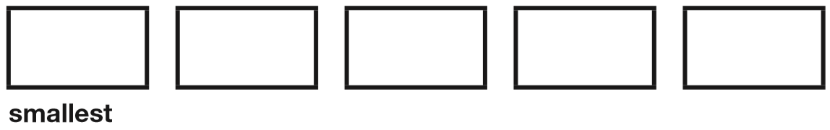
Write these numbers in order, starting with the smallest.
0.78 0.607 5.6 0.098 4.003
0
00
0.7 8
0
0.6 0 7
5.6
0 0
0.0 9 8
4.0 0 3
0.098
0.607
0.78
4.003
5.6
Notes:
2016 Paper 3 Q5

Slide 26
Jacob cuts 4 metres of ribbon into three pieces.
The length of the first piece is 1.28 metres.
The length of the second piece is 1.65 metres.
Work out the length of the third piece.
1.07 metres
or 107 centimetres
1
3
9
1.6 5
4.0 0
1
1
+
1.2 8
-
2.9 3
9
.
7
m
2
.
3
1
0
Notes:
2016 Paper 3 Q6

Slide 27
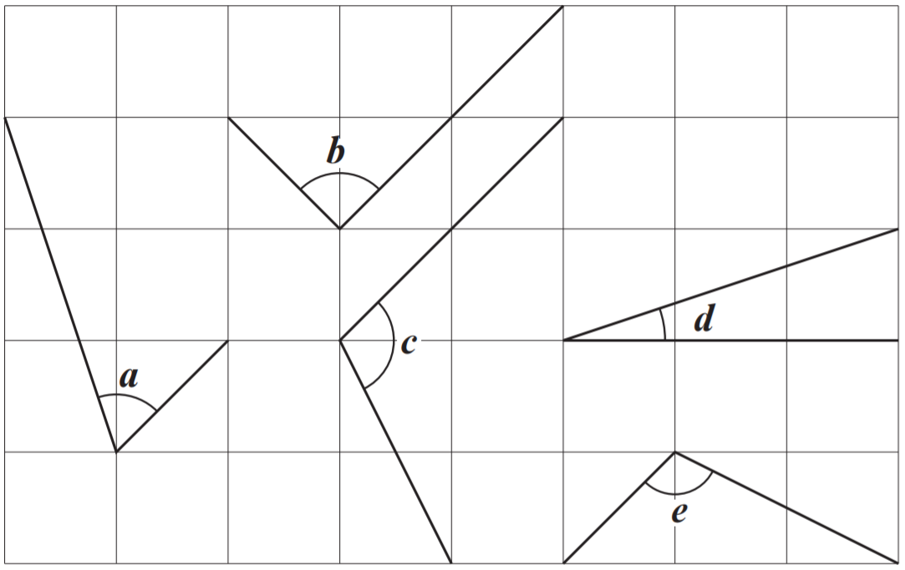
c
Write the letters of the angles that are obtuse.
Write the letters of the angles that are acute.
, e
a
, d
Notes:
2016 Paper 3 Q7

Slide 28
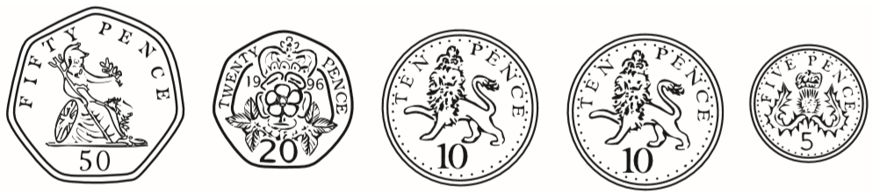
Olivia buys three packets of nuts.
She pays with a £2 coin.
This is her change.
What is the cost of one packet of nuts?
95p
35p
1
9
2.0 0
1
1
-
0.9 5
£
0
.
3
5
.
5
£
1
0
for 3 packets
1.0 5
3
1
1
Notes:
2016 Paper 3 Q8

Slide 29
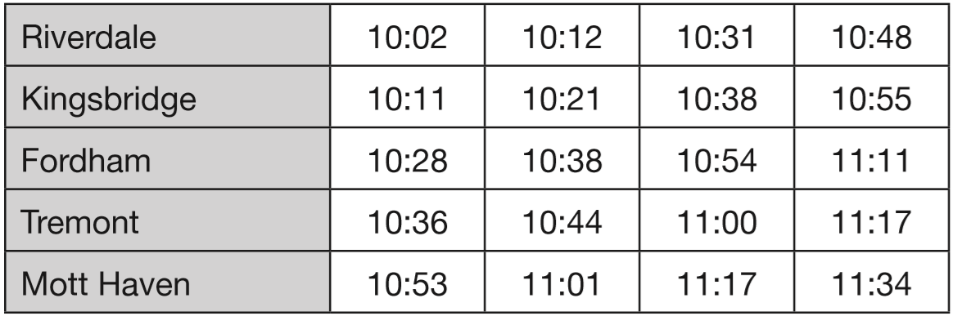
Here is part of the bus timetable from Riverdale to Mott Haven.
How many minutes does it take the 10:31 bus from Riverdale to reach Mott Haven?
+29m
+17m
29 + 17 =
46
10:31
11:00
11:17
It takes 46 minutes.
Notes:
2016 Paper 3 Q9 page 1

Slide 30
Here is part of the bus timetable from Riverdale to Mott Haven.
Mr Evans is at Fordham at 10:30
What is the earliest time he can reach Tremont on the bus?
10:44
Notes:
2016 Paper 3 Q9 page 2

Slide 31
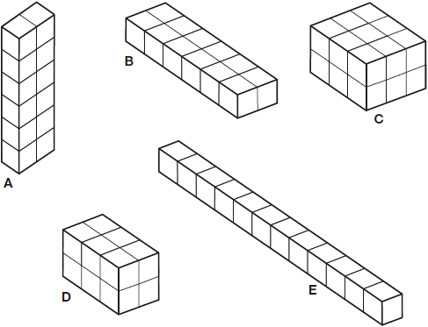

Emma makes a cuboid using 12 cubes.
Write the letter of the cuboid that has a different volume from Emma’s cuboid.
12
18
12
C
12
12
Notes:
2016 Paper 3 Q10

Slide 32
A toy shop orders 11 boxes of marbles.
Each box contains 6 bags of marbles.
Each bag contains 45 marbles.
How many marbles does the shop order in total?
11 x 6 =
66 bags
66 x 45 =
2970 marbles
2
3
6
6
x
4
5
3 3
0
2 6
4
0
2
9
7
0
Notes:
2016 Paper 3 Q11

Slide 33
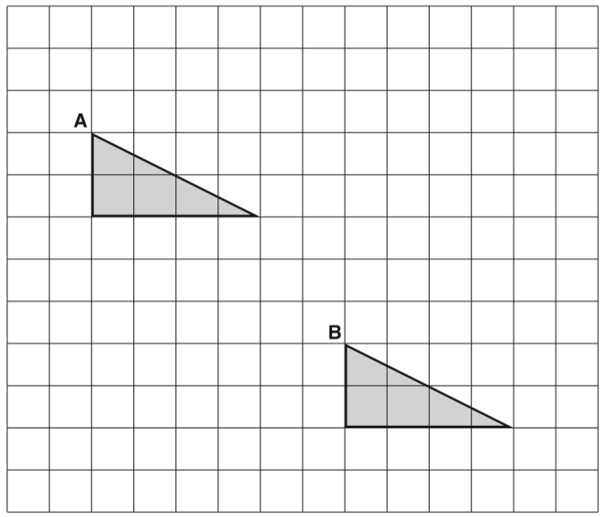
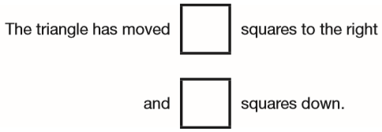
A triangle is translated from position A to position B.
Complete the sentence.
6
5
Notes:
2016 Paper 3 Q12

Slide 34
Lara chooses a number less than 20
She divides it by 2 and then adds 6
She then divides this result by 3
Her answer is 4.5
What was the number she started with?
15
15
÷2
7.5
+6
13.5
÷3
4.5
1
13.5 – 6 =
7.5
1
7.5
4.5
x
2
x
3
1 3
.
1 5
.
5
0
Notes:
2016 Paper 3 Q13

Slide 35
Complete each sentence using a number from the list below.
120 240 600 1,440 3,600 6,000
There are _____ seconds in an hour.
There are _____ minutes in a day.
60 seconds = 1 minute
3600
x60
x60
3600 seconds
= 1 hour
1440
60 x 60 = 3600
60 minutes = 1 hour
x24
x24
2
1440 minutes
= 1 day
2 4
x
0
6
1 4
4
0
Notes:
2016 Paper 3 Q14

Slide 36
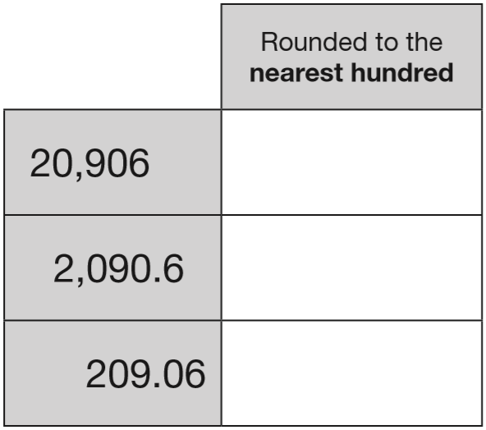
Complete this table by rounding the numbers to the nearest hundred.
20 900
2 0 9 0 6
2100
2 0 9 0.6
200
2 0 9.0 6
Notes:
2016 Paper 3 Q15

Slide 37
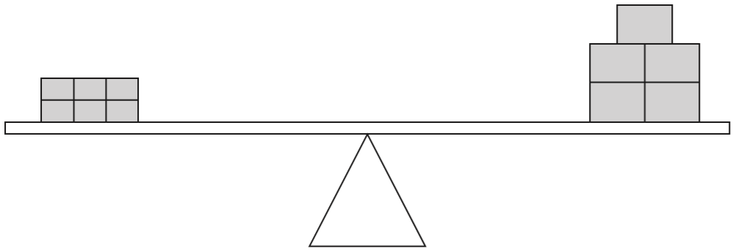
6 small bricks have the same mass as 5 large bricks.
The mass of one small brick is 2.5 kg.
What is the mass of one large brick?
3 kg
15 kg
6 small bricks =
6 x 2.5 =
3
5 large bricks = 15 kg
2.5
x
6
1 large brick =
15 ÷ 5 =
3 kg
1 5
0
.
Notes:
2016 Paper 3 Q16

Slide 38
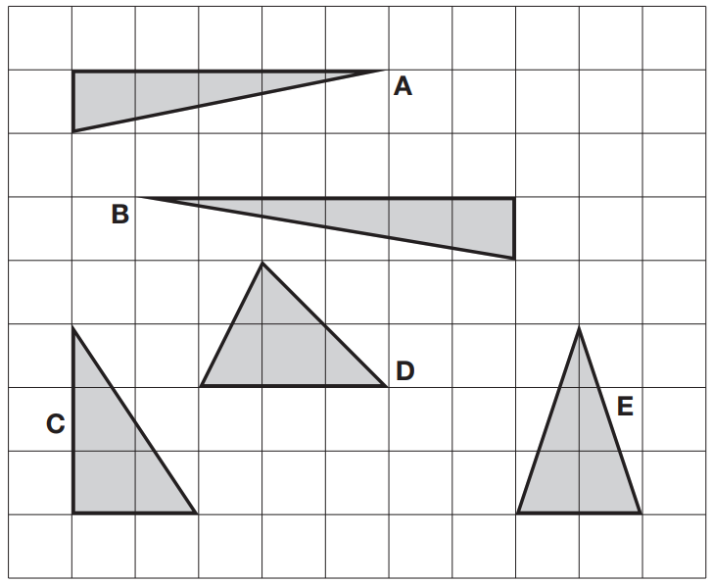
Here are five triangles on a square grid. Four of the triangles have the same area. Which triangle has a different area?
A
A
5 cm x 1 cm ÷ 2 =
2 ½ cm²
B
6 cm x 1 cm ÷ 2 =
3 cm²
C
2 cm x 3 cm ÷ 2 =
3 cm²
and E
D
3 cm x 2 cm ÷ 2 =
3 cm²
Notes:
2016 Paper 3 Q17

Slide 39
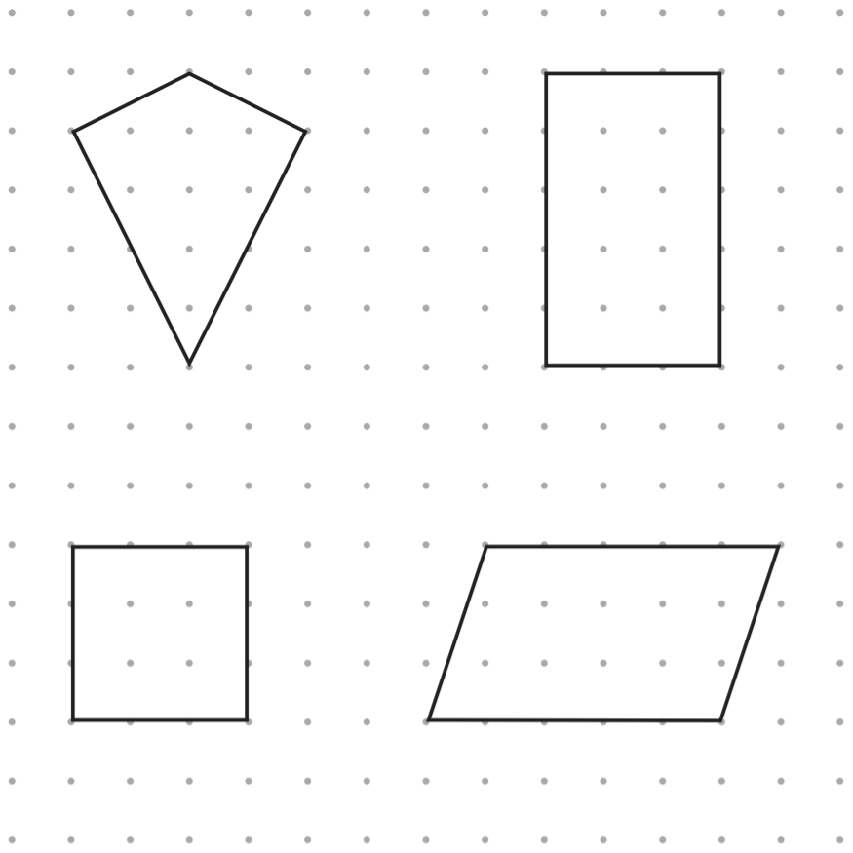
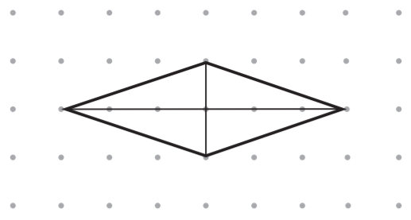
The diagonals of this quadrilateral cross at right angles.
✓
Tick all the quadrilaterals that have diagonals which cross at right angles.
✓
Notes:
2016 Paper 3 Q18

Slide 40
Circle two numbers that multiply together to equal 1 million.
200 2,000 5,000 50,000
5 0 0 0 x 2 0 0 =
1 0 0 0 0 0 0
Notes:
2016 Paper 3 Q19

Slide 41
Lara had some money.
She spent £1.25 on a drink.
She spent £1.60 on a sandwich.
She has three-quarters of her money left.
How much money did Lara have to start with?
£1.60 + £1.25 =
£2.85
£11.40
£1.60
£1.25
3
2
2.8 5
spent
£2.85
left
£2.85
left
£2.85
left
£2.85
x
4
£
.
0
1 1
4
Notes:
2016 Paper 3 Q20

Slide 42
5,542 ÷ 17 = 326
Explain how you can use this fact to find the answer to 18 × 326
This shows that 17 x 326 = 5542
so you can work out 326 + 5542
because 1 x 326 = 326
and if you add 1 times a number to 17 times a number,
you get 18 times that number.
Notes:
2016 Paper 3 Q21

