Slide 1
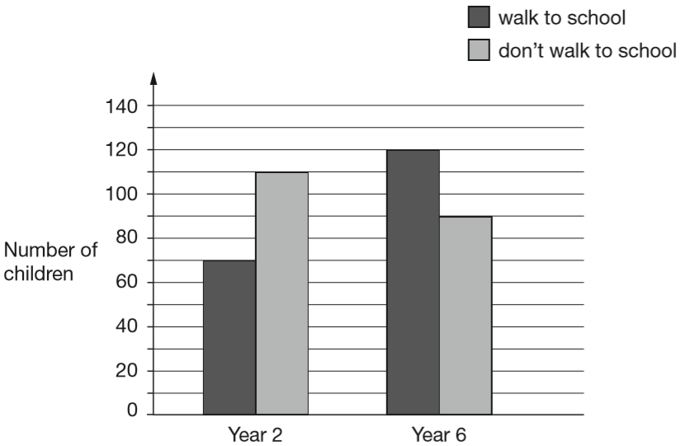
William asks the children in Year 2 and Year 6 if they walk to school.
This graph shows the results.
Altogether, how many children don’t walk to school?
110 + 90 =
200 children
110
90
Notes:
2017 Paper 2 Q1 page 1

Slide 2
William asks the children in Year 2 and Year 6 if they walk to school.
This graph shows the results.
How many more Year 6 children than Year 2 children walk to school?
120 – 70 =
50 children
70
Notes:
2017 Paper 2 Q1 page 2

Slide 3
Circle the number that is 10 times greater
than nine hundred and seven.
9,700 907 9,007 970 9,070
907 x 10 =
9070
Notes:
2017 Paper 2 Q2

Slide 4
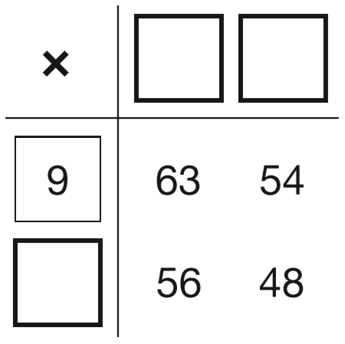
Write the missing numbers to make this multiplication grid correct.
7
6
8
Notes:
2017 Paper 2 Q3

Slide 5
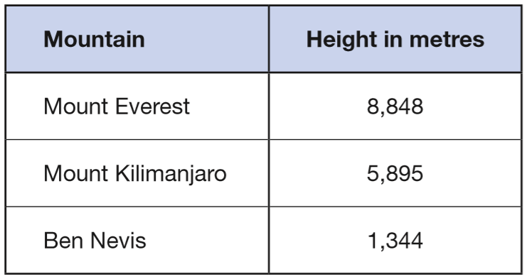
This table shows the heights of three mountains.
How much higher is Mount Everest than the combined height of the other two mountains?
1609 metres
1
1
5 8 9 5
+
1 3 4 4
7
2
3
9
3
8 8 4 8
1
-
7 2 3 9
1
6
0
9
Notes:
2017 Paper 2 Q4

Slide 6
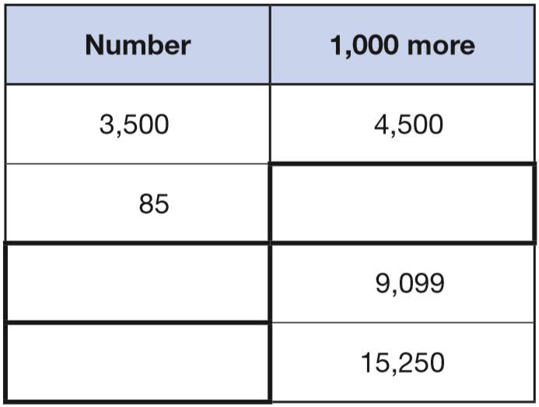
Complete this table with the missing numbers.
One row has been done for you.
1085
1000 + 85 =
8099
9099 – 1000 =
14250
15250 – 1000 =
Notes:
2017 Paper 2 Q5

Slide 7
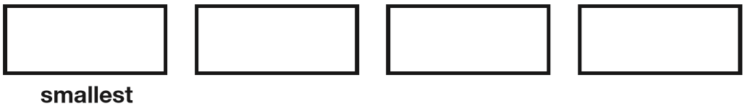
Write these numbers in order of size, starting with the smallest.
1.9 0.96 1.253 0.328
00
0
1.9
0 0
0.9 6
0
1.2 5 3
0.3 2 8
0.328
0.96
1.253
1.9
Notes:
2017 Paper 2 Q6

Slide 8
Write the missing numbers.
60 months = _____ years
72 hours = _____ days
84 days = _____ weeks
5
60 ÷ 12 =
5
3
72 ÷ 24 =
3
1 day = 24 hours
12
+24
84 ÷ 7 =
12
2 days =
48 hours
+24
3 days =
72 hours
Notes:
2017 Paper 2 Q7

Slide 9
At the start of June, there were 1,793 toy cars in the shop.
During June,
• 8,728 more toy cars were delivered
• 9,473 toy cars were sold.
How many toy cars were left in the shop at the end of June?
1048
0
1
1
1
1
1
4
1 7 9 3
1 0 5 2 1
1
1
+
8 7 2 8
-
9 4 7 3
1 0
5
2
1
1
0
4
8
Notes:
2017 Paper 2 Q8

Slide 10
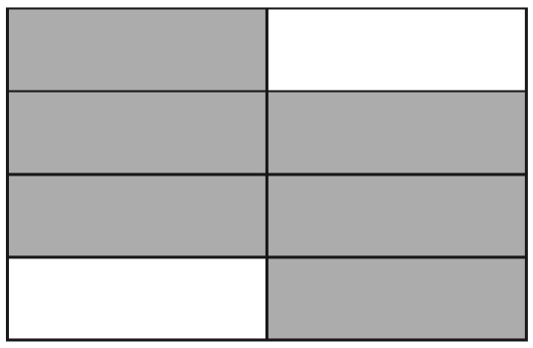
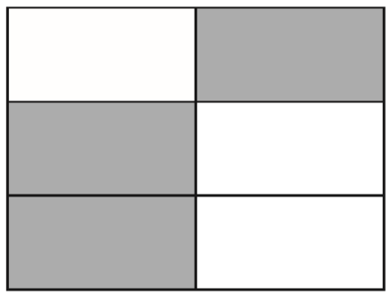
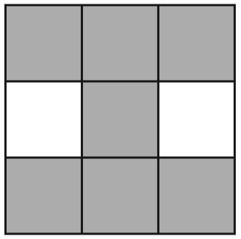
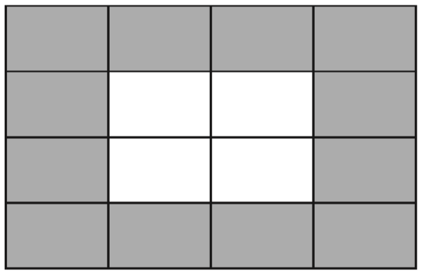
3
Tick two shapes that have shaded.
4
÷2
6
3
3
✓
=
8
4
6
÷2
÷4
7
1 2
3
✓
=
9
1 6
4
÷4
Notes:
2017 Paper 2 Q9

Slide 11
Round 84,516
to the nearest 10: ________
to the nearest 100: ________
to the nearest 1,000: ________
84 520
8 4 5 1 6
8 4 5 1 6
84 500
8 4 5 1 6
85 000
Notes:
2017 Paper 2 Q10

Slide 12
Here is a rule for the time it takes to cook a chicken.
Cooking time = 20 minutes plus an extra 40 minutes for each kilogram
How many minutes will it take to cook a 3 kg chicken?
140 minutes
20 + (40 x 3) =
20 + 120 =
140
2 kg
What is the mass of a chicken that takes 100 minutes to cook?
100 = 20 + (40 x ___)
2
100 – 20 =
80
80 ÷ 40 =
2
Notes:
2017 Paper 2 Q11

Slide 13

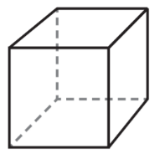
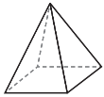
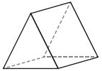
Here are diagrams of some 3-D shapes. Tick each shape that has the same number of faces as vertices.
triangular-based pyramid
cube
6 faces
4 faces
8 vertices
✓
4 vertices
square-based pyramid
triangular prism
5 faces
5 faces
6 vertices
✓
5 vertices
Notes:
2017 Paper 2 Q12

Slide 14
Ally and Jack buy some stickers.
Ally buys a pack of 12 stickers for £10.49
Jack buys 12 single stickers for 99p each.
How much more does Jack pay than Ally?
£1.39 more
Jack pays 12 x 99p
10
7
9 9
1 1.8 8
1
12 x £1 = £12
x
1 2
-
1 0.4 9
£12.00 - £0.12 = £11.88
0
3
£ .
8
£
1
.
9
1 1 8
Notes:
2017 Paper 2 Q13

Slide 15
Amina planted some seeds.
For every 3 seeds Amina planted, only 2 seeds grew.
Altogether, 12 seeds grew.
How many seeds did Amina plant?
18 seeds
3 planted 2 grew
x6
x6
18 planted
12 grew
Notes:
2017 Paper 2 Q14

Slide 16
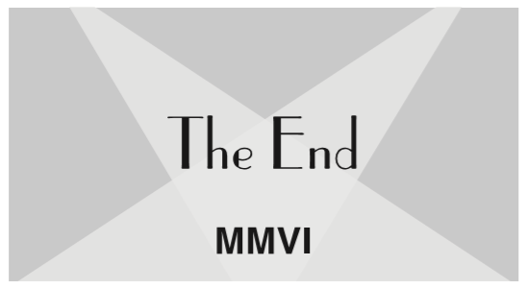
At the end of a film, the year is given in Roman numerals.
Write the year MMVI in figures.
M = 1000
2006
V = 5
I = 1
Notes:
2017 Paper 2 Q15

Slide 17
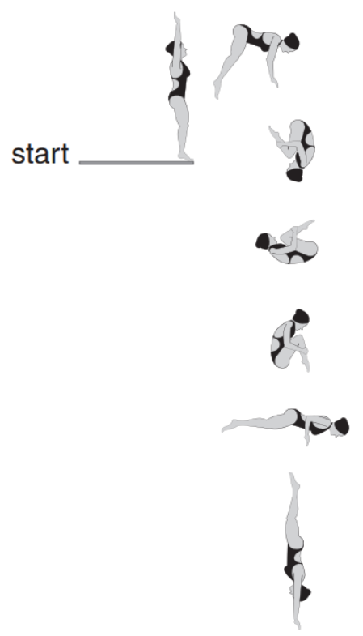
Layla completes one-and-a-half somersaults in a dive. How many degrees does Layla turn through in her dive?
90°
90°
Angles around a point add up to 360°.
90°
A whole turn is 360°.
Angles on a straight line add up to 180°.
90°
A half turn is 180°.
90°
One-and-a-half turns = 360° + 180°
= 540°
6 x 90° = 540°
90°
Notes:
2017 Paper 2 Q16

Slide 18
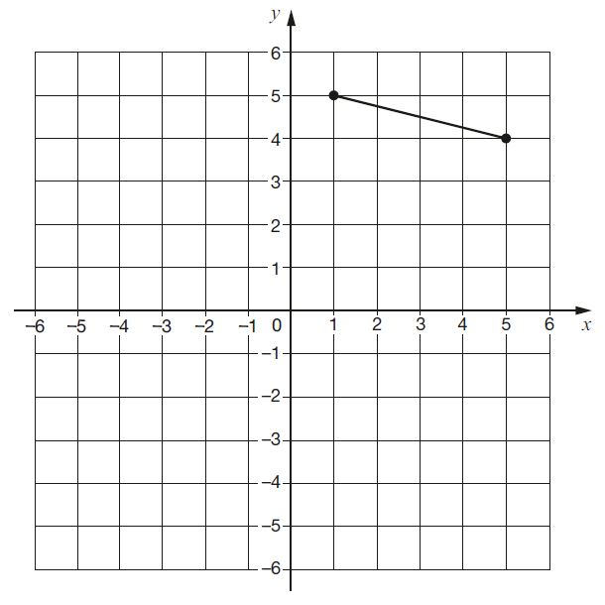
The vertices of a quadrilateral have these coordinates:
(1, 5)
(5, 4)
(1, −3)
(−3, 4)
One side of the quadrilateral has been drawn on the grid. Complete the quadrilateral.
Notes:
2017 Paper 2 Q17

Slide 19
A cat sleeps for 12 hours each day. 50% of its life is spent asleep.
A koala sleeps for 18 hours each day. ____% of its life is spent asleep.
75
÷12
x50
÷6
x25
1 2
1
5 0
1 8
3
7 5
=
=
=
=
2 4
2
1 0 0
2 4
4
1 0 0
÷12
x50
÷6
x25
Notes:
2017 Paper 2 Q18

Slide 20
Amina posts three large letters.
The postage costs the same for each letter.
She pays with a £20 note.
Her change is £14.96
What is the cost of posting one letter?
£1.68
1
9
9
2 0.0 0
£20.00 – £14.96 =
£5.04 for three letters
1
1
1
-
1 4.9 6
1 letter =
£5.04 ÷ 3 =
£1.68
0
£
0
5
.
4
£
1
.
6
8
3
5.0 4
2
2
Notes:
2017 Paper 2 Q19

Slide 21
2
Adam says, 0.25 is smaller than
Explain why he is correct.
5
x20
2 5
2
4 0
Two fifths is equivalent to four tenths, which is 0.4
0.25 is smaller than 0.4 because it has fewer tenths.
0.25 =
=
1 0 0
5
1 0 0
x20
0.25 is twenty-five hundredths.
Two fifths is equivalent to forty hundredths.
Notes:
2017 Paper 2 Q20

Slide 22
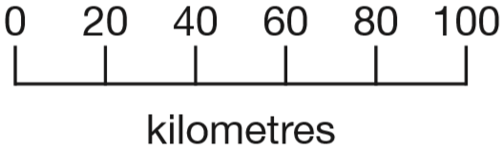
On a map, 1cm represents 20 km.
The distance between two cities is 250 km.
On the map, what is the distance between the two cities?
12 ½ cm
1 cm = 20 km
1 cm = 20 km
x12
÷2
12 cm =
240 km
½ cm =
10 km
250 km
250 ÷ 20 =
1
2
.
5
2
2 5
.0
1
Notes:
2017 Paper 2 Q21

Slide 23
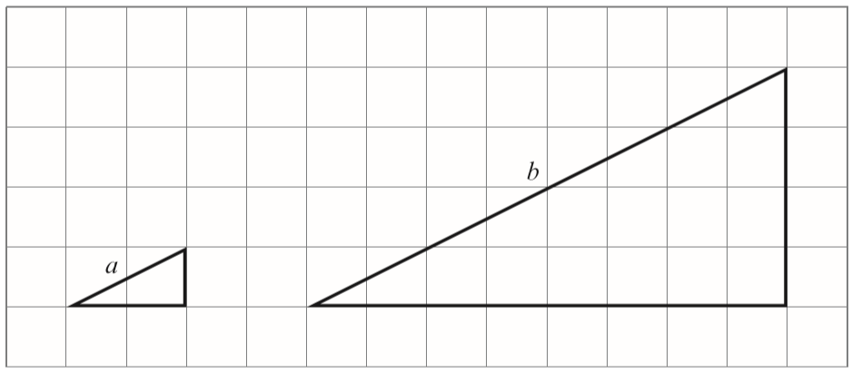
Here are two similar right-angled triangles.
Write the ratio of side a to side b.
a : b = ___: ___
1
4
4
1
2
8
Notes:
2017 Paper 2 Q22

Slide 24
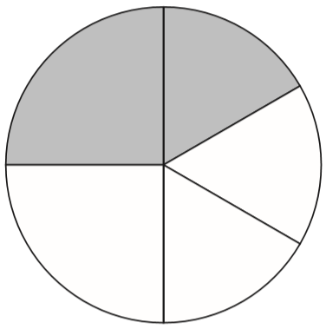
1
1
In this circle, and are shaded.
What fraction of the whole circle is not shaded?
4
6
7
1 2
5
1
1
5
+
=
1 2
4
6
1 2
1
1
x3
x2
6
4
1
3
1
2
=
=
4
1 2
6
1 2
x3
x2
3
2
5
+
=
1 2
1 2
1 2
1 2
5
7
-
=
1 2
1 2
1 2
Notes:
2017 Paper 2 Q23

Slide 25
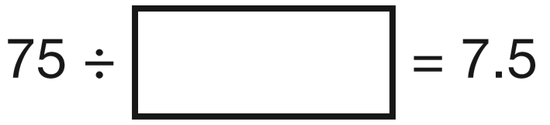
Write the missing number to make this division correct.
10
7 5
.
7.5
Notes:
2017 Paper 3 Q1

Slide 26
A group of friends earns £80 by washing cars.
They share the money equally.
They get £16 each.
How many friends are in the group?
5 friends
80 ÷ 16 =
1 friend = £16
5
+16
10 x 16 = 160
2 friends =
£32
so 5 x 16 = 80
+16
3 friends =
£48
+16
4 friends =
£64
+16
5 friends =
£80
Notes:
2017 Paper 3 Q2

Slide 27
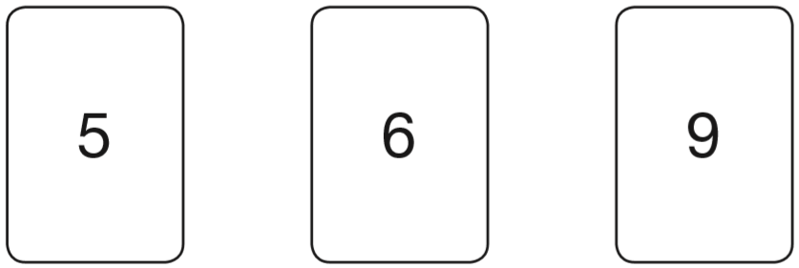
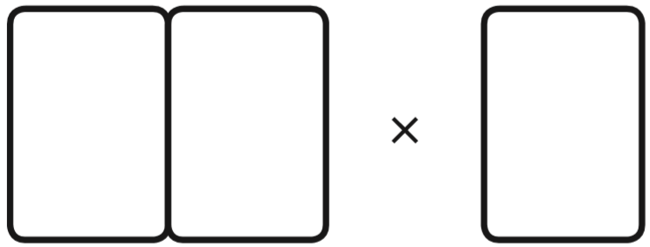
Chen uses these digit cards.
She makes a 2-digit number and a 1-digit number.
She multiplies them together.
Her answer is a multiple of 10
What could Chen’s multiplication be?
6 x 5 = 30
a multiple of 10
9
6
5
Notes:
2017 Paper 3 Q3

Slide 28
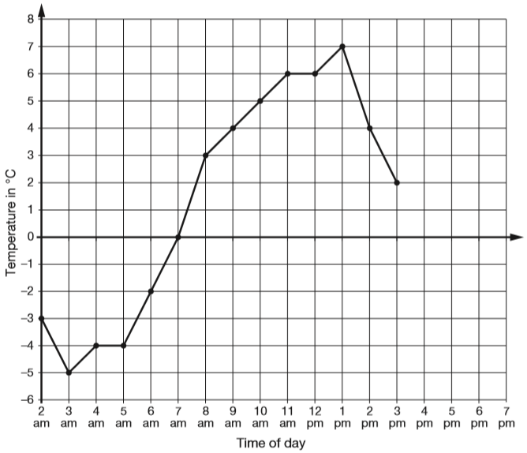
This graph shows the temperature in °C from 2 am to 3 pm on a cold day.
How many degrees warmer was it at 3 pm than at 3 am?
+5
+2
7 degrees
-5
0
2
At 6 pm the temperature was 4 degrees lower than at 3 pm.
What was the temperature at 6 pm?
-2
-2
-2
0
2
-2 degrees
Notes:
2017 Paper 3 Q4

Slide 29
The children at Farmfield School are collecting money for charity.
Their target is to collect £360
So far they have collected £57.73
How much more money do they need to reach their target?
5
9
9
£302.27 more
3 6 0.0 0
1
1
1
-
5 7.7 3
2
£
3
0
.
2
7
£57.73 + £0.27 =
£58
£58 + £2 =
£60
£60 + £300 =
£360
Notes:
2017 Paper 3 Q5

Slide 30
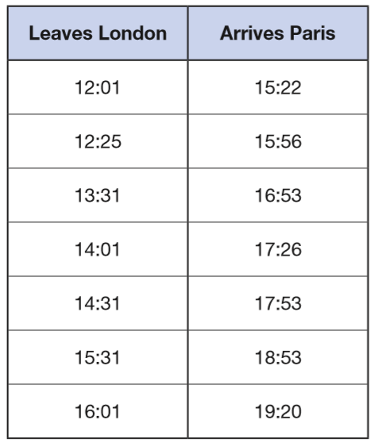
William wants to travel to Paris by train.
He needs to arrive in Paris by 5:30 pm.
Circle the latest time that William can leave London.
5:30 pm =
17:30
Notes:
2017 Paper 3 Q6

Slide 31
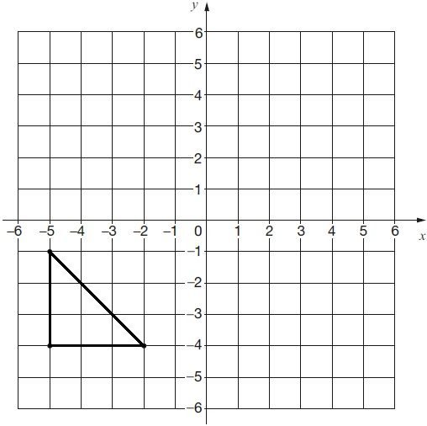
Here is a triangle drawn on a coordinate grid.
The triangle is translated
7 right and 5 up. Draw the triangle in its new position.
Notes:
2017 Paper 3 Q7

Slide 32
Write three factors of 30 that are not factors of 15
2, 6, 10, 30
Factors of 15:
Factors of 30:
✘
✘
1 x 30 = 30
✘
1 x 15 = 15
→ 1 and 15
→ 1 and 30
✘
✘
2 x 15 = 30
✘
3 x 5 = 15
→ 3 and 5
→ 2 and 15
3 x 10 = 30
✘
→ 3 and 10
5 x 6 = 30
✘
→ 5 and 6
Notes:
2017 Paper 3 Q8

Slide 33
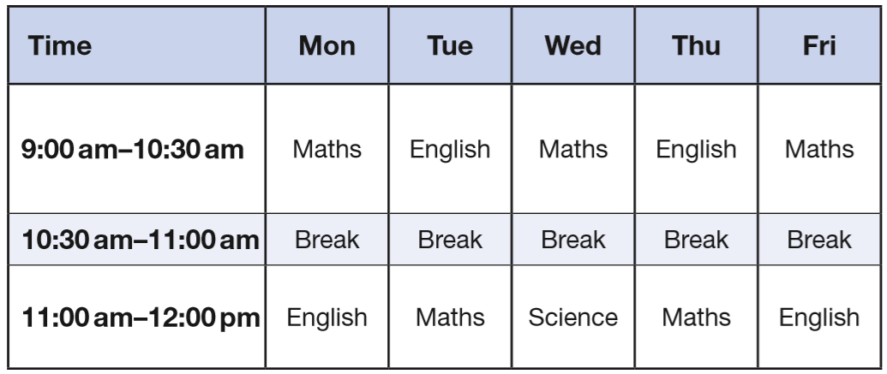
Here is the morning timetable for Chen’s class this week.
What is the total number of hours for English on this timetable?
5 hours
1 h
1 h 30
1 h 30
1 h
Notes:
2017 Paper 3 Q9

Slide 34
A bottle contains 568 millilitres of milk.
Jack pours out half a litre.
How much milk is left?
500 millilitres
68 millilitres
1 litre = 1000 millilitres
68 millilitres
568 – 500 =
Notes:
2017 Paper 3 Q10

Slide 35
A bicycle wheel has a diameter of 64 cm.
What is the radius of the bicycle wheel?
32 cm
3
2
2
6 4
diameter
radius
Notes:
2017 Paper 3 Q11

Slide 36
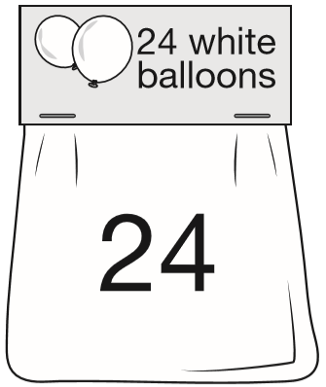
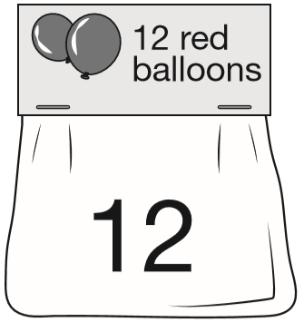
144
Adam buys 6 bags of white balloons.
Chen buys 3 bags of red balloons.
Adam says, ‘I have four times as many balloons as Chen.’
Explain why Adam is correct.
6 x 24 =
3 x 12 =
36
2
2
2 4
3 6
x
6
x
4
1 4
4
1 4
4
Adam has 6 x 24 = 144 balloons
Chen has 3 x 12 = 36 balloons
36 x 4 = 144
144 ÷ 4 = 36
3
6
4
1 4 4
2
Notes:
2017 Paper 3 Q12

Slide 37
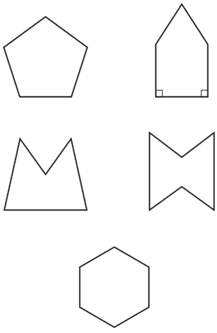
Circle the pentagon with exactly four acute angles.
only 1 acute angle
all obtuse angles
4 acute angles but not a pentagon
4 acute angles (1 reflex angle)
All obtuse angles and not a pentagon
Notes:
2017 Paper 3 Q13

Slide 38
3 pineapples cost the same as 2 mangoes.
One mango costs £1.35
How much does one pineapple cost?
90p
£2.70
2 mangoes = 2 x £1.35 =
1
3 pineapples = £2.70
1.3 5
x
2
£
0
9
0
.
1 pineapple =
£
.
0
2.7 0
2
7
3
2
£2.70
Mango £1.35
Mango £1.35
pineapple
90p
pineapple
90p
pineapple
90p
Notes:
2017 Paper 3 Q14

Slide 39

Look at the letters below.
Circle the letter that has both parallel and perpendicular lines.
Notes:
2017 Paper 3 Q15

Slide 40
There are 2,400 leaflets in a box.
William and Ally take 450 leaflets each.
Adam and Chen share the rest of the leaflets equally.
How many leaflets does Adam get?
900 taken
1500 shared
750 leaflets
1
1
4 5 0
2 4 0 0
1
+
4 5 0
-
9 0 0
7
5
0
9
0
0
1
5
0
0
2
1 5 0 0
1
2400 leaflets
750 Adam
750 Chen
450
450
1500
900
Notes:
2017 Paper 3 Q16

Slide 41
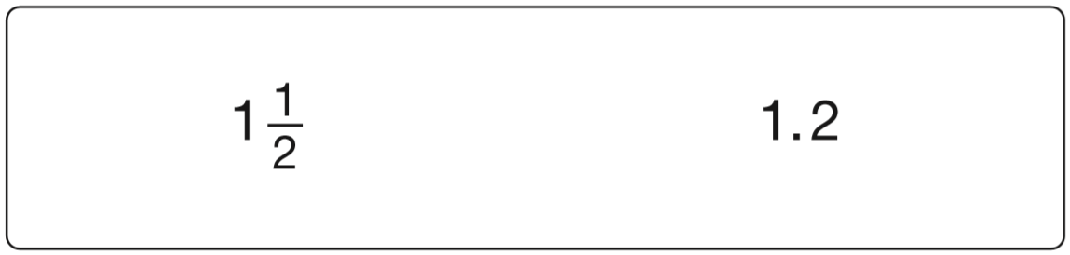

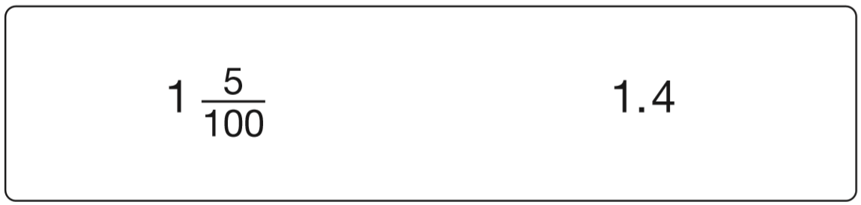
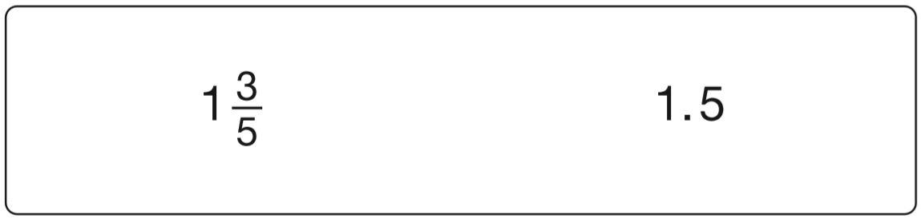
In each box, circle the number that is greater.
x5
1.5
1
5
=
2
1 0
x5
1.25
1.30
x25
1
2 5
=
4
1 0 0
1.05
1.40
x25
x2
3
6
=
1.6
5
1 0
x2
Notes:
2017 Paper 3 Q17

Slide 42
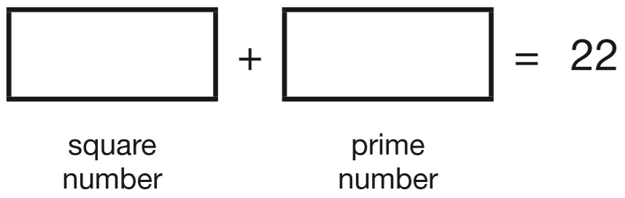
A square number and a prime number have a total of 22
What are the two numbers?
9
13
Square numbers: 1, 4, 9, 16, 25
Prime numbers: 2, 3, 5, 7, 11, 13, 17, 19, 23
Notes:
2017 Paper 3 Q18

Slide 43
Dev thinks of a whole number.
He multiplies it by 4
He rounds his answer to the nearest 10
The result is 50
Write all the possible numbers that Dev could have started with.
12 x 4 = 48
13 x 4 = 52
45 to 54 before rounding
12, 13
Multiples of 4: … 44, 48,
52,
56
too small
12 x 4
13 x 4
too big
Notes:
2017 Paper 3 Q19

Slide 44
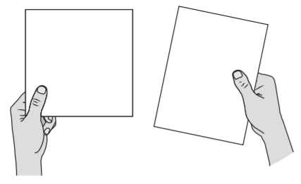
A square tile measures 20cm by 20cm.
A rectangular tile is 3cm longer and 2cm narrower than the square tile. What is the difference in area between the two tiles?
2
14 cm
Square tile = 20 x 20 = 400
Rectangular tile =
23
x
18 =
414
2
414 – 400 = 14
2
3
x
1
8
1
1 8
4
2
3
0
4
1
4
Notes:
2017 Paper 3 Q20

Slide 45

The numbers in this sequence increase by the same amount each time.
Write the missing numbers.
3
7
2
8
8
5
5
5
5
+
+
+
+
8
8
8
8
8
5
3
1
5
–
=
2
+
8
8
8
4
8
2
5
2
+
8
8
Notes:
2017 Paper 3 Q21

Slide 46
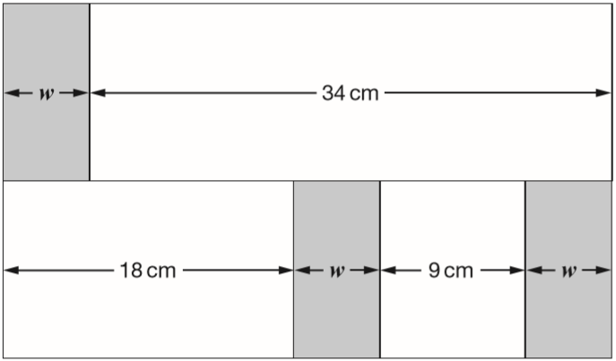
In this diagram, the shaded rectangles are all of equal width (w).
Calculate the width (w) of one shaded rectangle.
7 cm
34 + w
27 + w + w
7
27 + ___ = 34
Notes:
2017 Paper 3 Q22

Slide 47
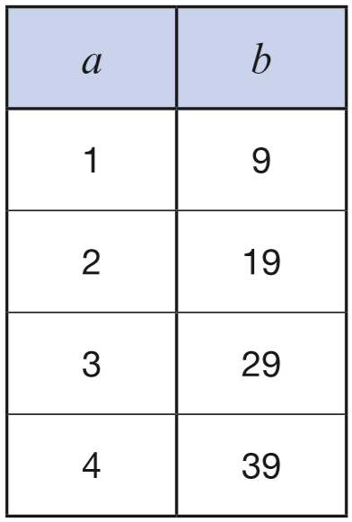
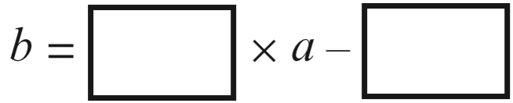
Here is a pattern of number pairs.
Complete the rule for the number pattern.
10
1
10
20
30
40
Notes:
2017 Paper 3 Q23

Slide 48
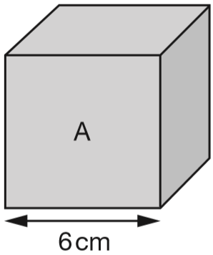
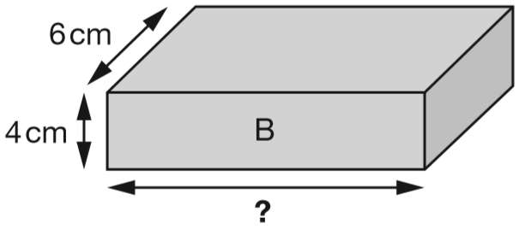
Cube A and cuboid B have the same volume.
Calculate the missing length on cuboid B.
9cm
3
3 6
x
6
2 1
6
6cm x 6cm x 6cm =
216cm³
6cm x 4cm x ____ = 216cm³
9cm
9
9cm
216 ÷ 24 =
24cm² x _____ = 216cm³
Notes:
2017 Paper 3 Q24

