Slide 1
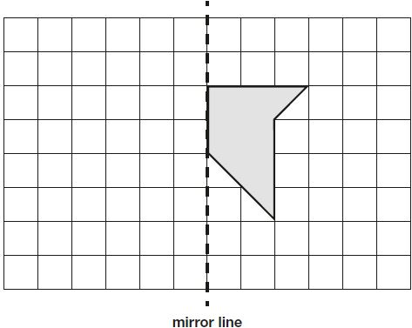
Here is a shape on a grid. Complete the design so that it is symmetrical about the mirror line.
Notes:
2018 Paper 2 Q1

Slide 2
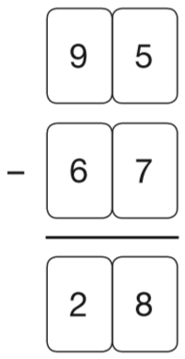
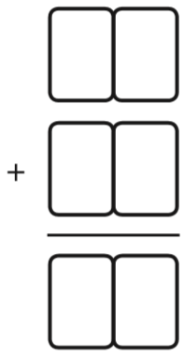
Stefan completes this calculation.
Write an addition calculation he could use to check his answer.
2 8
6 7
9 5
Notes:
2018 Paper 2 Q2

Slide 3
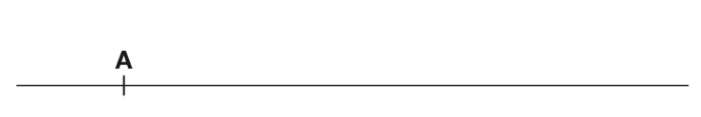
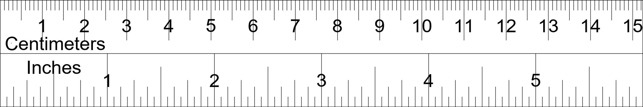
On the line below, mark the point that is 6.7 centimetres from A.
Notes:
2018 Paper 2 Q3

Slide 4
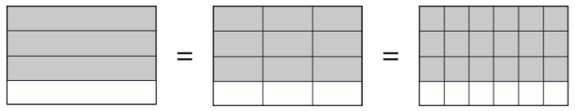
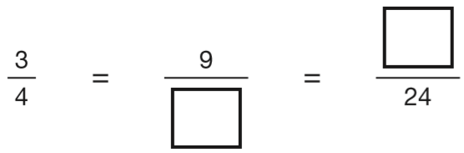
These diagrams show three equivalent fractions.
Write the missing values.
x3
x2
18
12
x3
x2
Notes:
2018 Paper 2 Q4

Slide 5
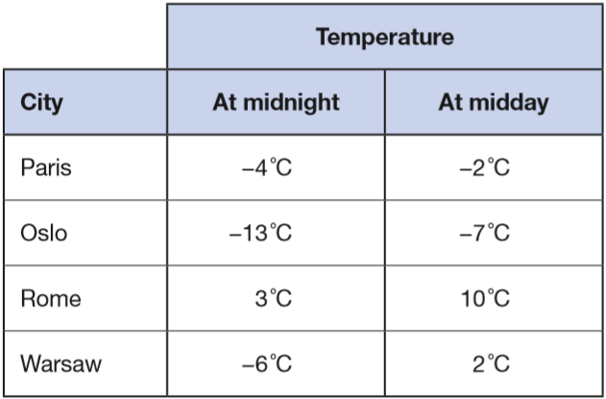
Here are the temperatures in four cities at midnight and at midday.
At midnight, how many degrees colder was Paris than Rome?
+4
+3
7 °C colder.
-4
0
3
Which city was 6 degrees colder at midnight than at midday?
Oslo
+6
-16
-15
-14
-13
-12
-11
-10
-9
-8
-7
-6
-5
-4
-3
-2
-1
0
1
2
3
4
5
6
7
8
9
Notes:
2018 Paper 2 Q5

Slide 6
The numbers in this sequence decrease by the same amount each time.
303,604 302,604 301,604 300,604 …
What is the next number in the sequence?
299,604
Notes:
2018 Paper 2 Q6

Slide 7
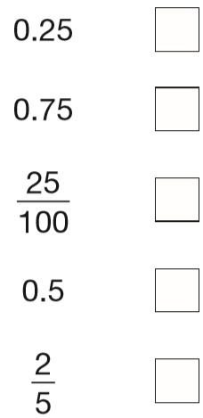
1
Tick the two numbers that are equivalent to
4
✓
x25
1
2 5
✓
=
4
1 0 0
x25
Notes:
2018 Paper 2 Q7

Slide 8
Ken buys 3 large boxes and 2 small boxes of chocolates.
Each large box has 48 chocolates.
Each small box has 24 chocolates.
How many chocolates did Ken buy altogether?
192 chocolates
48
48
48
24
24
2
1
4 8
2 4
1 4 4
x
3
x
2
+
4 8
1 4
4
4
8
1
9
2
Notes:
2018 Paper 2 Q8

Slide 9
The list below shows the years in which the Cricket World Cup was held since 1992:
1992, 1996, 1999, 2003, 2007, 2011, 2015
Adam says, ‘The Cricket World Cup has been held every four years since 1992.’ Adam is not correct. Explain how you know.
1996 + 4 = 2000
The next Cricket World Cup after 1996 was in 1999, not 2000
Notes:
2018 Paper 2 Q9

Slide 10
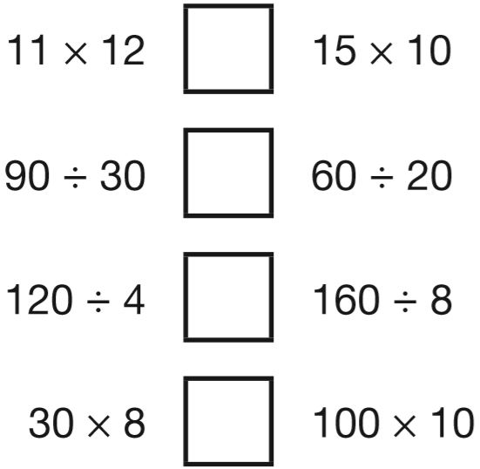
> = <
Write the correct symbol in each box to make the statements correct.
<
132
150
=
3
3
>
30
20
<
240
1000
Notes:
2018 Paper 2 Q10

Slide 11
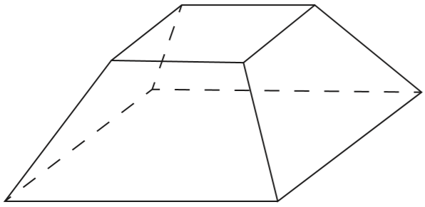
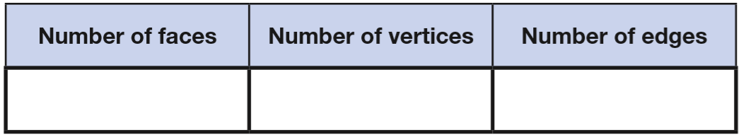
Here is a drawing of a 3-D shape.
Complete the table.
6
8
12
Notes:
2018 Paper 2 Q11

Slide 12
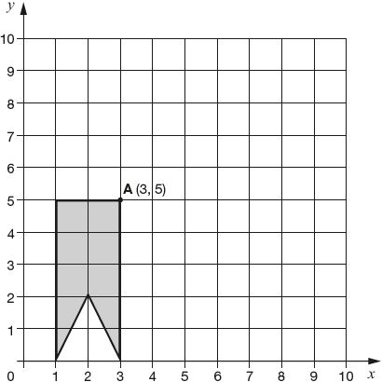
Here is a shape on a grid. The shape is translated so that point A moves to (7, 8). Draw the shape in its new position.
Notes:
2018 Paper 2 Q12

Slide 13
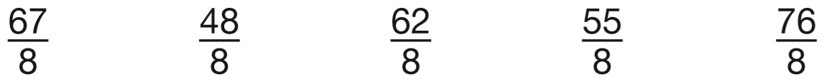
7
Circle the improper fraction that is equivalent to 6
8
7
6 x 8 + 7 =
6
8
4 8 + 7 =
5 5
Notes:
2018 Paper 2 Q13

Slide 14
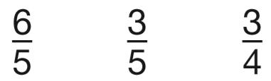
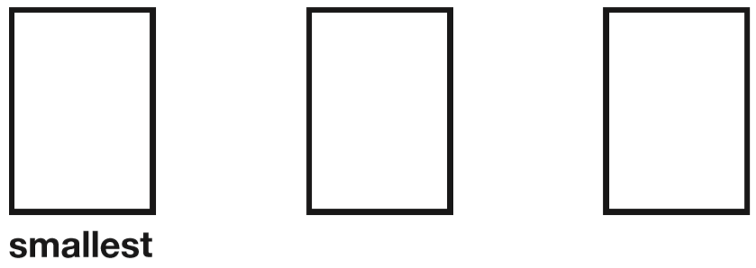
x4
6
2 4
=
5
2 0
Write these fractions in order, starting with the smallest.
x4
x4
3
3
6
3
1 2
5
=
5
4
5
2 0
x4
x5
3
1 5
=
4
2 0
x5
Notes:
2018 Paper 2 Q14

Slide 15
A box contains trays of melons.
There are 15 melons in a tray.
There are 3 trays in a box.
A supermarket sells 40 boxes of melons.
How many melons does the supermarket sell?
45 melons in a box
1800 melons
1
2
1 5
4 5
x
3
x
0
4
4
5
1 8
0
0
Notes:
2018 Paper 2 Q15

Slide 16
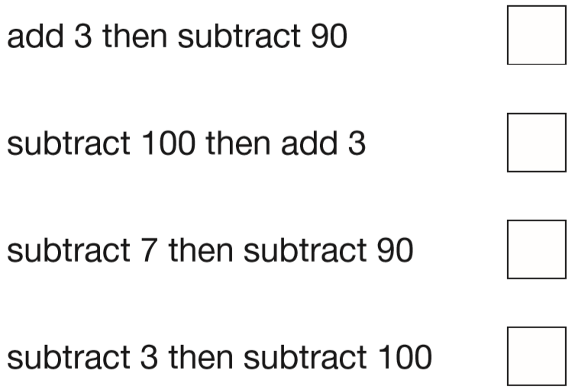
Adam wants to use a mental method to calculate 182 – 97
He starts from 182
Here are some methods that Adam could use.
Tick the methods that are correct.
only subtracts 87
✓
✓
subtracts 103
Notes:
2018 Paper 2 Q16

Slide 17
There are 28 pupils in a class.
The teacher has 8 litres of orange juice.
She pours 225 millilitres of orange juice for every pupil.
How much orange juice is left over?
8000 millilitres
6300 millilitres
1700 millilitres
1
or 1.7 litres
2
4
7
2
2
5
8 0 0 0
1
x
2
8
-
6 3 0 0
1
1 8
0
0
1
7
0
0
4
5
0
0
6
3
0
0
Notes:
2018 Paper 2 Q17

Slide 18
Last year, Jacob went to four concerts.
Three of his tickets cost £5 each.
The other ticket cost £7
What was the mean cost of the tickets?
£22 total cost on 4 tickets
£5.50
5 + 5 + 5 + 7 =
£22
£
5
5
0
.
4
2 2.0 0
2
Notes:
2018 Paper 2 Q18

Slide 19
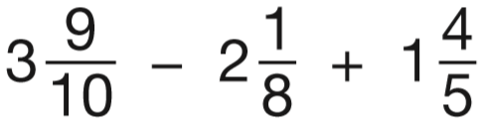
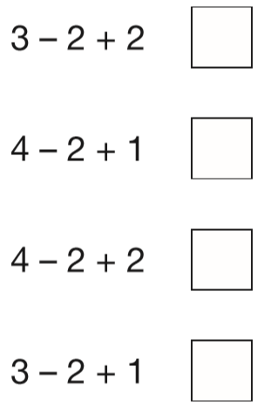
Layla wants to estimate the answer to this calculation.
Tick the calculation below
that is the best estimate.
more than ½
so round up
less than ½
so round down
more than ½
so round up
4
2
2
✓
Notes:
2018 Paper 2 Q19

Slide 20
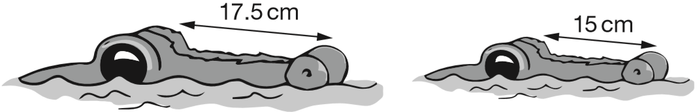
The length of an alligator can be estimated by:
• measuring the distance from its eyes to its nose
• then multiplying that distance by 12
What is the difference in the estimated lengths of these two alligators?
30 cm
9
6
6
1 7.5
1 5
x
1 2
x
1 2
2 1
.
0
0
1 8
0
2 1 0 – 1 8 0 =
3 0
Notes:
2018 Paper 2 Q20

Slide 21
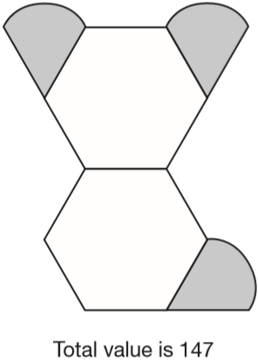
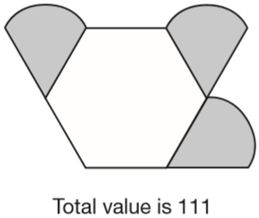
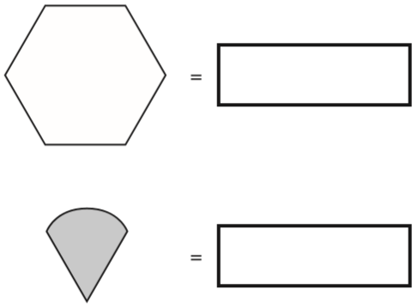

Amina is making designs with two different shapes.
She gives each shape a value.
Calculate the value of each shape.
25
25
25
25
36
36
36
25
36
25
25
this shape has 1 extra hexagon
147 – 111 =
36
36 + 3 = 111
so 3 = 75
111 – 36 =
75
= 75 ÷ 3 =
25
Notes:
2018 Paper 2 Q21

Slide 22
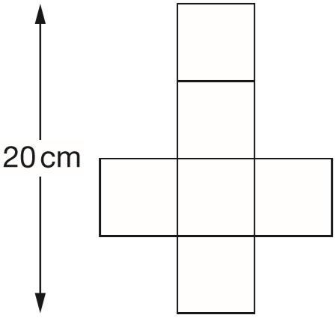
This is the net of a cube.
What is the volume of the cube?
20cm ÷ 4 = 5cm
5cm x 5cm x 5cm =
125cm³
Notes:
2018 Paper 2 Q22

Slide 23
The length of a day on Earth is 24 hours.
The length of a day on Mercury is 58 times the length of a day on Earth.
What is the length of a day on Mercury, in hours?
2
3
1408 hours
2
5 8
8
1 7 6
x 2 4 =
4 2 2 4
x
3
3
3
1 7
4
+ 2 =
1 7 6
1
1
4
0
3
2
1
8
1
7
6
3
4 2 2 4
1
2
6
4
x
2
4
1 7 6
1
7
0
4
x
8
3
5
2
0
1 4
0
8
4
2
2
4
Notes:
2018 Paper 2 Q23

Slide 24
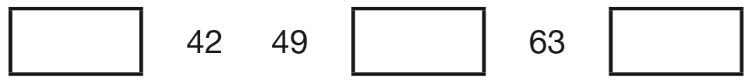
The numbers in this sequence increase by the same amount each time. Write the missing numbers.
35
56
70
+7
+7
+7
+7
+7
42 – 7 =
35
Notes:
2018 Paper 3 Q1

Slide 25
Adam chooses the colours for a new team shirt.
The shirt has two colours.
There are four colours to choose from: yellow, blue, white and red.
Write the two missing combinations.
The shirt could be:
• yellow and blue
• yellow and white
• yellow and red
• blue and white.
__________ and __________
__________ and __________
Y B W R
YB, YW, YR
BW, BR
WR
blue
red
white
red
Notes:
2018 Paper 3 Q2

Slide 26
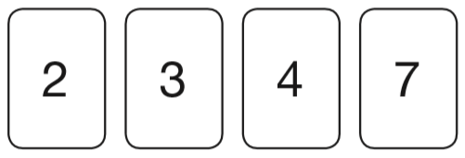
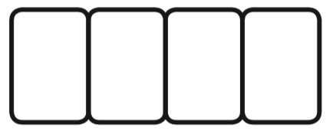
Here are four number cards.
Layla uses each card once to make a four-digit number.
She places:
• 4 in the tens column
• 2 so that it has a higher value than any of the other digits
• the remaining two digits so that 7 has the higher value.
Write a digit in each box to show Layla’s number.
2
7
4
3
Notes:
2018 Paper 3 Q3

Slide 27
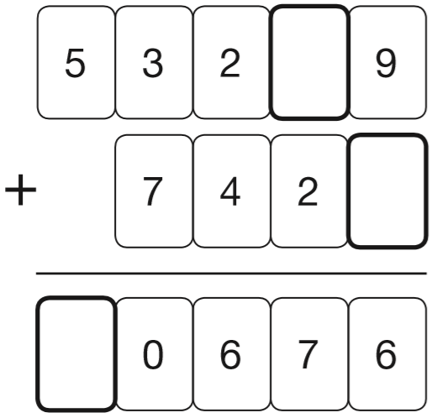
Write the three missing digits to make this addition correct.
1
1
4
7
6
Notes:
2018 Paper 3 Q4

Slide 28
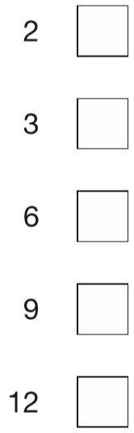
Tick the numbers that are common factors of both 12 and 18
✓
6 x 2 = 12 and 9 x 2 = 18
✓
4 x 3 = 12 and 6 x 3 = 18
✓
2 x 6 = 12 and 3 x 6 = 18
12 is not in the 9 times table
18 is not in the 12 times table
Notes:
2018 Paper 3 Q5

Slide 29
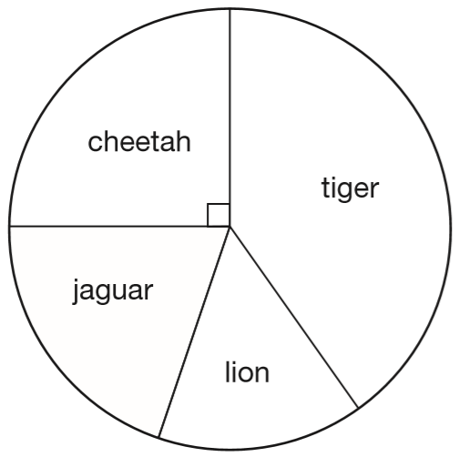
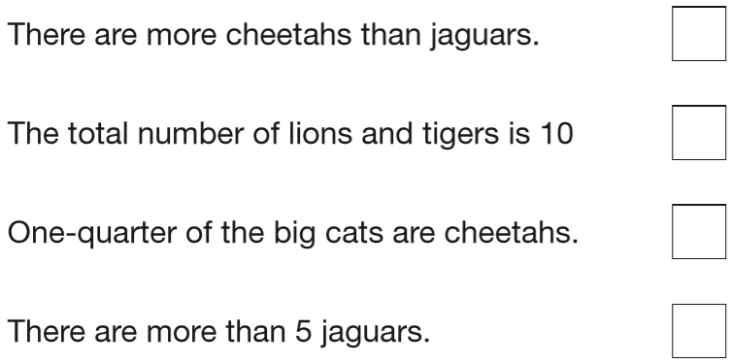
This chart shows the number of different types of big cat in a zoo.
There are 20 big cats in the zoo altogether.
Here are some statements about the chart.
Tick the statements that are true.
✓
✘
more than ½ of the 20 cats
✓
✘
less than ¼ of 20
Notes:
2018 Paper 3 Q6

Slide 30
A farmer is packing eggs.
Each box holds six eggs. The farmer has 980 eggs to pack.
How many boxes can the farmer fill using 980 eggs?
_____ full boxes
How many eggs will be left over?
_____ left over
1
6
3
r 2
163
6
9 8 0
3
2
2
Notes:
2018 Paper 3 Q7

Slide 31
Jack has £400
He spends 35% of his money on a new bike.
How much does Jack spend on his new bike?
He spends £140
3 5
4 0 0 ÷ 1 0 0 =
4
35% of 400 =
140
1 0 0
2
3 5
x
4
10% =
40
1 4
0
30% =
40 x 3 =
120
5% =
40 ÷ 2 =
20
35% =
120 + 20 =
140
Notes:
2018 Paper 3 Q8

Slide 32
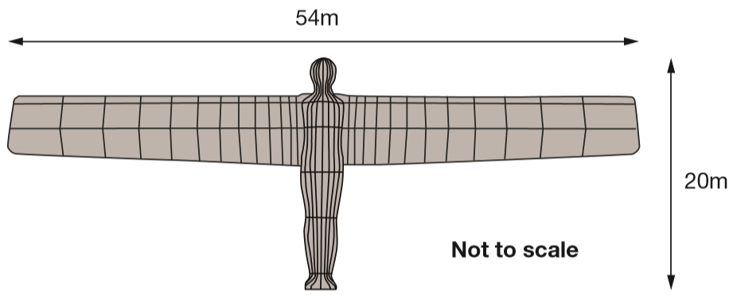
The Angel of the North is a large statue in England.
It is 20 metres tall and 54 metres wide.
Ally makes a scale model of the Angel of the North.
Her model is 40 centimetres tall.
How wide is her model?
108 cm wide
20 m tall 54 m wide
5 4
x2 (then ÷100)
x
2
40 cm tall
108 cm wide
1 0
8
Notes:
2018 Paper 3 Q9

Slide 33
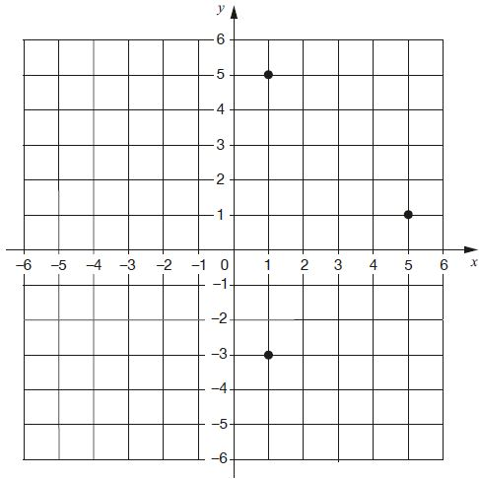
Layla draws a square on this coordinate grid.
Three of the vertices are marked.
What are the coordinates of the missing vertex?
(-3,
1)
Notes:
2018 Paper 3 Q10 first page

Slide 34
(-3,
1)
Notes:
2018 Paper 3 Q10 second page

Slide 35
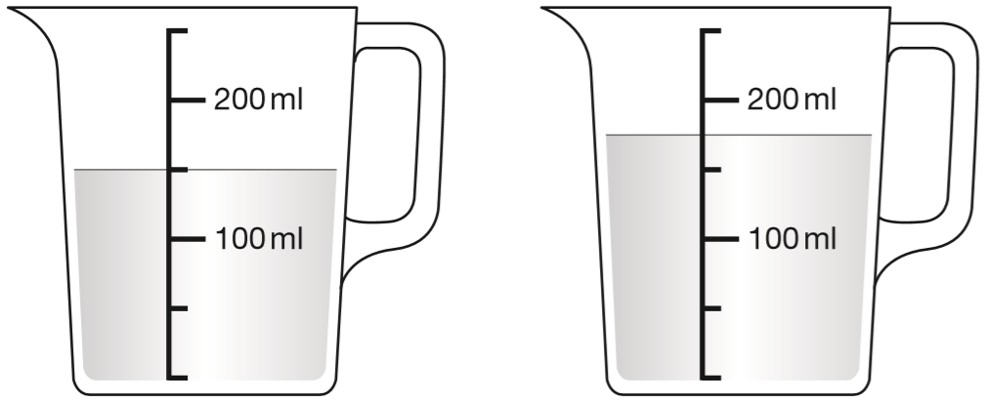
Stefan has 600 millilitres of water in a bottle.
He pours some of the water into two measuring jugs as shown.
How many millilitres of water are left in Stefan’s bottle?
175
150
150
125
275 millilitres
1
5
9
1 5 0
6 0 0
1
1
+
1 7 5
-
3 2 5
3
2
5
poured out
2
7
5
left
Notes:
2018 Paper 3 Q11

Slide 36
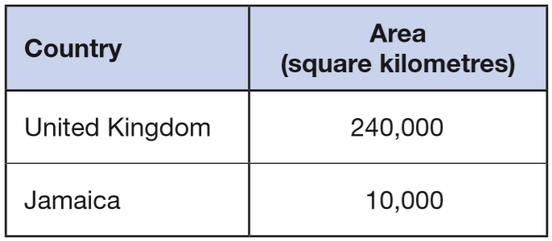
This table shows the areas of the United Kingdom and Jamaica.
The area of the United Kingdom is larger than the area of Jamaica. How many times larger is the United Kingdom?
_____ times larger
24
24
10 000 x ___ = 240 000
240 000 ÷ 10 000 =
24
Notes:
2018 Paper 3 Q12

Slide 37
A box contains 2.6 kg of washing powder.
Jack uses 65 grams of powder for each wash.
He uses all the powder.
How many washes did Jack do?
2600 grams
2.6 kg
2.600 kg
40 washes
2600 g
1 wash = 65 grams
x2
2 washes =
130 grams
x10
20 washes =
1300 grams
x2
40 washes =
2600 grams
Notes:
2018 Paper 3 Q13

Slide 38
Two of the angles in a triangle are 70° and 40°.
Jack says, ‘The triangle is equilateral.’
Explain why Jack is not correct.
The angles in an equilateral triangle are always the same (60°)
Notes:
2018 Paper 3 Q14

Slide 39
A shop prints designs on T-shirts.
They use this formula to work out the price for printing a design.
price = 60p × number of colours + £1.25
What is the price for printing a design that has 3 colours in it?
£3.05
60p x 3 + £1.25
60p x 3 =
180p
= £1.80
1
1.8 0
+
1.2 5
£
.
5
3
0
Notes:
2018 Paper 3 Q15 page 1

Slide 40
A shop prints designs on T-shirts.
They use this formula to work out the price for printing a design.
price = 60p × number of colours + £1.25
Amina has £5 to spend on printing a design.
What is the greatest number of colours she can have in the design?
6 colours
4
9
5.0 0
1
1
-
1.2 5
1 colour = 60p
.
5
£
3
7
to spend on colours
2 colours =
£1.20
4 colours =
£2.40
6 colours =
£3.60
7 colours =
too expensive
Notes:
2018 Paper 3 Q15 page 2

Slide 41
A book has 276 pages.
Amina has read of the book.
How many pages are left for Amina to read?
1
92 pages read
3
184 pages
9
2
1
2 7 6
9 2
1
3
2 7 6
-
9 2
x
2
1
8
4
1 8
4
276 pages
read
92
92
92
left
184
Notes:
2018 Paper 3 Q16

Slide 42

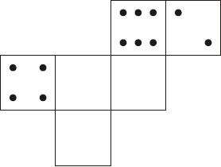
On a dice, the sum of the dots on opposite faces is always 7.
Draw dots on the three empty faces of the net so that it could fold up to make a dice.
Notes:
2018 Paper 3 Q17

Slide 43
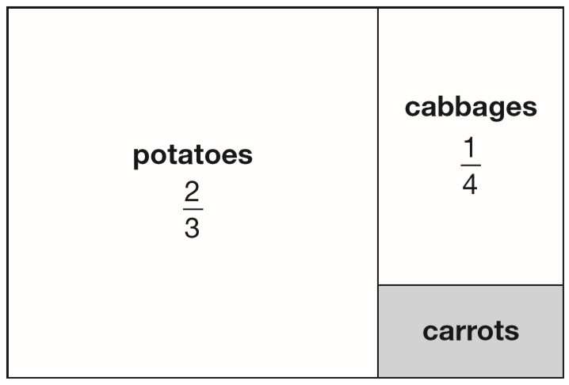
This is a diagram of a vegetable garden.
It shows the fractions of the garden planted with potatoes and cabbages.
The remaining area is planted with carrots.
What fraction of the garden is planted with carrots?
x4
x3
2
8
1
3
=
=
3
1 2
4
1 2
1 2
1 1
1
-
=
is carrots
x4
x3
1 2
1 2
1 2
8
3
1 1
is potatoes or cabbages
+
=
1 2
1 2
1 2
Notes:
2018 Paper 3 Q18

Slide 44
33,630 = 354 × 95
Use this multiplication to complete the calculations below.
354 × 9.5 =
3,540 × 95 =
3,363 ÷ 95 =
33,630 ÷ 95 = 354
3363
95 ÷ 10
336 300
354 x 10
35.4
33630 ÷ 10
354 ÷ 10
Notes:
2018 Paper 3 Q19

Slide 45
In March, Ken collects 2, 3 or 4 eggs each day from his hens.
In the first 20 days, Ken collects 57 eggs altogether.
There are 31 days in March.
What is the greatest number of eggs Ken can collect in March?
11 days of egg-collecting left
101 eggs
57 eggs already collected
11 x 4 = 44 eggs can still be collected
1
5 7
+
4 4
1 0
1
Notes:
2018 Paper 3 Q20

Slide 46
Jack finished a sponsored run in 53 minutes 25 seconds.
Ally finished 3 minutes 50 seconds after Jack.
How long did Ally take?
+3m
+35s
+15s
57 minutes 15 seconds
53:25
56:25
57:00
57:15
53 minutes 25 seconds
+ 4 minutes =
57 minutes 25 seconds
– 10 seconds =
57 minutes 15 seconds
Notes:
2018 Paper 3 Q21 page 1

Slide 47
Jack finished a sponsored run in 53 minutes 25 seconds.
Layla finished the run 8 minutes 45 seconds before Jack.
How long did Layla take?
-20s
-25s
-8m
44 minutes 40 seconds
44:40
45:00
45:25
53:25
53 minutes 25 seconds
– 9 minutes =
44 minutes 25 seconds
+ 15 seconds =
44 minutes 40 seconds
Notes:
2018 Paper 3 Q21 page 2

