Slide 1
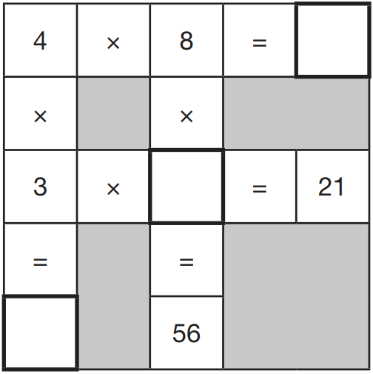
In this grid, there are four multiplications.
Write the three missing numbers.
32
21 ÷ 3 = 7
7
56 ÷ 8 = 7
12
Notes:
2019 Paper 2 Q1

Slide 2
What number is 1,000 less than 9,072?
8,072
Notes:
2019 Paper 2 Q2

Slide 3
Order the numbers starting with the largest.
Match each number with its order.
1,009,909
1st
largest
1,023,065
2nd
1,009,099
3rd
1,230,650
4th
smallest
Notes:
2019 Paper 2 Q3

Slide 4
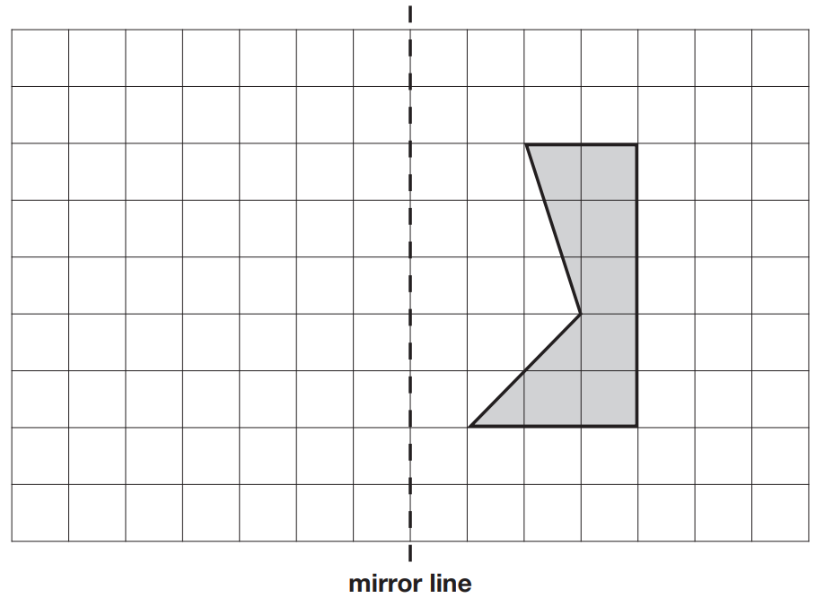
Here is a shaded shape on a square grid.
Reflect the shape in the mirror line.
Notes:
2019 Paper 2 Q4

Slide 5
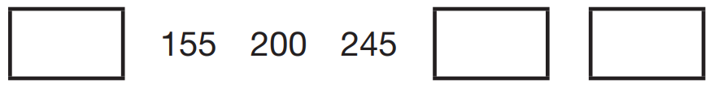
The numbers in this sequence increase by 45 each time.
Write the missing numbers.
110
290
335
+ 45
+ 45
+ 45
+ 45
+ 45
1
1
1 5 5
2 4 5
2 9 0
-
4 5
+
4 5
+
4 5
1
1
0
2
9
0
3
3
5
Notes:
2019 Paper 2 Q5

Slide 6
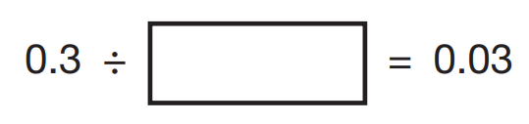
Write the missing number to make this division correct.
10
0.3
0.0 3
Notes:
2019 Paper 2 Q6

Slide 7
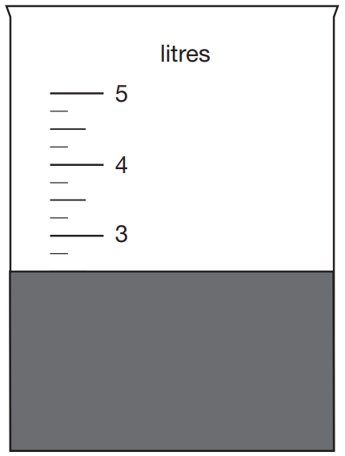
Jack pours some dark paint into a container.
In litres, how much paint is in the container?
1
2.5 litres
2 litres =
2
4
1
2
3
1
2
2
1
2
Notes:
2019 Paper 2 Q7

Slide 8

In this sequence, the rule to get the next number is:
Multiply by 2, and then add 3
Write the missing numbers.
1 1
1 0 9
x2 +3
x2 +3
x2 +3
2 5 – 3 =
2 2
5 3
x
2
2 2 ÷ 2 =
1 1
1 0
6
+ 3 =
1 0 9
Notes:
2019 Paper 2 Q8

Slide 9
Jack chose a number.
He multiplied the number by 7
Then he added 85
His answer was 953
What number did Jack choose?
124
x7
868
+85
953
8
4
1
1
2
4
9 5 3
He chose 124
1
7
8 6 8
1
2
-
8 5
8
6
8
Notes:
2019 Paper 2 Q9

Slide 10
A theme park sells tickets online.
Each ticket costs £24
There is a £3 charge for buying tickets.
Which of these shows how to calculate the total cost, in pounds?
number of tickets × 3 + 24
number of tickets × 24 + 3
✓
number of tickets + 3 × 24
number of tickets + 24 × 3
Notes:
2019 Paper 2 Q10

Slide 11
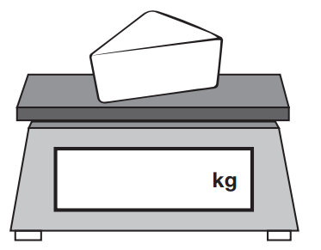
Amina is shopping. She says,
‘I would like to buy one-quarter of a kilogram of cheese.’
Write one-quarter on the scales as a decimal.
x25
1
2 5
=
4
1 0 0
x25
The cheese costs £1.35
Amina pays with a £2 coin.
How much change should Amina get?
0.25
65p
£2.00 – £1.35 =
1
9
2.0 0
1
1
-
1.3 5
.
5
£
0
6
change
Notes:
2019 Paper 2 Q11

Slide 12
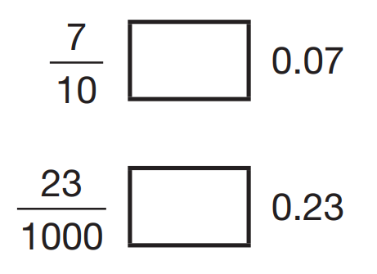
Here are three symbols.
< > =
Write one symbol in each box to make the statements correct.
70
0.7
>
7
0
100
100
<
0
23
230
0.023
100
1000
Notes:
2019 Paper 2 Q12

Slide 13
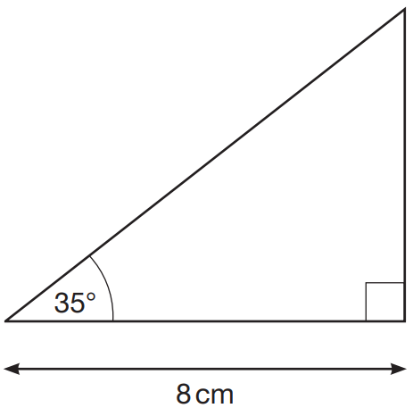
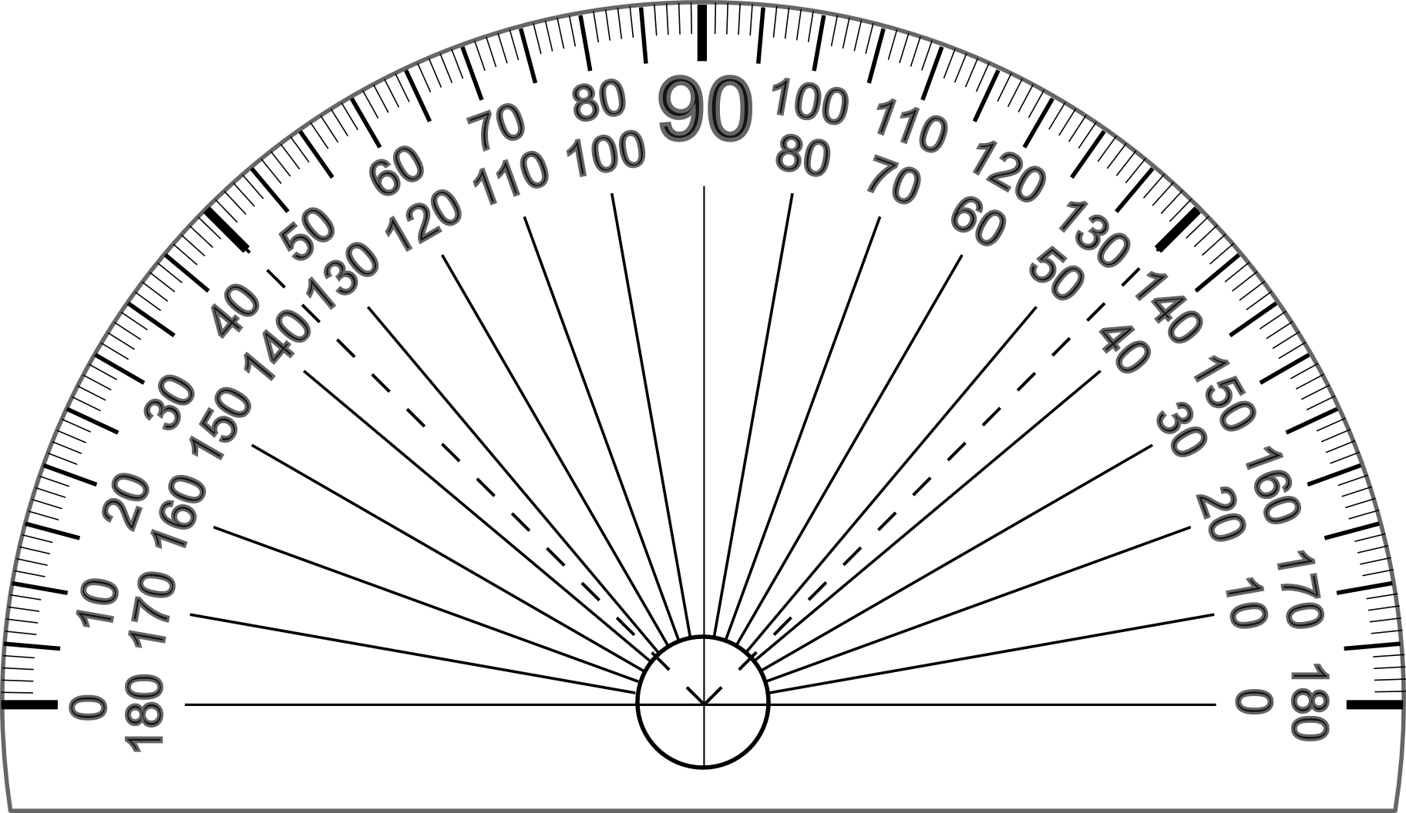
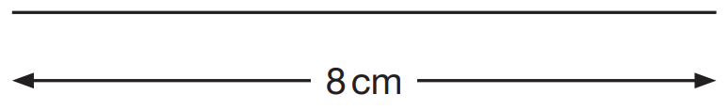
Here is a sketch of a triangle. It is not drawn to scale.
Draw the full-size triangle accurately below.
Use an angle measurer (protractor) and a ruler.
One line has been drawn for you.
Notes:
2019 Paper 2 Q13

Slide 14
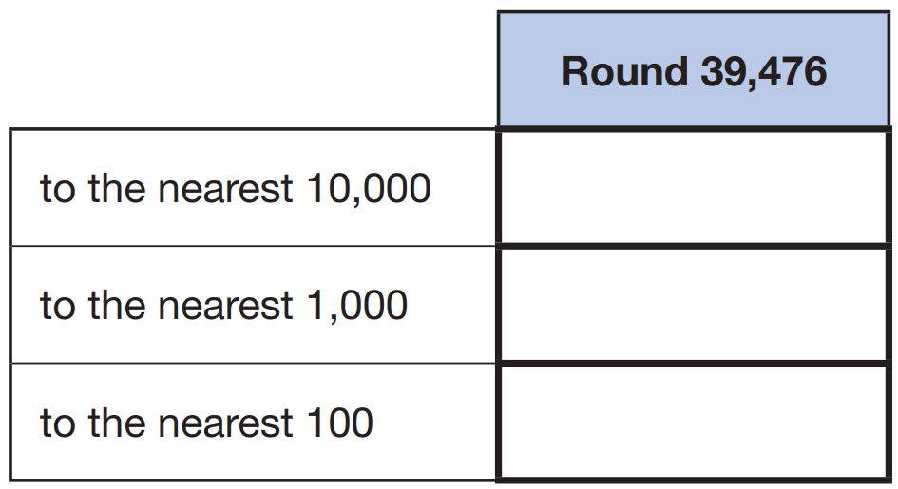
Complete the table.
3 9 4 7 6
40 000
3 9 4 7 6
39 000
3 9 4 7 6
39 500
Notes:
2019 Paper 2 Q14

Slide 15
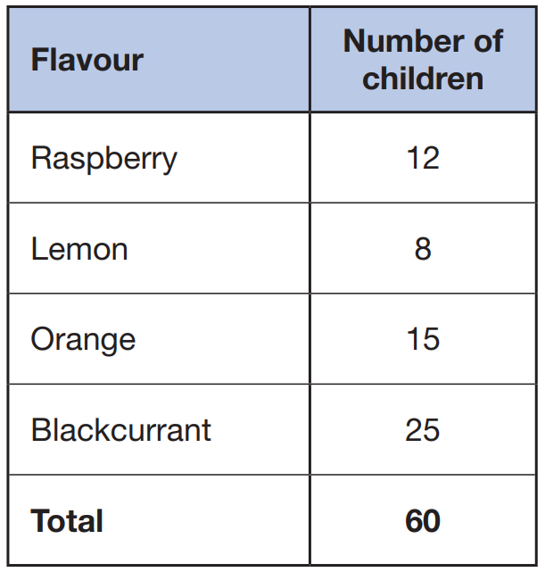
Amina asked 60 children to choose their favourite flavour of jelly. These were her results.
What percentage of the 60 children chose orange?
÷15
x25
1 5
1
2 5
=
=
= 25%
6 0
4
1 0 0
÷15
x25
Notes:
2019 Paper 2 Q15

Slide 16
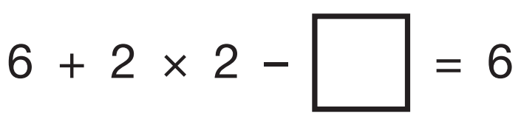
Write the missing number.
4
4
6 + 4 = 10
Notes:
2019 Paper 2 Q16

Slide 17
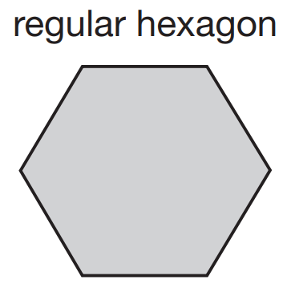
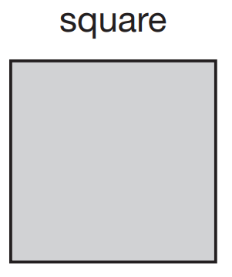
These two shapes have the same perimeter.
The length of each side of the hexagon is 8 centimetres.
Calculate the area of the square.
144 cm²
8
12
12 cm x 12 cm =
144 cm²
8
8
12
12
8
8
8
12
6 x 8 cm =
48 cm perimeter
48 cm ÷ 4 =
12 cm
Notes:
2019 Paper 2 Q17

Slide 18
Circle the prime number.
95 89 87
Explain how you know the other numbers are not prime.
1
9
95 is in the 5 times table
5
9 5
4
87 is in the 3 times table
2
9
3
8 7
2
89 is only in the 1 times table and the 89 times table
and a number with only 2 factors is a prime number.
95 and 87 have more than 2 factors.
Notes:
2019 Paper 2 Q18

Slide 19
A machine pours 250 millilitres of juice every 4 seconds.
How many litres of juice does the machine pour every minute?
3.75 l
250 millilitres = 4 seconds
60 ÷ 4 = 15
x2
so 250 ml is poured 15 times
500 millilitres =
8 seconds
250 x 15 =
3750
x2
3750 millilitres =
3.750 litres
1000 millilitres =
16 seconds
x2
2000 millilitres =
32 seconds
32 + 16 =
48
48 + 8 =
56
56 + 4 =
60
3000 ml
3500 ml
3750 ml
Notes:
2019 Paper 2 Q19

Slide 20
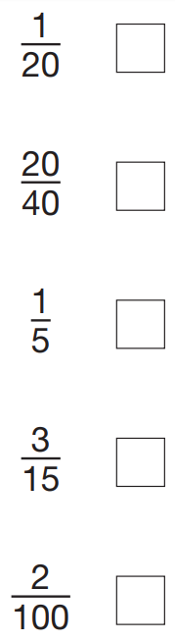
Tick the fractions that are equal to 20%.
✘
x5
1
5
=
= 5%
2 0
1 0 0
✘
x5
x20
1
2 0
✓
=
= 20%
5
1 0 0
x20
✓
÷3
x20
3
1
2 0
=
=
= 20%
1 5
5
1 0 0
✘
÷3
x20
Notes:
2019 Paper 2 Q20

Slide 21
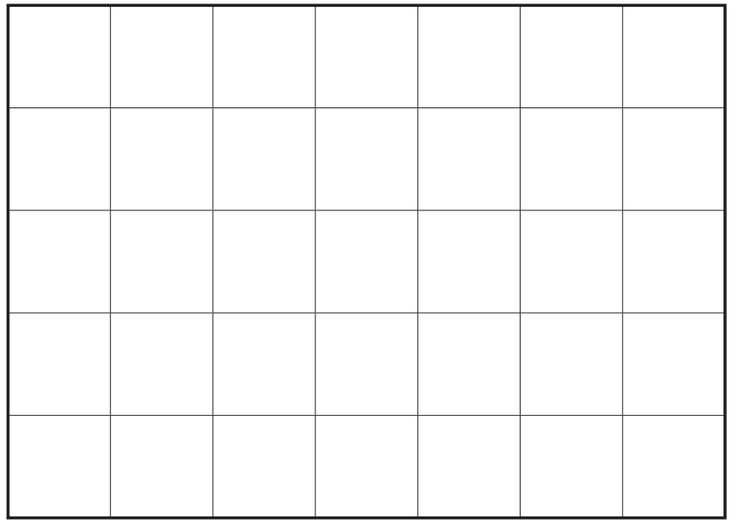
Adam has this rectangular piece of card. It is marked with grid lines.
Adam makes two straight cuts along the grid lines.
The two cuts divide the rectangle into 3 shapes:
• 2 squares of different size, and
• 1 rectangle.
Using the grid lines, draw two lines that show where Adam could have made his cuts. Use a ruler.
Notes:
2019 Paper 2 Q21

Slide 22
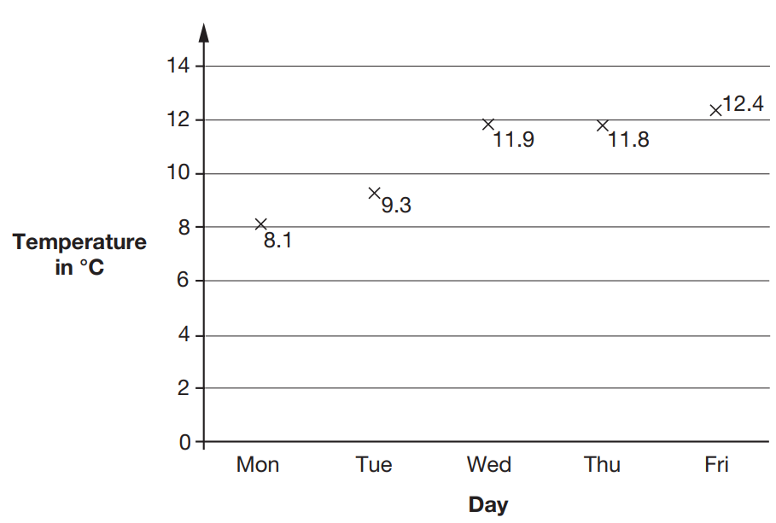
This graph shows the maximum temperature for five days.
For what fraction of the five days was the maximum temperature below 10 °C?
2 days below
5 days altogether
2
5
Notes:
2019 Paper 2 Q22 page 1

Slide 23
This graph shows the maximum temperature for five days.
What was the mean maximum temperature, to one decimal place?
53.4
29.2
41.0
17.4
10.7 °C
1
0
.
6
8
5
3
4
0
5 3
.4
1
0
.
6
8
Notes:
2019 Paper 2 Q22 page 2

Slide 24
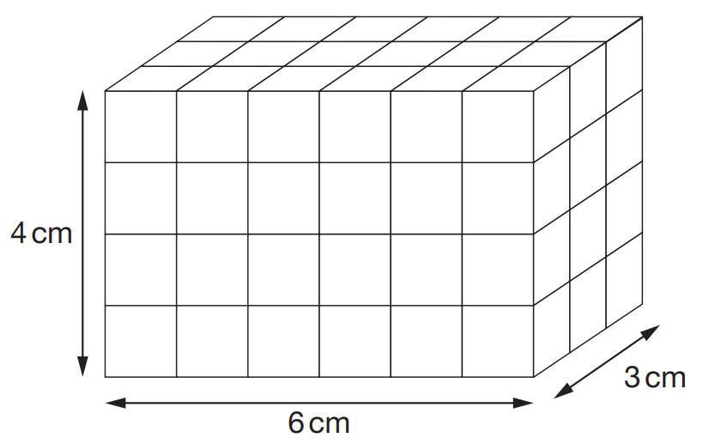
Amina made this cuboid using centimetre cubes.
Stefan makes a cuboid that is 5 cm longer, 5 cm taller and 5 cm wider than Amina’s cuboid.
What is the difference between the number of cubes in Amina’s and Stefan’s cuboids?
720 cubes
4cm x 6cm x 3cm =
72cm³
7 9 2
9cm x 11cm x 8cm =
792cm³
-
7 2
7
7
2
0
9 9
x
8
7 9
2
Notes:
2019 Paper 2 Q23

Slide 25
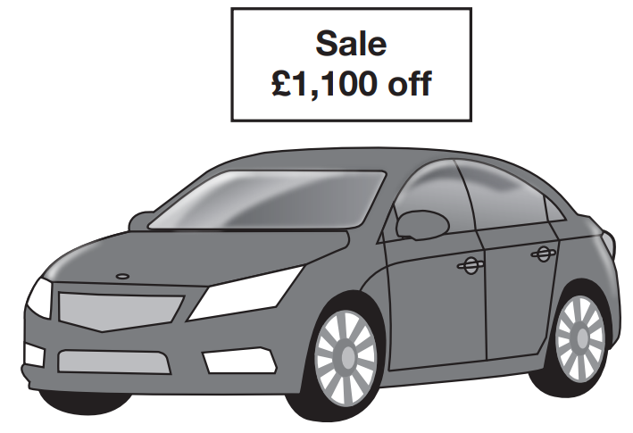
The original price of this car is £8,999
What is the sale price of the car?
£7,899
8 9 9 9
-
1 1 0 0
£
7
8
9
9
Notes:
2019 Paper 3 Q1

Slide 26
3,576,219
Which digit is in the ten thousands place?
7
Round 3,576,219 to the nearest million.
4 000 000
Notes:
2019 Paper 3 Q2

Slide 27
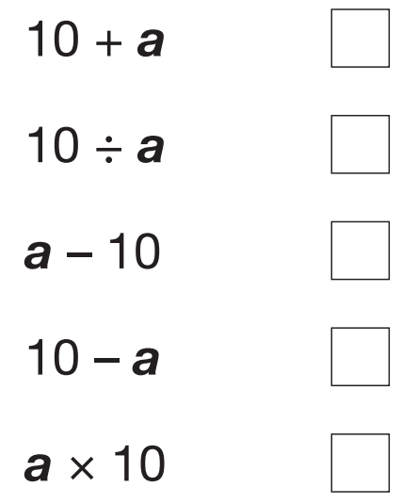
Dev says, ‘I had £10. I gave some money away.’
Which expression shows how much money Dev has left?
a is the amount of money, in pounds, that Dev gave away.
✓
Notes:
2019 Paper 3 Q3

Slide 28
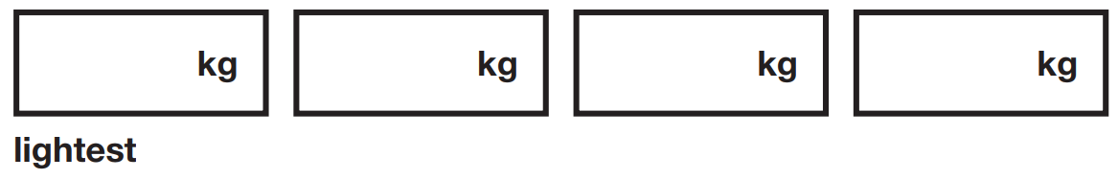
Write these masses in order, starting with the lightest.
1.250
0.990
1.25 kg 0.99 kg 1.025kg 0.009 kg
0
1.2 5
0
0.9 9
1.0 2 5
0.0 0 9
0.009
0.99
1.025
1.25
Notes:
2019 Paper 3 Q4

Slide 29
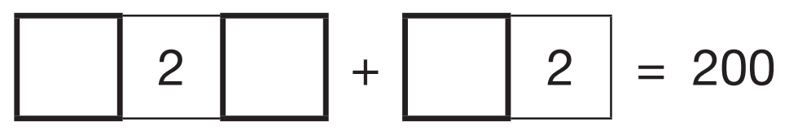
Write the missing digits to make this addition correct.
1
8
7
1
1
8
1
2
+
7
2
2 0 0
Notes:
2019 Paper 3 Q5

Slide 30
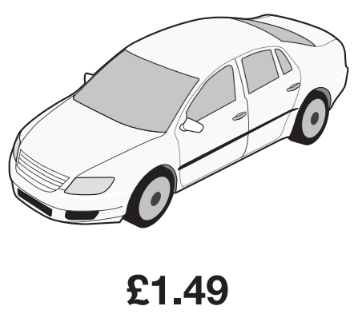
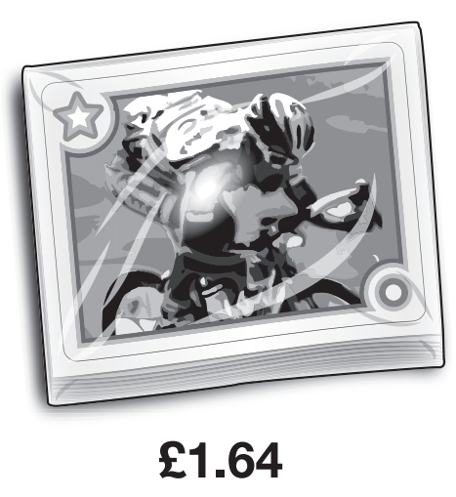
John buys one toy car and one pack of stickers.
He pays with a £10 note. How much change does John get?
He gets £6.87 change
1
1
1.4 9
+
1.6 4
1
3
.
3
0
9
9
1 0
.0 0
1
1
1
-
3.1 3
£
0
6
8
.
7
Notes:
2019 Paper 3 Q6

Slide 31
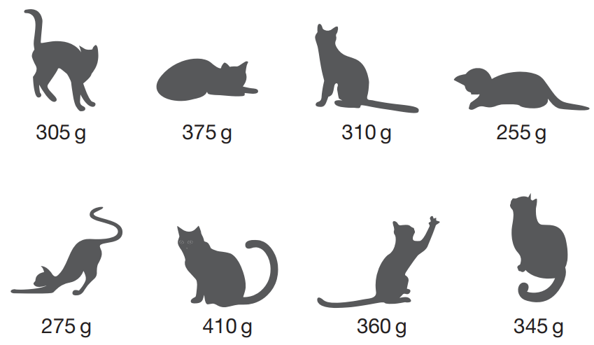
This picture shows the masses of eight kittens.
What is the difference in mass between the heaviest kitten and the lightest kitten?
155 g
1
3
0
4 1 0
1
-
2 5 5
1
5
5
Notes:
2019 Paper 3 Q7 page 1

Slide 32
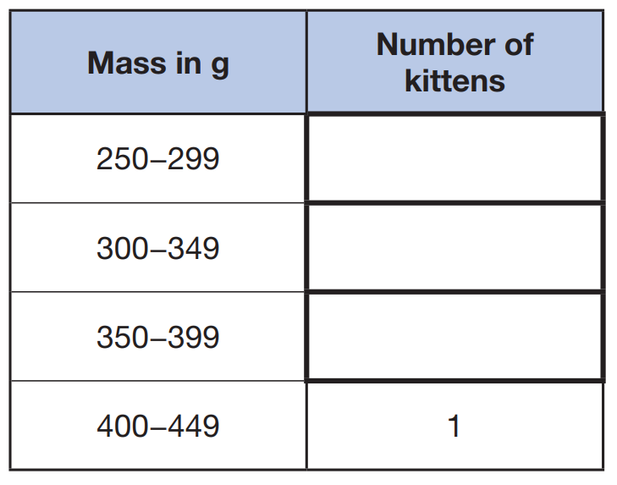
This picture shows the masses of eight kittens.
The masses of the kittens are to be put in four groups.
Write the missing numbers in the table. One has been done for you.
✘
✘
✘
✘
2
3
2
✘
✘
✘
Notes:
2019 Paper 3 Q7 page 2

Slide 33
Ken is playing a game.
He has 4,289 points.
Then he scores another 355 points.
Ken’s target is 6,000 points.
How many more points does Ken need to reach his target?
1356 points
1
1
5
9
9
4 2 8 9
6 0
0 0
1
1
1
+
3 5 5
-
4 6 4 4
4
6
4
4
1
3
5
6
Notes:
2019 Paper 3 Q8

Slide 34
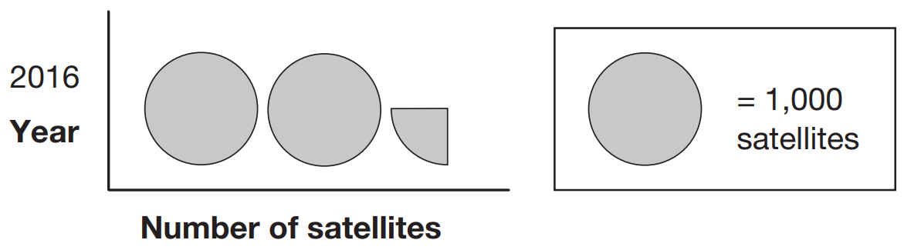
This pictogram shows the number of satellites above the Earth in 2016.
1000
1000
250
How many satellites were above the Earth in 2016?
2250
1
of 1000 =
2
5
0
4
4
1 0 0 0
2
Notes:
2019 Paper 3 Q9

Slide 35
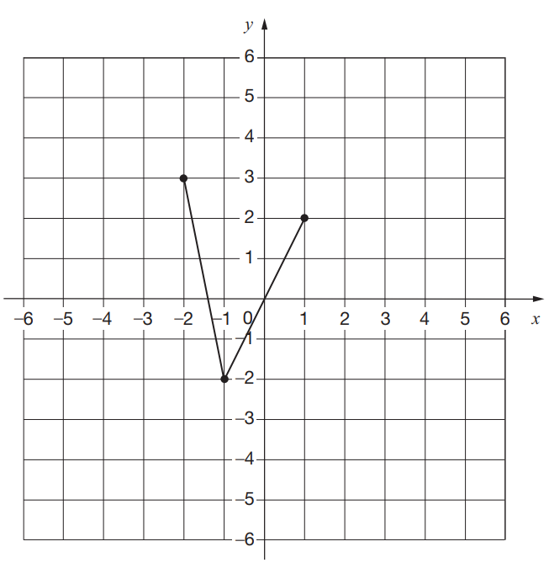
On the grid there are three points joined by two lines.
Lara plots another point on the grid at (–1, 2).
She joins the points to make a quadrilateral.
Complete Lara’s quadrilateral on the grid. Use a ruler.
Then Lara translates the quadrilateral 4 squares to the right. Draw the quadrilateral in its new position on the grid.
Notes:
2019 Paper 3 Q10

Slide 36
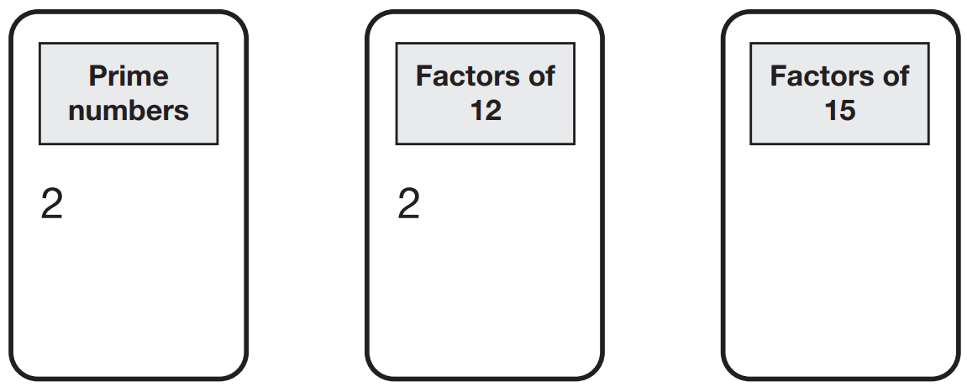
Here are five numbers.
2 3 4 5 6
Write each number on the correct cards.
The number 2 has been written on the correct cards for you.
3
3
3
5
4
6
5
Notes:
2019 Paper 3 Q11

Slide 37
Amina’s bed is 190 cm in length and 91 cm in width.
She is making a one-tenth scale model of the bed.
What are the length and width of Amina’s model?
Length = _____ cm Width = _____ cm
19
9.1
1 9 0 ÷ 1 0 =
1 9
9 1 ÷ 1 0 =
.
9 1
9
.
1
Notes:
2019 Paper 3 Q12

Slide 38
Kirsty says, ‘When you double the size of an acute angle, you always get an obtuse angle.’
Explain why Kirsty is not correct.
An acute angle is less than 90°
1° is an acute angle
Double 1° is 2° which is still less than 90°
Notes:
2019 Paper 3 Q13

Slide 39
How many days are there in September, October and November altogether?
91 days
January 31
February 28 or 29
March 31
April 30
May 31
June 30
July 31
August 31
September 30
October 31
November 30
December 31
30 days has September,
April, June and November,
All the rest have 31,
Except for February, it’s the one,
Which only has 28 days clear,
And 29 in each Leap Year
91
30 + 31 + 30 =
Notes:
2019 Paper 3 Q14

Slide 40
The International Space Station orbits the Earth at a height of 250 miles.
What is the height of the International Space Station in kilometres?
Use 8 kilometres equals 5 miles.
400 kilometres
8 kilometres = 5 miles
x50
x50
250 ÷ 5 =
50
400 kilometres
= 250 miles
8 x 50 =
400
Notes:
2019 Paper 3 Q15

Slide 41
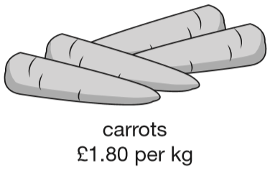
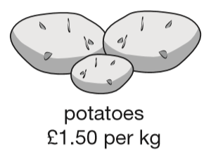
Jack buys 1 ½ kg of potatoes and ½ kg of carrots.
How much change does he get from £5?
£1.85 change
1
of 180 =
90
p on carrots
2
180 ÷ 2 =
90
1
of 150 =
7
5
p
2
2
1 5 0
1
£1.50 + £0.75 =
£2.25 on potatoes
4
9
£2.25 + £0.90 =
£3.15 spent
5.0 0
1
1
-
3.1 5
£5.00 – £3.15 =
£1.85 change
.
£
1
8
5
Notes:
2019 Paper 3 Q16

Slide 42
x + 2y = 20
x and y are whole numbers less than 10
What could x and y be?
2
4
6
8
x = _____
y = _____
9
8
7
6
2
6
9
1
+ (2 x
7
) = 20
4
8
8
6
Notes:
2019 Paper 3 Q17

Slide 43
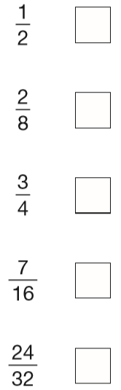
5
Tick the fractions less than
8
x2
x4
✓
5
1 0
5
2 0
x4
=
=
1
4
8
1 6
8
3 2
=
2
8
x2
x4
✓
x4
x2
✘
3
6
=
4
8
x2
✓
✘
Notes:
2019 Paper 3 Q18

Slide 44
Layla makes jewellery to sell at a school fair.
Each bracelet has 53 beads. She makes 68 bracelets.
Each necklace has 105 beads. She makes 34 necklaces.
How many beads does Layla use altogether?
3604
3570
7174 beads
4
1
2
2
6
8
1
0
5
1
5
3 6 0 4
x
3
x
3
4
+
3 5 7 0
2 0
4
4
2
0
7
1
7
4
3 4
0
0
3
1
5
0
3
6
0
4
3
5
7
0
Notes:
2019 Paper 3 Q19

Slide 45
Adam is making booklets.
Each booklet must have 34 sheets of paper.
He has 2 packets of paper.
There are 500 sheets of paper in each packet.
How many complete booklets can Adam make from 2 packets of paper?
2 x 500 =
1000 sheets
29 complete booklets
3 4
1
1x
1 7 0
5x
+ 3 4
2
9
+ 1 3 6
1
4x
3
4
1
0
0
0
6
8
2x
3
0
6
+ 3 4
- 6 8
1 0
2
3x
3 2
0
+ 3 4
- 3 0 6
1
1
3
6
4x
1 4
+ 3 4
1
7
0
5x
Notes:
2019 Paper 3 Q20 first page

Slide 46
Adam is making booklets.
Each booklet must have 34 sheets of paper.
He has 2 packets of paper.
There are 500 sheets of paper in each packet.
How many complete booklets can Adam make from 2 packets of paper?
2 x 500 =
1000 sheets
0
9
1
1 booklet = 34 sheets
29 booklets =
1
1 0 2 0
1
1
x10
-
3 4
10 booklets =
340 sheets
0
9
8
6
+340
20 booklets =
680 sheets
+340
30 booklets =
1020 sheets
…but that’s too many!
Notes:
2019 Paper 3 Q20 second page

Slide 47
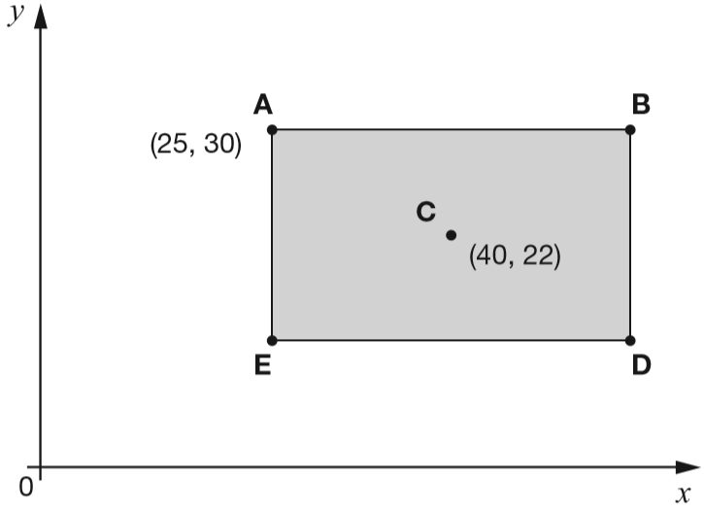
ABDE is a rectangle on coordinate axes.
The sides of the rectangle are parallel to the axes.
Point C is the centre of the rectangle.
What are the coordinates of B and D?
30
8
22
B is ( , )
D is ( , )
55
30
8
14
55
14
15
15
25
40
55
Notes:
2019 Paper 3 Q21

Slide 48
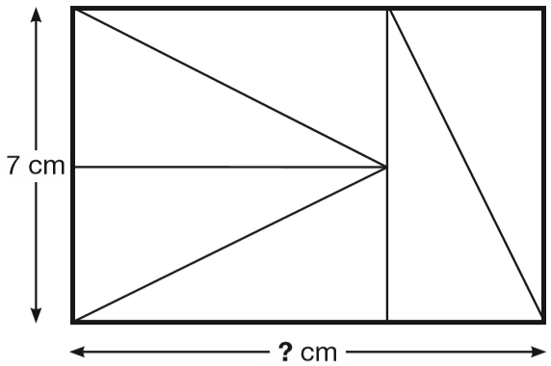
Six identical right-angled triangles are arranged to make a rectangle.
Calculate the length of the rectangle.
3
.
5
2
7
.0
1
7 + 3.5 =
10.5 cm
7 cm
3.5 cm
Notes:
2019 Paper 3 Q22

Slide 49

160
160
160
160
160
The distance from point P to point R is 800 metres. The distance from point P to point Q is 4 times the distance from point Q to point R.
Olivia says, ‘It is 600 metres from point P to point Q.’
Explain why Olivia is not correct.
800 ÷ 5 =
160
so it’s 160 metres from Q to R
160 x 4 =
640
so it’s 640 metres from P to Q
If it were 600 m from P to Q, it would be 600 ÷ 4 = 150 m from Q to R, and 600 + 150 = 750 m, not 800 m
Notes:
2019 Paper 3 Q23

