Slide 1
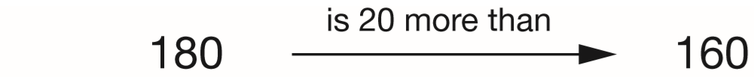
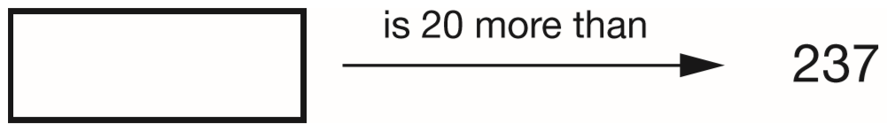
Write the missing number.
One is done for you.
257
237 + 20 =
257
Notes:
2015 (Sample) Paper 2 Q1

Slide 2
A pack of paper has 150 sheets.
4 children each take 7 sheets.
How many sheets of paper are left in the packet?
4 x 7 =
28 taken
4
1 5 0
1
-
2 8
1
2
2
sheets are left
Notes:
2015 (Sample) Paper 2 Q2

Slide 3
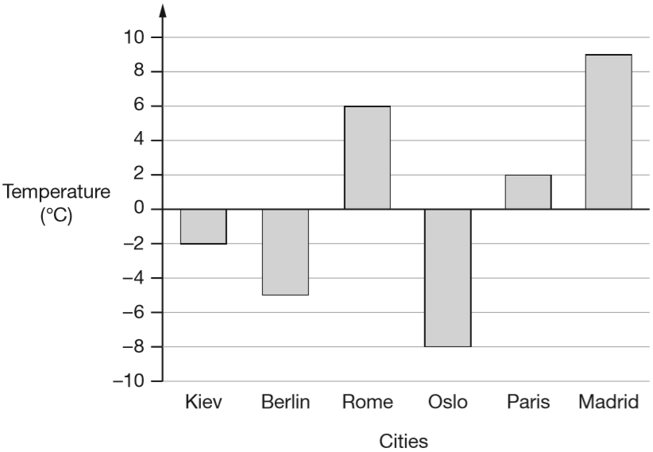
This graph shows the temperature in six cities on one day in January.
Which city was 4 degrees warmer than Kiev?
+2
+2
-2
0
2
Paris
Notes:
2015 (Sample) Paper 2 Q3 page 1

Slide 4
This graph shows the temperature in six cities on one day in January.
What was the difference between the temperature in Oslo and the temperature in Berlin?
3 degrees
-5
+3
-10
-9
-8
-7
-6
-5
-4
-3
-2
-1
0
1
2
3
4
5
6
7
8
9
10
Notes:
2015 (Sample) Paper 2 Q3 page 2

Slide 5
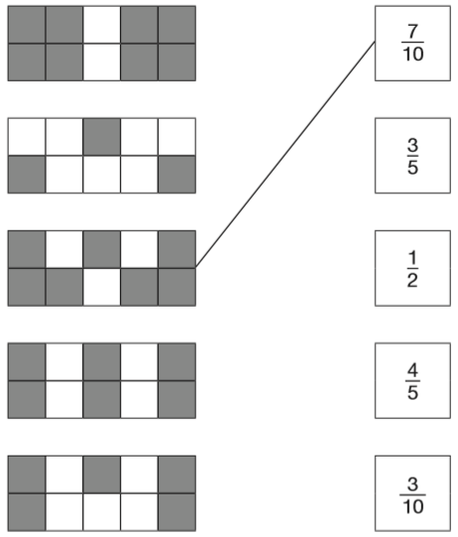
Here are some shapes made of squares.
A fraction of each shape is shaded.
Match each shape to its equivalent fraction.
One has been done for you.
÷2
8
4
=
1 0
5
÷2
÷2
6
3
=
1 0
5
÷5
÷2
5
1
=
1 0
2
÷5
Notes:
2015 (Sample) Paper 2 Q4

Slide 6
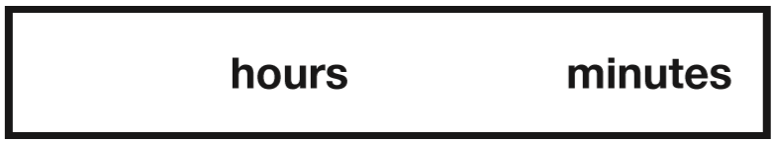
What is 444 minutes in hours and minutes?
7
24
60 minutes = 1 hour
120 minutes
= 2 hours
240 minutes
= 4 hours
360 minutes
= 6 hours
420 minutes
= 7 hours
+ 24 minutes
Notes:
2015 (Sample) Paper 2 Q5

Slide 7
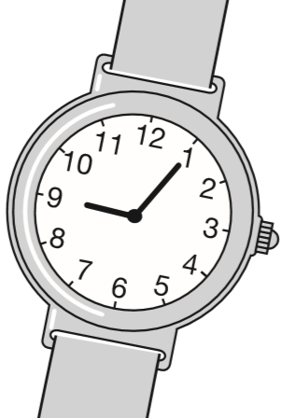
Stefan’s watch shows five minutes past nine.
The watch is twelve minutes fast.
What is the correct time?
-7m
-5m
8:53
8:53
9:00
9:05
Notes:
2015 (Sample) Paper 2 Q6

Slide 8
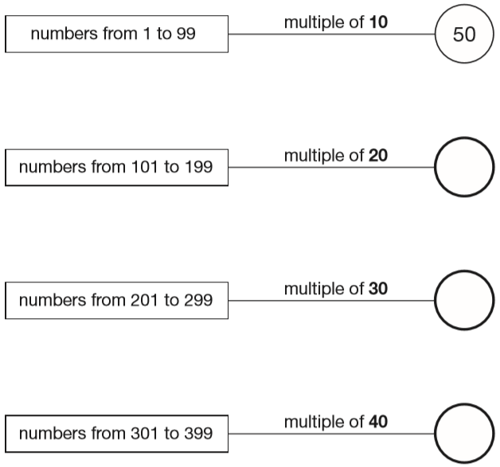
In the circles, write a multiple that belongs to each set.
One has been done for you.
120
180
160
140
210
270
240
320
360
Notes:
2015 (Sample) Paper 2 Q7

Slide 9
Maria bakes cakes and sells them in bags. She uses this formula to work out how much to charge for one bag of cakes.
Cost = number of cakes × 20p + 15p for the bag
How much will a bag of 12 cakes cost?
£2.55
12 x 20p =
240p
= £2.40
£2.40 + £0.15 =
£2.55
Notes:
2015 (Sample) Paper 2 Q8 page 1

Slide 10
Maria bakes cakes and sells them in bags. She uses this formula to work out how much to charge for one bag of cakes.
Cost = number of cakes × 20p + 15p for the bag
Olivia buys a bag of cakes for £5.15
Use the formula to calculate how many cakes are in the bag.
25 cakes
£5.15 = £0.15 =
£5.00
1 cake = 20p
25
£5.00 ÷ 20p =
5 cakes = £1
500 ÷ 20 =
25
25 cakes = £5
Notes:
2015 (Sample) Paper 2 Q8 page 2

Slide 11
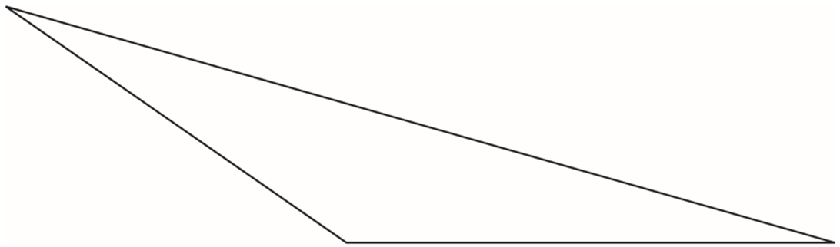
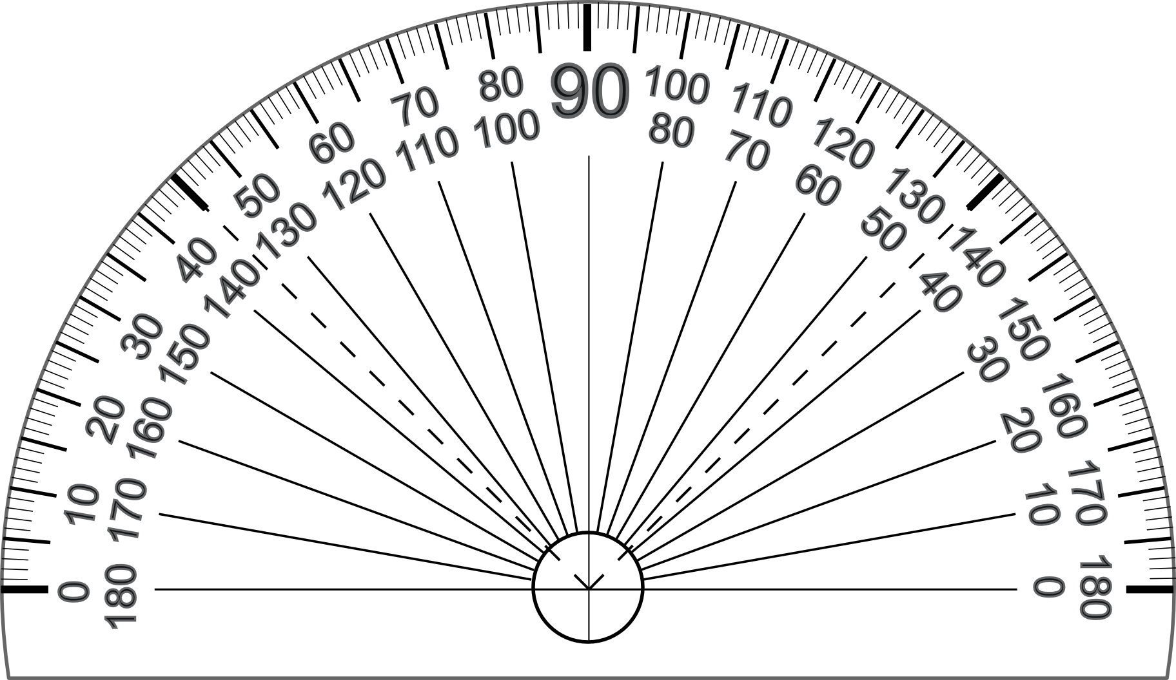
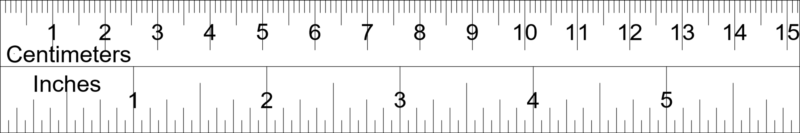
Here is a triangle.
Measure the shortest side accurately, in centimetres.
Measure the largest angle.
5.7 cm
6.7 cm
5.7 cm
You get the mark for an answer between 5.5 and 5.9 cm
145 degrees
You get the mark for an answer between 143 and 147 degrees
Notes:
2015 (Sample) Paper 2 Q9

Slide 12
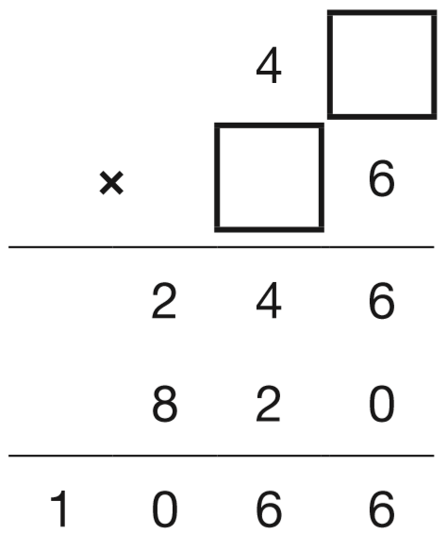
Write the two missing digits to make this long multiplication correct.
1
1 or 6
2
Notes:
2015 (Sample) Paper 2 Q10

Slide 13
Here is a number written in Roman numerals.
CXV
Write the number in figures.
115
C = 100
X = 10
V = 5
Notes:
2015 (Sample) Paper 2 Q11

Slide 14
What number is halfway between 1.4 and 2.1?
1.75
Add, then divide by 2
1.4 + 2.1 = 3.5
1.4
1.5
1.6
1.7
1.8
1.9
2.0
2.1
1.75
3.5 ÷ 2 =
1.75
1
.
5
7
2
3.5
0
1
1
1.7
0
0
1.8
1.75
Notes:
2015 (Sample) Paper 2 Q12

Slide 15
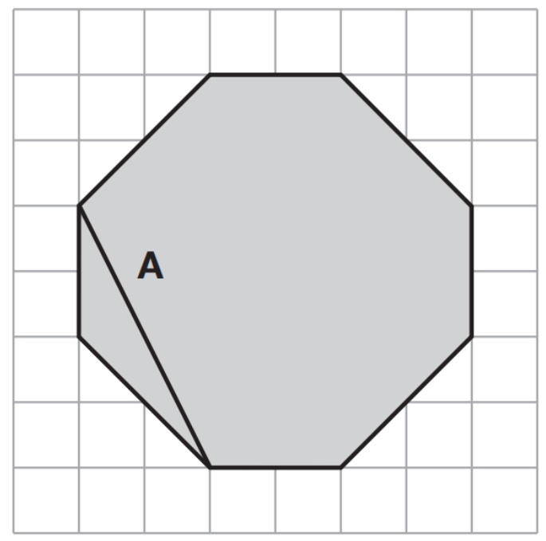
The diagram shows a shaded octagon on a square grid.
Line A joins two vertices of the octagon.
a) Join two vertices to draw a line perpendicular to line A.
b) Join two other vertices to draw a line parallel to line A.
Notes:
2015 (Sample) Paper 2 Q13

Slide 16
Round 124,531
to the nearest 10,000 __________
to the nearest 1,000 __________
to the nearest 100 __________
120 000
1 2 4 5 3 1
125 000
1 2 4 5 3 1
124 500
1 2 4 5 3 1
Notes:
2015 (Sample) Paper 2 Q14

Slide 17
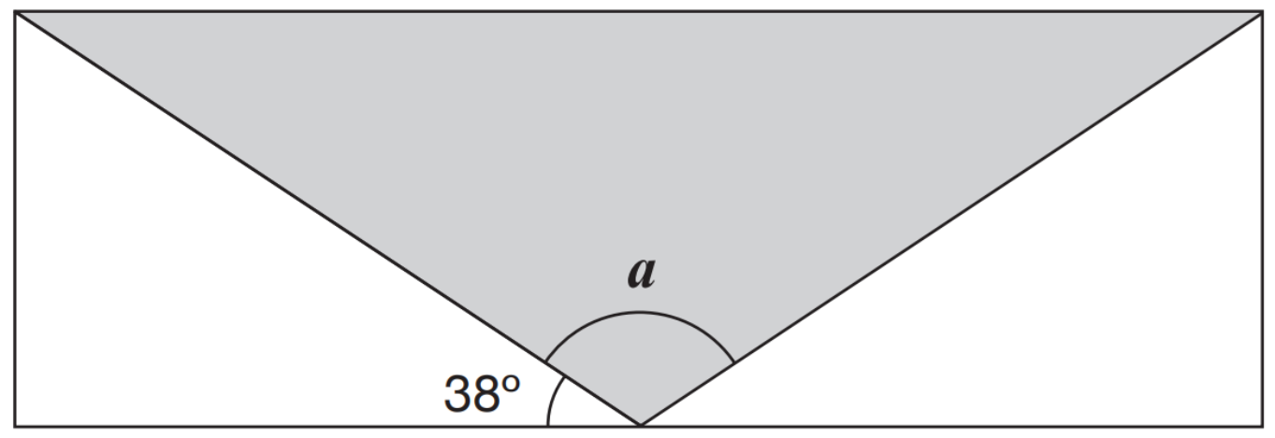
A shaded isosceles triangle is drawn inside a rectangle.
Calculate the size of angle a.
Angles on a straight line add up to 180°.
180° - 38° - 38° = 104°
a = 104°
104°
38°
Notes:
2015 (Sample) Paper 2 Q15

Slide 18
Large pizzas cost £8.50 each.
Small pizzas cost £6.75 each.
Five children together buy one large pizza and three small pizzas.
They share the cost equally.
How much does each child pay?
£5.75
2
1
6.7 5
2 0.2 5
x
3
£
5
.
+
8.5 0
7
5
.
5
2
7
£
2 0
2
£
8
.
5
5
2 8.7 5
3
2
Notes:
2015 (Sample) Paper 2 Q16

Slide 19
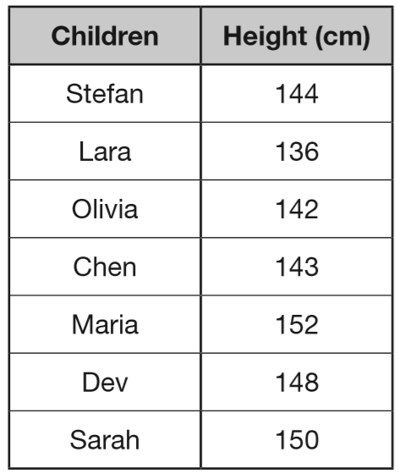
Seven children measured their heights.
What is the mean height of the children?
145 cm
1
4
5
cm
7
1 0 1 5
3
3
280
422
565
717
865
1015
Notes:
2015 (Sample) Paper 2 Q17

Slide 20
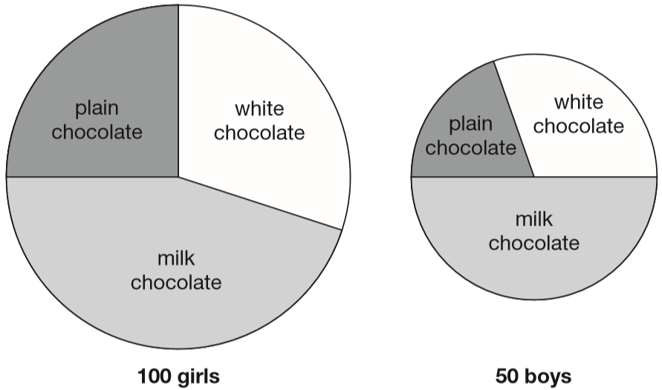
100 girls and 50 boys were asked which kind of chocolate they like best. These two pie charts show the results.
Dev says, ‘The pie charts show that more girls than boys liked milk chocolate best.’
Dev is correct.
Explain how you know.
1
1
of 100 = 25
of 50 =
25
4
2
Half of 50 = 25 boys
50 ÷ 2 =
25
Over a quarter of 100 = over 25 girls
Notes:
2015 (Sample) Paper 2 Q18

Slide 21
One gram of gold costs £32.94
What is the cost of half a kilogram of gold?
£16470
1 kilogram = 1000 grams
½ kilogram = 500 grams
£32.94 x 500 =
3 2.9 4
x 1000 to find 1 kg
£32940
3
2
9
4
0
.
then ÷ 2 to find ½ kg
£16470
1
6
4
0
£
7
2
3 2 9 4 0
1
1
1
4
2
x 100 to find 100 g
3 2.9 4
3 2 9 4
then x 5 to find 500 g
3
2
9
4
.
x
5
£
1 6
4
7
0
Notes:
2015 (Sample) Paper 2 Q19

Slide 22
2
On Saturday Lara read of her book.
On Sunday she read the other 90 pages to finish the book.
How many pages are there in Lara’s book?
5
150 pages
90
Sat
Sat
Sun
Sun
30
30
30
Sun
30
30
3
of = 90
150
30
5
90 ÷ 3 =
150
30 x 5 =
9 0 ÷ 3 = 3 0
3 0 x 5 = 1 5 0
Notes:
2015 (Sample) Paper 2 Q20

Slide 23
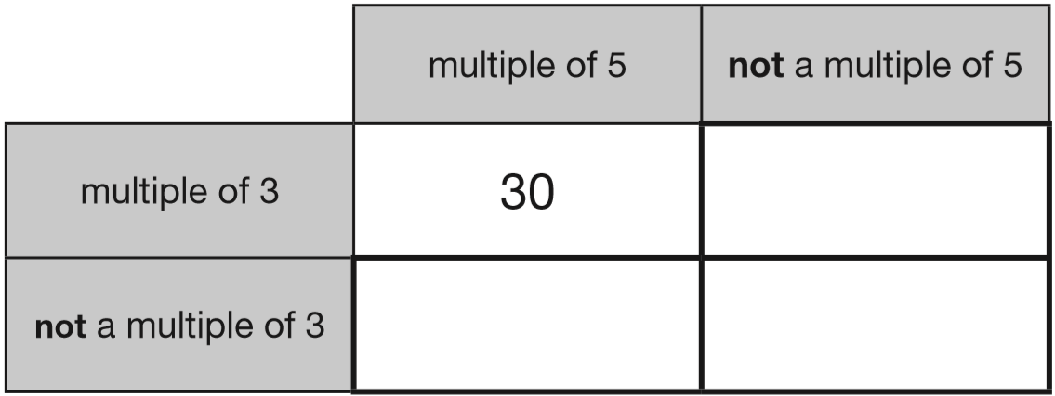
Here is a diagram for sorting numbers.
Write one number in each box.
One is done for you.
6
5
1
Notes:
2015 (Sample) Paper 3 Q1

Slide 24
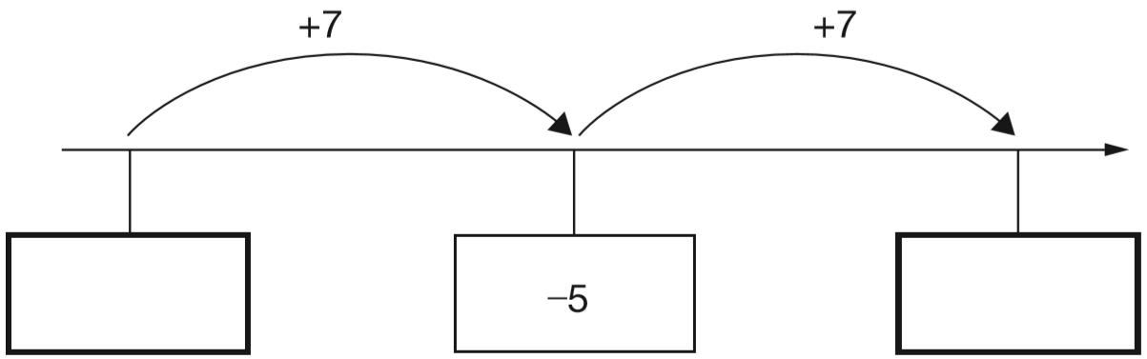
Here is part of a number line.
Write the missing numbers in the boxes.
+5
+2
-11
-10
-9
-8
-7
-6
-4
-3
-2
-1
0
1
-12
2
-5 – 7 =
-12
Notes:
2015 (Sample) Paper 3 Q2

Slide 25
Look at this number.
23,451.96
4
Write the digit that is in the hundreds place.
Write the digit that is in the hundredths place.
6
Ten thousands
Tens
Tenths
Thousands
Hundreds
Ones
Hundredths
1
1
10000
1000
100
10
1
10
100
1
1
100s
10s
1s
10 000s
1 000s
10
100
2 3 4 5 1 9 6
Notes:
2015 (Sample) Paper 3 Q3

Slide 26
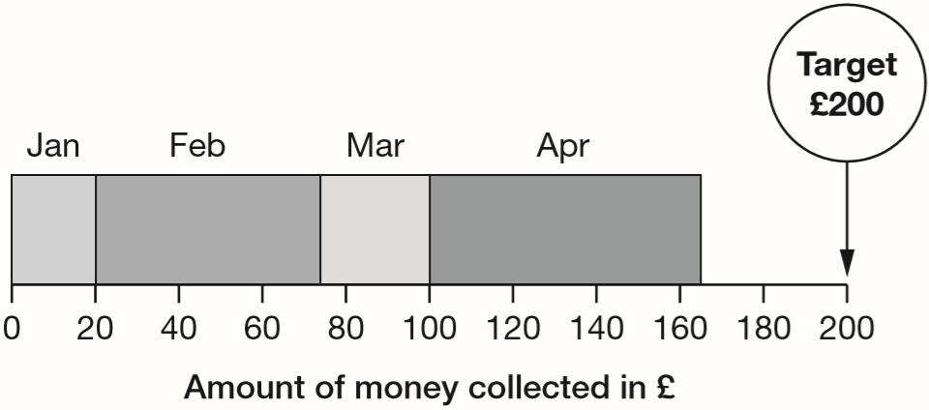
A school plans to collect £200 between January and May.
This chart shows how much they collected by the end of April.
Write the name of each month where they collected more than £50
How much money did they collect in February and March altogether?
20
53
27
64
70
170
February, April
£80
They collected £80
100 – 20 =
£80
53 + 27 =
Notes:
2015 (Sample) Paper 3 Q4

Slide 27
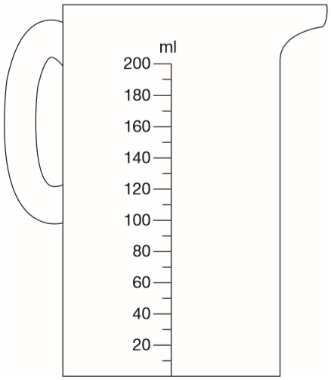
Chen pours 165 millilitres of milk into a measuring jug.
Draw an arrow on the jug to show the level of the milk.
170
Notes:
2015 (Sample) Paper 3 Q5

Slide 28
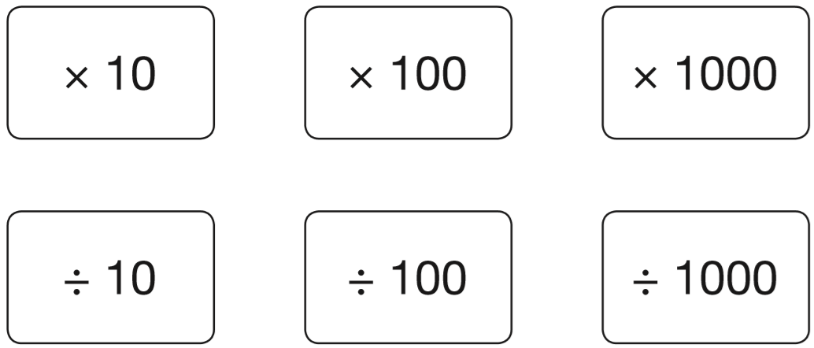
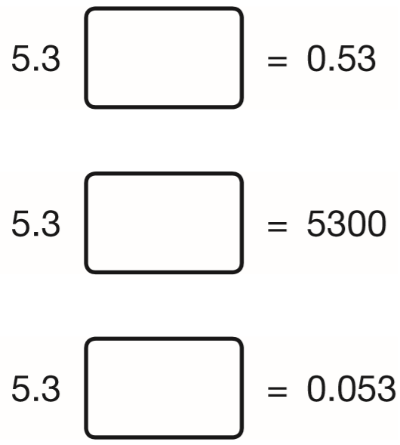
Here are six cards.
Use a card to complete each calculation.
÷10
x1000
5.3
5.3
5.3
0.5 3
.
5 3 0 0
0.0 5 3
÷100
Notes:
2015 (Sample) Paper 3 Q6

Slide 29
Write the number 53,148 in words.
Fifty-three
thousand,
one hundred and forty-eight
Notes:
2015 (Sample) Paper 3 Q7

Slide 30
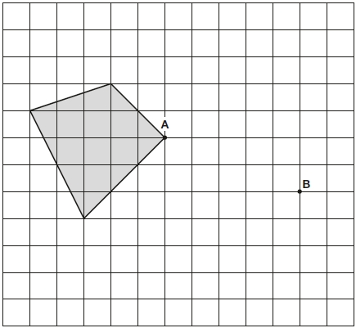
Here is a shaded shape on a grid. The shape is translated so that point A moves to point B. Draw the shape in its new position.
Notes:
2015 (Sample) Paper 3 Q8

Slide 31
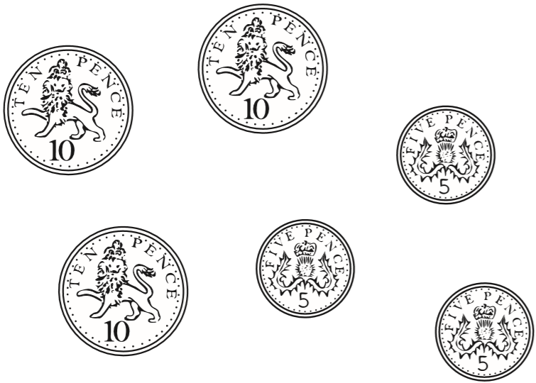
The mass of a 10p coin is 6.5g.
The mass of a 5p coin is half the mass of a 10p coin.
What is the mass of these six coins altogether?
29.25 g
1
3
.
6.5
2
5
1
1
6.5
6.5
2
6.5
0
1 9.5
0
3.25
x
1
3
+
9.7 5
.
1 9
5
9
2
5
2
.
3.25
6.5
1
3.25
3.2 5
x
3
.
9
7
5
Notes:
2015 (Sample) Paper 3 Q9

Slide 32
A bag of 5 lemons costs £1
A bag of 4 oranges costs £1.80
How much more does one orange cost than one lemon?
100p
180p
25p more
20p per lemon
100 ÷ 5 =
45 – 20 =
25p
180 ÷ 4 =
45p per orange
4
5
4
1 8 0
2
Notes:
2015 (Sample) Paper 3 Q10

Slide 33
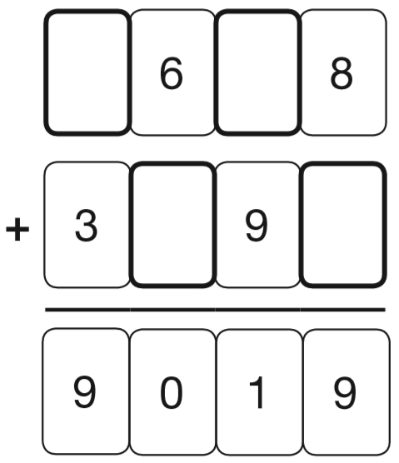
Write the four missing digits to make this addition correct.
1
1
5
2
3
1
Notes:
2015 (Sample) Paper 3 Q11

Slide 34
Two decimal numbers add together to equal 1
One of the numbers is 0.007
What is the other number?
0.993
0.007 + = 1
0.993
7 + 993 = 1000
so 0.007 + 0.993 = 1.000
0
9
9
1
.0 0 0
1
1
1
- 0.0 0 7
0
.
9
9
3
Notes:
2015 (Sample) Paper 3 Q12

Slide 35
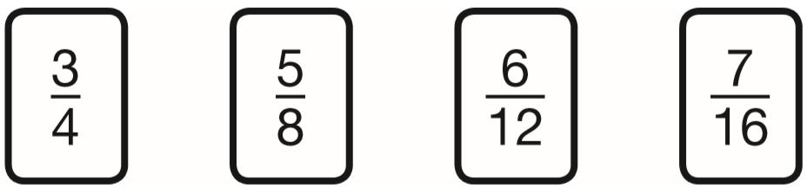
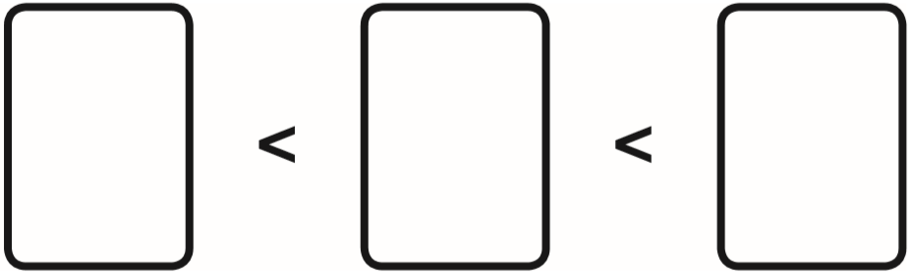
Here are four fraction cards.
Use any three of the cards to make this correct.
12
10
16
16
x4
3
1 2
=
4
1 6
x4
7
5
3
x2
1 6
8
4
5
1 0
=
8
1 6
x2
Notes:
2015 (Sample) Paper 3 Q13 page 1

Slide 36
Here are four fraction cards.
Use any three of the cards to make this correct.
x6
3
1 8
=
4
2 4
x6
x3
5
1 5
=
8
2 4
6
5
3
x3
1 2
8
4
x2
6
1 2
=
1 2
2 4
x2
Notes:
2015 (Sample) Paper 3 Q13 page 2

Slide 37
Here are four fraction cards.
Use any three of the cards to make this correct.
over ½
½
under ½
5
7
6
3
8
1 6
1 2
4
Notes:
2015 (Sample) Paper 3 Q13 page 3

Slide 38
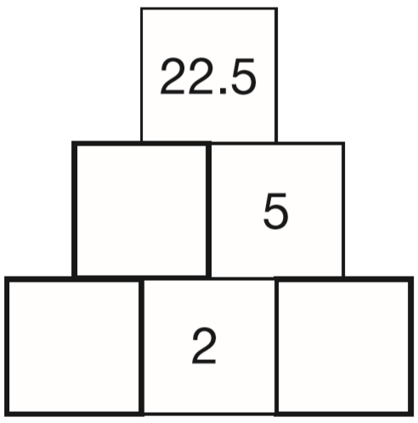
Here is a number pyramid.
The number in a box is the product of the two numbers below it.
Write the missing numbers.
.
4
5
5
2 2.5
2
4.5
2
.
5
2.25
2.5
2
5
.0
1
2
.
5
2
2
4.5
0
1
Notes:
2015 (Sample) Paper 3 Q14

Slide 39
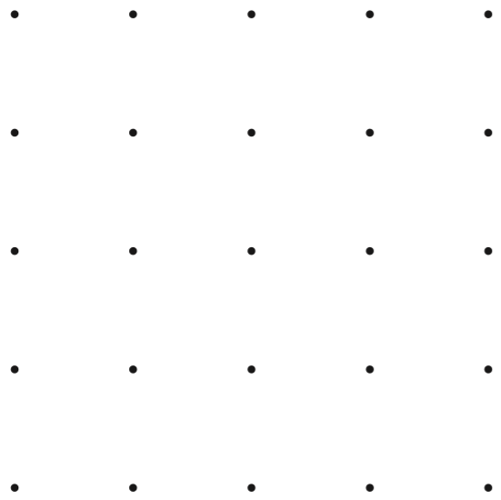
Join dots on the grid to make a quadrilateral that has 3 acute angles.
Notes:
2015 (Sample) Paper 3 Q15

Slide 40
Lara chooses a number less than 100
She divides it by 3 and then subtracts 11
She then divides this result by 2
Her answer is 10.5
What was the number she started with?
96
96
÷3
32
-11
21
÷2
10.5
21 + 11 =
32
1
3 2
1 0.5
x
3
x
2
9
6
2
1
.
0
Notes:
2015 (Sample) Paper 3 Q16

Slide 41
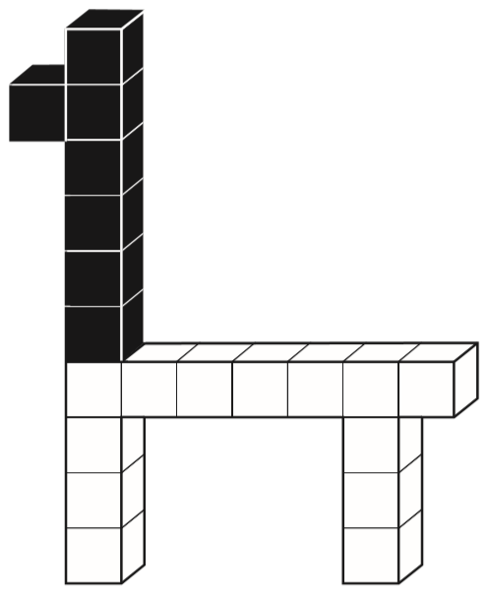
This model is made with 20 cubes.
What percentage of the cubes in the model is black?
35 percent
7 black cubes
20 cubes altogether
7
2 0
x5
7
3 5
=
2 0
1 0 0
x5
Notes:
2015 (Sample) Paper 3 Q17

Slide 42
Here are the ingredients for chocolate ice cream.
cream 400 ml
milk 500 ml
egg yolks 4
chocolate 120 g
sugar 100 g
Stefan has only 300ml of cream to make chocolate ice cream.
How much chocolate should he use?
400 cream = 120 chocolate
÷4
÷4
100 cream =
30 chocolate
x3
x3
300 cream =
90 chocolate
400 cream = 120 chocolate
x3
x3
1200 cream =
360 chocolate
÷4
÷4
90 g chocolate
300 cream =
90 chocolate
Notes:
2015 (Sample) Paper 3 Q18

Slide 43
The area of a rugby pitch is 6,108 square metres. A football pitch measures 112 metres long and 82 metres wide. How much larger is the area of the football pitch than the area of the rugby pitch?
1
7
1
1
2
9 1 8 4
1
x
8
2
-
6 1 0 8
1
2
2
4
3
0
7
6
The area of the football pitch is 3076 square metres larger.
8
9
6
0
9
1
8
4
Notes:
2015 (Sample) Paper 3 Q19

Slide 44
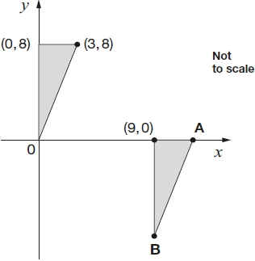
Here are two identical shaded triangles on coordinate axes.
Write the coordinates of points A and B.
3
8
A: (12,
0)
3
B: (9,
-8)
3
9
12
8
-8
Notes:
2015 (Sample) Paper 3 Q20

Slide 45
Ali puts these five numbers in their correct places on a number line.
511 499 502 555 455
11 more
1 less
2 more
55 more
45 less
499
Write the number closest to 500
Write the number furthest from 500
555
Notes:
2016 Paper 2 Q1

Slide 46
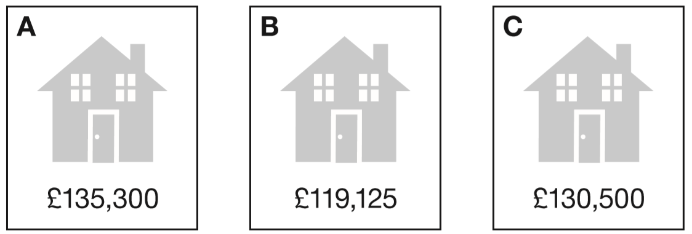
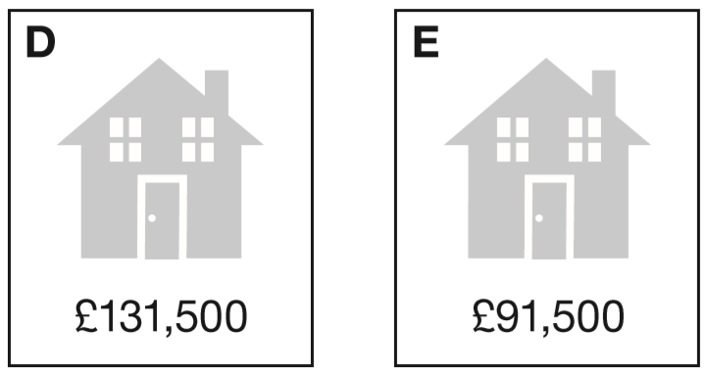
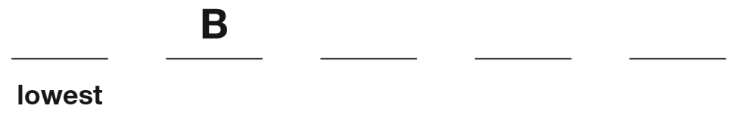
Put these houses in order of price starting with the lowest price.
One has been done for you.
E
C
D
A
1 3 5 3 0 0
1 1 9 1 2 5
1 3 0 5 0 0
1 3 1 5 0 0
9 1 5 0 0
Notes:
2016 Paper 2 Q2

Slide 47
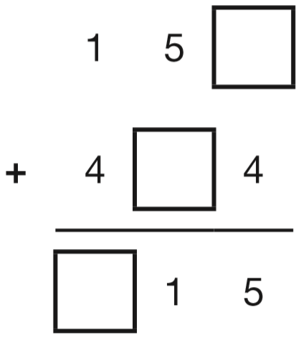
Write the three missing digits to make this addition correct.
1
1
6
6
Notes:
2016 Paper 2 Q3

Slide 48
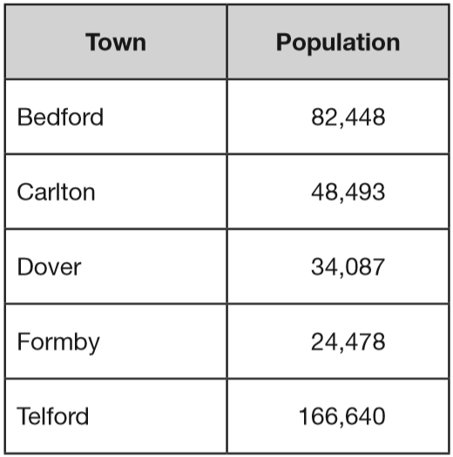
This table shows the number of people living in various towns in England.
What is the total of the numbers of people living in Formby and in Telford?
1
1
1
1 6 6 6 4 0
+
2 4 4 7 8
1
9
1
1
1
8
What is the difference between the numbers of people living in Bedford and in Dover?
7
3
8 2 4 4 8
1
1
-
3 4 0 8 7
4
8
3
6
1
Notes:
2016 Paper 2 Q4

Slide 49
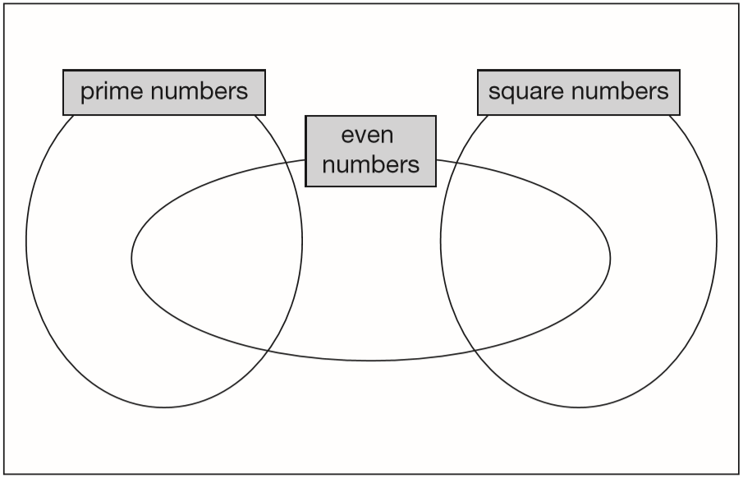
Write each number in its correct place on the diagram.
16 17 18 19
17
19
18
16
Notes:
2016 Paper 2 Q5

Slide 50
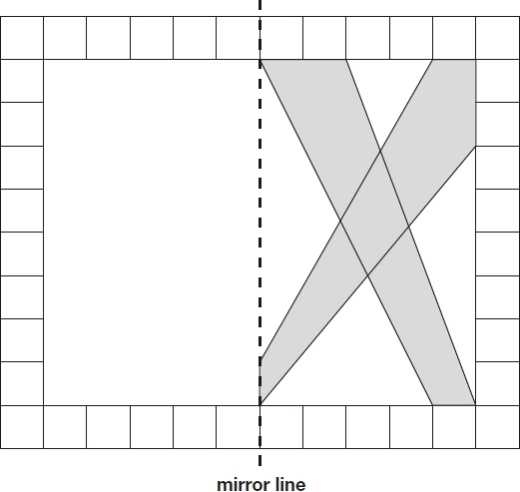
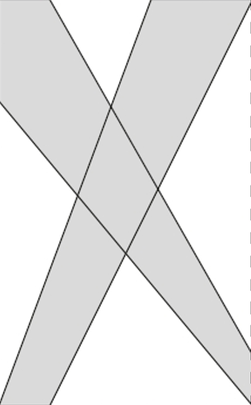
This diagram shows a shaded shape inside a border of squares. Draw the reflection of the shape in the mirror line.
Notes:
2016 Paper 2 Q6

Slide 51
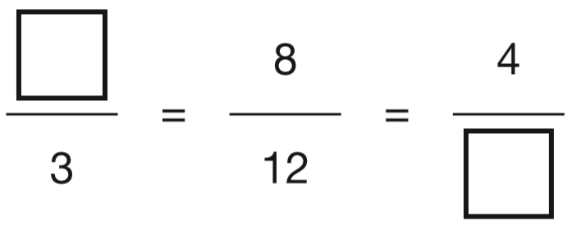
Write the two missing values to make these equivalent fractions correct.
x4
÷2
2
6
x4
÷2
Notes:
2016 Paper 2 Q7

Slide 52
Circle two numbers that add together to equal 0.25
0.05 0.23 0.2 0.5
0
0.2
0.2 3
0.0 5
0
+
+
0.2
2
✓
.
5
4
0
0
.
3
Notes:
2016 Paper 2 Q8

Slide 53
6 pencils cost £1.68
3 pencils and 1 rubber cost £1.09
What is the cost of 1 rubber?
1 pencil costs 28p
3 pencils costs 84p
25p
£
0
.
8
2
2
0
2 8
1.0 9
1
6
1.6 8
1
4
x
3
-
0.8 4
8
4
£
.
5
0
2
Notes:
2016 Paper 2 Q9

Slide 54
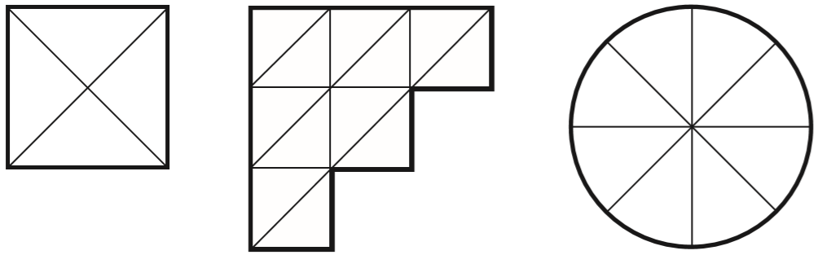
Each diagram below is divided into equal sections.
Shade three-quarters of each diagram.
x3
x2
3
9
3
6
=
=
4
1 2
4
8
x3
x2
Notes:
2016 Paper 2 Q10

Slide 55
A packet contains 1.5 kg of oats.
Every day Maria uses 50 g of oats to make porridge.
How many days does the packet of oats last?
30 days
1 kilogram = 1000 grams
1 day = 50 g
1.5 kilograms = 1500 grams
x2
2 days = 100 g
1500 ÷ 50 =
30
x5
10 days = 500 g
x3
30 days = 1500 g
Notes:
2016 Paper 2 Q11

Slide 56
n = 22
What is 2n + 9?
53
2 x 22 =
44
44 + 9 =
53
2q + 4 = 100
Work out the value of q.
48
100 – 4 =
96
96 ÷ 2 =
48
4
8
2
9 6
1
Notes:
2016 Paper 2 Q12

Slide 57
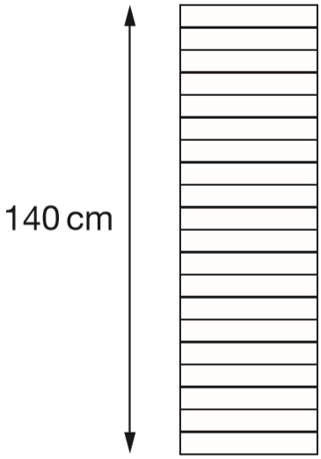
A stack of 20 identical boxes is 140 cm tall.
Stefan takes three boxes off the top.
How tall is the stack now?
119 cm
140 ÷ 20 =
7 cm each box
21 cm taken off
3 x 7 =
140 – 21 =
119 cm left
Notes:
2016 Paper 2 Q13

Slide 58
Write all the common multiples of 3 and 8 that are less than 50
24 and 48
Multiples of 8: 8, 16, 24, 32, 40, 48
8 x 3
16 x 3
1
6
3
4 8
1
Notes:
2016 Paper 2 Q14

Slide 59
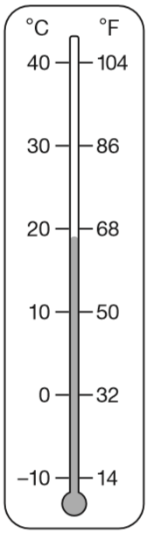
This thermometer shows temperatures in both °C and °F.
Work out what 25 °C is in °F.
77 °F
Half-way between 68 and 86
Add, then divide by 2
1
8 6
+
6 8
7
7
1 5
4
2
1 5 4
1
+5
+4
-4
-5
68
69
70
71
72
73
74
75
76
77
78
79
80
81
82
83
84
85
86
Notes:
2016 Paper 2 Q15

Slide 60
Write the number that is five less than ten million.
0
9
9
9
9
9
9
10,000,000 – 5 =
9,999,995
1 0 0 0 0 0 0 0
1
1
1
1
1
1
1
-
5
0
9
9
9
9
9
9
5
Write the number that is one hundred thousand less than six million.
6,000,000 – 100,000 =
5,900,000
5
6 0 0 0 0 0 0
1
-
1 0 0 0 0 0
5
9
0
0
0
0
0
Notes:
2016 Paper 2 Q16

Slide 61
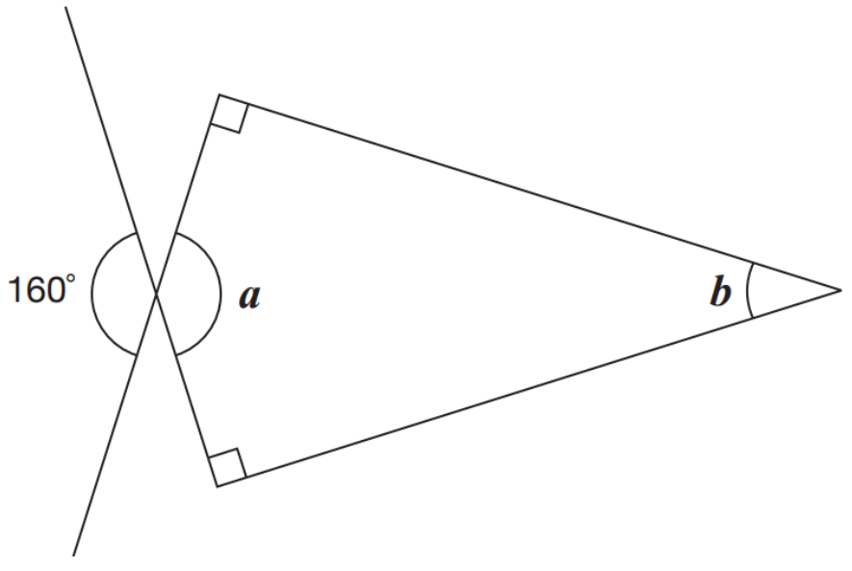
Calculate the size of angles a and b.
90°
160°
20°
90°
Vertically opposite angles are the same size.
a = 160°
Angles in a quadrilateral add up to 360°.
b = 360° - 160° - 90° - 90° =
20°
Notes:
2016 Paper 2 Q17

Slide 62
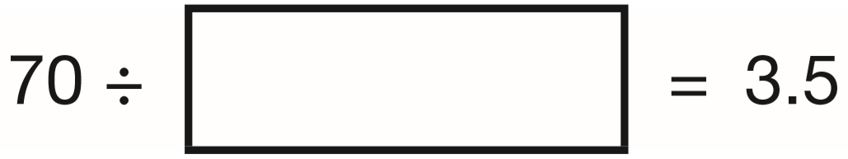
Write the missing number.
If 2 x 3.5 = 7
Then 20 x 3.5 = 70
So 70 ÷ 3.5 = 20
And 70 ÷ 20 = 3.5
20
2
0
1
3.5
7 0
3
.5
+
3.5
7
.
0
so 2 x 3.5 = 7
Notes:
2016 Paper 2 Q18

Slide 63
Miss Mills is making jam to sell at the school fair.
Strawberries cost £7.50 per kg.
Sugar costs 79p per kg.
10 glass jars cost £6.90
She uses 12 kg of strawberries and 10 kg of sugar
to make 20 jars full of jam.
Calculate the total cost to make 20 jars full of jam.
6
7.5 0
x
1 2
£
.
9 0
0
0
7 9 x 1 0 =
£ .
£90
7 9 0
£7.90
£13.80
£6.90 x 2 =
£13.80
£111.70
£90 + £7.90 + £13.80 =
£111.70
Notes:
2016 Paper 2 Q19

Slide 64
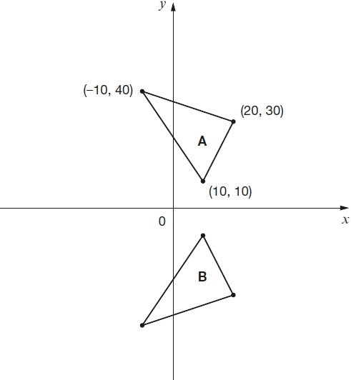
Here are two triangles drawn on coordinate axes.
Triangle B is a reflection of triangle A in the x-axis.
Two of the new vertices of triangle B are (10, −10) and (20, −30).
What are the coordinates of the third vertex of triangle B?
(10, -10)
(-10, -40)
(20, -30)
(-10,
-40)
Notes:
2016 Paper 2 Q20

Slide 65
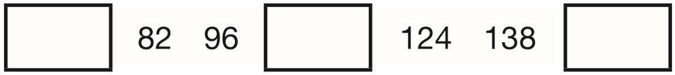
The numbers in this sequence increase by 14 each time.
Write the missing numbers.
68
110
152
7
1
1
8 2
9 6
1 3 8
1
–
1 4
+
1 4
+
1 4
6
8
1 1
0
1
5
2
Notes:
2016 Paper 3 Q1

Slide 66
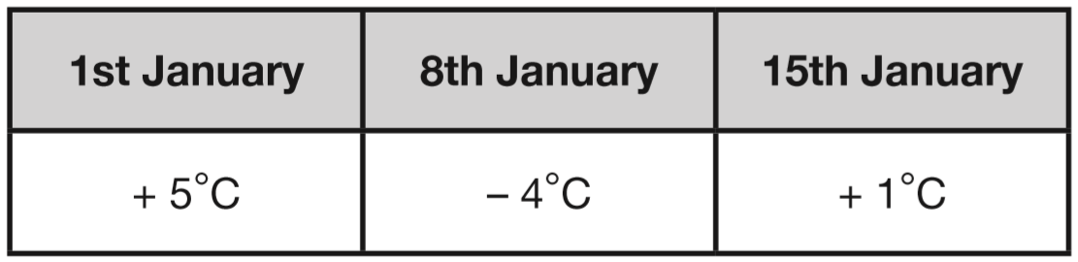
This table shows the temperature at 9am on three days in January.
What is the difference between the temperature on 1st January and the temperature on 8th January?
+4
+5
The difference is 9°C.
-4
0
5
On 22nd January the temperature was 7 degrees lower than on 15th January. What was the temperature on 22nd January?
-6
-1
The temperature was -6°C.
-6
0
1
Notes:
2016 Paper 3 Q2

Slide 67
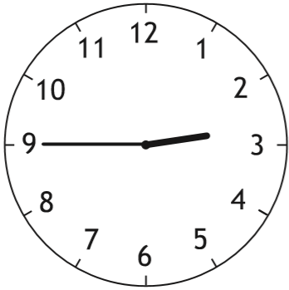
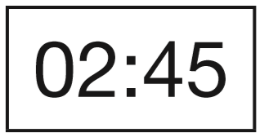
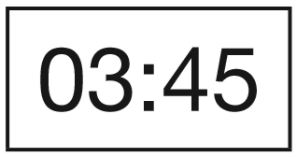



A clock shows this time twice a day.
Tick the two digital clocks that show this time.
✓
✓
Notes:
2016 Paper 3 Q3

Slide 68


Each shape stands for a number.
Work out the value of each shape.
32
18
18
32 + circle + circle + 32 = 100
32
32
32 + 32 =
64
32
64 + 2 circles = 100
3 triangles = 96
100 – 64 =
36
1 triangle =
2 circles = 36
32
1 circle =
18
32
3
2
3
9 6
1
8
2
3 6
1
18
Notes:
2016 Paper 3 Q4

Slide 69

Write these numbers in order, starting with the smallest.
0.78 0.607 5.6 0.098 4.003
0
00
0.7 8
0
0.6 0 7
5.6
0 0
0.0 9 8
4.0 0 3
0.098
0.607
0.78
4.003
5.6
Notes:
2016 Paper 3 Q5

Slide 70
Jacob cuts 4 metres of ribbon into three pieces.
The length of the first piece is 1.28 metres.
The length of the second piece is 1.65 metres.
Work out the length of the third piece.
1.07 metres
or 107 centimetres
1
3
9
1.6 5
4.0 0
1
1
+
1.2 8
-
2.9 3
9
.
7
m
2
.
3
1
0
Notes:
2016 Paper 3 Q6

Slide 71

c
Write the letters of the angles that are obtuse.
Write the letters of the angles that are acute.
, e
a
, d
Notes:
2016 Paper 3 Q7

Slide 72

Olivia buys three packets of nuts.
She pays with a £2 coin.
This is her change.
What is the cost of one packet of nuts?
95p
35p
1
9
2.0 0
1
1
-
0.9 5
£
0
.
3
5
.
5
£
1
0
for 3 packets
1.0 5
3
1
1
Notes:
2016 Paper 3 Q8

Slide 73

Here is part of the bus timetable from Riverdale to Mott Haven.
How many minutes does it take the 10:31 bus from Riverdale to reach Mott Haven?
+29m
+17m
29 + 17 =
46
10:31
11:00
11:17
It takes 46 minutes.
Notes:
2016 Paper 3 Q9 page 1

Slide 74
Here is part of the bus timetable from Riverdale to Mott Haven.
Mr Evans is at Fordham at 10:30
What is the earliest time he can reach Tremont on the bus?
10:44
Notes:
2016 Paper 3 Q9 page 2

Slide 75


Emma makes a cuboid using 12 cubes.
Write the letter of the cuboid that has a different volume from Emma’s cuboid.
12
18
12
C
12
12
Notes:
2016 Paper 3 Q10

Slide 76
A toy shop orders 11 boxes of marbles.
Each box contains 6 bags of marbles.
Each bag contains 45 marbles.
How many marbles does the shop order in total?
11 x 6 =
66 bags
66 x 45 =
2970 marbles
2
3
6
6
x
4
5
3 3
0
2 6
4
0
2
9
7
0
Notes:
2016 Paper 3 Q11

Slide 77


A triangle is translated from position A to position B.
Complete the sentence.
6
5
Notes:
2016 Paper 3 Q12

Slide 78
Lara chooses a number less than 20
She divides it by 2 and then adds 6
She then divides this result by 3
Her answer is 4.5
What was the number she started with?
15
15
÷2
7.5
+6
13.5
÷3
4.5
1
13.5 – 6 =
7.5
1
7.5
4.5
x
2
x
3
1 3
.
1 5
.
5
0
Notes:
2016 Paper 3 Q13

Slide 79
Complete each sentence using a number from the list below.
120 240 600 1,440 3,600 6,000
There are _____ seconds in an hour.
There are _____ minutes in a day.
60 seconds = 1 minute
3600
x60
x60
3600 seconds
= 1 hour
1440
60 x 60 = 3600
60 minutes = 1 hour
x24
x24
2
1440 minutes
= 1 day
2 4
x
0
6
1 4
4
0
Notes:
2016 Paper 3 Q14

Slide 80

Complete this table by rounding the numbers to the nearest hundred.
20 900
2 0 9 0 6
2100
2 0 9 0.6
200
2 0 9.0 6
Notes:
2016 Paper 3 Q15

Slide 81

6 small bricks have the same mass as 5 large bricks.
The mass of one small brick is 2.5 kg.
What is the mass of one large brick?
3 kg
15 kg
6 small bricks =
6 x 2.5 =
3
5 large bricks = 15 kg
2.5
x
6
1 large brick =
15 ÷ 5 =
3 kg
1 5
0
.
Notes:
2016 Paper 3 Q16

Slide 82

Here are five triangles on a square grid. Four of the triangles have the same area. Which triangle has a different area?
A
A
5 cm x 1 cm ÷ 2 =
2 ½ cm²
B
6 cm x 1 cm ÷ 2 =
3 cm²
C
2 cm x 3 cm ÷ 2 =
3 cm²
and E
D
3 cm x 2 cm ÷ 2 =
3 cm²
Notes:
2016 Paper 3 Q17

Slide 83


The diagonals of this quadrilateral cross at right angles.
✓
Tick all the quadrilaterals that have diagonals which cross at right angles.
✓
Notes:
2016 Paper 3 Q18

Slide 84
Circle two numbers that multiply together to equal 1 million.
200 2,000 5,000 50,000
5 0 0 0 x 2 0 0 =
1 0 0 0 0 0 0
Notes:
2016 Paper 3 Q19

Slide 85
Lara had some money.
She spent £1.25 on a drink.
She spent £1.60 on a sandwich.
She has three-quarters of her money left.
How much money did Lara have to start with?
£1.60 + £1.25 =
£2.85
£11.40
£1.60
£1.25
3
2
2.8 5
spent
£2.85
left
£2.85
left
£2.85
left
£2.85
x
4
£
.
0
1 1
4
Notes:
2016 Paper 3 Q20

Slide 86
5,542 ÷ 17 = 326
Explain how you can use this fact to find the answer to 18 × 326
This shows that 17 x 326 = 5542
so you can work out 326 + 5542
because 1 x 326 = 326
and if you add 1 times a number to 17 times a number,
you get 18 times that number.
Notes:
2016 Paper 3 Q21

Slide 87

William asks the children in Year 2 and Year 6 if they walk to school.
This graph shows the results.
Altogether, how many children don’t walk to school?
110 + 90 =
200 children
110
90
Notes:
2017 Paper 2 Q1 page 1

Slide 88
William asks the children in Year 2 and Year 6 if they walk to school.
This graph shows the results.
How many more Year 6 children than Year 2 children walk to school?
120 – 70 =
50 children
70
Notes:
2017 Paper 2 Q1 page 2

Slide 89
Circle the number that is 10 times greater
than nine hundred and seven.
9,700 907 9,007 970 9,070
907 x 10 =
9070
Notes:
2017 Paper 2 Q2

Slide 90

Write the missing numbers to make this multiplication grid correct.
7
6
8
Notes:
2017 Paper 2 Q3

Slide 91

This table shows the heights of three mountains.
How much higher is Mount Everest than the combined height of the other two mountains?
1609 metres
1
1
5 8 9 5
+
1 3 4 4
7
2
3
9
3
8 8 4 8
1
-
7 2 3 9
1
6
0
9
Notes:
2017 Paper 2 Q4

Slide 92

Complete this table with the missing numbers.
One row has been done for you.
1085
1000 + 85 =
8099
9099 – 1000 =
14250
15250 – 1000 =
Notes:
2017 Paper 2 Q5

Slide 93

Write these numbers in order of size, starting with the smallest.
1.9 0.96 1.253 0.328
00
0
1.9
0 0
0.9 6
0
1.2 5 3
0.3 2 8
0.328
0.96
1.253
1.9
Notes:
2017 Paper 2 Q6

Slide 94
Write the missing numbers.
60 months = _____ years
72 hours = _____ days
84 days = _____ weeks
5
60 ÷ 12 =
5
3
72 ÷ 24 =
3
1 day = 24 hours
12
+24
84 ÷ 7 =
12
2 days =
48 hours
+24
3 days =
72 hours
Notes:
2017 Paper 2 Q7

Slide 95
At the start of June, there were 1,793 toy cars in the shop.
During June,
• 8,728 more toy cars were delivered
• 9,473 toy cars were sold.
How many toy cars were left in the shop at the end of June?
1048
0
1
1
1
1
1
4
1 7 9 3
1 0 5 2 1
1
1
+
8 7 2 8
-
9 4 7 3
1 0
5
2
1
1
0
4
8
Notes:
2017 Paper 2 Q8

Slide 96




3
Tick two shapes that have shaded.
4
÷2
6
3
3
✓
=
8
4
6
÷2
÷4
7
1 2
3
✓
=
9
1 6
4
÷4
Notes:
2017 Paper 2 Q9

Slide 97
Round 84,516
to the nearest 10: ________
to the nearest 100: ________
to the nearest 1,000: ________
84 520
8 4 5 1 6
8 4 5 1 6
84 500
8 4 5 1 6
85 000
Notes:
2017 Paper 2 Q10

Slide 98
Here is a rule for the time it takes to cook a chicken.
Cooking time = 20 minutes plus an extra 40 minutes for each kilogram
How many minutes will it take to cook a 3 kg chicken?
140 minutes
20 + (40 x 3) =
20 + 120 =
140
2 kg
What is the mass of a chicken that takes 100 minutes to cook?
100 = 20 + (40 x ___)
2
100 – 20 =
80
80 ÷ 40 =
2
Notes:
2017 Paper 2 Q11

Slide 99




Here are diagrams of some 3-D shapes. Tick each shape that has the same number of faces as vertices.
triangular-based pyramid
cube
6 faces
4 faces
8 vertices
✓
4 vertices
square-based pyramid
triangular prism
5 faces
5 faces
6 vertices
✓
5 vertices
Notes:
2017 Paper 2 Q12

Slide 100
Ally and Jack buy some stickers.
Ally buys a pack of 12 stickers for £10.49
Jack buys 12 single stickers for 99p each.
How much more does Jack pay than Ally?
£1.39 more
Jack pays 12 x 99p
10
7
9 9
1 1.8 8
1
12 x £1 = £12
x
1 2
-
1 0.4 9
£12.00 - £0.12 = £11.88
0
3
£ .
8
£
1
.
9
1 1 8
Notes:
2017 Paper 2 Q13

Slide 101
Amina planted some seeds.
For every 3 seeds Amina planted, only 2 seeds grew.
Altogether, 12 seeds grew.
How many seeds did Amina plant?
18 seeds
3 planted 2 grew
x6
x6
18 planted
12 grew
Notes:
2017 Paper 2 Q14

Slide 102

At the end of a film, the year is given in Roman numerals.
Write the year MMVI in figures.
M = 1000
2006
V = 5
I = 1
Notes:
2017 Paper 2 Q15

Slide 103

Layla completes one-and-a-half somersaults in a dive. How many degrees does Layla turn through in her dive?
90°
90°
Angles around a point add up to 360°.
90°
A whole turn is 360°.
Angles on a straight line add up to 180°.
90°
A half turn is 180°.
90°
One-and-a-half turns = 360° + 180°
= 540°
6 x 90° = 540°
90°
Notes:
2017 Paper 2 Q16

Slide 104

The vertices of a quadrilateral have these coordinates:
(1, 5)
(5, 4)
(1, −3)
(−3, 4)
One side of the quadrilateral has been drawn on the grid. Complete the quadrilateral.
Notes:
2017 Paper 2 Q17

Slide 105
A cat sleeps for 12 hours each day. 50% of its life is spent asleep.
A koala sleeps for 18 hours each day. ____% of its life is spent asleep.
75
÷12
x50
÷6
x25
1 2
1
5 0
1 8
3
7 5
=
=
=
=
2 4
2
1 0 0
2 4
4
1 0 0
÷12
x50
÷6
x25
Notes:
2017 Paper 2 Q18

Slide 106
Amina posts three large letters.
The postage costs the same for each letter.
She pays with a £20 note.
Her change is £14.96
What is the cost of posting one letter?
£1.68
1
9
9
2 0.0 0
£20.00 – £14.96 =
£5.04 for three letters
1
1
1
-
1 4.9 6
1 letter =
£5.04 ÷ 3 =
£1.68
0
£
0
5
.
4
£
1
.
6
8
3
5.0 4
2
2
Notes:
2017 Paper 2 Q19

Slide 107
2
Adam says, 0.25 is smaller than
Explain why he is correct.
5
x20
2 5
2
4 0
Two fifths is equivalent to four tenths, which is 0.4
0.25 is smaller than 0.4 because it has fewer tenths.
0.25 =
=
1 0 0
5
1 0 0
x20
0.25 is twenty-five hundredths.
Two fifths is equivalent to forty hundredths.
Notes:
2017 Paper 2 Q20

Slide 108

On a map, 1cm represents 20 km.
The distance between two cities is 250 km.
On the map, what is the distance between the two cities?
12 ½ cm
1 cm = 20 km
1 cm = 20 km
x12
÷2
12 cm =
240 km
½ cm =
10 km
250 km
250 ÷ 20 =
1
2
.
5
2
2 5
.0
1
Notes:
2017 Paper 2 Q21

Slide 109

Here are two similar right-angled triangles.
Write the ratio of side a to side b.
a : b = ___: ___
1
4
4
1
2
8
Notes:
2017 Paper 2 Q22

Slide 110

1
1
In this circle, and are shaded.
What fraction of the whole circle is not shaded?
4
6
7
1 2
5
1
1
5
+
=
1 2
4
6
1 2
1
1
x3
x2
6
4
1
3
1
2
=
=
4
1 2
6
1 2
x3
x2
3
2
5
+
=
1 2
1 2
1 2
1 2
5
7
-
=
1 2
1 2
1 2
Notes:
2017 Paper 2 Q23

Slide 111

Write the missing number to make this division correct.
10
7 5
.
7.5
Notes:
2017 Paper 3 Q1

Slide 112
A group of friends earns £80 by washing cars.
They share the money equally.
They get £16 each.
How many friends are in the group?
5 friends
80 ÷ 16 =
1 friend = £16
5
+16
10 x 16 = 160
2 friends =
£32
so 5 x 16 = 80
+16
3 friends =
£48
+16
4 friends =
£64
+16
5 friends =
£80
Notes:
2017 Paper 3 Q2

Slide 113


Chen uses these digit cards.
She makes a 2-digit number and a 1-digit number.
She multiplies them together.
Her answer is a multiple of 10
What could Chen’s multiplication be?
6 x 5 = 30
a multiple of 10
9
6
5
Notes:
2017 Paper 3 Q3

Slide 114

This graph shows the temperature in °C from 2 am to 3 pm on a cold day.
How many degrees warmer was it at 3 pm than at 3 am?
+5
+2
7 degrees
-5
0
2
At 6 pm the temperature was 4 degrees lower than at 3 pm.
What was the temperature at 6 pm?
-2
-2
-2
0
2
-2 degrees
Notes:
2017 Paper 3 Q4

Slide 115
The children at Farmfield School are collecting money for charity.
Their target is to collect £360
So far they have collected £57.73
How much more money do they need to reach their target?
5
9
9
£302.27 more
3 6 0.0 0
1
1
1
-
5 7.7 3
2
£
3
0
.
2
7
£57.73 + £0.27 =
£58
£58 + £2 =
£60
£60 + £300 =
£360
Notes:
2017 Paper 3 Q5

Slide 116

William wants to travel to Paris by train.
He needs to arrive in Paris by 5:30 pm.
Circle the latest time that William can leave London.
5:30 pm =
17:30
Notes:
2017 Paper 3 Q6

Slide 117

Here is a triangle drawn on a coordinate grid.
The triangle is translated
7 right and 5 up. Draw the triangle in its new position.
Notes:
2017 Paper 3 Q7

Slide 118
Write three factors of 30 that are not factors of 15
2, 6, 10, 30
Factors of 15:
Factors of 30:
✘
✘
1 x 30 = 30
✘
1 x 15 = 15
→ 1 and 15
→ 1 and 30
✘
✘
2 x 15 = 30
✘
3 x 5 = 15
→ 3 and 5
→ 2 and 15
3 x 10 = 30
✘
→ 3 and 10
5 x 6 = 30
✘
→ 5 and 6
Notes:
2017 Paper 3 Q8

Slide 119

Here is the morning timetable for Chen’s class this week.
What is the total number of hours for English on this timetable?
5 hours
1 h
1 h 30
1 h 30
1 h
Notes:
2017 Paper 3 Q9

Slide 120
A bottle contains 568 millilitres of milk.
Jack pours out half a litre.
How much milk is left?
500 millilitres
68 millilitres
1 litre = 1000 millilitres
68 millilitres
568 – 500 =
Notes:
2017 Paper 3 Q10

Slide 121
A bicycle wheel has a diameter of 64 cm.
What is the radius of the bicycle wheel?
32 cm
3
2
2
6 4
diameter
radius
Notes:
2017 Paper 3 Q11

Slide 122


144
Adam buys 6 bags of white balloons.
Chen buys 3 bags of red balloons.
Adam says, ‘I have four times as many balloons as Chen.’
Explain why Adam is correct.
6 x 24 =
3 x 12 =
36
2
2
2 4
3 6
x
6
x
4
1 4
4
1 4
4
Adam has 6 x 24 = 144 balloons
Chen has 3 x 12 = 36 balloons
36 x 4 = 144
144 ÷ 4 = 36
3
6
4
1 4 4
2
Notes:
2017 Paper 3 Q12

Slide 123

Circle the pentagon with exactly four acute angles.
only 1 acute angle
all obtuse angles
4 acute angles but not a pentagon
4 acute angles (1 reflex angle)
All obtuse angles and not a pentagon
Notes:
2017 Paper 3 Q13

Slide 124
3 pineapples cost the same as 2 mangoes.
One mango costs £1.35
How much does one pineapple cost?
90p
£2.70
2 mangoes = 2 x £1.35 =
1
3 pineapples = £2.70
1.3 5
x
2
£
0
9
0
.
1 pineapple =
£
.
0
2.7 0
2
7
3
2
£2.70
Mango £1.35
Mango £1.35
pineapple
90p
pineapple
90p
pineapple
90p
Notes:
2017 Paper 3 Q14

Slide 125

Look at the letters below.
Circle the letter that has both parallel and perpendicular lines.
Notes:
2017 Paper 3 Q15

Slide 126
There are 2,400 leaflets in a box.
William and Ally take 450 leaflets each.
Adam and Chen share the rest of the leaflets equally.
How many leaflets does Adam get?
900 taken
1500 shared
750 leaflets
1
1
4 5 0
2 4 0 0
1
+
4 5 0
-
9 0 0
7
5
0
9
0
0
1
5
0
0
2
1 5 0 0
1
2400 leaflets
750 Adam
750 Chen
450
450
1500
900
Notes:
2017 Paper 3 Q16

Slide 127




In each box, circle the number that is greater.
x5
1.5
1
5
=
2
1 0
x5
1.25
1.30
x25
1
2 5
=
4
1 0 0
1.05
1.40
x25
x2
3
6
=
1.6
5
1 0
x2
Notes:
2017 Paper 3 Q17

Slide 128

A square number and a prime number have a total of 22
What are the two numbers?
9
13
Square numbers: 1, 4, 9, 16, 25
Prime numbers: 2, 3, 5, 7, 11, 13, 17, 19, 23
Notes:
2017 Paper 3 Q18

Slide 129
Dev thinks of a whole number.
He multiplies it by 4
He rounds his answer to the nearest 10
The result is 50
Write all the possible numbers that Dev could have started with.
12 x 4 = 48
13 x 4 = 52
45 to 54 before rounding
12, 13
Multiples of 4: … 44, 48,
52,
56
too small
12 x 4
13 x 4
too big
Notes:
2017 Paper 3 Q19

Slide 130

A square tile measures 20cm by 20cm.
A rectangular tile is 3cm longer and 2cm narrower than the square tile. What is the difference in area between the two tiles?
2
14 cm
Square tile = 20 x 20 = 400
Rectangular tile =
23
x
18 =
414
2
414 – 400 = 14
2
3
x
1
8
1
1 8
4
2
3
0
4
1
4
Notes:
2017 Paper 3 Q20

Slide 131

The numbers in this sequence increase by the same amount each time.
Write the missing numbers.
3
7
2
8
8
5
5
5
5
+
+
+
+
8
8
8
8
8
5
3
1
5
–
=
2
+
8
8
8
4
8
2
5
2
+
8
8
Notes:
2017 Paper 3 Q21

Slide 132

In this diagram, the shaded rectangles are all of equal width (w).
Calculate the width (w) of one shaded rectangle.
7 cm
34 + w
27 + w + w
7
27 + ___ = 34
Notes:
2017 Paper 3 Q22

Slide 133


Here is a pattern of number pairs.
Complete the rule for the number pattern.
10
1
10
20
30
40
Notes:
2017 Paper 3 Q23

Slide 134


Cube A and cuboid B have the same volume.
Calculate the missing length on cuboid B.
9cm
3
3 6
x
6
2 1
6
6cm x 6cm x 6cm =
216cm³
6cm x 4cm x ____ = 216cm³
9cm
9
9cm
216 ÷ 24 =
24cm² x _____ = 216cm³
Notes:
2017 Paper 3 Q24

Slide 135

Here is a shape on a grid. Complete the design so that it is symmetrical about the mirror line.
Notes:
2018 Paper 2 Q1

Slide 136


Stefan completes this calculation.
Write an addition calculation he could use to check his answer.
2 8
6 7
9 5
Notes:
2018 Paper 2 Q2

Slide 137

On the line below, mark the point that is 6.7 centimetres from A.
Notes:
2018 Paper 2 Q3

Slide 138


These diagrams show three equivalent fractions.
Write the missing values.
x3
x2
18
12
x3
x2
Notes:
2018 Paper 2 Q4

Slide 139

Here are the temperatures in four cities at midnight and at midday.
At midnight, how many degrees colder was Paris than Rome?
+4
+3
7 °C colder.
-4
0
3
Which city was 6 degrees colder at midnight than at midday?
Oslo
+6
-16
-15
-14
-13
-12
-11
-10
-9
-8
-7
-6
-5
-4
-3
-2
-1
0
1
2
3
4
5
6
7
8
9
Notes:
2018 Paper 2 Q5

Slide 140
The numbers in this sequence decrease by the same amount each time.
303,604 302,604 301,604 300,604 …
What is the next number in the sequence?
299,604
Notes:
2018 Paper 2 Q6

Slide 141

1
Tick the two numbers that are equivalent to
4
✓
x25
1
2 5
✓
=
4
1 0 0
x25
Notes:
2018 Paper 2 Q7

Slide 142
Ken buys 3 large boxes and 2 small boxes of chocolates.
Each large box has 48 chocolates.
Each small box has 24 chocolates.
How many chocolates did Ken buy altogether?
192 chocolates
48
48
48
24
24
2
1
4 8
2 4
1 4 4
x
3
x
2
+
4 8
1 4
4
4
8
1
9
2
Notes:
2018 Paper 2 Q8

Slide 143
The list below shows the years in which the Cricket World Cup was held since 1992:
1992, 1996, 1999, 2003, 2007, 2011, 2015
Adam says, ‘The Cricket World Cup has been held every four years since 1992.’ Adam is not correct. Explain how you know.
1996 + 4 = 2000
The next Cricket World Cup after 1996 was in 1999, not 2000
Notes:
2018 Paper 2 Q9

Slide 144

> = <
Write the correct symbol in each box to make the statements correct.
<
132
150
=
3
3
>
30
20
<
240
1000
Notes:
2018 Paper 2 Q10

Slide 145


Here is a drawing of a 3-D shape.
Complete the table.
6
8
12
Notes:
2018 Paper 2 Q11

Slide 146

Here is a shape on a grid. The shape is translated so that point A moves to (7, 8). Draw the shape in its new position.
Notes:
2018 Paper 2 Q12

Slide 147

7
Circle the improper fraction that is equivalent to 6
8
7
6 x 8 + 7 =
6
8
4 8 + 7 =
5 5
Notes:
2018 Paper 2 Q13

Slide 148


x4
6
2 4
=
5
2 0
Write these fractions in order, starting with the smallest.
x4
x4
3
3
6
3
1 2
5
=
5
4
5
2 0
x4
x5
3
1 5
=
4
2 0
x5
Notes:
2018 Paper 2 Q14

Slide 149
A box contains trays of melons.
There are 15 melons in a tray.
There are 3 trays in a box.
A supermarket sells 40 boxes of melons.
How many melons does the supermarket sell?
45 melons in a box
1800 melons
1
2
1 5
4 5
x
3
x
0
4
4
5
1 8
0
0
Notes:
2018 Paper 2 Q15

Slide 150

Adam wants to use a mental method to calculate 182 – 97
He starts from 182
Here are some methods that Adam could use.
Tick the methods that are correct.
only subtracts 87
✓
✓
subtracts 103
Notes:
2018 Paper 2 Q16

Slide 151
There are 28 pupils in a class.
The teacher has 8 litres of orange juice.
She pours 225 millilitres of orange juice for every pupil.
How much orange juice is left over?
8000 millilitres
6300 millilitres
1700 millilitres
1
or 1.7 litres
2
4
7
2
2
5
8 0 0 0
1
x
2
8
-
6 3 0 0
1
1 8
0
0
1
7
0
0
4
5
0
0
6
3
0
0
Notes:
2018 Paper 2 Q17

Slide 152
Last year, Jacob went to four concerts.
Three of his tickets cost £5 each.
The other ticket cost £7
What was the mean cost of the tickets?
£22 total cost on 4 tickets
£5.50
5 + 5 + 5 + 7 =
£22
£
5
5
0
.
4
2 2.0 0
2
Notes:
2018 Paper 2 Q18

Slide 153


Layla wants to estimate the answer to this calculation.
Tick the calculation below
that is the best estimate.
more than ½
so round up
less than ½
so round down
more than ½
so round up
4
2
2
✓
Notes:
2018 Paper 2 Q19

Slide 154

The length of an alligator can be estimated by:
• measuring the distance from its eyes to its nose
• then multiplying that distance by 12
What is the difference in the estimated lengths of these two alligators?
30 cm
9
6
6
1 7.5
1 5
x
1 2
x
1 2
2 1
.
0
0
1 8
0
2 1 0 – 1 8 0 =
3 0
Notes:
2018 Paper 2 Q20

Slide 155




Amina is making designs with two different shapes.
She gives each shape a value.
Calculate the value of each shape.
25
25
25
25
36
36
36
25
36
25
25
this shape has 1 extra hexagon
147 – 111 =
36
36 + 3 = 111
so 3 = 75
111 – 36 =
75
= 75 ÷ 3 =
25
Notes:
2018 Paper 2 Q21

Slide 156

This is the net of a cube.
What is the volume of the cube?
20cm ÷ 4 = 5cm
5cm x 5cm x 5cm =
125cm³
Notes:
2018 Paper 2 Q22

Slide 157
The length of a day on Earth is 24 hours.
The length of a day on Mercury is 58 times the length of a day on Earth.
What is the length of a day on Mercury, in hours?
2
3
1408 hours
2
5 8
8
1 7 6
x 2 4 =
4 2 2 4
x
3
3
3
1 7
4
+ 2 =
1 7 6
1
1
4
0
3
2
1
8
1
7
6
3
4 2 2 4
1
2
6
4
x
2
4
1 7 6
1
7
0
4
x
8
3
5
2
0
1 4
0
8
4
2
2
4
Notes:
2018 Paper 2 Q23

Slide 158

The numbers in this sequence increase by the same amount each time. Write the missing numbers.
35
56
70
+7
+7
+7
+7
+7
42 – 7 =
35
Notes:
2018 Paper 3 Q1

Slide 159
Adam chooses the colours for a new team shirt.
The shirt has two colours.
There are four colours to choose from: yellow, blue, white and red.
Write the two missing combinations.
The shirt could be:
• yellow and blue
• yellow and white
• yellow and red
• blue and white.
__________ and __________
__________ and __________
Y B W R
YB, YW, YR
BW, BR
WR
blue
red
white
red
Notes:
2018 Paper 3 Q2

Slide 160


Here are four number cards.
Layla uses each card once to make a four-digit number.
She places:
• 4 in the tens column
• 2 so that it has a higher value than any of the other digits
• the remaining two digits so that 7 has the higher value.
Write a digit in each box to show Layla’s number.
2
7
4
3
Notes:
2018 Paper 3 Q3

Slide 161

Write the three missing digits to make this addition correct.
1
1
4
7
6
Notes:
2018 Paper 3 Q4

Slide 162

Tick the numbers that are common factors of both 12 and 18
✓
6 x 2 = 12 and 9 x 2 = 18
✓
4 x 3 = 12 and 6 x 3 = 18
✓
2 x 6 = 12 and 3 x 6 = 18
12 is not in the 9 times table
18 is not in the 12 times table
Notes:
2018 Paper 3 Q5

Slide 163


This chart shows the number of different types of big cat in a zoo.
There are 20 big cats in the zoo altogether.
Here are some statements about the chart.
Tick the statements that are true.
✓
✘
more than ½ of the 20 cats
✓
✘
less than ¼ of 20
Notes:
2018 Paper 3 Q6

Slide 164
A farmer is packing eggs.
Each box holds six eggs. The farmer has 980 eggs to pack.
How many boxes can the farmer fill using 980 eggs?
_____ full boxes
How many eggs will be left over?
_____ left over
1
6
3
r 2
163
6
9 8 0
3
2
2
Notes:
2018 Paper 3 Q7

Slide 165
Jack has £400
He spends 35% of his money on a new bike.
How much does Jack spend on his new bike?
He spends £140
3 5
4 0 0 ÷ 1 0 0 =
4
35% of 400 =
140
1 0 0
2
3 5
x
4
10% =
40
1 4
0
30% =
40 x 3 =
120
5% =
40 ÷ 2 =
20
35% =
120 + 20 =
140
Notes:
2018 Paper 3 Q8

Slide 166

The Angel of the North is a large statue in England.
It is 20 metres tall and 54 metres wide.
Ally makes a scale model of the Angel of the North.
Her model is 40 centimetres tall.
How wide is her model?
108 cm wide
20 m tall 54 m wide
5 4
x2 (then ÷100)
x
2
40 cm tall
108 cm wide
1 0
8
Notes:
2018 Paper 3 Q9

Slide 167

Layla draws a square on this coordinate grid.
Three of the vertices are marked.
What are the coordinates of the missing vertex?
(-3,
1)
Notes:
2018 Paper 3 Q10 first page

Slide 168
(-3,
1)
Notes:
2018 Paper 3 Q10 second page

Slide 169

Stefan has 600 millilitres of water in a bottle.
He pours some of the water into two measuring jugs as shown.
How many millilitres of water are left in Stefan’s bottle?
175
150
150
125
275 millilitres
1
5
9
1 5 0
6 0 0
1
1
+
1 7 5
-
3 2 5
3
2
5
poured out
2
7
5
left
Notes:
2018 Paper 3 Q11

Slide 170

This table shows the areas of the United Kingdom and Jamaica.
The area of the United Kingdom is larger than the area of Jamaica. How many times larger is the United Kingdom?
_____ times larger
24
24
10 000 x ___ = 240 000
240 000 ÷ 10 000 =
24
Notes:
2018 Paper 3 Q12

Slide 171
A box contains 2.6 kg of washing powder.
Jack uses 65 grams of powder for each wash.
He uses all the powder.
How many washes did Jack do?
2600 grams
2.6 kg
2.600 kg
40 washes
2600 g
1 wash = 65 grams
x2
2 washes =
130 grams
x10
20 washes =
1300 grams
x2
40 washes =
2600 grams
Notes:
2018 Paper 3 Q13

Slide 172
Two of the angles in a triangle are 70° and 40°.
Jack says, ‘The triangle is equilateral.’
Explain why Jack is not correct.
The angles in an equilateral triangle are always the same (60°)
Notes:
2018 Paper 3 Q14

Slide 173
A shop prints designs on T-shirts.
They use this formula to work out the price for printing a design.
price = 60p × number of colours + £1.25
What is the price for printing a design that has 3 colours in it?
£3.05
60p x 3 + £1.25
60p x 3 =
180p
= £1.80
1
1.8 0
+
1.2 5
£
.
5
3
0
Notes:
2018 Paper 3 Q15 page 1

Slide 174
A shop prints designs on T-shirts.
They use this formula to work out the price for printing a design.
price = 60p × number of colours + £1.25
Amina has £5 to spend on printing a design.
What is the greatest number of colours she can have in the design?
6 colours
4
9
5.0 0
1
1
-
1.2 5
1 colour = 60p
.
5
£
3
7
to spend on colours
2 colours =
£1.20
4 colours =
£2.40
6 colours =
£3.60
7 colours =
too expensive
Notes:
2018 Paper 3 Q15 page 2

Slide 175
A book has 276 pages.
Amina has read of the book.
How many pages are left for Amina to read?
1
92 pages read
3
184 pages
9
2
1
2 7 6
9 2
1
3
2 7 6
-
9 2
x
2
1
8
4
1 8
4
276 pages
read
92
92
92
left
184
Notes:
2018 Paper 3 Q16

Slide 176


On a dice, the sum of the dots on opposite faces is always 7.
Draw dots on the three empty faces of the net so that it could fold up to make a dice.
Notes:
2018 Paper 3 Q17

Slide 177

This is a diagram of a vegetable garden.
It shows the fractions of the garden planted with potatoes and cabbages.
The remaining area is planted with carrots.
What fraction of the garden is planted with carrots?
x4
x3
2
8
1
3
=
=
3
1 2
4
1 2
1 2
1 1
1
-
=
is carrots
x4
x3
1 2
1 2
1 2
8
3
1 1
is potatoes or cabbages
+
=
1 2
1 2
1 2
Notes:
2018 Paper 3 Q18

Slide 178
33,630 = 354 × 95
Use this multiplication to complete the calculations below.
354 × 9.5 =
3,540 × 95 =
3,363 ÷ 95 =
33,630 ÷ 95 = 354
3363
95 ÷ 10
336 300
354 x 10
35.4
33630 ÷ 10
354 ÷ 10
Notes:
2018 Paper 3 Q19

Slide 179
In March, Ken collects 2, 3 or 4 eggs each day from his hens.
In the first 20 days, Ken collects 57 eggs altogether.
There are 31 days in March.
What is the greatest number of eggs Ken can collect in March?
11 days of egg-collecting left
101 eggs
57 eggs already collected
11 x 4 = 44 eggs can still be collected
1
5 7
+
4 4
1 0
1
Notes:
2018 Paper 3 Q20

Slide 180
Jack finished a sponsored run in 53 minutes 25 seconds.
Ally finished 3 minutes 50 seconds after Jack.
How long did Ally take?
+3m
+35s
+15s
57 minutes 15 seconds
53:25
56:25
57:00
57:15
53 minutes 25 seconds
+ 4 minutes =
57 minutes 25 seconds
– 10 seconds =
57 minutes 15 seconds
Notes:
2018 Paper 3 Q21 page 1

Slide 181
Jack finished a sponsored run in 53 minutes 25 seconds.
Layla finished the run 8 minutes 45 seconds before Jack.
How long did Layla take?
-20s
-25s
-8m
44 minutes 40 seconds
44:40
45:00
45:25
53:25
53 minutes 25 seconds
– 9 minutes =
44 minutes 25 seconds
+ 15 seconds =
44 minutes 40 seconds
Notes:
2018 Paper 3 Q21 page 2

Slide 182

In this grid, there are four multiplications.
Write the three missing numbers.
32
21 ÷ 3 = 7
7
56 ÷ 8 = 7
12
Notes:
2019 Paper 2 Q1

Slide 183
What number is 1,000 less than 9,072?
8,072
Notes:
2019 Paper 2 Q2

Slide 184
Order the numbers starting with the largest.
Match each number with its order.
1,009,909
1st
largest
1,023,065
2nd
1,009,099
3rd
1,230,650
4th
smallest
Notes:
2019 Paper 2 Q3

Slide 185

Here is a shaded shape on a square grid.
Reflect the shape in the mirror line.
Notes:
2019 Paper 2 Q4

Slide 186

The numbers in this sequence increase by 45 each time.
Write the missing numbers.
110
290
335
+ 45
+ 45
+ 45
+ 45
+ 45
1
1
1 5 5
2 4 5
2 9 0
-
4 5
+
4 5
+
4 5
1
1
0
2
9
0
3
3
5
Notes:
2019 Paper 2 Q5

Slide 187

Write the missing number to make this division correct.
10
0.3
0.0 3
Notes:
2019 Paper 2 Q6

Slide 188

Jack pours some dark paint into a container.
In litres, how much paint is in the container?
1
2.5 litres
2 litres =
2
4
1
2
3
1
2
2
1
2
Notes:
2019 Paper 2 Q7

Slide 189

In this sequence, the rule to get the next number is:
Multiply by 2, and then add 3
Write the missing numbers.
1 1
1 0 9
x2 +3
x2 +3
x2 +3
2 5 – 3 =
2 2
5 3
x
2
2 2 ÷ 2 =
1 1
1 0
6
+ 3 =
1 0 9
Notes:
2019 Paper 2 Q8

Slide 190
Jack chose a number.
He multiplied the number by 7
Then he added 85
His answer was 953
What number did Jack choose?
124
x7
868
+85
953
8
4
1
1
2
4
9 5 3
He chose 124
1
7
8 6 8
1
2
-
8 5
8
6
8
Notes:
2019 Paper 2 Q9

Slide 191
A theme park sells tickets online.
Each ticket costs £24
There is a £3 charge for buying tickets.
Which of these shows how to calculate the total cost, in pounds?
number of tickets × 3 + 24
number of tickets × 24 + 3
✓
number of tickets + 3 × 24
number of tickets + 24 × 3
Notes:
2019 Paper 2 Q10

Slide 192

Amina is shopping. She says,
‘I would like to buy one-quarter of a kilogram of cheese.’
Write one-quarter on the scales as a decimal.
x25
1
2 5
=
4
1 0 0
x25
The cheese costs £1.35
Amina pays with a £2 coin.
How much change should Amina get?
0.25
65p
£2.00 – £1.35 =
1
9
2.0 0
1
1
-
1.3 5
.
5
£
0
6
change
Notes:
2019 Paper 2 Q11

Slide 193

Here are three symbols.
< > =
Write one symbol in each box to make the statements correct.
70
0.7
>
7
0
100
100
<
0
23
230
0.023
100
1000
Notes:
2019 Paper 2 Q12

Slide 194


Here is a sketch of a triangle. It is not drawn to scale.
Draw the full-size triangle accurately below.
Use an angle measurer (protractor) and a ruler.
One line has been drawn for you.
Notes:
2019 Paper 2 Q13

Slide 195

Complete the table.
3 9 4 7 6
40 000
3 9 4 7 6
39 000
3 9 4 7 6
39 500
Notes:
2019 Paper 2 Q14

Slide 196

Amina asked 60 children to choose their favourite flavour of jelly. These were her results.
What percentage of the 60 children chose orange?
÷15
x25
1 5
1
2 5
=
=
= 25%
6 0
4
1 0 0
÷15
x25
Notes:
2019 Paper 2 Q15

Slide 197

Write the missing number.
4
4
6 + 4 = 10
Notes:
2019 Paper 2 Q16

Slide 198


These two shapes have the same perimeter.
The length of each side of the hexagon is 8 centimetres.
Calculate the area of the square.
144 cm²
8
12
12 cm x 12 cm =
144 cm²
8
8
12
12
8
8
8
12
6 x 8 cm =
48 cm perimeter
48 cm ÷ 4 =
12 cm
Notes:
2019 Paper 2 Q17

Slide 199
Circle the prime number.
95 89 87
Explain how you know the other numbers are not prime.
1
9
95 is in the 5 times table
5
9 5
4
87 is in the 3 times table
2
9
3
8 7
2
89 is only in the 1 times table and the 89 times table
and a number with only 2 factors is a prime number.
95 and 87 have more than 2 factors.
Notes:
2019 Paper 2 Q18

Slide 200
A machine pours 250 millilitres of juice every 4 seconds.
How many litres of juice does the machine pour every minute?
3.75 l
250 millilitres = 4 seconds
60 ÷ 4 = 15
x2
so 250 ml is poured 15 times
500 millilitres =
8 seconds
250 x 15 =
3750
x2
3750 millilitres =
3.750 litres
1000 millilitres =
16 seconds
x2
2000 millilitres =
32 seconds
32 + 16 =
48
48 + 8 =
56
56 + 4 =
60
3000 ml
3500 ml
3750 ml
Notes:
2019 Paper 2 Q19

Slide 201

Tick the fractions that are equal to 20%.
✘
x5
1
5
=
= 5%
2 0
1 0 0
✘
x5
x20
1
2 0
✓
=
= 20%
5
1 0 0
x20
✓
÷3
x20
3
1
2 0
=
=
= 20%
1 5
5
1 0 0
✘
÷3
x20
Notes:
2019 Paper 2 Q20

Slide 202

Adam has this rectangular piece of card. It is marked with grid lines.
Adam makes two straight cuts along the grid lines.
The two cuts divide the rectangle into 3 shapes:
• 2 squares of different size, and
• 1 rectangle.
Using the grid lines, draw two lines that show where Adam could have made his cuts. Use a ruler.
Notes:
2019 Paper 2 Q21

Slide 203

This graph shows the maximum temperature for five days.
For what fraction of the five days was the maximum temperature below 10 °C?
2 days below
5 days altogether
2
5
Notes:
2019 Paper 2 Q22 page 1

Slide 204
This graph shows the maximum temperature for five days.
What was the mean maximum temperature, to one decimal place?
53.4
29.2
41.0
17.4
10.7 °C
1
0
.
6
8
5
3
4
0
5 3
.4
1
0
.
6
8
Notes:
2019 Paper 2 Q22 page 2

Slide 205

Amina made this cuboid using centimetre cubes.
Stefan makes a cuboid that is 5 cm longer, 5 cm taller and 5 cm wider than Amina’s cuboid.
What is the difference between the number of cubes in Amina’s and Stefan’s cuboids?
720 cubes
4cm x 6cm x 3cm =
72cm³
7 9 2
9cm x 11cm x 8cm =
792cm³
-
7 2
7
7
2
0
9 9
x
8
7 9
2
Notes:
2019 Paper 2 Q23

Slide 206

The original price of this car is £8,999
What is the sale price of the car?
£7,899
8 9 9 9
-
1 1 0 0
£
7
8
9
9
Notes:
2019 Paper 3 Q1

Slide 207
3,576,219
Which digit is in the ten thousands place?
7
Round 3,576,219 to the nearest million.
4 000 000
Notes:
2019 Paper 3 Q2

Slide 208

Dev says, ‘I had £10. I gave some money away.’
Which expression shows how much money Dev has left?
a is the amount of money, in pounds, that Dev gave away.
✓
Notes:
2019 Paper 3 Q3

Slide 209

Write these masses in order, starting with the lightest.
1.250
0.990
1.25 kg 0.99 kg 1.025kg 0.009 kg
0
1.2 5
0
0.9 9
1.0 2 5
0.0 0 9
0.009
0.99
1.025
1.25
Notes:
2019 Paper 3 Q4

Slide 210

Write the missing digits to make this addition correct.
1
8
7
1
1
8
1
2
+
7
2
2 0 0
Notes:
2019 Paper 3 Q5

Slide 211


John buys one toy car and one pack of stickers.
He pays with a £10 note. How much change does John get?
He gets £6.87 change
1
1
1.4 9
+
1.6 4
1
3
.
3
0
9
9
1 0
.0 0
1
1
1
-
3.1 3
£
0
6
8
.
7
Notes:
2019 Paper 3 Q6

Slide 212

This picture shows the masses of eight kittens.
What is the difference in mass between the heaviest kitten and the lightest kitten?
155 g
1
3
0
4 1 0
1
-
2 5 5
1
5
5
Notes:
2019 Paper 3 Q7 page 1

Slide 213

This picture shows the masses of eight kittens.
The masses of the kittens are to be put in four groups.
Write the missing numbers in the table. One has been done for you.
✘
✘
✘
✘
2
3
2
✘
✘
✘
Notes:
2019 Paper 3 Q7 page 2

Slide 214
Ken is playing a game.
He has 4,289 points.
Then he scores another 355 points.
Ken’s target is 6,000 points.
How many more points does Ken need to reach his target?
1356 points
1
1
5
9
9
4 2 8 9
6 0
0 0
1
1
1
+
3 5 5
-
4 6 4 4
4
6
4
4
1
3
5
6
Notes:
2019 Paper 3 Q8

Slide 215

This pictogram shows the number of satellites above the Earth in 2016.
1000
1000
250
How many satellites were above the Earth in 2016?
2250
1
of 1000 =
2
5
0
4
4
1 0 0 0
2
Notes:
2019 Paper 3 Q9

Slide 216

On the grid there are three points joined by two lines.
Lara plots another point on the grid at (–1, 2).
She joins the points to make a quadrilateral.
Complete Lara’s quadrilateral on the grid. Use a ruler.
Then Lara translates the quadrilateral 4 squares to the right. Draw the quadrilateral in its new position on the grid.
Notes:
2019 Paper 3 Q10

Slide 217

Here are five numbers.
2 3 4 5 6
Write each number on the correct cards.
The number 2 has been written on the correct cards for you.
3
3
3
5
4
6
5
Notes:
2019 Paper 3 Q11

Slide 218
Amina’s bed is 190 cm in length and 91 cm in width.
She is making a one-tenth scale model of the bed.
What are the length and width of Amina’s model?
Length = _____ cm Width = _____ cm
19
9.1
1 9 0 ÷ 1 0 =
1 9
9 1 ÷ 1 0 =
.
9 1
9
.
1
Notes:
2019 Paper 3 Q12

Slide 219
Kirsty says, ‘When you double the size of an acute angle, you always get an obtuse angle.’
Explain why Kirsty is not correct.
An acute angle is less than 90°
1° is an acute angle
Double 1° is 2° which is still less than 90°
Notes:
2019 Paper 3 Q13

Slide 220
How many days are there in September, October and November altogether?
91 days
January 31
February 28 or 29
March 31
April 30
May 31
June 30
July 31
August 31
September 30
October 31
November 30
December 31
30 days has September,
April, June and November,
All the rest have 31,
Except for February, it’s the one,
Which only has 28 days clear,
And 29 in each Leap Year
91
30 + 31 + 30 =
Notes:
2019 Paper 3 Q14

Slide 221
The International Space Station orbits the Earth at a height of 250 miles.
What is the height of the International Space Station in kilometres?
Use 8 kilometres equals 5 miles.
400 kilometres
8 kilometres = 5 miles
x50
x50
250 ÷ 5 =
50
400 kilometres
= 250 miles
8 x 50 =
400
Notes:
2019 Paper 3 Q15

Slide 222


Jack buys 1 ½ kg of potatoes and ½ kg of carrots.
How much change does he get from £5?
£1.85 change
1
of 180 =
90
p on carrots
2
180 ÷ 2 =
90
1
of 150 =
7
5
p
2
2
1 5 0
1
£1.50 + £0.75 =
£2.25 on potatoes
4
9
£2.25 + £0.90 =
£3.15 spent
5.0 0
1
1
-
3.1 5
£5.00 – £3.15 =
£1.85 change
.
£
1
8
5
Notes:
2019 Paper 3 Q16

Slide 223
x + 2y = 20
x and y are whole numbers less than 10
What could x and y be?
2
4
6
8
x = _____
y = _____
9
8
7
6
2
6
9
1
+ (2 x
7
) = 20
4
8
8
6
Notes:
2019 Paper 3 Q17

Slide 224

5
Tick the fractions less than
8
x2
x4
✓
5
1 0
5
2 0
x4
=
=
1
4
8
1 6
8
3 2
=
2
8
x2
x4
✓
x4
x2
✘
3
6
=
4
8
x2
✓
✘
Notes:
2019 Paper 3 Q18

Slide 225
Layla makes jewellery to sell at a school fair.
Each bracelet has 53 beads. She makes 68 bracelets.
Each necklace has 105 beads. She makes 34 necklaces.
How many beads does Layla use altogether?
3604
3570
7174 beads
4
1
2
2
6
8
1
0
5
1
5
3 6 0 4
x
3
x
3
4
+
3 5 7 0
2 0
4
4
2
0
7
1
7
4
3 4
0
0
3
1
5
0
3
6
0
4
3
5
7
0
Notes:
2019 Paper 3 Q19

Slide 226
Adam is making booklets.
Each booklet must have 34 sheets of paper.
He has 2 packets of paper.
There are 500 sheets of paper in each packet.
How many complete booklets can Adam make from 2 packets of paper?
2 x 500 =
1000 sheets
29 complete booklets
3 4
1
1x
1 7 0
5x
+ 3 4
2
9
+ 1 3 6
1
4x
3
4
1
0
0
0
6
8
2x
3
0
6
+ 3 4
- 6 8
1 0
2
3x
3 2
0
+ 3 4
- 3 0 6
1
1
3
6
4x
1 4
+ 3 4
1
7
0
5x
Notes:
2019 Paper 3 Q20 first page

Slide 227
Adam is making booklets.
Each booklet must have 34 sheets of paper.
He has 2 packets of paper.
There are 500 sheets of paper in each packet.
How many complete booklets can Adam make from 2 packets of paper?
2 x 500 =
1000 sheets
0
9
1
1 booklet = 34 sheets
29 booklets =
1
1 0 2 0
1
1
x10
-
3 4
10 booklets =
340 sheets
0
9
8
6
+340
20 booklets =
680 sheets
+340
30 booklets =
1020 sheets
…but that’s too many!
Notes:
2019 Paper 3 Q20 second page

Slide 228

ABDE is a rectangle on coordinate axes.
The sides of the rectangle are parallel to the axes.
Point C is the centre of the rectangle.
What are the coordinates of B and D?
30
8
22
B is ( , )
D is ( , )
55
30
8
14
55
14
15
15
25
40
55
Notes:
2019 Paper 3 Q21

Slide 229

Six identical right-angled triangles are arranged to make a rectangle.
Calculate the length of the rectangle.
3
.
5
2
7
.0
1
7 + 3.5 =
10.5 cm
7 cm
3.5 cm
Notes:
2019 Paper 3 Q22

Slide 230

160
160
160
160
160
The distance from point P to point R is 800 metres. The distance from point P to point Q is 4 times the distance from point Q to point R.
Olivia says, ‘It is 600 metres from point P to point Q.’
Explain why Olivia is not correct.
800 ÷ 5 =
160
so it’s 160 metres from Q to R
160 x 4 =
640
so it’s 640 metres from P to Q
If it were 600 m from P to Q, it would be 600 ÷ 4 = 150 m from Q to R, and 600 + 150 = 750 m, not 800 m
Notes:
2019 Paper 3 Q23

