Slide 1
Roman numerals for 1, 5, 10, 50, 100, 500, 1000
IVXLCDM

Slide 2
what you get when you add
sum

Slide 3
what you get when you subtract
difference

Slide 4
what you get when you multiply
product

Slide 5
what you get when you divide
quotient

Slide 6
10 is a ________ of 1, 2, 5 and 10
multiple

Slide 7
a multiple of 2 is an ____ number
even

Slide 8
a number that is in the times tables of two different numbers e.g. 24 is a ______ ________ of 4 and 6 because it is in both the 4 times table and the 6 times table
common multiple

Slide 9
the lowest number that is in the times tables of two different numbers e.g. 12 is the ______ ______ ________ of 4 and 6 because it is the lowest number that is in both the 4 times table and the 6 times table
lowest common multiple

Slide 10
a number that divide into another number with no remainder e.g. 1, 2, 5 and 10 are ______s of 10
factor

Slide 11
a number that divides into two different numbers with no remainders e.g. 5 is a ______ ______ of 10 and 15 because it has both 10 and 15 in its times table
common factor

Slide 12
a number which has only two factors (the number 1 and itself) e.g. the first _____ ______s are 2, 3, 5 and 7 e.g. to work out if you have a _____ ______, you can divide it by 2, 3, 5 and 7 and if you get remainders for all, then you know that you do e.g. 29 is a _____ ______ because it is only in the 1 times table and the 29 times table
prime number

Slide 13
a number which has more than two factors e.g. 9 is a _________ _______ because it has three factors: 1, 3 and 9 e.g. 10 is a _________ ______ because it has four factors: 1, 2, 5 and 10
composite number

Slide 14
a factor which is also a prime number e.g. 2, 3 and 5 are _____ ______s of 30 because they are prime numbers and 30 is in their times tables
prime factor

Slide 15
what you get when you multiply a number by itself e.g. 1, 4, 9, 16, 25, ...
square number

Slide 16
what you get when you multiply a number by itself and then by itself again e.g. 1, 8, 27, 64, 125, ...
cube number

Slide 17
first digit after the decimal point
tenths

Slide 18
second digit after the decimal point
hundredths

Slide 19
third digit after the decimal point
thousandths

Slide 20
a fraction with a denominator of 100 can be expressed as a __________ e.g. 0.42 is the same as 42 _______ e.g. 0.05 is the same as 5 _______ e.g. 33/100 is the same as 33 _______
percentage

Slide 21
millimetres in a centimetre
10

Slide 22
centimetres in a metre
100

Slide 23
metres in a kilometre
1000

Slide 24
grams in a kilogram
1000

Slide 25
millilitres in a litre
1000

Slide 26
1 mile = ___ kilometres
1.6

Slide 27
8 kilometres = _ miles
5

Slide 28
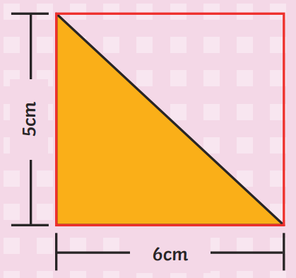
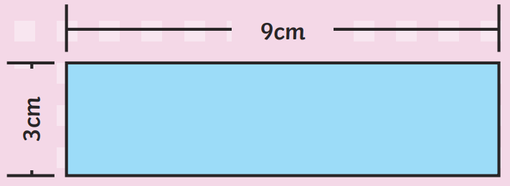
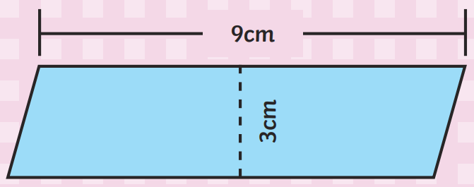
the amount of 2D space something takes up e.g. length x width = ____ of a rectangle e.g. base x height = ____ of a parallelogram e.g. base x height ÷ 2 = ____ of a triangle
area

Slide 29
the distance around the outside e.g. a rectangle with longer sides of 6 cm and shorter sides of 4 cm will have a _________ of 20 cm
perimeter

Slide 30
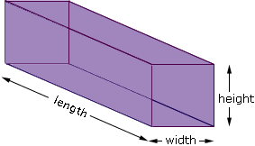
the amount of 3D space something takes up e.g. length x width x height = ______ of a cuboid
volume

Slide 31
seconds in a minute
60

Slide 32
minutes in an hour
60

Slide 33
hours in a day
24

Slide 34
September, April, June and November have __ days
30

Slide 35
January, March, May, July, August, October and December have __ days
31

Slide 36
February has 28 days or 29 in a ____ ____
leap year

Slide 37
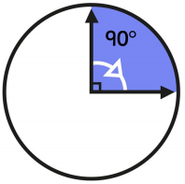
degrees in a quarter turn
90

Slide 38
degrees in a half turn
180

Slide 39
degrees in three quarters of a turn
270

Slide 40
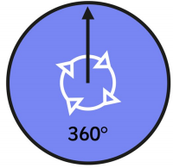
degrees in a whole turn
360

Slide 41
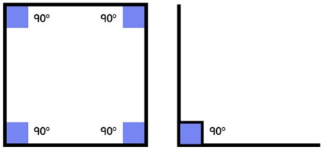
degrees in a right angle e.g. on angle diagrams, a right angle is shown with a small square
90

Slide 42
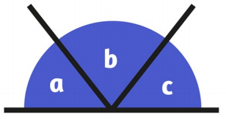
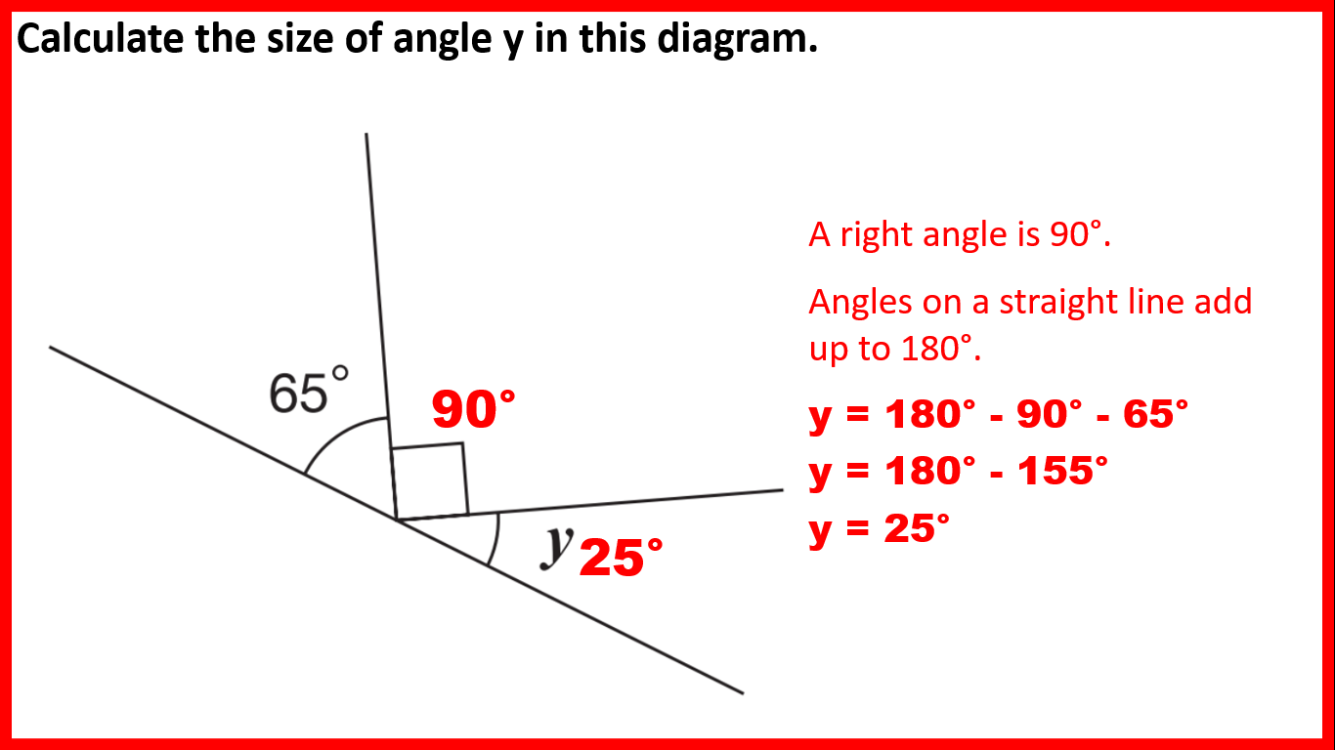
degrees on a straight line e.g. you can find an unknown angle on a straight line by subtracting the other angle(s) from ___
180

Slide 43
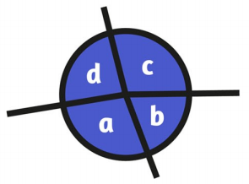
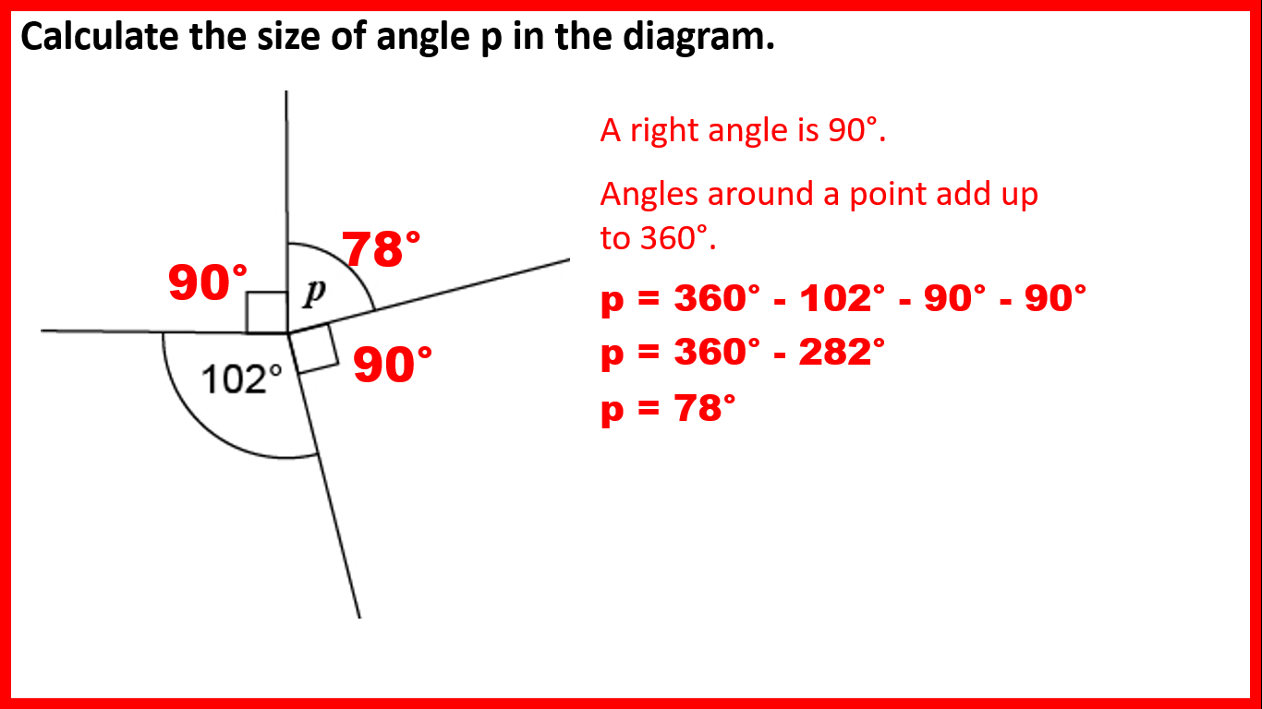
degrees around a point e.g. you can find an unknown angle on a point by subtracting the other angle(s) from ___
360

Slide 44
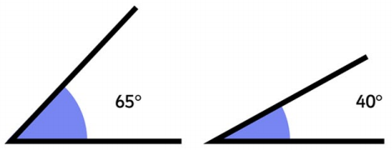
angles less than 90 degrees are _____ angles
acute

Slide 45
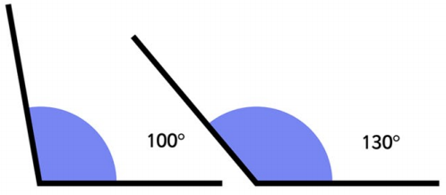
angles greater than 90 degrees but less than 180 degrees are ______ angles
obtuse

Slide 46
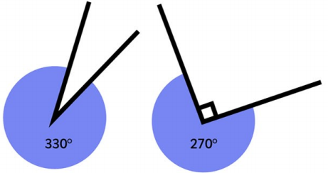
angles greater than 180 degrees are ______ angles
reflex

Slide 47
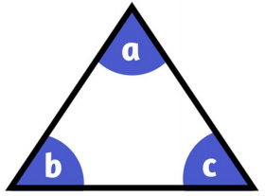
angles in a triangle total ___ degrees e.g. you can find an unknown angle in a triangle by subtracting the total of the other two angles from ___
180

Slide 48
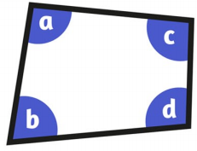
angles in a quadrilateral total ___ degrees e.g. you can find an unknown angle in a quadrilateral by subtracting the total of the other three angles from ___
360

Slide 49
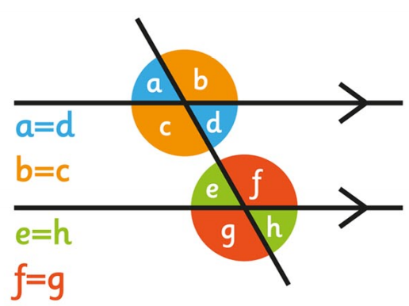
when two straight lines cross, opposite angles are _____
equal

Slide 50
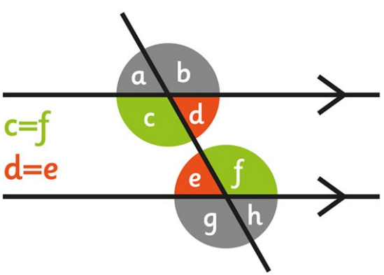
on parallel lines, alternate (Z or backwards-Z) angles are _____
equal

Slide 51
lines would never cross no matter how far we extended them (like train tracks)
parallel

Slide 52
lines that cross at right angles or would cross at right angles if we extended them
perpendicular

Slide 53
a shape with four sides
quadrilateral

Slide 54
a shape with five sides
pentagon

Slide 55
a shape with six sides
hexagon

Slide 56
a shape with eight sides
octagon

Slide 57
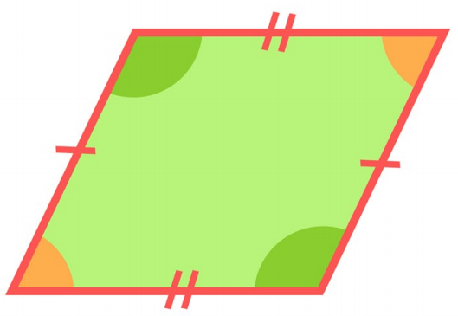
a shape which has two pairs of parallel lines is called a _____________
parallelogram

Slide 58
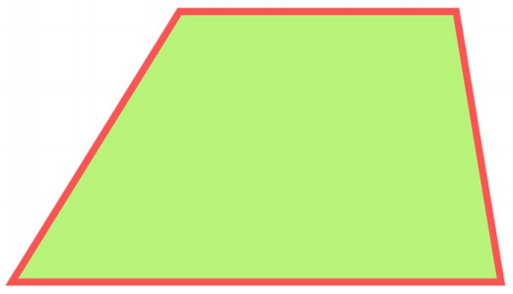
a shape which has one pair of parallel lines is called a _________
trapezium

Slide 59
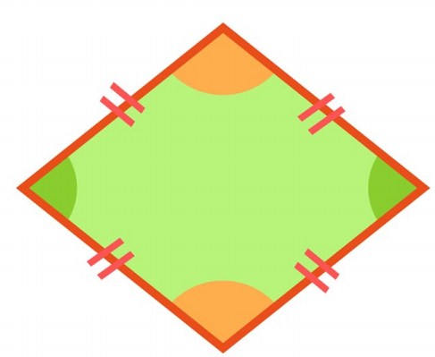
a parallelogram with sides of the same length is called a _______
rhombus

Slide 60
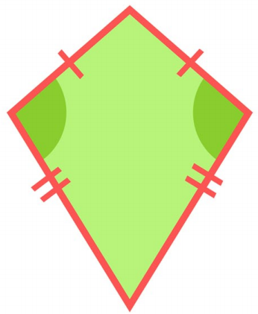
a shape with two pairs of equal sides adjacent (next) to each other is called a ____
kite

Slide 61
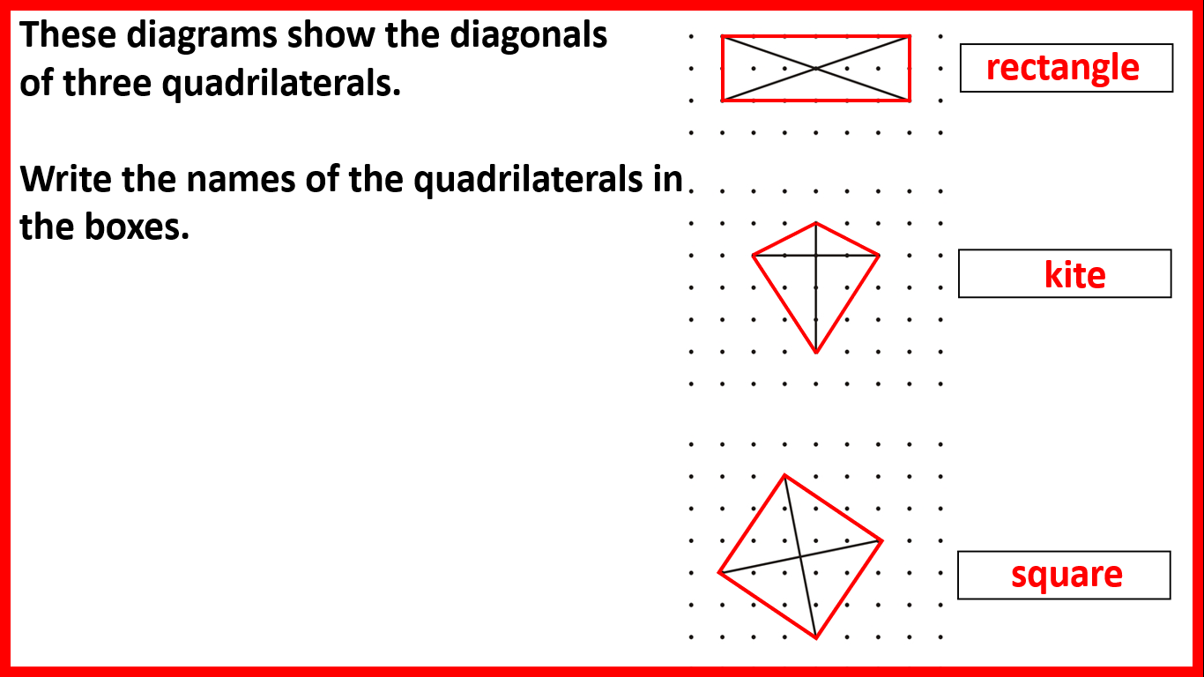
a line drawn from one vertex to the opposite vertex
diagonal

Slide 62
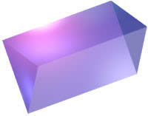
a 2D shape that has been 'stretched out' to make a 3D shape
prism

Slide 63
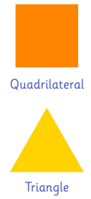

a shape with equal sides and equal angles
regular

Slide 64
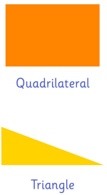

a shape which does not have equal sides and/or equal angles
irregular

Slide 65
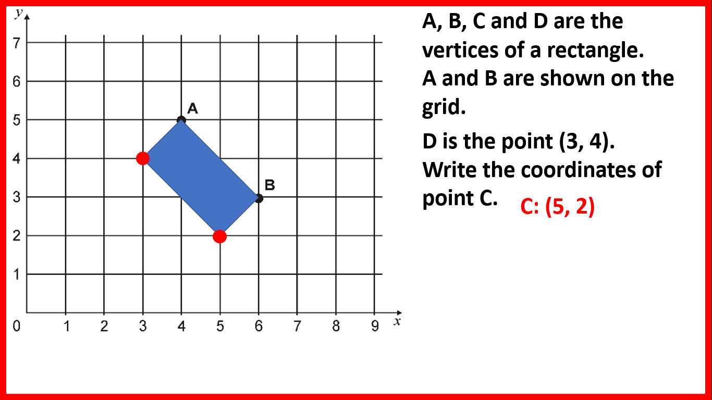
do we write the x or y coordinate first?
x

Slide 66
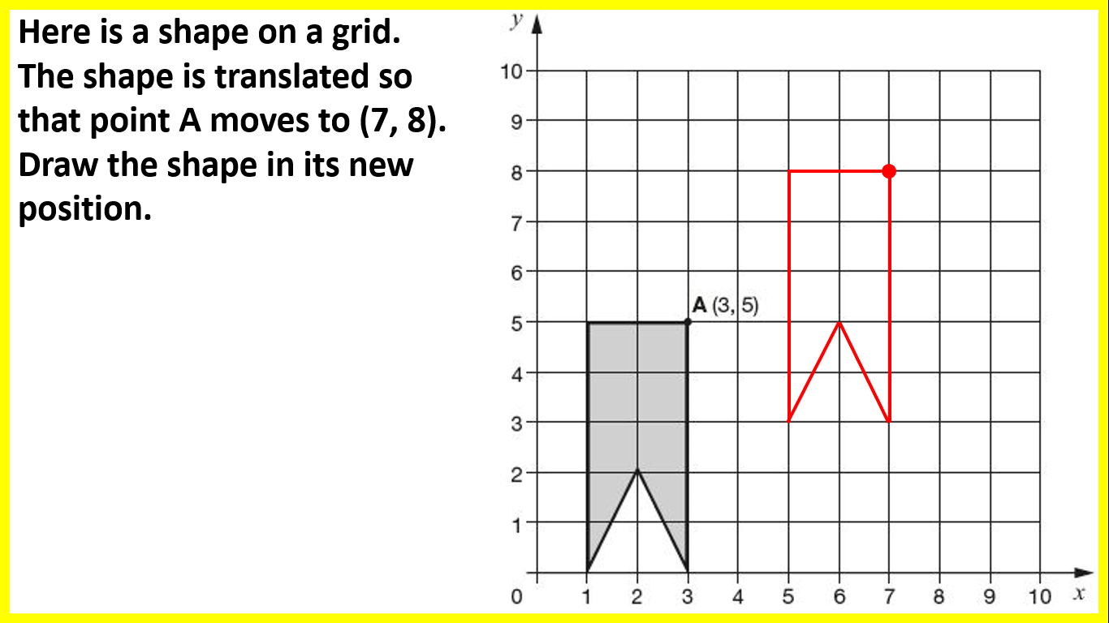
when we _________ a shape we move it to a new position (without changing its size or rotating it)
translate

Slide 67
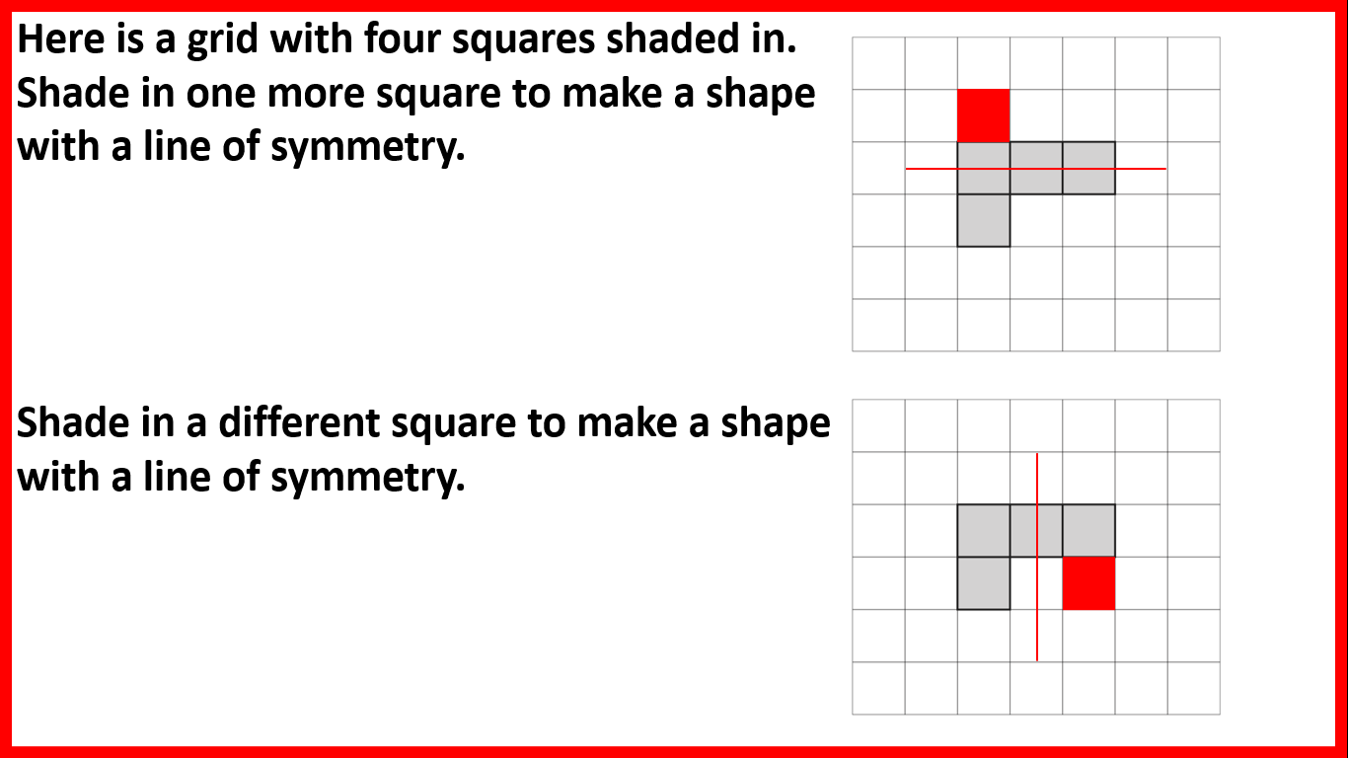
when you have the same reflected on both sides, you have ________
symmetry

Slide 68
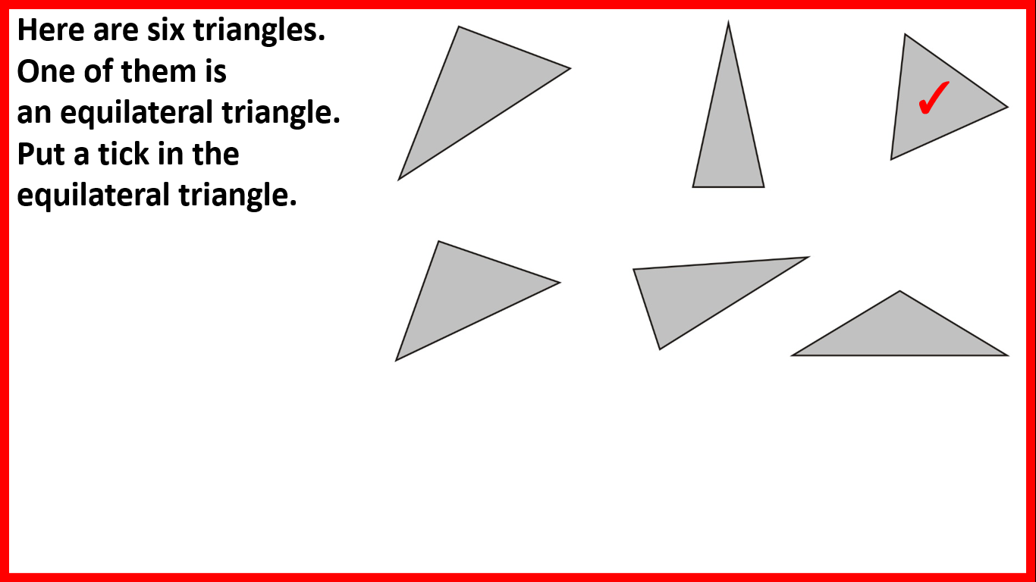
a triangle with sides of the same length and angles of the same size (60 degrees) is called an ___________ triangle
equilateral

Slide 69
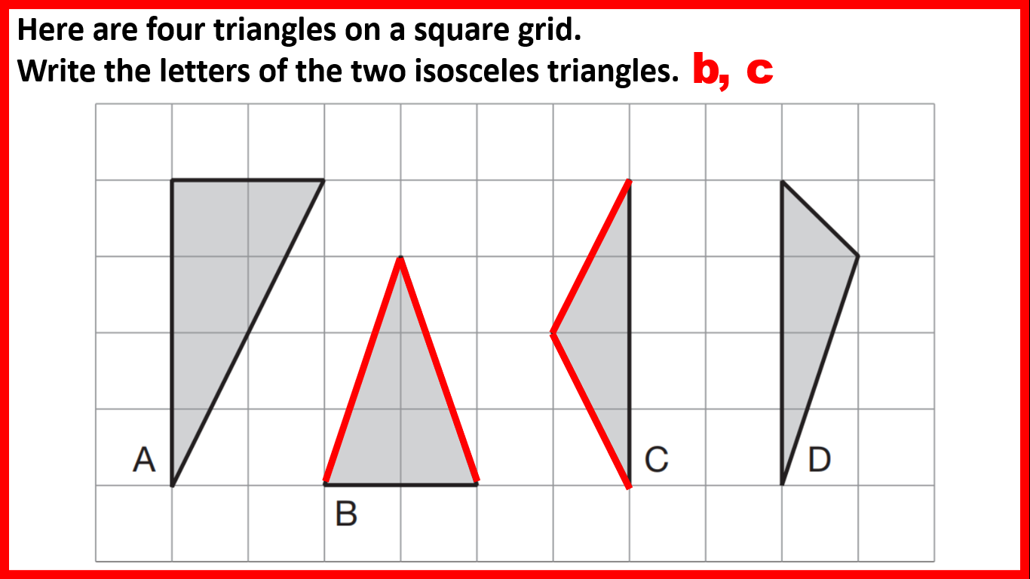
a triangle with two sides of the same length and two angles of the same size is called an _________ triangle
isosceles

Slide 70
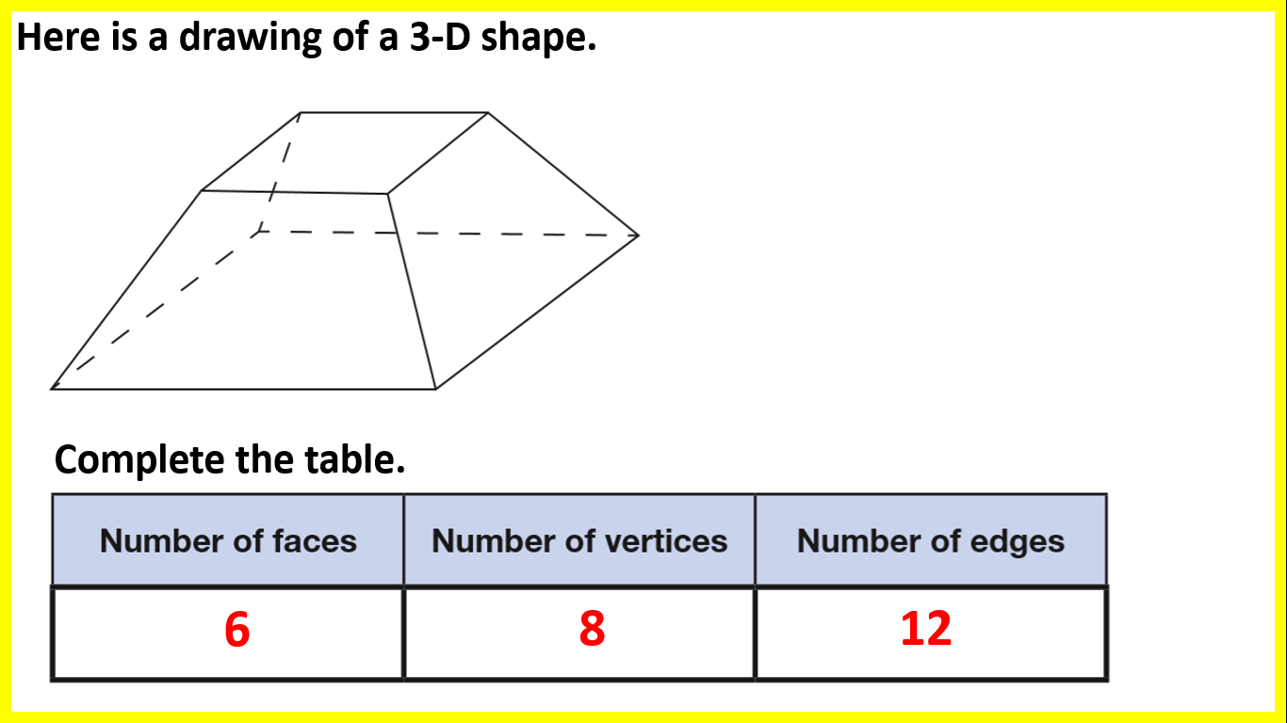
the flat surfaces of a 3D shape are called _____
faces

Slide 71
the 'lines' joining faces of a 3D shape are called _____
edges

Slide 72
the 'pointy bits' (where edges meet) of a 3D shape are called ________
vertices

Slide 73
part: part e.g. a cake is cut into 18 slices. 15 are eaten. 3 are not eaten. The _____ of eaten to uneaten slices is 15:3 e.g. a _____ of 15:3 can be simplified to 5:1
ratio

Slide 74
with algebra, 3y means 3 _____ y
times

Slide 75
a 2D representation of the faces of a 3D shape
net

Slide 76
the perimeter of a circle
circumference
circumference

Slide 77
the length from the centre to the edge of a circle
radius
radius

Slide 78
a line connecting two points on the edge of a circle which passes through its centre
diameter
diameter

Slide 79
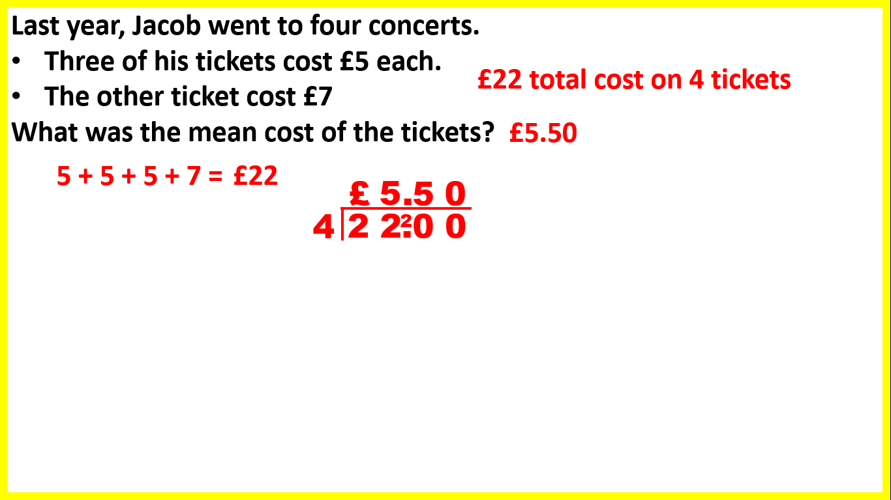
the total amount divided by the number of things is the ____
mean

